Slide 1
Cluster Counting/Timing: data reduction and pre-processing of drift chamber signals sampled at high rates
AIDA++ DCH#1 LoI
F. Grancagnolo
INFN – Lecce

Slide 2
Cluster Timing for spatial resolution

Slide 3
Cluster Counting for particle identification

Slide 4
Data Transfer issues:
IDEA DCH at Z-pole - Example
Running conditions
91 GeV c.m. energy
200 KHz trigger rate
100 KHz Z decays
30 KHz γγ → hadrons
50 KHz Bhabha
20 KHz beam backgrounds
DCH operating conditions
drift cells: 56,000 , layers: 112
max drift time (≈1 cm): 400 ns
cluster density: 20/cm
gas gain: 6×10⁵
single e⁻ p.h.: 6 mV
r.m.s. electronics noise: 1 mV
e⁻ threshold: 2 mV; rise time 1 ns
signal digitization:
12 bits at 2×10⁹ bytes/s

Slide 5
Example: "full signal spectrum" data transfer
Z decays:
10⁵ events/s × 20 tracks/event × 130 cells/track × 4×10⁻⁷ s × 2×10⁹ bytes/cell/s ≅ 200 Gb/s
γγ → hadrons:
3×10⁴ events/s × 10 tracks/event × 130 cells/track × 4×10⁻⁷ s × 2×10⁹ bytes/cell/s ≅ 30 Gb/s
Bhabha:
5×10⁴ events/s × 2 tracks/event × 0 cells/track × 4×10⁻⁷ s × 2×10⁹ bytes/cell/s ≅ 0 Gb/s
Beam noise (assume 2.5% occupancy):
2×10⁴ events/s × 1.5×10³ cells/event × 4×10⁻⁷ s × 2×10⁹ bytes/cell/s ≅ 25 Gb/s
Isolated peaks (assume 2.5% occupancy):
2×10⁵ events/s × 1.5×10³ cells/event × 4×10⁻⁷ s × 2×10⁹ bytes/cell/s ≅ 250 Gb/s
Transferring all digitized data (reading both ends of wires):
≥ 1 TB/s!

Slide 6
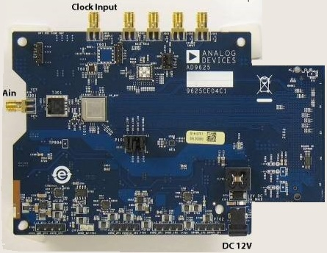
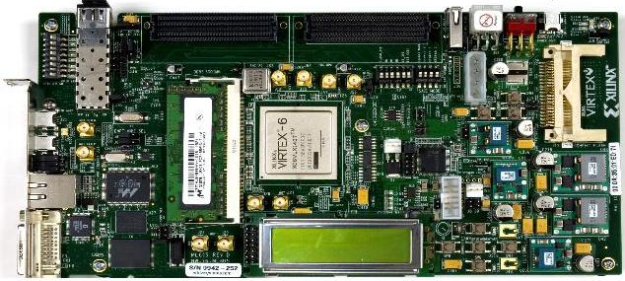
The proposed solution for a single channel
The solution consists in transferring, for each hit drift cell, instead of the full spectrum of the signal, only the minimal information relevant to the application of the cluster timing/counting techniques, i.e. the amplitude and the arrival time of each peak associated with each individual ionisation electron.
This is accomplished by using a FPGA for the real time analysis of the data generated by the drift chamber and successively digitized by an ADC.
A fast readout algorithm (CluTim) for identifying, in the digitized drift chamber signals, the individual ionization peaks and recording their time and amplitude has been developed as VHDL/Verilog code implemented on a Virtex 6 FPGA, which allows for a maximum input/output clock switching frequency of 710 MHz. The hardware setup includes also a 12-bit monolithic pipeline sampling ADC at conversion rates of up to 2.0 GSPS.
AD9625-2.0EBZ
Evaluation Board
Xilinx ML605
Evaluation Board

Slide 7
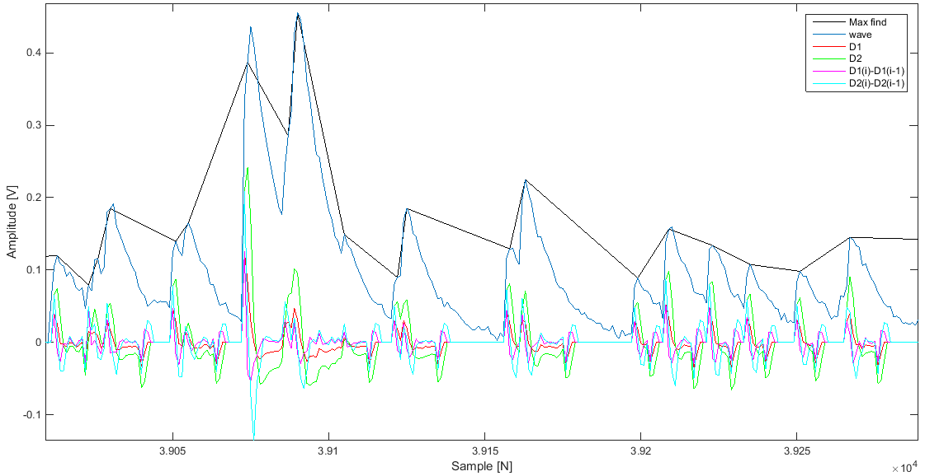
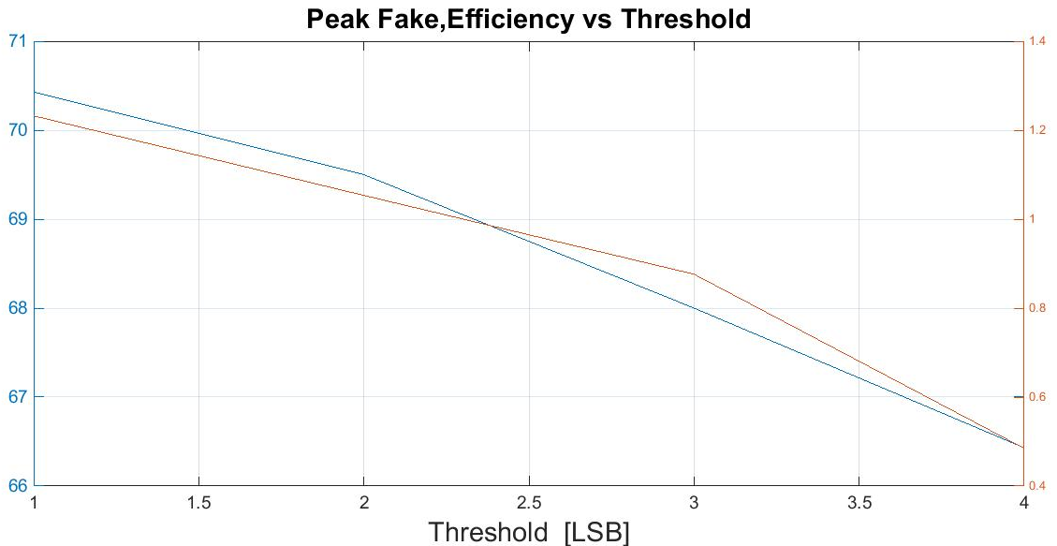
Example: CluTim algorithm
The Use of FPGA in Drift Chambers for High Energy Physics Experiments
Field Programmable Gate Array, May 2017, ISBN 978-953-51-3207-3
G. Chiarello et al 2017 JINST 12 C03056
At the beginning of the signal processing procedure, a counter starts to count, providing the timing information related to the signal under scrutiny. The determination of a peak is done by relating the i-th sampled bin to a number n of preceding bins, where n is related to the rise times of the signal peak. Once a peak is found, it is sent to pipeline memories which are are continuously filled as new peaks are found. When a trigger signal occurs at time t₀, the reading procedure is enabled and only the data relative to the found peaks in the [t₀; t₀ + t_{max}] time interval are transferred to an external device
Input signal, values of the auxiliary functions and found peaks. Efficiency and fake rate
Sixteen samples S_{K,X} at 125MHz to the FPGA input.
STEP 1: Of the Sixteen samples S_{K,X} ,where K is the sample number among those available , and X is the time instant in which they are present, the functions D1_{K,X} e D2_{K,X} are calculated with use of the following equations :
D1_{K,X}=((2*S_{k,X}-S_{K-1,X}-S_{K-2,X})/16)*3
D2K,X =((2*S_{k,X}-S_{K-2,X}-S_{K-3,X})/16)*5
STEP 2: The values ​​of D1_{K,X} and D2_{K,X} and the differences between D1_{K,X} and D1_{K-1,X} and between D2_{K,X} and D2_{K-1,X} are compared with the thresholds proportional to the level of noise present in the input signal.
STEP 3: In order to transfer the data in memory , the last step before being sent to an external device is to check that there are no adjacent peaks
Sixteen samples S_{K,X} at 125MHz to the FPGA input.
STEP 1: Of the Sixteen samples S_{K,X} ,where K is the sample number among those available , and X is the time instant in which they are present, the functions D1_{K,X} e D2_{K,X} are calculated with use of the following equations :
D1_{K,X}=((2*S_{k,X}-S_{K-1,X}-S_{K-2,X})/16)*3
D2K,X =((2*S_{k,X}-S_{K-2,X}-S_{K-3,X})/16)*5
STEP 2: The values ​​of D1_{K,X} and D2_{K,X} and the differences between D1_{K,X} and D1_{K-1,X} and between D2_{K,X} and D2_{K-1,X} are compared with the thresholds proportional to the level of noise present in the input signal.
STEP 3: In order to transfer the data in memory , the last step before being sent to an external device is to check that there are no adjacent peaks

Slide 8
Example: CluTim data transfer
Z decays:
10⁵ events/s × 20 tracks/event × 130 cells/track × 50 peaks/cell × 2 bytes/peak ≅ 25 Gb/s
γγ → hadrons:
3×10⁴ events/s × 10 tracks/event × 130 cells/track × 50 peaks/cell × 2 bytes/peak ≅ 4 Gb/s
Bhabha:
5×10⁴ events/s × 2 tracks/event × 0 cells/track × 50 peaks/cell × 2 bytes/peak ≅ 0 Gb/s
Beam noise (assume 2.5% occupancy):
2×10⁴ events/s × 1.5×10³ cells/event × a few peaks/cell × 2 bytes/peak ≅ 0 Gb/s
Isolated peaks (assume 2.5% occupancy):
2×10⁵ events/s × 1.5×10³ cells/event × a few peaks/cell × 2 bytes/peak ≅ 0 Gb/s
Transferring only time and amplitude of each electron peak (reading both ends of wires):
≈ 60 GB/s!

Slide 9
Goal of the AIDA++ call
The goal of the proposed activity is to be able to implement, within a single FPGA board, more sophisticated peak finding algorithms on as many analog to digital conversion channels as possible for parallel pre-processing, in order to reduce costs and system complexity for a tracking detector designed to operate at the next generation of lepton colliders.
Contacts - Partners
F. Grancagnolo – INFN Lecce
M. Panareo – Università del Salento e INFN Lecce
N. De Filippis – Politecnico di Bari e INFN Bari
I. Logashenko – Budker Institute for Nuclear Physics, Novosibirsk, Russia
F. Vivaldi – CAEN SpA, Italia

Slide 10
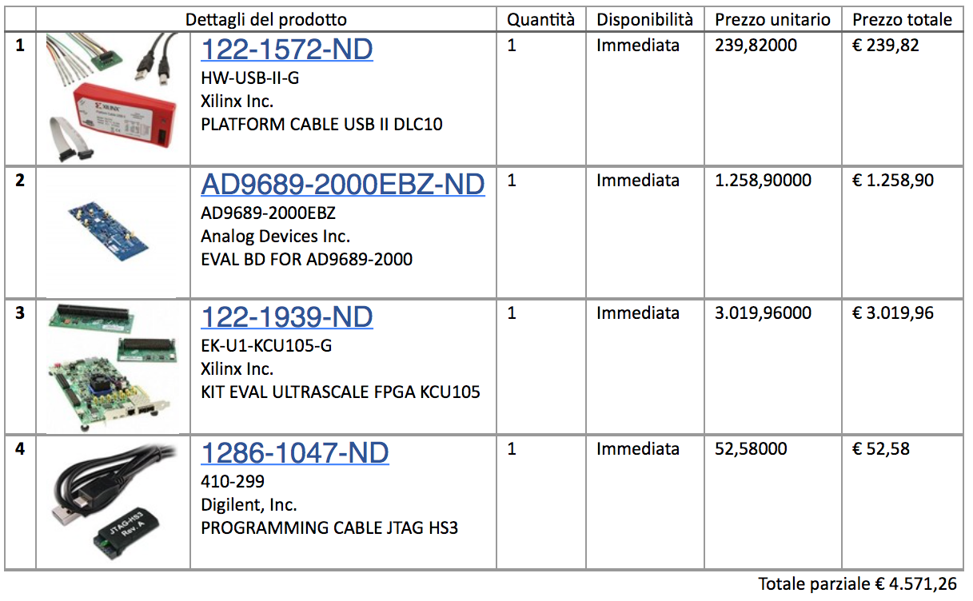
Shopping list

