Slide 1
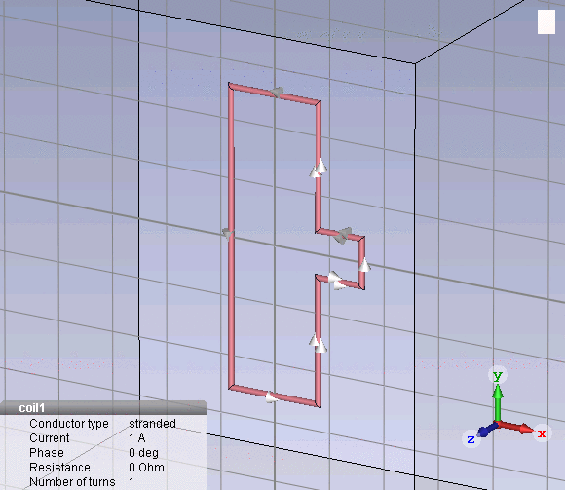
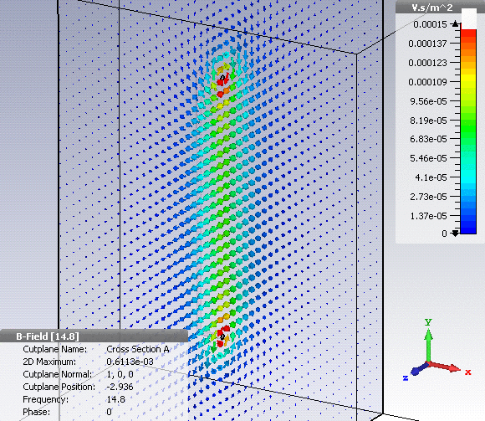
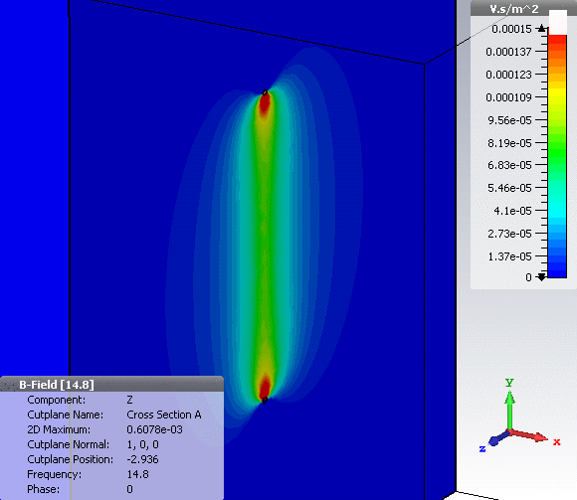
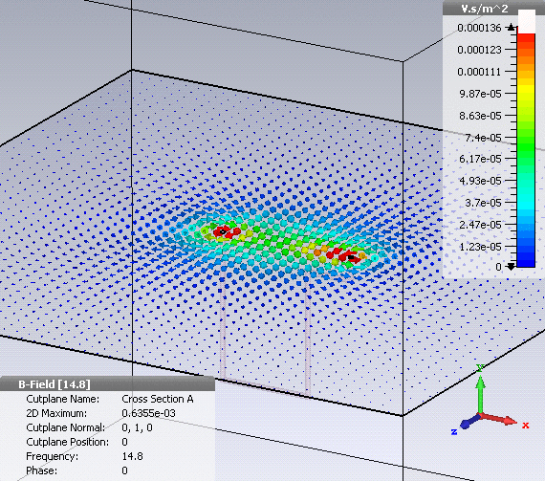
NepTune - RF Coil geometry
16mm
B vector – x=0
22mm
Bz magnitude – x=0
B vector – y=0

Slide 2
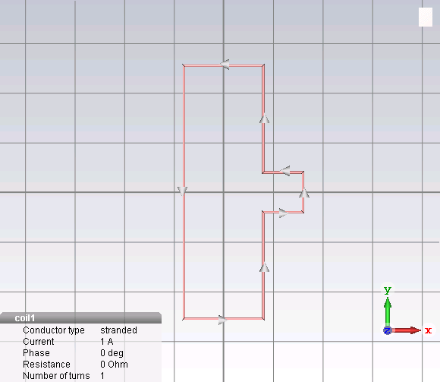
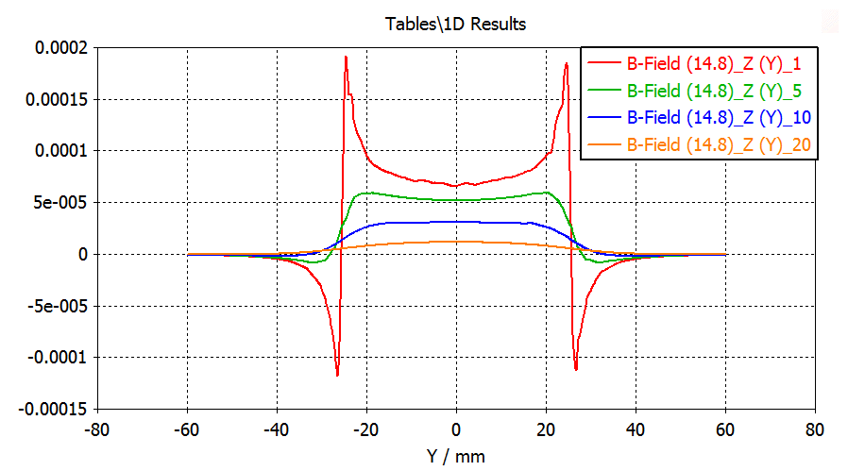
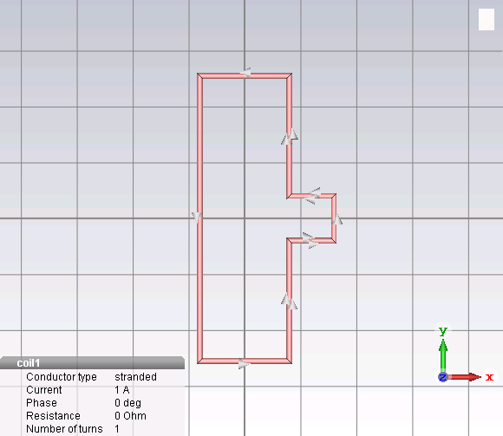
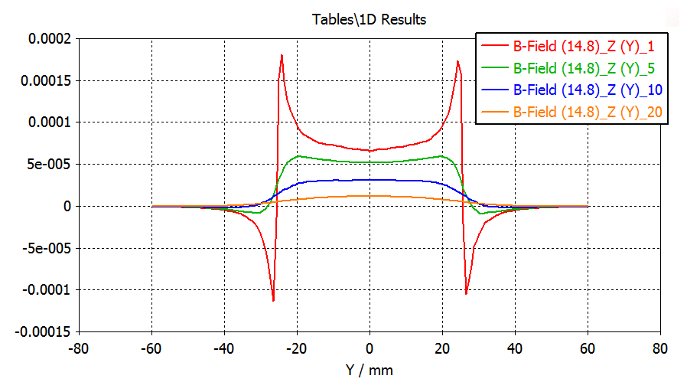
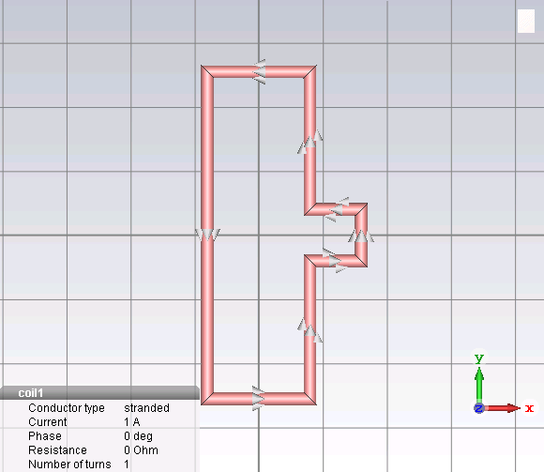
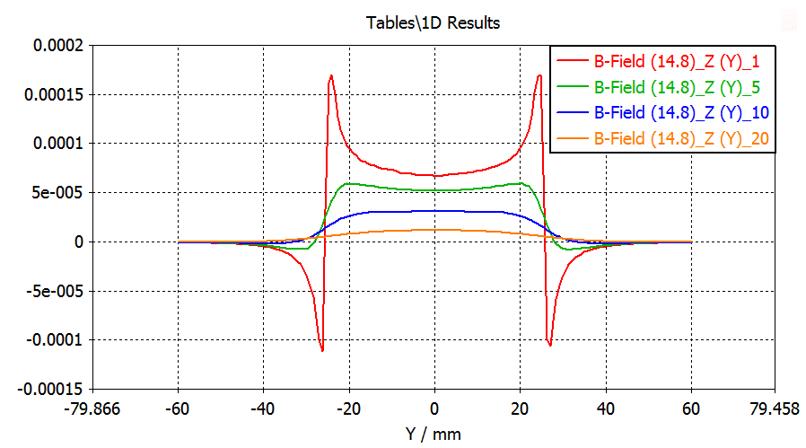
Wire radius variations
R=0.25mm
R=0.50mm
R=1.00mm

Slide 3
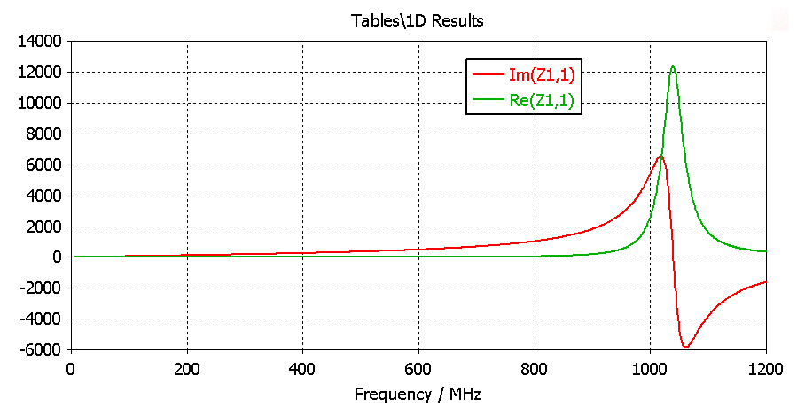
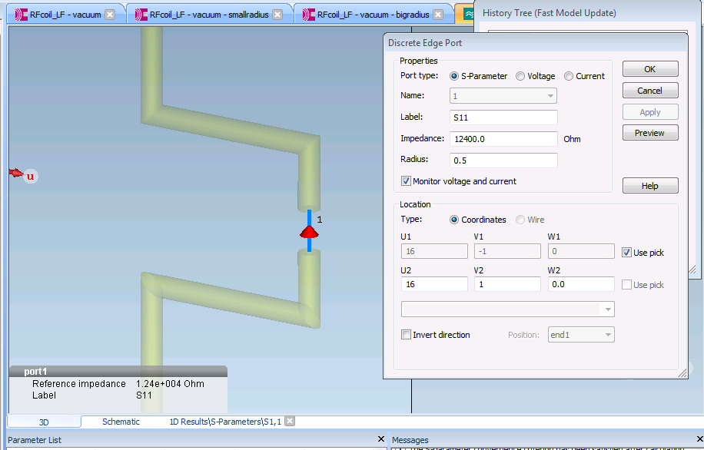
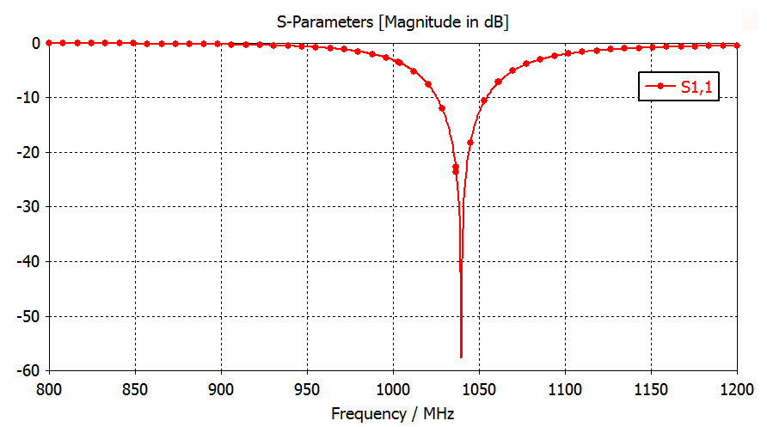
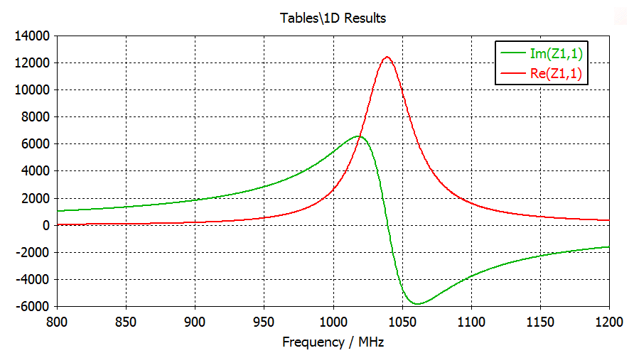
Searching for its natural resonant frequency
Discrete Voltage Generator is needed - Driven frequency solver
Discrete Voltage Port
Broad Band Impedance
Reflection coefficient
Impedance - Zoom

Slide 4
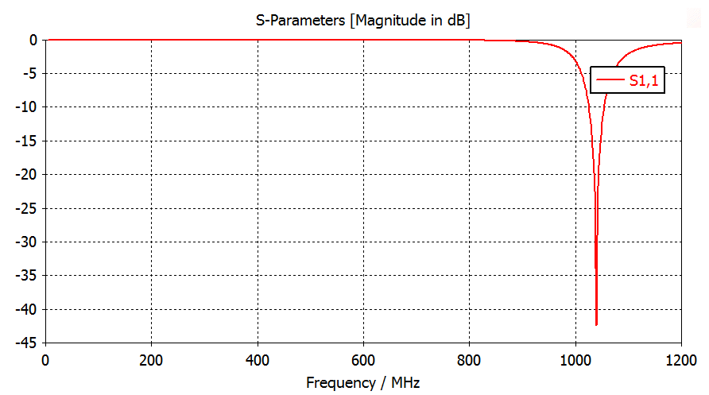
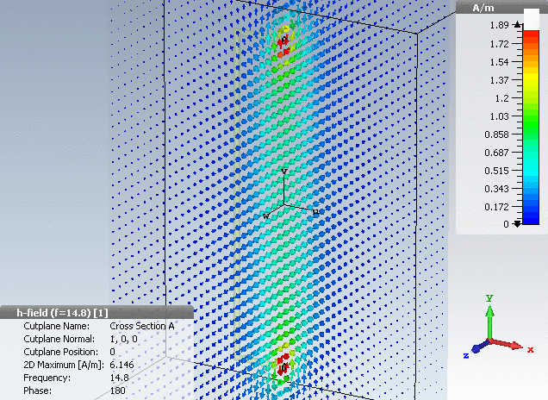
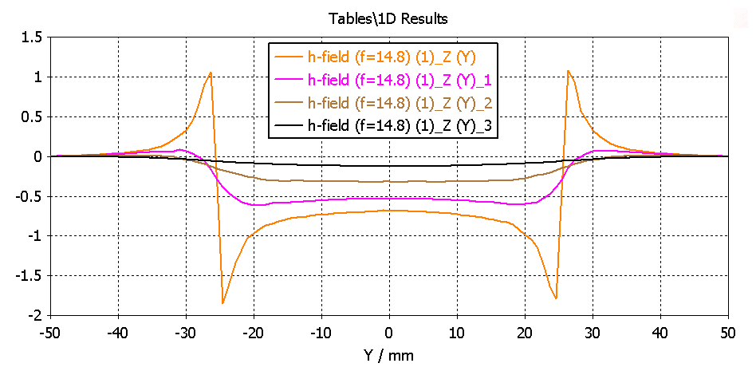
Driven RF Magnetic Field @ 14.8MHz
Discrete Voltage Port
Reflection coefficient
14.8 MHz
H vector @ 14.8 MHz
Hz real @ 14.8 MHz along y, z var

Slide 5
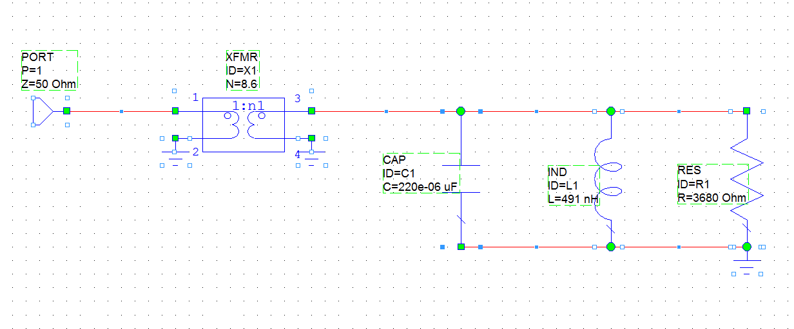
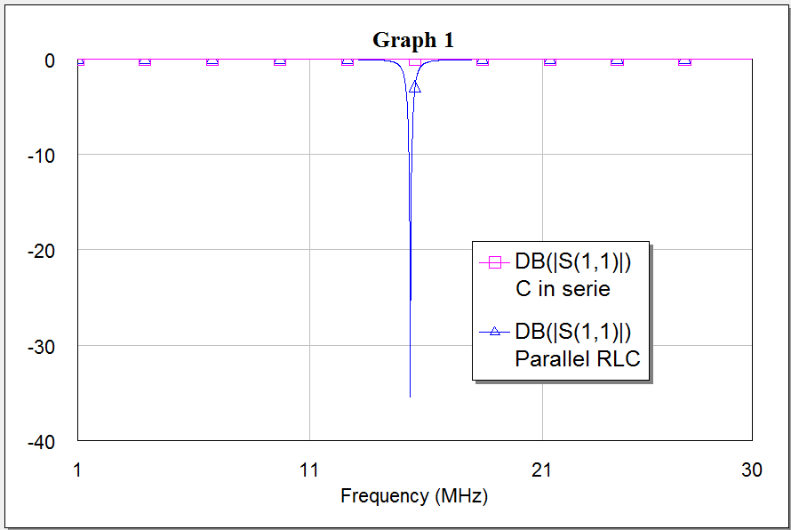
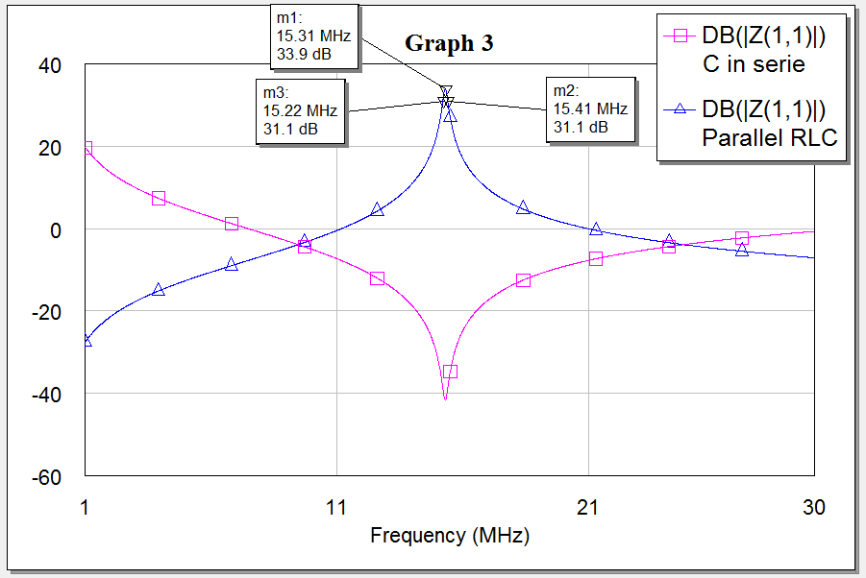
Microwave Office (NI) – Tuning and Matching
Example on the tuning and matching a resonant circuit
RF coil equivalent circuit
Matching netwok
Tuning Capacitor
Impedance
Reflection coefficient
Q is about 80

