Slide 1

GSI Aftermath: a TDAQ account
S. Biondi, A. Mengarelli, R. Ridolfi, M. Villa
University and INFN
Bologna
Bologna, 17/05/2019

Slide 2
Outline
Runs
GSI integration experience
  What worked
  What needs improvements
    for DAQ-WD and DAQ-VTX integration
DAQ-WD interface
DAQ-VTX interface
Offline event building
Next steps

Slide 3
Runs
14 in total for 504 MB (daq) + 223 MB(vtx)+8726 MB (wd):
7 April – no target – first DAQ runs with beams – changing detector conditions…
  2197 (BM only), 2199 (BM, VTX), 2200 (BM, VTX),
  tests: 2202 (BM, WD, VTX), 2203 (BM, WD), 2204 (BM, WD,), 2205 (BM, WD, fragm. Trigger),
  All good, no target, VTX thresholds low, BM HV nominal: 2210, 2211, 2212 (+2209 no beam, 58k)
8 April – BM HV & TOF scans
  BM HV scans, with target & high VTX threholds:
  2239, 2240, 2241
  TOF scan: 2242

Slide 4
GSI integration experience
These lists show the TDAQ point of view (not the data content)
What worked without problems:
  Beam Monitor (VME boards only; not a single DAQ problem; all information stored; all thresholds stored). But… no HV in DB!
  Network: everybody was able to have a cable connection.
  Storage: too few data taken – good runs in less than 50 GB!
  DAQ and detectors in standalone manner…..

Slide 5
What needs improvements
Trigger configuration: fixed at GSI; too much workload on the shifter
WD and VTX starting procedures: needs to be automatic
Several minor details at the TDAQ level: all meant to reduce shifter workload or to have automatic data, configuration and counters savings
Online monitoring and warnings

Slide 6
DAQ-WD interface problems - 1
BCO start, timestamp start
  (used for event synchronization);
WD starts early;
TDAQ sends two BCOReset:
WD uses the first, trigger module uses the second
(BTW: too few bits in the BCO#)
Trigger start;
  WD provides first triggers before the actual run start (between the first and the second BCOReset)
  Cured with changes in the V2495 firmware

Slide 7
DAQ-WD interface problems - 2
WD event losses
  Examples from run 2212 – 116 k events for daq:
    WD evt 0 not matchable
    WD evt 1-12350 matched with daq 0-12349
    From WD evt 12350-41367 one every three WD events is not written out (hw trig # jumps)
    No more data after WD evt 41367, hw trig 51948 (daq has 64k more events)
  Same pattern in other runs: ONE unmatchable event at the beginning, ~10k perfect, then 1 over three lost, stop recording at some point

Slide 8
DAQ-WD interface successes
Except for the begin, all WD triggers are correctly handled by the DAQ (no losses), the busy logic works ok,
BCO timing difference are OK (all matches within +-1 us)
Partial conclusion:
  Once solved for start-of-run problems and event losses (need a SSD), the events can be built online reliably and automatically.
  Joint work already planned (june?)

Slide 9
DAQ-VTX interface problems - 1
Integration done only at GSI – not ideal…
Busy from vertex missing; decided for a fixed busy lenght (about 2-3 us) costing us a DAQ rate of 300 Hz
BCO not forwarded to VTX
  - > problems in event building
-> Timestamp candidates:
framecounter (185 us period)
internal clock value (0.5 us period)
VTX is missing triggers (run dependent)

Slide 10
DAQ-VTX interface problems - 2
Basically all variables that can be used for event building are NOT reliable:
  HW triggers restarts after the first 100-200 event (approx 11 s VTX black-out)
  Sequential events with the same frame counter value have been observed
  Clearly wrong frame counter values
  Out of sequence internal clock values and/or frame counters
  Buggy HW trigger counters (rare)
  Wrong event-internal clock value association (constantly off by 1 event)

Slide 11
DAQ-VTX interface problems - 3
Observed VTX freezing:
  About 11 s long, always after 100-250 events from the start, consistently on all runs and implying an hw trigger reset
  Can happen also during runs and without hw trigger reset (e.g.: run 2212, VTX evts 39450-39451 matched with 40975 and 41248, 930 ms apart)

Slide 12
DAQ-VTX interface successes
7 april runs
  Long sequences of events that can be matched (DAQ-VTX), starting from event 0
  Not many VTX fragment losses (<3%).
8 april runs (high vtx threshold)
  Clearly different from 7 april runs.
  No matching starts from evt #0
  LOTS of triggers are lost (busy too short?)
    eg run 2240: 20004 daq evts, 10238 vtx evts (50%), 8749 matches from evt 128 to 19954
Almost all VTX triggered events are recorded
(wrt WD, events are small)

Slide 13
Offline Event building matches
RUN | DAQ EVTs | WD EVTs | VTX Evts | WD matched | VTX Matched | WD&VTX matched
2210 | 20463 | 15091 | 19059 | 15090 | 19004 | 13723
2211 | 62782 | 26985 | 61322 | 26984 | 61120 | 25494
2212 | 116349 | 41368 | 114238 | 41367 | 113777 | 39556
2239 | 20821 | 15618 | 10246 | 15617 | 448 | 342
2240 | 20004 | 15370 | 10238 | 15369 | 8749 | 6560
2241 | 20041 | 15235 | 9777 | 15234 | 8348 | 6174
2242 | 202729 | 68078 | 110721 | 68077 | 29458 | 21572
Note:
WD – all but first events are matched (in each run)
VTX - #vtx/#daq ≈ 98% first 3 runs, #vtx/#daq ≈ 50% last 3 runs,
VTX matches at 99.5% in run 2212, 85.4% in run 2240, 27% in run 2242

Slide 14
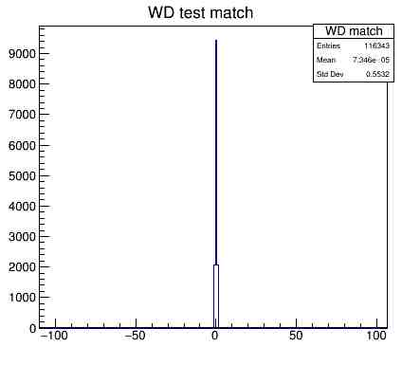
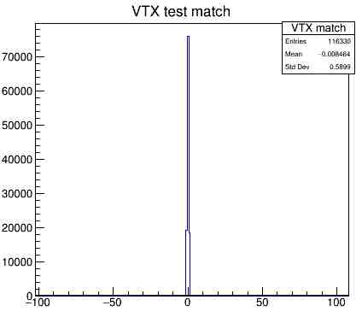
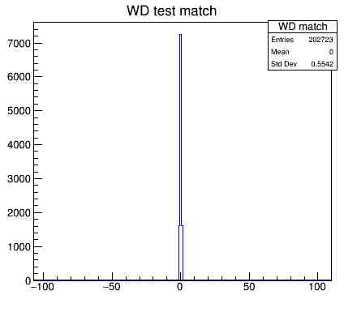
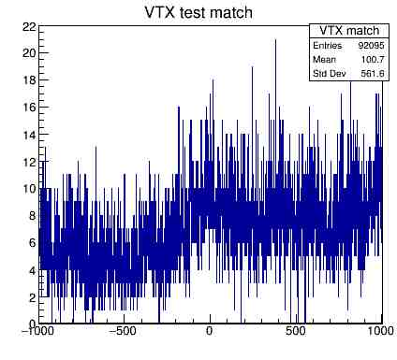
RUN 2212
RUN 2212
BCO difference: WD-DAQ
BCOlike difference: VTX-DAQ
RUN 2242
RUN 2242
BCO difference: WD-DAQ
BCOlike difference: VTX-DAQ

Slide 15
Conclusions
Several problems have been observed at GSI – and can be observed only with real detectors (simulations are not enough) and enough time
WD seems working in a reproducible manner -> a path to fix all problems has been already drafted
VTX shows different behaviour in different days/runs. We need to study and understand all the (TDAQ) problems
For now: we have 7 runs with all detectors in it (3 looks
good). It’s time to play with and to see what
is inside the data
Shoe !

Slide 16
The end

Slide 18
DAQ-WD matches in run 2212
DAQ
Evt HWT BCO BCODIFF
0 0 33393 33394
1 1 35768 2375
2 2 1422810 1387042
3 3 1439408 16598
4 4 1448413 9005
5 5 1451440 3027
6 6 1458024 6584
7 7 1466418 8394
8 8 1481037 14619
9 9 1486616 5579
10 10 1491839 5223
WD
EV HW BCO BCODIFF1 BCODIFF2
0 1 63376 63377 128912
1 2 2308 4294906228 4467
2 3 4682 2374 2374
3 4 15468 10786 10786
4 5 32067 16599 16599
5 6 41071 9004 9004
6 7 44099 3028 3028
7 8 50682 6583 6583
8 9 59076 8394 8394
9 10 8160 4294916380 14619
10 11 13739 5579 5579
11 12 18962 5223 5223

