Slide 1
Status of the work
for the emulsions
after the exposure at GSI
A. Alexandrov, G. De Lellis, A. Di Crescenzo, G. Galati, A. Iuliano, A. Lauria, M. C. Montesi, A. Pastore, V. Tioukov
Università di Napoli “Federico II”, INFN Napoli, INFN Bari

Slide 2
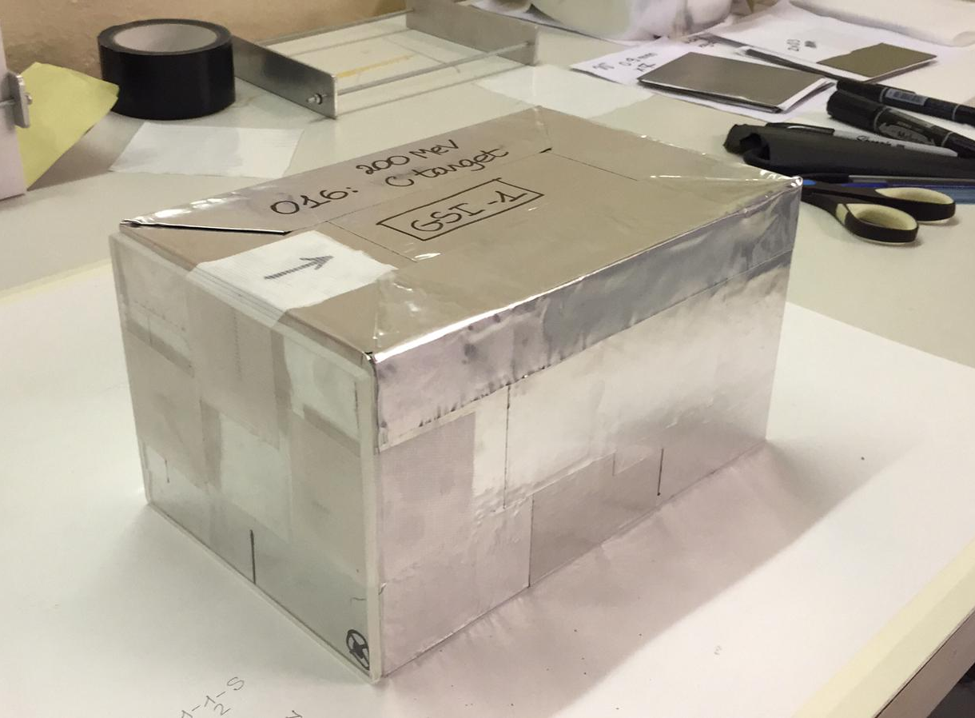
Brick Preparation @ CERN
 | Oxygen 200 MeV/n | Oxygen 400 MeV/n
Carbon | GSI1 | GSI3
Polyethylene | GSI2 | GSI4
Beam
Target

Slide 3
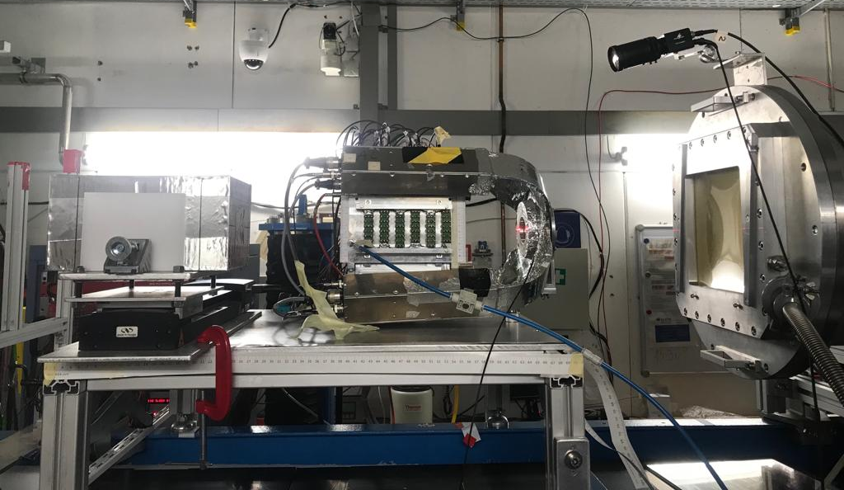
4 Bricks Exposured at GSI
 | Oxygen 200 MeV/n | Oxygen 400 MeV/n
Carbon | GSI1 | GSI3
Polyethylene | GSI2 | GSI4
520 emulsions have been exposed
Beam
Target

Slide 4
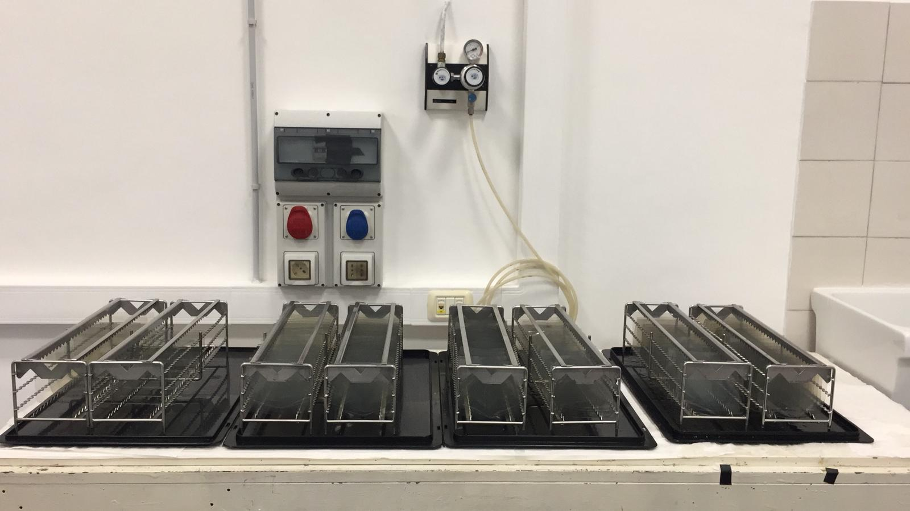
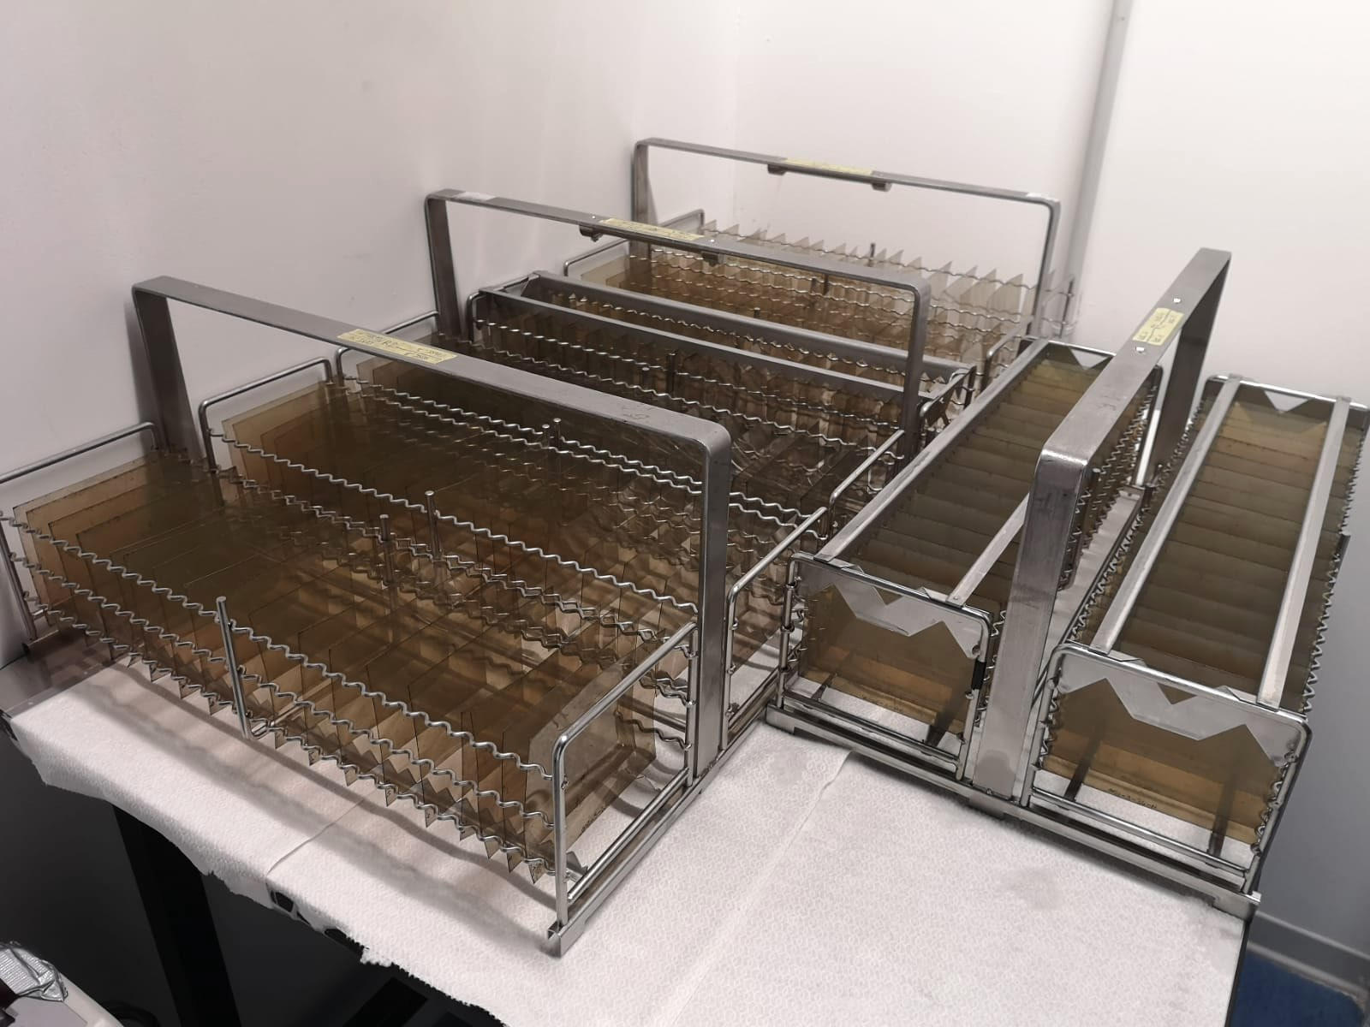
Emulsions Development
400 emulsions have been developed in Naples new dark room facility
120 emulsions (stack 2) have undergone different thermal treatments and have been developed at LNGS
All emulsions have been cleaned from silver residuals and have been treated with glycerine in order to minimize distortions and other problems due to the development and drying processes

Slide 5
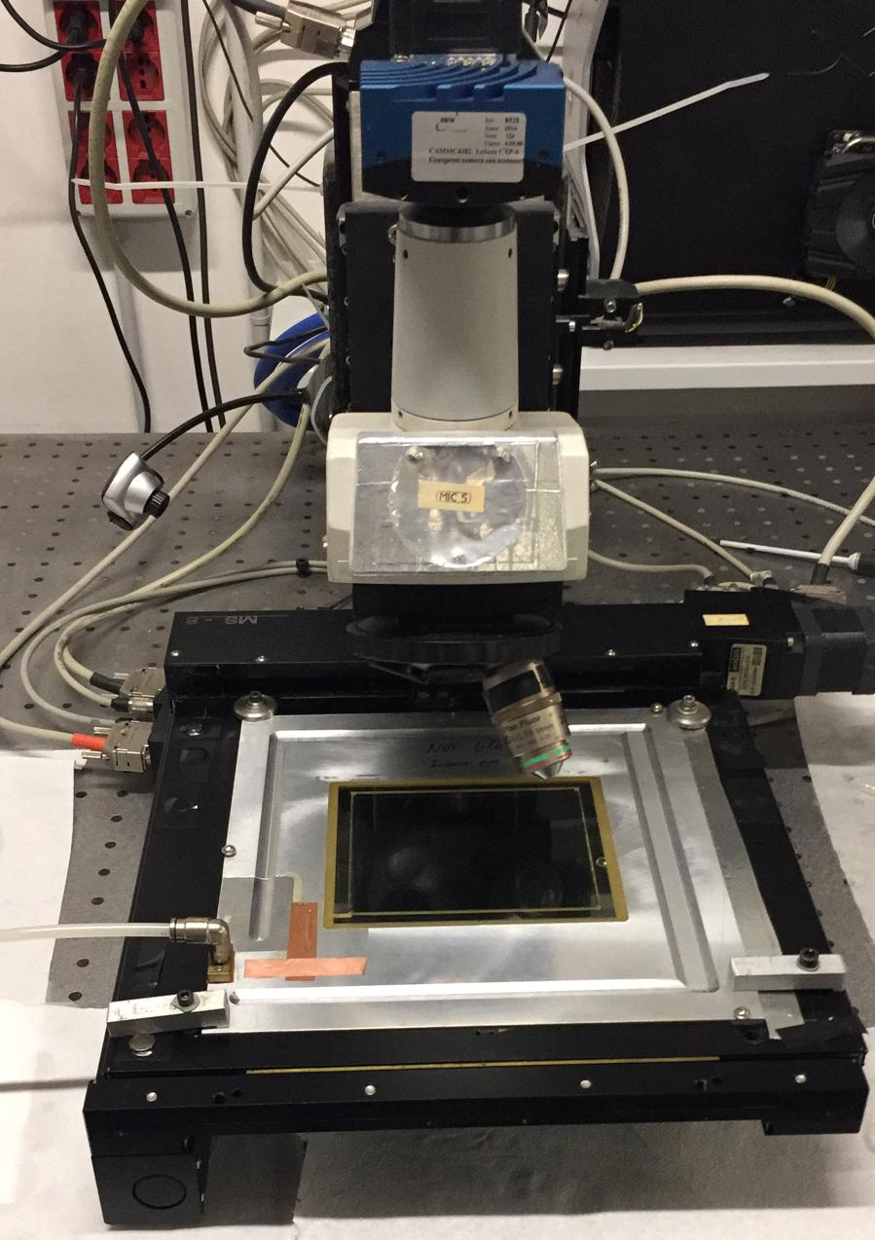
Emulsions Scanning
Scanning began on 7th May
One dedicated microscope in Naples
Scanning parameter optimization on-going
30 emulsions (GSI2, stack 1) have been already scanned

Slide 6
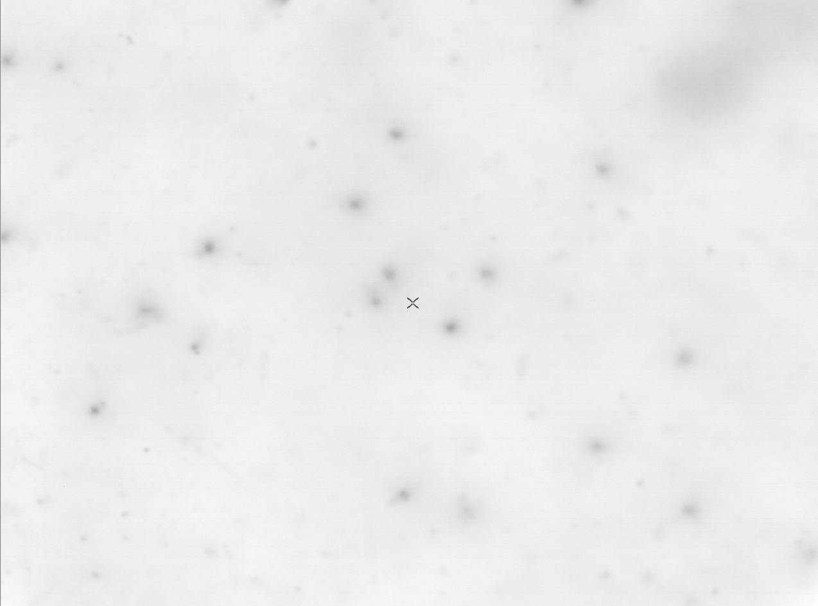
300 μm

Slide 7
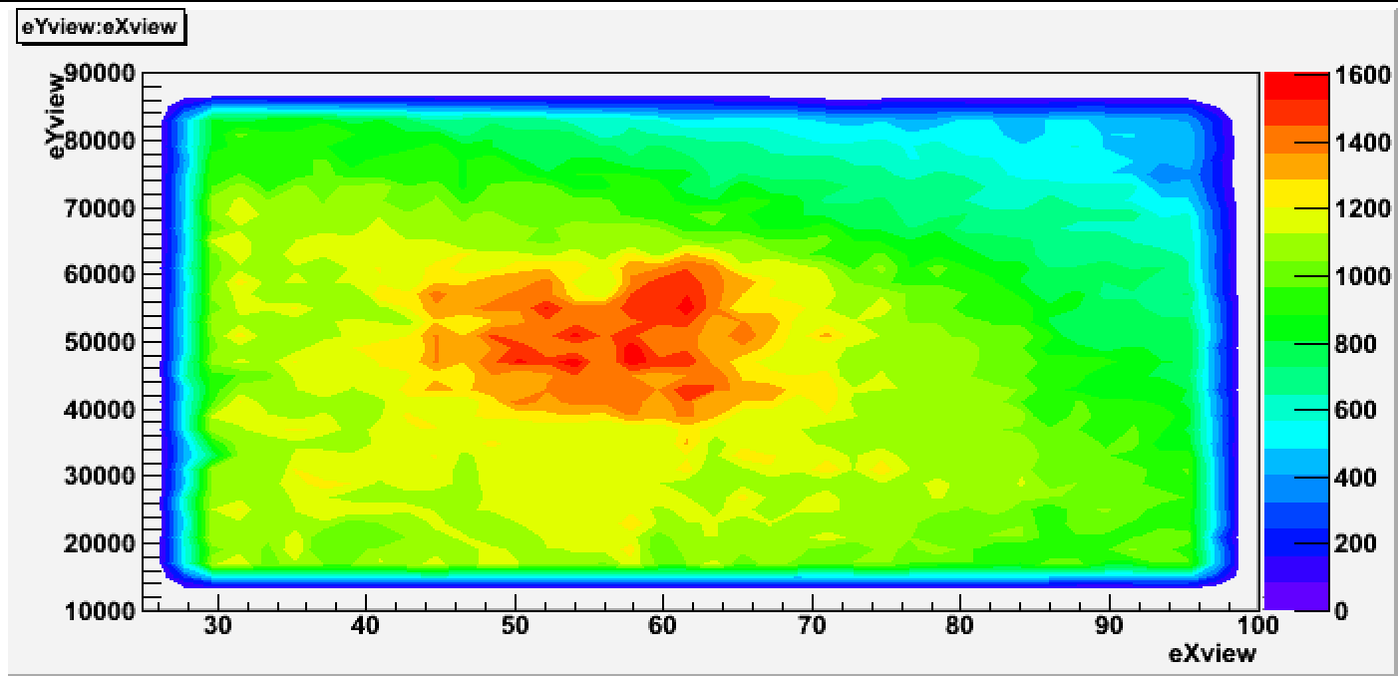
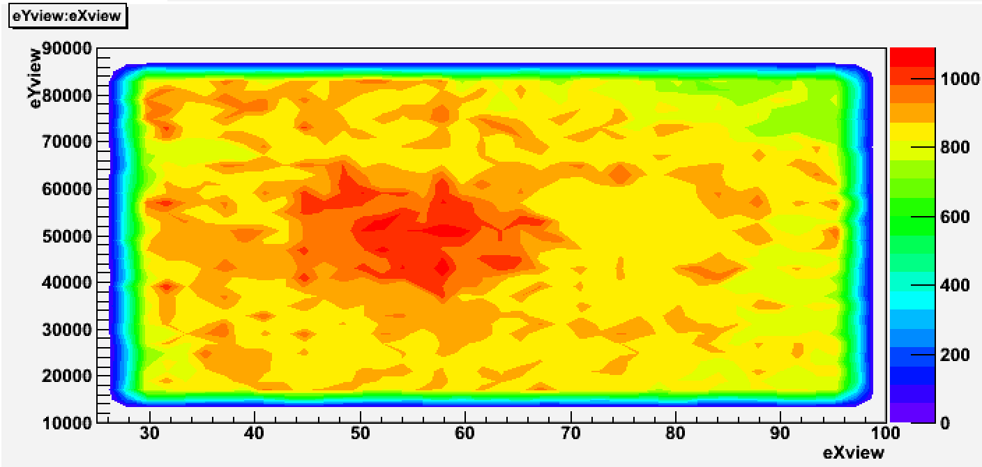
Some Preliminary Results
PLATE 1
PLATE 30
X - Y microtrack distributions
Slope X microtrack distributions

Slide 8
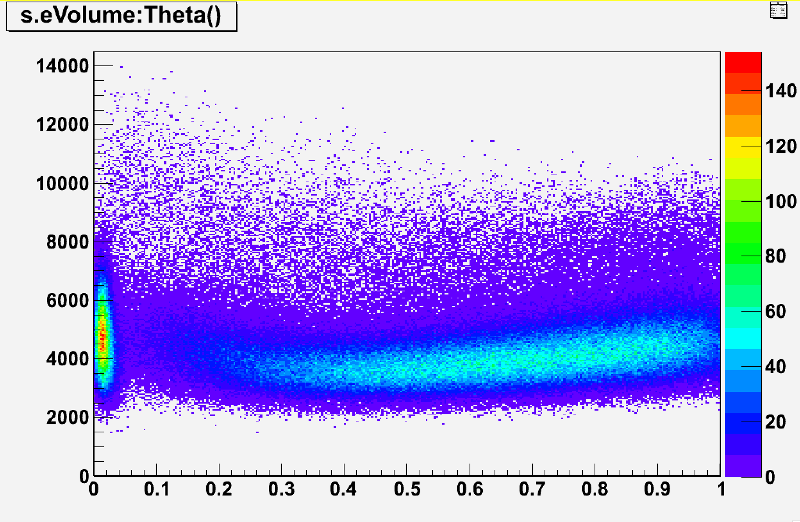
Some Preliminary Results
PLATE 1
Signal
Cosmic Rays

Slide 9
Back Up Slides

Slide 10
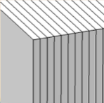
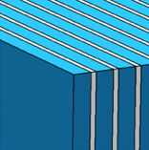
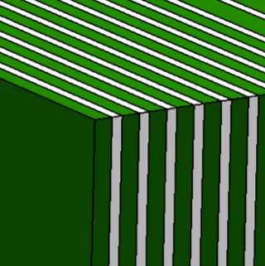
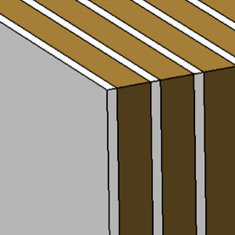
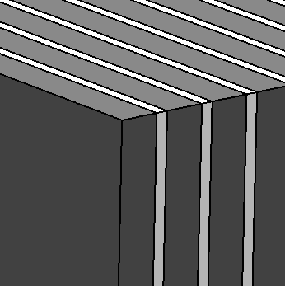
Emulsion spectrometer design
Emulsion film
300 μm
Polyethylene
1000 μm
Tungsten
500 μm
Tungsten
900 μm
C (C4H4) layer
1000 (2000) μm
Lead
1000 μm
beam
10 cm
12 cm
Charge identification
only emulsion layers
Momentum measurement
and isotope identification
alternated layers of emulsions and passive material (plastic, tungsten and lead)
Vertexing
alternated layers of emulsions and target (C or C2H4)
Notes:
The Emulsion Cloud Chamber detector is made of three sections:
SECTION 1: alternated layers of emulsion films and target (C/C2H4)
Vertex detector
Tracking of all charged particles
SECTION 2: emulsion films only
Charge identification for low Z fragments
SECTION 3,4,5: alternated layers of emulsion films and passive material
Momentum measurement by range and Multiple Coulomb Scattering (MCS)
Isotopic identification

Slide 11
Detector Structure
 | Oxygen 200 MeV/n | Oxygen 400 MeV/n
S1 | C (30x1mm) / C2H4 (30x2mm) + 29 emu
S2 | Emu (36)
S3 | Polyethylene (10x1mm)+10emu
S4 | W (10x0.5mm)+10emu
S5 | W (15x0.9mm)+15emu
S6 | Pb (20x1mm)+20emu | Pb (40x1mm)+40emu
S1
S2
S3
S4
S5
S6
S1
S2
S3
S4
S5
S6
S1
S2
S3
S4
S5
S6
S1
S2
S3
S4
S5
S6

