Slide 1

IBL
Genova ATLAS Weekly Meeting
Genova, November, 11 2009
G. Darbo - INFN / Genova
Indico agenda page:

Slide 2
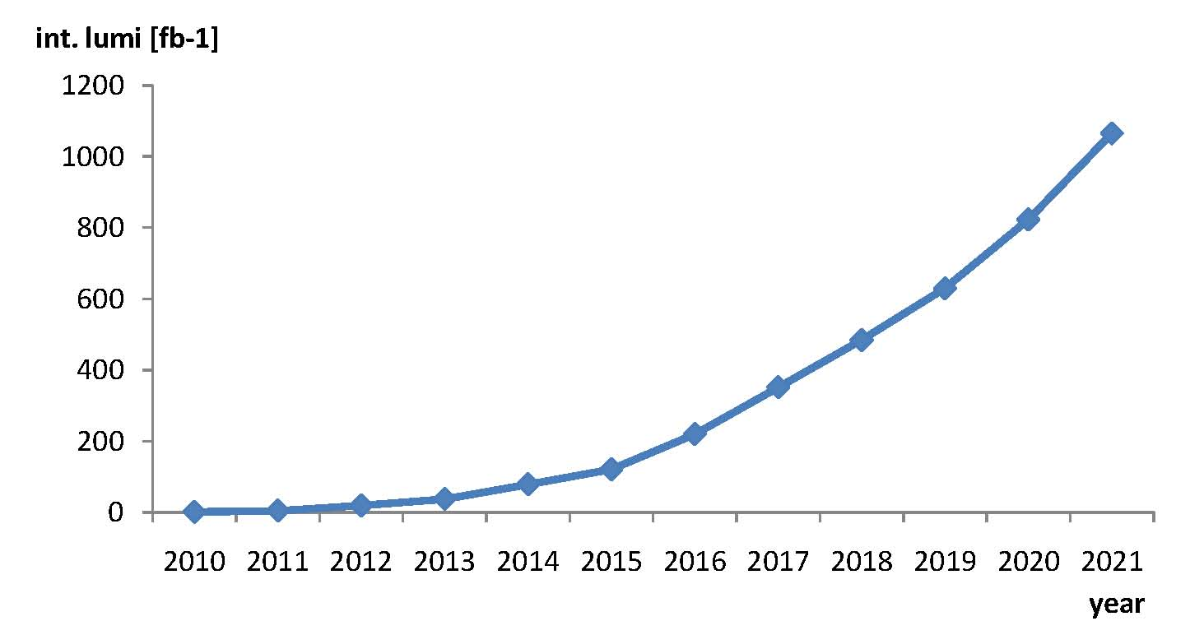
Total Integrated Luminosity
IR upgrade
+ crab cavities
shutdown
for Linac4
connection
lifetime limit
of IR quadrupoles
(LHC PR 633 and
Ranko Ostojic)
estimate from
last week’s LMC
Ref.: Frank Zimmerman – AUW Nov.2009

Slide 3
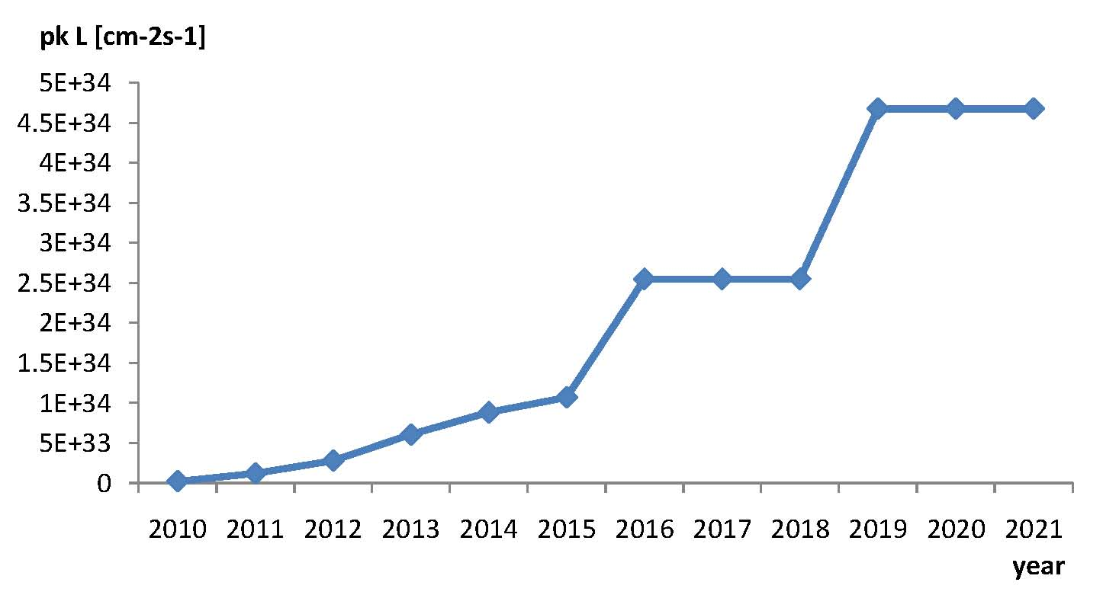
Peak Luminosity
IR upgrade
+ crab cavities
shutdown
for Linac4
connection
Ref.: Frank Zimmerman – AUW Nov.2009

Slide 4
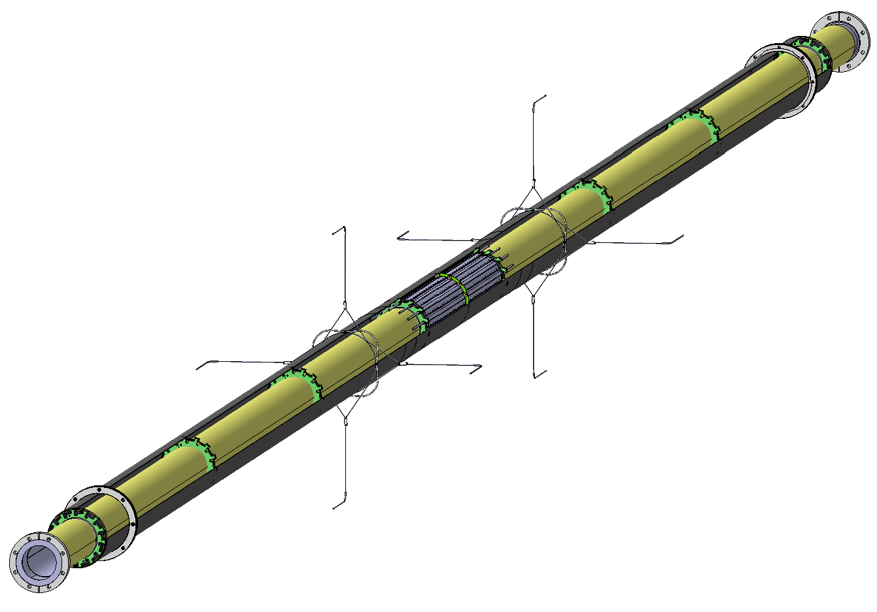
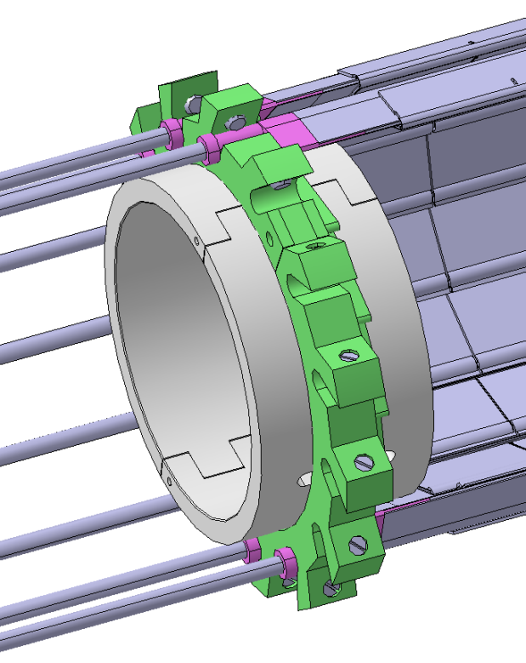
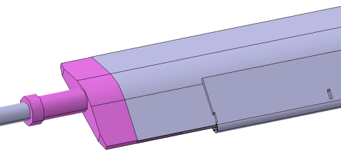
IBL Package
Ref.: Y.Gusakov, N.Hartman, R.Vuillermet
Material from Raphael/Neal
Global support conceptual design well advanced
  Started detailed drawing of parts and FEA
  Tooling for integration need development
Mock-up in bld.180 at CERN to test extraction/installation
PP1 Collar
Sealing service ring
Alignment wirers
IST
IBL Support Tube
Stave
Stave
Insert
To fix to support, survey reference

Slide 5
IBL GM last Week
Agenda
Thursday 05 November 2009
09:00->10:55 General Introduction
  Physics Goal, IBL Technical Overview, FE-I4 Review, TDR
11:25->13:10 Software Simulation
  IBL Software WG status and reports
14:00->16:20 Module Working Group (WG1)
16:50->19:30 Stave Working Group (WG2)
Friday 06 November 2009
09:00->10:35 Critical Project Issues
  focus on critical issues in the areas where we have made or need to make decisions on the project.
11:05->13:00 Integration & Installation Working Group (WG3)
14:00->16:30 Off-detector working Group (WG4)
Indico: http://indico.cern.ch/conferenceDisplay.py?confId=64406

Slide 6
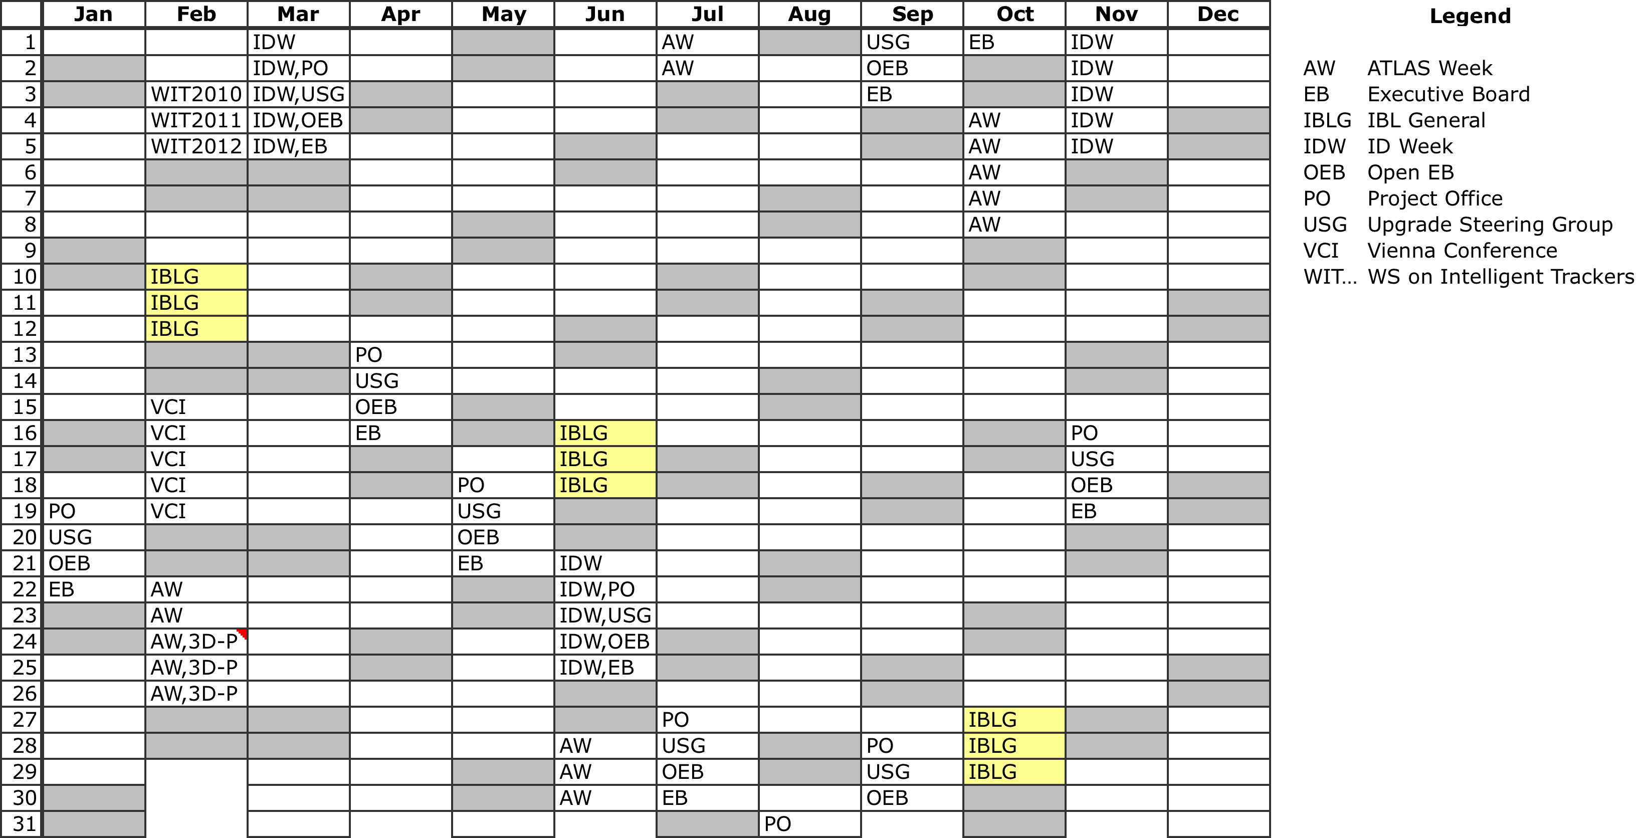
2010 IBL General Meeting
Fix the slots of 3 contiguous days – decide later on if we need 2, 2.5 or 3 days
  We could use one day (1/2 day for special meetings/review)
  Proposed dates do not conflict with ID Weeks and ATLAS week
  AUW are not decided yet – in discussion an external AUW (date depend on hosting institute)

Slide 7
FE-I4 Status & Review
FE-I4 review (Nov. 3-4) – Status:
  14 Design Engineers
  24 blocks (18 full custom + 6 synthesised) – ready with simulation
  Integration of the chip just started – “glue logic” to put together the blocks
  Full simulation, scan chain & testability still al lot to do
  The chip will use T3 process option (isolated deep n-weel to separate analog to digital blocks) from IBM that will be available by December
Chip submission
  The chip will be probably submitted in 3 months Feb-Mar 2009.
  Chips will be available after 2.5–3 months. Engineering run is for 2 to 24 wafers.
  Test system will use USBPix developed by Bonn (for the moment supports FE-I3). Hardware adapter fpr FE-I4, single FE-I4 card and firmware in development at Bonn/Gottingen (Joern) / Dortmund (Jens)
    One system with FE-Ie orderd by Claudia to Bonn,

Slide 8
FE-I4
FE-I4 IC Designers
  Bonn
    Michael Karagounis, Tomasz Hemperek, Andre Kruth
  CPPM
    Mohsine Menouni, Denis Fougeron, Fabrice Gensolen
  INFN Genova
    Roberto Beccherle
  LBNL
    Abder Makkaoui (lead designer), Dario Gnani, Julien Fleury (visiting from LAL)
  NIKHEF
    Ruud Kluit, Jan-David Schipper, Vladimir Gromov, Vladimir Zivkovic
  Designers collaborate remotely using the Cliosoft collaboration platform.

Slide 9
3D Sensors - FBK
Detectors for FBK have been tested in the test-beam. Planned irradiation with FE-I3 to 4x10¹⁵ 1 MeV neutron equivalent (already tested a FE-I3 without sensor – see next slide)
MoU with TN/GE and FBK-irst
  Develop two run (25+25 wafers) of single/double sided 3D sensor
    Single sided allows active edge but require HV from the bump-side. Through dedicated pad in the FE-I4 (can stand 150V?). It also require wafer bonding (etching of each device all around need support)
    Double side (actual design can have 170µm guard ring and not active edge
Funding:
  Discussion going on with FBK. Proposed 25 k€ (2009) Genova, 26.5k€ (TN, GRV 2010),
  Contribution form CERN of 5k€ reduce the total of 25k€ on Genova (TID)
  Sensors bought by Udine (12.5k€) for FBK, CNM and Sintef
  Wafer Bonding proposed as in-kind from Oslo
Bump-bonding -> see slide on Selex
Arriving FE-I3 with 3D sensor for Sintef to wire bond (and preliminary test)

Slide 10
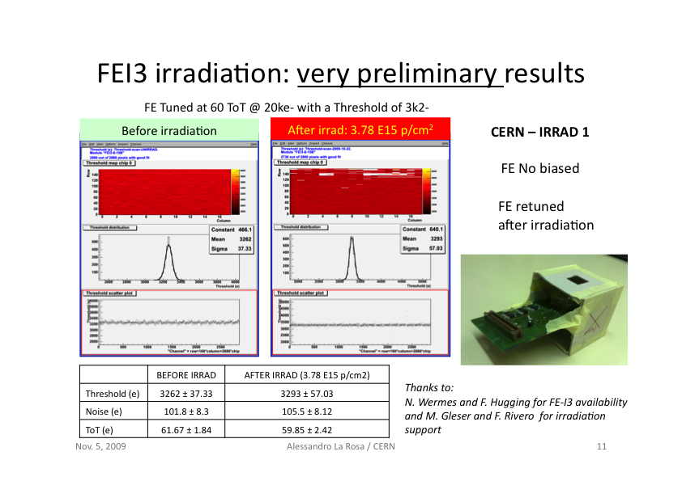
Irradiation of 3D and FE-I3
Ref.: A. La Rosa – AUW Nov.2009

Slide 11
Selex
I have visited Selex 10 days Ago (together with other two person from Torino – FP420 and Panda). Deep discussion with AM Fiorello, S. di Gioia e G. Corda.
Interest to follow collaboration with Genova on 3 lines:
  Continue FE-I3 bumb-bonding with existing FE-I3 chips with bump deposited.
  Develop FE-I4 dummy program to set up the process
    Need to by a flip-chip head for the size of FE-I4 (~2 k€)
    Need to define best program of dummies:
      Dummy-to-dummy, Sensor (3D) to dummy, thinning of dummy FE-I4, test of removing wafer bonding (3D sensor single side) after bump-deposition
    If the previous step works, try with FE-I4 (convince the IBL collaboration to use FE-I4 with Selex)
Availability of resources:
  We have >10 k€ on 2009 at Genova. Make an “open contract for initial work with them”
  On IBL project (from the 130k€ sj) we can consider 25 k€ could go for bump-bonding development at Selex and ~10 k€ to IZM.
Milano (G.Alimonti) could be interested…

Slide 12
Flex + ROD
Flex – see Claudia’s talk:
  Activity leaded by Claudia with Genova/Bonn – need more interaction with SLAC for Type1 services and PP0.
ROD
  Base line accepted to use VME (SLAC is not)
  Bologna active with Paolo and should propose a design architecture
    Looks that ROD could become an INFN deliverable, but need work in short time
  E-BOC.
    We did not move ahead with the full “ROD package” that included the e-BOC from Genova. This would need to involve “Totem Friends”.
    German groups are pushing ahead eBOB. We need to get active soon if we want to have a contro-proposal.

Slide 13
Backup slides

Slide 14
i-MoU
IBL Memorandum-of-Understanding
  Between ATLAS Collaboration and those Institutes who contribute to the IBL budget line in the M&O-B budget line of the Pixel or to the new-project funds
ATLAS management plans to have an interim-MoU by end 2009
  This will become a MoU as sensor decision will be taken and TDR will be written
Interim-MoU – Why an i-MoU?
  proceed in two steps:
    Enable all interested Institutes to contribute to the selection of the suitable sensor technology for the IBL. Choice expected by end of 2010.
    Consolidate the Institute resources behind the construction of the IBL, once sensor technology is decided.
Way to contribute – Through:
  M&O-A: For common infrastructure items – Share amongst the ATLAS FA in proportion to staff holding PhD – in kind contribution possible (even if the FA is not signing IBL MoU)
  M&O-B: Included since 2002 in the M&O-B for the “B-Layer Replacement” – cost shared by the FA who participated in the construction of the Pixel – in-kind contribution possible
  New-project: items and increased cost with the concept of the Insertable B-Layer, which are also related to the available options for the sensor technology - shared by Institutes based on “open bidding” – also possible in-kind contribution
In-kind contribution
  Institutes making in-kind contribution shall ensure that have adequate infrastructure at their home laboratories (personal, infrastructure, technical facilities).

Slide 15
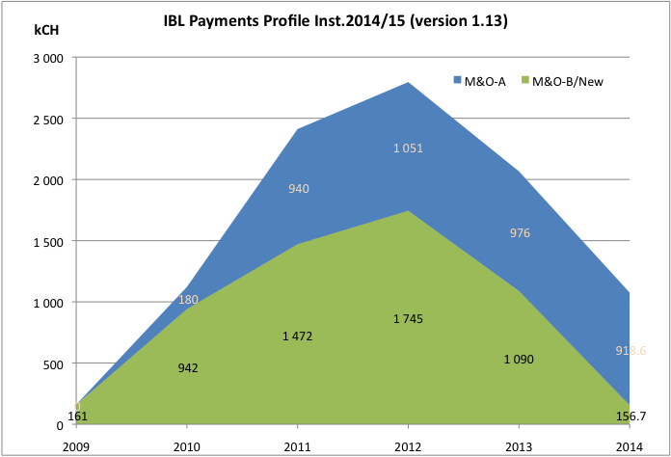
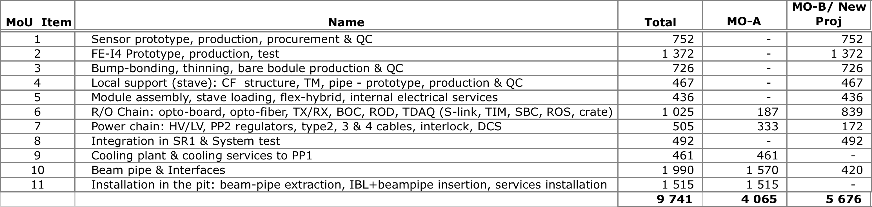
Interim-MoU – Project Funding
M&O-A:
  To cover common costs.
  Spending is needed from 2010
  Items might be covered in kind
M&O-B/New-project
  Deliverables
  Central orders (FE-I4, Sensors, Bump-bonding, etc)

Slide 16
FE-I4 Review
Maurice will report later today from the two day-long FE-I4 review (held on Tue and Wed this week), but I feel the need to bring my appreciation:
  To Kevin (review chair) and all the reviewers for the great attention to all the aspects of the design;
  To the whole FE-I4 team leaded by Abder and Maurice for the excellent quality of the work, documentation and skill put in this challenging design:
    It is >67 M-transistors chip: an order of magnitude step forward from the previous generation chips (FE-I3/MCC-I2.1)
    It is the most challenging FE chip that the HEP community has developed ever
    We still have to “wait” three months for submission: it is a bit of delay, but is worth to wait!
  On behalf of the IBL Collaboration I bring the full support to the FE-I4 team for the hard work has done and to the one still to be done.

Slide 17
IBL Logo
Still no IBL logo to replace the iLogo (interim-Logo)
I know that you are too busy for making the detector…
… but for relaxing you can try some of your artist’s skills!

