Slide 1

Proposal of a compact Inverse Compton X-ray
Source for advanced radiological imaging
Luca Serafini – INFN-Milan and University of Milan
luca.serafini@mi.infn.it
Massimo Placidi – Università di Bologna – massimoplacidi@icloud.com
Seminar Outline
Overview of Compton Sources (ICS) and Applications
Paradigms for Compton Sources (Linac – based, Storage ring – based, Energy Recovery Linac – based, Linac+FEL – based)
Brilliance Chart (ICS, bremsstrahlung, FELs, Light Sources, etc)
STAR @ UniCal
BoCXS for Bologna metropolitan area

Slide 2
Inverse Compton Sources, Overview, Theory, Main Technological Challenges – Photonic Colliders
New Generation of X/γ ray beams via electron-photon beam collisions for advanced applications in medicine/biology-material science/cultural heritage/national security and fundamental research in nuclear physics and high energy physics (e-γ, γ-γ colliders, pol. e⁺ beams, hadron. physics, etc)
Inverse Compton Sources (ICS) are e⁻/photon colliders aimed at producing secondary beams of photons
Several Test-Facilities world-wide: after a decade of machine test&development we are entering the era of User Facilities in X-ray imaging and γ-ray Nuclear Physics and Photonics

Slide 3
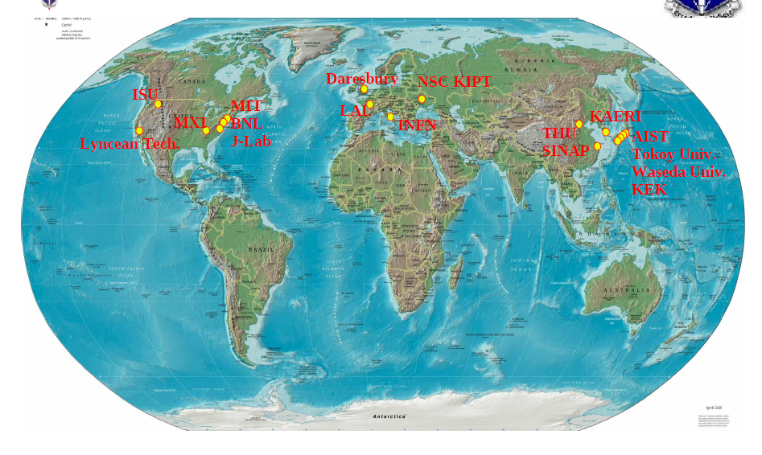
CALA
ELI-NP
HigS
STAR
ICS are the most effective “photon accelerators” (boost twice than FELs)
“4γ² boost effect”
Courtesy A. Variola

Slide 4
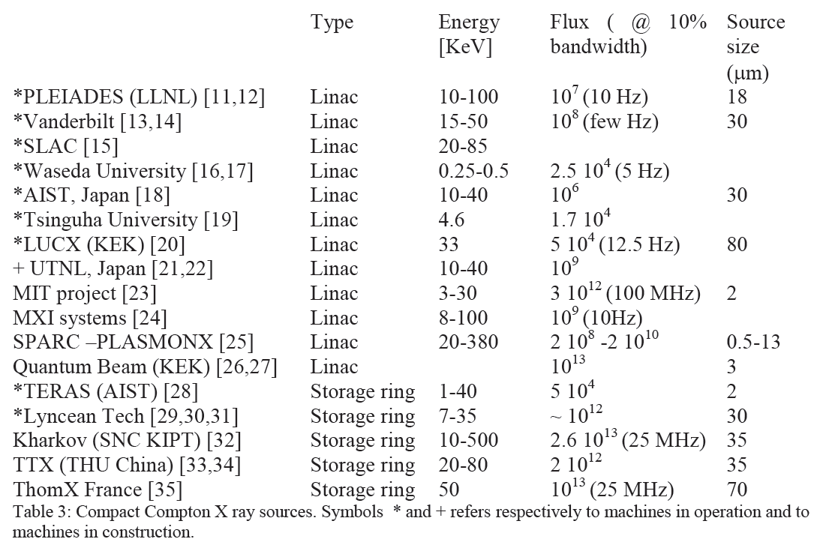
Existing and planned Thomson sources
STAR (Calabria) Linac 20-100 5.10¹⁰ (100 Hz) 18
ELI-NP-GBS Linac+Laser-Recirc 0.2-20 MeV 10¹² (100 Hz) 18
From THOMX Conceptual Design Report, A.Variola, A.Loulergue, F.Zomer, LAL RT 09/28, SOLEIL/SOU-RA-2678, 2010

Slide 5
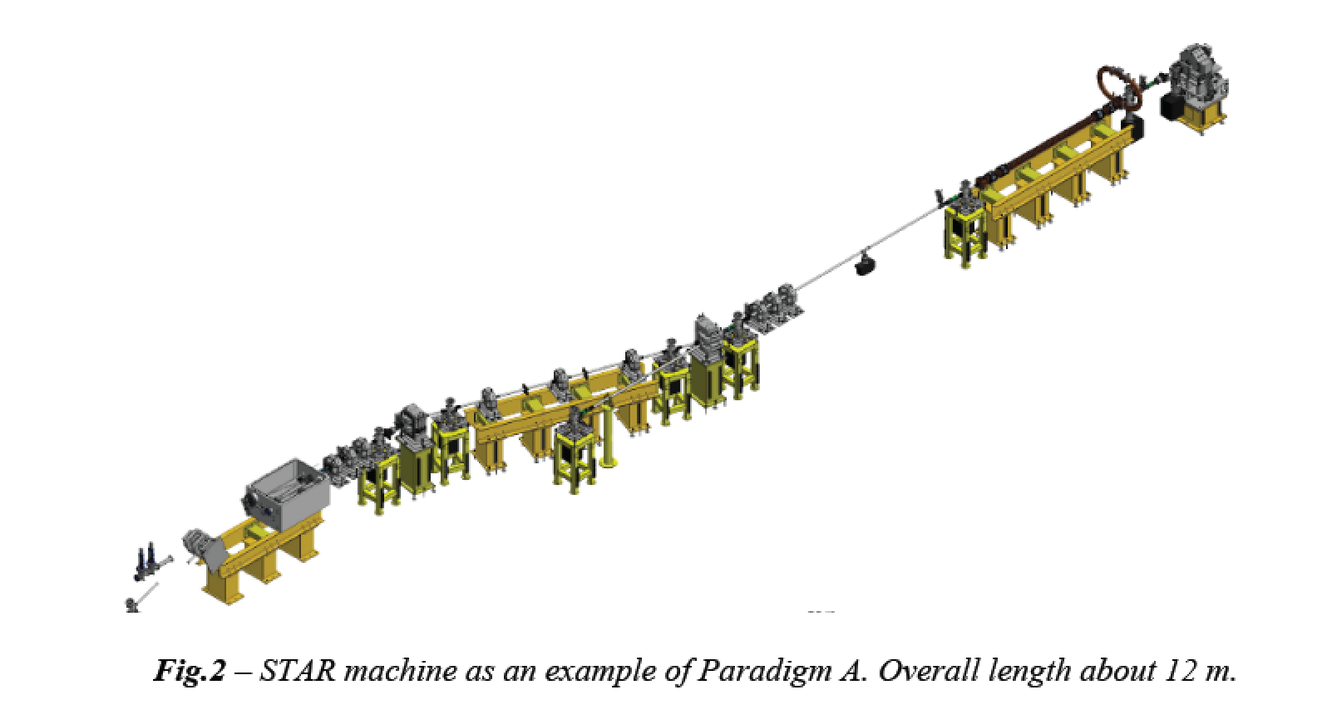
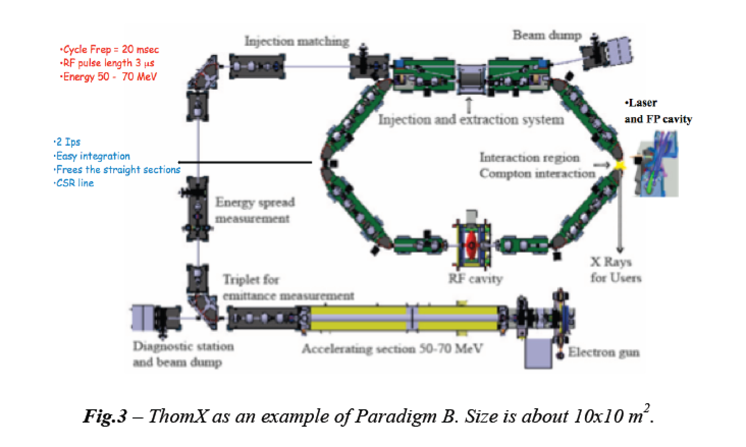
highly asymmetric compact*
electron-photon colliders
w/o laser recirculator 5.10¹⁰ ph/s
w laser recirculator 10¹² ph/s
*10 m, 10 M$
secondary photon beams via large
lorentz boost of c.m. reference frame
MeV/GeV’s electrons
eV’s photons
up to 10¹² ph/s
with MW-class FP
optical cavities

Slide 6
MariX/BriXS Program at Universita’ degli Studi di Milano and INFN
10¹³ - 10¹⁴ ph/s
with 100 mA e⁻ beams
Courtesy V. Petrillo

Slide 7


After 1 year of hard work...
CDR has been published and
available for download at
www.marix.eu

Slide 8


Slide 9
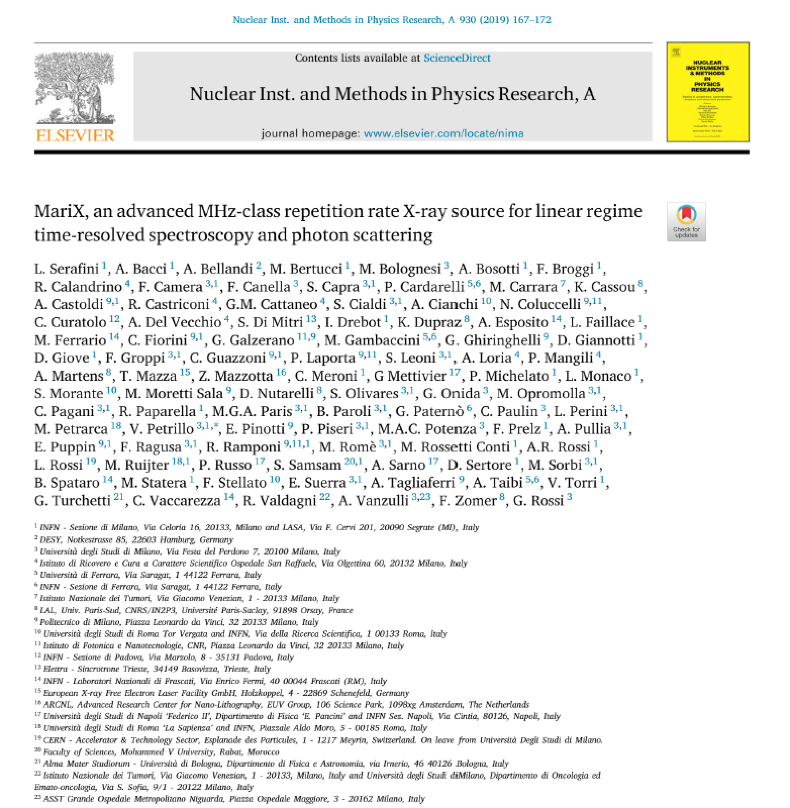
Executive Summary
published on NIM-A

Slide 10
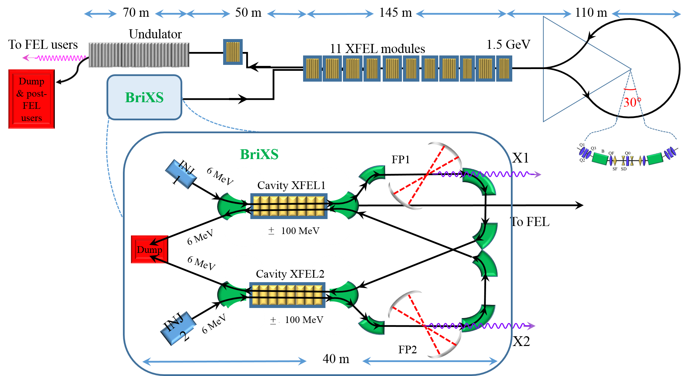
BriXS & MariX FEL based on bubble arc compressor:
we use twice the same 1.5 GeV SC CW Linac
A relativistic-doppler antenna
3.2-3.8 GeV
3.-3.6 GeV
1.5-1.8 GeV
Elettra-like
Compton
A boosted e-γ
Collider
Compton
BriXS: 20-180 keV mono-chromatic X-rays up to 5.10¹² photons/sec in 5% bdw

Slide 11


Slide 12
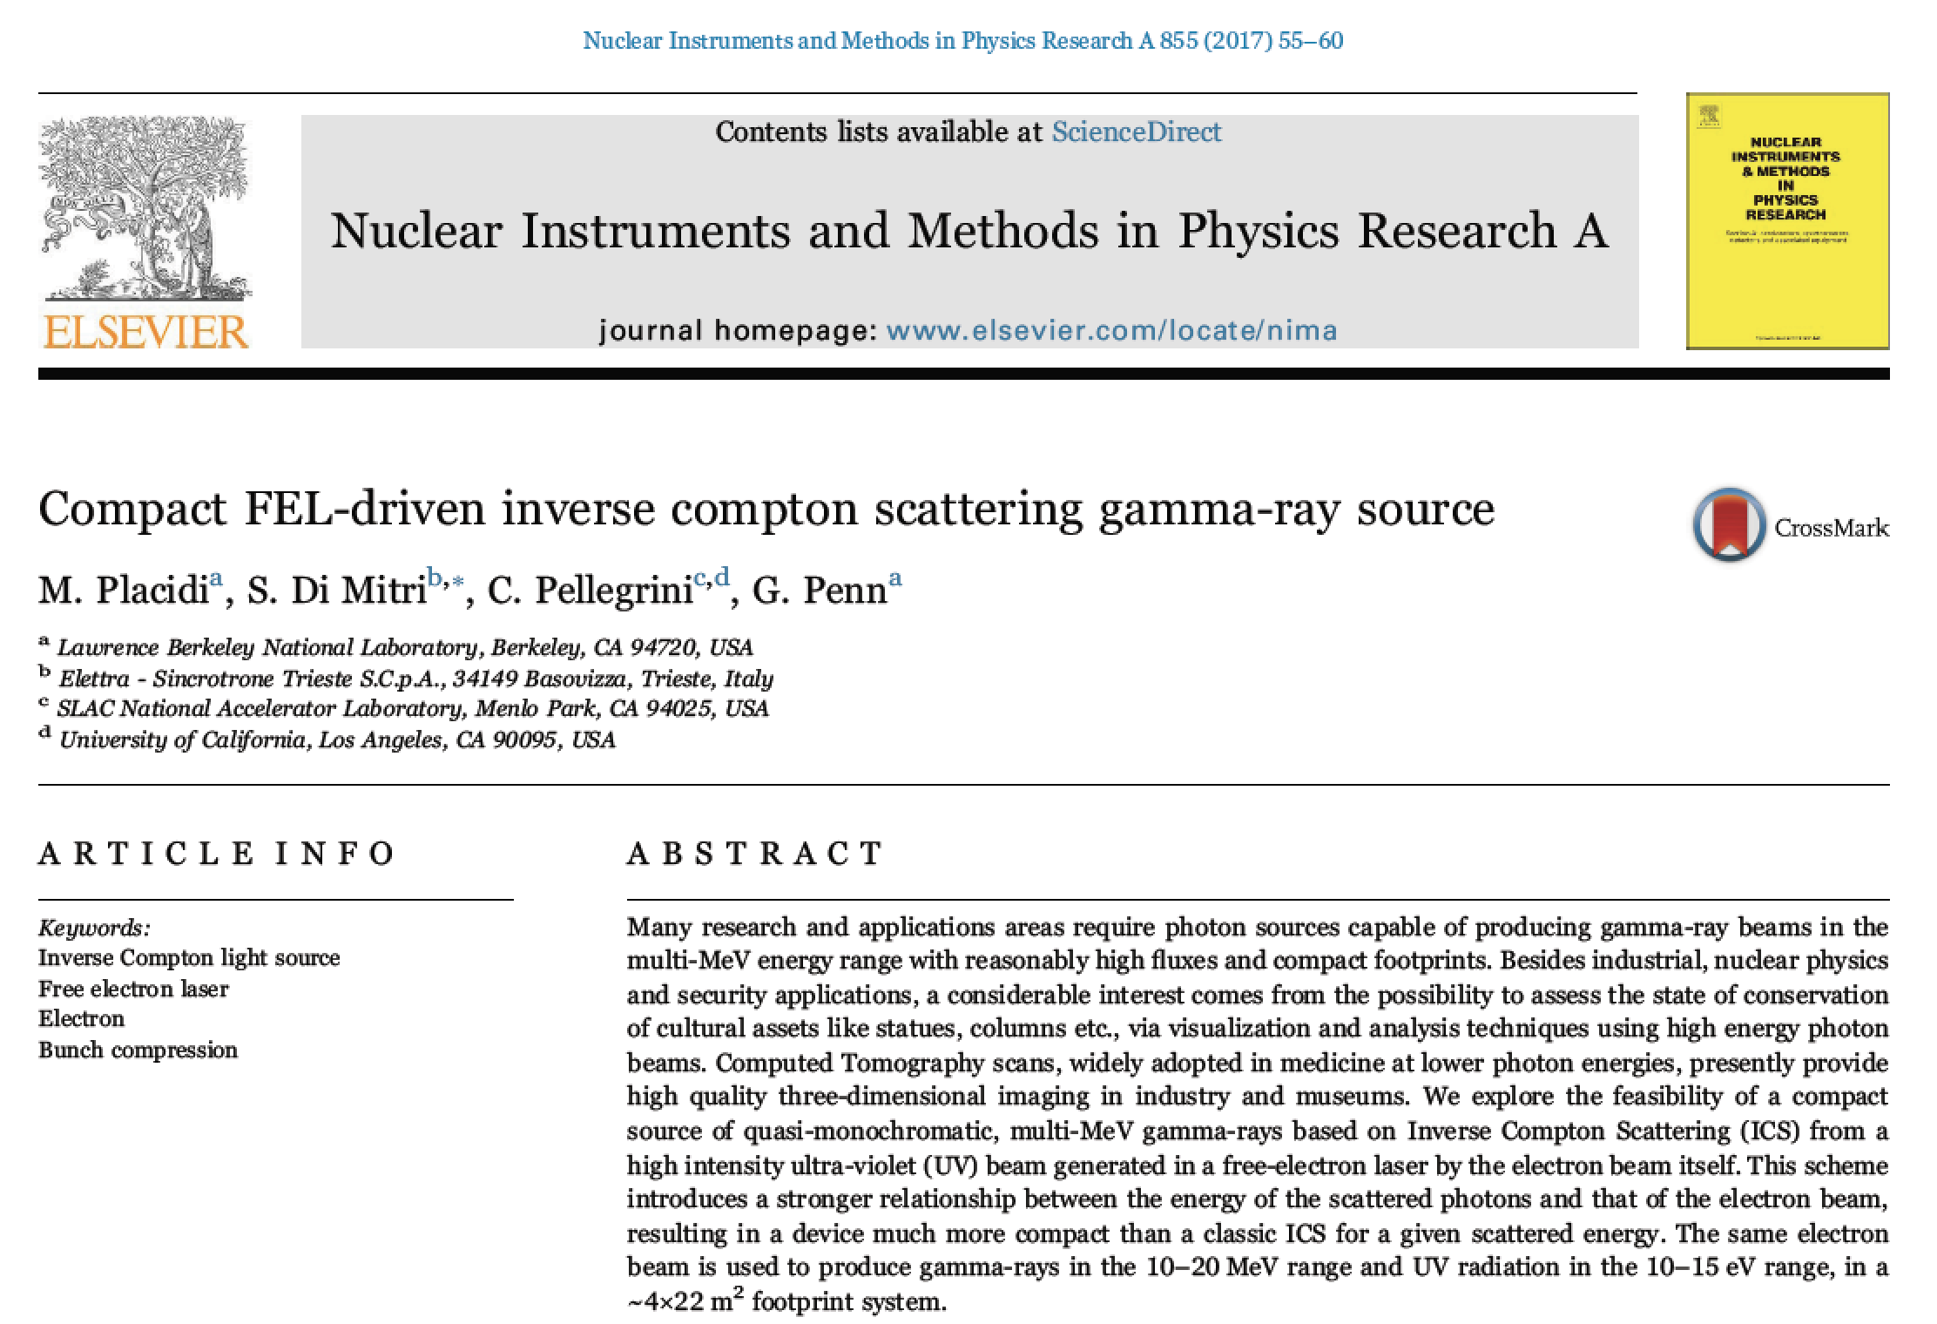
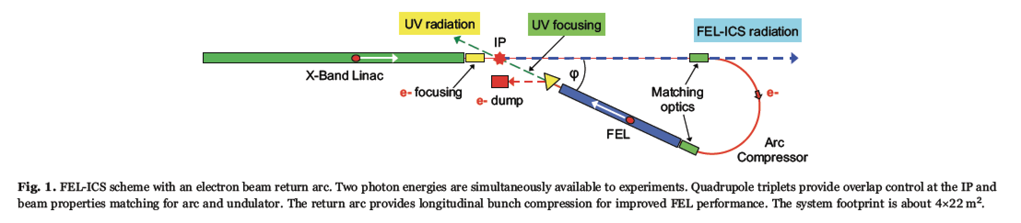
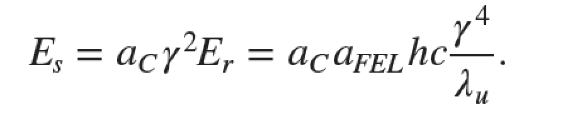

Slide 13
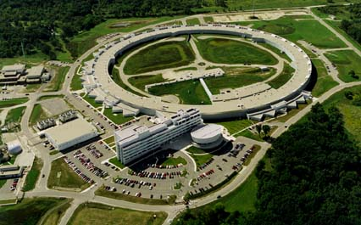
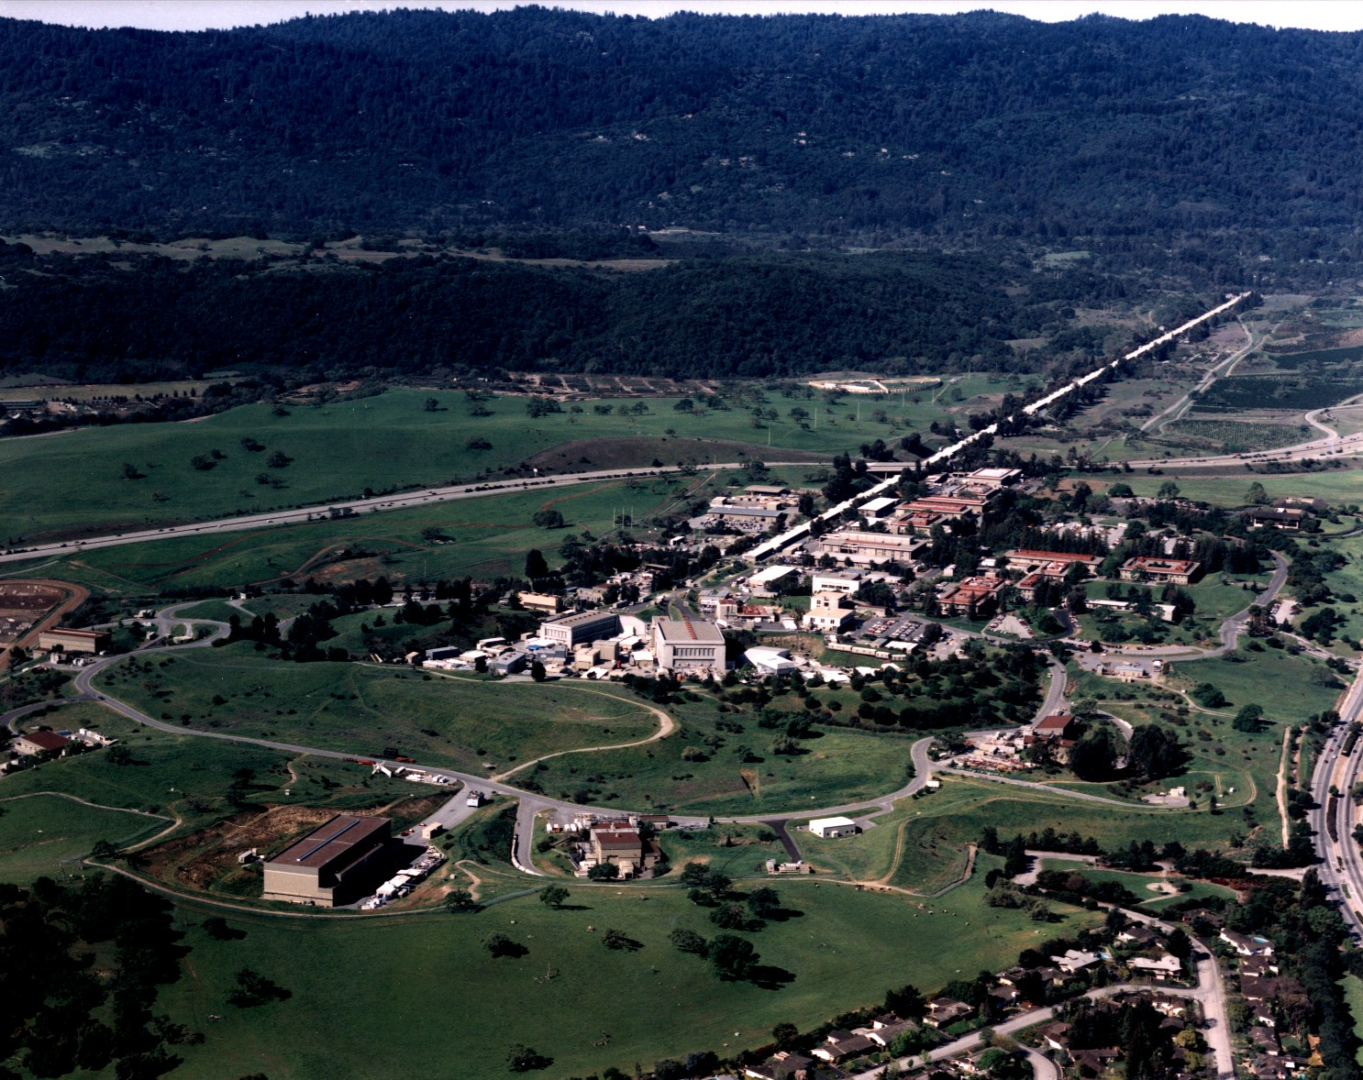

3rd-4th Generation Light Sources
Synchrotron light sources: < 50 keV, > 50 ps (100 m, 300 M$)
X-ray FEL (LCLS): energy ≤25 (50?) keV, 1-100 fs (1 km, 1 G$)
New approach: inverse Compton scattering (ICS) 20-200 keV , sub-ps, (10 m , 10 M$) – sometimes called Laser Synchrotron since a laser pulse substitutes the magnetic undulators
The critical frequency of synchrotron radiation is
$ω_{c}\sim \frac{1}{\frac{1}{2}∆t}\sim \frac{3cγ^{3}}{2ρ}$ $\sim$ B $γ^{2}$

Slide 14
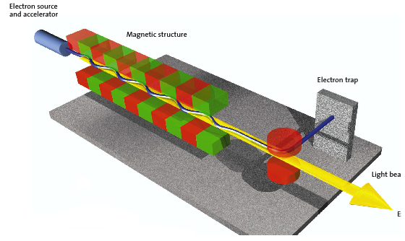
The Classical E.M. view (Maxwell eq.): Thomson Sources as synchrotron radiation sources with electro-magnetic undulator
FEL’s and Thomson/Compton Sources common mechanism:
collision between a relativistic electron and a (pseudo)electromagnetic wave
3 km
cm und. period λ_{u}
1-25 GeV
electrons
100-0.5 Å
photons
20-150 MeV electrons
0.8 μm laser λ
20-500 keV
photons
20 m

Slide 15
FEL resonance condition
(magnetostatic undulator )
Example : for λ_{R}=1A, λ_{w}=2cm, E=7 GeV
Violation of Energy-Momentum Conservation !!
(electromagnetic undulator )
Example : for λ_{R}=1A, λ=0.8μm, E=25MeV
Example : for hν=10 MeV, λ=0.4μm, E=530 MeV
laser power
L. Serafini et al., Proceedings of the SPIE,
Volume 6634, article id. 66341G (2007)
laser spot size

Slide 16
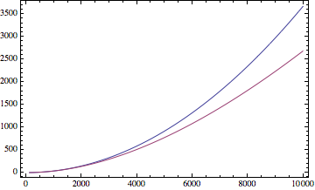
γ−γ Colliders
X/γ
[MeV]
Polarized
Positrons
FELs (pure γ²)
Nuclear
Photonics
Δ
Thomson
X-rays
1 GeV
T_{e} [MeV]
1 TeV
0.511
E_{cm} [MeV]
1.533

Slide 17
Quantum Model: a look at what happens in the Center of Mass reference system (kinematics)
Lab ref.
c.m. ref.
Recall some Basics

Slide 18
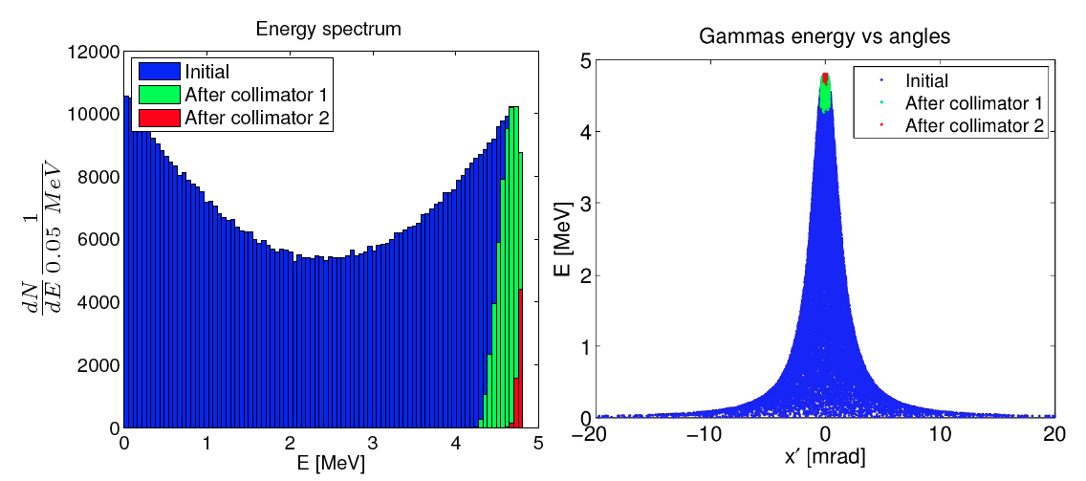
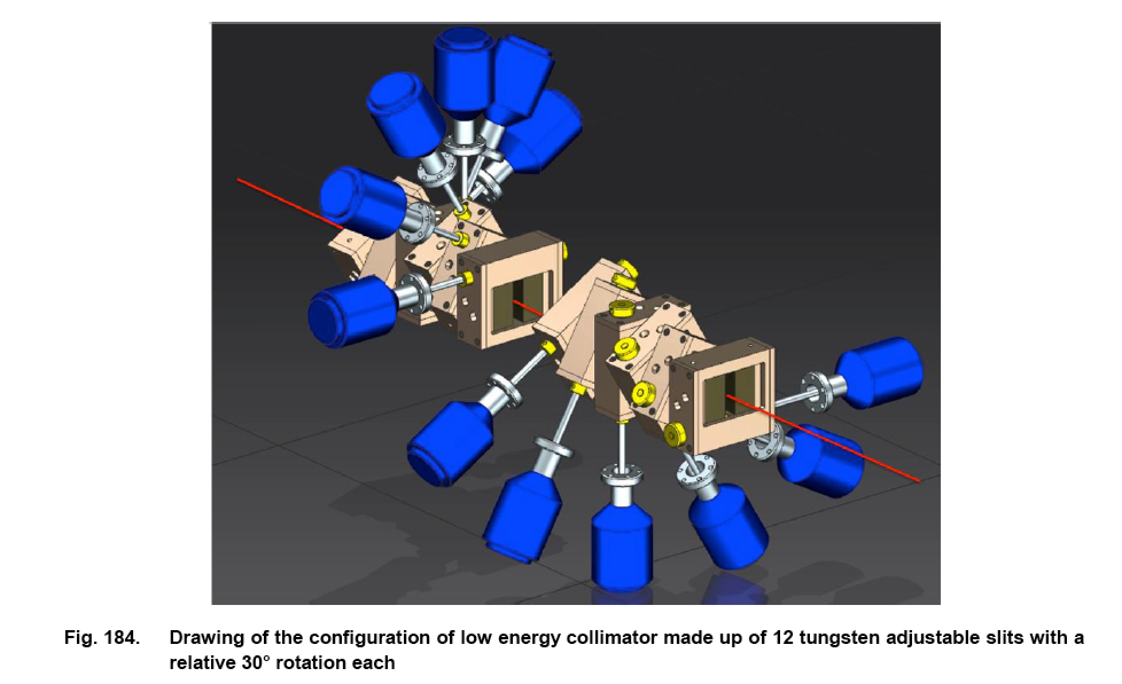
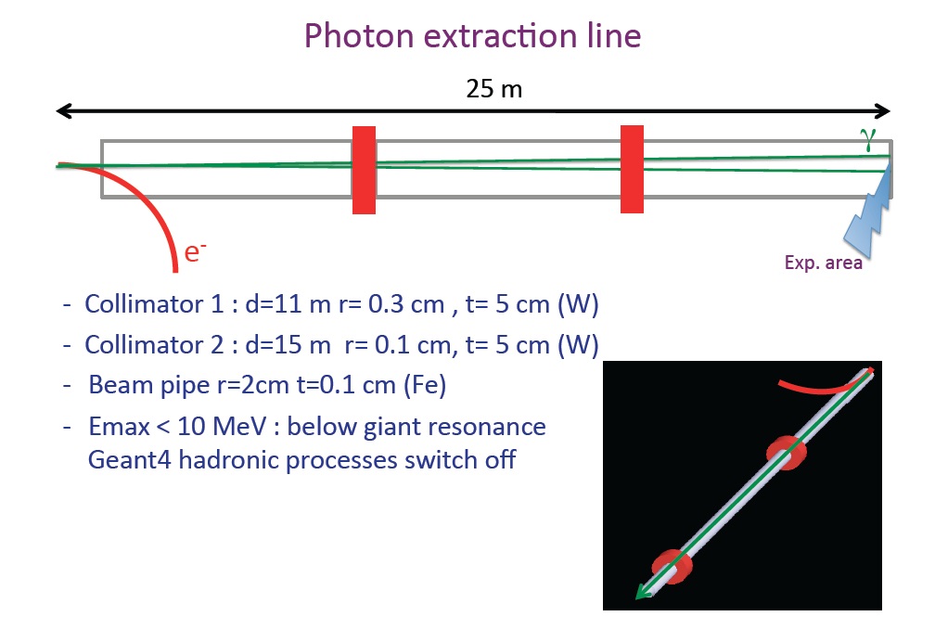
300 μrad
60 μrad
Courtesy M. Gambaccini

Slide 19
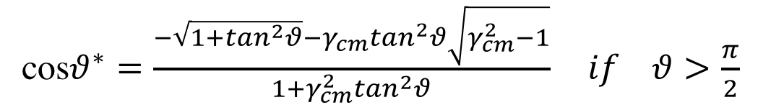
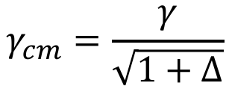
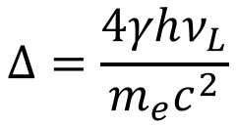
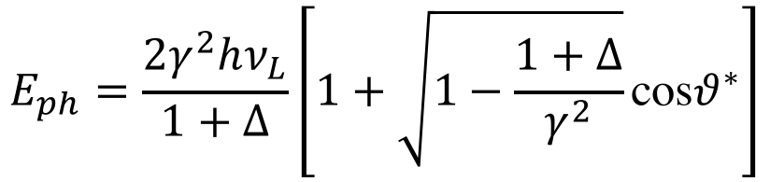
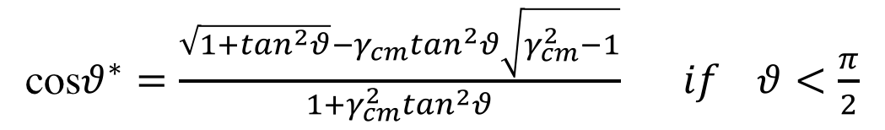
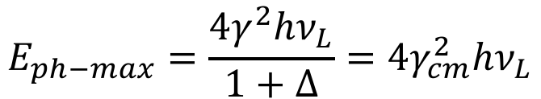
Recap
(exact analytical formula, no approximations)
$$Δ=\frac{4γhν_{L}}{m_{e}c^{2}}$$
$$γ_{cm}=\frac{γ}{\sqrt{1+Δ}}$$
$$E_{ph}=\frac{2γ^{2}hν_{L}}{1+Δ}\left[1+\sqrt{1−\frac{1+Δ}{γ^{2}}}\text{cos}θ^{∗}\right]$$
cos$θ^{∗}=\frac{\sqrt{1+\tan^{2}θ}−{γ_{cm}tan}^{2}θ\sqrt{γ_{cm}^{2}−1}}{1+γ_{cm}^{2}\tan^{2}θ} if θ<\frac{π}{2}$
cos$θ^{∗}=\frac{−\sqrt{1+\tan^{2}θ}−{γ_{cm}tan}^{2}θ\sqrt{γ_{cm}^{2}−1}}{1+γ_{cm}^{2}\tan^{2}θ} if θ>\frac{π}{2}$
$$E_{ph−max}=\frac{4γ^{2}hν_{L}}{1+Δ}=4γ_{cm}^{2}hν_{L}$$

Slide 20





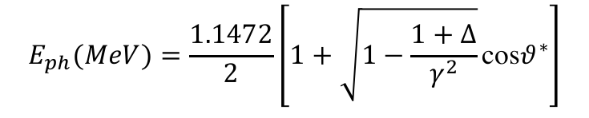

Recap
(exact analytical formula, example 250 MeV electrons against hν_{L}=1.2 eV photons)
$$E_{ph}(MeV)=\frac{1.1472}{2}\left[1+\sqrt{1−\frac{1+Δ}{γ^{2}}}\text{cos}θ^{∗}\right]$$
$$γ=490.$$
$$Δ=0.0046$$
$$γ_{cm}=488.88$$
$$E_{ph}(eV)$$
$$E_{ph}(eV)$$
$$θ$$
$$θ=1/γ$$

Slide 21


Recap
(exact analytical formula, example 250 MeV electrons against hν_{L}=1.2 eV photons)
$$E_{ph}(MeV)=\frac{1.1472}{2}\left[1+\sqrt{1−\frac{1+Δ}{γ^{2}}}\text{cos}θ^{∗}\right]$$
$$γ=490.$$
$$Δ=0.0046$$
$$γ_{cm}=488.88$$
$$E_{ph}(eV)$$
$$θ$$

Slide 25
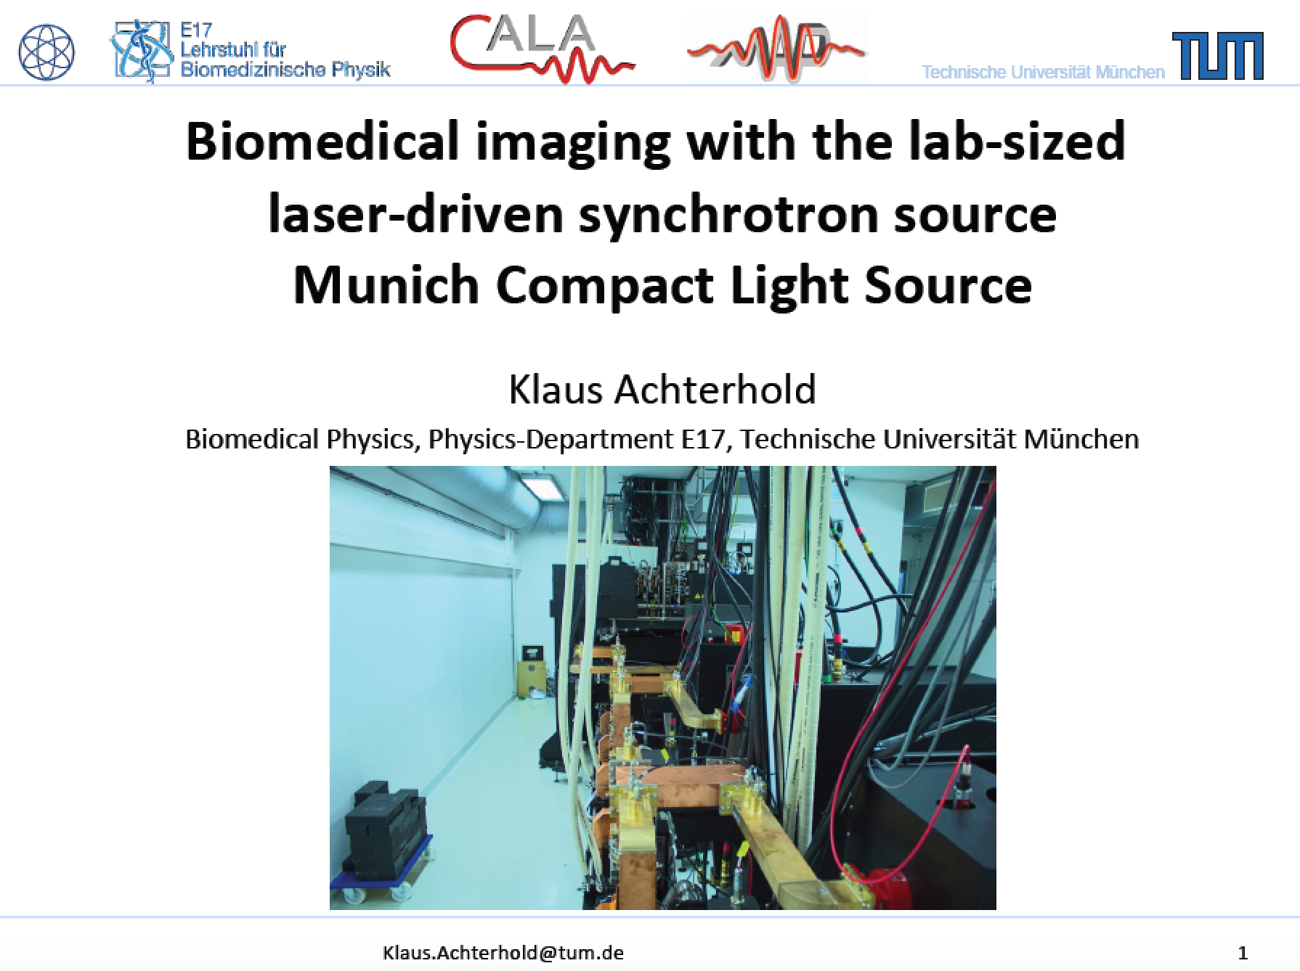
An ICS based X-ray User Facility in operation in Germany
Compact machine
10x10 m²
In operation since
early 2015

Slide 26
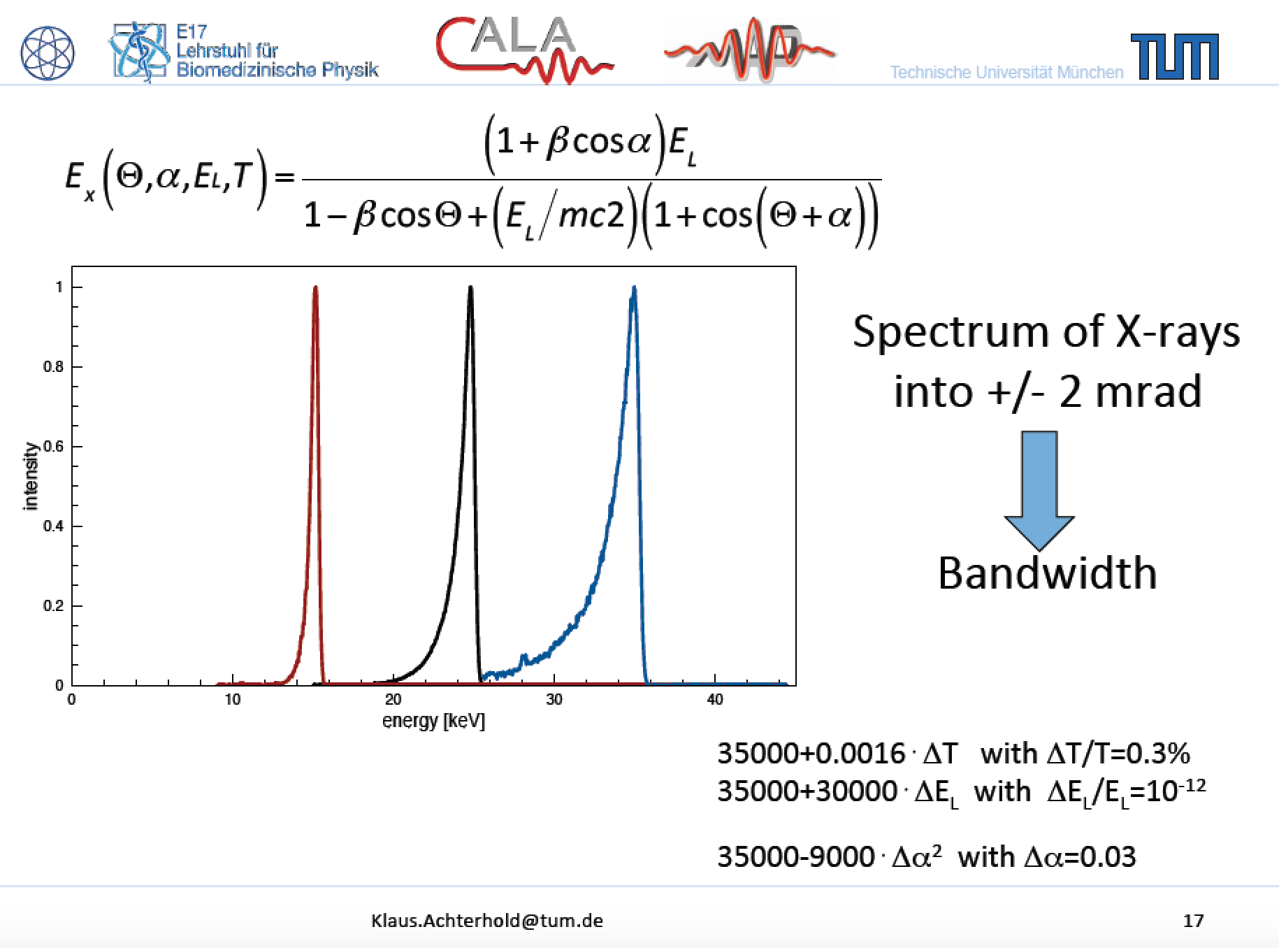
measured
Measured 1.5.10¹⁰ ph/sec with 20 mA

Slide 27
measured
Measured 5.10¹⁰ ph/sec with 20 mA

Slide 28
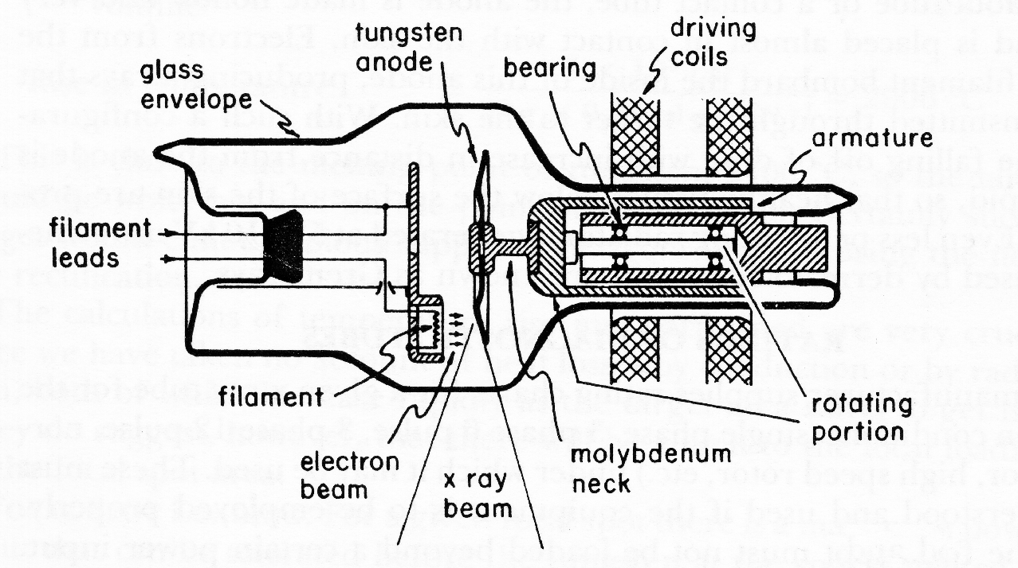
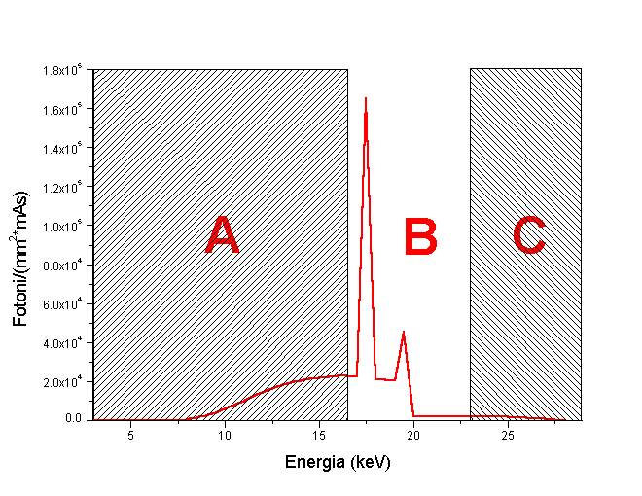
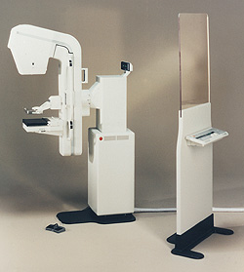
Great example of Radio-logical imaging applied to mass screening over population: mammography
Conventional X-ray tube for mammography
Spatial resolution ~100 μm
High Flux ~10⁷ γ/(mm²s) equivalent to ~5.10¹¹ γ/s over 20x20 cm² area.
Absent in
Thomson
Source
X-ray
spectrum!
65 cm
Low energy photons in the spectrum are absorbed by tissue, delivering radiation dose without bringing informations to detector. Risk of inducing secondary tumors increases without increasing the benefit of detecting early tumors

Slide 29
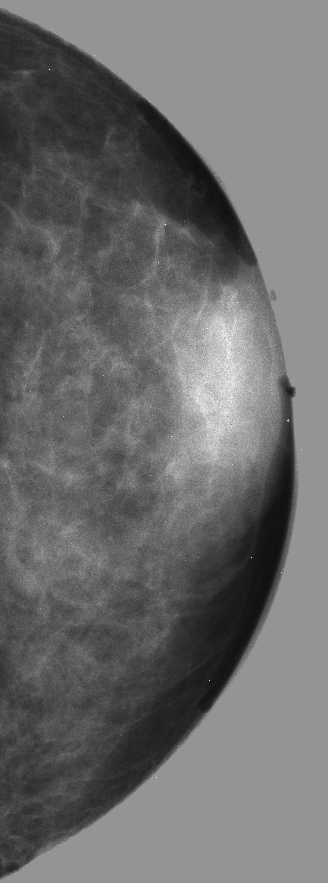
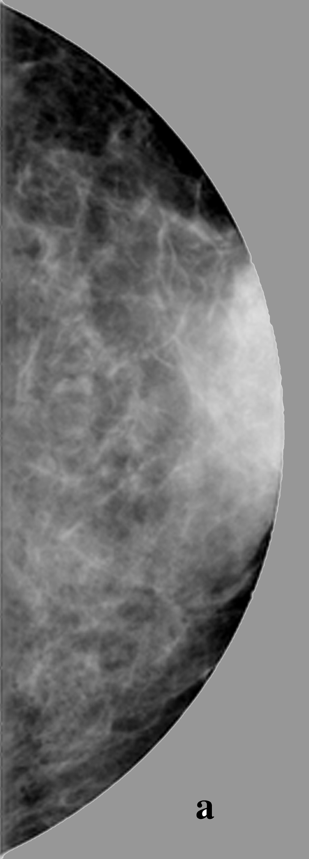

Mammography with Mono-chromatic X-rays at 20 keV has been proven
far superior in Signal-to-Noise-Ratio w.r.t. conventional mammographic tubes,
with a considerably lower radiation dose to the tissue
a) SR digital image
Energy 17 keV
Scan step 100 mm
MGD 1 mGy
Conventional
X-ray tube 26 kVp
MGD 1 mGy
b) SR digital image
Energy 20 keV
Scan step 100 mm
MGD 0.33 mGy
3 cm thick in vitro human breast tissue

Slide 30
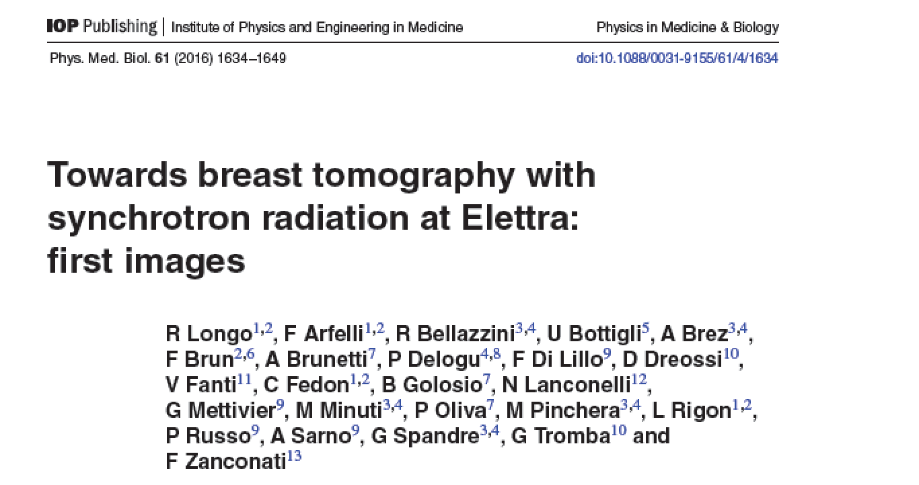
Compact Thomson X-ray Sources could be located inside hospitals to diagnose
and treat patients directly at the hospital site (unlike Synchrotrons…)

Slide 31
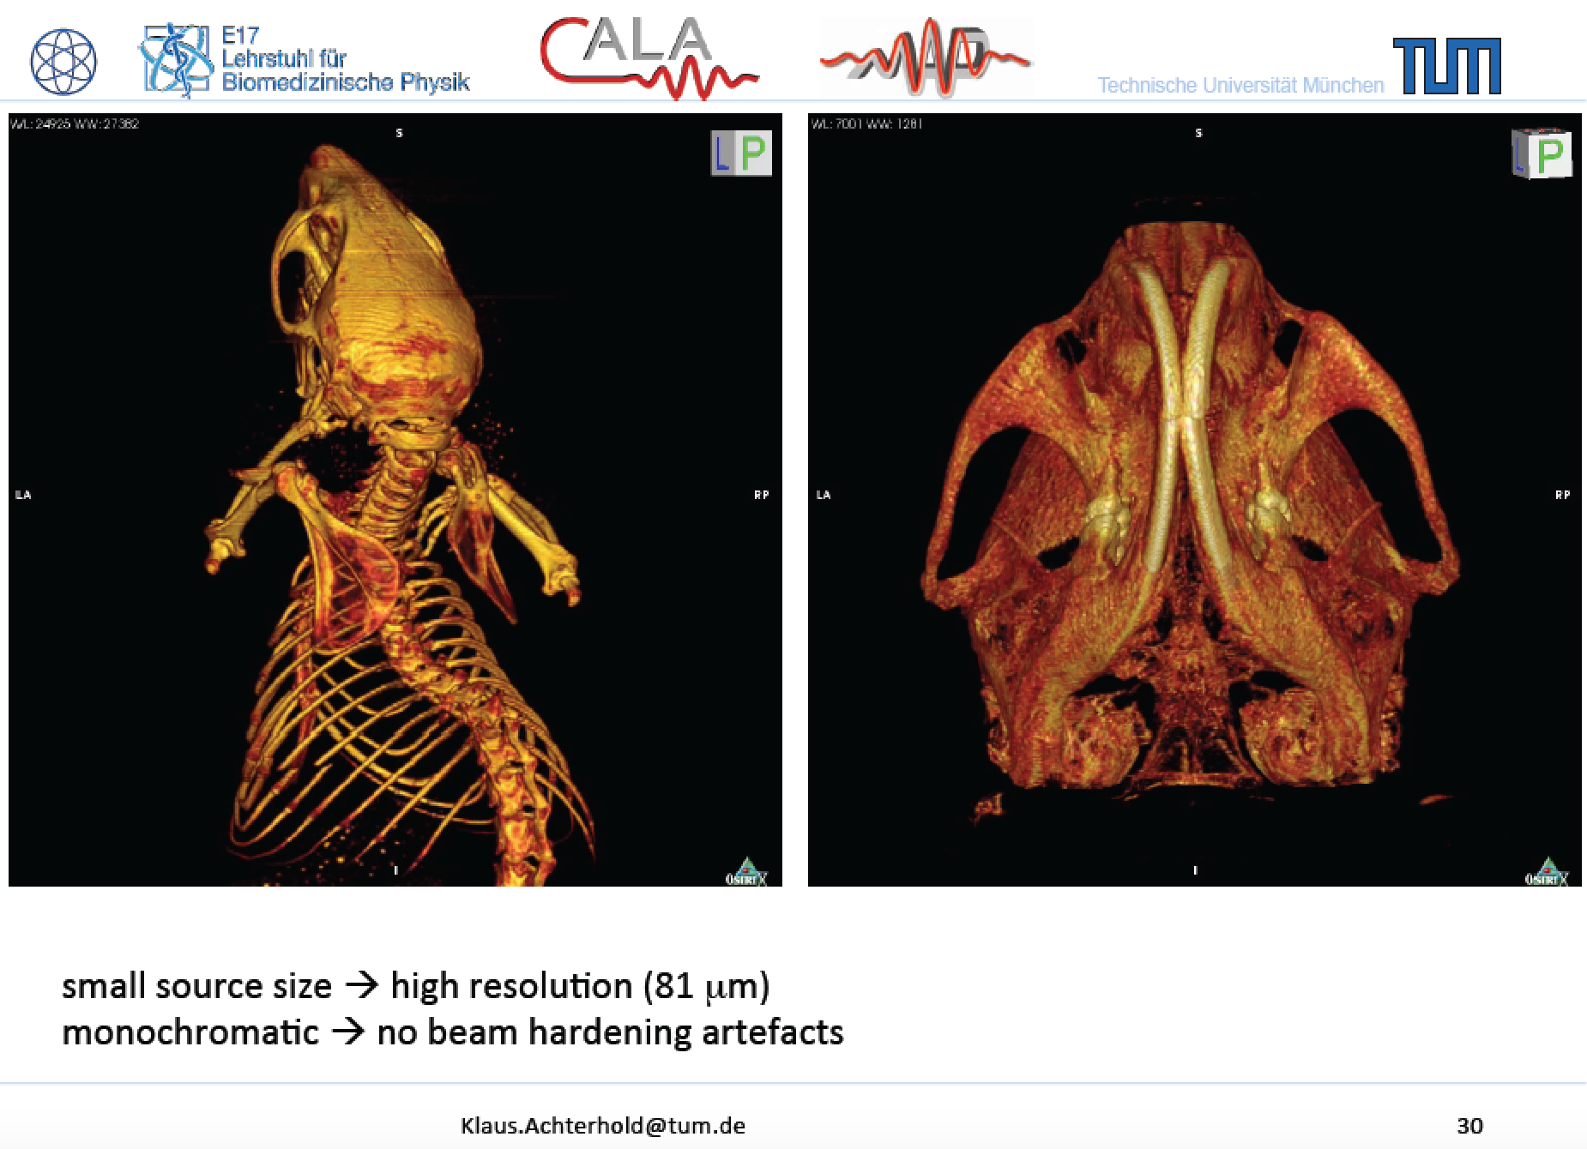
Phase Contrast Imaging made possible
by small round source spot size (< 20 μm)

Slide 32
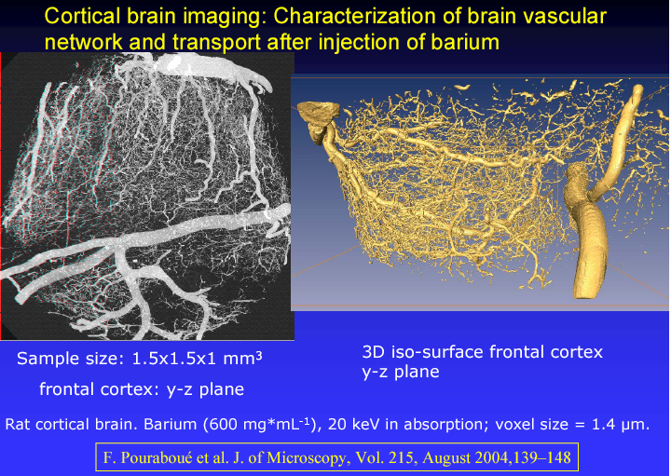
courtesy of A. Bravin (ESRF)
Bio-Medical Advanced Imaging with Mono-chromatic X-rays, demonstrated at
Synchrotrons, is possible also with High Flux Thomson X-ray Sources
in 20 keV-100 keV energy range

Slide 33
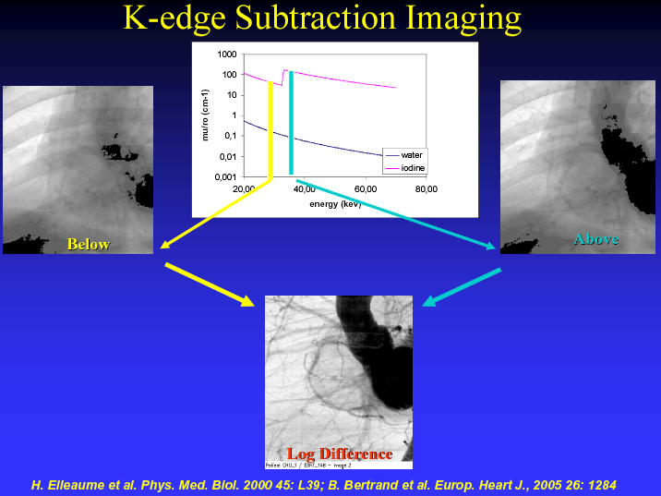
Bio-Medical Advanced Imaging with Digital Subtraction of Mono-chromatic
X-ray shots are also possible with High Flux Thomson X-ray Sources with
picosecond to millisecond time resolution

Slide 34
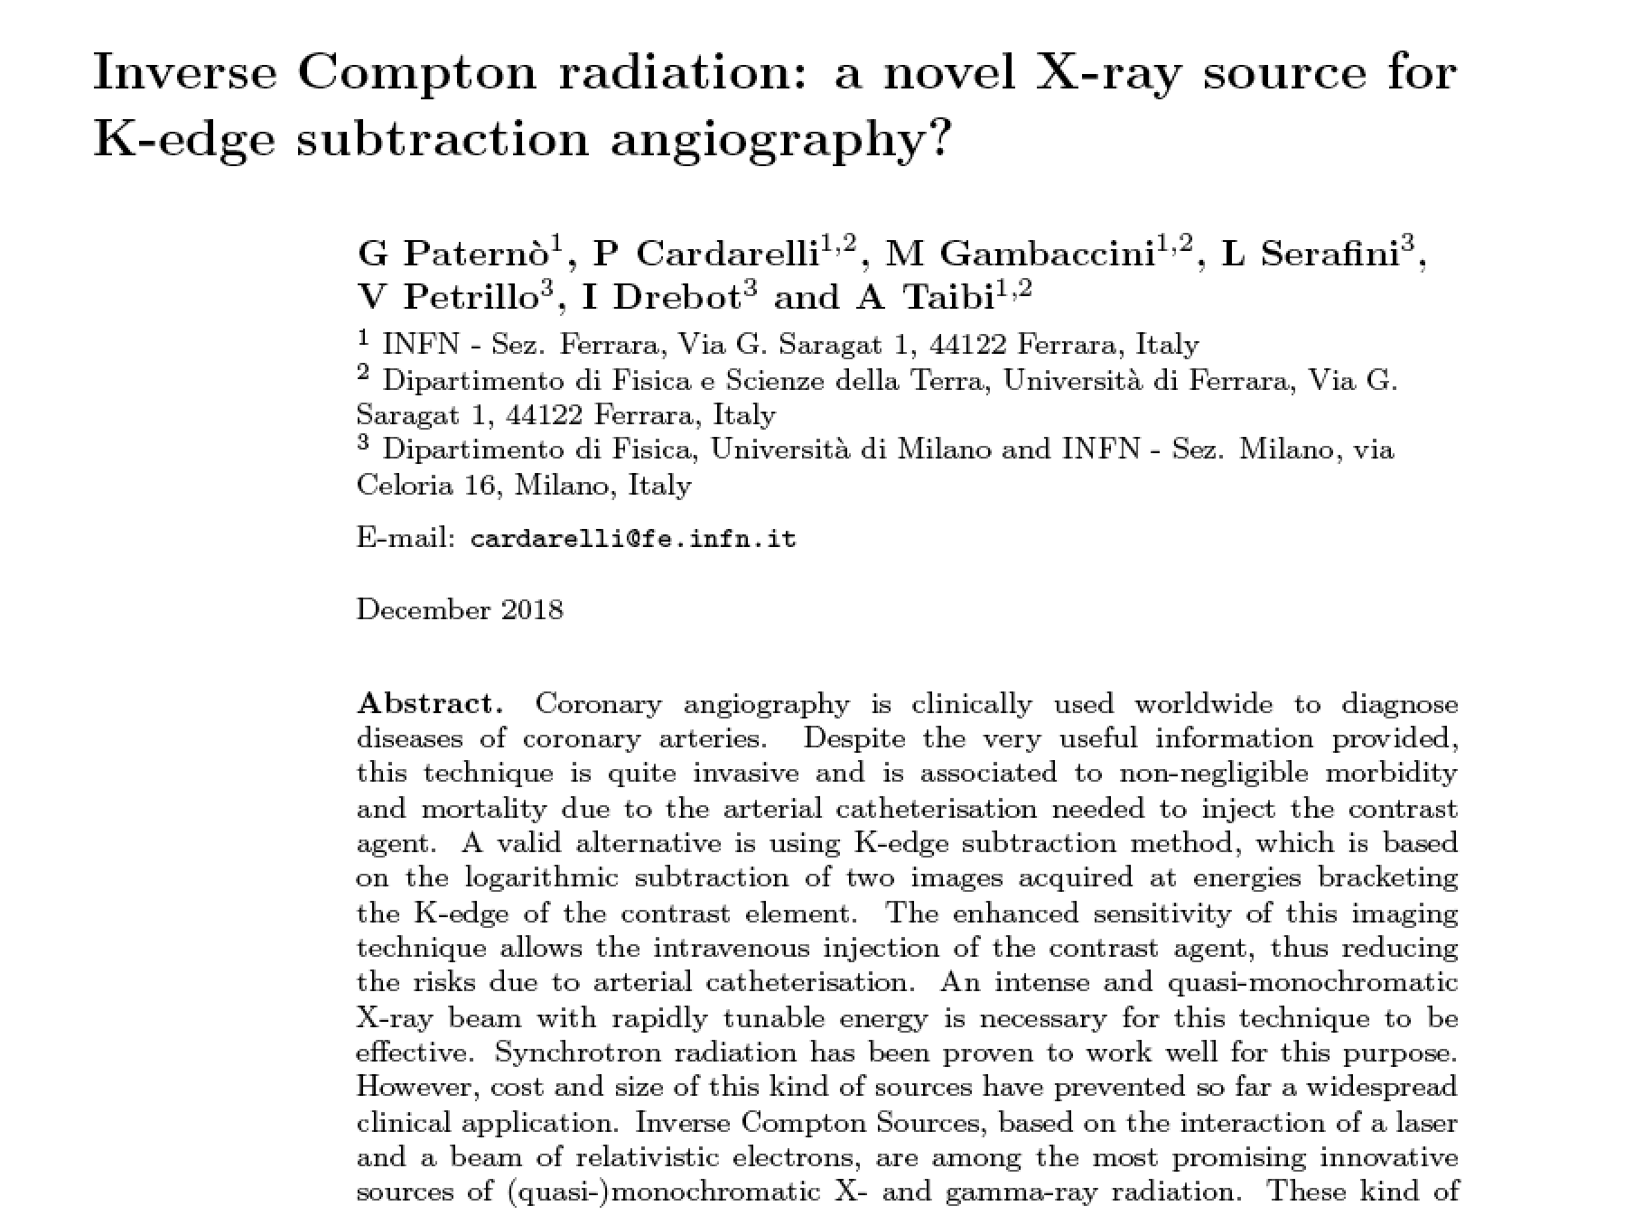
MariX-RAD CSN5-INFN
Resp. Naz. Paolo Cardarelli
Univ. di Ferrara
accepted for publication on Physics in Medicine and Biology

Slide 35
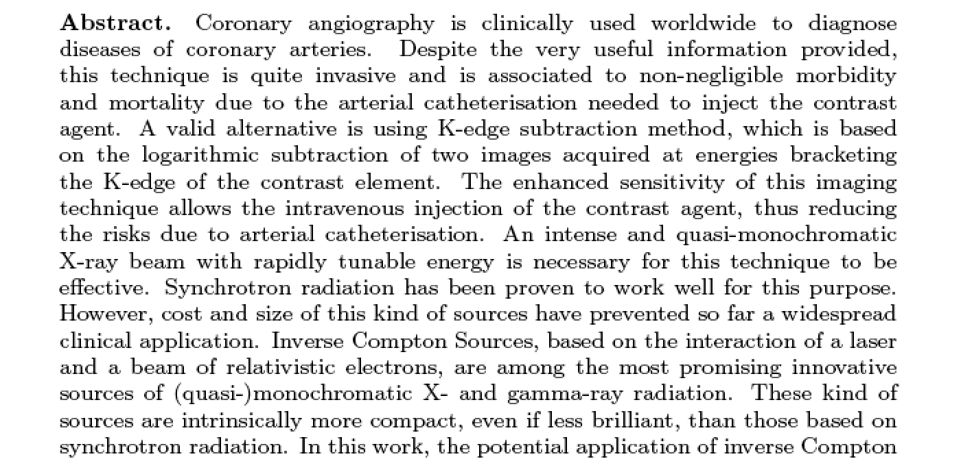
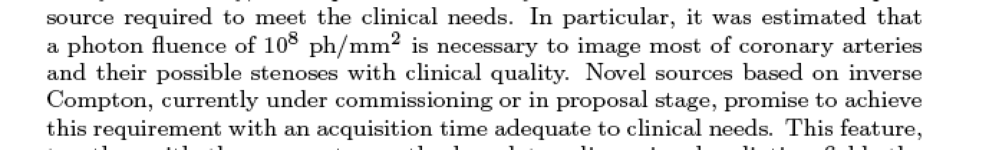
MariX-RAD CSN5-INFN - Resp. Naz. Paolo Cardarelli - Univ. di Ferrara

Slide 36
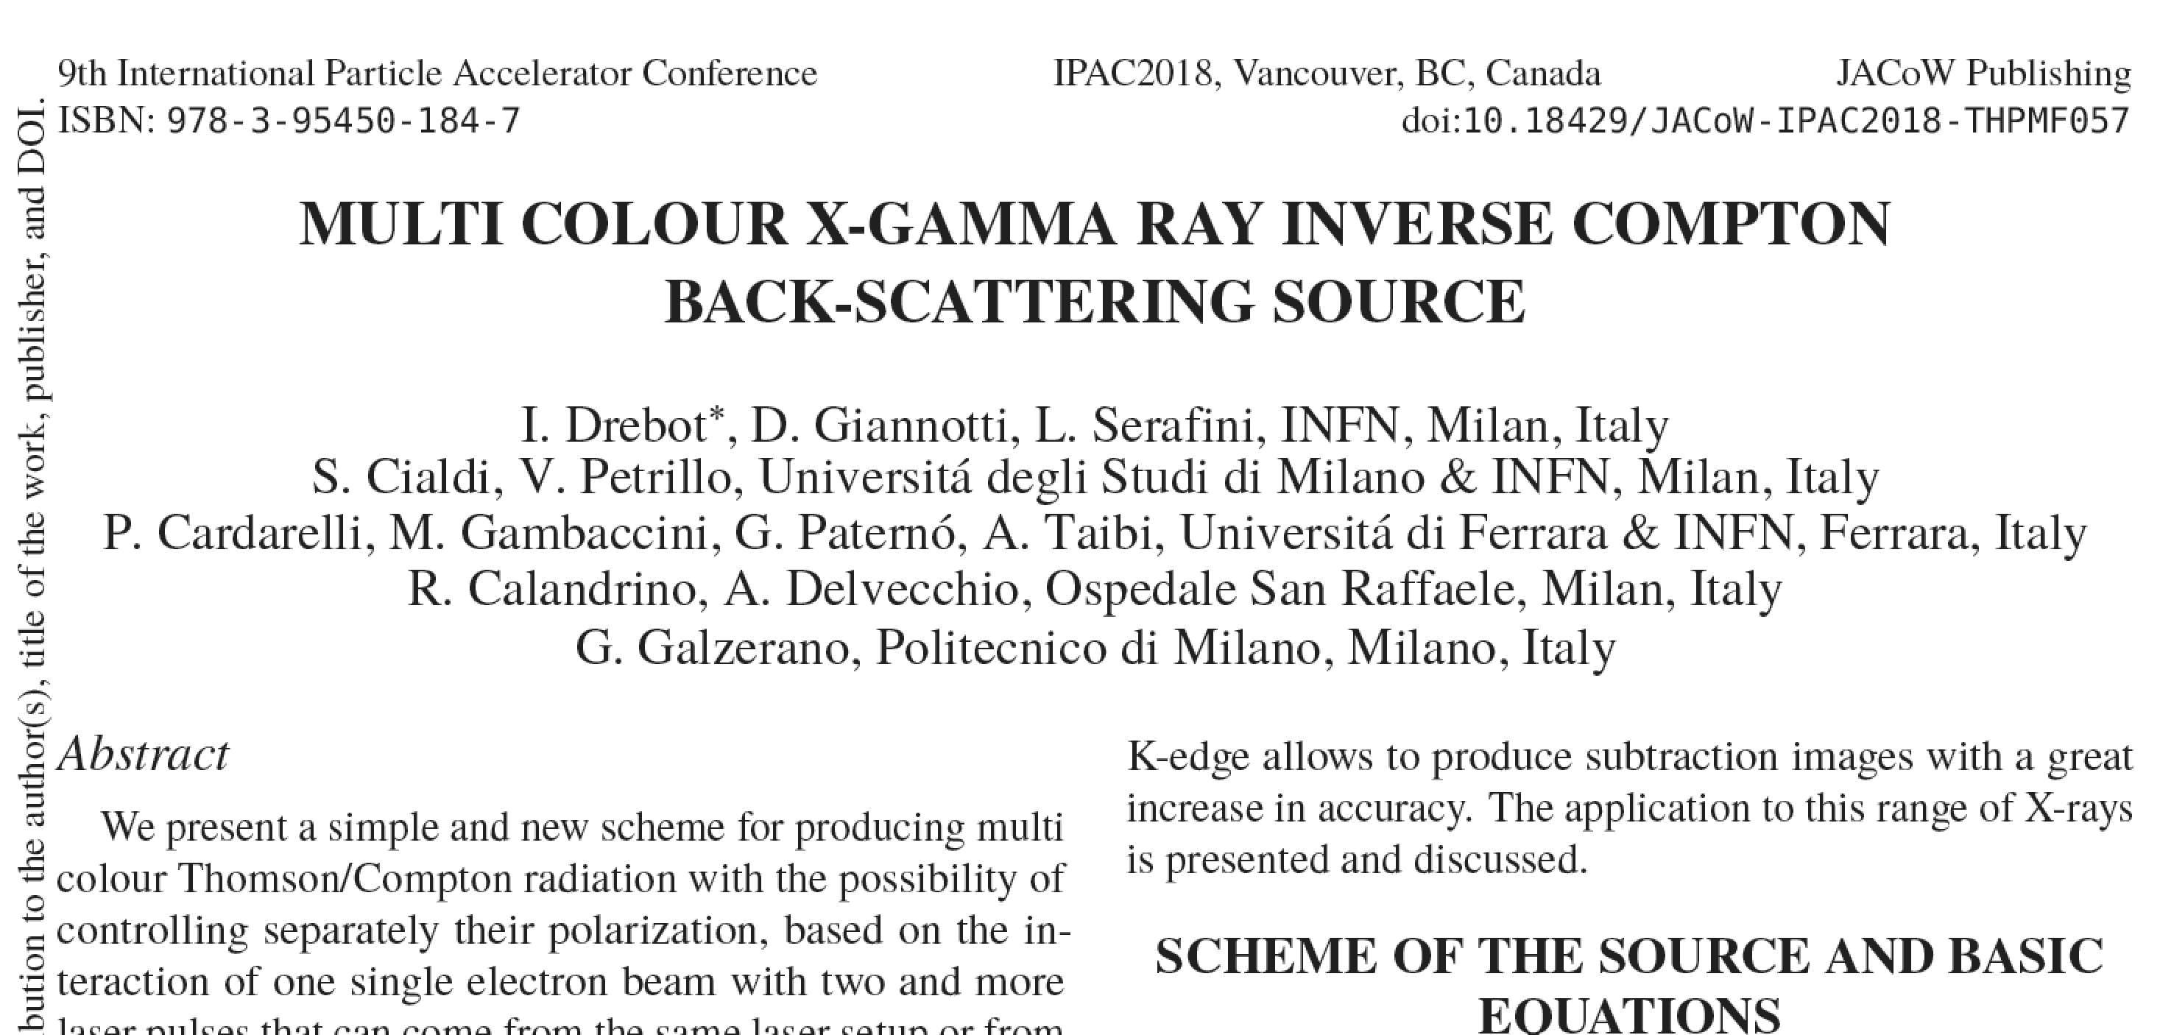
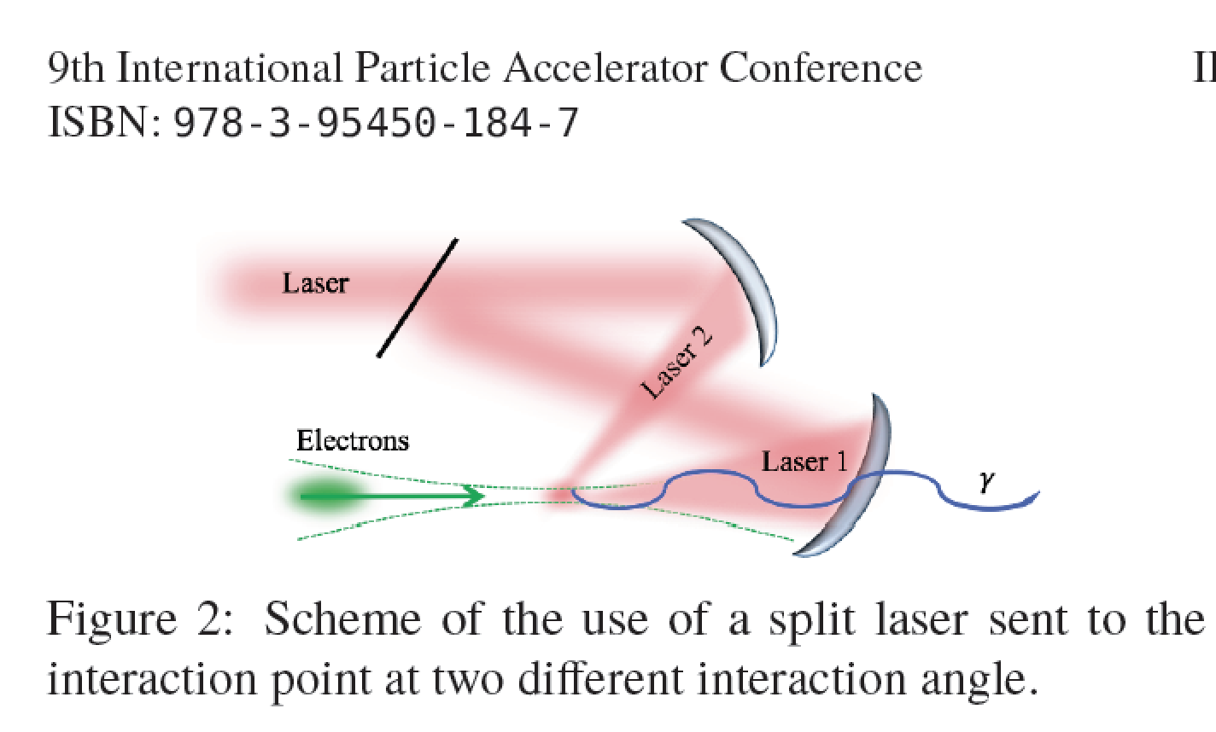
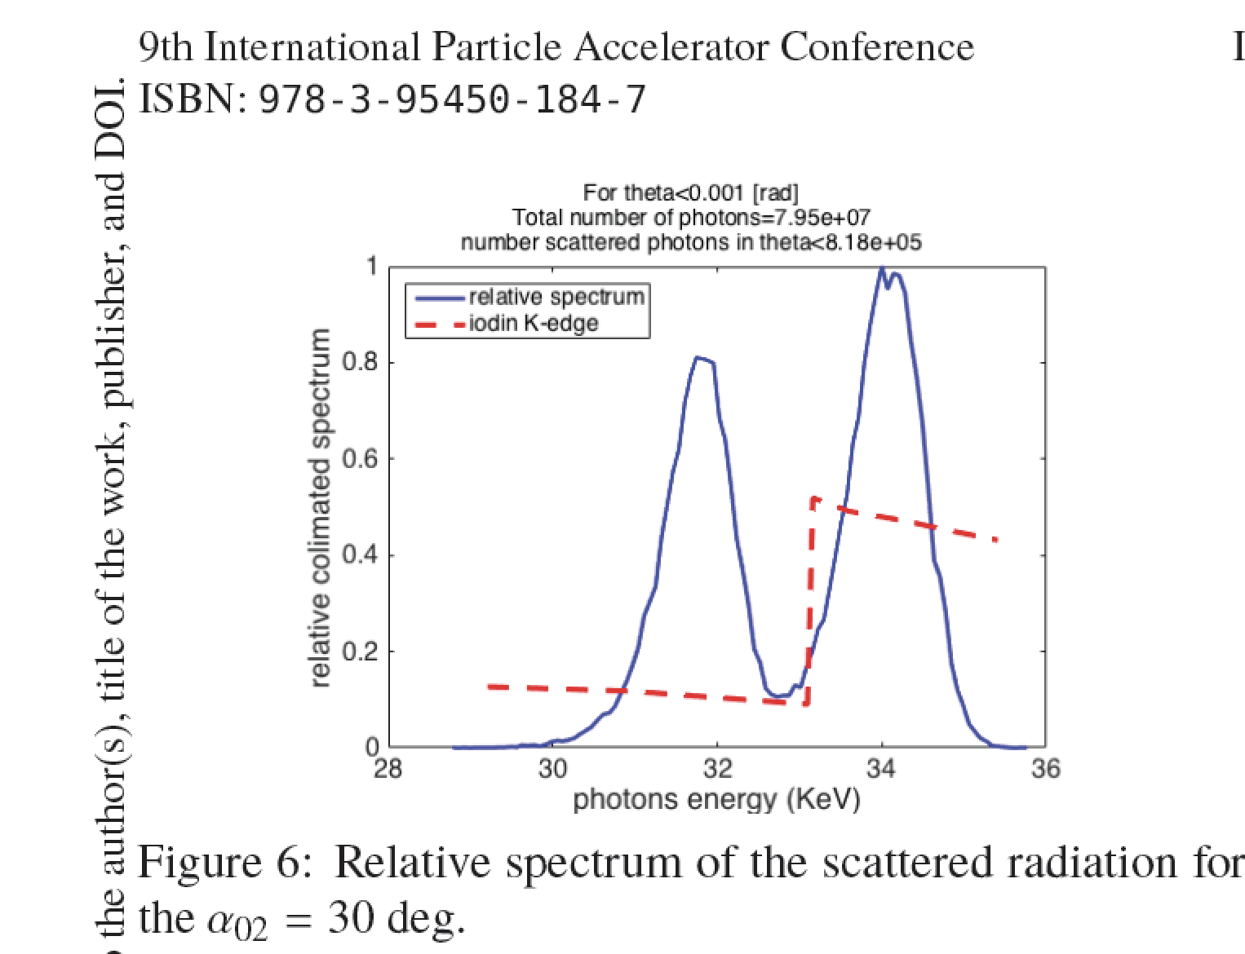

Slide 37
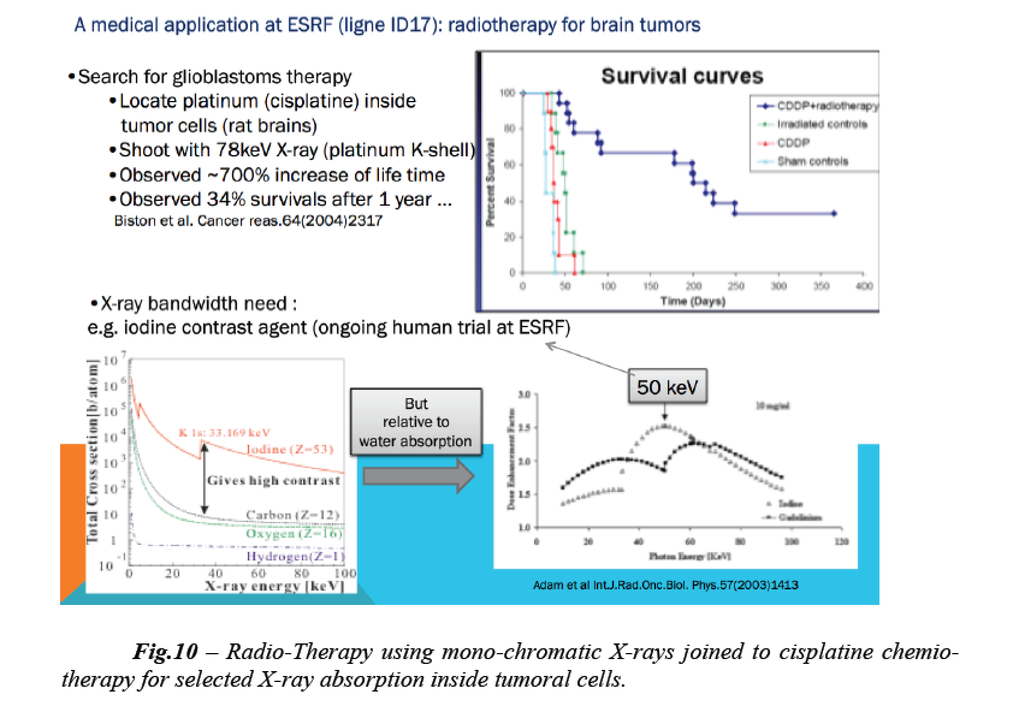
comprehensive overview recently presented at the PAHBB-2016 Workshop (see https://conferences.pa.ucla.edu/hbb/index.html) by A. Variola (INFN-LNF)

Slide 38
Advancing Thomson X Ray Sources for
Bio/Medical Imaging Applications and Matter Science

Slide 39

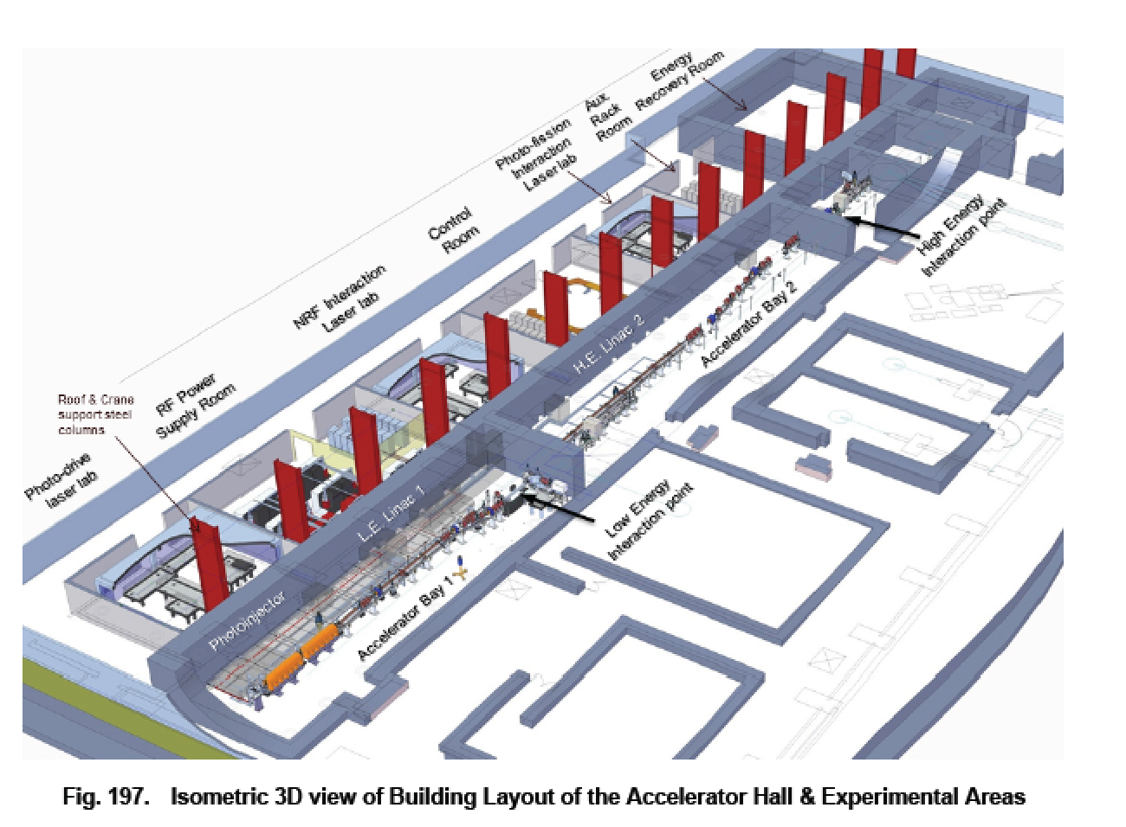
Accelerator and Equipments
in ELI-NP Building
100 m, 100 M$ scale
A γ-ray User Facility in construction in
Romania: ELI-NP-GammaBeamSystem

Slide 40
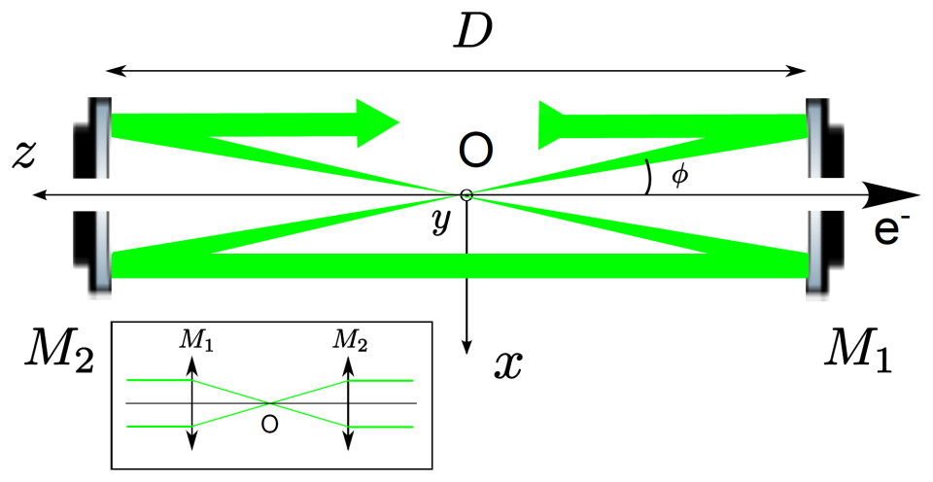
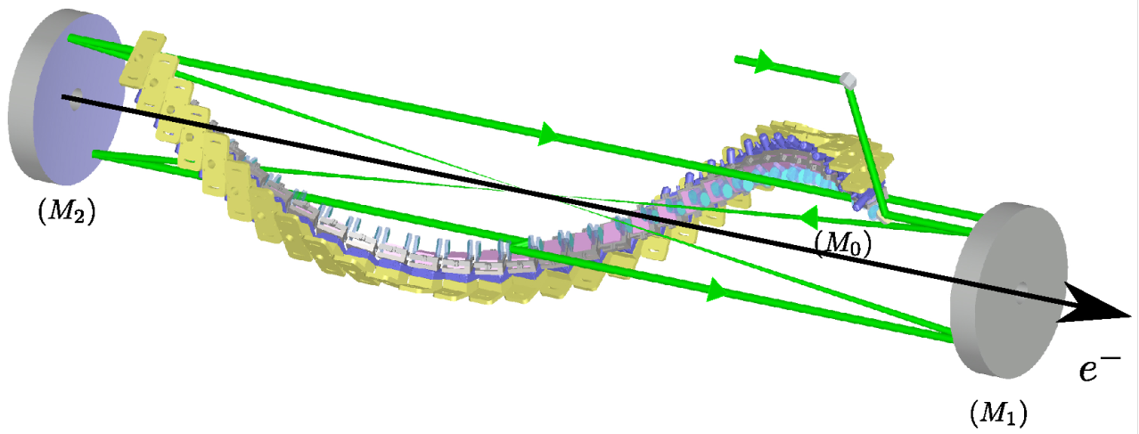




Optical system: laser beam circulator (LBC) for J-class psec laser pulses focused down to μm spot sizes
Electron beam is transparent to the laser (only 10⁹ photons are back-scattered at each collision out of the 10¹⁸ carried by the laser pulse)
Circulator principle
PARAMETERS = OPTIMIZED ON THE GAMMA-RAY FLUX
2 high-grade quality parabolic mirrors
  Aberration free
Mirror-pair system (MPS) per pass
  Synchronization
  Optical plan switching
    Constant incident angle = small bandwidth
Laser power = state of the art
Angle of incidence (φ = 7.54°)
Waist size (ω₀ = 28.3μm)
Number of passes = 32 passes
30 cm
2.4 m
courtesy K. Cassou

Slide 41
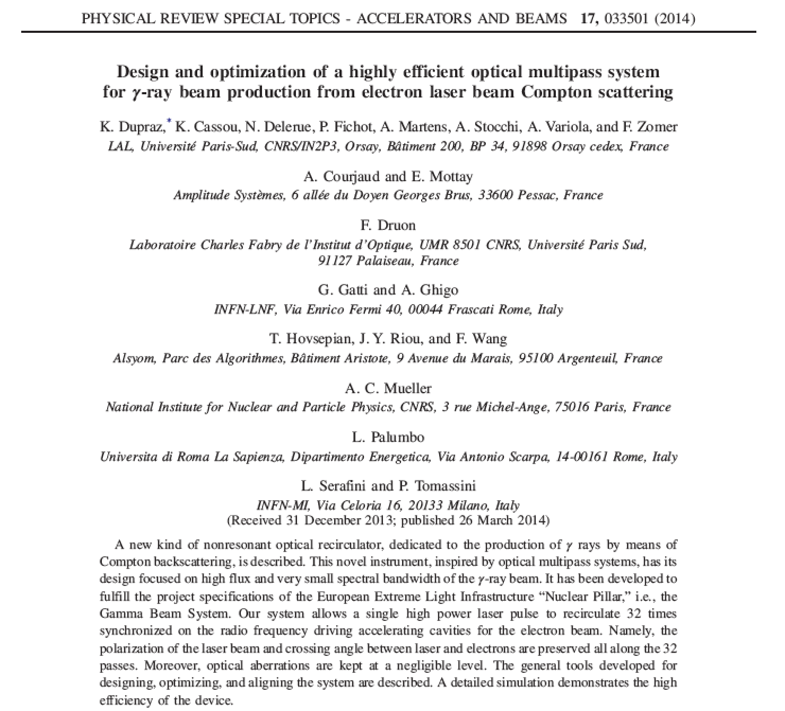

Slide 42
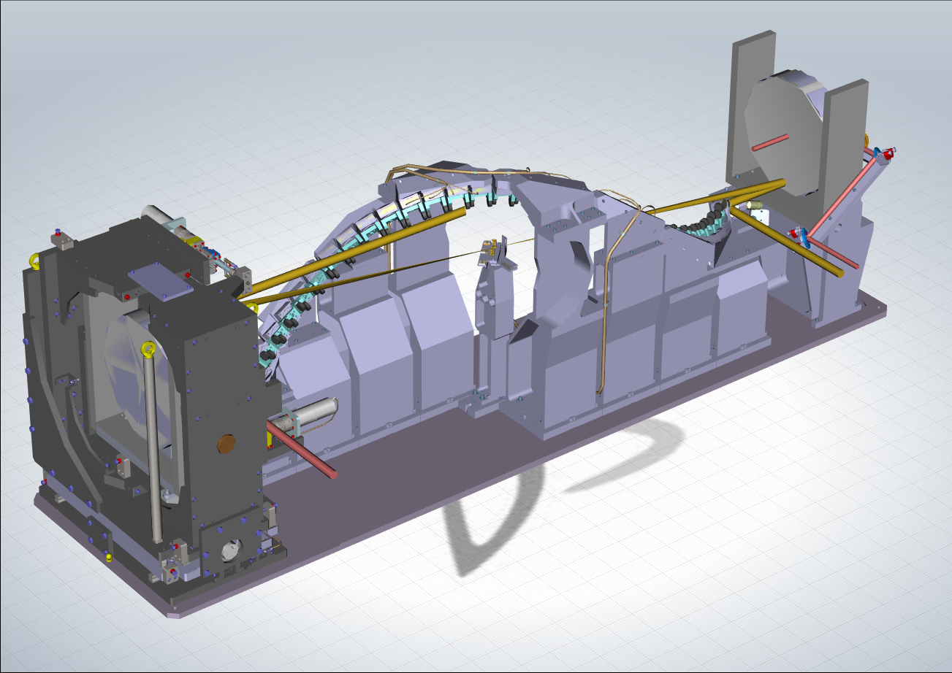
Laser pulse round-trip is about 16 nsec. A fresh electron bunch must be transported and focused at the IP every 16 nsec, for 32 round trips (total of 480 nsec -> need long flat RF pulse)
γ-ray beam time structure: micro-pulses carrying about 10⁵ photons within the bandwidth (0.3%-0.5%) with 0.8 psec pulse duration, in trains of 32 micro-pulses, repeating at 100 Hz (10 msec train-to-train separation)
courtesy K. Cassou

Slide 43
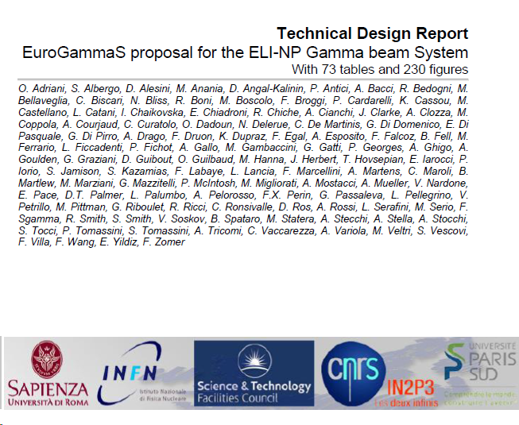
109 Authors, 327 pages
published today on ArXiv
http://arxiv.org/abs/1407.3669

Slide 44
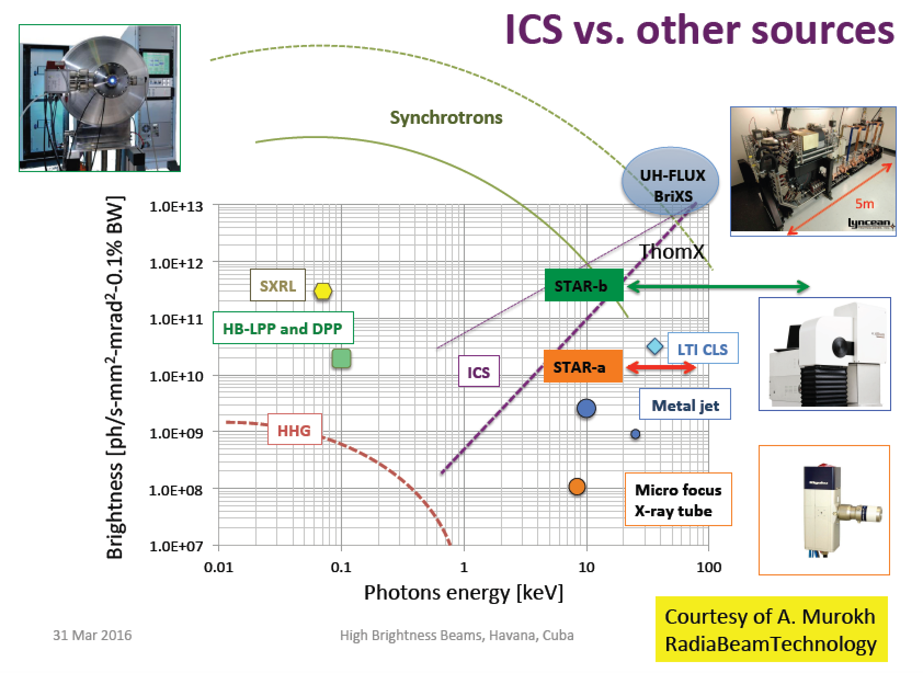

Rivaling with Synchr. Light Sources for energies above 50 keV
$$B_{av}=\frac{N_{ph}f}{ε_{x}^{2}\frac{ΔE_{X}}{E_{X}}}$$

Slide 45
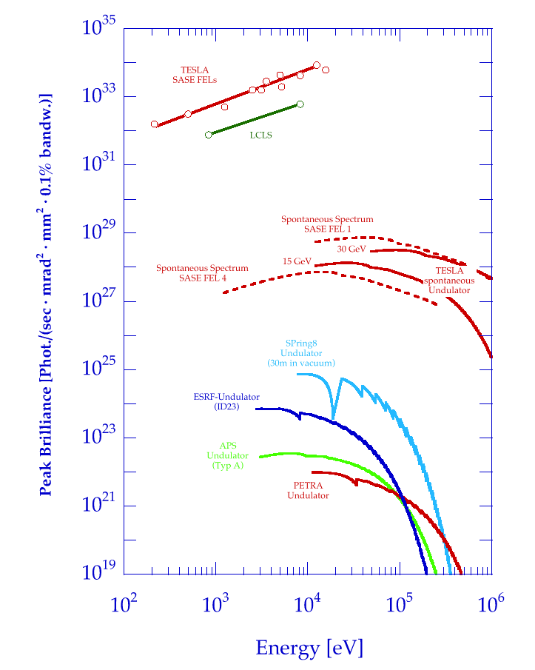
Brilliance of Lasers and X-ray sources
ELI
12.4
1.24
0.124
λ (nm)
BELLA
FLASH
Thomson/Compton Sources
Outstanding X/γ photon beams
for Exotic Colliders

Slide 46
highly asymmetric compact*
elecron-photon colliders
*10 m, 10 M$
secondary photon beams via large
lorentz boost of c.m. reference frame
MeV/GeV’s electrons
eV’s photons

Slide 47

STAR – Southern europe Thomson source for Applied Research
is a good example of research infrastr. based on X-ray beam lines for a regional facility to be built in an developing region/country
10 m

Slide 52
STAR Hangar and Bunker

Slide 53

Stato Bunker STAR a Gennaio 2016

Slide 54

Stato Bunker STAR a fine Maggio 2017

Slide 55


Slide 56


Slide 57


Slide 58


Slide 59

Commissioning will start soon - first beams expected within end of 2019

Slide 60


