Slide 1
A Compact X-ray Source for
Advanced Radiological Imaging
THE MESSAGE
BRING IMPROVED IMAGING QUALITY
for BIOMEDICAL APPLICATIONS
to CLINICAL and UNIVERSITY
LABORATORIES

Slide 2
THE CHALLENGE
DRAWBACKS in CONVENTIONAL (X-ray Tubes) ABSORPTION DIAGNOSTICS
on Soft Tissues: Cartilages, Angiography, Breast, Brain, Lung
Polychromatic, Not Tunable, Low contrast
Quality usually enhanced using contrast agents
not always patient-friendly
ENHANCED IMAGING
BETTER RESOLUTION
SHORTER EXPOSURE / DOSE
LESS CONTRAST AGENTS
X-ray SOURCES
Energy-tunable
High flux
Monochromatic
ADVANCED IMAGING TECHNIQUES
EXIST
NOT (YET) AVAILABLE
IN CLINICS

Slide 3
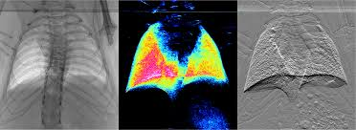
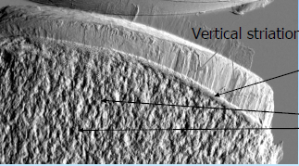
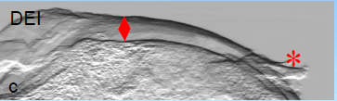
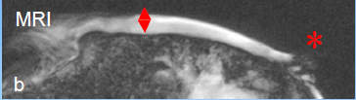
MEDICAL IMAGING TECHNIQUES
X-ray Absorption
X-ray Refraction
  Analyzer-Based Imaging (ABI)
CONVENTIONAL MAMMOGRAPHY: LIMITED RESOLUTION FOR DENSE BREASTS
Grating Interferometry (GI)
Diffraction-Enhanced Computerized Tomography (DEI-CT)
ABI - Courtesy: M. Kitchen et al. / Monash University
Courtesy: G. Tromba et al. / Elettra TS
Nuclear Magnetic Resonance (NMR)
Courtesy: G. Tromba et al. / Elettra TS
Courtesy: G. Tromba et al. / Elettra TS
Differential Phase Contrast Imaging (DPCI)
Courtesy: G. Tromba et al. / Elettra TS
Courtesy: F. Pfeiffer et al. / PSI

Slide 4
NMR / DPCI DIAGNOSTICS COMPARISON
Courtesy: R. Calandrino et al. / SRH Milano
OPTION |  | NMR | DPC
Spatial resolution [mm] |  | >3 | 0.01-0.03
Data registration time [s] |  | 1200 | 30
Image reconstruction time [s] |  | 120 | <1
Primary diagnostics tool? |  | NO | YES
Vessel system | VISIBILITY w/o contr. agent | NO | YES
Nervous system |  | NO | YES
Lymphatic system |  | NO | YES
Soft tissues |  | NO | YES
Skeleton |  | YES | YES
Claustrophobic patients |  | Difficult | Possible
Patients with metallic implants |  | Impossible | Possible
Patients with non-metallic implants |  | Limited | Possible
Real time examination during surgery |  | Impossible | Possible

Slide 5
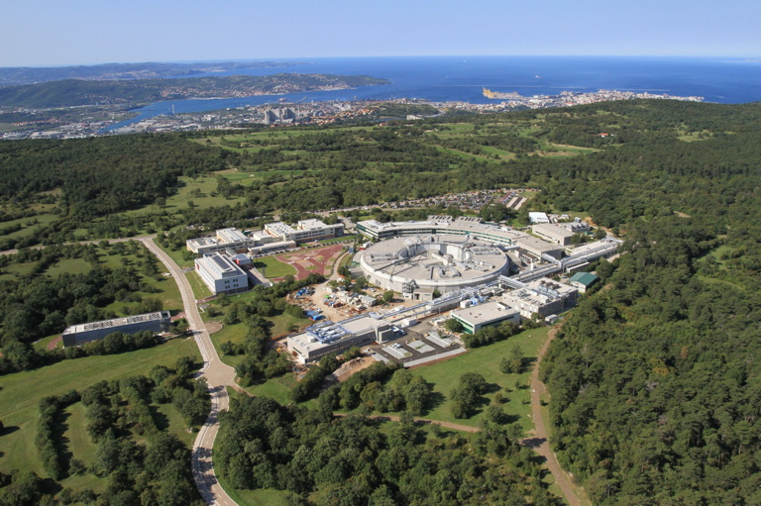
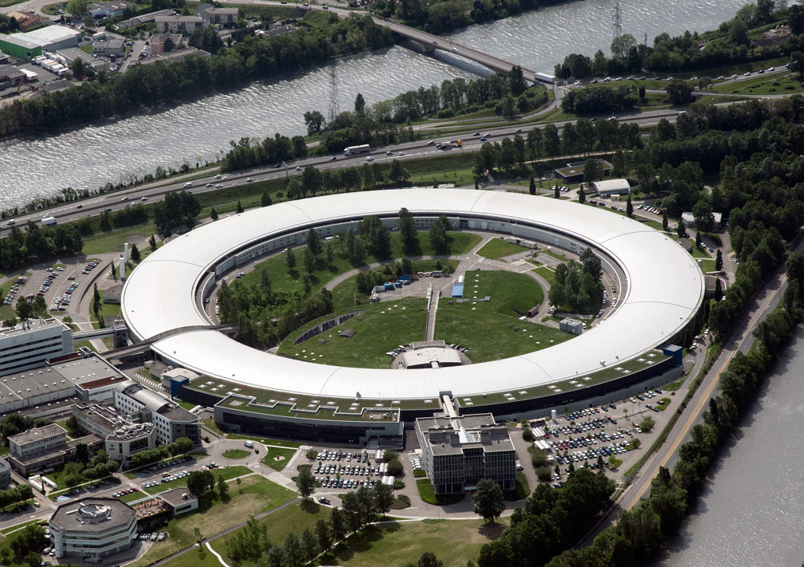
LAB-size LIGHT SOURCES
270 m
83 m
ELETTRA / Trieste
2.4 GeV e- / 260 m Circumference
5-10 keV X-rays
ESRF / Grenoble
6 GeV e- / 844 m Circumference
10-40 keV X-rays

Slide 6
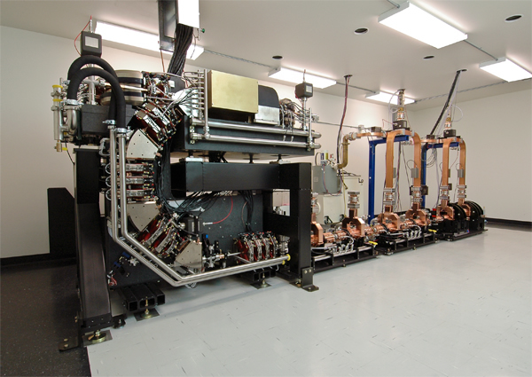
A COMPACT X-ray SOURCE
MuCLS / Munich Compact Light Source
Courtesy: LTI & F. Pfeiffer et al. / TUM
MuCLS @TUM
SIDE VIEW
e-
Linac
e- Desktop Storage Ring
35-40 MeV, 65 MHz, 4.6 m
TOP VIEW
5 m
e-
IP
30-40 keV X-rays
at 65 MHz rep. rate
3x10^11 ph/s
CLS / Lyncean Technologies Inc. / Palo Alto, CA
40 MeV e- / 5x4 m² footprint
30-40 keV X-rays
Laser Optical Cavity
300kW, 65 MHz, 9.2 m
IR Laser

Slide 7
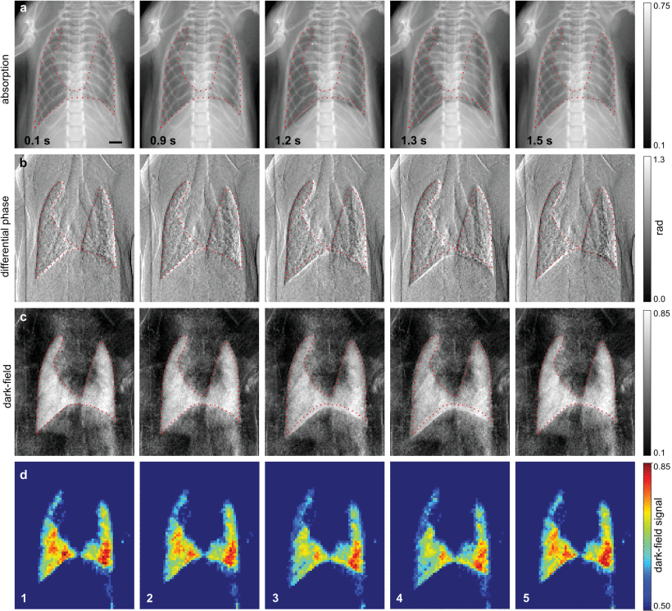
MuCLS Dynamic In Vivo Chest X-ray Dark-Field Imaging in Mice
R. Gradl et al: IEEE Transactions on Medical Imaging ( Volume: 38 , Issue: 2 , Feb. 2019 )
X-ray grating Interferometry combines
-- Conventional attenuation
-- Phase Contrast
-- Dark Field
Dark-field signal depends on number and size of alveoli
Useful tool in lung tissue imaging
Blur reduction during a full breath cycle
Short exposures + High flux
40 ms, 90 ms and 140 ms exposure times
30, 15 and 10 images per breath.
Absorption
DPC
Dark Field imaging
Dark Field signal

Slide 8
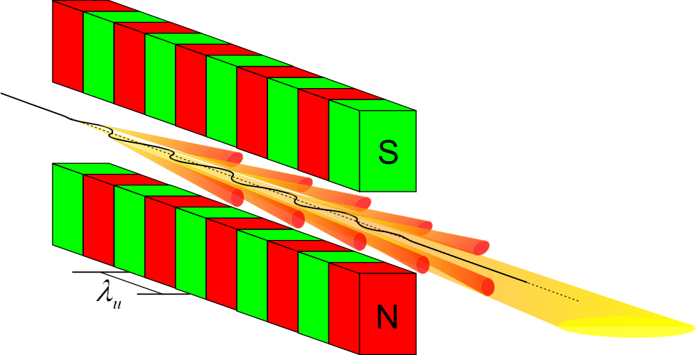
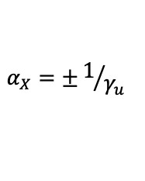




FROM GOLIATH TO DAVID…
UNDULATOR
X-ray energy has
similar expression
ICS
e-
$$E_{X}^{u}\sim hc\frac{γ_{u}^{2}}{λ_{u}}$$
λ_{u}
$$α_{X}=±1/{γ_{u}}$$
Laser pulses
Mini-undulators
ADVANTAGES
$λ_{ph}\sim {10}^{−4}$ $λ_{u}$
$$γ_{ICS}\sim {10}^{−2}{ γ}_{u}$$
270 m
$$α_{X}^{ICS}{≫α}_{X}^{u}$$
IMAGING DISTANCE
5 m
COLLIMATION
ESRF: 6 GeV e- / 844 m Circumference
10-40 keV X-rays
CLS: 40 MeV e- / 5x4 m² footprint
30-40 keV X-rays

Slide 9
A COMPACT X-Ray SOURCE
BoCXS: A Multidisciplinary Imaging Facility
in the center of a Scientific Triangle
The availability of a compact source
offering high quality X-ray imaging
at moderate cost and limited space requirements
can have an important impact in
Clinical and University-size Laboratories.

Slide 10




Double Output S-Band STAR–like System
Phase I
Interaction
Regions
$$E_{X1}≤120 keV$$
IP Diag.
$$α_{X}≥±6.4 mrad$$
S-Band RF Structure
3m / 25MeV/m
20⁰ - 25⁰ Doglegs
X-Ray
S-Band Ph-Inj
e-
h_{L1}
Matching
Triplets
Yb-YAG
Laser
e- Dumping
Dipoles
USERS
e-
h_{L2}
80 MeV
e-
X-Ray
BPM
IP Diag.
$$E_{X2}≤240 keV$$
H/V Steering
$$α_{X}≥±6.4 mrad$$
~4 m
~9 m

Slide 11
INITIAL PERFORMANCE
PHASE I – e- ENERGY: 80 MeV tunable
X-ray ENERGY : (120 – 240) keV
X-ray FLUX : (2 – 0.5)x10¹⁰ ph/s
X-ray DIVERGENCE : +/- 6.4 mrad
X-ray REP. RATE: 100 Hz

Slide 12
OUTLOOK
HIGH BRILLIANCE, ENERGY-TUNABLE, QUASI-MONOCHROMATIC
X-RAY BEAMS
PROVIDE ADVANCED BIOMEDICAL IMAGING
IMPROVED SPACIAL RESOLUTION
REDUCED BEAM EXPOSURE
RADIOLOGICAL EXAMINATIONS WITHOUT CONTRAST AGENTS
FRIENDLY TO PATIENTS WITH
METALLIC IMPLANTS AND/OR STIMULATORS
A COMPACT X-ray SOURCE
INSTALLED IN CLINICAL LABORATORIES OR UNIVERSITIES
WOULD PROVIDE AN INVALUABLE TOOL IN SOFT TISSUE IMAGING
IN THE BOLOGNA METROPOLITAN AREA

Slide 13
A PROJECT IS A DREAM WITH A DEADLINE
THANK YOU FOR YOUR TIME

Slide 14
SPARE SLIDES

Slide 15
FREQUENCY BANDS IN PARTICLE ACCELERATORS
BAND | f_{RF} (GHz) | λ_{RF} (cm) |  | COMMON LIFE
S | 2.998 – 2.856 | 10.0 –10.5 |  | Satellite communications
C | 5.996 – 5.712 | 5.0 –5.25 | S-Band 2nd harmonic | 5G technology
X | 11.9942 – 11.424 | 2.5 –2.62 | S-Band 4th harmonic | Radar applications

Slide 16




Double Output S-Band STAR–like System
Phase II
$$E_{X1}≤440 keV$$
IP Diag.
Interaction
Regions
$$α_{X}≥±3.3 mrad$$
2 x S-Band RF Structures
6m / 25MeV/m
20⁰ - 25⁰ Doglegs
X-Ray
S-Band Ph-Inj
e-
h_{L1}
Matching
Triplets
Yb-YAG
Laser
e- Dumping
Dipoles
USERS
e-
h_{L2}
e-
X-Ray
155 MeV
BPM
IP Diag.
$$E_{X2}≤880 keV$$
H/V Steering
$$α_{X}≥±3.3 mrad$$
~7 m
~12 m

Slide 17
MODULAR IMPLEMENTATION PHASES
PHASE I – e- ENERGY: 80 MeV
X-ray ENERGY : (118 – 235) keV
X-ray FLUX : (20 – 5)x10⁹ ph/s
X-ray DIVERGENCE : +/- 6.4 mrad
Rep. rate = 100 Hz
Laser: Fund. & 2nd harm.
PHASE II – e- ENERGY: 155 MeV
X-ray ENERGY : (0.44 – 0.88) MeV
X-ray FLUX : (20 – 5)x10⁹ ph/s
X-ray DIVERGENCE : +/- 3.3 mrad
PHASE III – e- ENERGY: 155 MeV
X-ray ENERGY : (0.44 – 0.88) MeV
X-ray FLUX : (6 – 1.5)x10¹¹ ph/s
X-ray DIVERGENCE : +/- 3.3 mrad
Rep. rate = 3 kHz
Laser: Fund. & 2nd harm.

