Slide 1
6D inertial
seismic isolation system
Leonid Prokhorov, Conor Mow-Lowry, Denis Martynov,
Sam Cooper, Amit Ubhi, Chris Collins,
Chiara di Fronzo, David Hoyland

Slide 2
Outline
6D
  Motivation
  Concept
  Status & Plans

Slide 3
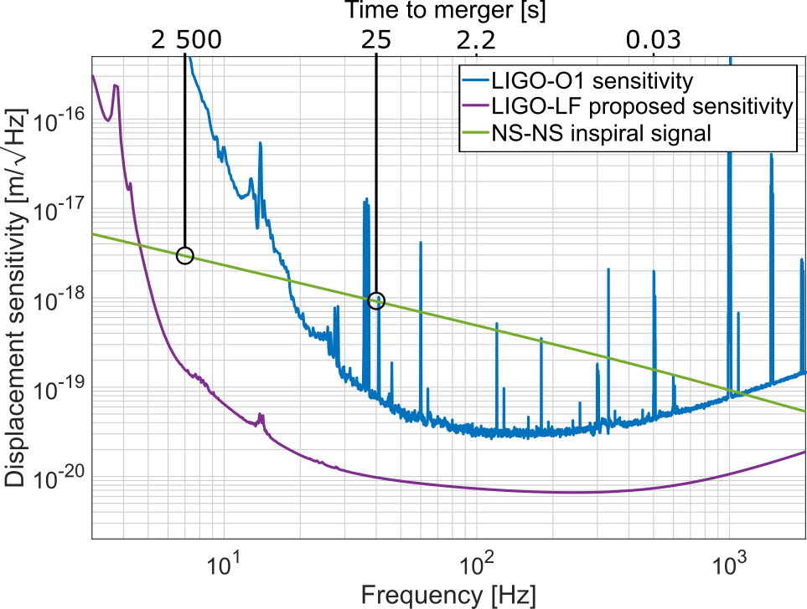
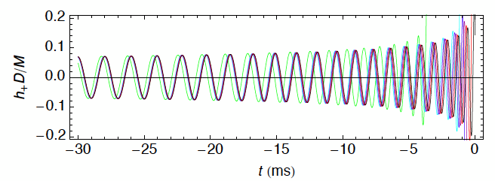
Advantages of low-f GW detectors
Localisation approximately 5 square degrees, 1 minute before merger, assuming 2 LIGO-LF observatories in the US.
For a discussion of LIGO-LF
and low-f limitations, see:
Yu et al., PRL 120 141102 (2018)

Slide 4
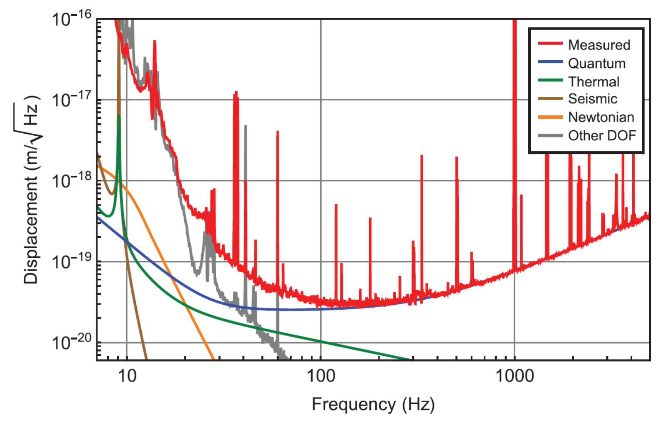
Low-f noises and the seismic wall
‘Technical’ noise and astrophysical signals are both rich at low frequencies in gravitational-wave detectors
https://doi.org/10.1103/PhysRevLett.116.131103
Notes:
What can low-f do?

Slide 5
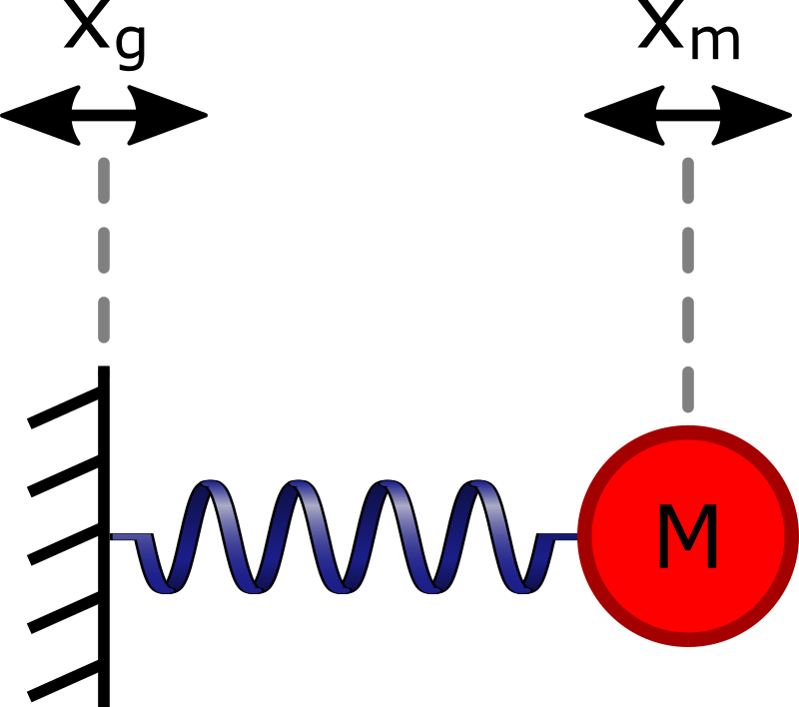
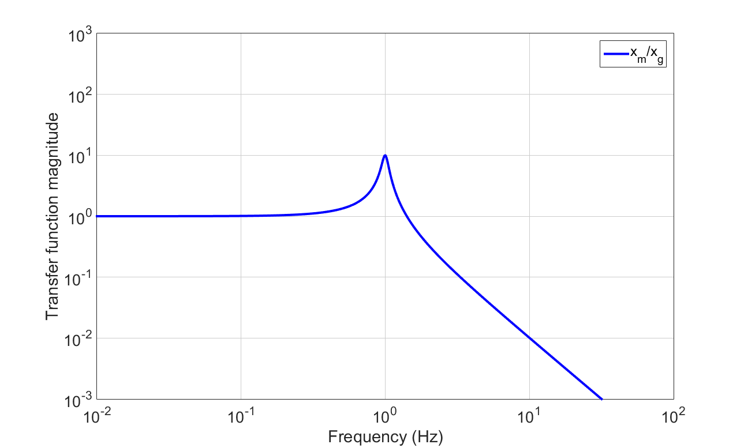
Suspended mass seismometers
How conventional seismometers work
It’s mass on the spring

Slide 6
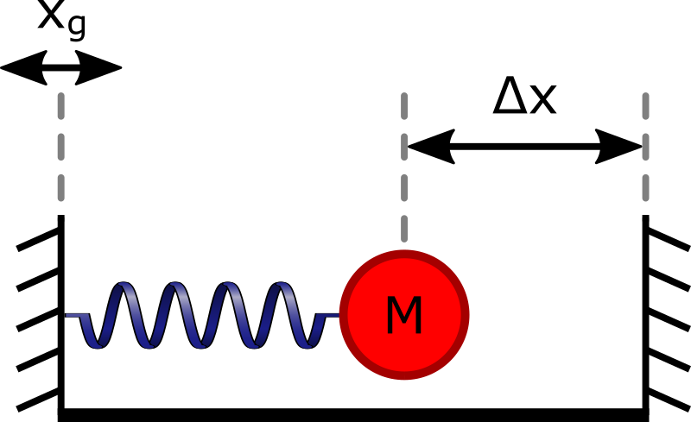
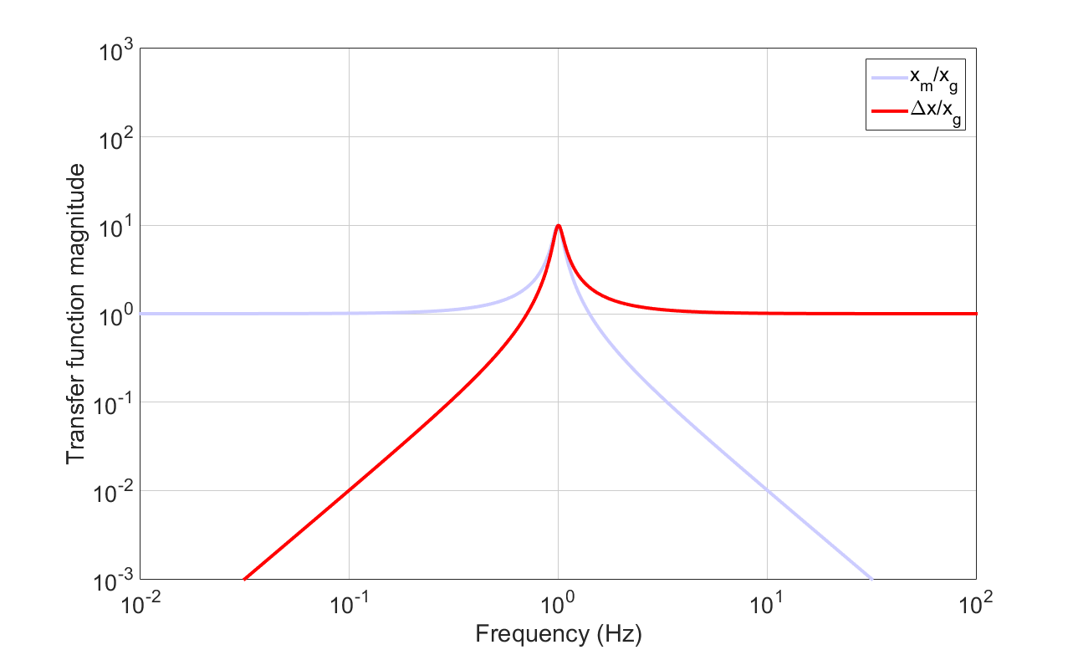
Seismometer readout
Below the resonance mass moves with the seismometer
6

Slide 7
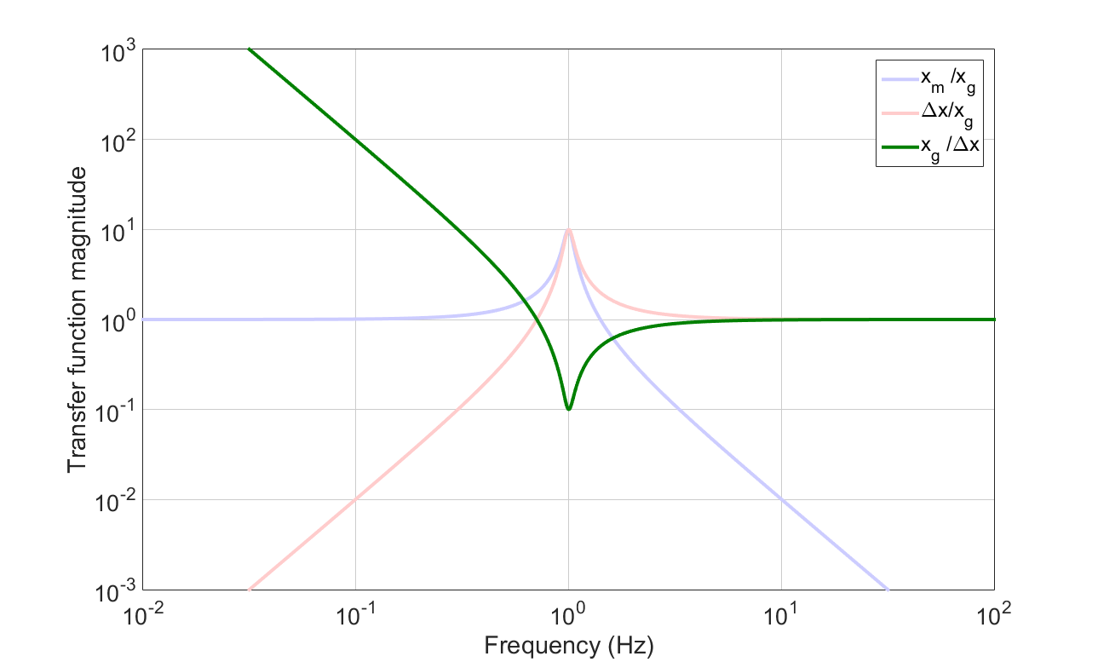
Plant inversion
Converting measured relative position into an inertial-equivalent output results in unbounded noise at low-frequency

Slide 8
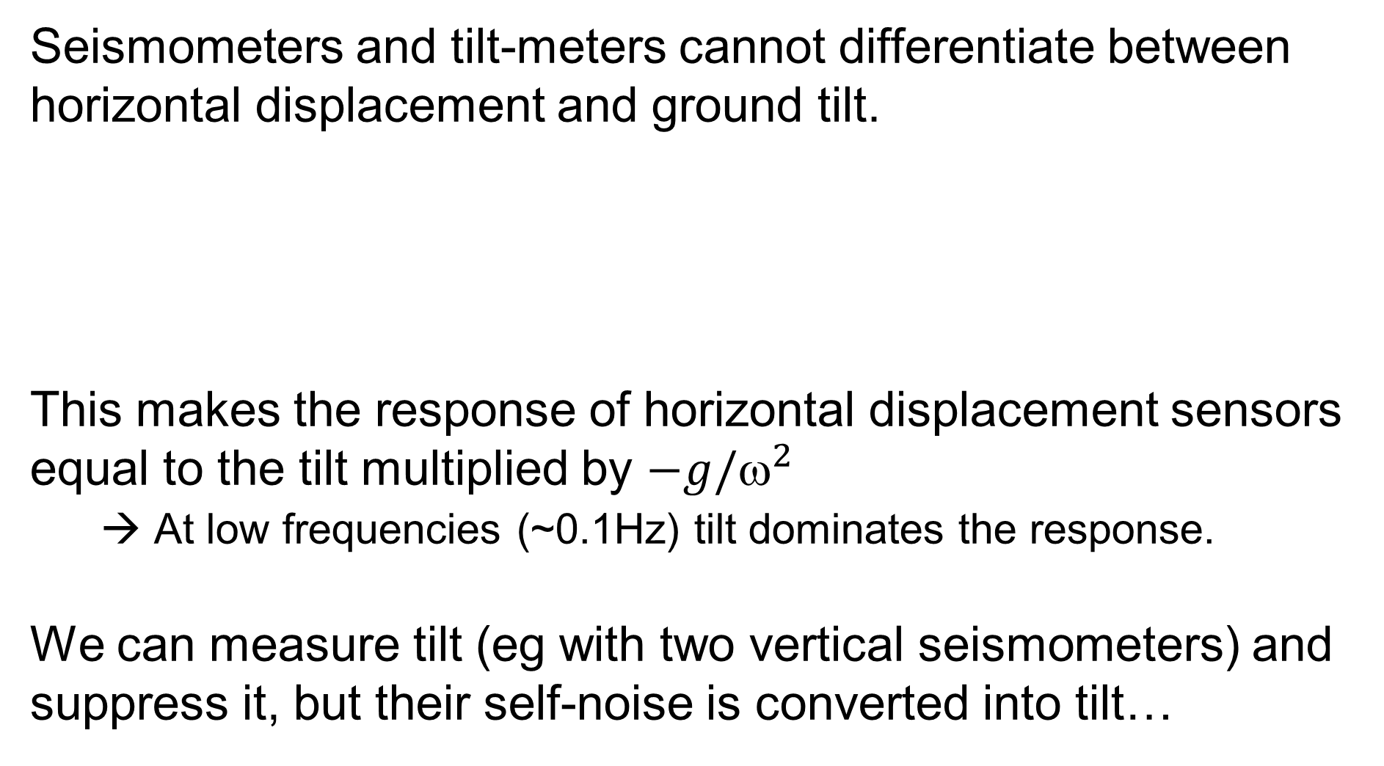
The tilt problem
δx ∝ ax
δx ∝ gθ
8

Slide 9
Tilt-injection with (T240) seismometers
T240 tilt-noise and its effect on
horizontal sensor output through tilt injection
Calibration step | Effect on displacement | Relevant frequency
Plant-inversion | 1/f² | 1 Hz
Tilt-baseline | 1 | --
Tilt-to-horizontal coupling | 1/f² | g/(2πf)²=1 @0.5 Hz
Result | 1/f⁴ | Below 0.5 Hz
Even at the self-noise floor, the low-f motion induced by tilt-control becomes enormous

Slide 10
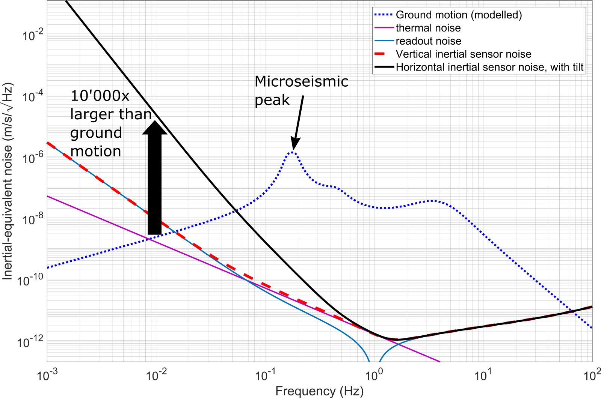
Tilt-injection (T240)

Slide 11
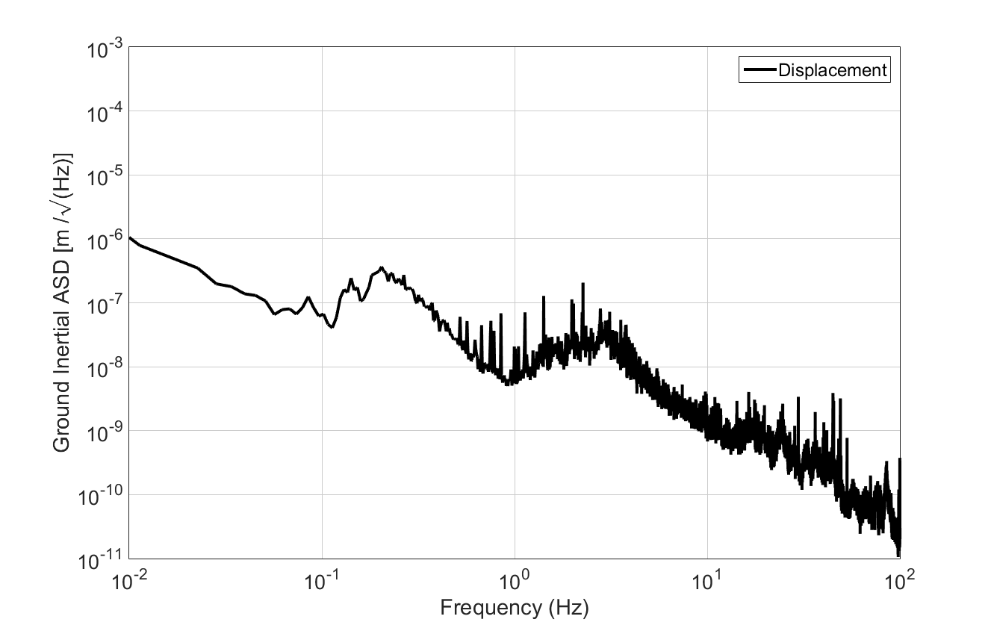
Important frequency region: 10 mHz – 100 Hz
Low-frequency noise
and tilt-to-length coupling
Principle suspension modes
and ‘Auxilliary’ control signals
μ-Seismic motion,
Principle ground RMS
Sensitive region
for GW detectors

Slide 12
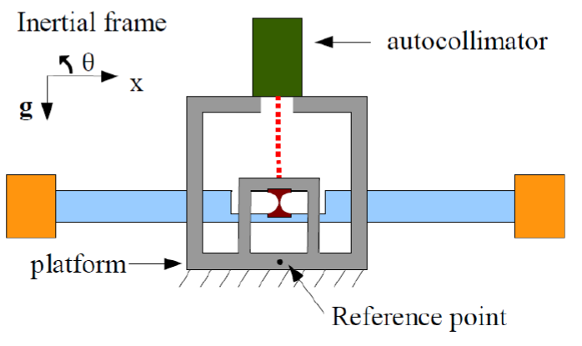
Beam rotation sensors
Measure tilt on one axe
Bar suspended by
thin metal flexures
Works on LIGO sites
Several projects to improve the performance, at least 3 talks at previous LVK meeting
Different types of sensors

Slide 13
Should be taken into account
When create a new displacement or tilt sensor, we should think about:
Tilt to length coupling
Noise of sensors, actuators and electronics often increase at low-frequencies
Cross-coupling of different modes
Dynamic range

Slide 14
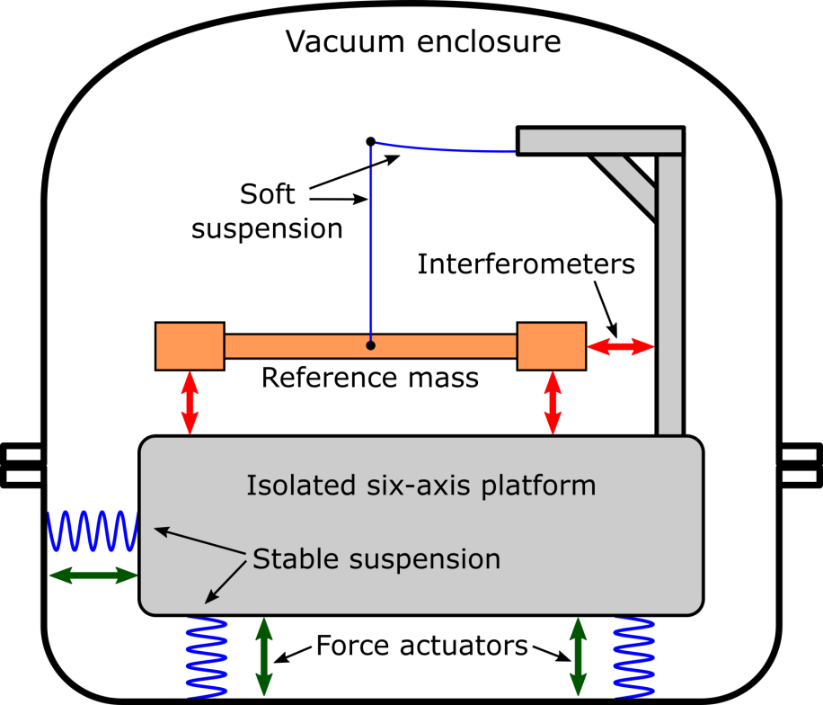
6D Isolator Concept
Impose the inertial stability of the reference mass on the isolated platform using active feedback.
Reference mass is suspended by silica fibre
Position of the reference mass is measured by interferometric sensors.
Active platform is actuated to follow the reference mass
(as drag-free satellites)
All DOF are sensed
C. Mow-Lowry, D. Martynov https://arxiv.org/abs/1801.01468

Slide 15
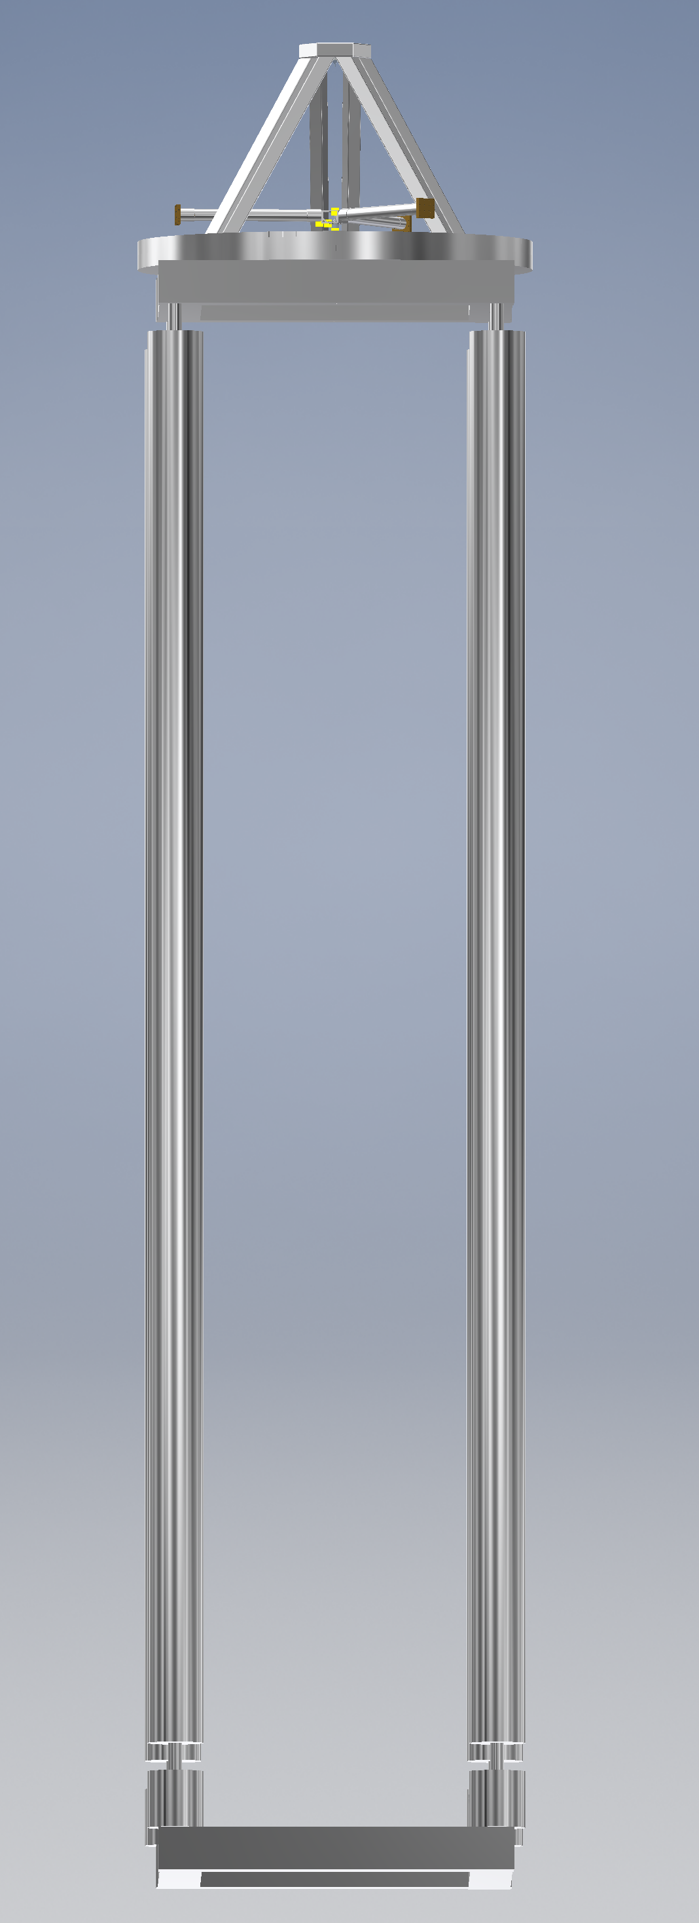
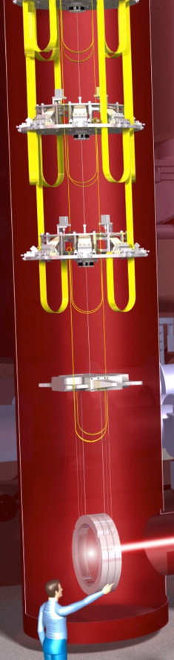
6D Isolator Concept
Reference mass
Actuated platform
We propose using this system for stabilising ISI platform
in future GW detectors
Key features needed:
Low noise sensors
Low loss to meet low noise requirements
Low frequencies
Suspension chain
Test
Mass

Slide 16
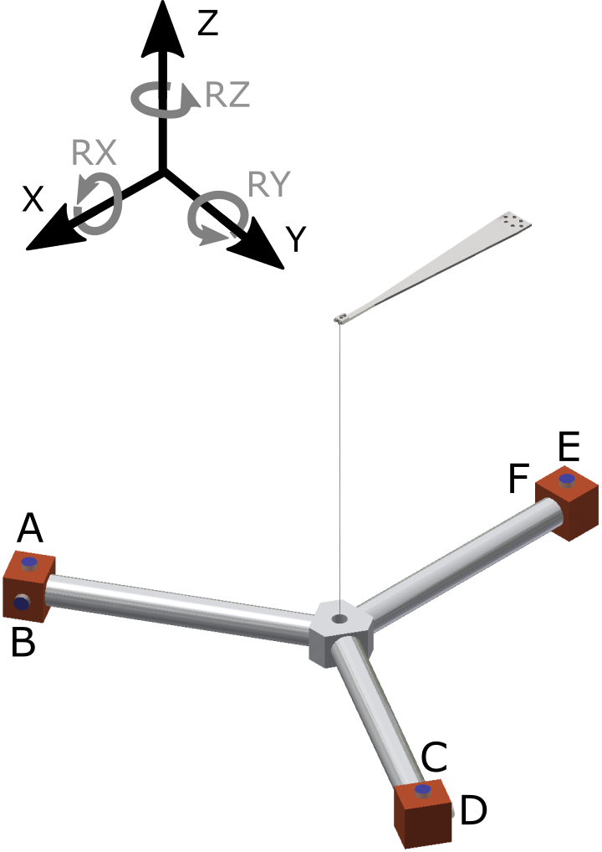
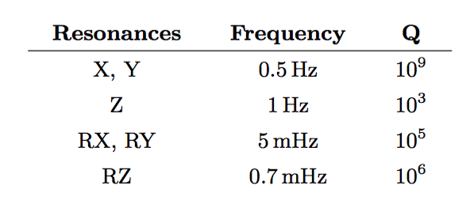
6D Isolator Parameters
Pendulum length | 0.7 m
Reference mass diameter | 1.2 m
Mass | 3.8 kg
Fibre: material, diameter | Fused Silica 200 μm
Center of mass close to suspension point

Slide 17
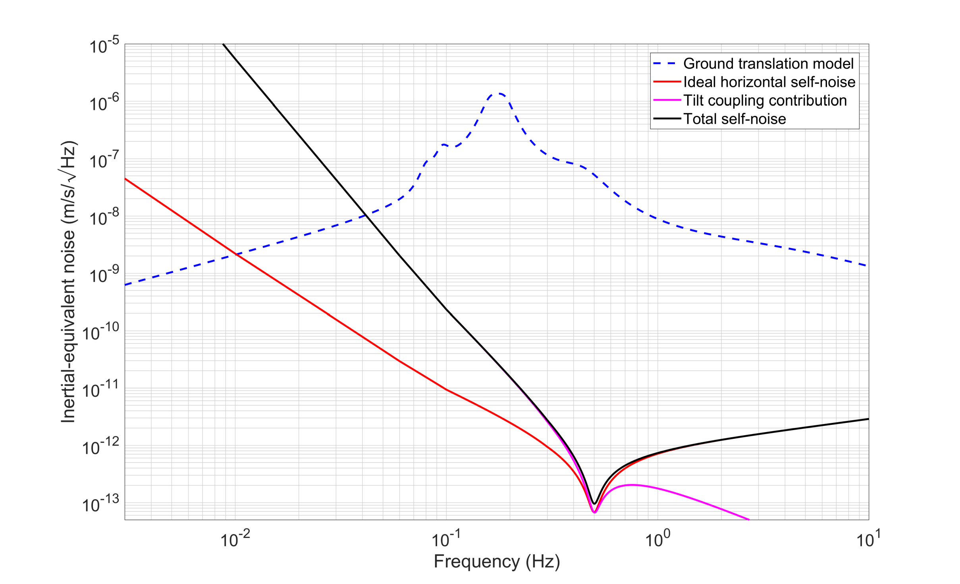
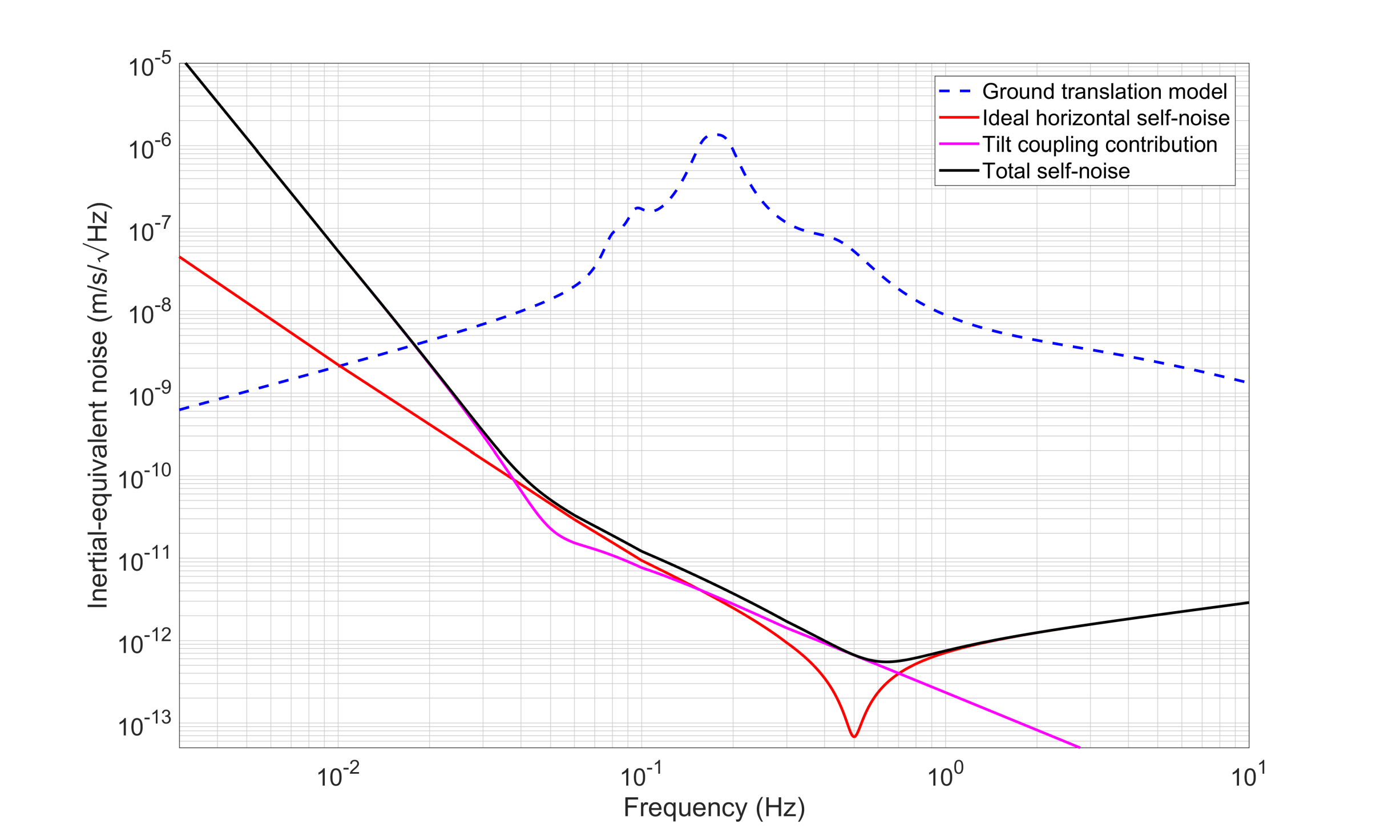
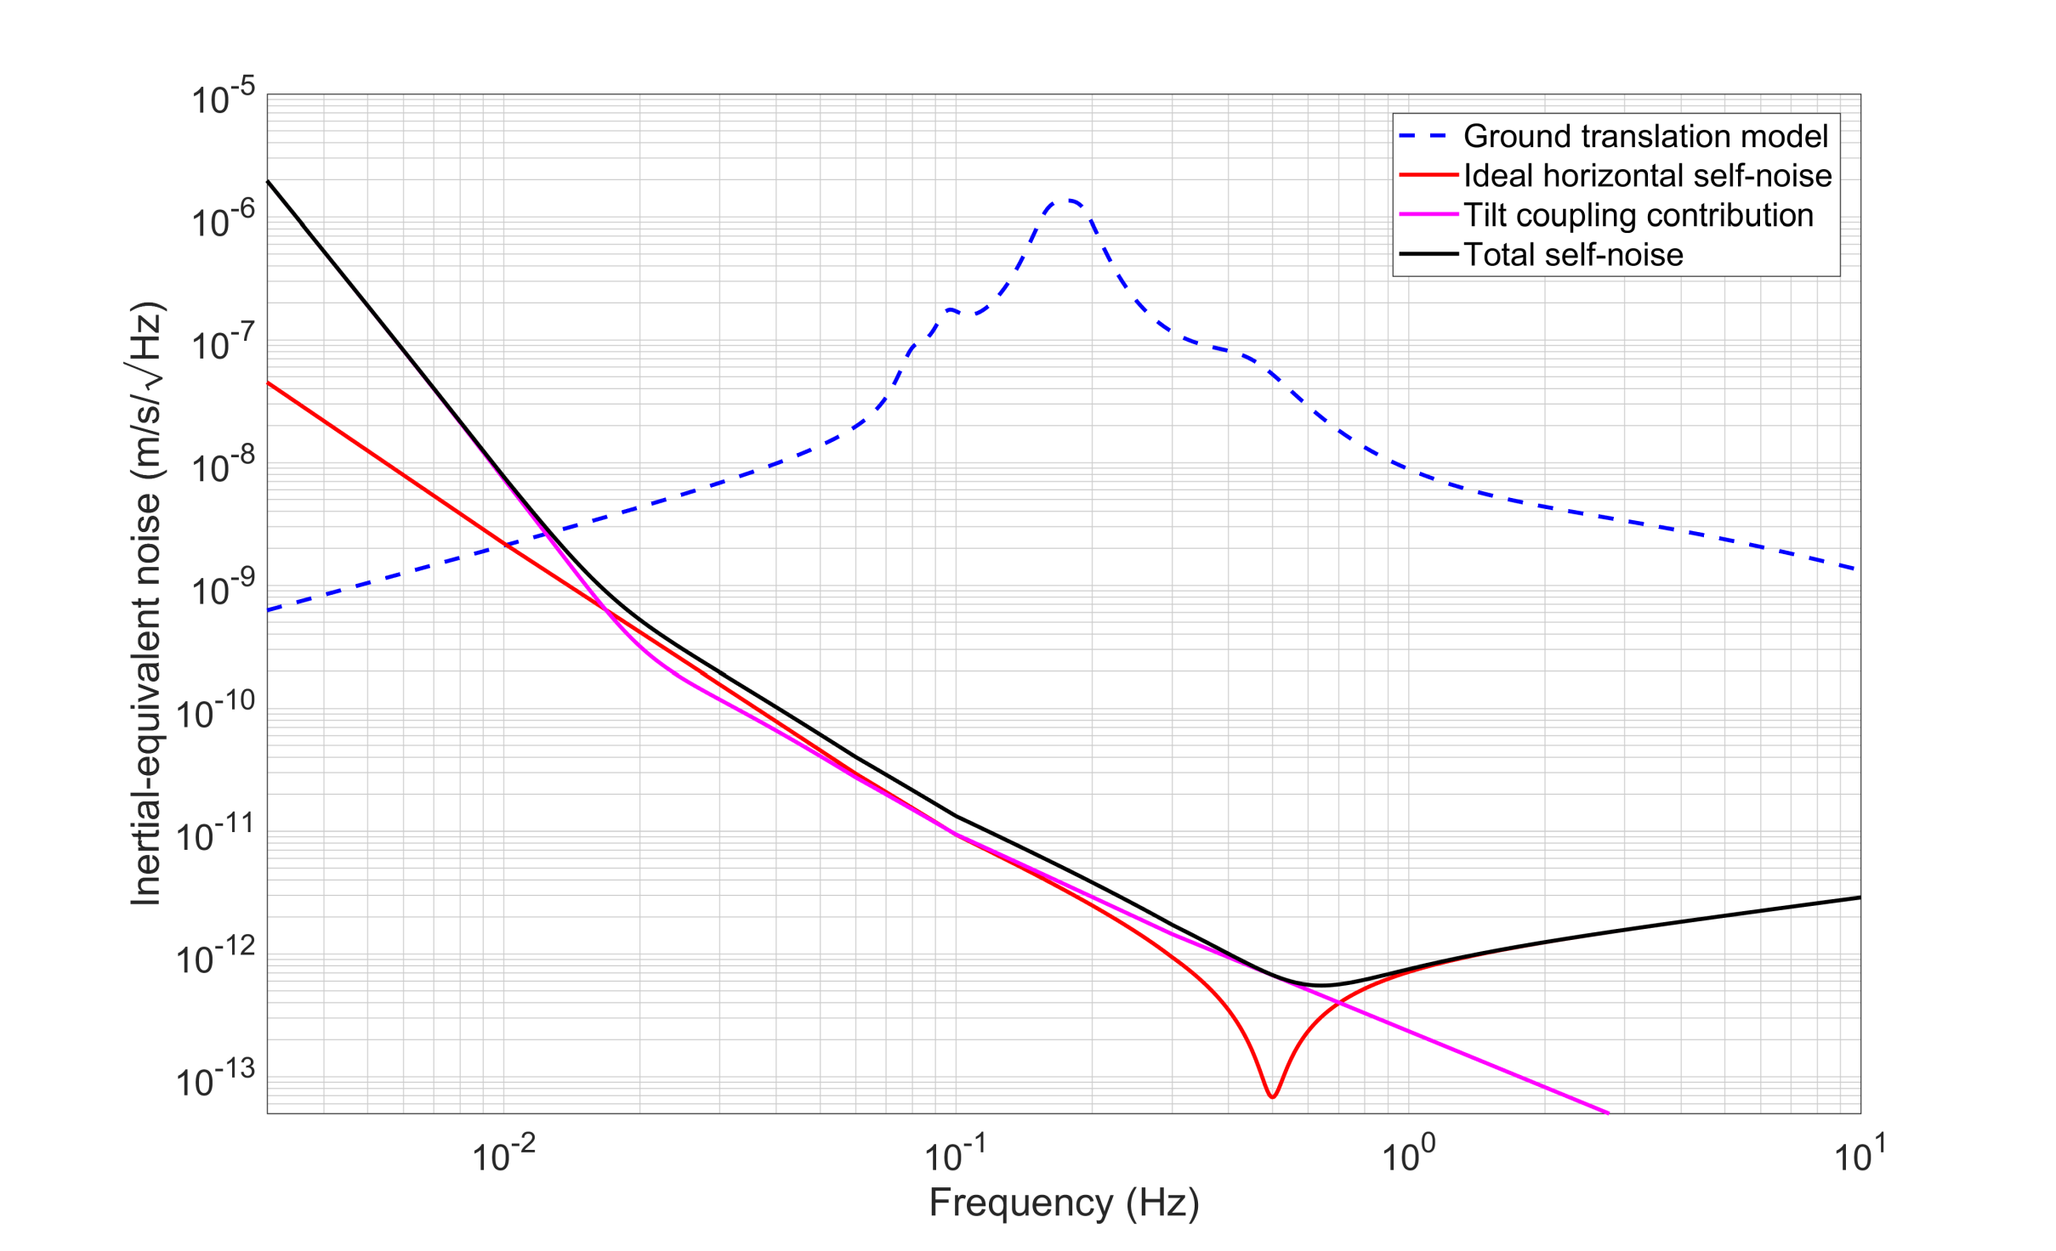
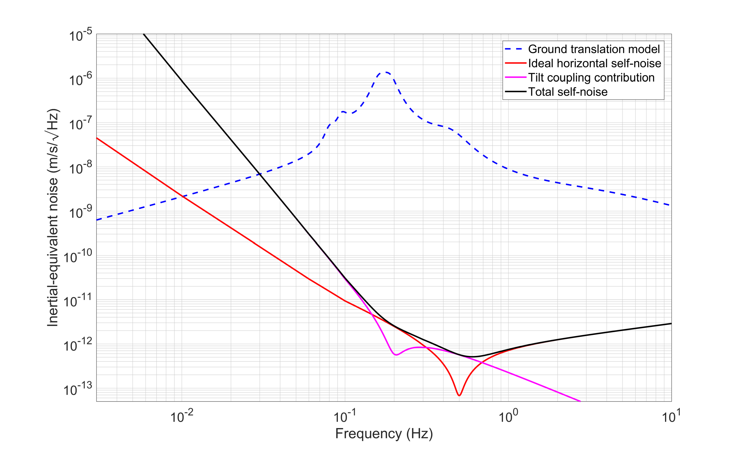
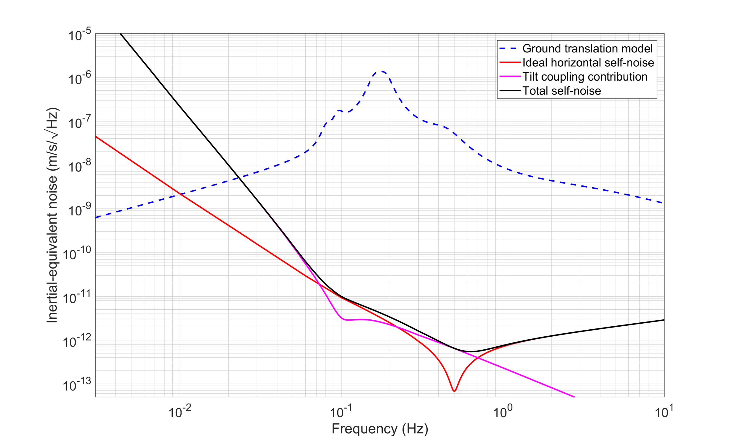
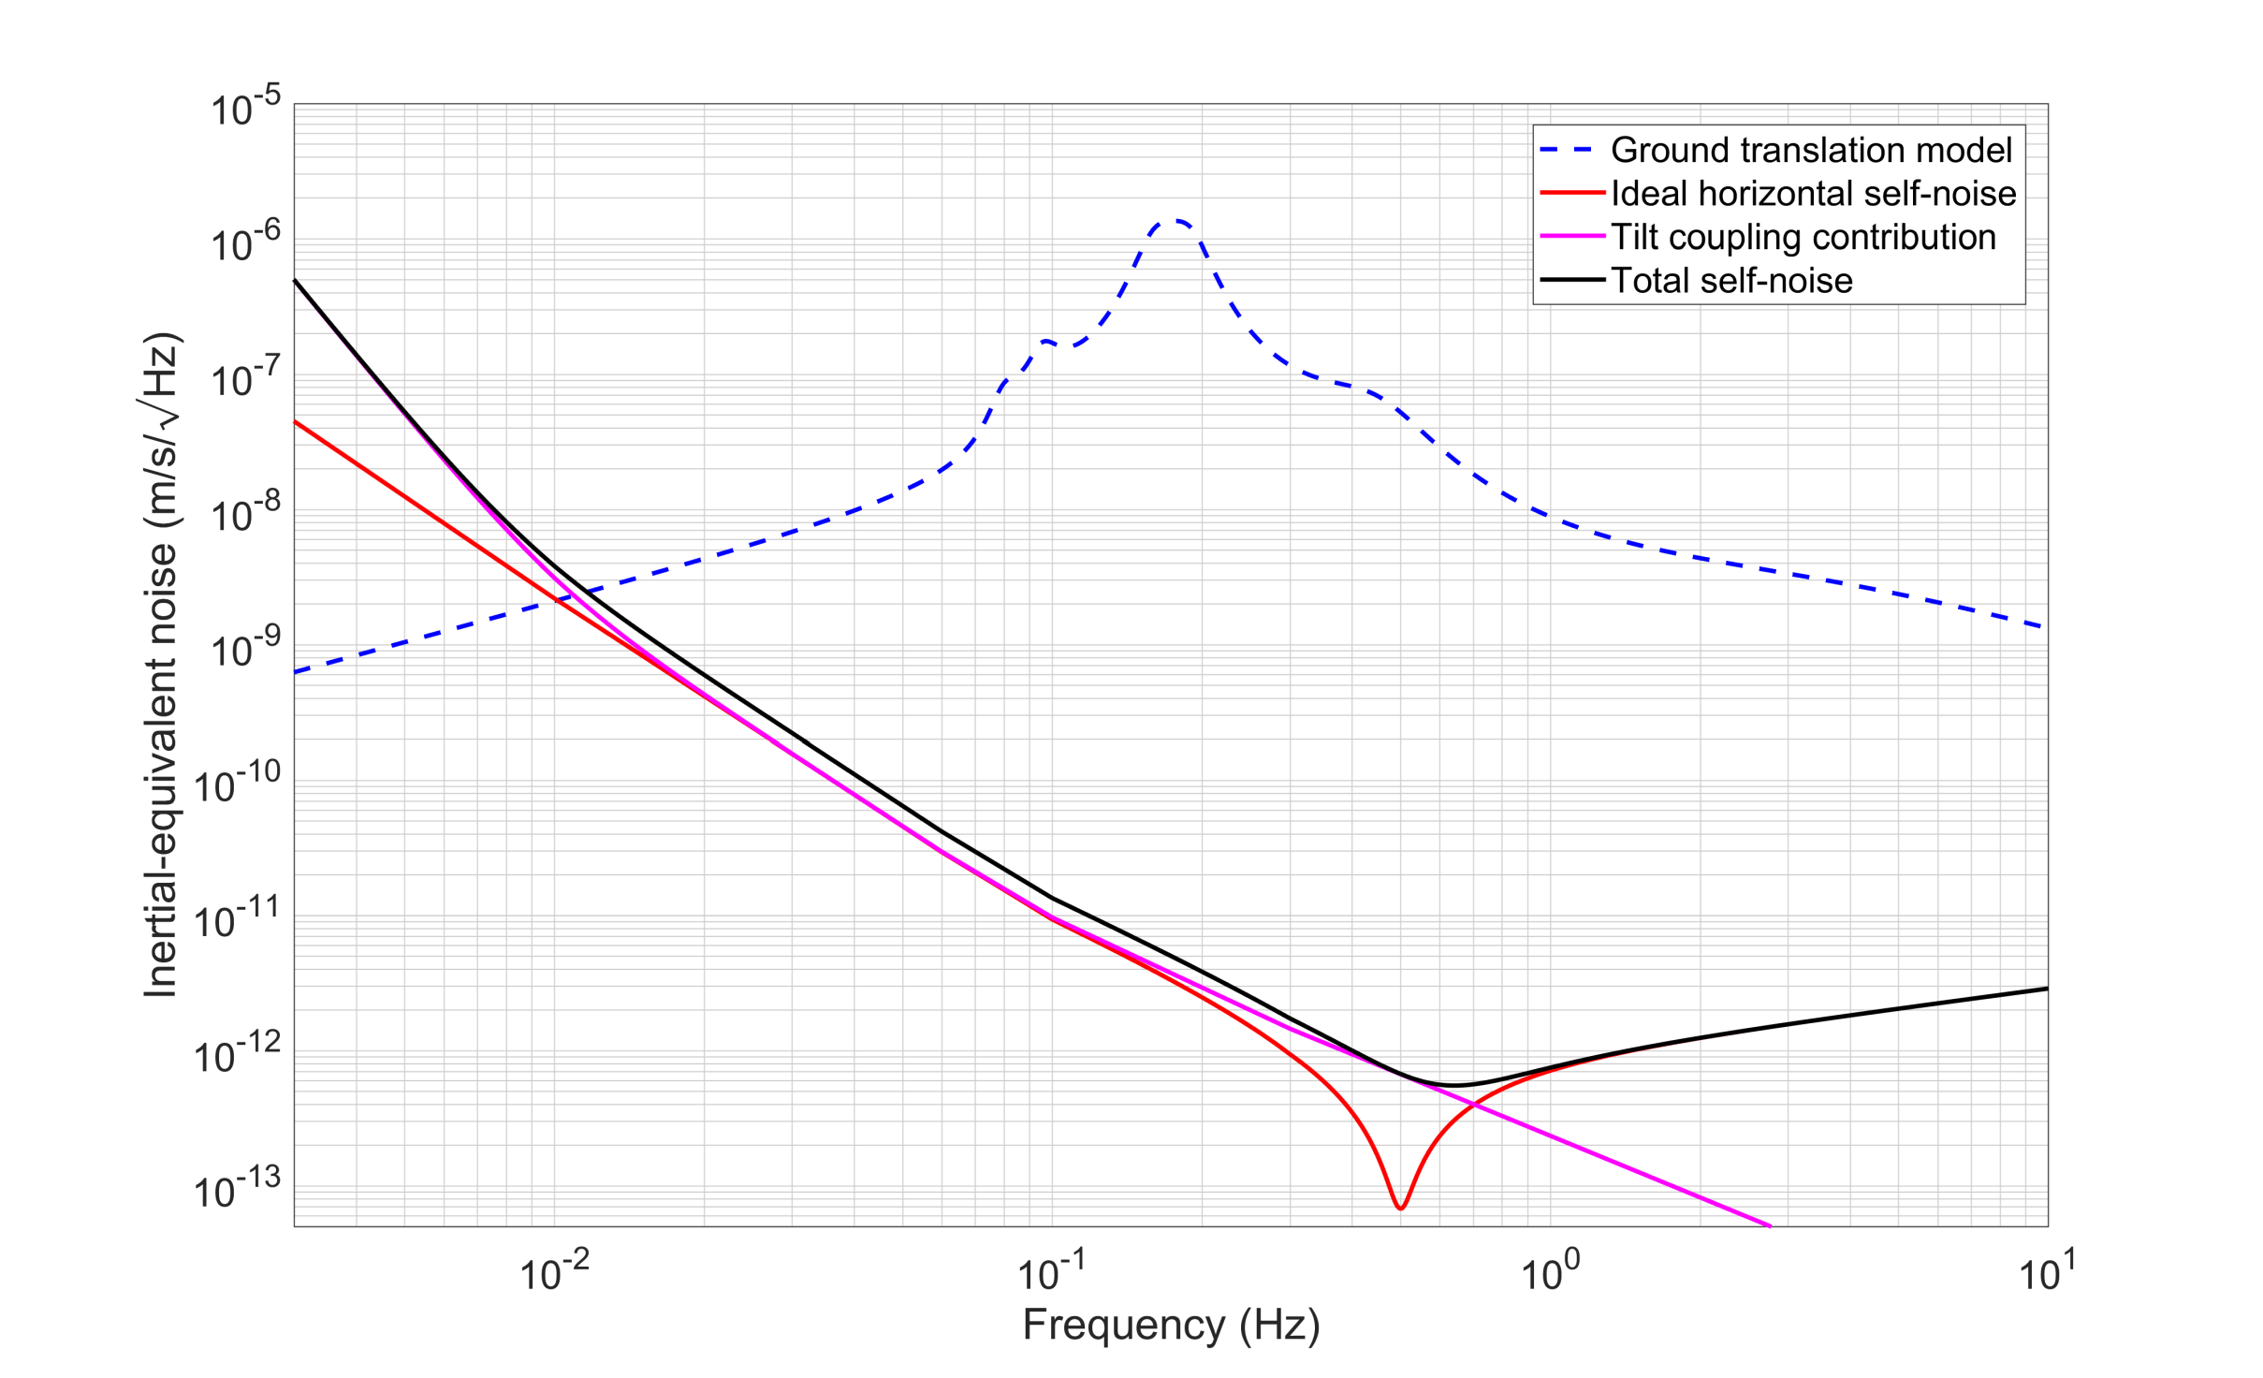
6D: change the dynamics
We can reduce the readout noise in rotation by employing very ‘soft’ oscillators. In ‘6D’ the resonant frequencies are all < 10mHz

Slide 18
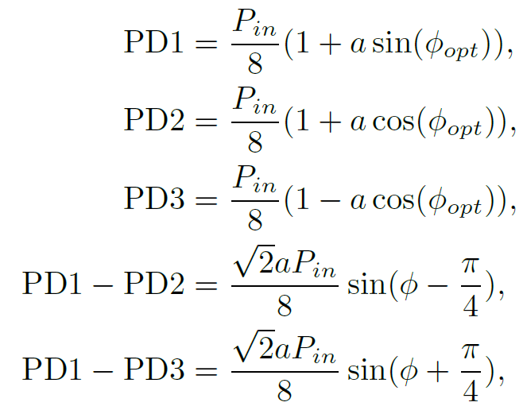
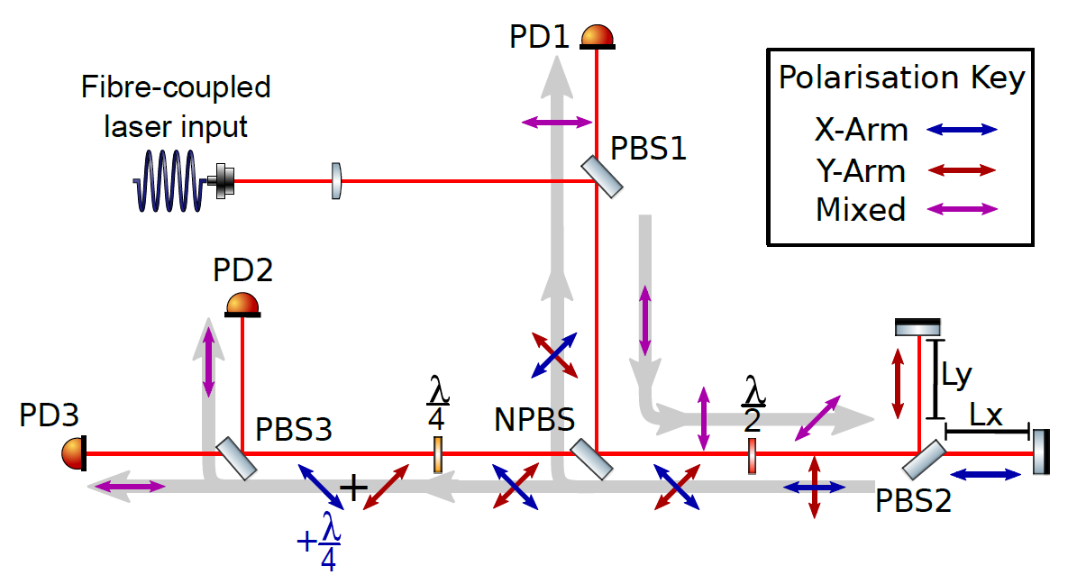
Sensor: Homodyne Quadrature Interferometer (HoQI)
- Phasemeter based on earlier work at Birmingham
- Arbitrary operating point and large working range
- Large intensity noise and offset suppression

Slide 19
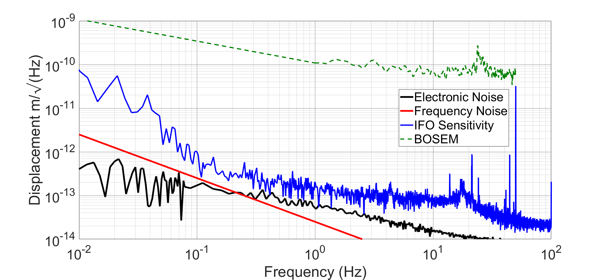
HoQI performance
Measurements performed in air. High-f is residual differential motion.
Low-f is limited by air currents and temperature (we think), best performance at night – still better performance seen in vacuum, but with issues.
Sam Cooper et al., CQG 35 095007 (2018)
http://iopscience.iop.org/article/10.1088/1361-6382/aab2e9/meta

Slide 20
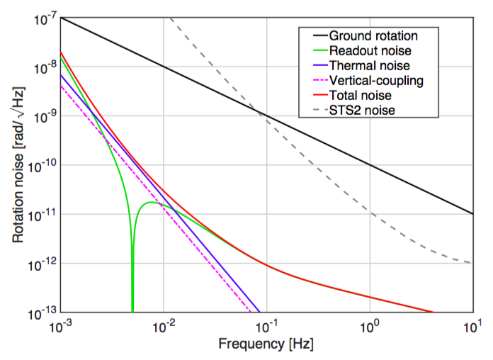
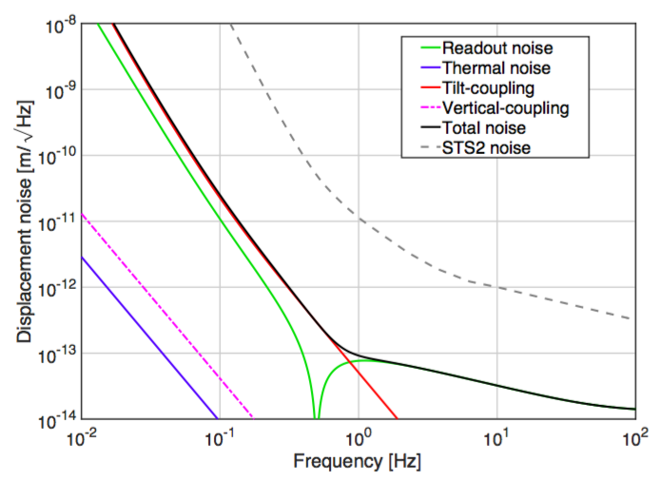
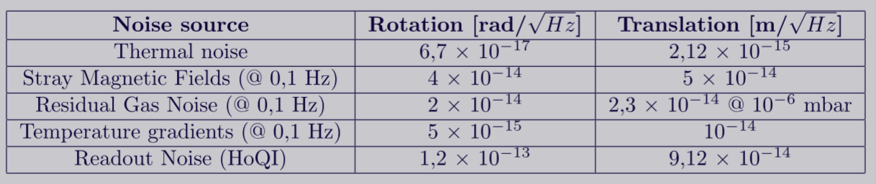
Noise budget

Slide 21
6D Isolator Concept
Key advantages:
Measures and stabilizes
all DoF simultaneously
Small mode cross-coupling
Silica suspension:
  low internal loss
  soft
HoQI readout has good sensitivity and range
Disadvantages:
has 3 very soft DoF!

Slide 22
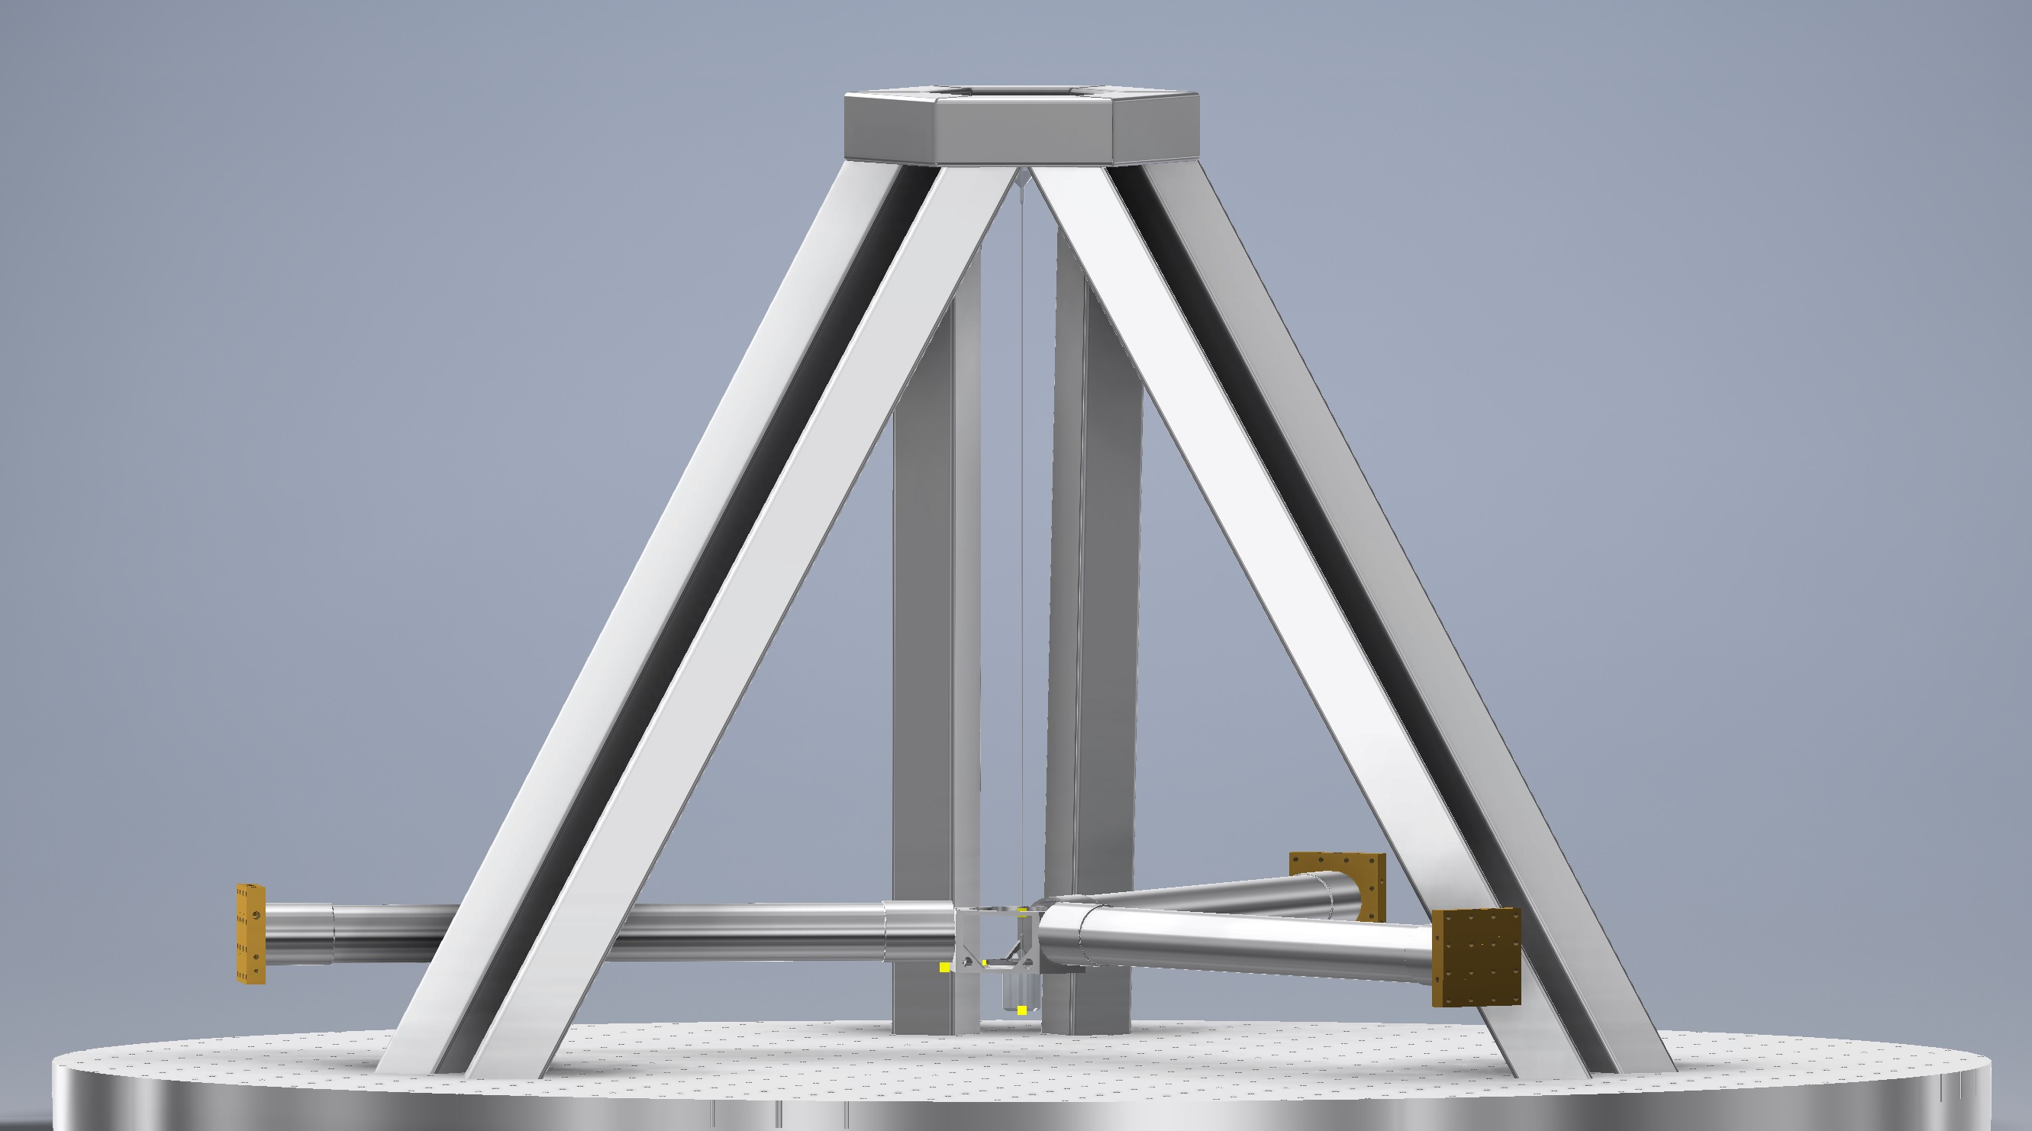
Current status
We work on the first version of 6D seismometer

Slide 23
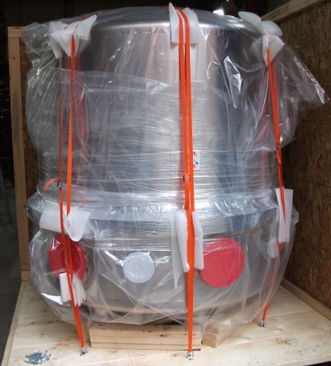
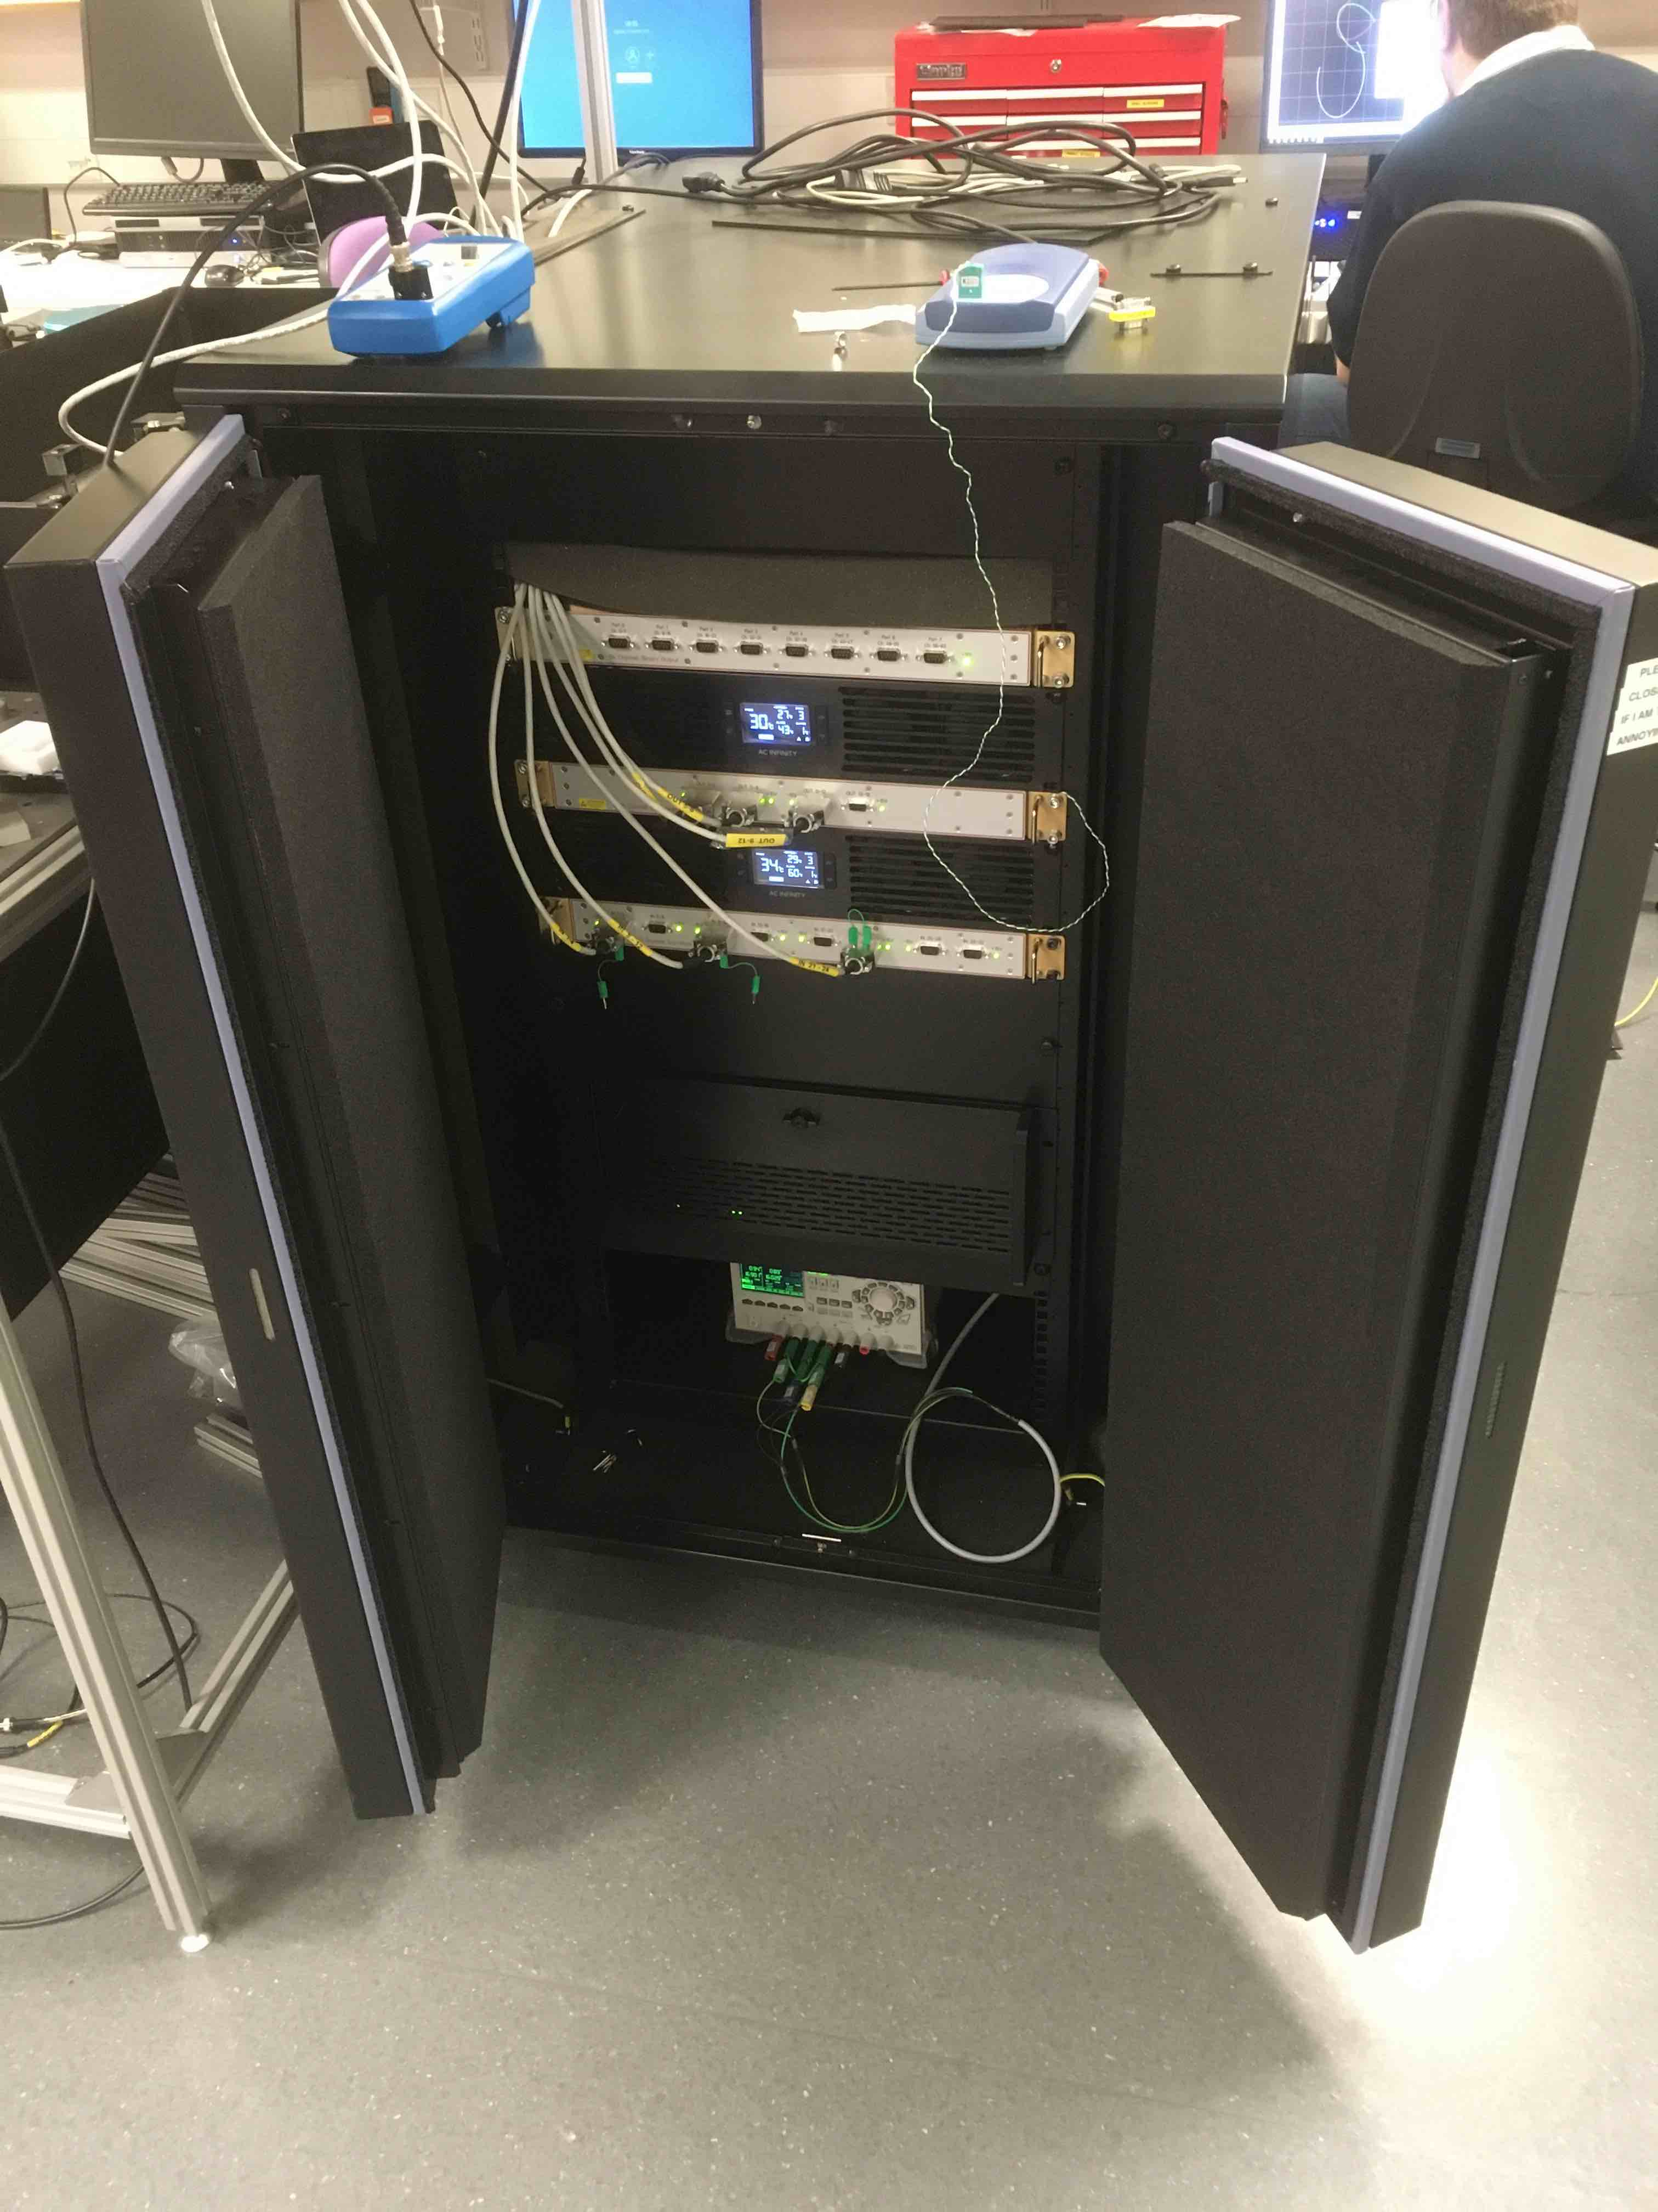
Equipment
Basement laboratory under renovation
Vacuum chamber delivered
aLIGO-style CDS server installed

Slide 24
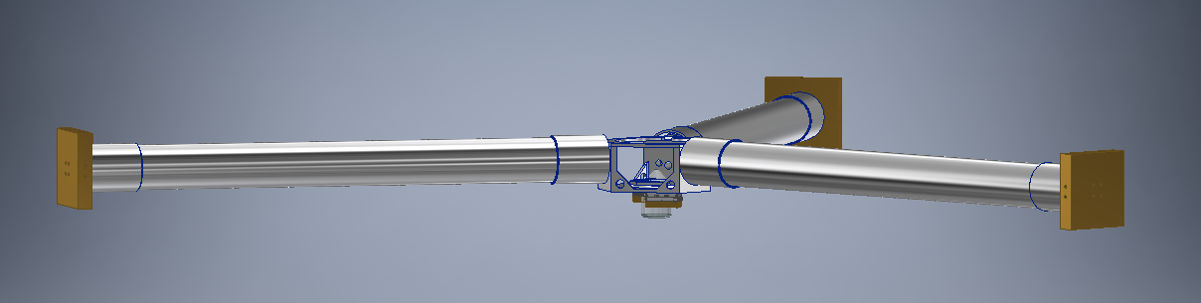
Design
Test mass in production
Ongoing design work on
  Rigid active platform
  Suspension frame
  Test mass release mechanism
  et cetera

Slide 25
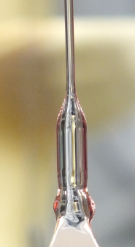
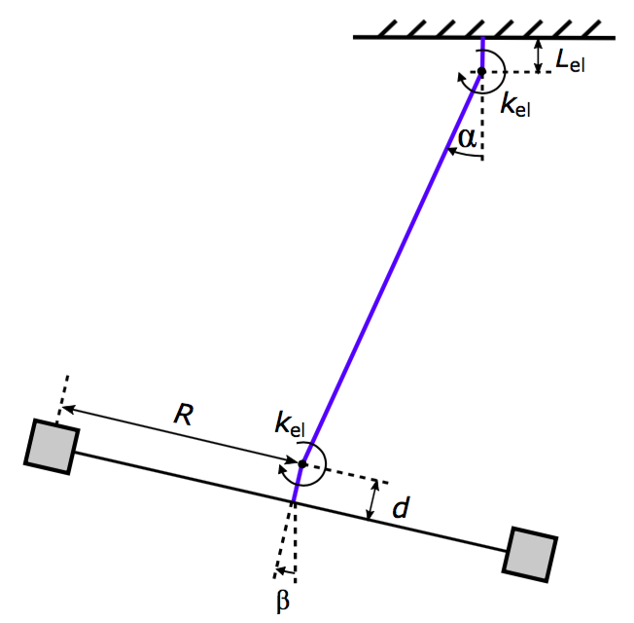
Fused-silica suspensions
Fibre manufacturing at Glasgow scheduled for Nov 2019
Bending occurs near
the end of the fibre
We need the shortest possible transition to thin part of the fibre to minimize the bending rigidity
* Yes, we are going to use silica suspension
for a 1st version
25

Slide 26
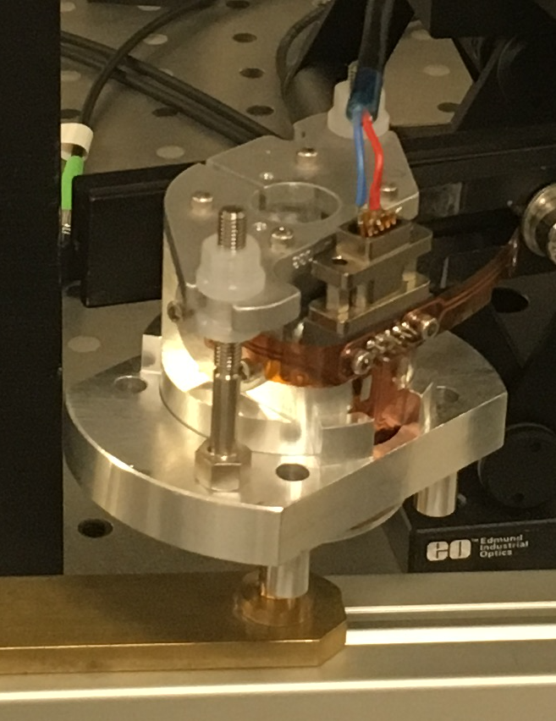
Actuation
  We use coil-magnet actuation (BOSEMs) for a first version
  Later we expect it to be replaced with ESD.
  ESDs are not sensitive to magnetic field
  BOSEMs have larger dynamic range and not sensitive to electrical charges (our TM is isolated)
  We might need a charge control when install ESD
26

Slide 27
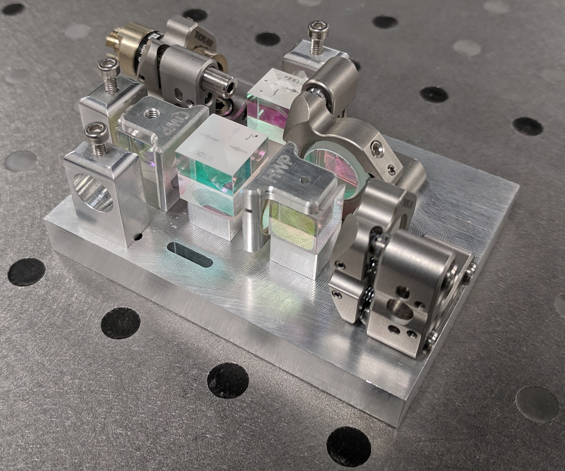
Sensors: HoQI
Tests ongoing
New electronics,
Fibre feedthrough,
Some redesign of clamping and tuning,
Corner cubes tests
27

Slide 28
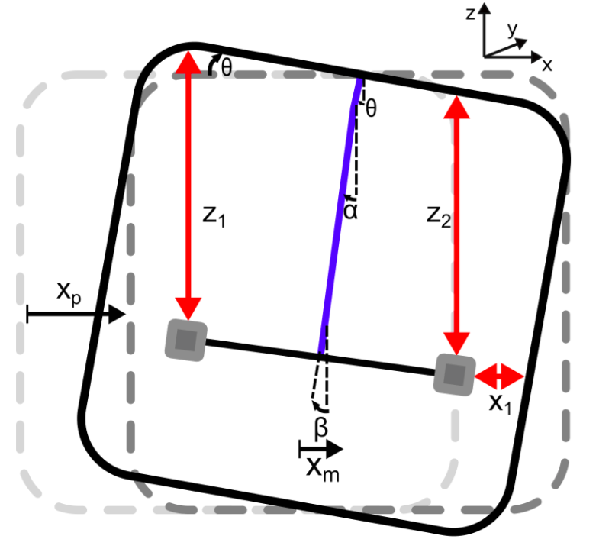
Controls
How to combine sensor readout to get
a translation and tilt?
Aim is to build a more detailed state-space model of this set up
Currently a state-space model for the suspension point motion of the 6D pendulum has been made.
28

Slide 29
Control loop
Aim is to build a more detailed state-space model of our set up
Basic idea of control loop for
stabilisation of the platform
Coupled degrees of freedom
(X and RY or Y and RX)
Purpose of 6D sensor is to decouple the degrees of freedom such that the bandwidth of sensing is increased in translation (X, Y)
Blending of inertial and displacement sensors crucial for large bandwidth
ISI – Platform
SF – Suspension Frame
6D – inertial sensor
6D⁻¹ – Filter for plant inversion
SF⁻¹ – Filter for inverting Suspension Frame
LP – Low pass filter
HP – High pass filter
A – Actuator and filters
29

Slide 30
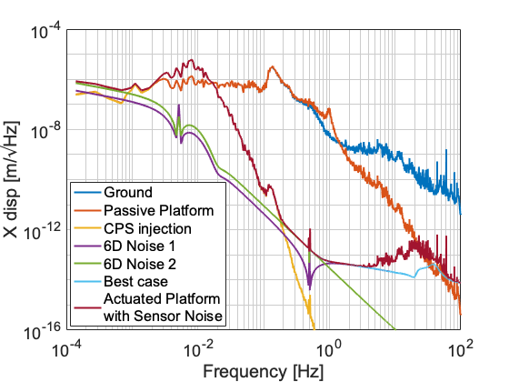
Controls
A noise budget showing estimated suppression of the platform motion in translation (X).
The model is limited by the low passed CPS injection below ~0.3Hz and the actuator gain above 5 Hz.
Improving the blending filters and the actuation filters could increase the suppression in these limiting areas.
30

Slide 31
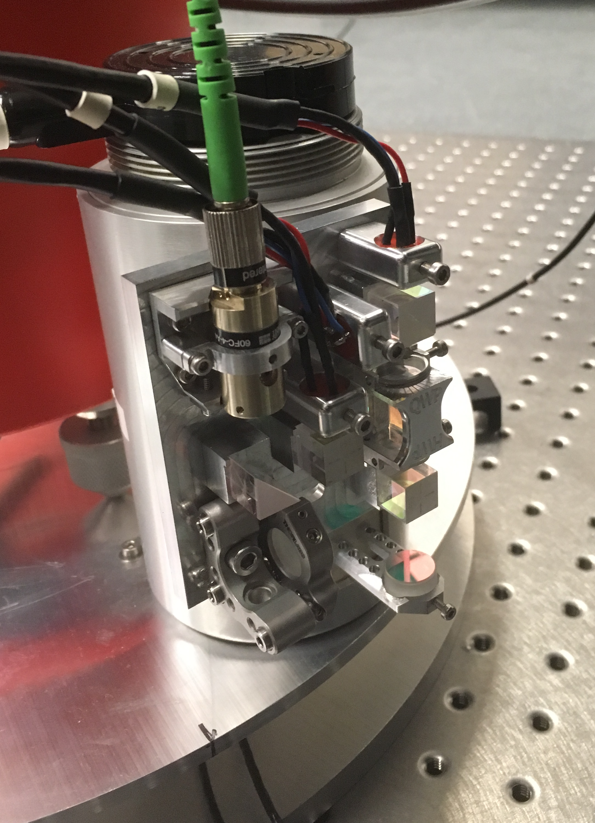
HoQI and controls test
Tests of 1D (vertical) active isolation platform with
3x L4C seismometers (coil and HoQI readout) and
1x S13 are ongoing.
Tests for control of two coupled DoF (X and RY) with HoQI and BOSEMs are planned
31

Slide 32
Is it feasible?
Pros:
+ Simple core mechanics
+ Closed-loop linearisation and actuation noise suppression
+ Proven (static) interferometer performance
Cons:
- Thermal coupling and stray forces
- Z-coupling and recoil losses
- Drift and alignment control of ultra-soft suspension in 3D
32

Slide 33
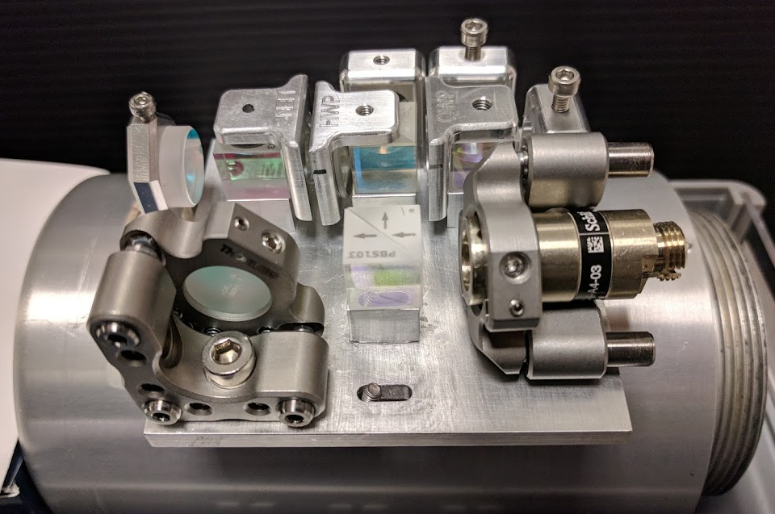
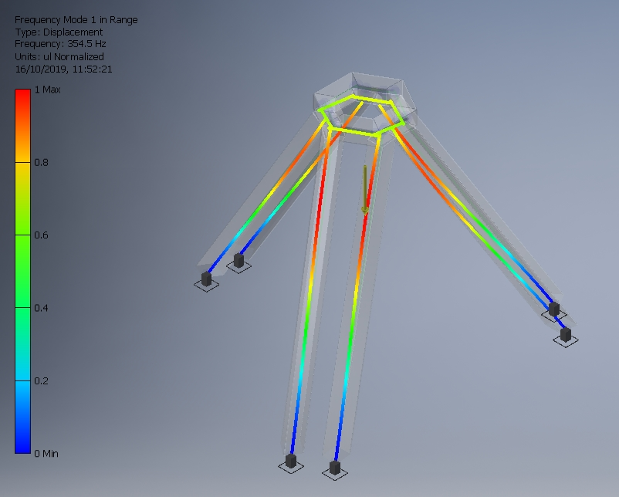
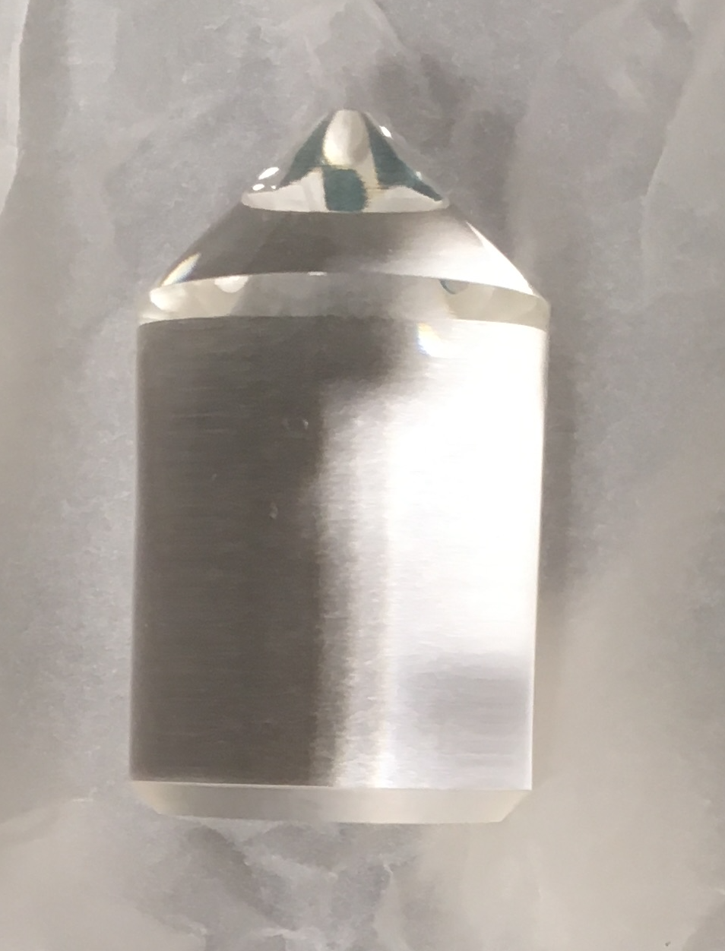
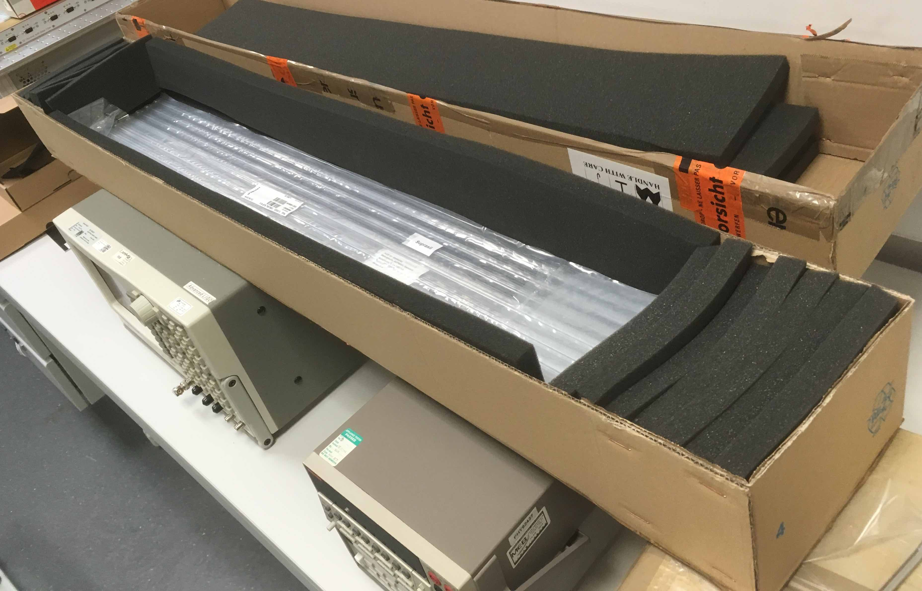
Plans
More design
More manufacturing
More tests
To suspend a Test Mass and see drifts, noises and deal with control.

Slide 34
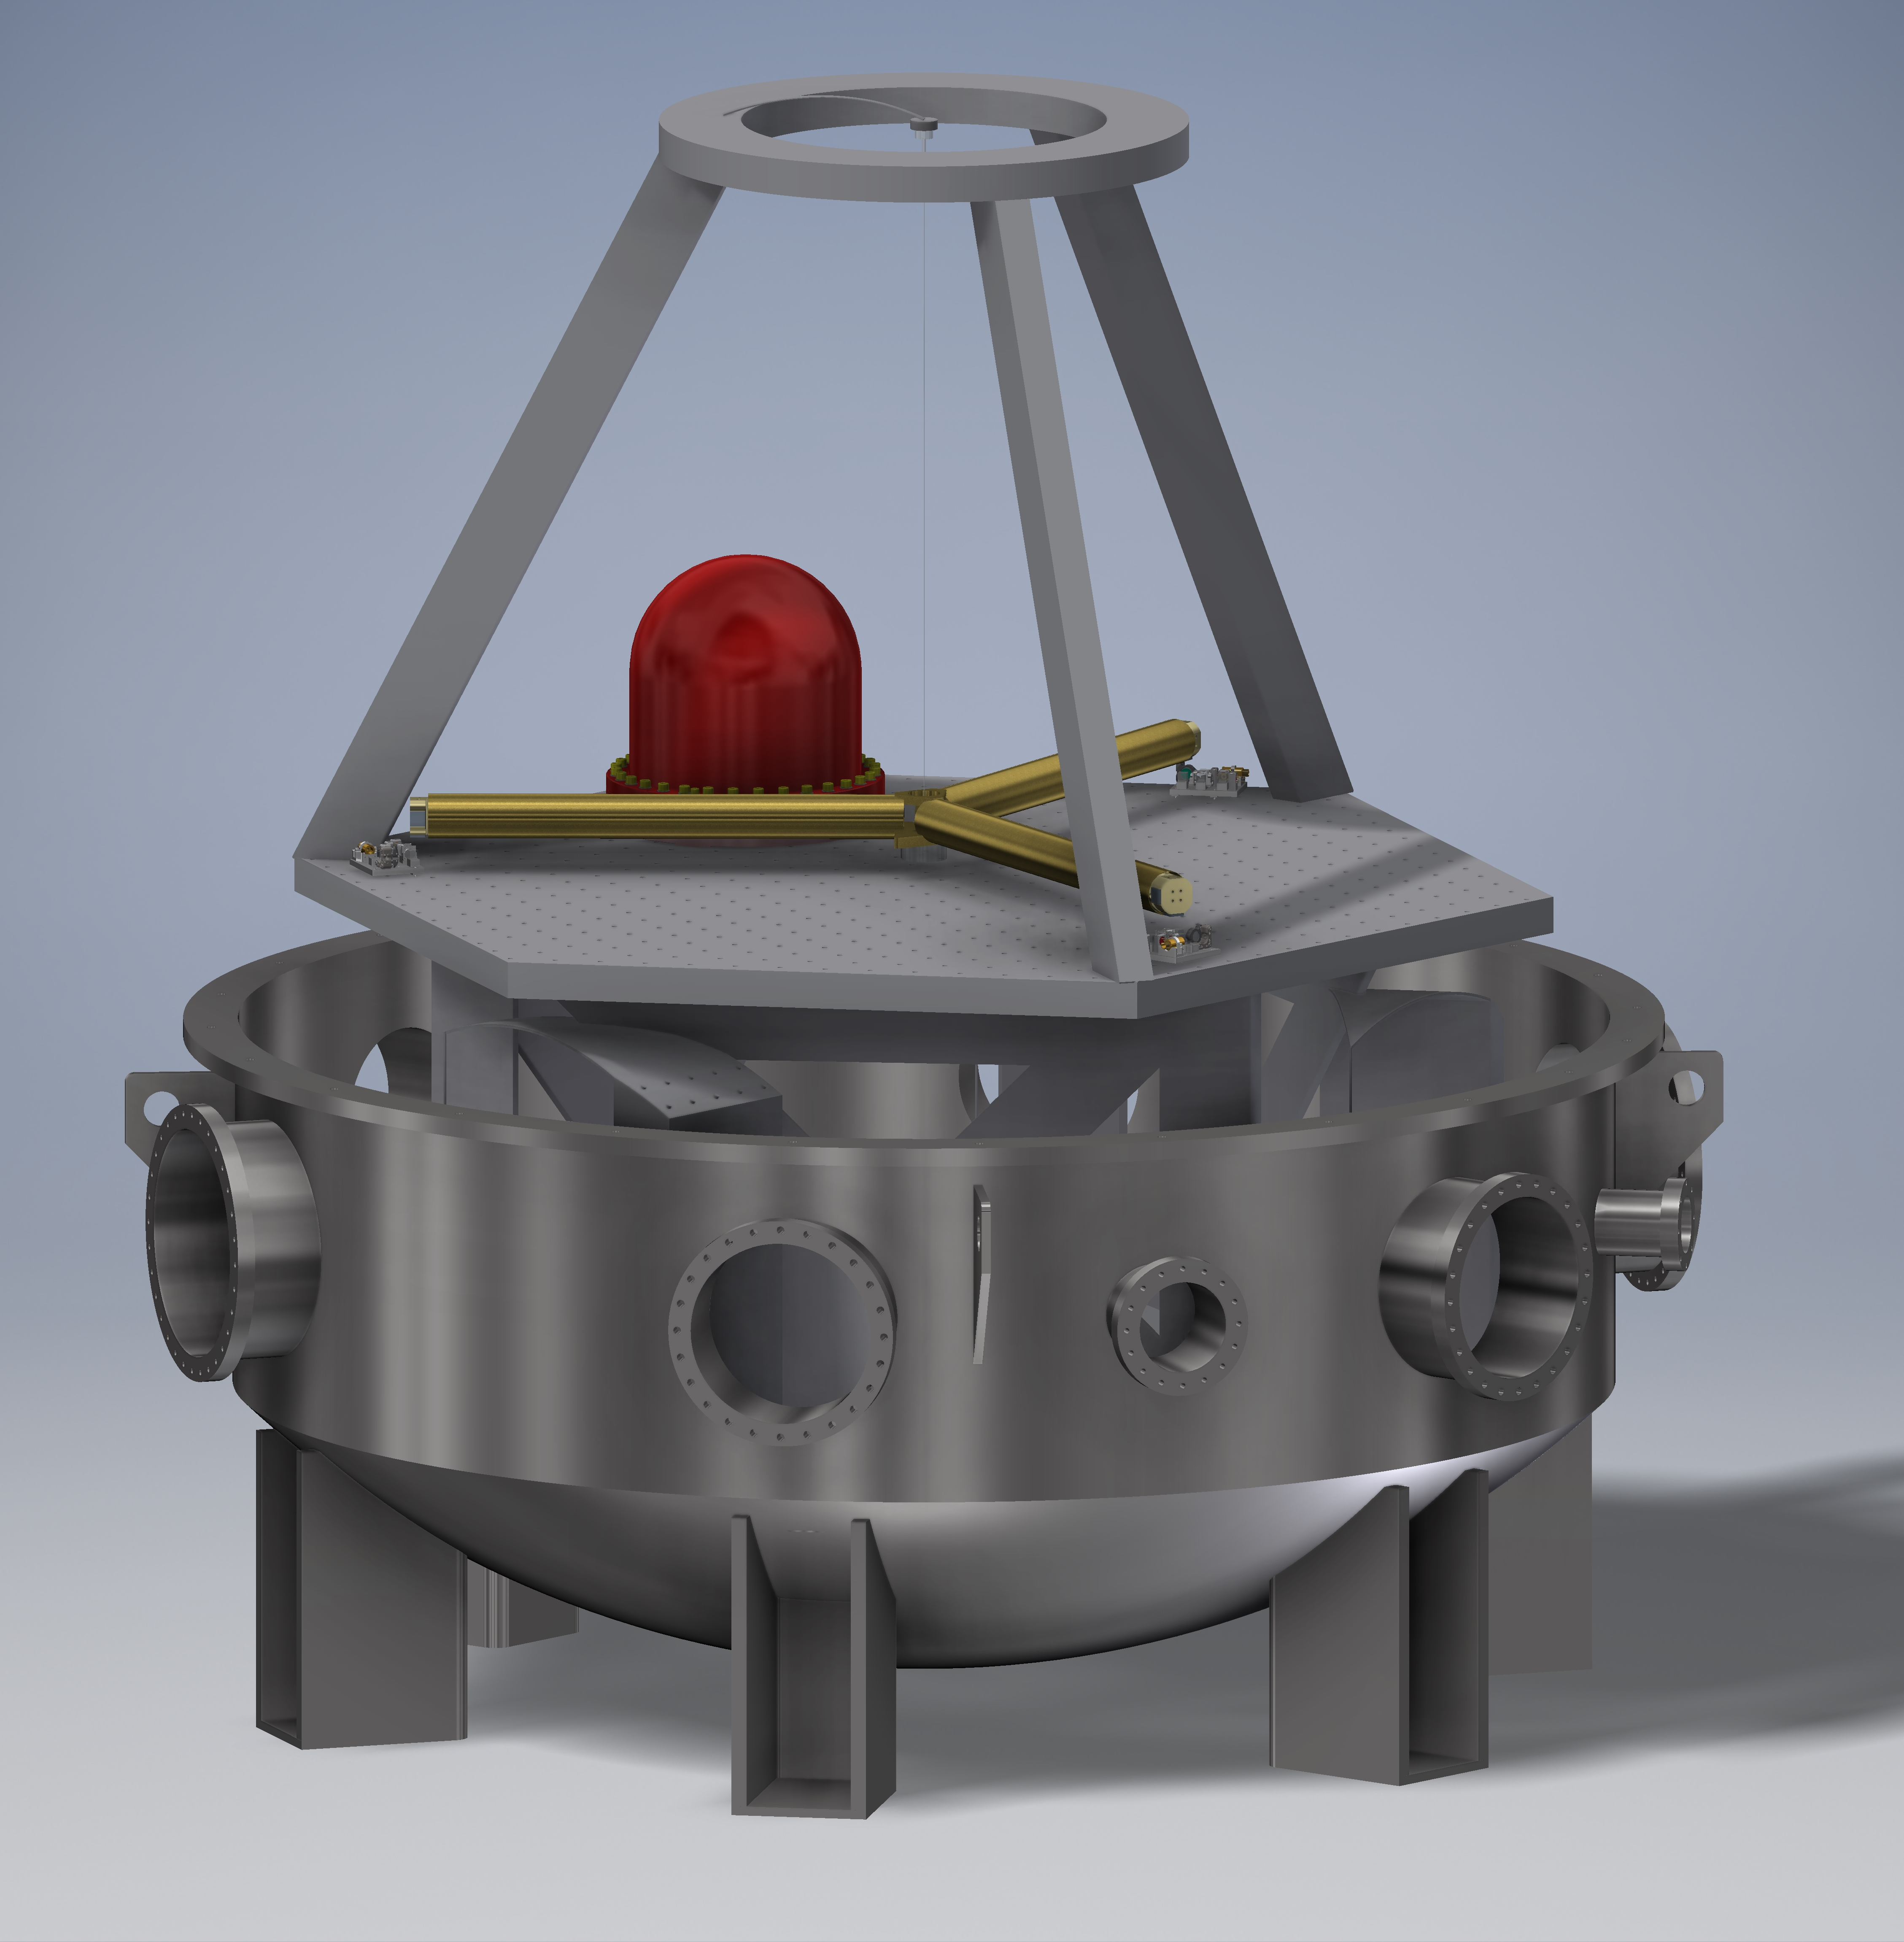
Questions?

