Slide 1
Improving Gravitational-Wave Detectors with Entangled Light
Sebastian Steinlechner¹, Jan Schönbeck²,
Mikhail Korobko², Melanie Ast³, Roman Schnabel²
¹ Maastricht University, the Netherlands
² Universität Hamburg, Germany
³ Leibniz-Universität Hannover, Germany
GRASS 2019, Padova, Italy

Slide 2
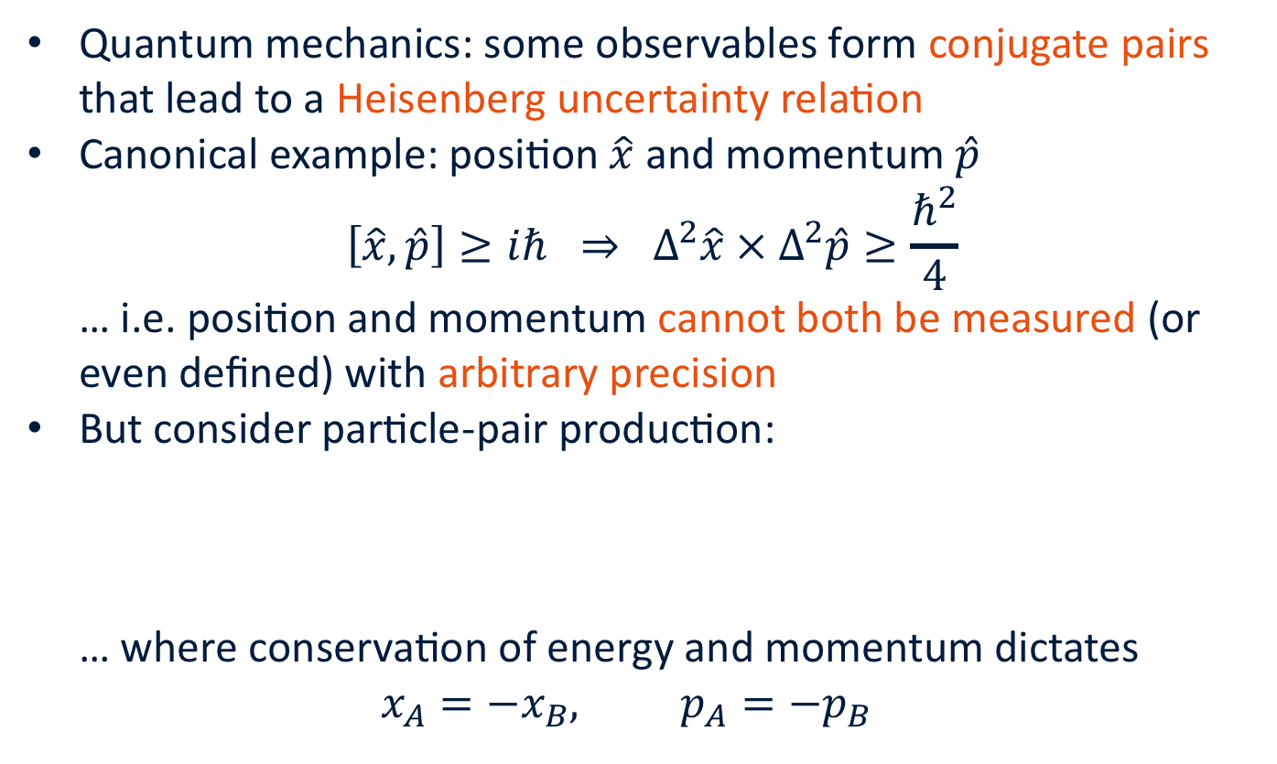
Introduction
Quantum mechanics: some observables form conjugate pairs that lead to a Heisenberg uncertainty relation
Canonical example: position $\hat{x}$ and momentum $\hat{p}$
$\left[\hat{x},\hat{p}\right]≥iℏ ⇒ Δ^{2}\hat{x} × Δ^{2}\hat{p}≥\frac{ℏ^{2}}{4}$
… i.e. position and momentum cannot both be measured (or even defined) with arbitrary precision
But consider particle-pair production:
… where conservation of energy and momentum dictates
$x_{A}=−x_{B}, p_{A}=−p_{B}$
A
B

Slide 3
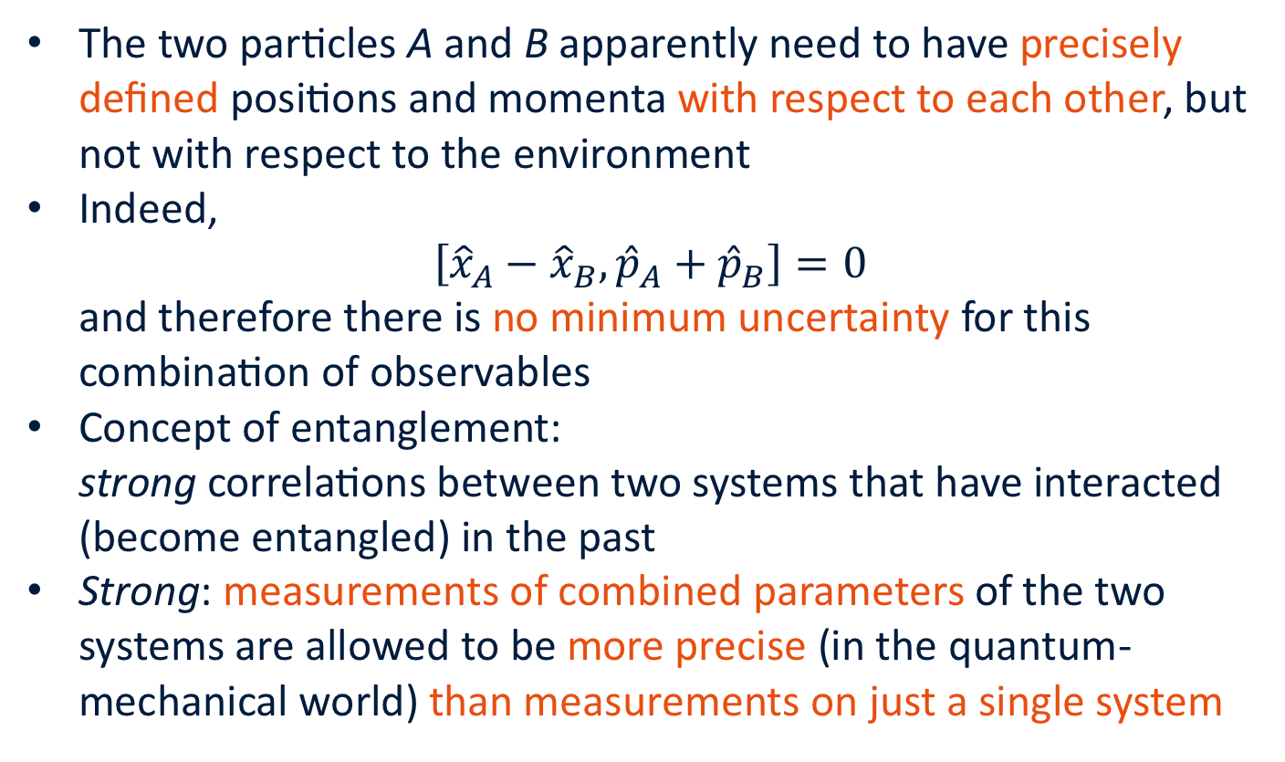
Entanglement
The two particles A and B apparently need to have precisely defined positions and momenta with respect to each other, but not with respect to the environment
Indeed,
$\left[{\hat{x}}_{A}−{\hat{x}}_{B}, {\hat{p}}_{A}+{\hat{p}}_{B}\right]=0$
and therefore there is no minimum uncertainty for this combination of observables
Concept of entanglement:
strong correlations between two systems that have interacted (become entangled) in the past
Strong: measurements of combined parameters of the two systems are allowed to be more precise (in the quantum-mechanical world) than measurements on just a single system

Slide 4
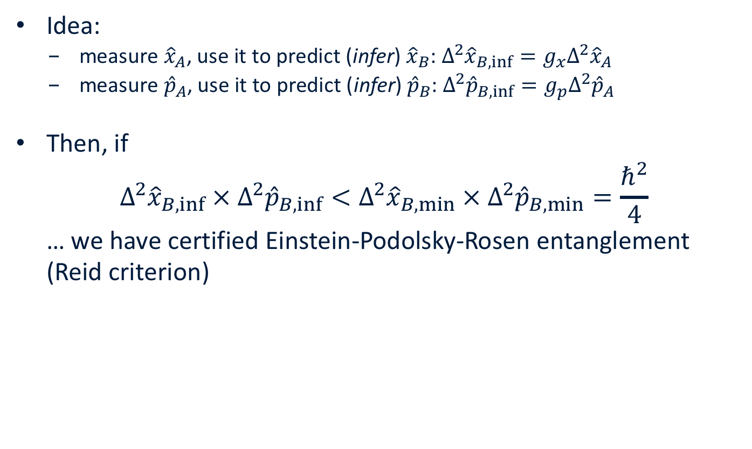
Einstein-Podolsky-Rosen Entanglement
Idea:
  measure ${\hat{x}}_{A}$, use it to predict (infer) ${\hat{x}}_{B}$: $Δ^{2}{\hat{x}}_{B,inf}=g_{x}Δ^{2}{\hat{x}}_{A}$
  measure ${\hat{p}}_{A}$, use it to predict (infer) ${\hat{p}}_{B}$: $Δ^{2}{\hat{p}}_{B,inf}=g_{p}Δ^{2}{\hat{p}}_{A}$
Then, if
$Δ^{2}{\hat{x}}_{B,inf} × Δ^{2}{\hat{p}}_{B,inf}<Δ^{2}{\hat{x}}_{B,min} × Δ^{2}{\hat{p}}_{B,min}=\frac{ℏ^{2}}{4}$
… we have certified Einstein-Podolsky-Rosen entanglement
(Reid criterion)

Slide 5
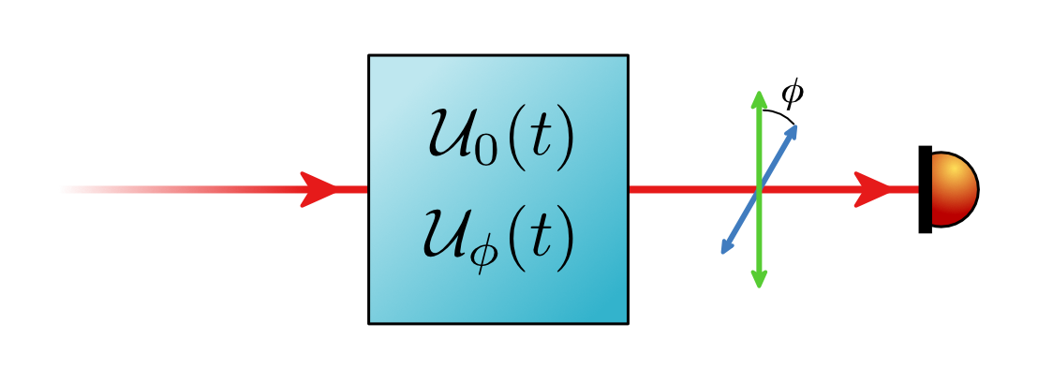
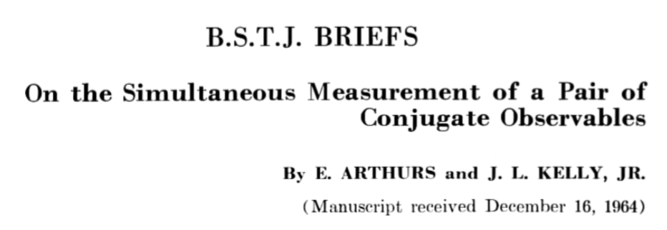
Simultaneous measurement of conj. observables
measurement scenario:
  have signal encoded in one quadrature of a continuous-wave light field,
  e.g. amplitude modulation
  some other signal is encoded in another quadrature
what is the best (& experimentally feasible) measurement strategy?
Notes:
continue from here:
want to measure x1 and x2 of output light
heisenberg says there’s uncertainty relation between those
how would one actually do this? -> eight-power homodyne (get picture from SFB talk!) -> AK

Slide 6
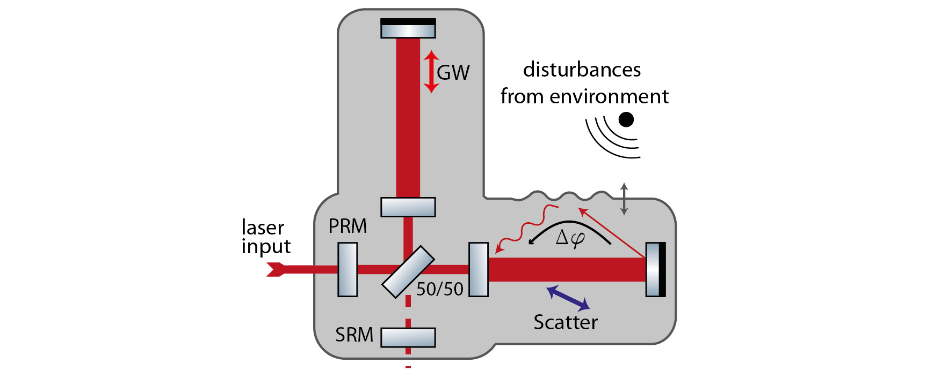

Example Signal: Scattered Light
scattered light in GW detectors
  some ppm scatter out of high-power interferometer mode, get phase-modulated from vibrating vacuum walls etc.
  some small fraction of this modulated light field finds its way back into the main mode
  GW signal (the “useful” signal) is contained in the output’s amplitude quadrature only; scattered light has arbitrary phase delay and thus arbitrary orientation in quadrature space
can model the time-series of the measured phase quadrature and then subtract its projection from the amplitude quadrature, leaving only GW signal

Slide 7
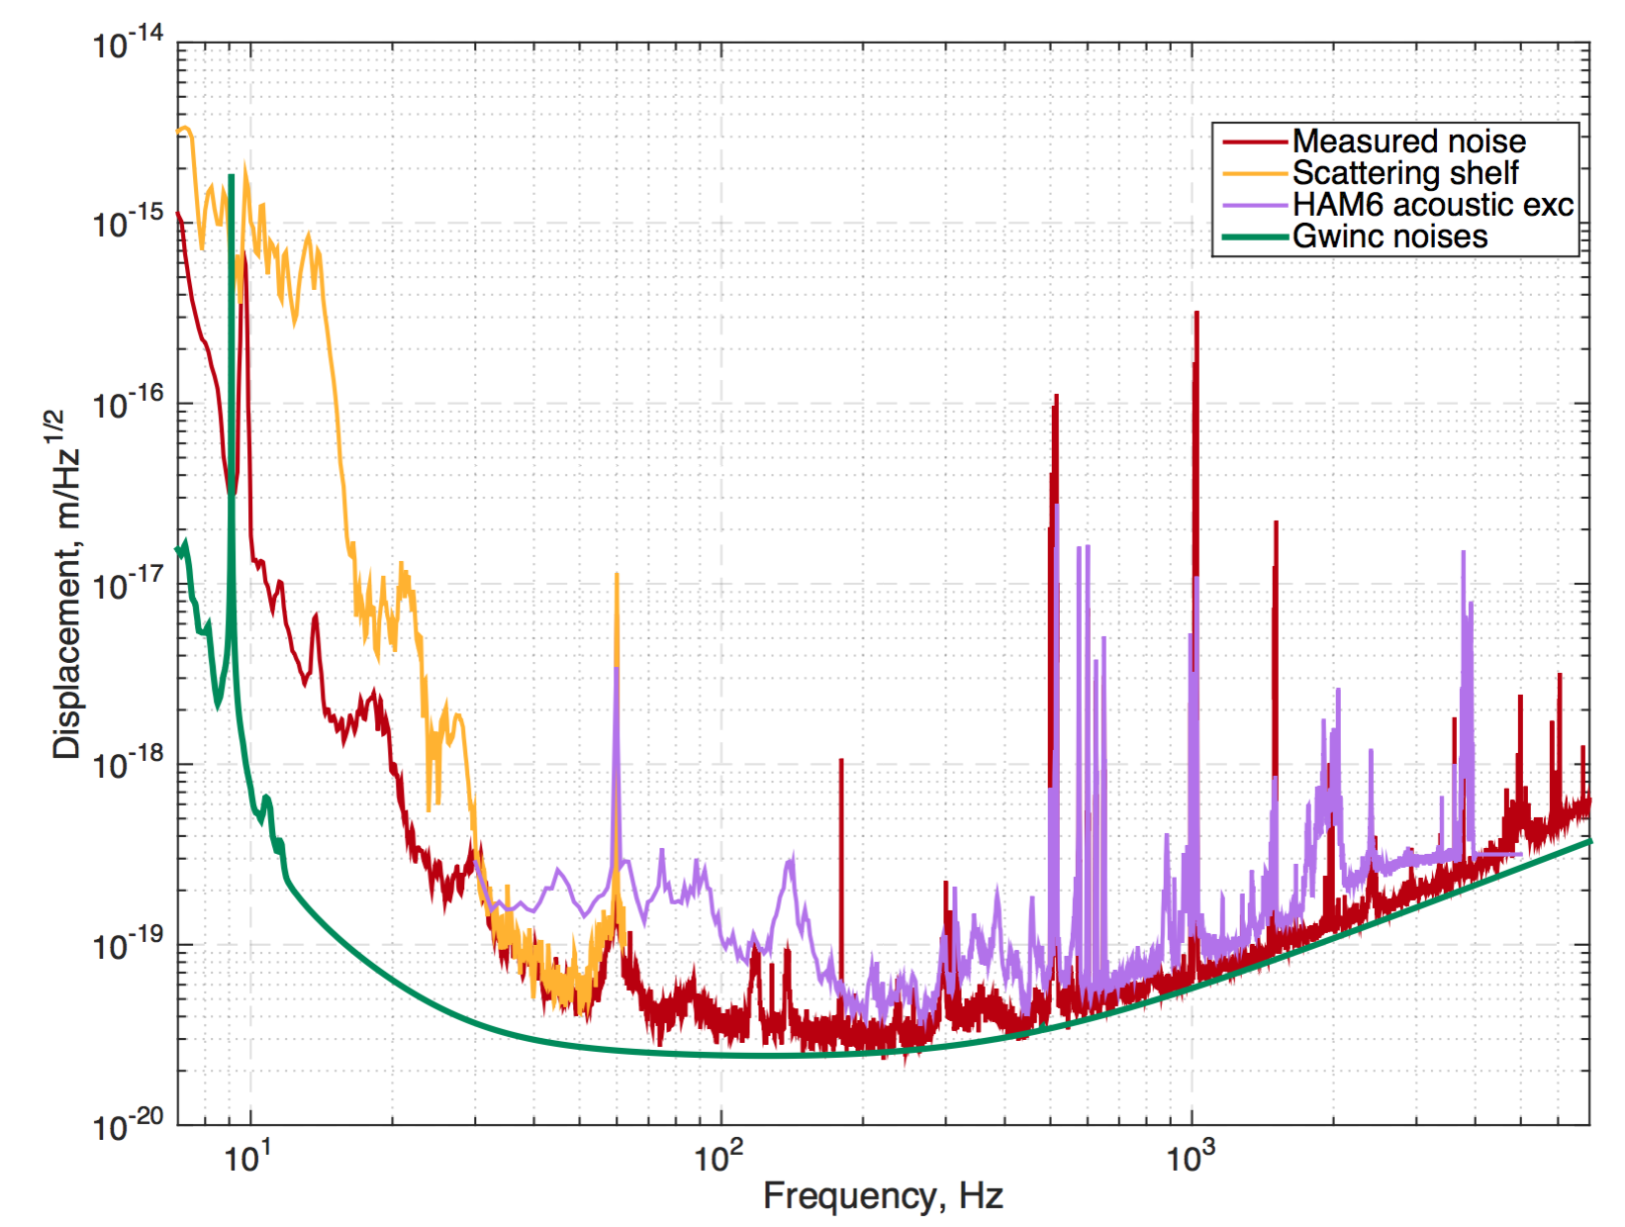
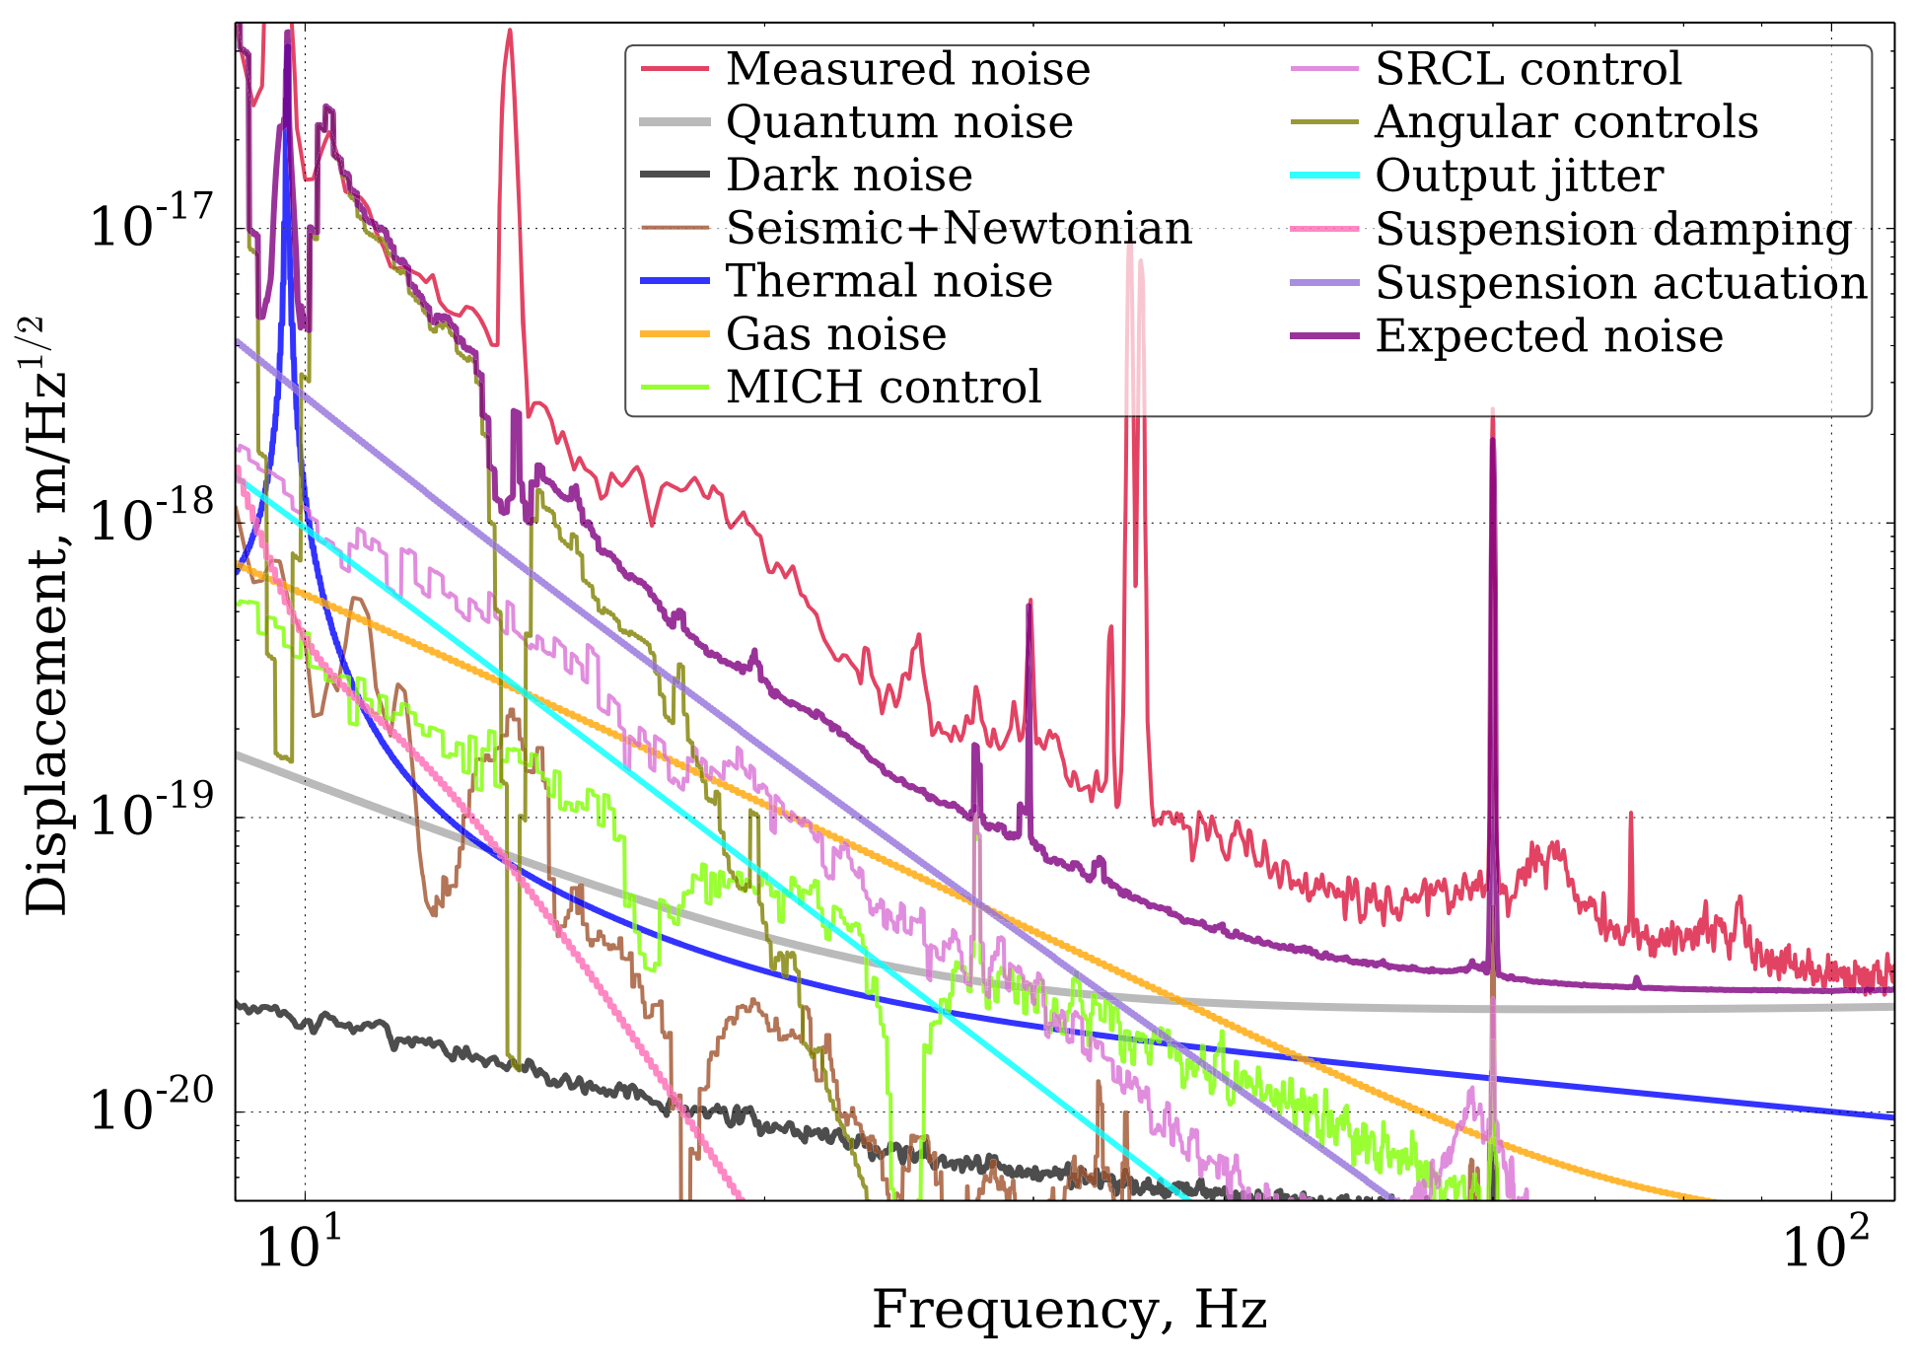
Scattered light in GW detectors
L1 noise composition around GW150914
Investigation of scattering noise
Phys. Rev. D 93, 112004
D. Martynov, PhD thesis, Caltech 2015
discrepancy between expected
(projected) and measured noise

Slide 8

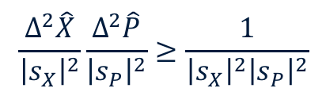

Simultaneous measurement of conj. observables
What is the best (& experimentally feasible) measurement strategy?
define inverse SNR (= NSR):
Since the operators for two orthogonal quadratures do not commute, we have
How would one measure this?
$$\frac{1}{\text{SNR}}=\frac{Δ^{2}\hat{X}}{{\left|s_{X}\right|}^{2}}$$
where $\hat{X}→\hat{X}+s_{X}(t)$ and similarly for P
$$\frac{Δ^{2}\hat{X}}{{\left|s_{X}\right|}^{2}}\frac{Δ^{2}\hat{P}}{{\left|s_{P}\right|}^{2}}≥\frac{1}{{\left|s_{X}\right|}^{2}{\left|s_{P}\right|}^{2}}$$
for a vacuum-state uncertainty of 1.
Notes:
continue from here:
want to measure x1 and x2 of output light
heisenberg says there’s uncertainty relation between those
how would one actually do this? -> eight-power homodyne (get picture from SFB talk!) -> AK

Slide 9
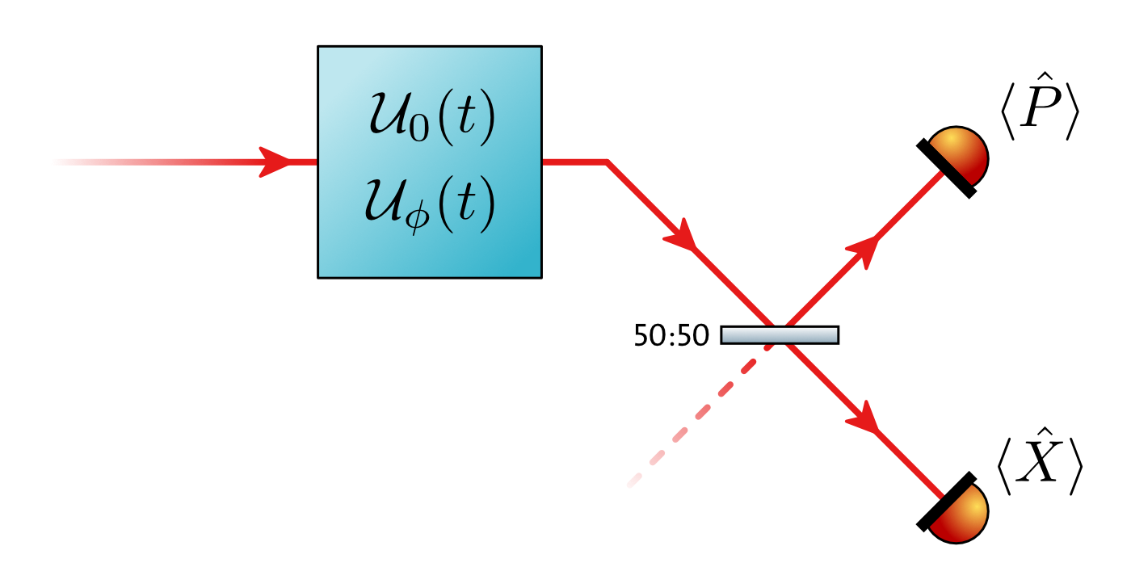
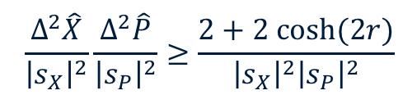
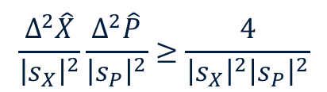
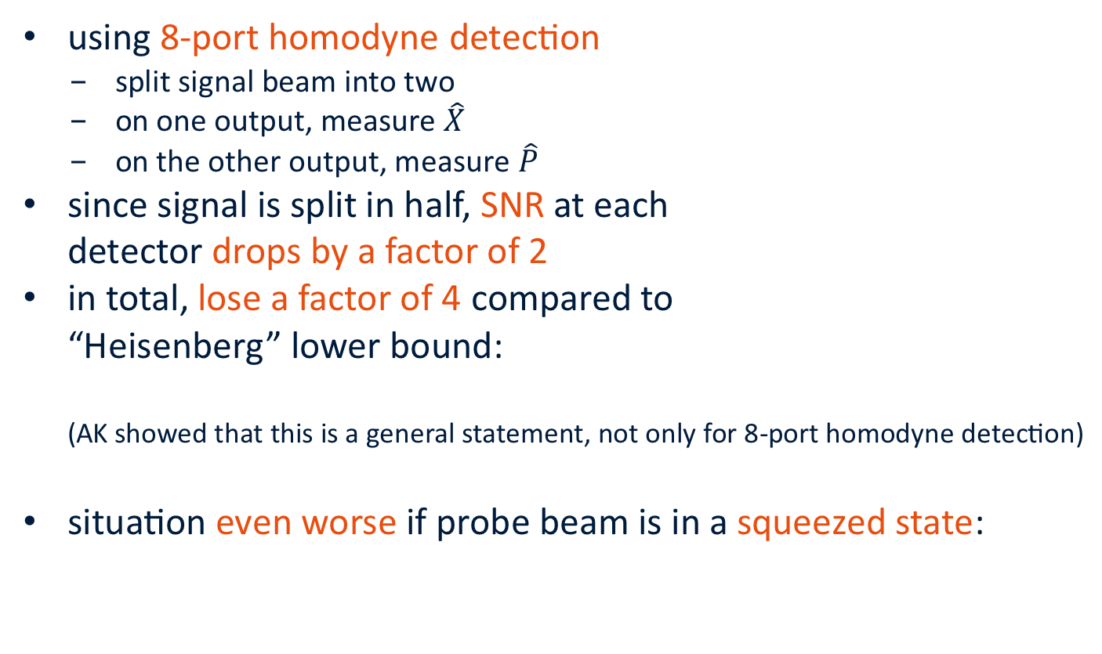
Simultaneous measurement of conj. observables
using 8-port homodyne detection
  split signal beam into two
  on one output, measure $\hat{X}$
  on the other output, measure $\hat{P}$
since signal is split in half, SNR at each
detector drops by a factor of 2
in total, lose a factor of 4 compared to
“Heisenberg” lower bound:
(AK showed that this is a general statement, not only for 8-port homodyne detection)
situation even worse if probe beam is in a squeezed state:
$$\frac{Δ^{2}\hat{X}}{{\left|s_{X}\right|}^{2}}\frac{Δ^{2}\hat{P}}{{\left|s_{P}\right|}^{2}}≥\frac{4}{{\left|s_{X}\right|}^{2}{\left|s_{P}\right|}^{2}}$$
$$\frac{Δ^{2}\hat{X}}{{\left|s_{X}\right|}^{2}}\frac{Δ^{2}\hat{P}}{{\left|s_{P}\right|}^{2}}≥\frac{2+2 cosh(2r)}{{\left|s_{X}\right|}^{2}{\left|s_{P}\right|}^{2}}$$
Notes:
make new graph of QDM measurement
here, use only very right side (beam through U(t), U’(t), then split into two parts, two BHDs)

Slide 10
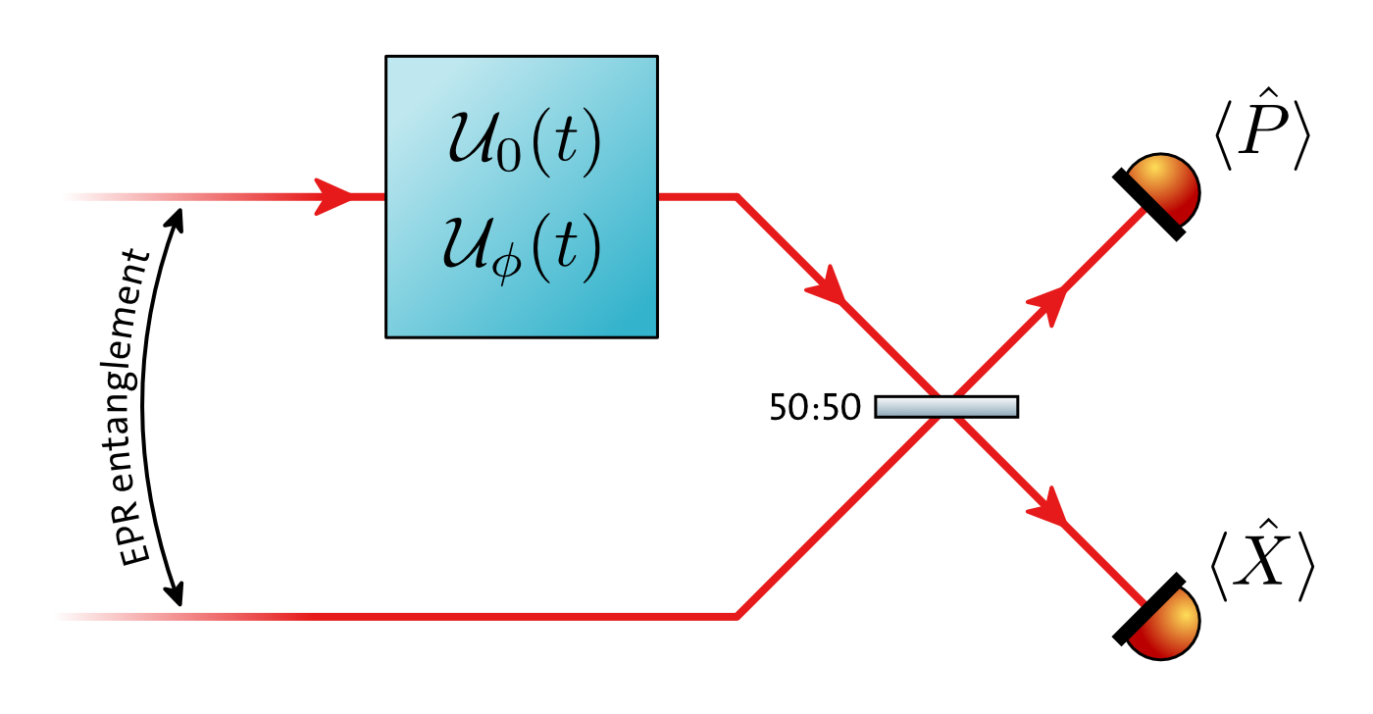

We can do better: Quantum-Dense Metrology
Instead of measuring $\hat{X}, \hat{P}$ directly, compare signal beam to a reference beam that does not carry the signal
If signal and reference beams are (EPR) entangled, we can measure their difference (= the encoded signal) with sub-shotnoise sensitivity, because $\left[{\hat{X}}_{A}−{\hat{X}}_{B}, {\hat{P}}_{A}+{\hat{P}}_{B}\right]=0$
see also D’Ariano et al, Phys Rev Lett 87, 1–4 (2001),
Genoni et al, Phys Rev A 87, 012107 (2013)

Slide 11
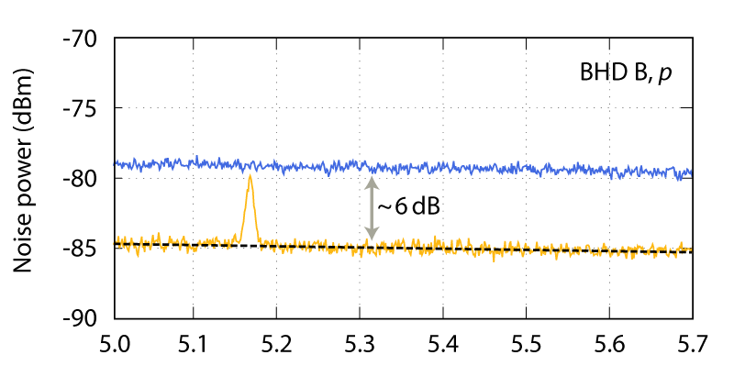
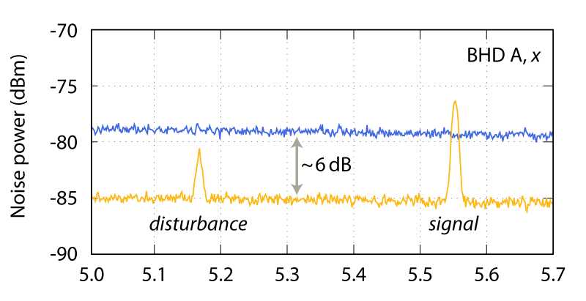
Conceptual demonstration
simultaneous, sub-shotnoise readout of two orthogonal quadratures
vacuum level
Frequency (MHz)
Frequency (MHz)
vacuum level
Nature Photonics, 10.1038/nphoton.2013.150
Frequency (MHz)

Slide 12
Experimental demonstration
Laser source: Nd:YAG,
2W @ 1064nm
Signals at audioband frequencies,
shifted to MHz and demodulated
Two-mode-squeezed entanglement source:
one monolithic squeezer, one hemilithic squeezer, PPKTP, squeezing >10dB
Detection with two balanced homodyne detectors (BHD1&2)
M. Meinders, R. Schnabel, CQG (2015), 10.1088/0264-9381/32/19/195004
M. Ast, S. Steinlechner, R. Schnabel, 10.1103/PhysRevLett.117.180801

Slide 13
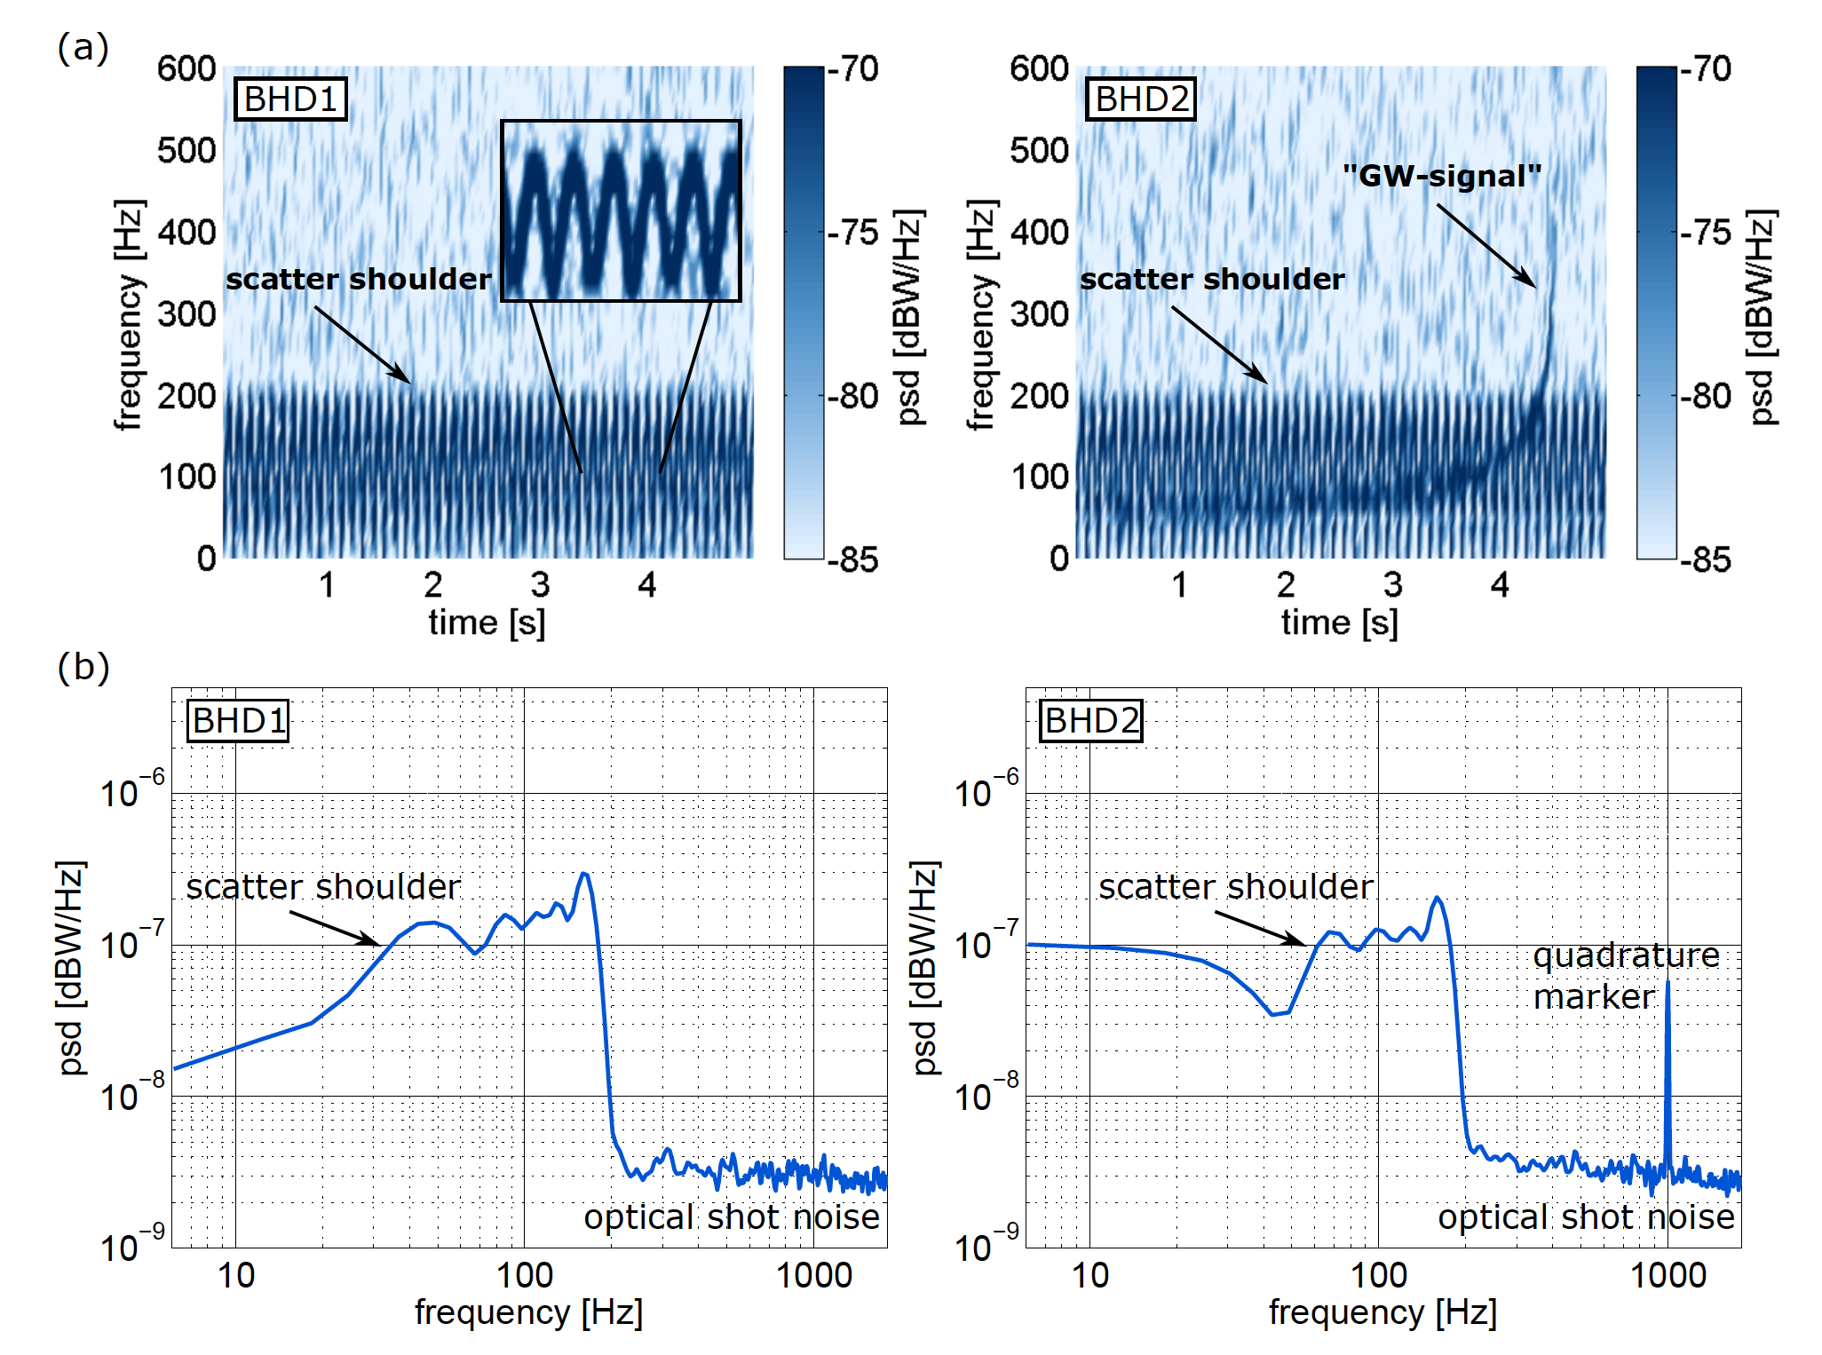
Spectrograms of the scattering noise
proof-of-principle, without quantum-dense readout enhancement

Slide 14
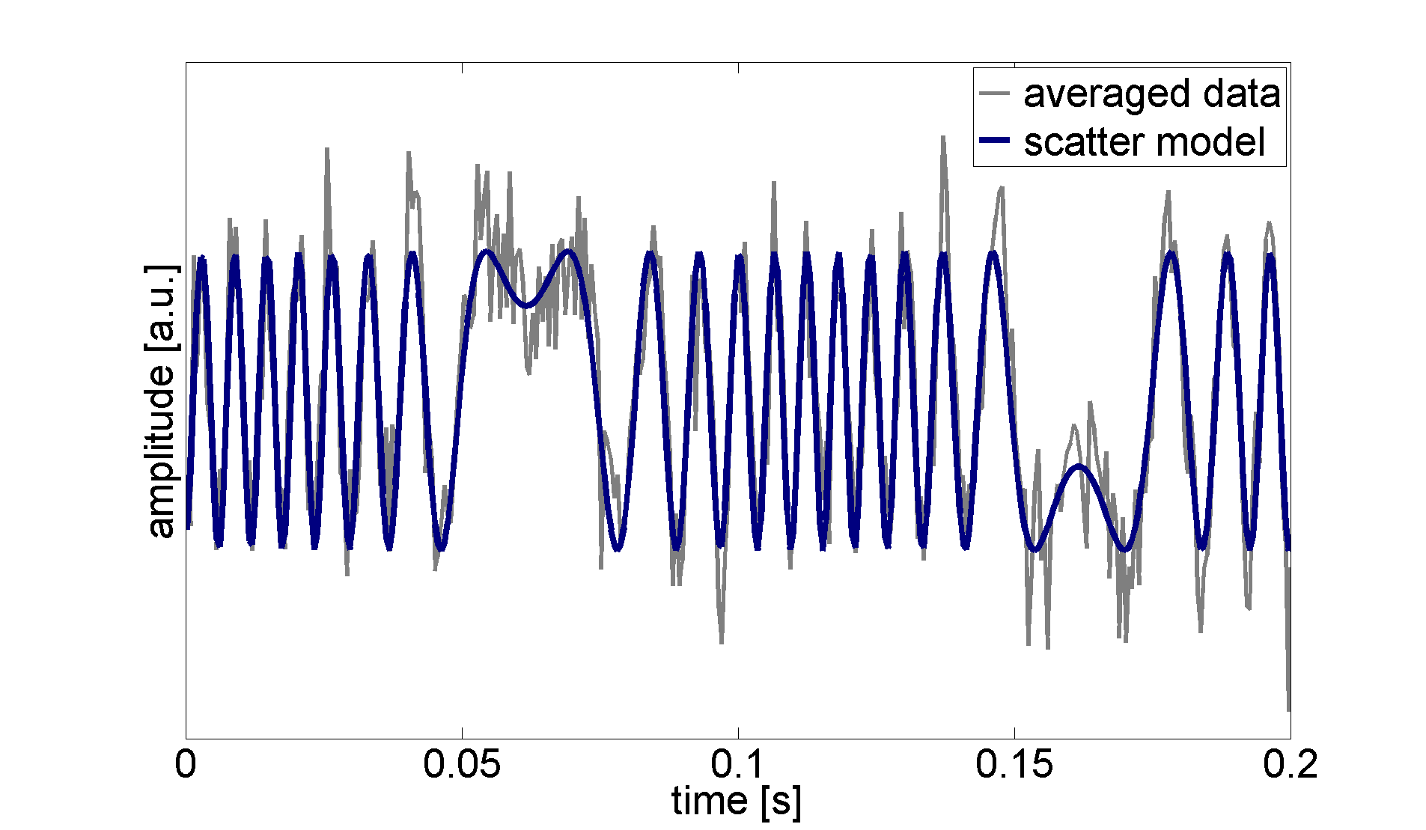
Time-domain modelling
phase measurement
$p_{sc}\left(t\right)∝{cos⁡(φ}_{0}+\frac{2π}{λ} A_{m} sin⁡(2πf_{m}t+φ_{m}))$
(experiment included up to 5th harmonic
to account for nonlinearity of the PZT)

Slide 15
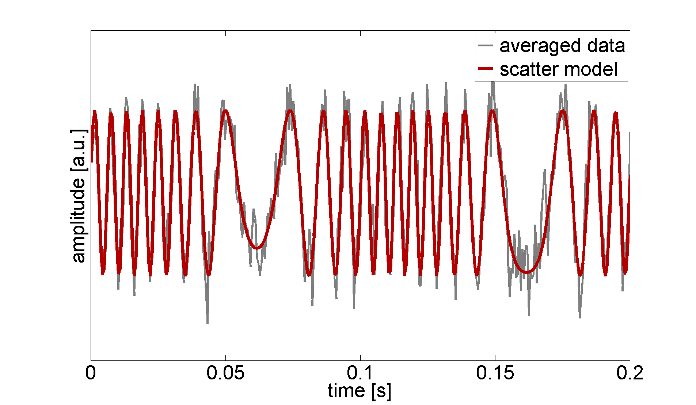
Time-domain modelling
phase measurement
$p_{sc}\left(t\right)∝{cos⁡(φ}_{0}+\frac{2π}{λ} A_{m} sin⁡(2πf_{m}t+φ_{m}))$
(experiment included up to 5th harmonic
to account for nonlinearity of the PZT)
amplitude measurement
$$⇒ φ\left(t\right) ⇒{ x}_{sc}\left(t\right)∝\sin{φ(t)}$$

Slide 16
Result of scatter subtraction

Slide 17
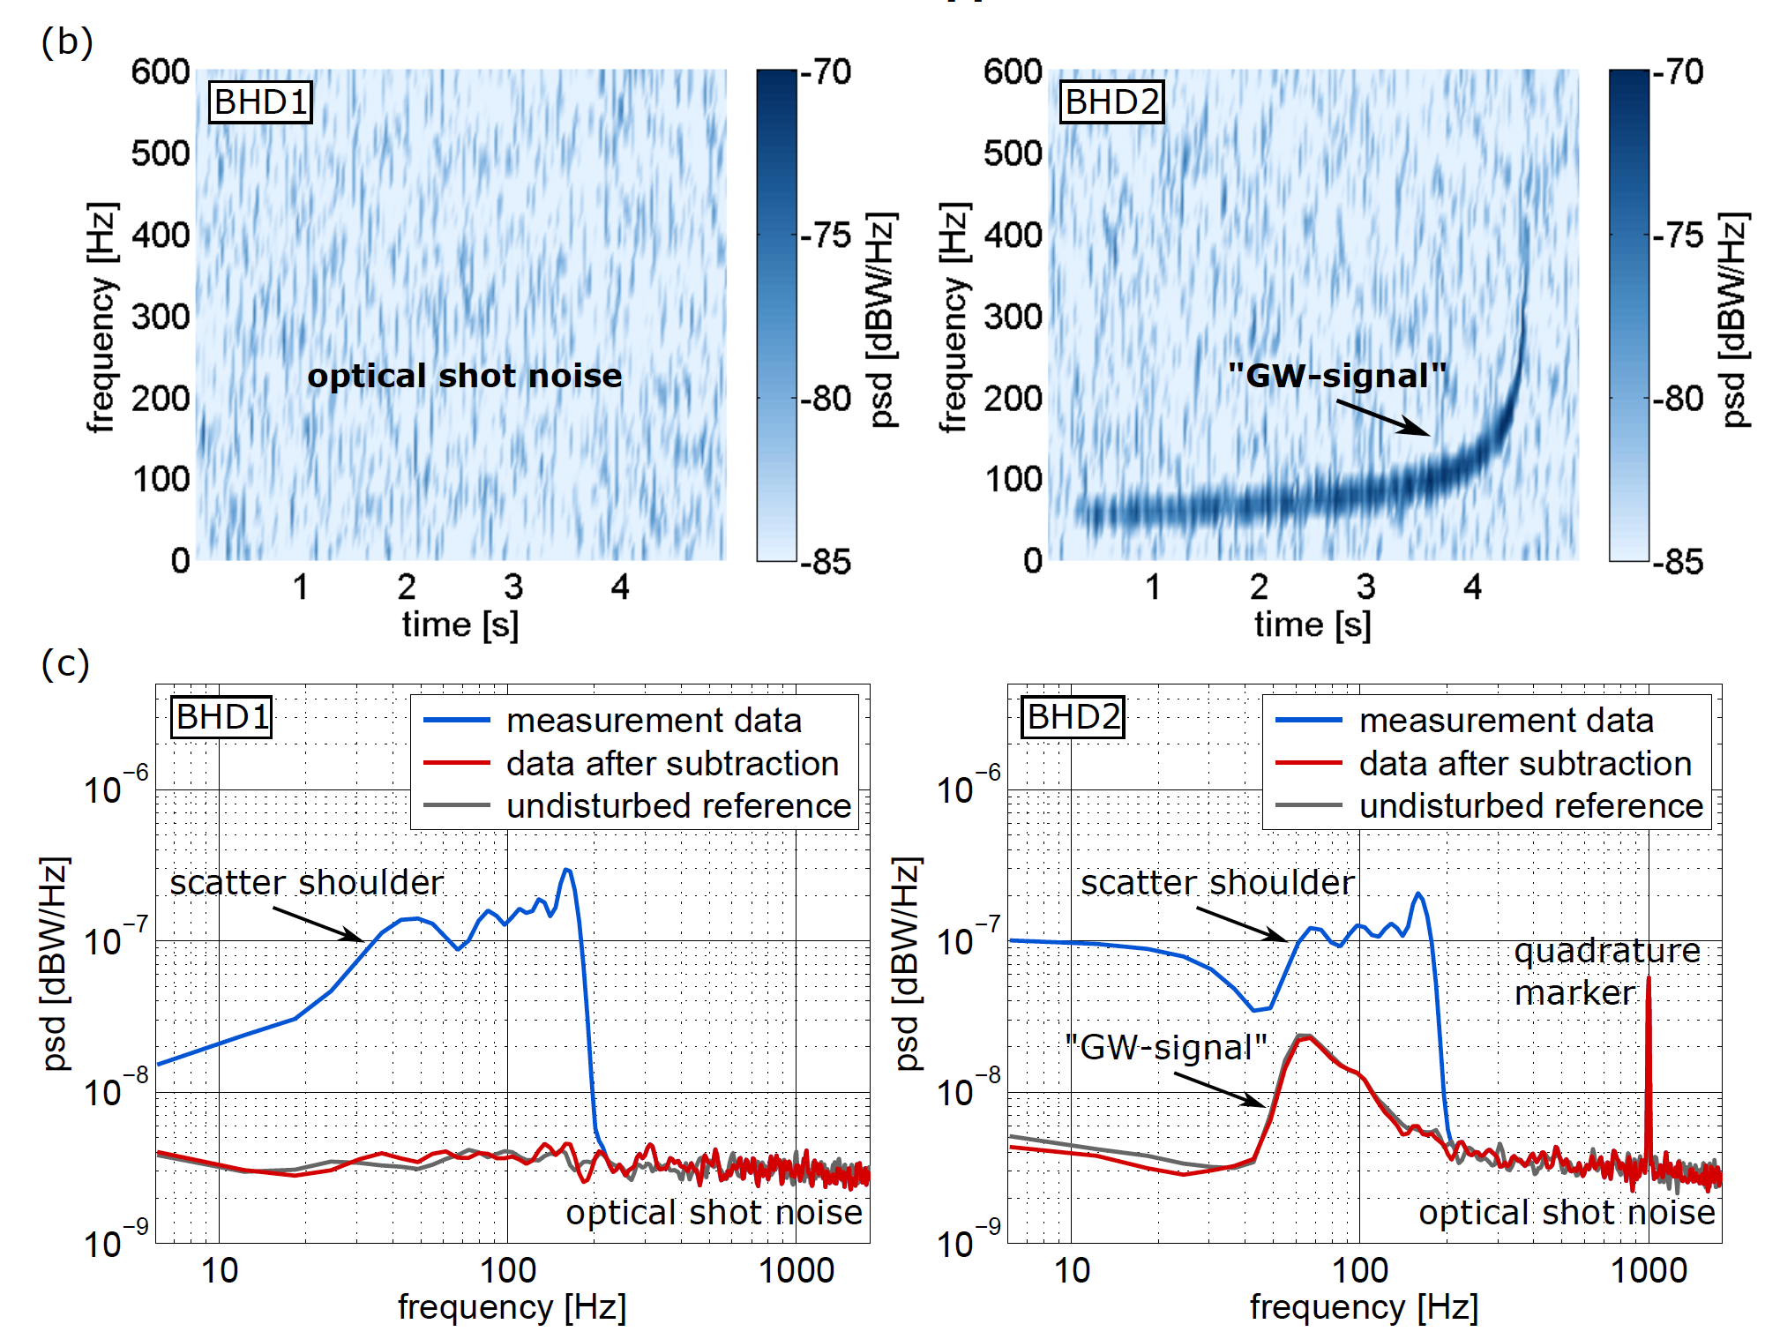
Result of scatter subtraction

Slide 18
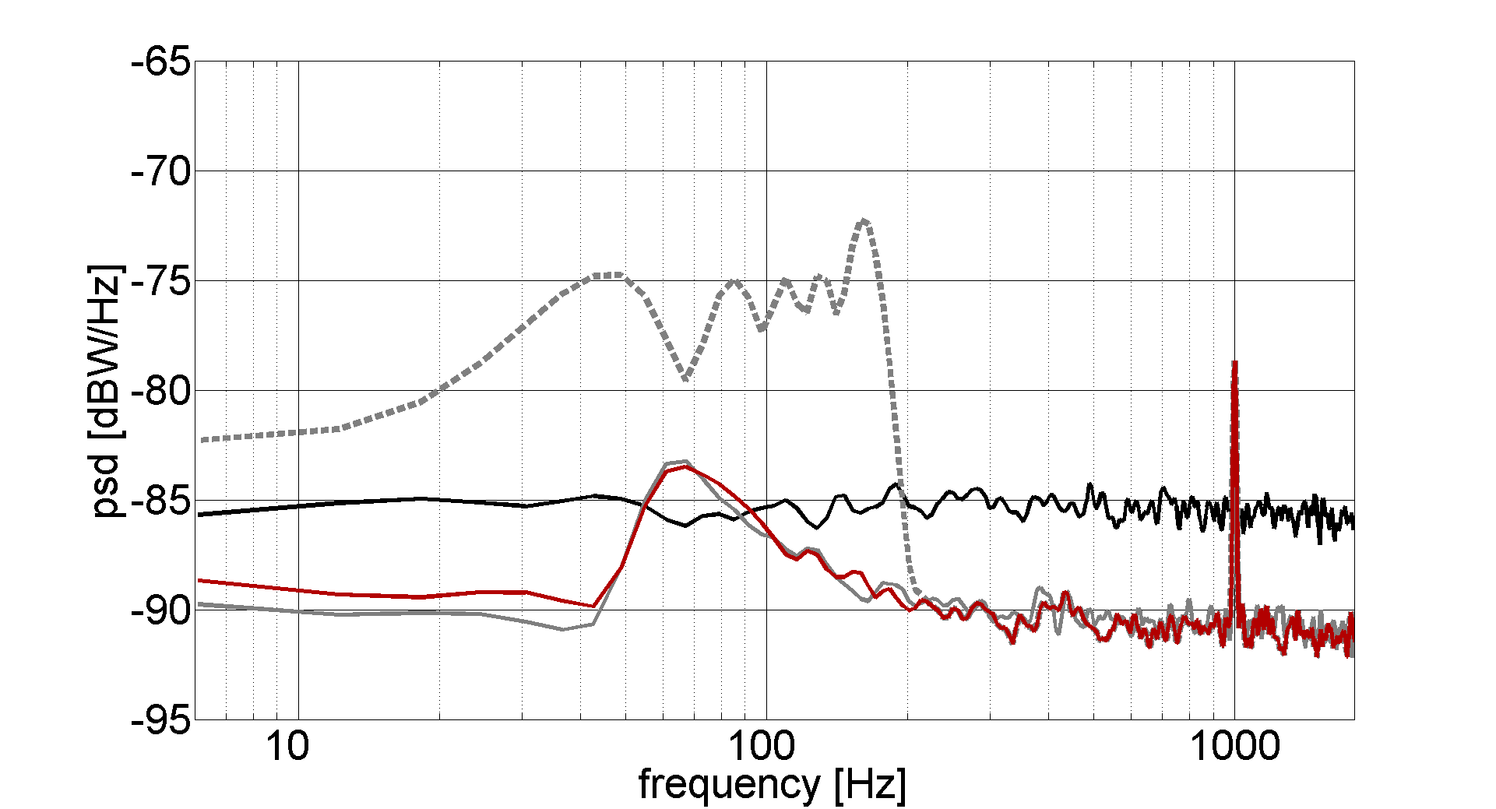
Result with quantum-dense readout
Successfully demonstrated subtraction of signals in one quadrature, by measuring projection in orthogonal quadrature
  reduction of classical noise using quantum technologies
  sub shot-noise measurement that wasn’t even shot-noise limited to begin with!
scatter shoulder
quadrature
marker
“GW” signal
shot noise
~ 5dB!
reference
(no scatter)
data after
subtraction

Slide 19
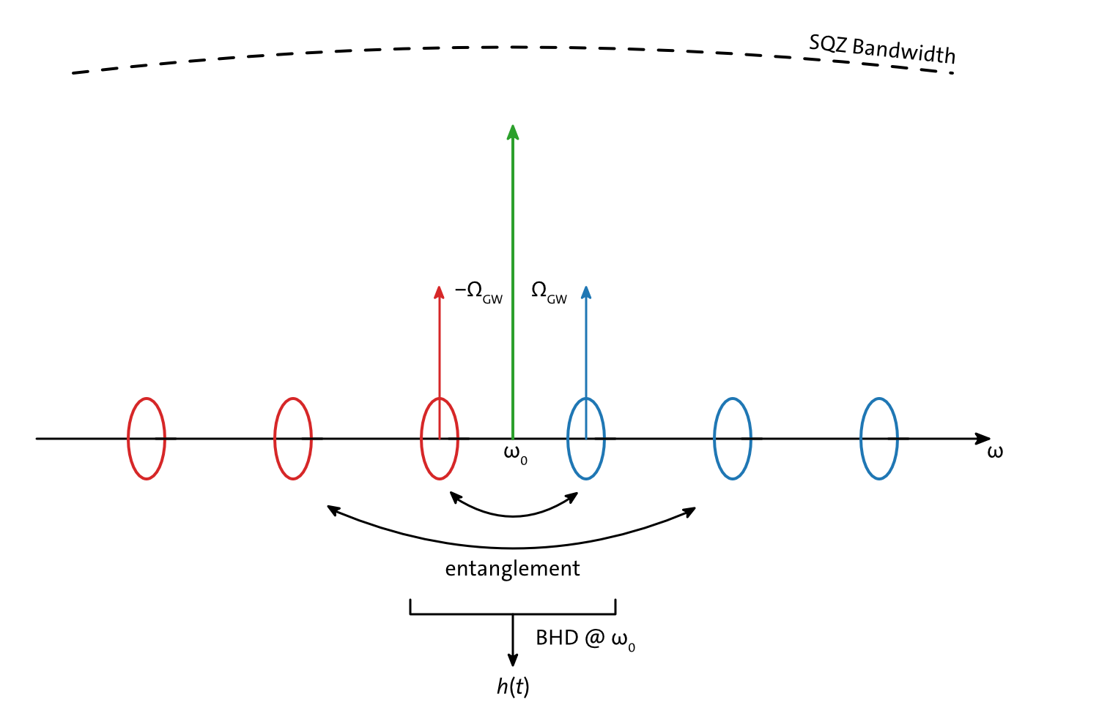
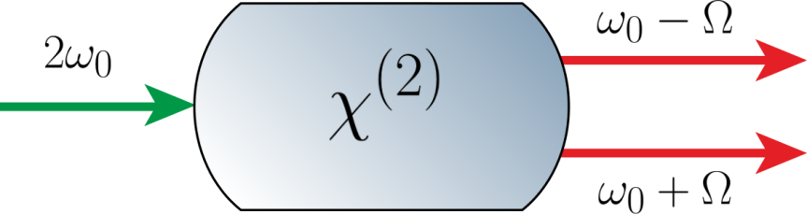
Squeezing is Entanglement of Noise Sidebands
Squeezing introduces strong noise correlations between upper and lower sidebands

Slide 20
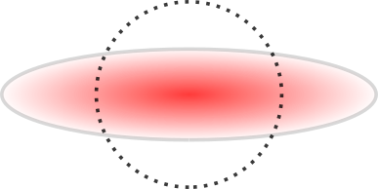
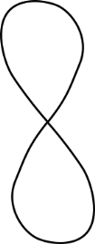


Entanglement of Noise Sidebands
Y
The two sidebands can be measured independently and then combined (conditioned) in post-processing
⇒ Conditional Squeezing
X
B. Hage Phys. Rev. A 81 (2010)
Notes:
How to produce squeezed states in the lab: Use PDC! 3-Photon process, one pump photon at the frequency 2omega is used to create two photons at omega plus/minus capital Omega
Here we have the phase space again but added a third dimension, the frequency, double-sided spectrum. We see the noise of each photon and it has more noise then a vacuum state. But we also introduced correlations (or entanglement) between the two photons indicated by plus and circle symbols. Results in a squeezed state in a single-sided spectrum

Slide 21
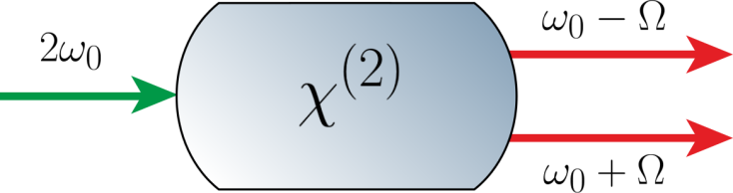
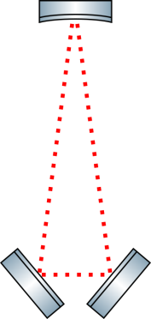




Entanglement of Noise Sidebands
signal
$$+π$$
$$+π/2$$
$$U(Ω)$$
$$U_{1}$$
idler

Slide 22
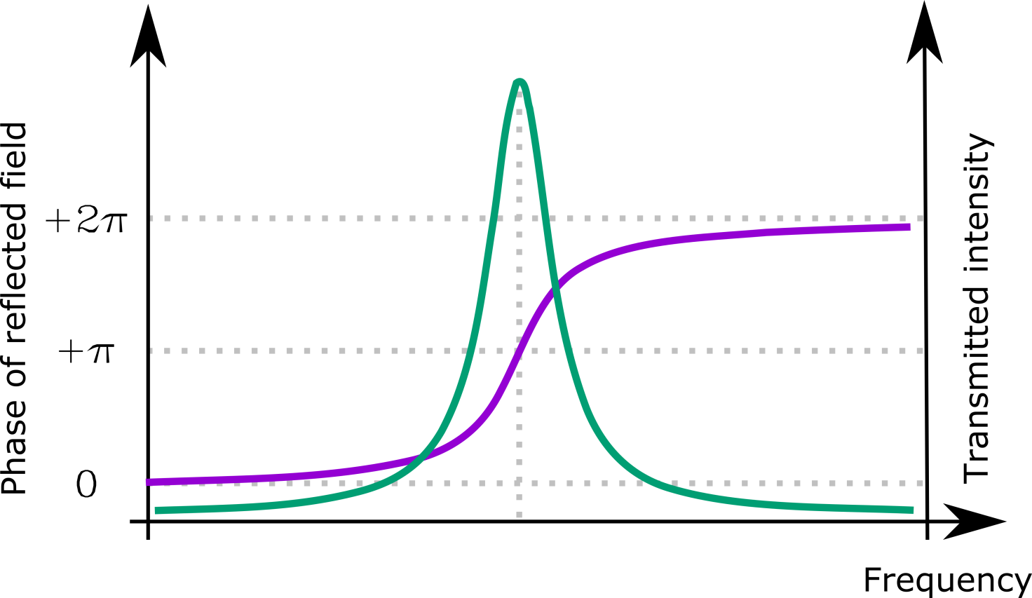
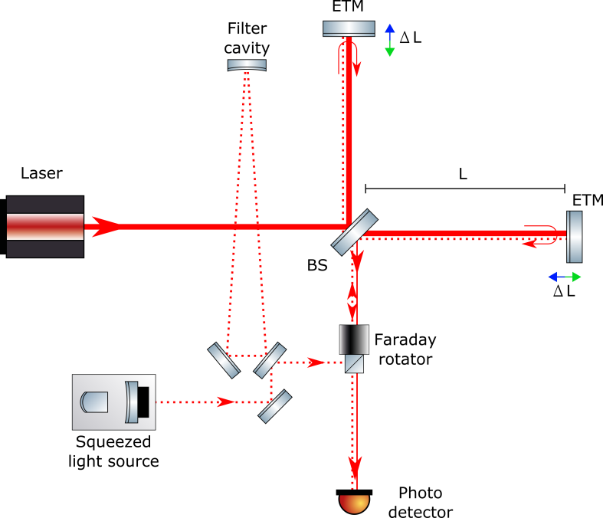
Frequency-dependent Sqz with a Filter Cavity
Kimble et al. Phys. Rev. D 65 (2001)

Slide 23
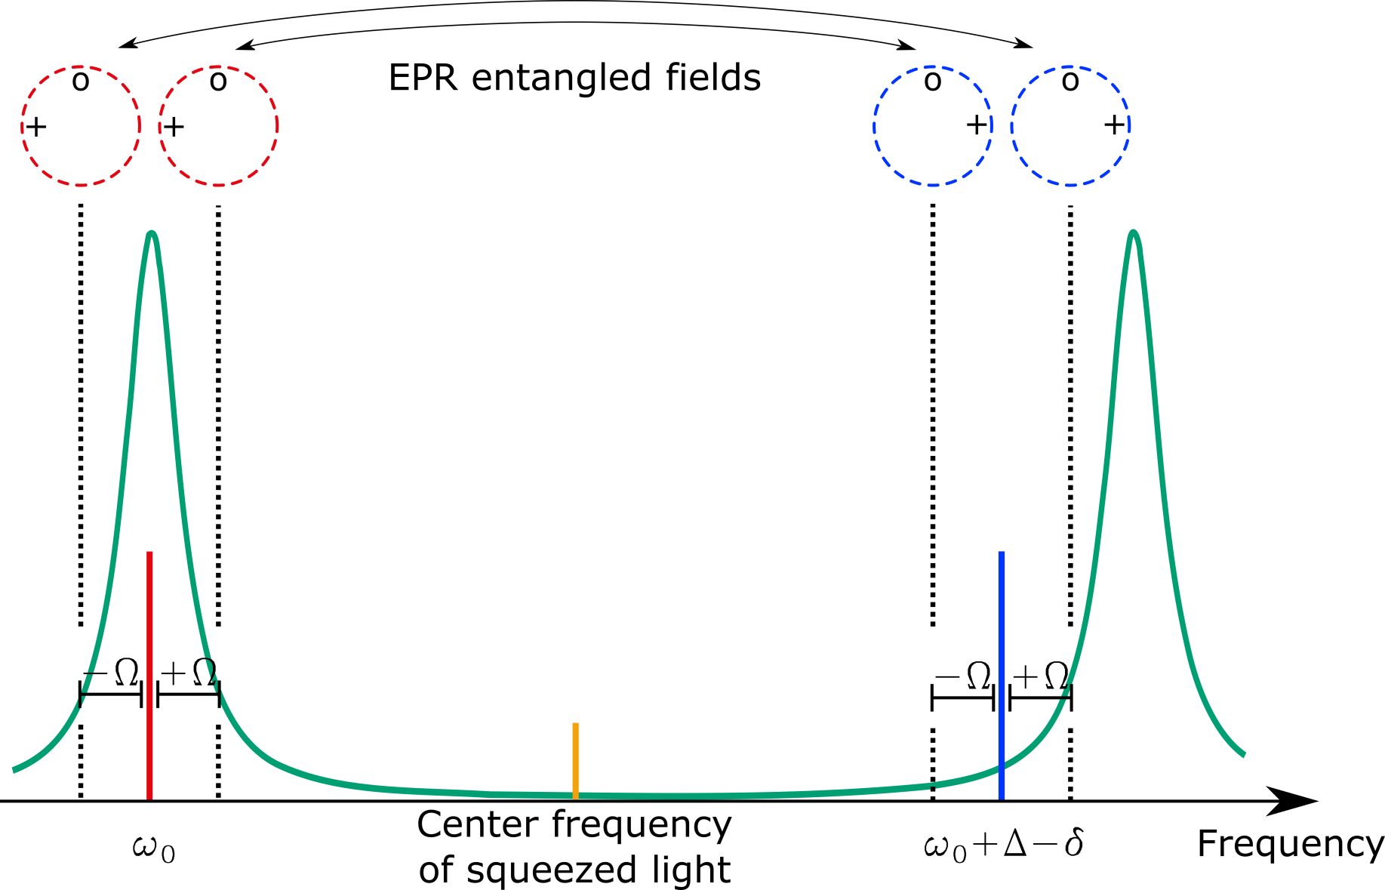
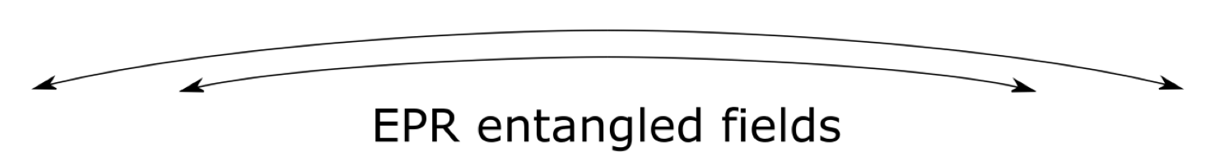
Proposal using EPR-Entanglement
Ma et al. Nature Physics 13 (8) (2017)

Slide 24
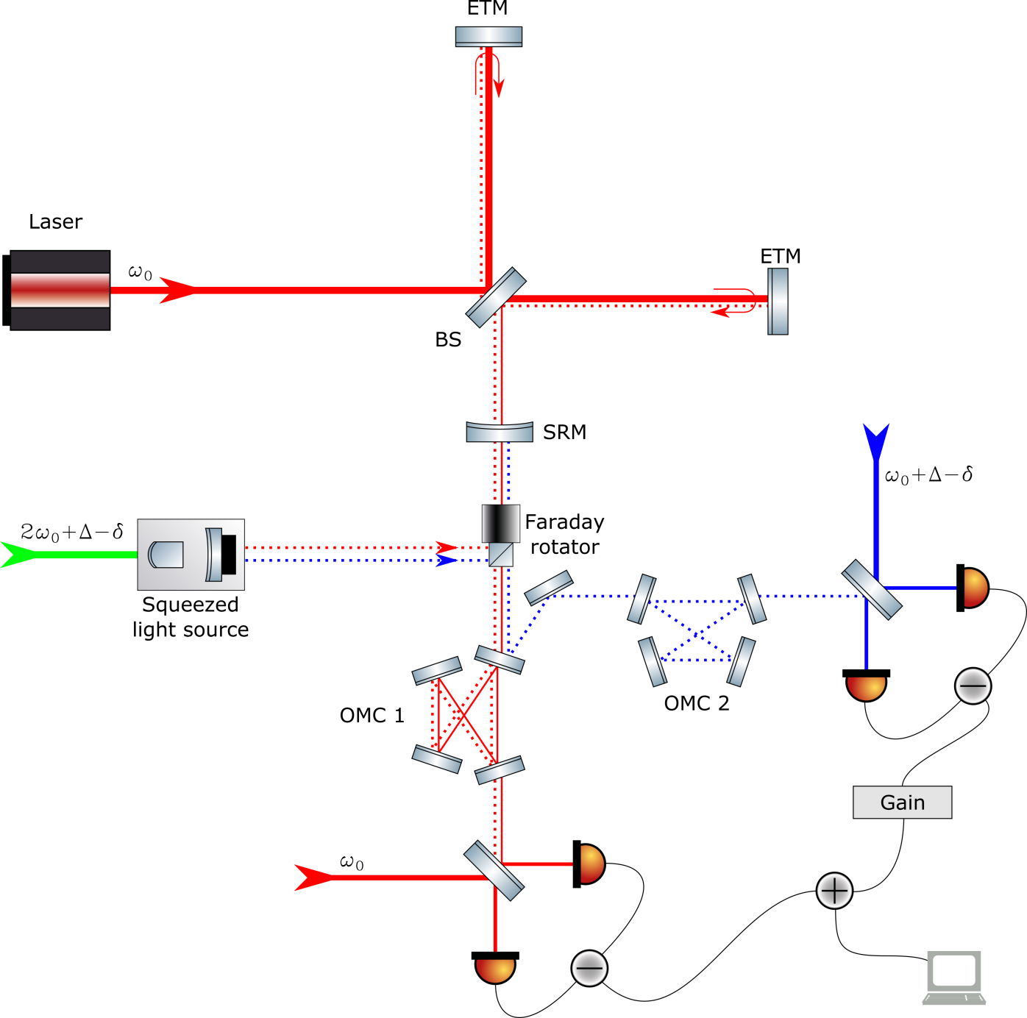
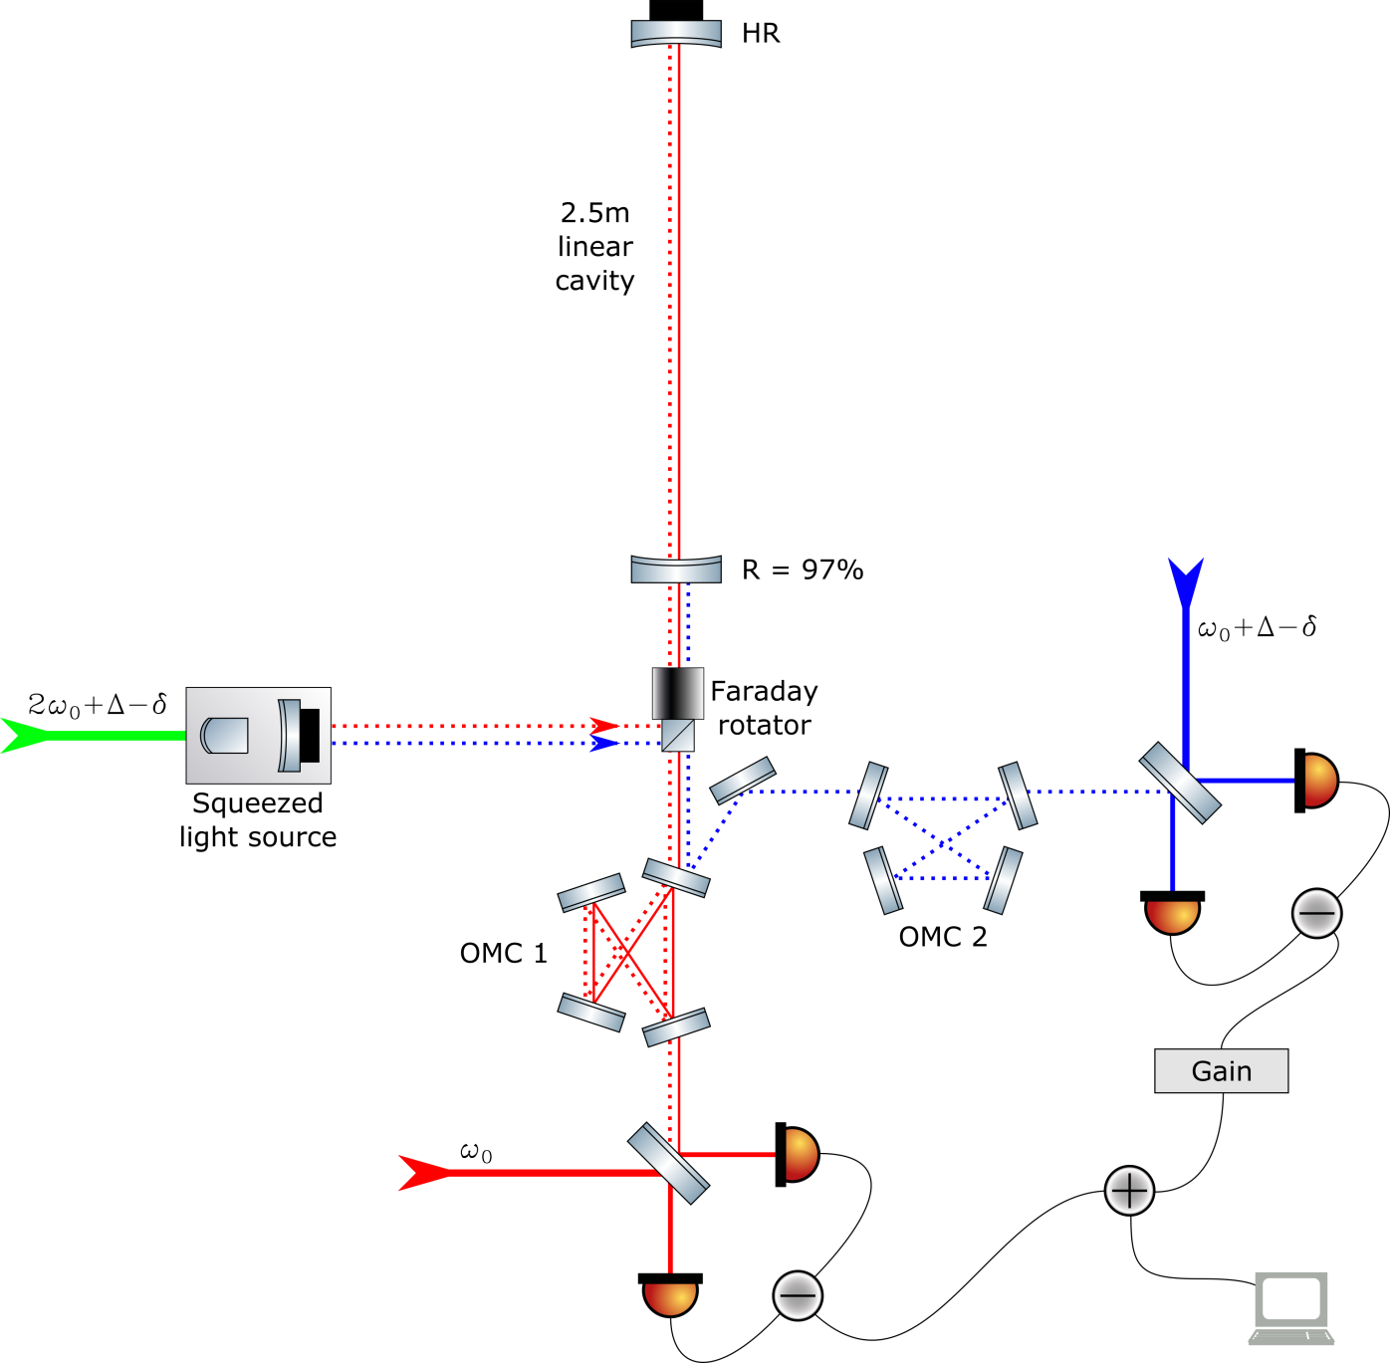
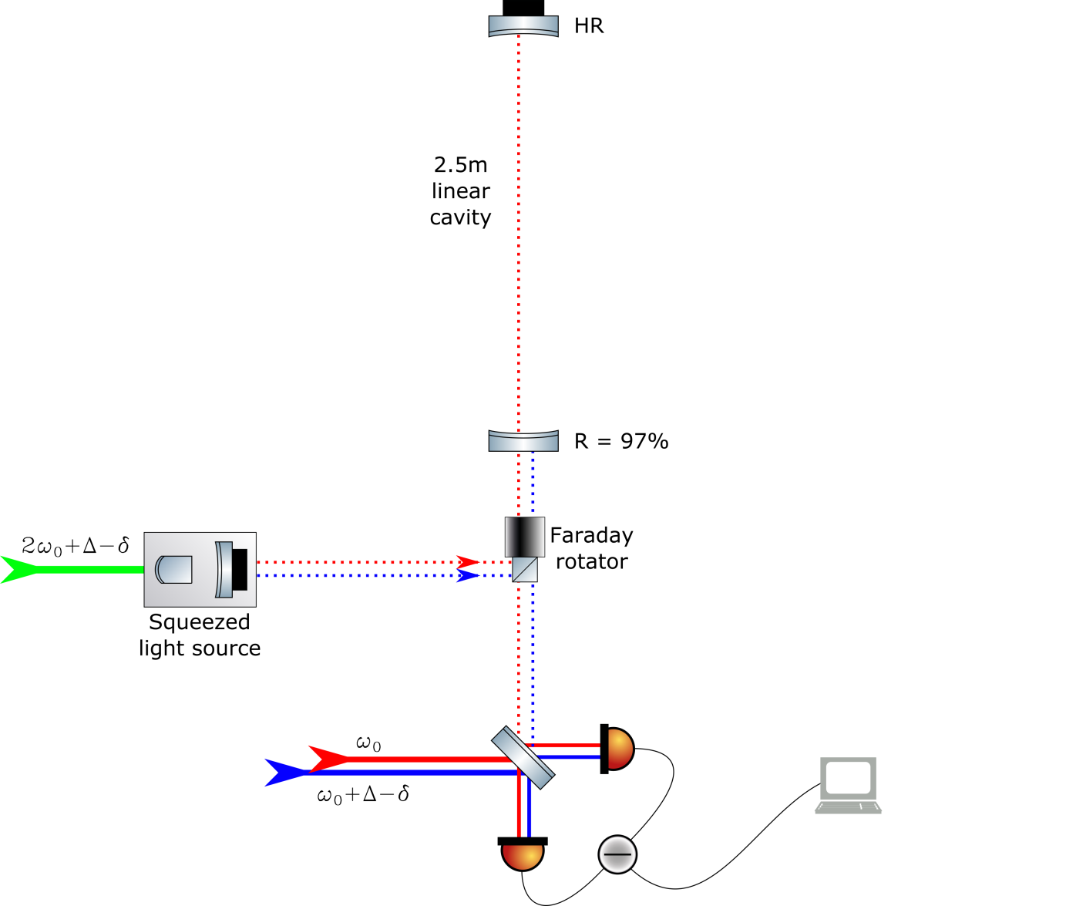
Experimental Realisation

Slide 25
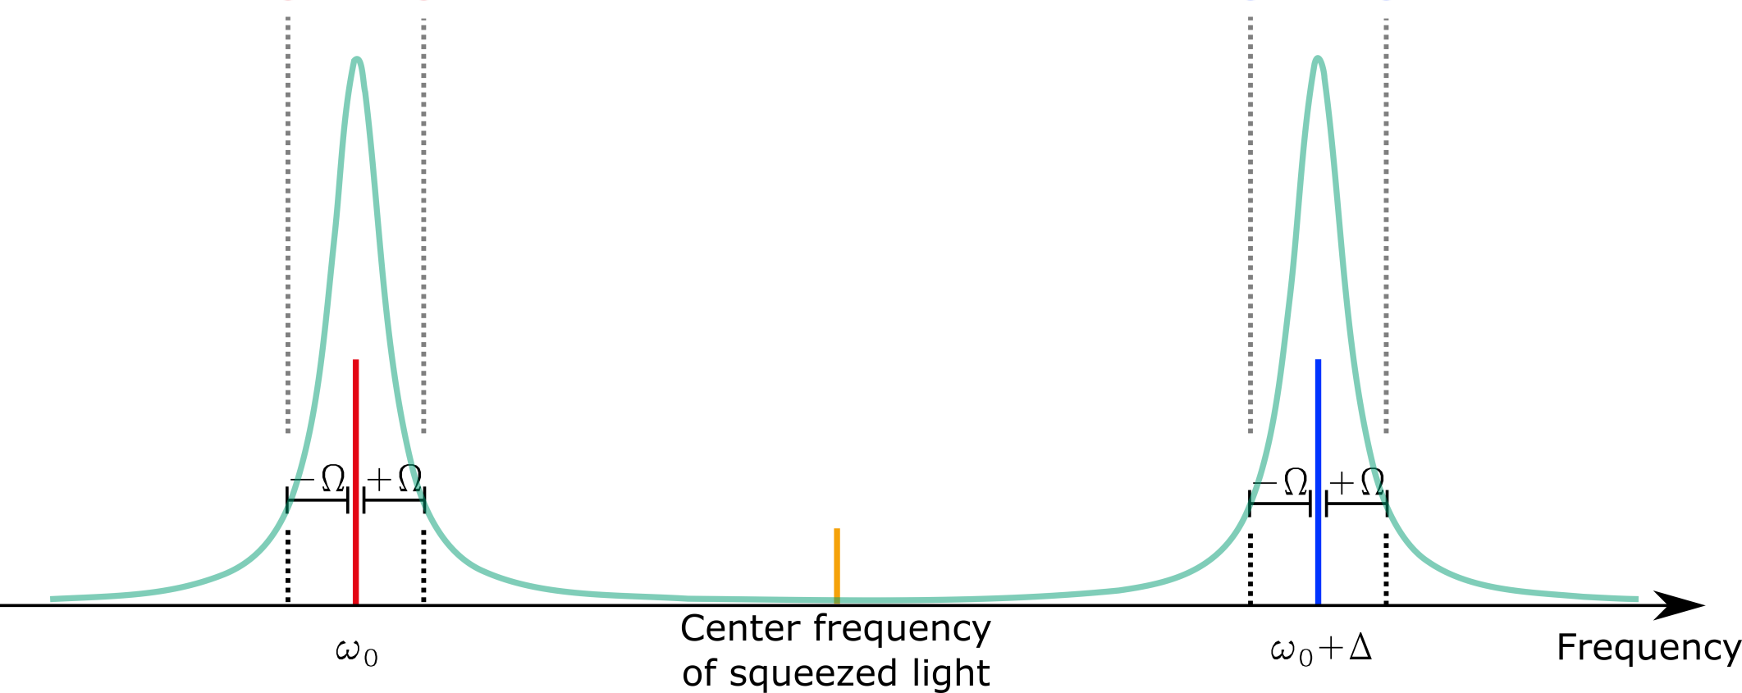
Results – No Detuning

Slide 26
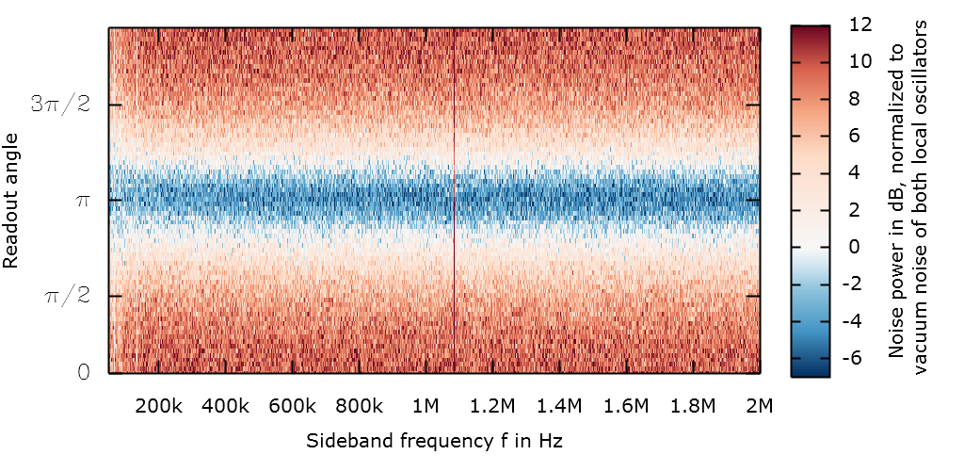
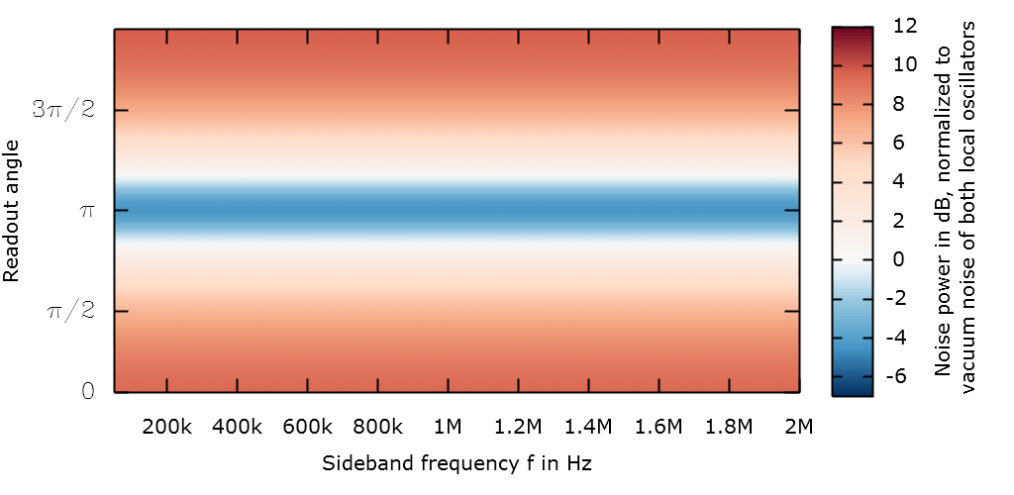
Results – No Detuning
Measurement
Fitted model

Slide 27
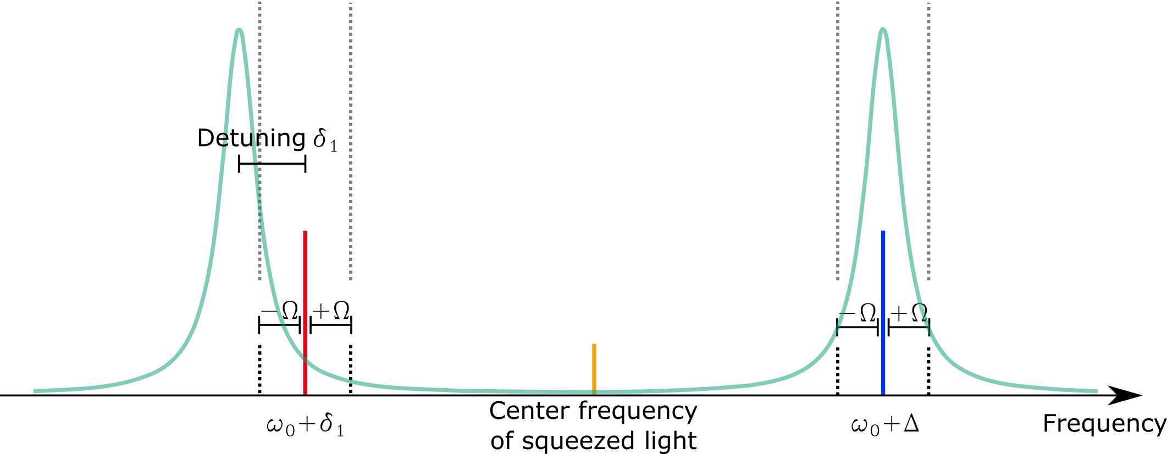
Results – Emulating Frequency Dependence

Slide 28
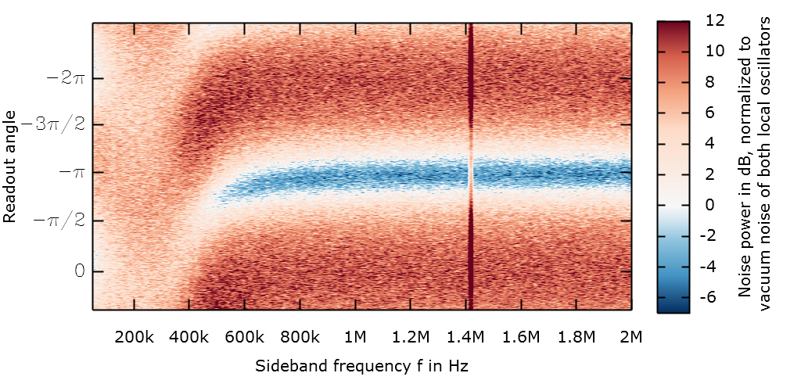
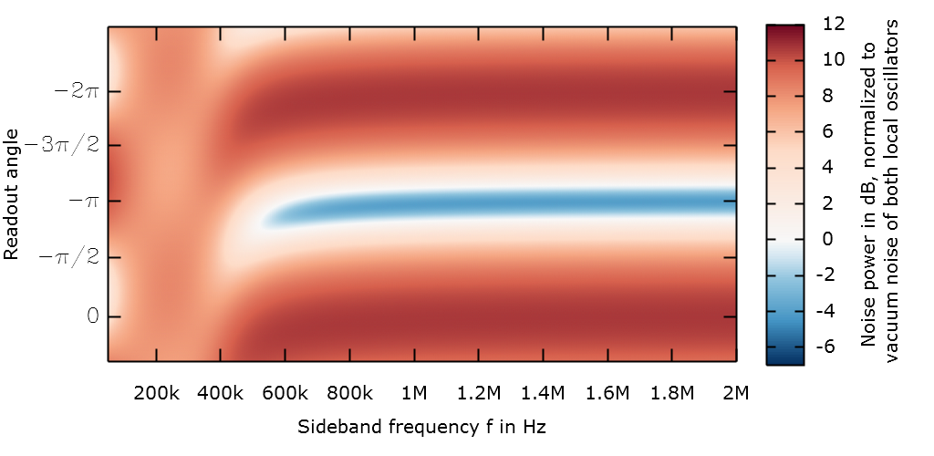
Results – Emulating Frequency Dependence
Measurement
Fitted model

Slide 29
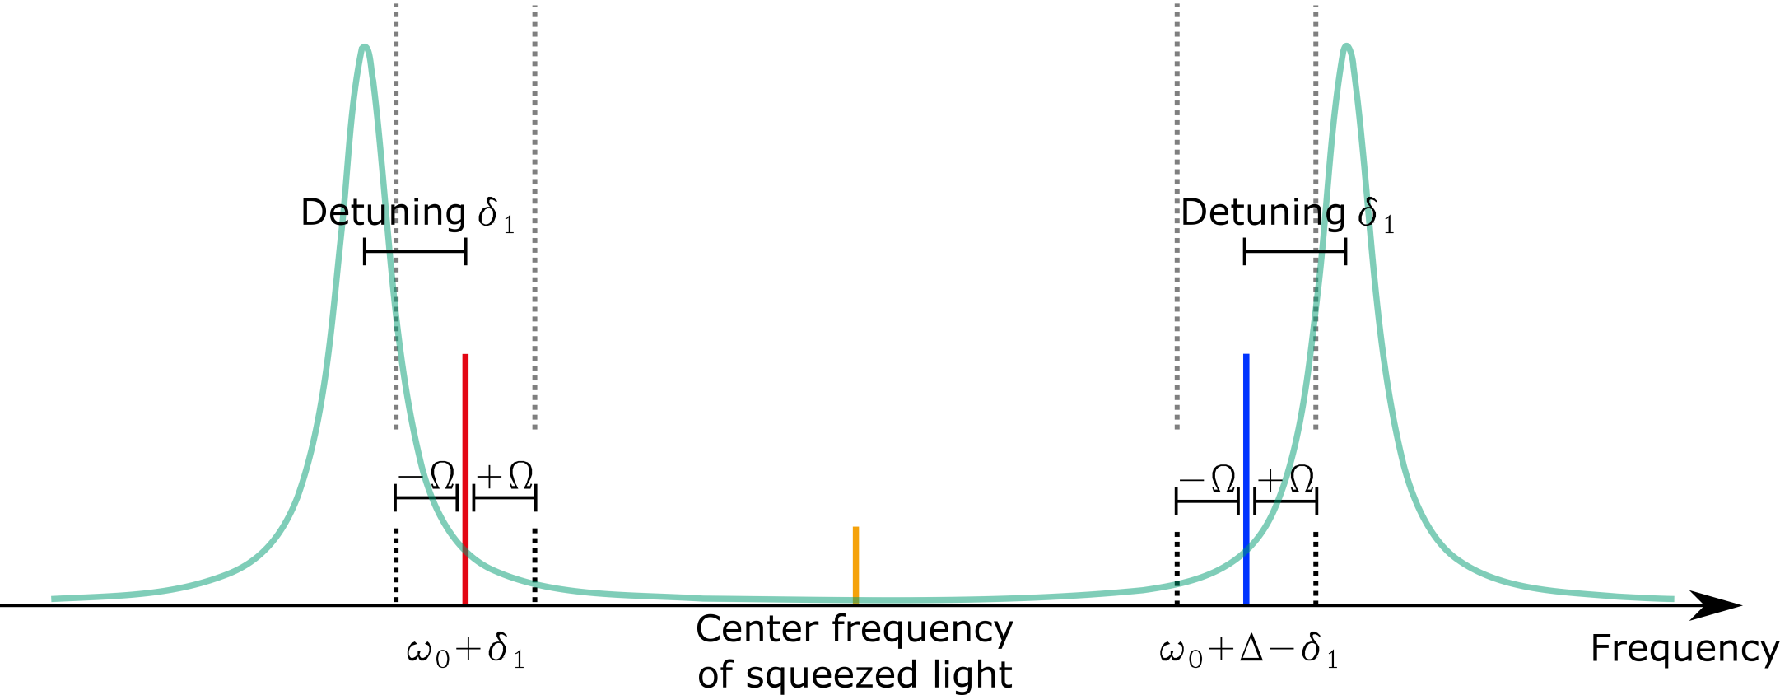
Results – Compensating Frequency Dependence

Slide 30
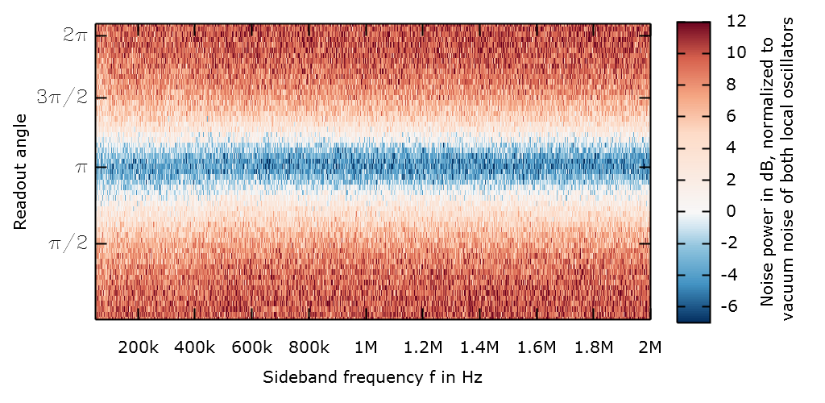
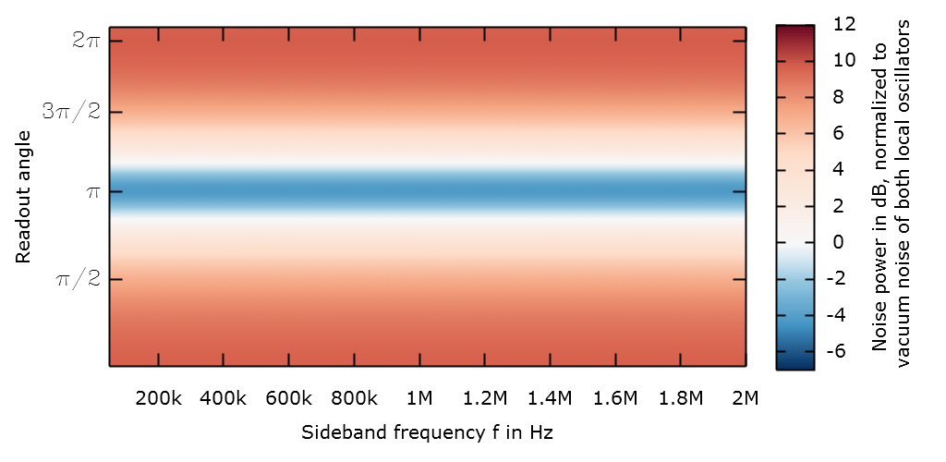
Results – Compensating Frequency Dependence
Measurement
Fitted model

Slide 31
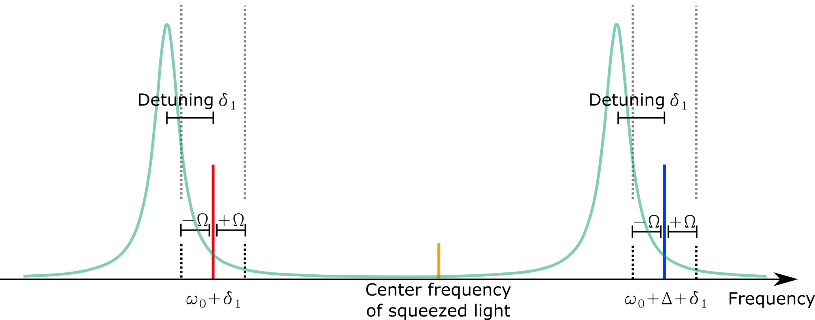
Results – Symmetric Detuning

Slide 32
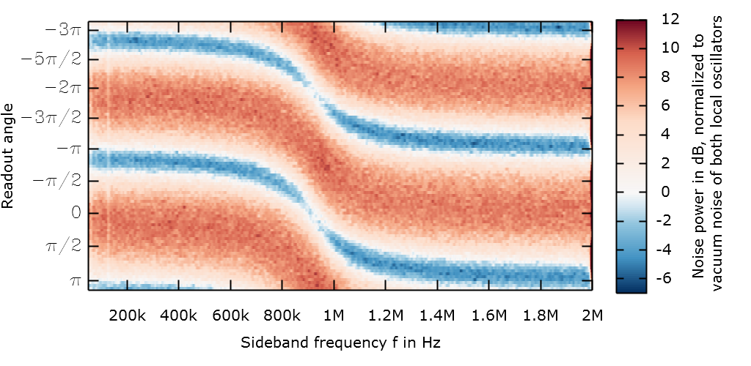
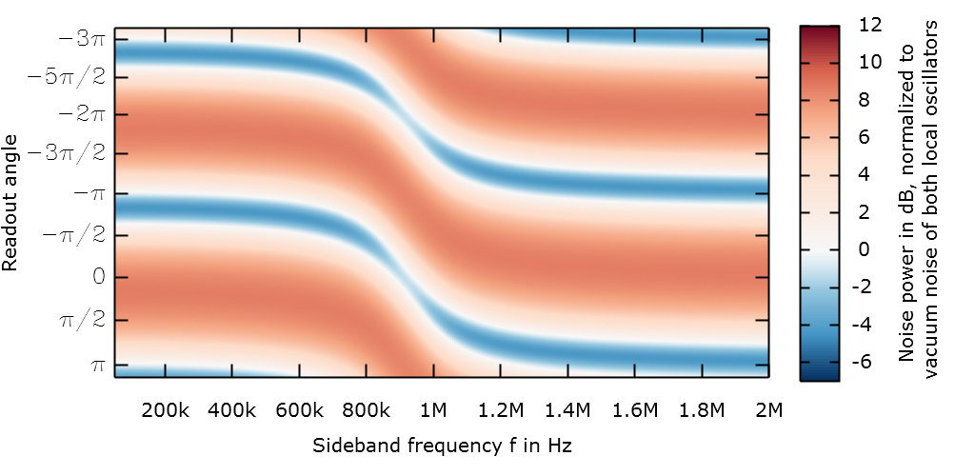
Results – Symmetric Detuning
Measurement
Fitted model

Slide 33
Summary
The strong correlations inherent to entangled states of light allow for new approaches in precision interferometery
With Quantum-Dense Metrology, two conjugate observables can be read out with sub-shotnoise accuracy, even in the presence of classical noise
Exploiting the entanglement inherent to squeezed light, a higher longitudinal mode of the signal-recycling cavity can be used as a frequency-dependent filter (conditional squeezing), replacing an additional filter cavity
We have demonstrated Quantum-Dense Metrology and Conditional Squeezing in table-top experiments and verified their feasibility

