Slide 1
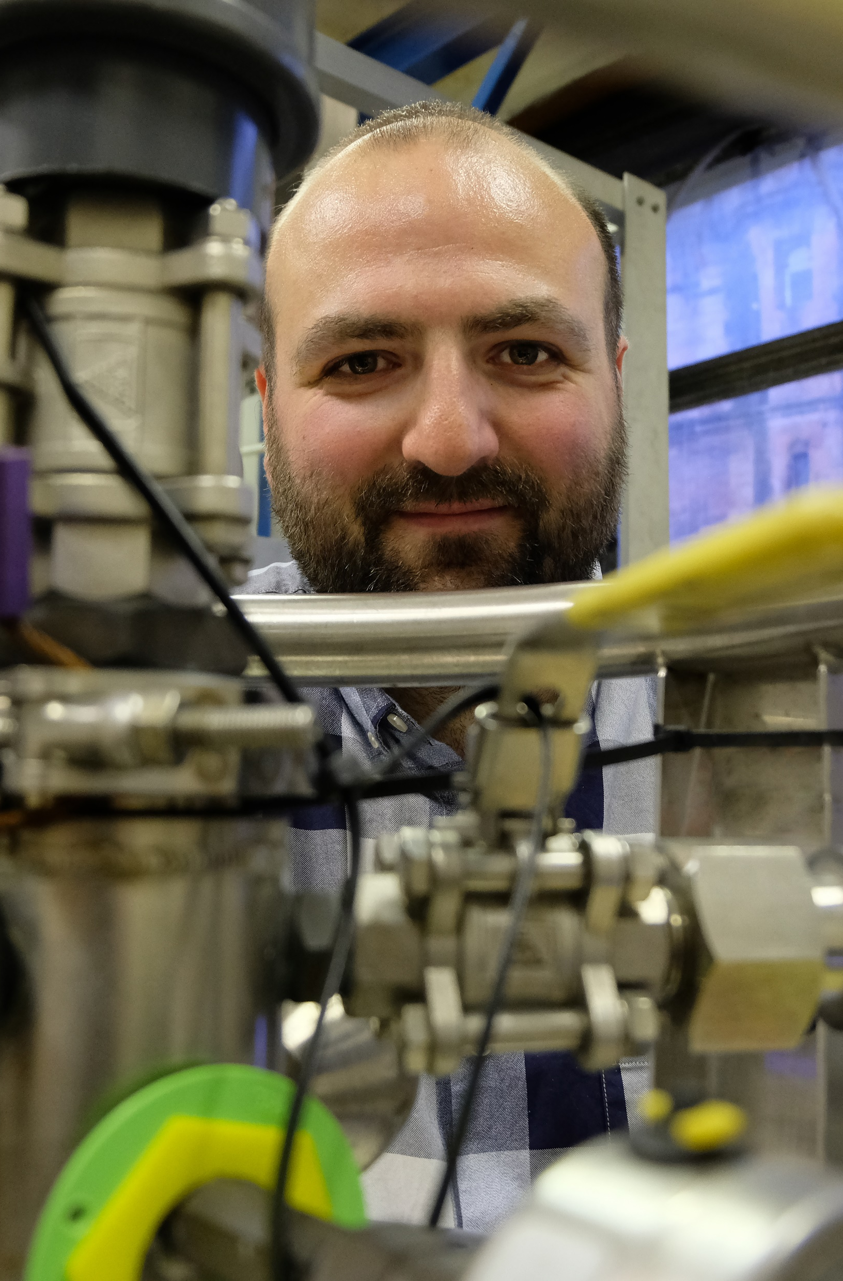



Multimaterial Coatings for
3rd Generation Gravitational
Wave Detectors
Dr Peter G. Murray
Research Fellow
Institute for Gravitational Research

Slide 2


Peter Murray
on behalf of
Jessica Steinlechner
Iain Martin
Simon Tait
Maya Kinley-Hanlon
Graeme McGhee
Sheila Rowan
Jim Hough
Jessica Steinlechner
Lukas Terkowski
Felix Pein
Roman Schnabel

Slide 3

Content
Introduce multi-material coatings
Absorption at 2µm
Room temperature mechanical loss measurements
Cryogenic mechanical loss measurements
What do we know so far?
Future Plans

Slide 4
Background
Silica/(doped) tantala is the coating of choice in current advanced gravitational wave detectors
e.g. low absorption and relatively low mechanical loss
However, the thermal noise performance (due to mechanical loss) will be a limiting factor in their operating sensitivities
Amorphous silicon (a-Si) has been shown to have very low mechanical loss
Unfortunately, it has much higher absorption than both silica and (doped) tantala
So, can we design a coating which can take advantage of the low mechanical loss of a-Si while still using silica/tantala layers to keep low absorption?

Slide 5
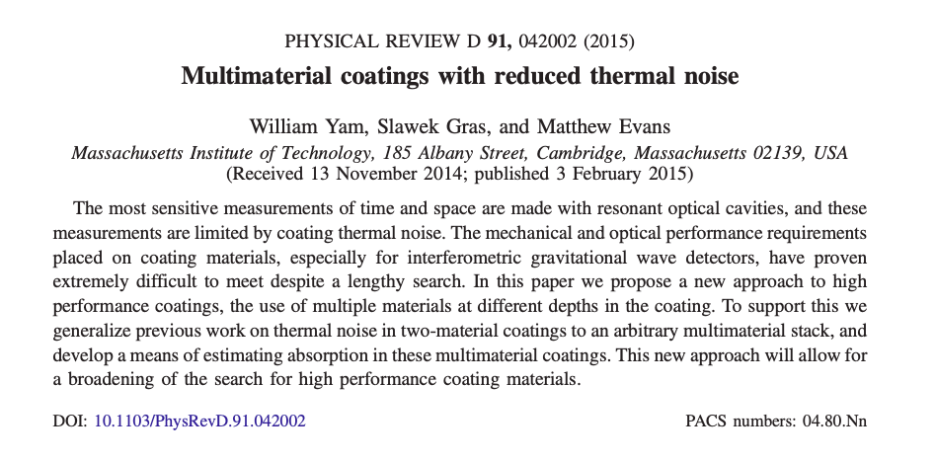
Background

Slide 6
Background
Since those 2015 papers we have learned:
The optical absorption of ion-plated coatings is ~ 3× lower than for IBS a-Si (at their optimum heat treatment)
The optical absorption (at their optimum heat treatment) of ion-plated a-Si is ~7× lower at 2 μm than at 1550 nm
At 2 μm the absorption also can be reduced by at least 70 % with cryogenic cooling
(reduction with cooling previously shown for IBS a-Si at 1550 nm by A. Markosyan)
The cryogenic mechanical loss of as-deposited ion-plated silica found to be lower than IBS silica (R. Robie thesis)
Designed a multi-material coating, deposited using ion-plating, and optimised for use at 2 μm

Slide 7
Multimaterial coating design

Slide 8
Multimaterial coating design
 | a-Si | SiO₂ | Ta₂O₅ | SiO₂
Lower | 5 | 5
Upper |  |  | 5 | 5
Full | 5 | 5 | 5 | 5

Slide 9
Absorption at 2 µm

Slide 10
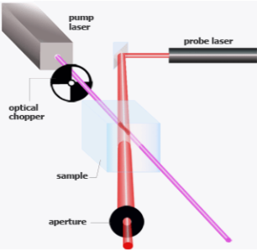
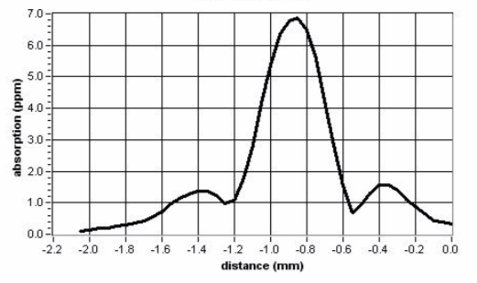
Absorption at 2 µm
Absorption measured using a Photothermal Common-Path Interferometer
                Peak shows the level of coating absorption

Slide 11
Absorption at 2 µm
Previous work by J. Steinlechner (Phys. Rev. Lett. 120, 263602) also showed a minimum in the absorption of ion-plated deposited a-Si at ~500 °C

Slide 12
Room Temperature Mechanical Loss

Slide 13
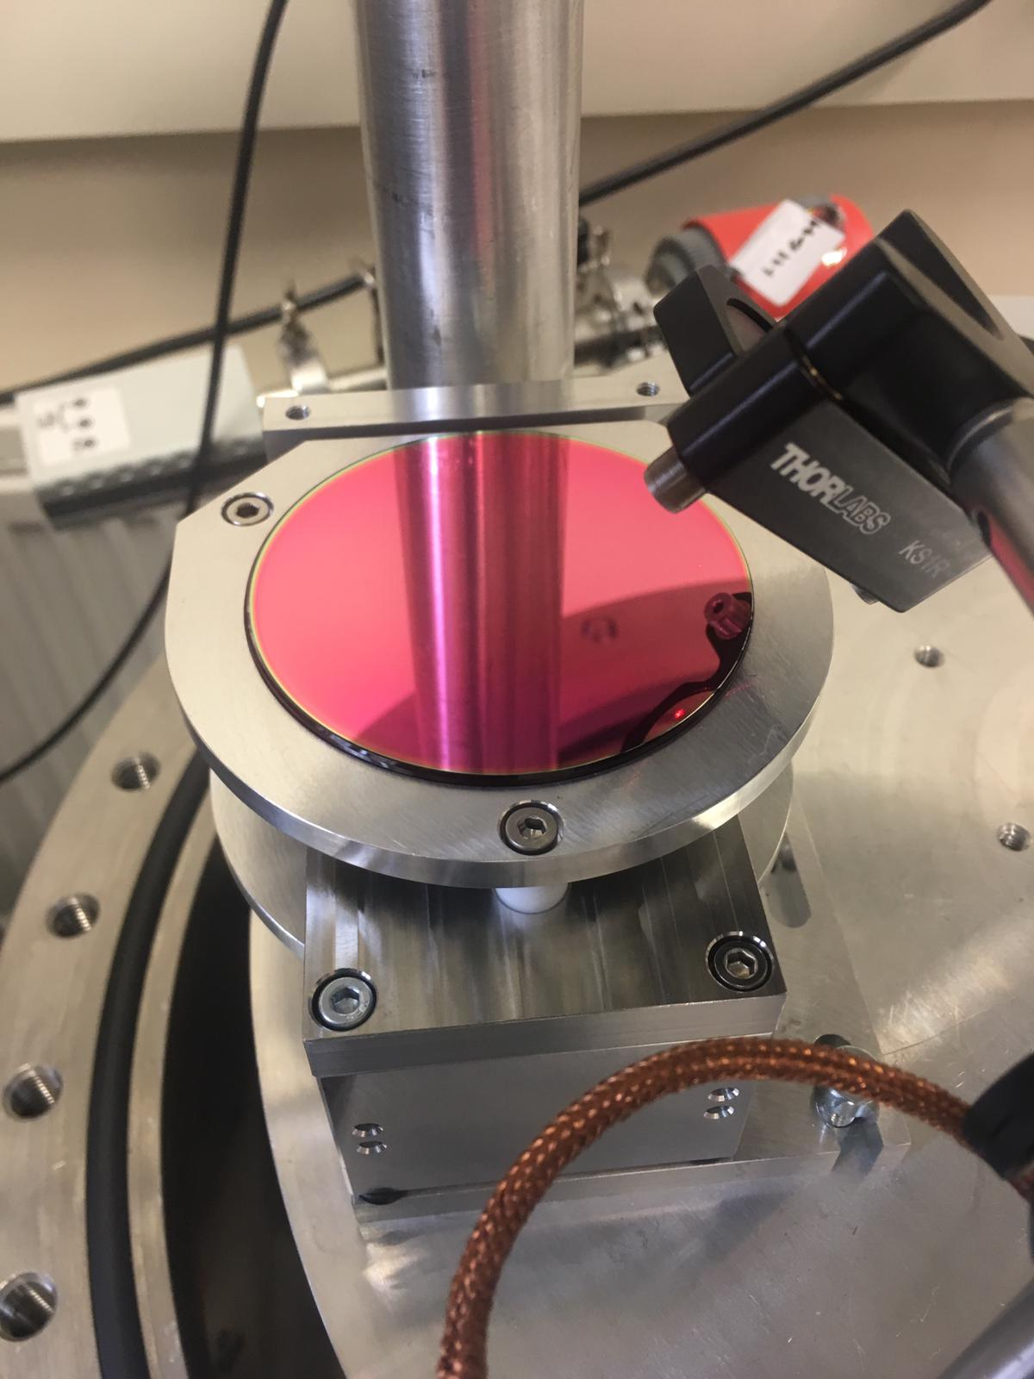
Mechanical loss samples
 | a-Si | SiO₂ | Ta₂O₅ | SiO₂
Lower | 5 | 5
Upper |  |  | 5 | 5
Full | 5 | 5 | 5 | 5
3in silica discs
For measurement on GeNS
[Cessarini, E. et al.
Rev.Sci.Instrum.80 (2009), 053904]
Silica cantilevers
For room temperature mechanical loss and stress measurements
Silicon cantilevers
For cryogenic mechanical loss measurement
2in Silicon discs
For cryogenic mechanical loss measurement

Slide 14
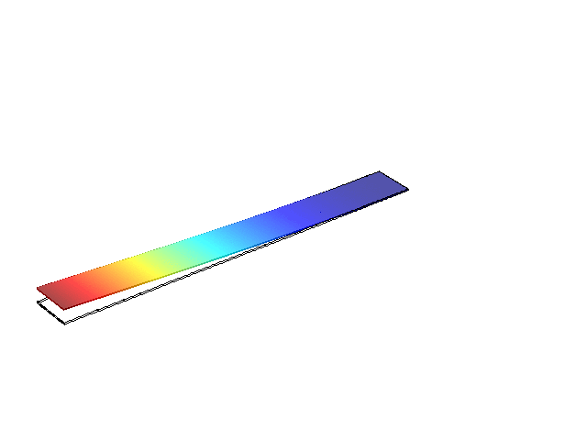
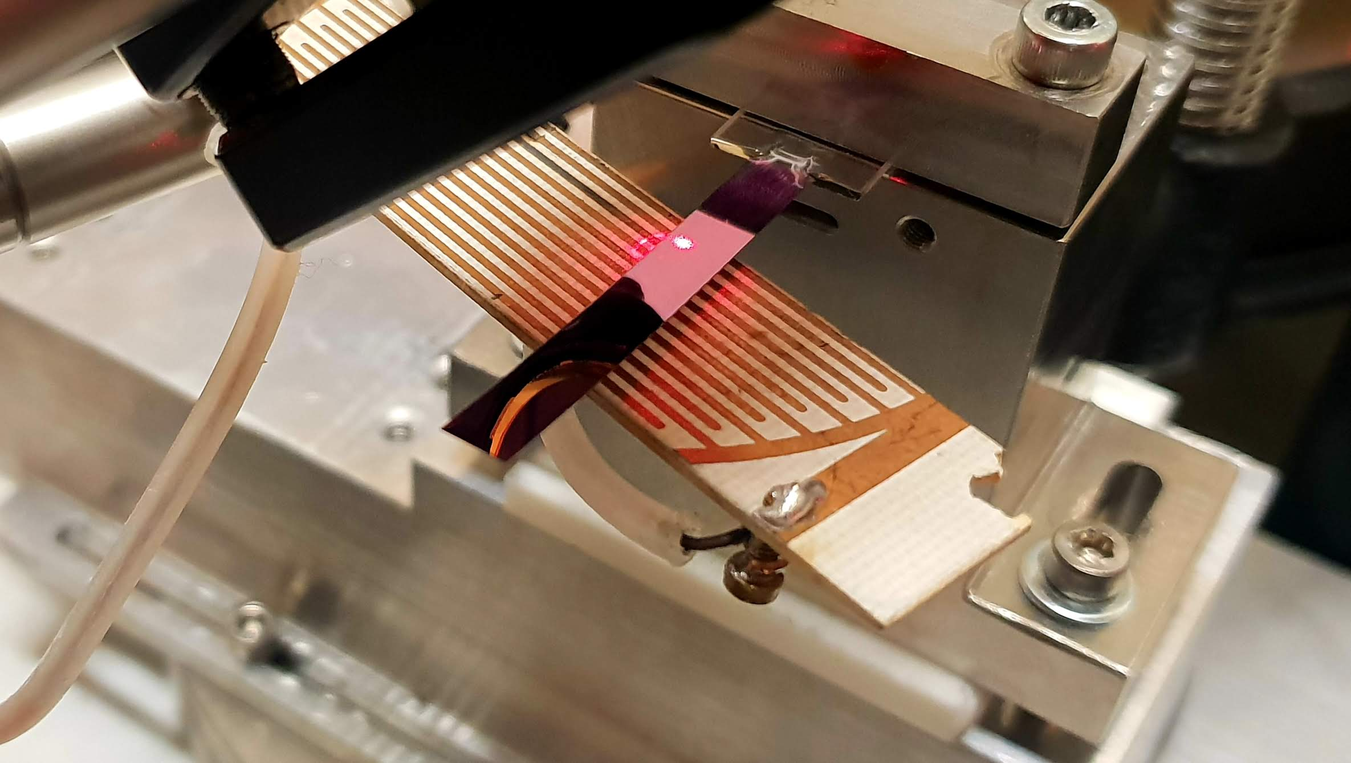
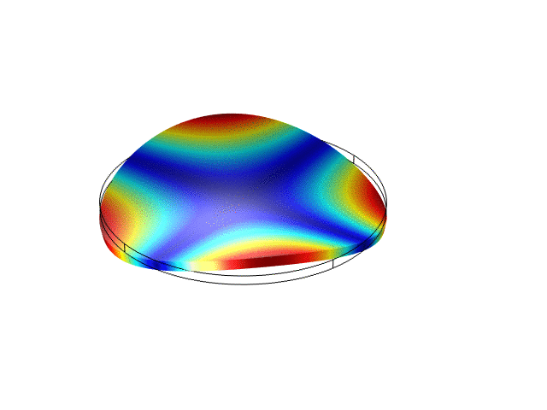

Mechanical loss measurements
Cantilevers are held tightly on a thicker “clamping” block
Discs are balanced on a convex lens at the centre of the GeNS
System is pumped down to high vacuum <10⁻⁶ mBar
Laser light is shone onto the surface of the samples and reflected onto a quad photodiode
Samples are electrostatically driven at resonance via drive place placed nearby
The ring down is recorded
$$A\left(t\right)=A_{0} e^{−π{ ʄ}_{0 }ф t}$$

Slide 15
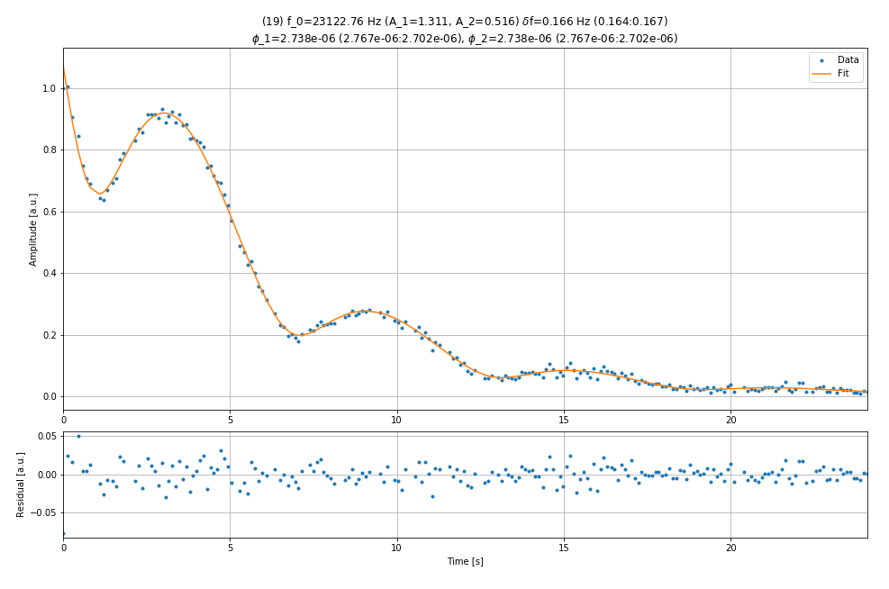
Room Temperature Measurements
Full Stack Ta₂O₅/SiO₂/aSi
Developed a new python script to better deal with degenerate modes
Here ~δf = 0.16 Hz
Preliminary

Slide 16
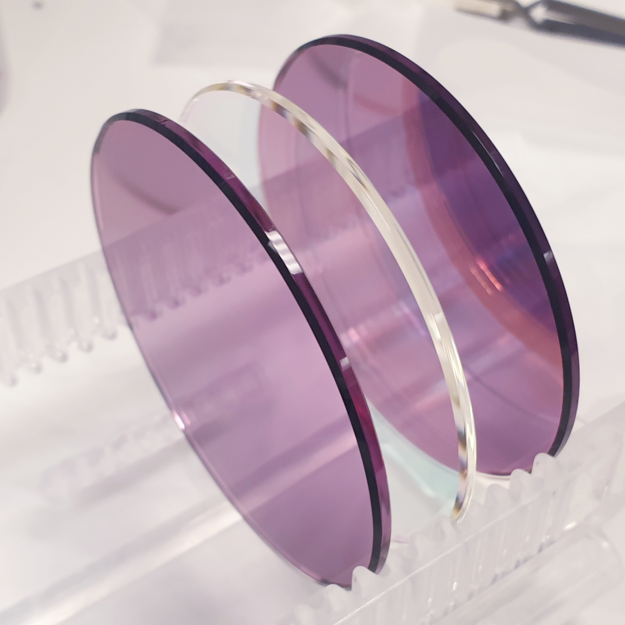
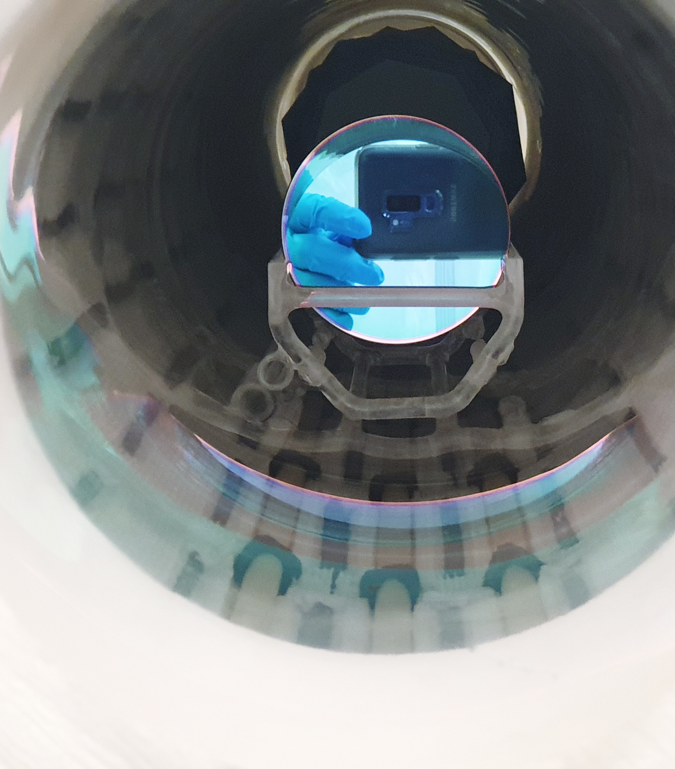
Heat treatment of samples to
300, 400 and 500 °C

Slide 17
Room Temperature Measurements
Full Stack Ta₂O₅/SiO₂/aSi
Preliminary

Slide 18
Room Temperature Measurements
Full Stack Ta₂O₅/SiO₂/aSi
Preliminary

Slide 19
Room Temperature Measurements
Full Stack Ta₂O₅/SiO₂/aSi
Preliminary

Slide 20
Average coating loss
after increased heat treatment

Slide 21
Average coating loss
after increased heat treatment

Slide 22
Average coating loss
after increased heat treatment

Slide 23
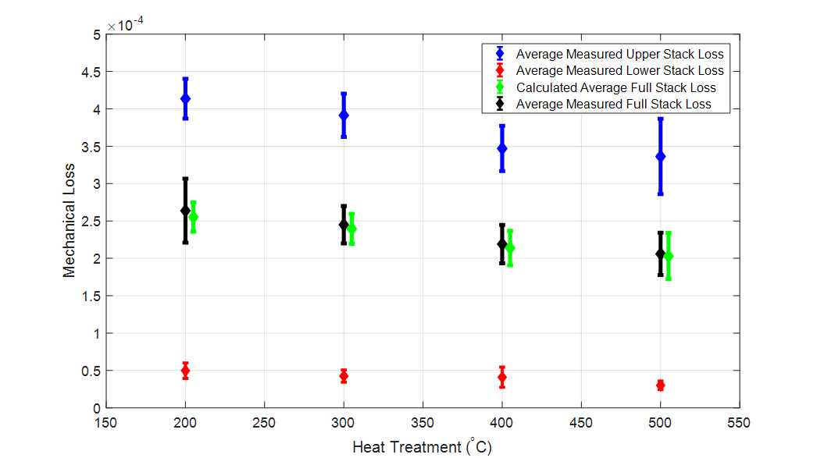
Average coating loss
after increased heat treatment
Measurement of mechanical loss of
550, 600 °C + heat treatments currently underway

Slide 24
Cryogenic Mechanical Loss

Slide 25
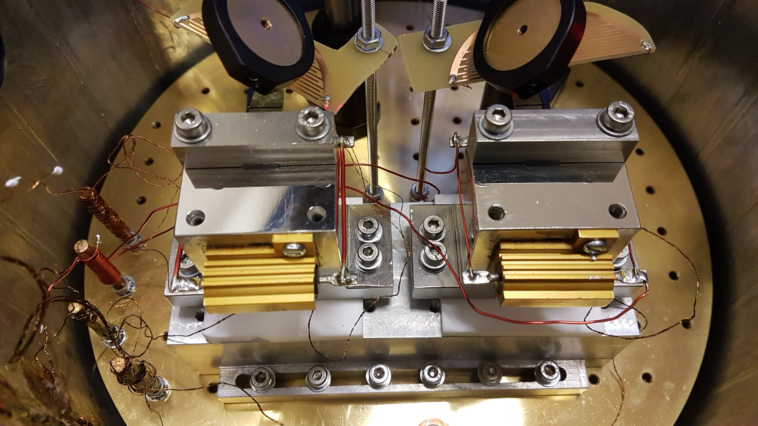
Cryogenic Mechanical Loss
Dual experimental set up
Simultaneous 2× silicon cantilever measurements

Slide 26
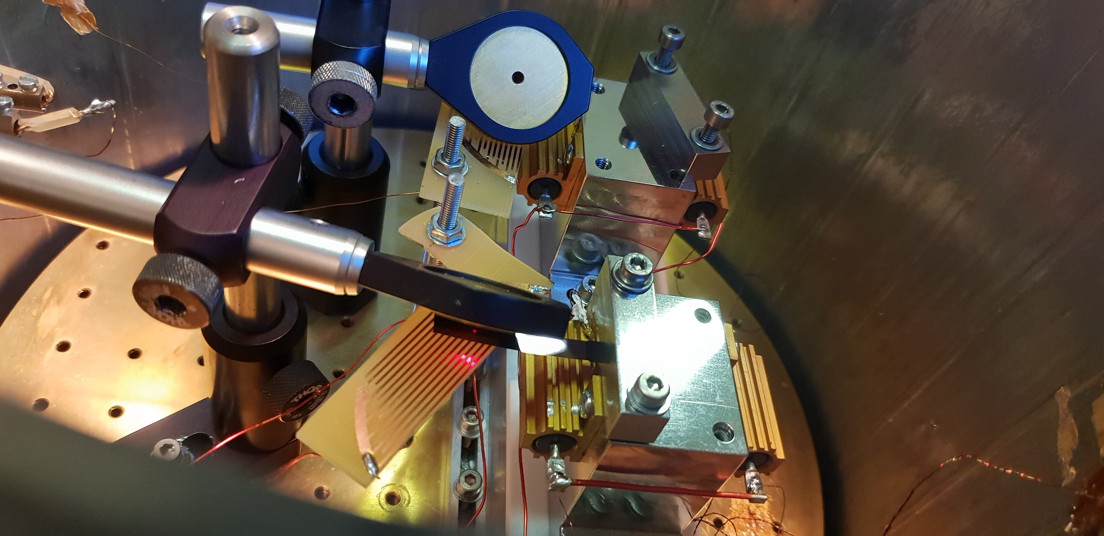
Cryogenic Mechanical Loss
2× independent read out systems
Liquid cryogen (LHe/LN₂) cooled
~8 – 300 K PID temperature control

Slide 27
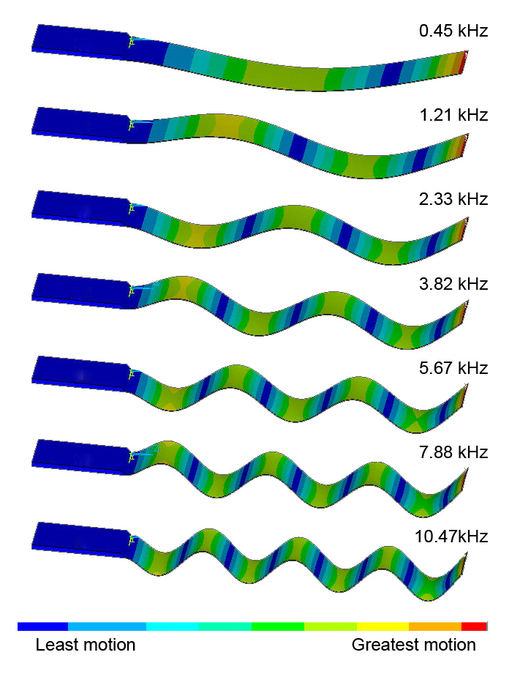
Cryogenic Mechanical Loss
Measure a range of the bending modes from 500 Hz – 30,000 Hz
These are easily predictable
Also measure a number of torsional modes
These can either be found by running a wide scan or
Use bending mode resonant frequencies to calculate the cantilever thickness which can then be used in finite element models

Slide 28
Typical Cryogenic Mechanical
Loss Measurements
Upper Stack Ta₂O₅/SiO₂ ~1.29 kHz

Slide 29
Predicting mechanical loss
2015 paper written using measured values from IBS coatings

Slide 30
Single Layer SiO₂ ~1.19 kHz

Slide 31
Single Layer SiO₂ ~1.19 kHz

Slide 32
Single Layer Ta₂O₅ ~1.27 kHz

Slide 33
Single Layer aSi ~1.05 kHz
aSi measurements now extended to cover 10-300K

Slide 34
Single Layer a-Si ~1.05 kHz

Slide 35
Predicting Multimaterial
Mechanical Loss

Slide 36
Predicted Lower Stack SiO₂/a-Si
Mechanical Loss

Slide 37
Predicted Lower Stack SiO₂/a-Si
Mechanical Loss

Slide 38
Predicted Upper Stack Ta₂O₅/SiO₂
Mechanical Loss

Slide 39
Predicted Upper Stack Ta₂O₅/SiO₂
Mechanical Loss

Slide 40
Predicted Full Stack Ta₂O₅/SiO₂/a-Si
Mechanical Loss
Believe curvature of cantilever is effecting thermoelastic loss
(M. Fletcher PhD thesis 2019)

Slide 41
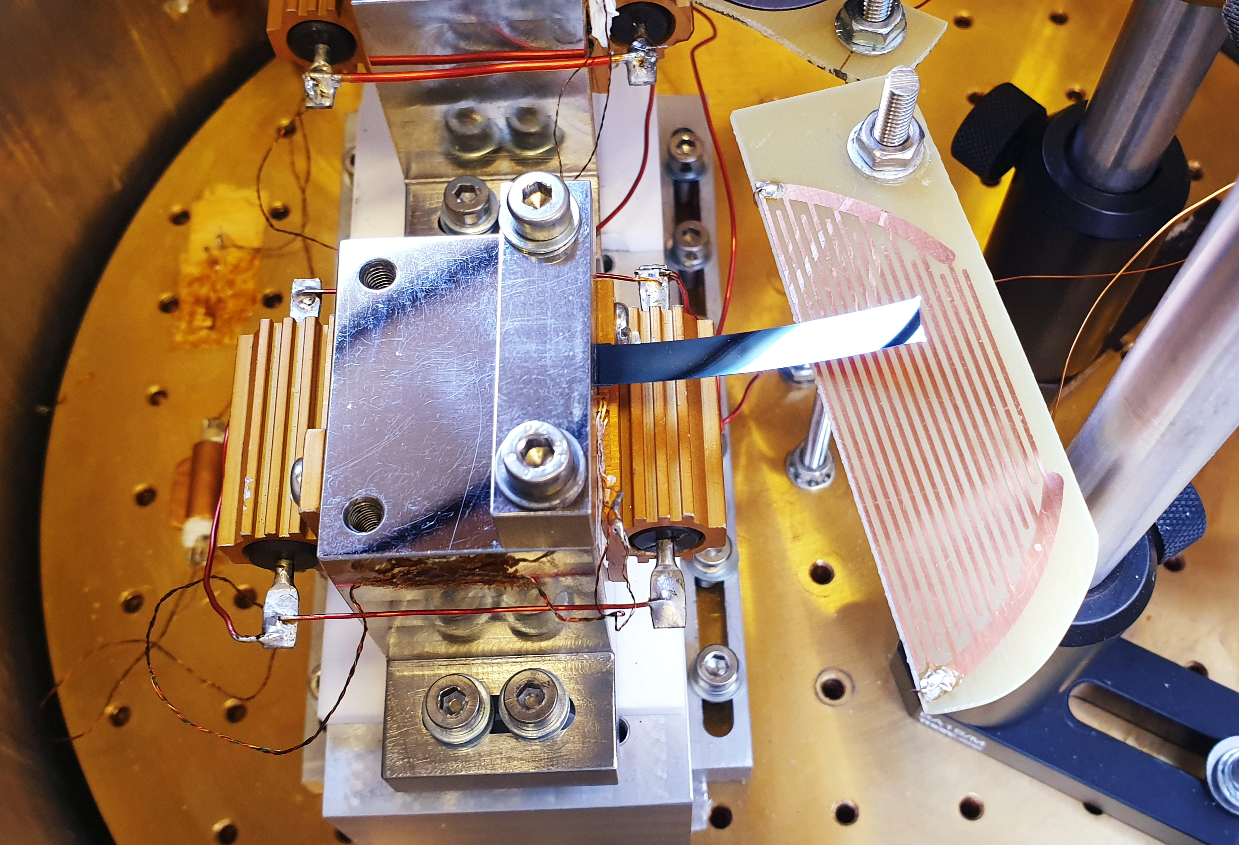
Predicted Full Stack Ta₂O₅/SiO₂/a-Si
Mechanical Loss

Slide 42
Comparison of Ion-plated
losses with IBS predictions
2015 paper written using measured values from IBS coatings
These had also been heat treated
We have as-deposited values on IBS samples for comparison

Slide 43
Comparison of Ion-plated
losses with IBS predictions
Lower Stack SiO₂/a-Si
?

Slide 44
Comparison of Ion-plated
losses with IBS predictions
Upper Stack Ta₂O₅/SiO₂
?

Slide 45
Comparison of Ion-plated
losses with IBS predictions
Full Stack Ta₂O₅/SiO₂/a-Si
?

Slide 46
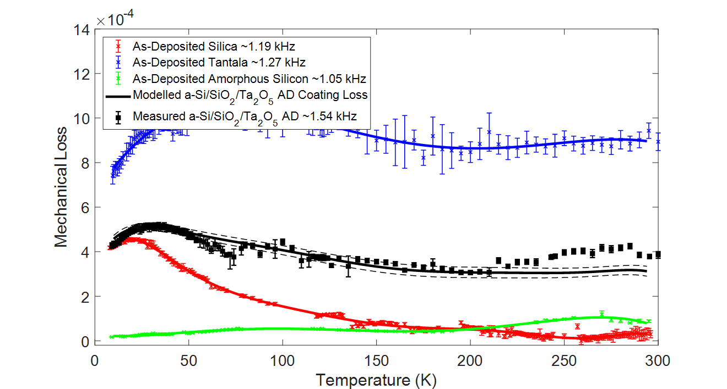
Predicted 500 °C HT
Full Stack Ta₂O₅/SiO₂/a-Si
Mechanical Loss

Slide 47
Predicted 500 °C HT
Full Stack Ta₂O₅/SiO₂/a-Si
Mechanical Loss

Slide 48
Predicted 500 °C HT
Full Stack Ta₂O₅/SiO₂/a-Si
Mechanical Loss

Slide 49
Predicted 500 °C HT
Full Stack Ta₂O₅/SiO₂/a-Si
Mechanical Loss

Slide 50
Predicted 500 °C HT
Lower Stack SiO₂/a-Si
Mechanical Loss

Slide 51
Predicted 500 °C HT
Upper Stack Ta₂O₅/SiO₂
Mechanical Loss

Slide 52
Comparison of Ion-plated
losses with IBS predictions
Full Stack Ta₂O₅/SiO₂/aSi
At low temperatures as-deposited
ion-plated full stack has lower loss than best estimate for an equivalent heat treated IBS coating

Slide 53
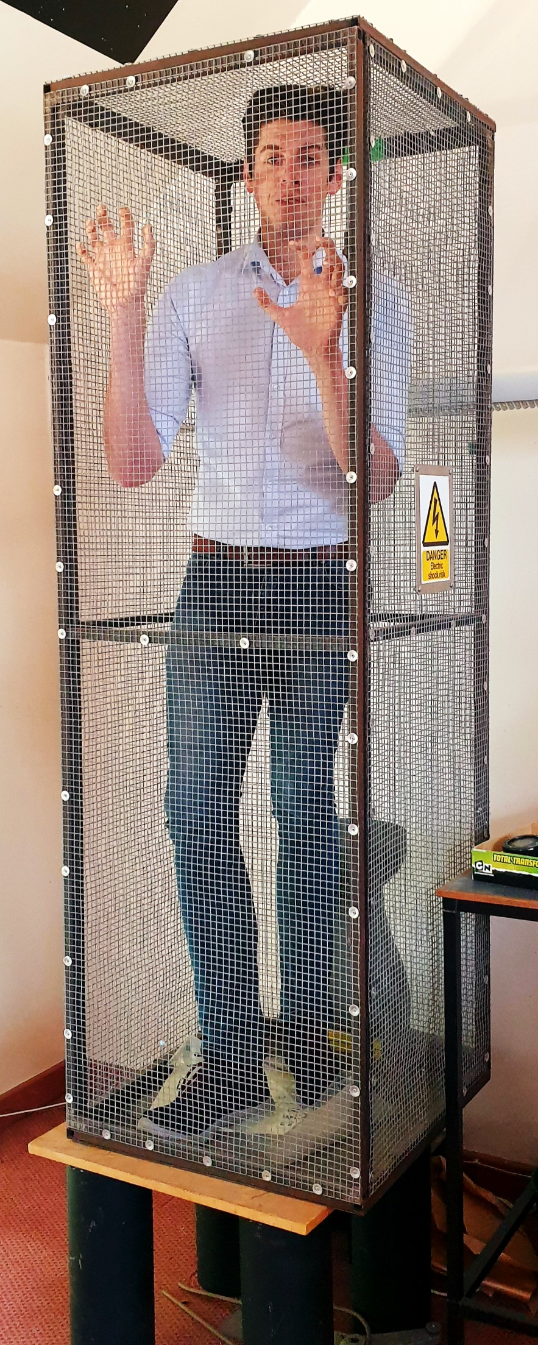
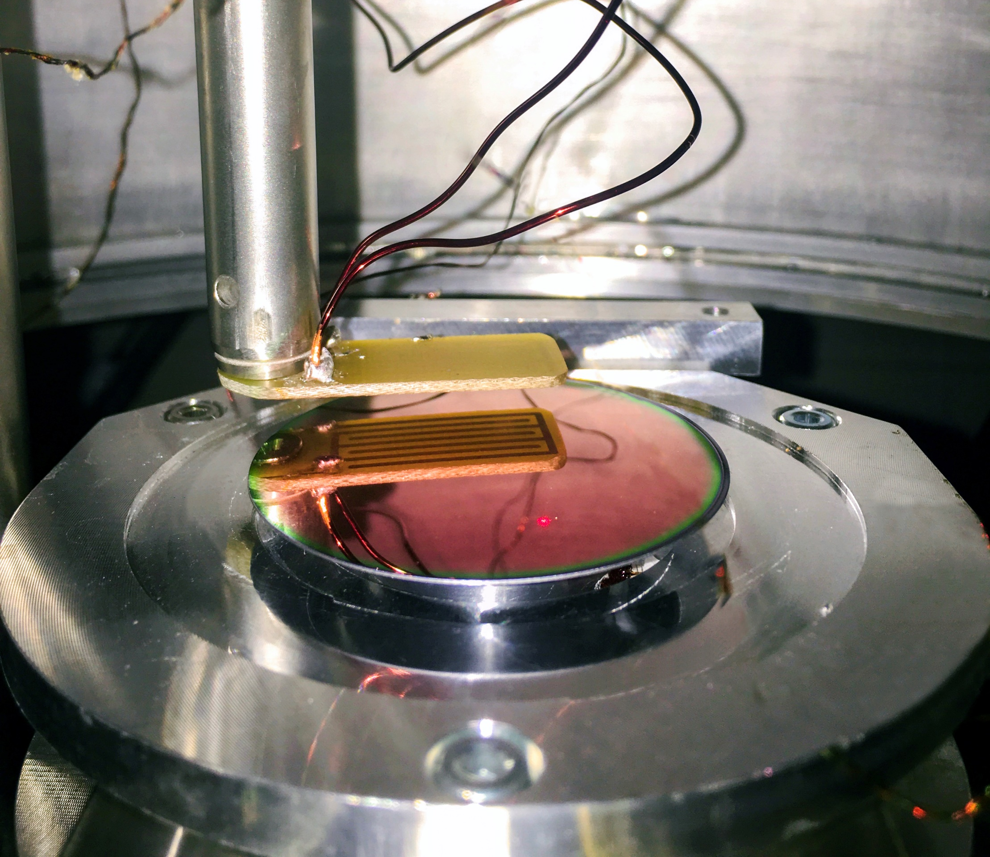
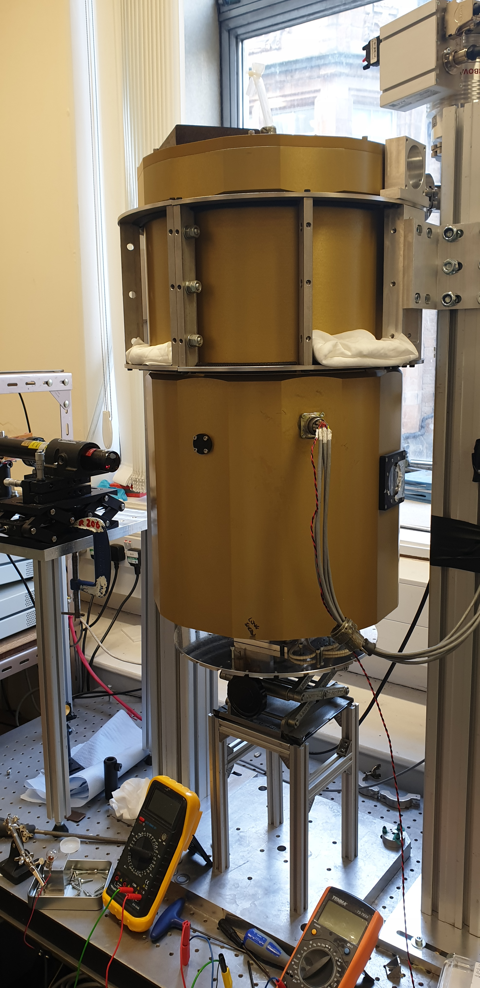
Future Plans: CryoGeNS
Cryogenic mechanical loss measurements
of 2” diameter silicon discs is now underway
Results will appear in ~2020 thesis by S. Tait

Slide 54
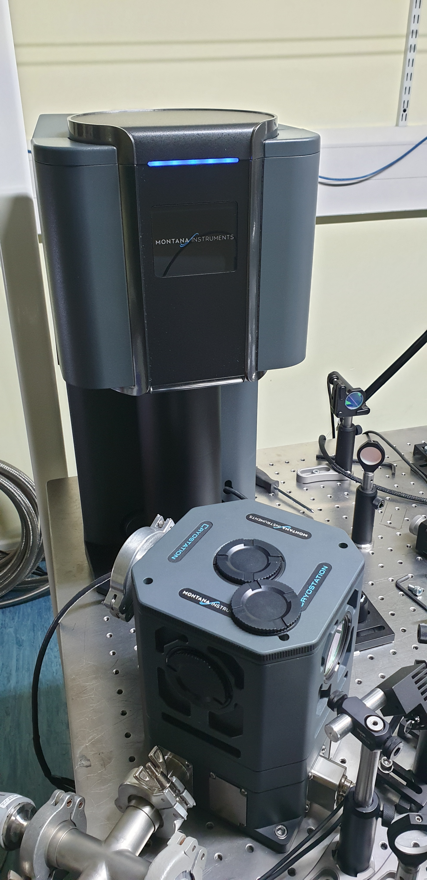
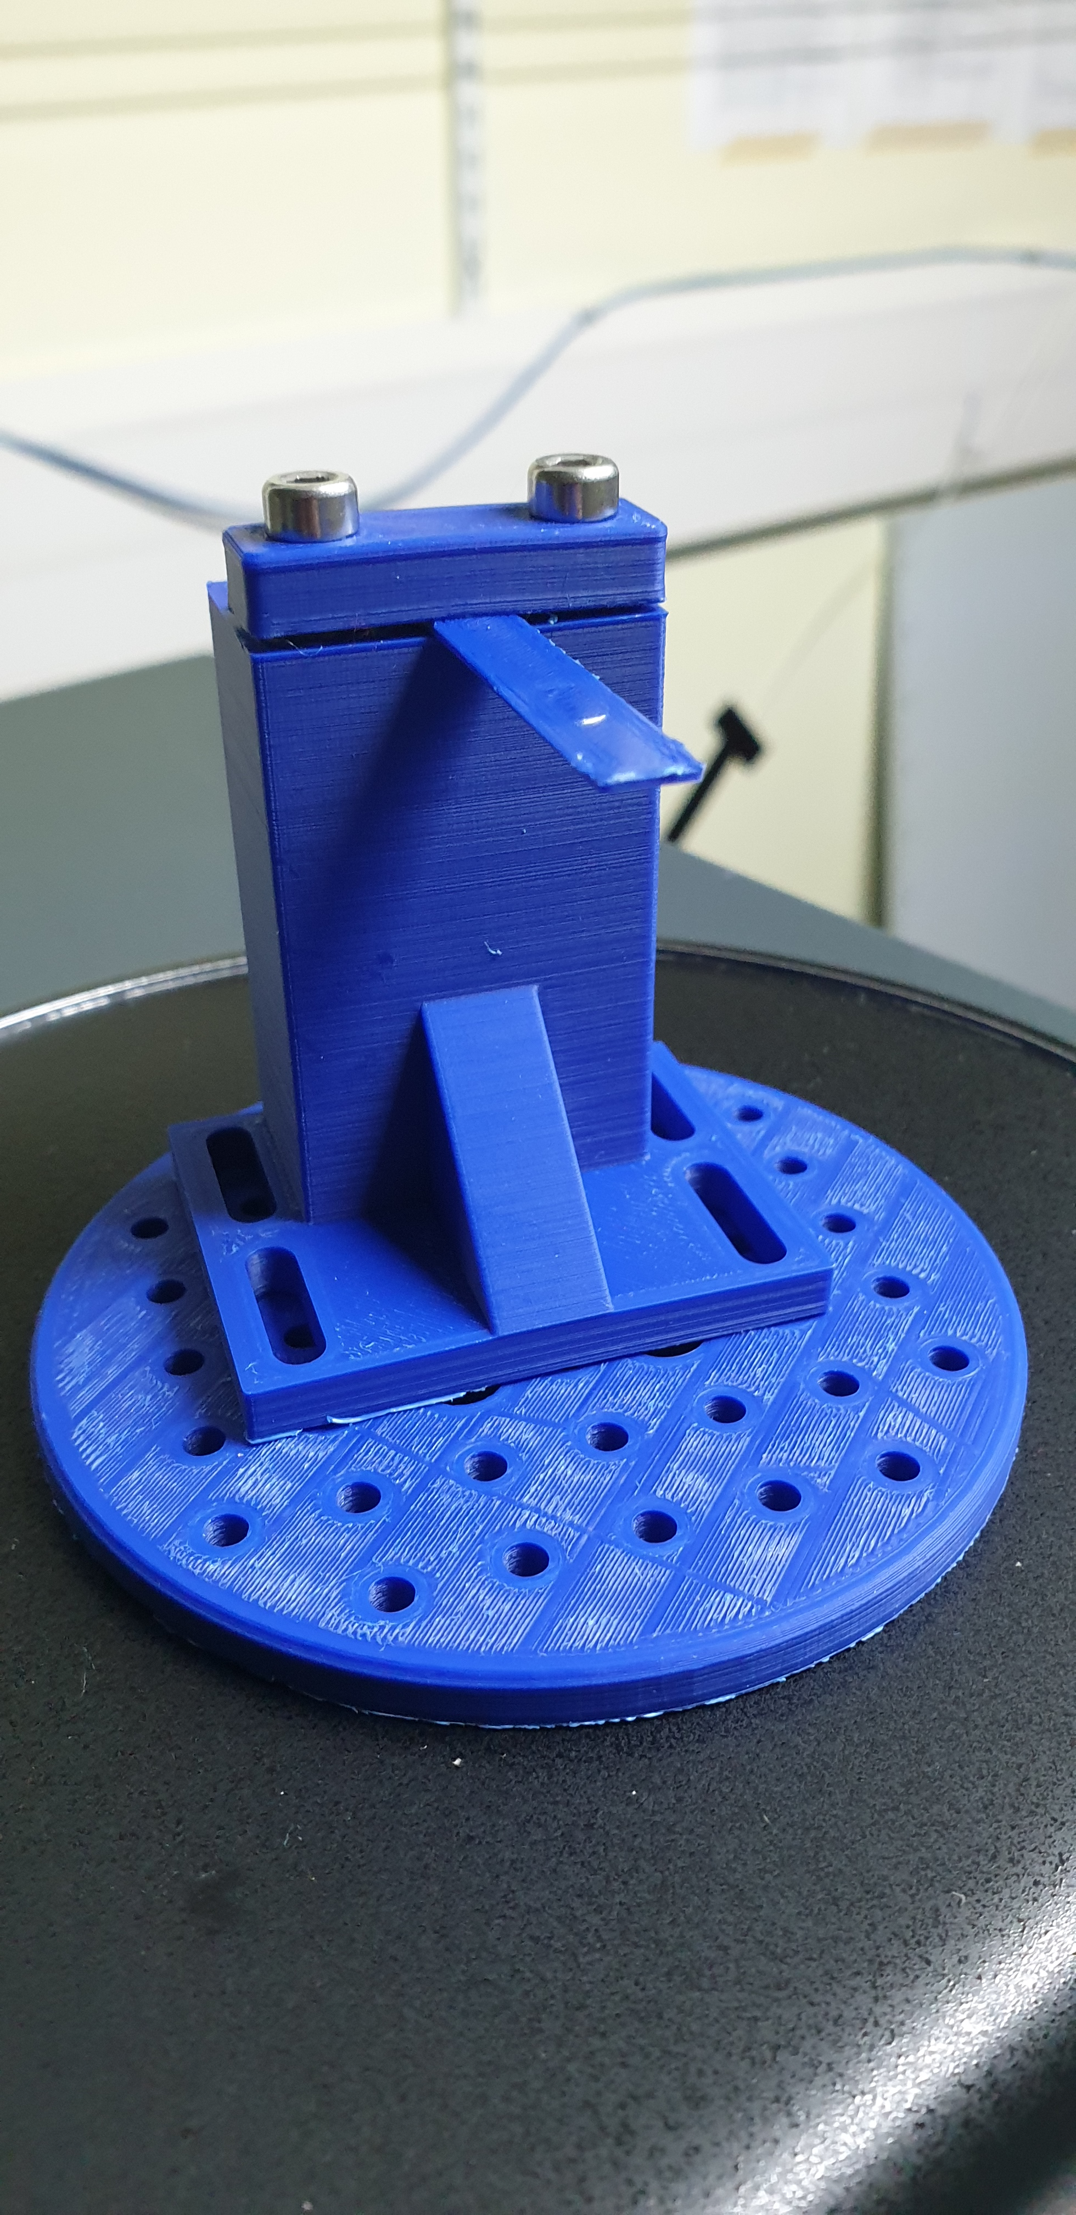
Future Plans: Cryogen Free GeNS
Commissioning a new small pulse-cooled cryostat
M. Kinley-Hanlon and
2 MSci students V. Graham and B. McCrindle
Flexible small experimental space
Cryogenic absorption
Silicon Cantilever
measurements
Silicon GeNS
measurement

Slide 55
In Summary…
Multimaterial coating behaves as expected based on our predictions from single-layers
A minima in absorption is observed after heat treatment at 500 °C
Mechanical loss also observed to improve with heat treatment
Mechanical loss of the full multimaterial stack is ~40% lower than the “upper” silica/tantala coating

Slide 56
In Summary…
Shown predictions of mechanical
loss of multimaterial coatings
from single layers match
experimentally measured values
  Both in terms of level of
  mechanical loss and loss peaks
At low temperatures, even in
their as-deposited state
ion-plated, these multimaterial
coatings perform better than the
best theoretical IBS multimaterial coating
Heat treatment of multilayer stacks to 500 °C should further improve the cryogenic mechanical loss
This point towards seeing a real thermal noise reduction for acceptable absorption compared to silica/tantala
Exciting time ahead with cryogenic cantilever, GeNS and absorption measurement capabilities

Slide 57


Thank you for your attention
peter.murray@glasgow.ac.uk
#TeamUoG
@UofGravity

