Slide 1

Paolo Michelato
ESS & PIP II
Paolo Michelato
per il gruppo SCRF

Slide 2
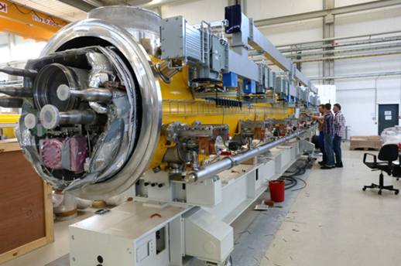
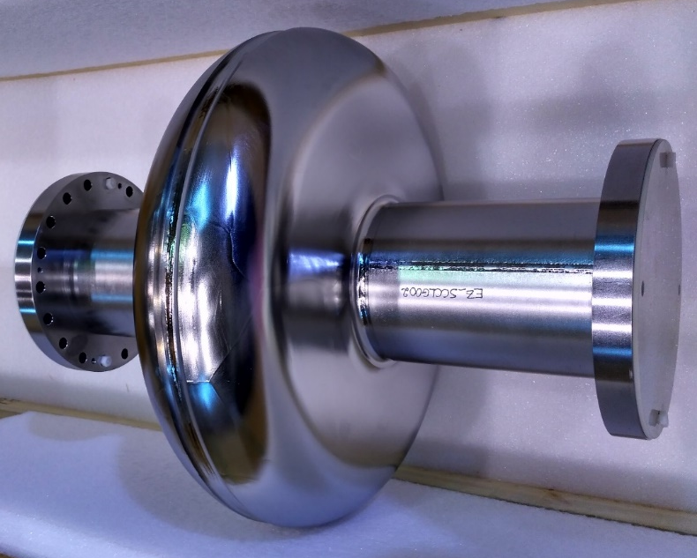
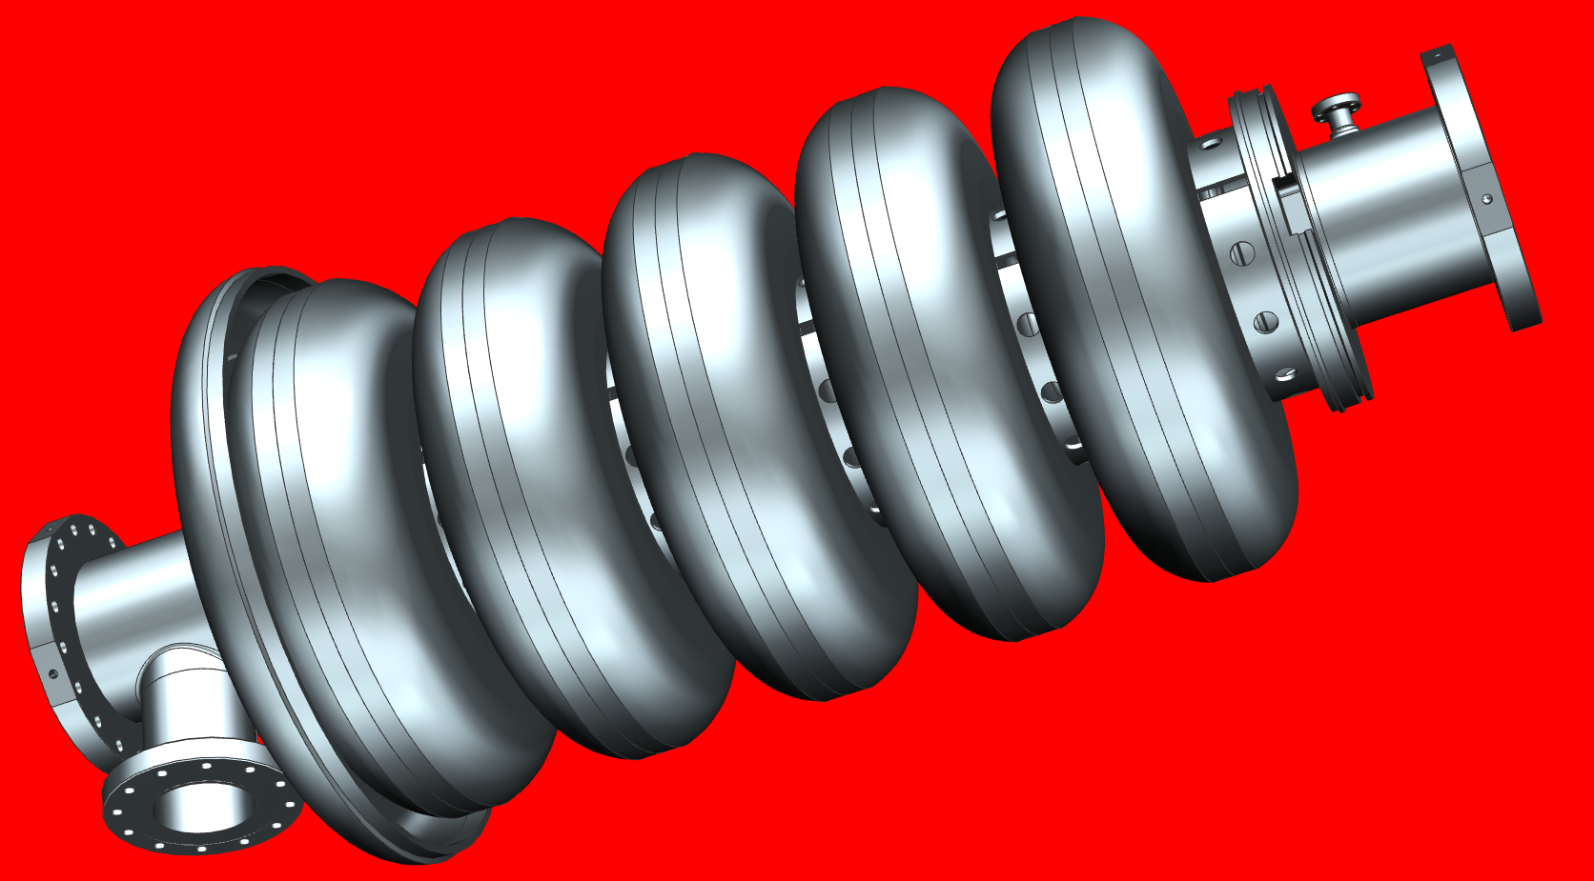
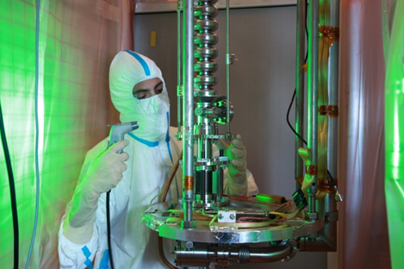
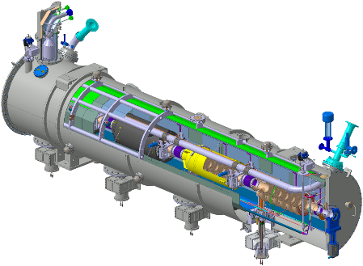
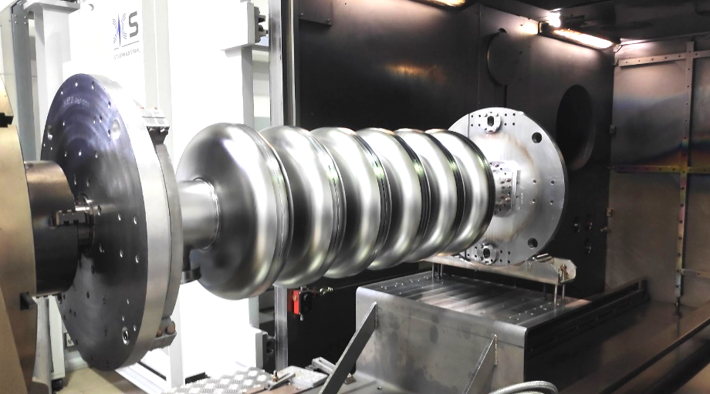
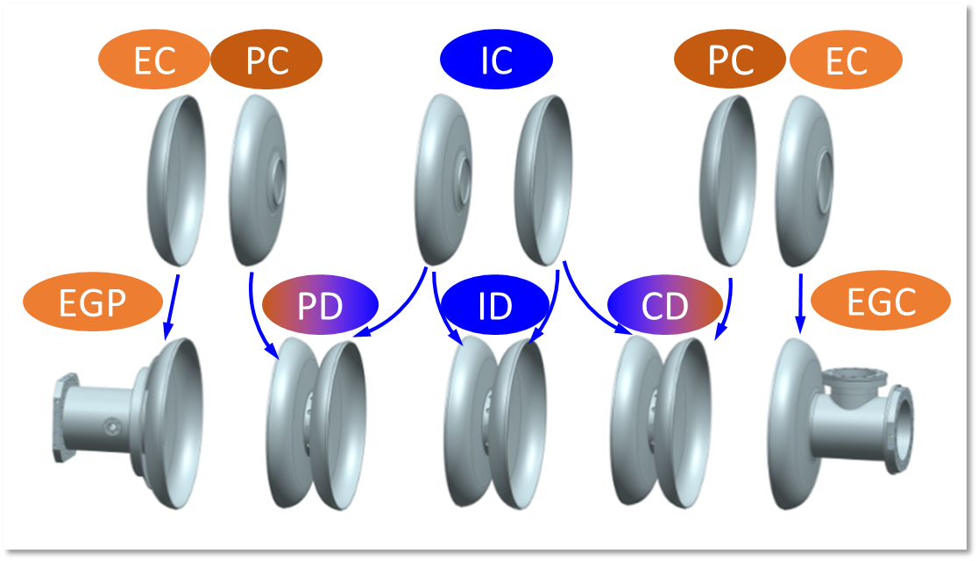
What’s going on at LASA on Superconducting Cavities?
TRASCO
ADS
SNS
PDS-XADS
MAX
MYRRHA
European XFEL
PIP R&D
PIP construction
Superconducting cavities, cryomodules and ancillaries
2010
2015
2020
2025
ESS preconstruction
ESS construction

Slide 3

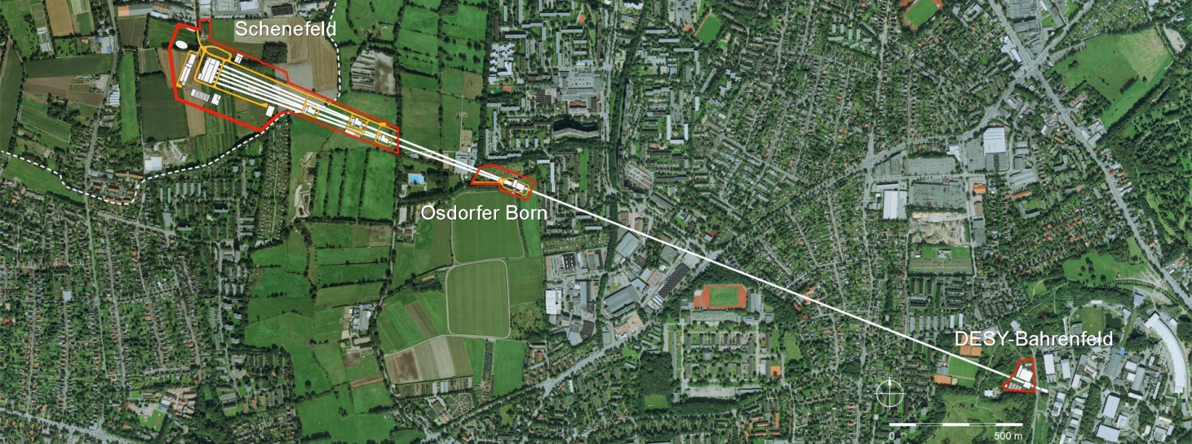

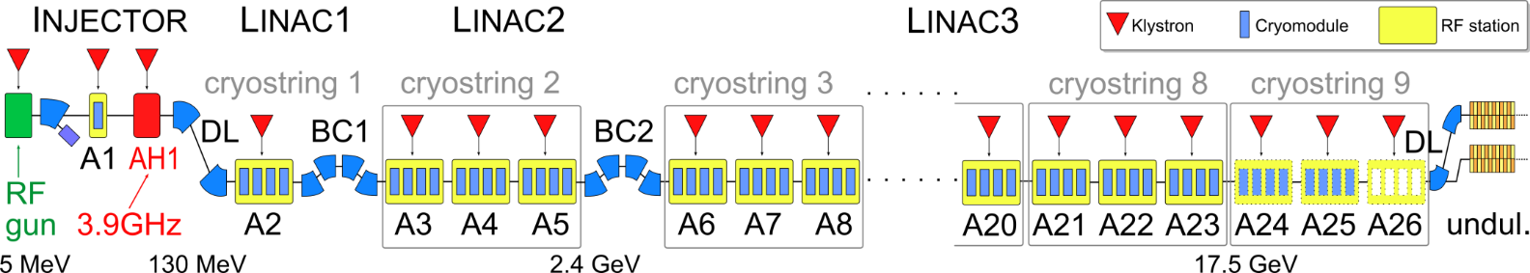
















The European XFEL facility and SC accelerator
The European X-ray Free Electron Laser
  17.5 GeV light source user facility
  Photon energy 0.24-24 keV
  Pulse duration ~ 10-100 fs
  Pulse energy few mJ
  1.4 ms RF pulses at 10 Hz
  10 Hz (27 000 b/s)
  5 beamlines / 10 instruments
  Start version with 3 beamlines and 6 instruments
Experimental Hall
Photon Beam Lines
Undulators
Electron Beam
Distribution
Beam Dumps
2.1 km
Collimation
Linear Accelerator
Bunch
Compressor
3.9 GHz 3rd Harmonic
Cryomodule
Superconducting
Cavities & tuners
Injector
Cryomodules
  The XFEL SC accelerator
  800 SC-RF TESLA-type cavities, couplers & tuners
  101 cryomodules, 26 RF stations
  e- beam 1.35 mA nom., up to 500kW beam power
  Bunch length: 600 μs (2700 pulses inside)
  2 years of cavity / cryomodules tests / tunnel installation
European XFEL Italian Contribution (based on INFN know how): 33 Meuro (2005)
All components produced by Italian Industry

Slide 4

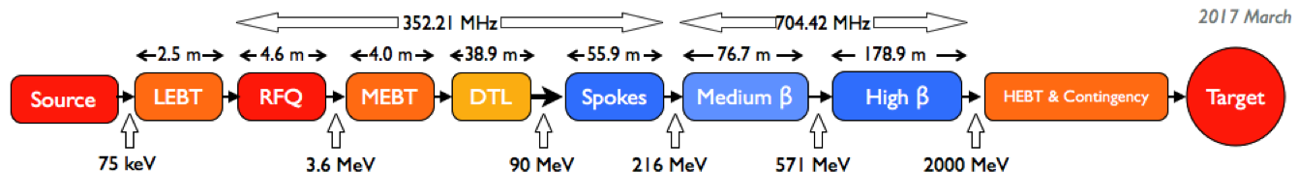
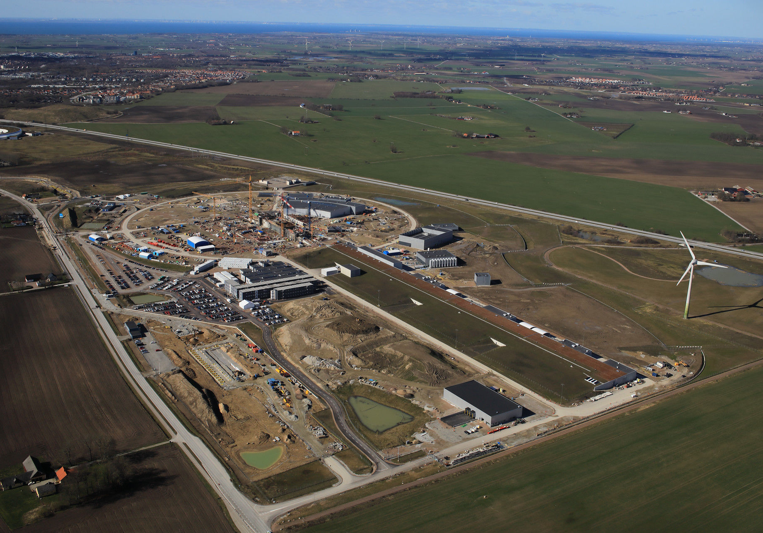
INFN LASA Contribution to ESS
LASA contribution
INFN LASA In-Kind contribution for 11.6 M€.
  Fabrication of 36 cavities in the industry, including treatments, tuning and He tank following a
  Built to Print strategy.
  Cavities delivered ready for the cold test.
    Analogous strategy as for the XFEL successful experience
  Cold test in a qualified infrastructure (DESY).
  Delivery at CEA ready for the cryomodule assembly.
Series cavities production at the industry:
    First cavity, ready for the cold test by November 2018
    Cold test at DESY and CEA delivery: December 2018
    Delivery rate: 2 cav/3 weeks
ESS Parameters
Max Energy | 2 GeV
Average beam power | 5 MW
Peak beam power | 125 MW
Peak beam current | 62.5 mA
Pulse length | 2.86 ms
Repetition rate | 14 Hz
Energy from SC sections | 96 %

Slide 5
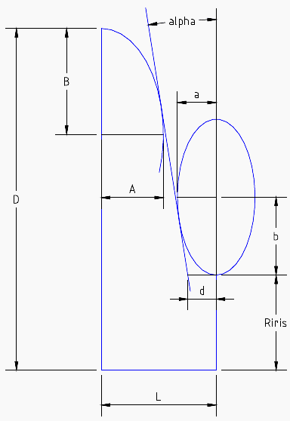
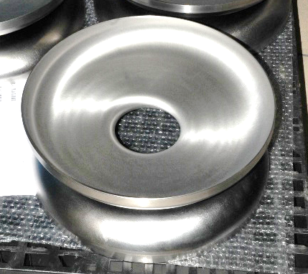
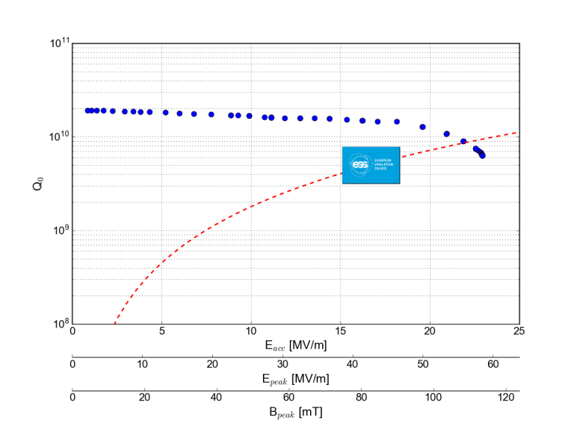
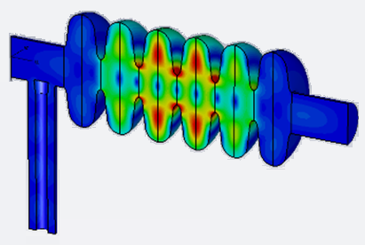
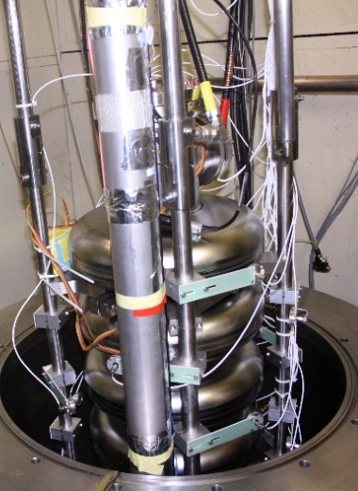
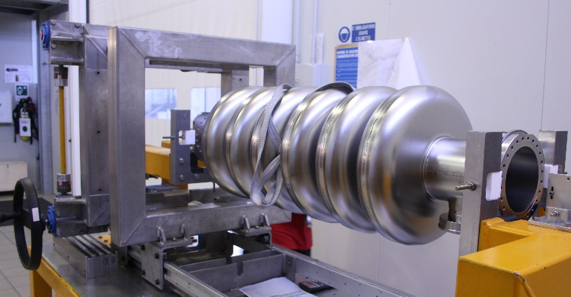
INFN-LASA ESS Medium beta cavities: from design to series
INFN R&D on ESS prototypes
  INFN design, plug compatible with ESS cryomodule.
  Know how transfer to the industry
  Built prototypes at industry with same procedures as for series.
  Final handling and test done in the qualified infrastructure at LASA.
  Successful result well over specification
Cell shape design
Dumb-Bells
ESS specs:
E_{acc} >16.7 MV/m
Q₀> 5⋅10⁹
HOM analyses
Cavity tuning
INFN LASA ESS cavity prototype MB001 qualification at 2.0 K
Cold test @ LASA

Slide 6
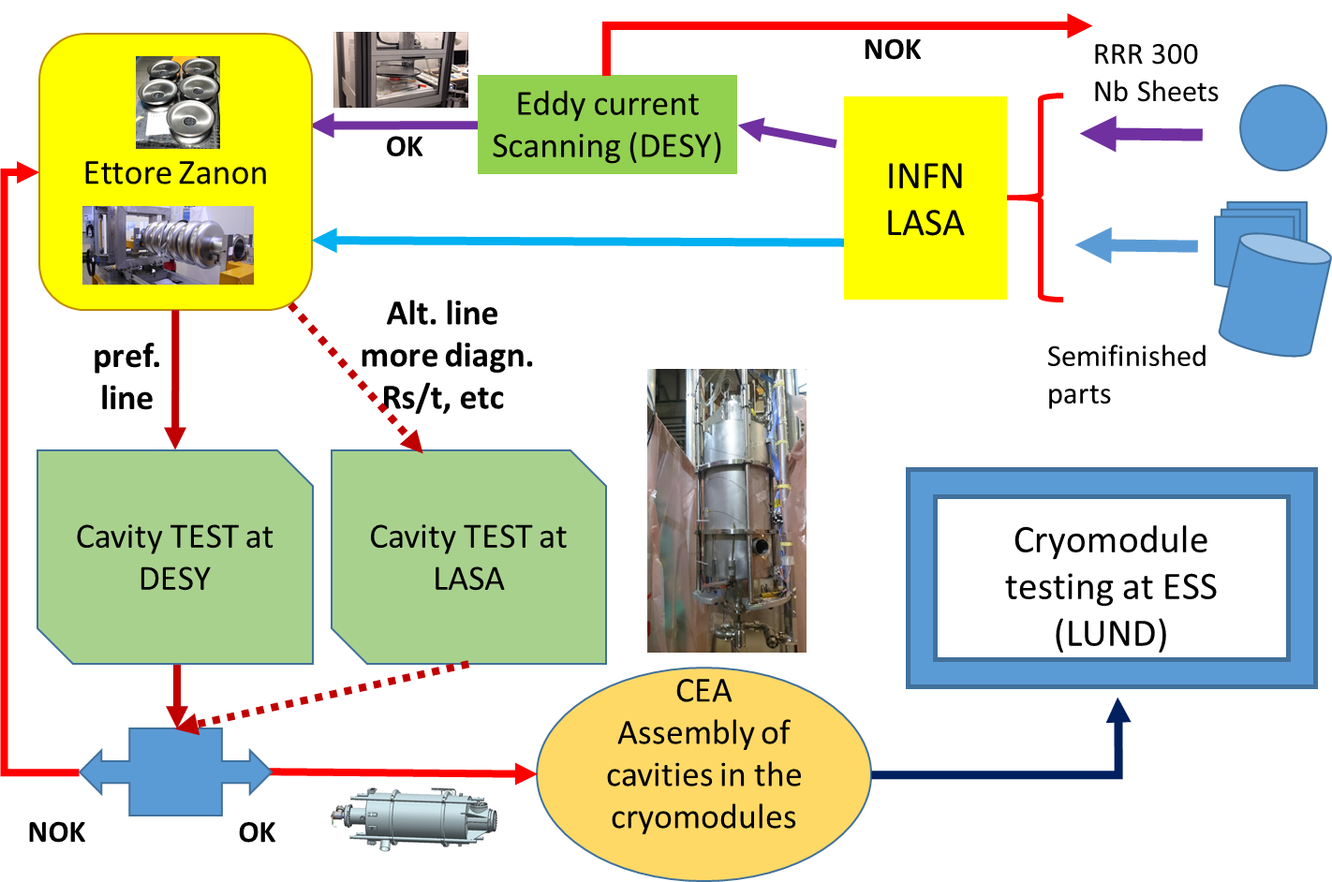
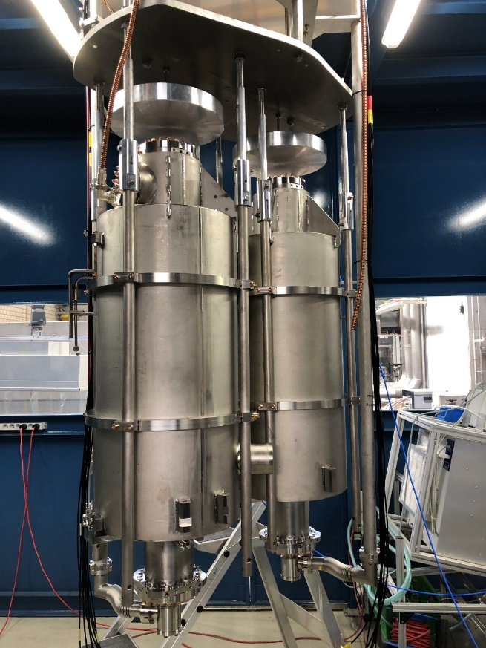
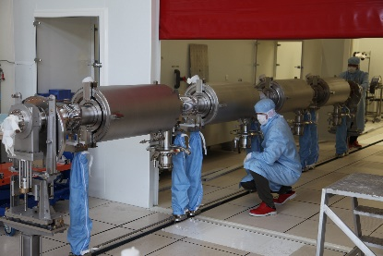
INFN-LASA ESS cavities production workflow

Slide 7
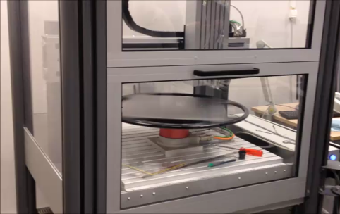
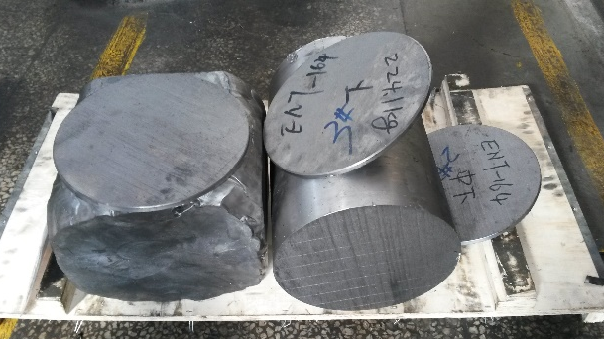
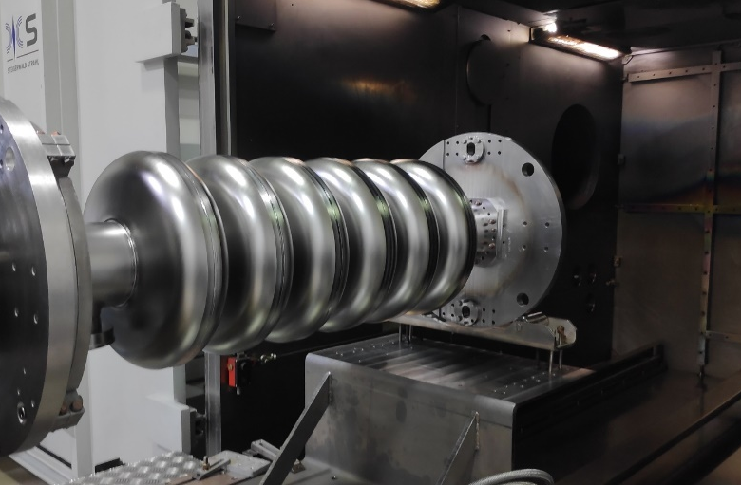
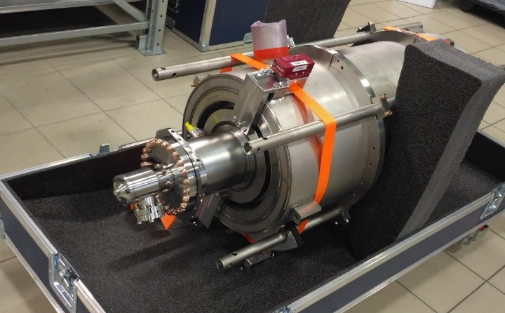






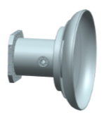

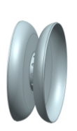

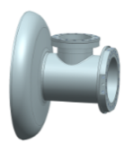
INFN-LASA ESS cavity production
Niobium Procurement
Ca. 4000 kg of Nb sheets delivered in 3 batches
Eddy current scanning of sheets at DESY
All semi-finished products (tubes, MC, PU, etc.) at Zanon
Raw material at Nb vendor site
Sheet eddy current scanning at DESY
Cavity Fabrication
Nb sheets are deep drawn to form the half cell
Half cells are EB welded to form the Dumb Bell
All parts are EB welded together to form the cavity.
Surface treatment: BULK BCP (200 μm removal)
Heat treatment @600°C for Hydrogen degassing
Inner surface Visual inspection
Field flatness tuning
The He-Tank is the welded to the cavity
Final BCP (20 μm)
Cavity is shipped to DESY
Cavity after welding
Dressed cavity ready for shipment
EC
PC
IC
PC
EC
EGP
PD
ID
CD
EGC

Slide 8
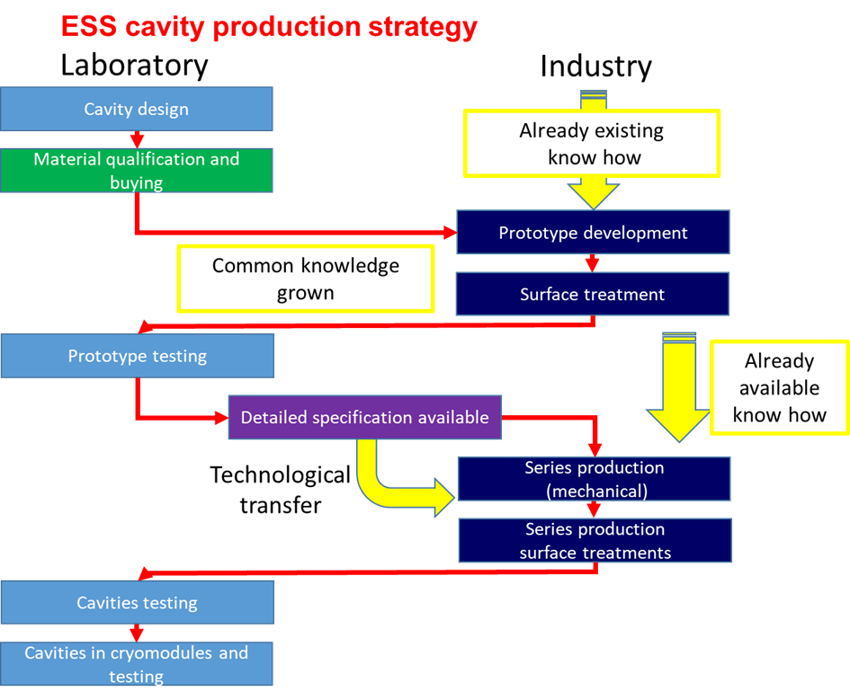
INFN ESS cavities production strategy

Slide 9
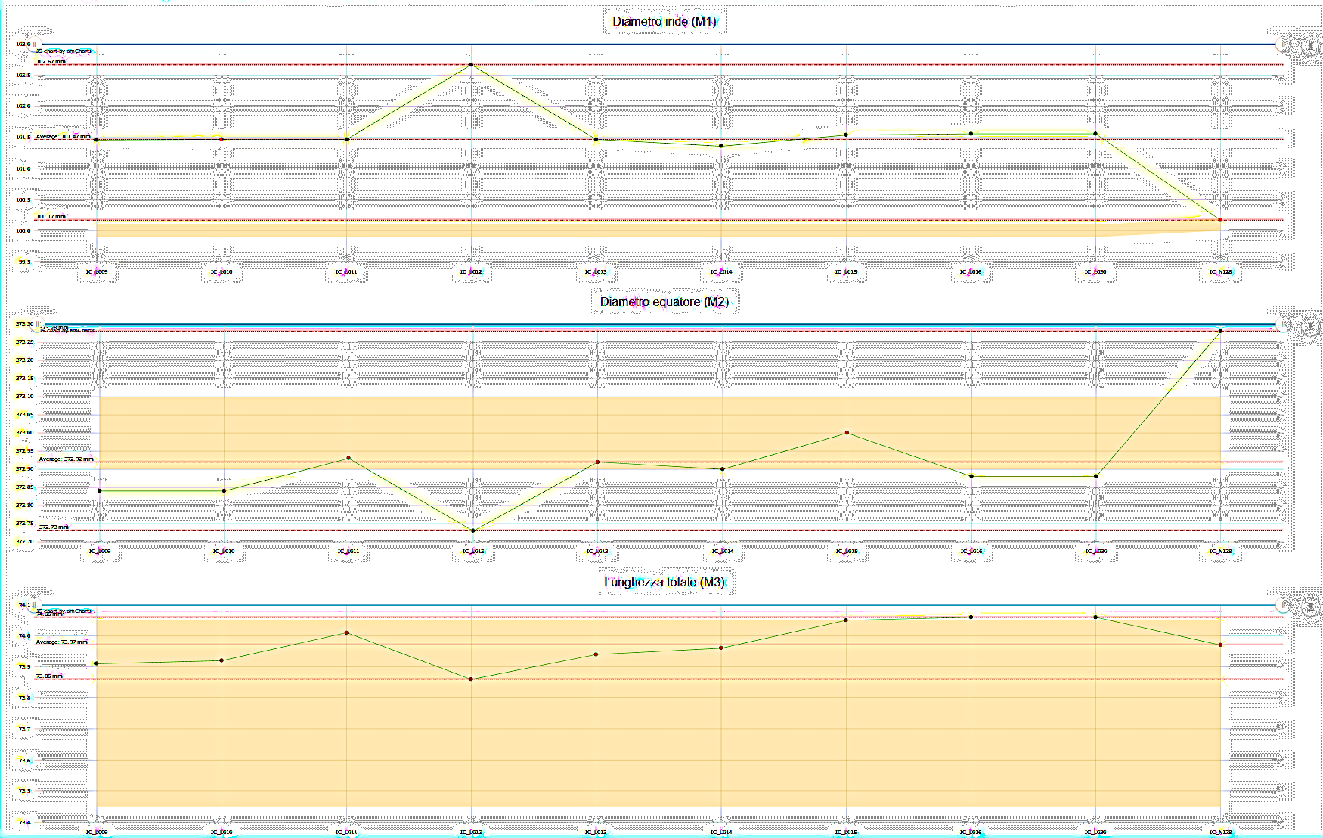
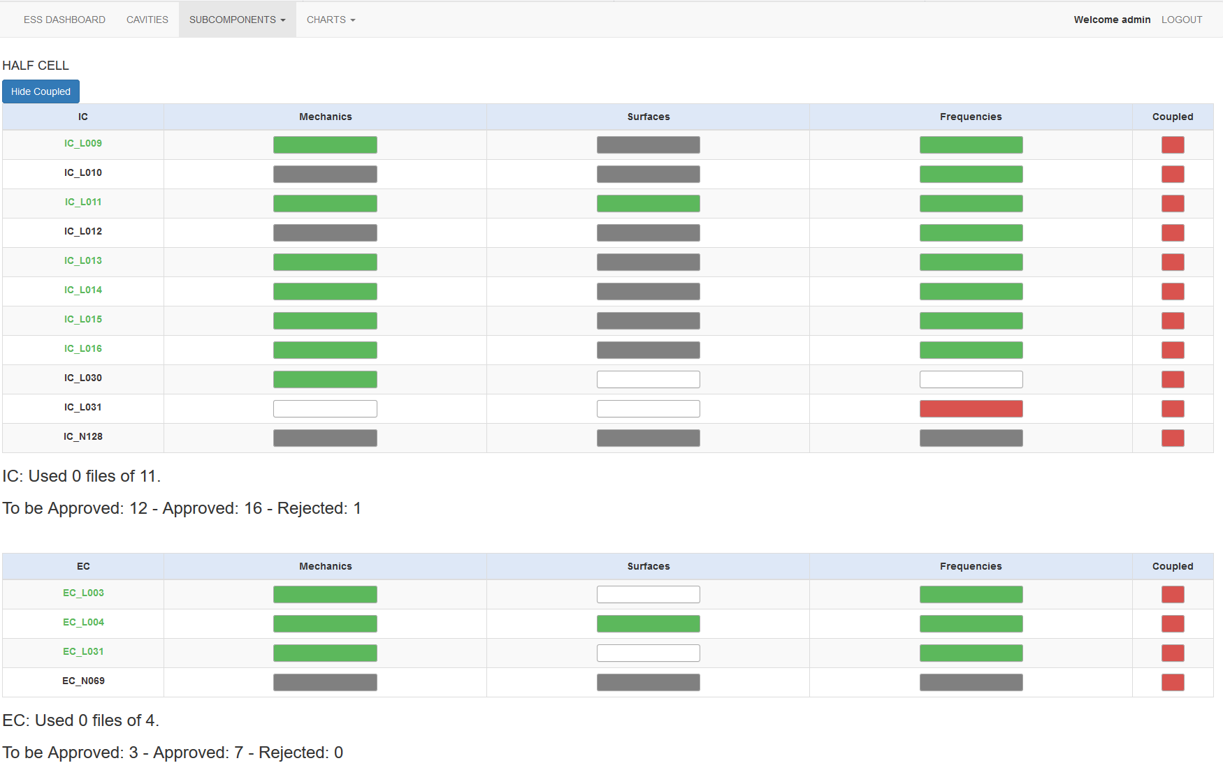

INFN-LASA ESS QA/QC and document flow
≈ 100 documents /cavity
Total of > 4000 documents to be:
  Exchanged among:
  EZ – INFN – ESS - CEA
  Managed and stored with INFN ALFRESCO DMS
  Analyzed for statistics, deviations, guidance and feedback for production
Trends figure
Document and data management developed in the
framework of collaboration
Dashboard

Slide 10
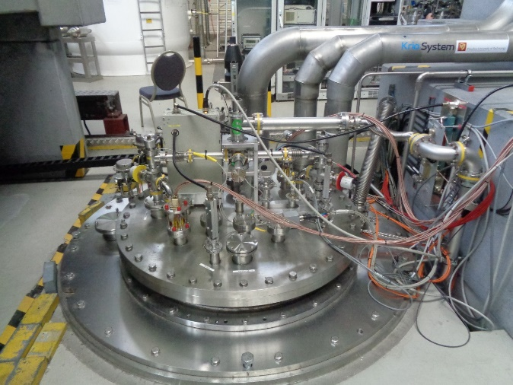
INFN-LASA ESS cavities testing
  Cavity are mostly tested at DESY AMTF facility
  Two cavities tested at a time in the same cryostat
  Q vs E_{acc} curve acquired at 2 K temperature
  External radiation measurement (counter, NaI scintillator)
Vertical insert
ESS SPECS
ESS specification asks for Q₀ = 5·10⁹ at E_{acc} = 16.7 MV/m.
The most of cavities largely overcome 20 MV/m gradient with limited or absent field emission. Also Q₀ > 10¹⁰ at nominal gradient.
Cryostat cover

Slide 11
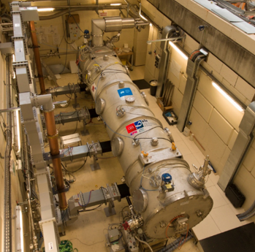
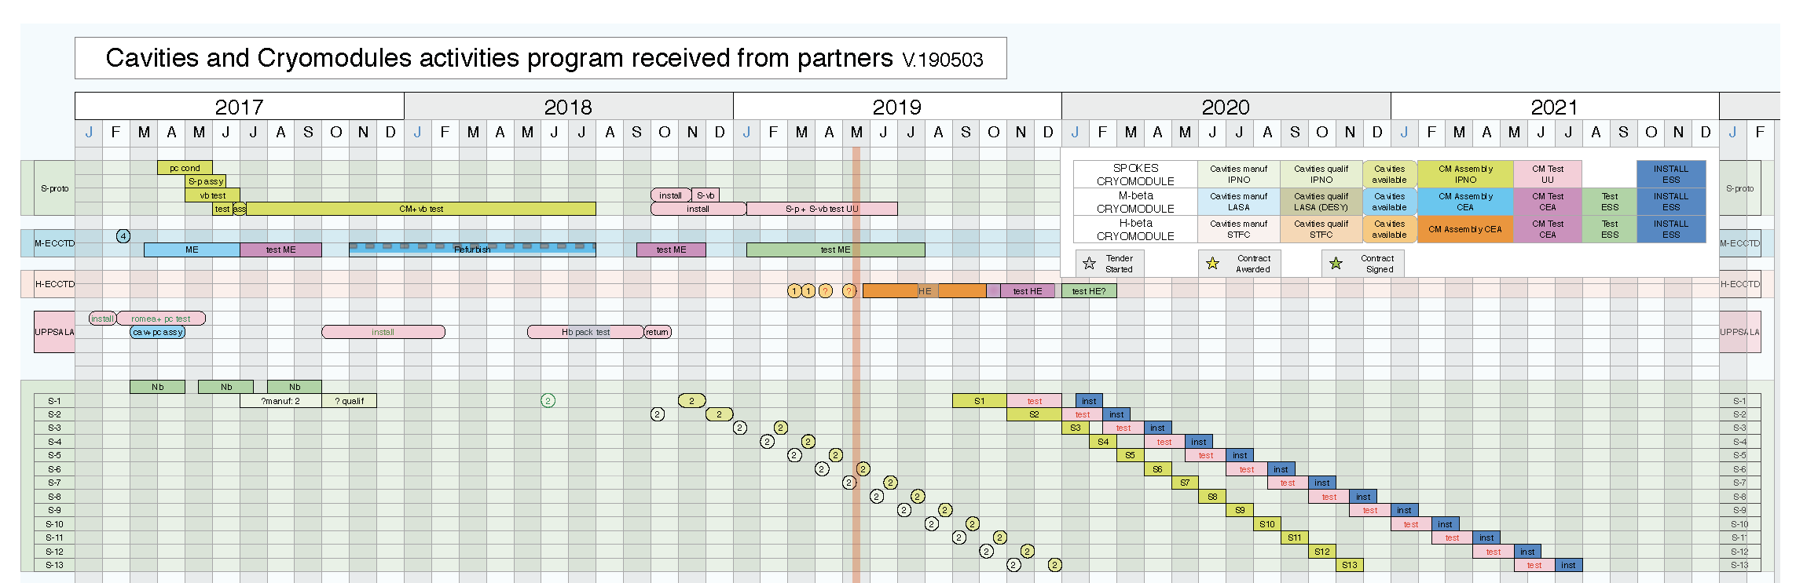
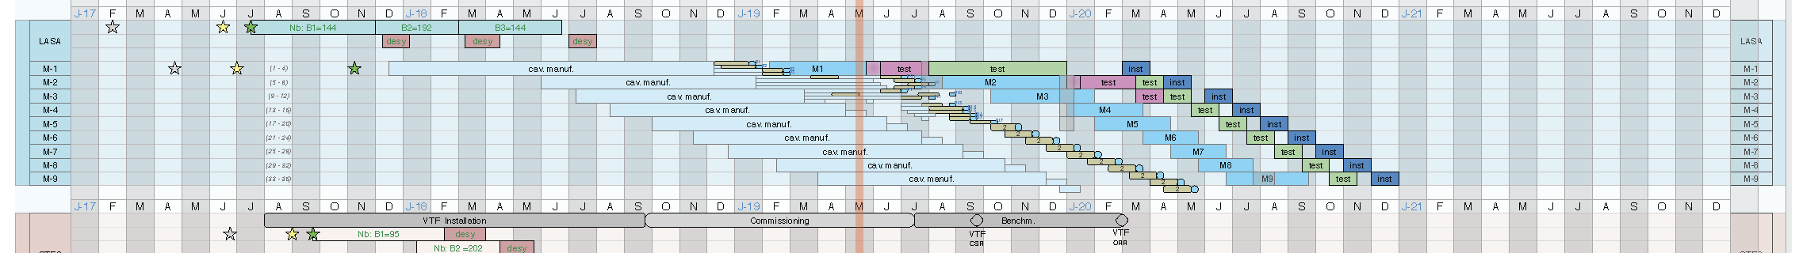
Status and time schedule of the INFN-LASA series cavities for ESS
4 cavities successfully tested, delivered at CEA, integrated in the Module M-1, under assembly at CEA
3 cavities under test at DESY, to be sent at CEA within mid of July for module M-2
3 additional cavities will be delivered at DESY within July end to be tested, for M-2 and M-3.
2 cavities to be delivered to LASA for additional cold test in the next 2 months
A total of 21 cavities welded at Ettore Zanon, under processing
for surface treatment.
All subcomponents (half cells, terminal cell, etc.) already deep drawn

Slide 12
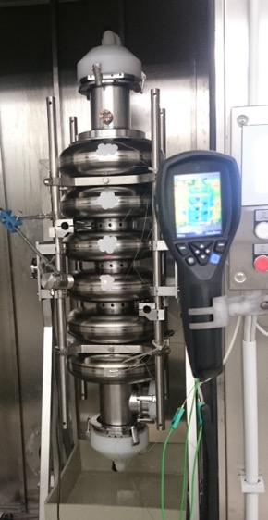
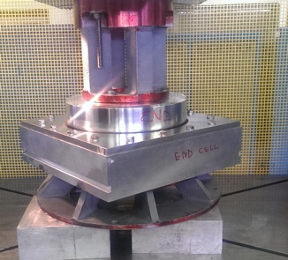
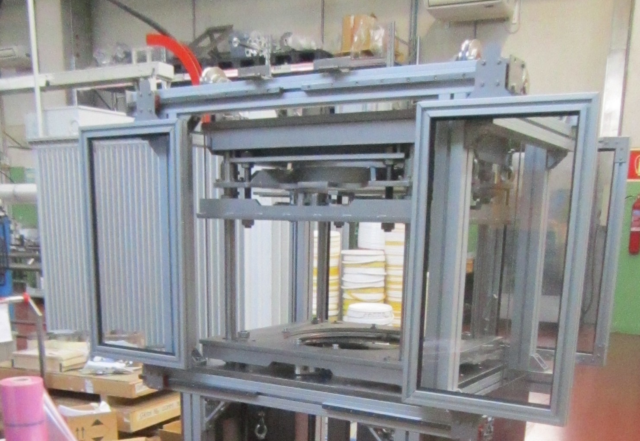
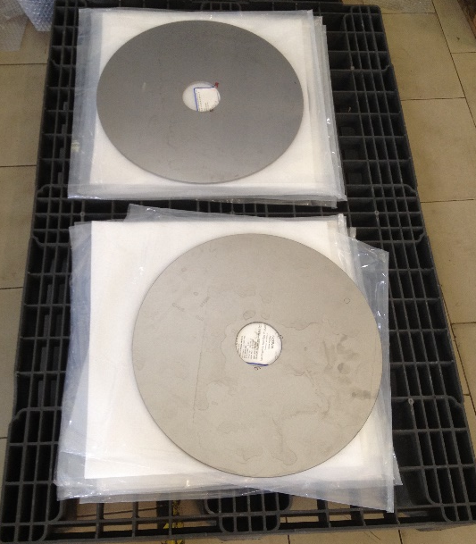
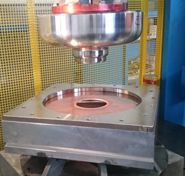
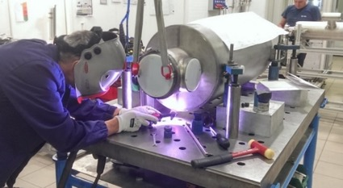
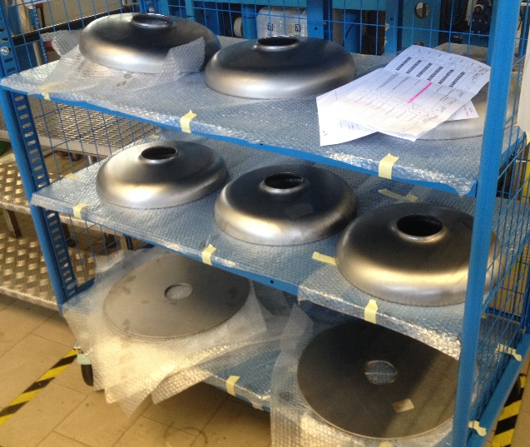
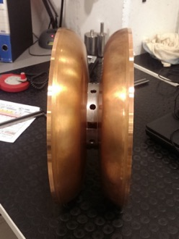
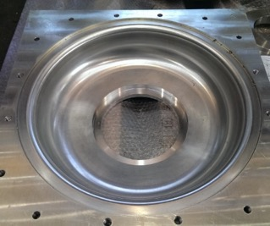
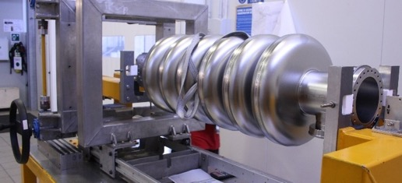
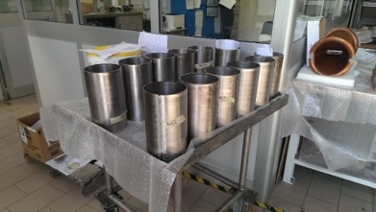
Activity at Ettore Zanon for ESS
Co.Co.De for
HC and DB RF measurements
Half cell deep drawing
Bulk BCP
Nb sheets water cut
Test of deep drawing dies
Cavity integration in He tank
Nb sheets deep drawn
Cu DumbBell
Deep drawing dies
Cavity tuning machine
Nb tubes for end group

Slide 13

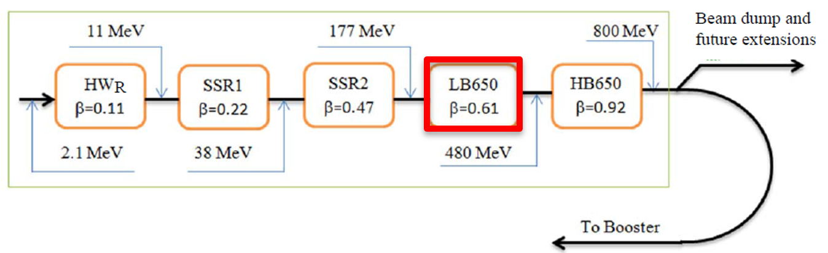
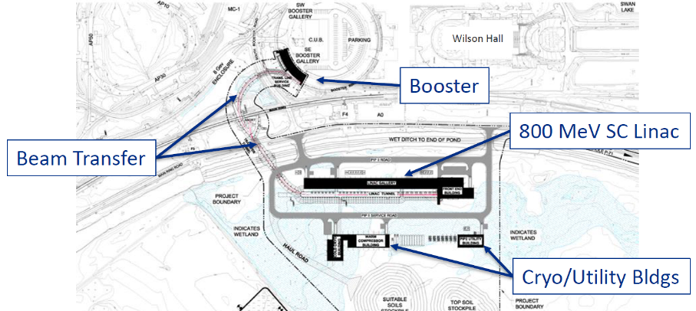
The PIP-II project
World-leading beam power to the neutrino programs
> 1 MW proton beam up to 120 GeV
using Booster and Main Injector.
Modern 800 MeV superconducting
linac of CW-capable components,
initially operated in pulsed mode.
RT
SC
LASA contribution
Low-Beta (LB650, b=0.61) cryomodule:
recently reviewed to host 4 650 MHz, 5-cells cavities instead of 3 as in the former design.

Slide 14
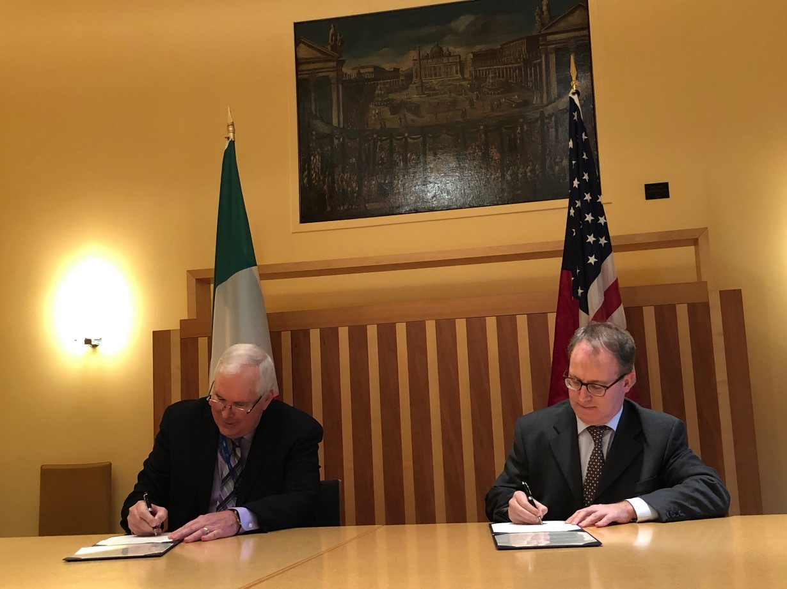
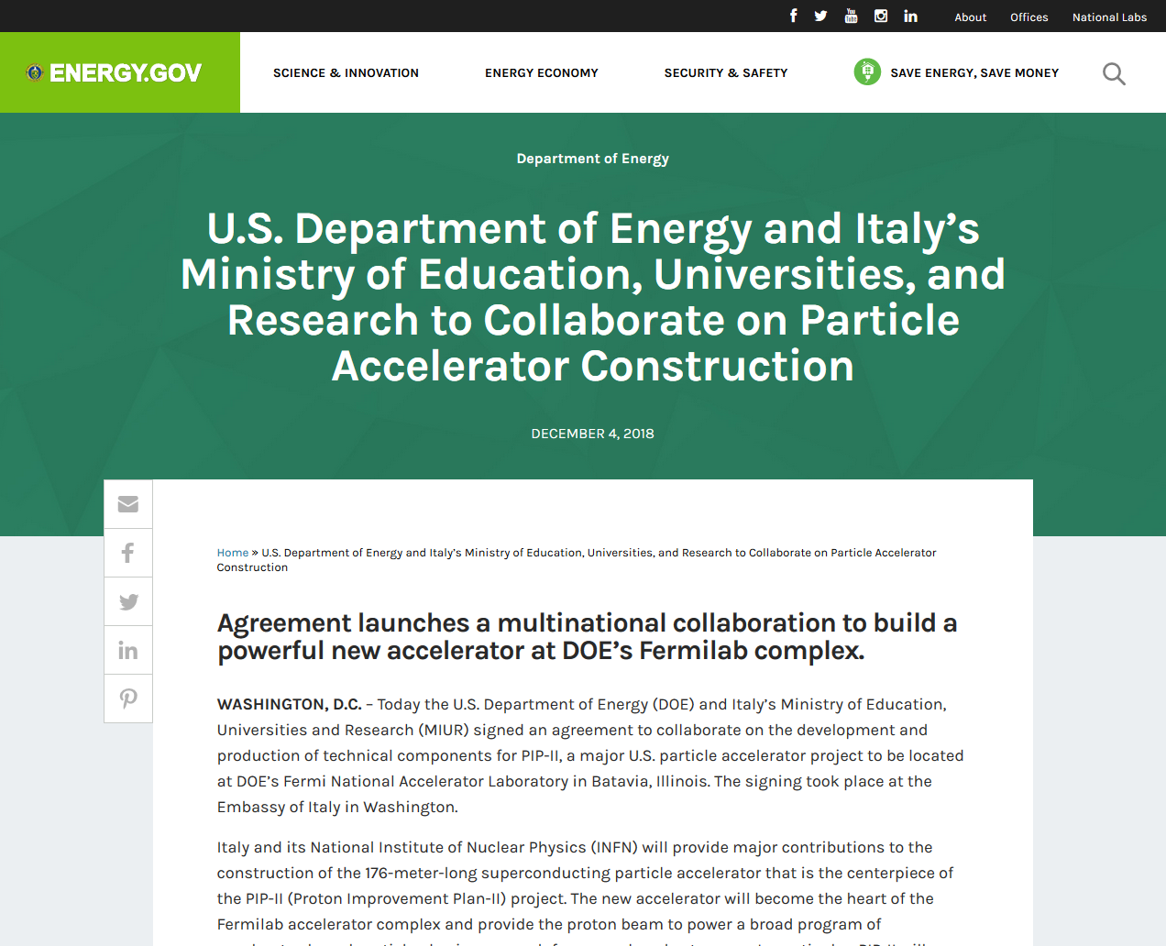
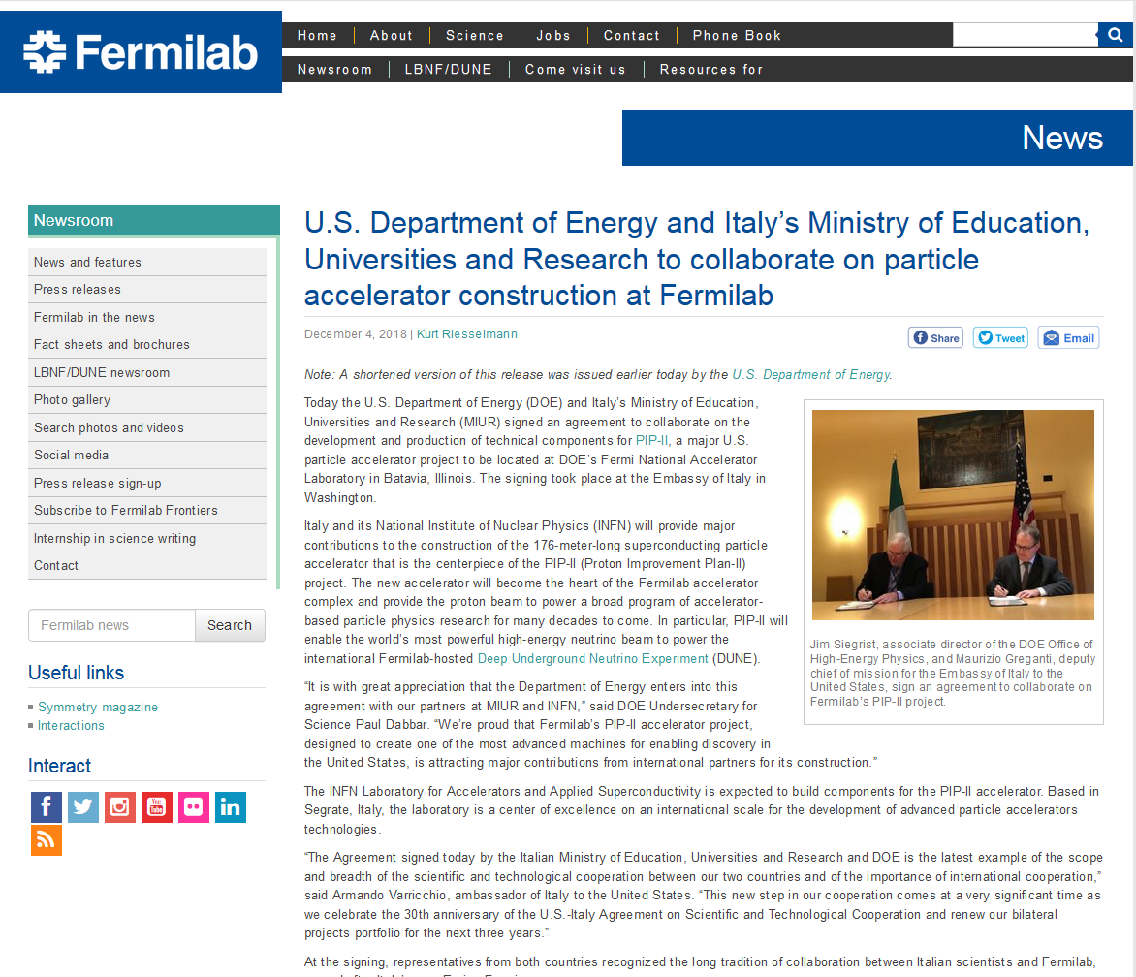
INFN & PIP-II
A long-term fruitful Collaboration exists between Fermilab and INFN.
  A first agreement between DoE and Italian Ministry of Education, University and Research (MIUR) in July 2017 quote high power proton accelerators.
  Green light in 2018 from MIUR for an Italian participation to the realization of PIP-II through
  an in-kind contribution mediated by INFN LASA.
  INFN-LASA is today expected to build the 650 MHz cavities required by the low-beta section of the
  front-end linac, as signed by US Department of
  Energy and Italian MIUR on December 4th 2018.
December 4th, 2018, the U.S. DOE and Italy’s MIUR agreement signed

Slide 15
INFN & PIP-II
INFN - LASA firstly provided a novel RF design for the LB650 cavities, fully plug compatible with the Fermilab technical interfaces and performances specifications.
  This cavity design has been chosen for PIP-II LB650 as the best compromise between CW and pulsed operation performances
INFN-LASA contribution is expected to cover the needs of LB650 section, and this includes:
  40 SC cavities (36 plus contingency) delivered as ready for string assembly, equipping 9 cryomodules.
  Qualification via vertical cold-test through a qualified cold-testing infrastructure acting as a subcontractor. INFN-LASA will cover a limited number of cavity tests.
  Compliance to the PIP-II Technical Review Plan, the procedure
  issued by Fermilab in order to meet PIP-II technical,
  schedule and budget commitments.
  Engagement of INFN-LASA and Fermilab technical teams to
  ensure that final cavity design properly interfaces with
  external components.
PIP-II LB650 Project Specifications
Acc. Gradient | 17.5 MV/m
Q₀ | 2.3 10¹⁰
RF rep rate | 20 Hz to CW
Beta | 0.61

Slide 16

INFN PIP-II Cavity Design
INFN LB650 for PIP-II, cold cavity
β_{geometric} | 0.61
Frequency | 650 MHz
Number of cells | 5
Iris diameter | 88 mm
Cell-to-cell coupling, k_{cc} | 0.95 %
Frequency separation π-4π/5 | 0.57 MHz
Eq. diameter - IC | 389.8 mm
Eq. diameter - EC | 392.1 mm
Wall angle – Inner & End cells | 2 °
Effective length (10*L_{hc}) | 704 mm
Optimum beta β_{opt} | 0.65
E_{peak}/E_{acc} @ β_{opt} | 2.40
B_{peak}/E_{acc} @ β_{opt} | 4.48 mT/(MV/m)
R/Q @ β_{opt} | 340 Ω
G @ β_{opt} | 193 Ω
Inner cells stiffening radius | 90 mm
External cells stiffening radius | 90 mm
Wall thickness | 4.2 mm
Longitudinal stiffness | 1.8 kN/mm
Longitudinal frequency sensitivity | 250 kHz/mm
LFD coefficient k_{ext} at 40 kN/mm | -1.4 Hz/(MV/m)²
Pressure sensitivity k_{ext} at 40 kN/mm | -11 Hz/mbar
Maximum Pressure VM stress at 50 MPa | 2.9 bar
Maximum Displacement VM stress at 50 MPa | 1.5 mm
INFN LB650 RF Design rationales:
Cell coupling k_{cc} optimized assuming TESLA-type cavity as a reference, of the quantity N²/(βk_{cc}), where N is number of cells, β relative velocity. It models field-flatness sensitivity to cell frequency errors.
End Cell frequency tuning achieved by increasing the diameter of the whole terminal cell thus preserving its round shape and symmetry.
Maximize G factor while preserving sidewall angle at 2° avoiding potentially negative value during the cavity field flatness tuning stage.
Achieve a large frequency separation between π and 4/5 π modes.
Single stiffening rings at both end and inner cells,
preserving manufacturing quality and
tunability with respect to a
double stiffener.
Example of EM analyses performed: Dipole HOM at 1678 MHz showing partial reflections in the FPC

Slide 17


INFN & PIP-II – from Design to Manufacturing
In order start validating cavity design, fabrication procedures and surface treatments, several prototype cavities are being realized:
5 single-cell cavities, 3 already manufactured and 2 soon to be delivered
2 complete 5-cell cavities, fully compliant to the current state of cavity interfaces as per Fermilab specifications. Delivery expected after summer 2019.
  Eddy Current scanning of Nb sheets ongoing now at DESY.
INFN prototype
as designed
Surface inspection of copper mockup
End-group stage
5 delivered single-cell cavities

Slide 18


INFN-LASA and Fermilab joint agenda items
Electro-Polishing RF surface treatment: specific tools
are being developed and the process recipe is being
optimized for the PIP-II geometry with steep cell walls.
  The difference in size and shape requires a careful
  optimization of treatment parameters and electrode
  geometry with respect to 1.3 GHz tesla-shaped cavities
  First step: successful results with test EP removal
  at the prototypes vendor premises on a single-cell cavity.
Prototypes shared with Fermilab, surface treated and qualified by means of vertical cold-tests in both infrastructures early 2020.
In-depth characterization of magnetic flux expulsion performances of the Niobium material of these prototypes at the VTS facility at FNAL.
Jacketing and dressing of at least one multi-cell prototype to conclude this phase with an horizontal test with power coupler by late 2020.

Slide 19
Infrastruttura criogenica e test RF

Slide 20







Superconducting cavities testing facilities
Bunker with vertical LHe cryostat, φ 700 mm, 4500 mm depth, can hold large SC cavities as 500 MHz
Sub-cooling system for superfluid helium, up to 1.5 K.
Cooling power 40 W a 2.0K
2 Cold inserts for cavity testing
RF generators: 700 MHz, 1.3 and 3.9 GHz, with
related accessories as PLL, power meters, etc.
Associated infrastructures
  ISO4 clean room (9 m²)
  High Pressure Rinsing facility
  Slow pumping Slow venting system
  UP water production plant (100 l/h)

Slide 21




Cryogenic infrastructure
Helium Liquefier:
LINDE TCF100 (second hand in 1983)
  40 l/h with LN₂
  Manual operation
  Refurbishment for automatic operation under way
Liquefier compressor: Sulzer, dry, 4 pistons
Recovery compressors: 100 m³/h
He purifier Linde, single column
He gas inventory: 4000 Nm³
LHe storage dewar: 4000 l
Balloon: 100 m³
On line He gas analysis: H₂O, O₂, N₂

Slide 22
Cryogenic infrastructure – workload
Helium Liquefier operation is fully enslaved to experiments and to the maintaining infrastructure as dewars cold (about 400 h/year for this purpose).
SC RF cavity processes 2300 liters of LHe for each test.
SC Magnet processes 1200 liters of LHe for each test.
Typical annual running figures.
  Running time, last 5 Y: between 1000 and 2000 h/y, depending on experiments.
  Discontinuous operation for the liquefier: typically 80 – 100 h for a single liquefaction cycle, every 3 - 5 weeks and up to 20 cycles per year.
  LHe produced per year: ∼ 40000 l
  Losses for physiological leaks, about
  5-7 LHe liters per day. Remedy under way.
Limited man power and no turnover!
  Typically one person runs the liquefier
  Support available from groups and
  lab General Services (3 more peoples)
  No margin available if more plant
  intense use is foreseen as for next years
year | SRF tests | SCM tests | LHe purchased (l) | LHe cost (€/l) no VAT
2015 | 5 | 2 | 2700 | 8.10
2016 | 5 | 2 | 3600 | 8.50
2017 | 2 | 2 | 4500 | 9.10
2018 | 2 | 2 | 2700 | 11.8
2019 | 3 (5 tot) | 4 (5 tot) | (3600) | (13 or more?)
2020 | 5 | 5 | (> 4000) | ?
2021 | 3 | 5 | (> 4000) | ?
2022 | 3 | 5 | (> 4000) | ?

Slide 23
Cryogenic infrastructure: status and upgrade
Warm helium gas management, from recovery to 200 bar storage
  Contract awarded to Linde for a fully automized and remotely controllable gas panel with embedded process and operator safety measures.
Helium liquefier status: in operation, limited degraded in performances, LHe transfer efficiency reduced.
  Assessment of TCF100 status by LINDE to happen soon. Then just two options are available. Only limited maintenance is possible only on heat-exchangers (60 k€).
  Revamping: keeping the existing cold-box and upgrade the full control chain, both hardware (pneumatic actuators) and software (PLC) to a modern unit.
  No guarantee on coldbox lifetime!
  350 k€ + VAT, 6 months lead time, 4 weeks installation time
  Buying a new liquefier (60 l/h).
  1.2 - 1.5 M€ + VAT, including piping and electrical installation
  8 months lead time, 6 weeks installation time

Slide 24
Personale
 | Ricercatori e tecnologi |  |  |  | Tecnici
 | TI |  |  |  | TI
 | Angelo Bosotti |  |  |  | Massimo Bonezzi
 | Paolo Michelato |  |  |  | Massimo Fusetti
 | Laura Monaco
 | Carlo Pagani |  |  |  | Calcolo (Pietro Spada)
 | Rocco Paparella |  |  |  | Progettazione e officina (Carlo Uva)
 | Daniele Sertore |  |  |  | Servizi generali (Luca Imeri, Mauro Quadrio)
 | TD |  |  |  | TD
 | Alessio D'Ambros |  |  |  | Vito Vizziello
 | Michele Bertucci
 | Giorgio Fornasier
 | Tommaso Grimaldi
 | Sandeep Mohanty

Slide 25
Photocathodes for High Brightness Photoinjectors
LASA is providing high QE Cs₂Te photocathodes since ‘90s (more than 150 photocathode produced) to different labs for high brightness RF electron gun operation, representing the state of the art in this field.
  DESY (FLASH, PITZ, REGAE)
  E-XFEL
  APEX (LBNL)
  FAST (FNAL)
  LBNL for the LCLS II commissioning
Preparation Chamber at LASA
13 mm
10 mm
5 mm
2005
2009
2015
1999
2001
2003
2004
2011
2013
2016
1998
2000
2002
2006
2007
2008
2010
“New diagnostic”
VT installation
Cs₂Te Production & Transfer
Cs₂Te Production
Cs₂Te Transfer

Slide 26


New Collaborations on photocathodes
Shanghai Tech University
(MoU signed with INFN in Feb 2019)
  Interest for a complete photocathode systems
  based on Cs₂Te for RF Gun
  Interest for a complete modified photocathode
  systems based on Cs₂Te for 500 kV DC Gun
DESY Zeuthen (cost sharing with INFN LEAPh)
  Established a reproducible procedure to grow alkali antimonide compounds (green sensitive) on INFN plugs
  Development (design and construction) and of a new photocathode system for visible light sensitive photocathode (base pressure in the low 10⁻¹¹ mbar)
New Pumping System based on D2000 NexTorr (SAES)

Slide 27


Photocathode Stress test for CW operation (BriXSinO)
The operation of photocathodes at 1 MHz as SHINE, LCLS II, MariX, and even more at the 100 MHz repetition rate foreseen for BriXs is a challenge for the present photocathodes and lasers.
INFN supported a photocathode stress test, funding the buying of a first part of the 100 MHz BriXSinO laser system.
We plan a stress test for Cs₂Te photocathodes at LASA in our DC gun with a dedicated laser (tender in progress)
  Laser: 10 W in IR and 0.5 W in UV @ 100 MHz
  DC Gun: 100 kV (max), 8 mm gap
  Photocathode charge (QE=5 % @ 254 nm): 50 pC
Uscita alternativa per cross correlatore
*
BBO
λ/2
Sistema telescopico 2
*
HP10
A
LBO
PBS
Dic1
Dic2
*
delay
Foc-CC
Shaping
BBO
UV-det
*
α-BBO
BS-diag
T
«CCD»
Sistema telescopico 3
Sistema telescopico 4
BS-UV
PC
Oscilloscopio

Slide 28
Spare slides

Slide 29
Cryoplant layout

Slide 30





Lifetime and extracted charge in pulsed operation
73.3 QE Evolution
Pulsed operation
800 μs, 1 MHz, 10 Hz
73.3 Dark Current Evolution
Δ time=439 days
Δ time > 3 years
Extracted charge: 3.1 C
Extracted charge: ~ 20 C

Slide 31




Lifetime and extracted charge in CW operation
CW operation
1 MHz

Slide 32


Photocathodes for High Brightness Photoinjectors
LASA photocathode systems are UHV systems and consist of a preparation system, a transport box (suitcase) and a transfer system for insertion of the photocathodes into the gun.
The systems have been installed in many labs and several suitcases (> 10) are available for photocathode exchange between the labs.
The upgraded version of the suitcase is
based on SAES NexTorr pump, allowing
shipping by plane.
DESY FLASH
Final Tuning
Preparation Chamber at LASA
Transport Box
VT installation
New transport box
Preparation Chamber

Slide 33



Cs₂Te growth studies and stability
  Cs₂Te growth studied by XPS
  (in collaboration with UniModena)
    Different compounds identified before
    formation of the correct stochiometric ratio
  On-line monitoring of reflectivity and spectral response allows achieving stable and reproducible photoemissive films.
  Deposition stable and reproducible
  also changing Te film thickness both
  in QE and in reflectivity
Hg lamp
A. di Bona et al., JAP80(1996)3024
Prep. chamber viewport
Shutter
Filter wheel
Incident power
Reflected power
Photodiode
Photocurrent signal
Remote controller

Slide 34


Cs₂Te R&D
5th harmonic (λ = 211 nm)
ε_{th} = 0.7 ± 0.1 mm mrad
for 1 mm rms spot radius
Intensive R&D activity has supported the production process aiming in deeper understanding of the physical properties of the materials
  Optical properties
  Photoemission model
  Thermal Emittance
Vacuum
Cs₂Te
Cs₂Te
4th harmonic (λ = 264 nm)
ε_{th} = 0.5 ± 0.1 mm mrad
for 1 mm rms spot radius
Molibdenum
R_{s}
R_{p}
n | k | σ [nm] | thickness [nm]
1.75 | 0.356 | 0 | 38.5

