Slide 1
RF laboratory instrumentation
L. Piersanti, M. bellaveglia, F. cardelli, A. Gallo

Slide 2
summary
Recap of dB formalism and scattering parameters
Time domain measurements
Digital oscilloscope
Frequency domain measurements
Spectrum Analyzer (SA)
Vector Network Analyzer (VNA, or simply NA)

Slide 3

Conversion to db scale
A convenient form to express large power or voltage ratios is the “dB scale”
$dB=20 \log\left(\frac{V_{2}}{V_{1}}\right)$ = $10 \log\left(\frac{P_{2}}{P_{1}}\right)$
When dB is given, the conversions are:
$\frac{V_{2}}{V_{1}}={10}^{dB/20}$ and $\frac{P_{2}}{P_{1}}={10}^{dB/10}$
Expressing voltage and power ratios in dB simplifies the algebra, since multiplication is reduced to addition and division to subtraction
We use $dB$ to simplify ratios. An absolute measure of power is given by the quantities $dBm$ or $dBW$:
$$dBm=10 \log\left(P_{mW}\right) ⇒ 0 dBm=1 mW$$
$$dBW=10 \log\left(P_{W}\right)⇒0 dBW=1 W$$
Power | 1 µW | 10 µW | .1 mW | 1 mW | 10 mW | .1 W | 1 W | 10 W | .1 kW | 1 kW | 10 kW | .1 MW | 1 MW
dBm | -30 | -20 | -10 | 0 | 10 | 20 | 30 | 40 | 50 | 60 | 70 | 80 | 90
dBW | -60 | -50 | -40 | -30 | -20 | -10 | 0 | 10 | 20 | 30 | 40 | 50 | 60

Slide 4





2-ports Network characterization
I₁
I₂
V₁
DUT
V₂
Low frequency network characterization
$$y_{12}={\left.\frac{I_{1}}{V_{2}}\right|}_{V_{1}=0}$$
Hybrid parameters
Admittance parameters
Impedance parameters
$V_{1}=$ $h_{11}I_{1}+h_{12}V_{2}$
$I_{2}=$ $h_{21}I_{1}+h_{22}V_{2}$
$I_{1}=$ $y_{11}V_{1}+y_{12}V_{2}$
$I_{2}=$ $y_{21}V_{1}+y_{22}V_{2}$
$V_{1}=$ $z_{11}I_{1}+z_{12}I_{2}$
$V_{2}=$ $z_{21}I_{1}+z_{22}I_{2}$
$$z_{12}={\left.\frac{V_{1}}{I_{2}}\right|}_{I_{1}=0}$$
At high frequency is very hard to measure total voltage and current at the device ports
A voltmeter or a current probe cannot be directly connected to get an accurate measurement, due to the impedance of the probe itself and the difficulty to correctly place the probe at the desired position
In the case of a short circuit with a wire; the wire itself has an inductance that can be of substantial magnitude at high frequency. Also open circuit (I=0 condition at high frequencies is not obtained simply “opening” a circuit, due to irradiation…) leads to capacitive loading at the terminal
In addition, active device may oscillate or even self-destruct when connected to short or open terminations!!!

Slide 5


Scattering parameters
Incident
S₂₁
Transmitted
a₁
Reflected
b₂
S₁₁
DUT
Port 1
Port 2
S₂₂
b₁
Reflected
a₂
Transmitted
S₁₂
Incident
For a 2 port device, two other independent equations may be written, which are function of incident (a) and reflected (b) waves:
Where b₁ comprises the sum of a quantity reflected from port 1 and a quantity that is the result of the transmission trough the device in the reverse direction (and vice versa for b₂) .
These quantities are scaled to be proportional to the voltage wave amplitude and phase such that:
${\left|a_{n}\right|}^{2}$= incident power on the n-th port
${\left|b_{n}\right|}^{2}$= emerging power from the n-th port
$b_{1}=$ $S_{11}a_{1}+S_{12}a_{2}$
$b_{2}=$ $S_{21}a_{1}+S_{22}a_{2}$

Slide 6



Measuring S parameters (1)
Incident
S₂₁
Transmitted
a₁
b₂
S₁₁
DUT
Port 1
Port 2
b₁
a₂
Reflected
$b_{1}=$ $S_{11}a_{1}+S_{12}a_{2}$
$b_{2}=$ $S_{21}a_{1}+S_{22}a_{2}$
$$S_{11}={\left.\frac{b_{1}}{a_{1}}\right|}_{a_{2}=0}$$
$$S_{21}={\left.\frac{b_{2}}{a_{1}}\right|}_{a_{2}=0}$$
Ideal matched load (Z₀) on port 2
Related to familiar measurements: gain, loss, reflection coefficient
Defined in terms of voltage travelling waves – relatively easy to measure at high frequencies
No connection of undesirable loads to the DUT (short or open), but only matched loads
Measured S parameters of multiple devices can be cascaded to predict overall system performance

Slide 7


Scattering parameters (2)
$m$: port where signal emerges
$n$: port where signal is applied
S_{m n}
$N$-port device has $N^{2}$ scattering parameters
Parameter | Common measurement term
S₁₁ | Forward reflection coefficient (input match)
S₂₁ | Forward transmission coefficient (gain or loss)
S₂₂ | Reverse reflection coefficient (output match)
S₁₂ | Reverse transmission coefficient (isolation)
S parameters are inherently complex, linear quantities. They are expressed as real-and-imaginary or amplitude-and-phase pairs
However, often we want to look only at the magnitude of an S-parameter (e.g. when looking at insertion loss or input match), and often a logarithmic scale is more useful. A log-magnitude display let us see far more dynamic range than a linear format

Slide 8
TIME domain measurements

Slide 9
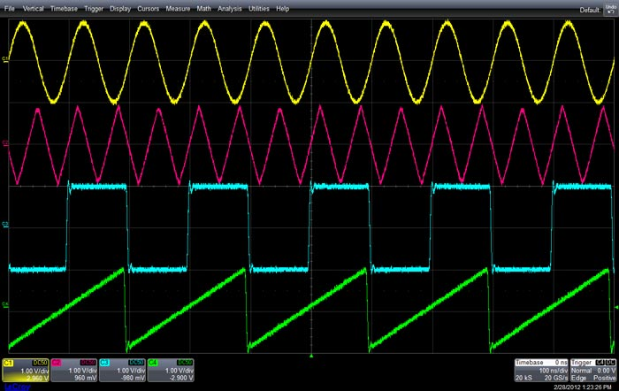
Digital oscilloscope
One of the most common and intuitive device in a RF/electronics/particle physics LAB
Signal characterization in time domain (amplitude vs time)
Input signal is buffered and then A/D converted. Instrument BW and resolution depend on the front-end, ADC “quality” (n. of bits) and software efficiency
Digital data stream is stored, processed and displayed according to experimental needs. For example: special digital signal algorithms allow smart triggering of the instrument
Analog to Digital
Converter
Acquisition
Memory
Image
Processing
Display
Amp
Analog
waveform
Digitized
waveform
Trigger circuit
DIGITAL OSCILLOSCOPE SIMPLIFIED BLOCK DIAGRAM

Slide 10
Frequency domain measurements

Slide 11
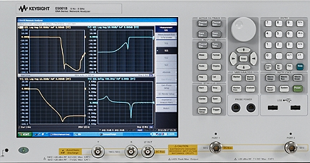
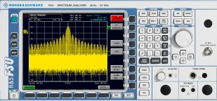
What is the difference between network and spectrum analyzers?
NETWORK ANALYZERS
SPECTRUM ANALYZERS
Measure “known” signals (in terms of frequency)
Measure “unknown” signals (in terms of frequency)
Amplitude ratio
Phase difference
Power
Frequency
Frequency
Measure signal amplitude characteristics (carrier level, sidebands, harmonics, phase noise etc.)
Are receivers only (single channel)
Can be used for scalar components measurements (NO phase) with tracking generator
Easy to get a trace, much more complicated than a VNA to interpret the results
Characterize components, devices, circuits, sub assemblies and even accelerating structures
Contain source and multiple receivers
Display ratioed amplitude and phase (frequency or power sweeps)
Hard to get an accurate trace, easy to interpret the results

Slide 12
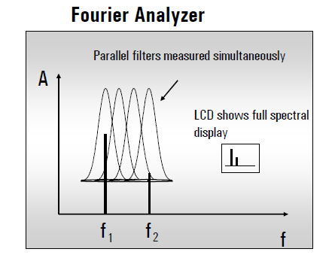
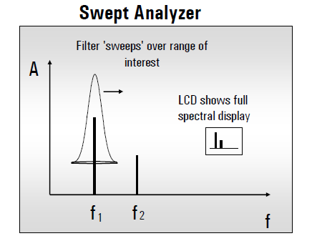
Spectrum analyzer (signal characterization in frequency domain)
Two main system architectures:
Takes a time-domain signal, digitizes it using digital sampling, then performs the DFT and displays the result. As ADC and DSP technology advances are becoming more prevalent, this architecture is more and more used.
Most common type. These analyzers sweep a reference signal across the frequency range of interest, mixing it with the unknown signal displaying all the frequency components present.

Slide 13
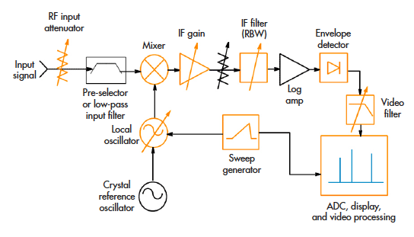
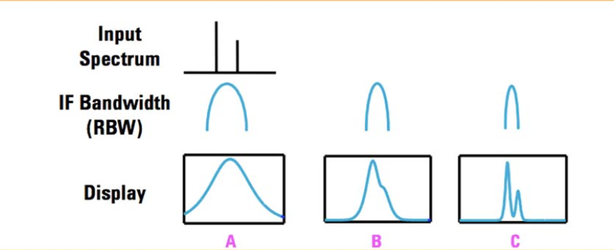
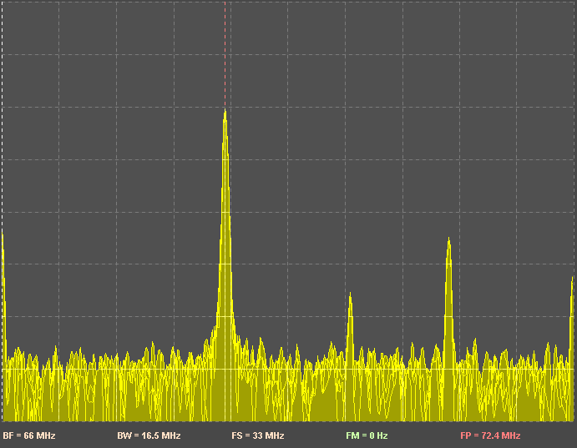
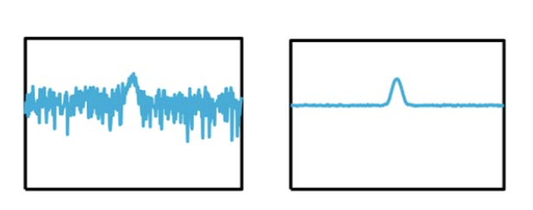
Swept analyzers
An internal source sweeps a selected frequency range to downconvert and filter the input signal. The IF filter output power reveals the spectral content of the signal at the instantaneous frequency scanned by the instrument.
RBW determines how closely two input signal peaks with comparable amplitudes can be spaced and have the spectrum analyzer resolve the difference between them.
Video BW determines how fast the sweep can go for the data acquisition and display to accurately follow it (trace average/smoothing).

Slide 14
Vector Network Analyzer (VNA)
Internal description
Calibration – error matrix
Practical example: measurement of a filter

Slide 15
VNA building blocks
A Vector Network Analyzer measures the scattering matrix elements s_{ij} (i.e. input/output matching and forward/backward transfer function) of a Device Under Test
1. Source
Device Under Test
(DUT)
Z₀
2. Signal separation
4. Process and display
Incident
Reflected
Transmitted
3. Detector and receiver
An internal sine wave source is swept within a given frequency range.
Reflected and transmitted signals are measured and normalized to the source. The direction of the excitation can be inverted.

Slide 16
VNA building blocks
1. Source
DUT
Z₀
2. Signal separation
4. Process and display
Incident
Reflected
Transmitted
3. Detector and receiver

Slide 17
Reference source
Supplies stimulus for our “stimulus/response” system
Either frequency or power sweep (non-linear behavior of amplifiers)
Either based on open loop VCOs (cheap, high phase noise) or synthesized sweepers (higher performance especially with narrowband components, frequency resolution and stability)
The majority of network analyzer sold today has integrated, synthesized sources, providing excellent frequency resolution and stability

Slide 18
VNA building blocks
1. Source
DUT
Z₀
2. Signal separation
4. Process and display
Incident
Reflected
Transmitted
3. Detector and receiver

Slide 19
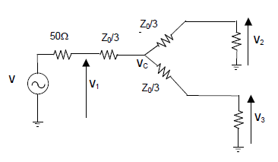
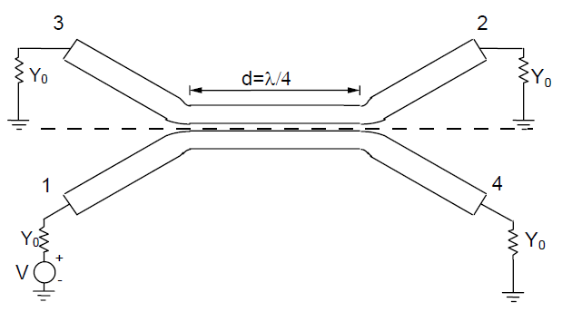
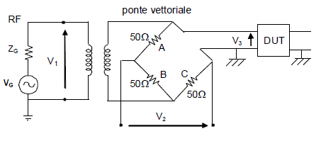
Signal separation
Measure a portion of the incident signal to provide a reference for ratioing
Resistive splitters
Non directional, broadband
> 6 dB insertion loss on each arm
Directional couplers
Low insertion loss, good isolation and directivity
Widely used in the microwave, high pass response makes them unusable below 40 MHz
Separate forward and reflected travelling waves at the input of the DUT
Directional couplers are again ideal components due to their isolation, directivity and low insertion loss
However, due to the difficulty to make them broadband, bridges are often used (DC, higher losses)

Slide 20
VNA building blocks
1. Source
DUT
Z₀
2. Signal separation
4. Process and display
Incident
Reflected
Transmitted
3. Detector and receiver

Slide 21
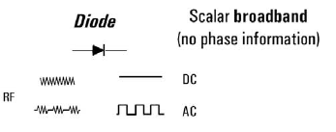
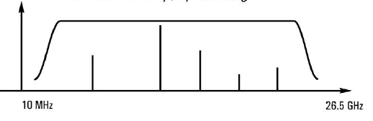
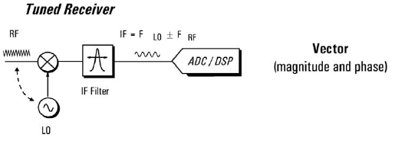
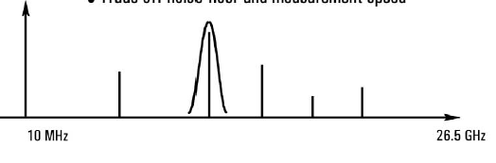
Detector and receiver
Direct detection (scalar)
Peak detector (RF diodes)
Broadband (typically from 10 MHz to 30 GHz), low-cost
Dynamic range of the order of 60 dB
Sensitive to source harmonics and other spurious signals
Tuned Receiver (vector – super heterodyne)
Uses a local oscillator (LO) to mix the RF down to a lower intermediate frequency (IF)
The IF signal is bandpass filtered (narrows the bandwidth and improves the sensitivity and dynamic range)
By means of ADC and DSP to extract magnitude and phase information from the IF signal.
Tuner-receiver approach is used in vector network analyzers and spectrum analyzers

Slide 22
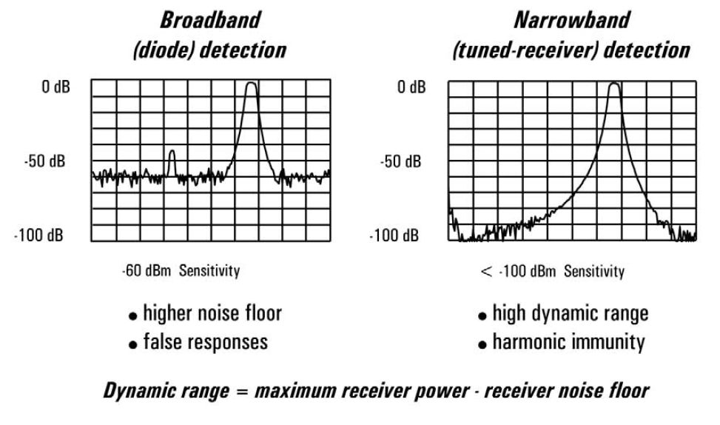
Detection schemes comparison
Dynamic range is defined as the maximum power the receiver can accurately measure minus the receiver noise floor
Many applications require a high dynamic range: e.g. measurement of a filter stopband performance
Notice that the filter exhibit 90 dB of rejection, which is not measurable with the scalar detection (due to the higher noise floor)
Scalar detection prone to false responses: e.g. a harmonic of the source might fall in the passband of the filter. The detector will register a response even though the stopband is attenuating the frequency of the fundamental. In a tuned receiver such signal would be filtered away and would not appear on the display
Source sub-harmonics and spurious outputs can also cause false display responses

Slide 23
VNA building blocks
1. Source
DUT
Z₀
2. Signal separation
4. Process and display
Incident
Reflected
Transmitted
3. Detector and receiver

Slide 24
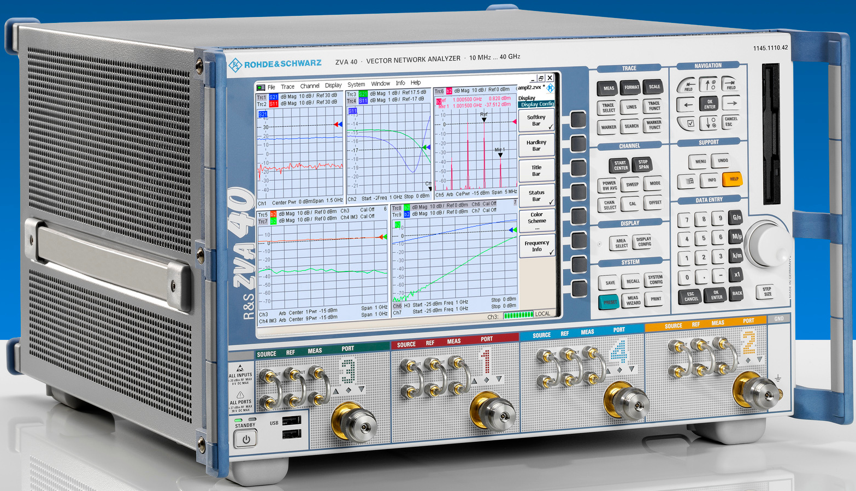
Process and display
Instrument set-up
Power, frequency, IF filter, number of points, averages
Various formatting modes:
Linear and log sweeps
Linear and log formats
Polar plots
Smith charts
Trace markers
Limit lines
Internal measurements automation (save/recall state)
PC compatible programs used to automate measurements and create intuitive GUI (LabView)

Slide 25
Measurement error sources
Three basic sources of measurement error
Systematic:
Due to imperfections in the analyzer and test setup
Repeatable (and therefore predictable), time invariant
Characterized during calibration process and mathematically removed during measurements
Random
Unpredictable (they vary with time in a random fashion)
Cannot be removed by calibration
Main contributors: switch and connector repeatability, instrument noise (source phase noise, sampler noise, IF noise)
Drift
Instrument or test system performance changing AFTER a calibration has been done
Primarily caused by temperature variation
Can be removed by further calibrations
The timeframe over which a calibration remains accurate depends on the rate of drift in the test environment
Usually, providing a stable ambient temperature is sufficient to minimize drift errors
Calibration
Cannot be removed
Re-calibration or temperature stabilization
Notes:
Systematic errors are caused by imperfections in the test equipment and test setup. If these errors do not vary over time, they can be characterized through calibration and mathematically removed during the measurement process. Systematic errors encountered in network measurements are related to signal leakage, signal reflections, and frequency response.
Random errors vary randomly as a function of time. Since they are not predictable, they cannot be removed by calibration. The main contributors to random errors are instrument noise (e.g., sampling circuit noise, and the IF noise floor), switch repeatability, and connector repeatability. When using network analyzers, noise errors can often be reduced by increasing source power, narrowing the IF bandwidth, or by using trace averaging over multiple sweeps.
Drift errors occur when a test system’s performance changes after a calibration has been performed. They are primarily caused by temperature variation and can be removed by additional calibration. The rate of drift determines how frequently additional calibrations are needed.

Slide 26
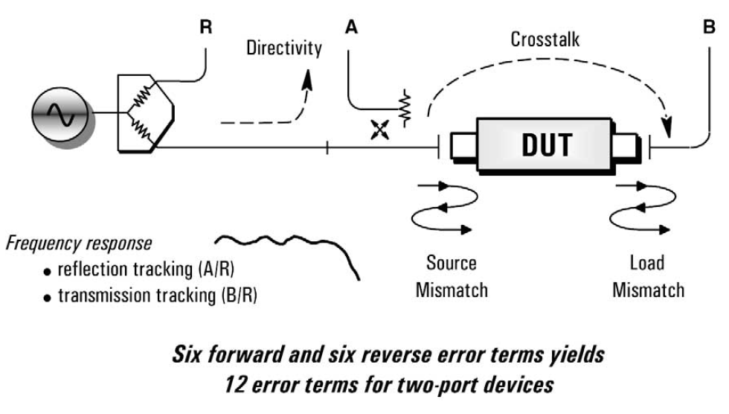
Systematic measurement errors
3 categories of errors:
Signal leakage:
Directivity
Crosstalk
Signal reflections:
Source match
Load match
Receiver frequency response:
Reflection tracking
Transmission tracking
The full 2 port error model includes all six terms for the forward and six terms for the reverse direction
Notes:
There are six types of systematic errors that can be grouped in three categories:
• Directivity and crosstalk errors relating to signal leakage • Source and load impedance mismatches relating to reflections
• Frequency response errors caused by reflection and transmission tracking within the test receivers
(The full two-port error model includes all six of these terms for the forward direction and the same six (with different data) in the reverse direction, for a total of twelve error terms. This is why two-port calibration is often referred to as twelve-term error correction.)

Slide 27
Types of error correction
Response (normalization)
Simple to perform (direct connection of network analyzer’s ports)
Only corrects for tracking errors
Stores reference trace in memory, then it calculates data/memory
Vector
Requires measurement of multiple standards (open, short, load, thru)
Requires an analyzer that can measure both magnitude and phase (VNA)
Accounts for all major sources of systematic error
1-port calibration:
Used for reflection measurement
Can correct only 3 terms (directivity, source match and reflection tracking)
Full 2-port calibration:
Used both for reflection and transmission measurements
12 systematic error terms are measured and removed
Ususally require 12 measurements on 4 known standards (thru, open, short, match - TOSM)
The electrical lengths of each standard are defined in a calibration kt file, stored in the network analyzer
Notes:
There are two basic types of error correction—response (normalization) corrections, and vector corrections.
Response calibration is simple to perform, but corrects for only a few of the 12 possible systematic error terms (namely, reflection and transmission tracking). Response calibration is a normalized measurement in which a reference trace is stored in the network analyzer’s memory, and the stored trace is divided into measurement data for normalization. A more advanced form of response cali- bration for reflection measurements, called open/short averaging, is commonly found on scalar analyzers and averages two traces to derive a reference trace.
Vector error correction is a more thorough method of removing systematic errors. This type of error correction requires a network analyzer capable of measuring (but not necessarily displaying) phase as well as magnitude, and a set of calibration standards with known, precise electrical characteristics.
The vector-correction process characterizes systematic error terms by measuring known calibration standards, storing these measurements within the ana- lyzer’s memory, and using this data to calculate an error model which is then used to remove the effects of systematic errors from subsequent measure- ments. This calibration process accounts for all major sources of systematic errors and permits very accurate measurements. However, it requires more standards and more measurements than response calibration. The two main types of vector error correction are the one-port and two-port calibrations.
Two-port error correction yields the most accurate results because it accounts for all of the major sources of systematic error. The error model for a two-port device reveals the four S-parameters measured in the forward and reverse directions.
Once the system error terms have been characterized, the network analyzer utilizes four equations to derive the actual device S-parameters from the meas- ured S-parameters. Because each S-parameter is a function of all four meas- ured S-parameters, a network analyzer must make a forward and reverse test sweep before updating any one S-parameter.
When performing a two-port calibration, the part of the calibration that char- acterizes crosstalk (isolation) can often be omitted. Crosstalk, which is signal leakage between test ports when no device is present, can be a problem when testing high-isolation devices such as a switch in the open position, and high- dynamic-range devices such as filters with a high level of rejection.

Slide 28
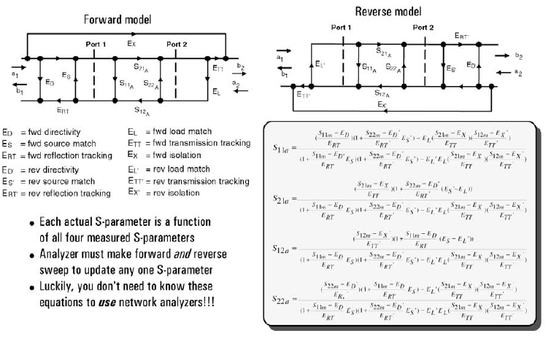
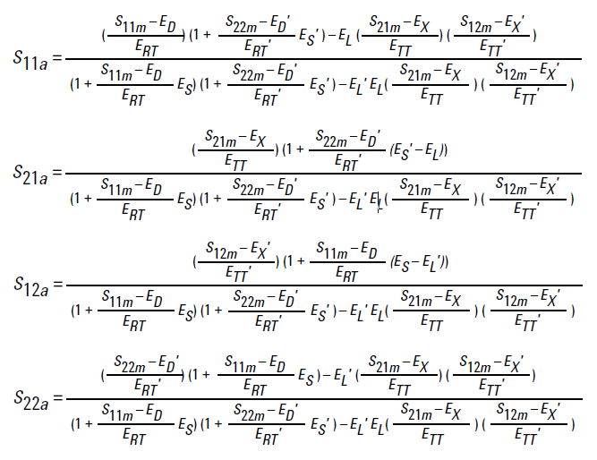
2-port error model
Each actual S-parameter is function of all four measured S-parameters
VNA must make a forward and reverse sweep to update any one S-parameter
Luckily you don’t need to know these equations to use a network analyzer!!!

Slide 29
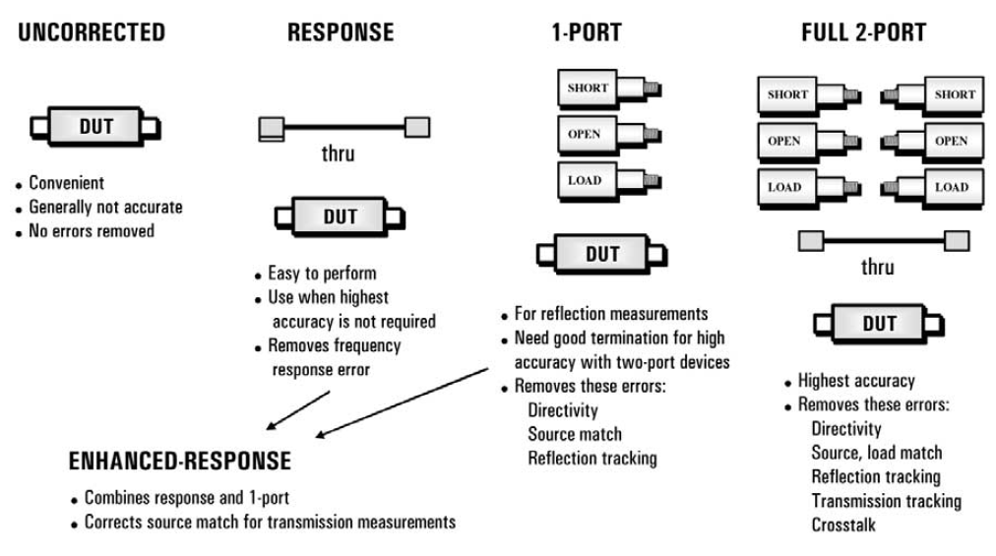
Summarizing…

Slide 30
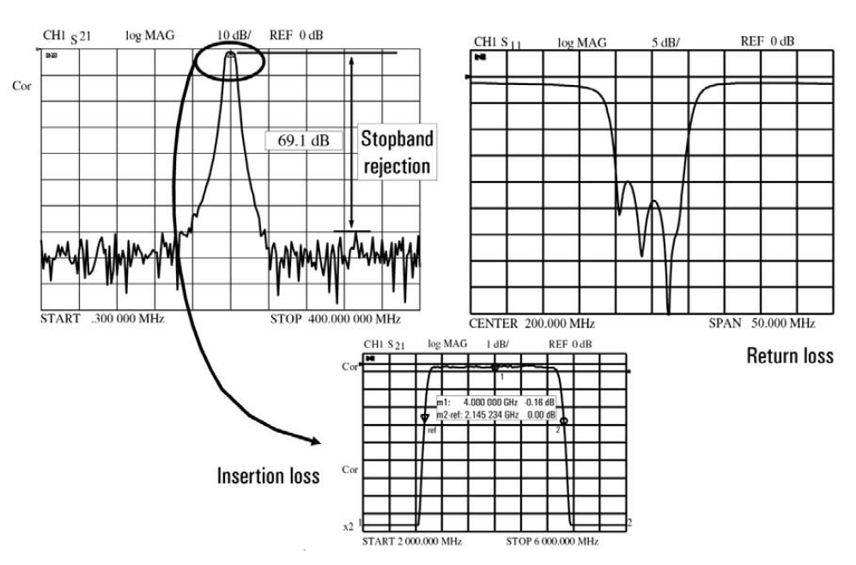
Example: filter characterization
Parameters to measure:
Insertion loss
Bandwidth
Out of band rejection (how well the filter passes signal within its bandwidth while simultaneously rejecting all other signals outside the same bandwidth)
Return loss (high reflection in the stopbands, reasonable match in the passband)
VNA parameters to set:
Frequency (start-stop or center-span)
Source power
Number of points
IF bandwidth
N. of averages

Slide 31
REFERENCES
[1] Keysight Technologies website:
www.keysight.com
[2] Keysight techincal notes: www.keysight.com/main/facet.jspx?t=79831.g.1&cc=IT&lc=ita&sm=g

