Slide 1
Stato Farming ed evoluzione
Stefano Dal Pra
Diego Michelotto
Andrea Chierici

Slide 2
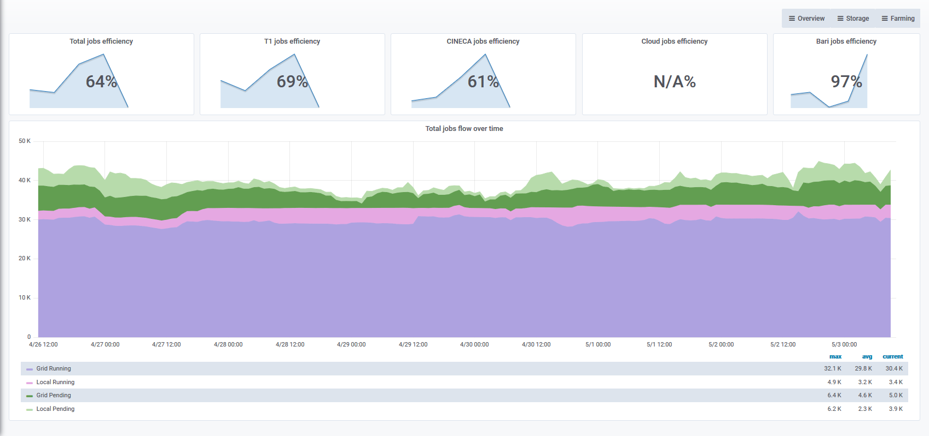
Job trends

Slide 3
Computing resources
Farm power: approx. 410 KHS06
Tenders in production: 2015, 2016, 2017, Cineca, ReCaS, 2014
extra-pledge for Virgo (approx. 56 KHS06)
2019 tender should be 37352 HS06
Investigated “Convenzione CONSIP Lotto 7”, roughly 13,41 euro/HS06

Slide 4
Condor in production (1)
Ready for production with test cluster for LHC and grid submissions
Following, local submitting Exps
Planning to slowly add WNs once the productions proves to be stable
While doing this, adapt monitoring and other tools
Work done on HTC-CE accounting

Slide 5
Condor in production (2)
HTC-CE
Possible to request GPUs, with accounting
BDII configured to publish Grid Info Provider
TODO
Integrate cluster monitoring
More tests on CE-jobrouter configuration
Define policy for job accounting files

Slide 6
Cloud@CNAF
1 production infrastructure for SDDS (mitaka)
1 testbed infrastructure for T1 + SDDS (rocky)
Soon ready for production
General specs
Everything is configured in HA
Automated installation via puppet
DBs are backed up
GPFS is the storage backend
TODO
Integration with IAM for Authn/Authz
Accounting
Upgrade to stein when available

