Slide 1
Experimental activity #2: Photocathode RF Gun
Overview:
This device is used a particles source in high brightness electron Linacs
Description of Photocathode RF Gun System and working principle
Theory of Resonant cavities and Multi-cells structures
Tuning of a cavity: Slater theorem and bead drop technique
Example of a real RF Gun
Overwiew of the measurement activity

Slide 2
Experimental activity #2: RF Photocathode Gun
An RF Gun is an electron source that generates very low emittance pulsed beams. The electron bunches are generated by photoelectric effect.
Very short laser pulses hit a metallic cathode, which is embedded in an electromagnetic accelerating structure.
It is a Standing Wave (SW) structure realized by two coupled resonant cavities.
The emitted electron bunches are confined by a solenoidal magnetic field and accelerated by an oscillating electric field on the gun axis.
Picosecond laser pulses and RF fields are synchronized for efficient acceleration.
The ratio of the number of electrons emitted per incident photon is called Quantum Efficiency (Q_{e}) which is a function of the photon energy. For metals, the minimum energy photons are typically in the ultraviolet range (λ(Cu) < 267nm).
klystron
Master Oscillator
RF signal
Drive Laser
Solenoid
Electron beam
Cathode

Slide 3
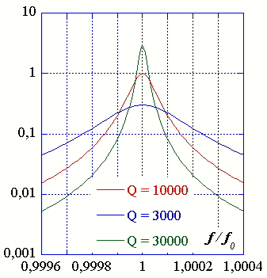

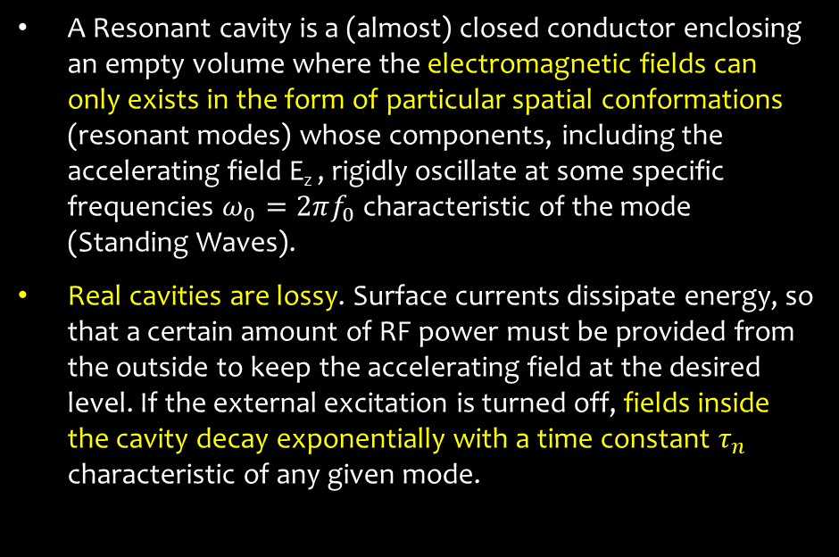



Standing Wave structures: Resonant cavities
A Resonant cavity is a (almost) closed conductor enclosing an empty volume where the electromagnetic fields can only exists in the form of particular spatial conformations (resonant modes) whose components, including the accelerating field E_{z} , rigidly oscillate at some specific frequencies $ω_{0}=2πf_{0}$ characteristic of the mode (Standing Waves).
Real cavities are lossy. Surface currents dissipate energy, so that a certain amount of RF power must be provided from the outside to keep the accelerating field at the desired level. If the external excitation is turned off, fields inside the cavity decay exponentially with a time constant $τ_{n}$ characteristic of any given mode.
Electric field
beam
${Q_{L}}_{ }=ω_{0}\frac{U}{P_{diss}+P_{out}} →$ $\frac{1}{Q_{L}}= \frac{1}{Q_{0}}+\frac{1}{Q_{ext}} →$ $\left\{\begin{matrix}Q_{0}=(1+β)Q_{L} \\ Q_{ext}= {Q_{0}}/β\end{matrix}\right.$
$$Q_{L}=\frac{∆ω|_{3 dB}}{ω_{0}}$$
$$β= \frac{Q_{0}}{Q_{ext}}=\frac{P_{out}}{P_{diss}} ≅\left\{\begin{aligned}\begin{matrix}<1 undercoupled → \frac{1−|ρ|}{1+|ρ|} \\ =1 critically coupled \end{matrix} \\ >1 overcouped → \frac{1+|ρ|}{1−|ρ|}\end{aligned}\right.$$
$$ρ$$
Reflection coefficient

Slide 4
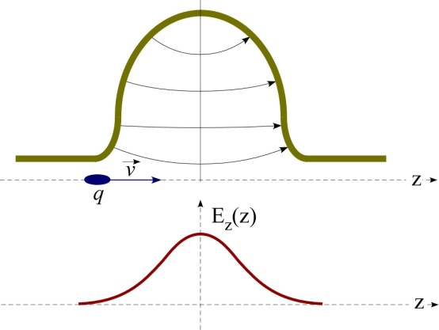
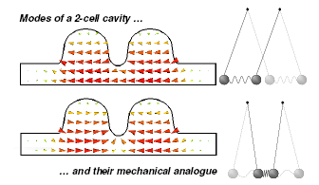





Cavities and multi-cell cavities
Cylindrical cavity or pillbox operating at the TM₀₁₀ accelerating mode. This mode has a longitudinal electric field in the centre of the cavity which is suitable for particle acceleration.
$$E_{r}=E_{θ}=H_{r}=H_{z}=0$$
$$E_{z}\left(r\right)=E_{0}J_{o}({p_{01}r}/a)$$
$$H_{θ}\left(r\right)={−j\sqrt{ε/μ}E}_{0}J_{1}({p_{01}r}/a)$$
Usually to have a more efficient acceleration more cavities (N) are coupled together.
The N-cells structure obtained behaves like a system composed by N oscillators coupled together.
Each single-cell mode degenerates in a set of N possible coupled oscillation modes of the whole system, characterized by a cell-to-cell phase advance given by:
$Δφ_{n}={nπ}/{N−1}$ $n=0,1…N−1$
SW multi-cell cavities are designed to use the last mode ($∆φ_{N−1}=π)$for acceleration ($L_{cell}= λ/2)$.

Slide 5
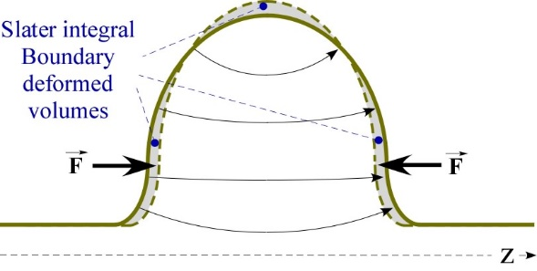
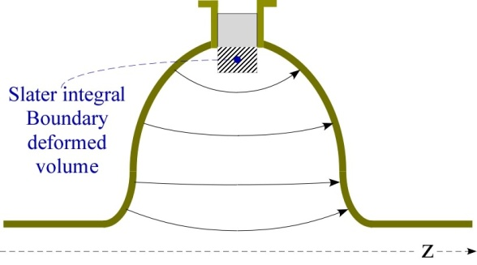

Slater Theorem
For a cavity on resonance, the electric and magnetic stored energies are equal. If a small perturbation is made on the cavity wall, this will generally produce an imbalance of the electric and magnetic energies, and the resonant frequency will shift to restore the balance. The Slater perturbation theorem describes the shift of the resonant frequency, when a small volume ΔV is removed from the cavity of volume V. The general result is
$$\frac{ω_{pert}−ω_{0}}{ω_{0}}=\frac{\int_{∆V}^{ }{(μH^{2}−εE^{2})}dτ}{\int_{V}^{ }{(μH^{2}+εE^{2})}dτ}=\frac{∆U_{H}−∆U_{E}}{U}$$
Where U is the total stored energy.
This theorem can be used also to measure the field profiles in the cavity by inserting a perturbing object and measuring the frequency shifts while moving it along selected paths. The theorem mathematical expression is different in this case and form factors need to be introduced because field lines are strongly deformed in this case, while they are almost unperturbed when the boundary is slightly deformed.
$$\frac{ω_{pert}−ω_{0}}{ω_{0}}=\frac{1}{4U}\int_{∆V}^{ }{(k_{B_{∥}}}μB_{∥}^{2}+k_{B_{⊥}}μB_{⊥}^{2}−k_{E_{∥}}εE_{∥}^{2}−k_{E_{⊥}}εE_{⊥}^{2})dτ$$

Slide 6
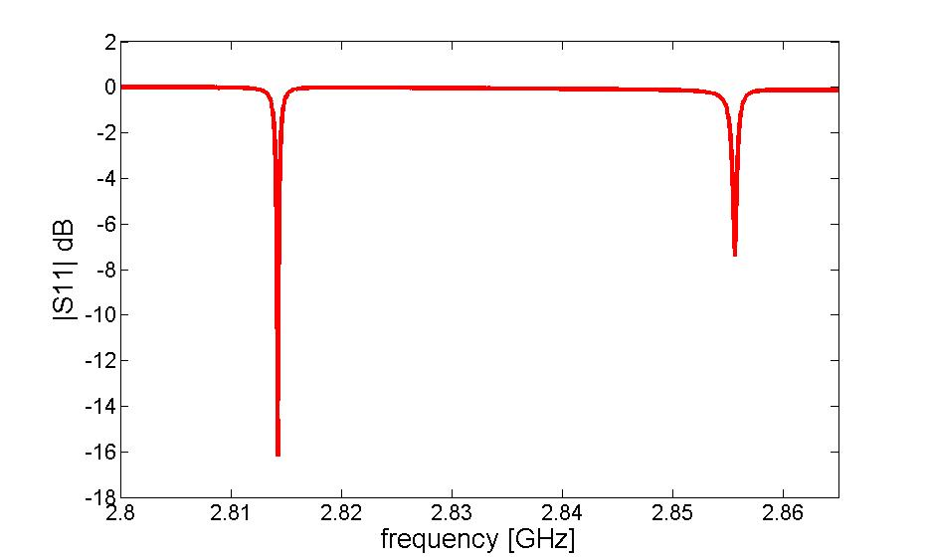




Bead Drop Measurement
Nylon wire
Probe
Network Analyzer
1-port Reflection measurement
bead
If the perturbing object (bead) is a perfectly conducting sphere the values of the form factors are:
$$k_{E_{∥}}=k_{E_{⊥}}=3; k_{B_{∥}}=k_{B_{⊥}}=3/2$$
If a sphere of radius a is moved along the beam axis of a cavity the E field profile and the R/Q of a resonant accelerating mode can be estimated according to:
$$E_{z}(z)≈ \sqrt{\left|\frac{(ω_{pert}(z)−ω_{0})}{ω_{0}}\right|\frac{U}{επa^{3}} }$$
R
Q
$$\frac{R}{Q}= \frac{V^{2}}{2P_{diss}}∙\frac{P_{diss}}{ω_{0}U}= \frac{1}{2πω_{0}εa^{3}}{\left|\int_{L}^{ }{\sqrt{\left|\frac{\left(ω_{pert}−ω_{0}\right)}{ω_{0}}\right|}sign(z)e^{jω_{0}z/c}dz}\right|}^{2}$$
$$V={\left|\int_{L}^{ }{{\hat{E}}_{z}\left(z\right)e^{jω_{0}z/c}dz}\right|}^{ }$$
Sign of the E-field profile (it takes into account the phase variation of the field )

Slide 7
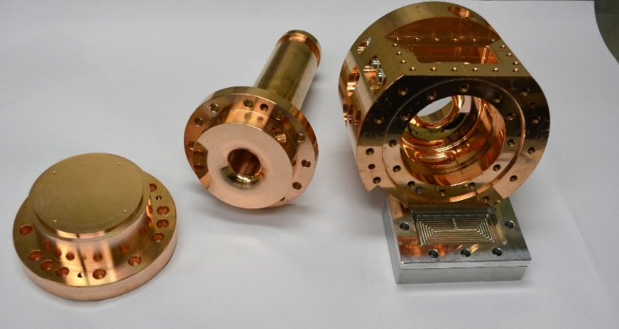
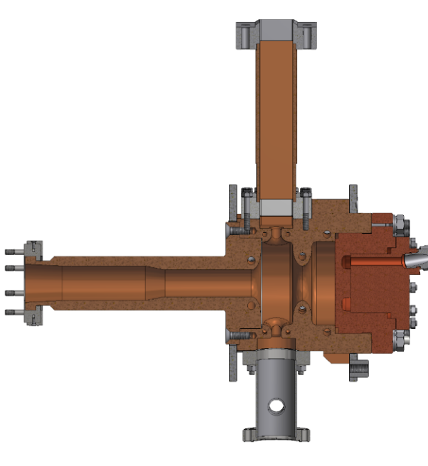
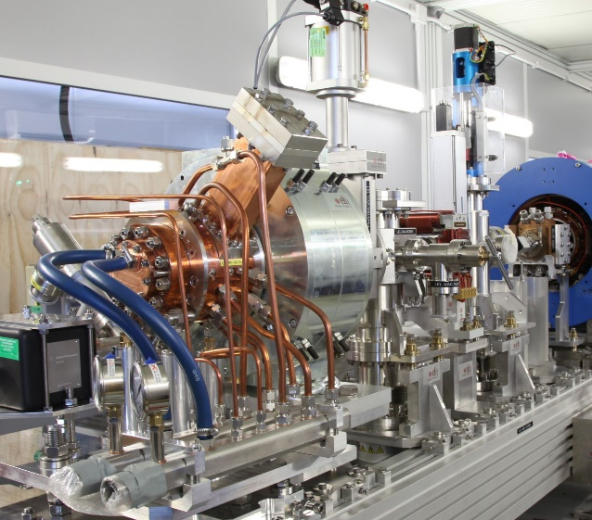
ELI-NP RF photocathode gun
1.6 cell photoinjector of the BNL/SLAC/UCLA type with new features:
elliptical shaped irises with larger aperture
Symmetric port to compensate the dipole field component
coupling hole rounded to reduce the pulsed heating
cooled cathode
fabrication without brazing using the clamping gasket technique
RF frequency | GHz | 2.856
Rep. Rate | Hz | 100
Working Mode | π mode (SW)
Max Rf input power | MW |  | 16
RF peak field at the cathode | MV/m |  | 120
Average dissipated power | kW |  | 1.5
Unloaded Q factor | 14500
Coupling coefficent β | 3
Working temperature | °C |  | 33 -34
Filling time | ns |  | 420
Shunt Impedance | MΩ/m |  | 1.64
Type of cathode | copper
RF gun
Input Waveguide
waveguide
cathode
Beam tube
pumping port
cells
Cathode
Solenoid

Slide 8

Experience overwiew
RF Gun characterization in reflection with Network Analizer
Calibration
Localize the two resonating modes measuring the S11 (NA settings: f_{start}=2.8GHz f_{stop}=2.86GHz)
Estimate the frequency separation $Δf$ between the two modes.
Measure the resonant frequency and the S11|_{fres} and compute the coupling factor β for the two modes (NA settings: f_{center}=f_{res} span=4MHz) (NOTE: the π-mode is overcoupled β > 1, the 0-mode is undercoupled β < 1)
RF Gun characterization in transmission with Network Analizer
Measure the S21 of the device and using the «Bandwidth» function (Marker Search -> Bandwidth) measure the Loaded Quality Factor Q_{L}
Compute the Unloaded Quality Factor Q₀ and the External Quality Factor Q_{ext}
Longitudinal electric field profile measurement with “bead-drop” technique (mode π):
Ticks drawn on the nylon wire are equally spaced every 5 mm
Fill a spreadsheet with: bead position (z [m]) and measured f_{res}
Compute and plot (f-fres)/fres vs z and finally E_{z} vs z

Slide 9

R/Q calculation:
From the spreadsheet, compute R/Q
(Note: The spherical bead radius is a=0.0018m, ε=8.85418781762E-12, c=299792458 m/s)
Filling/Decay time $τ$ measurement (time domain with realistic RF pulse)
The filling or decay time, is the time for the energy stored in the cavity with loaded Q = Q_{L} to build to 1/e of its saturation point
Connect the RF signal generator through a switch and an amplifier to the Gun and read the output probe through the oscilloscope
100Hz, few us pulses
5V
15V
switch
scope
f_{π}
Measure the filling time τ of the gun. Compare it with the one evaluated from Q_{L.}
(OPTIONAL) Longitudinal electric field profile measurement with “bead-drop” technique (mode 0)
Repeat the procedure of point 3 for the 0 mode

Slide 10









Useful Formulae
Accelerating voltage on axis
Cavity filling time
$$V={\left|\int_{L}^{ }{{\hat{E}}_{z}\left(z\right)e^{jω_{0}z/c}dz}\right|}^{ }$$
$$τ=\frac{2Q_{L}}{ω_{0}}$$
Unloaded Q
External Q factor
$$Q_{0}= ω_{0}\frac{U}{P_{diss}}$$
$$Q_{ext}= ω_{0}\frac{U}{P_{out}}$$
Loaded Q factor
$\frac{1}{Q_{L}}= \frac{1}{Q_{0}}+\frac{1}{Q_{ext}} →$ $\left\{\begin{matrix}Q_{0}=(1+β)Q_{L} \\ Q_{ext}= {Q_{0}}/β\end{matrix}\right.$
$$Q_{L}=ω_{0}\frac{U}{P_{tot}} → Q_{L}=\frac{∆ω_{0}|_{3 dB}}{ω_{0}}$$
Coupling coefficient β
$$β= \frac{Q_{0}}{Q_{ext}}=\frac{P_{out}}{P_{diss}} ≅\left\{\begin{matrix}\frac{1+|ρ|}{1−|ρ|} if overcoupled \\ \frac{1−|ρ|}{1+|ρ|} if undercoupled\end{matrix}\right.$$
R/Q and Accelerating field from the perturbation measurement
$$E^{2}≈ \left|\frac{(ω_{pert}−ω_{0})}{ω_{0}}\right|\frac{U}{επa^{3}}$$
$$\frac{R}{Q}= \frac{1}{2πω_{0}εa^{3}}{\left|\int_{L}^{ }{\sqrt{\left|\frac{\left(ω_{pert}−ω_{0}\right)}{ω_{0}}\right|}sign(z)e^{jω_{0}z/c}dz}\right|}^{2}$$

Slide 11
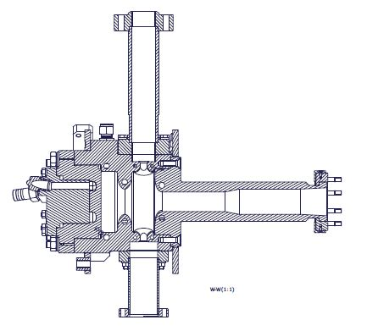
Solutions
Main Parameters | 0-mode | π-mode
Res. frequency | 2814.3 GHz | 2855.7 GHz
Freq. separation | 41 MHz
Input coupling coeff. (β) | 0.9 | 1.86
Q_{L} | 4700 | 3600
Q₀ | 9000 | 10400
Q_{ext} | 9900 | 5600
R/Q factor | ≈117 Ω | -
Filling time | ≈360 ns | -
Input waveguide
cathode
Full cell
Beam pipe
Vacuum tube
½ cell
General measurement
settings:
f_{start} = 2.8 GHz
f_{stop} = 2.86 GHz
Single mode measurement
settings:
f_{center} = f_{res}
f_{span} = 4 MHz

