Slide 1
Software status of the LHC experiments (and some facts / ideas on what we could have done betteR)
Tommaso Boccali (INFN-Pisa / CERN)

Slide 2
outline
Computing at LHC: size, status, tasks
The software stacks: components, tools
The main SW components
The central code
Data Management, Workload Management
(not covering much) Main external tools
Geometry, information services, …
DB and DB interfaces
SW distribution
The Frameworks
How to configure them
Their capabilities
How universal are all these? What would be reusable?

Slide 3
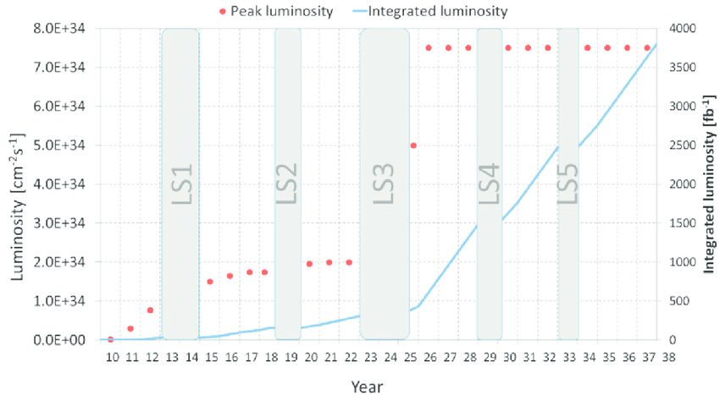
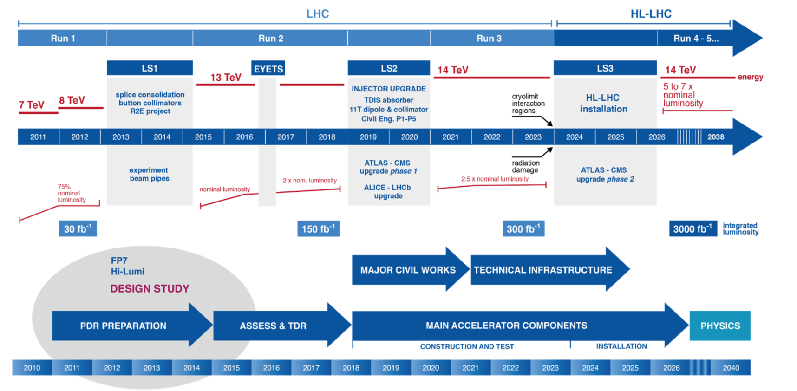
The Computing @ LHC: orders of magnitude
Disclaimer valid for most of that talk: if we talk about future general purpose experiments, ATLAS and CMS are a better comparison. The fact that they are also bigger as deployed resources and complexity is a plus.
LHC is now in Long Shutdown #2, after 2 successful Runs (2009-2012 and 2015-2018)
It can seem a lot, but we are at the start of the adventure: we collected 5% of the luminosity
Our systems, including software and computing, are not static, and need to evolve with changing LHC or detector conditions
RunI
RunII
RunIII
RunIV
RunV
RunVI
?

Slide 4
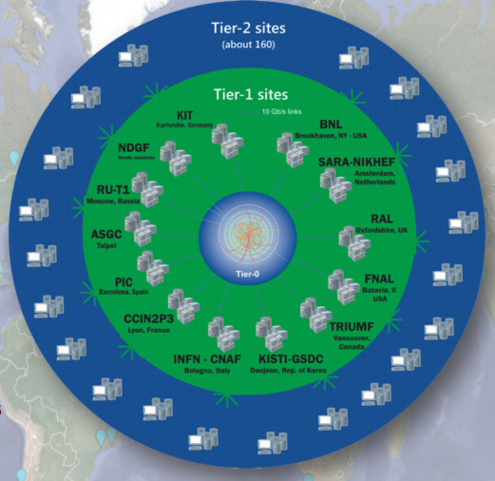
Typical experiments needs @ 2018
Process in sync
Events to offline ~ GB/s
Tier0
Events to GRID some GB/s
2x-3x the data traffic
Some 500 users per week submitting analyses
MC Production teams
users

Slide 5
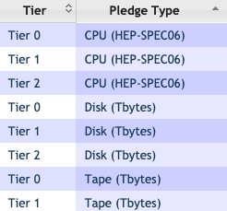
WLCG total resource deployment @2018
From WLCG Rebus:
In reality more than this:
Experiments report overpledges 1.5-2x
HPC centers, filter farms, T3s, Commercial Clouds… are not in these
This in action for ATLAS… →
~650k CPU cores
~530 PB disk
~770 PB disk

Slide 6
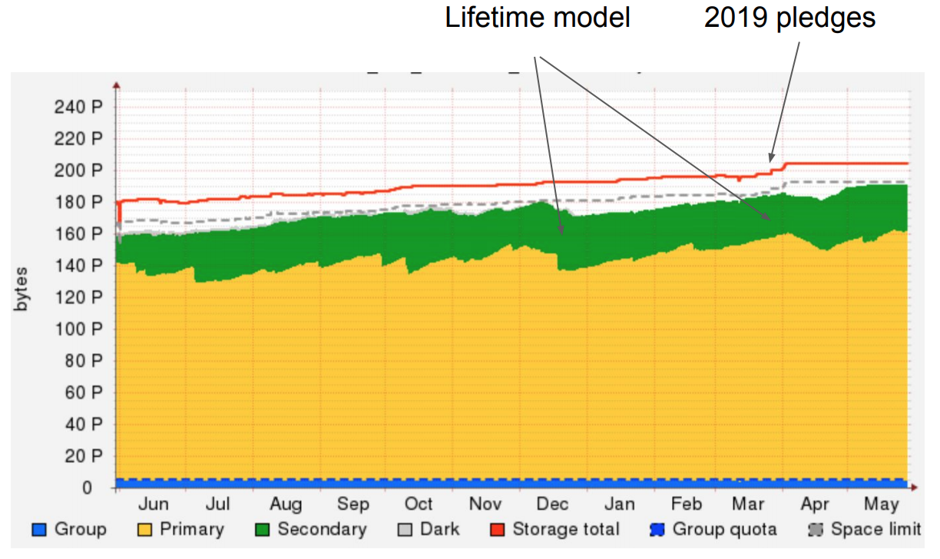
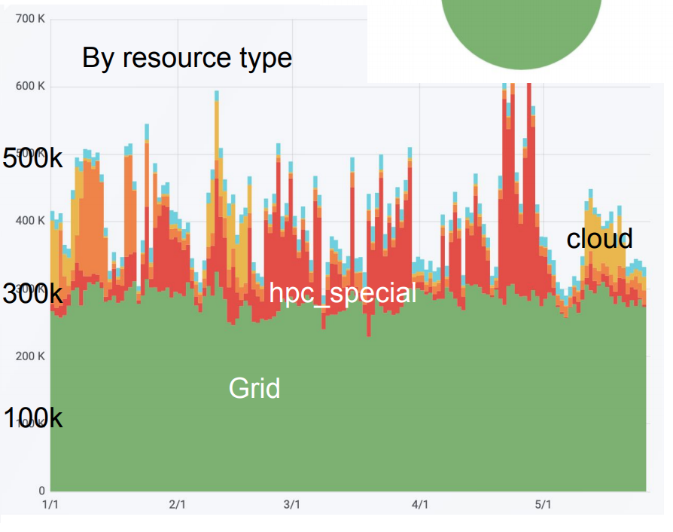
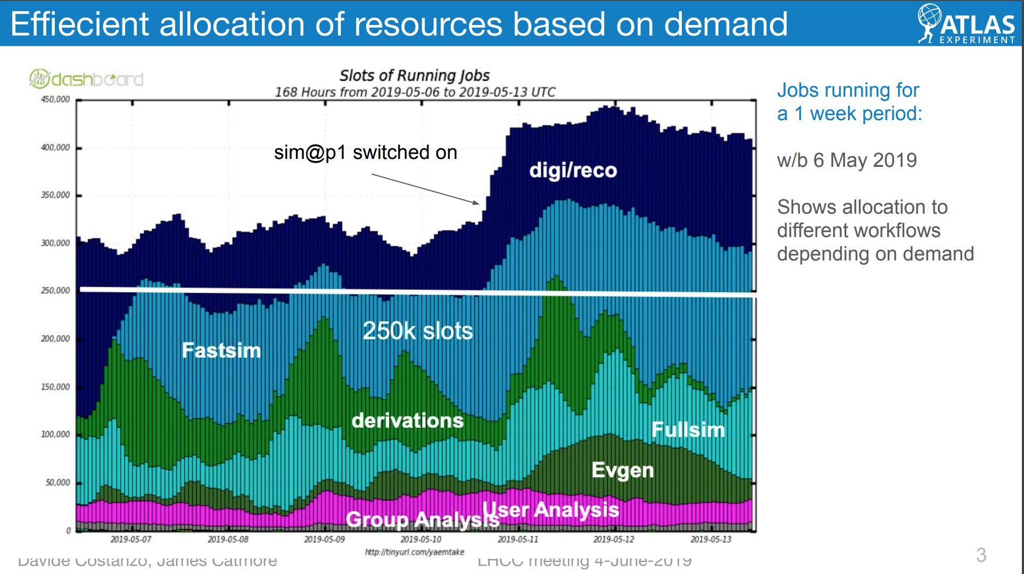
DataManagement at multiple 100 PB
Utilization kept @ 95%
Thousands of daily decisions taken by a policy driven system
Caches driven by the same system
LRU caches
Predictive caches
WorkloadManagement @ a scale of ~500kCores (+ some factor of pending payloads)
24x7: no pauses, no
Complex priority system, with late binding
Workflows with different IO, memory, CPU needs
Targetting GRID, clouds, batch systems, HPC systems, …

Slide 7
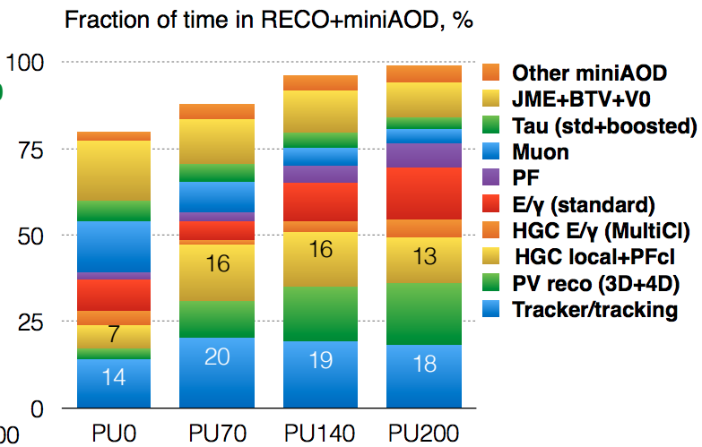
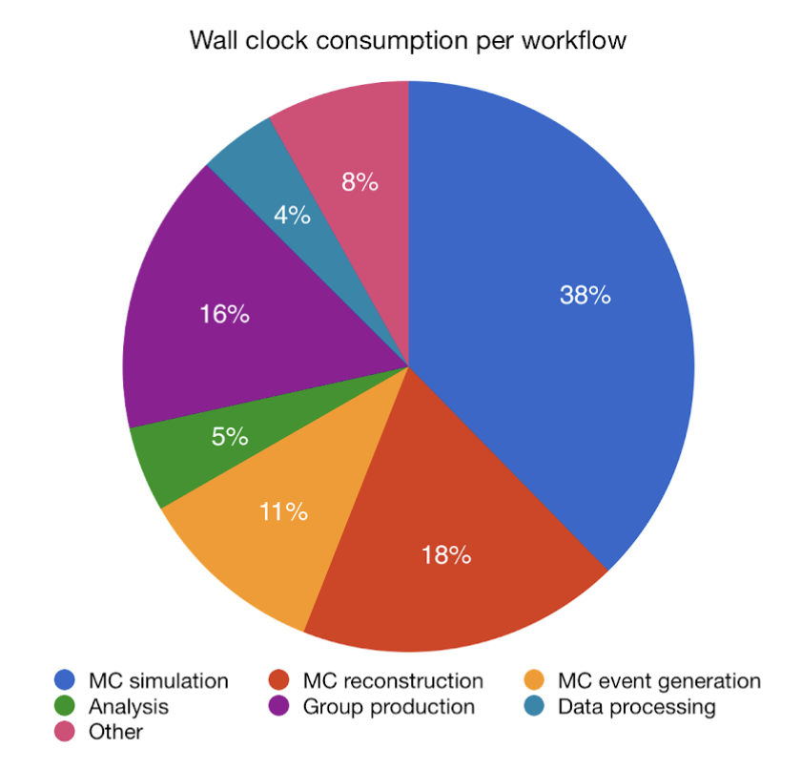
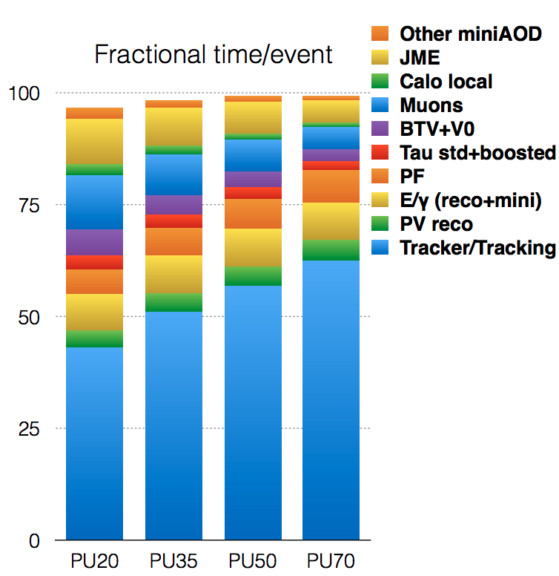
Where is time spent?
ATLAS
Reconstruction
~ 20 sec/ev
CMS
CMS: MC Reco + Data processing predominant

Slide 8
Primary sw stacks – ATLAS and CMS
ATLAS and CMS have recently changed the copyright model for their sw → Apache 2.0
This means reuse no-question-asked is ok
Including grabbing code without telling us
This means the code now is openly available (CMS’s was already with a previous open source license)
LHCb is GPL, and ALICE not-clear-to-me – less clear utilization models
Why a so open copyright?
Clearly because it is public money – but we could have stayed with GPL if this was the only problem
Industrial collaboration is the key: subjects like Intel, Google etc would not touch our code if it was GPL, since the would be forced to release the changes openly
We can use these two sw stacks to try and dig the complexity
https://gitlab.cern.ch/atlas
https://github.com/cms-sw/cmssw

Slide 9
SLOC (source lines of code)
SLOC are a standard industry metric, and there are tools to translate them into «man years» and in the end to $$ (assuming a US market)
The result is enormous, but reflects the fact that both software stacks are 15 years old or more
It does NOT include externals, like Geant4, geometry engines, particle generators, ROOT, etc
We can restrict the computation to the Core Frameworks, which are less experiment oriented, and easier to be used in not-too-different experiments
ATLAS/Gaudi: 115k SLOC, 29 FTEy, 4M$
CMSSW/FWCore and friends: 325k SLOC, 87 FTEy, 12M$

Slide 10
SLOC #2
Just to set the scale:
Linux Kernel is: 15M sloc, 4800 FTEy, 650M$ (3x CMS)
Geant4 is: 1.2M sloc, 330 FTEy, 45 M$ (1/4x CMS)
The choice to go full Open Source (and even more choose Apache 2.0) was not painless
In at least one case, we had to refuse using a «better tool» (it was NeuroBayes at these times) even if offered for free – but w/o access to the source
It was a good choice:
ATLAS now has a service able to compile from scratch on a given architecture (say PowerPC) as a part of the Workload management system (ACSC) – not possible w/o source of «everything»
In the end, shortly the open source «marketplace» was able to provide Keras/Tensorflow, which are even better

Slide 11
Externals
Many externals are needed to build the code stack.
Example from CMS (467):
alpgen qd root_cxxdefaults sockets catch2 gcc-ccompiler gcc-cxxcompiler gcc-f77compiler mpfr cmsswdata codechecker csctrackfinderemulati cuda-stubs cuda-gcc-support cvs2git dablooms db6 dmtcp doxygen eigen fastjet-contrib fastjet-contrib-archi gcc-analyzer-ccompile gcc-analyzer-cxxcompi gcc-atomic gcc-checker-plugin gcc-plugin gdb geant4-parfullcms geant4data py2-numpy openloops git glibc glimpse gmake gnuplot gosam gosamcontrib hdf5 igprof intel-license ittnotify lapack lcov libffi libxslt llvm md5 openblas ofast-flag openmpi professor py2-sympy py2-absl-py py2-appdirs py2-argparse py2-asn1crypto py2-atomicwrites py2-attrs py2-autopep8 py2-avro py2-awkward py2-backcall py2-backports py2-backports-functooccj py2-backports_abc py2-beautifulsoup4 py2-bleach py2-bokeh py2-bottleneck py2-cachetools py2-certifi py2-cffi py2-chardet py2-click py2-climate py2-colorama py2-contextlib2 py2-cryptography py2-cx-oracle py2-cycler py2-cython py2-dablooms py2-decorator py2-defusedxml py2-docopt py2-downhill py2-dxr py2-entrypoints py2-enum34 py2-flake8 py2-flawfinder py2-fs py2-funcsigs py2-functools32 py2-future py2-futures py2-gast py2-gitdb2 py2-gitpython py2-google-common py2-googlepackages py2-grpcio py2-h5py py2-h5py-cache py2-hep_ml py2-histbook py2-histogrammar py2-html5lib py2-hyperas py2-hyperopt py2-idna py2-ipaddress py2-ipykernel py2-ipython py2-ipython_genutils py2-ipywidgets py2-jedi py2-jinja2 py2-jsonpickle py2-jsonschema py2-jupyter py2-jupyter_client py2-jupyter_console py2-jupyter_core py2-keras py2-keras-application py2-keras-preprocessi py2-kiwisolver py2-lint py2-lizard py2-llvmlite py2-lxml py2-lz4 py2-markdown py2-markupsafe py2-matplotlib py2-mccabe py2-mistune py2-mock py2-more-itertools py2-mpld3 py2-mpmath py2-nbconvert py2-nbdime py2-nbformat py2-networkx py2-neurolab py2-nose py2-nose-parameterize py2-notebook py2-numba py2-numexpr py2-oamap py2-onnx py2-ordereddict py2-packaging py2-pandas py2-pandocfilters py2-parsimonious py2-parso py2-pathlib2 py2-pbr py2-pexpect py2-pickleshare py2-pillow py2-pip py2-pkgconfig py2-plac py2-pluggy py2-ply py2-prettytable py2-prometheus_client py2-prompt_toolkit py2-protobuf py2-prwlock py2-psutil py2-ptyprocess py2-py py2-pyasn1 py2-pyasn1-modules py2-pybind11 py2-pybrain py2-pycodestyle py2-pycparser py2-pycurl py2-pydot py2-pyflakes py2-pygithub py2-pygments py2-pymongo py2-pyopenssl py2-pyparsing py2-pysqlite py2-pytest py2-python-cjson py2-python-dateutil py2-python-ldap py2-pytz py2-pyyaml py2-pyzmq py2-qtconsole py2-rep py2-repoze-lru py2-requests py2-root_numpy py2-root_pandas py2-rootpy py2-scandir py2-schema py2-scikit-learn py2-scipy py2-seaborn py2-send2trash py2-setuptools py2-simplegeneric py2-singledispatch py2-six py2-smmap2 py2-soupsieve py2-sqlalchemy py2-stevedore py2-subprocess32 py2-tables py2-tensorflow py2-terminado py2-testpath py2-theanets py2-theano py2-thriftpy py2-tornado py2-tqdm py2-traitlets py2-typing py2-typing_extensions py2-uncertainties py2-uproot py2-uproot-methods py2-urllib3 py2-virtualenv py2-virtualenv-clone py2-wcwidth py2-webencodings py2-werkzeug py2-wheel py2-widgetsnbextensio py2-xgboost py2-xrootdpyfs pydata pyminuit2 pyqt python-paths python_tools rootglew scons sloccount tcmalloc tcmalloc_minimal tensopy2-virtualenvwrapperrflow tinyxml2 xtl blackhat boost boost_header python bz2lib cascade_headers ccache-ccompiler ccache-cxxcompiler ccache-f77compiler zlib gmp photos_headers pythia6_headers openssl clhep clhepheader cppunit cuda curl libxml2 dcap root_interface xz xerces-c vecgeom_interface hepmc_headers distcc-ccompiler distcc-cxxcompiler distcc-f77compiler dpm expat fastjet fftjet fftw3 freetype gbl gdbm gsl giflib google-benchmark libjpeg-turbo hector heppdt madgraph5amcatnlo llvm-cxxcompiler jemalloc jimmy_headers ktjet libhepml libuuid llvm-ccompiler llvm-f77compiler meschach mxnet-predict numpy-c-api x11 oracle pacparser yoda protobuf python3 qd_f_main sqlite sigcpp tauola_headers tbb tensorflow-framework tensorflow-runtime tensorflow-xla_compil0-pafccj3 toprex_headers utm valgrind vdt_headers xrootd xtensor boost_system boost_iostreams boost_serialization boost_program_options boost_python boost_regex boost_signals boost_test cascade yaml-cpp photos pythia6 pcre cub cuda-api-wrappers cuda-cublas cuda-cufft cuda-curand cuda-cusolver cuda-cusparse cuda-npp cuda-nvgraph cuda-nvjpeg cuda-nvml cuda-nvrtc das_client vecgeom hepmc frontier_client google-benchmark-main libpng iwyu-cxxcompiler libtiff libungif llvm-analyzer-ccompil llvm-analyzer-cxxcomp mcdb opengl openldap oracleocci pyclang qtbase sip starlight tauola tensorflow-c tensorflow-cc tkonlinesw toprex vdt boost_chrono boost_filesystem boost_mpi cgal lhapdf classlib davix rootcling geant4core photospp geant4static graphviz lwtnn millepede qt3support rivet tkonlineswdb cgalimageio herwig rootmathcore rootrio pythia8 geant4vis thepeg pyquen qt rootrint rootrflx rootsmatrix rootx11 sherpa charybdis rootthread dire tauolapp geant4 geneva herwigpp jimmy qtdesigner rootgeom rootxmlio vincia rootcore evtgen roothistmatrix rootmath rootxml rootphysics rootgpad rootfoam rootspectrum root rootminuit rootgraphics rootgui rootinteractive roothtml rootminuit2 dd4hep-core roofitcore mctester professor2 rooteg rootgeompainter rootrgl rootged rootguihtml rootmlp rootpy dd4hep dd4hep-geant4 roofit rooteve roottmva roostats rootpymva histfactory coral
Note that gcc is there! CMS ships its own compiler, so dependency on the host Linux is only at the level of glibc

Slide 12
Needs from a framework
The framework is clearly the most important piece of a software stack
There are two approaches for a new experiment:
Start with something easy, which matches the low scale needs of a technical proposal / letter of intent; be ready to start again from scratch at least a couple of times; CMS:
Y< 2000: CMSIM+CMKIN (Fortran + Geant3)
2000<Y<2005: OSCAR + ORCA (C++ + Geant4 + ObjectivityDB/ROOT)
Y>2005: CMSSW (C++ + Geant4 + ROOT)
The last «change» (ORCA to CMSSW) took from 2004 to 2007 to reach the same level, with 2 devel teams needed (the old SW used for a TDR while preparing the new one)
Search on the «market» a working solution, tested on a running experiment with comparable (or bigger) needs, and use it
Admittedly, we never did it up to now; we «love» starting from scratch
Even if, to some extent, the initial CMSSW release was using the Event Model from CDF and the Setup model from CLEO

Slide 13
what happened in the meantime?
Our frameworks had to survive / cope with a lot of landscape changes in their lifetime (in the last incarnations, last 10 y):
From GRID to Clouds to Virtualization to HPC to heterogeneous computing (GPU, FPGA, QC even…)
From data locality to streaming storage federations
From SL4/gcc4 to CC7/gcc8
From 32 to 64 bit
From single process to multi process (COW) to multi threaded (TBB)
From single core PCs to O(300) cores per PC (KNL)
From configs to Python as the uber language
From fully scheduled execution to unscheduled (needed for multi threading)
Analysis support from PAW-ROOT(cint)-ROOT(cling)-PyROOT-UpROOT-AVRO
None was un-anticipated, but eventually they were not supposed to be so fast and so important for the standard running

Slide 14
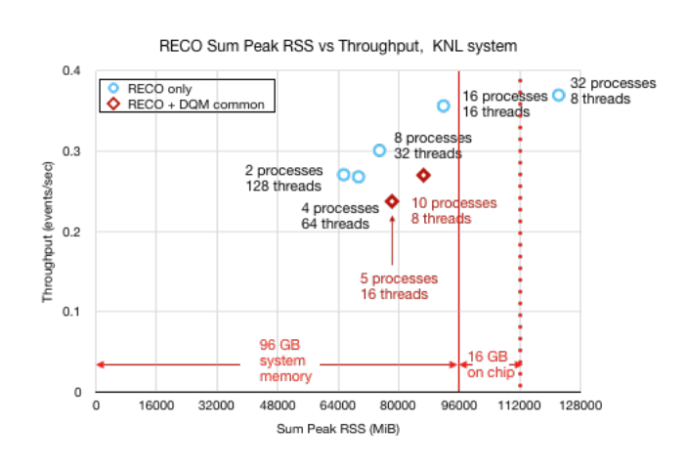
Needs (today or tomorrow early morning) from a Framework
Not covering the obvious ones, it is very probable that even in the early phases of a new experiment SW life cycle, there will be the need to
Have a solid Multi Threading infrastructure:
Have memory under control on current eInfra also in case of large payloads (FCC-hh, for example)
Grants / access to special machines for targeted production, with low RAM (NERSC Cori, CINECA, …)
Have the capability to be future proof
Heterogeneous computing: mostly (but not only) HPC related (Capability for GPU, FPGA code)
Be able to run in segregated environments (HPC, ….)
Edge services, internal tunnelling, …
Support native Cloud protocols (Object Storage, S3, Google Storage, …)
Today mostly via ROOT
CMS Reconstruction running on a KNL
(256 threads – 96 GB RAM)

Slide 15
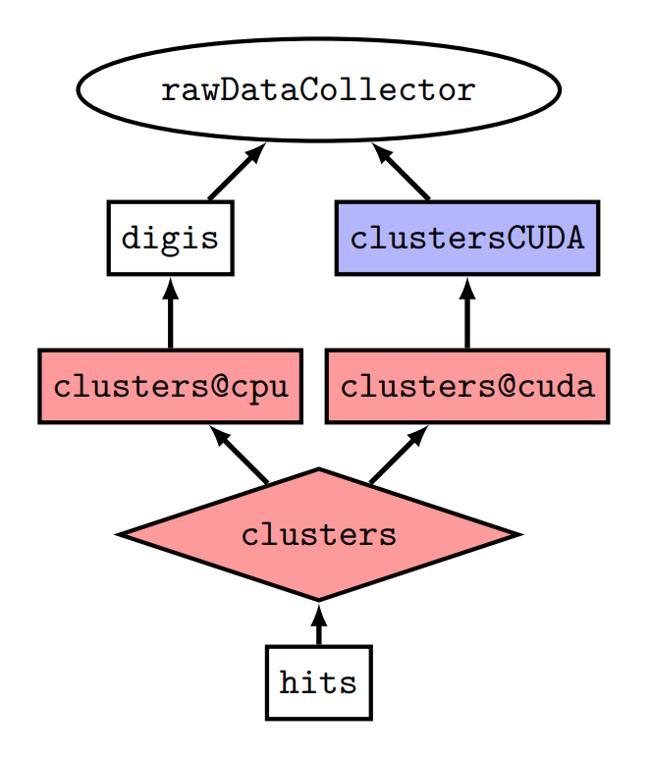
Heterogeneous computing
CMSSW approach (in production):
“SwitchProducers”: “equivalent” modules or module sequences, with the same initial input and producing the same final output. Used to provide portability between different architectures
“ExternalWork”: Enables TBB to run (other) tasks in CPU while something is being run elsewhere, e.g. in accelerator(s) -- so CPU is not waiting for GPU to finish, for example
acquire() → prepares and send work to an accelerator; CPU is then freed
produce() → called when GPU is done, finalizes outputs
Full tracking: module by module, it is possible to access which specific version was used

Slide 16
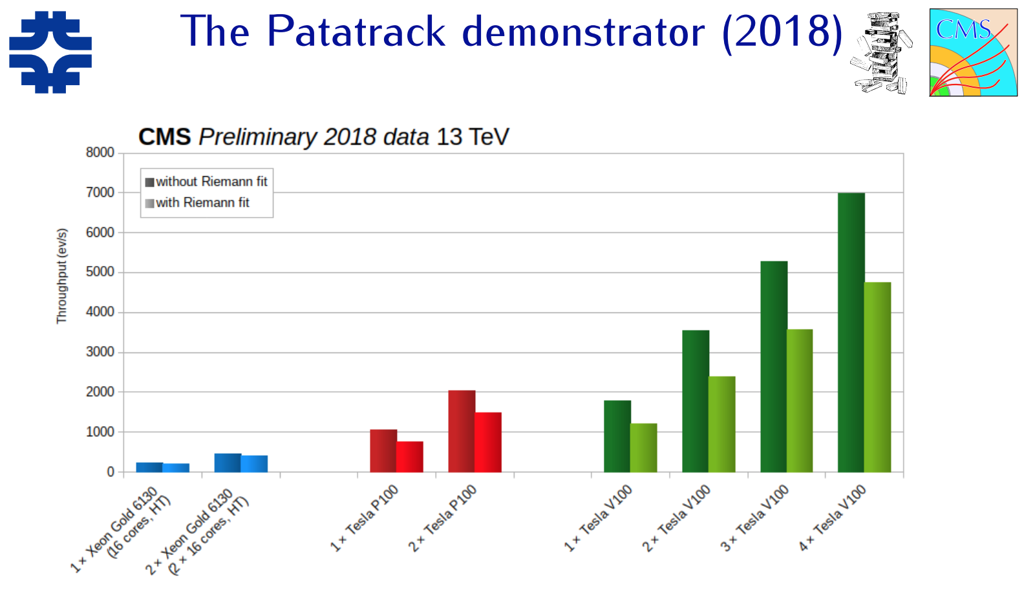
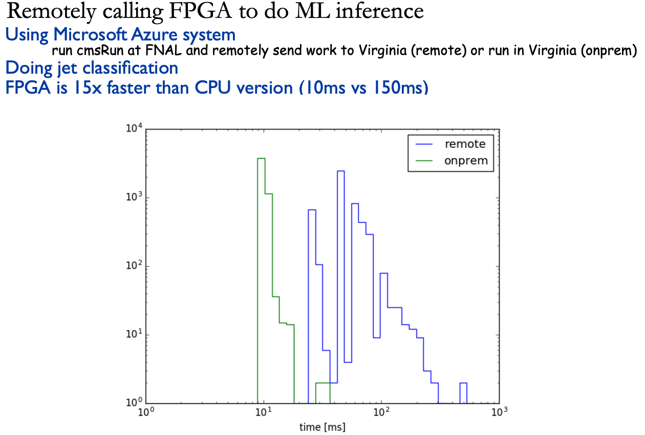
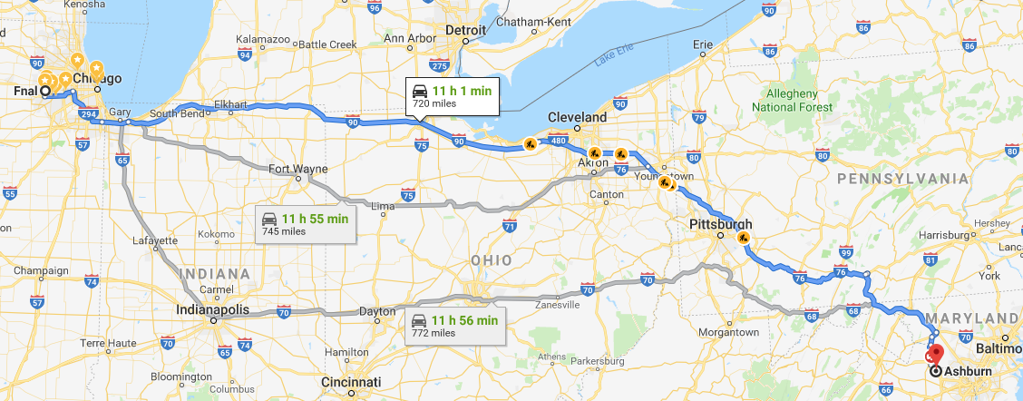
Examples:
Model for NVidia GPUs with CUDA is being prototyped as part of the Patatrack project
Supports chains of Modules passing data on GPU memory
Data transferred to CPU only when needed
Expose as much of the parallelism as possible
Same or similar components are expected to be useful for other GPUs, FPGA etc.
E.g. SONIC project is using the system for connecting to remote FPGA resources for ML inference

Slide 17
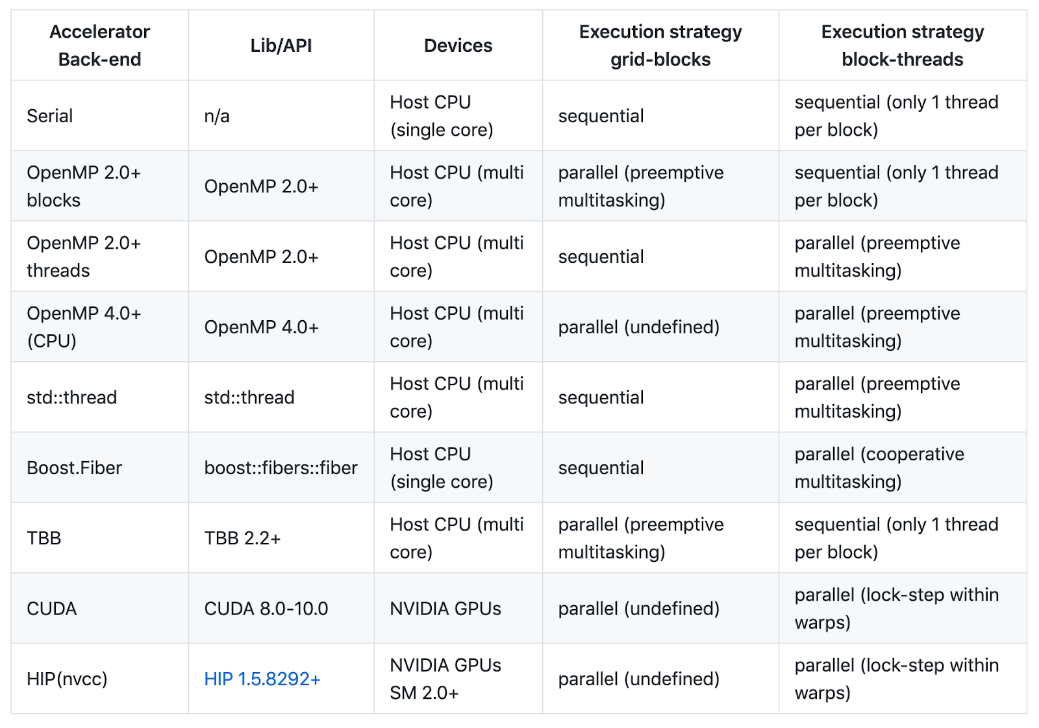
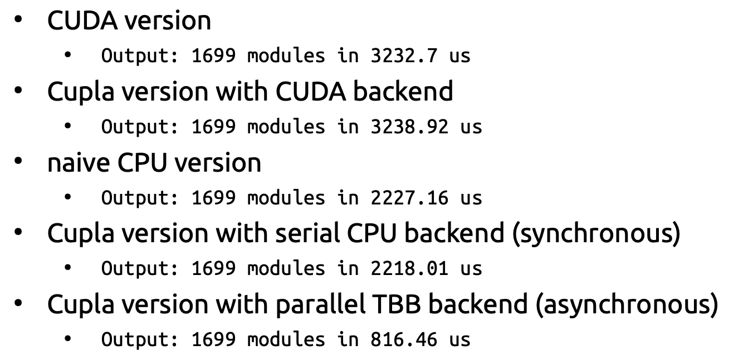
Next Step …
We can seamlessly run two codes (CPU and GPU, CPU and FPGA, …) for a single task, but at the moment we still need to write them
2x (Nx?) the devel effort
Physics validation problematic
Next step: try and find a way to have (efficient) GPU and CPU (and eventually FPGA, AMD, …) from a single code base
ECoM2X initiated studies to evaluate Alpaka and Kokkos
Initial evaluation very positive
No performance loss wrt direct CUDA
Decent performance on CPU, and possibility to use TBB
Very easy to port existing CUDA to them
For the time being, we can continue using CUDA directly
preliminary!
Sandia, supports future DOE HPC
Uni Dresden

Slide 18
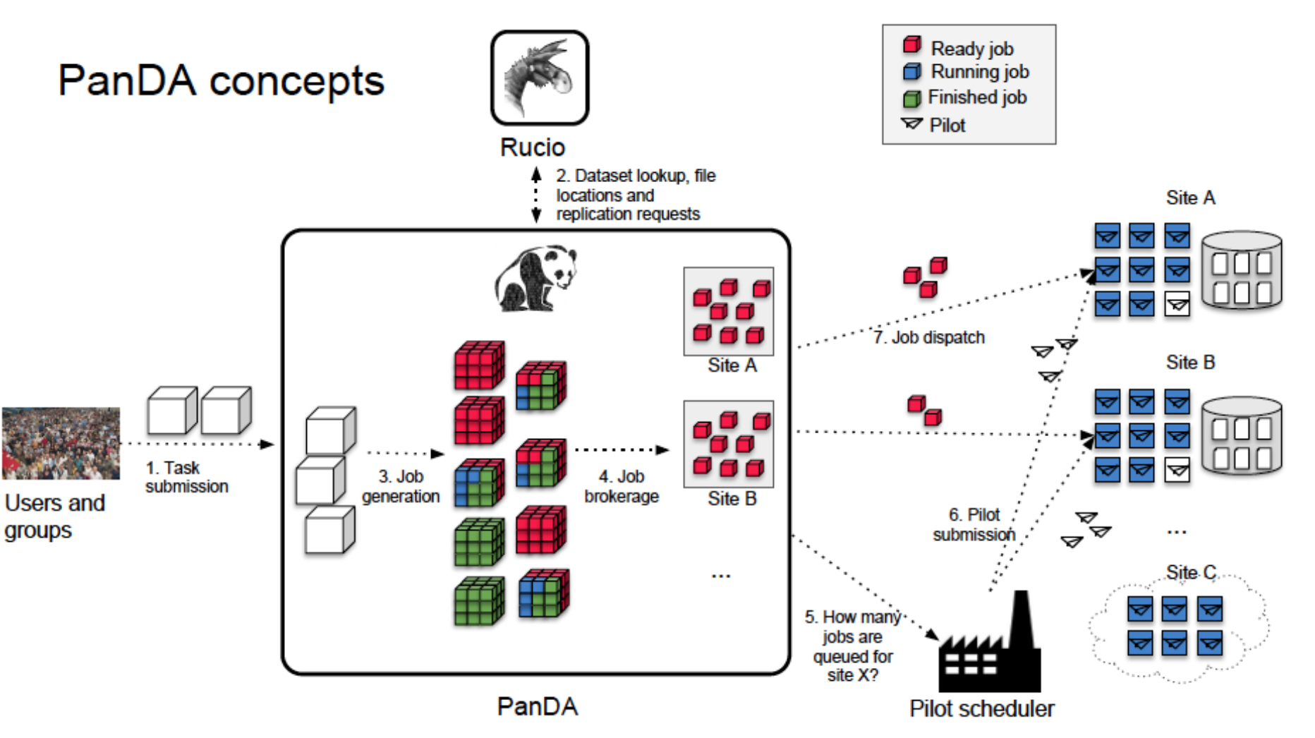
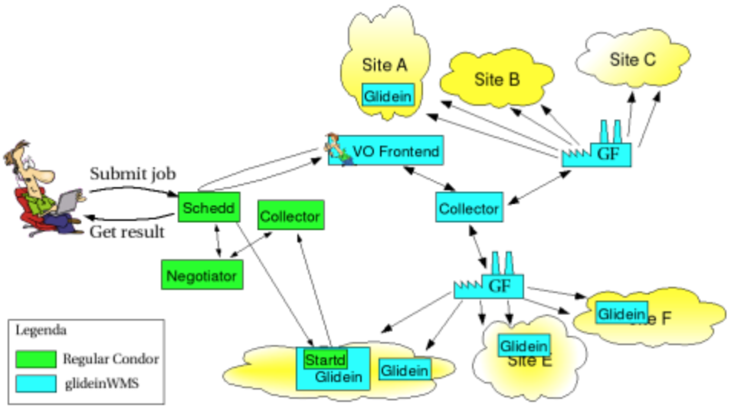
Workload management
BigPanda
OR:
Splitting a logical task in single jobs
Handling multi core nodes
Allow late binding (→ pilots!)
Matching jobs and available machines (with different memory / processors / bandwidth to certain data)
All these at the scale of
CMS: O(4M) jobs/day + equivalent # of analysis jobs
Directed to O(100) sites, with potentially different nodes per site – with HTCondor, every node could be declaring different specs
GlideinWMS
Dirac

Slide 19
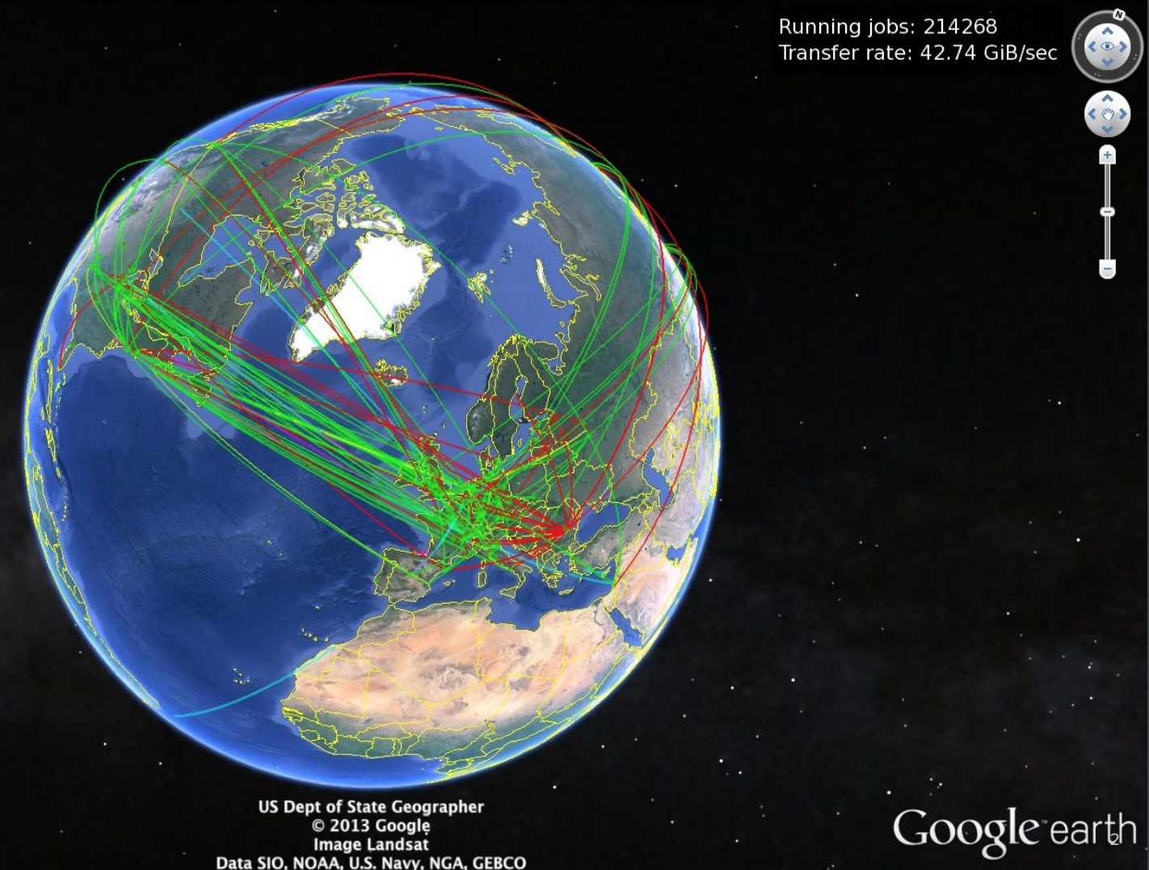
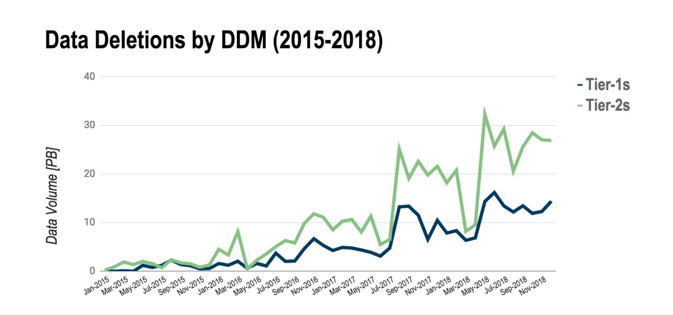
data management
OR:
Managing a O(200) PB storage, usually used at >90%, maintaining a system workable for analysis and production, by:
CMS: transferring actively at 3 GB/s all around the year
CMS: DM system automatically deletes O(40PB/month) of «least used data» and and replicates a similar amount
ATLAS and CMS have converged on Rucio for Run3+; it is becoming the de-facto solution for
Studies on future storage systems (Datalake, XDC, ESCAPE)
LHCb still on Dirac comphehensive solution

Slide 20
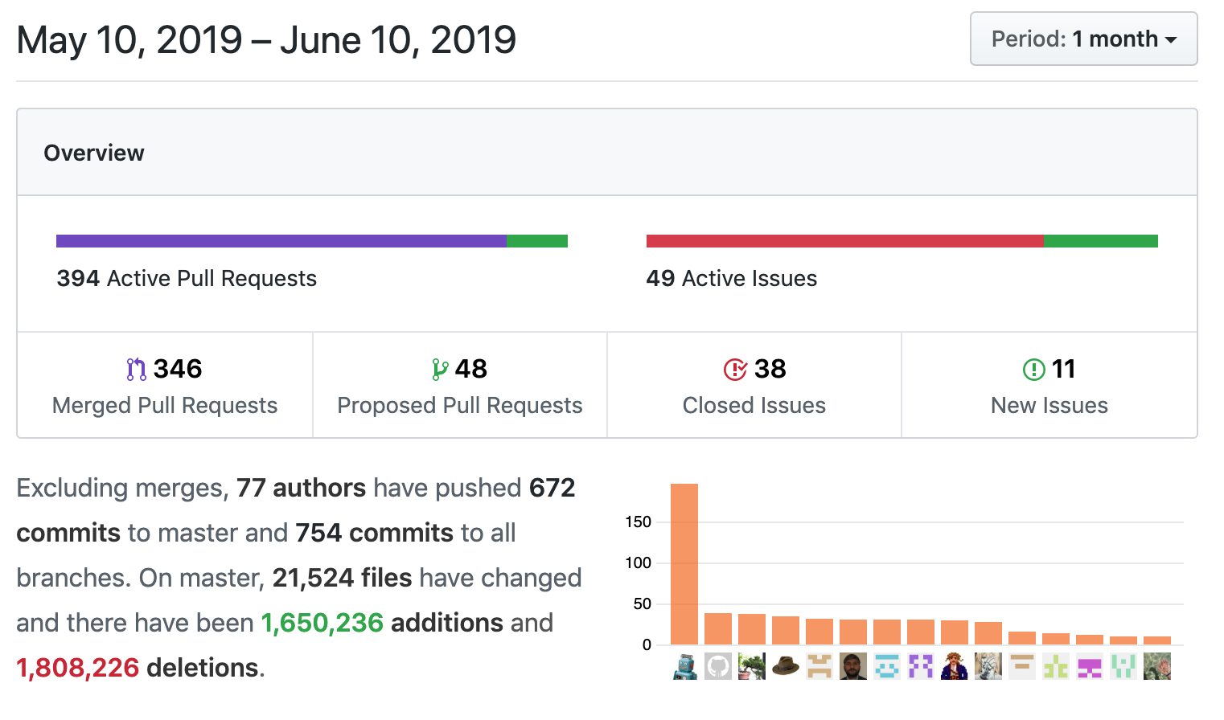
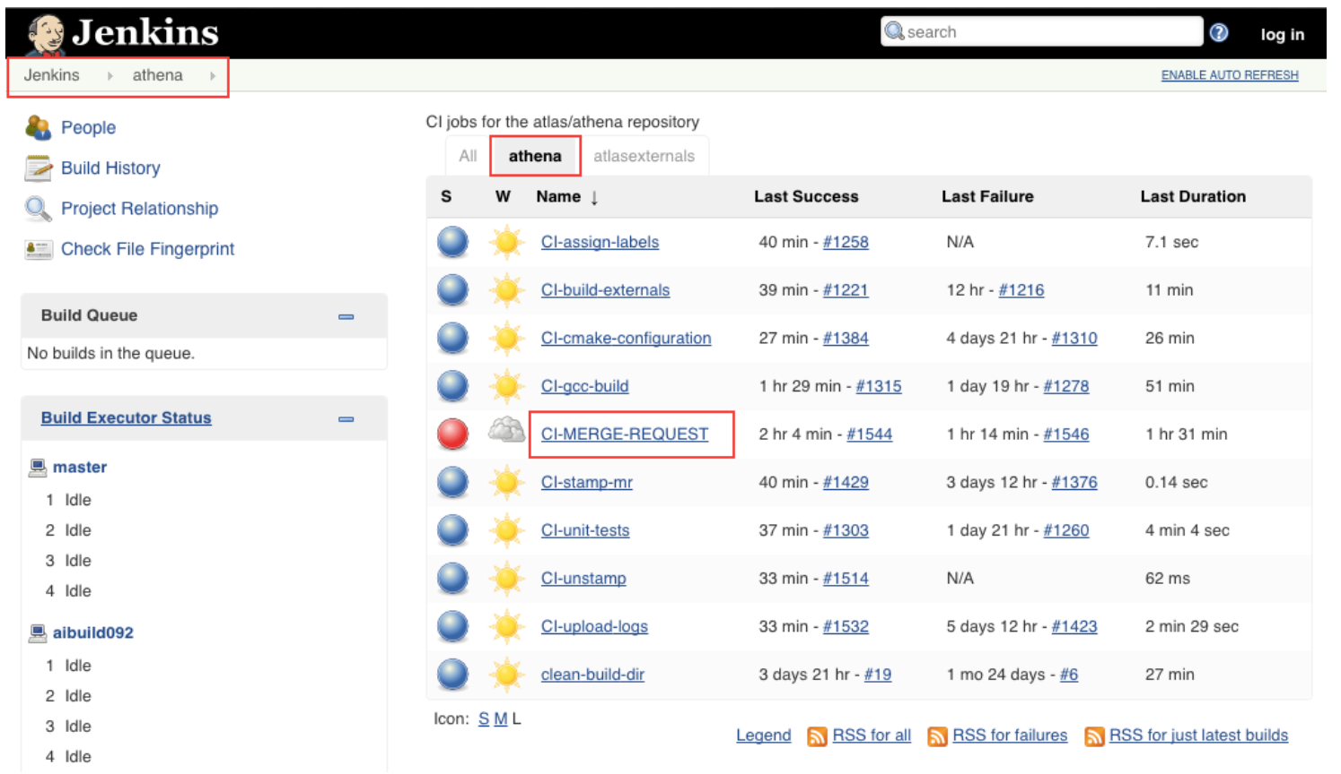
Other issue – not to be forgotten
Continuous integration:
Everyone started small, with «integration by hand» of code
Today the scale is →
A CI platform is essential, and uses O(400) cores at any moment to test every single pull request for effects on candle plots
Software distribution:
We all started with RPMs – a mess
CVMFS has been a clear lifesaver here – baseline for any new experiment
(light) virtualization:
Full virtualization (a-la VMWare) mostly abandoned; singularity seems the way to go (all in userland)

Slide 21
Geant4
Clearly the de facto standard, but indeed a moving target
Stable releases
Stable releases with code backported from R&D («GeantV»)
VecGeom: use vector/SIMD registers to speed up navigation (now in CMS’s G4)
Long term R&D
GeantV transport engine in «alpha» and «beta» releases to be evaluated by 2022, and then eventually backported to Geant4
There is a lot of push for a GPU-enabled Geant4, which would automatically enable O(20-50)% of the experiments workflows to be GPU-ready
Not covered here!

Slide 22
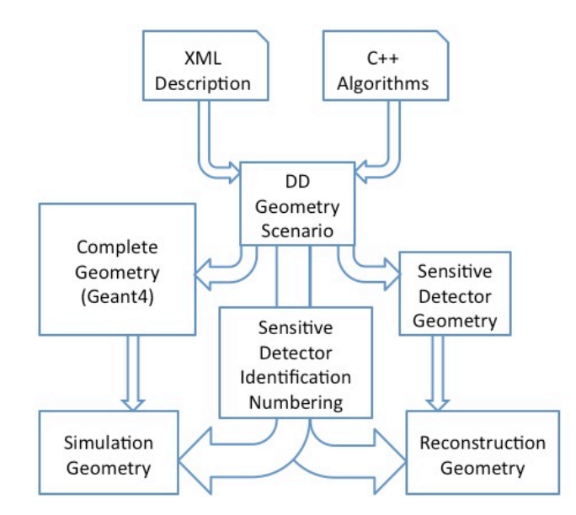
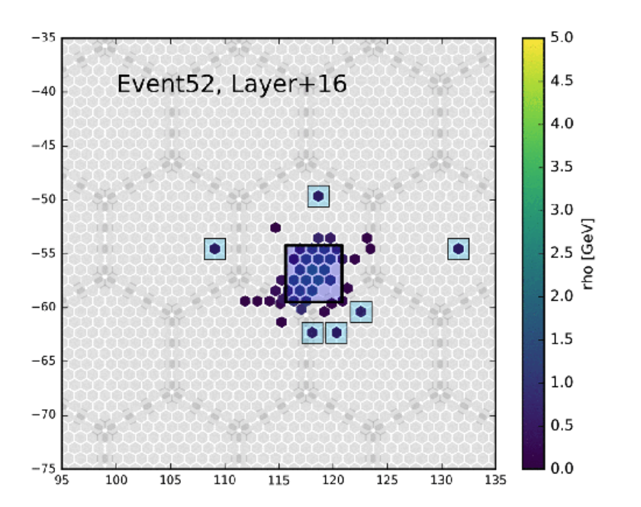
Geometry engines
Geometry Version (CMS) | # of logical volumes | # of Touchables («physical volumes»)
Run 1 | 4152 | 2.1M
Run II | 4257 | 2.1M
Run III | 3716 | 2.1M
Run IV (PhaseII) | 5372 | 21.9M
The level of accuracy needed in Full Simulations is such that the positioning of cables and small structures like screws can have an impact on the precision
Currently, specific engines different in every experiment
Why is it relevant?
!!!
Not covered here!
Convergence to DD4HEP happening:
Selected by CMS
Evaluated by LHCb
Interest also from ATLAS
CMS DDD

Slide 23
Machine learning interactions
ML algorithms are going to be first-class citizens even before the HL-LHC timescale
The infrastructure for «running» these algorithms («inference») is not utterly complicated
just make sure tensorflow / keras / caffe / theano are in your sw stack
The training phase is at the moment handled mostly as an external problem
Direct use of keras
Possibly run on specific centers (ATLAS = Tier3s)
HPC seem the natural place where to run them

Slide 24
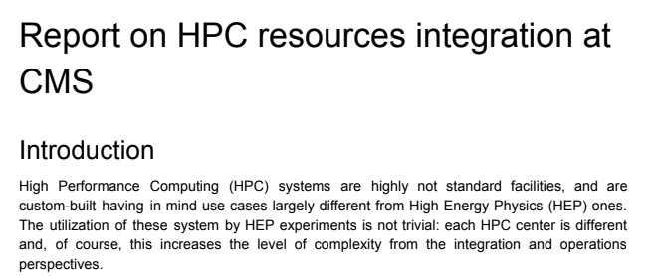
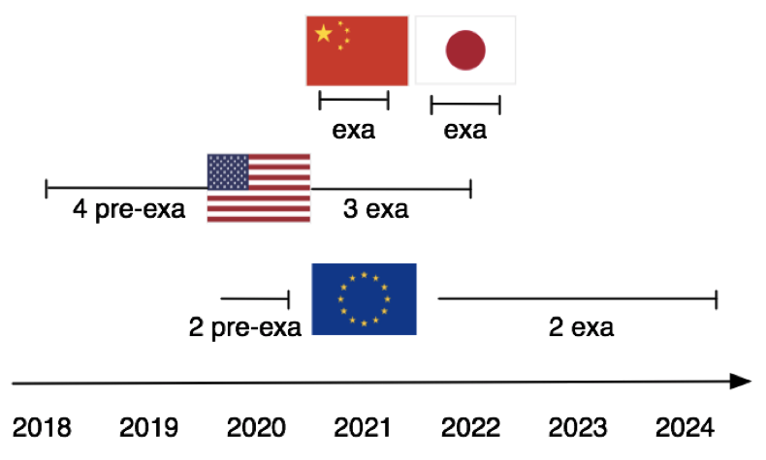
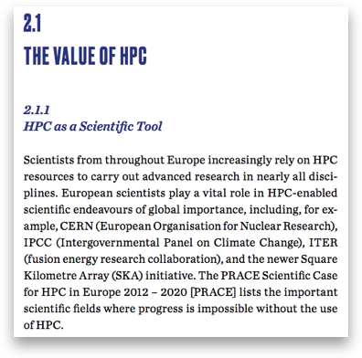
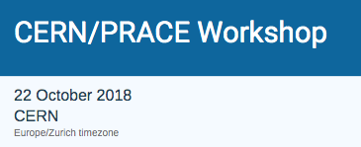
hpc
Impartant FAs are requesting in perspective a an higher utilization of “SuperComputers” (HPC centers)
Not a trivial task: currently we are not able to drive:
Main architecture (x86? ARM? PowerPC?)
Sw: can we recompile / validate on it?
Accelerators (GPUs? FPGAs? Proprietary stuff?)
Sw: what can we do with these?
Connection policies (segregated nodes? TCP/IP?)
Tunneling? Edge services? Proxies?
Access policies? (2 factor authentication? Strict user policies?)
Vacuum model?
Basic node parameters (RAM? Local disk? OS?)
Is our MT good enough to fit? Can our virtualization run on it?
Services (CVMFS? Virtualization?)
Fat containers? Singularity?
In practice, some centers are more friendly (down to “grid-like”) than others (“you will not touch anything”)
Experience exists, what is starting now is a concerted effort to try and have political handles on these systems

Slide 25
Conclusions and lessons learnt
First conclusion is obvious: we do have a working sw stack, able to cope with today’s LHC conditions. We are confident to see an evolution path to HL-LHC
Some lessons learnt:
A sw stack (and more specifically its framework part) are complex code tools: tens of years of expert manpower went into them; they should be considered for next generation of experiments
The tools are complicated because our world is complicated: atypical resources, opportunistic utilization, remote data repositories: there might be no room left for “start easy and simple, and then evolve” – evolve may soon translate into “rewrite the code may times”
It is always nice and rewarding to write your own tool, but what about long term support? Can you/us afford it?

