Slide 1
Status of DArT vessel
Luciano Romero
CERN
30-April-2019

Slide 2
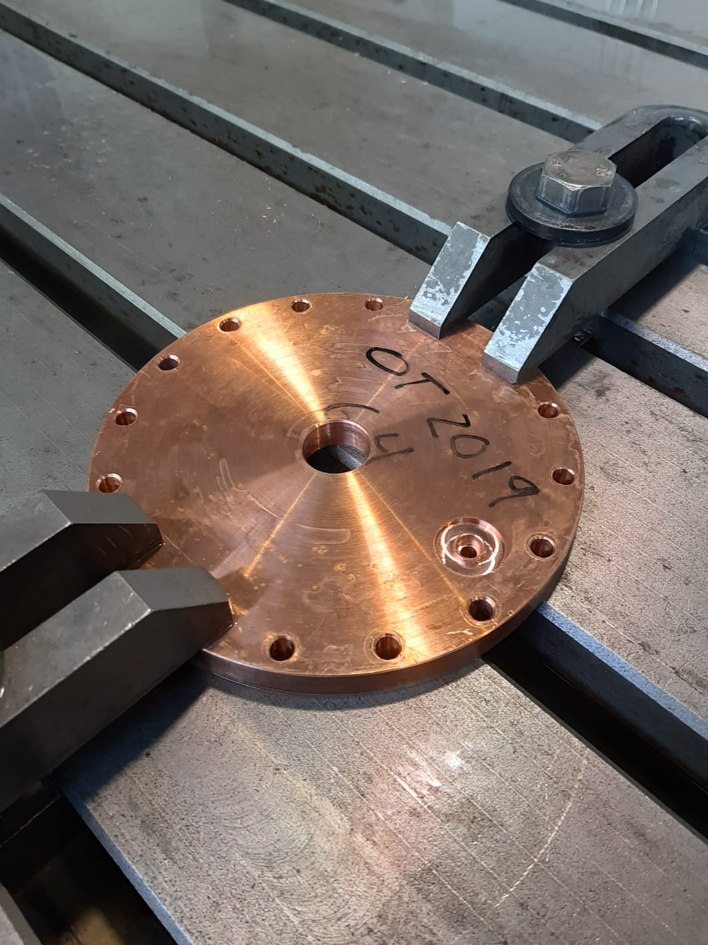
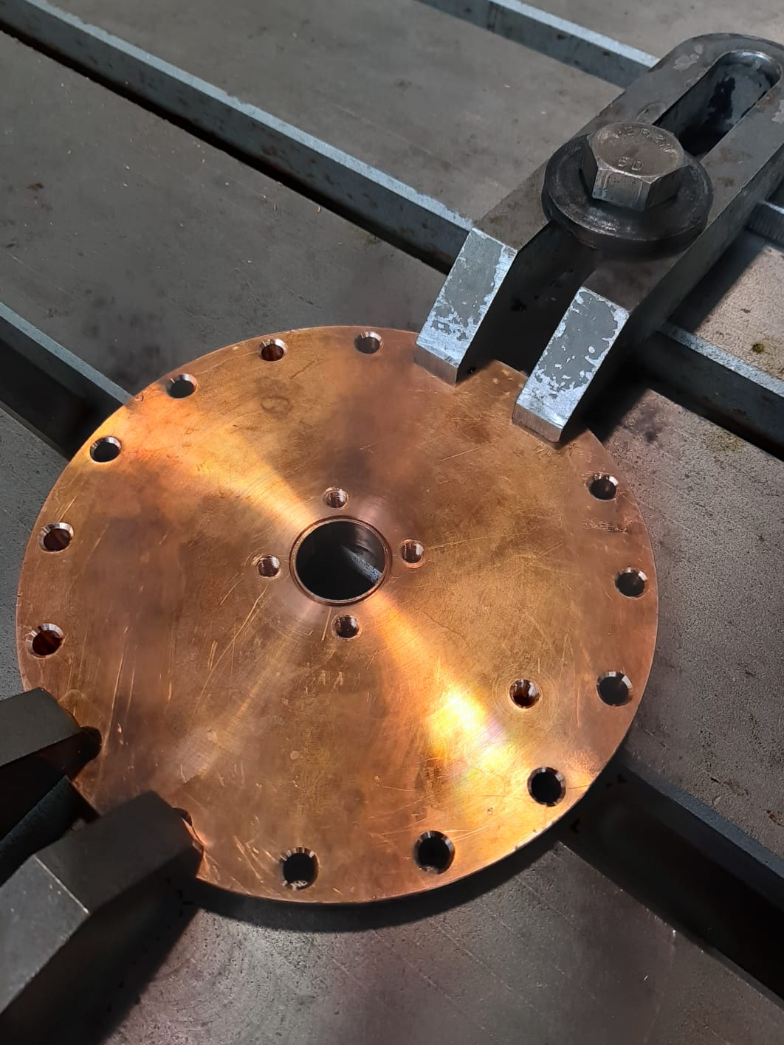
The vessel cap is being produced at Ciemat workshop.
Top
Bottom

Slide 3
The copper tubes have to be welded to the flange.
The inox pipes have to be welded to the copper tubes.
Current copper tubes are standard, not OFC.
OFC tubes are already ordered.
A new flange with OFC tubes will be produced in the future.

