Slide 1
XUV Laboratory

Slide 2
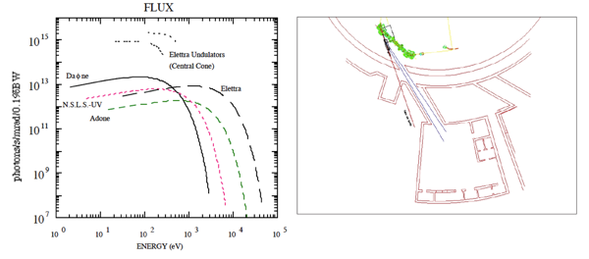
Bending Magnet source for UV and XUV
and its Laboratory

Slide 3
Bending Magnet source for UV and XUV
and its Laboratory
This is the energy range where:
most of the photo-chemistry take place!
photo induced desorption Dominate.
Perfectly covers the photo energy range of (HL)- LHC
Well matching the FCC-hh SR spectrum
Monchromatic
20 –1000 eV
“White light”
4 –1000 eV

Slide 4
Bending Magnet source for UV and XUV
and its Laboratory
WE COVER THIS RANGE BY:
LEB: 30 – 160 eV
HEB: 60- 1000 eV
WINDY: Wight Light (0 – 150 eV)
White light line for desorption yield
Monchromatic
20 –1000 eV
“White light”
4 –1000 eV

Slide 5
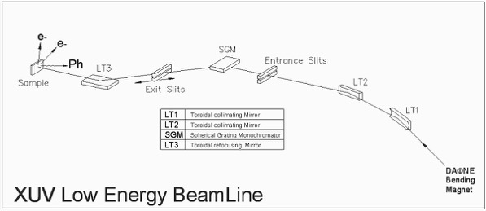
LEB: 30-160 eV. About 17 mRad horizontal
Spot:
2 x 2 mm

Slide 6
LEB: 30-160 eV. About 17 mRad horizontal
Monochromator 20- 200 eV
Focus vertically entrance to exit slit
Collimate to
a parallel beam
Spot:
2 x 2 mm
ReFocus:
exit slits to Sample
Focus:
Vert. to Entrance slits
Hor . To exit slits

Slide 7
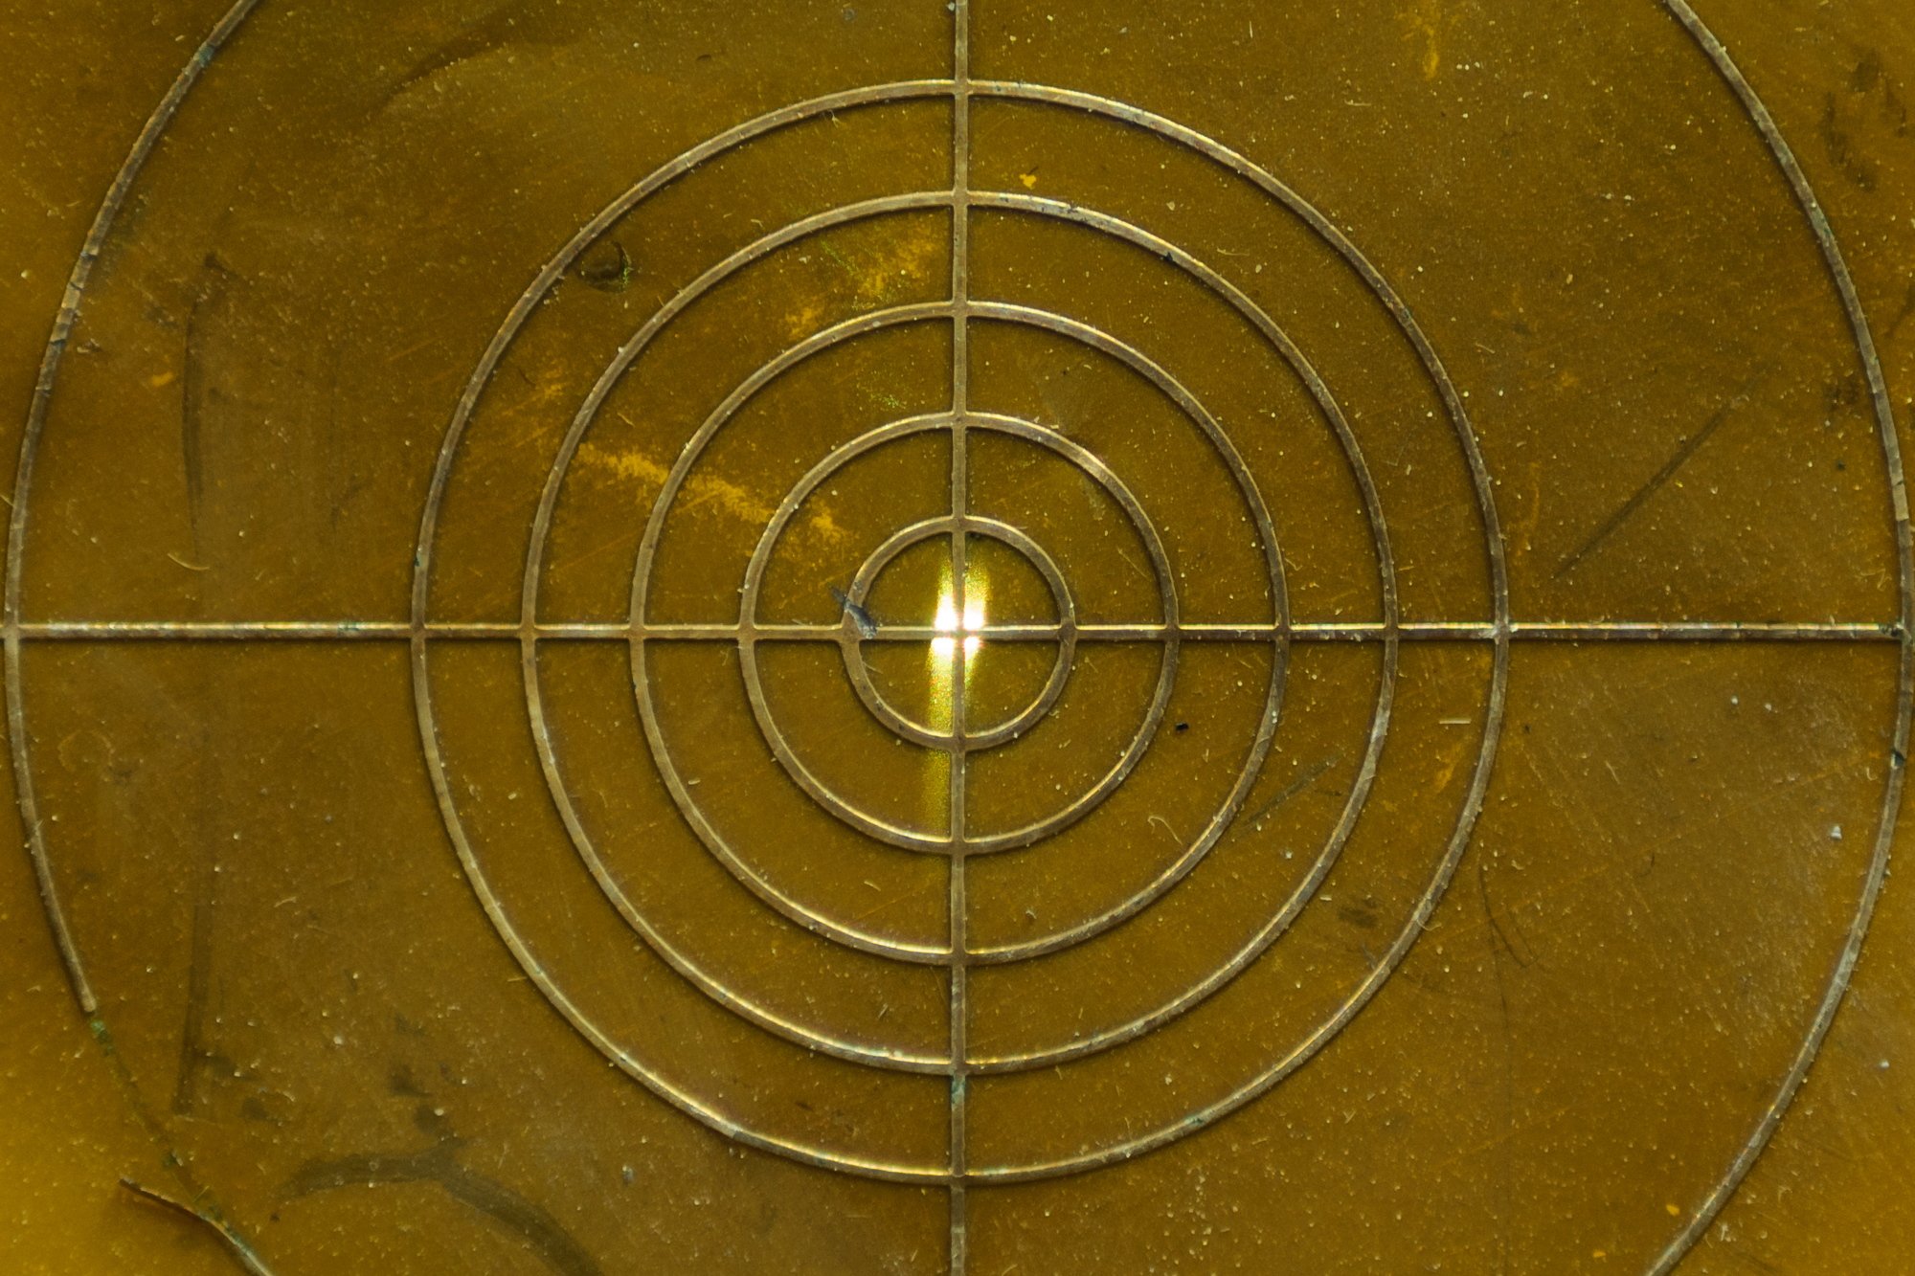
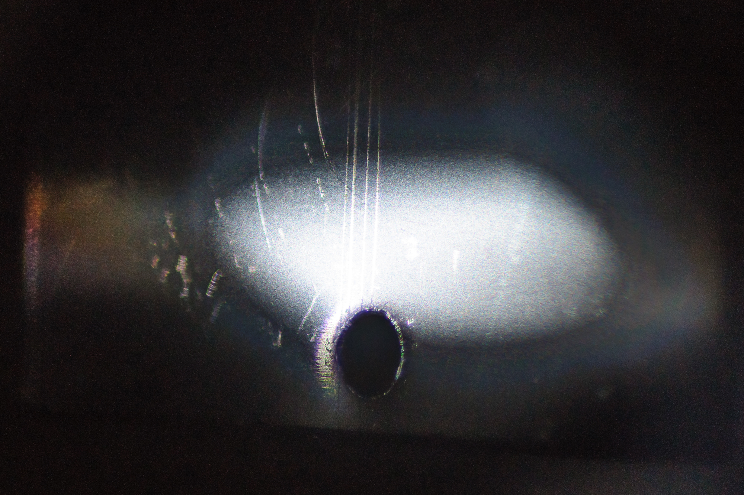
LEB: 30-160 eV. About 17 mRad horizontal
Monochromator 20- 200 eV
Focus vertically entrance to exit slit
Collimate to
a parallel beam
To be alligned!
Spot:
2 x 2 mm
ReFocus:
exit slits to Sample
Focus:
Vert. to Entrance slits
Hor . To exit slits

Slide 8
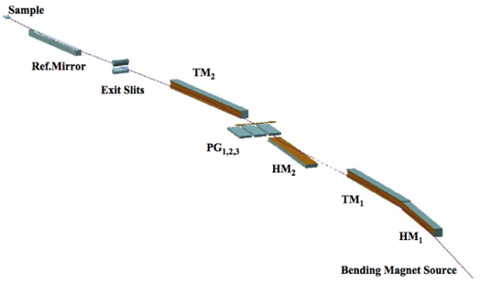
HEB: 60 -1000 eV. About 8 mRad horizontal
Spot:
2 x 2 mm

Slide 9
HEB: 60 -1000 eV. About 8 mRad horizontal
Spot:
2 x 2 mm
Monochromator 60- 1000 eV
Plane grating and mirror
Collimate to
a parallel beam
ReFocus:
exit slits to Sample
Focus:
Vert. to Entrance slits
Hor . To exit slits

Slide 10
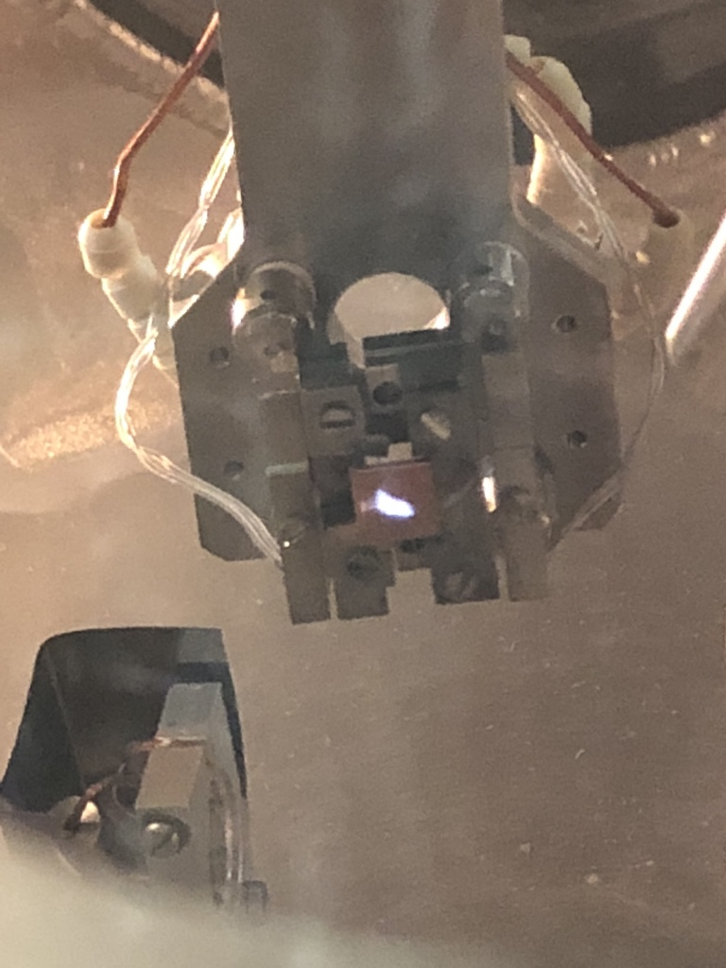
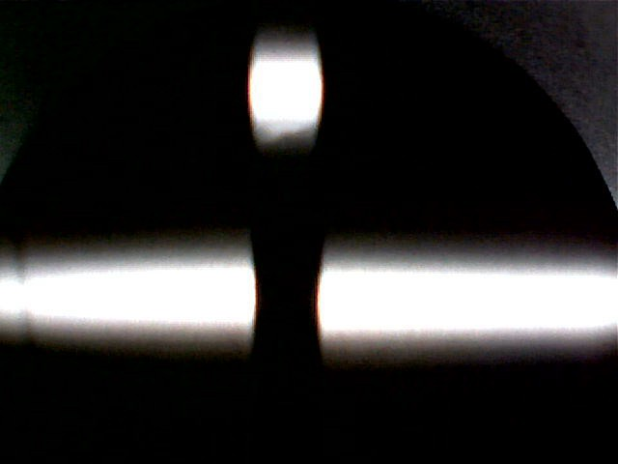
HEB: 60 -1000 eV. About 8 mRad horizontal
Monochromator 60- 1000 eV
Plane grating and mirror
Spot:
2 x 2 mm
Collimate to
a parallel beam
ReFocus:
exit slits to Sample
We hope we need
only small
adjustments
Focus:
Vert. to Entrance slits
Hor . To exit slits
~ 5 mm
~ 35 mm

Slide 11
WINDY: UNDER CONSTRUCTION
Linea Alta Energia
Camera dello Specchio
WINDY
(non in scala)
extra (removable) mirror(7° incidence)

Slide 12
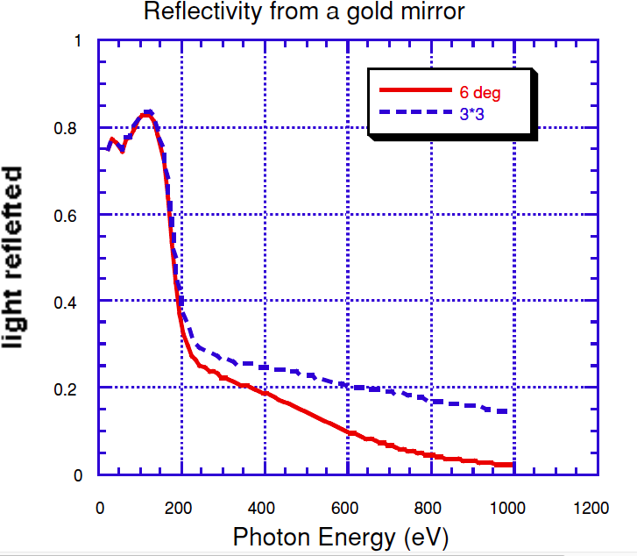
WINDY: UNDER CONSTRUCTION
Geometrical
Acceptance
(~8hx2v mrad)
~ 5 mm
~ 35 mm

Slide 13
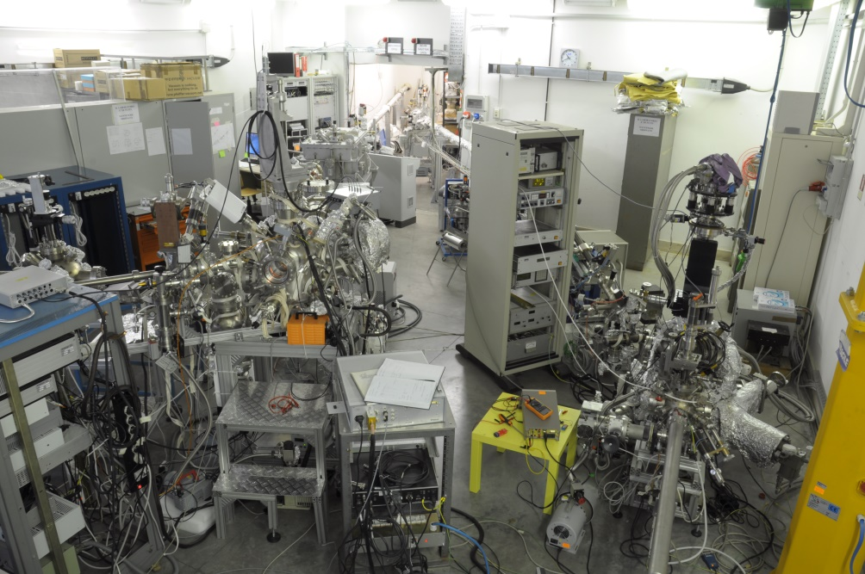
Experimental stations
HEB
60-1000 eV
LEB
30-200 eV

Slide 14
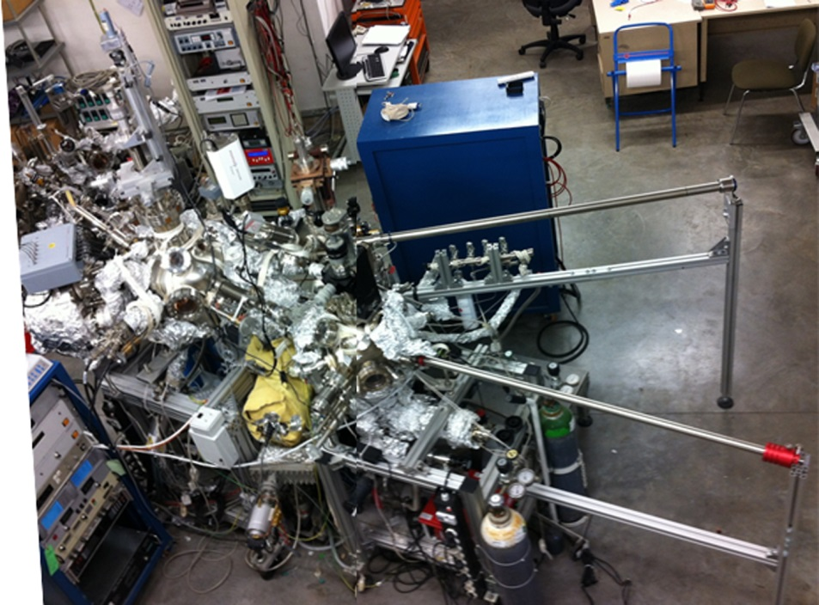
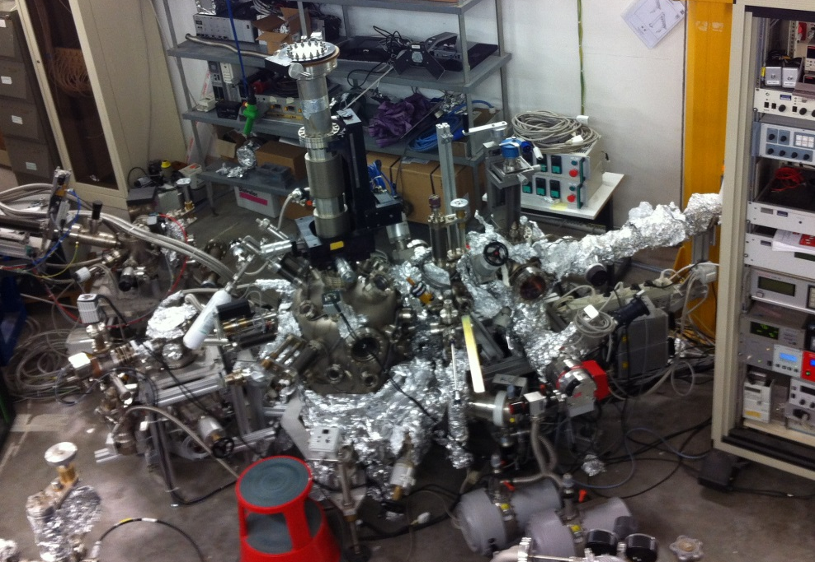
Material Science Laboratory @ INFN-LNF
ultra high vacuum systems
background pressure 1x10⁻¹⁰ mbar
small area (1x1 cm²) sample

Slide 15
Material Science Laboratory @ INFN-LNF
preparation
chamber
main chamber
fast-entry lock

Slide 16
Material Science Laboratory @ INFN-LNF
secondary electron yield
SEY= δ=
=
Iout
Igun - Isample
Iin
Igun

Slide 17
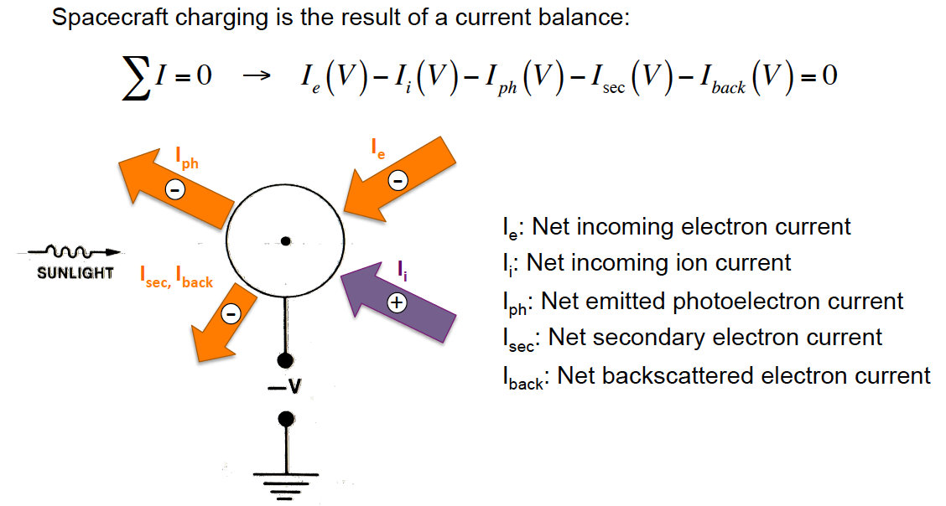
Secondary Electron Yield (SEY)
Of interest to Accelerator Technology
In spacecrafts, two materials with different SEY, PE and R can charge differently and cause disruptive discharge. (20% SC failure!)

Slide 18
Material Science Laboratory @ INFN-LNF
secondary electron yield
To BE MOUNTED SOON:
10 K closed-cycle refrigerator
10 K closed-cycle refrigerator
SEY= δ=
=
Iout
Igun - Isample
Iin
Igun
ALL MEASUREMENTS AT LOW TEMPERATURES

Slide 19
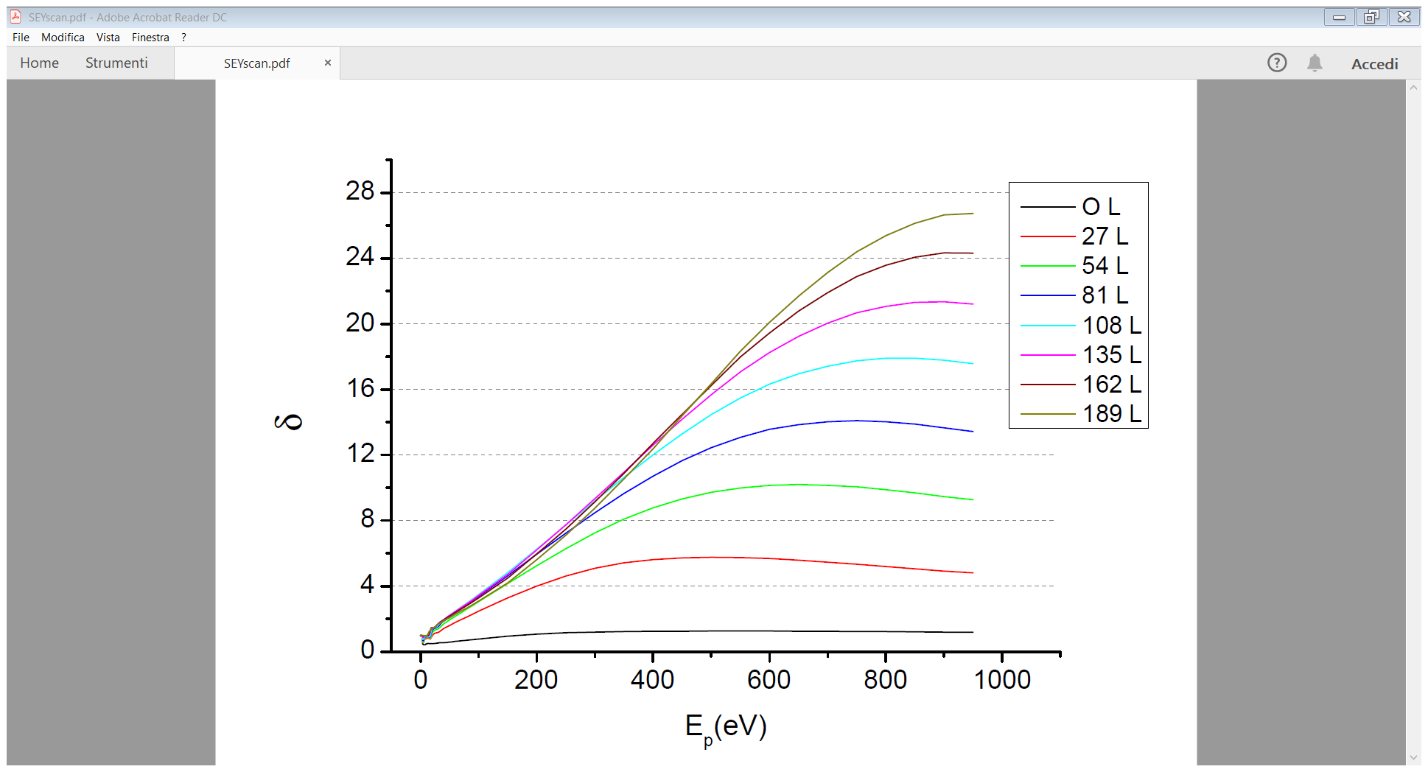
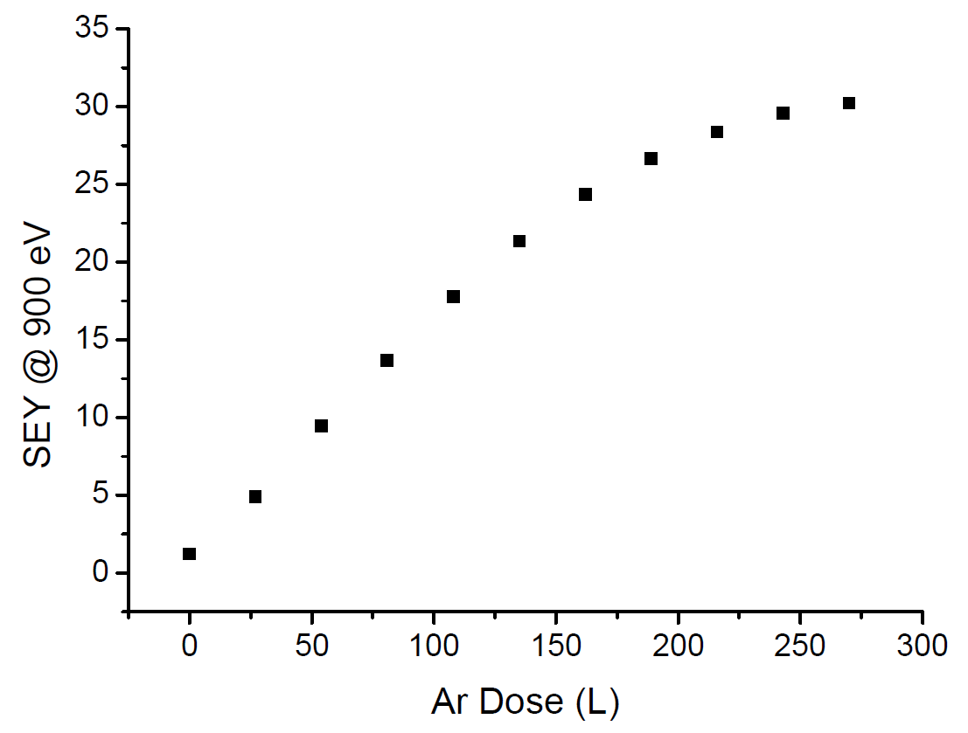
SEY measurements at 10 K
Ar
Cu
SEY on ICES: very sensitive to thickness
Can BE used to study Electron Stimulated
desorption.

Slide 20
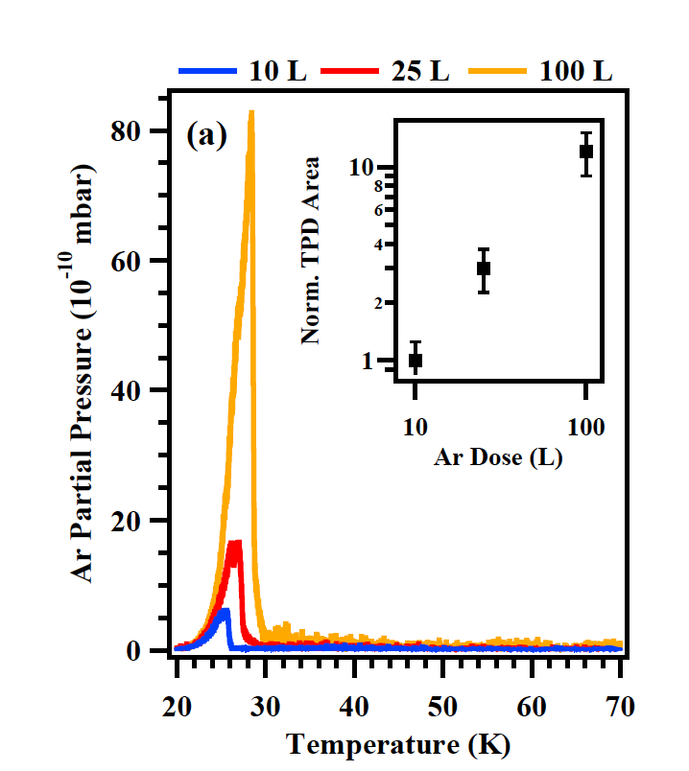
Material Science Laboratory @ INFN-LNF
Quadrupole Mass Spectrometer:
Thermal Desorbtion
Electron Induced Desorbtion
Photo Induced Desorbtion

Slide 21
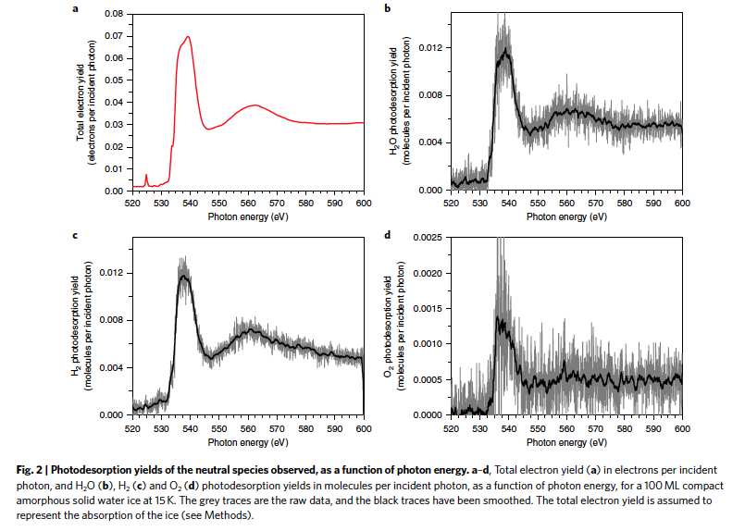
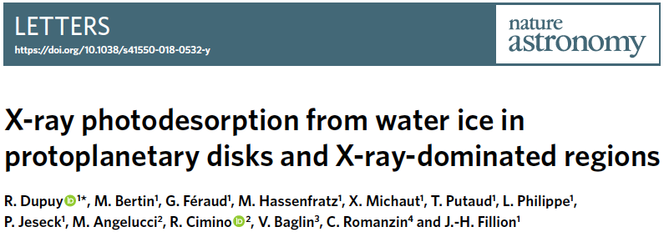
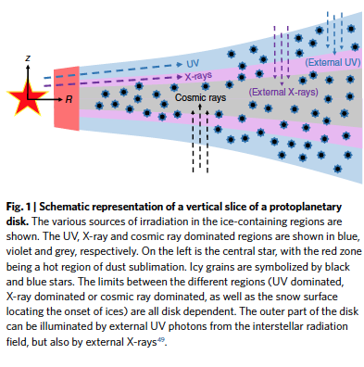
Photo- electron and thermal Desorption studies are of importance to accelerator’s R&D but also to a number of other research area.

Slide 22
Material Science Laboratory @ INFN-LNF
secondary electron yield
+
TPD
UV photoeletron
spectroscopy
X-ray photoeletron
spectroscopy

Slide 23
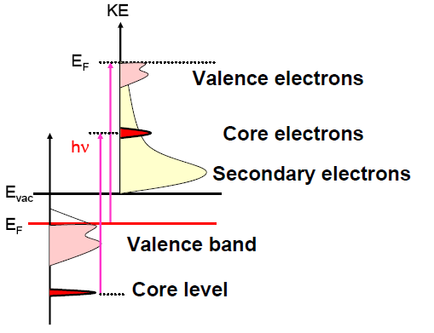
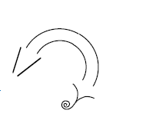
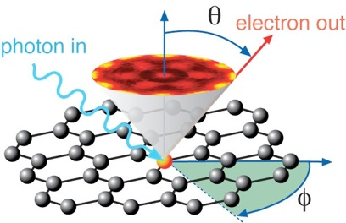
Photoelectron spectroscopy @ LNF
XUV1 exp. station
AlKα (1486 eV) and MgKα (1253 eV)
HeI (21.2 eV) and HeII (40.8 eV)
Electron energy analyser
X-ray and UV Photoelectron Spectroscopy
XPS and UPS
SR (60 - 1000 eV)
XUV1 exp. station
HeI (21.2 eV) and HeII (40.8 eV)
Monochromatized
Angle resolved electron energy analyser
SR (30 - 150 eV)
Angle Resolved
PhotoElectron Spectroscopy ARPES
KE=hv-BE-φ
KE: kinetic
energy
φ: work function
BE: binding
energy
electron
analyzer

Slide 24
Feasible experimental activity
Material tests and characterization
(in UHV: SEY, XPS, UPS, STM/AFM; in air: Raman)
In UHV:
Radiation (electrons, photons, ions) induced surface modification
Thermal programmed desorption (combined with XPS)
Photon induced desorption (conventional sources)
Film growth for SEY optimization
In the tube furnace:
High pressure material growth
Controlled annealing processes of ‘large’ scale samples
With the DAΦNE beam available:
X-ray beam induced surface chemistry
X-ray beam induced desorption
.......

Slide 25
WINDY Project
Photo induced desorption from Long-Samples at low grazing angles
comparison with other experiments on Reflectivity, SEY, PEY.
Long Sample

Slide 26
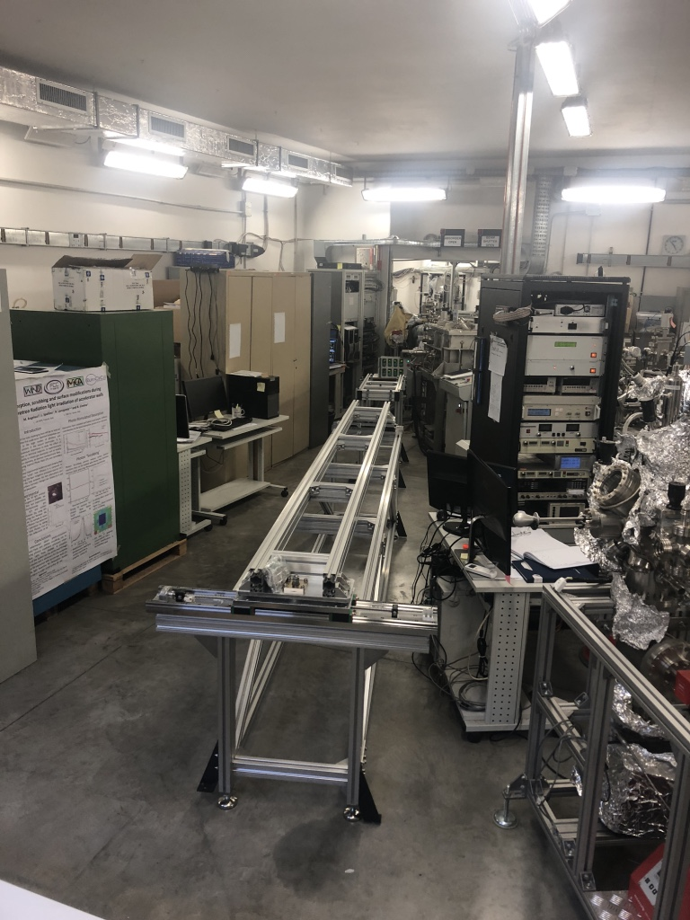
Status(al 14/03/19)
Mirror in position and in UHV
Supports mounted
All ancillaries in house (motors, slits BPM, valves etc)
Chambers and test sample just arrived

Slide 27
XUV laboratory offers a wide range of techniques for:
Material Science
Accelerator R&D
Low Temperature studies
Etc.

