Slide 1

On the significant role played by the
AMICI European Technology Infrastructure
for the development and build-up of
the Large Research Infrastructures and the
Requirements for their Sustainability
Report by the AMICI Task 2.3 on “Sustainability”

Slide 2
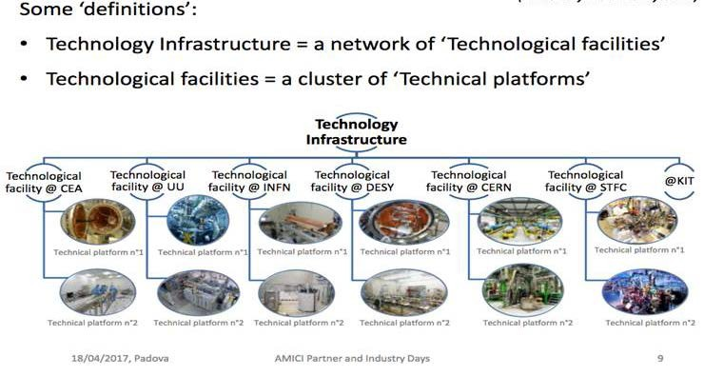
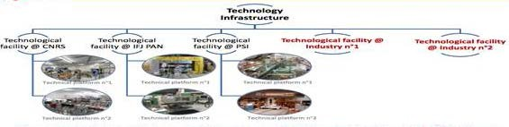
The AMICI European Technology Infrastructure

Slide 3
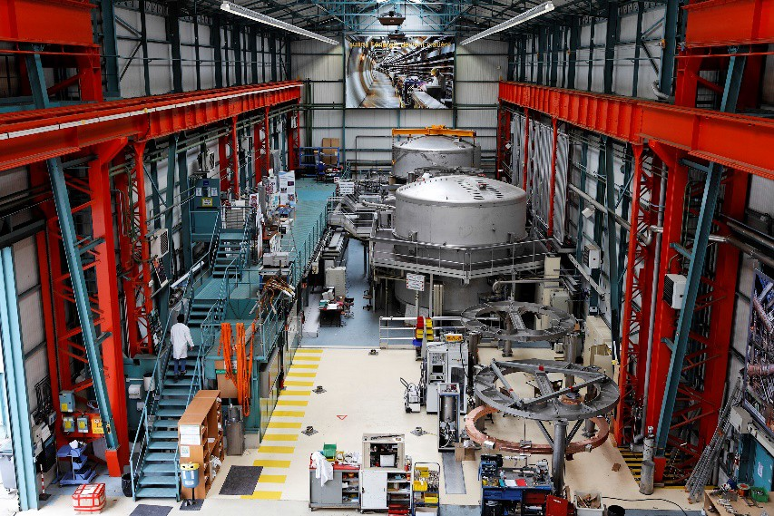
The AMICI TIs and the large accelerator RIs
Many of the AMICI Technological Infrastructures CEA, CERN, CNRS, DESY, FREIA, IFJ PAN, INFN, KIT, PSI and STFC used to have Research Infrastructures on their sites.
Basic science Research Infrastructures for High Energy Physics, Nuclear Physics, Synchrotron Radiation Science, Spallation Neutron Science, New Energy Sources, Environmental Research and other sciences are successively becoming much larger and expensive and therefore also much fewer in the world.
The few large labs that still host Research Infrastructures, like ESS, XFEL and CERN, do not have enough on-site Technical Platforms and capacity to develop and construct the new large Research Infrastructures and therefor need the co-operation of the Technological Facilities.
Test stations for superconducting magnets and large cryogenic components at CEA Saclay

Slide 4
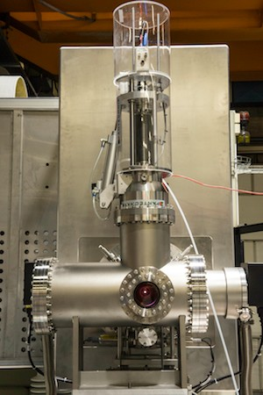
The ESS example
The European Spallation Source is being constructed in a ‘green field’
Most technical components for its build-up are being developed at the Technological Infrastructures all around Europe, fabricated in European industry, assembled and tested at the Technological Facilities and then transported to the ESS site at Lund in Sweden.
It has been estimated that it would have required about 7 additional years and about 77 MEUR additional funding to build up all required Technical Platforms and competences locally in Lund before starting of build-up of the ESS linac.
This is to be compared to the nominal total construction time 10 years and total nominal cost 570 MEUR of the ESS accelerator project.

Slide 5
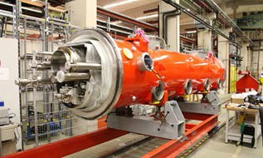
The different types of Technological Facilities
1. Single laboratories having a large accelerator facility with a wide research user community like CERN, DESY, PSI, INFN Frascati and STFC RAL.
2. National clusters of a number of smaller laboratories which have smaller accelerator facilities mostly for accelerator and magnet technology developments like the national laboratories of INFN, STFC and CNRS-IN2P3.
3. Single laboratories with no major research accelerator but a major program of development, production and tests of equipment for Research Infrastructures like CEA-Saclay, FREIA and IFJ PAN.
Technological Facilities having an accelerator Research Infrastructure with an associated scientific user community ( type 1 ) have less problems with sustainability owing to the support to the Research Facility provided by its user community.
An almost finished European XFEL
3.9 GHz module after assembly at DESY

Slide 6
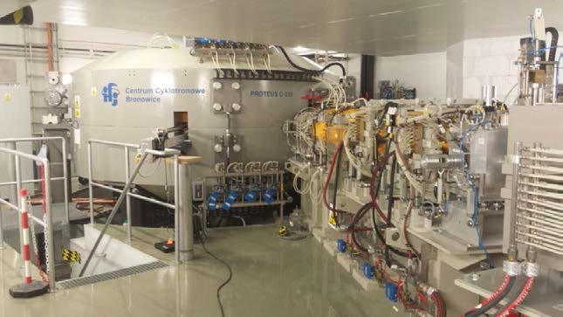
The relation between TI and RIs
Normally the Technological Facility will demand the Research Infrastructure to cover the full costs of all purchased equipment components, industrial orders and consumables needed for the work at the Technological Infrastructure and in some cases also for the personnel costs.
On the other hand, the Research Infrastructure is usually not asked to pay for rental costs, overheads or for the depreciation of existing technical infrastructure at the Research Infrastructure. There is also no provision for a profit to be made by the Technological Facility.
As both parties to such an agreement are contributing to the financing of the common project, the co-operation has the character of a collaboration of mutual interest and benefit and not that of the of a commercial relation.
Test beam facility at IFJ PAN

Slide 7
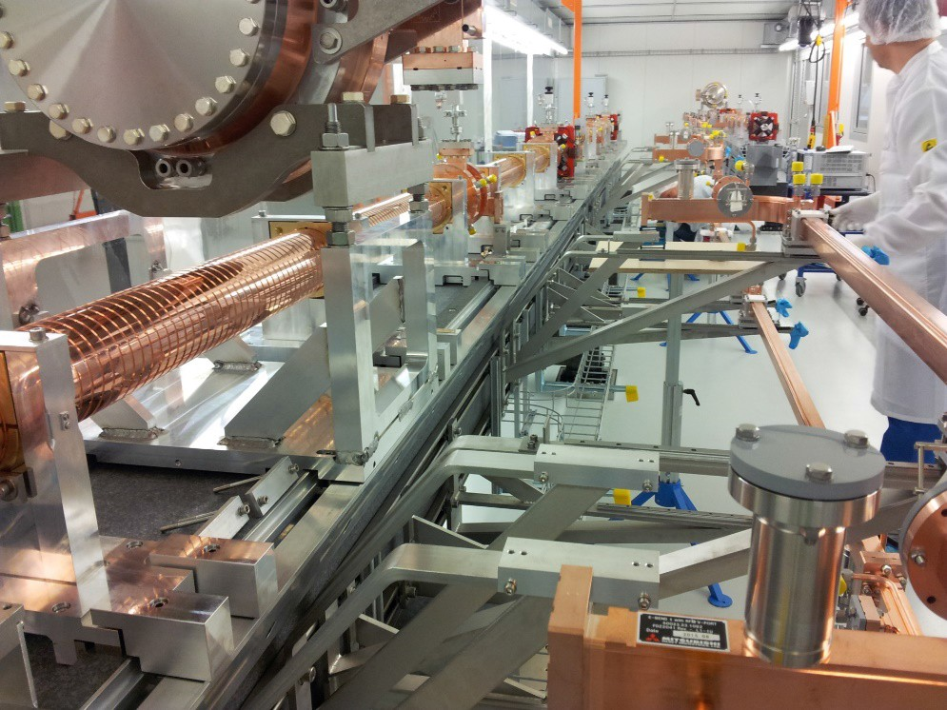
The important but not well known role of the TIs
This new paradigm for how the very large and new Research Infrastructures are developed, build and maintained in Europe is not well known by the general public.
The usual understanding is that, e.g., the CERN LHC and its upgrade, DESY's XFEL and ESS's neutron spallation source are build by and at CERN, XFEL and ESS, respectively, and that is all.
The extensive and intensive interplay required between all the European Technological Facilities in collaboration with European High-Tech Industry for the development, build-up and maintenance of the new very large Research Infrastructures is to a varying degree unknown on the political level.
This implies a problem for motivating public support towards the operation costs of the Technological Facilities and thus for their sustainability, thereby eventually compromising Europe’s future ability to develop and build up new large Research Infrastructures as well as to develop new applications in Society.
C-band accelerating structures test stand at PSI

Slide 8
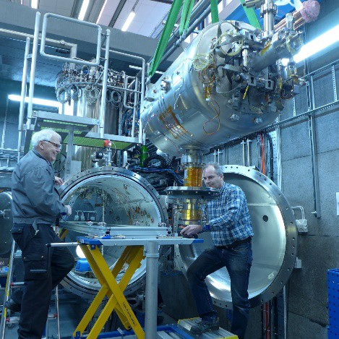
The need for sustaining the TFs
It is essential for the future of European fundamental science, as well as for the development of European high-tech industry, that the new and important role played by the European Technological Facilities be understood by the national science and technology funding sources such that the sustainability of the Technical Facilities can be guaranteed.
One example of this situation is that in Sweden, where the FREIA Laboratory was created in Uppsala as a Technological Facility in 2012, after the shutdown of the TSL national accelerator laboratory there.
FREIA now operates as one of the Technological Facilities in Europe, currently with programs of tests of superconducting accelerator cavities for ESS and of superconducting orbit corrector dipoles and crab cavities for the CERNs HighLumi Upgrade.
FREIA is currently financed essentially on a project basis and has till now received only minor financial support from the Swedish National Research Council and the Swedish Industrial Innovation Agency which is on a level that is insufficient cover the basic operation costs for FREIA of ca 1.8 MEUR/year.
Insertion of the ESS spoke cavity
prototype for tests in the FREIA
horizontal cryostat

Slide 9
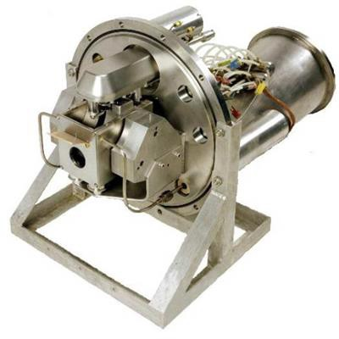
What needs to be explained about the TF’s
Experimental fundamental science, has since the Renaissance been the long-term driver of technological, and therefore also commercial and economical, development in Europe.
The research infrastructures have become so large and so complex that they require the active support of all European Technological Facilities and High-Tech Industry for their development and build-up.
This calls for international coordination and cooperation between the European Technological Facilities and for sustained support for their operation.
Such co-operation is needed in order to keep the leading position in fundamental scientific research and technological development that Europe, with the US, has had until now, but which is now seriously challenged by other upcoming major regions in the world like China and India
Multi-purpose test stand for high
power proton accelerator front end
technologies at STFC

Slide 10
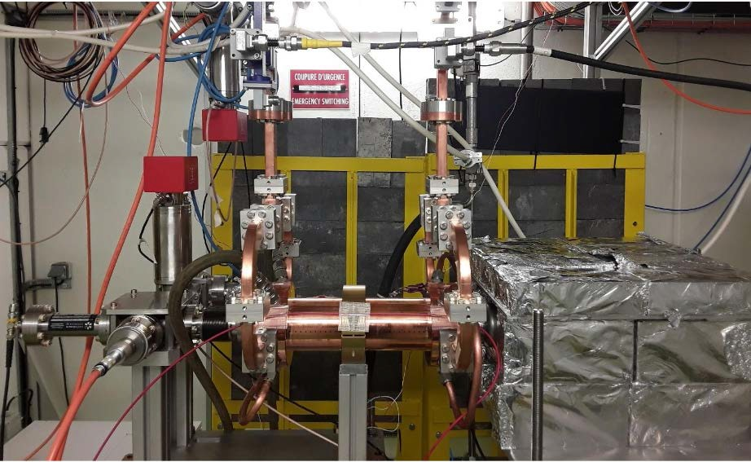
The financing conditions for the TF’s and for Industry
It is both time-consuming, risky and costly for commercial enterprises to spend the time and the resources needed to explore the possibility and commercial interest of developing the brand-new technologies proposed for the Research Infrastructures.
It is therefore often necessary to involve scientists and engineers that have experience of working with the specific type of Research Infrastructure in question, having at their disposal an adequately equipped network of complementary Technological Facilities to undertake the design- and prototype test work in collaboration with the enterprise.
Even if the enterprise is ready to invest funding in the development, the Technological Facility must on its side be able to provide personnel and infrastructure resources in the co-operation – if the Technological Facility were to have to ask the commercial enterprise to cover all costs for the co-operation, this would normally represent too big a risk for the enterprise.
So even if the Technological Facility can establish a business case with the co-operating enterprise, it is thus in need of sustained public funding for the co-operation. For this it may for certain projects apply for regional funds and EU Regional Funding but, even so, it cannot, as a public service organization, sustain itself on a purely commercial basis.
Test stand for X-band accelerating
structures for CLIC at CERN

Slide 11
Conclusions: Requirements on the funding of TF’s
It is of decisive importance that the European Technological Facilities be sustained. Without that it will not be possible to continue to develop, design and build the new world-leading large Research Infrastructures in Europe required for keeping Europe’s leading position within the scientific, technological and economic development in the world.
It order to achieve this, it will be necessary to explain to the general public, and in particular to the European science and technology funding agencies, that the motivation for Society to provide the required financial support to the Technological Facilities in Europe, and thereby guarantee their sustainability, is:
that a significant fraction of the advanced scientific research in Europe, on which the further technical and economic development of our Society is critically dependent, is based on the use of large international Research Facilities and that the European Technological Facilities have nowadays become absolutely vital actors for the development, build-up, maintenance and later upgrade of these Research Facilities and
that the European Technological Facilities make it possible for modern European industry to develop the qualitatively new technologies required by the Research Infrastructures, that soon constitute the basis also for many new practical applications in Society, and also to develop certain new technologies that are directly intended for practical applications in Society, like e.g. for medical or industrial applications.
Winding of a CCT orbit
corrector dipole
prototype for HL-LHC at the
Scanditronix AB company

Slide 12
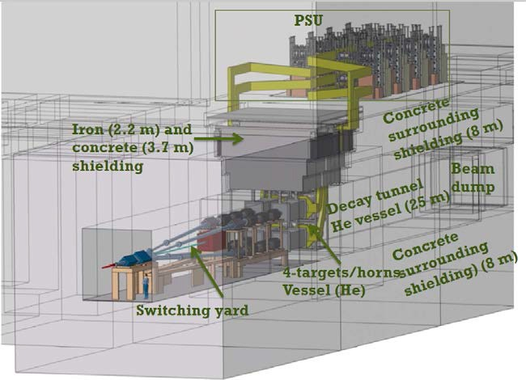
Conclusions: Requirements on the TF’s
It will, at the same time, be necessary for the European Technological Facilities to better coordinate their efforts and avoid unnecessary duplication such that they together cover, in an optimized and cost-efficient way, all significant needs for the technology developments required by the new frontline Research Infrastructures in Europe and in the world.
Furthermore, their collaboration with European Industry needs be organized in a more coherent way, in particular regarding handling of Intellectual Property and transfer of knowledge to Industry, in order to enhance the role of Industry as qualified producer of the innovative instrumentation and infrastructure required for the future development of new Research Infrastructures as well as of Society at large.
It is the aim and purpose of AMICI to facilitate a development in this direction by acting as a coordinating and supporting common platform for the European Technological Facilities.
Layout of the 4 magnetic Hardon
CollectorHorns with their 350 ‘000 A
pulsed current sources for ESSnuSB

