Slide 1
Teledyne e2v – STFC Collaboration
Dr Imran Tahir
17 September 2019
2nd AMICI-Industry Forum, Brussels

Slide 2
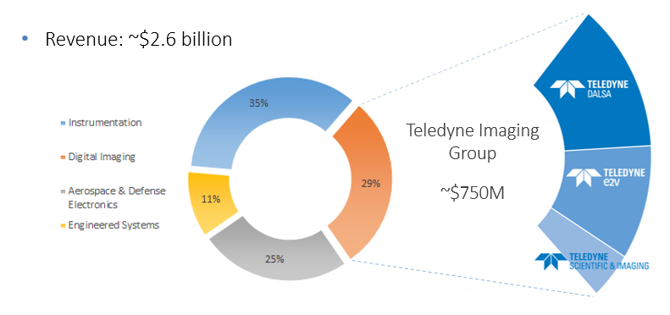
Teledyne Technologies

Slide 3
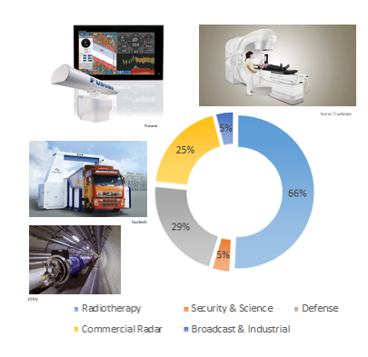
Teledyne e2v – RF Power
Radiotherapy
High-voltage switching and microwave sources for cancer treatment
Commercial Radar
Microwave sources and components for large-vessel and airborne radar
Security & Science
High-voltage switching and microwave sources for cargo scanning and high-energy physics
Broadcast & Industrial
Inductive output and Gridded tubes for TV broadcast and industrial heating applications
Defence
Travelling-wave and high-power microwave sources for military applications

Slide 4
Teledyne e2v – RF Products

Slide 5
Te2v-STFC Collaboration – The Challenge
Teledyne e2v:
Recognised that access to a linear accelerator and radiation test facility would:
Enable them to speed up product development
Address more customer requests and issues
STFC:
Required a supported linear accelerator platform
Collaboration with other industrial users
Engagement with academic research
Notes:
Teledyne e2v recognised that access to an accelerator and radiation test facility would enable them to speed up product development and address more customer requests and STFC required a supported accelerator platform for industrial and academic engagement.

Slide 6
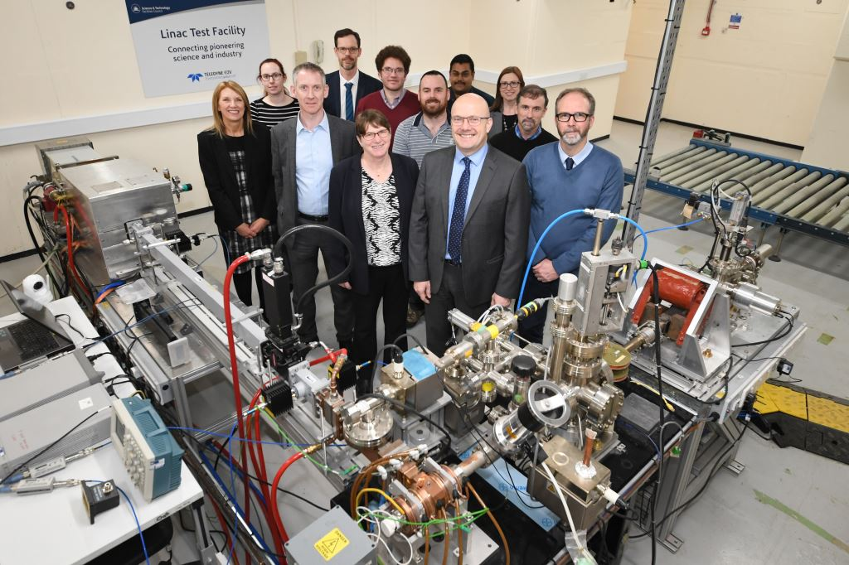
The Solution
Provision of test facilities at Daresbury Laboratory by STFC to Te2v
Infrastructure of the Linac Test Facility
STFC staff expertise in commissioning and operating Linacs
Support of Compact Linac by Te2v at STFC
Quality of performance
Continuity of operation
The collaboration has ensured a mutually reliable platform over time
Notes:
Through collaboration with STFC Daresbury Laboratory, Teledyne e2v has been able to take advantage of the Compact Linac and Linac Test Facility, and expertise of STFC’s staff and the support of Teledyne e2v ensures a reliable platform.

Slide 7
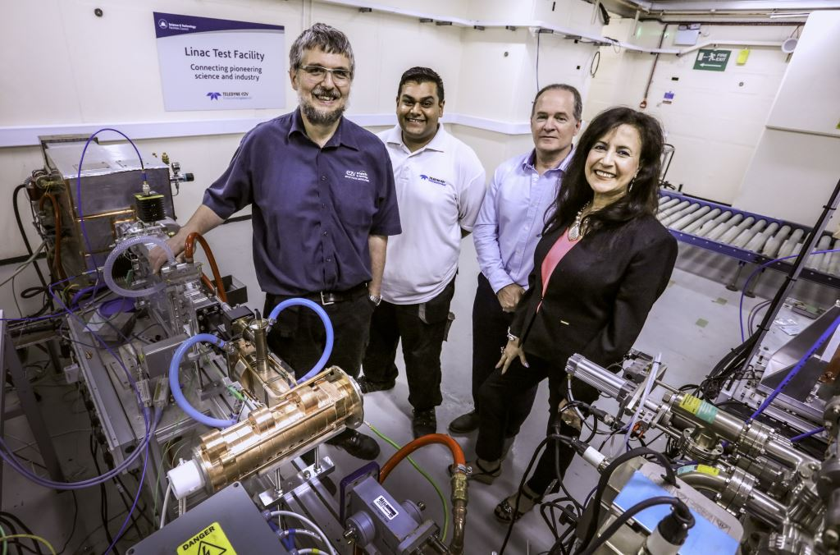
The Benefit
For Teledyne e2v:
Assessing Impact of new Te2v products
Evaluating customer system designs
Improving performance to meet increasing global demands
Improving on product/system reliability to reduce downtime and service costs
For STFC:
Supported platform for academic engagement
Performance platform for further industrial collaborations
Advancing research in medical and security Linacs sector
State of the art global partnerships through Te2v such as Accelerad
Notes:
Teledyne e2v can assess the impact of new products and system designs against the wider performance and reliability aspirations of its customers and STFC has a reliable, supported platform for academic &industrial engagement.

Slide 8
Academic Research
Continued history of Te2v in funding academic research at universities and through STFC
Some examples:
(With Lancaster University, Cockcroft Institute, Queen Mary University London)
Stabilisation of magnetrons for use in International Linear Collider SC Cavities
Study of Multipactor Discharges in complex structures
High power high frequency CW Radial Inductive Output Tubes
Computer modelling of magnetrons and crossed field devices

Slide 9
Collaboration Future
Further bridge the gap between Industry, STFC and Academia
Workshops to enhance engineering skills in areas of mutual interest
Partnerships in strategic areas of personnel development
Continue to support Linac Test Facility at STFC
Continuous improvement in medical and security Linacs
Preserve diminishing knowledge in high power RF as people retire

