Slide 1

The challenge of cooperating with industry in R&D activities
P.Fabbricatore - Coordinator of AMICI WP-5 Industrialization
INFN Genova

Slide 2







WP5 - Industrialization
AMICI WP-5 aims to sensitize and train the industrial companies in the needs, the knowledge (know-how), the techniques, the methods and the quality standards involved in the accelerator and superconducting magnet technologies developed in the Technical Infrastructures.
In this framework, together with AMICI industrial partners, many aspects of the cooperation with industry in R&D activities were investigated (personnel trainings, harmonization of technical information, construction of models and prototypes, legal frameworks) with the aim to overcome barriers and effectively include the industry in the AMICI ecosystem.

Slide 3
AMICI and Industry
  In the AMICI model, the partnership with industry is considered a fundamental element of the AMICI integrated Technological Infrastructure, with a double link: through an Industry Advisory Group and an Industrial Liason Group

Slide 4
Cooperation with industry in R&D activities
What exists, issues and possible improvements in the framework of AMICI ecosystem for:
The legal frameworks in EU for innovative projects
The developments of models and prototypes
Trainings
Harmonization
The Intellectual Property

Slide 5
The legal frameworks in EU for innovative projects
A Guidance on Innovation Procurement has been issued by the European Commission in May 2018 with the possible administrative public procedures for innovation. We have checked that the identified procedures have been already integrated into the national laws for public contracts:
• Pre-commercial procurement (PCP)
• Innovation Partnership
• Competitive procedure with negotiation
• Competitive dialogue
In an R&D phase the first two procedures looks applicable. In the next two slides these legal procedures will be briefly reviewed with reference to the AMICI fields of interest. As general remark for all procedures: in all cases a public selection of the company/ies shall be done

Slide 6
Pre-commercial procurement (PCP)
Pre-Commercial Procurement (PCP) is the procurement of research and development of new innovative solutions before they are commercially available. PCP involves different suppliers competing through different phases of development. The risks and benefits are shared between the procurers and the suppliers under market conditions.
The spirit of the PCP scheme is to fund companies to perform R&D in a competitive environment. The business case is to engage small/medium industries to work on edge technologies, even if no large market volumes are expected.

Slide 7

An example of PCP: QUACO
A positive Pre-Commercial Procurement (PCP) initiative was funded by EU under the name QUACO (H2020 PCP). The project run in collaborative effort among four partners (two from AMICI): CERN, CEA, CIEMAT, NBCJ coordinated by CERN, around the development of the Q4-MQYY full scale quadrupole magnet prototypes for HL LHC project.
A possible drawback of PCP is related to the IP for the following (construction) phases: Only the involved companies have the needed knowledge and detect part of IP, so holding an advantage wrt possible competitors.
18/09/2019
AMICI Second Industry Forum
7

Slide 8
Innovation Partnership
Unlike in the case of Pre-Commercial Procurement, the Innovation Partnership is regarding the development of solutions with a reasonable marketing perspective.
The Partnership for Innovation combines the R&D phase of the PCP and the purchase phase of the developed product (innovative solutions subject to the Public Procurement of Innovative solutions PPI ) in one tender procedure and may involve the involvement of one or more operators in every phase (with the possibility, after each phase, to conclude the partnership or reduce the number of partners involved).
Even if there are not known examples yet within the AMICI community, this procedure looks to be well suitable for developing prototypes for accelerators or superconducting magnets having as following step the mass production. The lock-in* issue is intrinsically excluded by the nature of the procedure based on the choice of the best potential users since the R&D phase.
* The lock-in is a situation in which a customer using a product or service cannot easily transition to a competitor’s product or service.

Slide 9
The developments of models and prototypes
The following points are the result of AMICI-Industry discussions and analyses within the WP5.4 working group studying the Conditions for developing prototypes with Industry
Definitions
Model: A device based on first development of conceptual ideas with a scaled (and many times progressive) approach. Usually tooling is not (fully) available yet. Many models could be necessary before moving to the next step of prototyping. In terms of Technology Readness Level a model stays in the range TRL4-TRL5.
Prototype: An almost mature component, for final assessing and training of tools and manufacturing methods . In principle it could be used in an accelerator. Also in this case more than one prototype could be required before moving to the following step of component production. A prototype can range between TRL6 and TRL8.
Mass Production: Mature components. No more changes applied wrt the last prototype (TRL9)
Industry involvement

Slide 10
Developing prototypes with AMICI model
The involvement of the industry in the prototyping shall be done if possible at an early stage of the design unless the component to be developed is highly challenging and not well defined yet.
The role of the industry should not simply cover manufacturing aspects but also design aspects in collaboration with TI. This is important to allow industry set the basis for future products beyond the scopes of the specific prototyping activities.
The industry asks to be timely informed about the need for a prototype development

Slide 11
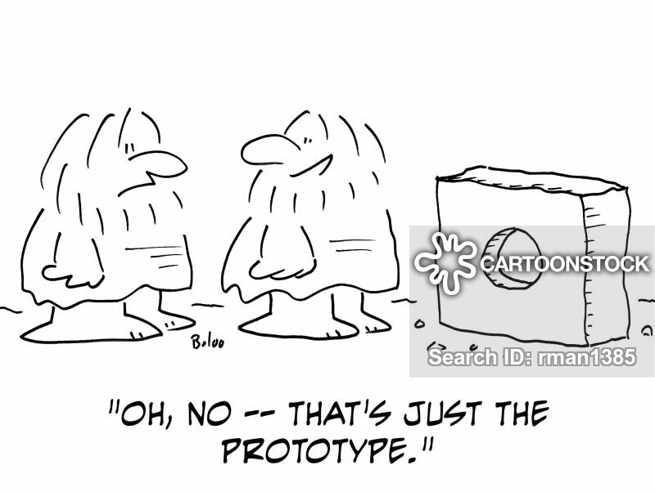
Developing prototypes with AMICI model
More discussions needed for:
The content of the R&D is limited → industry would like to apply a principle (the subsidiary principle) to perform in first person this activity.
There is a strong preference of Industry in performing the activities at the Industry premises. However there are examples where Industry personnel works in the TI facilities for constructing prototype (The superconducting coils of quadrupoles for HL-LHC at CERN).
18/09/2019
AMICI Second Industry Forum
11

Slide 12
Trainings
In the framework of the AMICI WP5 (Industrialization), the task WP5.1 (Professional training and apprenticeship) aims at promoting professional skills training and cross improvement between TI and industry. Both training opportunities in TI and in industry have been considered, with the same basic strategy (enforce a powerful support mechanism for effective knowledge and technology transfer between TI and industry) but with different aspects and weights:
Training and apprenticeship in TI. It aims at defining the conditions and setting the basis for an apprenticeship pilot program dedicated to train technicians and engineers from industry in hands-on fabrication, assembly or test of accelerator and magnet.
Training and apprenticeship in Industry. This part is mainly dedicated to understand the opportunities and the conditions for secondments of young researchers of TI in industry.

Slide 13
Training and apprenticeship in TI
Supply Chain
Training in TI is needed to bring the supply chain to the challenging performance requirements set by the laboratories in charge of the RI project realization.
Training is a must for key technologies reaching high TRL, soon to be industrialized: companies are ready to send personnel in TI, at their own cost, only if contracts are within 2-3 years.
For standard competences (e.g. magnetic measurement, vacuum technology, RF technology), apprenticeship is already available in the public and private sectors.
Sustaining pre-existing know-how in industry entails system-engineering and quality-assurance methodology enforced at the interface between Industry and TI.
18/09/2019
AMICI Second Industry Forum
13

Slide 14
Training and apprenticeship in Industry
Secondments of TI personnel in industry appears a powerful tool for facilitating knowledge transfer between industry and TI and enabling the TI personnel to gain direct knowledge of current industry practices, with many positive aspects
However, this practice is not common among the AMICI partners. Independently on the reasons for the missing use till now of secondments, AMICI should encourage this practice through a definition of general protocol to start secondments on specific programs of general interest for accelerator and superconducting magnets
There are positive examples in Academia which can be followed.
Possible issues for industry are related to the IP management and to the disclosure of patented or reserved industrial methods or, more in general, knowledge. These aspects should be analysed case by case and specific non-disclosure agreements shall be done.
For TI staff a possible issue of long secondments in industry is related to the role and the career of the seconded personnel once back to the home institutions. For avoiding possible problems of this kind, the TIs should be encouraged to specify clear rules supporting the seconded personnel.
30/05/2018
18/09/2019
AMICI Steering Committee
AMICI Second Industry Forum
14
14

Slide 15
Harmonization
One of the action for creating the AMICI ecosystem consists in establishing both common knowledges, background and use of material and components properties and common standards. The use of design methods and tools common to all integrated TFs allows the industries to face innovative contracts with the same approach and uniformly accepted level of information. To this aim, two main activities were performed:
The development of a database dedicated to accelerators and large superconducting magnets (accelerating structures, magnets, diagnostics, ancillaries…) to create a common reference database (see S.Grohman’s talk)
Standardization of one of the most peculiar aspects of the AMICI field of interest: Cryogenics. A new European Standard “Helium cryostats -- Protection against excessive pressure” has been developed and will be applicable to superconducting magnet cryostats and cryostats for superconducting radio-frequency cavities, to cold-boxes of helium refrigerators and liquefiers, to ultra-low temperature refrigerator systems using 3He and 3He/4He mixtures as well as to helium distribution systems including valve boxes. (see S.Grohman’s talk)

Slide 16
The Intellectual Property
IP in Academia. Academia’s requirements for IP generated in a project are primarily to publish results of research and show the impact of the establishment’s research in tangible terms; this can be through licensing IP for royalty income or sale of know-how through consultancy.
IP in Industry. The organisational goals will be to gain a competitive edge from future new products and processes. Industry requirements for the IP generated in a project will be to give a company freedom to operate, to make and sell the new products, services in the future.
IP in R.I. or T.I. A government funded laboratory’s IP requirement for IP generated in a project is generally a hybrid of industry and academia; primarily it requires its IP in order to efficiently operate the laboratories through publication or patenting. Another strategic goal of R.I.s is to transfer their IP to industrial partners for industrial application outside their research field through licensing or selling IP that is not critical.

Slide 17

The management of IP in AMICI
All the TIs of AMICI are extremely open to cooperate with industries and negotiate appropriate agreements on a case by case basis with a pragmatic approach
Background knowledge
Each party keeps the ownership of IPR related to pre-existing knowledge/ patents
Foreground knowledge
There are alternative provisions:
In case of collaborative research IPR may be jointly owned; shares are based on the importance of respective contributions
In case of research contract IPR may be jointly owned or exclusively owned by the customer (if so, contract value increases)

Slide 18
Conclusions
Cooperation with Industry in R&D for accelerators and superconducting magnets is fundamental, specially in the developments of models and prototypes.
AMICI is setting up a model of cooperation for engaging industry in the low TRL phases of development still preserving the ownership by the Technological Facilities of the developed technologies
Activities are already ongoing for constructing a common background TI–Industry of knowledges, quality and standards
The role of the trainings TI←→ Industry is considered among the crucial points and its enforcement will be one of the next actions of the AMICY community

Slide 19
Thank you for your attention
18/09/2019
AMICI Second Industry Forum
19

