Slide 1
UTOFPET: design of a highly scalable TOF-PET detector concept
Nicola Belcari
FATA2019
Fast Timing Applications for Nuclear Physics and Medical Imaging
Acireale 3-5 September 2019
The research leading to these results has received funding from the the European Union’s Horizon 2020 research and innovation programme under grant agreement No 688735 - Photonics Based Sensing ERA-NET Cofund – www.utofpet.com

Slide 2
The UTOFPET project
Network type: ERA-NET Cofund
Funding Framework: Horizon 2020
Joint call: Photonic Based Sensing (PhotonicSensing)
The Consortium
University of Pisa, UNIPI, Nicola Belcari & Giancarlo Sportelli
AGE Scientific s.r.l., AGE, Giovanni Franchi
Universiteit Gent, UGENT, Stefaan Vandenberghe
Molecubes NV, MOLE, Roel Van Holen
École polytechnique fédérale de Lausanne, EPFL, Edoardo Charbon & Claudio Bruschini
www.utofpet.com

Slide 3
Project objectives
The UTOFPET (Ultra-Time-of-Flight PET) project aims at developing a highly modular and scalable TOF-PET detector module with beyond-state-of-the-art performance, i.e., providing:
an intrinsic spatial resolution of less than 1 mm
a timing resolution below 140 ps FWHM (leading to a CTR of 200 ps for a pair of detectors)
a maximum sustainable count-rate of 1 Mcps.

Slide 4
Design phylosophy
The new PET detector is based on SiPM coupled to monolithic scintillators and processed on a distributed data acquisition network.
Motivation:
Conveying all the produced data to a single, centralised acquisition device is inefficient.
A distributed acquisition system would be desirable instead, where the computational burden is shared among the detectors.

Slide 5
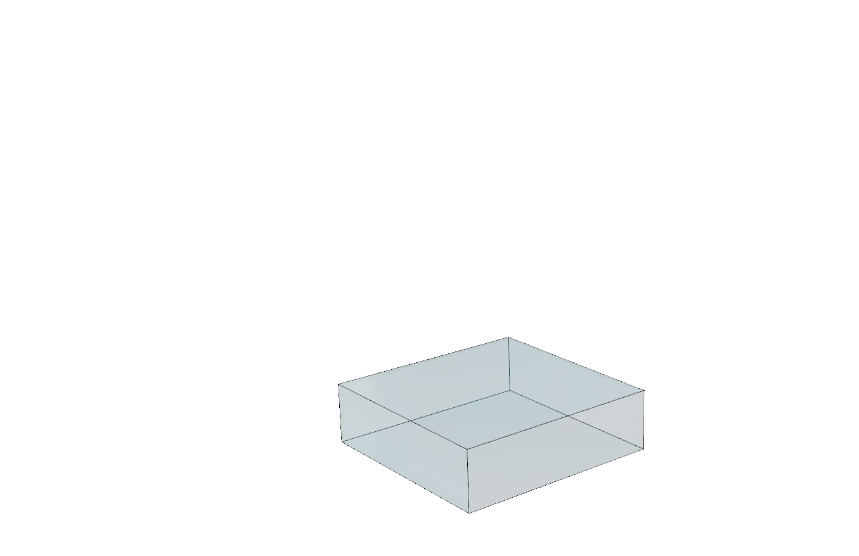
Design concept - Detector
The UTOFPET detector is based on a continuous LYSO scintillator crystal
  intrinsic spatial resolution that is not limited by a physical pixel size
  depth-of-interaction (DOI) estimation capability
    Less parallax error
    CTR improvement
Continuous LYSO block
51.8 mm x 51.8 mm x 12 mm

Slide 6
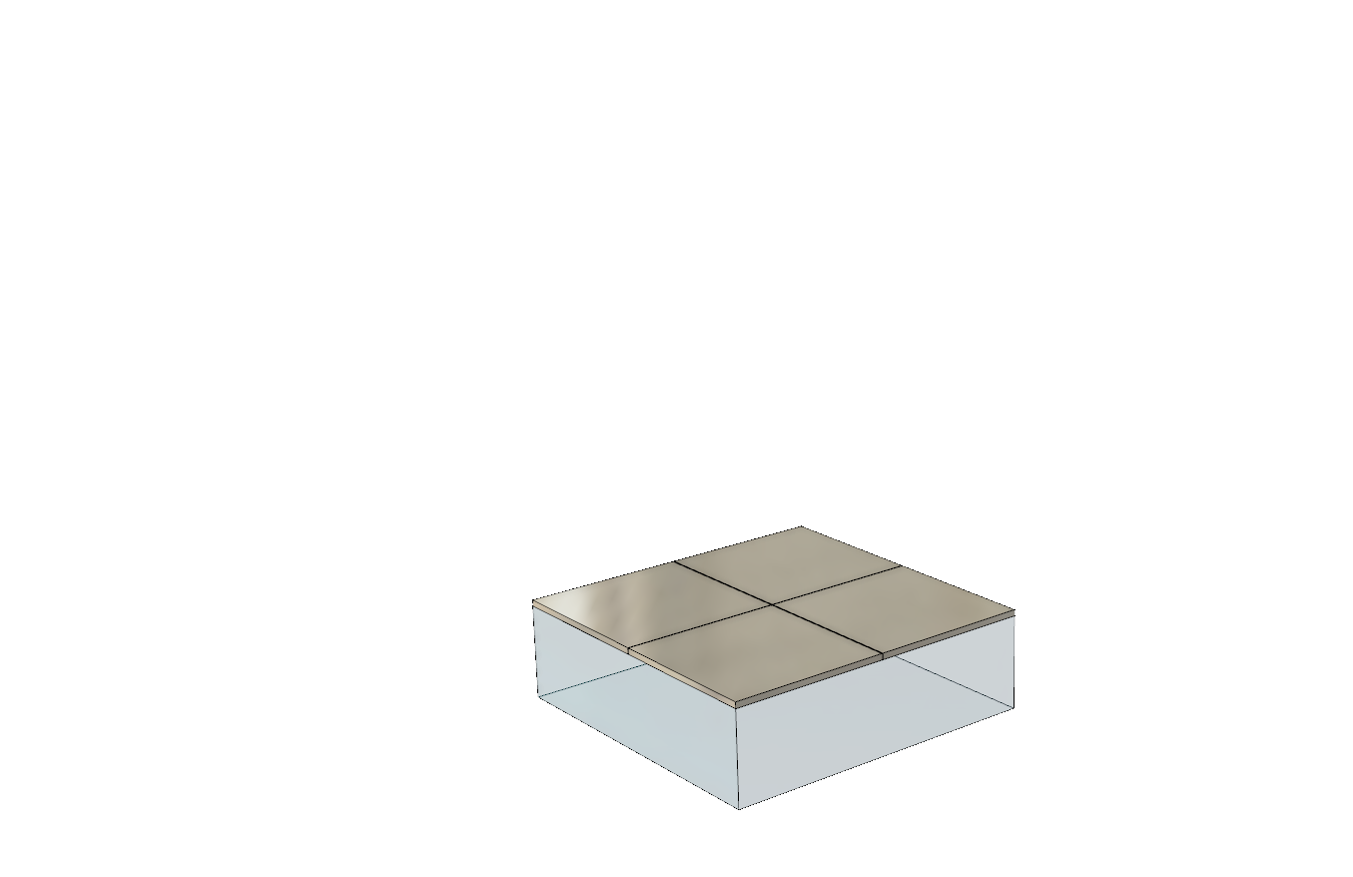
Design concept - Detector
The UTOFPET detector is based on a continuous LYSO scintillator crystal
The crystal is coupled to a matrix of 256 SiPMs (single elements or, e.g., four 64 ch arrays).
16 x 16 SiPM
3 mm x 3 mm
(3.2 mm pitch)
Continuous LYSO block
51.8 mm x 51.8 mm x 12 mm

Slide 7
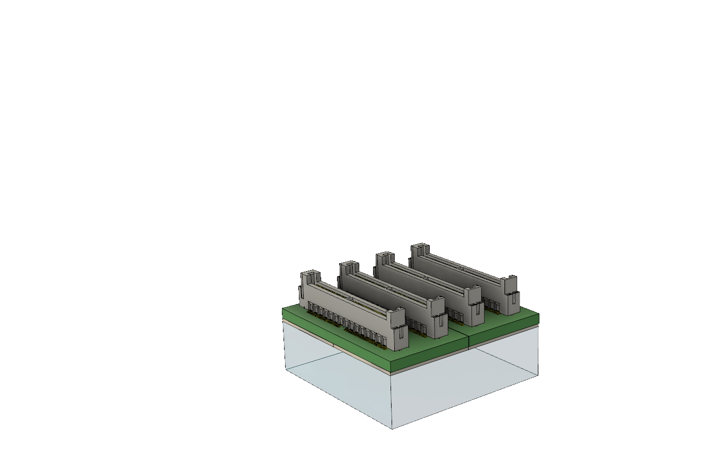
Design concept - Detector
The UTOFPET detector is based on a continuous LYSO scintillator crystal
The crystal is coupled to a matrix of 256 SiPMs (single elements or, e.g., four 64 ch arrays).
SiPMs are soldered on a single board
16 x 16 SiPM
3 mm x 3 mm
(3.2 mm pitch)
Continuous LYSO block
51.8 mm x 51.8 mm x 12 mm

Slide 8
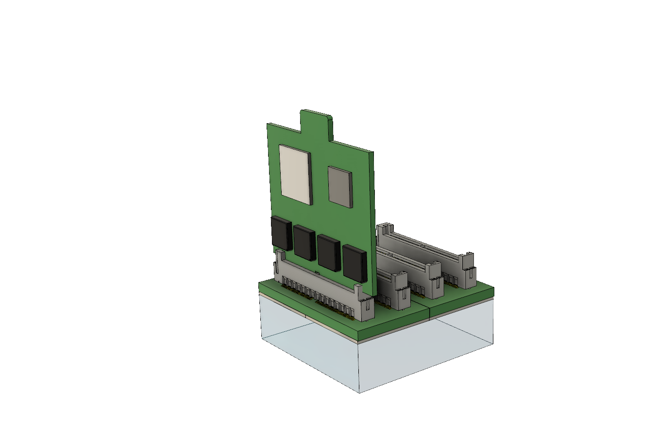
Design concept - Frontend DAQ
All the SiPM outputs are read individually to improve performance in terms of CTR.
Signals are read out by HRFlexToT ASIC installed on dedicated ASIC boards
the ASICs are located as close as possible to the SiPMs so as to minimize analogue signal degradation.
HRFlexToT ASIC
(16 Channels)

Slide 9
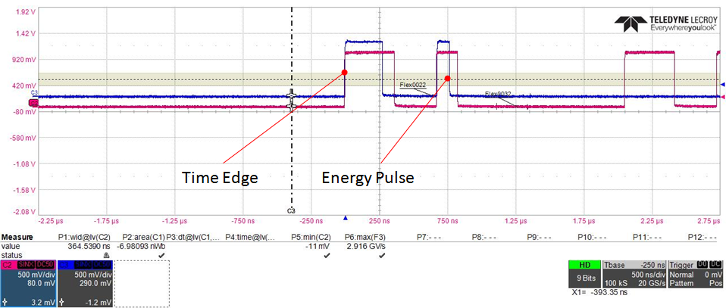
ASIC: HRFlexToT
Linear ToT ASIC
Time and energy information are encoded into two digital pulses
FPGA-based TDC readout
Time information
(CLK as a reference)
Energy information
(lenght proportional to energy)
Notes:
The second pulse contains the energy information, its length depends linearly on the signal area and has a width between few tens of nanoseconds and about 600 ns.

Slide 10
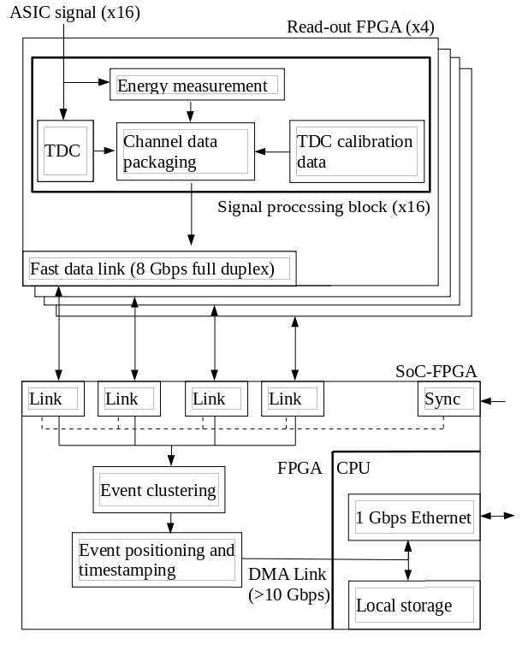
Design concept - Frontend DAQ
Read-out FPGA
(Altera Cyclone 10)
SiPM bias
voltage supply
HRFlexToT ASIC
(16 Channels)

Slide 11
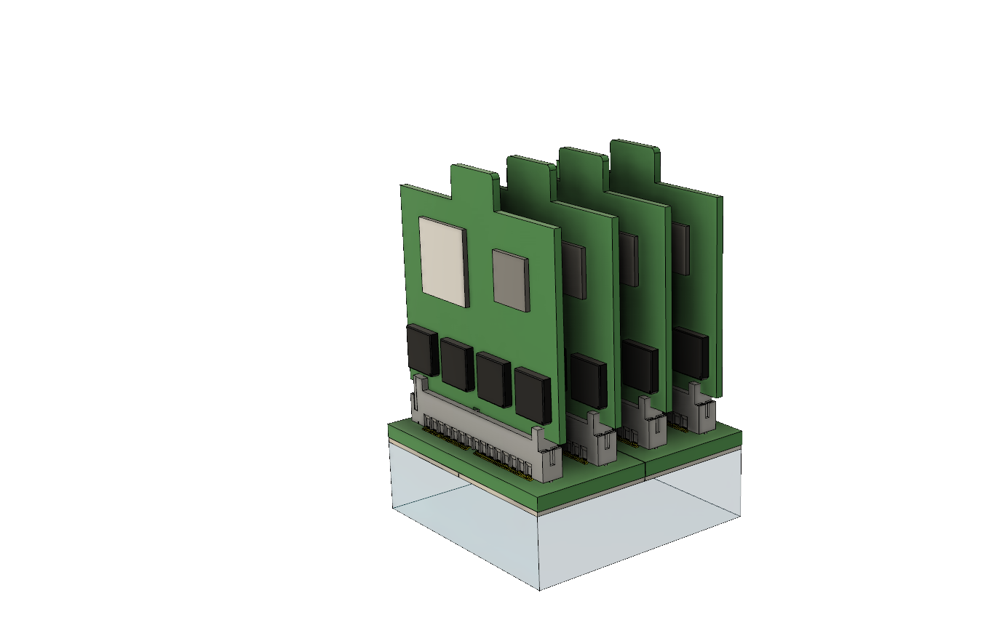
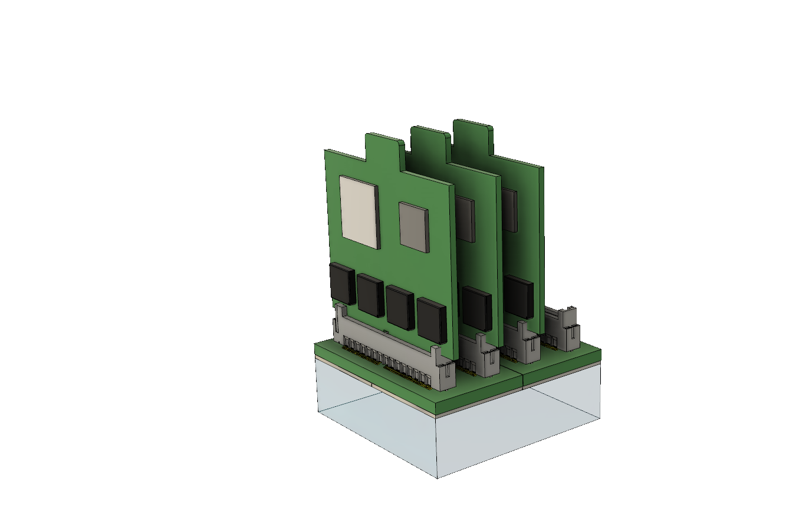
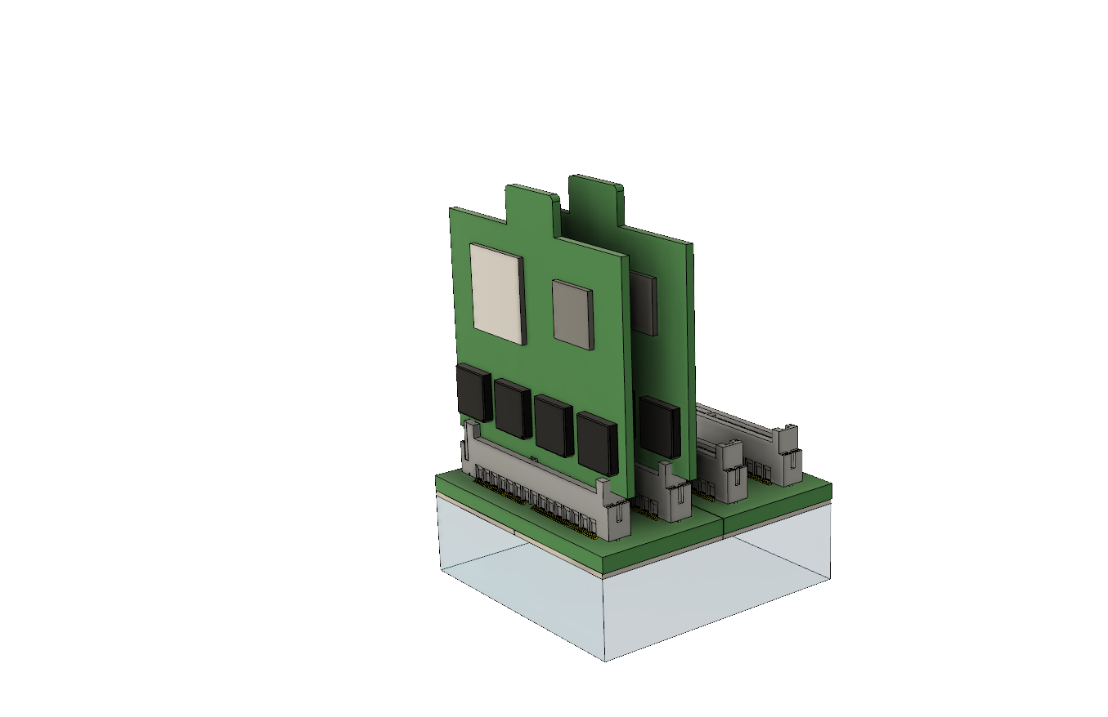
Design concept - Frontend DAQ
A stack of four ASIC boards allows reading out up to 256 SiPM output signals.
Notes:
Each frontend board reads one quarter of the SiPM matrix (4 × 16 elements) and

Slide 12
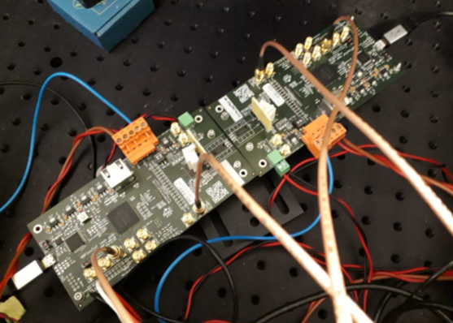
HRFlexToT/SiPM evaluation setup
Two HRFlexToT evaluation boards were used in the tests.
For each board, the digital output of the ASIC and the analog output of the shaper were sent to an oscilloscope, sampling at 20 GS/s.
Notes:
The analog output was used in the oscilloscope trigger to avoid the acquisition of pedestal events when SiPMs were tested, while the analysis was based on the digital output only. Since the pedestal events can be also discarded in the FPGA, this trigger method does not introduce a bias with respect to the case of the final detector. For all the acquisitions, the minimum value of gain was used. In the acquisitions for the coincidence time resolution, the distance between first and second pulse of the ASIC was chosen so to have at least about 100 ns between the end of the first pulse and the leading edge of the second one. For the 6 x 6 mm2 MPPC, the delay was increased of about 300 ns with respect to the standard settings due to the longer pulse shape.

Slide 13
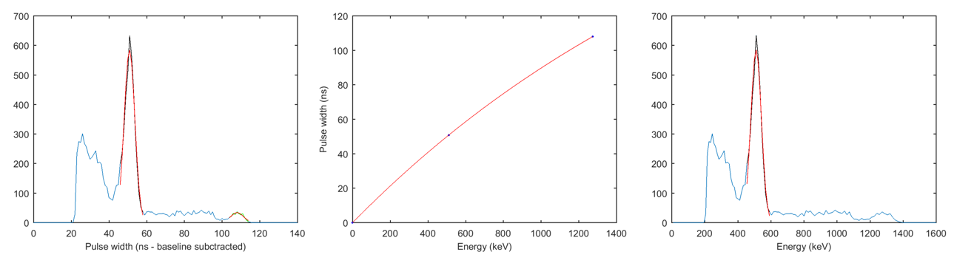
Energy resolution evaluation: method
The energy spectra were obtained using a ²²Na source.
A single SiPM is coupled to a 3 mm x 3 mm x 5 mm LYSO crystal.
The position of the two peaks were used to correct for the saturation of the SiPM

Slide 14
Energy resolution evaluation: results
Six types of SiPMs were tested from three manufacturers.
No clear trend in the dependence on the bias.
An improvement of energy resolution with SiPM active area.
Best results are for SiPMs with smaller cell size.
Notes:
There is not a clear trend in the dependence on the bias, this could be due to the uncertainties in the saturation correction process. It could be observed that 3 x 3 mm² Hamamatsu MPPC feature a higher energy resolution due to the higher cell size (50 µm, compared to 30 µm cell size of Broadcom and 35 µm of OnSemi). An improvement of energy resolution with SiPM active area can be observed, even if the scintillator area is 3 x 3 mm² for all the devices. In fact, the optical coupling and the epoxy interface on the SiPM allow a spatial spread of the light, using an effective area of the SiPM larger than the area of the scintillator.

Slide 15
CTR evaluation: method
A ⁶⁸Ge source was used.
An energy window of a FWHM around the photo-peak was considered. No time-walk correction was applied to the results.
The threshold of the ASIC discriminator was chosen as the lower compatible with the noise level of the SiPMs and electronics.
The coincidence time resolution is expressed as the FWHM of the time difference distribution between the triggers of the first digital pulse for the two ASICs.

Slide 16
CTR evaluation: results
Broadcom SiPM and Hamamatsu MPPC with 3 x 3 mm² and 4 x 4 mm² active area reached a CTR below the 200 ps target. A result close to 200 ps was reached also with 6 x 6 mm² MPPC
The OnSemi SiPMs with 4 x 4 mm² active area reached a CTR of about 180 ps only at the higher value of overvoltage, while the best CTR obtained with the 3 x 3 mm² SiPM is about 210 ps.
Notes:
the optimum bias voltage of the Hamamatsu 6 x 6 mm² case is lower than for 3 x 3 mm², this is due to the higher dark noise of large area device and is confirmed in the Hamamatsu documentation.
In some cases the range of overvoltages in which the energy resolution was investigated is lower than that used for the CTR study, this is due to the fact that for the calibration also the 1274 keV peak should not saturate the shaper. In the CTR study the limits in overvoltage is not given by energy saturation but only by the level of noise of the SiPM at high bias voltages.
A degradation of time resolution in OnSemi SiPM was observed with overvoltages above 6 V, in agreement with the datasheet that suggests a 3 - 6 V working range.

Slide 17
Design concept - Backend DAQ
Monolithic scintillator:
  high processing power for the large number of SiPM triggered simultaneously.
  time and energy characterization algorithms are more
Solution:
  distribute the processing power by increasing parallelisation and performing most of the processing as close as possible to the photosensor.

Slide 18
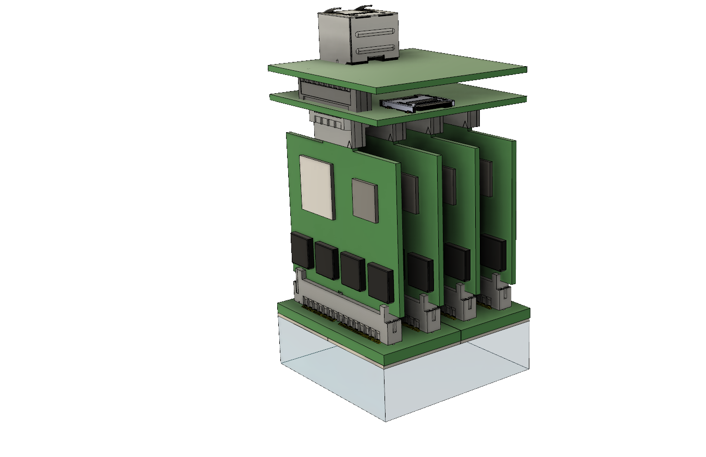
Design concept - Backend DAQ
Sync in
Ethernet connector (PoE)
Main SoC FPGA
microSD card slot
A linux-based operating system (OS) runs on the hard processor system (HPS) integrated in the SoC-FPGA.
It can perform high-level network management, data compression and transmission.
Notes:
The “event clustering” process produces the dataset to be further processed for retrieving (x, y) position, DOI, energy and time of interaction. Data are then stored locally on a Secure Digital (SD) card and transmitted during the acquisition to a file server through a separate thread instantiated on the SoC via a Gigabit Ethernet connection. Data transmission to the server is completely independent from the acquisition and can be delayed to happen offline. In this way, it is possible to remove the bottleneck of data concentration speed. During the acquisition, singles are sorted with a real-time software-based process running on the server and only coincidence data are stored on disk.
This is made possible by the linux…

Slide 19
Design concept - Backend DAQ
Sync in
UTOFPET DAQ features:
All the detectors operate independently
No global constraint, such as the total acceptance bandwidth of a data concentrator or a file server
The only centralized infrastructure is the one used for clock distribution.
Ethernet connector (PoE)
Main SoC FPGA
microSD card slot
Notes:
With the proposed architecture, all the detectors operate independently, without any global constraint, such as the total acceptance bandwidth of a data concentrator or a file server. The only centralized infrastructure is the one used for clock distribution.

Slide 20
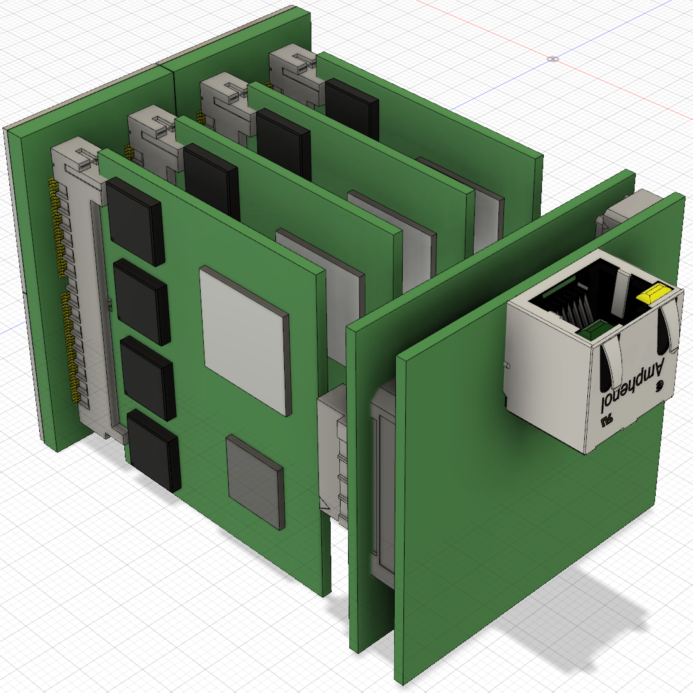
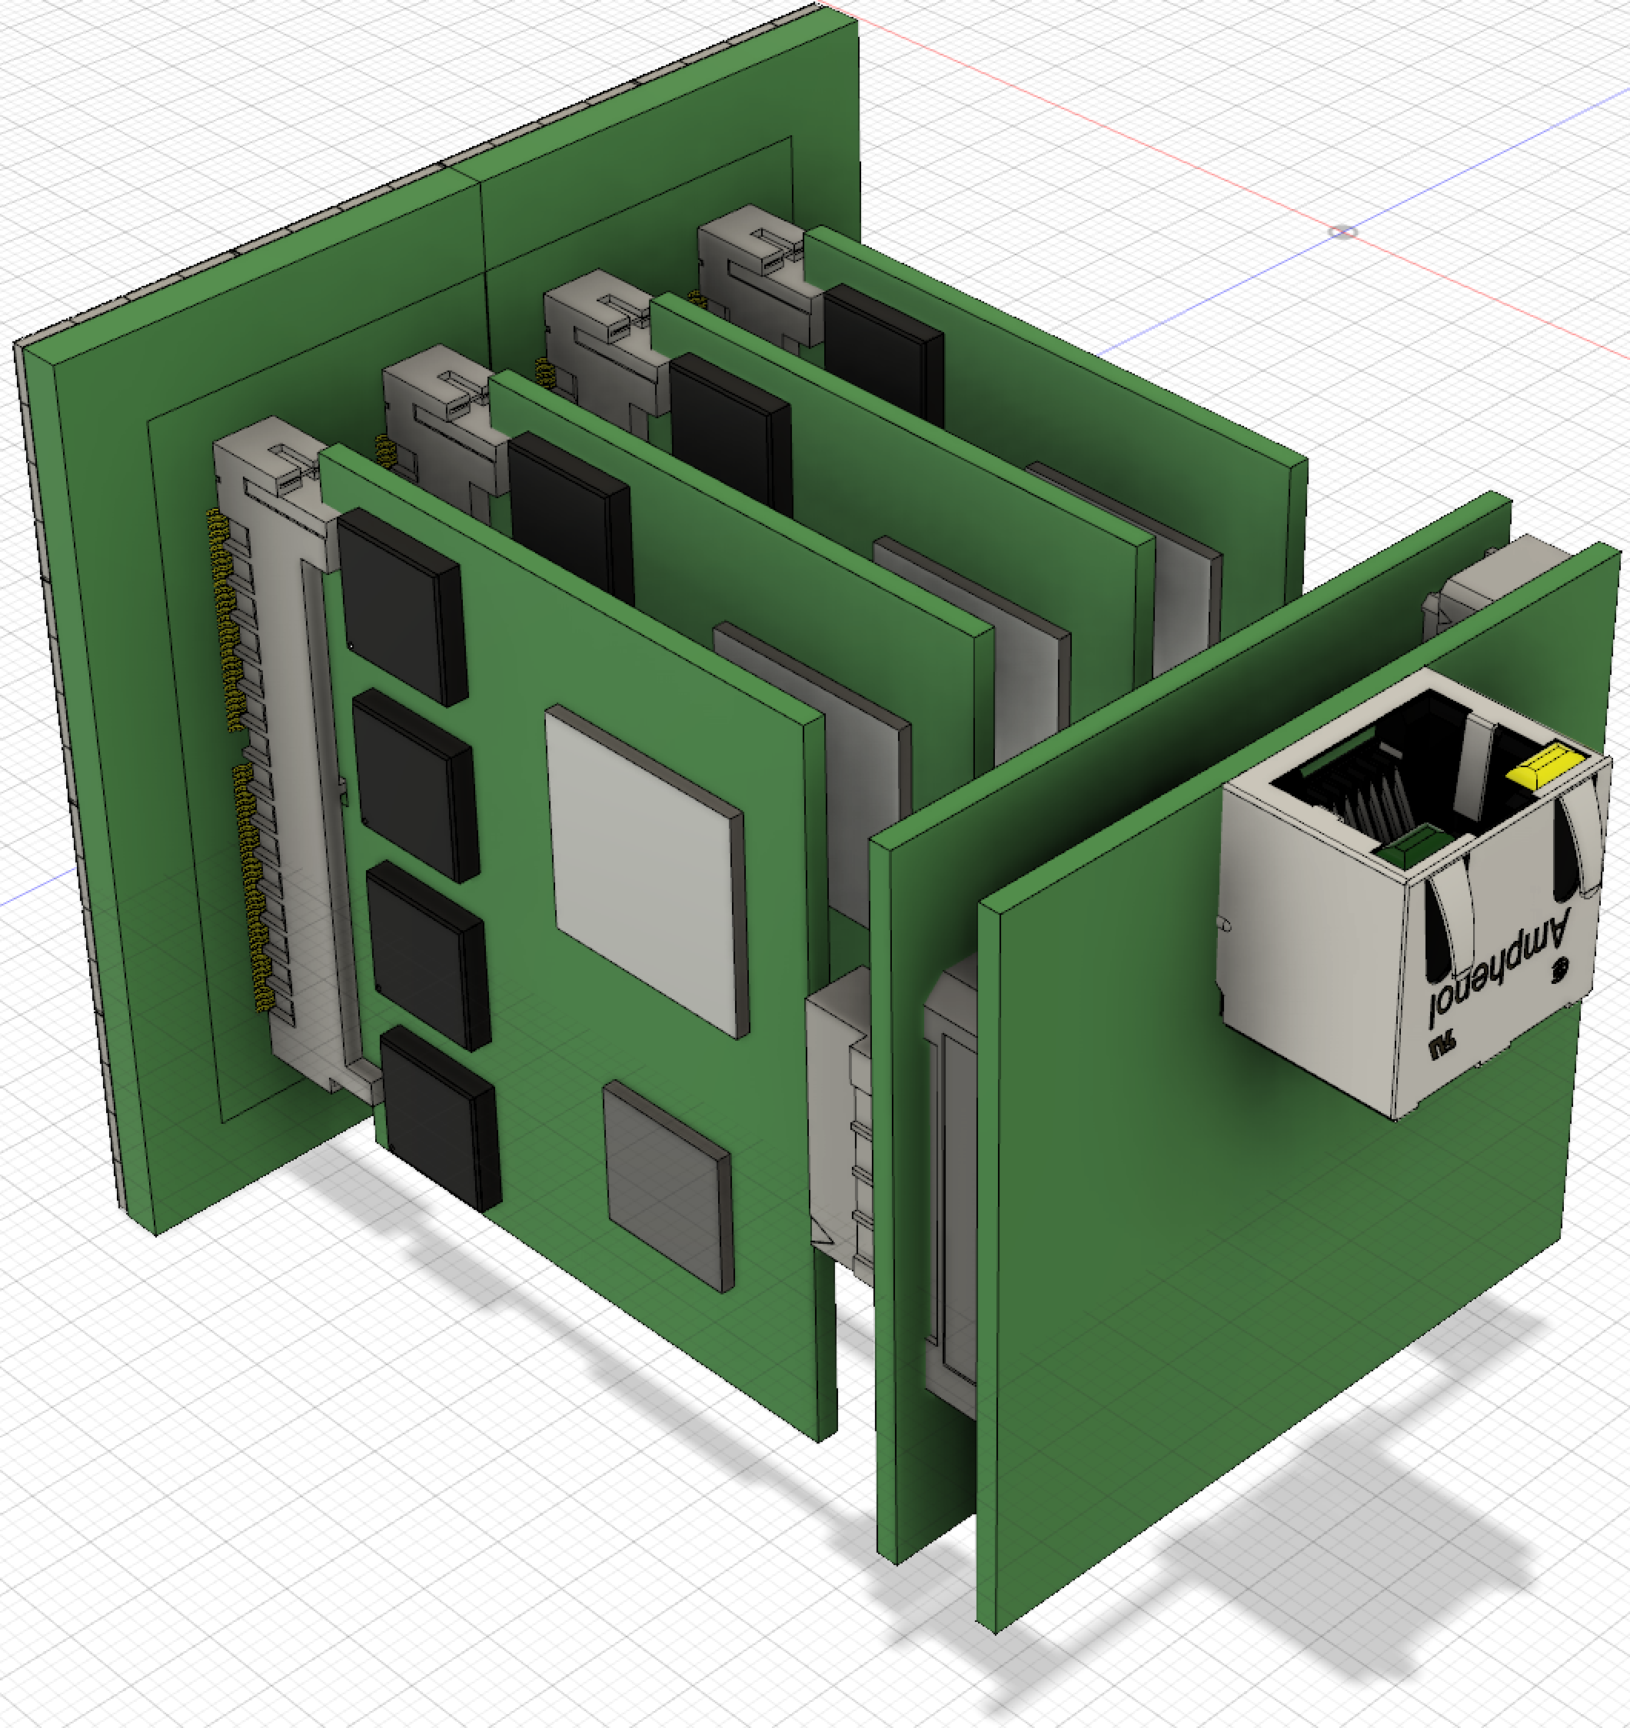
SiPM choiche
This dimension constrains the maximum size of the boards so as to allow various detectors to be tiled with no dead space in between.
The electronics will be also compatible with the use of 4 mm × 4 mm SiPMs, then creating an active surface of about 64 mm × 64 mm.
3 mm x 3 mm
(Hamamatsu)
54.4 mm x 54.4 mm
4 mm x 4 mm (Broadcom)
65.1 mm x 65.1 mm

Slide 21
Machine Learning based event positioning
Event processing must be done in the module for scalability and bandwidth reasons
Standard statistical methods require a computational burden that is not compatible with FPGA (or embedded CPU) implementation
  The memory requirements are too high for using the FPGA memory blocks
Requirements:
  Computationally inexpensive and implementable on modern low-end FPGAs.
  Sub-mm position determination
  1 MHz count rate compatible

Slide 22
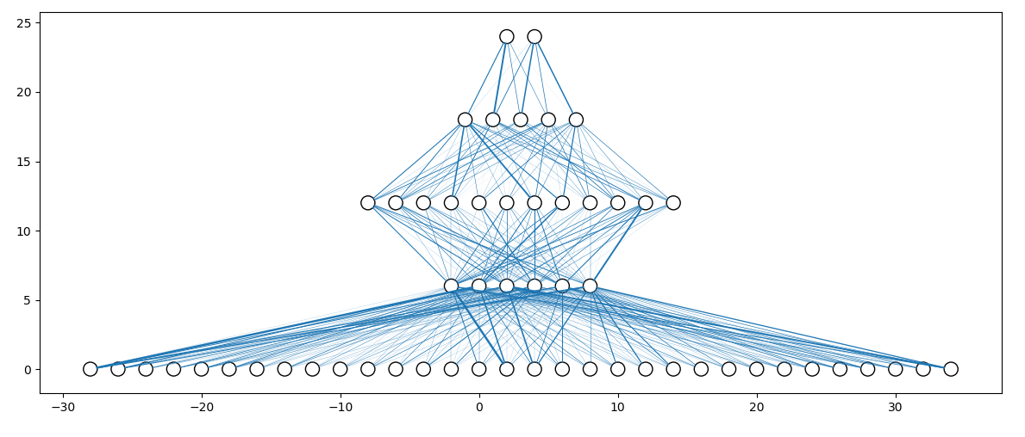
Machine Learning based event positioning
We designed a neural network with only three hidden layers, for a total of 1000 weights of 16 bits.
The loss function minimized during the training phase is the Euclidean distance between the reconstructed interaction point and the nominal interaction point
Avoid any transcendental function. In our case:
  Comparisons with 0
  1374 Multiplications
  About 1000 additions
the network input is represented by the 16 rows and 16 columns normalized sums
The network output is composed by two neurons, representing the (x,y) coordinates of the event (not quantized).
Notes:
A possible solution is implementing the algorithm in FPGA with a neural network

Slide 23
Machine Learning based event positioning
The data used for training have been simulated with GATE v8.0. The monolithic crystal is defined as LYSO with dimensions 50 mm x 50 mm x 16 mm.
  No intrinsic radioactivity of lutetium is modelled;
  Compton scattering and photoelectric effect are enabled in the GATE physics
  realistic surface reflection model (LUT Davis model)
  The lateral sides are modelled as rough surfaces painted with black paint, while the top of the crystal is defined as polished and covered with a specular reflector.
The network has been trained with 10.000 events for each different (x,y) position in a grid ranging from (0.25, 0.25) mm to (48.25, 48.25) mm with steps of 1 mm in both directions.

Slide 24
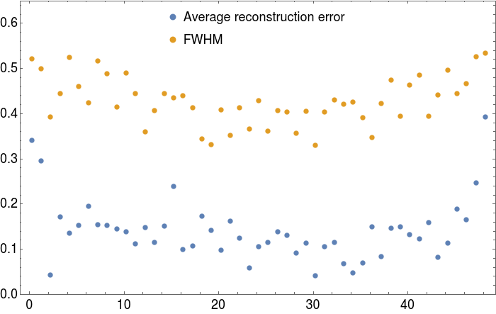
Machine Learning based event positioning
Y position (mm)
Reconstructed “flood map” with the 49 x 49 irradiation positions (1 mm steps)
Mean reconstruction error and FWHM of the irradiated spots on the diagonal of the crystal.
The average position reconstruction error is 0.12 mm
The average FWHM is 0.34 mm at the centre of the crystal and 0.48 mm at the edges.
X position (mm)

Slide 25
Conclusions
Initial measurements confirm the feasibility of a sub-mm spatial resolution, sub-200 ps CTR detector using monolithic LYSO and SiPMs
UTOFPET exploits the scalability benefits provided by SoC-FPGAs for creating a distributed DAQ wich is suitable for multiple applications ranging from brain-dedicated systems to total body PET scanners.
UTOFPET is expected to drive a big leap in sensitivity with a cost-effective and easily customizable solution.

Slide 26

Acknowledgements
Maria Giuseppina Bisogni, Pietro Carra, Esther Ciarrocchi, Matteo Morrocchi Giancarlo Sportelli (UNIPI)
Mariele Stockhoff, Charlotte Thyssen, Stefaan Vandenberghe (UGENT)
Ewout Vansteenkiste, Karel Deprez, Roel Van Holen (MOLECUBES)
Giovanni Franchi, Andrea Puccini (AGE)
Edoardo Charbon, Claudio Bruschini, Francesco Gramuglia, Esteban Venialgo (EPFL)
www.utofpet.com
The research leading to these results has received funding from the the European Union’s Horizon 2020 research and innovation programme under grant agreement No 688735 - Photonics Based Sensing ERA-NET Cofund

Slide 27
Backup
The energy spectra were obtained using a ²²Na source read out by a single SiPM
The position of the two peaks were used to correct for the saturation of the SiPM, so to obtain the correct value of the energy resolution. Starting from the pulse width distribution, the width corresponding to the pedestal value at the used gain was subtracted (p2 parameter obtained in the linearity test), the position of the two peaks was then related to the deposited energy using the equation: Width=a (1-e^(-E⁄b) ), the relation was then inverted so to convert the pulse width in terms of keV. The 511 keV peak was then fitted again using a gaussian function and the energy resolution was obtained as the FWHM over the peak position. Figure 8 shows an example of a pulse width spectrum (left), the dependence of the peak position as a function of the energy (center) and the corrected energy spectrum together with the gaussian fit of the 511 keV peak.

