Slide 1

New approaches to detector readout in particle physics and medical applications with efficient timing
Yuri Venturini

Slide 2


Traditional Readout System for Timing Measurements
Detector 1
Manual tuning of parameters (in particular delay and attenuation of CFD)
Low flexibility
Expensive solution
Additional chain to measure amplitudes of the pulses
CFD1
START
TAC
MCA
Detector 2
STOP
CDF2
Time Spectrum
Shaping
Amplif
Peak
Sensing
ADC
Preamp
2x Energy Spectrum
Notes:
Let’s start from the old times! This is the traditional analog chain to perform timing measurements. In this example we have two PMTs followed by Constant Fraction Discriminator giving the start/stop to a TAC. Then the TAC is feeding the MCA to extract the time spectrum. If also the measurements of the amplitude is needed, another chain must be added, splitting the signal from PMTs in two branches. Which are the problems of this approach? Mainly the complexity of the system, use of many electronic boards (so high cost…), low flexibility and manual tuning of the parameters (especially delay and attenuation of the CFD are critical). So we propose the new Digital approach to this kind of measurements, using Digitizers.

Slide 3




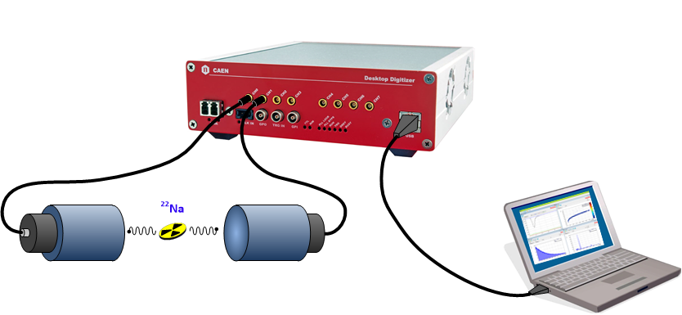
Digital Readout: all-in-one
early A/D conversion
FPGA
Detector
FADC
streaming
Preamp
01100101
Shaping
BLR
Peak
Sensing
PHA
Energy Spectrum (MCA)
Delay
BLR
Integral
QDC
Double
Integral
Fast/Slow
PSD
Timing
Filter
Discr
Logic
GPIOs
Scaler
Counts
MCS/Rates
Sync
clock
TDC
Time
TAC/TOF
Software
Settings
Notes:
As you can see, here you have just one board, in this case CAEN DT5730, replacing all the analog chain. The detector is directly connected to the Digitizer inputs and all the signal processing is implemented in the FPGA, with different features depending on the firmware loaded onboard. Of course the advantages with respect to the analog chain are clear, especially in terms of cost, compactness and flexibility, but there could be some problems when trying to perform efficient timing measurements with very fast signal (I’m thinking for example to fast pulses with 1.5 ns rising edge which are typical of BaF2 detectors). So, let’s have a look in detail at the digital CFD implemented in CAEN Digitizers, to see where the possible problems could be.

Slide 4
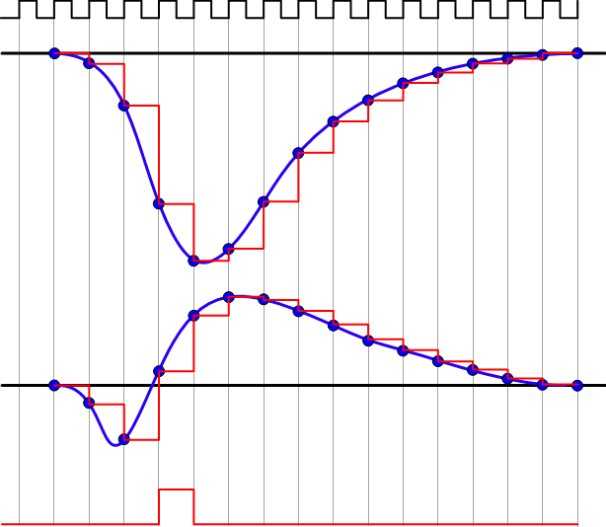
Digital CFD
CLK
INPUT
digital CFD: same principle as analog
CFD_{N+1} = f * S_{N} - S_{N-D}
f = Fraction, D = delay
COARSE TSTAMP = T_{CLK} * Clock Counter
FINE TSTAMP = T_{CLK} * B/(B-A)
Linear interpolation: good results if there are at least 3/5 points on the rising edge. If not, the "ZC correction algorithm" can be applied to improve the timing resolution
ZC FINE TSTAMP
B
CFD
COARSE TSTAMP
A
TRIGGER
Notes:
The principle of the digital CFD is identical to the analog one. So the signal is delayed and attenuated to form a signal with zero crossing. In this way it is possible to obtain not only a coarse time stamp (given basically by the Digitizer clock counter) but also a fine time stamp given by the linear interpolation of the points before and after the zero crossing. Empirically we saw that good results of the interpolation are obtained if there are at least 3/5 points on the rising edge of the pulse. So, in the case of a 1.5 ns rising edge, I would need a sampling rate of 2-3 GS/s at least …. Very expensive! …. But there is a solution: even sampling at much lower rates, I can apply a correction given by a LUT and improve timing resolution. And we saw experimentally that this gives very good results….

Slide 5
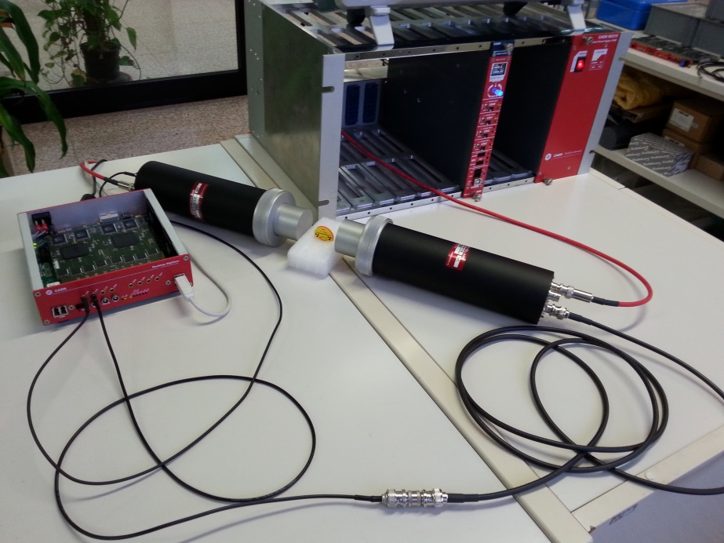
Test Setup
Test n 1: Pulse generators
Agilent 81110A and Tektronix AFG3252 to generate pulses with different rising edges (1, 2.5, 5, 10 and 20 ns)
Passive splitter + cable delay to make a start-stop measurement (self timing)
HP Step Attenuator (10, 20, 30, 40 dB) on the stop signal to measure the walk
Test n 2: Self-timing of LaBr₃ and BaF₂ detectors
Single detector output, passive splitter and cable delay (~11 ns)
BaF₂: 1” mod. Scionix 38A38/2M-E1-BAF-X-N (PMT: Hamamatsu H3378-51)
LaBr₃: 2” mod. Saint Gobain Brilliance 380 (PMT: R6231)
²²Na source
ROI @ 511 keV peak
Test n 3: TOF between two BaF₂ detectors
Two BaF2 detectors (same mod. as test 2)
Gamma-gamma coincidence
ROI @ 511 keV peak
Digitizer:
DT5730: 500 MS/s, 14 bit Flash ADC
On-line digital CFD in FPGA (no waveform readout)
Notes:
Here is the test we made with fast input pulses and real detectors acquiring with DT5730 CAEN Digitizers, 500MS/s, 14bit FADC. Leggere brevemente I test fatti.

Slide 6


Digital CFD results
Test | Rise Time | Amplitude | ZC corr | Start-Stop Resolution
 |  |  |  | RMS | FWHM
Pulse Generator | 1 ns | 450 mV |  | 9.5 ps | 22 ps
Pulse Generator | 5 ns | 450 mV |  | 10.1 ps | 24 ps
Pulse Generator | 20 ns | 450 mV |  | 1.9 ps | 4.5 ps
BaF₂ to BaF₂ | 1.3 ns | 130 mV |  | 120 ps | 280 ps
BaF₂ to BaF₂ | 1.3 ns | 130 mV |  | 538 ps | 1.3 ns
BaF₂ to LaBr₃ | 1.3/15 ns | 130/200 mV |  | 186 ps | 437 ps
NaI to NaI | 20 ns | 100 mV |  | 1.02 ns | 2.40 ns
Notes:
These are the results of the test. It is to note how the timing resolution changes if the ZC correction algorithm is used or not. So this demonstrates that good timing resolution are achievable with let’s say standard Digitizers (500 MS/s), even when the use of extreme fast sampling rates might seem inevitable.

Slide 7
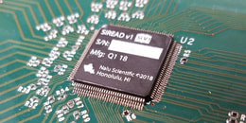
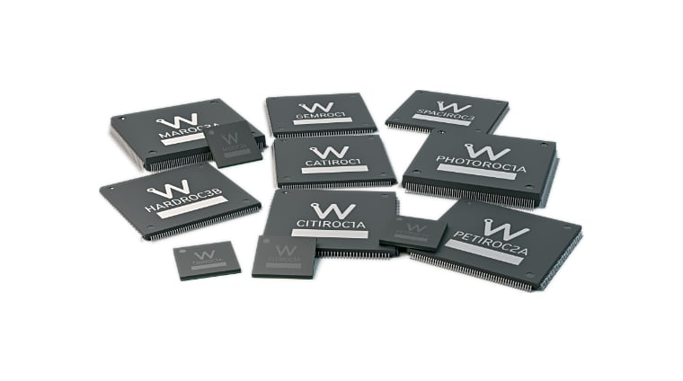
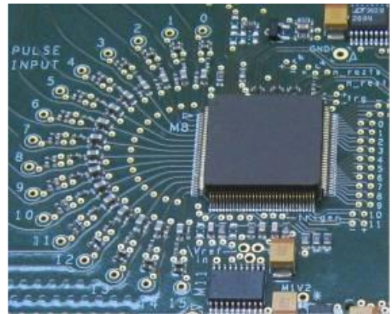
Timing Measurements with Digitizers: conclusion
One board fits all main measurements needs
Flexibility, especially in the parameters tuning
Accurate timing requires high sampling rates: 2/3 GHz to sample a typical rising edge of 1.5 ns
Good timing resolution is achievable even without using extreme high sampling rates: good results with CAEN DT5730 (500 MS/s, 14-bit) and ZC correction algorithm
Measurements with no dead time are possible using FADC
IF sampling rate > 1GHz is really needed ….
ASICs
Notes:
Summarizing the benefits of the Digital approach to time measurements: ….elenco….
In case the high sampling rate is really a requirement for a good time measurements, there is no other option but using ASICs if you want to maintain a reasonable cost per channel and have at the same time a great amount of channels in a compact chip.

Slide 8
ASICs: few examples
WeeROC ASICs:
  CITIROC (SiPM readout)
  PETIROC (SiPM readout with high timing resolution)
  MAROC, PHOTOROC (PMTs)
  GEMROC (GEM Readout)
  SKIROC (PIN Diode and Silicon Detectors)
Sampic (10 GS/s SCA waveform digitizer and ps TDC) from LaL, D. Breton
AARDVARC (13 GS/s) and ASOC (3.2 GS/s) SCA waveform digitizer and ps TDC from Nalu Scientific
Analog:
Preamp, shaper, discriminator, TDC, ADC, ….
SCA:
High sampling rate
ASICs are competitive to Digitizers when huge sampling rates and/or high channel density are required.
It is possible to build a large multichannel system with a reasonable budget.
Notes:
Here you see some examples of the ASICs one could use. ….

Slide 9
SCA vs FADC
Switched Capacitor Arrays |  | Flash ADCs
PROs | CONs | PROs | CONs
High density (16 or 32 channels in a VME board) | Dead Time (typ. 100-200 µs) | No dead time in the acquisition | Power consumption
High sampling rate (> 1 GS/s) | Low depth (e.g. 1024 points = 300 ns) | Continuous data acquisition and processing | Cost per channel
Low Power | Need amplitude and timing calibration | Good linearity and ultra low jitter | Huge data throughput to manage
Low cost per channel | Not independent channel triggering | Independent channels
Notes:
Making a comparison between FADC and SCA, you see that what really makes the difference are the cost, sampling rate and dead time. So these are the main points to take in mind when choosing one or the other technology. Since ASICs are becoming more and more widely used, CAEN decided to push on the development of electronics equipment which can host and manage ASICs for detector readout.

Slide 10
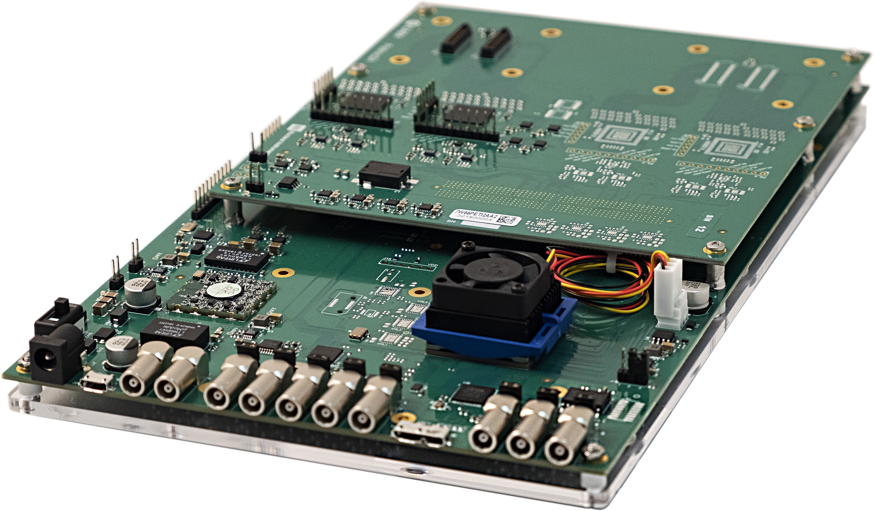
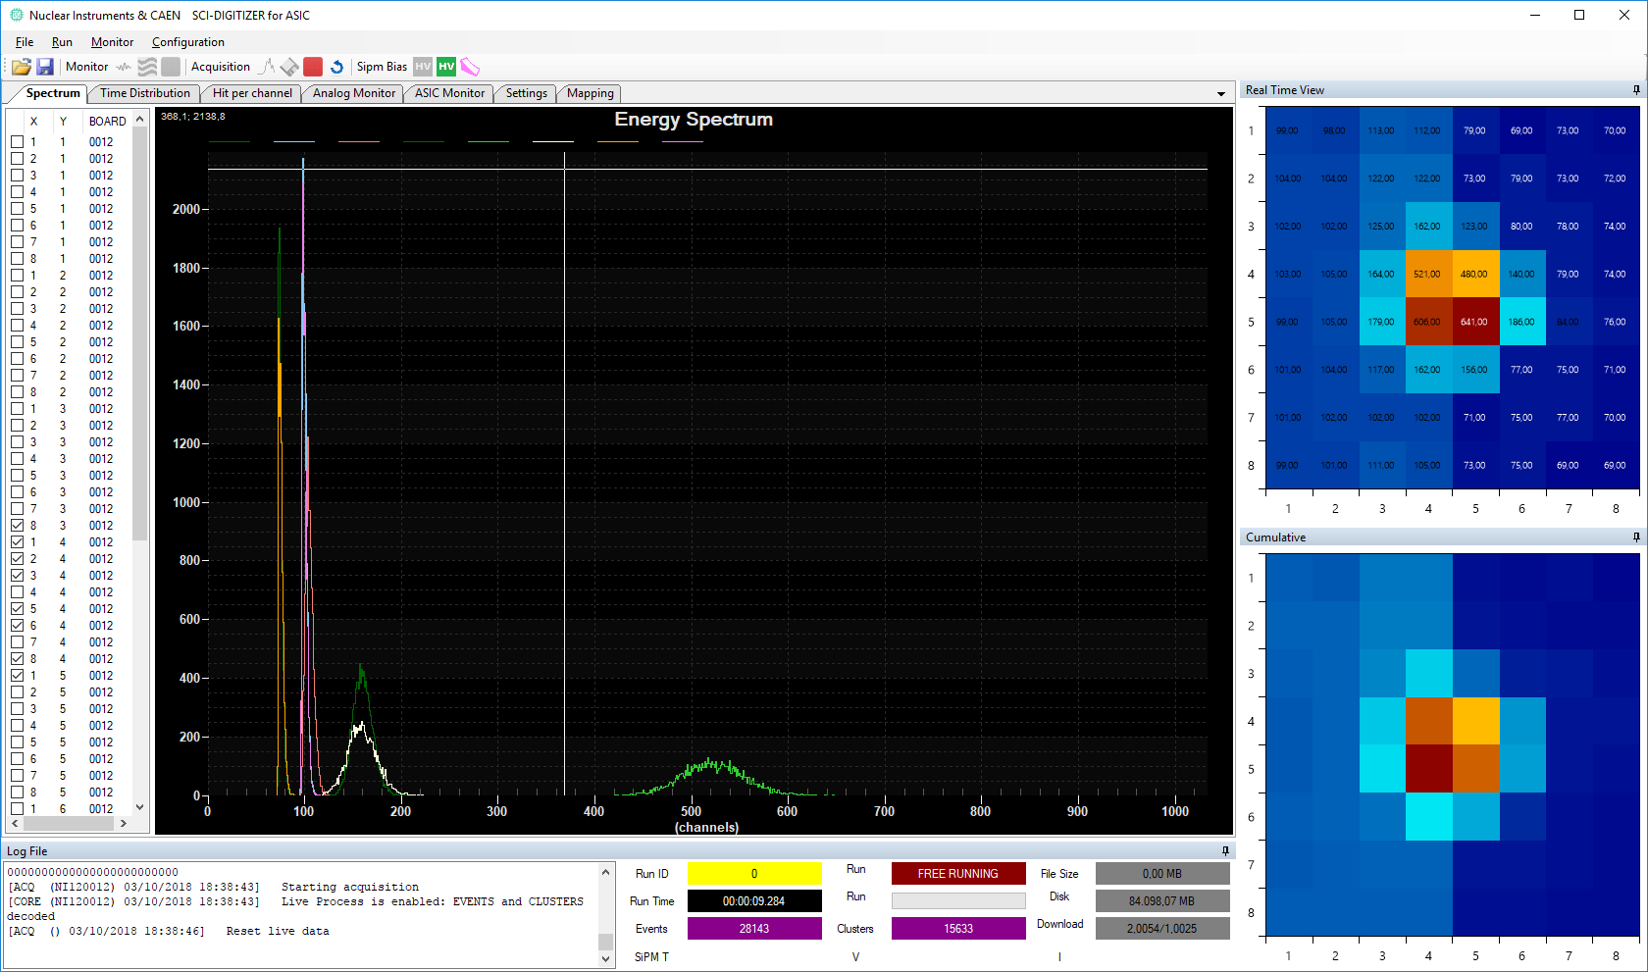
DT5550W: Readout System based on WeeROC ASICs
Programmable Board based on Weeroc ASICs
Available with Petiroc and Citiroc for SiPM Readout
Single Desktop Unit available with 32, 64, and 128 channels
80MS/s, 14bit ADC
On-board Power Supply for SiPM Bias (20-85 V)
Cross-board synchronization for System-building
SiPM-based imaging, spectroscopy and ToF applications
Open-FPGA
Evaluation of the ASIC performances
Full-featured SiPM Readout System
Building of small experimental setup (up to 500 channels)

Slide 11
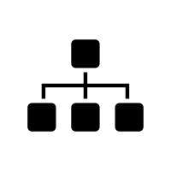

FERS platform: a Distributed Front End Readout System
Front End Preamplifiers, A/D conversion and data processing in small FE card
TDlink: synchronization, readout and slow control over optical fibers
Concentrator Board: provides global synch + data sorting, formatting and storage
Easy scalability to thousands channels
Reduced cable cost, noise pickup, signal attenuation
bulkiness, contact failures…
FERS Concentrator
1/10 GbE, USB 3.0
FERS units
FERS units
Network
TDlink
Notes:
To provide a system with maximum flexibility, we decided to develop a platform which could be easy-scalable and could be used to build a distributed readout system. We called it FERS-5200, Frontend Readout System., It is composed of two main units: the FERS itself, a small card to be placed near the detectors and a Concentrator board which is capable to manage multiple FERS units. In particular here the communication is based on Tdlink, so optical fibers to allow the exchange of great amount of data.

Slide 12
FERS platform
FERS unit (A52xx): single card housing Front End ASICs, ADC and/or TDC, FPGA, I/Os, interfaces and, in some cases, detector power supply
FERS concentrator (DT5215): desktop board managing the readout of multiple FERS units, event sorting, data
buffering and efficient transfer to host computers
FERS communication interfaces: TDlink (sync + commands + data) or Ethernet, USB 2.0 (data only, mainly used for evaluation)
Different FERS units will be part of a unique family, all sharing the same architecture and readout protocols
A5202: first member of the family, based on Citiroc-2A (by Weeroc). 64 channel readout for SiPMs.
Potential future developments:
  Maroc (PMTs)
  Petiroc (SiPM readout with high timing resolution)
  Sampic (10 GS/s SCA waveform digitizer and ps TDC) from LaL, D. Breton
  AARDVARC (13 GS/s) and ASOC (3.2 GS/s) SCA waveform digitizer and ps TDC from Nalu Scientific
  Digital readout for discrete components preamps (e.g. A1442, 16 channel preamp for Silicon Strip Detectors)
  and others…
Notes:
Fers unit is a SMALL CARD which hosts analog frotend (in particular ASICs), ADC/TDC, FPGA, comm. Interfaces
The concentrator instead is a desktop board with optical links and other signal lines to manage the readout of multiple FERS units as well as data buffering and event sorting.
There will be a family of FERS units, all sharing the same architecture so that the integration of new ASICs or new FE technology will be very easy to do.
The first we are launching on the market is A5202, hosting two CITIROC to readout up to 64 channel- SIPM with a single card.
Future development : …..

Slide 13
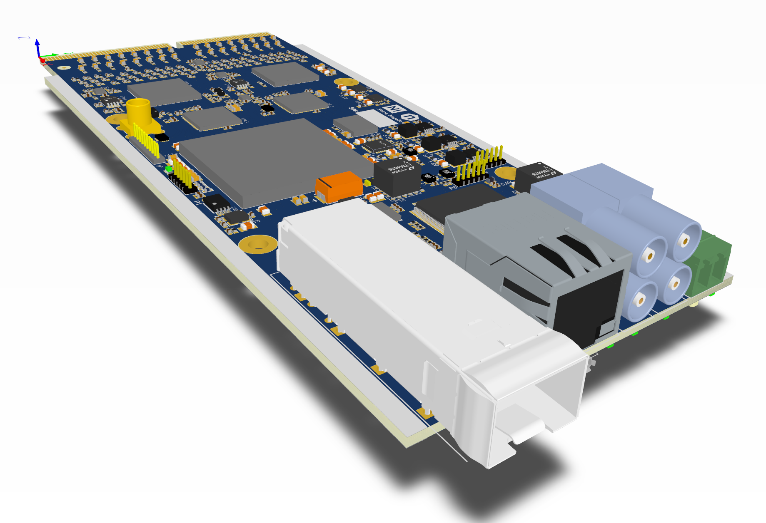
A52xx: general structure
Single board → stand alone readout system or scalable into a multichannel chain
Common architecture for all the Frontend Units of the FERS-5200 family: easy integration of different ASICs
TDLink (up to 6 Gbps), Ethernet and USB 2.0 readout interface
Auxiliary I/Os for sub-ns timing and low latency trigger distribution (alternative to TDlink)
DETECTOR input
FRONT END (ASICs or discrete)
ADC / TDC
PROCESSING
FPGA
READOUT INTERFACE
OPTICAL LINK
ETHERNET
USB (evaluation)
POWER
DETECTOR BIAS
Notes:
As I said, we are planning to maintain a common architecture for all FERS units. Here we see the first example,. A5202. The card is designed to be A STAND ALONE UNIT as well a SCALABLE to thounsand channels- You see here the main parts highlighted, ……

Slide 14
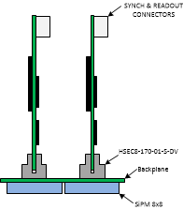
A52xx: mechanics
The size of the FERS unit is ~15 x 6 cm (size for the A5202) : is the size of your smartphone!
The inputs (signals from the detectors) comes through 0.8 mm edge contacts mating a
Samtec HSEC8-170-01 connector
When used “stand alone”, the card can be housed in a box with an adapter to 2.54 mm header connector for the inputs
For experiments, a custom backplane or cable adapter can be designed to fit the mechanics of the detector
Notes:
From a mechanical point of view the card is very very COMPACT, the detectors connectors are specifically chosen for SiPM in this case and are based on edge-contacts. But of course we also supply adapters to header connectors to allow a comfortable usage of the board also for first lab experiments, while for large experiments is easy to design a custom backplane or cable adapter.

Slide 15
A5202: 64 channel SiPM readout (Citiroc 2A)
Based on two ASICs Citiroc 2A (Weeroc): 64 channel SiPM readout
Up to 4096 channels managed by a single concentrator board
Embedded HV bias (20-100V) with temperature feedback. Individual HV adjust per channel
Programmable gain and shaping time
Individual discriminator thresholds: down to 1/3 pe
50 ps TDC for high resolution time stamping (OR trigger to Reference Input on LEMO)
Acquisition modes: photon counting, spectroscopy mode (PHA), list mode (channel ID + Tstamp + ToT)
Notes:
This is the scheme of the A5202 with CITIROC: …………

Slide 16
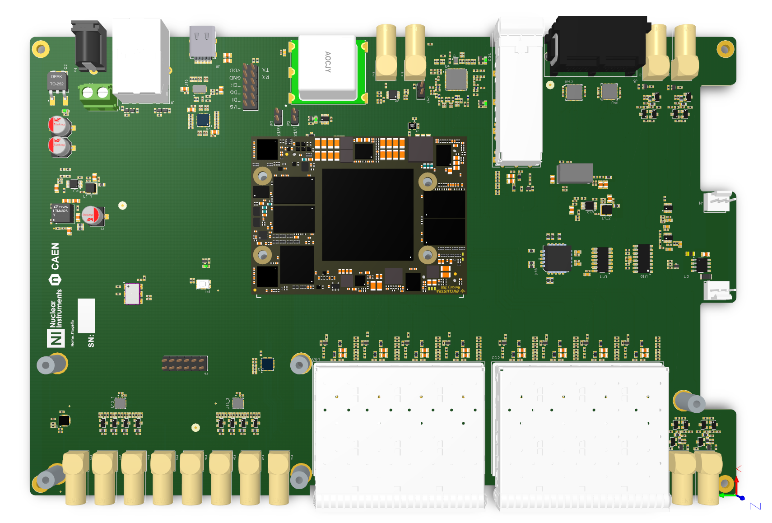
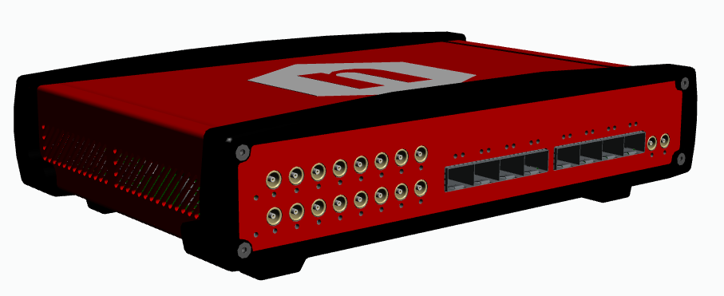
DT5215 – Concentrator Board
Ultrastable OCXO Clock Source
Clock I/O
GPS 1pps compatible
USB-C
10 Gbps/e
1 Gbps Ethernet
Zynq Ultrascale + SoC
Inter-Concentrator Synchronization
Zynq Ultrascale + SoC
Manage readout process
Event sorting
Event Builder
L2 trigger and coincidence
Readout burst caching
(up to 8 Gbyte RAM)
4 core @ 1.2 GHz processor for
custom data processing
GPIO (x16)
8x Tdlink @ 6.25 Gbps
Notes:
This is the architecture of the concentrator board. This will be compatible with all future developments of the FERS units: ………dire qualcosina In particular the concentrator board hosts a powerful ARM processor and memory storage in the ZynQ SoC which is very useful to implement event sorting, data buffering and efficient transfer of data before feeding the DAQ line in the software.

Slide 17
Tdlink: building the multiboard system
Daisy chainable serial link on fiber optic (up to 6 Gb/s).
Provides data transfer (readout + slow control), clock distribution, synchronized commands for time stamp reset, acquisition control, trigger distribution and/or validation, busy management
One link connects up to 16 FERS units
One concentrator board with 4/8 links can read 64/128 FE units, that is 4096/8192 channels!
FERS-tree: Multiple concentrator boards can be synchronized to build large readout systems
Notes:
The main decision driver of this project has been the need to provide a really scalable system with maximum performances. So that’s why we decided to implement daisy-chainable optical link to manage the readout of multiple units. Spiegare fino a dove si può arrivare……

Slide 18
Acquisition and Readout Modes
Acquisition modes:
  MCS Mode (e.g. photon counting in SiPMs): uses fast discriminator signals. No dead time in counting, up to ~20 Mcps/ch.
  Spectroscopy Mode: A/D conversion of the pulse height (preamp + shaper + peak hold + 14 bit ADC). Common trigger (int. or ext.), zero suppression. Max trigger rate = 100 KHz.
  Timing Mode: independent hit recording: channel ID + timing (deltaT, 0.5 ns resolution) relative to a common start or common stop (T-ref signal from LEMO input). Gating mode (coincidence window). Max total hit rate = ~50 Mcps/board.
  Timing + ToT: same as timing mode, with added Time Over Threshold (low resolution spectroscopy). Linearization LUT. Max total rate = ~20 Mcps.
    Other acquisition modes for other ASICs (e.g. waveforms readout of SCA digitizers => 1024 samples per trigger)
FERS unit: formatted data packets created by FPGA. Little data buffering.
FERS concentrator: two readout strategies:
  Common trigger => Readout based on Trigger Number or Trigger Time Stamp. Event Building in the concentrator board: data packets belonging to the same trigger (coming from all FERS units) are merged into a single event data block saved to the concentrator memory.
  Individual self-triggers => each channel pushes data asynchronously, typically at different rates. Data aggregated in small packets in FERS units, then bigger packets in FERS concentrator. Data correlation demanded to DAQ software in computers.
The concentrator board provides an ARM processor running Linux and huge DDR memory for data
buffering and efficient transfer to host computers

Slide 19
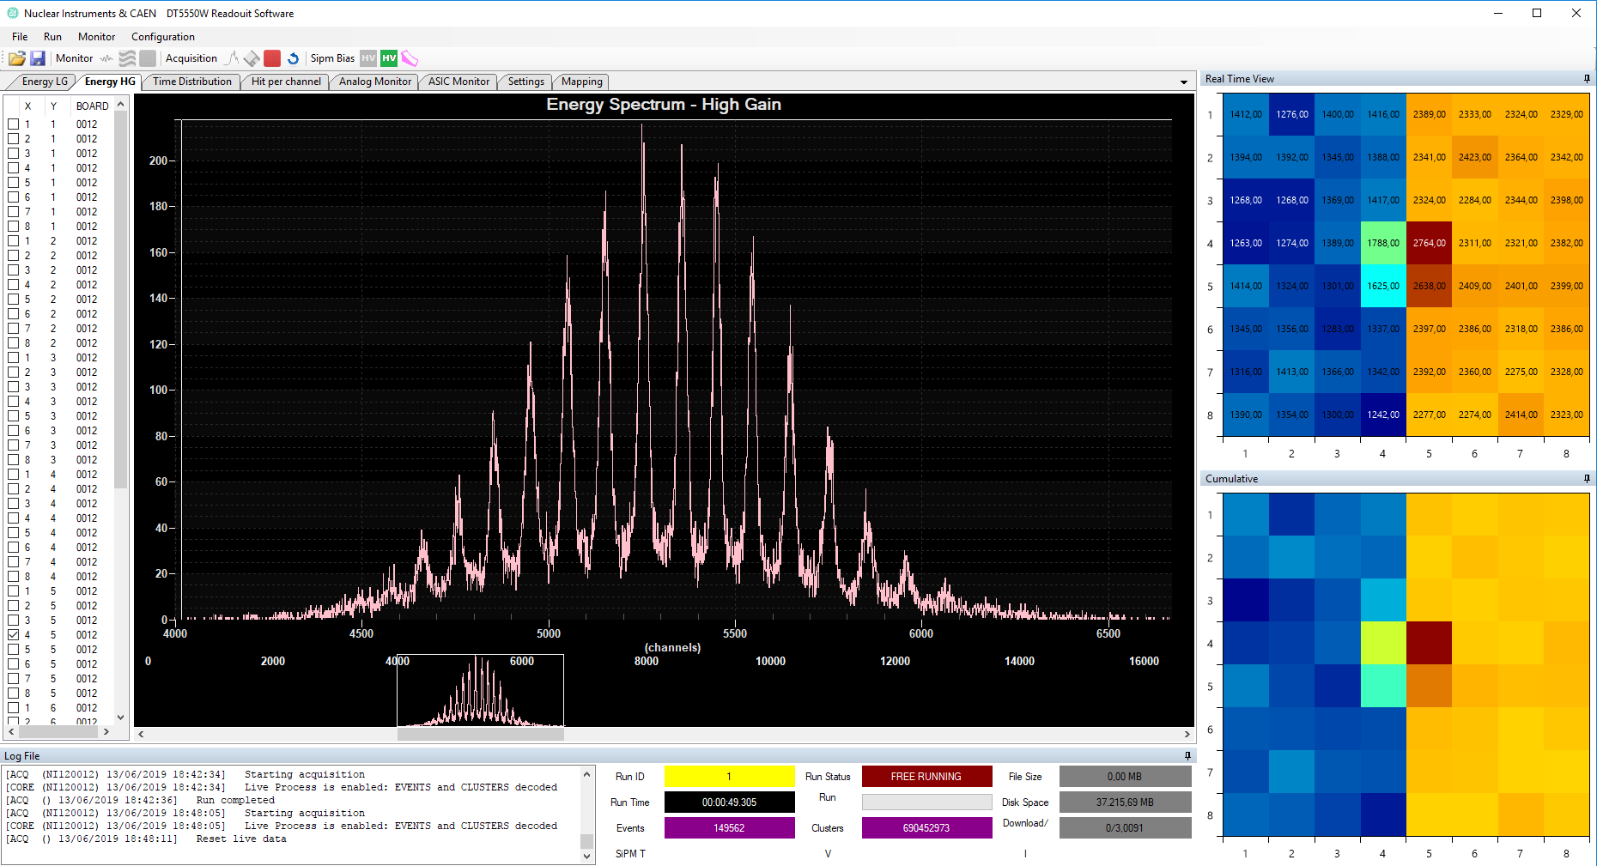
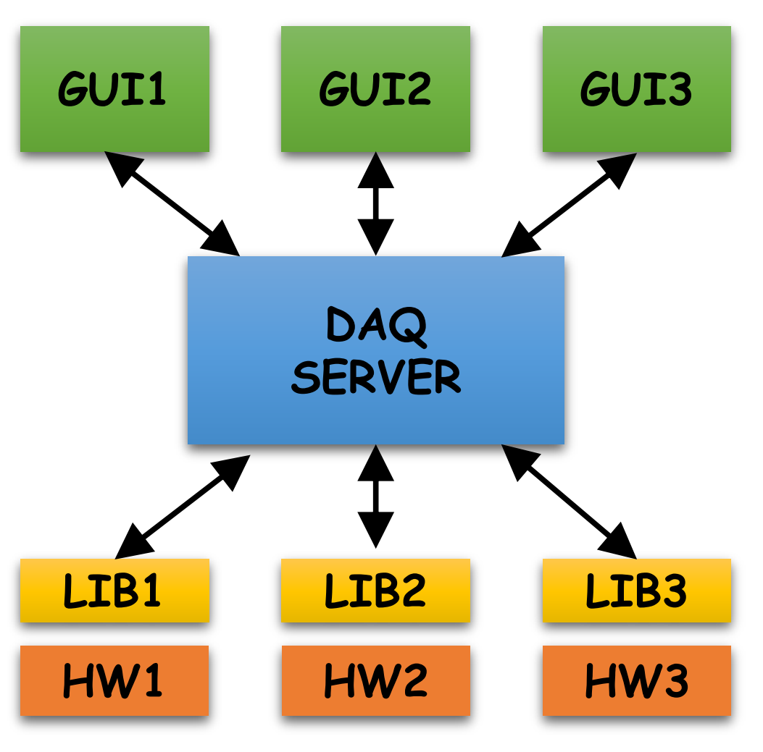
Readout Software
Support for etherogenous CAEN readout platform
Event building and event processing with user plugins
Application specific configuration and control GUI
Notes:
The software we plan to provide with FERS will have a common structure to the software for other CAEN boards. The core will be the same, the only things that will change from application to application will be the GUI, which will be also accessible and editable by the user.

Slide 20
THANKS FOR YOUR ATTENTION!

Slide 21
BACKUP SLIDES

Slide 22
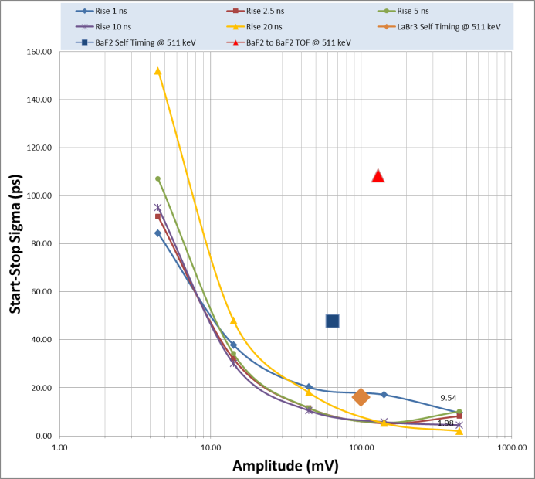
Digital CFD: RMS vs Amplitude

Slide 23
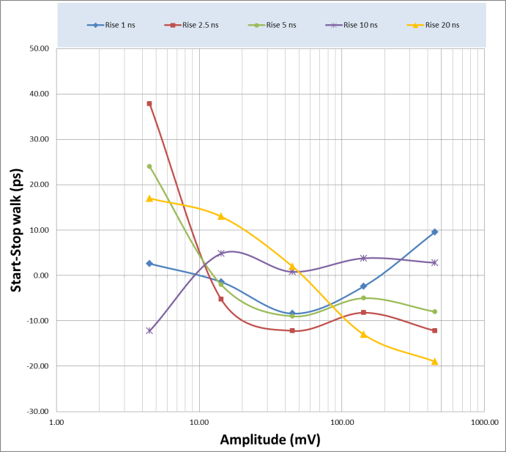
Digital CFD: Walk vs Amplitude

Slide 24
A5202: 64 channel SiPM readout (Citiroc 2A)

Slide 25
Acquisition and Readout Modes
Example of Individual/Self Trigger Readout with 3 FERS units acquiring 4 events (with trigger loss on 1 and 2)

