Slide 1

PETsys Electronics SA
Electronics for fast timing
S. Tavernier

Slide 2
PETsys Electronics SA
- Introduction to electronics for fast timing
in application reading scintillators
- discussion of realistic amplifiers
- Future ASICs

Slide 3
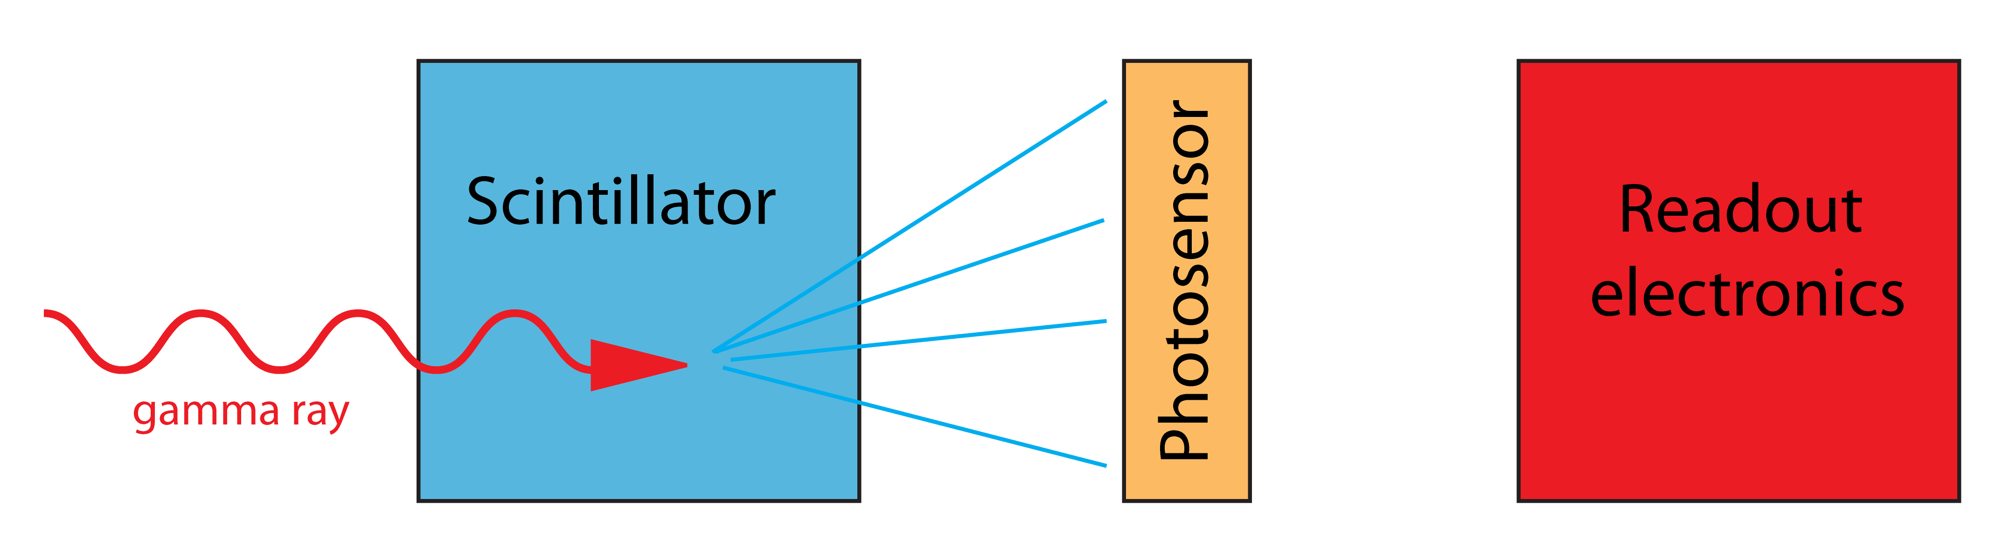
PETsys Electronics SA
Arrival first photons
Determines time
Resolution
For two LYSO 20 mm long the Coincidence Time Resolution (CTR) to about 100 ps for ideal electronics
CTR always FWHM
Photosensor and electronics should
be optimized together
The best way to characterise the timing
performance is the
Single Photon Time Resolution (SPTR)
SPTR always r.m.s.

Slide 4
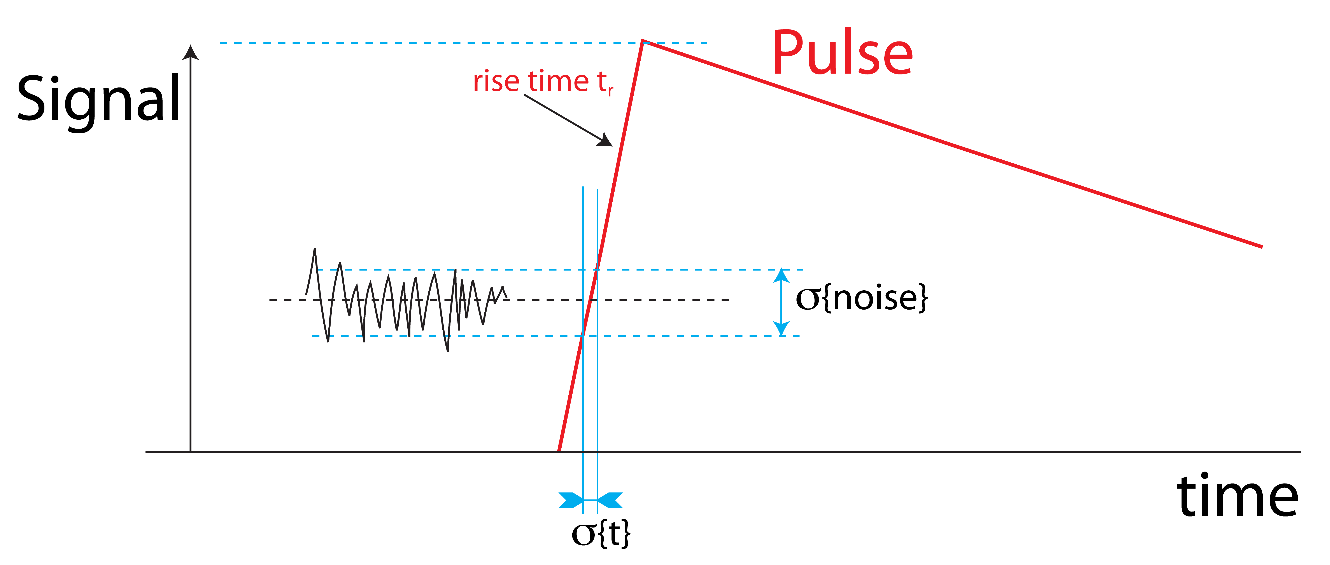
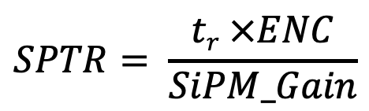
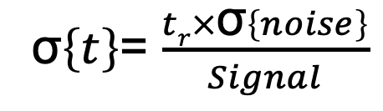
PETsys Electronics SA
If the signal comes from one
detected photon
Equivalent
Noise
Charge
σ$\left\{t\right\}$= $\frac{tr×\text{σ}\left\{noise\right\}}{Signal}$
$$SPTR= \frac{tr ×ENC}{SiPM_Gain}$$

Slide 5
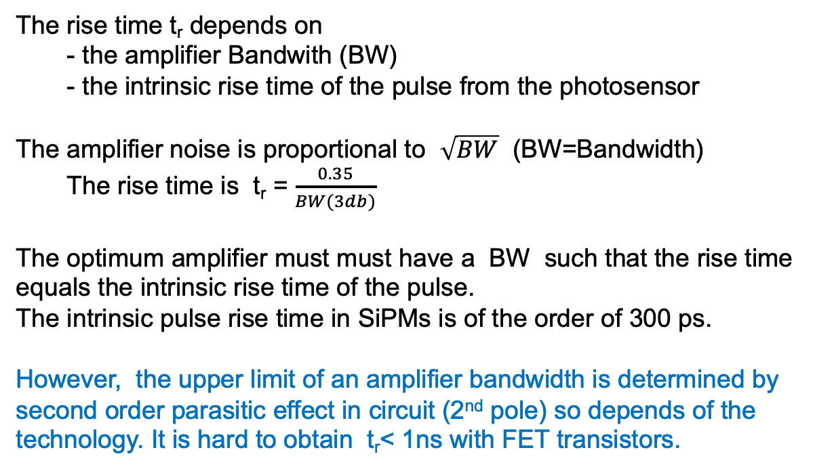
PETsys Electronics SA
The rise time t_{r} depends on
- the amplifier Bandwith (BW)
- the intrinsic rise time of the pulse from the photosensor
The amplifier noise is proportional to $\sqrt{BW}$ (BW=Bandwidth)
The rise time is t_{r} = $\frac{0.35}{BW(3db)}$
The optimum amplifier must must have a BW such that the rise time equals the intrinsic rise time of the pulse.
The intrinsic pulse rise time in SiPMs is of the order of 300 ps.
However, the upper limit of an amplifier bandwidth is determined by second order parasitic effect in circuit (2nd pole) so depends of the technology. It is hard to obtain t_{r}< 1ns with FET transistors.

Slide 6
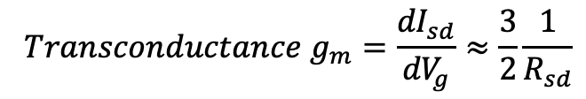


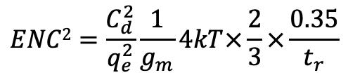
PETsys Electronics SA
Theoretical limit on timing performance of an amplifier
Every resistor has current noise
The noise of the FET transistor is
σ$2\left\{inoise\right\}=4kT\frac{1}{R_{sd}}×BW=4kT\frac{1}{R_{sd}}×\frac{0.35}{t_{r}}$
The is equivalent noise charge is
$ENC2=\frac{C_{d}^{2}}{q_{e}^{2}×g_{m}^{2}}×$ $4kT×\frac{1}{R_{sd}}\frac{0.35}{t_{r}}$
$$Transconductance g_{m}=\frac{{dI}_{sd}}{{dV}_{g}}≈\frac{3}{2}\frac{1}{R_{sd}}$$
$$ENC2=\frac{C_{d}^{2}}{q_{e}^{2}}\frac{1}{g_{m}}4kT×\frac{2}{3}×\frac{0.35}{t_{r}}$$
The equivalent noise charge becomes

Slide 7

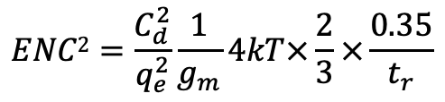

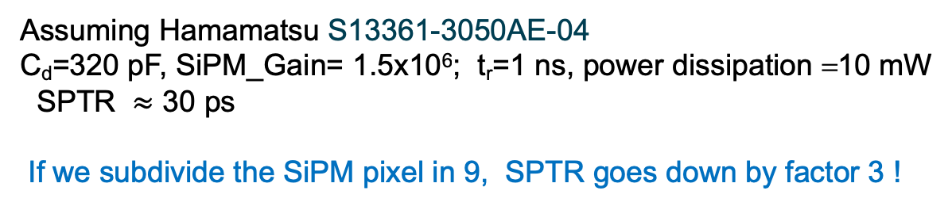
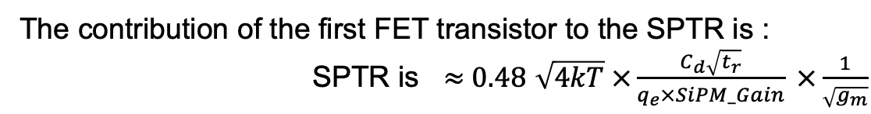
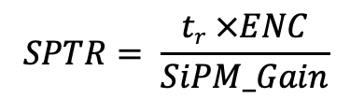
PETsys Electronics SA
$$ENC2=\frac{C_{d}^{2}}{q_{e}^{2}}\frac{1}{g_{m}}4kT×\frac{2}{3}×\frac{0.35}{t_{r}}$$
$$SPTR= \frac{tr ×ENC}{SiPM_Gain}$$
The contribution of the first FET transistor to the SPTR is :
SPTR is $≈$0.48 $\sqrt{4kT} ×\frac{C_{d}\sqrt{t_{r}}}{q_{e}×SiPM_Gain} ×\frac{1}{\sqrt{g_{m}}}$
You can reduce the noise of the first amplifier by reducing the
transconductance
$$gm∝Power dissipation$$
$SPTR ∝ \frac{Cd }{SiPM_Gain}$ $\sqrt{t_{r}}\frac{1}{\sqrt{Power dissipation}}$
Assuming Hamamatsu S13361-3050AE-04
C_{d}=320 pF, SiPM_Gain= 1.5x10⁶; t_{r}=1 ns, power dissipation =10 mW
SPTR $≈$ 30 ps
If we subdivide the SiPM pixel in 9, SPTR goes down by factor 3 !

Slide 8
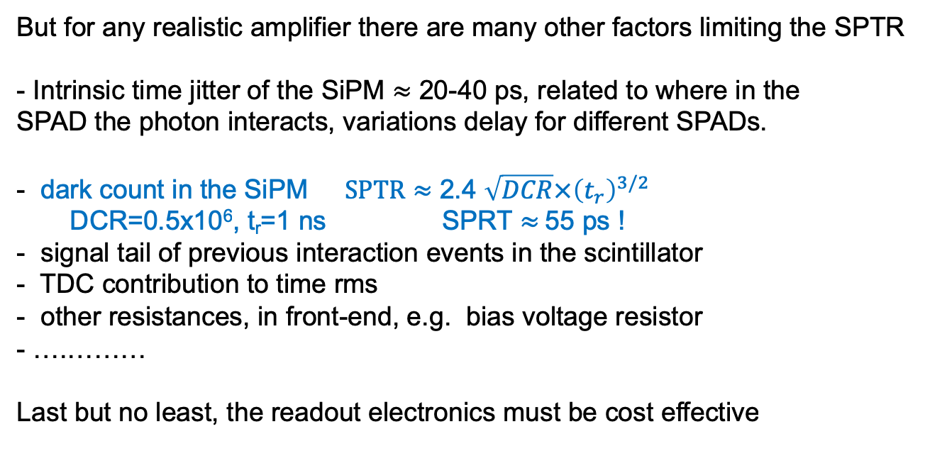
PETsys Electronics SA
Realistic amplifiers
But for any realistic amplifier there are many other factors limiting the SPTR
- Intrinsic time jitter of the SiPM $≈$ 20-40 ps, related to where in the
SPAD the photon interacts, variations delay for different SPADs.
- dark count in the SiPM $SPTR≈$ 2.4 $\sqrt{DCR}×{\left(t_{r}\right)}^{3/2}$
DCR=0.5x10⁶, t_{r}=1 ns SPRT $≈$55 ps !
- signal tail of previous interaction events in the scintillator
- TDC contribution to time rms
- other resistances, in front-end, e.g. bias voltage resistor
- ….………
Last but no least, the readout electronics must be cost effective

Slide 9
PETsys Electronics SA
ASICs are essential for a cost effective solution
Three categories available from the scientific community:
  ASICs with Analog part only: amplifiers, amplifier + discriminators
    NINO, FlexTOT, FastIC
  pulse sampling:
    DSR, SAMPIC1, SAMPIC2
  Fully integrated: amplifier, discriminators, ADC, TDC
    PETA, PETIROC, STIC, TOFPET2, TOFHiR, DIET (Qinghua/ China)

Slide 10
PETsys Electronics SA
PETsys TOFPET2 ASIC

Slide 11
PETsys Electronics SA
General Philosophy
- Every ASIC channel is fully independent, and independently
Configurable. Whenever a combination of threshold conditions is met
➜ out event record with time and amplitude
- every global triggering is done in firmware
- Only do in firmware what need to be done in firmware

Slide 12
PETSYS TOFPET2 ASIC
The PETsys TOFPET2 ASIC is a front-end
Analog to digital interface
64 independent channels in 5x5 mm²
Standard CMOS 110 nm , UMC
Positive and negative signal polarity
Noise 1.2 -1.5 mV - 1 p.e. 30 mV
Charge integration 10 bit (7bit effective)
TDC time binning 30 ps
Low power : 8.2 mW/Ch
Event rate: up to 600 kHz per channel
4 event analog buffer before each TDC or ADC
On-chip calibration circuitry
128-ch SiP
64-channel ASIC

Slide 13
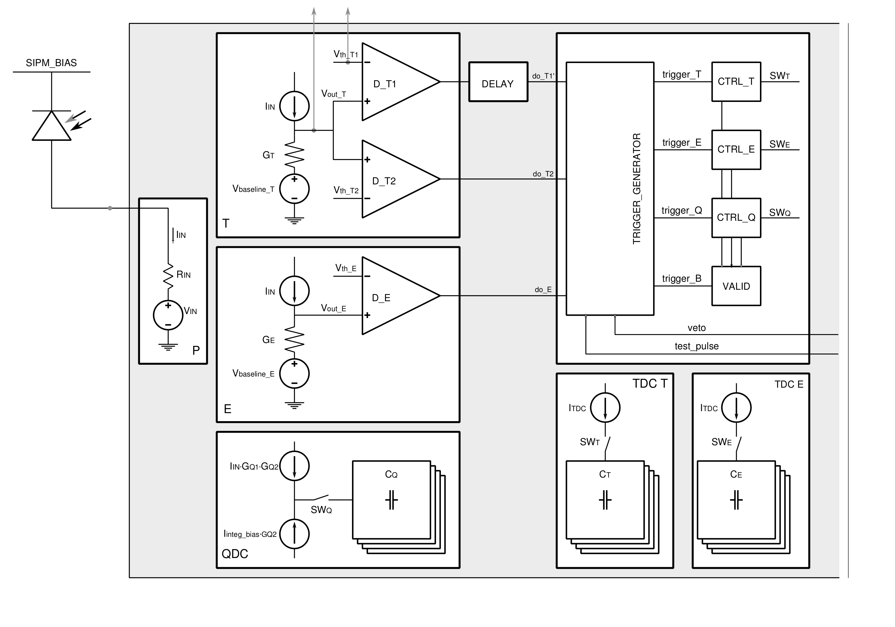
PETSYS TOFPET2 ASIC
128-ch SiP

Slide 14
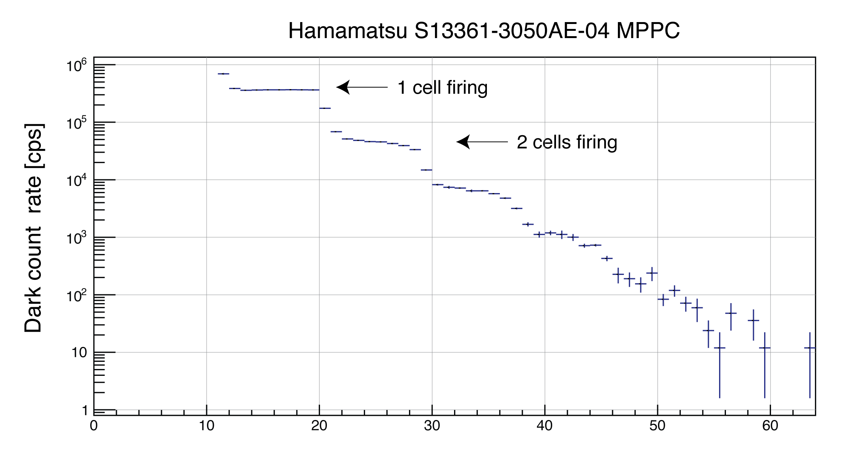
PETSYS TOFPET2 ASIC
Dark counts as a function of threshold
128-ch SiP
Threshold

Slide 15
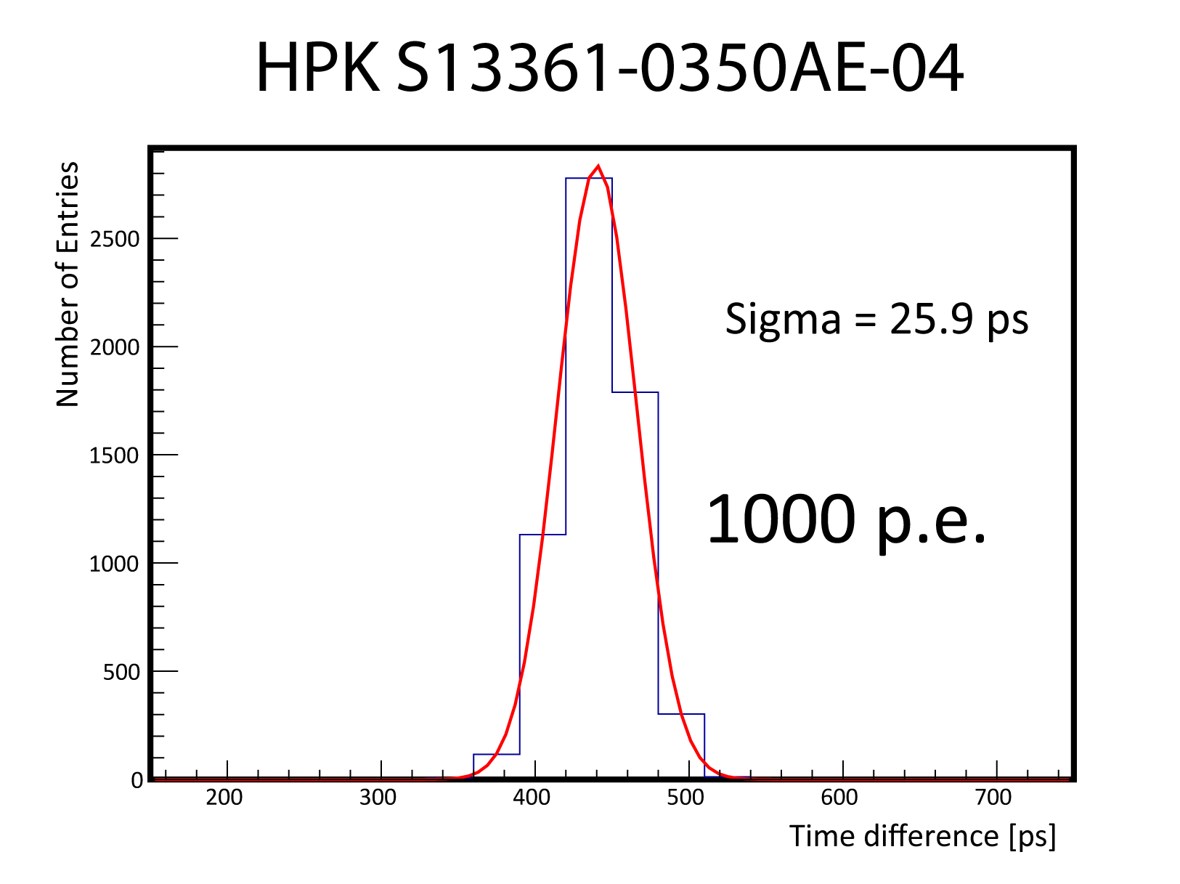
PETSYS TOFPET2 ASIC
Time resolution (r.m.s) for laser pulse of about 1000 detected photons
Corresponds to
CTR 86 ps
The TDC rms 23 ps
explains 76 ps of
This CTR!
128-ch SiP

Slide 16
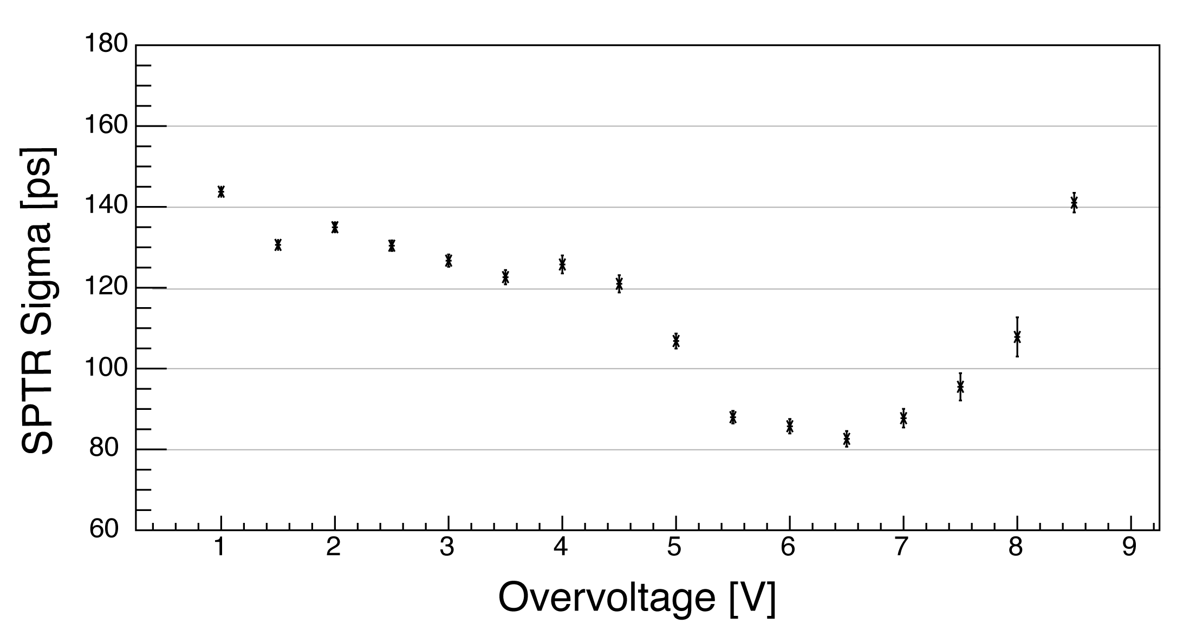
PETSYS TOFPET2 ASIC
SPTR as a function of SiPM overvoltage
HPK S13361-3050AE-04
128-ch SiP

Slide 17
TOFPET2 time resolution with LYSO
  - LYSO: 2 x 2 x 3 mm³
  (LSO:Ce:0.4%Ca (Agile)
  - Hamamatsu MPPC
  S13361-3050AE-04
  - 3 V overvoltage
  - 4 p. e. threshold
  - 15 °C
  - Na22 Source
CTR
119 ps

Slide 18
TOFPET2 time resolution with LYSO
  - LYSO: 3 x 3 x 20 mm³ ;
  ( standard commercial LYSO)
  - Hamamatsu MPPC
  S13361-3050AE-04
  - 3 V overvoltage
  - 4 p. e. threshold
  - 15 °C
  - Na22 Source
183 ps

Slide 19
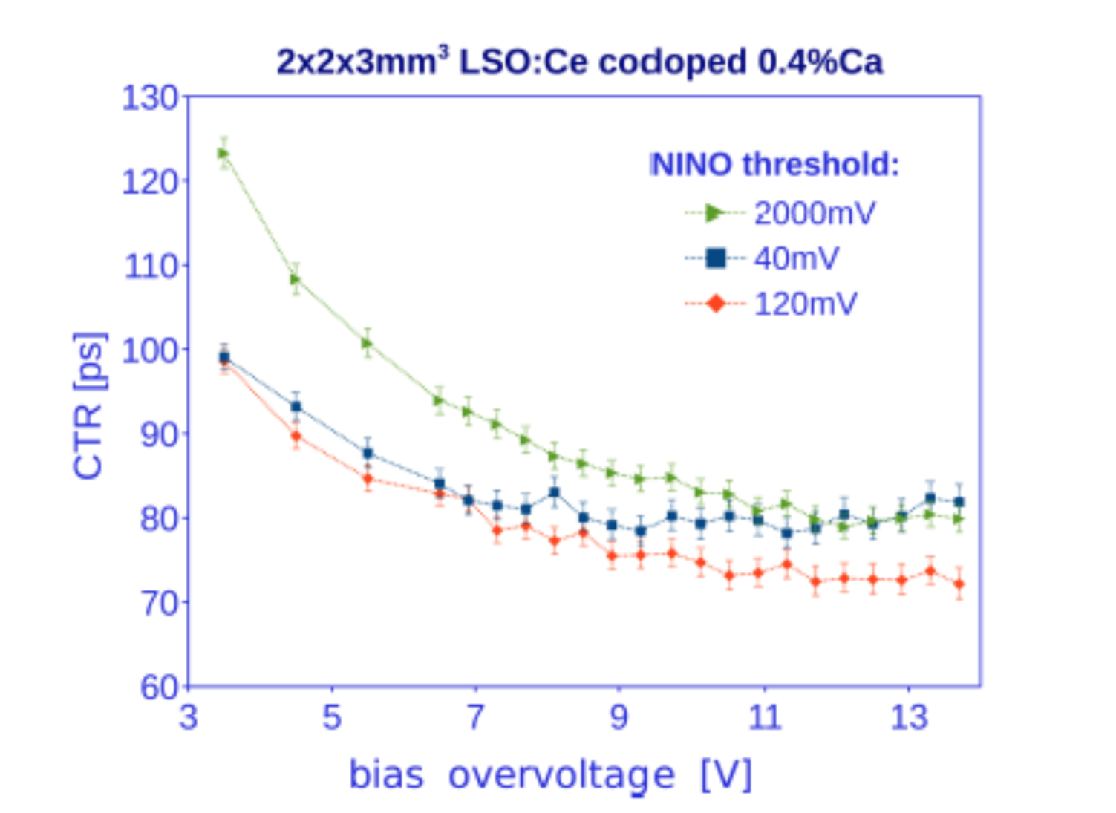
PETsys Electronics SA
LYSO 2x2x3 mm Hamamatsu MPPC 119 ps
Threshold about 4 ph, Overvoltage 3 V
Compare this to the best results published (Gundacker)
LYSO 2x2x3 mm Hamamatsu MPPC 75 ps
At 3 V Overvoltage Gungacker
gets about 100 ps !
The remaining difference is due
TDC

Slide 20
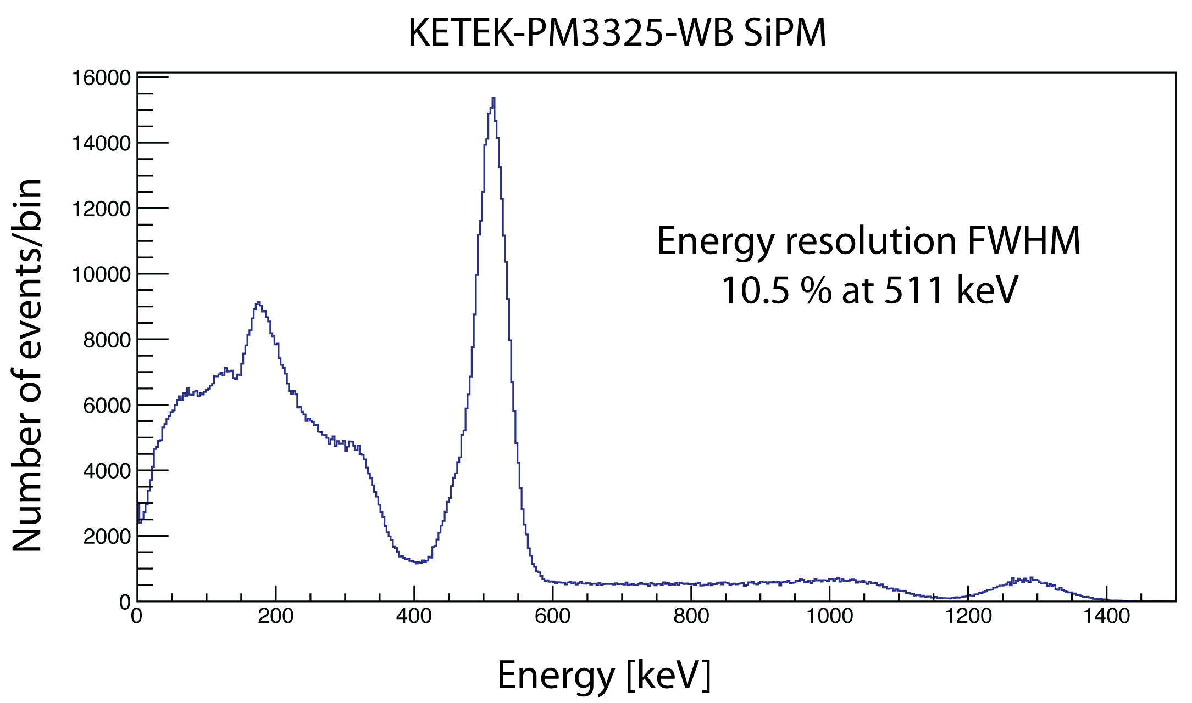
TOFPET2 Energy resolution
With Na22 point source / Corrected for SiPM non-linearity
  LYSO: 3 x 3 x 5 mm³; KETEK

Slide 21
New ASICs for reading SiPMs
The CMS MTD (barrel) case

Slide 22
CMS MIP Timing Detector (MTD)
LYSO/SiPM
(BTL - Barrel Timing Layer)
Si LGAD
(ETL - Endcap Timing Layer)

Slide 23
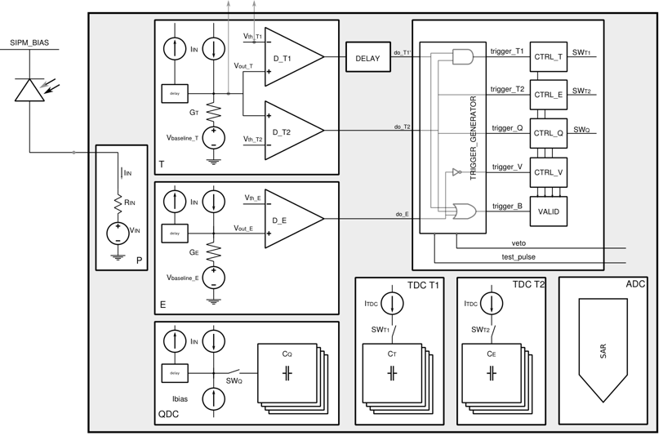
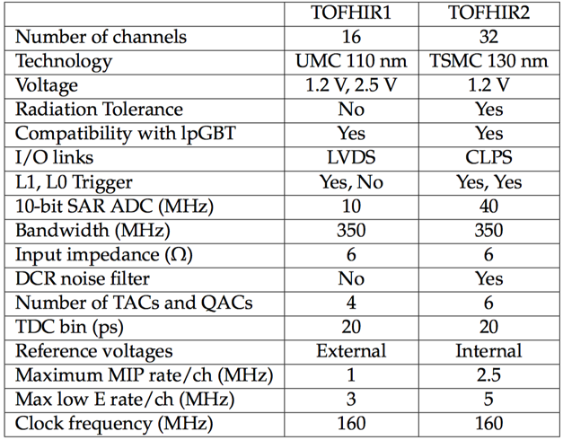
TOFHIR ASIC
Frontend ASIC of the CMS MTD Barrel Timing layer
Developed by PETsys in collaboration with LIP
noise filter T
discri T1
SiPM
postamp T
discri T2
Trigger logic
noise filter E
discri E
preamp
postamp E
noise filter Q
QDC
TDC T1
TDC T2
ADC

Slide 24
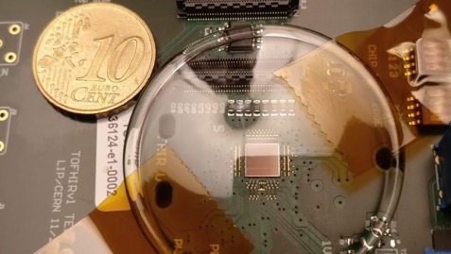

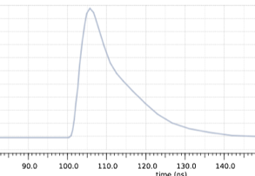
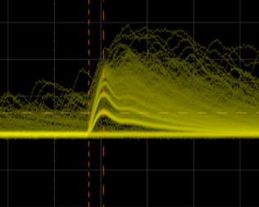
Summary of TOFHIR1 tests
Preliminary tests of the main TOFHIR1 blocks are finished
  performance is matching expectations
Digital logic and I/O is working
  Configuration cycles are validated
  Data transmission and reception are validated
Improved TDC; based on 10-bit SAR ADC is working/
  Good linearity; noise 0.8 LSB
  Time resolution 15 ps rms on test pulse
Time resolution with laser pulses ~ 20 ps
  corresponds to CTR of 66 ps
Δt between two channels with test pulse
TOFHIR1 Test Board
DAQ board
simulation
spy channel

Slide 25
DCR noise cancelation
SiPM dark count rate (DCR) increases with radiation
  Expect a few tens of GHz at the end of HL-LHC
Solution: analog CFD-like circuit to achieve noise cancellation
Will be implemented in TOFHIR2
Sum: cancel DCR noise
Input pulse
Delay ~500 ps
DCR noise ~0.5 ns before leading edge has ~90% correlation to noise under the pulse leading edge
Delayed and inverted pulse

Slide 26
TOFHIR ASIC
- TOFHIR1 (UMC 110 nm): Test dies available. Improved TDC validated
- TOFHIR2 (TSMC 130 nm): Under development, will have Dark count noise suppression
- After successful test of TOFHIR2 we will develop a new version of the ASIC for PET application incorporating these improvements TOFPET 3 ASIC

Slide 27
PETsys Electronics
Summary and conclusion
- The readout electronics must be tailored to the photosensor (SiPM)
- Existing amplifiers are still far way from any theoretical limit of what can be achieved as time resolution
- At present the time resolution achievable in PET is more limited by the scintillator than by the the electronics !
- To reach 10 ps CTR resolution in PET, we need more light in the first 100 ps ! But, of course, if one finds better scintillators we will also need better amplifiers.

Slide 28
PETsys Electronics
Grazie per aver ascoltato la mia presentazione

Slide 29
PETsys Electronics SA

Slide 31
High Luminosity – LHC (Phase-2)
Now
2024
2026
HL-LHC: Upgrade of LHC and injectors to increase beam intensity
  L_{inst} > 5 × 10³⁴ cm⁻¹ s⁻¹, up to 140-200 pileup
  Ultimate integrated luminosity target of 3000 fb⁻¹ (10x LHC) - baseline
Experiments: ATLAS and CMS upgrades for HL-LHC conditions
  Radiation hardness
  Mitigate physics impact of high pileup ( more than 5x LHC )

