Slide 1

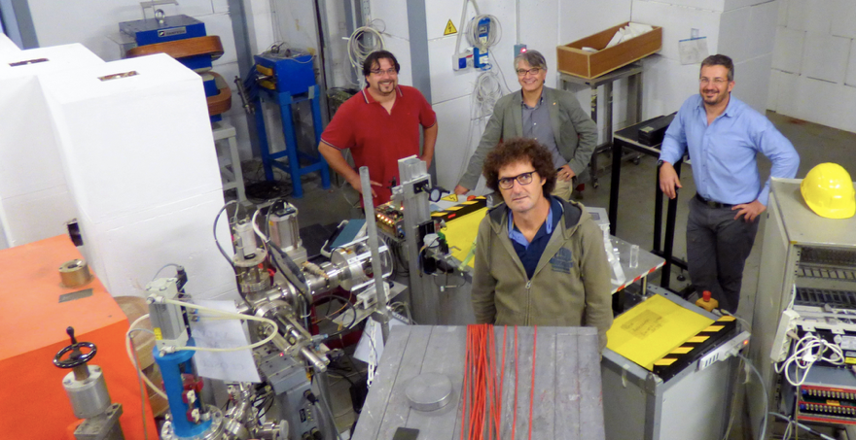
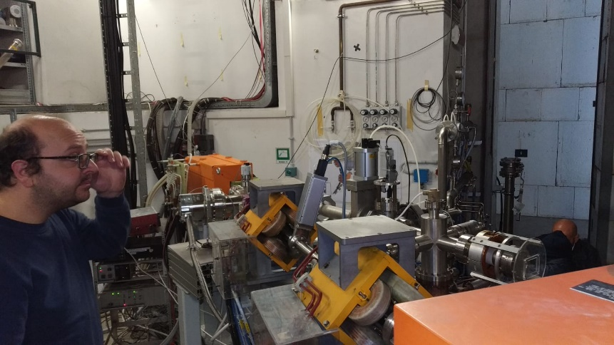
BTF status report
Istituto Nazionale di Fisica Nucleare
Laboratori Nazionali di Frascati
Scientific Committee Meeting
May 2019
BTF group
Bruno Buonomo, Claudio Di Giulio, Luca Foggetta, Gianfranco Morello, Paolo Valente

Slide 2


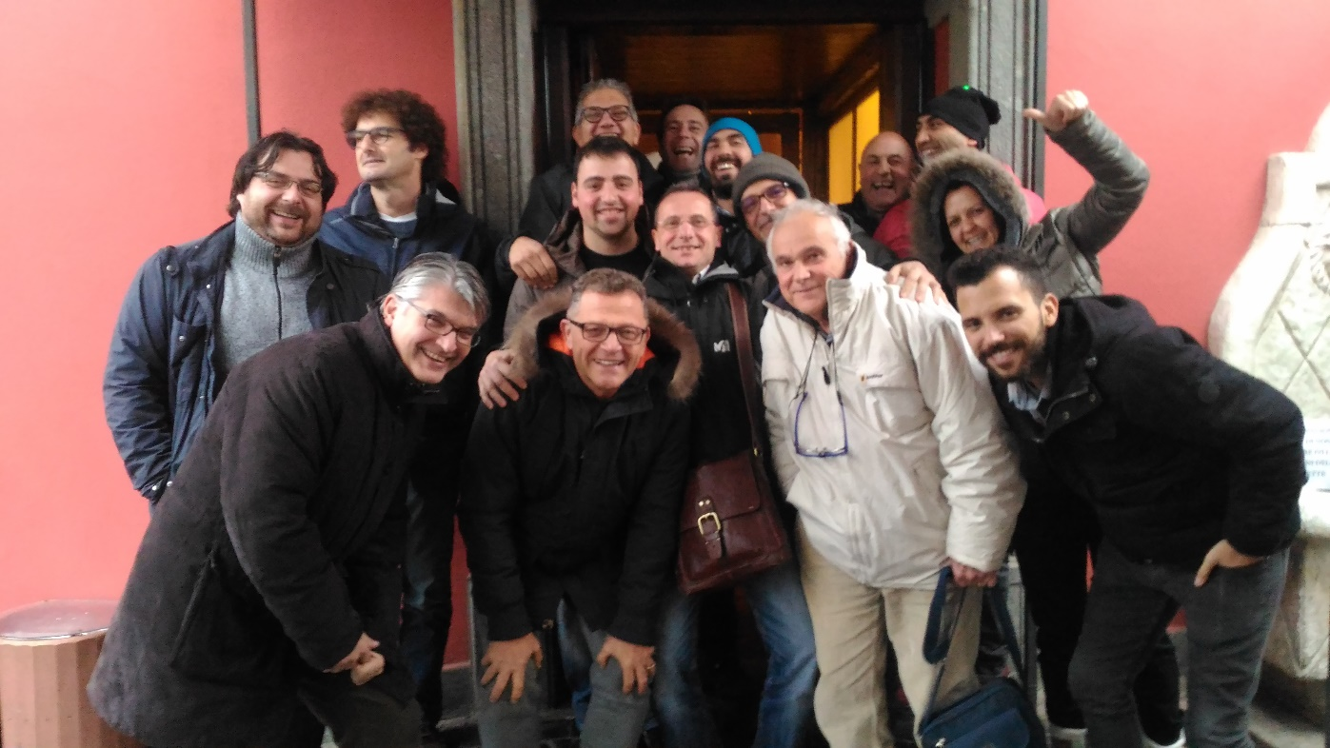
People
BTF group
Bruno Buonomo, Claudio Di Giulio, Luca Foggetta,
Gianfranco Morello, Paolo Valente
LINAC staff
Maurizio Belli, Riccardo Ceccarelli, Alberto Cecchinelli , Renato Clementi*,
Graziano Piermarini, Luis Antonio Rossi, Serena Strabioli, Raffaele Zarlenga
* Retired
Technical and Accelerator Divisions services
Sergio Cantarella, Oreste Cerafogli*, Enrico Di Pasquale, Alessandro Drago, Adolfo Esposito, Oscar Frasciello, Andrea Ghigo, Simona Incremona, Franco Iungo, Stefano Lauciani, Roberto Mascio, Stefano Martelli, Marco Paris, Stefano Pioli, Luigi Pellegrino, Francesco Putino, Ruggero Ricci, Ugo Rotundo, Lucia Sabbatini, Claudio Sanelli, Franco Sardone, Giancarlo Sensolini, Alessandro Stecchi, Angelo Stella, Alessandro Vannozzi & DAFNE operators for runs
* Retired

Slide 3
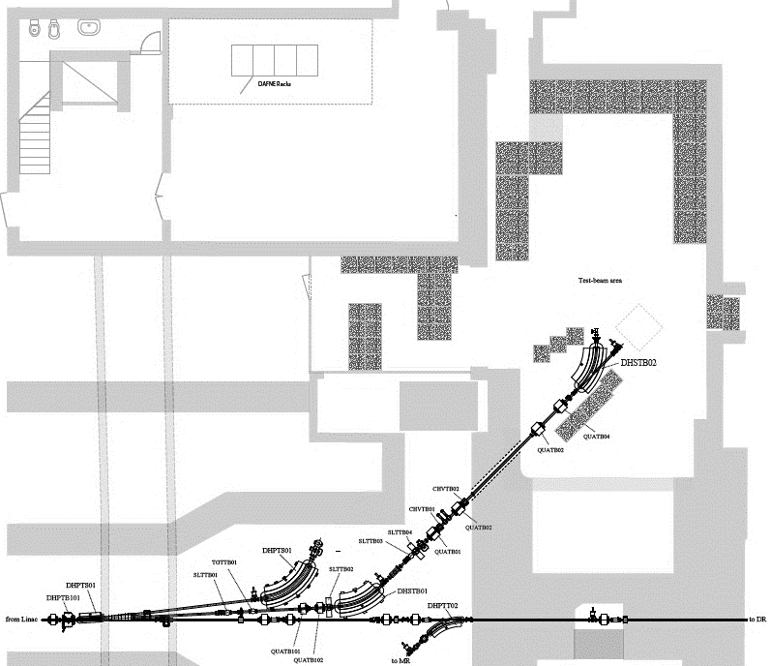
Activities
Build a second beam-line and experimental hall
PADME run
Preparation of new test beam campaign
Consolidate the LINAC: extend lifetime of 10 years

Slide 4
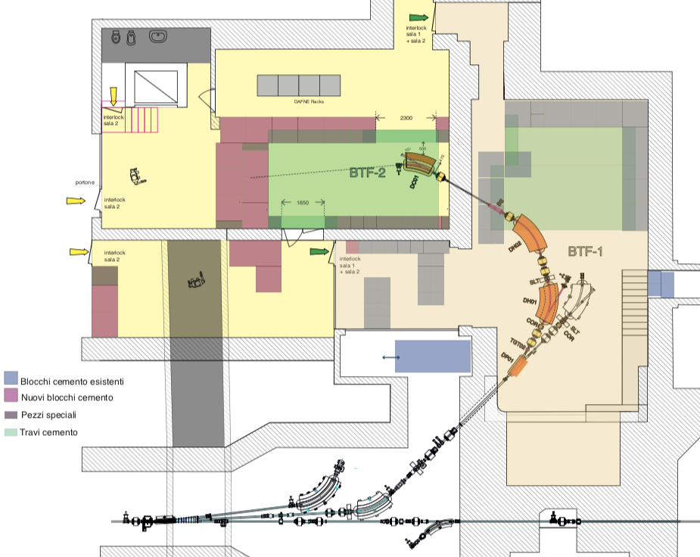
Activities
Build a second beam-line and experimental hall
  Hard handshaking with all the other DAFNE-BTF-LINAC activities:
  Essentially people for implementing the infrastructure
  BTF Experimental hall 1 closed for PADME run => no joint upgrading during it
  Not touching existent DAFNE subsystem, racks, cables…
  Non interlocking activities also for SIDDHARTA 2

Slide 5
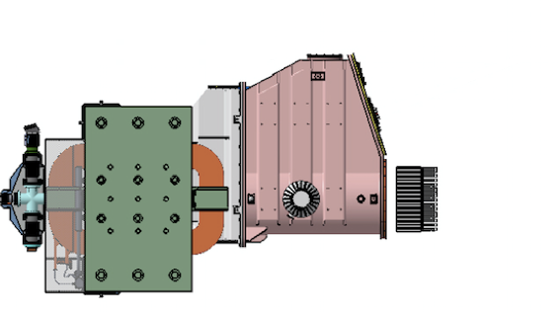
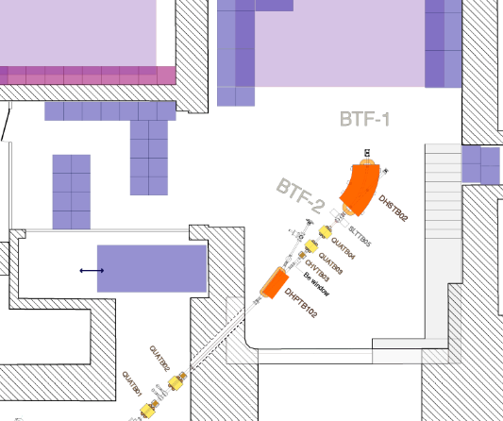
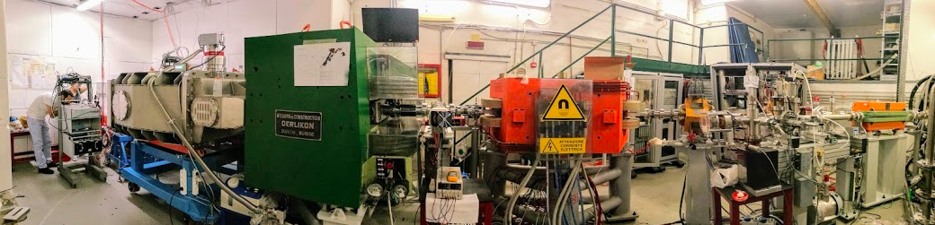
Activities
Restart with long positron pulses for the PADME run
  Implementing the setup for BTF1 and PADME
  Make the joints for both (slow control, signals, intercalibrations)
  Setup LINAC+BTF for the PADME requirement
  Assuring a stable run for months (10¹³ good cooked positrons)
Restart test-beam access
  AIDA 2020 duties
ACTUAL

Slide 6
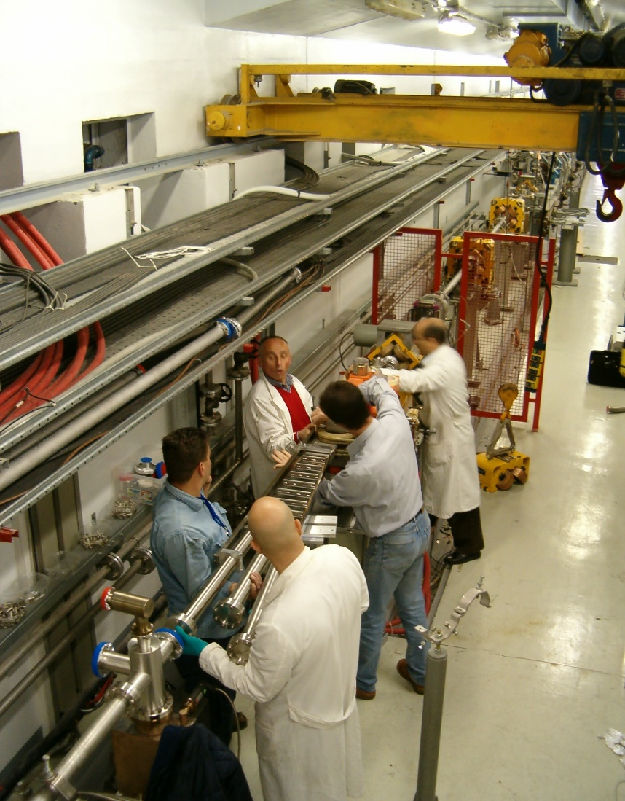
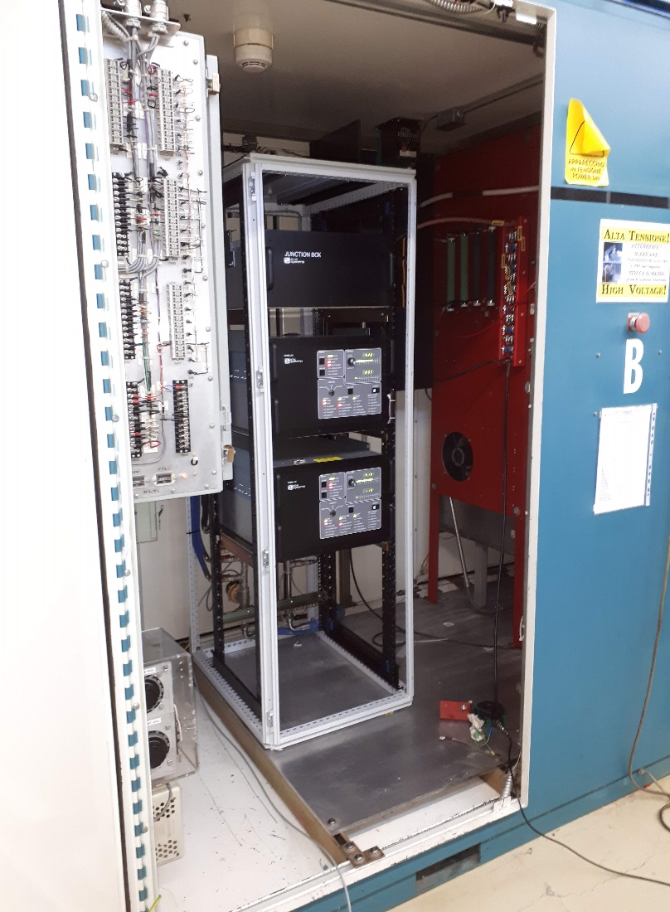
Activities
Consolidate the LINAC: extend lifetime of 10 years
  Implementing HVPS on 4 mod’s
  Substituting mod’s and subsystem old electronics with a new embedded one
  Improved Maintenance and Diagnostics
Critical implementation for just one reason
  LINAC has to be ready for all of the scheduled activities (and we got it):
  BTF user run
  DAFNE in SIDDARTHA run
  PADME run
Two completely different beams
Cannot be currently overlapped

Slide 7
Timeline
Timeline
12/11/2015: 1st proposal to INFN MAC
16/03/2016: Conceptual design INFN-16-04/LNF, Review of INFN MAC
22/06/2016: Review with CERN warm magnets group
10/10/2016: Final layout of beam-lines
17/01/2017: Meeting with INFN LASA magnets group
01/03/2017: Workshop with industries and ILO in Bologna
06/04/2017: First part of funding available (1.6 M€)
22/06/2017: Status report to INFN MAC
20/09/2017: Start of BTF shutdown
01/10/2017: Second part of funding available (350 k€)
19/12/2017: Start of civil engineering
01/04/2018: Start of beam line dismounting
04/07/2018: Third part of funding available (650 k€)
12/07/2018: First beam in BTF-1 line beam setup
20/07/2018: END of beam commissioning
Aug. 2018 : Summer shutdown
15/09/2018: Restart LINAC op. and PADME RUN1
23/10/2018: Status report to INFN MAC
21/12-07/01 2019 : Winter shutdown and maint.
26/02/2019: First beam in BTF-2 line beam setup
01/03/2019: END of PADME RUN1
04/03/2019: LINAC available for DAFNE
06-29/03/2019: LINAC HVPS Mod.B installation
30/03/2019: LINAC ready for DAFNE
2016
2017
2018
2019
€
€
€
Shutdown
BTF1 and PADME install and commissioning
Shutdown
PADME RUN 1
PADME RUN 1
Shutdown

Slide 8
User status
Users publications related to BTF activities 2018
Performance of the prototype of the charged particle veto system of the PADME experiment, F. Ferrarotto et al., IEEE TNS 99 (2018).
Performance of the diamond active target prototype for the PADME experiment at the DAΦNE BTF, R. Assiro et al., Nucl. Instrum. Meth. A898 (2018) 105.
Study on the High Energy Particle Detector calorimeter, B. Panico et al., PoS ICRC 2017 (2018) 172
Study of the Performance of an Optically Readout Triple-GEM, M. Marafini et al., IEEE TNS 65 (2018) 604.
Response of microchannel plates in ionization mode to single particles and electromagnetic showers, A. Yu. Barnyakov et al., Nucl. Instrum. Meth. A 879 (2018) 6.
Study of the performance of the NA62 small-angle calorimeter at the DAΦNE Linac, A. Antonelli et al., Nucl. Instrum. Meth. A 877 (2018) 178.
Study on the high energy particle detector calorimeter, B. Panico et al., PoS ICRC2017 (2018) 172.
The PADME Tracking System, G. Georgiev et al., arXiv:1804.00618 [physics.ins-det].
Dark Photon Search with PADME at LNF, G. Piperno, Int. J. Mod. Phys. Conf. Ser., 46, 1860047 (2018).
Status and prospects for the PADME experiment at LNF, P. Gianotti et al., EPJ Web of Conferences 166, 00009 (2018).
Design, status and perspective of the Mu2e crystal calorimeter, N. Atanov et al., arXiv:1801.03159 [physics.ins-det].
Combined readout of a triple-GEM detector, V. C. Antoci et al., arXiv:1803.06860 [physics.ins-det].
The AMY (Air Microwave Yield) experiment to measure the GHz emission from air shower plasma, J. Alvarez-Muniz et al., arXiv:1807.08174 [astro-ph.IM]
Proposal for Using DAΦNE as Pulse Stretcher for the Linac Positron Beam, Susanna Guiducci et al., J.Phys.Conf.Ser. 1067 (2018) no.6
Fast Ramped Dipole and DC Quadrupoles Design for the Beam Test Facility Upgrade, Lucia Sabbatini et al., IPAC2018 proc.
The PADME calorimeters for missing mass dark photon searches, F. Ferrarotto et al., JINST 13 (2018) no.03
The Mu2e undoped CsI crystal calorimeter, N. Atanov et al., JINST 13 (2018) no.02
An Active Diamond Target For The Padme Experiment, F. Oliva et al., 19th Frascati Spring School “Bruno Touschek” proc.
…

Slide 9
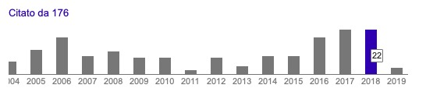
User status
Users publications related to BTF activities 2019
Electron beam test of the large area Mu2e calorimeter prototype, N. Atanov et al, J.Phys.Conf.Ser. 1162 (2019)
Development of the SLRI beam test facility for characterization of monolithic active pixel sensors, K. Kittimanapun et al, Nucl.Instrum.Meth. A930 (2019)
The Investigation on the Dark Sector at the PADME Experiment, Fabio Ferrarotto , Universe 5 (2019) no.2
Characterization and performance of PADME’s Cherenkov-based small-angle calorimeter, A. Frankenthal et al., Nucl.Instrum.Meth. A919 (2019) 89-97
Citations of Nucl. Instrum. Meth. A515 (2003) 524

Slide 10
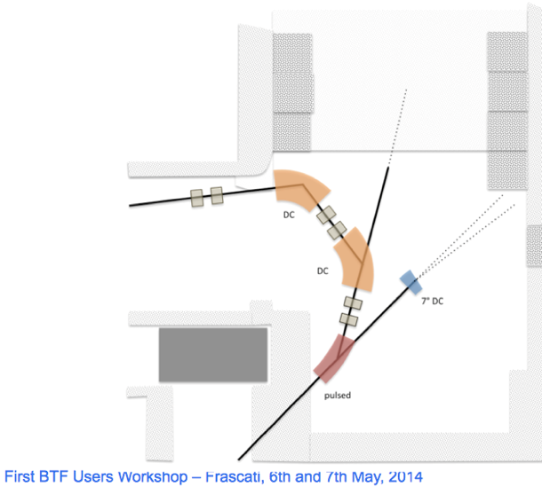
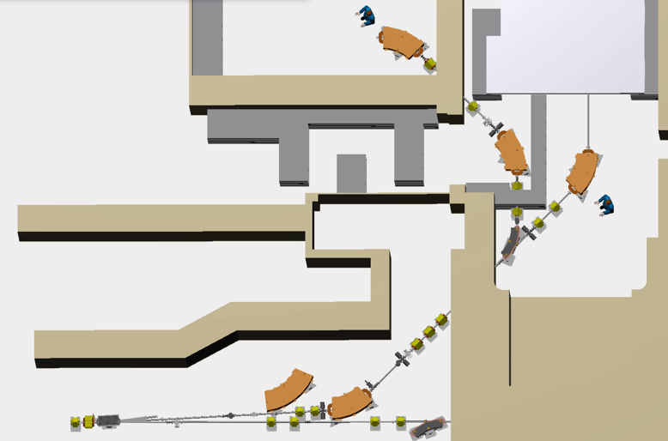
Layout
First sketch, May 2014
Conceptual Design Report, March 2016

Slide 11
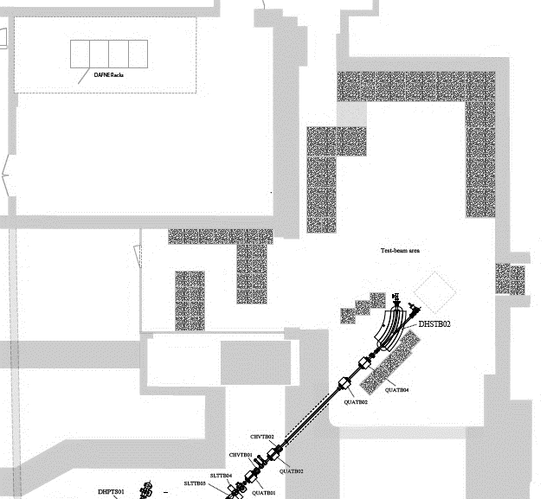
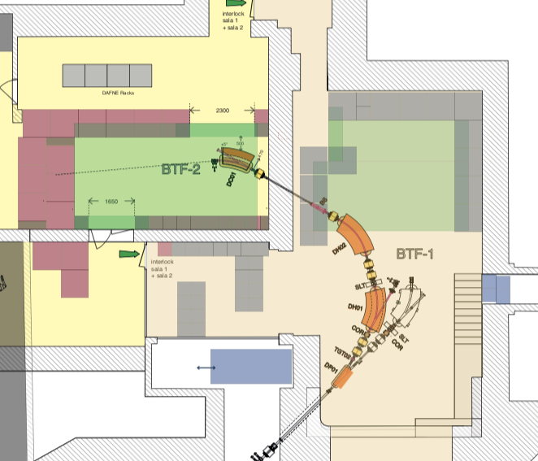
Layout
Planned
BTFEH2
Beam Area
≈ 15m²
2017
BTFEH1
Beam Area
≈ 25m²
Control room
Beam Area
~35m²
Two Alternative Beam Line
CR moved to different location
Duty cycled operations
Single Beam Line
Near to BTF-CR

Slide 12
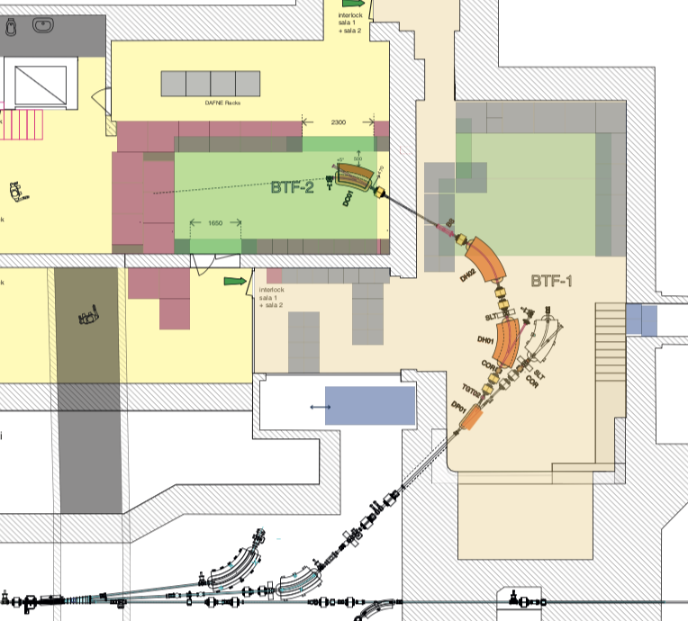
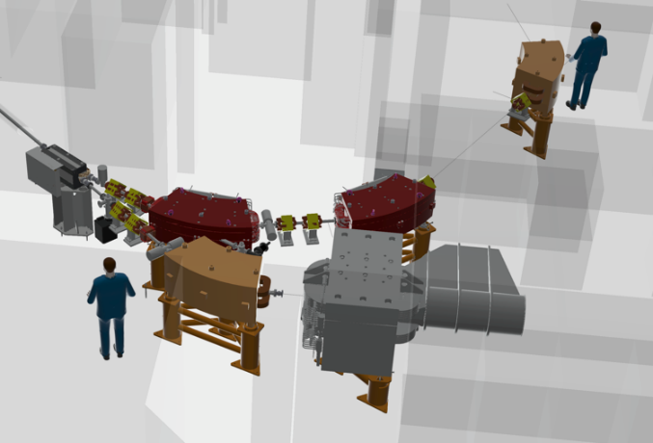
Layout
Planned
 | Old BTF | Planned BTFs
Magnets number | 11 (3Dip,6Qua,2Cor) | + 12 (+4Dip,6Qua,2Cor)
Scrapers (axes) | 8 | +4
Beam stoppers | 1 | +1
Targets | 1 | +1
ICTs | 3 | +2
DAQ | 1 | +1
Ion Pumps | 4 (2 for user vac) | +3
BTFEH2
User Area
≈ 15m²
Two Alternative Beam Line
CR moved to different location
Duty cycled operations
BTFEH1
User Area
≈ 30m²
Increased water cooling capability
Increased stability air conditioned system
Big control room
New Power Supply hall

Slide 13
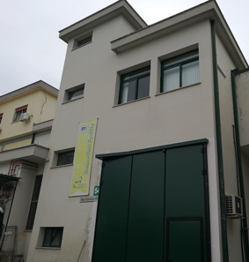
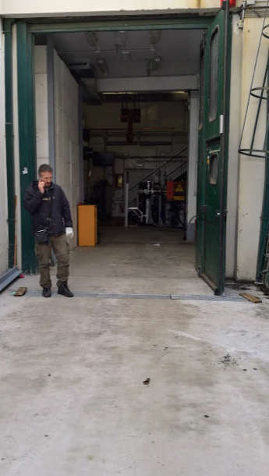
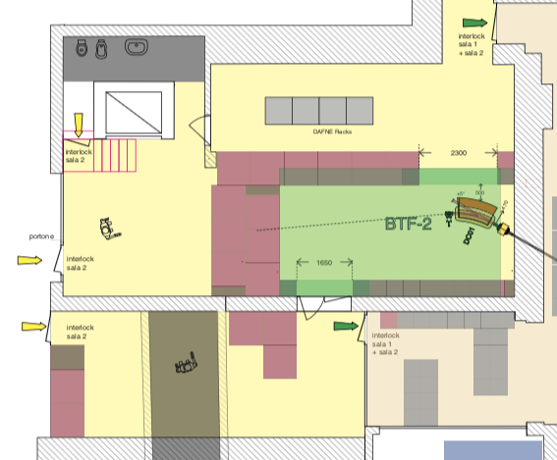
BTF Exp. Hall 2
End civil w. Phase 1
(Winter 2018)
New main entrance
BTF-2 Secondary entrance
Improving floor strength for BTF2 shielding chicane
External shielding blocks ready to be installed
Largely used in the past months
=> A very good result

Slide 14
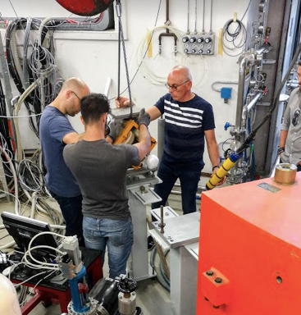
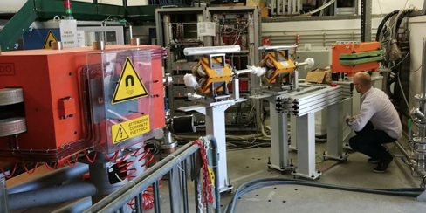
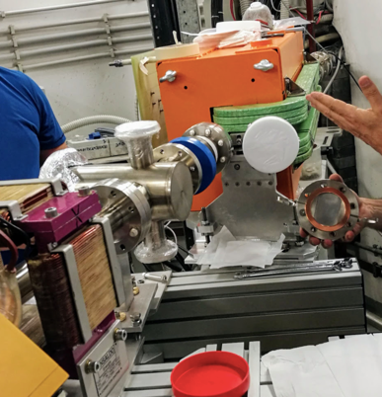
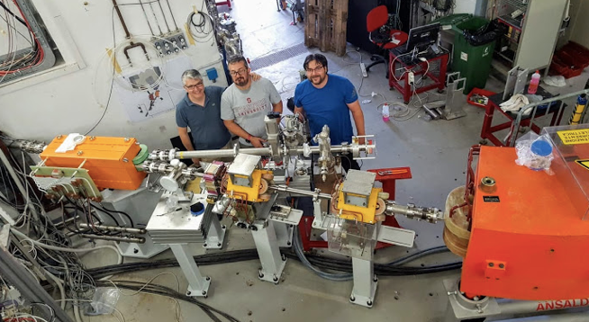
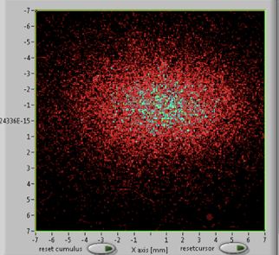
BTF1&PADME Installations
BTF 1 Commissioning
(June2018)
Ion pump
Be Window
Fast Dipole
Very quick installation:
  One month from scratch to BTF-1 beam
Doubled the line
  Ready for PADME beam commissioning
BTF1 First beam
12 Jul. ‘18
Be Window
TMP pump

Slide 15

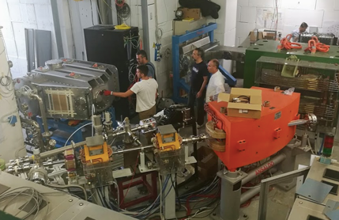
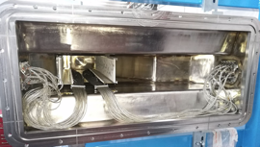
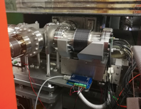
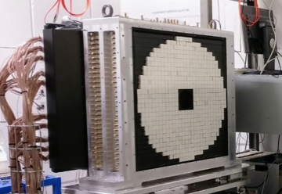
BTF1&PADME Installations
Parts Commissioning
(June2018)

Slide 16
BTF1&PADME Installations
Parts Commissioning
(June2018)
Ready for beam commissioning

Slide 17
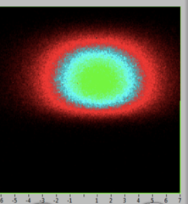
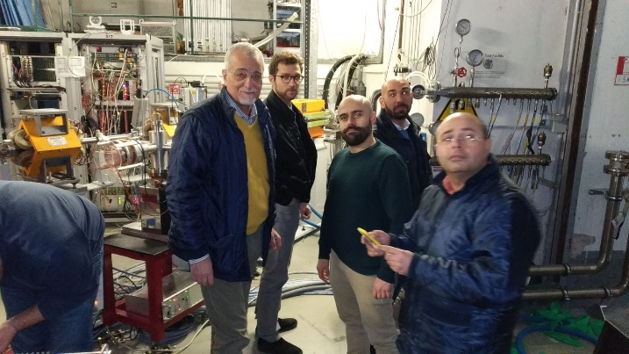
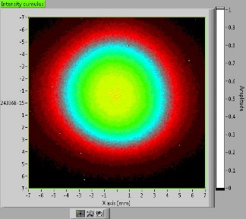
PADME beam commissioning
Commissioning BTF1 beam with secondary electron beam (450 MeV): July 2018
Commissioning PADME beam with secondary positron beam (550 MeV): Sep. 2018
First user on new BTF-1 line, PADME (dark photon searches) experiment: Oct. 2018 – end of Feb. 2019
Commissioning PADME beam with primary positron beam (490 MeV): end of Feb. 2019
End of PADME RUN1: 1st March 2019
Primary Beam
Secondary Beam

Slide 18
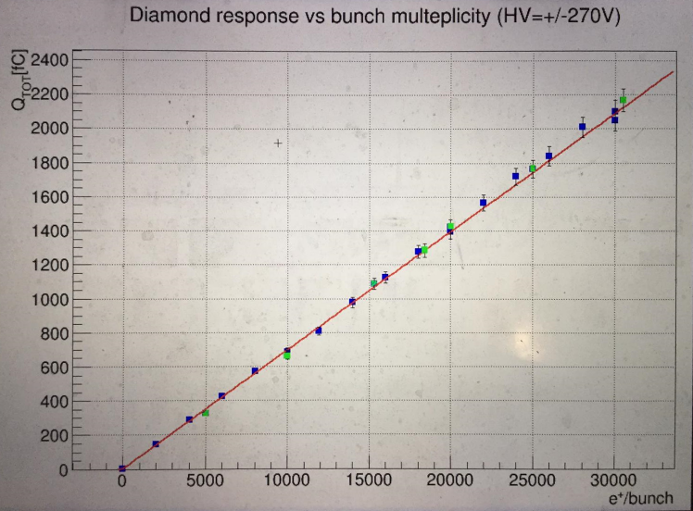



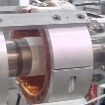


PADME beam commissioning
BTF Hall 1 - BTF diagnostic layout
Impossibility to have BTF diagnostic in PADME run
  Big vacuum vessel with its own => using alternative measurement paths
PADME-Decoupled diagnostic for essentially:
  charge, position and transverse dimensions
Used for PADME initial data validation, beam setup, background studies and afterwards for fast beam checking
Be Window
Be Window
Fitpix (pixel det) and calorimeter
ICT & Resistor BCM (current monitor) LINAC-tunnel
Before target
YAG:Ce and Nd FLAGS

Slide 19
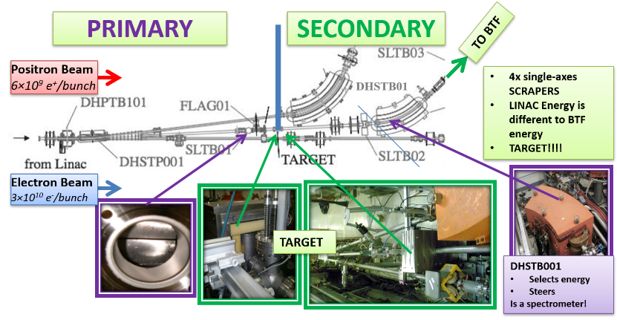


BTF short recap
BTF beam transport
Primary or secondary beams
The beam can be delivered in different modes: dedicated or opportunistic operations and with or without attenuating target. Different ranges of beam parameters can be achieved:
Fixed energy, E₀
  Steering and transverse tuning
High current
  from top current
  tunable in 6 orders of magnitude from 10¹⁰ prim/bunch
LINAC Conditioned Primary Beam, E₀
Tunable energy
  All energies from E₀ to ≈30 MeV
Tunable multiplicity
  From max(E) to single particle per shot
Particle type decoupled from LINAC
Cu target, 1.7-2-2.3 x₀

Slide 20
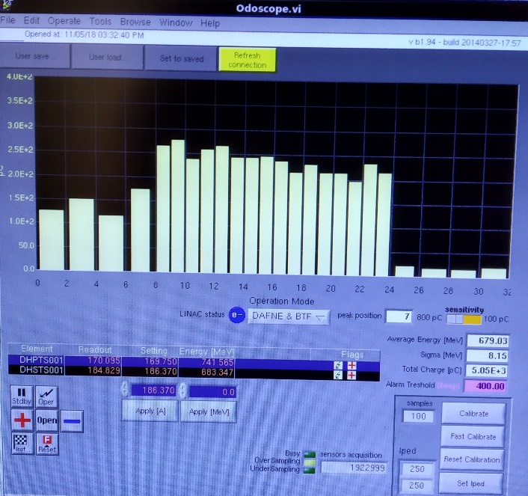
PADME beam
BTF secondary beam commissioning
July 2018
Request changed due to increased capability in PADME detection
Longer pulse = from 150ns up to 350ns (trials) => set default on 250ns
averaged on SAC measured charge to time readout
More multiplicity = from 10k up to 30k => set default on 25k
Actual Secondary Beam configuration for PADME:
Secondary Positron Beam Production at the BTF target
  Electron Primary energy 670MeV
  LINAC current higher than DAFNE ops
  Multiplicity max(545MeV, scraper’d) above 25k
  Very good beam control and run stability for PADME
Drawbacks
  Primary beam energy spread more than 6%, beam losses
  Background and some diagnostic ageing
  Implementation of safety rules (i.e. cool down of target)

Slide 21

PADME beam
BTF primary beam commissioning
Mar 2019
Actual Positron Primary Beam configuration for PADME:
Beam Production at the LINAC converter target
  Primary transported energy 490MeV
  Very low LINAC current (10⁷ pos/bunch) then scraping to reach 25k POT/bunch
    lower background
  No rad damage issues
  Higher multiplicity is not a problem
  Seems better beam energy spread
Drawbacks
  Low max beam energy (under PADME needs) => still working on
  Not so good beam control and run stability for PADME => still working on
  No (or very low sensitivity) LINAC current monitor (BCM, BPM) => still working on
  Beam stability in position (less) and multiplicity => still working on

Slide 22
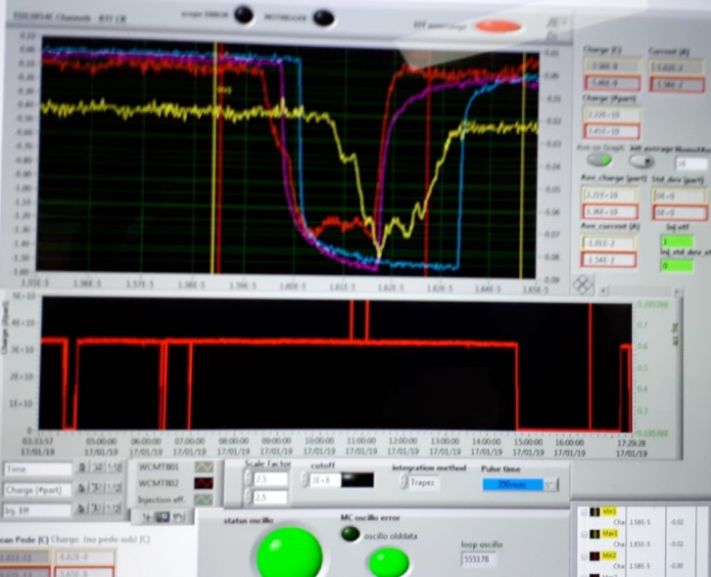
PADME RUN1
Start online activities on Sep. 2018, initially with a standard secondary beam in order to
  fix magnets fields,
  Improving data exchange from BTF to PADME (exp. slow control, vacuum and LINAC),
  BTF data and software developing for matching on-field PADME needs
  improving safety rules for PADME team access, improving H24 operation
In Oct. 2018 trials with different beam transport setup, energy and timing to increasing knowledge with PADME data online for beam fine tuning on PADME detectors.
  Sharing knowledge and defining operational parameters to DAFNE operators for H24 ops
  PADME detector and data debugging
Fixing a complete set of nominal parameter, so starting beam on in Nov. 2018 for PADME RUN1
  Optimal background dose reached on target
Final focus beam parameters detection are mutually exclusive (starting from the point of view of network delivery to the DAQ/detectors involved) for PADME and BTF diagnostics
a good way for a non interleaved cross-calibration and powerful debugging

Slide 23
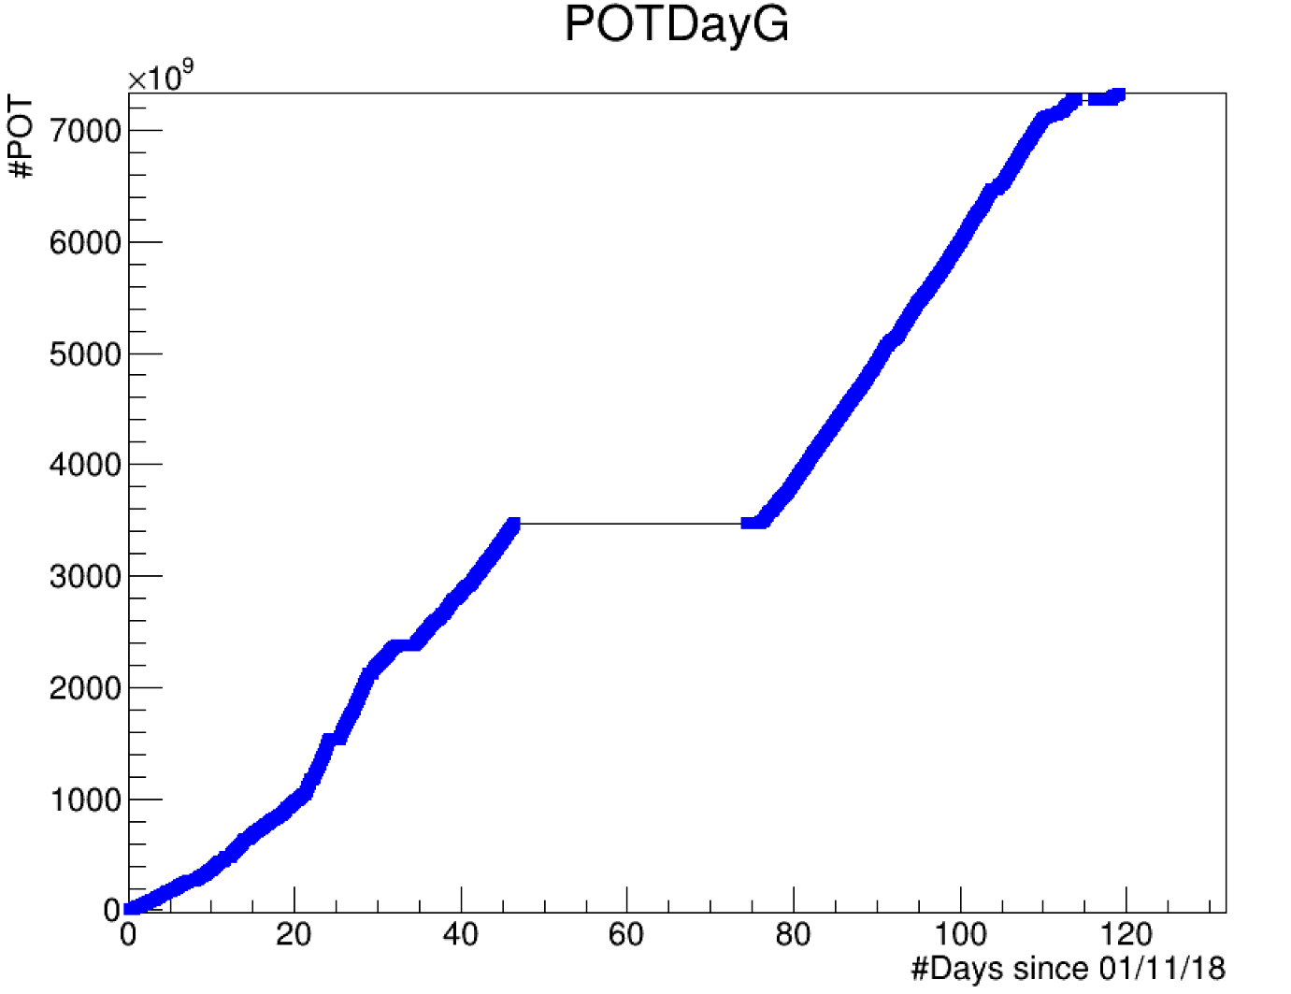
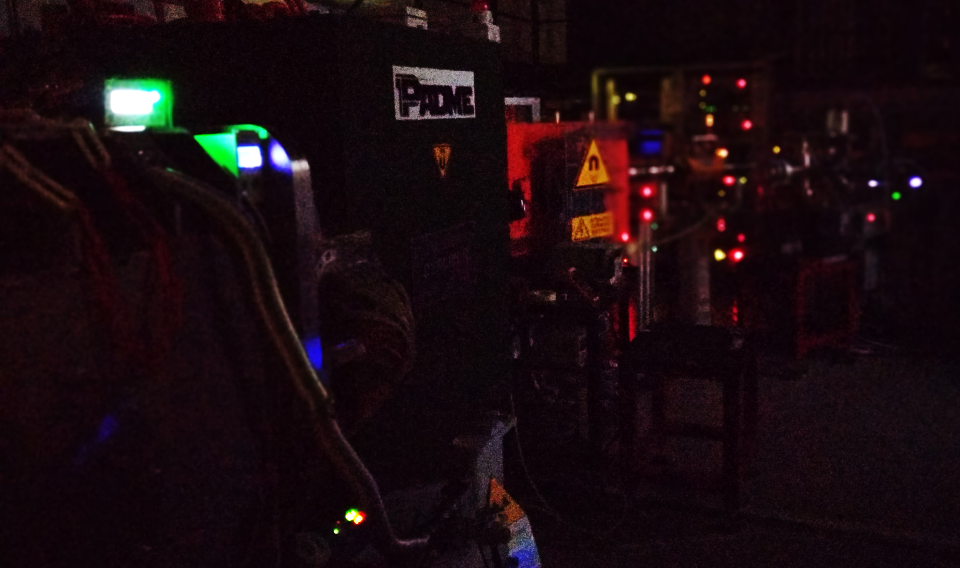
PADME RUN1
PADME RUN 1 calendar
The beam delivery, in the major part of the involved configurations, run smoothly
Some stops for minor problems/setup for PADME (see Mauro Raggi presentation)
Two stops involving vacuum opening/major problem for PADME has been taken in a opportunistic way together the other LINAC-BTF improvements
Highly charged LINAC beam promoted improvements in safety rules in shielding and LINAC access:
  Experiences of few faulty detectors in the area of BTF target: two flag cameras and power supply in hodoscope and target area
  Some scraper encoders, but open loop command remains completely operative (and not so much used)
  Increasing shielding in the target area to reduce background in BTFEH1 and related areas
Using every minutes until the scheduled shutdown (Winter 2018 and safety checks)
  Official RUN1 ends on Feb. 21st and then we start primary beam and fast dipole test
PADME coll. Courtesy
PRELIMINARY
Winter Shutdown

Slide 24
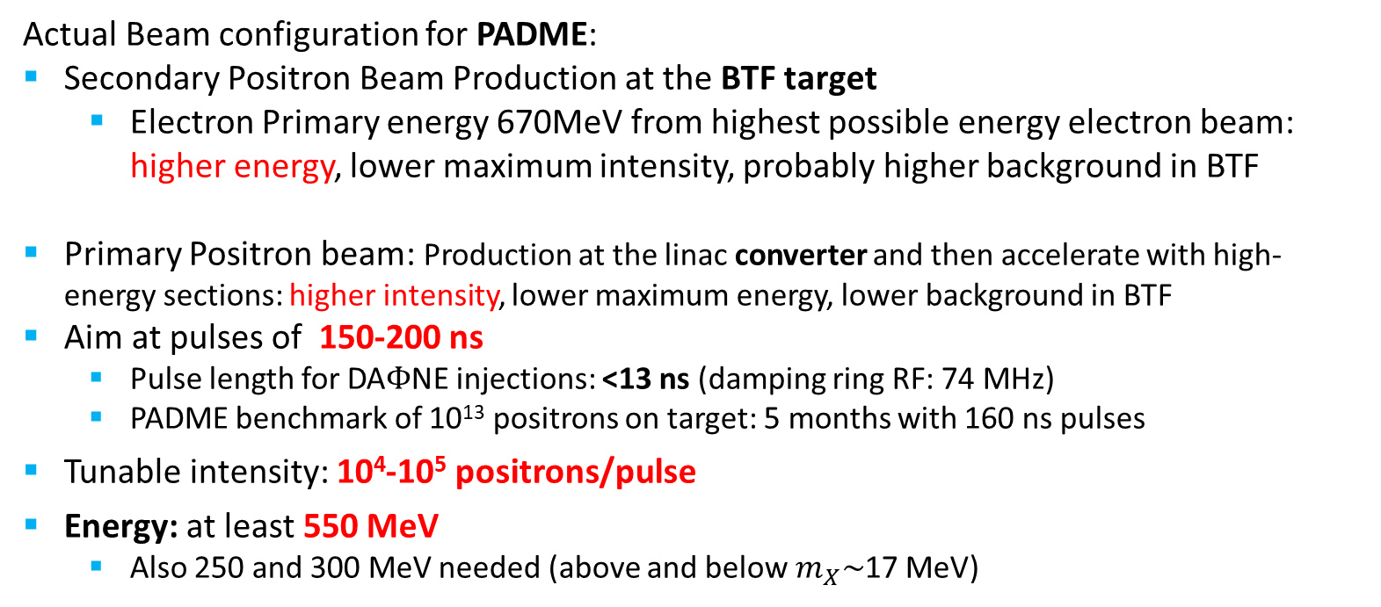
PADME beam
BTF Hall 1 – PADME RUN 1
Actual Beam configuration for PADME:
Secondary Positron Beam Production at the BTF target
  Electron Primary energy 670MeV from highest possible energy electron beam: higher energy, lower maximum intensity, probably higher background in BTF
Primary Positron beam: Production at the linac converter and then accelerate with high-energy sections: higher intensity, lower maximum energy, lower background in BTF
Aim at pulses of 150-200 ns
  Pulse length for DA$Φ$NE injections: <13 ns (damping ring RF: 74 MHz)
  PADME benchmark of 10¹³ positrons on target: 5 months with 160 ns pulses
Tunable intensity: 10⁴-10⁵ positrons/pulse
Energy: at least 550 MeV
  Also 250 and 300 MeV needed (above and below $m_{X}\sim$17 MeV)

Slide 25

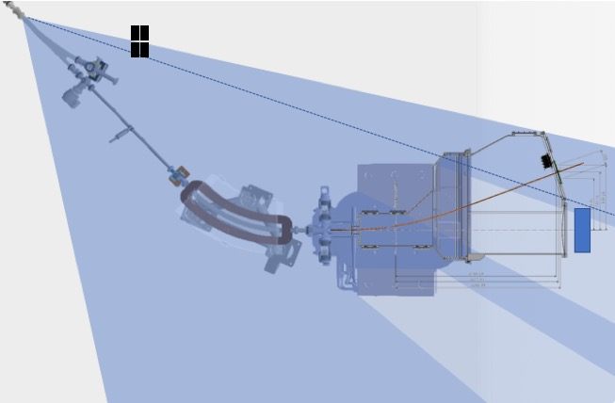
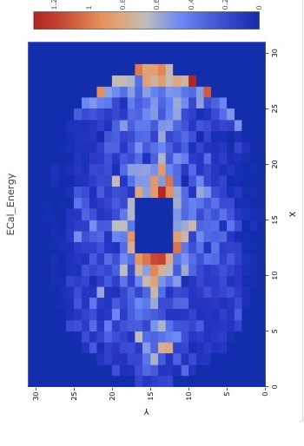
PADME BACKGROUNG
During initial PADME RUN 1 phase
Calibrating the assembly of detectors and analyzing the background impact on PADME detectors
Hypothesis on different sources
  Outer bkg
    BTF target (photons and neutrons)
    Scrapers
  Inner bkg
    Be window (multiple scat & bremsstrahlung)
    PADME target holders
    Negative differential aperture joints
    Pipe hitting
Hot witness are
  Ecal outer X>0 bkg for outer photons
  Ecal inner for bremsstrahlung’d positrons scraping the inner surface of former PADME chamber
Trials in 7 different position with Pb bricks shielding
Y = beam plane (1240mm) ± 300mm
Not found a significant BKG variation with these trials

Slide 26
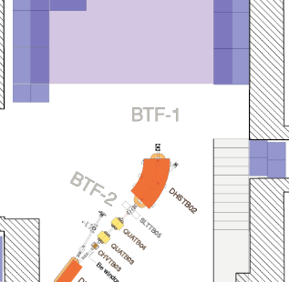
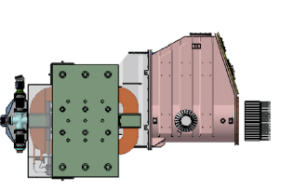



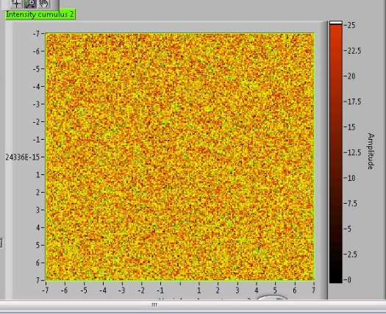
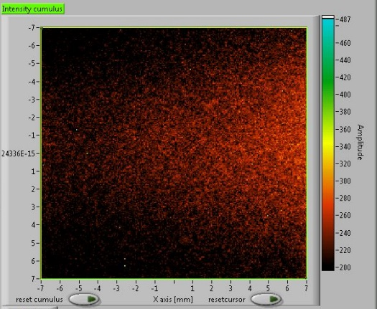
PADME BACKGROUNG
Actual Positron Secondary Beam configuration for PADME:
Diffused low energy photon (≈10 MeV) background in BTFEH1 coming from target
Some not fully understood background sources coming from pipes/Be-window
Strategies:
Limited use of scraper
Minimization on LINAC current density on target
Modulator Timing studies to exploit X-Z coupling due to energy spread
Beam Line and PADME MC simulations

Slide 27
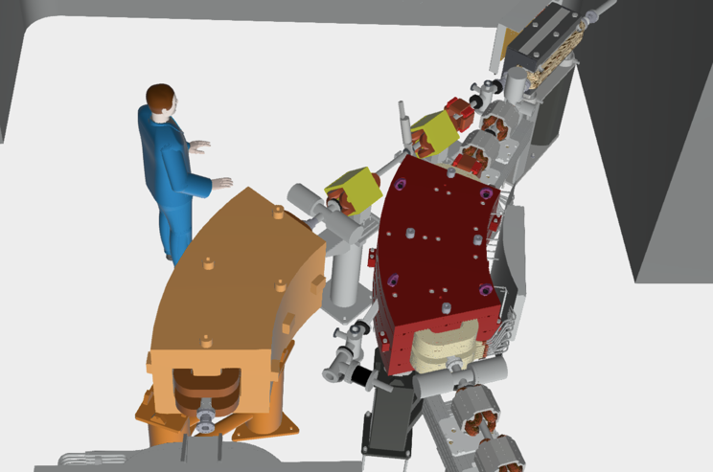


Btf doubling line in detail
In the meantime of PADME run…
ACTUAL (w/o PADME)
Existing 45$°$ dipole
Beam-splitting
New fast-dipole
Scrapers
New 45$°$ dipole
BTF-1 line
PADME (2018)
New Quadrupole
BTF-2 line

Slide 28
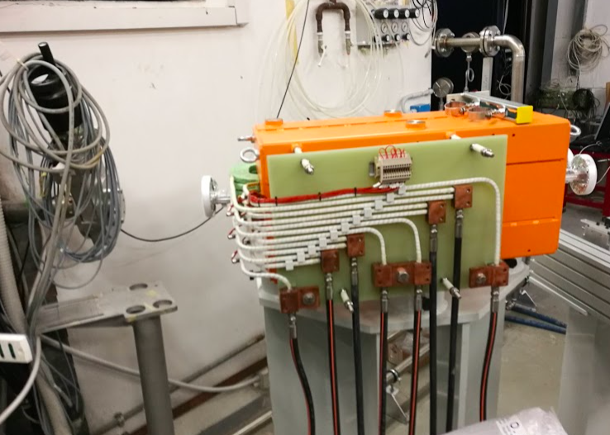
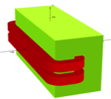
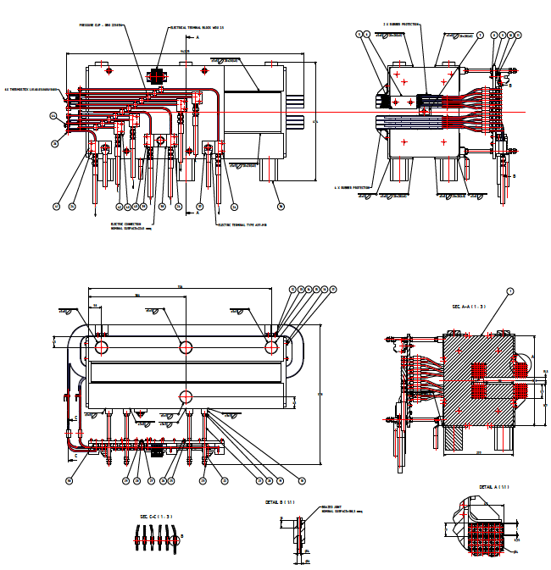




Btf doubling line / magnets
Fast C-dipole
Fast dipole - In house design (Late 2017)
Construction at ORMET (Genova)
Some issues on pole but seems ok
Assembly in strong collaboration with LNF technicians
Delivering, characterization and installation in June 2018
Just used for BTF-2 beam commissioning

Slide 29



Btf doubling line / magnets
H-dipole
H dipole - In house design and assembly (Late 2017)
Construction at SIGMAPHI
Delivering&characterization complete: March 2019
Very good result in field measurement
Installation prob Autumn 2019
Radial Scan I=269A
B [g]
∆B/B0 longitudinal I=269A
X (mm)
Exc. Curve
B [g]
S (mm)
I [A]

Slide 30



Btf doubling line / magnets
QUADS and C-Dipole
  QUADS
QUANTITA’ 7
Gradiente nominale 20 T/m
Diametro Apertura 45 mm
Lunghezza del nucleo magnetico 180 mm
Larghezza del nucleo magnetico 270 mm
Altezza del nucleo magnetico 270 mm
Corrente Nominale 93 A
Numero di spire per polo 45
Resistenza del magnete 116 mΩ
Induttanza del magnete 22 mH
Quads - In house design and assembly (Late 2017)
Construction at SIGMAPHI
Bid complete, in production
Delivery expected at July 2019
Installation prob. Autumn 2019
Design and Construction at DANFYSIK
Bid complete, in production
Delivery expected at November 2019

Slide 31






Btf doubling line / elements
Scrapers, target, beam stopper and pipes
Beam stopper and target
In house new design of:
  overlapped blade scraper (10um step)
  two position, thin Cu target
  thin walled pipes for DP(installed) and DC(working) magnets
For the scrapers and target:
  Electronics, controls, vacuum OK!
  Ready to be installed
Overlapped blade scrapers
Aluminium thin wall DP01

Slide 32






Btf doubling line / btf-2 Bunker
Mar. 2019
Mar. 2018
Completely mapped with overall BTF+LINAC placing network
Not totally complete due to waiting remaining magnets and cooling pipeline
All of the remaining concrete blocks are ready
Not so much problems in deploying

Slide 33



Btf doubling line / Services
AIR and COOLING
Apr. 2019
Sep. 2018
Apr. 2019
Used for PADME RUN1 and BTF2 commissioning
Improved project for both the hall
Close to commissioning :
Final connection to the upgraded capability LINAC cooling tower (now using the old one)
Ventilation machine group on the BTF roof (next week commissioning)

Slide 34





Btf doubling line / Power Supply
Fast C-dipole
Used for BTF-2 beam commissioning with DAFNE timing sequence signal
EEI manufactured in strong collaboration with LNF
  Implementation of an automated beam delivery machine in the PS firmware, initially for debugging purposes
Cable routing complete for all of the magnets in the new BTF PS hall
Delivered in December 2018
Installation in June 2019 after fixing the new BTF PS hall, not ready due to needed floor enhancement
Temporary location of pulsed dipole power supply (waiting for final cooling system)

Slide 35






Btf d. L. – Fast dipole Power Supply
Ramp start time jitter < 50µs
Fast ramp to max current in <95ms
Current Resolution and reproducibility at granularity level (±6.6 mA)
Max current Ripple < ±33ppm

Slide 36




Btf d. L. – dips&quads power supply
DIPOLE PS
Current Resolution and reproducibility at granularity level
Just used for H-dipole commissioning
Max current Ripple << ±100ppm
QUADRUPOLE PS
DIPOLE PS
Current Resolution and reproducibility at granularity level
Max current Ripple << ±100ppm

Slide 37








Btf-2 beam commissioning
In the PADME run meantime…
3$×$3 mm² RMS
Two days in the last end of PADME RUN1
490 MeV primary positron beam
Same upstream optics, no optimization
Few shot due to some needed fix and to permit
RUN1 test with positron
4$×$1.5 mm² RMS
Second set of beam diagnostics (Silicon pixel, calorimeter) available

Slide 38




Linac activities
SPARC modulators management
LINAC up for PADME from Sept 2018 up to the end of Febr. 2019
Few problems during the run, mostly opportunistic maintenance
  Few stop due to electronic board fake interlock
  Thyratron substitution on Mod. A and EOL resistors in Mod C.
  New BCM installed
Linac Consolidation
  New thyratron cooling system
  New cooling circuit for the HVPS mods
Linac Upgrade
  Rush to save time in the switching period from PADME to SIDDHARTA2 (got it, sharing time with SPARC requirements)
  Installation of second couple new solid state TDK M.303 (Master+Slave) + Junction Box + 15:1 transformer -> final setup in mod racks
  Trials on new embedded modulator control system (Mod.B)

Slide 39




Linac activities
In Winter stop Dec-2018 Jan-2019

Slide 40







Linac upgrade – Mod.B final setup
Old fashioned HV 3-p rectifier to solid state cap charging HVPS
  Bid assigned to TDK -> bunch of couple Mod.303, at each arrival prompt installation to mods
  Fully operational on mod D in test setup from March 2018.
  Fully operational from 29th March of 2019 in final setup in modulator B.
Solid state
HVPS
12:1
15:1
Mod B @ 6 March 2019
Max P. OUT 33.2 MW
Mod B @ 29 March 2019
Max P. OUT 36.1 MW

Slide 41



Linac upgrade – Mod.B final setup
Linac upgrade
Huge retrofit effort to match the previous TITAN BETA HVPS installation, both for aged electronics and safety implementation philosophy
Mod. D test setup
Mod. B HVPS final setup
Mod. B LCS test setup
New Local Control System installed on mod B in «spy» mode:
  Based on NI C/RIO+PXI
  Software development in progress
  The FPGA DAQ runs monitoring the modulator, without controlling it.
  Working since beginning of Oct: ’18
  The fault statistics detected between old control system and new ones are consistent at 98%. In investigation the differences.
  Test on the Analog and Digital Signal on-going and first try to control the modulator with new system tested for 1h in April 2019.
  Still to be tested in dedicated mode for safety issue on Mod B

Slide 42





Linac upgrade - New E Modulator
New power
supplies rack
New tank
Using test experience will optimize the design for the new modulator in house installation
All of the Tank elements are in preparation for installation
Some re-machining in the tank due to construction errors
These items are in slow but constant implementation
.

Slide 43







Dissemination&events
Several Local and National TV&Radio News
Consultants for a science based movie “Conversazioni Atomiche” Istituto Luce prod., Felice Farina director
Public conference for Fermhamente Exbition
  Educational Cosmic ray stand
LNF educational days and events

Slide 44
conclusions
BTF-1 routinely operational since September 2018
PADME RUN1 accomplished
Beam delivered also on the new BTF-2 line, operating the beam switching dipole
Users test-beam call opened in February 2019
  First week of June 2019: users on BTF-2 line foreseen
Mar. 2019: LINAC long maintenance (refurbishing of modulators’ PFN charging power supplies) done
Magnets, supports, etc. for transporting the beam in the second bunker are available or in final production
Waiting for authorization of bunker BTFEH-2 (still pending at the Ministry, hopefully last step)
Installation of last part of BTF-2 branch possible in September 2019
  In this case, PADME restart possible from October 2019

Slide 45








BTF amarcord
Thank you for the attention
45

Slide 46
SPARE SLIDES

Slide 47



External BTF Exp. Hall 2
Starting point civil w.
(Winter 2018)

Slide 48





External BTF Exp. Hall 2
Start Civil w. Phase 1
(Winter 2018)
New main entrance
BTF 2 Secondary entrance
Improving floor strength for BTF2 shielding chicane

Slide 49






Internal BTF Exp. Hall 2
Start & Preparation
(Winter 2018)
Dec 2017
formerly BTF control room
Inside
Jan 2018
Feb 2018
Mar 2018
Dismantling control room equipment
Fixing interference with DAFNE subsystems
Remove false floor
Deeply joined with very fragile DAFNE subsystem
Re-organize all cables routing
Prepare demolitions

Slide 50



Internal BTF Exp. Hall 2
Civil w. Phase 2
(Spring 2018)
Make room for the bunker in the second experimental hall
Remove internal wall

Slide 51







Internal BTF Exp. Hall 2
Civil w. Phase 2
(Spring 2018)
Reinforcing pavement for magnet installation
Working over on cable pit for 9 years…

Slide 52



Internal BTF Exp. Hall 2
Civil w. Phase 2
(Summer 2018)
Maintaining a conditioned space for DAFNE racks
Make a comfortable passage for BTF1 and racks op.s
Deeply accordance with RSPP and Rad Safety group

Slide 53




Internal BTF Exp. Hall 1
Preparation & start
(Winter/Spring 2018)
Dismantling (almost all) cables, shielding, services
Removing vacuum pipe and pumps, magnets and girder
Has been found the perfect match with the assembly operation in BTFEH 2

Slide 54





Internal BTF Exp. Hall 1
Civil w. Phase 2
(End Spring 2018)
Ready for hosting PADME (Init Summer 2018)
DP-01
Fast dipole
BTF-2 line
vacuum vessel
target
dipole
BTF-1 line
calorimeter
DHSTB02
dipole
Both of the halls prepared for a fresh installation
Blue lining and hole drilling
New services started to be implemented in (supervisor endpoint, new compressed air and water cooling pipeline)
Restoring the fixed alignment sight point for the entire BTF1 and BTF2 alignment network

Slide 55






Internal BTF Exp. Hall 1&2
Civil w. Phase 2
(End Spring 2018)
Drilling hole for pipe in BTFEH2
Holes also for a new Power Supply hall, second floor
Implementation of a new routing for cables (safety, interlocks, power supply)
Implementation of the upgraded safety system

Slide 56





BTF1&PADME Installations
BTF 1 Commissioning
(June2018)
Very strong collaboration between PADME team and LNF-AD-BTF staff to match PADME detectors in BTF environment (network, air, cooling, power, safety, controls and rad interlocs…)
Implemented safety rules for BTF access by PADME user

Slide 57
DP01

Slide 58
Quads
DC01
Magnet type | DC01
Quantity | 1
Beam Energy (MeV) | 920
Deflection Angle (°) | 35
Gap Aperture (mm) | 35
Curvature radius (mm) | 1800
Nominal flux density (T) | 1.71
Maximum Integrated Field Quality | 1E-3 over ±15 mm
Maximum ΔB/B₀ | 1E-3 over ±15 mm
Hollow Copper Conductor Dimension provided by INFN (mm) | 9.5x9.5 hole diameter 5.5
Beam trajectory height from the floor (mm) | 1240
Maximum coils overhang from the iron yoke end faces (mm) | 250
Minimum Clearance Between the two Coils (mm) | 60
  QUADS
QUANTITA’ 7
Gradiente nominale 20 T/m
Diametro Apertura 45 mm
Lunghezza del nucleo magnetico 180 mm
Larghezza del nucleo magnetico 270 mm
Altezza del nucleo magnetico 270 mm
Corrente Nominale 93 A
Numero di spire per polo 45
Sezione del conduttore 5mmx5mm (foro diametro 3 mm)
Resistenza del magnete 116 mΩ
Induttanza del magnete 22 mH
Tensione nominale 11 V
Potenza nominale 1020 W
Peso del ferro 48 kg
Peso del rame 16 kg
Peso totale 64 kg
Numero di circuiti dell’acqua per magnete 2
Aumento di temperatura dell’acqua 18 °C
Portata totale nominale 0.015 l/s
Velocità nominale dell’acqua 1 m/s
- Perdita di pressione nominale 3.7 bar
PARAMETER | VALUE
Beam Energy (MeV) | 926
Deflection Angle (°) | 35
Nominal flux density (T) | 1.7099
Maximum Integrated Field Quality | 7.7E-4 over ±15 mm
Maximum ΔB/B₀ | 2.4E-4 over ±15 mm
Overall Width (mm) | 855
Overall Height (mm) | 686
Overall Length (mm) | 1440
Mechanical iron yoke aperture angle (°) | 33.77
Turns per pole | 130
Pancake per pole | 5
Pancake turns configuration | 13horizontal 2vertical
Hollow conductor cross section (mm) | 9.5x9.5mm hole diameter 5.5mm
Magnet resistance (mΩ)@25°C | 209
Magnet inductance (mH) | 436
Nominal current (A) | 235
Nominal voltage (V) | 60
Nominal power (kW) | 12
Iron weight (kg) | 1800
Copper weight (kg) | 480
Total weight (except the magnet support) (kg) | 2280
Nominal water temperature drop ΔT (°C) | 15
Nominal total water flow (l/min) | 14.5
Nominal water velocity (m/s) | 1.02
Nominal pressure drop ΔP (bar) | 3

