Slide 1
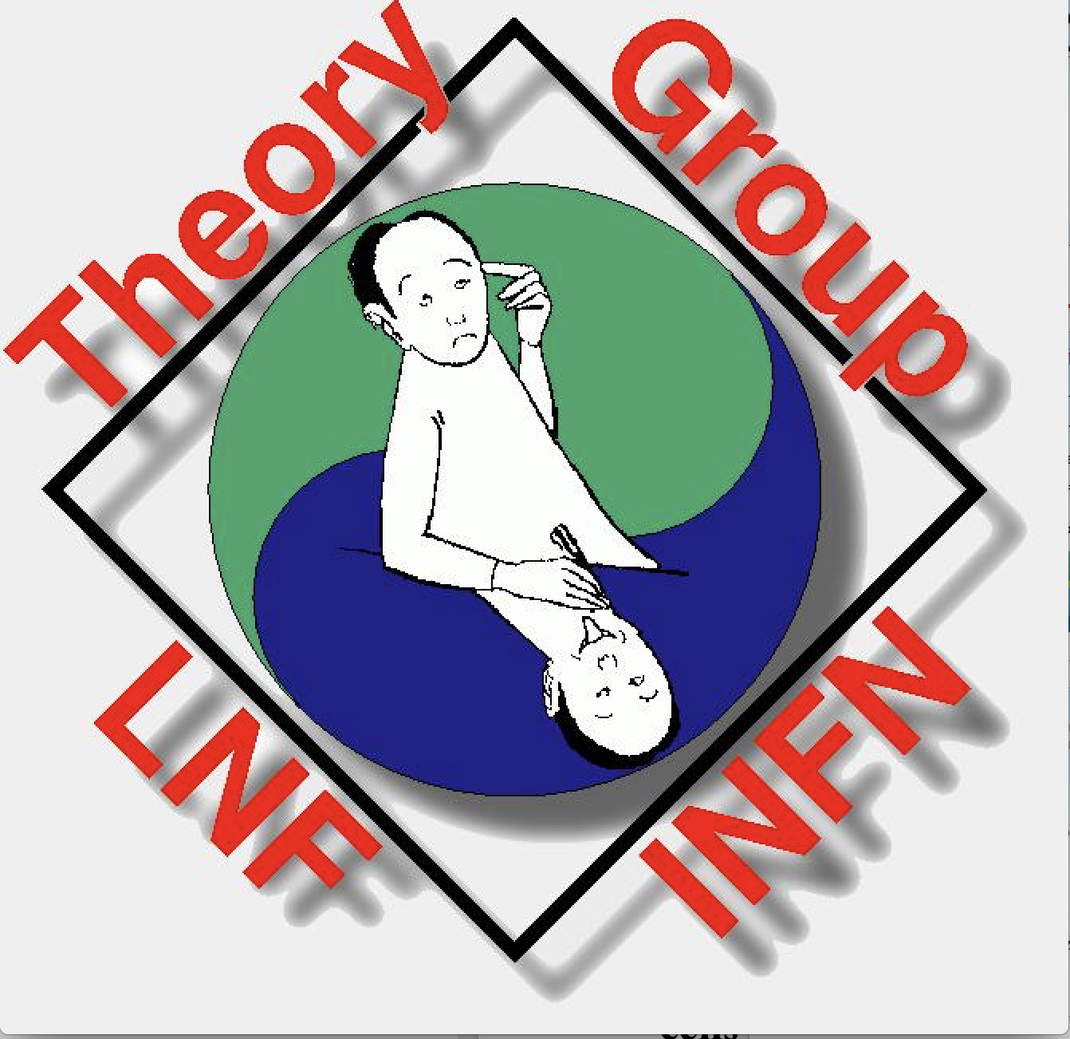
Enrico Nardi
LNF Scientific Committee Meeting 9/05/2019
Theory at LNF
Present situation (IS, composition, budget)
Recent happenings relevant for TH@LNF
Contributions and connections with EXP@LNF
TH@LNF strengthening strategies (local)
TH@LNF strengthening strategies (management)

Slide 2
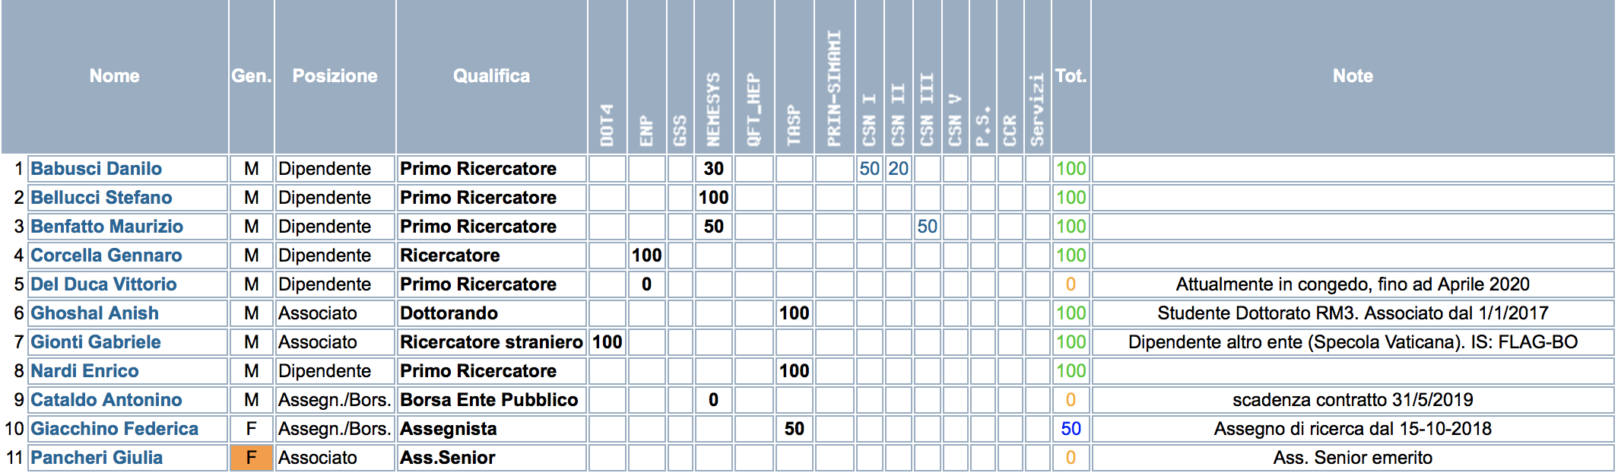


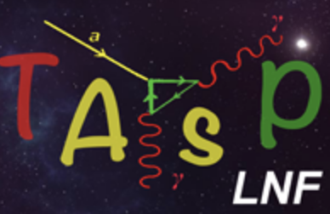
Anagrafica 2019
Exploring New Physics 1.0 FTE
Non equilibrium dynamics models and excited
state properties of low-dimensional systems
Theoretical Astroparticle Physics 3.5 FTE
2.0 FTE
--------------------------------------------------------------------------------------------------------------------------------------
Total: 8.3 FTE
1.8 FTE
Dot Gr4:
Notes:
TOTALE FTE 2015 (26.5) Budget 72.5 K€ No. seminari anno 2014: 4

Slide 3
Budget
(not including special contributions for conferences/workshops)
Missioni Indiviso Total Spec. Contrib.
2019 (K€) 4.0+2.0 21.5+2.5 30.0 10.0
2018 (K€) 4.0+3.0 22.5+3.5 33.0 10.0
2017 (K€) 3.5+3.5 24.5+3.5 35.0 9.0
Budget not rich, but if handled carefully it is sufficient
Some “sufference” (signaled more than once in CSN4) for Missioni
Special contributions are a relevant part of the budget
Budget handling: equal subdivision among staffs with FTE ≧ 50%
Years 2014/15: budget 72.5K€ for up to 26.5 FTE (30% Engeneers/Chemists, 25% FIS-03)
CSN4 requested more coherence in associations and a scaling down of the budget.
- April 2015 V. Del Duca: Leave of the absence to ETH, Zurich (until April 2020)
- June 2016 G. Isidori: Resigned for Zurich U. (already on leave since 2011)
- October 2018 M.P. Lombardo: Transferred to INFN-FI

Slide 4
Sample of Scientific Activities
Seminars & 1h.+ Talks (30%-35% budget)
2016 2017 2018
- Seminars 23 20 26
- Talks@Institutes -- 18 8
- Talks@Workshops 8 18 12
- Lessons@SSchool 15 -- 15
-----------------------------------------------------------------------
Total: 39 56 61
(It wouldn’t look bad for a mid-size group, and it is remarkable for a small-size group)

Slide 5
Recent happenings relevant for TH @ LNF
June 2013: Consulting group for theoretical physics at LNF was set up
A. Lerda (President CSN4), M. Mangano (CERN), A. Masiero (GE)
➔ Report with recommendations for the strengthening of the Group
(Workshops/Institutes to attract young researchers, strengthen relations with Rome U., activities coordinated with experimental colleagues, also for what concerns raising funds and resources)
All recommendations have been addressed and matched during the triennium 2015/18
November 2017: Report of the “Comitato Valutazione Internaz.” to the INFN President
“We are concerned that the Theory Group at LNF is very small, and, we were told, lacks coherence. A strong theory group would contribute to the intellectual atmosphere at the laboratory, so addressing this issue will be increasingly important as the active experimentation in HEP decreases at LNF.”
The Report contains only one raccommendation for CSN4 (National level):
Recommendation: CSN4-1. “In association with the Lab director, the INFN should plan for the success of the LNF theory group”
14-15 May 2018: Report of the 55th MEETING of the LNF Scientific Committee :
A general concern for the scientific activities in the Lab is the continued decline in the number of theoretical physicists. The SC chair confirms that this should be an item of priority for the upcoming SC meeting, with a possible strong statement to be made by the committee.
Notes:
A seguito della forte riduzione nel numero di staff, scarsa coesione nelle attività, etc.

Slide 6
Recent happenings relevant for TH @ LNF
29 May 2018: Meeting in “Presidenza INFN” on the future of TH @ LNF
A. Masiero, F. Zwirner (TH members in GE), A. Lerda (President CSN4)
L. Silvestrini, F. Morales, G. Degrassi (TH Coordinators RM1, RM2,RM3), E. Nardi
Three hypothesis put forth: 1. Act concretely to strengthen TH @ LNF; 2. “Non fare nulla”;
3. “Pursuing a more active policy to encourage aggregation and impact in theoretical groups of the Rome area reorganizing the theory in Frascati ” [read: close the group, transfers to RM]
24 September 2018: Discussion about TH @ LNF at the meeting of the GE [Invitated: P. Campana (LNF Director), A.Lerda (President CSN4)]
The LNF Director presented a Report prepared together with the TH Group which also included strong statements in support of the strengthening of TH@LNF from leading exprmnt. colleagues (Resp. LNF Research Division, Coordinators GR1/2/3, the spokespersons of PADME and KLASH)
“Finally, to cooperate with the TH Group efforts […] it is fundamental that the management will provide clear signals of interest in fostering and strengthening Theoretical Physics at LNF”
5-6 November 2018: Report of the 56th MEETING of the LNF Scientific Committee :
The SC would like to hear presentations (and possibly have in-depth discussions with the proponents) on the following projects/items at the next meeting:
Theory at LNF
[7 items in total: Axion searches, DAPHNE-TF, PADME, SIDDARTHA, ELI-NP, LATINO]
Notes:
A seguito della forte riduzione nel numero di staff, scarsa coesione nelle attività, etc.

Slide 7
Fundamental steps to overturn the closing hypothesis:
29 May 2018: Meeting on the future of TH@LNF (Masiero, Zwirner, Lerda, Coord RM1,2,3)
We have recalled the recommendations of CG-2013: (Masiero, Lerda, Mangano)
Growth in activities […] like Summer Institutes, Workshops, Schools […]
Programs focused to attract at LNF colleagues of the Rome area.
3. Activities optimized and coordinated with experimental colleagues
And we have stressed the following:
7 Rome Joint Workshops, 8 Summer/Winter/Spring/Autumn Institutes, 2 LNF Spring Schools,
3 n&n workshops, 2 Assegni cof. with RM U. Joint th-exp publications (PRL, PRD). Contribution to KLASH (axion-exp.) CDR. Support to ALPs@PADME. Organization of LNF General Seminars, Providing an ACE for ATLAS. Submitted a theory-experimental PRIN proposal (PADME oriented)
All the GC-2013 recommendations had been addressed and fully matched ! 😜
24 September 2018: LNF-Director at the discussion on TH@LNF at GE meeting
Presented document on status, activities, impact of LNF-TH in the Labs.
The strong statements of EXP@LNF colleagues 😘 had presumably an important impact
As finally the strong support from the Director (“condivido in toto l’analisi e lo sforzo notevole fatto” – “I fully agree with the analysis and with the remarkable efforts made” )
Notes:
appointed Analysis Consultant Expert (ACE) for the ATLAS top-mass determination experimental group.

Slide 8
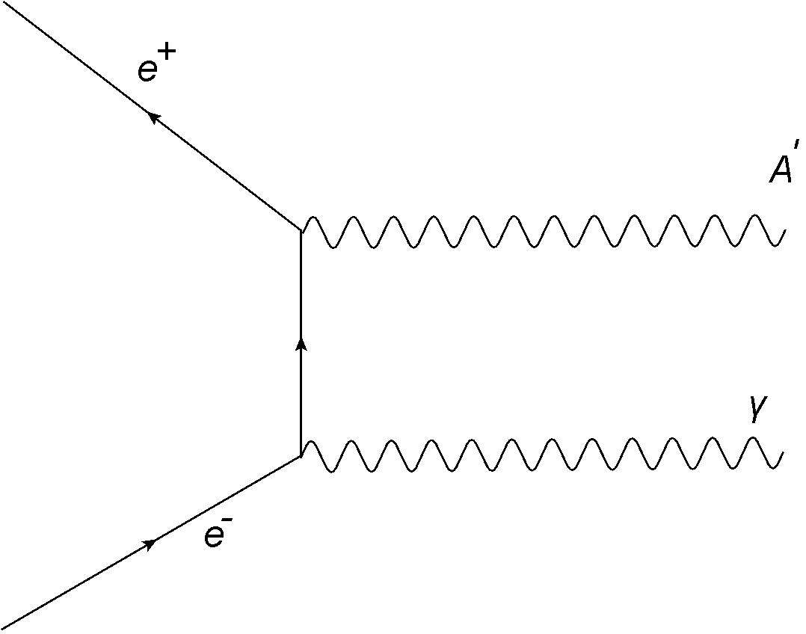
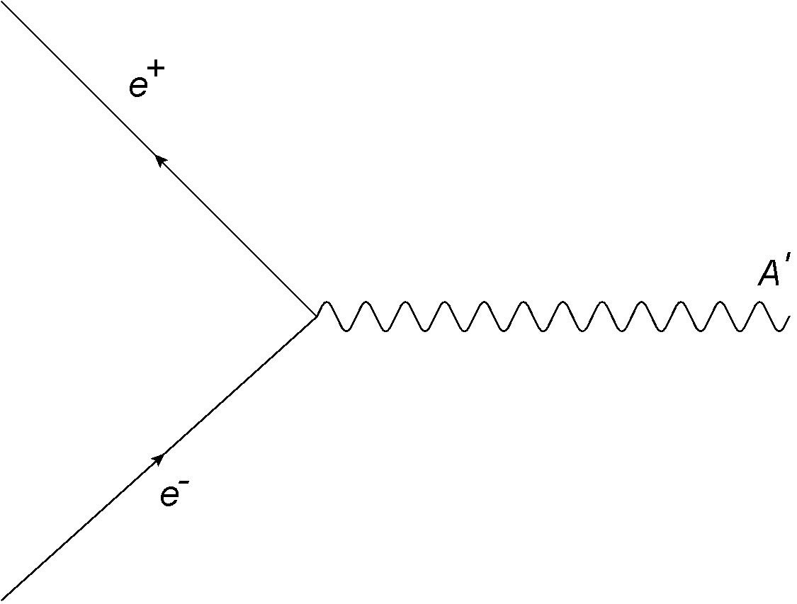
Connections and contributions to EXP@LNF (examples)
(it is not an account of all TH@LNF activities !)
“Resonant production of DP in e+ beam dump experiments” Phys.Rev. D97 (2018)
With C.D.R. Carvajal (UdeA), A. Ghoshal (RM3), D. Meloni (RM3), M. Raggi (RM1)
Collaborative TH-EXP effort: with M. Raggi (RM1) and A. Di Crescenzo (NA)
Notes:
Unsuccessful, because of the bibliometric filter

Slide 9
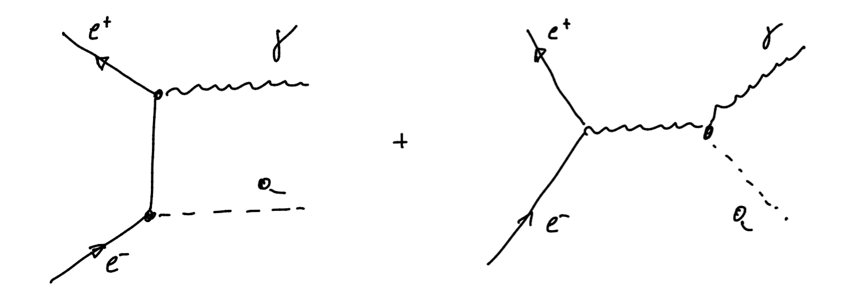
ALPs @ PADME [with G. Corcella, L. Delle Rose (FI), F. Giacchino (LNF Gr1+4), M. Raggi (RM1)]
Study of pseudoscalar
production in association
with a single photon
The KLASH Physics Case (Contribution to the KLASH CDR)
[with F. Bjorkeroth (LNF),
M. Giannotti (Barry U.),
L. Visinelli (Uppsala U.)]
Canonical axion DM window
----

Slide 10
TH@LNF strengthening strategies (local):
Fixed term contracts
1. INFN Postdoctoral fellowships for non Italian citizens (theory)
One ongoing for TasP-LNF (F. Bjorkeroth).
For 2019 only 7 fellowships assigned to CSN4 (decreased from 14 because of FELLINI COFUND)
One has been again assigned to TAsP-LNF giving continuity to one TH-LNF postdoc position
2. “Assegni di ricerca” LNF
One ongoing EPN cofunded by RM3 (G.M.Pruna). Actively searching for other cofundings.
3. CABIBBO Fellowship (new and important)
Senior postdoc (Assegno): 3 years (2yr. @ LNF + 1yr. @ RM1,2 or 3). Call 2019, start 2020.
At regime: 2 TH-postdocs at LNF + 1 in the Rome area
4. FELLINI COFUND (2nd round, 15 fellowships)
Deadline July 16. TH-LNF is actively searching for high profile candidates
5. More speculative, but possible:
Postdoctoral position for TH support to the Consolidator ERC project INITIUM
(Innovative tecnology for directional DM detection. PI: E. Baracchini)
Notes:
Local

Slide 11
TH@LNF strengthening strategies (Management) Permanent positions The different modalities for hiring:
1. National Public “Concorso” (with no pre-assigned workplace)
2. Direct call (Chiamata diretta, Art. 16 del D. Lgs. 218/2016)
3. “Concorso” reserved for protected categories (Legge 12 marzo 1999 no.68)
4. National Public “Concorso” (with pre-assigned workplace)
5. “Mobilità da Ente del comparto o da altra Amministrazione” (D.Lgs. 165/2001)
6. “Utilizzo delle graduatorie di concorso precedente”
7. Fixed term contracts turned into permanent (Stabilizzazioni, art. 36)
8. Trasfer to LNF from another INFN section
Notes:
Unavoidable, in view of forthcoming retirements (horizon: 4/5 years)

Slide 12
TH@LNF strengthening: the attempted roads:
National Public “Concorso” (with no pre-assigned workplace)
Constant interactions with several candidates with good chances of success in forthcoming competitions. Invitations, seminars, ongoing collaborations, to favor their familiarity with the LNF scientific environment.
2. Direct call (Art. 16 del D.Lgs. 218/2016)
Several attempts in the past in this direction (declined by the INFN managment). Presently, we are building contacts with 3/4 colleagues with permanent positions abroad that expressed some interest in a possible return in Italy.
3. Concorso riservato categorie protette (Legge 12 marzo 1999 no, 68)
The first road attempted (fall 2015). Excellent idea: basically a research position for free ! Our candidate eventually scored 4° in the regular concorso. Declined by the INFN managment. It was later voted and approved as a viable modality for hiring researchers: CD May 23rd, 2017
4. National Public “Concorso” with pre-assigned workplace
From the Report at the GE meeting 24/09/2018: Suggestions to the management:
Hire an outstanding young researcher via a dedicated “concorso” with appropriate profile tuned to the LNF-TH needs. (Declined)

Slide 13
My personal opinion and conclusions:
In a phase in which the LNF activities in fundamental physics studies are facing a reconversion: new types of experiments are already ongoing or are being planned, innovative ideas are continuously discussed, and more than ever colleagues of experimental groups are seeking confrontation with theorists and inputs from them, strengthening TH@LNF should become a priority for INFN.
Besides the LNF Theory Group, leading colleagues of LNF experimental collaborations, the LNF Director, the INFN International Evaluation Committee (CVI) have already put forth strong statements in this direction. In the 55th meeting the SC has also expressed concern for the continuous weakening of TH@LNF, and has considered the possibility of formulating a strong statement.
I think that the INFN management should take in due consideration the wide convergence of all these views.
Thank you for your attention

Slide 15
Gruppi Teorici in alcuni altri Laboratori:
DESY 18 staff/30 postdocs
FERMILAB 16/10
SLAC 9/10
KEK 24/33
LAP-TH 22/6

