Slide 1

From very large to compact small accelerators
Prof. Luigi Palumbo
University of Rome “La Sapienza” and INFN, Italy
Retreat Fisica Particelle Elementari
Assisi June,18 2019

Slide 2
Contents
- High Luminosity LHC
- Future Circular Colliders
- Limits of rf accelerating structures
- High frequency high gradient RF
- Plasma wave acceleration
- Compact linear accelerators for medical and industry
- Compact proton sources

Slide 3

Accelerators phisycs and techonology team 2019:
Permanent staff:
PhD student:
Serena Persichelli
Letizia Ventura
Giorgia Favia
Danilo Quartullo
Eleonora Belli
Marco Marongiu
Lucia Giuliano
Lorenzo Teofili
Fabio Cardelli
Francesco Filippi
Massimiliano Scisciò
Anna Giribono
Master thesis students:
Francesco Latini (2016)
Diego Ferrazza (2016)
Giacomo Mazzacano (2017)
Matteo Pandolfi (2018)
Alberto Cutone (2018)
Debora Ventura (2018)
Paola Racano (2018)
Leandro Intelisano (2019)
Fabio Bosco (2019)
Jordan Arnesano (2019)
…...
.....
Luigi Palumbo
Mauro Migliorati
Andrea Mostacci
Luca Ficcadenti
Massimo Petrarca
Bruno Spataro
Post-Doc:
Luigi Faillace
Danilo Quartullo
Mostafa Behtouei

Slide 4
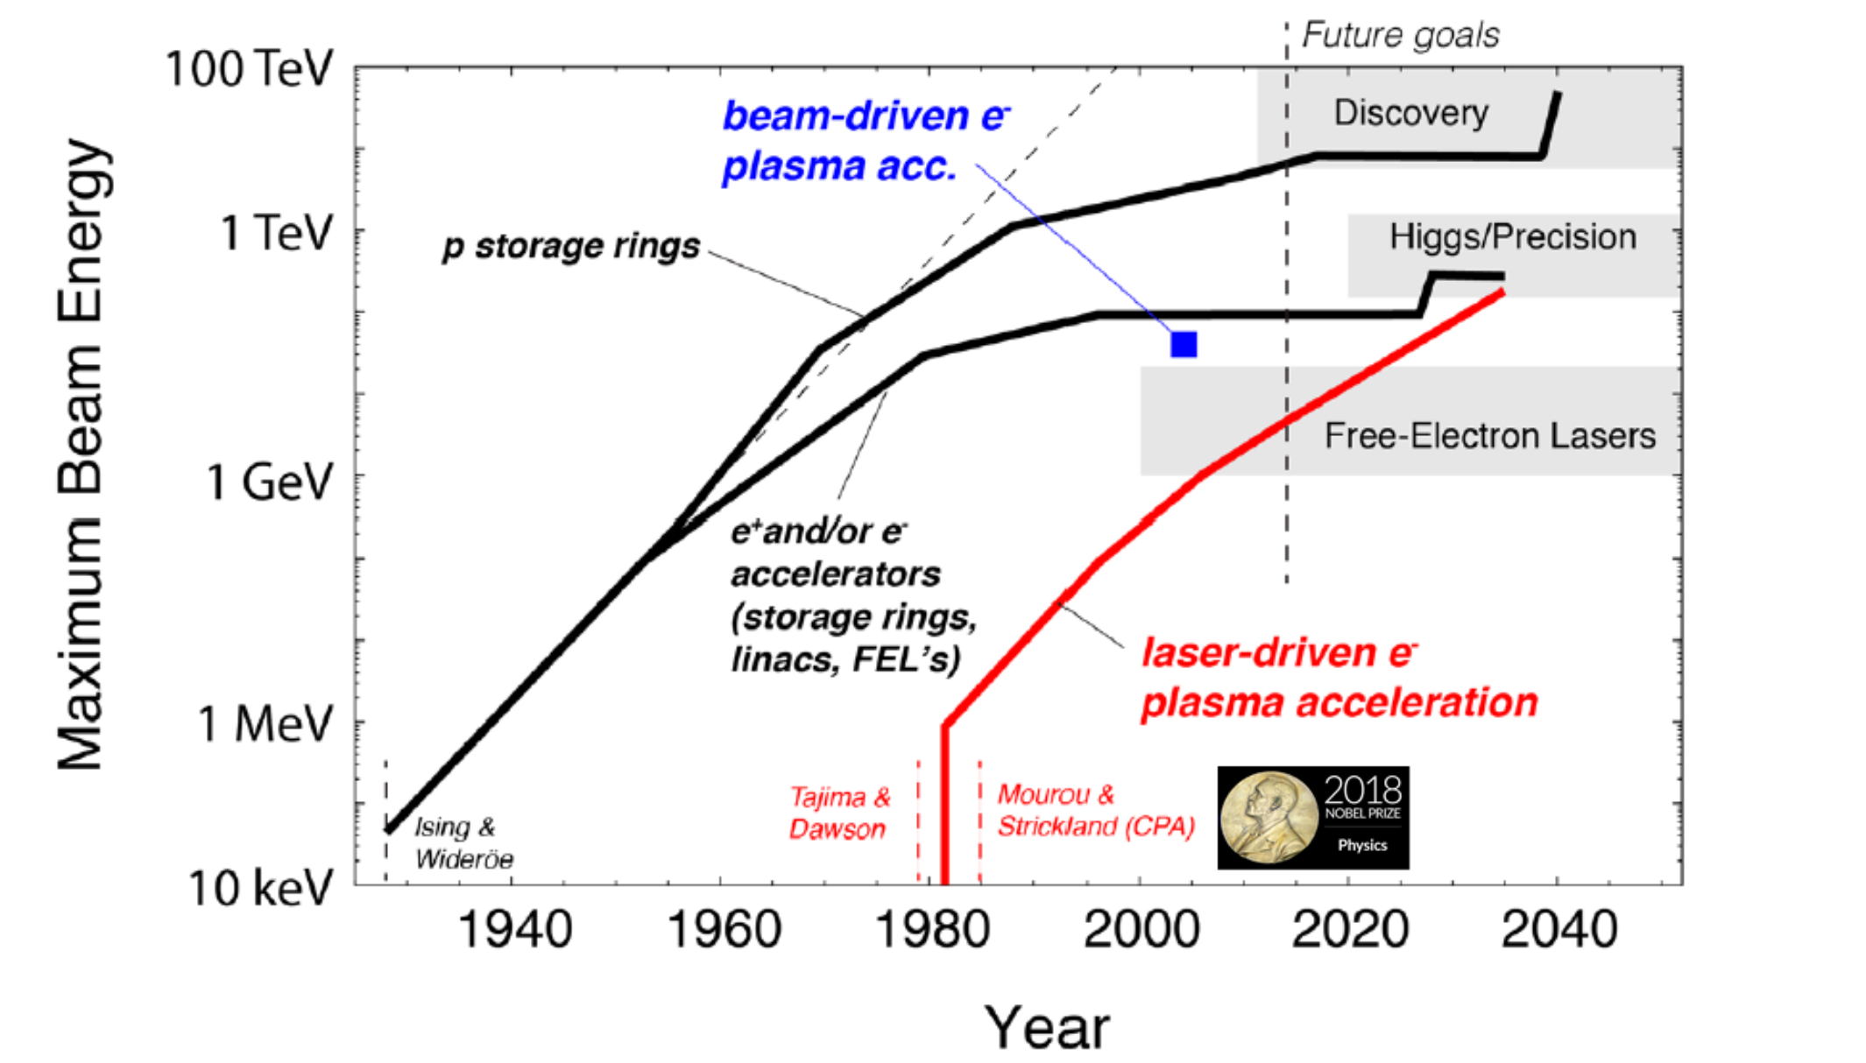
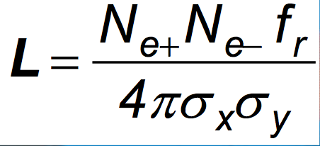
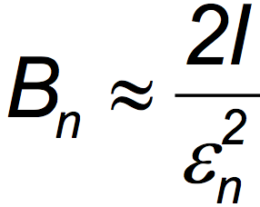
Livingston curve for accelerators

Slide 5
VERY LARGE accelerators projects:
Need of new Large Colliders beyond LHC ?
Physics requests:
a) Increase the Luminosity HL-LHC
b) Increase the energy ILC, FCChh, FCCee

Slide 6
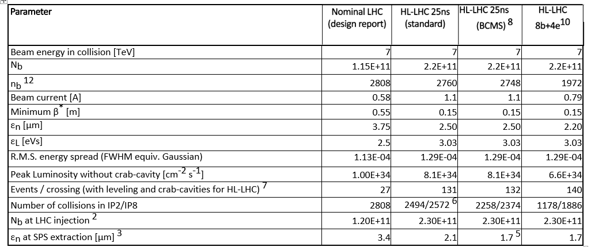
Relevant parameters list of HL-LHC

Slide 7
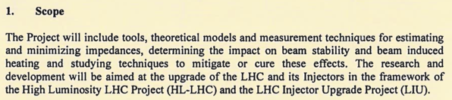
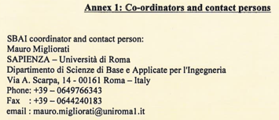
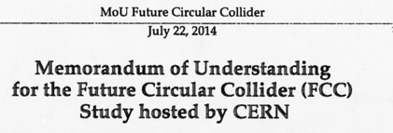
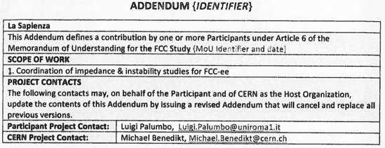
MICA experiment: Hi-Lumi and FCCee activities
(M. Migliorati et al.)
A collaboration agreement was signed between SBAI Department and CERN for High Luminosity LHC and injector chain.
A Memorandum of understanding was signed between SBAI Department and CERN for FCCee.

Slide 8
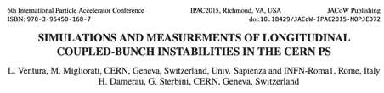
MICA experiment: Hi-Lumi LHC activity
We coordinated the evaluation of the impedance model of the CERN Proton Synchrotron with both theoretical studies and beam measurements.
We also studied different instabilities occurring in the machine

Slide 9
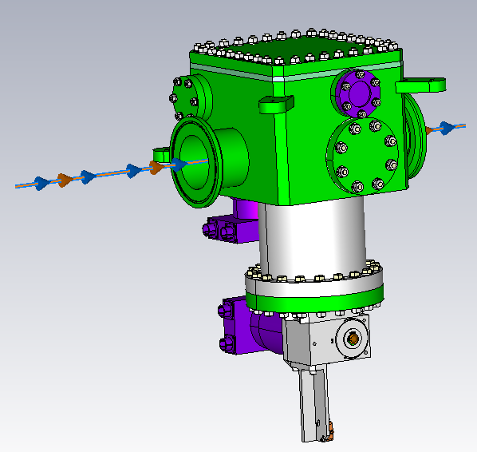
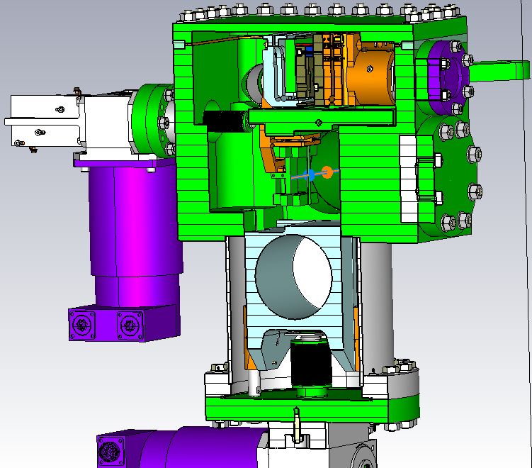
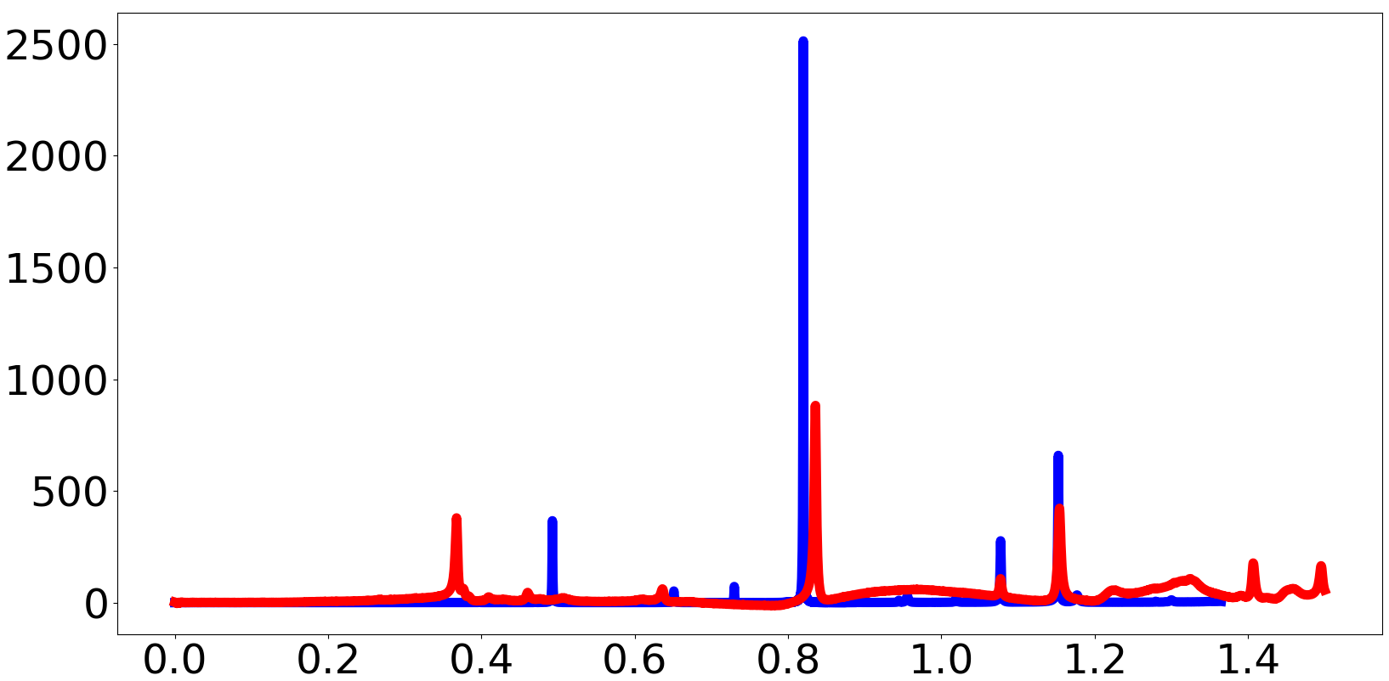
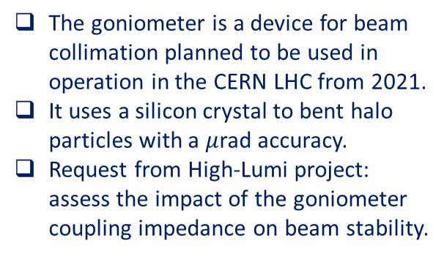

MICA experiment :Impedance studies for the Hi-Lumi LHC
The goniometer is a device for beam collimation planned to be used in operation in the CERN LHC from 2021.
It uses a silicon crystal to bent halo particles with a $μ$rad accuracy.
Request from High-Lumi project: assess the impact of the goniometer coupling impedance on beam stability.
Tank
Rail
Beam
Mechanical motor to move the rail left and right
Crystal
Mechanical motor to move the shielding cylinder up and down
Shielding cylinder
Holder
CAD model in CST simulations (external and internal views)
Longitudinal impedance
EM simulations and bench measurements performed to evaluate the impedance.
  The complexity of the internal features of the goniometer makes simulations difficult.
  Measurements can be affected by artifacts and uncertainties.
Collaboration between Sapienza SBAI Department and CERN for this study.
Re Z [$Ω$]
Measurement
Simulation
Frequency [GHz]

Slide 10
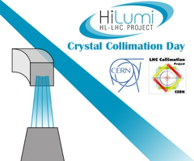
Crystal at Hi-Lumi LHC (Gianluca Cavoto)
  Review of all the experimental results obtained with crystal at SPS, LHC and with H8 test beams
Crystal collimation
  LHC, in operation
  HL-LHC
Future applications under study
  Crystal-aided SPS extraction (BDF)
  LHC crystal extraction (ALICE and LHC-b)
  MDM (and EDM) with crystals (LHC-b)
  UA9 double crystal experiment on SPS
  The future after the future: MDM of τ (!)

Slide 11
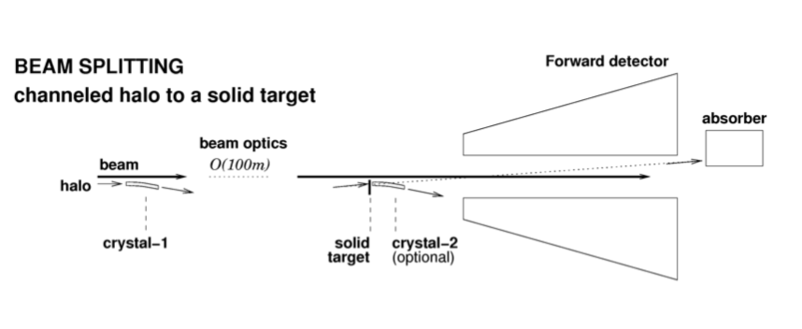
LHC crystal extraction
Non-resonant and parasitic extraction
  Intercept the LHC beam halo with a bent crystal

Slide 12
MICA experiment: activity FCCee (Migliorati)

Slide 13
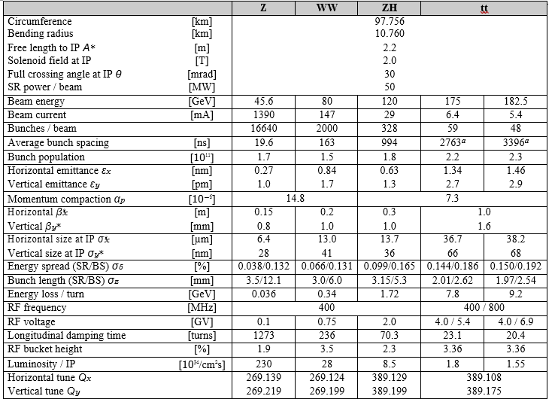
Relevant parameters of FCCee

Slide 14
FCC-ee challenges
Luminosity challenges(*)
Luminosity cannot be fully demonstrated before the project implementation
Luminosity is a feature of the facility not the individual technologies
Have to rely on experiences, theory and simulations
Foresee margins
FCC-ee is based on experience from LEP, DAPHNE, KEKB, PEP II, superKEKB, …
Gives confidence that we understand performance challenges
New beam physics occurs in the designs,
e.g. beamstrahlung is unique feature of FCC-ee
Identified and anticipated in the design, should be able to trust simulations
The technologies required are improved versions of those from other facilities
(*) See C. Biscari, and L. Rivkin, P. Burrows, F. Zimmermann, Open Symposium towards updating the European Strategy for Particle Physics
May 13-16, 2019, Granada, Spain

Slide 15
FCC-ee challenges
Maturity(*)
Do not see a feasibility issue with technologies or overall design
But more hardware development and studies essential to ensure that the performance goal can be fully met
E.g. high power klystrons, strong-strong beam-beam studies with lattice with field errors, …
RF technology(*)
Accelerator Technologies are ready to go forward for construction in few years
SRF accelerating technology is well matured for the realization including cooperation with industry but represents a challenge for high-Q SRF cavity at < GHz and for Nb Thin-film Coating
Continuing R&D effort for higher performance is very important for future project upgrades. Energy efficiency (RF efficiency) is also important
High synchrotron radiation constraint
(*) See C. Biscari, and L. Rivkin, P. Burrows, F. Zimmermann, Open Symposium towards updating the European Strategy for Particle Physics
May 13-16, 2019, Granada, Spain

Slide 16
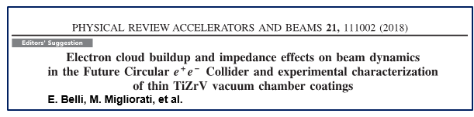
MICA experiment: FCC-ee activity (1/2)
Our group is responsible of single beam collective effects for the FCC-ee machine:
Impedance and instability studies for FCC-ee
Evaluation of the frequency-dependent impedance due to resistive wall in the multilayer case
Effect of coating on the microwave instability threshold

Slide 17
MICA experiment: FCC-ee activity (2/2)
Measurements of SEY at different thickness to determine a minimum effective coating mitigating e-could instabilities with low impact on the resistive wall impedance
A coating of 100-200 nm with NEG can help to reduce the RW impedance and, at the same time, guarantee a reasonable performance in terms of pumping and electron cloud mitigation
NEG materials consisting of Titanium (Ti), Vanadium (V), Zirconium (Zr) it achieves a homogeneous surface

Slide 18
Linear Collider projects (CLIC, ILC)
e⁺ target
e⁻
With a reduced power consumption and a minimum cost
Reach the highest collision energy
Reach the highest luminosity
BDS = Beam Delivery System
RTML = Return To Main Linac

Slide 19
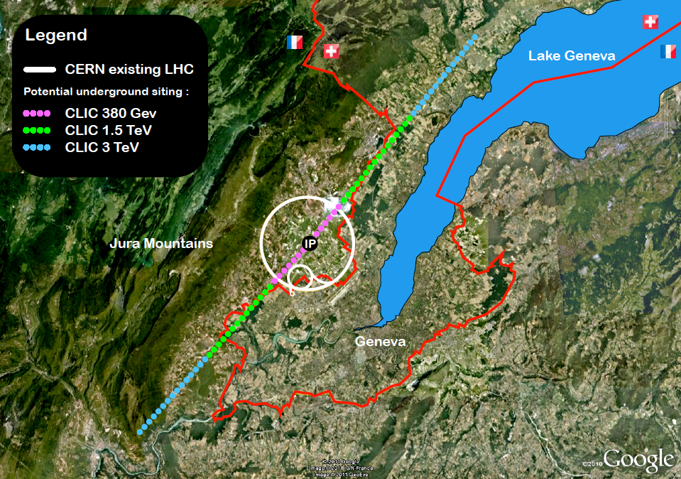

Slide 20
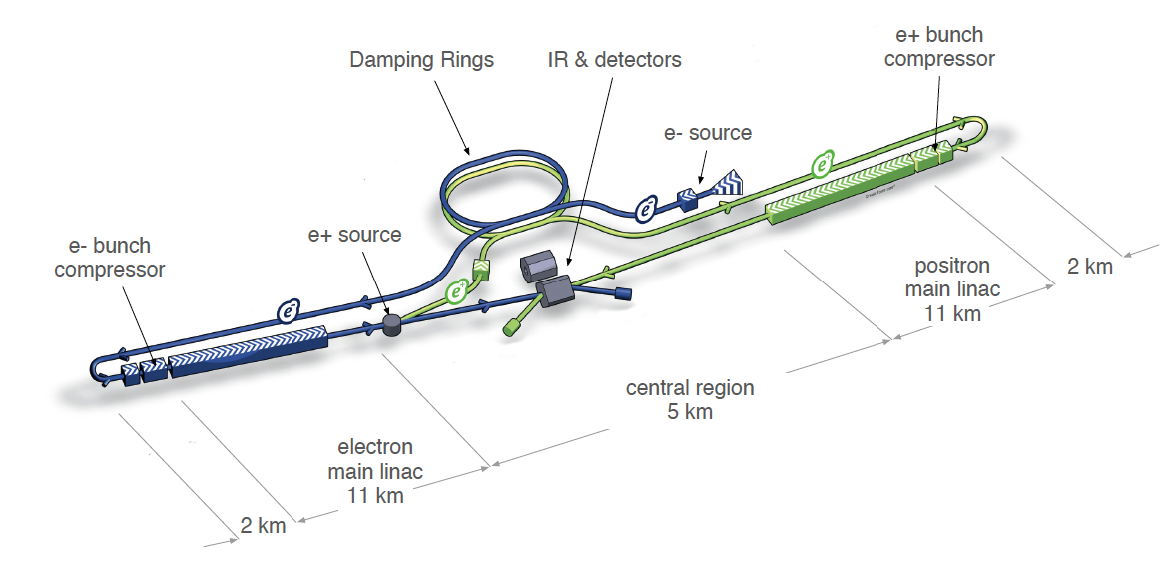
ILC (International Linear Collider) e+ e-

Slide 21
ILC parameters
Parameter | Symbol | ILC | Unit
Center of mass energy | E_{cm} | 500 | GeV
Main Linac RF Frequency | f_{RF} | 1.3 | GHz
Luminosity | L | 2 | 10³⁴ cm⁻² s⁻¹
Luminosity (in 1% of energy) | L_{99%} | 1 | 10³⁴ cm⁻² s⁻¹
Linac repetition rate | f_{rep} | 5 | Hz
No. of particles / bunch | N_{b} | 20 | 10⁹
No. of bunches / pulse | k_{b} | 1312
Overall two linac length | l_{linac} | 22 | km
Proposed site length | l_{tot} | 31 | km
Beam power / beam | P_{b} | 10.8 | MW
Wall-plug power to beam efficiency | η_{wp-rf} | 9.4 | %
Total site AC power | P_{tot} | 230 | MW
Transverse horizontal emittance | γε_{x} | 8000 | nm rad
Transverse vertical emittance | γε_{y} | 40 | nm rad
Horizontal IP beam size before pinch | σ*_{x} | 640 | nm
Vertical IP beam size before pinch | σ*_{y} | 5.7 | nm
Beamstrahlung energy loss | δ_{B} | 2.4 | %

Slide 22
A tremendous amount of challenging parameters
Accelerating gradient ( G = 100 MV/m)
Very low break down rate in the accelerating cavities (BDR < 10⁻⁷)
Beam emittance production and preservation (ge _{n} = 5 nm.rad at Damping ring exit)
Ground motion and stability requirements
Positron flux ( 1.1 10¹⁴ e⁺/s => 20 times more than the SLC machine produced)
Beam size at IP (s_{y} = 1 nm)
Power consumption ( ~ 600 MW)
Cost (several billions of €, $, CHF,…..)
+ many others; none will be discussed in this seminar; only the beam size at IP is illustrated in the next slide

Slide 23
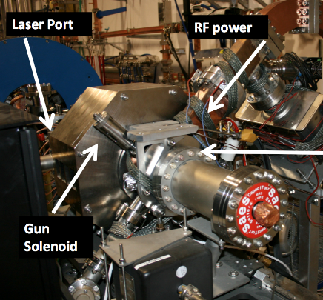
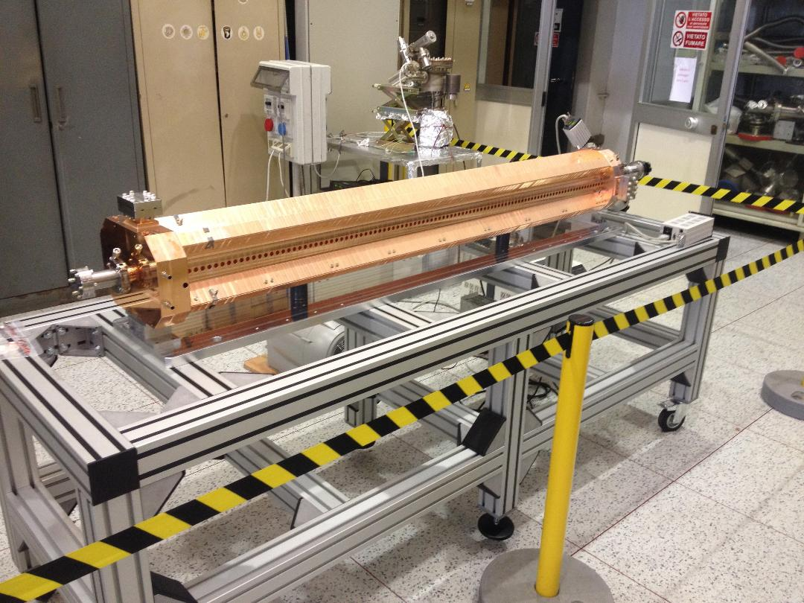
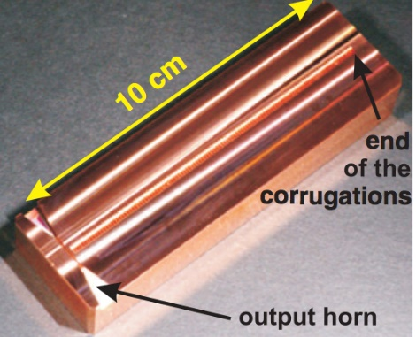
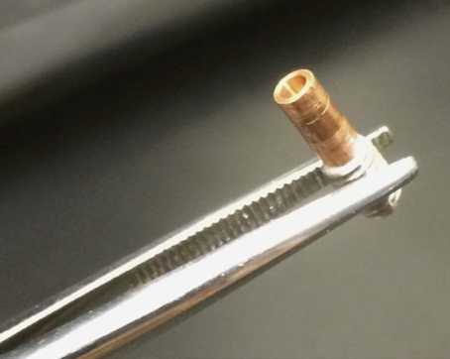
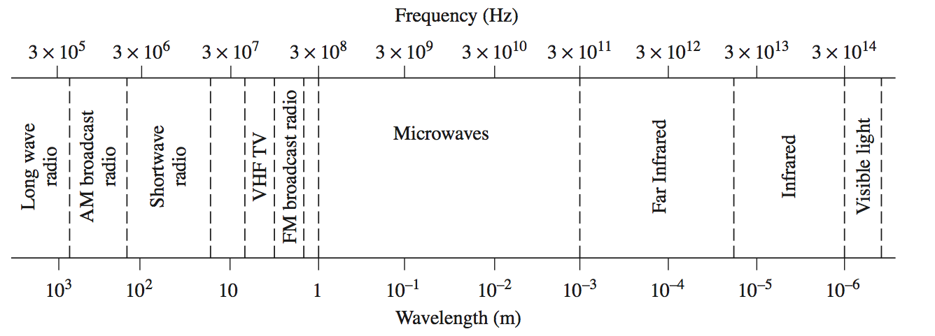
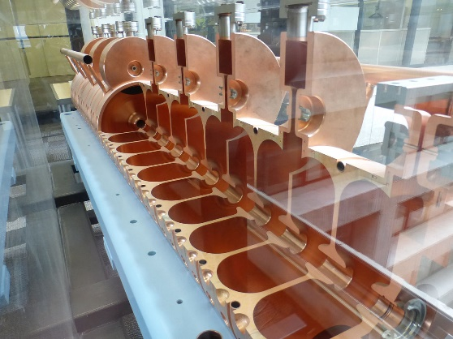
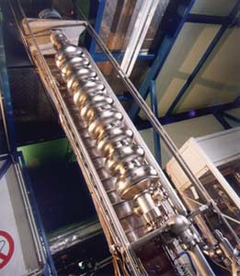
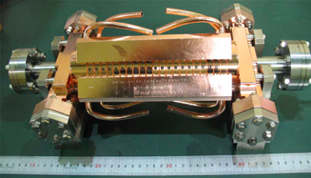
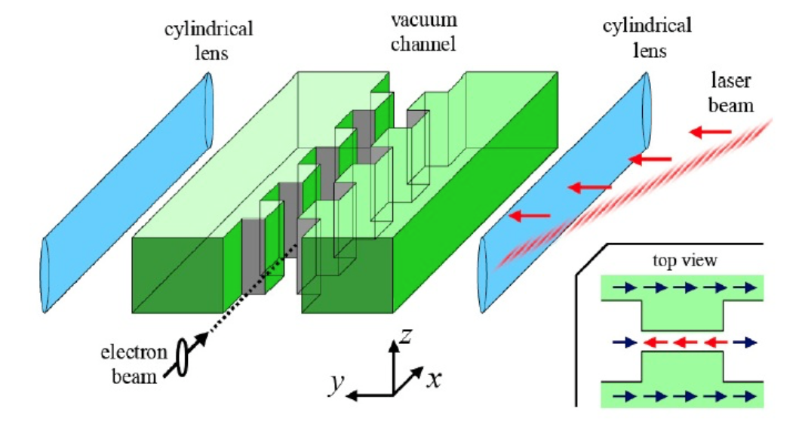
Accelerating structures and EM spectrum
3MHz
3GHz
110GHz
450GHz
6GHz
future
dielectric
11GHz
800MHz
1.3GHz
23

Slide 24
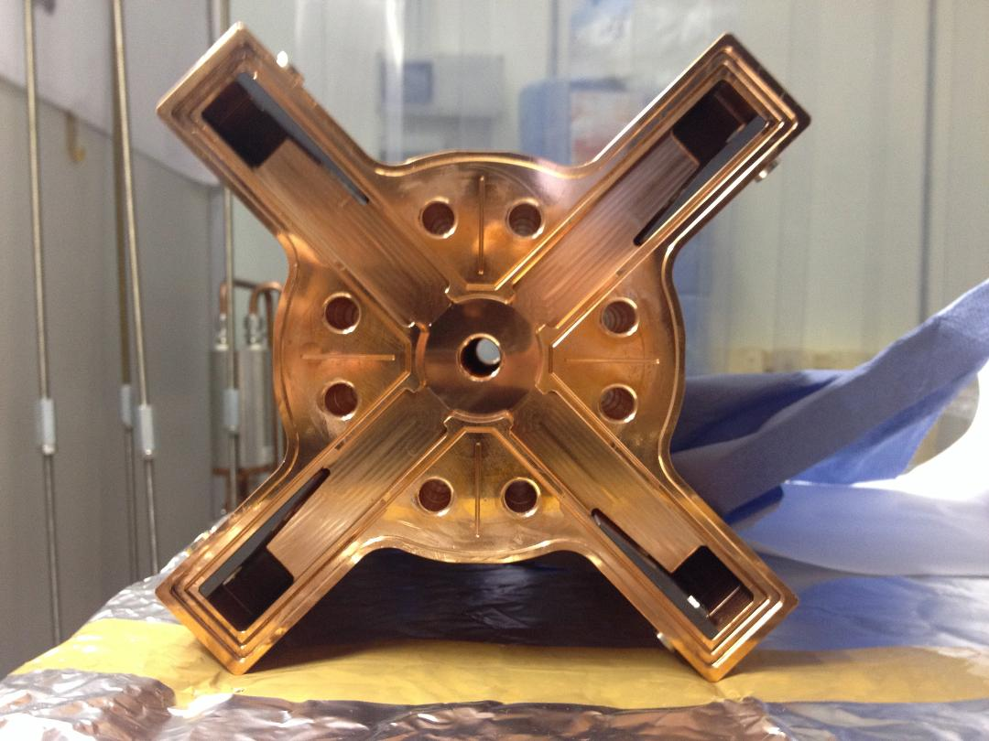
C-band R&D for GBS-ELI

Slide 25
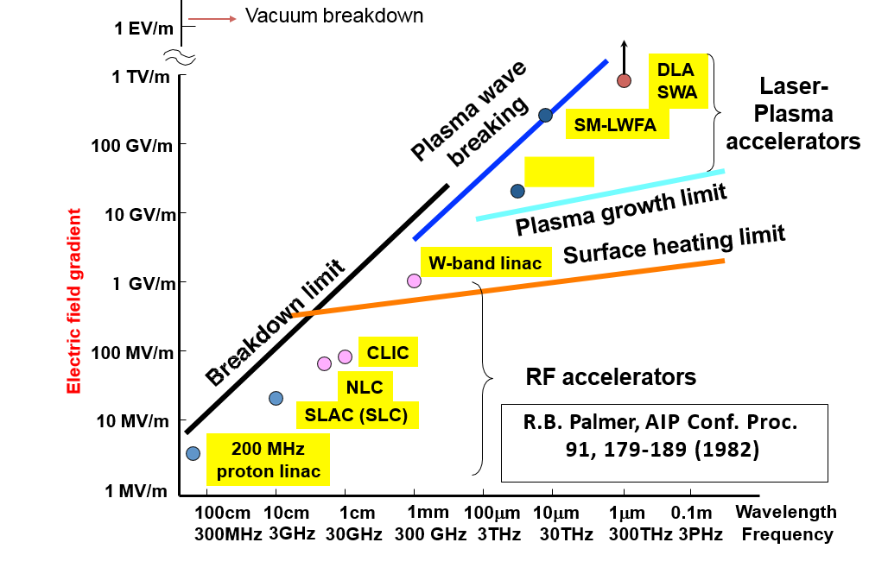
Accelerating field limits
LWFA

Slide 26
R&D to reach high gradient RF at high frequency
(Bruno Spataro et al.)
Using material with a higher fusion temperature
Avoiding the device heating at high temperature as done in conventional brazing
R&D on material
R&D on fabrication techniques
R&D on material
R&D on fabrication techniques
Sintered Molybdenum (Bulk)
[NIM-A-657 (2011)]
- Electroplated [NIM-A-657 (2011)]
Electroforming [JINST, March 8, 2016]
Electron Beam welding (EBW) [JINST, September 19, 2018]
Tungsten inert gas welding (TIG)
      [JINST, September 19, 2018]
Molybdenum sputtering
[study in progress in Osaka]

Slide 27
Demetra experiment
The MOTIVATION :
The research project is devoted to the R&D of key components for existing accelerators and for the next generation of accelerators. New technologies are necessary to achieve the Multi-TeV energies of future linear colliders, x-ray FELs, etc.
To use in high brilliance photo-injectors to compensate the beam longitudinal phase-space distorsion, enhanced by the bunch compression of the acceleration process
To gain know-how in vacuum microwave technologies
Approach :
To study new materials and manufacturing techniques including single and multi-layer surfaces with precision-controlled properties

Slide 28
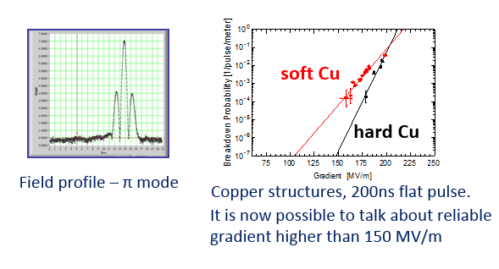
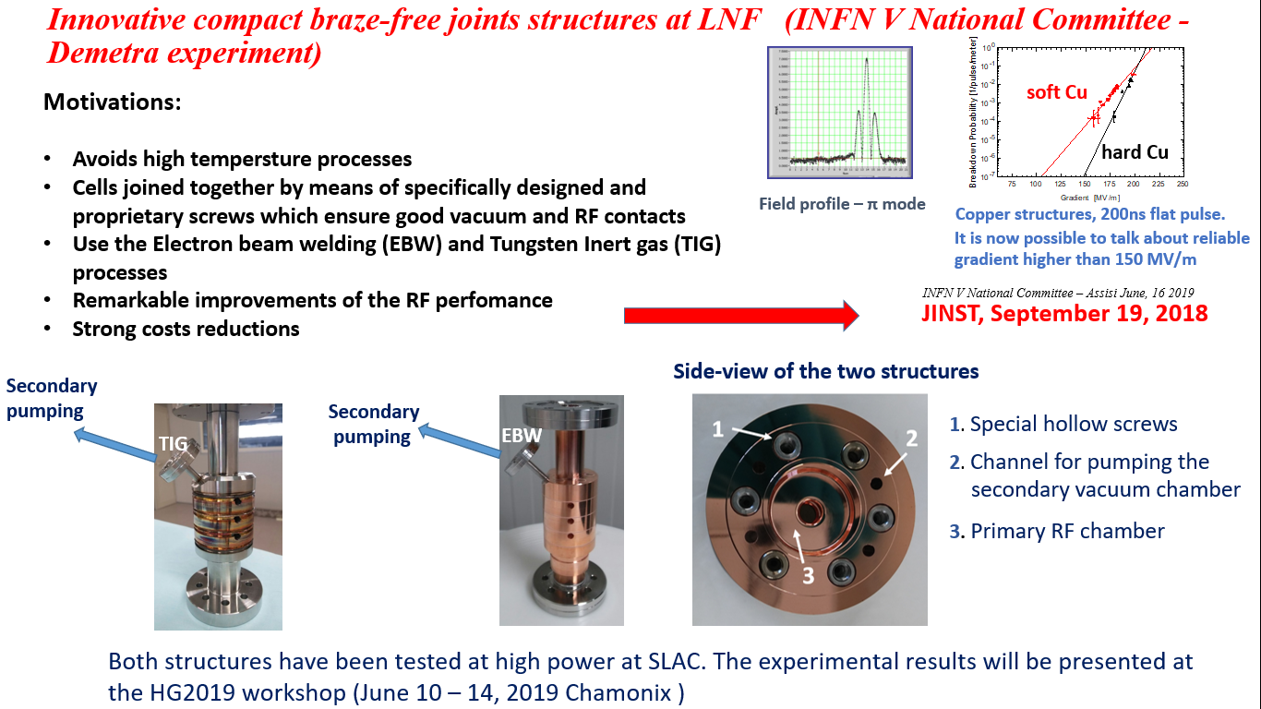
Innovative compact braze-free joints structures at LNF (1/2)
Motivations:
Avoids high tempersture processes.
Cells joined together by means of specifically designed and proprietary screws which ensure good vacuum and RF contacts.
Use the Electron beam welding (EBW) and Tungsten Inert gas (TIG) processes.
Remarkable improvements of the RF perfomance
Strong costs reductions
JINST, September 19, 2018

Slide 29
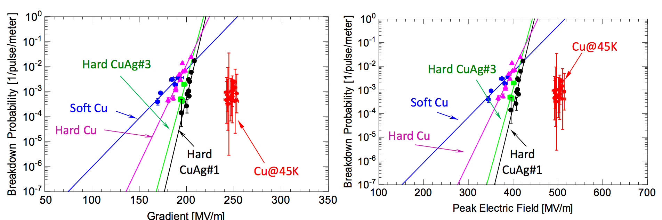
Innovative compact braze-free joints structures at LNF (2/2)
Ultra-High Field Cryogenic Radiofrequency Cu structures with a lower breakdown probability (S and X band experimental results)
Cryocooler system
S Band
Cu@45K
Emax = 250 MV/m
(surface electric field)
X Band
Cu@45K
Emax = 500 MV/m
(surface electric field)
PRAB 22, 023403 (2019)

Slide 30
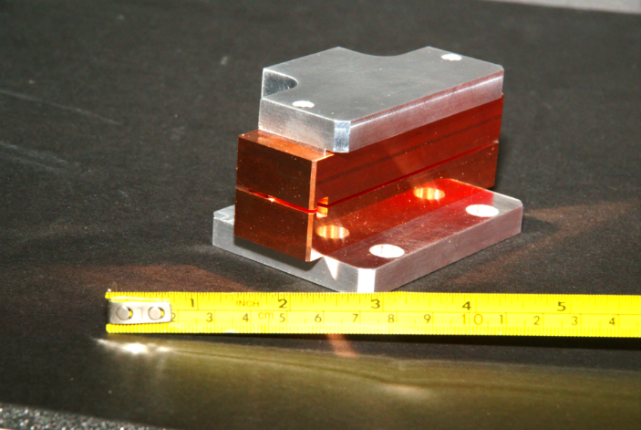
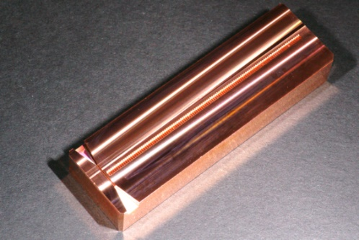
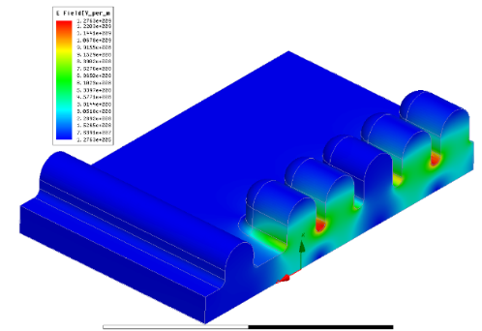
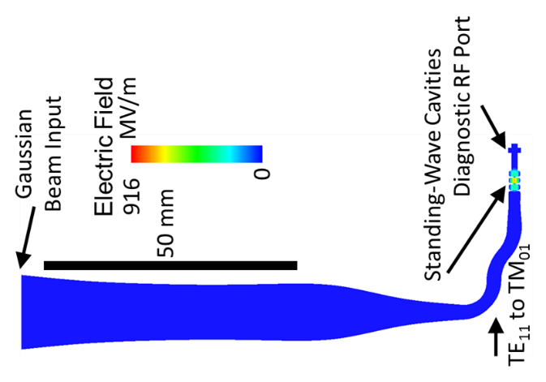
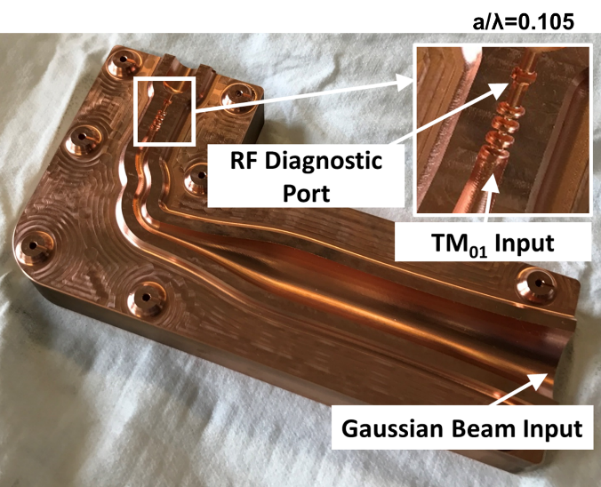
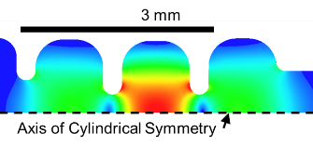
W Band Structures - Demetra experiment
PRAB [19, 011301 (2016)]
PRAB [19, 051302 (2016)]
First 110 GHz Open Structure
PRAB [19, 111301 (2016)]
NIMA [59852 (2018)]
M. Dal Forno et al. (SLAC) – INFN/LNF
PRAB [21, 091301 (2018)]
10 cm
Eacc = 300 MV/m
RF out
Esup = 1.5 GV/m
electron
beam
output horn
High- Gradient Acceleration structure at 110 GHz at MIT
E. Nanni et al. (SLAC) - INFN/LNF
Moving Forward to Test @ MIT, Target 1 MW - Eacc > 400 MV/m
Mode launcher, snake shape, and converter from TE₁₁ to TM₀₁ mode.
Split-Cell Structure with Mode Converter and Cavities
IOP Conf. Series:
Conf. Series 874, (2017) 012039

Slide 31
Accelerating field limits (original)
LWFA

Slide 32
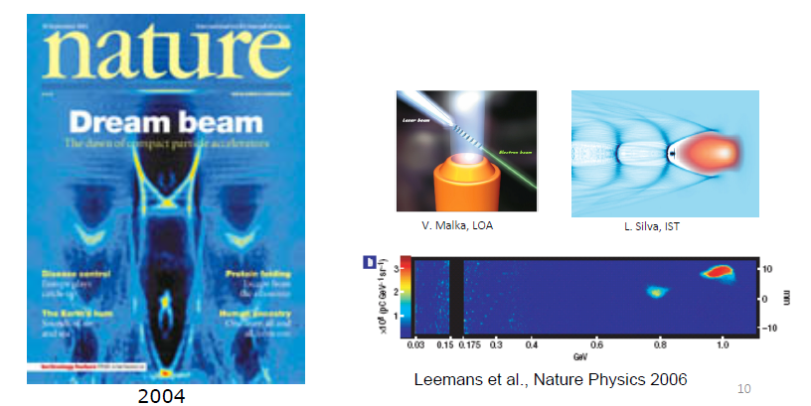
Laser-driven electron acceleration
Laser-driven electron acceleration has made its breaktthrough on tens of TW laser systems in 2004 and reaching 1 GeV in 2006

Slide 33
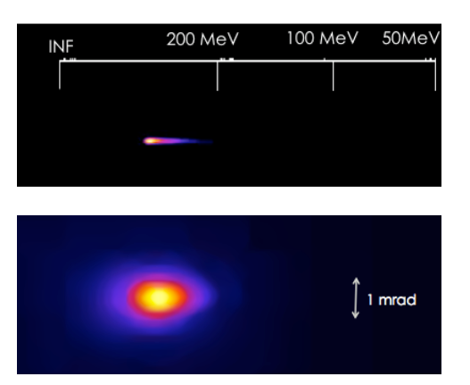
Summary of self-injection
Laser-driven electron acceleration has made its breaktthrough on tens of TW laser systems in 2004 and reaching 1 GeV in 2006
Reliable production of >200 MeV electron bunches with ≈mrad divergence.
Stability, spectral width and energy control (vs density) in progress.

Slide 34
Nel 2014 presso la struttura FACET (Facility for Advanced Accelerator Experimental Tests) del laboratorio SLAC (Stanford Linear Accelerator Center), negli Stati Uniti, è stato realizzato il primo esperimento in cui un pacchetto di elettroni pilota crea l’onda di plasma che, a sua volta, accelera efficientemente un secondo pacchetto. Questo esperimento ha raggiunto risultati record dimostrando la possibilità di ottenere un’efficienza di trasferimento di energia tra i due pacchetti di elettroni del 30%, con un guadagno di energia di circa 1,6 GeV su 36 cm di lunghezza di plasma (un gradiente di energia di circa 4,4 GeV/m), e una dispersione media di energia del 2%.
FACET
Presso il Lawrence Berkeley national laboratory si studia la possibilità di utilizzare una successione di stadi di accelerazione basati su una combinazione di queste nuove tecniche laser-plasma per accelerare, fino a energie di 10 GeV, un pacchetto di elettroni su una distanza dell’ordine del metro. In tal modo si potrebbe costruire un collisore lineare elettroni-positroni con energia di 1 TeV (per fascio) costituito da soli 100 moduli di accelerazione al plasma, riducendo quindi drasticamente la dimensione complessiva della macchina rispetto ai progetti basati su una tecnologia standard, come ILC.

Slide 35
In principle, there are several methods to create the high-quality multi-GeV electron beams by plasma acceleration proposed for EuPRAXIA. In the first place, the plasma wakefield can be driven by a high-power laser pulse (Laser Wakefield Acceleration – LWFA) or by a moderate energy electron beam (Plasma Wakefield Acceleration – PWFA). The first technique requires a laser system able to deliver pulses of around 100 fs duration in the petawatt regime; the second employs either a radiofrequency (RF) electron linac or a laser wakefield accelerator providing 0.5 – 1.0 GeV electrons in ultrashort bunches of a few femtoseconds.
Secondly, the accelerated particle beam may come from the plasma electrons trapped in the back of the wake (internal injection) or from an external electron beam, precisely timed to arrive at the plasma structure on the peak of the longitudinal electric field in the forward direction (external injection). The external electron beam, in turn, may come from a radiofrequency linac or a preceding laser wakefield accelerator.
Finally, the electrons may be accelerated up to the final energy in a single plasma structure or in a sequence of plasma structures where the electrons accelerated in the first stage are injected in a second stage for further acceleration.
The EuPRAXIA study is considering all possible combinations between these schemes at the moment, in order to reach its baseline parameters. In total, there are nine different scenarios, of which the most promising ones will be selected in 2019:​
EUPRAXIA: (European Plasma Research Accelerator with eXcellence In Applications)

Slide 36
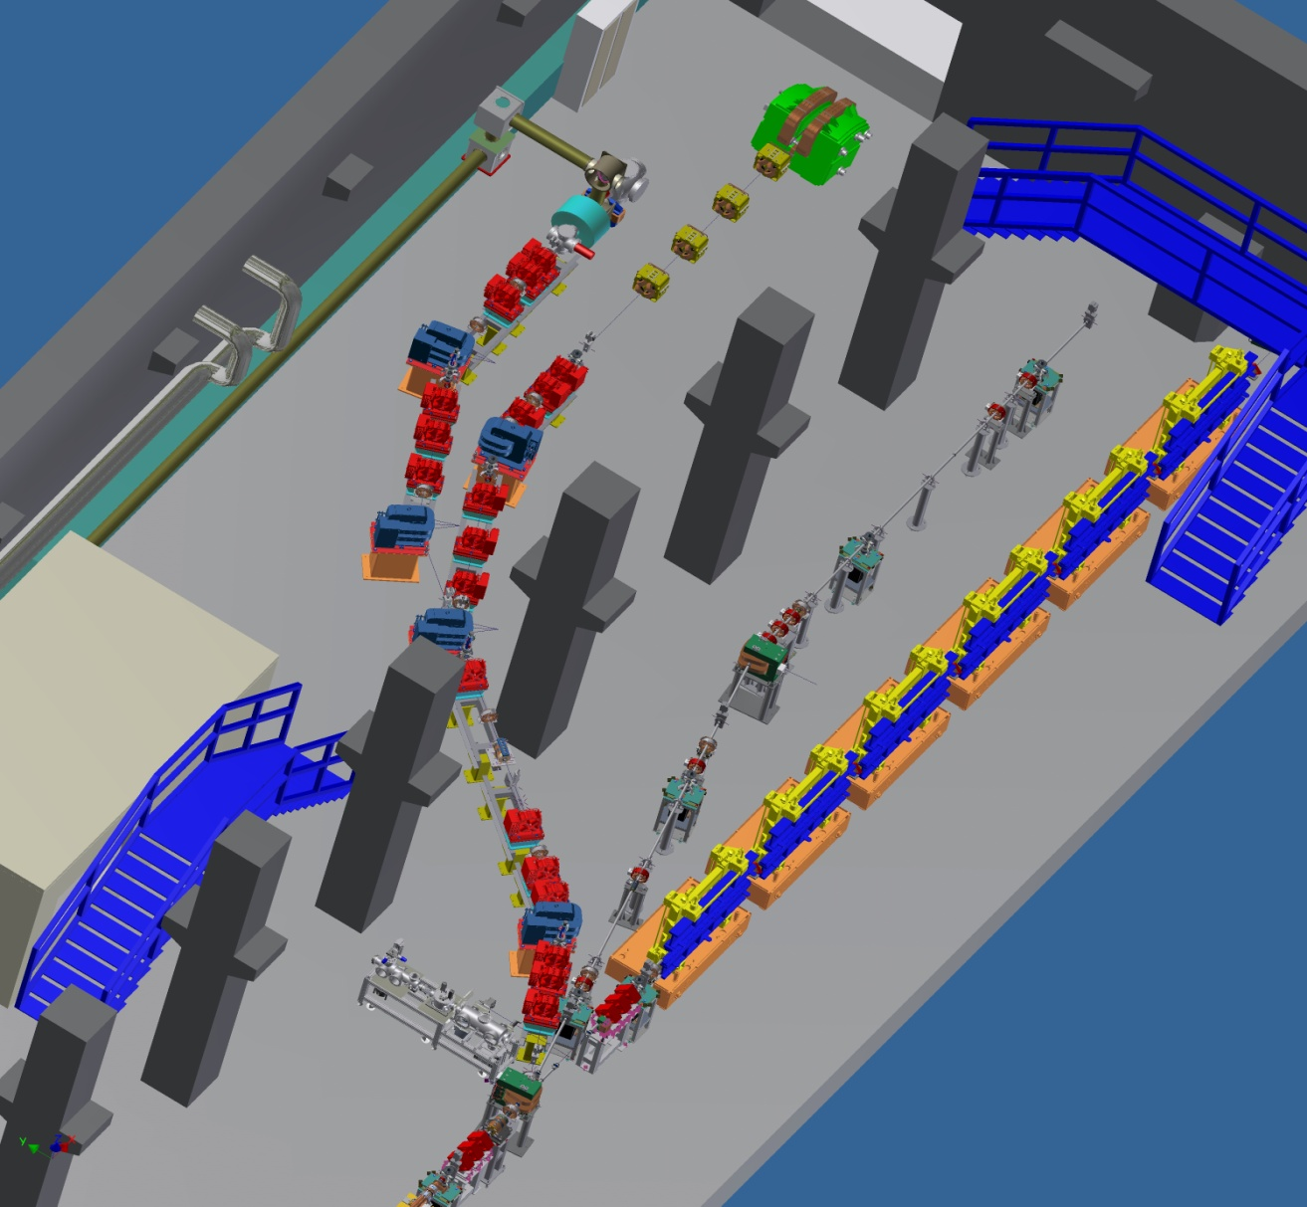

SPARC_LAB
Sources for Plasma Accelerators and Radiation Compton with Lasers And Beam
External Injection into plasma
SL_EXIN
laser input line
300 TW, < 25 fs
Ti:Sa laser
Plasma Wakefield
Acceleration (COMB beams)
SL_COMB
High Brightness electron beam
from SPARC

Slide 37
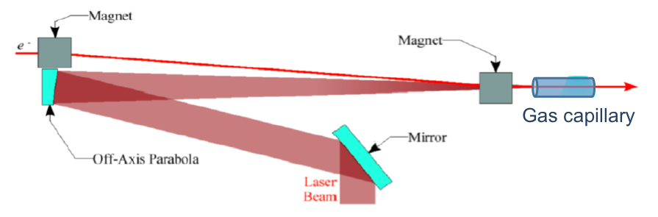
Plasma acceleration experiments @ SPARC_LAB
External Injection into plasma
SL_EXIN
laser input line
300 TW, < 25 fs
Ti:Sa laser
Plasma Wakefield
Acceleration (COMB beams)
SL_COMB
High Brightness electron beam
from SPARC

Slide 38
Plasma acceleration experiments @ SPARC_LAB
External Injection into plasma
SL_EXIN
laser input line
300 TW, < 25 fs
Ti:Sa laser
Plasma Wakefield
Acceleration (COMB beams)
SL_COMB
High Brightness electron beam
from SPARC

Slide 39
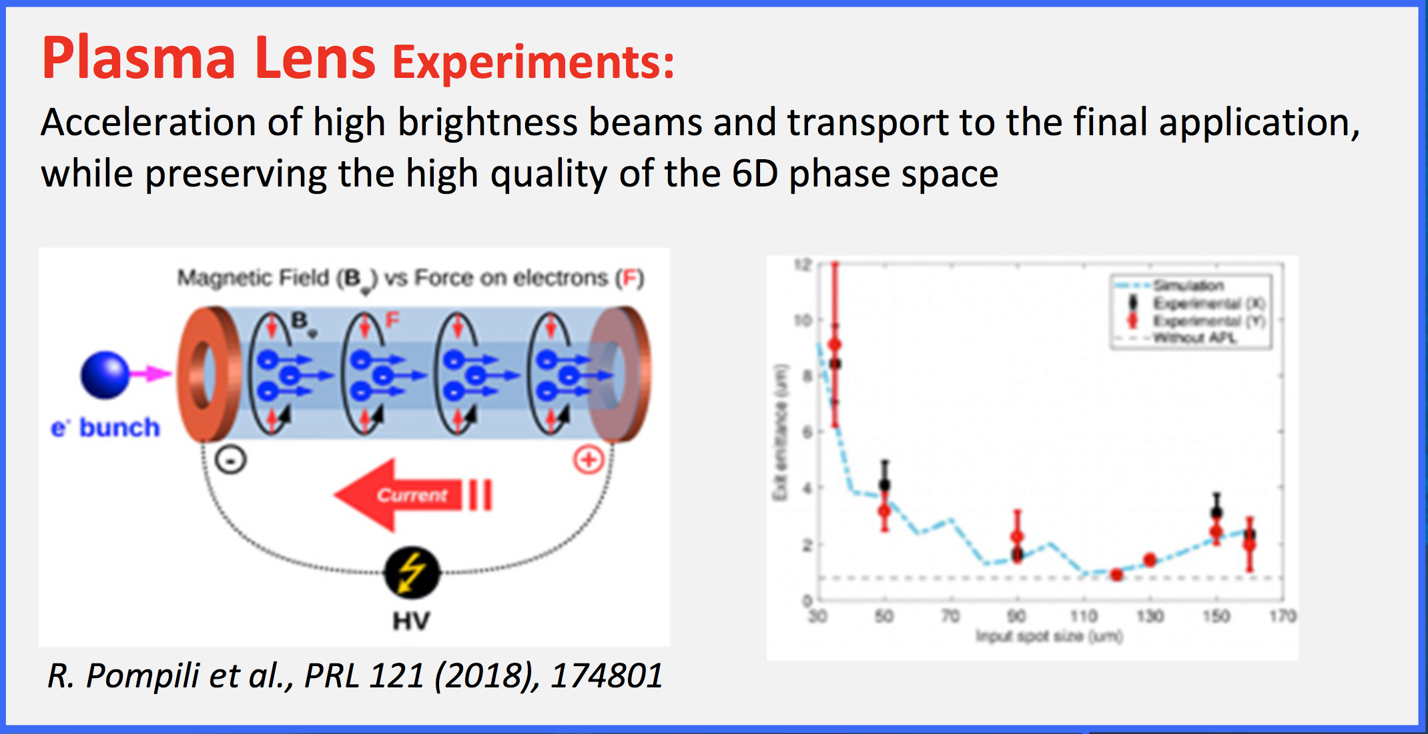
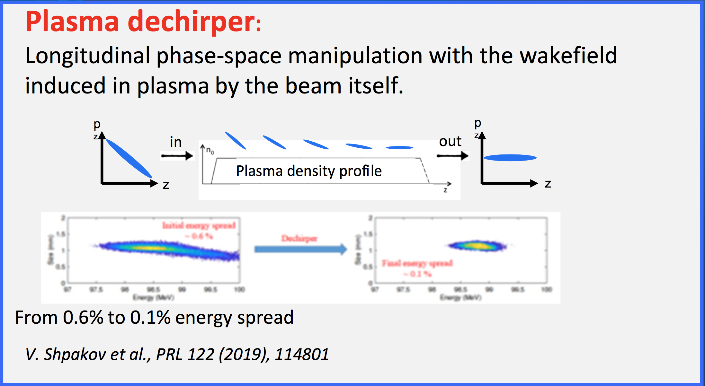
Sparc_Lab recent results
Courtesy of
M. Ferrario (INFN), IPAC 2019

Slide 40
TERA (Terahertz ERA): CALL INFN-CSN5 2018-2020
(S.Lupi – M. Petrarca et al.)
The aim of the TERA project is to build a synergic interdisciplinary collaboration among different INFN sections and external institutions with the final goal to push forward a strong R&D activity on THz technology with particular regard to THz acceleration.
Benefit of THz radiation:
Small time jitter (fs level and below)
Easy control of phase (long wavelength vs nowadays optomechanical and electronic capabilities)
kHz repetition rate
Bfield beyond actual device (2kT/m) and Efield up to 1GV/m

Slide 41
Outlook of THz for accelerators
Higher field gradient up to ~ 1GV/m
pC charge level
Accelerating structure design optimization
Staging of structures
Terahertz accelerator modules easily fit into two fingers.© DESY/Heiner Müller-Elsner
NATurE PHoToNiCS | VOL 12 | JUNE 2018 | 336–342 |

Slide 42
Compact accelerators and sources: applications

Slide 43
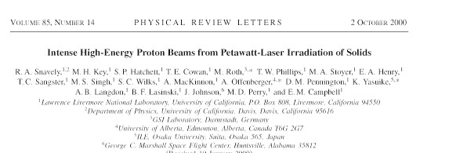





LaserHdriven proton sources
Ultra-intense short pulse laser proton beams are generated on hundreds of TW systems and make their breakthrough in 2000 achieving up to 60 MeV from µm targets.
Year 2000
Bulk Target (Al)
Surface contaminant (H₂O)
Bulk Target (Al)
-
-
-
-
Surface contaminant (H₂O)
Laser:
J / ~1 ps (>10 TW)
>10¹⁸ W cm⁻² μm²
-
-
-
H⁺ ion
fewfew
IIλλ²²
-
+ -
+ -
+ -
+ -
- -
- -
- -
- -
- -
e
Properties:
High number (~10¹³)
High energy (~60 MeV)
Produced in short time (~ ps)
Laminar (100 times be\er than conventional accelerator)
-
-
-
Target Normal Sheath Acceleration
22

Slide 44
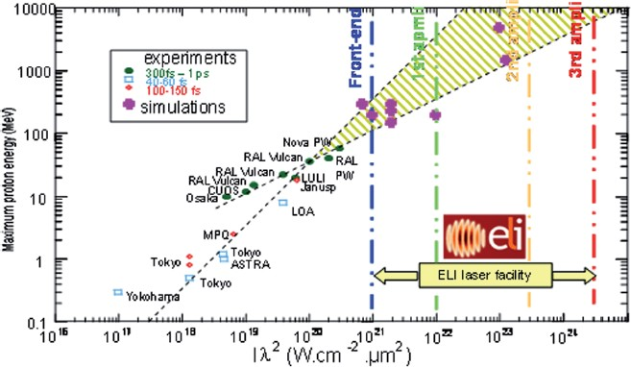
LaserHdriven proton acceleration
Scaling laws indicate that higher: power systems should generate ions suitable for many applications
ELI Whitebook

Slide 45
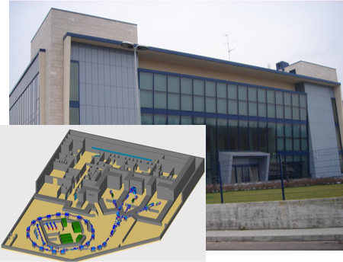
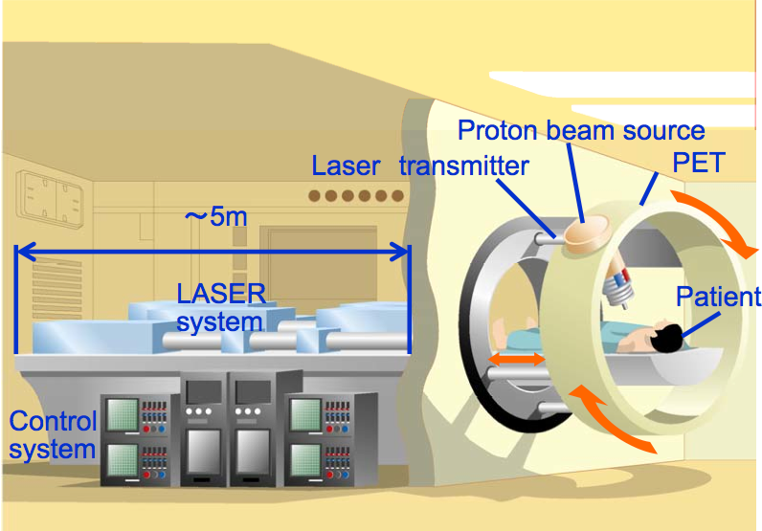
Today
Tomorrow ?

Slide 46
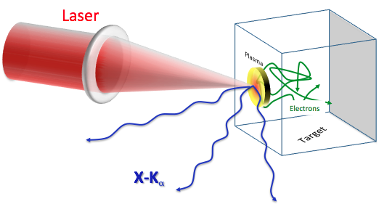


Laser-driven X-ray sources @ ELI Beamlines
Plasma sources
Harmonics (gas)
LUX/XFEL
X-rays from relativistic e-beams

Slide 47


Small accelerators for industrial applications
The technology is based on the MicroLinac (originally developed at SLAC), an X-band linear accelerator powered by an inexpensive and commonly available magnetron.
1 MeV MicroLinac for industrial radiography
2 MeV MicroLinac, with mobile phone shown
for scale.

Slide 48


Small accelerators for medical applications:
FLASH therapy
Ultra-High dose in very short pulse resultes more efficiently than conventional RT in the cancer cure.

