Slide 1
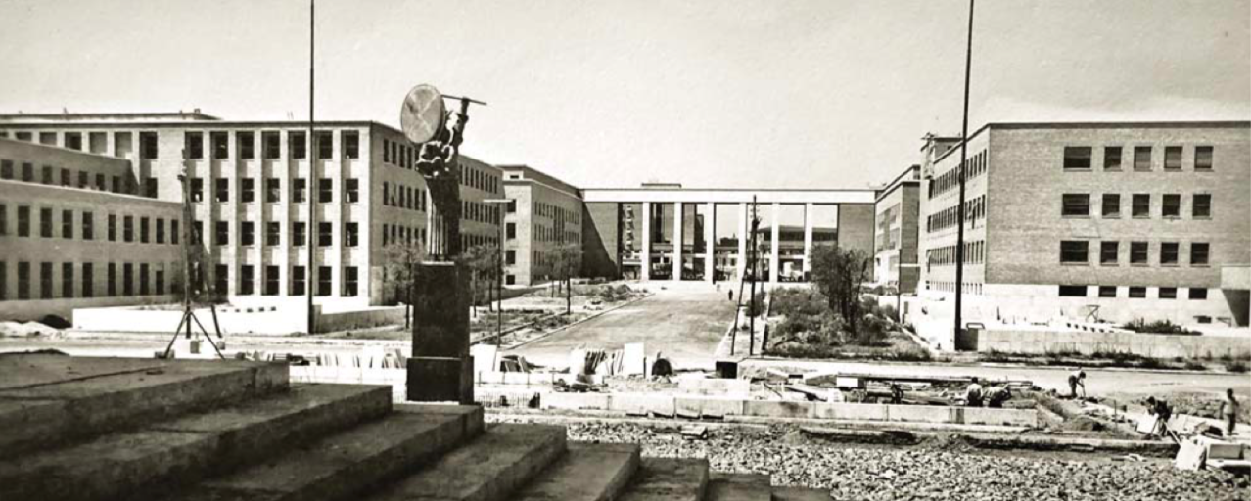
High intensity projects
Mandate:
Summarize activities without details
Summarize existing knowledge
Summarize needs: missing knowledge and resources
Future perspectives
Ritiro della Sezione di Roma
Assisi, 16-18 Giugno 2019

Slide 2
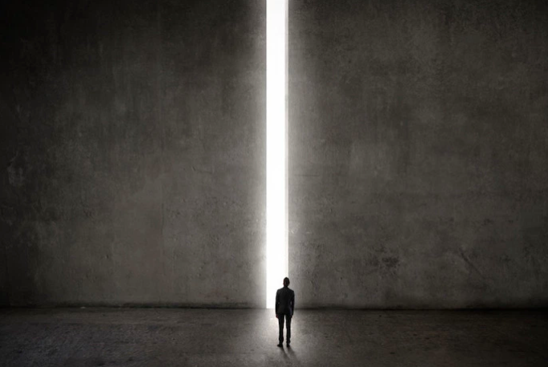
Rare processes = high intensity
coupling
Known
Energy
$μ→eγ, 3e$, $τ→3μ$
$μN→eN$
Flavour physics (c, b)
$K→ πν\overline{ν}$
LFV, LNV
$pN→pN+X$, $π^{0},η,η^{′}→γX$
K $→π+X$, $B→K+X$, $D→π+X$
$e^{+}e^{−}→γX$, $e^{+}e^{−}→X$
$eN→eN+X$
F. Renga, C. Voena
Intensity
mass
Hidden sector

Slide 3
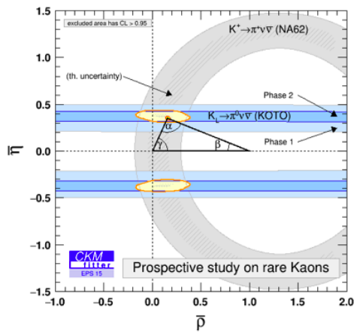
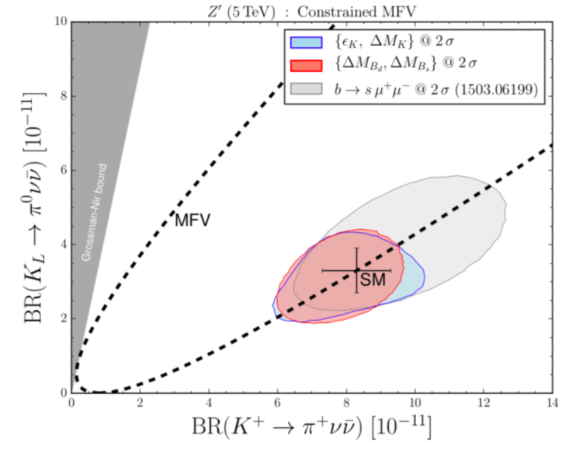
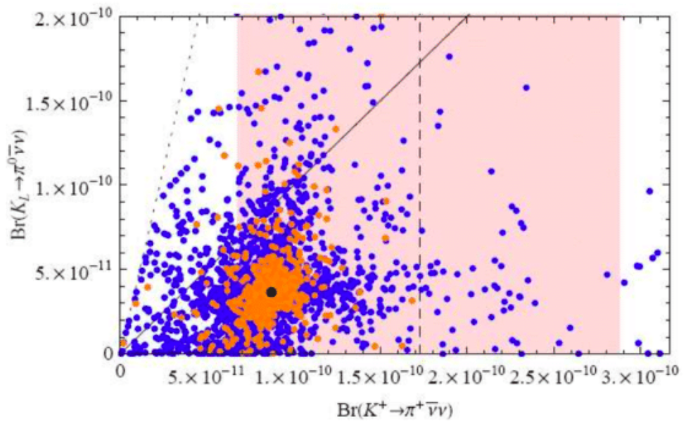
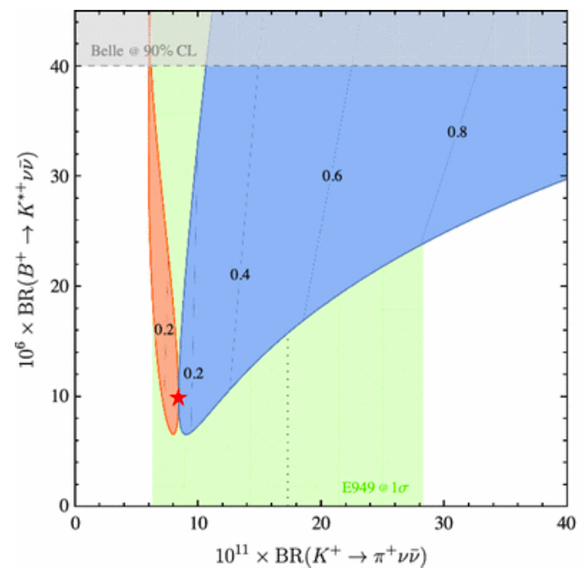
Rare kaon decays: $K→πν\overline{ν}$
10% precision on both $πν\overline{ν}$ modes allows to over-constrain the unitary triangle and possibly show new physics
In Standard Model:
Many different BSM scenarios can be tested
$Z’$ in constrained MFV
Randall-Sundrum
LFU violation

Slide 4
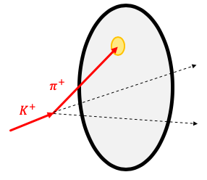
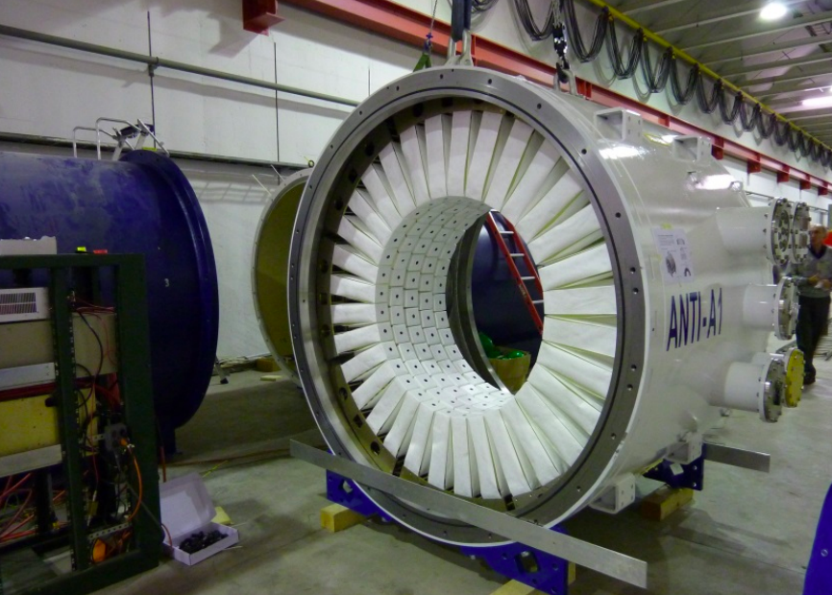
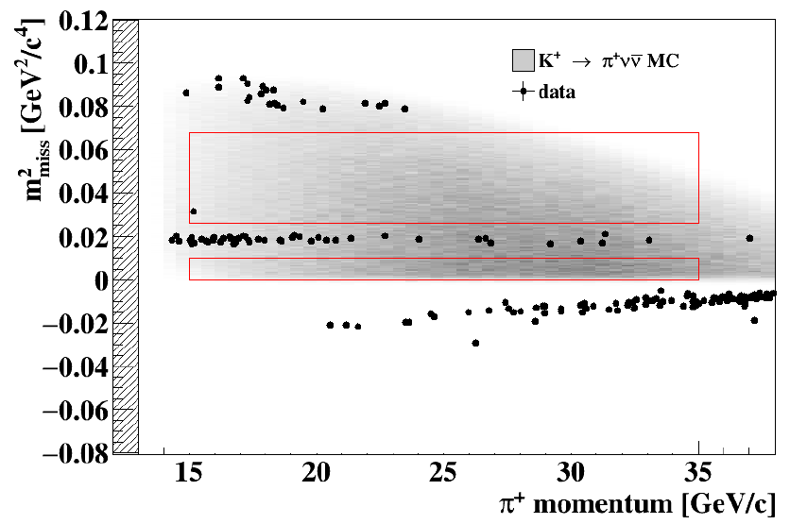
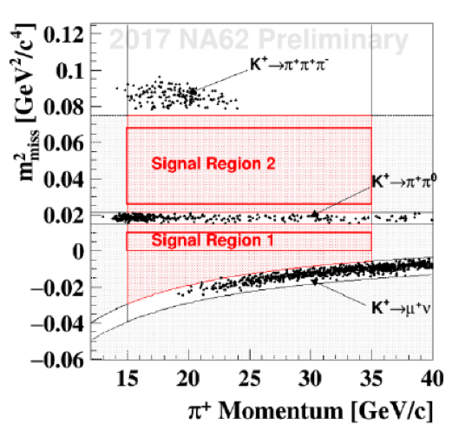
$K^{+}→π^{+}ν\overline{ν}$: NA62
Roma1 group in SPSC-P-326 proposal since 2005
NA62 approved in December 2008
Roma1 group actively participated to the R&D, design, construction, installation and running of the experiment, with contributions to
Ermetic photon veto system: liquid Kr calorimeter + large angle and small angle detectors. LAV: Cherenkov detectors
Electronics (ToT boards for photon and charged veto, muon detectors)
Online infrastructure, central data recording
Trigger
Offline
Simulation, data handling, databases and computing
Analysis
1 event/0.15$±$0.09_{stat}$±$0.01_{syst}
2.5 events expected
2016 data
30 days
1.3$×$10¹² ppp
2017 data
161 days
2$×$10¹² ppp
2018 data
217 days
2.3$×$10¹² ppp

Slide 5
NA62 future perspectives
Proposal to run in RUN3, between LS2 and LS3: 2021-2023 (NA62++)
Main objective: getting close to the 10% precision for $BR(K^{+}→π^{+}ν\overline{ν})$
Some time ($\sim$3 months) to be devoted to hidden sector studies, in dump mode
Running at higher intensities after LS3?
Improve the statistical error towards the ultimate theoretical uncertainty
Maximum intensity of $K^{+}$ beam: first evaluations indicate x4 wrt nominal intensity: NA62 at x4 in RUN4 and beyond = NA62x4
2026 onwards
How much is sustainable from the experiment side?
Trigger
Readout
Detectors
…
Interplay with KLEVER proposal
$K^{+}$ and $K_{L}$ experiments very difficult to run concurrently
NA62++ to be approved by funding agencies (INFN [CSN1] and CERN in first place)
Until LS3, discussed in PBC
After LS3, from the ESPP
NA62x4 discussion within the Collaboration
Interest for high-throughput, high-performance data handling for level 0 trigger
Members of APE group participating to NA62 activities since some years
Upgrade the FPGA-based level-0 trigger processor for coping with x4 intensity
Improve level 0, e.g. including RICH reconstruction

Slide 6
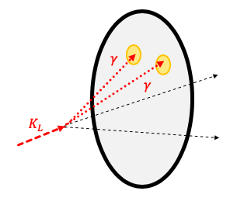
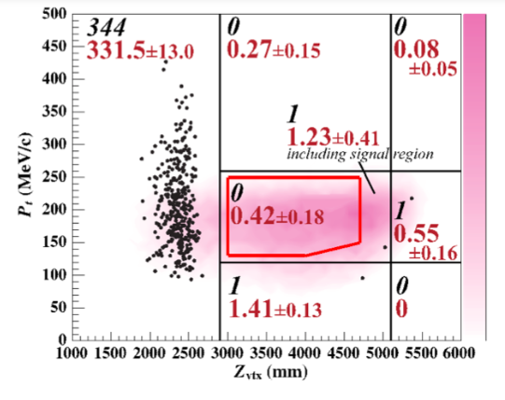
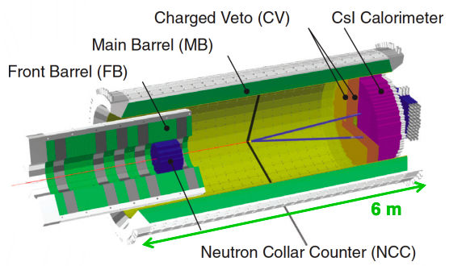
$$K_{L}→π^{0}ν\overline{ν}$$
Much harder signature wrt charged mode:
Two photons with unbalanced p_{T} and nothing else
$M\left(γγ\right)=M_{π^{0}}$
No involvement of Roma1 people
J-PARC
2015 run final result
Similar data-set in 2016 run: analysis ongoing
2019: run started with upgraded calorimeter
Further steps towards 100 events will be needed
KOTO Step 2
New neutral beam-line
Decrease angle, increase beam momentum from 2.1 to 5.2 GeV
Increase fiducial volume from 2 to 11 m
New detector
Increase beam power to >100 kW
Approximately 10 events/year

Slide 7
Rare kaon decays: KLEVER
No strong involvement of Roma1 people
High-energy experiment: complementary approach to KOTO
Photons from $K_{L}$ decays boosted forward
Makes photon vetoing easier
Veto coverage only out to 100 mrad
Roughly same vacuum tank layout and fiducial volume as NA62
Possible to re-use liquid Kr calorimeter, NA62 experimental infrastructure?
In order to run at Run 4 (2026 onwards), need to install in 2024-2025

Slide 8
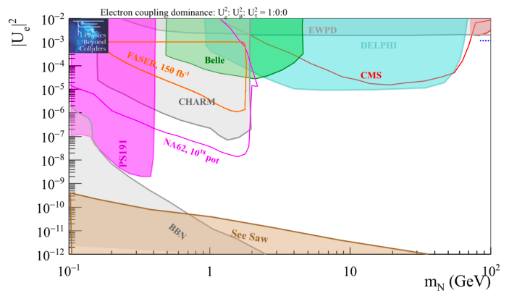
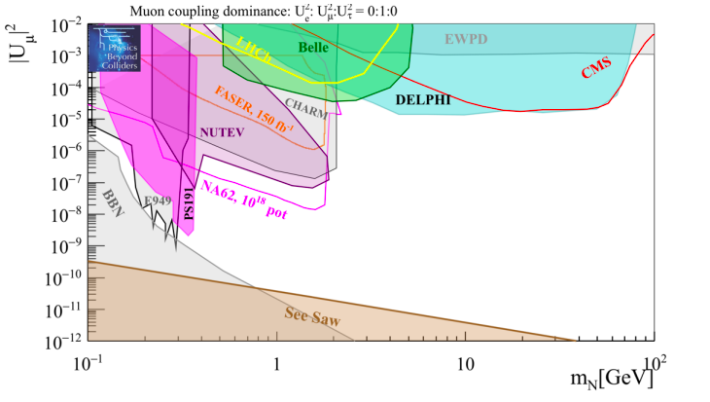
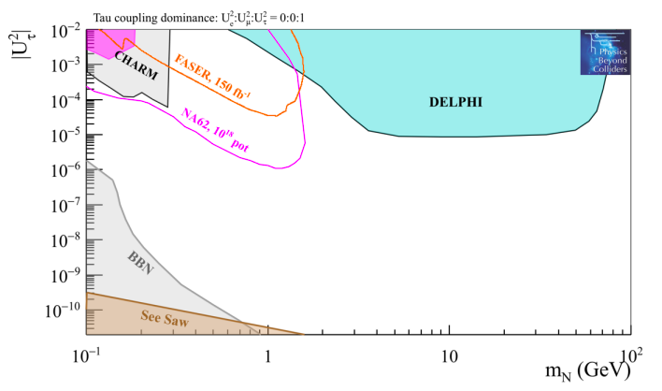
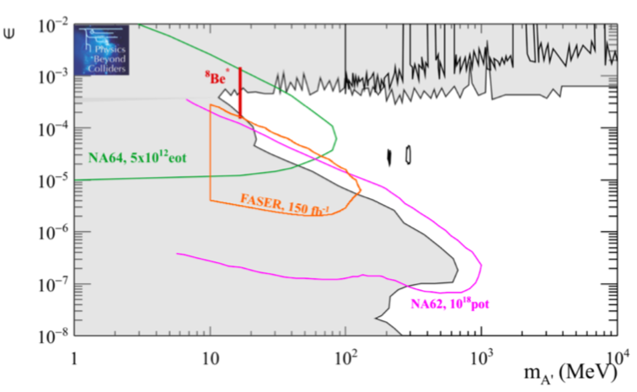
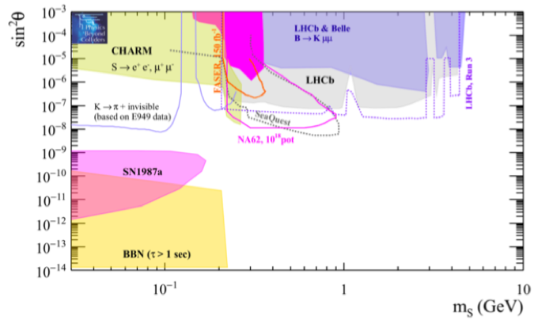
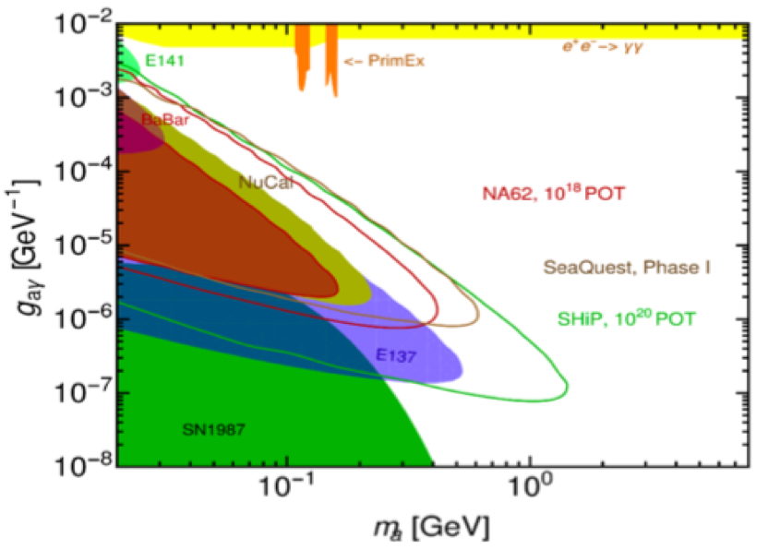
NA62++: hidden sector
NA62 in dump mode: evaluated in the framework of Physics Beyond Colliders
Remove Beryllium target and close Iron/Copper collimators
2$×$10¹² ppp * 0.5$×$10⁶ pulses * 1 pulse/16 s
10¹⁸ pot in 3 months
HNL sensitivity: to simplify, coupling only to one neutrino generation at the time
arXiv:1901.09966
Dark photon
$$A^{′}→ee, μμ$$
10¹⁸ pot
Dark scalar
$$S→μμ$$
10¹⁸ pot
$$K^{+}→πS$$
$S→$invisible
ALP, Primakoff production,
$$a→γγ$$
10¹⁸ pot

Slide 9
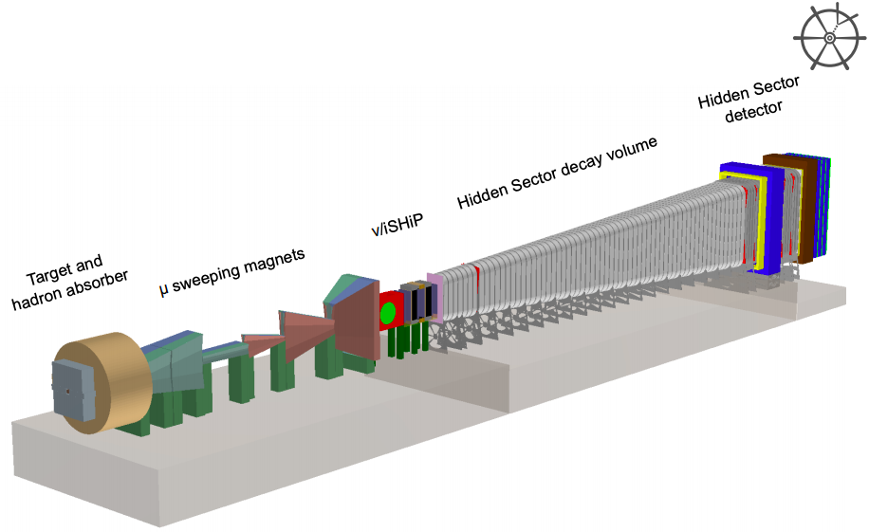
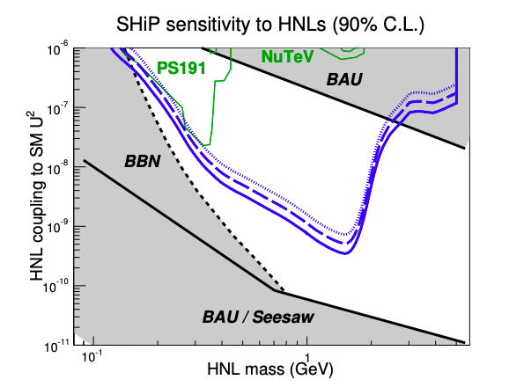
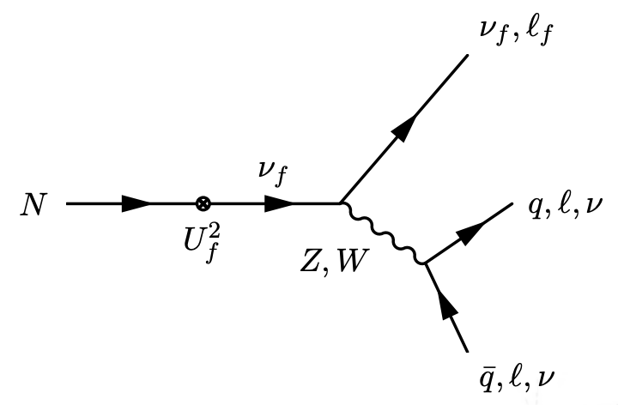
Hidden sector: SHiP
Small involvement of Roma1 people
Target peak power 2.5 MW (average 355 kW)
Extremely radioactive environment
Many constraints on the integration, access, thermal stress, radioactivity...
Active muon shield
Reduce by 6 orders of magnitude muon flux
High field to minimize length (1.8 T)
Neutrino detector
Hidden sector detector
Heavy neutral lepton
Dark photon

Slide 10
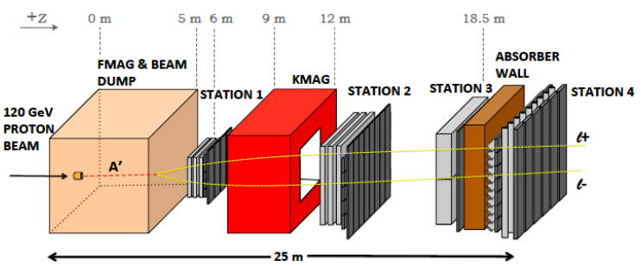
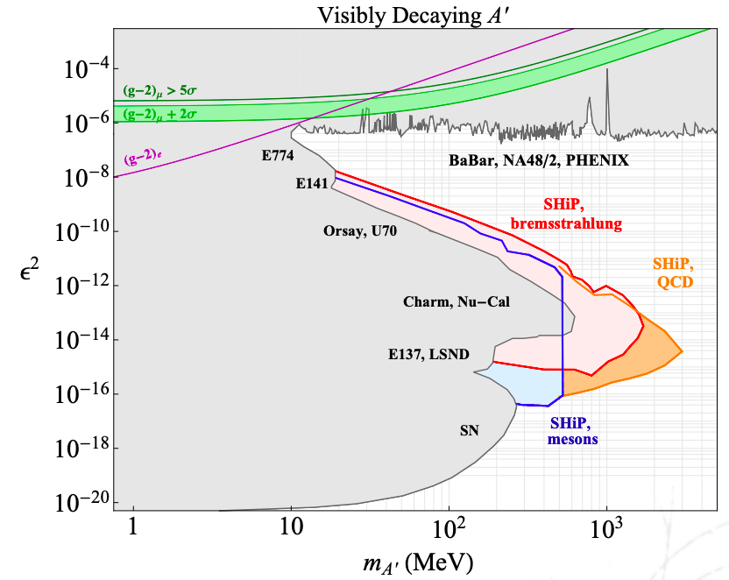
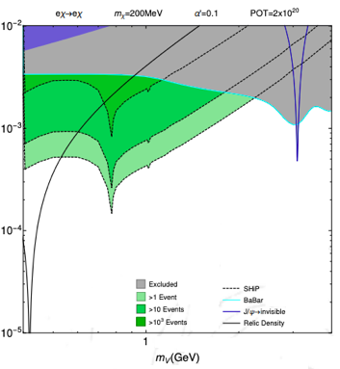
Hidden sector: SHiP
See also at Fermilab: SeaQuest
Target peak power 2.5 MW (average 355 kW)
Extremely radioactive environment
Many constraints on the integration, access, thermal stress, radioactivity...
Active muon shield
Reduce by 6 orders of magnitude muon flux
High field to minimize length (1.8 T)
Neutrino detector
Hidden sector detector
Heavy neutral lepton
Dark photon
arXiv:1504.04855
$$ε$$
$m_{A′}$(GeV)

Slide 11
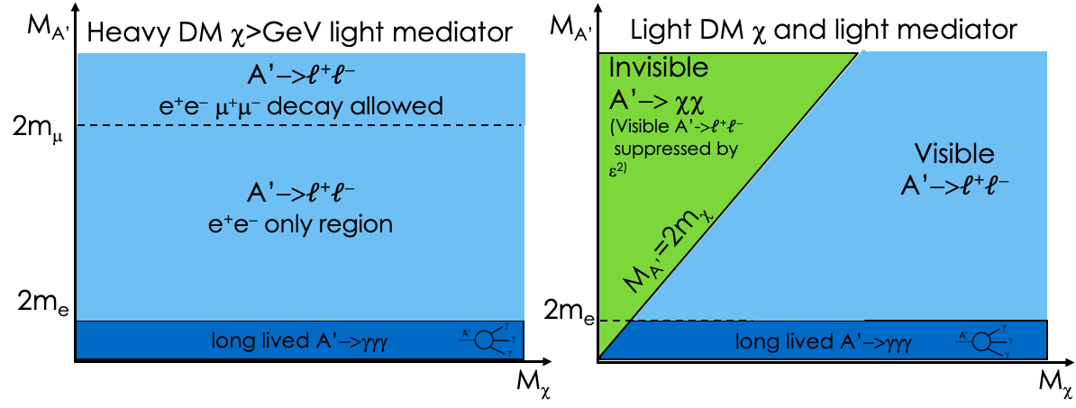
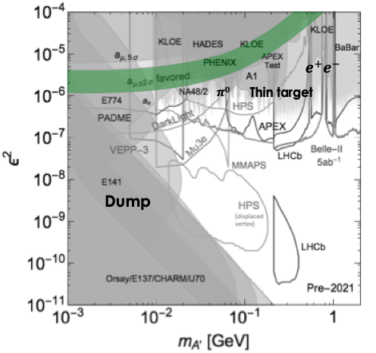
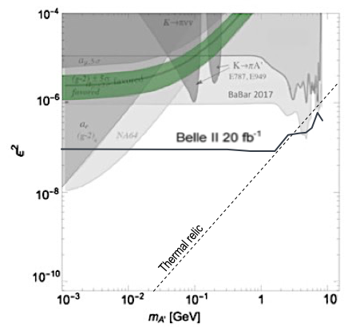
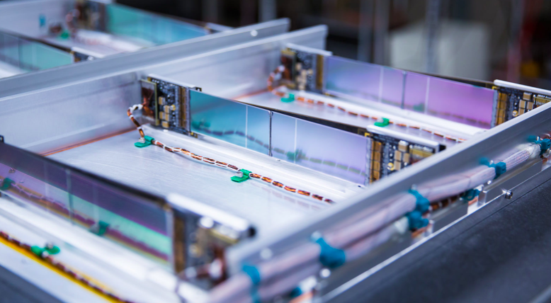
Hidden sector: dark photon decays
Visible
Invisible
APEX and HPS experiment running at JLab

Slide 12
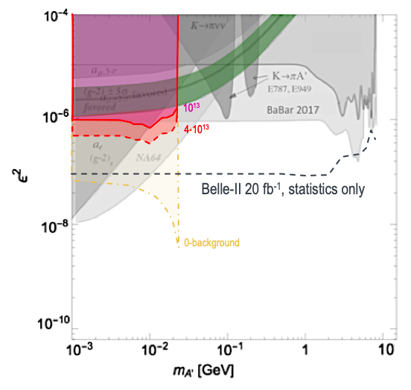
Invisible decays: PADME
The idea was born essentially in Rome (V. Kozhuharov, M. Raggi and P. Valente) – at the end of 2013 – and has been proposed and approved in the framework of INFN “What Next?” program (Design Report Sep. 2015)
Funding 2016-2018: in these 3 years the experiment has been completely designed, optimized, built, installed and commissioned
First data taking (Physics) in Nov. 2018 – Feb. 2019
Running again in July 2019 (Engineering) and Nov. – Dec. 2019 (Physics)
Contributions in all aspects:
Physics
BGO calorimeter
Readout, DAQ, DCS, monitoring, data handling, computing, …
Analysis

Slide 13
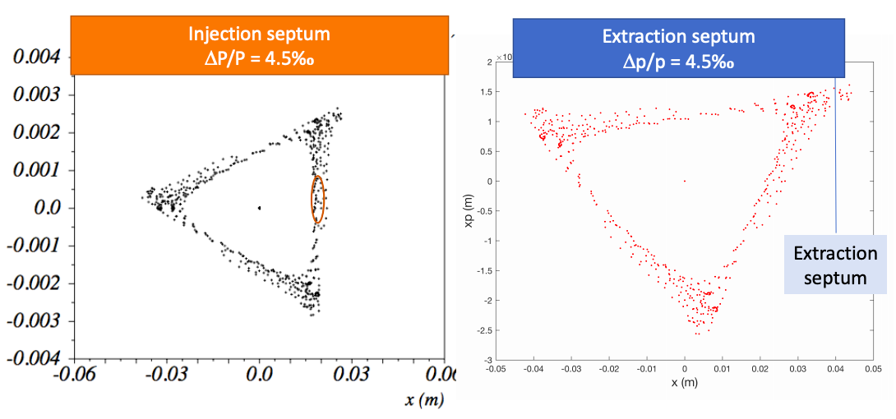
Future perspective: PADME@DA$Φ$NE
PADME ”luminosity” mainly limited by the positron beam intensity, due to the need of limiting pile-up and over-veto
Dictated by the time resolution of the detectors and the time structure of the positron beam
Hard limits:
LINAC maximum repetition rate is 50 Hz
LINAC maximum pulse length is $\sim$300 ns (due to RF compression)
Basic idea: inject the LINAC positron beam in one of the DA$Φ$NE rings and “stretch” it by extracting particles as slowly as possible. Two main options:
Resonant extraction: drive the beam towards a $n+\frac{1}{3}$ tune resonance and “spill” unstable particles out of the ring (with electric/magnetic septa)
Non-resonant extraction: drive the beam towards a bent crystal and use channeling deflection
J.Phys.Conf.Ser. 1067 (2018) no.6, 062006
Use synchrotron radiation loss and chromaticity to drive the resonance
RF and wigglers off $→$ significant savings on operations cost
All beam extracted in 660 turns = 0.2 ms
$∆p/p=1.4 {10}^{−3}$
Discussion on future use of DA$Φ$NE accelerator complex is ongoing:
Positron extracted beam could be used for other purposes (arXiV:1711.06877)
Workshop on DA$Φ$NE Test Facility: https://agenda.infn.it/event/16334/
Crystals for positron channeling also interesting for radiation production
Interplay with other activities

Slide 14
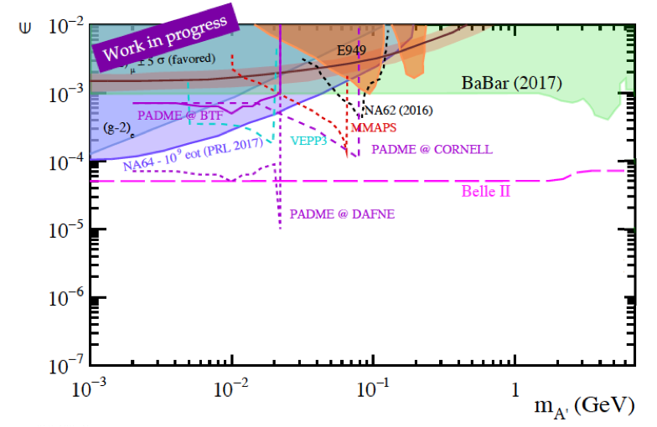
$A’→$invisible 5 years scenario
PBC benchmark 2
Hardware modifications for resonant extraction from DA$Φ$NE:
Remove the low-$β$ insertion from IR1
Magnetic extraction septum (can be equal to the injection one)
Electrostatic extraction septum $\sim$50KV/cm, thickness $\sim$100 µm, length $\sim$1m
Modification of the transfer line to inject directly from the linac to the ring
Insert a collimation system on the transfer line to control emittance and energy spread of the injected beam
Installation of additional shieldings (if needed)
arXiv:1901.09966

Slide 15
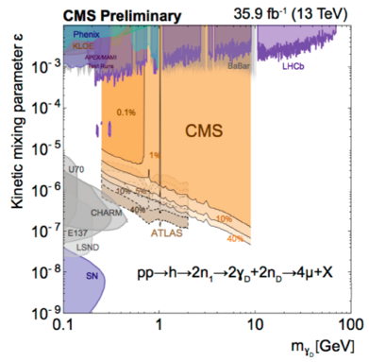
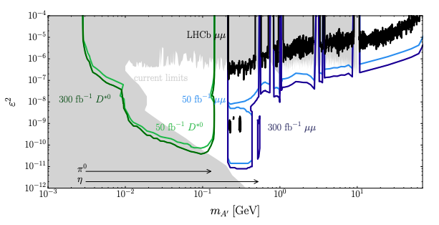
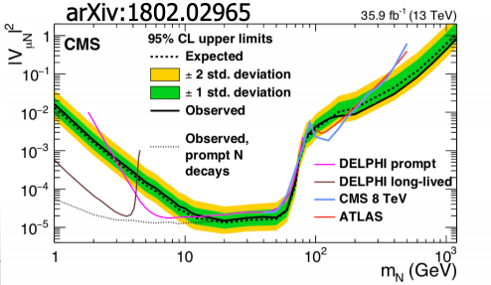
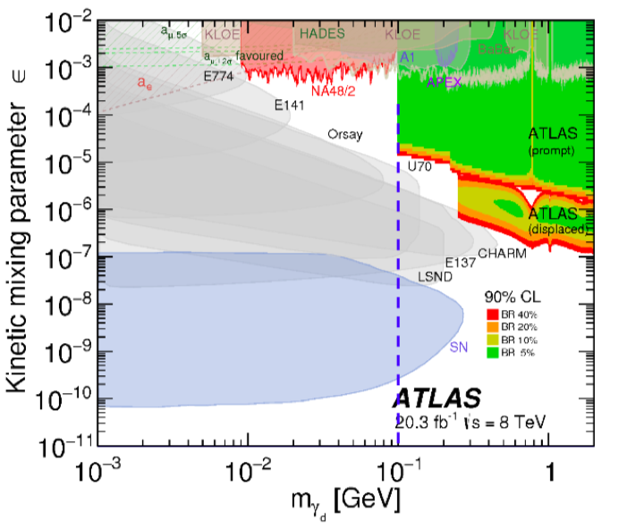
Hidden sector: ATLAS, CMS, LHCb
$$D^{∗0}→D^{0}e^{+}e^{−}$$
Inclusive $μ^{+}μ^{−}$
Higgs decays
Example: Dark photon
New software trigger, can trigger on displaced vertices and new signatures (e.g. $Z’→eμ$)
Example: HNL
$N$ produced in $W$ decays, then:
$$N→Wℓ$$
$W→ℓν$

Slide 16
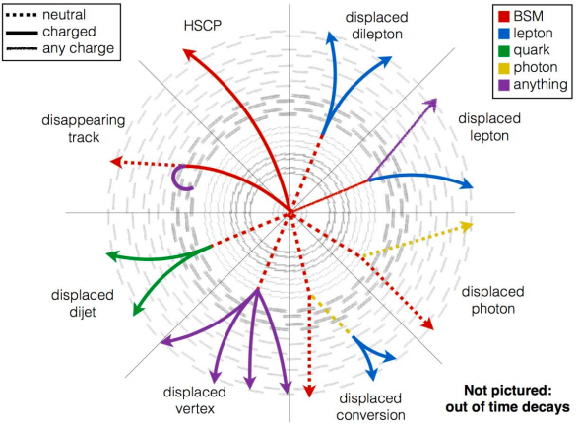
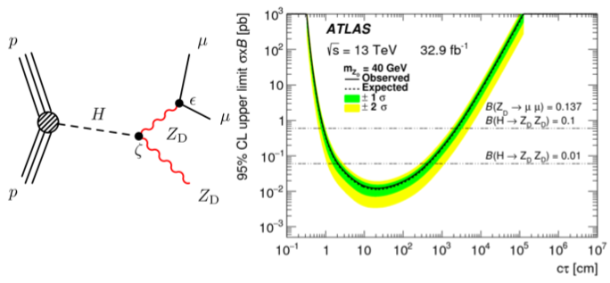
Hidden sector: ATLAS, CMS, LHCb
Not only Higgs decays:
$Z’→μμ (χ\overline{χ},ν\overline{ν})$
Use a dedicated, additional detector if LLP is:
Too light
Too long-lived
Milli-charged
…
Long Lived Particles signatures at LHC
A. De Roeck

Slide 17
FASER
No INFN active member
Look for inelastic pp scattering events with low pT, very forward, very weakly coupled (long-lived) particles
Very compact
Hosted in service gallery underground
FASER 1 already taking data in RUN3 (challenging)
FASER 2: larger detector (enlarged cavern) taking data in HL-LHC phase
Examples: dark photon, ALP, Dark Higgs, HNL
arXiv:1901.04468

Slide 18
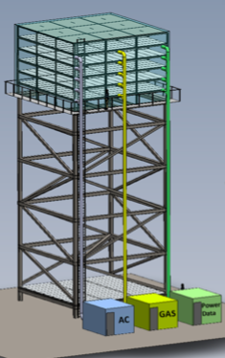
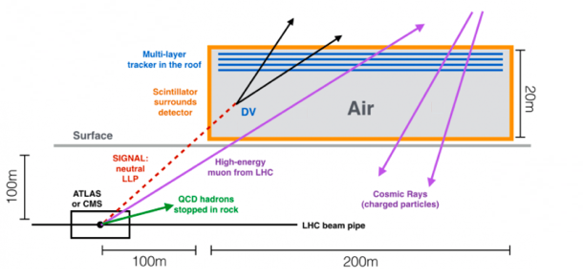
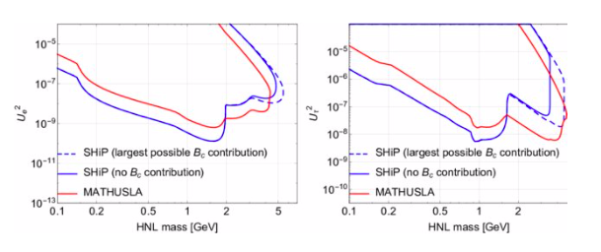
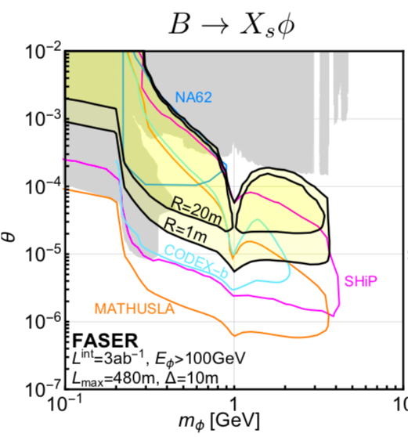
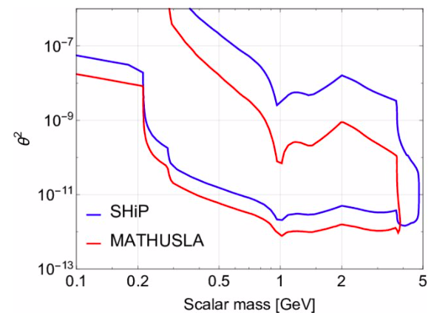
MATHUSLA
Proposers from Roma1 & Roma2
Run at HL-LHC
Huge, modular, surface detector
3 orders of magnitude improvement in exotic Higgs decays sensitivity
Examples: scalar portal, $h→SS, B→KSS$; HNL; dark Higgs
arXiv:1901.04040

Slide 19
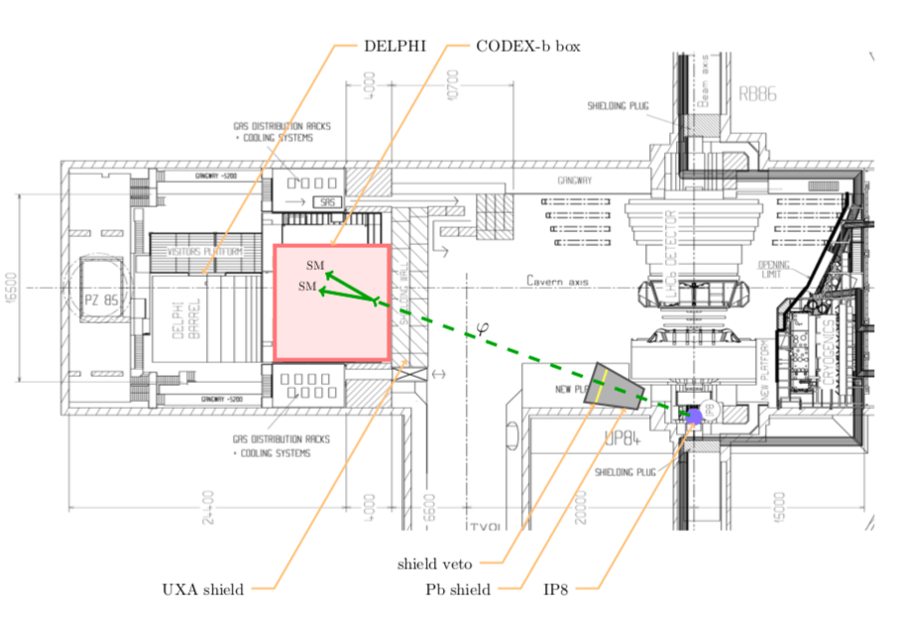
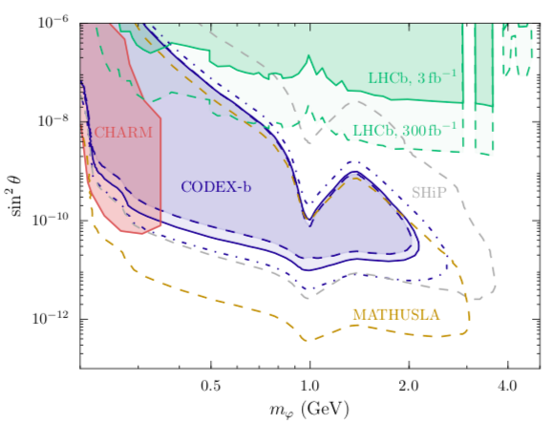
CODEX-b
LHCb detector
Compact: 10$×$10$×$10 m³, 1% angular acceptance
6 tracking layers on all “box” faces (RPC)
5 sets of trackers in the box (3 vertical layers)
1 cm granularity, <100 ps time resolution

Slide 20
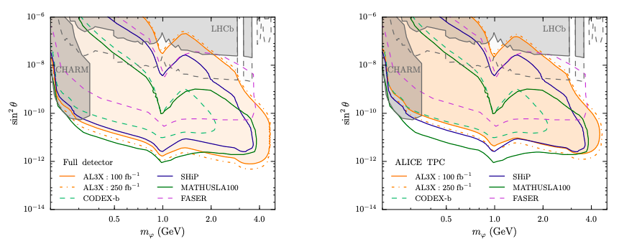
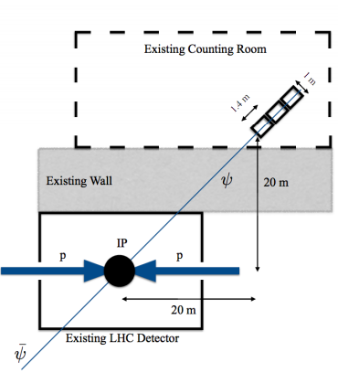
Other ideas…
Full detector
Only existing ALICE TPC
MilliQan
AL3X: Reuse ALICE from Run5
MilliQan: search millicharged particles

Slide 21
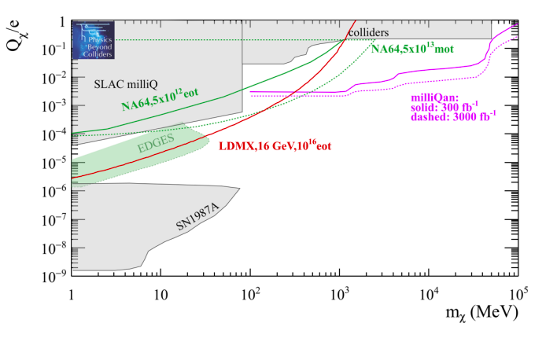
Millicharged
Look for very feeble ionization/excitation signal in detector (scintillator)
From colliders: invisible width of the $Z$

Slide 22
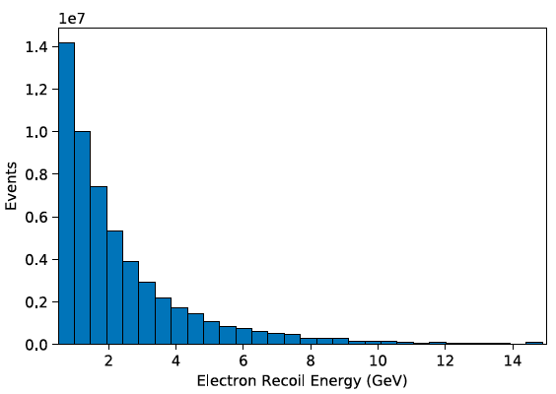
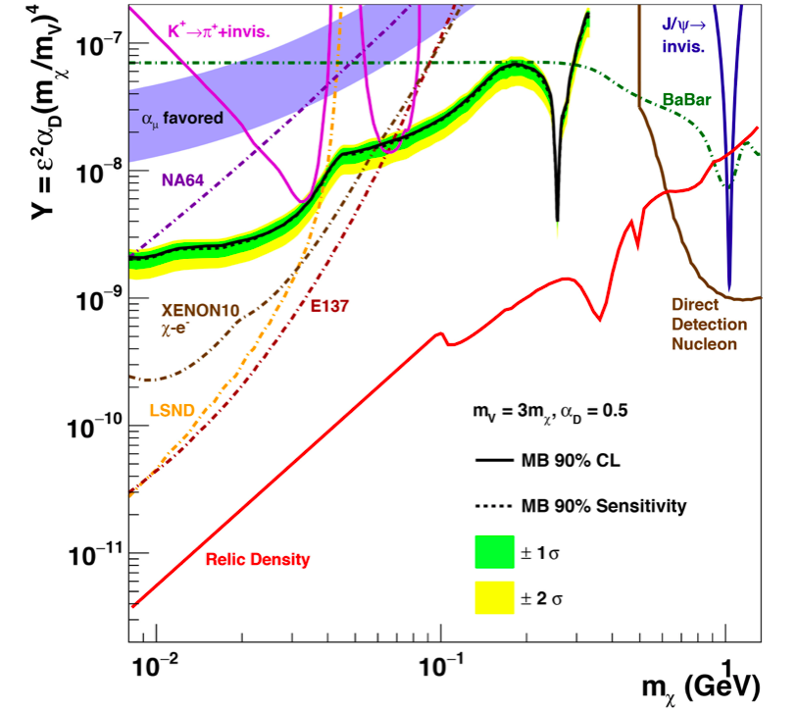
Hidden sector: neutrino experiments
Phys.Rev. D95 (2017) no.3, 035006
MiniBooNE
but also T2K, DUNE, NOvA, etc.

Slide 23
Hidden sector: BDX at JLAB
Dump+recoil
PRL 121 (2018) no.4, 041802
dump
detector
Alternative:
MESA low-energy (155 MeV), high-current
superconducting electron linac (Mainz)
10²² EOT
1 beam-year at Hall-A or
3 beam-years at Hall-C
800 Cs(Tl) crystals
total interaction volume
$\sim$0.5$×$0.5$×$3 m³
A. Denig

Slide 24
Hidden sector: LDMX
Beam: individual tag of 10¹⁶ incident e⁻
A low-current, multi-GeV, e⁻ beam (10¹⁶/year ≈ 1 e⁻/3 ns)
Possibilities:
DASEL@SLAC (4/8 GeV)
CEBAF@JLab (up to 11 GeV)
SPS extracted e⁻ (eSPS)
Large beam spot (~10 cm²)
Two-stage approach to LDMX: 4×10¹⁴ “Phase I” 2022? 1x10¹⁶ “Phase II” 2026?
arXiv:1808.05219
24
arXiv:1901.09966

Slide 25
Hidden sector: 10-15 years projections
ALP
Dark photon
Dark scalar
… and many others
from PBC report: arXiv:1901.09966

Slide 26
Hidden sector: 10-15 years projections
Heavy neutral leptons
… and many others
from PBC report: arXiv:1901.09966

Slide 27
Summary
New physics searches via loop diagrams can access very high scales and the needed precision is still challenging the experimental technique
The dark sector paradigm is very attractive and a enormous experimental effort is taking place, all over the world, attacking a large number of models
Two key aspects should not be neglected when comparing experiments:
Time and effort is needed for getting the experiment approved, built and running. In addition, significant statistics is often quoted, and time for taking and analysing data is also not negligible!
5 – 10 – 15 years scenarios, excellent exercise by PBC working group
Sensitivity/exclusion power is often model-dependent!
Complex models have more than 2 parameters, and arbitrary choices have to be made when showing 2D plots

Slide 28
Comments and questions
If an accelerator or experimental apparatus is available, try to exploit it as much as possible. Adapting an experiment for a new search can give unexpected sensitivity to new models
“Anomalies” (like ${(g−2)}_{μ}$, Beryllium) give some guidance, but the search for BSM should really be as wide as possible
A number of “not so big” experimental programs are being proposed/prepared/used, offering physics opportunities and the possibility of having an impact with a reasonable effort and in a reasonable time
Interest in Roma1 has been growing in the latest years for hidden sector initiatives
Can we improve synergies?
Can we have more impact?

