Slide 1
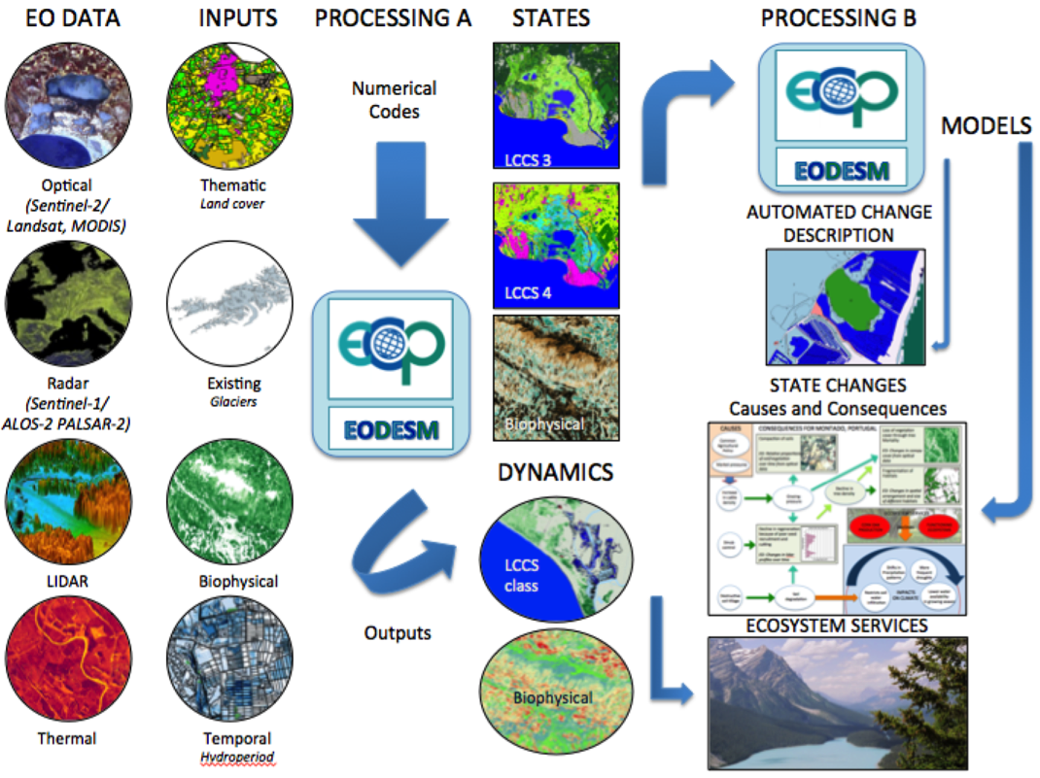
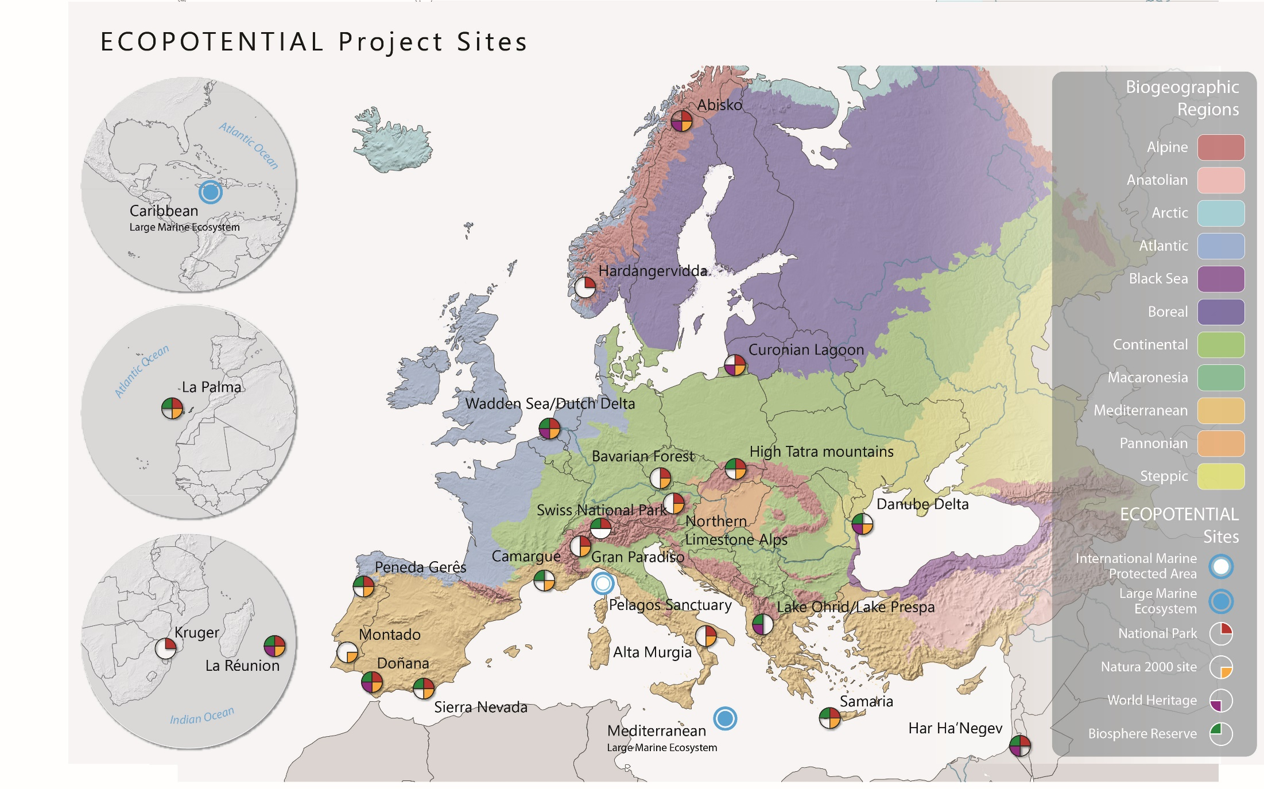
Satellite time-series analysis for Ecosystem monitoring within HORIZON2020 ECOPOTENTIAL and ERA-PLANET projects M. Adamo, C. Tarantino, S. Vicario, P. Blonda
https://www.ecopotential-project.eu
on behalf of the ECOPOTENTIAL partners involved in EO data generation and harmonization
ECOPOTENTIAL project: improving future ecosystem benefits through EO (2015-2019).
Coordinator: Antonello Provenzale (CNR)
Project manager: C. Marangi (CNR-IAC)
The Earth Observation Data for Ecosystem Monitoring (EODESM)
Prof. Richard Lucas, Aberystwyth University, Ceredigion, Wales (UK)

Slide 3
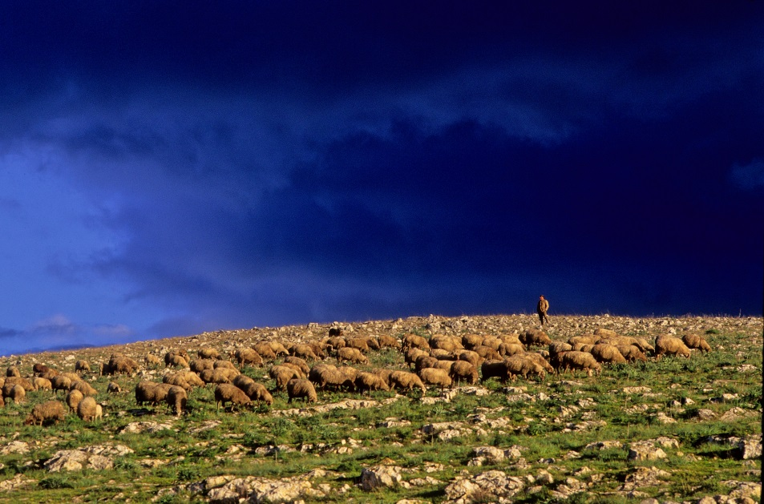
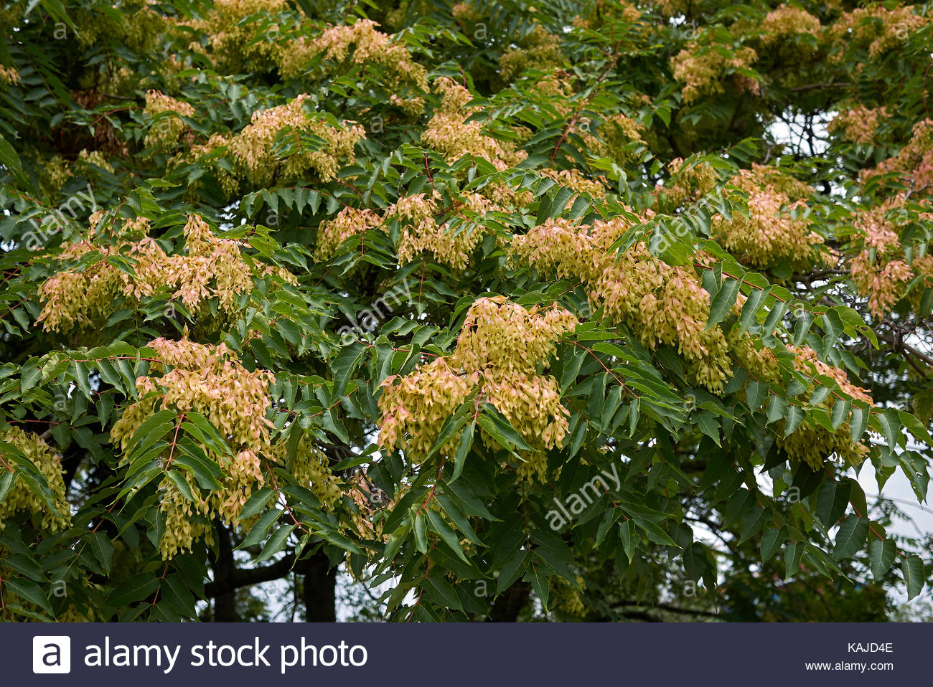
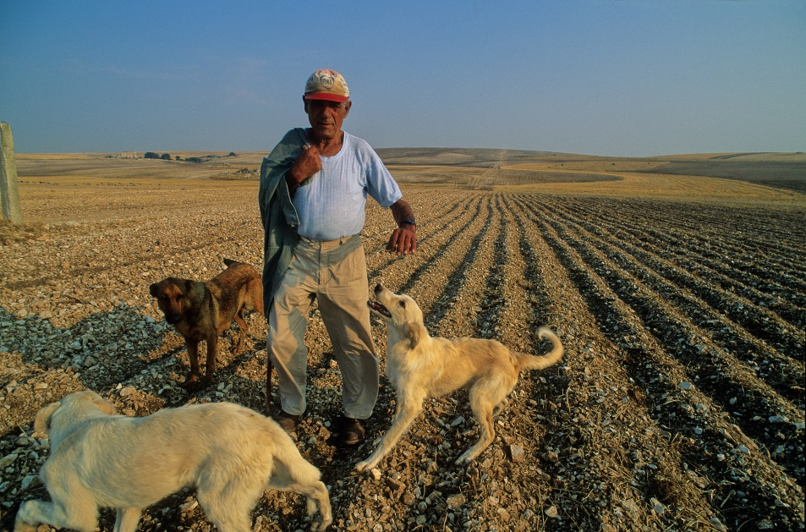
Example_1: Natural grasslands ecosystem in semi-arid Murgia Alta National Park (IT)
Threaths
Rock graining in natural grasslands for agriculture purposes: land degradation;
Ailanthus altissima invasion;
Users requirements
Grasslands habitats (i.e., 6210; 62A0; 6220) extent and Conservation status
Changes
Landsat time series 2010-2018;
Sentinel-2 data intra-annual time series
Multi-seasonal Worlview-2/3 imagery

Slide 4
Study area: Murgia Alta National ParkObjectives
Focusing on the monitoring of the extension and changes of grasslands ecosystems according to the European Union Biodiversity Strategy to 2020: Murgia Alta PA study site.
Use of intra-annual Time Series (TS) Landsat images to exploit the additional contribution of high temporal frequency of acquisition (16-days) in spite of the not very high spatial resolution (30 m.)
Testing of TS of Modified Soil Adjusted Vegetation Index (MSAVI) for:
Land Cover (LC) mapping, by supervised classification
LC Change (LCC) detection, comparing different algorithms (PCC, CCA, BFAST)
Habitat mapping, by supervised classification
IV ECOPOTENTIAL General Meeting
Rome, 20-24 May 2019

Slide 5
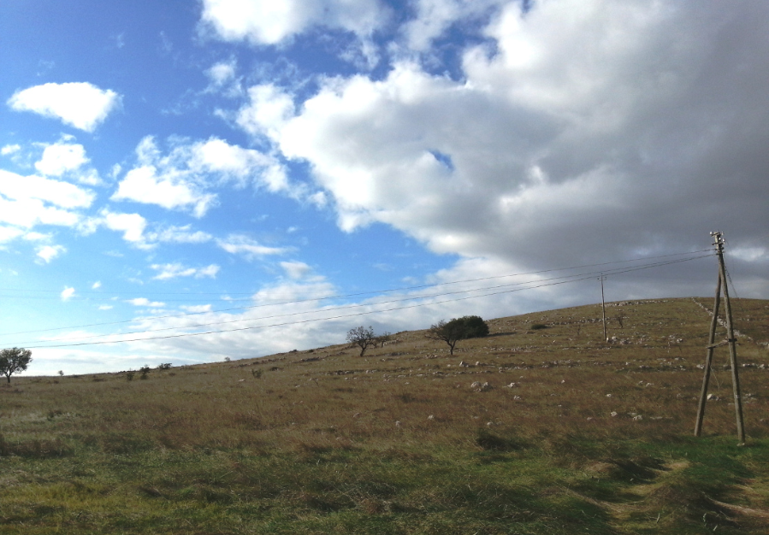
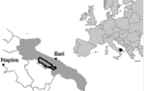
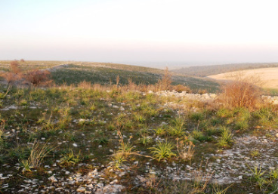
Murgia Alta PA: semi-arid ecosystem
Focus on Natural Grasslands
Interaction between agro-ecosystems and natural grasslands: stone graining and loss of natural ecosystems
(Murgia Alta storyline)
IV ECOPOTENTIAL General Meeting
Rome, 20-24 May 2019

Slide 6
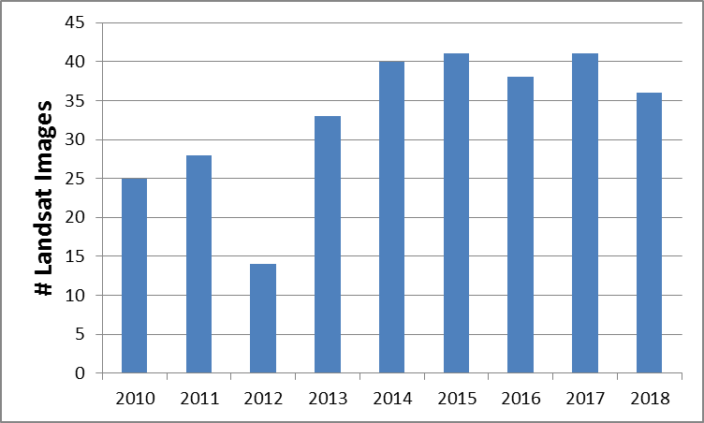
Landsat dataset
296 Landsat (5,7 and 8) images from 2010-2017
IV ECOPOTENTIAL General Meeting
Rome, 20-24 May 2019

Slide 7
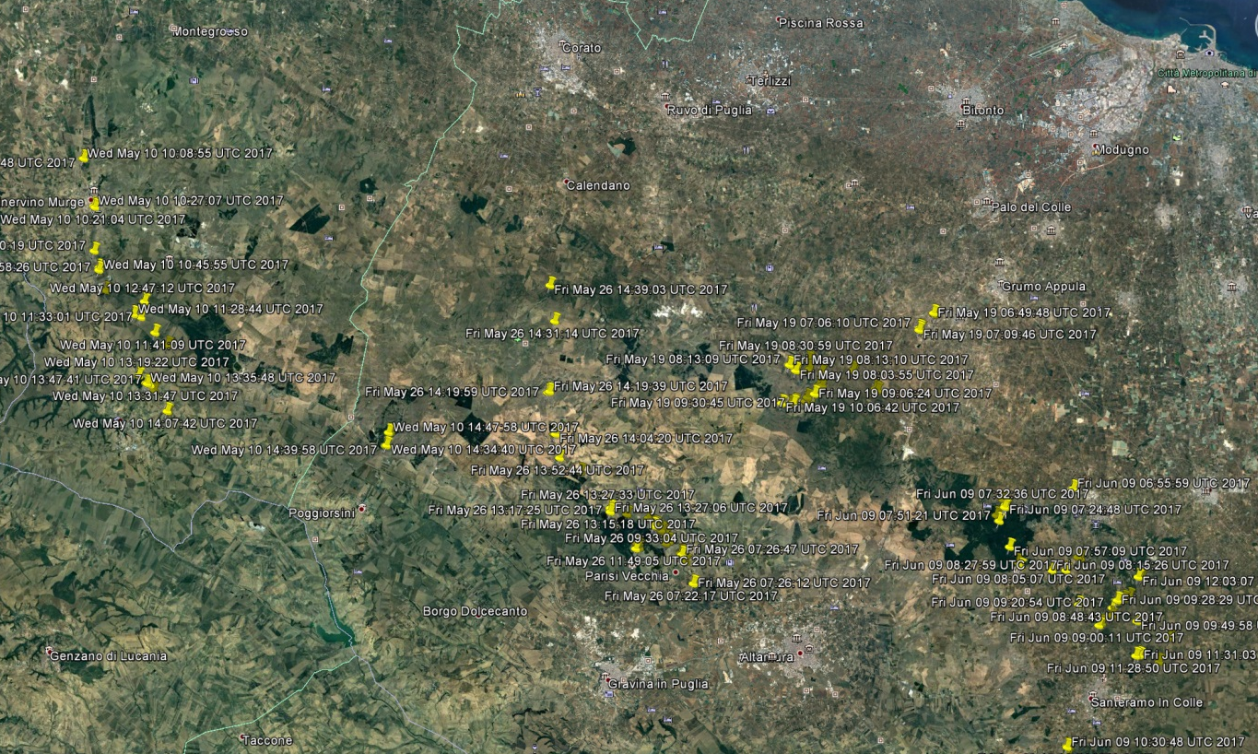
Ground truth
To train the supervised classifier and validate the LC/LU maps (in LCCS taxonomy) reference samples were selected from in-situ campaigns carried out in different years through “The LCCS Field App”.
The mobile App has been developed by UNSW (WP4) and is openly available.
LCCS reference points for Murgia Alta, Italy, in LCCS code
IV ECOPOTENTIAL General Meeting
Rome, 20-24 May 2019

Slide 8
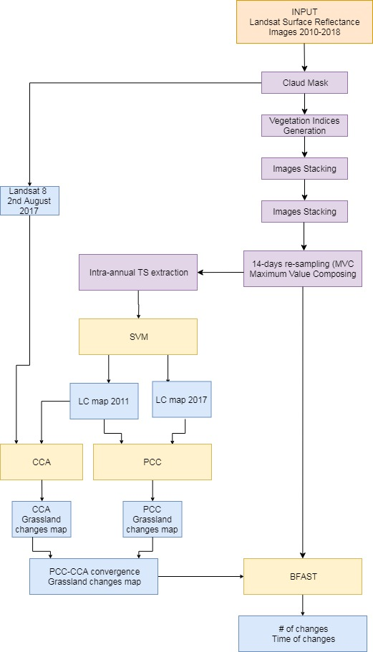
Dataset: L5, L7 and L8 images
The MVC method (Holben, 1986) selects, on a pixel by pixel basis, the highest value of the Vegetation Index considered in 14-days time period.
Classification:
Input: Intra-annual MSAVI TS
10 target classes mapped.
2011 and 2017
SVM applied using Radial Basis Function (RBF) as kernel function (after tuning of parameters after Cross-Validation)
BFAST (Verbesselt et al., 2012) combines the decomposition of time series into season, trend, and remainder components with iterative change detection method.
IV ECOPOTENTIAL General Meeting
Rome, 20-24 May 2019

Slide 9
LC classification
Input: Intra-annual MSAVI TS
10 target classes mapped.
2011 and 2017
SVM applied using Radial Basis Function (RBF) as kernel function (after tuning of parameters after Cross-Validation)
IV ECOPOTENTIAL General Meeting
Rome, 20-24 May 2019

Slide 10
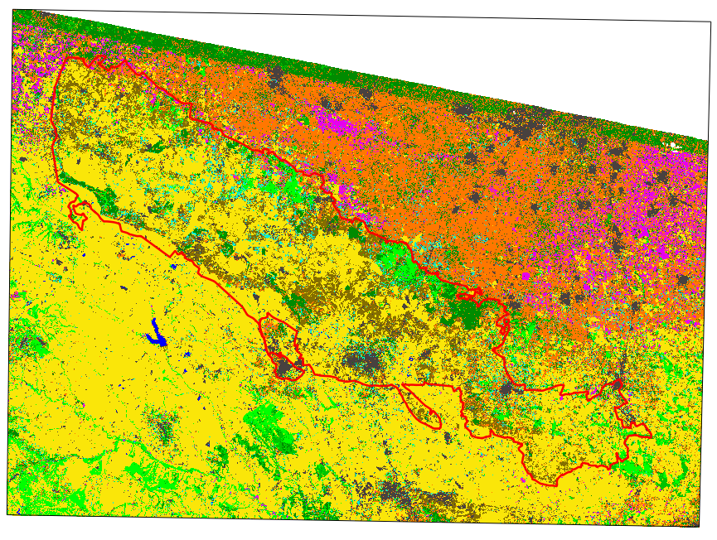
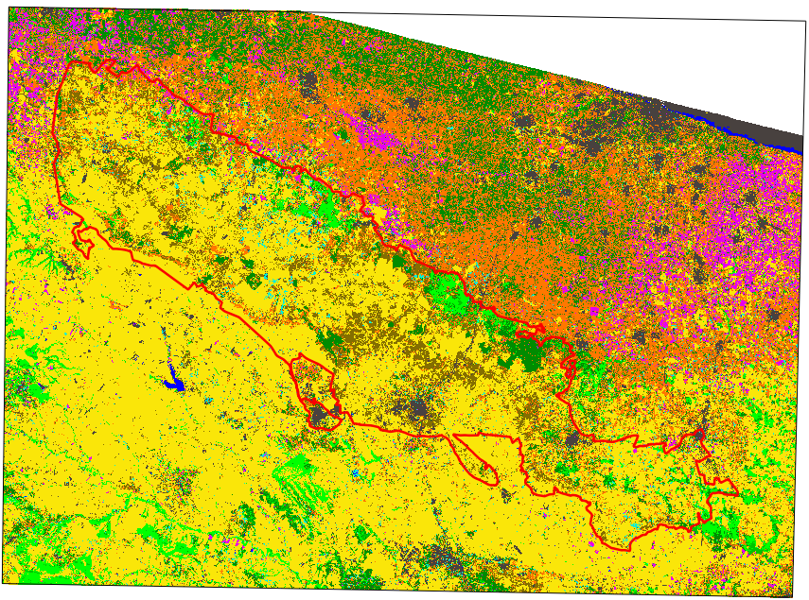
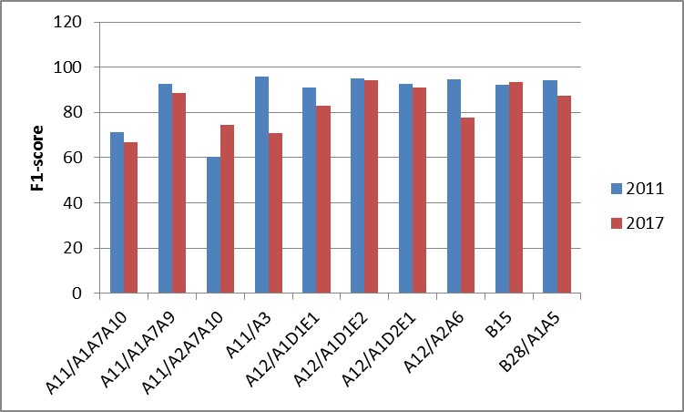
Land Cover (LC) mapping from inter-annual Landsat time series
Land Cover map (T₁=2011)
Land Cover map (T₂=2017)
OA=93,1%
OA=85,8%
1:900.000
LEGEND LC
FAO-LCCS2
 | A11/A1A7A10
 | A11/A1A7A9
 | A11/A2A7A10
 | A11/A3
 | A12/A1D1E1
 | A12/A1D1E2
 | A12/A1D2E1
 | A12/A2A6
 | B15
 | B28/A1A5
Grasslands mapping has an high acccuracy (≈90%)
Most grasslands confusion with A11/A3 and B15
IV ECOPOTENTIAL General Meeting
Rome, 20-24 May 2019
Validazione e confusioni di grassland nei due anni (pat)

Slide 11
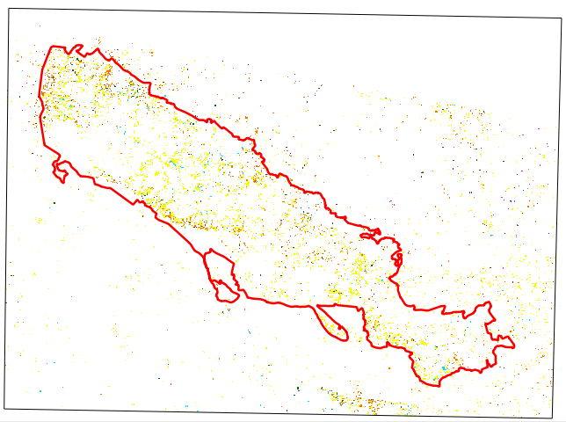
Change detection by
Post Classification Comparison (PCC)
Natural Grasslands change detection in Murgia Alta PA (2011-2017)
1:700.000
LEGEND CHANGE
GRASSLANDS TRANSITIONS INTO:
 | A11/A1A7A10
 | A11/A1A7A9
 | A11/A2A7A10
 | A11/A3
 | A12/A1D1E1
 | A12/A1D1E2
 | A12/A1D2E1
 | B15
 | NO CHANGE
Change map from PCC
(2011-2017)
OA=OA_{T1}.OA_{T2}=79.9%
From -> To class-transitions are known
IV ECOPOTENTIAL General Meeting
Rome, 20-24 May 2019

Slide 12
Inter-annual time series analysis
BFAST, Breaks For Additive Season and Trend
harmonic model
piecewise linear function
Phenological change →change in the seasonal shape due to short-term climate fluctuations (e.g. temperature and rainfall) or anthropological disturbances
Abrupt changes → changes in trend caused by disturbances such as deforestation, floods, and fires
Gradual changes → linear trend triggered by a moderate change in seasonality, land degradation or long-term trends in mean annual rainfall.

Slide 13
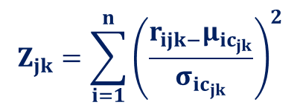
Change detection by Cross-Correlation Analysis (CCA)
Step 1: Computing Z-statistics
A Land Cover map
for a selected target class
(Time T₁ )
Where:
is the Z-score for a pixel jk belonging of a given class (stratum);
i is the band number in the multispectral image;
n is the number of bands;
is the thematic class being analysed; pixel jk belongs to the corresponding layer in T₂;
is the reflectance in band i for pixel jk in a given class;
is the mean reflectance value in band i of all pixels in a given class ;
is the standard deviation of the reflectance value in band i of all pixels in a given class .
superimposed on:
One multispectral
satellite image
(Time T₂ , T₂ > T₁)
Step 2: Thresholding
producing a change/no change binary map occurred at T₂ for the selected target class.
Koeln, G. and Bissonnette, J. Cross-Correlation Analysis: Mapping landcover changes with a historic landcover database and a recent, single-date, multispectral image. In Proceedings of the 2000 ASPRS Annual Convention, Washington, DC, USA, 22-26 May 2000.
Tarantino, C.; Adamo, M.; Lucas, R.; Blonda P. Detection of changes in semi-natural grasslands by cross correlation analysis with WorldView-2 images and new Landsat 8 data. Remote Sens. Environ. 2016, 175, 65–72.
IV ECOPOTENTIAL General Meeting
Rome, 20-24 May 2019

Slide 14
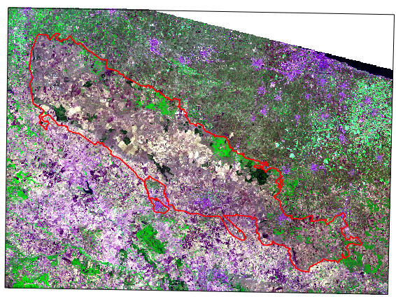
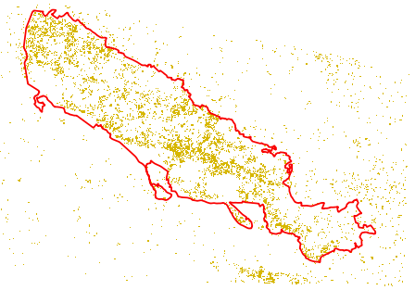
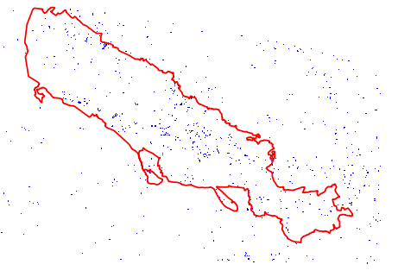
CCA: Natural Grasslands change detection in Murgia Alta PA (2011-2017)
Natural Grasslands from Land Cover map (T₁=2011)
Landsat 8 image (T₂=2017)
1:1.000.000
Area |  | Natural Grasslands (2011)
(km²)
AOI | ≈5300 | ≈290
PA | ≈1350 | ≈217
Natural Grasslands
Time: August 2nd, 2017;
Spatial resolution: 30 m;
False colour composite:
band 4, band 5, band 2.
%Change Natural Grasslands
AOI | ≈12.9%
In PA | ≈7.2%
Out PA | ≈5.7%
Changes from Natural Grasslands to Other
Change map from CCA
(2011-2017, TH=µ±1σ)
No Changes/Not considered area
IV ECOPOTENTIAL General Meeting
Rome, 20-24 May 2019

Slide 15
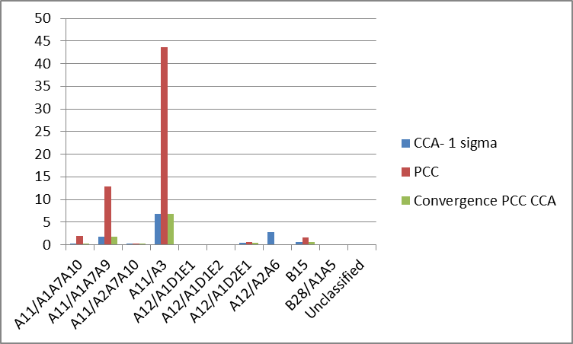
PCC vs CCA
How much?
PCC →% of changes: 62,1 of grassland 2011
CCA – 1 sigma →% of changes: 12,9 of grassland 2011
Convergenza tra i due→% of changes: 10,1 of grassland 2011
How?
2017
When?
IV ECOPOTENTIAL General Meeting
Rome, 20-24 May 2019

Slide 16
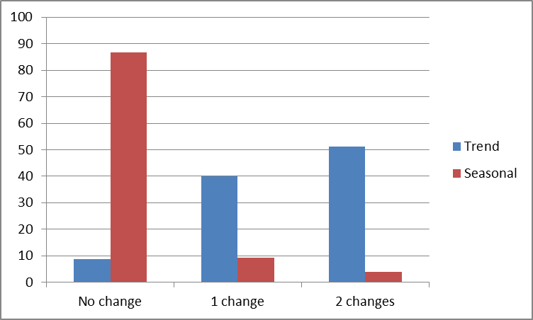
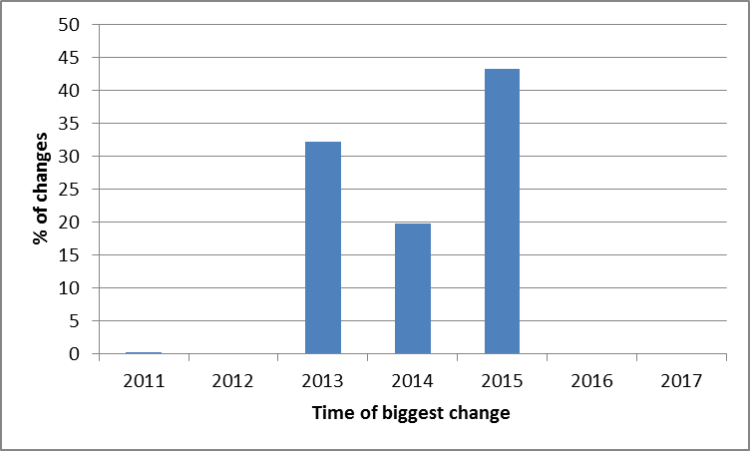
BFAST
Convergence of evidence
When?
Pixels di change in BFAST mostly in the trend indicating class transitions:
Less than 10% are not changes in BFAST
40% has only one change in the period
50% has two change in the period
Most changes occur in 2015
IV ECOPOTENTIAL General Meeting
Rome, 20-24 May 2019

Slide 17
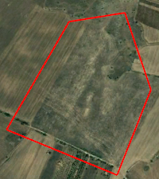
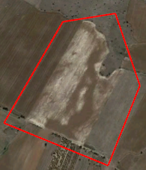
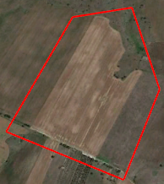
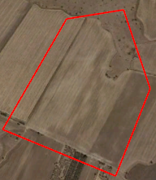
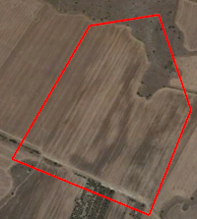
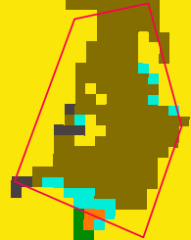
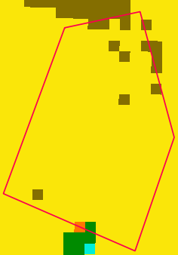
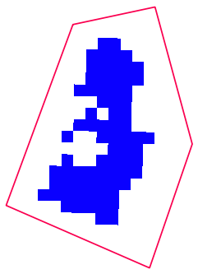
Close-up 1
September, 5th 2010
September, 25th 2013
May, 30th 2015
August, 26th 2017
July, 20th 2018
LEGEND LC
FAO-LCCS2
 | A11/A1A7A10
 | A11/A1A7A9
 | A11/A2A7A10
 | A11/A3 herbaceous cultivated
 | A12/A1D1E1
 | A12/A1D1E2
 | A12/A1D2E1
 | A12/A2A6 grassland
 | B15
 | B28/A1A5
Changes from Natural Grasslands to Other
No Changes/Not considered area
Grassland -> cultivated transition
LC map 2011
LC map 2017
Change from CCA
2011-2017
1:10.000
IV ECOPOTENTIAL General Meeting
Rome, 20-24 May 2019

Slide 18
Close-up 1
September, 5th 2010
September, 25th 2013
May, 30th 2015
August, 26th 2017
July, 20th 2018
2011
2012
2013
2014
2015
2016
2017
MSAVI
Time of biggest
change
# of trend
changes
1:10.000
IV ECOPOTENTIAL General Meeting
Rome, 20-24 May 2019

Slide 19
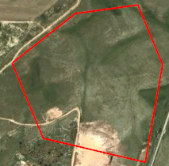
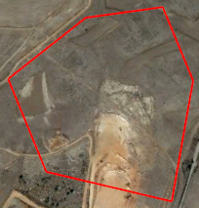
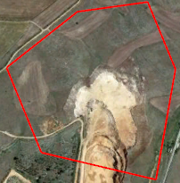
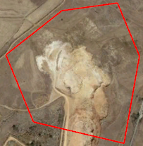
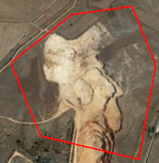
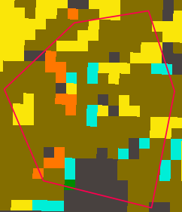
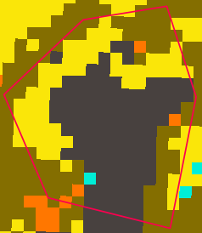
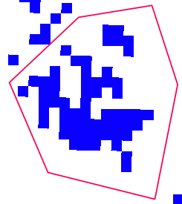
Close-up 2
May, 13th 2010
September, 25th 2013
May, 30th 2015
August, 26th 2017
July, 20th 2018
LEGEND CHANGE
GRASSLANDS TRANSITIONS INTO:
 | A11/A1A7A10
 | A11/A1A7A9
 | A11/A2A7A10
 | A11/A3
 | A12/A1D1E1
 | A12/A1D1E2
 | A12/A1D2E1
 | B15
 | NO CHANGE
Changes from Natural Grasslands to Other
No Changes/Not considered area
Grassland -> extraction site transition
LC map 2011
LC map 2017
Change from CCA
2011-2017
1:10.000
IV ECOPOTENTIAL General Meeting
Rome, 20-24 May 2019

Slide 20
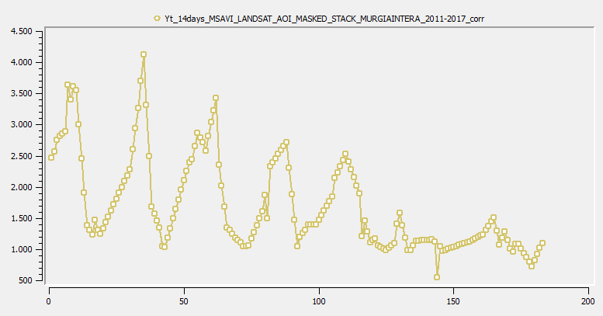
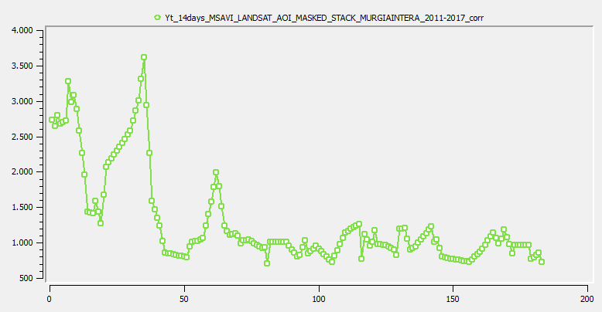
Close-up 2
May, 13th 2010
September, 25th 2013
May, 30th 2015
August, 26th 2017
July, 20th 2018
2011
2012
2013
2014
2015
2016
2017
MSAVI
2011
2012
2013
2014
2015
2016
2017
Time of biggest
change
# of trend
changes
MSAVI
1:10.000
IV ECOPOTENTIAL General Meeting
Rome, 20-24 May 2019

Slide 21
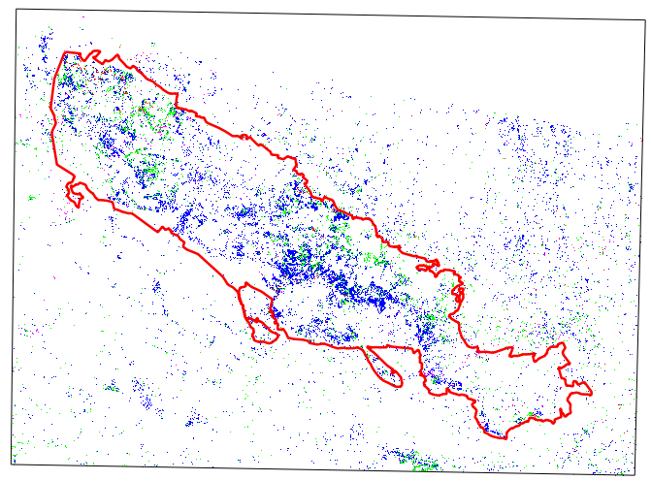
Habitat mapping from inter-annual Landsat time series
Few number of ground truth polygons: their number of pixels at 30 m. is further reduced
1:700.000
LEGEND HABITAT
Annex 1 to Habitat Directive
 | 6210
 | 6220-HYPARRENIA HIRTA
 | 62A0
 | GRASSLAND NO HABITAT
Supervised classification
SVM classifier
RBF kernel function
26 intra-annual MSAVI Landsat images 2017
OA%=96.97±1.62%
?????

Slide 22
Main Results
The use of intra-annual TS represents the possibility to consider the phenology evolution of vegetation LC classes: grasslands was among the better identified LC classes (high accuracy ≈90% for 2011 used as reference T₁ map for change detection)
Ground truth useful for LC maps validation is obtainable by in field campaign (as through Richard Lucas’ mobile app) but for LCC maps validation it is not possible to obtain in field information back in time: the problem can be approached by convergence of the results by different methods (convergence of evidence).
For those pixels of changes detected by both CCA and PCC methods, information about where they occurred in a certain period and the specific arrival transition can be known. Bfast can add information about the year/month when changes occurred.
Intra-annual TS perform better than 4 multi-seasonal VHR images for the habitat mapping.
All the products can be ingested in EODESM
Next advancements:
Study of other spectral indexes from Landsat
Use of spectral indexes from Sentinel-2 TS (RedEdge, 10 m. could be better than 30m. even though grassland patch in Murgia Alta are rather extensive)

Slide 23
Thanks for your
attention!!!
IV ECOPOTENTIAL General Meeting
Rome, 20-24 May 2019

