Slide 1
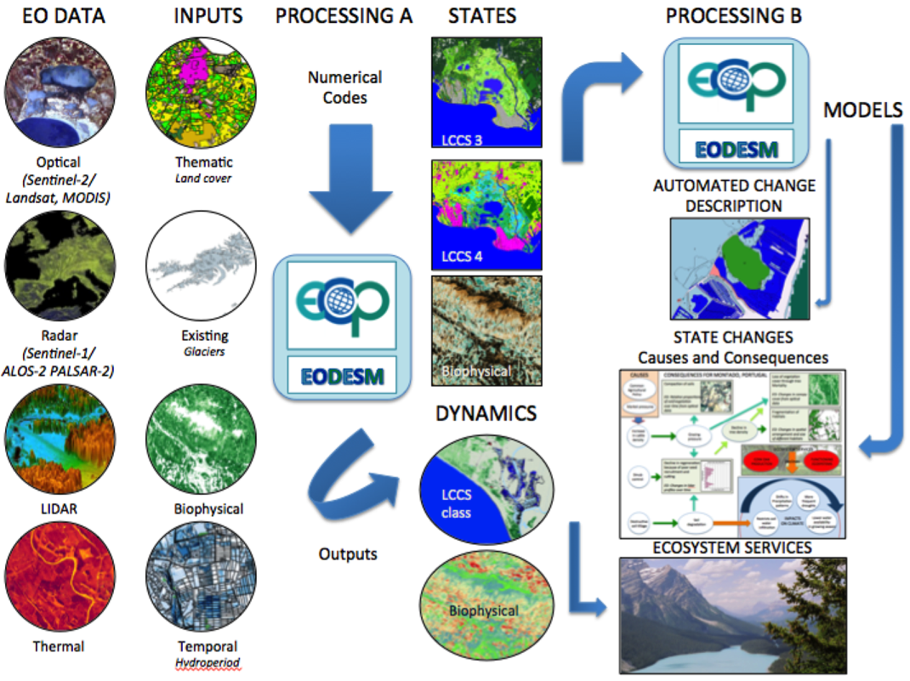

Satellite time-series analysis for Ecosystem monitoring within HORIZON2020 ECOPOTENTIAL and ERA-PLANET
M. Adamo, C. Tarantino, S. Vicario, P. Blonda (CNR-IIA)
https://www.ecopotential-project.eu
on behalf of the ECOPOTENTIAL partners involved in EO data generation and harmonization
ECOPOTENTIAL project: improving future ecosystem benefits through EO
2015-2019; 46 Partners
Coordinator: Antonello Provenzale (CNR)
Project manager: C. Marangi (CNR-IAC)
ECOPOTENTIAL considers cross-scale geosphere-biosphere interactions at regional to continental scales, addressing long-term and large-scale environmental and ecological challenges.
The Earth Observation Data for Ecosystem Monitoring (EODESM)
Prof. Richard Lucas, Aberystwyth University, Ceredigion, Wales (UK)

Slide 2


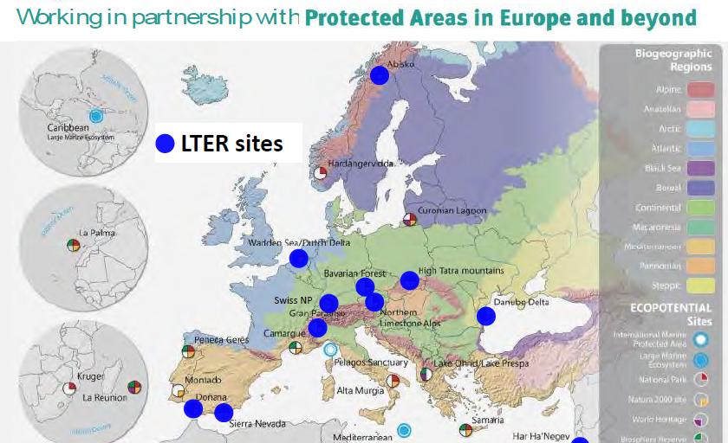
The project contribution to the engagement priorities of UN Sustainable Development Goal (SDG) 15
Goal 15: Protect, restore and promote sustainable use of terrestrial ecosystems, …, halt and reverse land degradation and biodiversity loss
Production and dissemination of new knowledge for informed decision making by:
  Monitoring: EVs, Ecosystem extent and functioning, and changes through the Earth Observation Data for EcoSystem Monitoring (EODESM) system
  Modelling: Macro-systems Ecology and scenario analysis for future Protected Areas protections
  Fostering the transition from the web of data to the web of knowledge: Models and services are fed into the Virtual Laboratory (VL) platform
  Developing a community of practices. It involves researchers, PA managers, and policy makers –

Slide 3




















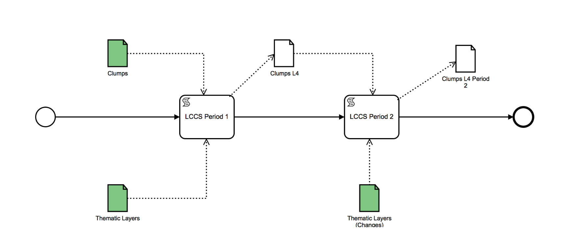













Virtual Laboratory (VL): from data to knowlegde
Knowledge bases
EO products
EO Infrastructure
Datasets
ECOPOTENTIAL
VLAB
Long-term preservation
archives
VLab APIs
VLab
Portal and apps
EODESM
Source code
EODESM Workflow
Remote processing services
Credits: P. Mazzetti (CNR). WP10
VLAB End User
The project virtual environment to facilitate the activities in the ecosystem community-of-practice

Slide 4
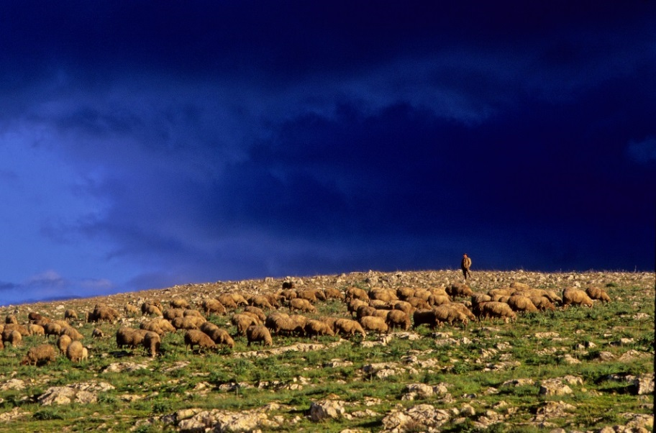
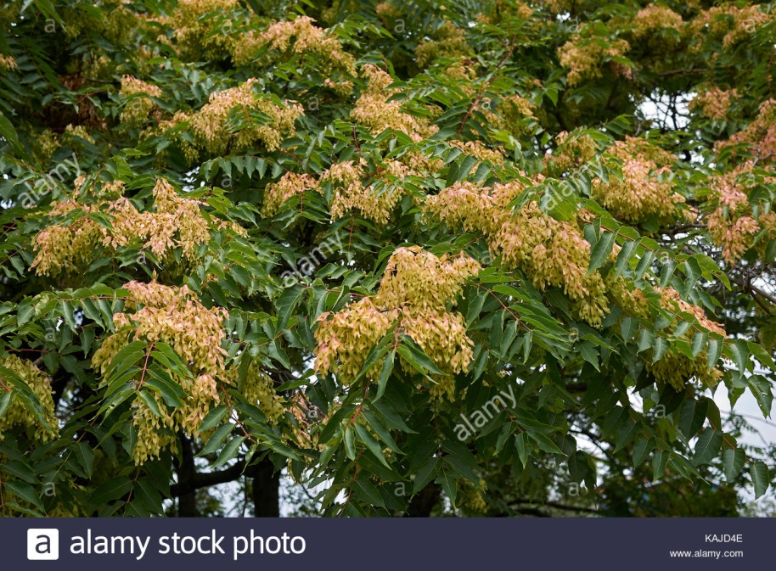
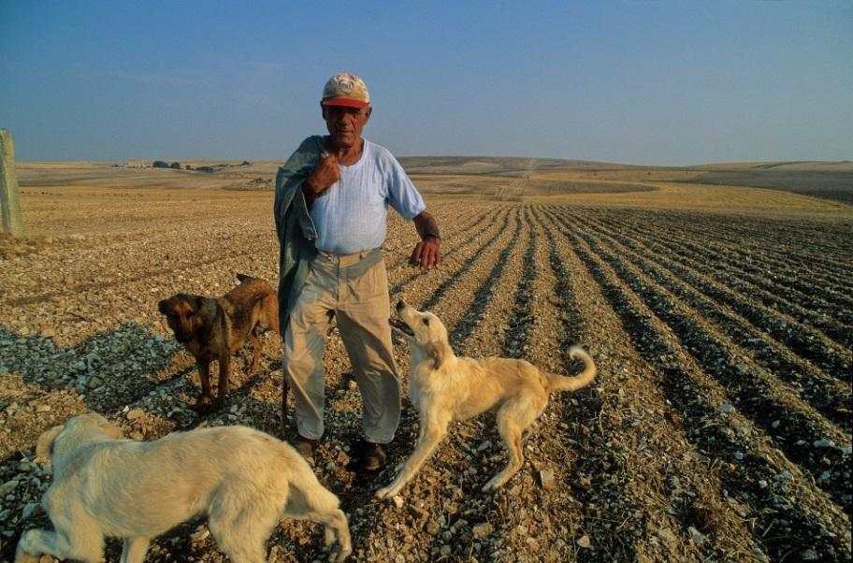
Natural grasslands ecosystem in Murgia Alta
Threaths
Rock graining in natural grasslands for agriculture purposes: land degradation;
Ailanthus altissima invasion;
Users requirements
Grasslands habitats (i.e., 6210; 62A0; 6220) extent and Conservation status
Changes
Sentinel-2 data intra-annual time series
Landsat time series 2010-2018;
Multi-seasonal Worlview-2/3 imagery

Slide 5
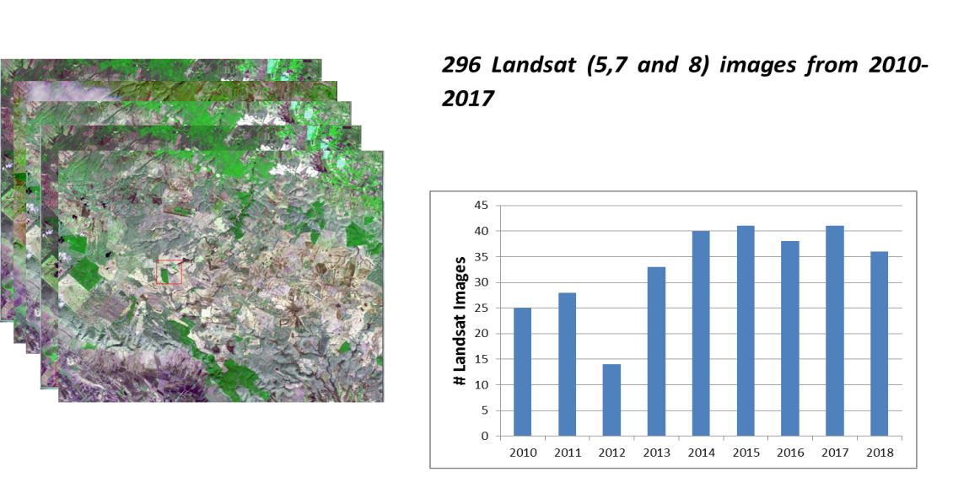
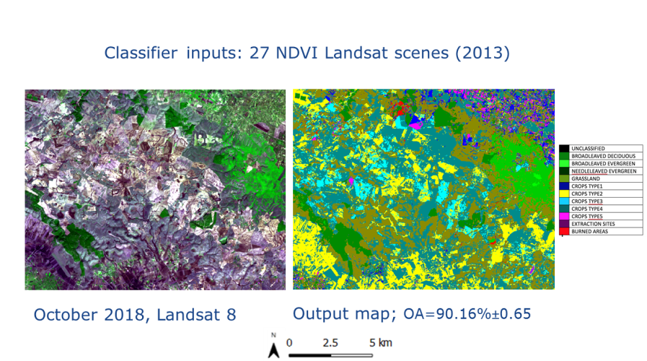
Data Cube in the ftp RECAS site
Inter and intra-annual time series (TS) of Copernicus data for semi-operational to operational:
  LC mapping when the lack of information layers and ground truth data may hamper EODESM classification and subsequent habitat mapping;
  Multi-temporal change detection in LC and Essential Variables (e.g., GPP);
  Evaluation of management policies effectiveness, e.g., eradication of A. Altissima.

Slide 6
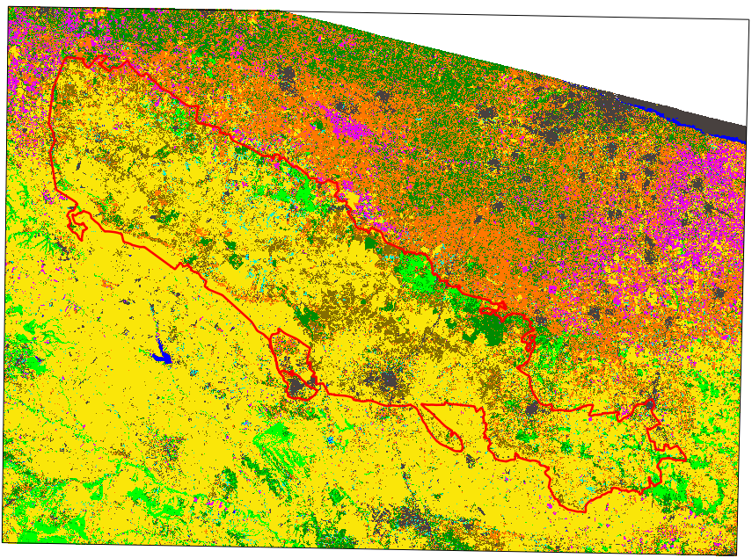
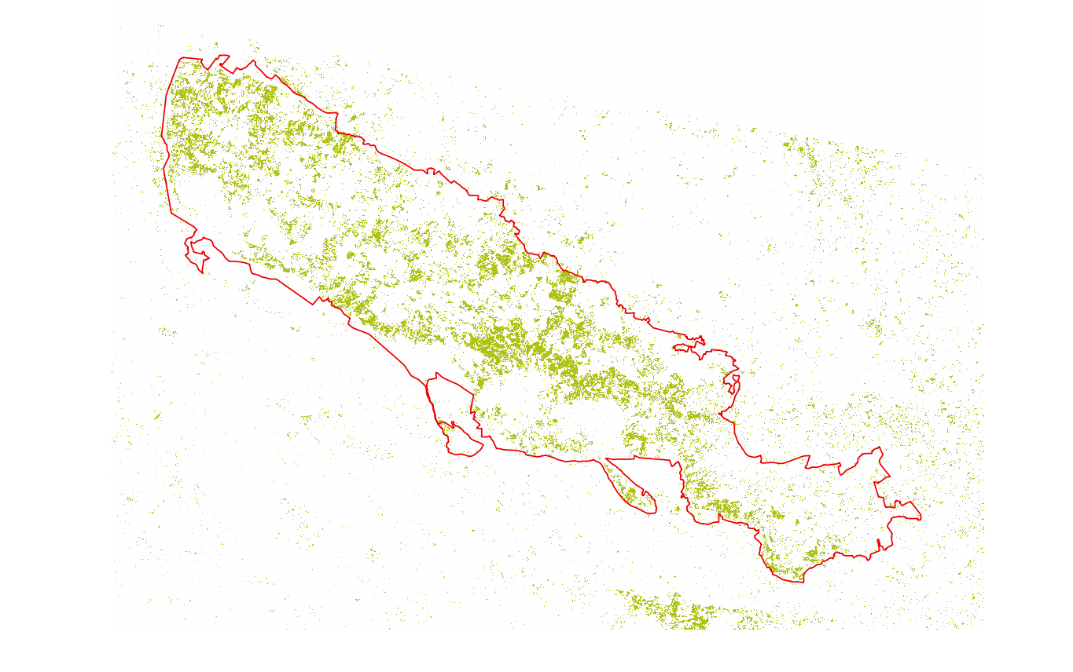


LC mapping from intra-annual Landsat time series
Land Cover map (2017)
OA=85.8%±1.71%
FAO-LCCS Taxonomy
 | A11/A1A7A10 Cultivated/TreesBroadleavedDeciduous
 | A11/A1A7A9 Cultivated/TreesBroadleavedEvergreen
 | A11/A2A7A10 Cultivated/ShrubsBroadleavedDeciduous
 | A11/A3 Cultivated/Herbaceous
 | A12/A1D1E1 Natural/BroadleavedEvergreen
 | A12/A1D1E2 Natural/BroadleavedDeciduous
 | A12/A1D2E1 Natural/NeedleleavedEvergreen
 | A12/A2A6 Natural/HerbaceousGraminoids
 | B15 Artificial Surfaces
 | B28/A1A5 Natural/WaterStading
Grasslands mapping recognized with high accuracy (F1 score≈90%)
Most grasslands misclassification with A11/A3 (cultivated herbaceous) and B15 (mainly extraction sites, abandoned land)
F1 score= $\frac{2∗User^{′}s∗Producer^{′}s}{User^{′}s+Producer^{′}s}$
1:900.000
IV ECOPOTENTIAL General Meeting
Rome, 20-24 May 2019

Slide 7
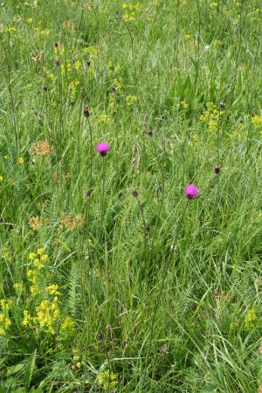
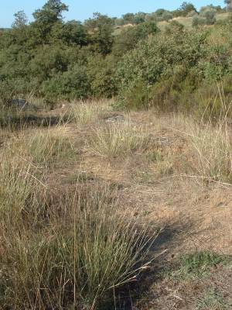
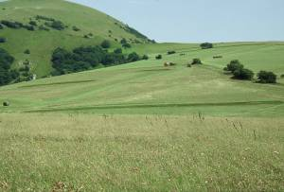
From LC to Habitats
6210
62A0
6220
(Hyparrhenia hirta)
Can phenology from intra-annual TS help in habitat discrimination?
Reference fields available for natural grasslands Annex 1 habitats:
6210 Semi-natural dry grasslands and scrubland facies on calcareous substrates (Festuco-Brometalia)
62A0 Eastern submediterranean dry grasslands (Scorzoneretalia villosae)
6220 Pseudo-steppe with grasses and annuals of the Thero-Brachypodietea (Hyparrhenia hirta)
IV ECOPOTENTIAL General Meeting
Rome, 20-24 May 2019

Slide 8
INTRA_ANNUAL: Habitat mapping flow chart
MSAVI: Modified Soil Adjusted Vegetation Index
INPUT
Intra-annua MSAVI TS from
26 Landsat L2A images, 2017
SVM°
INPUT:
10-classes reference LC data
LC map 2017
Natural Grasslands layer
SVM°
INPUT:
4-classes reference habitat data
Habitat map
  °Radial Basis Function (RBF) as kernel function

Slide 9
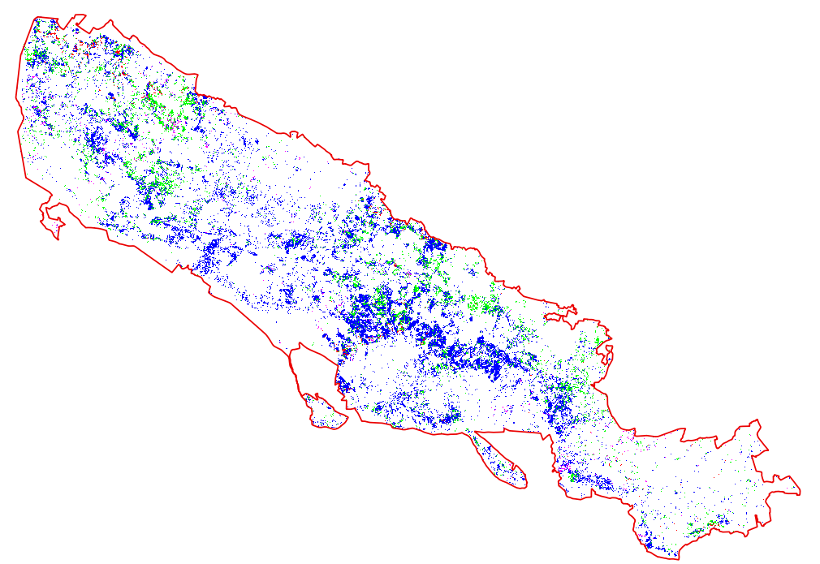
1. Habitat mapping from inter-annual Sentinel-2
SVM classifier
OA(%)=96.97±1.62
Annex 1 HABITAT
 | 6210
 | 62A0
 | 6220-Hyparrhenia hirta
 | Other
Future work:
  Multiple input spectral indexes from both Landsat and Sentinel-2 data
1:700.000

Slide 10
2. Inter and Intra-annual time series for change
Issue: no change ground truth available for change maps validation
Proposed solution:
Convergence of evidence from different change detection algorithms:
  Cross Correlation Analysis (CCA) between one map and a recent image (where?);
  Post Classification Comparison (PCC) of two supervised classified maps (from-to);
  Breaks For Additive Season and Trend (BFAST) analysis of Landsat TS (when?)
IV ECOPOTENTIAL General Meeting
Rome, 20-24 May 2019

Slide 11
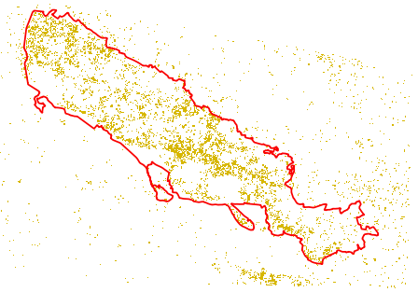
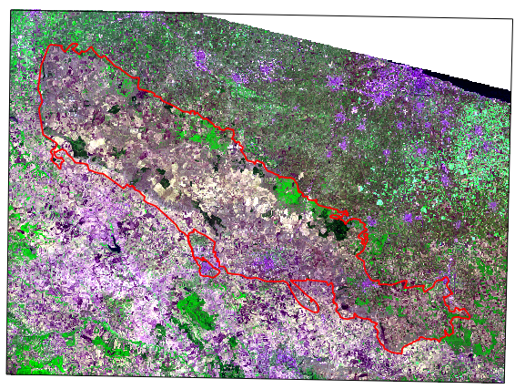
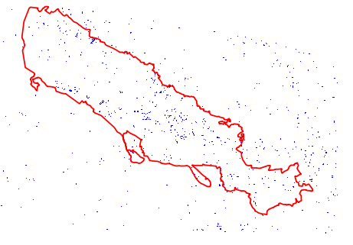
2. 1 Change CCA: 2011-2017
Natural Grasslands from LC map (T₁=2011)
Landsat 8 image (T₂=2017)
1:1.000.000
Area |  | Natural Grasslands (2011)
(km²)
AOI | ≈5300 | ≈290
PA | ≈1350 | ≈217
Copernicus Natural Grasslands layer
Change map from CCA
(2011-2017, TH=µ±1σ)
August 2017
False colour composite:
band 4, band 5, band 2.
%Change of Natural Grasslands
Within PA | ≈9.31
Within a buffer of 10 km around PA | ≈21.5
Changes from Natural Grasslands to Other
No Changes/Not considered area

Slide 12
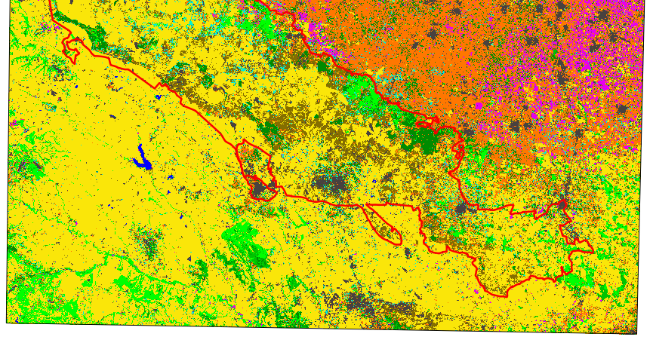
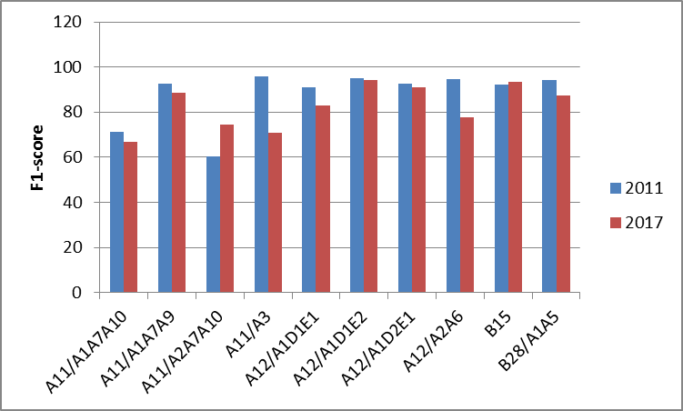
2.2 Change PCC: 2011-2017 input LC maps
LC map (T₁=2011)
LC map (T₂=2017)
OA=93.1%±1.24%
1:900.000
OA=85.8%±1.71%
FAO-LCCS Taxonomy
 | A11/A1A7A10 Cultivated/TreesBroadleavedDeciduous
 | A11/A1A7A9 Cultivated/TreesBroadleavedEvergreen
 | A11/A2A7A10 Cultivated/ShrubsBroadleavedDeciduous
 | A11/A3 Cultivated/Herbaceous
 | A12/A1D1E1 Natural/BroadleavedEvergreen
 | A12/A1D1E2 Natural/BroadleavedDeciduous
 | A12/A1D2E1 Natural/NeedleleavedEvergreen
 | A12/A2A6 Natural/HerbaceousGraminoids
 | B15 Artificial Surfaces
 | B28/A1A5 Natural/WaterStading
IV ECOPOTENTIAL General Meeting
Rome, 20-24 May 2019
Validazione e confusioni di grassland nei due anni (pat)

Slide 13
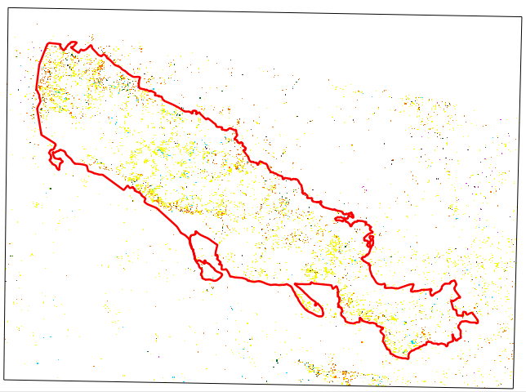
PCC (2011-2017) output change map
OA=OA_{T1}.OA_{T2}=79.9%
GRASSLANDS TRANSITIONS INTO:
 | A11/A1A7A10 Cultivated/TreesBroadleavedDeciduous
 | A11/A1A7A9 Cultivated/TreesBroadleavedEvergreen
 | A11/A2A7A10 Cultivated/ShrubsBroadleavedDeciduous
 | A11/A3 Cultivated/Herbaceous
 | A12/A1D1E1Natural/BroadleavedEvergreen
 | A12/A1D1E2 Natural/BroadleavedDeciduous
 | A12/A1D2E1 Natural/NeedleleavedEvergreen
 | B15 Artificial Surfaces
 | NO CHANGE
%Change of Natural Grasslands
Within PA | ≈56.35
Within a buffer 10 km around PA | ≈80.05
Change map from PCC
(2011-2017)
1:700.000
From-to class transitions are detected
IV ECOPOTENTIAL General Meeting
Rome, 20-24 May 2019

Slide 14
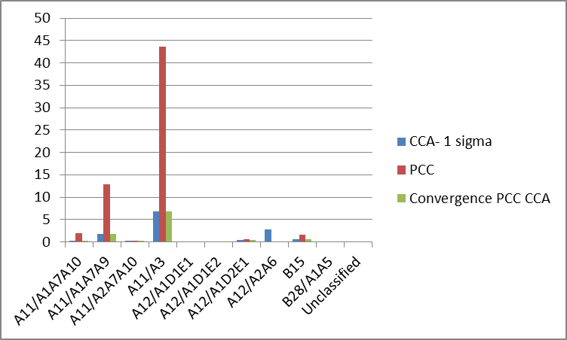
Convergence of evidence
%Change of Natural Grasslands
Intersection PCC-CCA |  | CCA | PCC
Within PA | ≈6.9 | ≈9.31 | ≈56.35
Within a buffer 10 km around PA | ≈18.3 | ≈21.5 | ≈80.05
PCC overestimation of grasslands transition to Cultivated/Herbaceous (A11/A3) may be due to misclassifications in the 2 input LC maps;
Convergence of evidence between PCC and CCA can reduce this overestimation.
From-To?
Grasslands change in CCA and not in PCC
IV ECOPOTENTIAL General Meeting
Rome, 20-24 May 2019

Slide 15
    EODESM long-term analysis: Breaks For Additive Season and Trend (BFAST)
BFAST analysis of 296 inter- annual Landsat time series
Seasonality for
forested area:
Break point
Trend:
Deforestation to regrowth

Slide 16
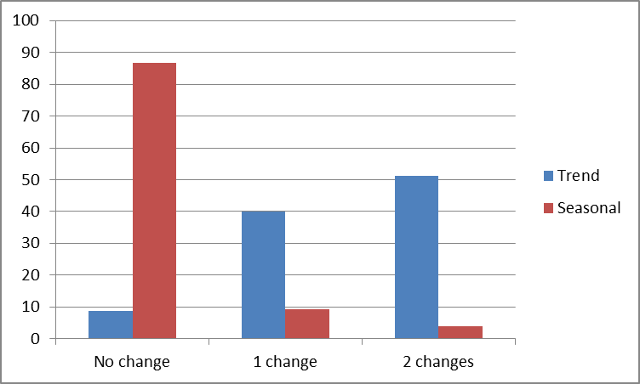
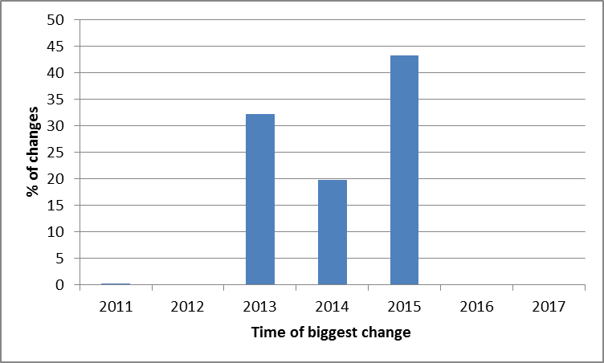
BFAST: 2010-2018 time series
BFAST was finally applied to pixels identified as changes by both PCC and CCA:
BFAST recognizes most of such changes in the Trend component
≈ 10% no change;
≈40% with 1 change;
≈50% with 2 change
≈ 30% changes in 2013;
≈20% changes in 2014;
≈40% changes in 2015
Distributed over time :
When?

Slide 17
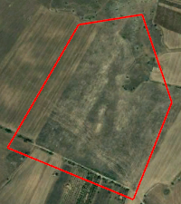
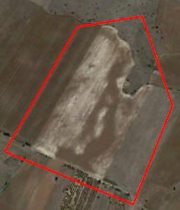
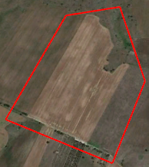
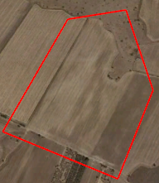
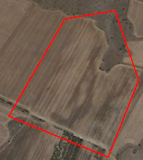
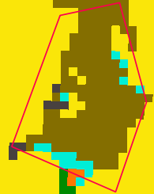
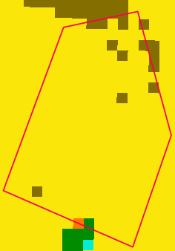
Close-up 2
September, 5th 2011
September, 25th 2013
May, 30th 2015
August, 26th 2017
July, 20th 2018
GRASSLANDS TRANSITIONS INTO:
 | A11/A1A7A10 Cultivated/TreesBroadleavedDeciduous
 | A11/A1A7A9 Cultivated/TreesBroadleavedEvergreen
 | A11/A2A7A10 Cultivated/ShrubsBroadleavedDeciduous
 | A11/A3 Cultivated/Herbaceous
 | A12/A1D1E1Natural/BroadleavedEvergreen
 | A12/A1D1E2 Natural/BroadleavedDeciduous
 | A12/A1D2E1 Natural/NeedleleavedEvergreen
 | B15 Artificial Surfaces
 | NO CHANGE
LC map 2011
LC map 2017
Grassland -> cultivated transition
1:10.000
IV ECOPOTENTIAL General Meeting
Rome, 20-24 May 2019

Slide 18
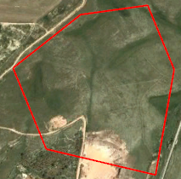
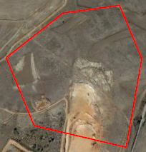
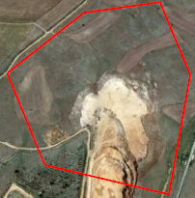
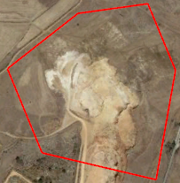
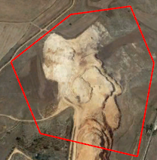
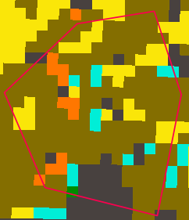
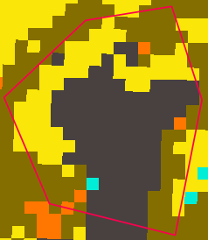
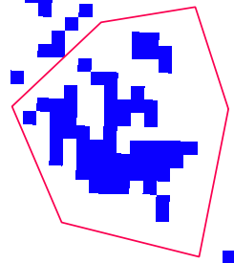
Close-up 2
May, 13th 2010
September, 25th 2013
May, 30th 2015
August, 26th 2017
July, 20th 2018
LEGEND CHANGE
GRASSLANDS TRANSITIONS INTO:
 | A11/A1A7A10
 | A11/A1A7A9
 | A11/A2A7A10
 | A11/A3
 | A12/A1D1E1
 | A12/A1D1E2
 | A12/A1D2E1
 | B15
 | NO CHANGE
Changes from Natural Grasslands to Other
No Changes/Not considered area
Grassland -> extraction site transition
LC map 2011
LC map 2017
Change from CCA
2011-2017
1:10.000
IV ECOPOTENTIAL General Meeting
Rome, 20-24 May 2019

Slide 19
Thanks for your
attention!!!

