Slide 1
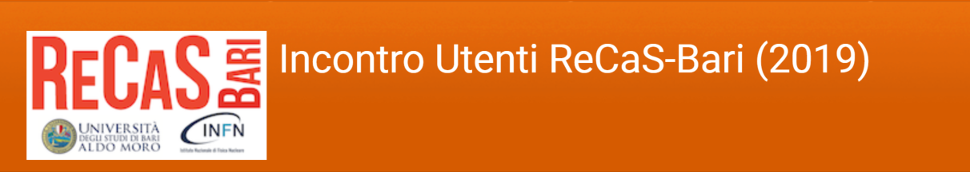

Osservazione della superficie della Terra e investigazione dei fenomeni naturali dallo spazio: scenari correnti e futuri
Albano M., Atzori S., Bignami C., Moro M., Polcari., Salvi S., Tolomei C., Stramondo S.

Slide 2
INGV – ReCaS collaboration: yesterday, today…
Obiettivi:
- Progettazione, realizzazione e implementazione di una infrastruttura cloud per la
ricezione, il trattamento e l’archiviazione dati provenienti dalle reti sismica e geodetica della regione PUGLIA presso il datacenter ReCaS;
- Realizzazione di un’acquisizione centralizzata delle risorse di monitoraggio sismico
e geodetico presenti sul territorio della Regione Puglia;
- Calcolo in tempo reale di mappe di scuotimento a partire dai dati della Rete Sismica Nazionale acquisiti dal datacenter ReCaS;
- Calcolo di soluzioni geodetiche a partire dai dati della Rete Integrata Nazionale GNSS dell’INGV.
Nel 2019 sono iniziate le attività con ReCaS nell’ambito del Telerilevamento Satellitare

Slide 3
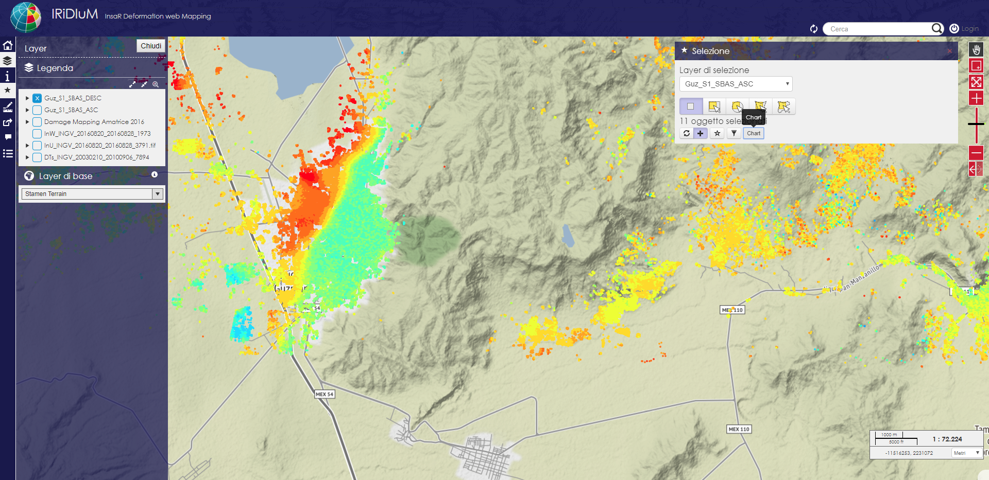
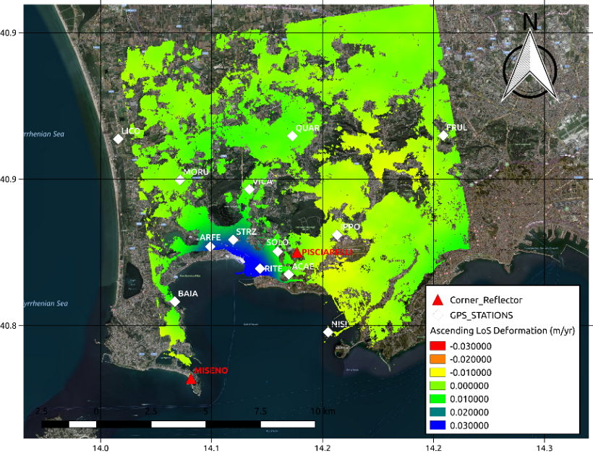
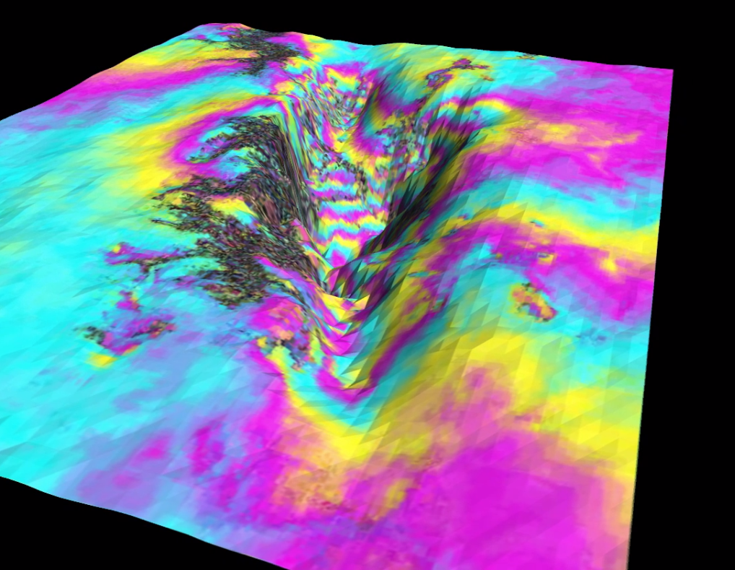
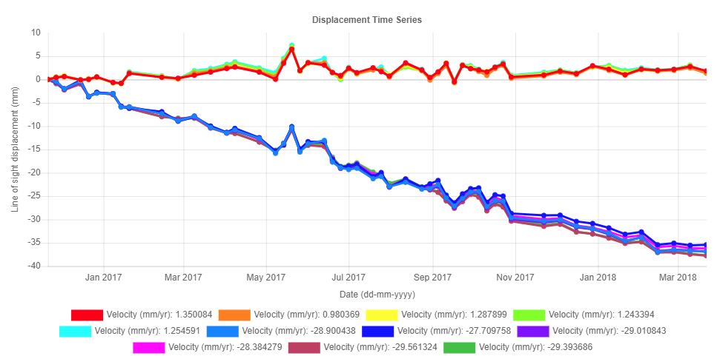
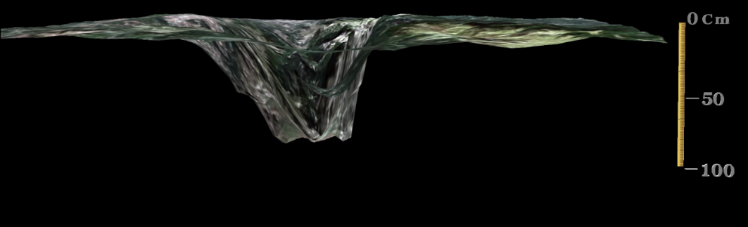
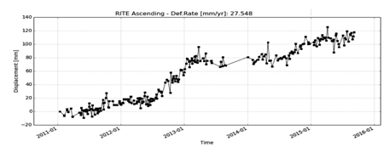
INGV – ReCaS collaboration: … and tomorrow
The INGV GEOSAR Laboratory widely produces and exploits InSAR processing outcomes for studying the phenomena characterizing Earth’s surface
Subsidence of about 1m of the Castelluccio plain.
Multi-temporal InSAR in Campi Flegrei

Slide 4
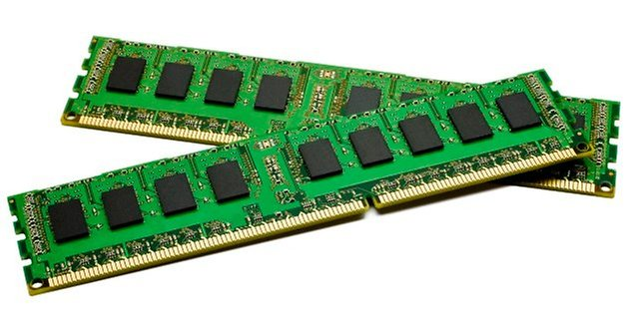

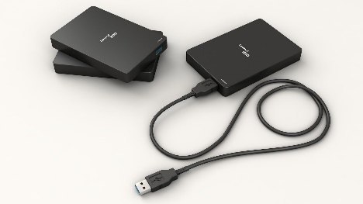
INGV – ReCaS collaboration: … and tomorrow
Improvements in designing sensors and satellites led to growing development of space programs
Cosmo-SkyMed (ASI)
ALOS-1/2 (JAXA)
Radarsat-1/2 (CSA)
TerraSAR-X/Tandem-X (DLR)
Sentinel-1 (ESA)
Each mission provide SAR data with different resolution, spatial coverage, revisit time etc.
Very huge amount of SAR images (ex. Each S1 image is about 7Gb -> ~ 420Gb/anno)
Sentinel-1A/B missions provide images of areas of ~ 250Km every 6 days, allowing a near-real time updating of SAR deformation maps
Collaboration with the data center ReCaS-Bari
GEOSAR Lab INGV needs moving from workstation data processing towards cloud data processing and storage to minimize computational time and overcome data archiving problems

Slide 5
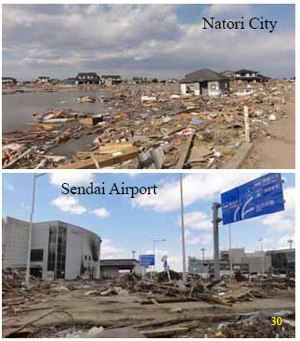
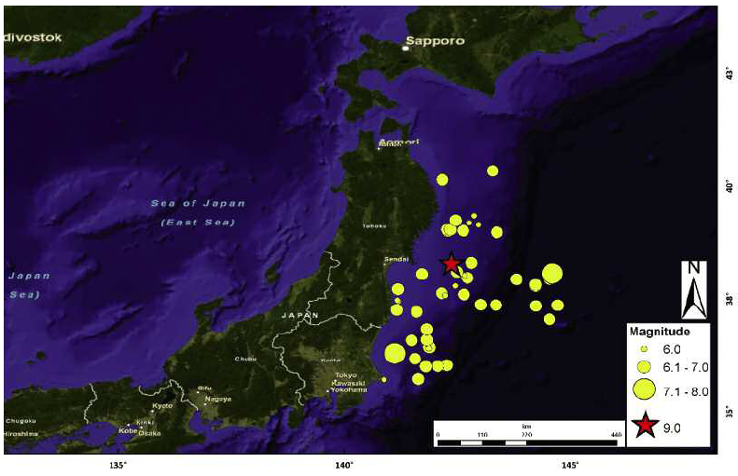
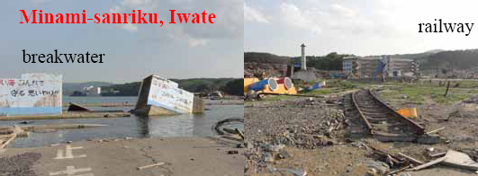
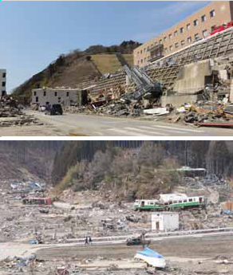
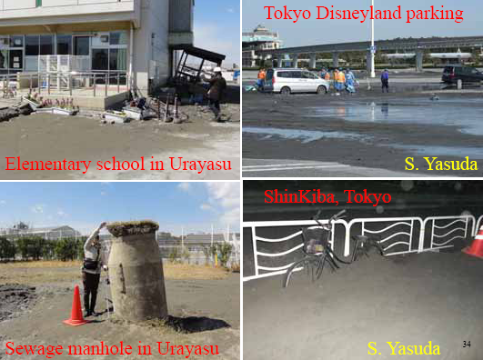

Slide 6
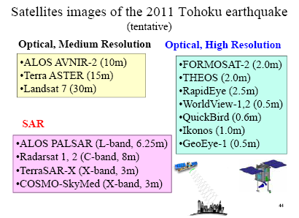
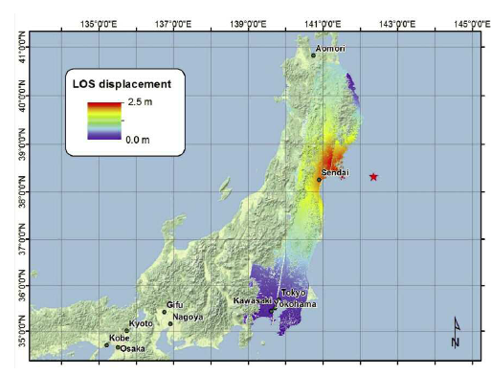
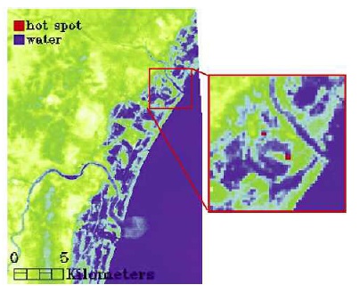
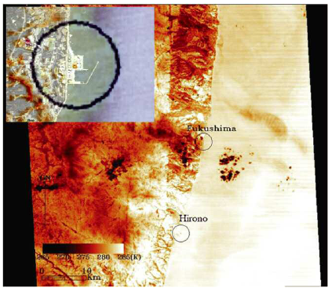
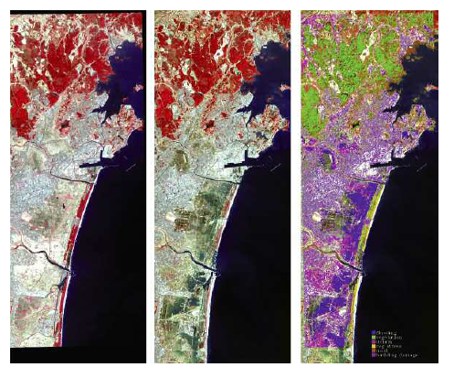
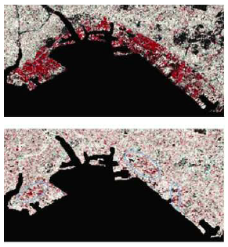
Satellites “view”, “detect”, “measure”
Displacement
Fires
At different scales, “Remote Sensing”
provides a synoptic view of the investigated area
Liquefaction
Infrastructures
Inundation and debris

Slide 7
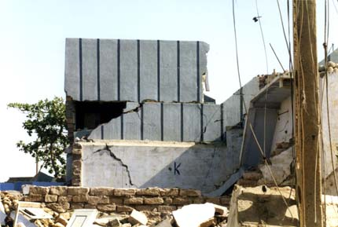
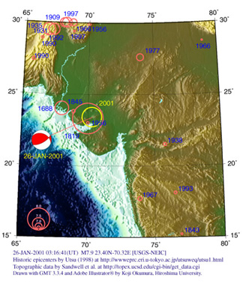
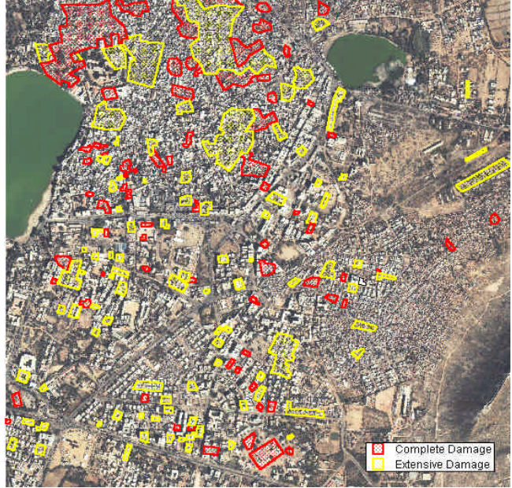
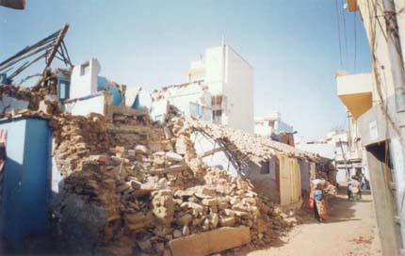
Buji earthquake
2001
Remote Sensing is helpful in “remote” regions
and for large scale disasters. Although in the past...

Slide 8
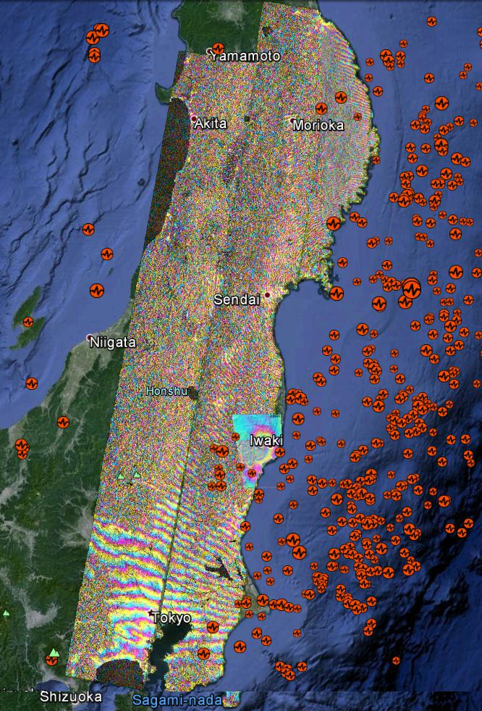
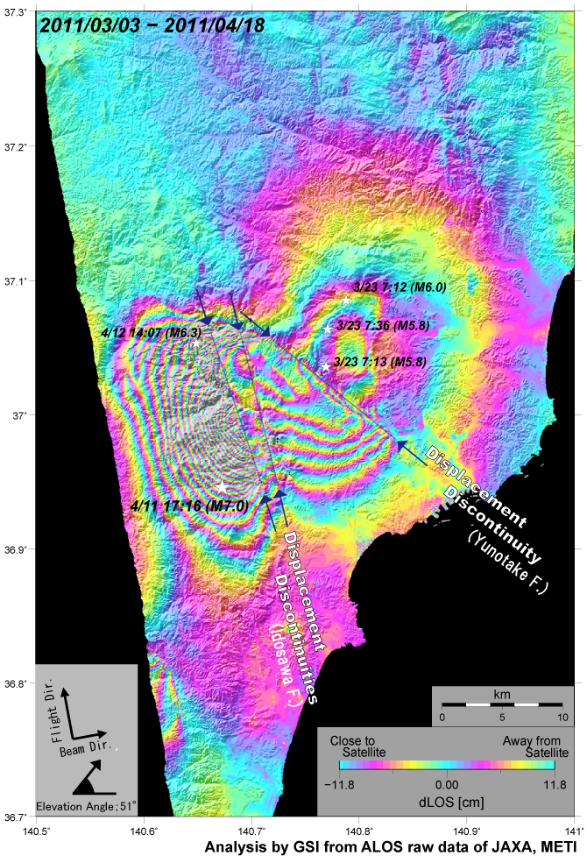
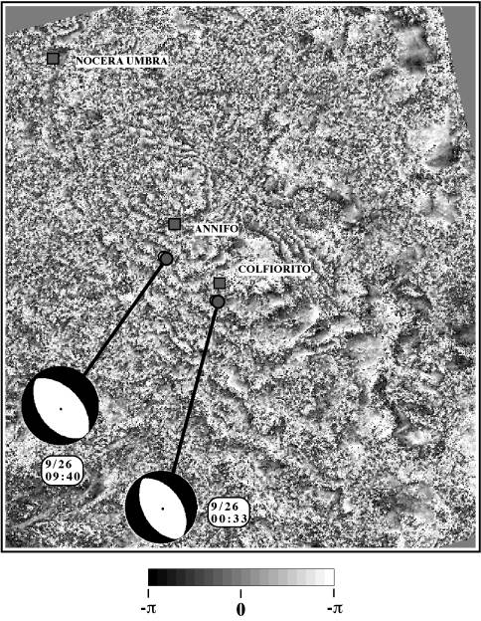
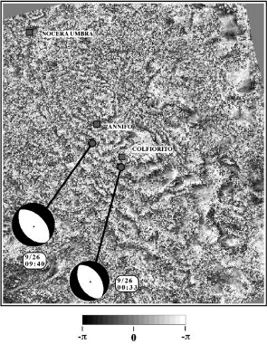
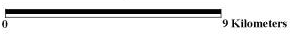
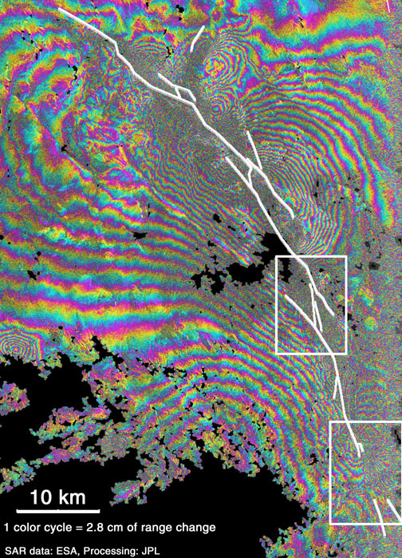
Limits, capabilities, synergic use of EO data
~ 3 m average and up to 6.2 meters of right-lateral displacement
~ 25 cm of vertical displacement
>500 km

Slide 9
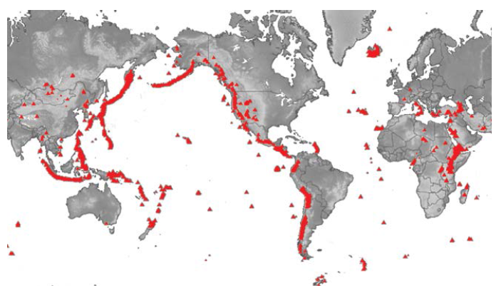
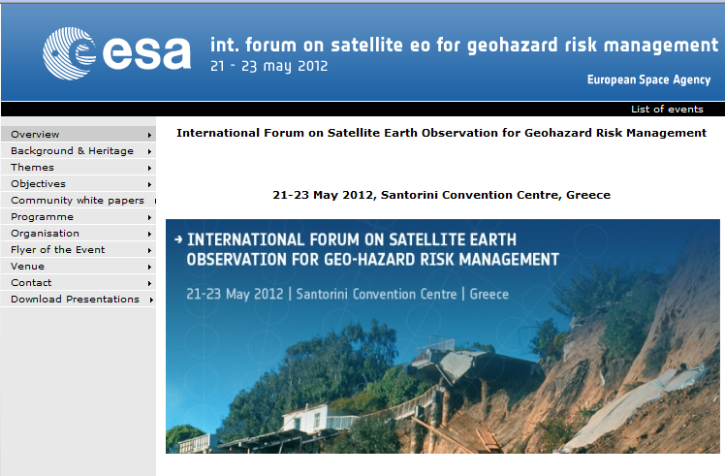
Geohazard priorities
- About 1500 volcanoes are known to have erupted in the last 12 000 years (the
Holocene Era);
about 700 of these, mostly subaerial, have erupted at least once in historical times (Siebert et al., 2010).
Worldwide, about 100 volcanic unrests are observed yearly, and about a half of them become observable eruptions.
It is estimated that less than 10% of active volcanoes are monitored on an on-going basis, meaning that about 90% of potential volcanic hazards do not have a dedicated observatory and are either monitored occasionally, or never…
from GeoHazard week 2012
ESA Publication

Slide 10
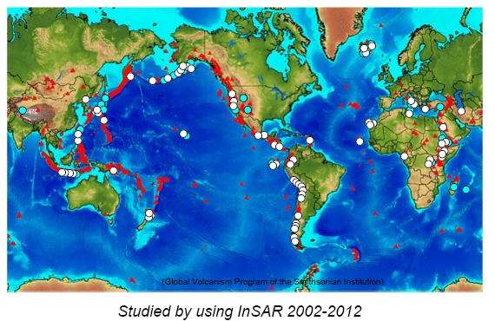
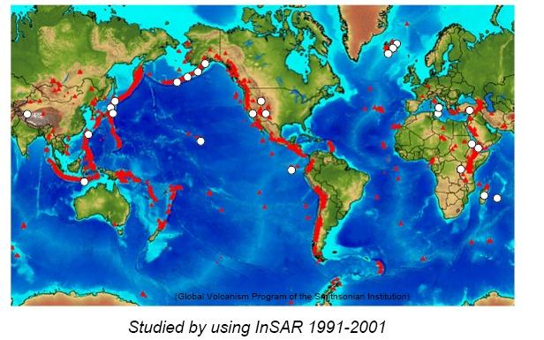
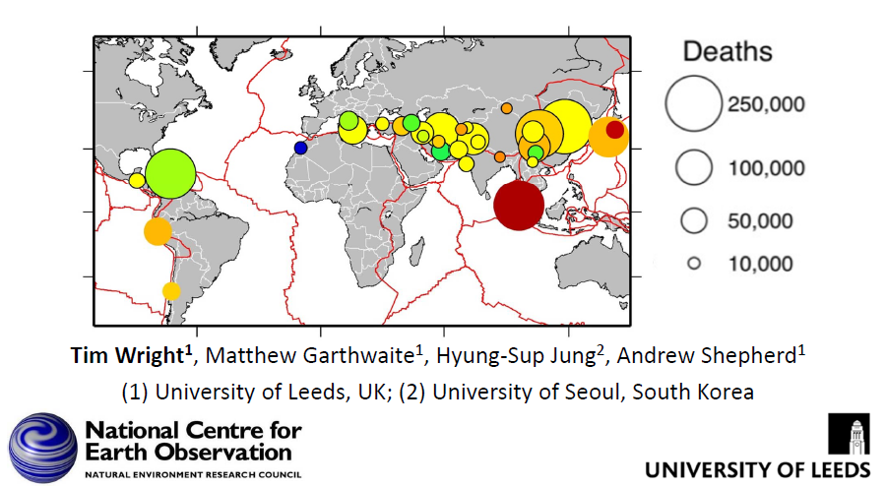
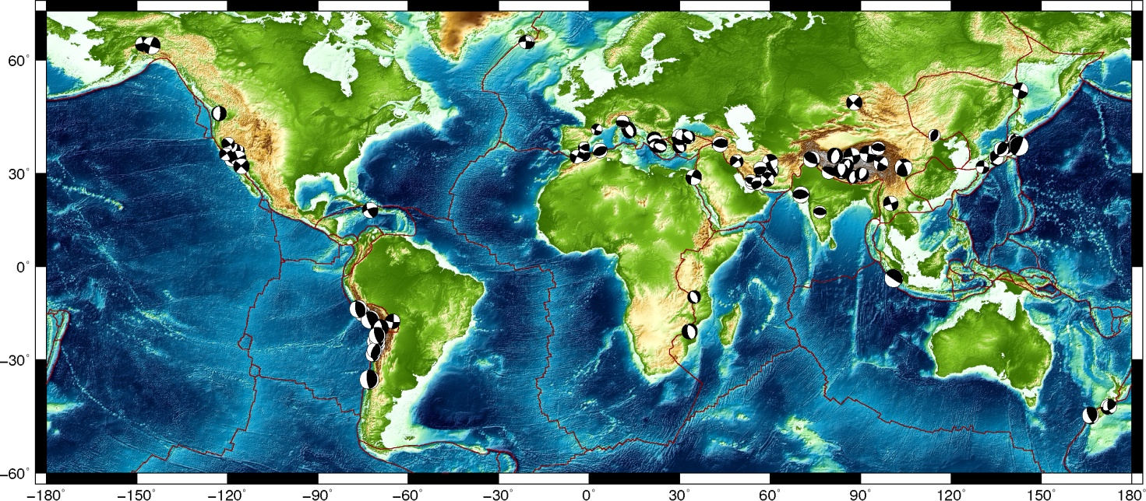
Volcanoes studied using DInSAR
from G. Puglisi, Santorini Forum, May 2012
100 Earthquakes studied in 1992-2012 based on the use of DInSAR
(from Wright T.J. et al., 2013)

Slide 11
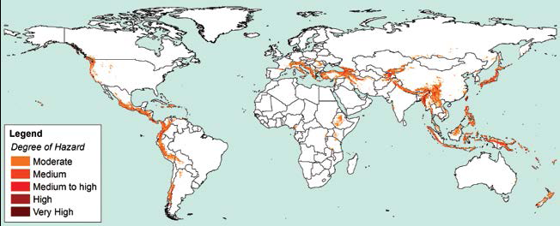
Geohazard priorities
Global Landslide Hazard Distribution (GDLND), derived from the landslide hotspot map at global scale (Nadim et al., 2006) based on a heuristic landslide hazard model considering slope, lithology, soil moisture, precipitation, temperature and seismicity.
from GeoHazard week 2012
ESA Publication
The Great Wenchuan earthquake in 2008 triggered more than 60 000 landslides.

Slide 12
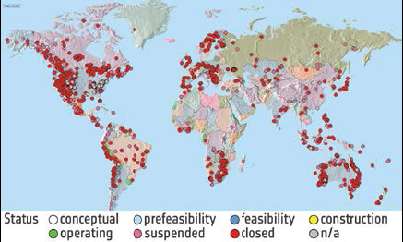
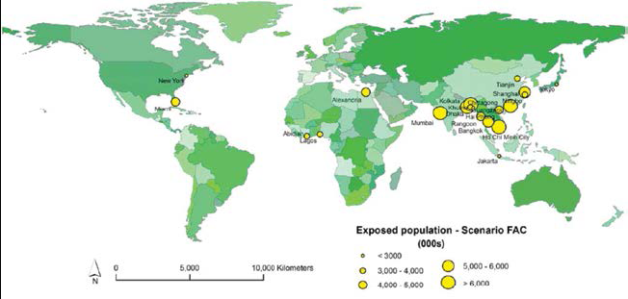
Geohazard priorities
Inactive Mines of the world (Source: Raw Material Group 2012, www.rmg.se)
Top 20 cities for coastal flood risk by exposed population in 2070 (Source: Nicholls et al (2007), OECD, Paris)

Slide 13
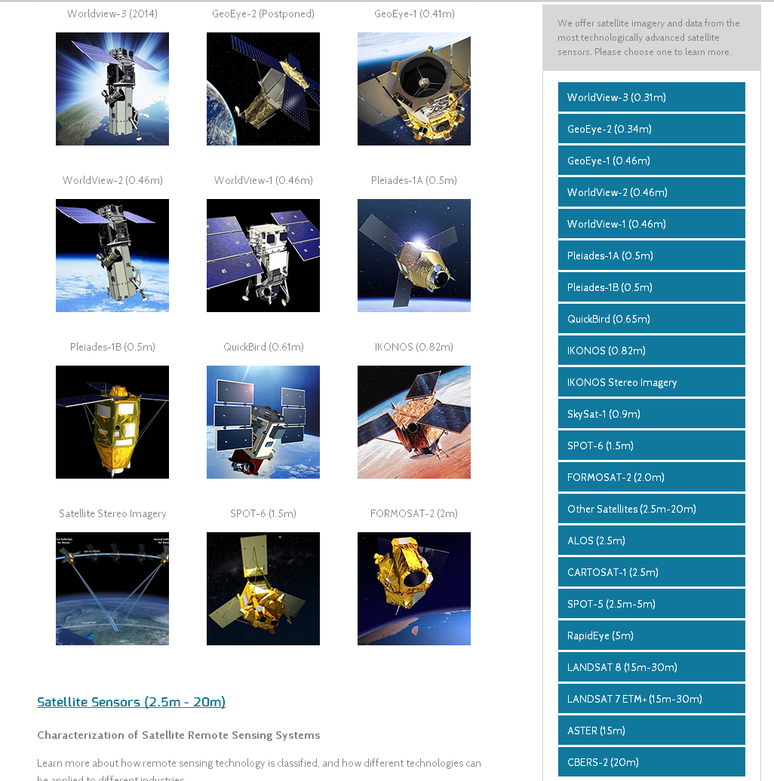
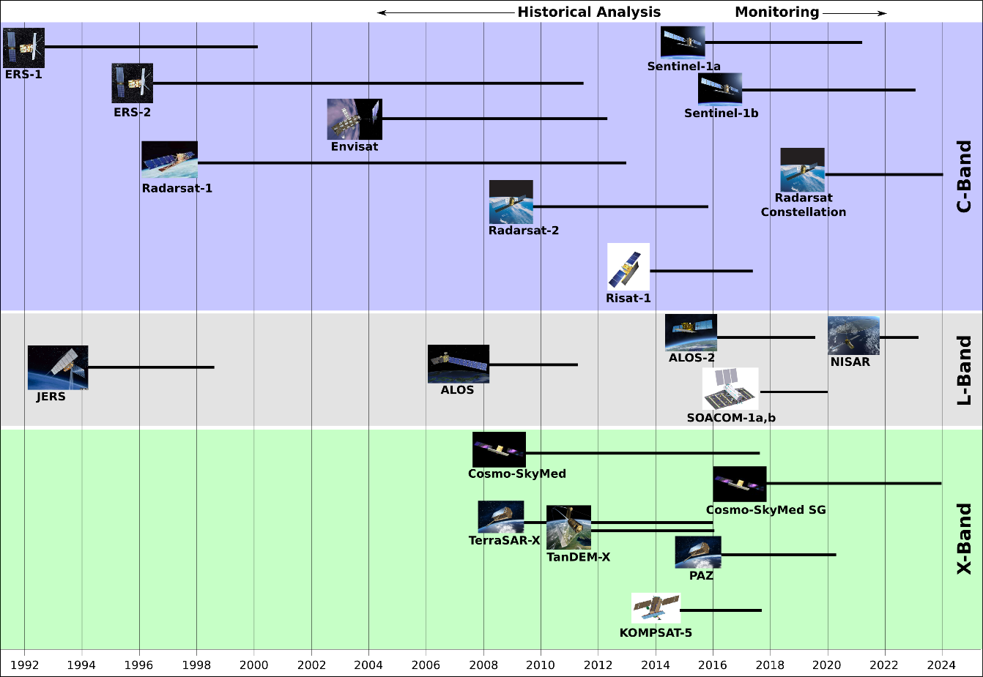
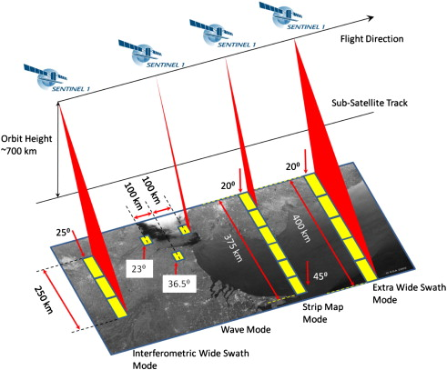
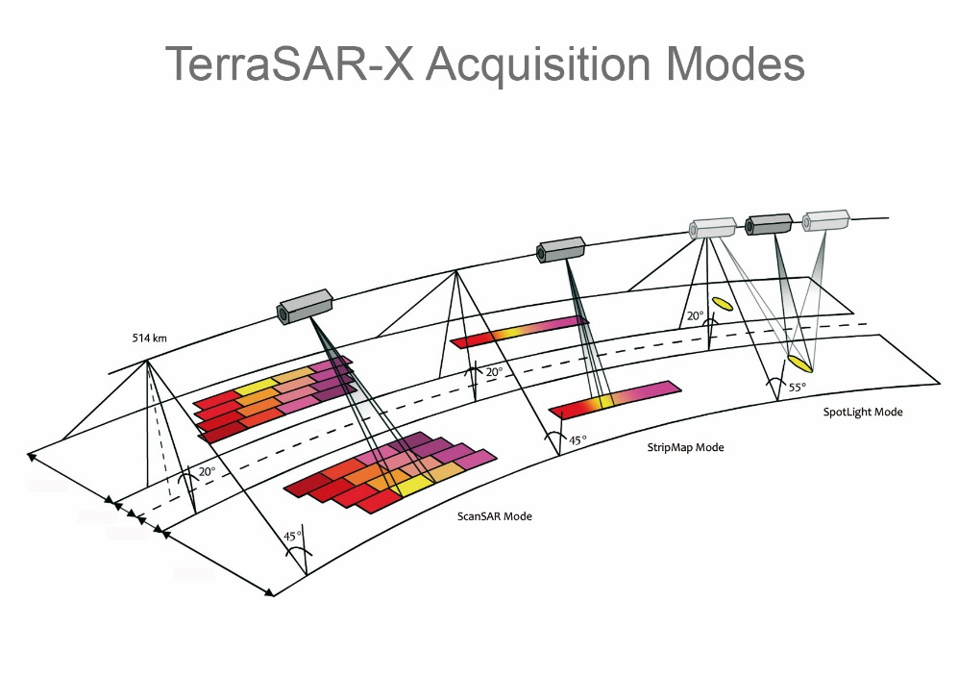
SAR Satellite missions...
...and a fleet of VHR “optical” and “commercial” satellites

Slide 14
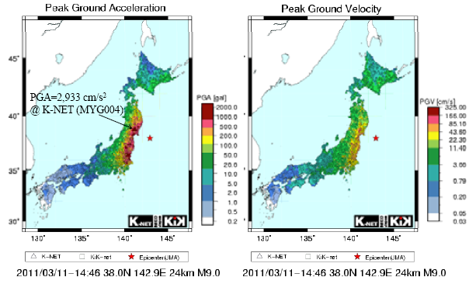
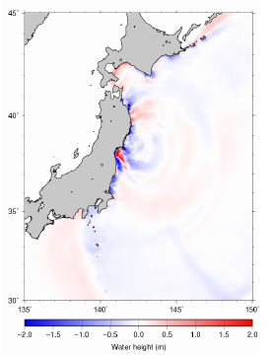
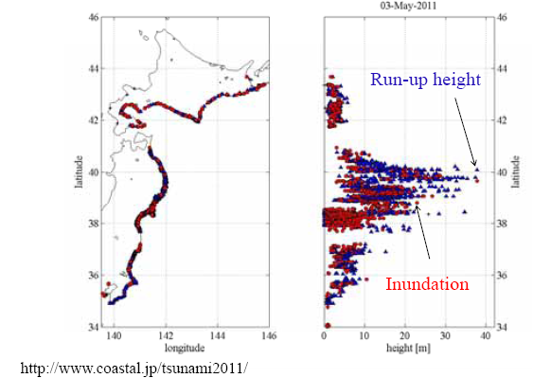
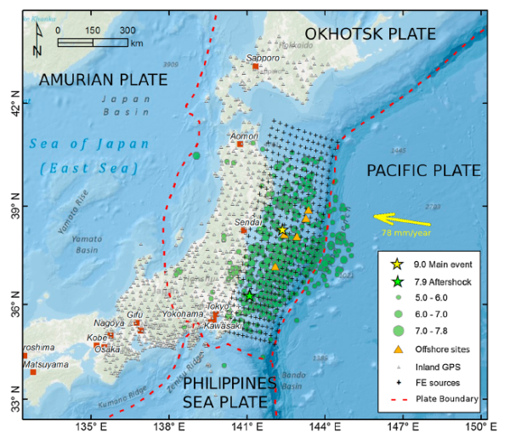
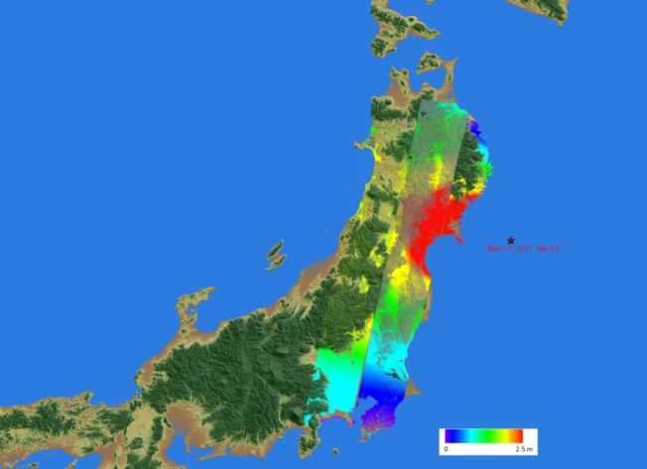
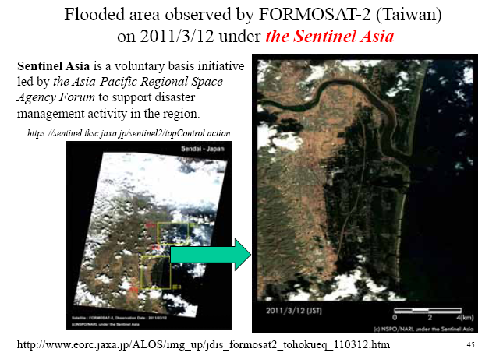
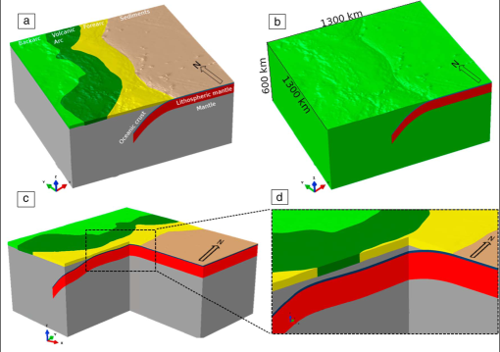
Cascading effects: from earthquake to tsunami...
EO data can contribute to detect effects, to measure
Deformation and for modelling

Slide 15






...to Deep Seated Grav. Slope. Deformation
What about the resulting hazard?
DSGSG may affect lifelines, dams, ...
Colle Clinelle
Colle Campetello
In presence of major earthquakes DSGSD
may evolve in catastrophic collapses

Slide 16




…to critical infrastructures
NPP, power plants, lifelines, dams, major bridges, tunnels…
EO data may provide a reliable contribution to estimating risk

Slide 17


Other events: flooding, landslides,…

Slide 18























Volcanoes: static and dynamic deformation,
hazard and risk
Orsi et al., EPSL 2009
→ One of the best monitored volcanoes on Earth
→ One of the highest volcanic risk on Earth
May 2011 – May 2012
May 2012 – May 2013
Multisensor - multidisciplinary approach is a solution
Vel 4.5 cm/yr
Vel 11 cm/yr

Slide 19

Monitoring networks are driven by level of risk?
EO observations at the base of monitoring strategy decisions

Slide 20


Monitoring networks are driven by level of risk?
In areas where the historical record is sparse, satellite data should be an important
component for risk assessment chain.
• Requirement to systematically include EO in long term and short term risk assessments.

Slide 21



Human induced: urban subsidence

Slide 22





Human induced: subsurface fluids extraction
UK. Rebound from groundwater recharge, compressible alluvial soils and areas underlain by salt.
Offshore reservoir
Subsidence on land

Slide 23


Human induced: gas-fluids storage-extraction
The pumping of oil is often imaged as a "bull's-eye" feature, such as the 58 mm of subsidence measured in the Beverly Hills Oil Field (5 years: Oct. 1993–Oct. 1998).
USGS
InSAR imagery shows a complex subsidence pattern associated with hydrocarbon extraction north of Bakersfield and shows that faults play a vital role in subsidence.
USGS

Slide 24


Human induced: mining and abandoned mines
Miners made large shafts and left behind pillars of coal to support the roof that weakened, leading to slow downward movement of the roof until it collapsed.
The ground surface above Frank mine has been settling up to 3.15 mm annually. Average changes of up to 3.2 mm per year, relative to the reference area, were also observed overlying the footprint of the abandoned Bellevue underground mine to the east.
Alberta Geological Survey
Abandoned gypsum mining Luxembourg

Slide 25




Human induced: nuclear

Slide 26
In conclusion: INGV – ReCaS
Today: INGV-ReCaS first year collaboration
Seismology, Geodesy data storage and computing resources
INGV services toward Regional Civil Protection
Remote Sensing is now starting: SAR data storage and processing
Medium and long term obiectives: evaluate further activities and exploit increasing experience for common National and EU projects

Slide 27
Grazie!

