Slide 1
COSMO-SkyMed data for territory monitoring
luca.fasano@asi.it

Slide 2
COSMO-SkyMed first generation

Slide 3
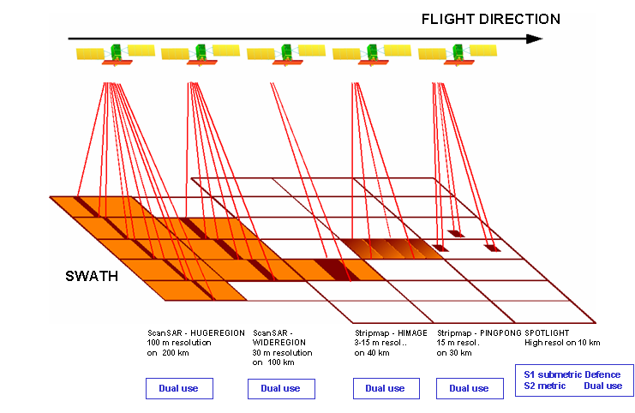
COSMO-SkyMed first generation
The largest Italian investment in Space Systems for Earth Observation
Commissioned and funded by ASI and the Italian Ministry of Defense
4 X-band SAR satellites constellation day/night all weather
Dual system
Operational for many years
On demand system + background
High performance, flexibility and reactivity
Possibility to expand to external partner/users (partner-UGS / CUT), giving the capabilities for:
Acquisition Request
Satellite data acquisition, also by local antenna
Data processing and distribution
Archiving and cataloguing
25 ott 2008
CSK FM3
9 dic 2007
CSK FM2
CSG FM2
5 nov 2010
CSK FM4
8 giu 2007
CSK PFM
CSG PFM
2007
2008
2009
2010
2011
2012
2013
2014
2015
2016
2017
2018
2019
3

Slide 4
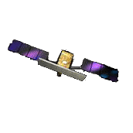
Space Segment
Orbital characteristics:
sun synchronous:
Inclination 97.86°;
Revolutions/day 14.8125;
Orbit Cycle 16 days ;
Eccentricity 0.00118;
Semi Major Axis 7003.52 km;
Nominal Height 619.6 km.
CSK2
CSK4
67,5°
CSK3
CSK1
Interferometric revisit:
Day
1
2
3
4
5
6
7
8
9
10
11
12
13
14
15
16
17
CSK1
CSK3
CSK4
CSK2
CSK1

Slide 5
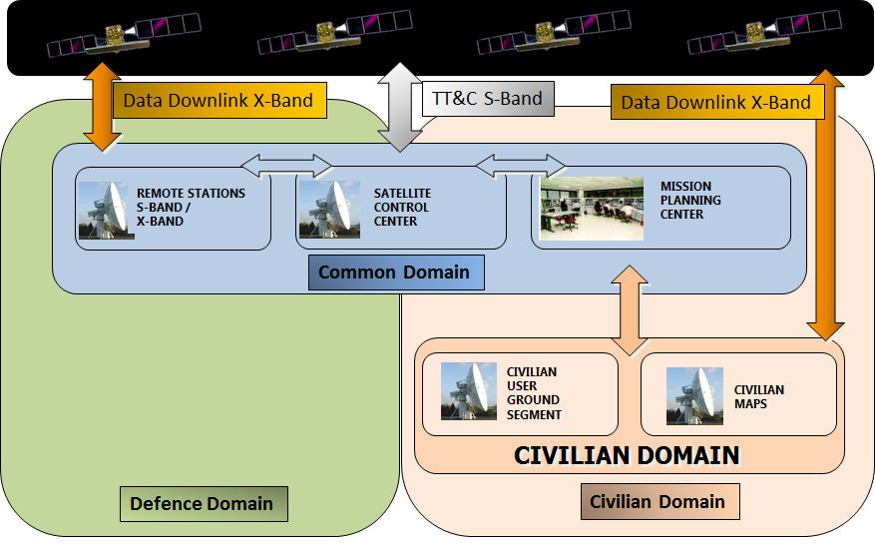
Ground Segment

Slide 6
CSK Data Policy
License
Civilian Domain (75%)
AD
partner
Institutional Users (managed by ASI)
Commercial Users (managed by e-Geos)
Defence Domain (25%)
Absolute Priority
COSMO-SkyMed System Utilization Guidelines
Details of Civilian data distribution and control
07/03/2007: COSMO-SkyMed National Data Policy and Resources Sharing (DPRS) (ASI – AD)
General principles of the national policy for the distribution of COSMO-SkyMed civil component data
 | APPLICANTS | SpotLight2 | StripMap | ScanSAR
A | Natural or legal persons, to whom it is prohibited to provide any kind of COSMO-SkyMed product | No | No | No
B | Special cases. Countries whose users can be granted use of SL2 limited to their national territory | Own territory only | Yes | Yes
C | Particular combination of applicant country – requested area to be submitted to OICI assessment | Case by case assessment (by OICI) | Yes | Yes
D | All other cases not falling within the case studies as set forth in the lines “A”, “B” and “C” of this table | Yes | Yes | Yes

Slide 7
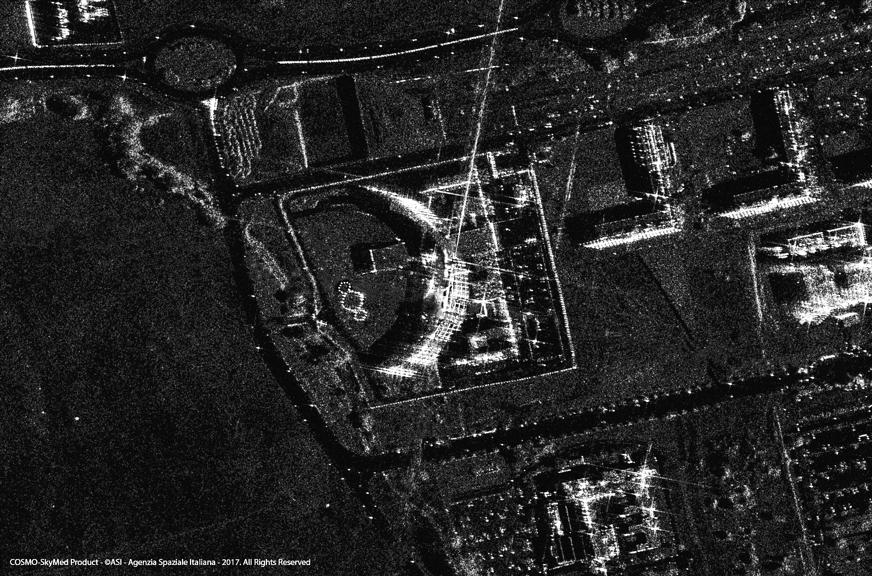
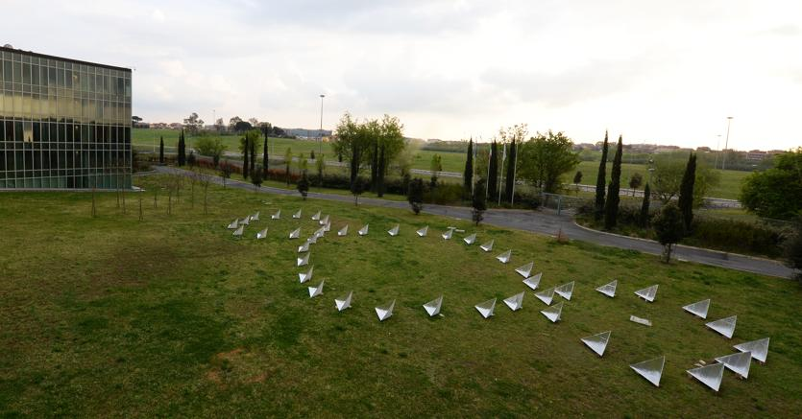

Slide 8
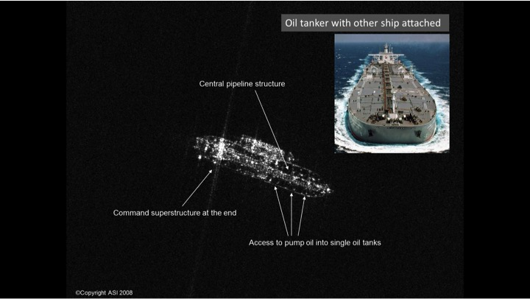
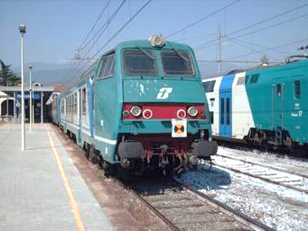
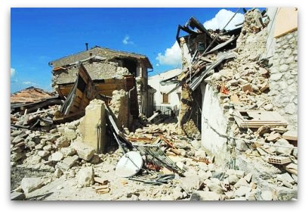
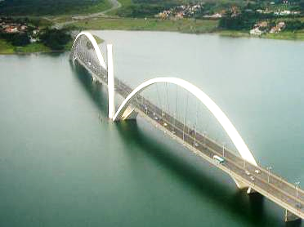
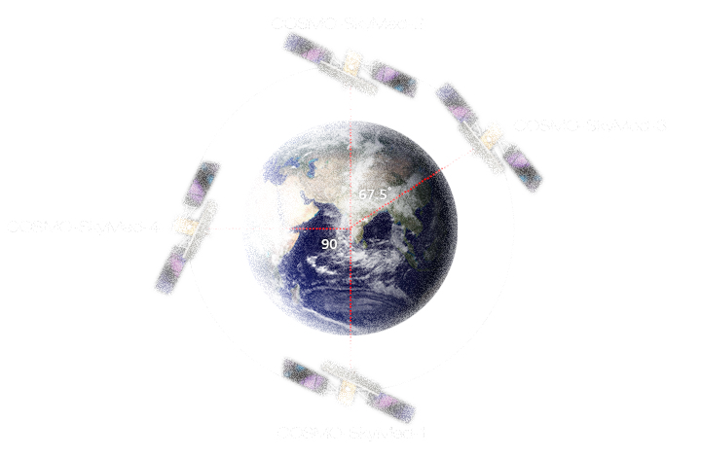
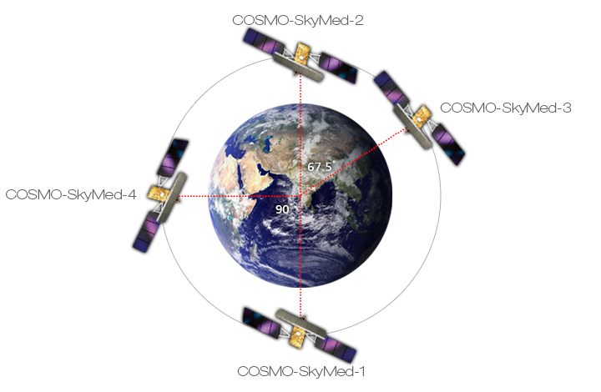
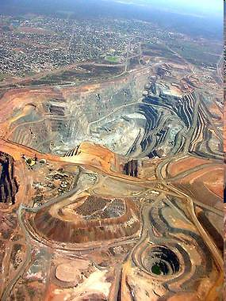
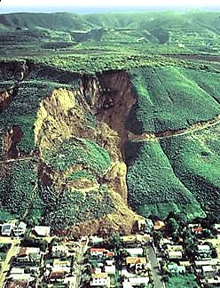
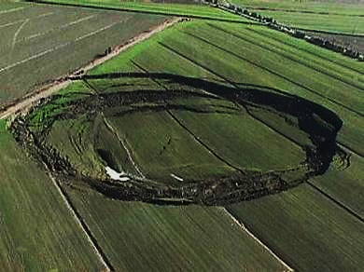
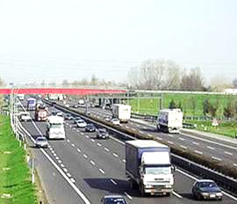
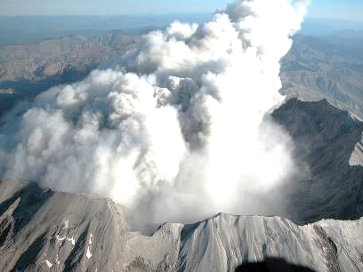
COSMO–SkyMed Applications
Railway
infrastructures
Bridges
Vessel detection
Pipelines
Earthquakes
Mining activities
Building
Analysis and monitoring of soil deformations
Landslides
Subsidence phenomena
Highways
Volcanic phenomena
Oil&Gas

Slide 9
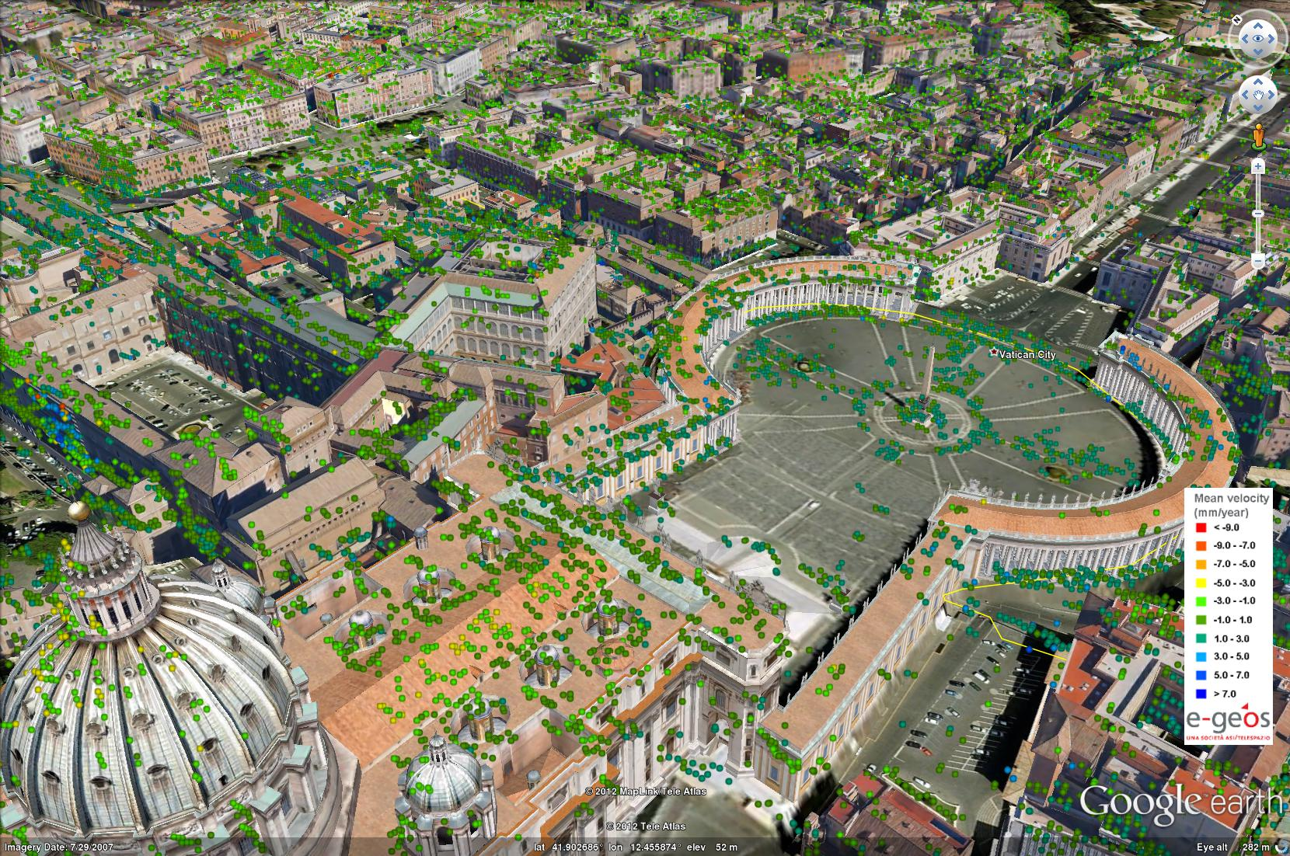
Buildings Monitoring
Monitoring the Stability of St. Peter's Basilica

Slide 10
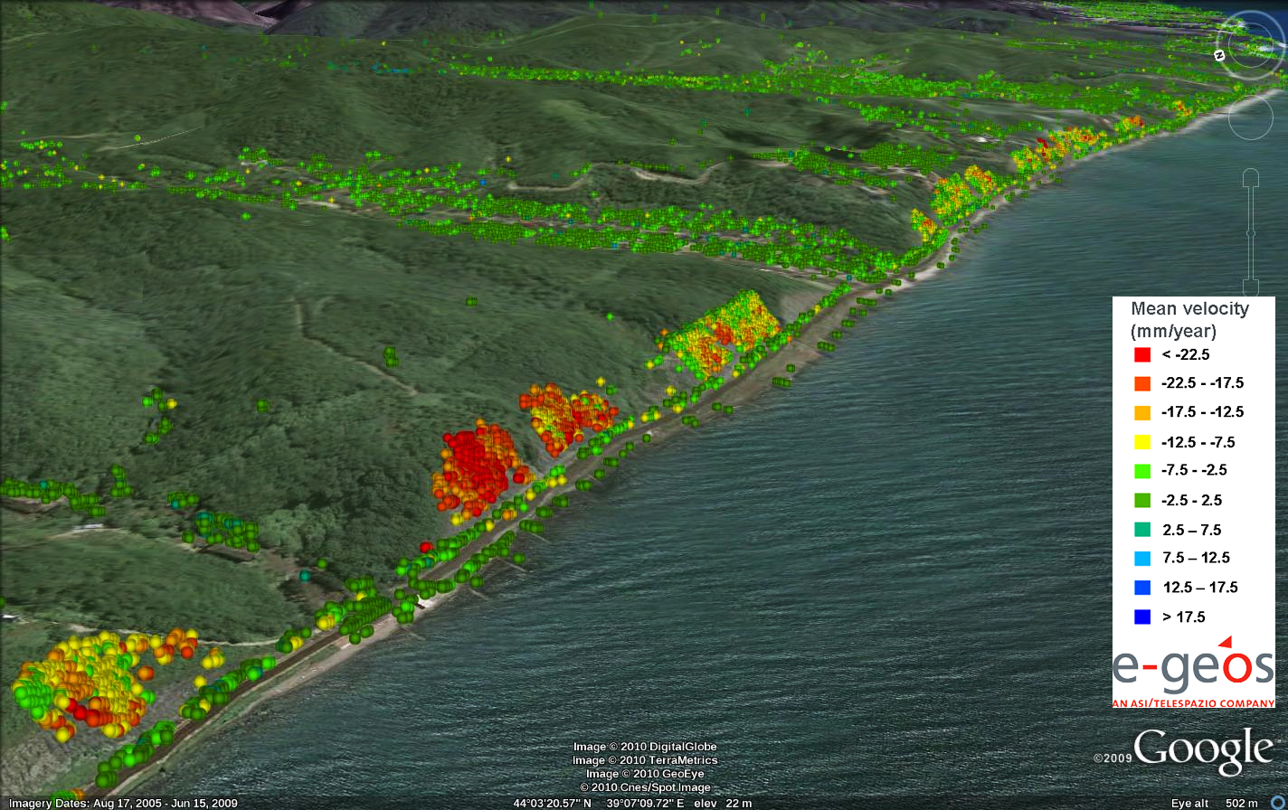
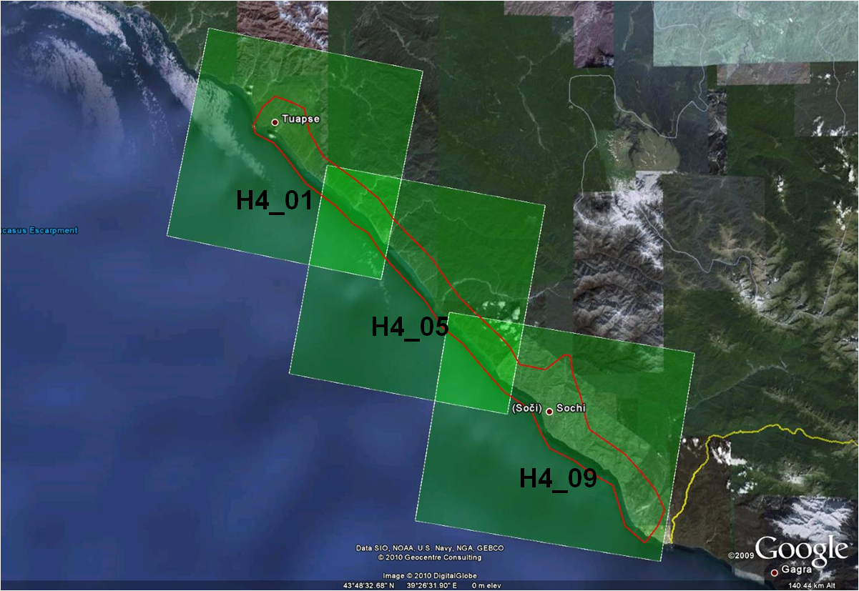
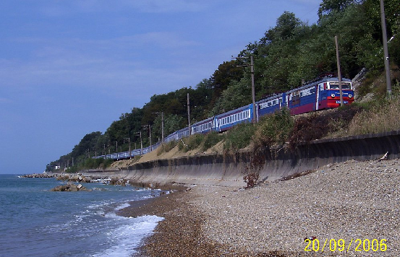
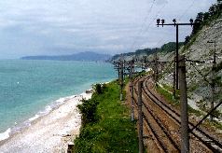
Landslides Monitoring
Ground monitoring near a railway with COSMO data by e-GEOS for the Russian Railway company
Areas with landslide risk
Black Sea
Area of interest
Covering the AoI with COSMO-SkyMed Stripmap
Railway
analisi

Slide 11
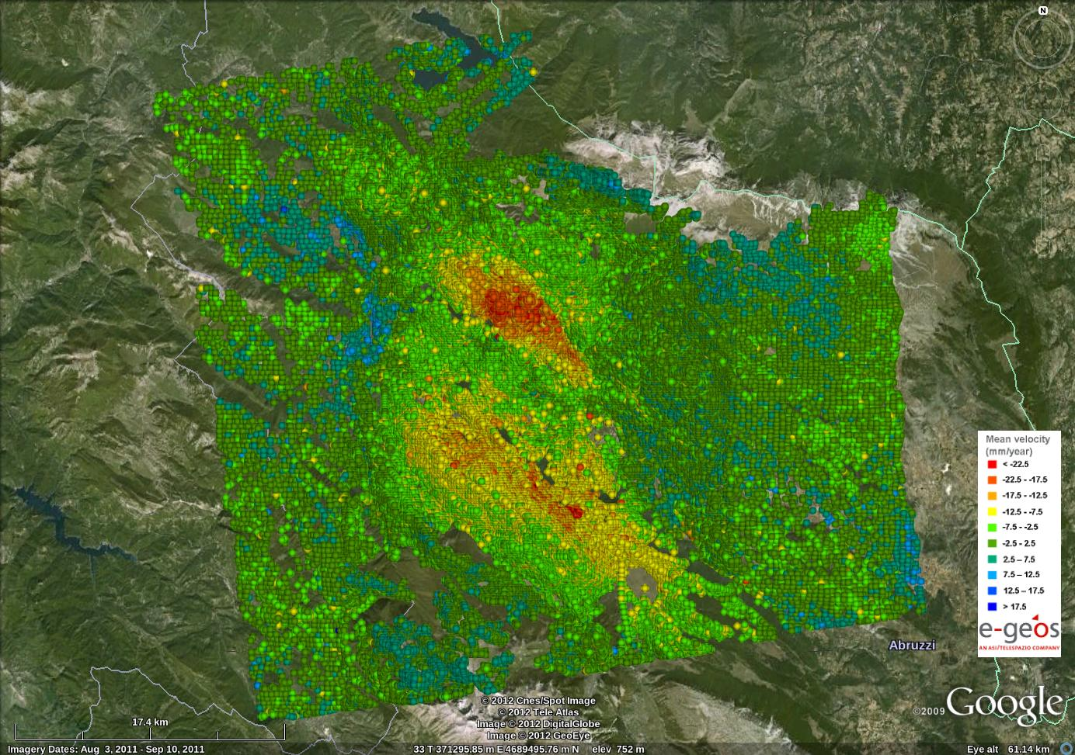
Post seismic Analysis: L’Aquila Earthquake - 2009
analisi

Slide 12
COSMO-SkyMed second generation

Slide 13
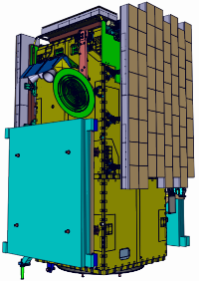
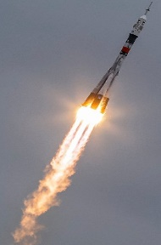
COSMO-SkyMed second generation
The Second Generation (CSG) is the follow on system to COSMO- SkyMed (CSK)
Operational continuity/preserve
Performance improvements/enhance
The first satellite is scheduled to be launched in 2019
NOW
Nov.2017
2020
SOYUZ(Korou SC)
VEGA-C(Korou SC)
Phase C
Phase D
Phase E1
Phase E2
CDR
Manifacturing / AIT
Launch/Commis./Operations

Slide 14
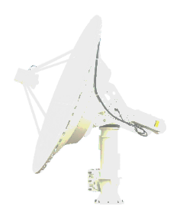
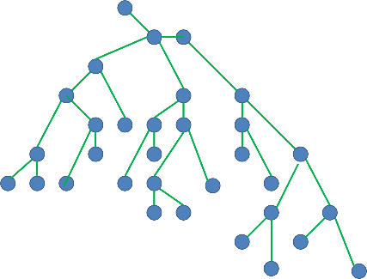
…in Ground Segment
Improvements
…in Space Segment
A Satellite Platform enhanced in terms of:
augmented electrical power (i.e. 40% more) - to sustain the imaging performances
A new Avionics Subsystem (AVS) - for a very high satellite agility
an increased propulsion fuel tank capacity - for a prolonged operative lifetime.
A renewed Payload Data Handling and Transmission (PDHT) design that significantly improves the performances of the PDHT currently in use in CSK, in terms of:
data reception rate from SAR (x 4)
on-board data storage capacity (x 2)
space-to-ground data transmission throughput (x 2)
The Ground Segment (GS) upgraded in order to:
manage, control, and utilise a System with such an increased performance
ensure the full architectural integration between the ‘old’ CSK and the new CSG
Other System improvements:
Very urgent / Last Minute Planning Services
Dynamic Resources Management and new Planning Algorithms

Slide 15
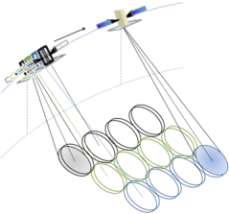
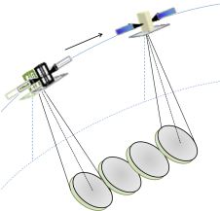
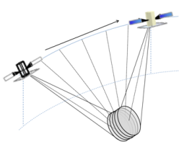
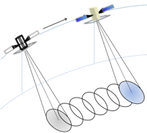
SAR improvements
Multi Burst ScanSAR
Stripmap
Quad Pol
Spotlight
Non-Standard Modes
A brand-new design of the Synthetic Aperture Radar (SAR) instrument, capable to make the space resolution of the “narrow field images” finer than CSK, while providing multi-polarization.
Standard Modes
Spotlight
Spotlight
Spotlight 2A - best resol
Spotlight 2B – same swath of CSK
Spotlight 2C – less power cons.
Stripmap
HIMAGE
Ping Pong
Quadpol
ScanSAR
ScanSAR-1
ScanSAR-2
Operational
DI2S Spotlight 2B
Theatre Spotlight 2x

Slide 16
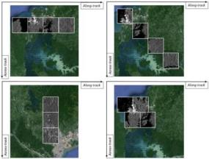
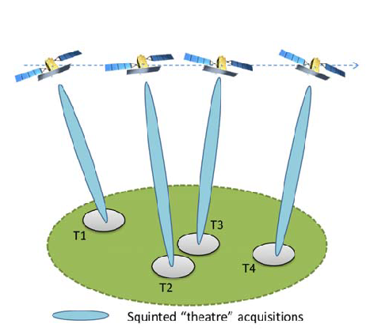
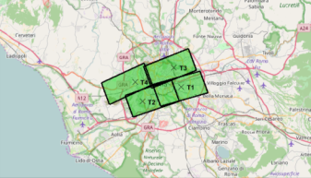
Theatre Acq mode
Thanks to the agility of CSG platform (Control Moment Gyro attitude actuator), the satellite will be able to acquire while manoeuvring.
Spotlight acquisitions on a Theatre scenario are similar to standard Spotlight acquisitions, apart from a non-zero Doppler azimuth.

Slide 17
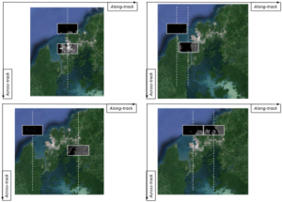
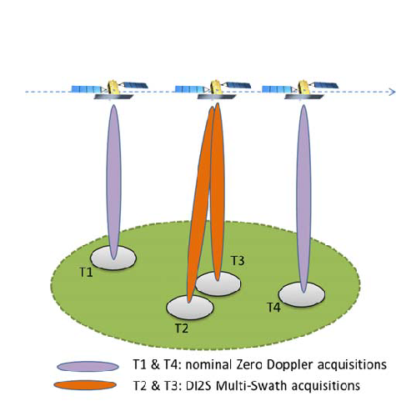
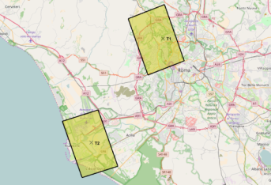
DI2S Acq mode
DI2S spotlight technique exploits the SAR capability to work at doubled PRF, in order to simultaneously acquire two different images.
The swath is reduced, but the resolution and other performances are maintained.

Slide 18
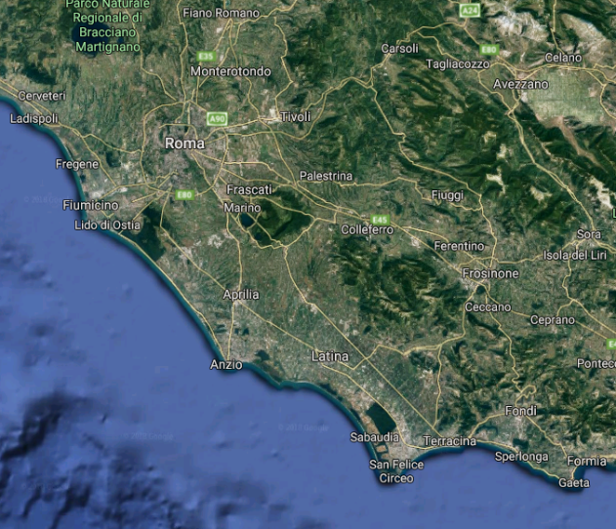
NOT STANDARD ACQ. MODES
CSG Improvements in Acquisition Modes
CSG HIMAGE mode:
A Quad-Pol mode introduced
CSG Spotlight standard mode:
Improved resolution
Separation between spotlight images is ~100 km
CSG Theatre mode:
The platform agility allows to perform pitch maneuvers
More images in a theatre region can be acquired
Along track
CSG DI2S:
The SAR instrument capabilities allows to acquire two targets almost simultaneously (using double PRF)
The swath is reduced in range
Across track

Slide 19
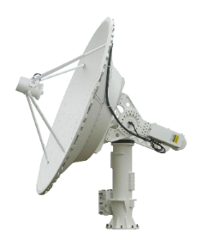
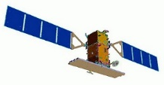
CSG New User Services
Very Urgent. Asynchronous requests: they can be inserted until little time before commands uplink
Last Minute Planning. An orbital segment is «booked». If it is planned, the user can insert the real request until little time before commands uplink
Near Real Time. High priority in receiving data from external station and in processing
Very Urgent
Last Minute Planning

Slide 20
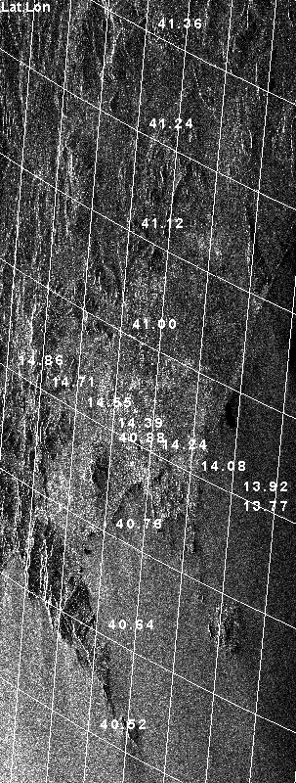
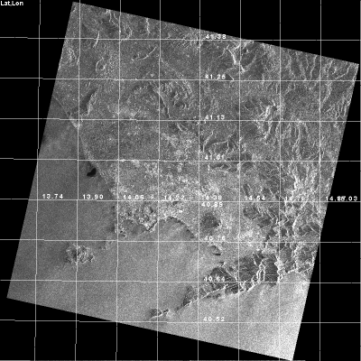
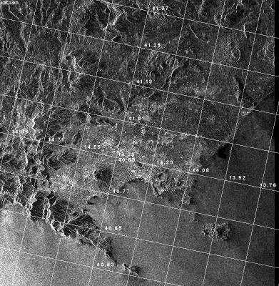
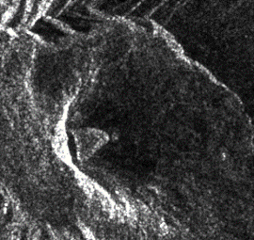
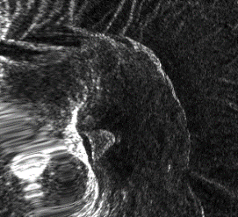
CSG Standard Products
Level | Code | Sample Information | Projection
1A | SCS_B | focused data, Hamming weighted and radiometrically equalized | Slant Range / Azimuth (Zero-Doppler)
 | SCS_U | focused data, unweighted and not radiometrically equalized
 | SCS_F | focused data, apodized and radiometrically equalized (only available in the Spotlight case)
1B | DGM_B | detected, multilooked (despeckled), Hamming weighted | Ground (WGS84 Ellipsoid) / Azimuth (Zero-Doppler)
 | DGM_F | detected, apodized (only available in the single-look Spotlight case)
1C | GEC_B | detected, multilooked | UTM (-80≤ lat < 84°) UPS (otherwise) OR Geodetic LatLon
 | GEC_F | detected, apodized (only available in the single-look Spotlight case)
1D | GTC_B | backscattering coefficient, multilooked, | UTM (-80≤ lat < 84°) UPS (otherwise) OR Geodetic LatLon Projected onto a reference elevation surface
 | GTC_F | backscattering coefficient, apodized (only available in the single-look Spotlight case)
Level 1A
Level 1B
Level 1C
Level 1D
2 types of production:
Standard Delivery: the mode associated to the distribution of Precision Product (in terms of their geolocation accuracy)
Fast Delivery: near-real time production mode, hence originating lower geolocation accuracy products

Slide 21
Thank You!
Roberto Formaro
ASI
Head of Technology and Engineering Department
roberto.formaro@asi.it
For further information visit www.prisma-i.it
Thank You

