Slide 1

ProtoDUNE Photon Detection Update March 2019
Chris Macias
Indiana University
ProtoDUNE PD Update, March 2019
Notes:
Write “many thanks to …” on corresponding slides

Slide 2
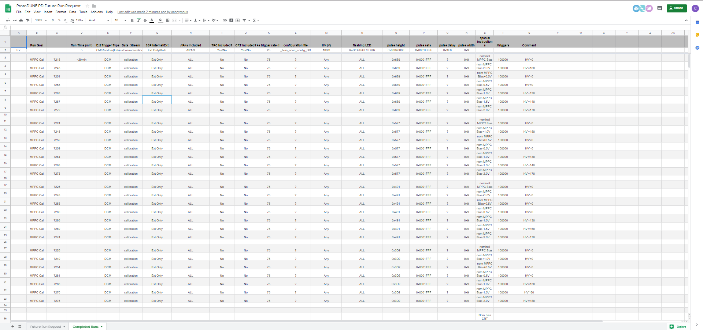
PDS Test Run: March 18th – April 7th
Calibration (DCM) Runs
Cosmic Telescope Runs
Cosmic Runs
CRT Trigger
Noise Runs
Test Runs can be found here:
https://docs.google.com/spreadsheets/d/1Wrbo0-DLiKRtKgW4N8wxsgImX2qjeN4P9b_VQLijeJw/edit?usp=sharing

Slide 3
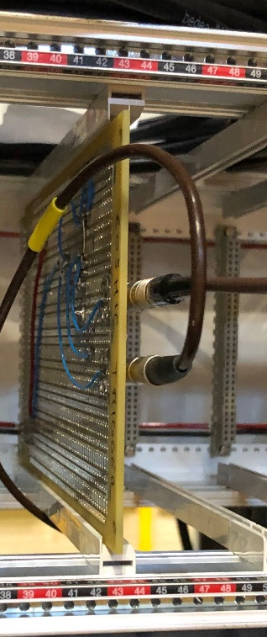
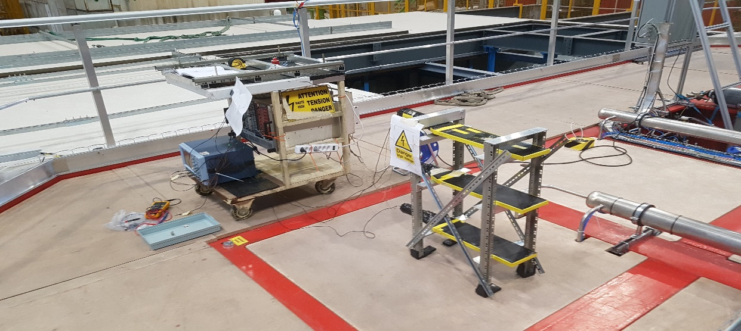
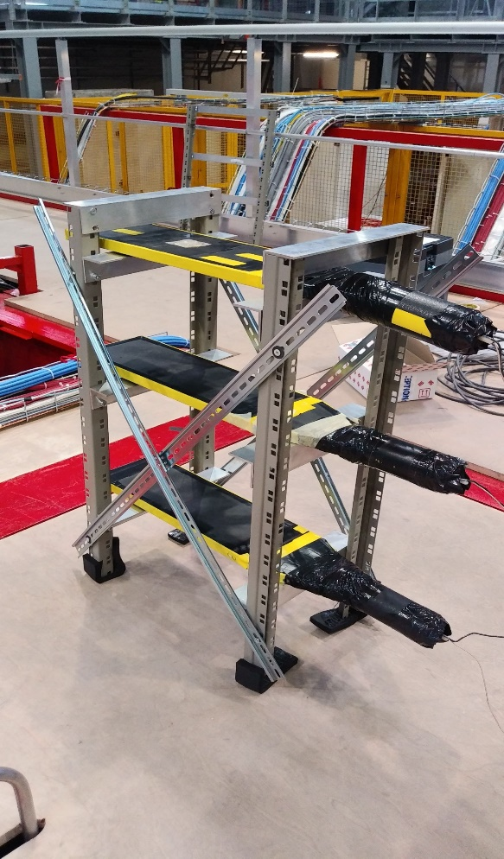
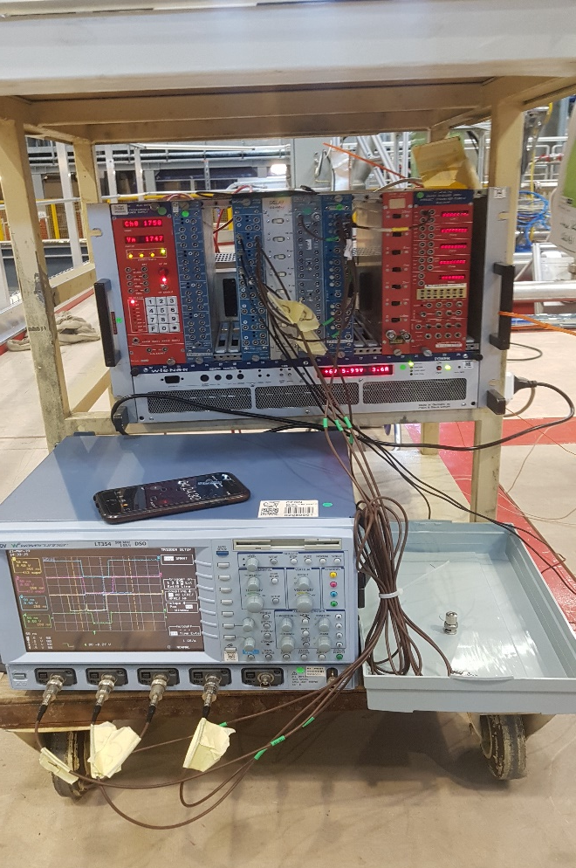
Cosmic Telescope
Tel-Input
Using 3-fold coincidence
3 Scintillating Paddles
Trigger to CTB
Xavier has made PDS telescope trigger to CTB
Working trigger to DAQ!
Sample runs available w/ telescope above APA-3 drift path
Run 7278 & 7279
Still in progress
Tune PMT Thresholds
Verify all triggers are accounted for
Verify tracks with TPC
Output to CTB
APA-3

Slide 4
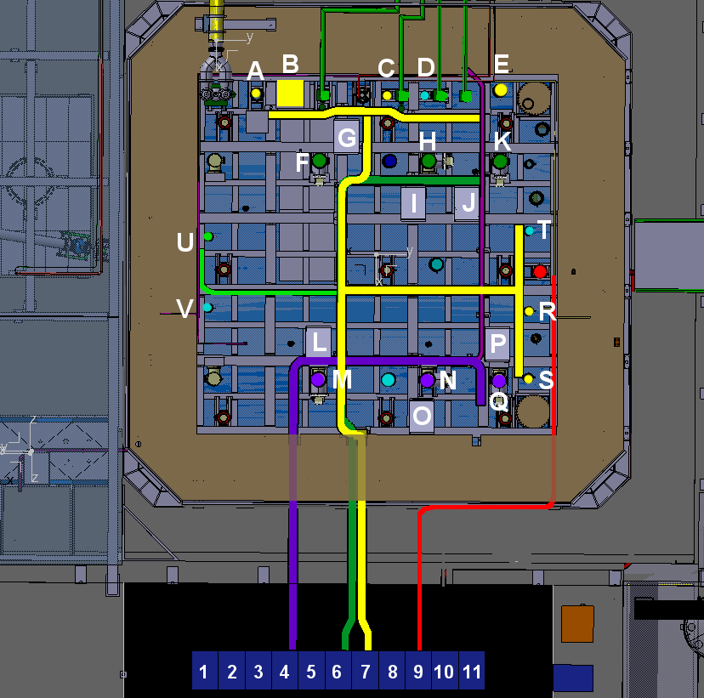

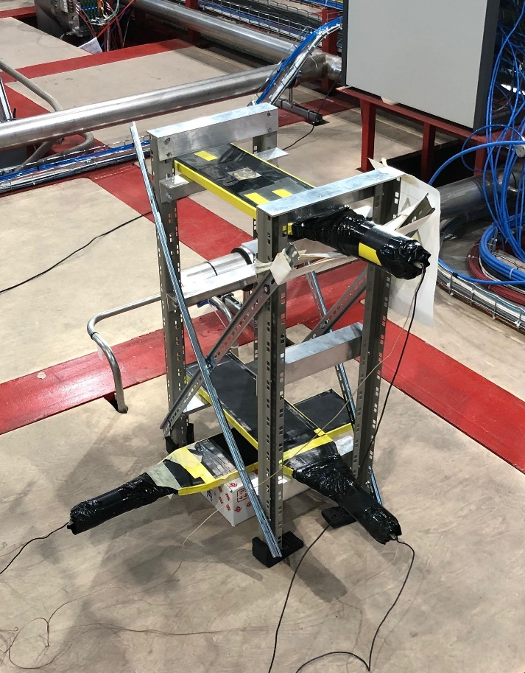
Cosmic Telescope “Above” APA3
DAQ Side
USDaS
MSDaS
DSDaS
USRaS
MSRaS
DSRaS
Rack Side

Slide 5
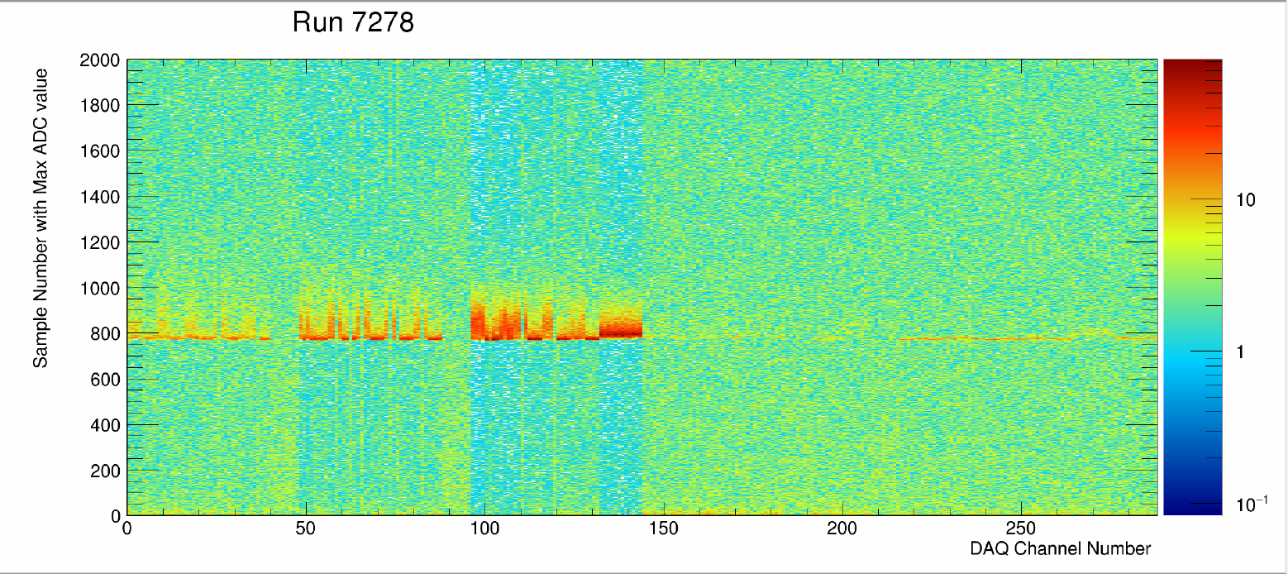
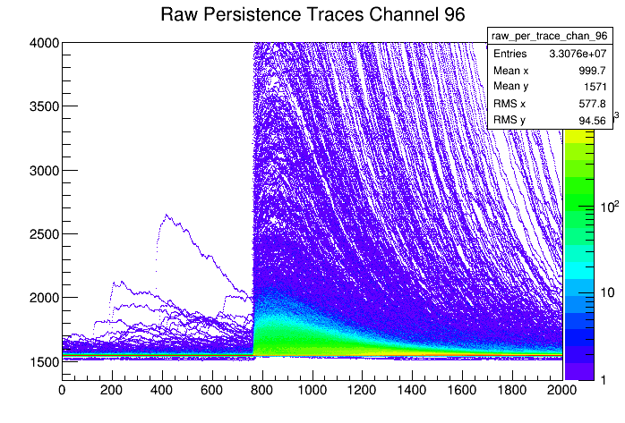
APA_1_3_Run_Run7278 RAW DATA
Telescope alignment →
Time [ticks]
APA-1
APA-2
APA-3

Slide 6
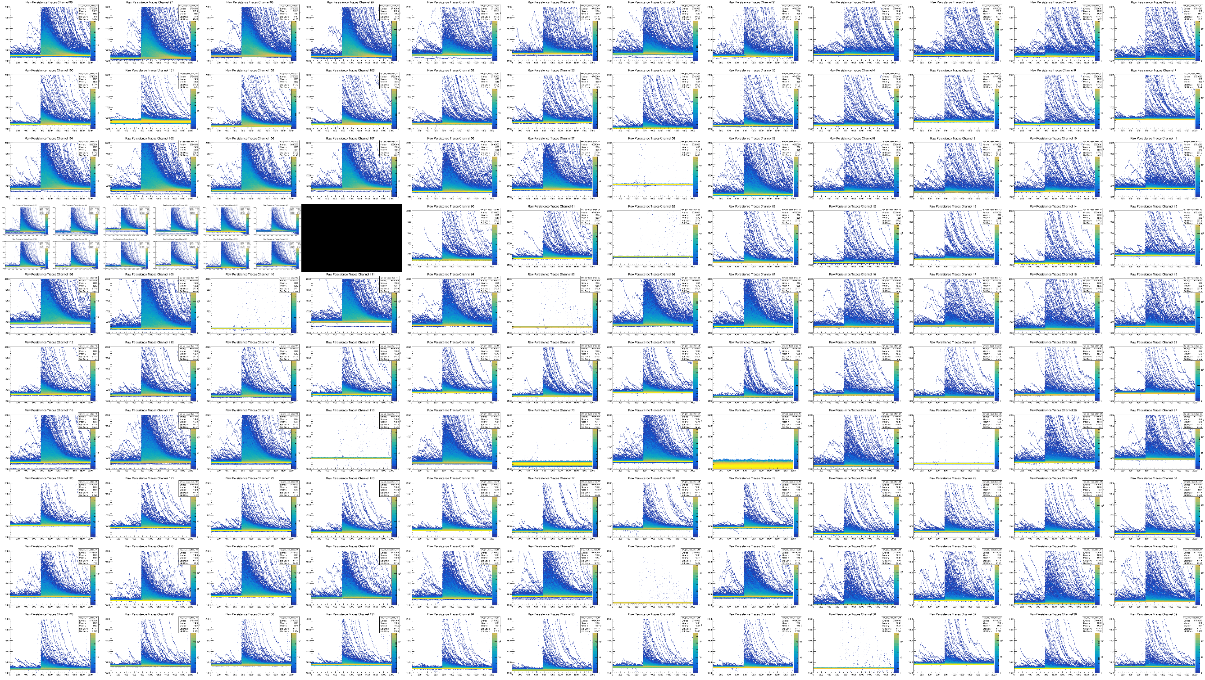
APA_1_3_Run_Run7278 RAW DATA- Persistence Traces
APA-3
APA-2
APA-1
ARAPUCA

Slide 7

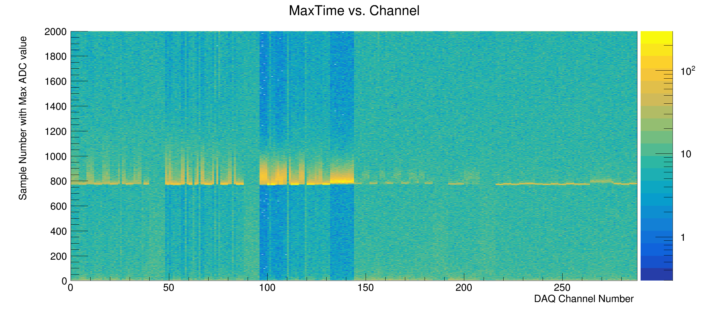
APA_1_3_Run_Run7278 RAW DATA
Telescope alignment →
Time [ticks]
APA-1
APA-2
APA-3

Slide 8
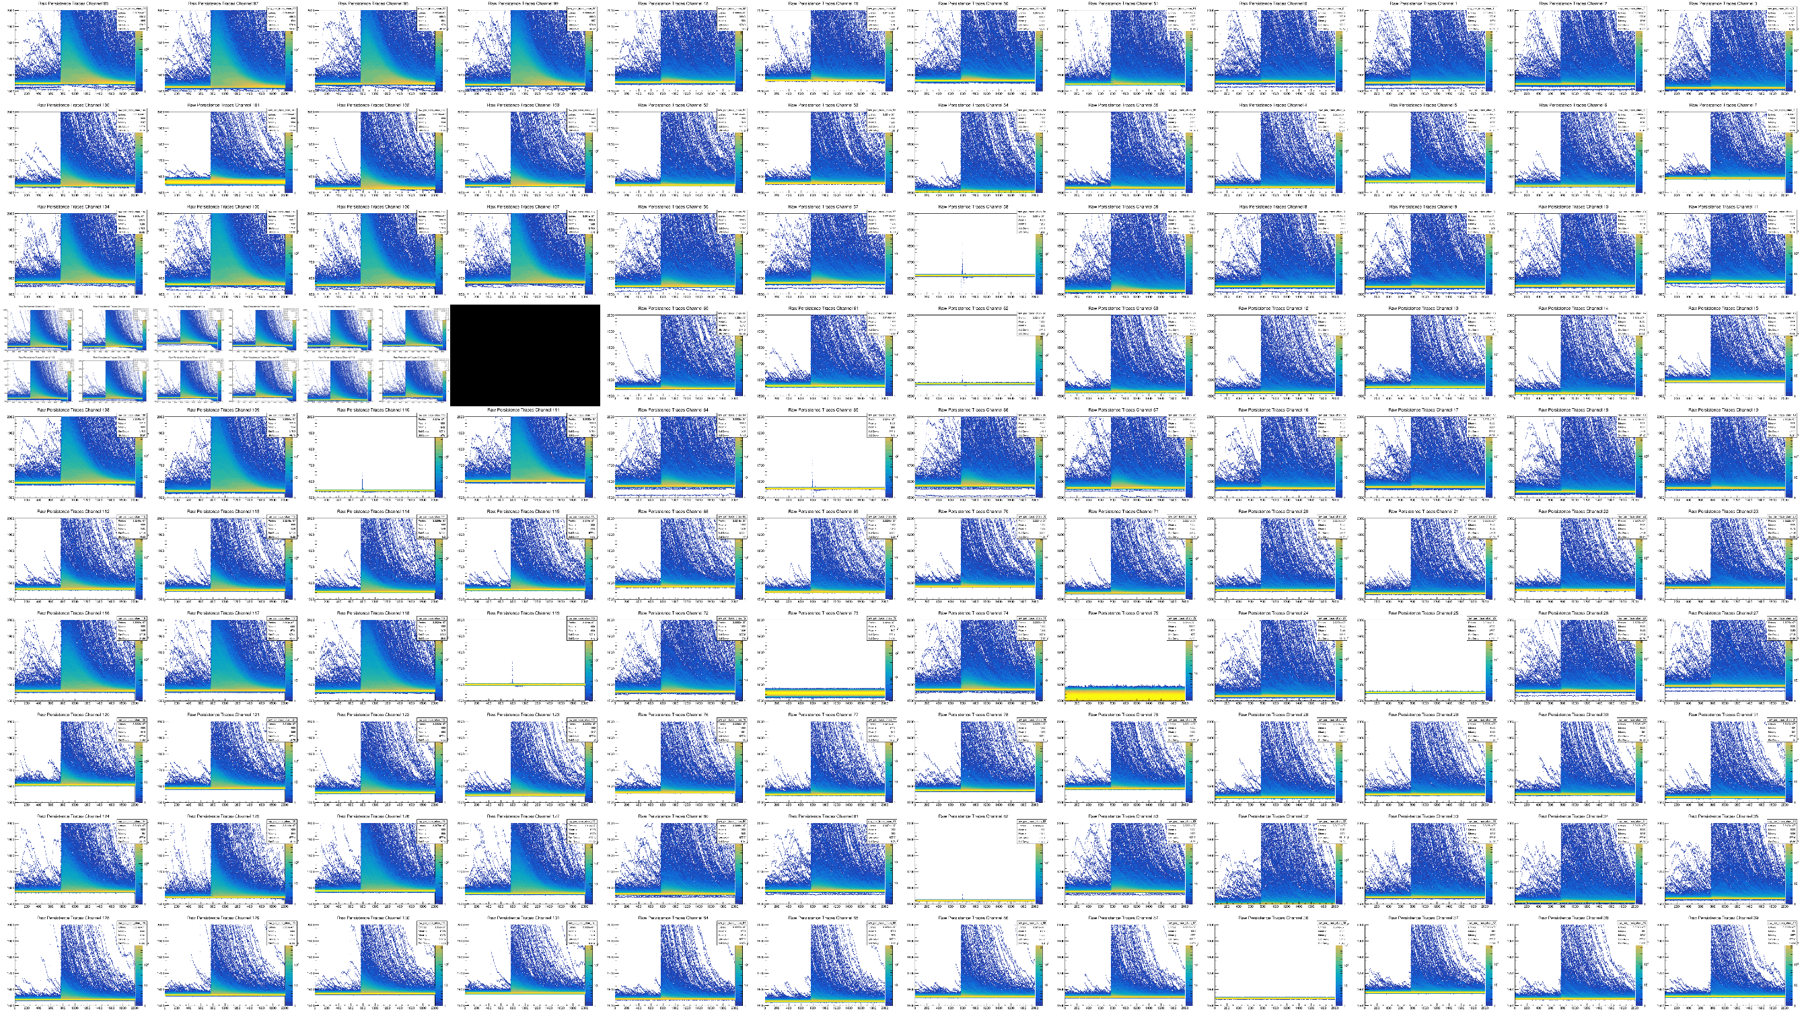
APA_1_3_Run_Run7279 RAW DATA- Persistence Traces
APA-3
APA-2
APA-1
ARAPUCA

Slide 9
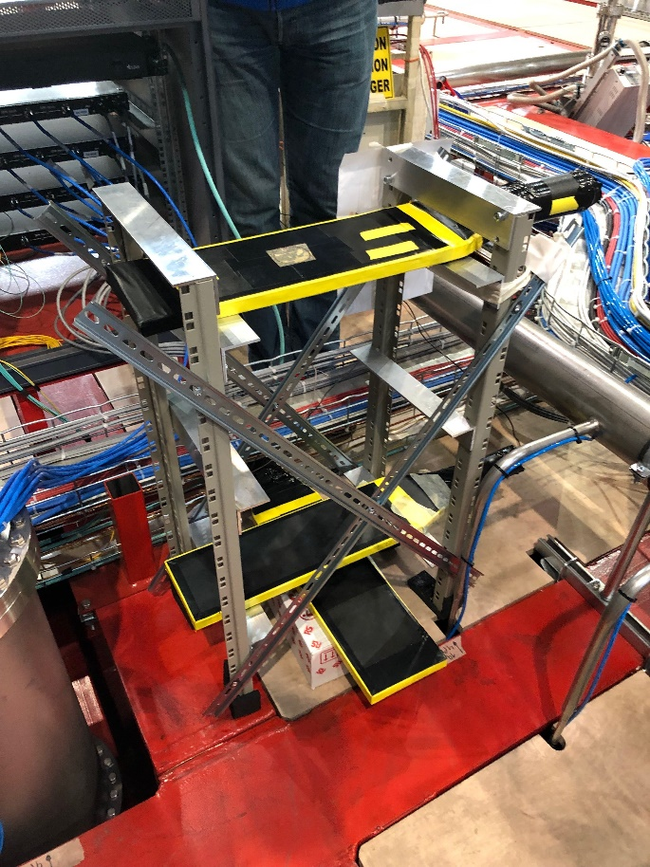
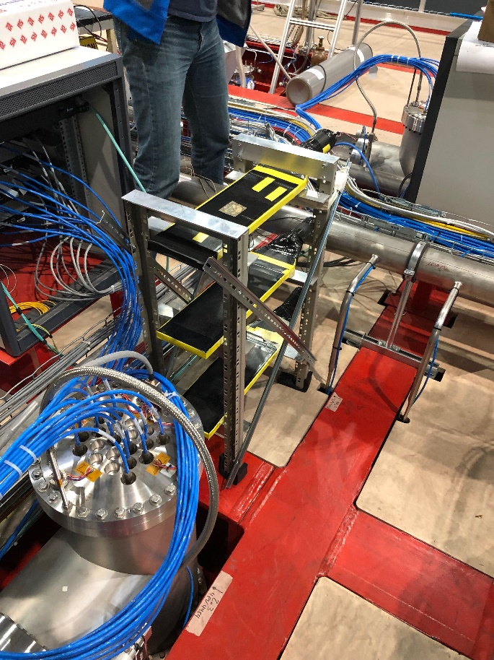
Cosmic Telescope “Above” APA6
DAQ Side
USDaS
MSDaS
DSDaS
USRaS
MSRaS
DSRaS
Rack Side

Slide 10

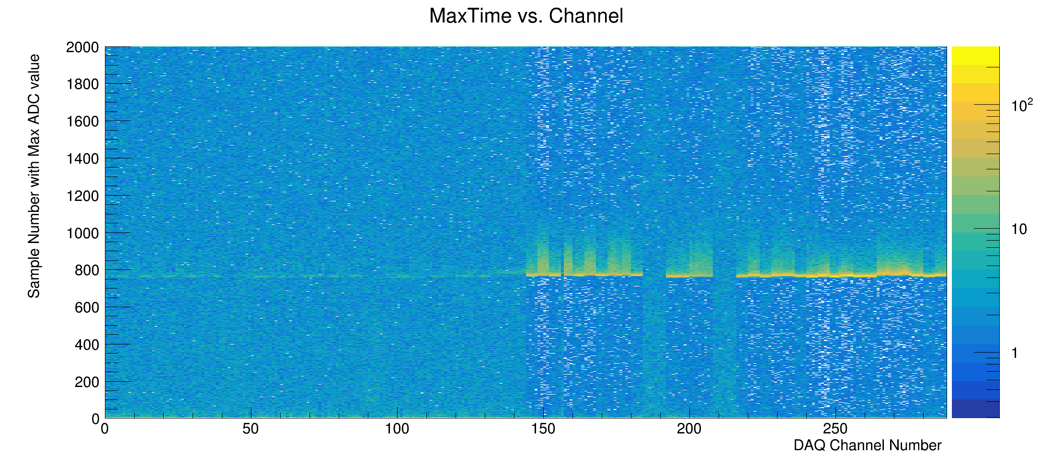
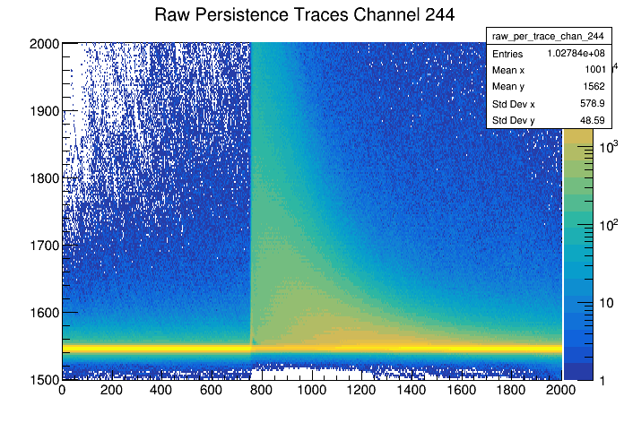
APA_4_6_Run7301 RAW DATA
← Telescope alignment
APA-1
APA-2
APA-3
APA-4
APA-5
APA-6

Slide 11
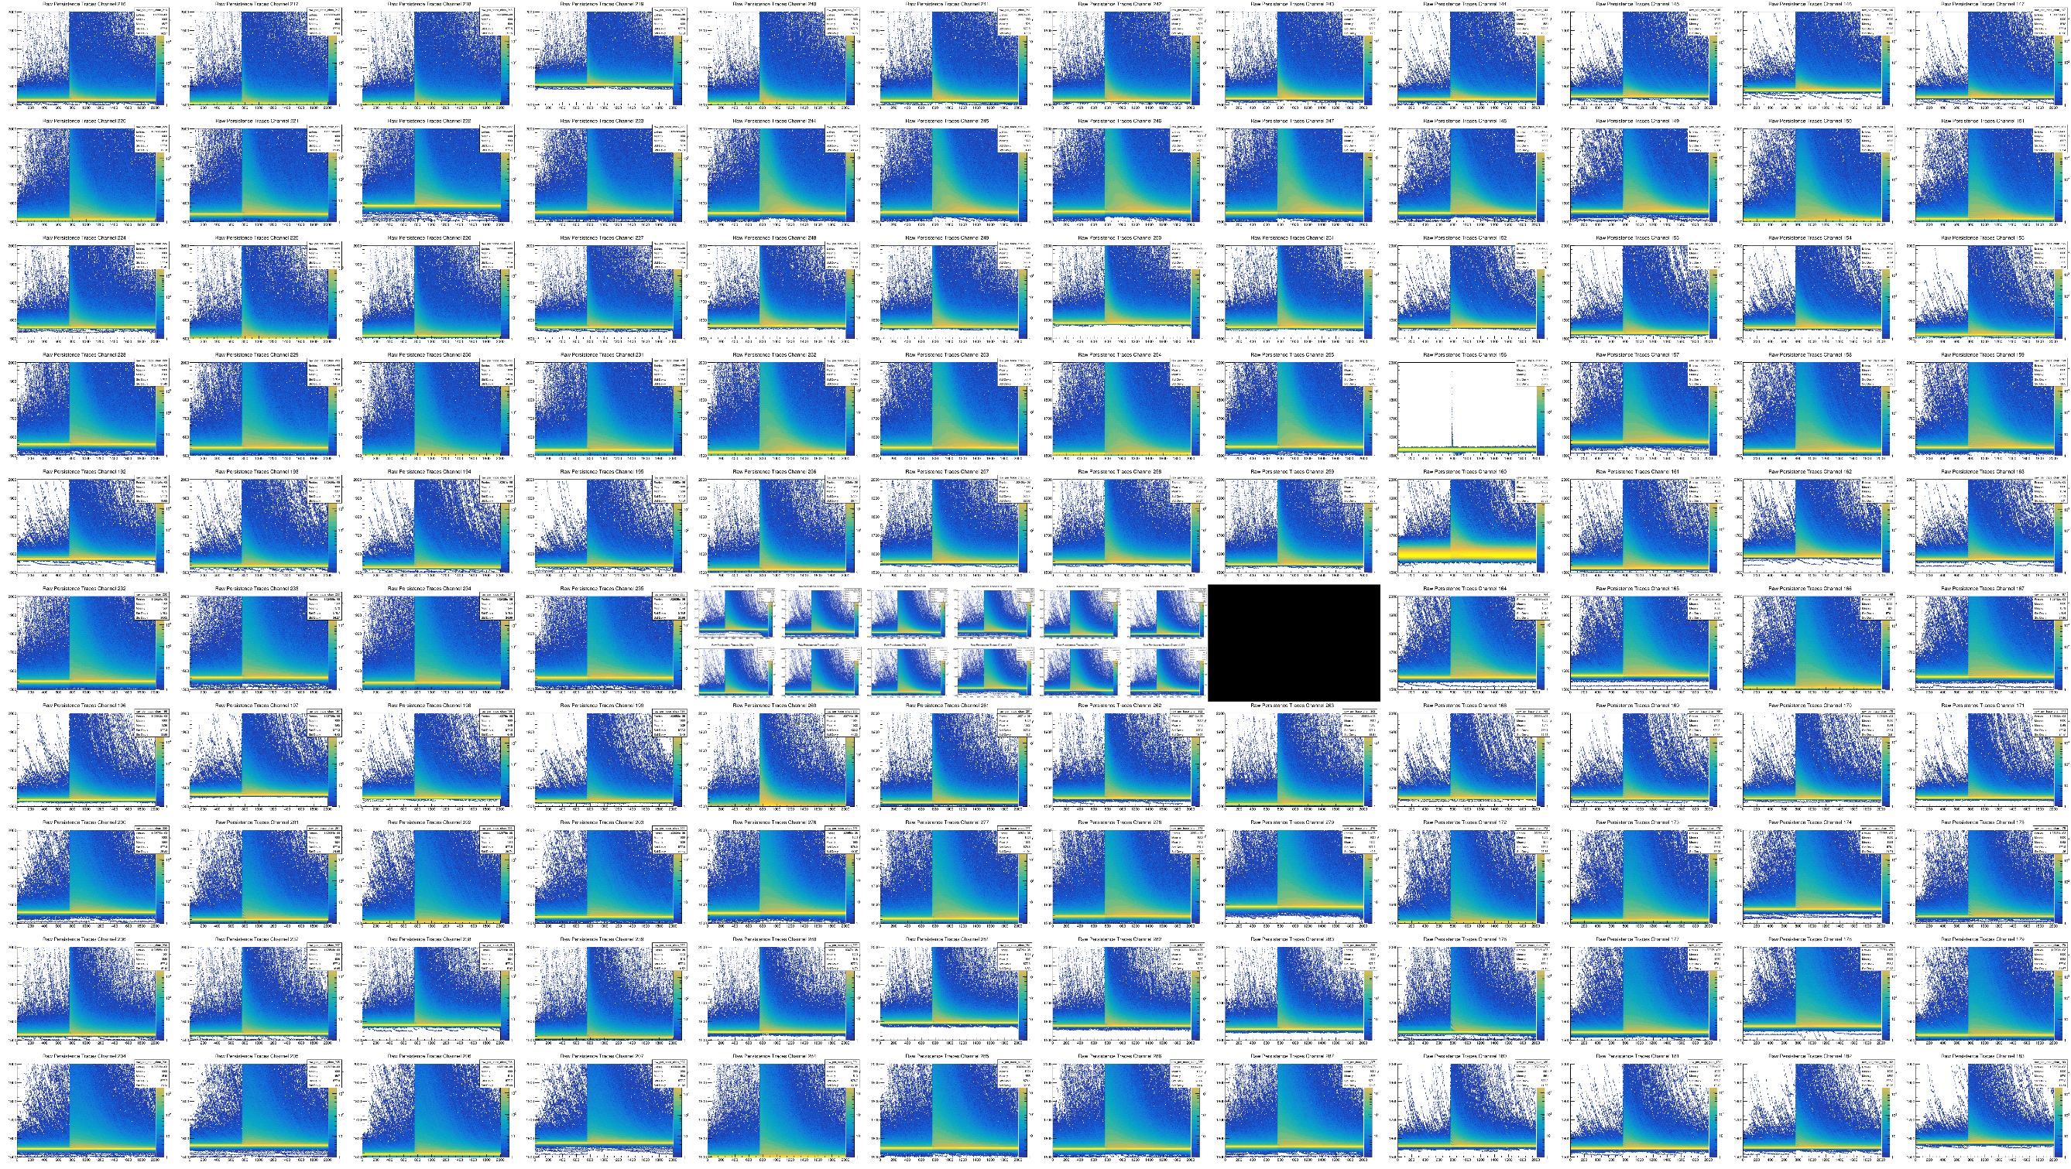
APA_4_6_Run7301 RAW DATA- Persistence Traces
APA-5
APA-6
APA-4
ARAPUCA

Slide 12

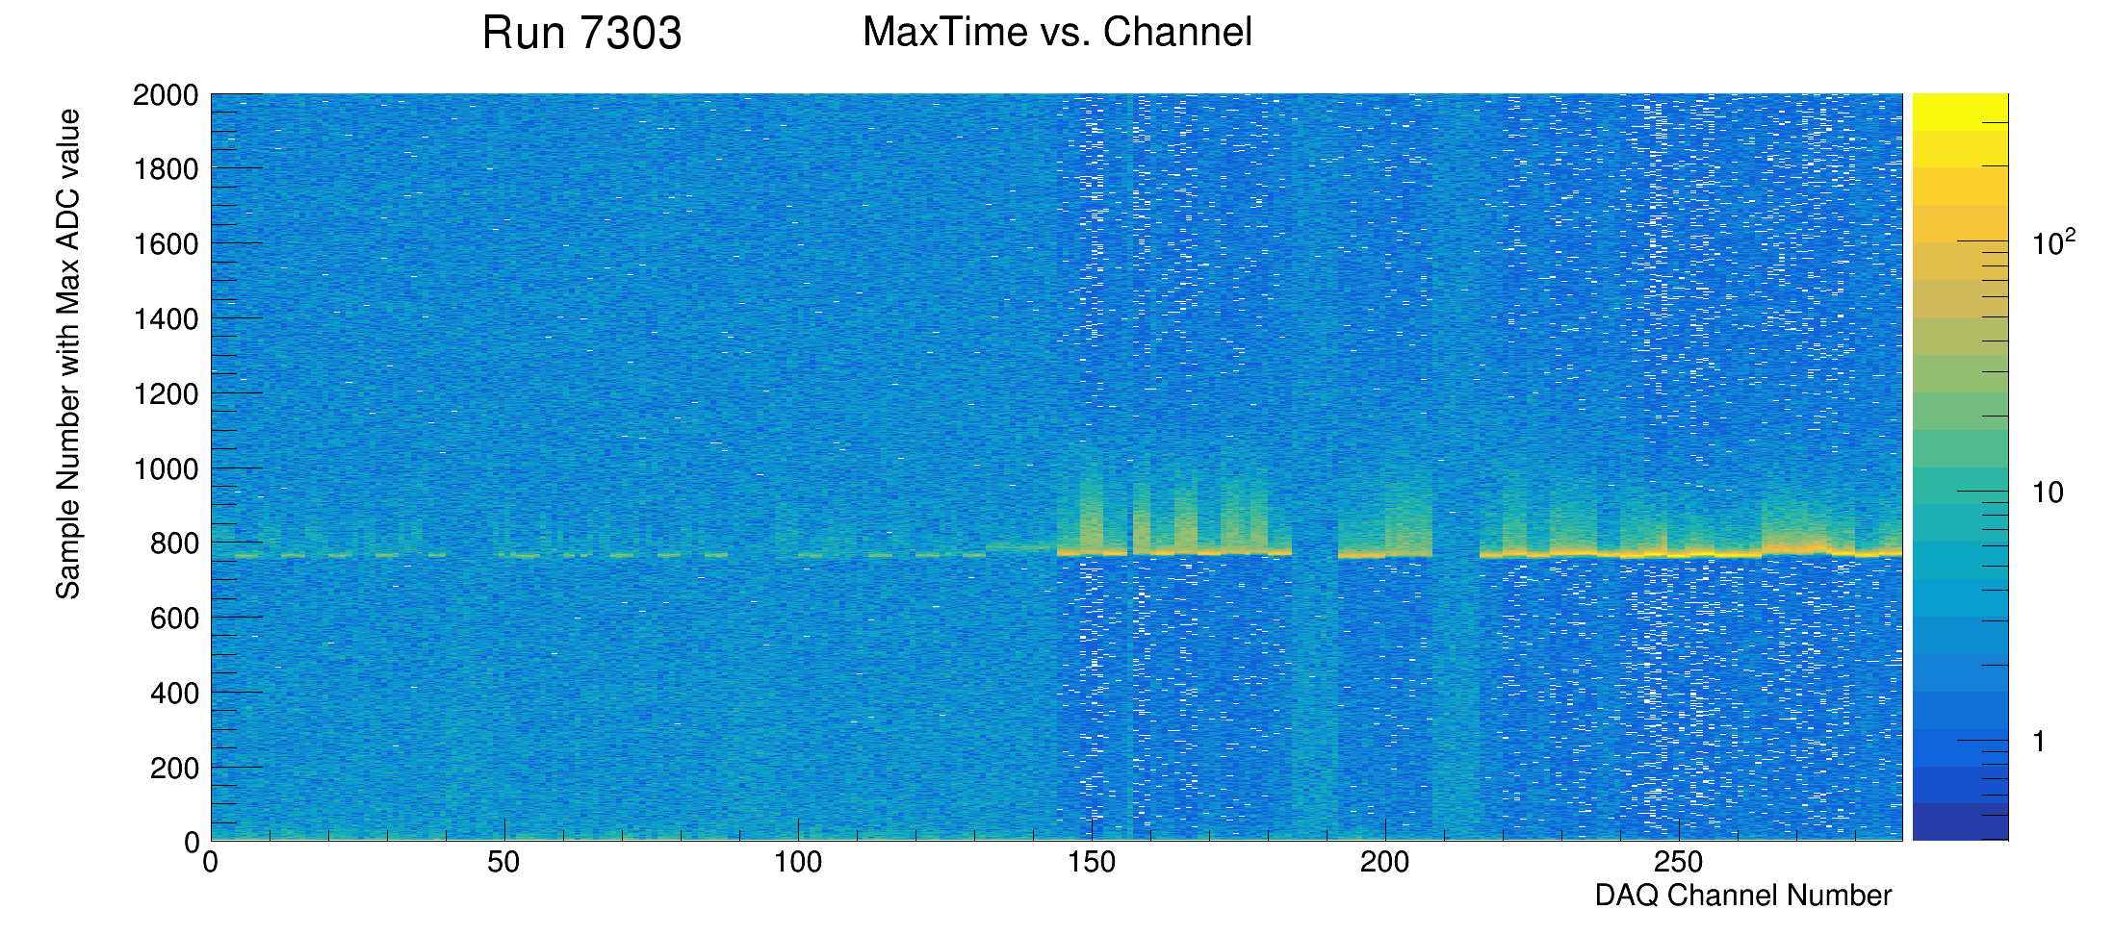
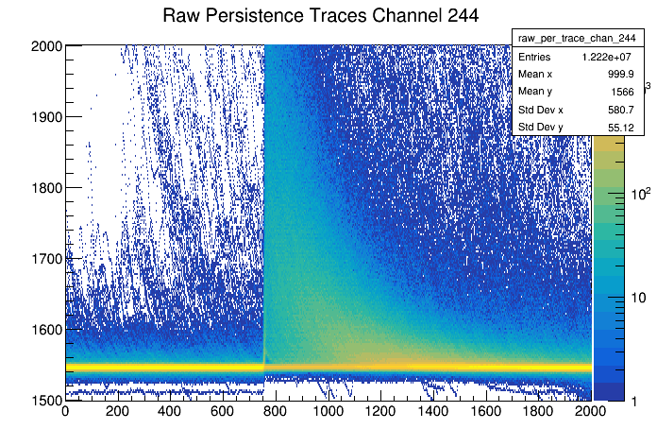
APA_4_6_Run7303 RAW DATA
← Telescope alignment
APA-1
APA-2
APA-3
APA-4
APA-5
APA-6

Slide 13
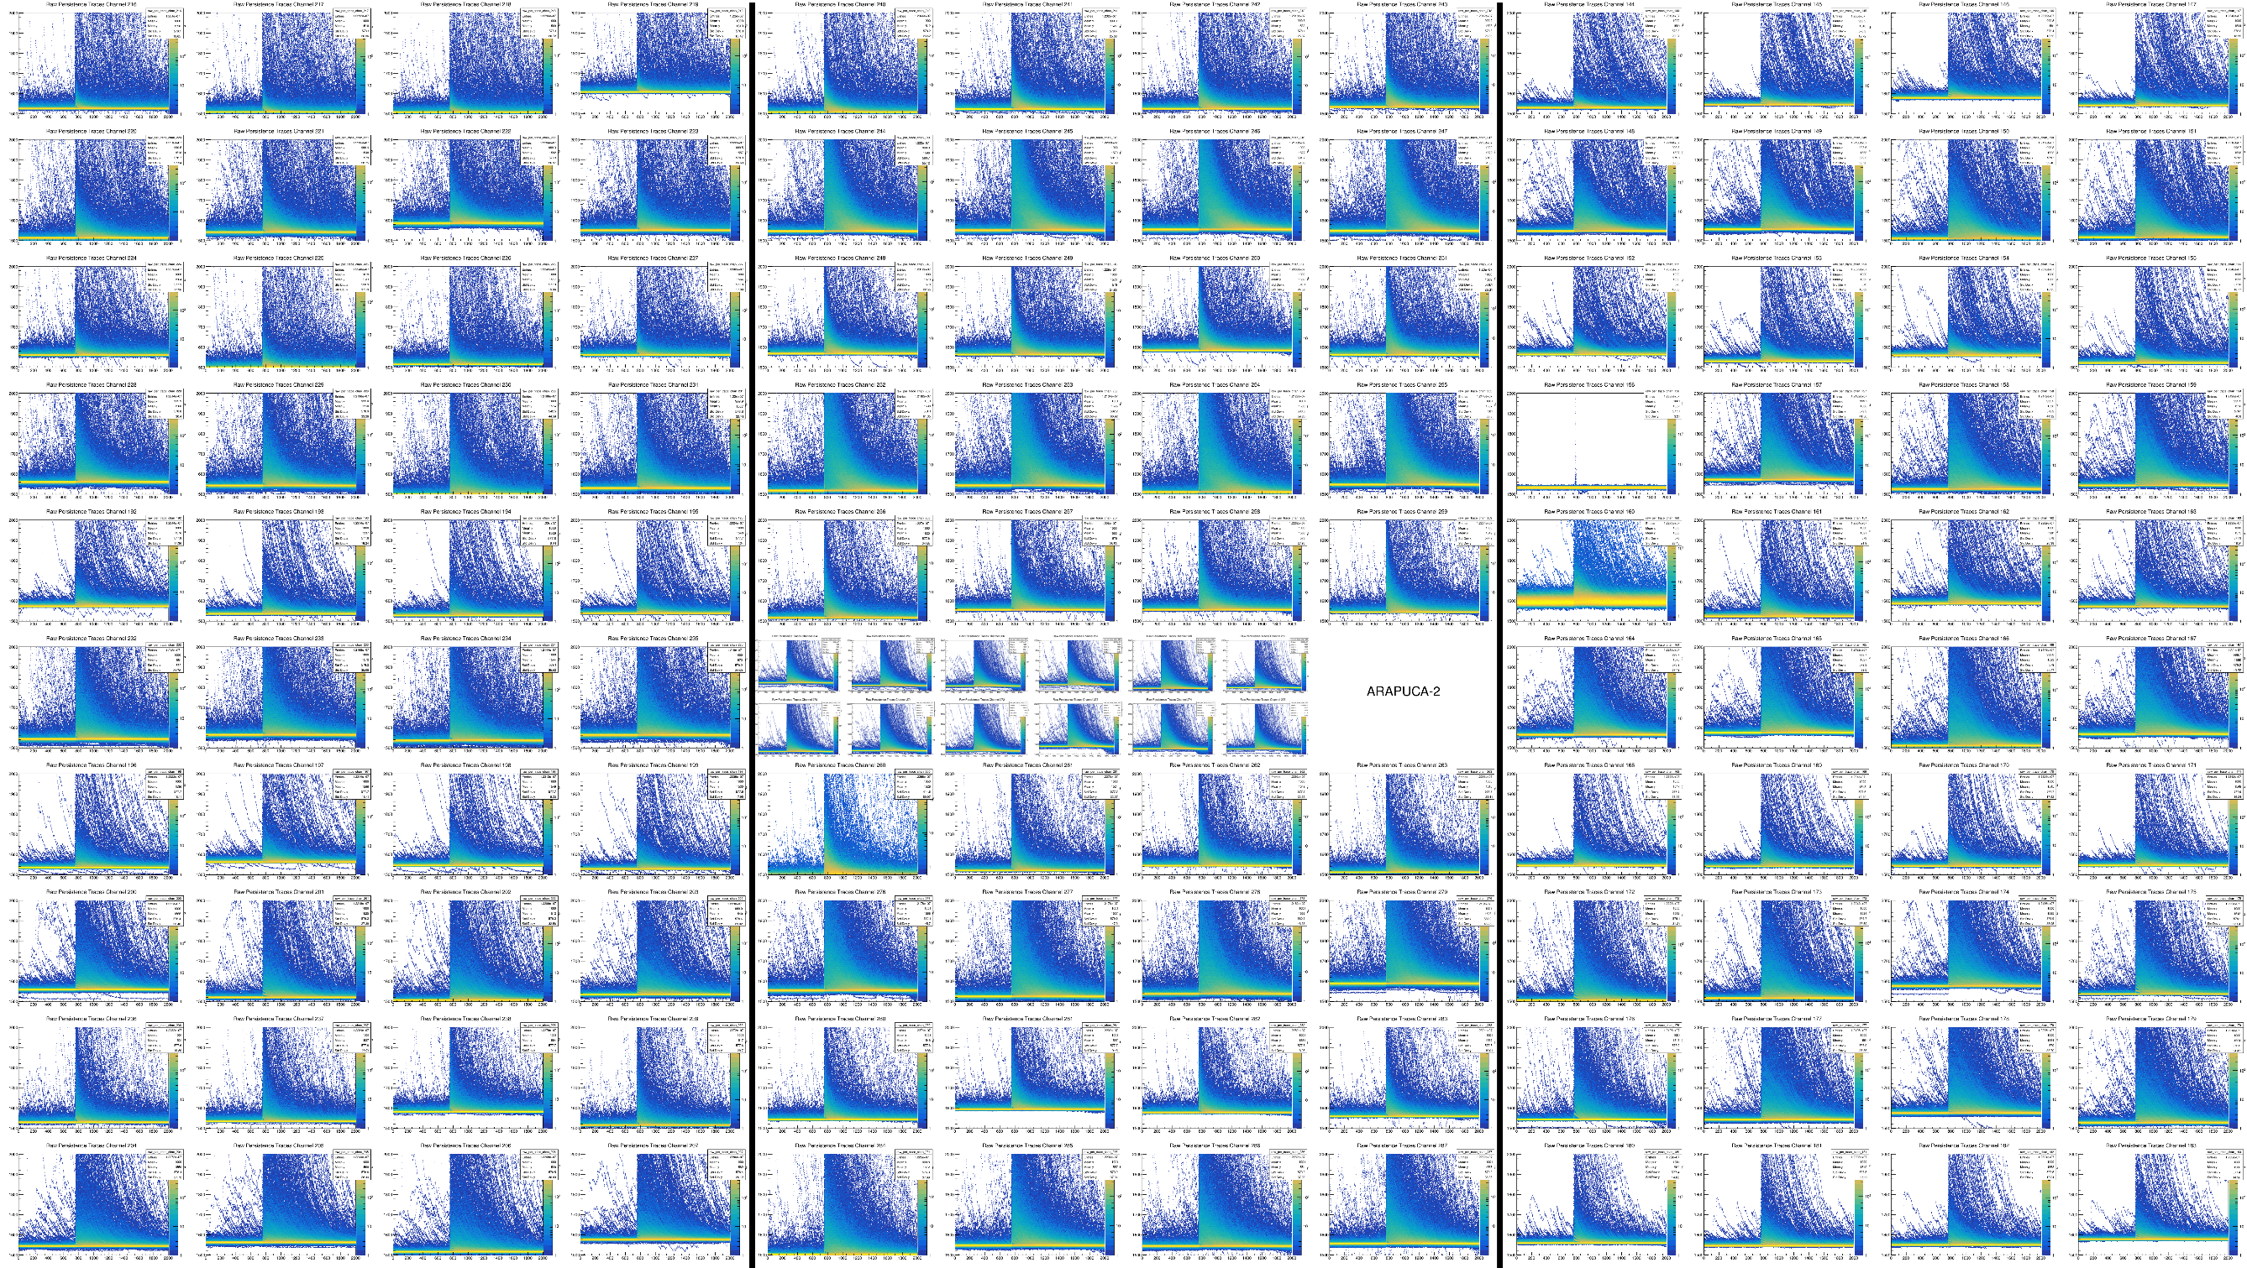
APA_4_6_Run7303 RAW DATA- Persistence Traces
APA-5
APA-6
APA-4
ARAPUCA

