Slide 1
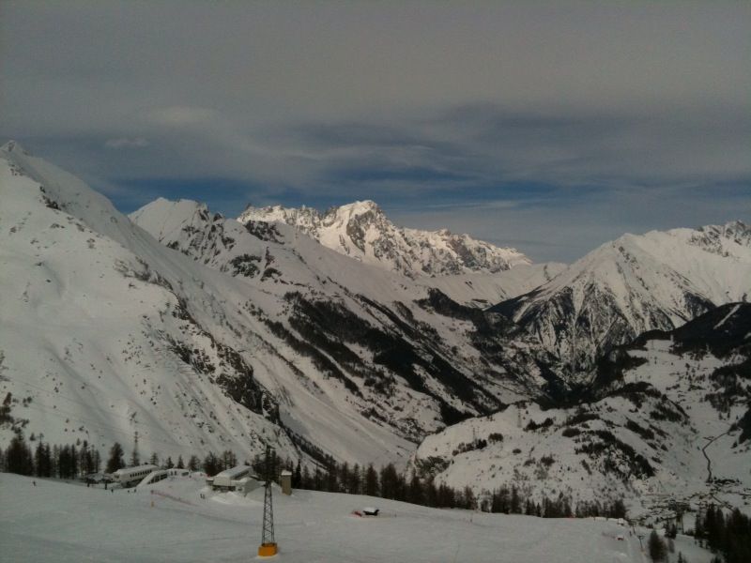
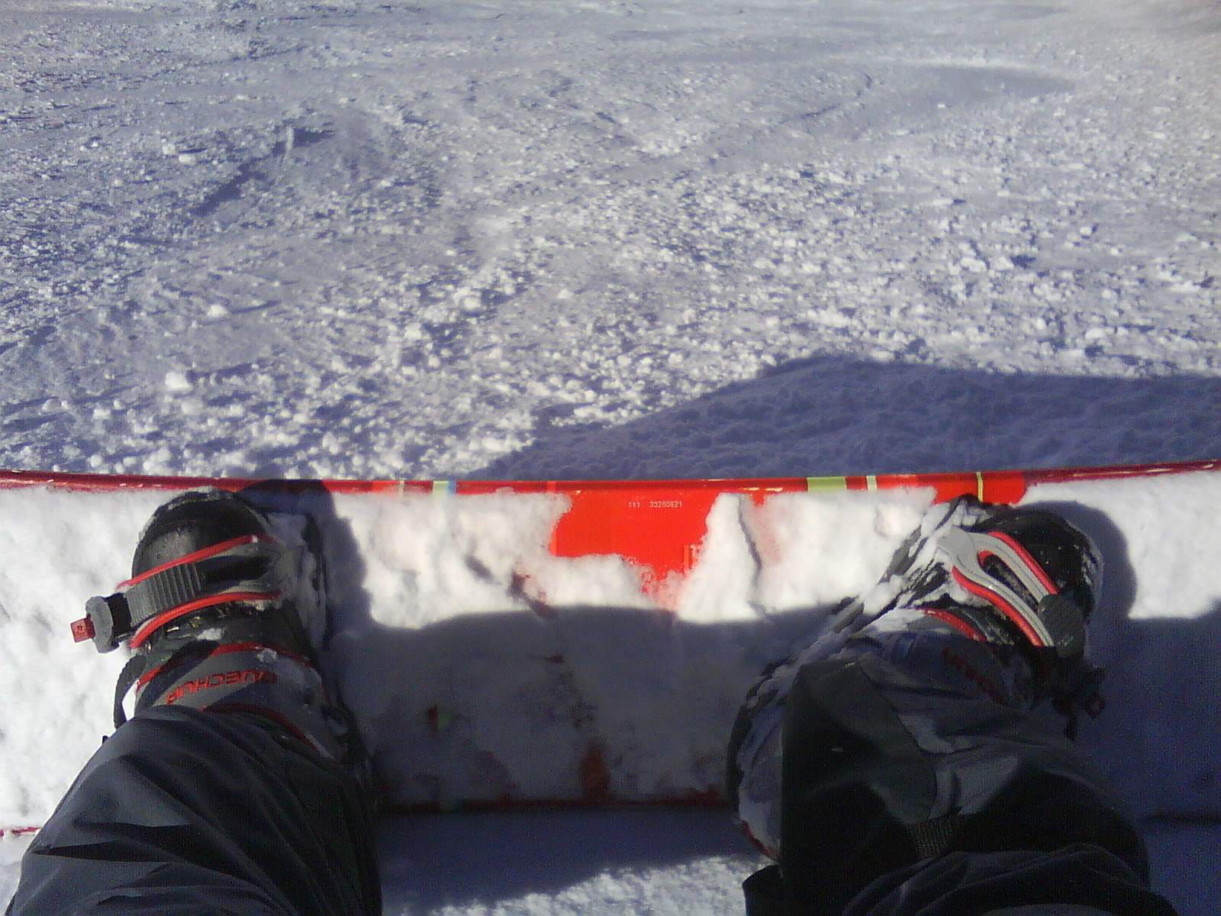
Hot Topics from CMS (off the press)
Les Rencontres de Physique de la Vallée d’Aoste
La Thuile, 2010
Stéphanie Beauceron on behalf of the CMS collaboration
Courtesy of R. Tenchini

Slide 2
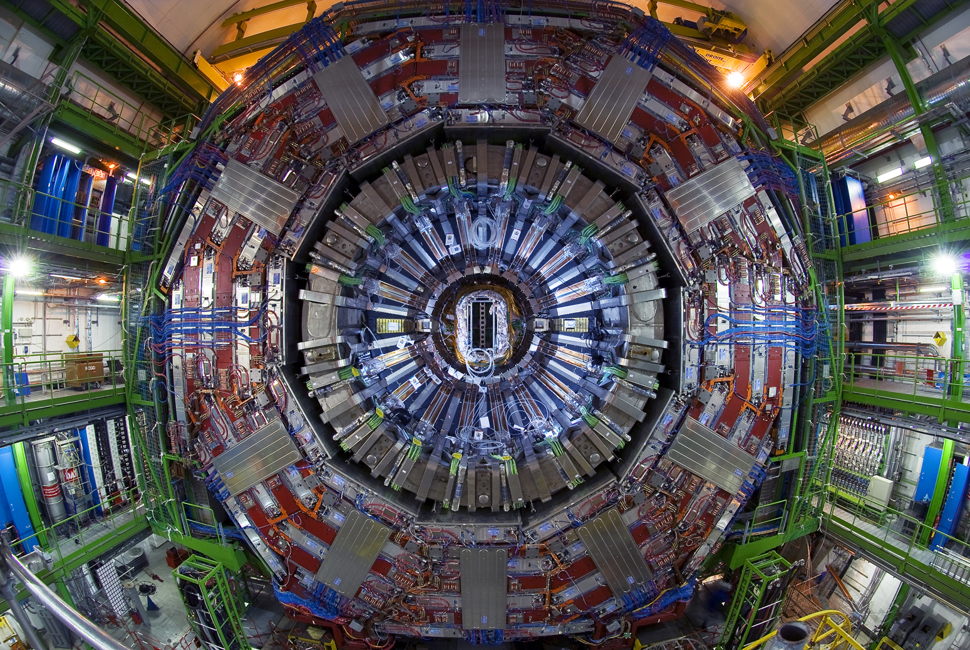
On the Road to Standard Model and Searches…
Tracker, wonderful tool
Ecal, control calibration
Jets
Missing E_{T}, a challenging variable
Particle Flow algorithm, improvement all the way…
Conclusion

Slide 3
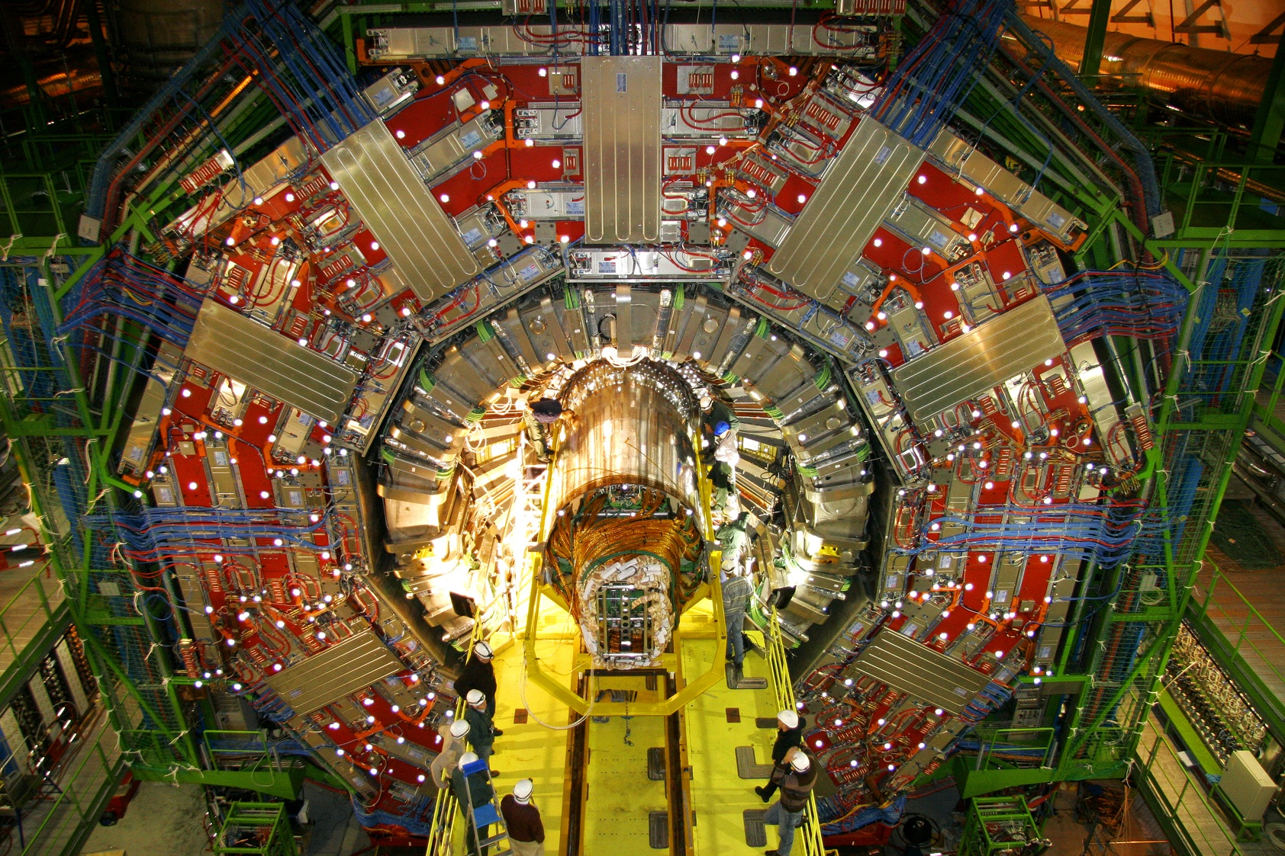
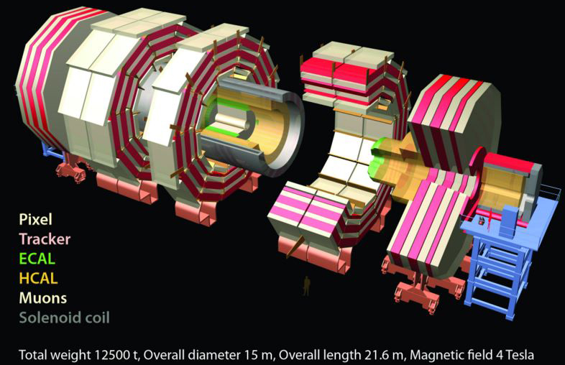
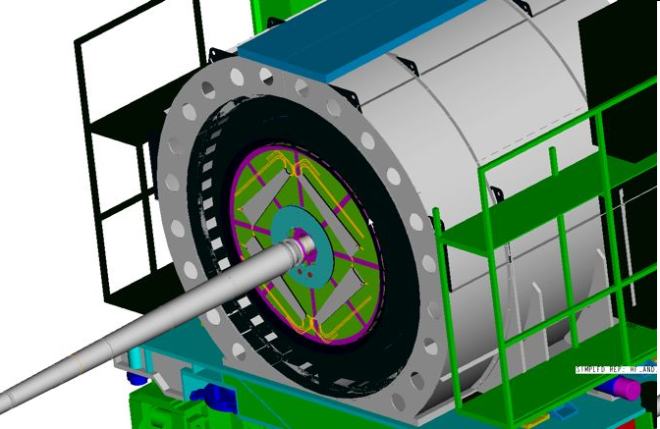
CMS Data Recording
Data are recorded using High Level Trigger as a pass through (rate of collisions maximum 20 Hz)
Record all events
Mainly identify collisions events using Beam Scintillator Counter [BSC]
BSC
Luminosity recorded:
~10 μb⁻¹ at 900 GeV
~0.4 μb⁻¹ at 2.36 TeV

Slide 4
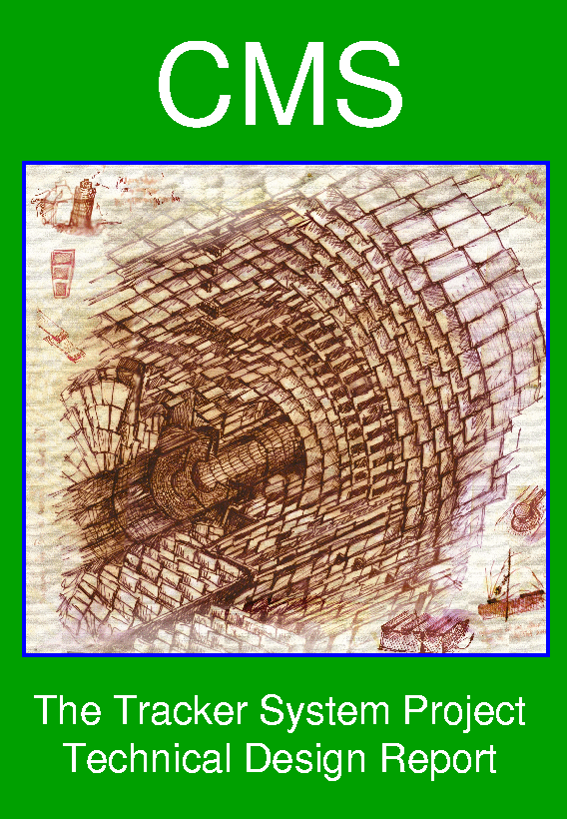
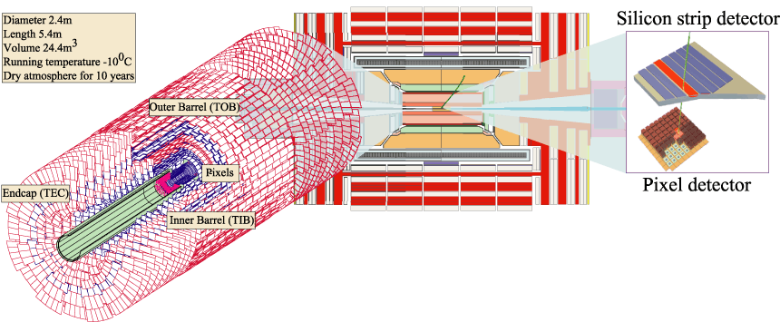
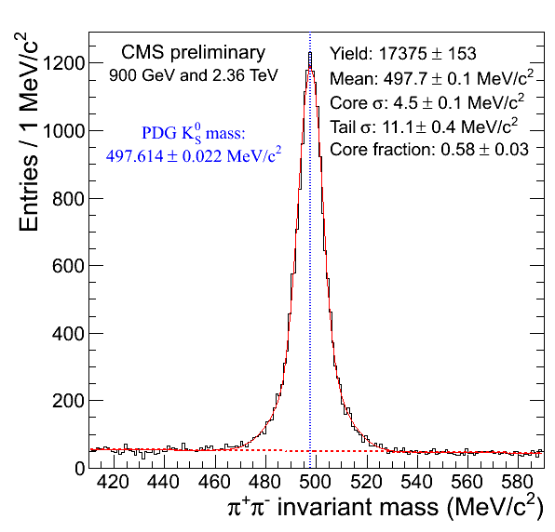
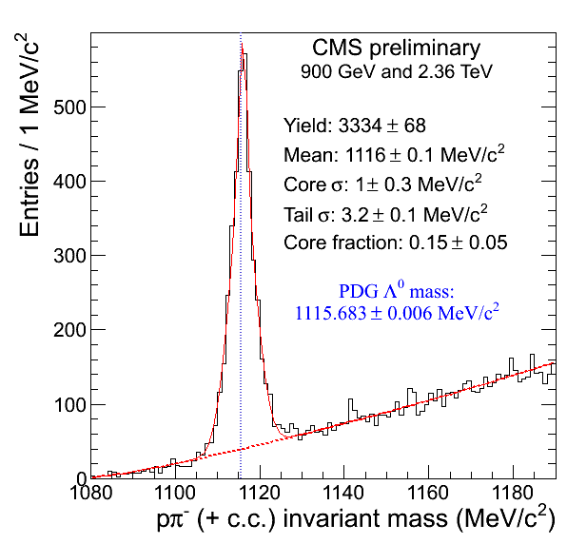
Tracking Quality
K_{s}
Alignment from Cosmics data taken over summer 2009.
Selection:
Tracks with at least 6 hits
Normalized chi² < 5
impact parameter with beam spot > 0.5 sigma,
Both tracks at 1 cm of each other, oppositely charged
Λ
Notes:
Selection:
Tracks with at least 6 hits
normalized chi² < 5
impact parameter with beam spot > 0.5 sigma,
Both tracks at 1 cm of each other,
oppositely charged.
V0 vertex: normalized chi² < 7.0, separated from the beam spot in the radial space
no daughter track hits

Slide 5
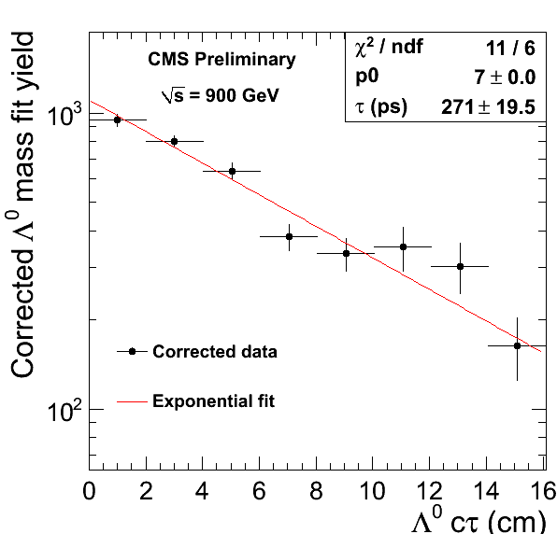
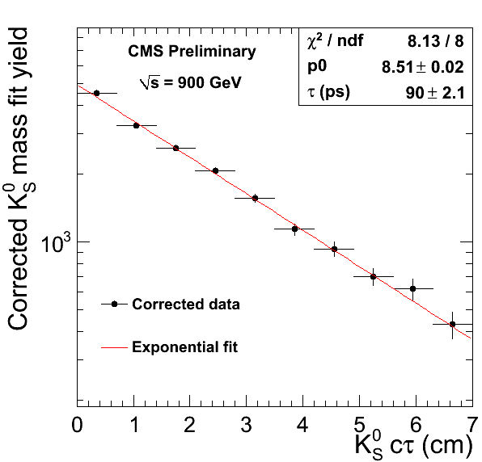
Lifetime
Monte Carlo is simulated with the same conditions as in data.
Data and MC are split into bins of cτ and a fit for the yield is performed in each bin.
Divide MC yields by true (exponential) distribution to obtain correction factor.
Correct data and fit for lifetime.
PDG: 89.53 ± 0.05 ps
PDG: 263.1 ± 2.0 ps
CMS: 90.00 ± 2.10 ps
CMS: 271.0 ± 20 ps
K_{s}
Λ
➔ accurate tracking and vertex simulation, even outside the beam region
Notes:
Selection:
Tracks with at least 6 hits
normalized chi² < 5
impact parameter with beam spot > 0.5 sigma,
Both tracks at 1 cm of each other,
oppositely charged.
V0 vertex: normalized chi² < 7.0, separated from the beam spot in the radial space
no daughter track hits

Slide 6
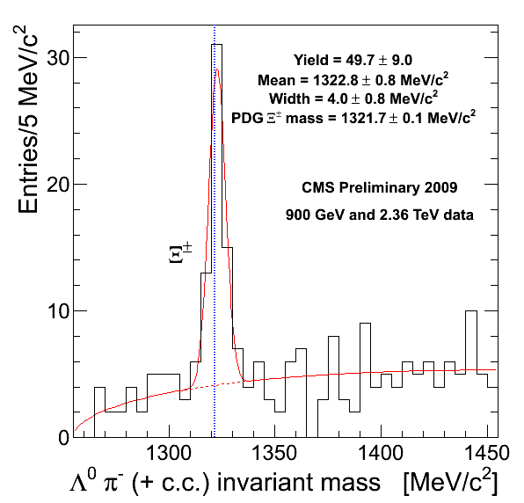
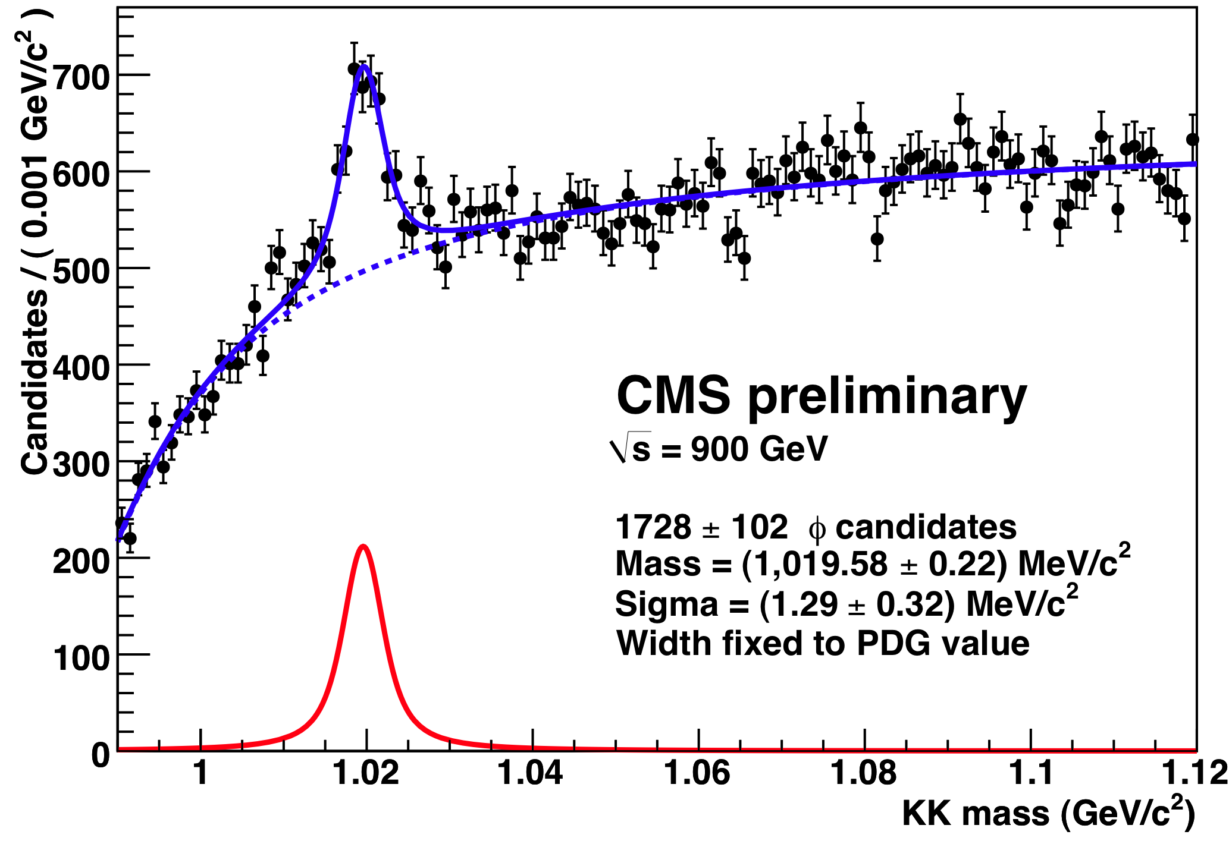
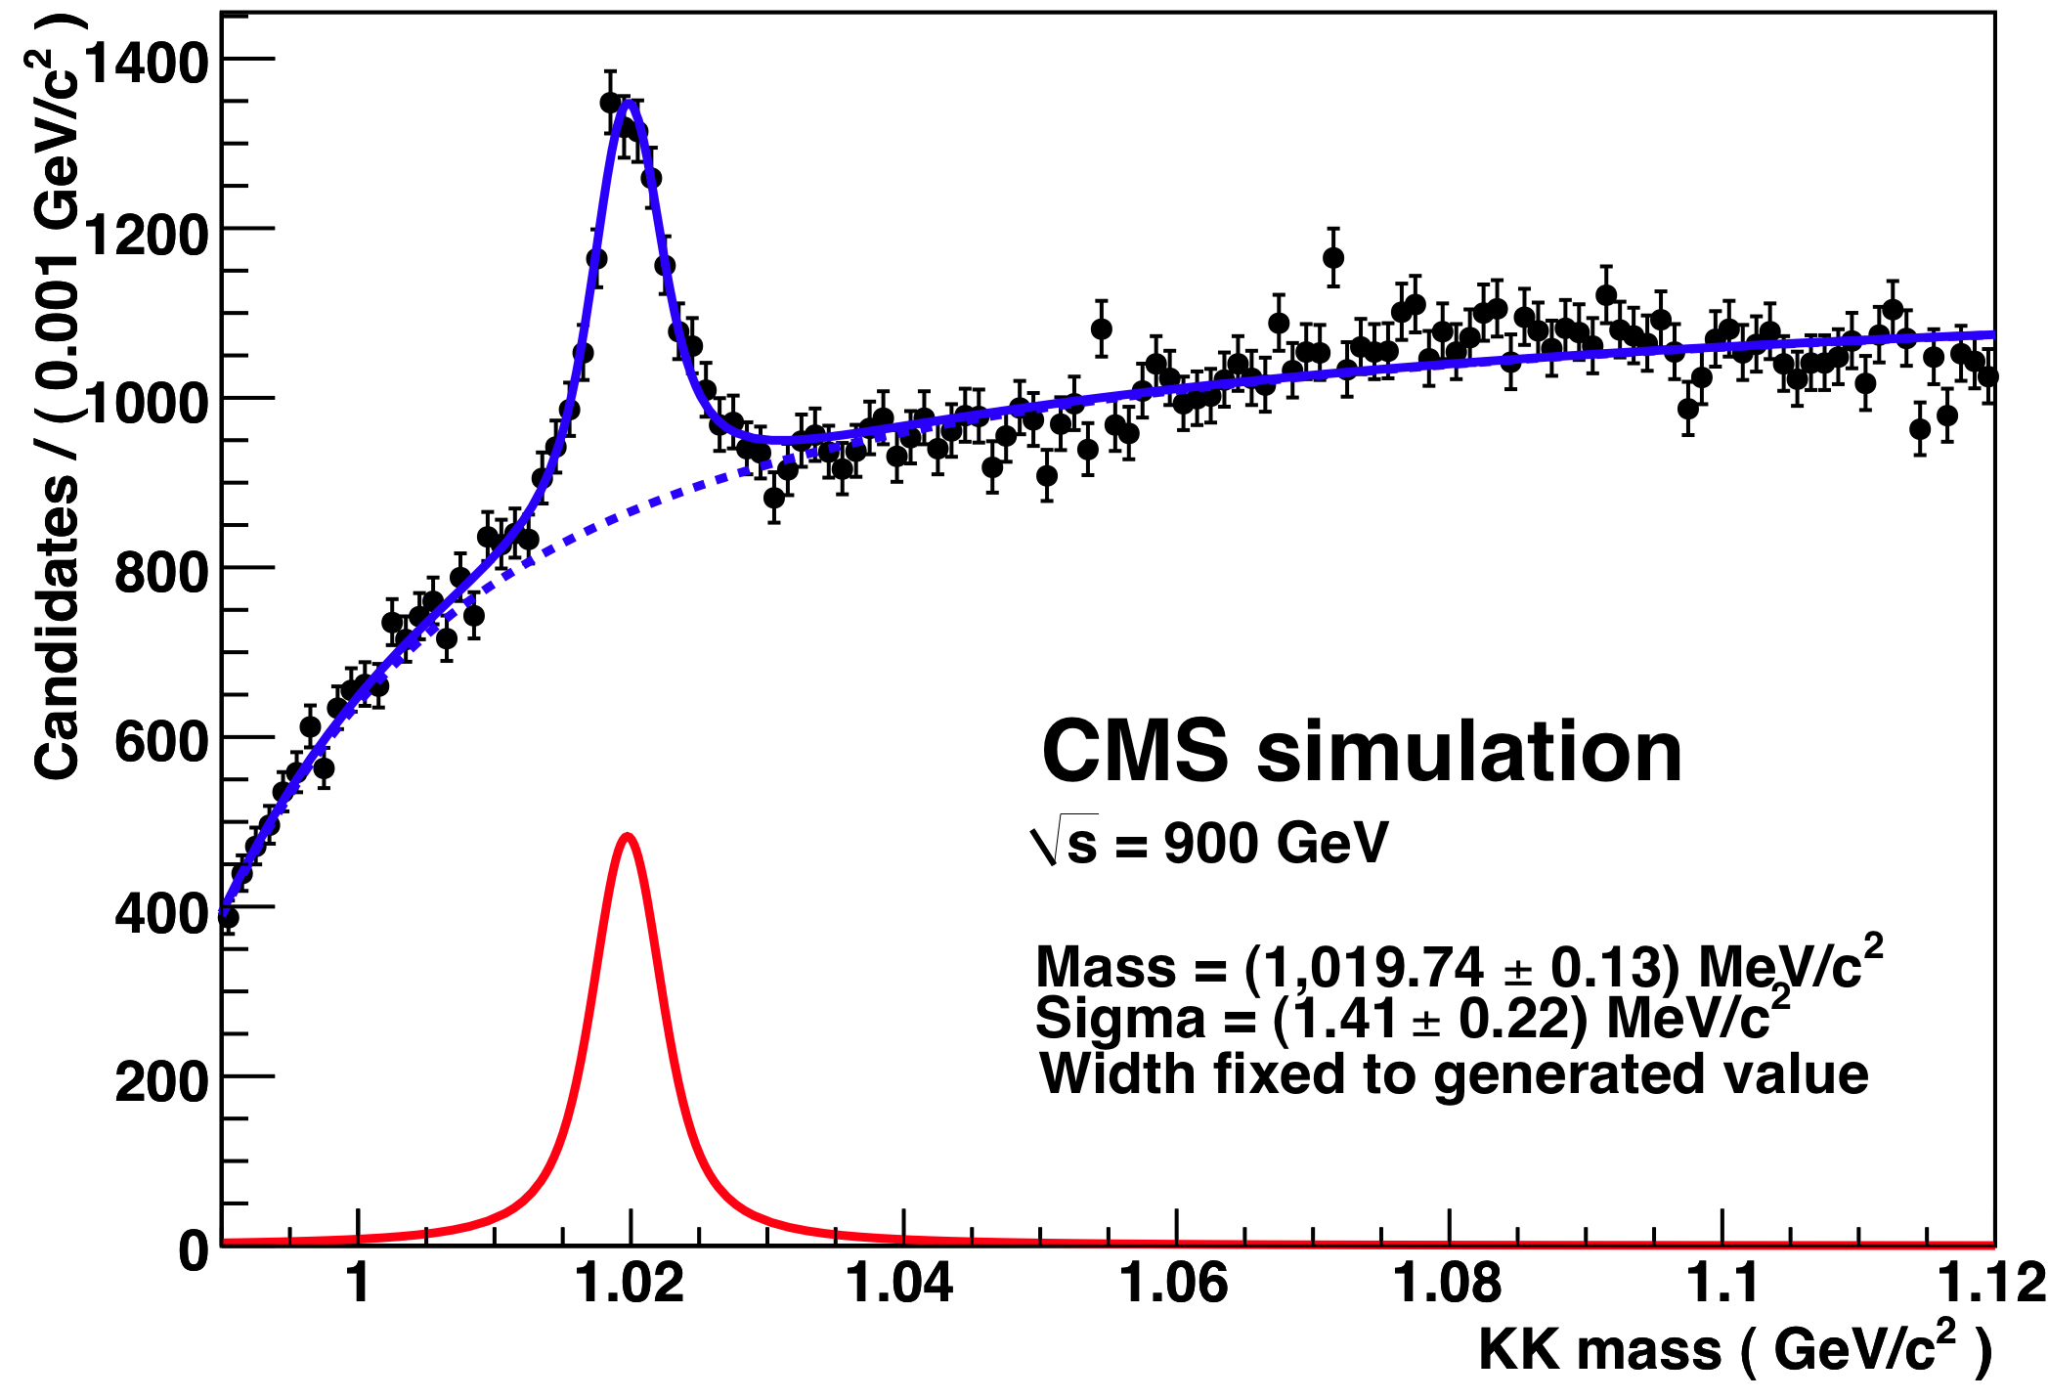
Tracking Results
p
π⁻
Λ⁰
π⁻
Selection for Ξ:
Lambda mass within 8 MeV
Lambda-pion vertex fit probability > 1%
Both pions have the same sign charge
3D impact parameter significance > 3 for all three tracks
Ξ⁻
Primary
Gaussian convoluted with Breit-Wigner
φ →KK:
Kaons with tracks ≥5hits, χ_{norm}² < 2, d_{xy}<3mm, p_{T}>0.5 GeV
Particle ID: p>1GeV OR dE/dx inside kaon range
Data
MC
Alignment of tracker system is well understood
Notes:
kinematic fit of each combination of a reconstructed Lambda and a charged track in the event is performed to compute the invariant mass of the Lambda pion combination, where the track is fit using a pion mass hypothesis and a constraint to the PDG value is applied for the Lambda mass.

Slide 7
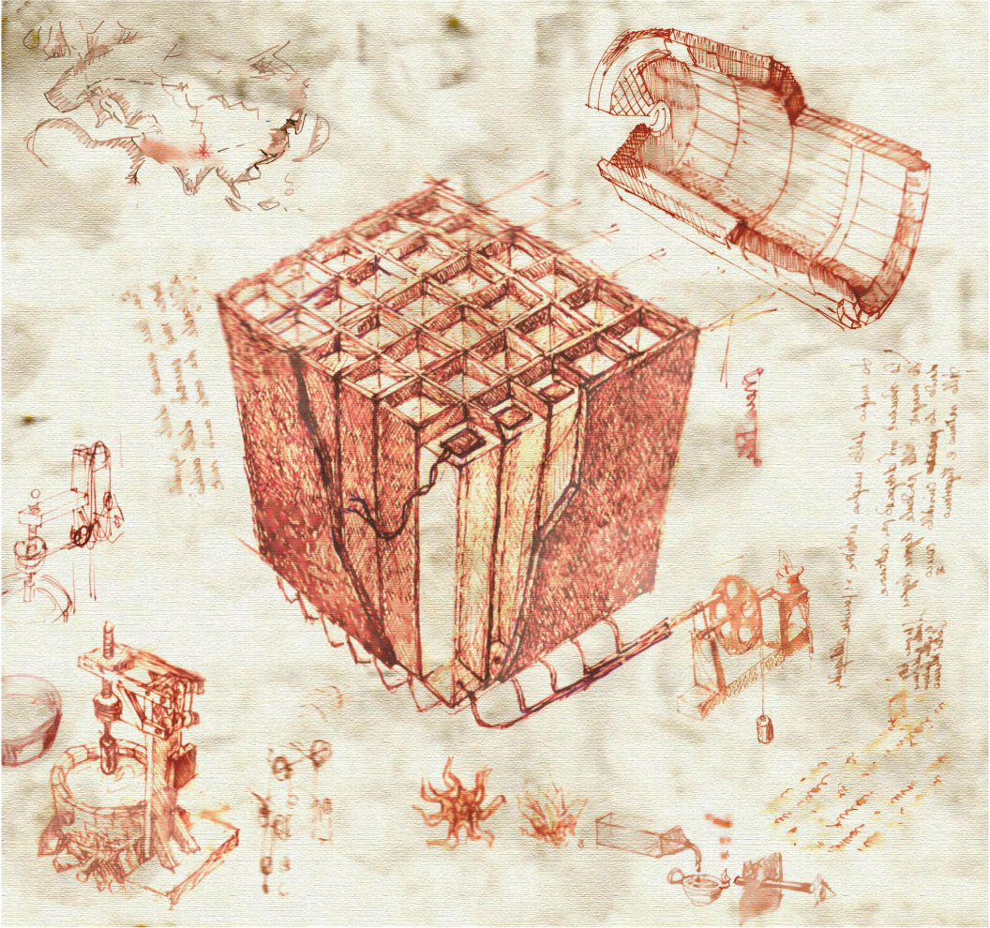
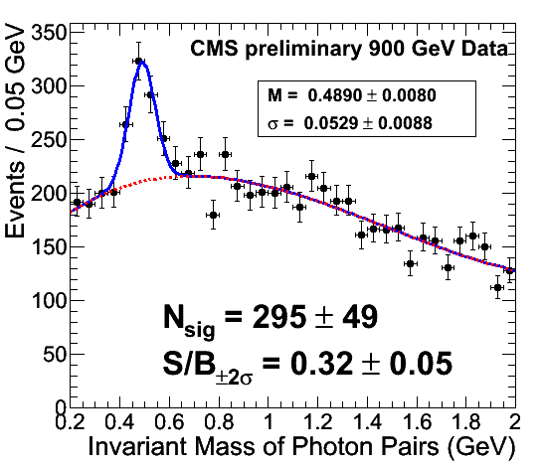
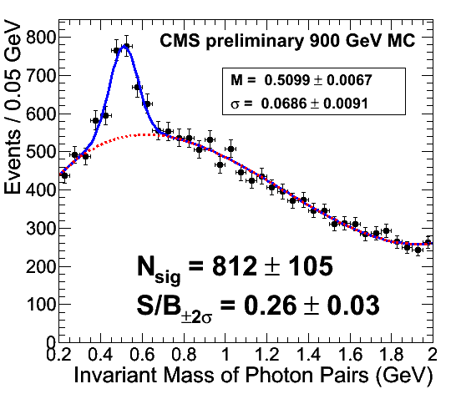
Electromagnetic Calorimetry
γ in barrel
E_{T}(γ)>400 MeV;
E_{T}(η)>2.0 GeV;
S4/S9 > 0.85 (shower shape)
Precalibration from Test Beam period for ¼ of barrel + Cosmic running (~1-2% precision)
Data
Mass and width compatible with MC
η yield scale as expected:
Data: N(η) / N(π⁰) = 0.020 ± 0.003
MC: N(η) / N(π⁰) = 0.021 ± 0.003
MC
Good agreement between data and MC

Slide 8
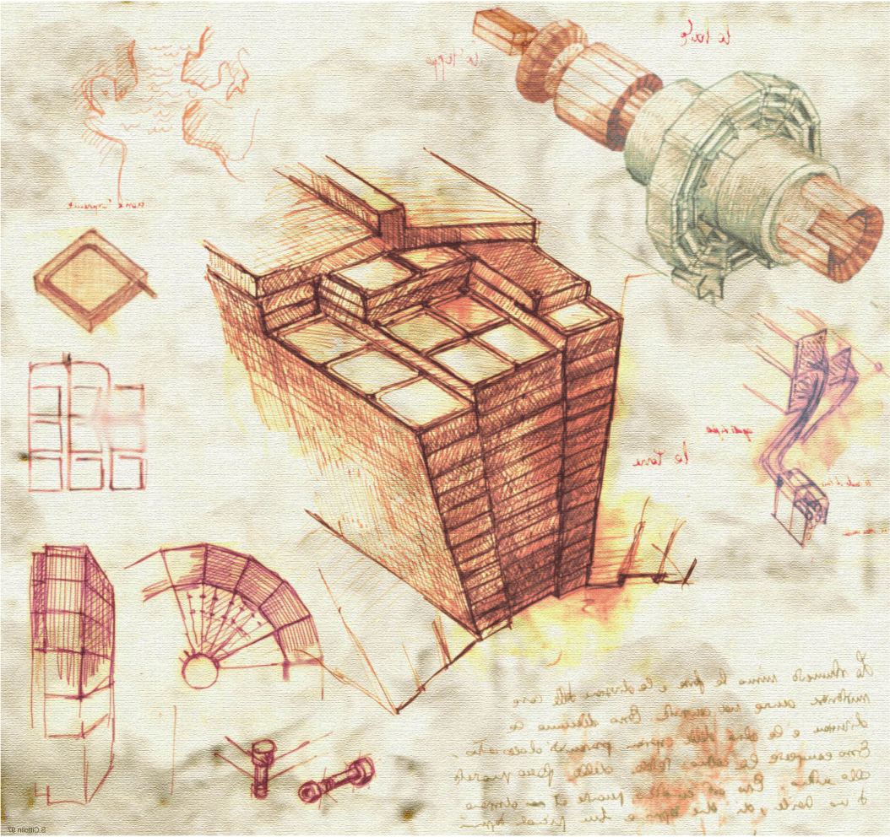
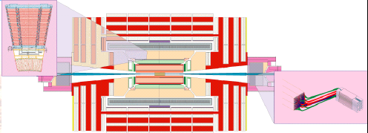
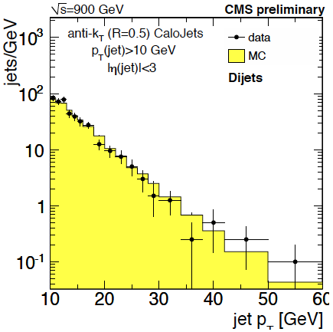
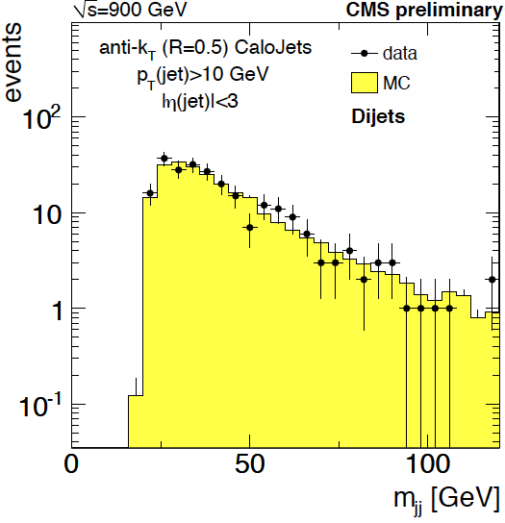
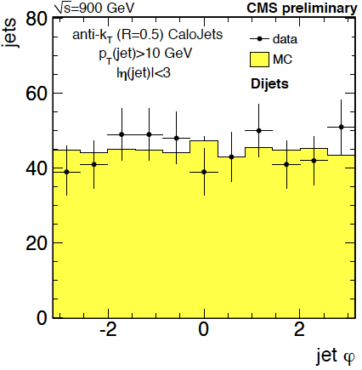
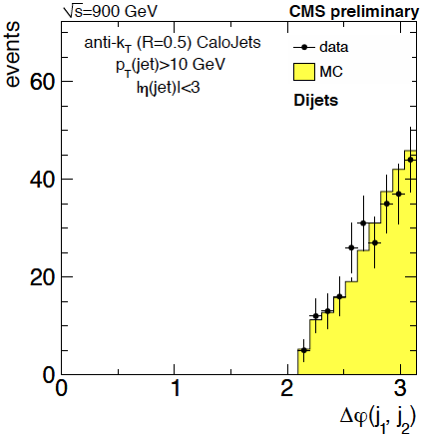
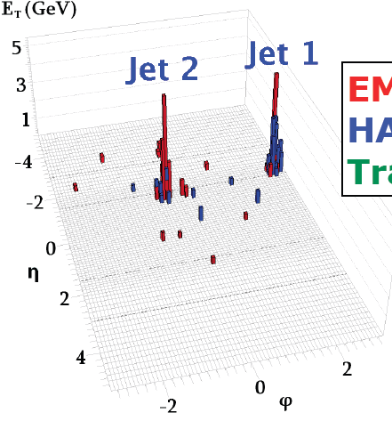
Calorimetry in Action
Jets reconstructed using Anti-KT R=0.5 algorithm
Di-jet analysis:
P_{T}>10 GeV
|η|<3.0
|Δφ(j1,j2) – π|<1.0
Jet Energy Scale corrections from simulation

Slide 9
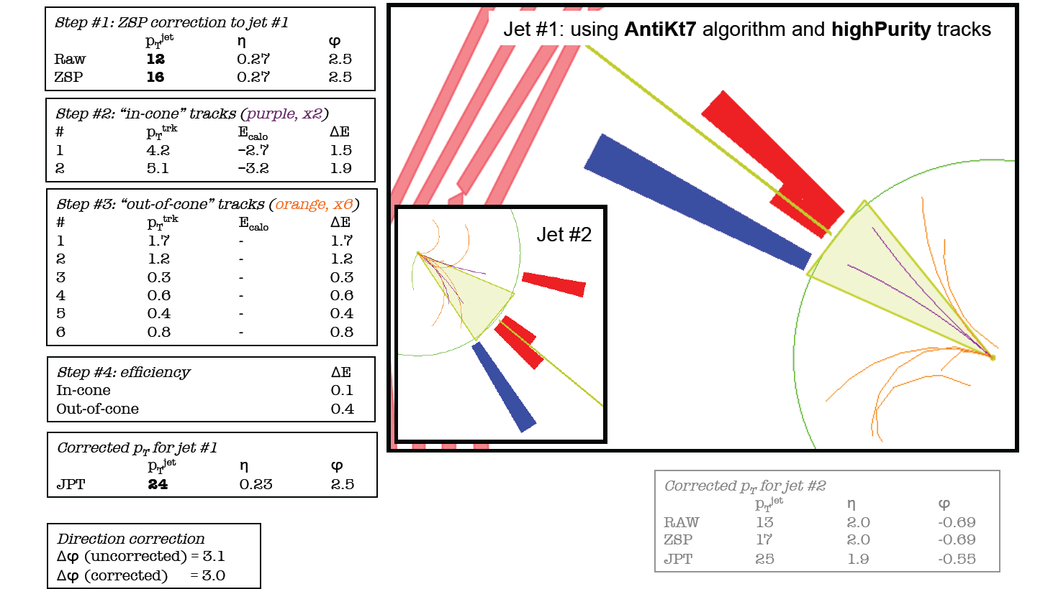
Tracks + Calorimetry
Corrected p_{T} of
24 and 25 GeV
when including tracks.

Slide 10
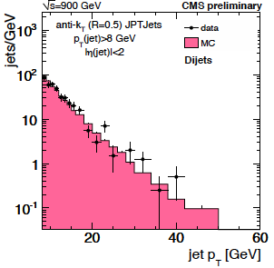
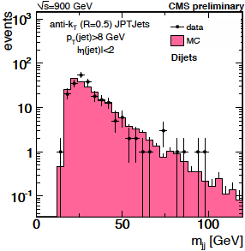
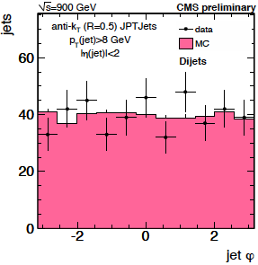
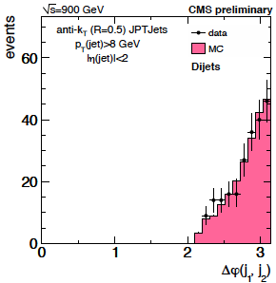
Jets + Tracks
Jets reconstructed as Jets+tracks
Di-jets:
P_{T}>8 GeV
|η|<2.0
|Δφ(j1,j2) – π|<1.0
Good agreement between data and MC and good agreement between calorimeter based jets and jets + tracks

Slide 11
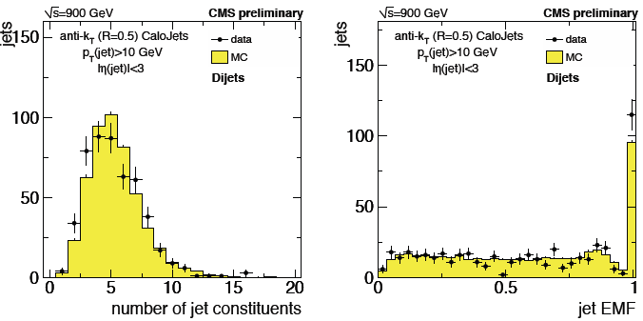
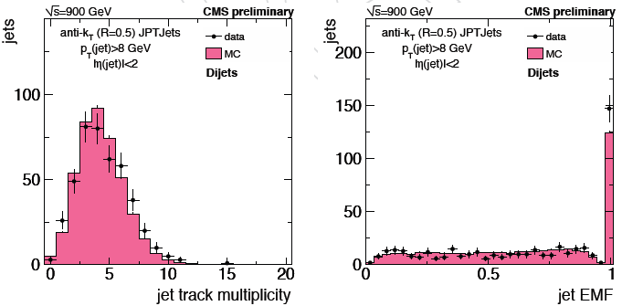
Jet Properties
Jets reconstructed using Anti-KT R=0.5
Jets + Tracks
Good description of the variables
Clear understanding of jets, confident to look for high energetic jets…

Slide 12
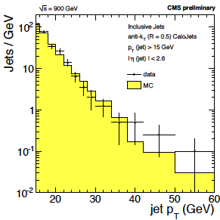
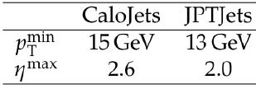
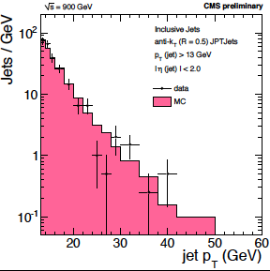
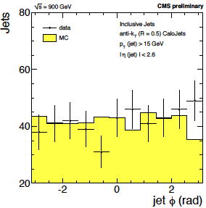
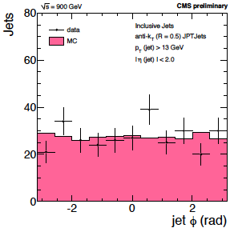
Inclusive Jets Analysis
Good agreement for inclusive jets analysis for both algorithms

Slide 13
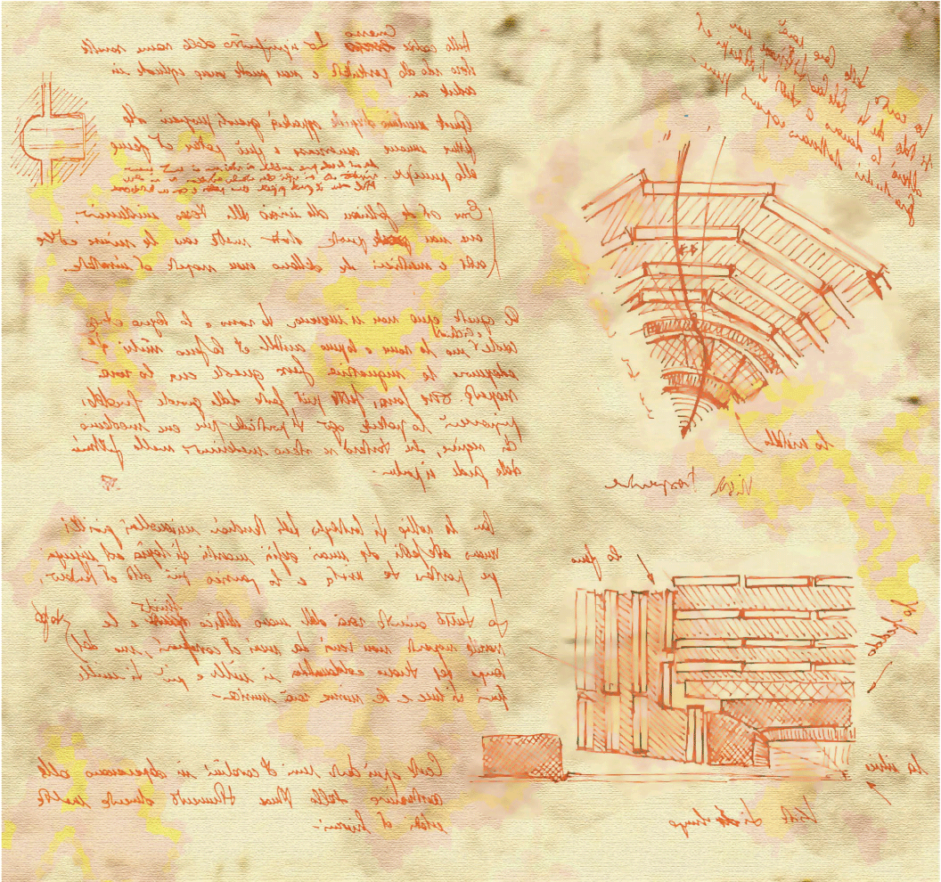
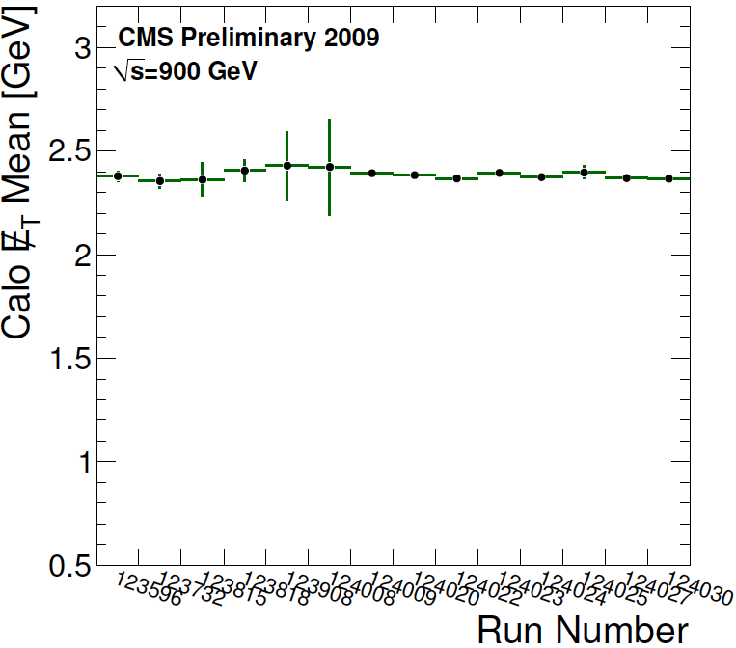
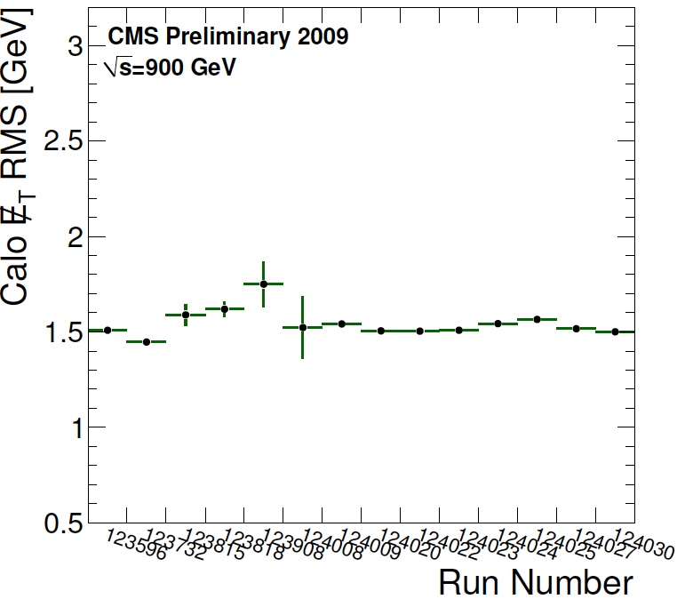
Missing E_{T}
Important variables for physics analysis but most challenging variable to understand
➔ Rely on good understanding of all the other objects.
RAW Calorimetric ME_{T}
➔ Stability of calorimetric missing E_{T} calculation during the whole period of data taking.

Slide 14
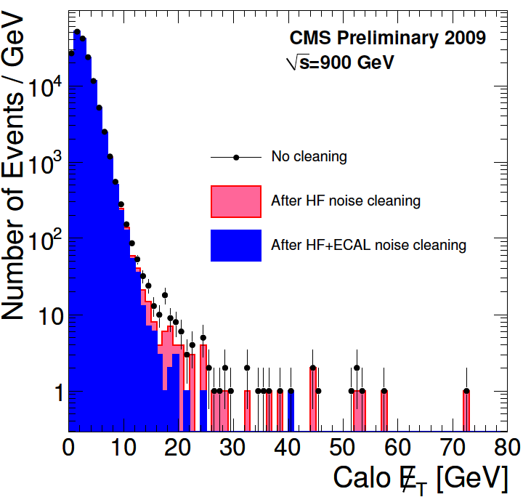
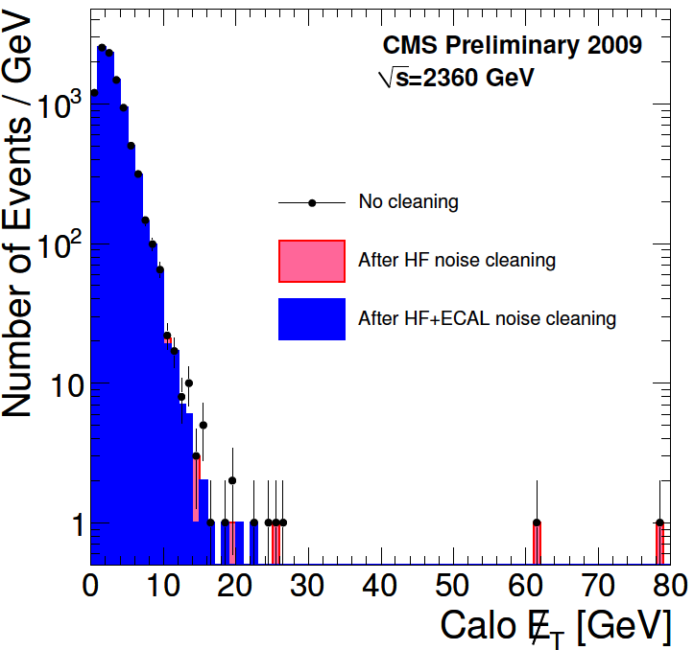
Missing E_{T}
Cleaning of Missing E_{T}: (Events are not removed, only hot spot)
Noise in Hadronic Forward (particle hitting the PMT window)
Noise in Hadronic Calorimeter [HB/HE] (specific pattern of channels)
Noise in Electromagnetic Calorimeter (single Hot channel)
Data
Data
Clear understanding of the different noise behavior, cleaning procedures are in place

Slide 15
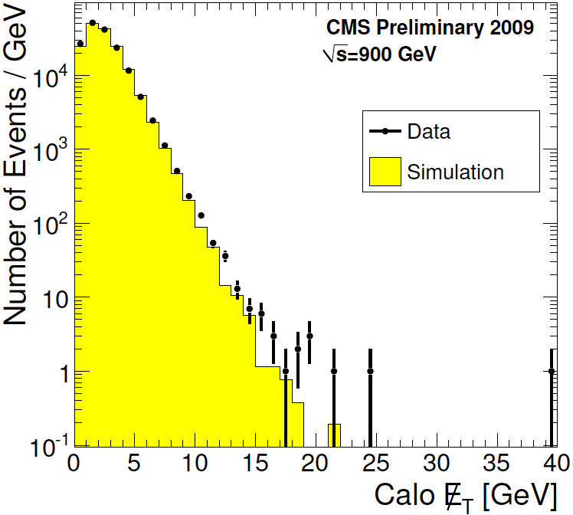
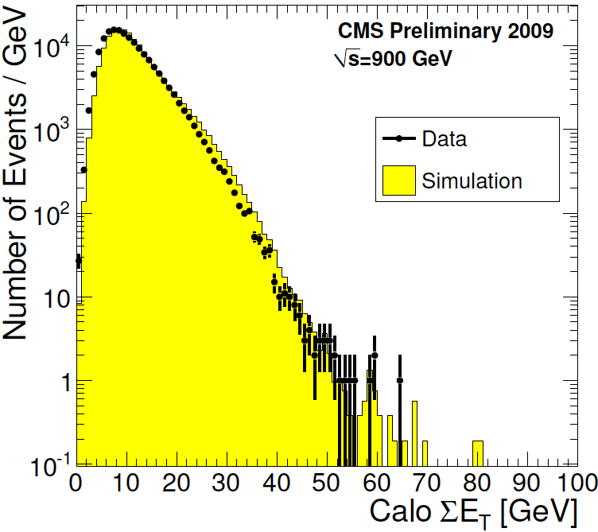
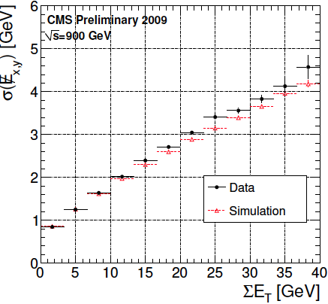
Missing E_{T}
Calorimeter only
Good description of missing E_{T} variable and reasonable of Sum E_{T}
Agreement Data/MC on variables even if calibration of detector are not final

Slide 16
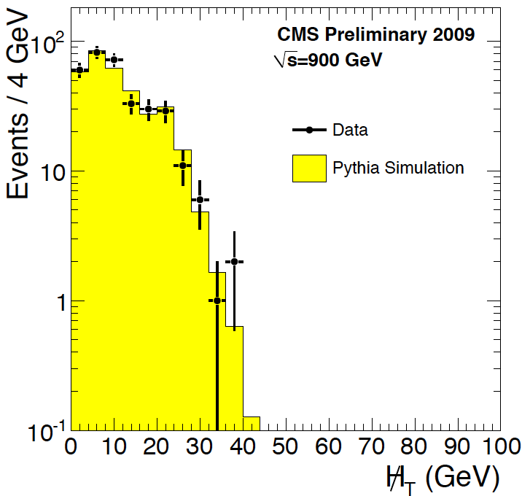
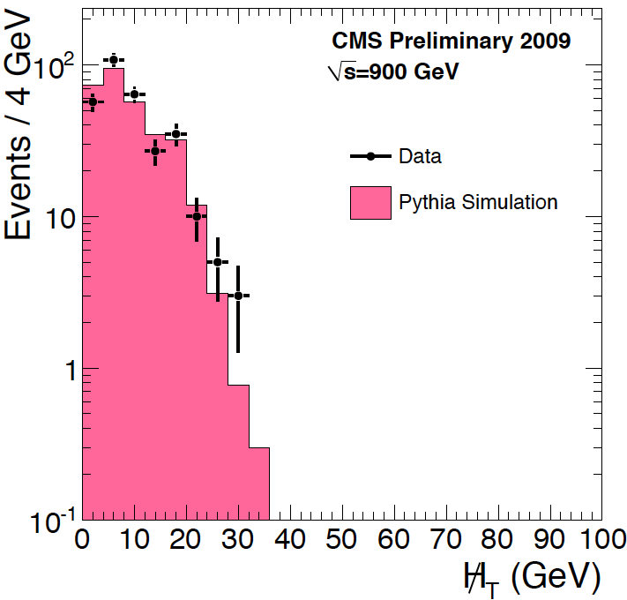
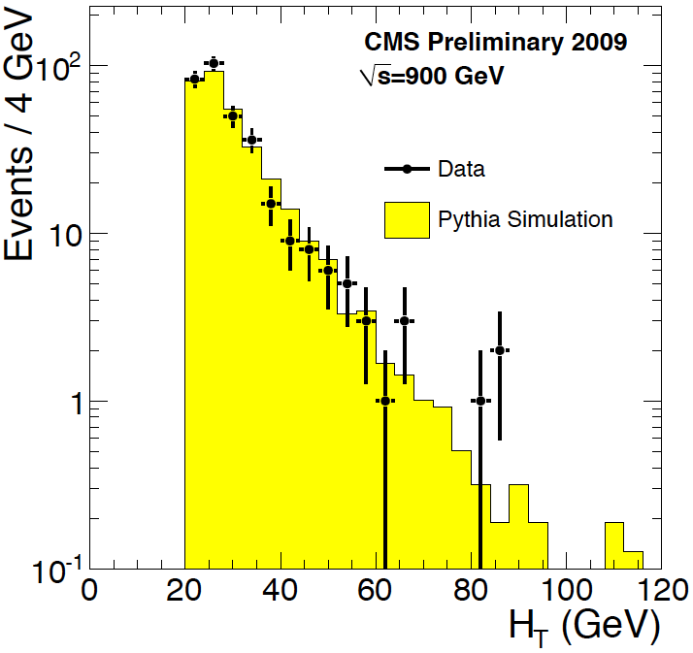
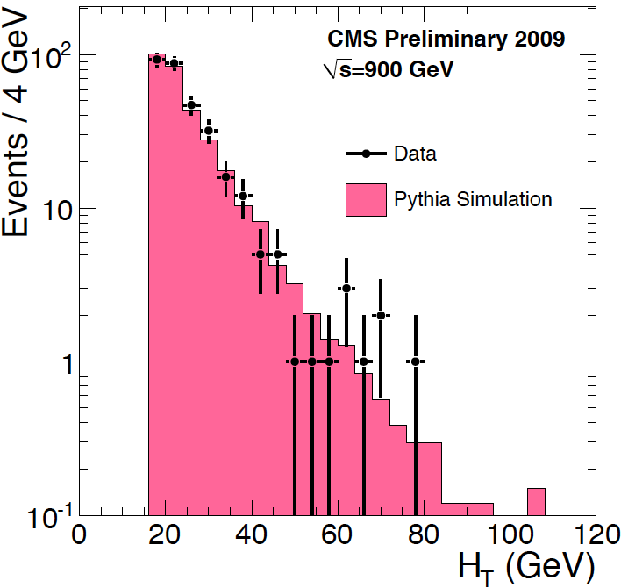
MH_{T}/H_{T}
→
MH_{T} = |- Σ p_{T}(jets)| H_{T} = Σ |p_{T}(jets)|
CaloJet
Tracks+Jet

Slide 17
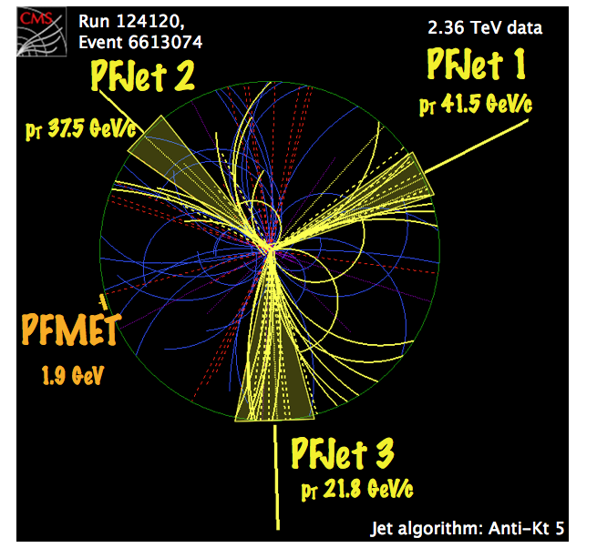
Particle Flow Algorithm
Exploring the fine resolution and granularity of part of the CMS detector to improve the identification and resolution of reconstructed objects using Particle Flow Algorithms.
Principle: link track and cluster and cluster to cluster in fine grain
Multijet at 2.36 TeV

Slide 18
Particle Flow Commissioning
Need to establish track Ecal/Hcal cluster link:
P_{T} of tracks>1 GeV

Slide 19
Particle Flow Jets
Charged Hadrons Calibration:
Inclusive jet analysis: p_{T}^{raw} > 5 GeV
Calorimeter response to hadrons well simulated

Slide 20
Particle Flow Jet Properties
Jets reconstructed using Anti-KT R=0.5 algorithm from particle flow particles
Di-jet analysis:
P_{T}>8 GeV
|η|<3.0
|Δφ(j1,j2) – π|<1.0

Slide 21
ME_{T} using Particle Flow
SumE_{T} > 3 GeV
Particle-based ME_{T} relative resolution is about twice as good as for the CaloMET

Slide 22
And finally…
CMS Back Alive!

Slide 23
Conclusion
From the first collisions day, a lot of results have been appearing very quickly
➔ Understanding and commissioning of the detector is in well advanced stage
Start to use complex algorithms with very few fine tuning
Agreement with simulation is impressive all the way through
CMS is waiting for higher statistics of data and higher center of mass energy to start to perform searches
➔ By ICHEP, should start to see more Standard Model physics at 7 TeV and…

Slide 24
BackUp

Slide 25
AntiKt

