Slide 1

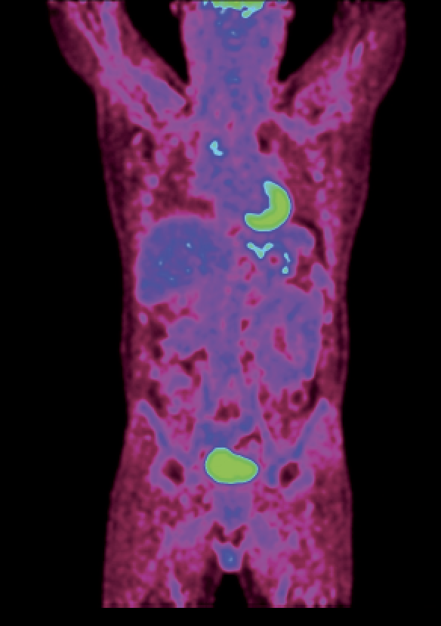

Drawing with
Antimatter
Piergiorgio Cerello
INFN - Torino

Slide 2
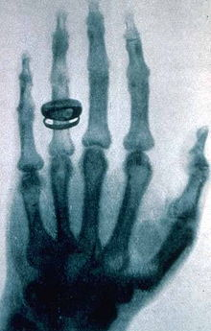
Roentgen
1895
X-rays
Radiography
Looking through matter

Slide 3
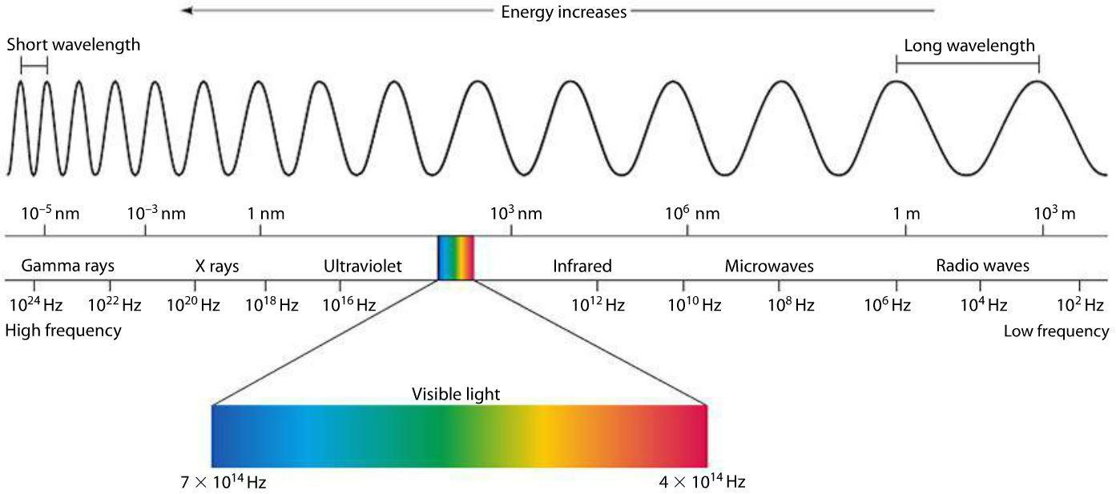
The Electromagnetic Spectrum

Slide 4
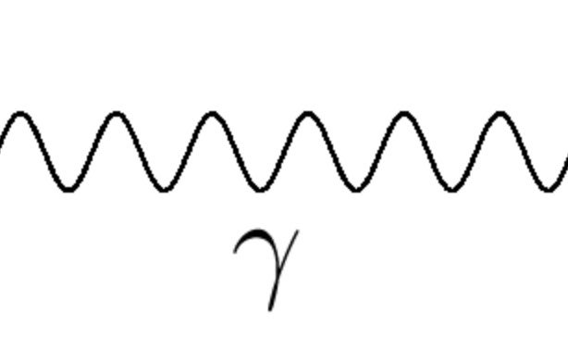
The photon
E = hν

Slide 5
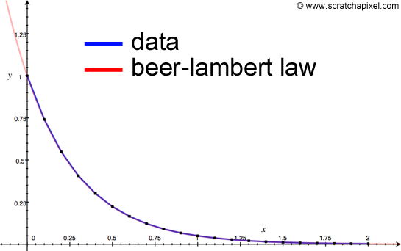
Photons through matter
I(z) = I(0) exp(-μ(ρ)z)
ρ = ρ(z)

Slide 6
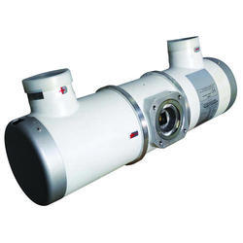
X-ray tubes

Slide 7
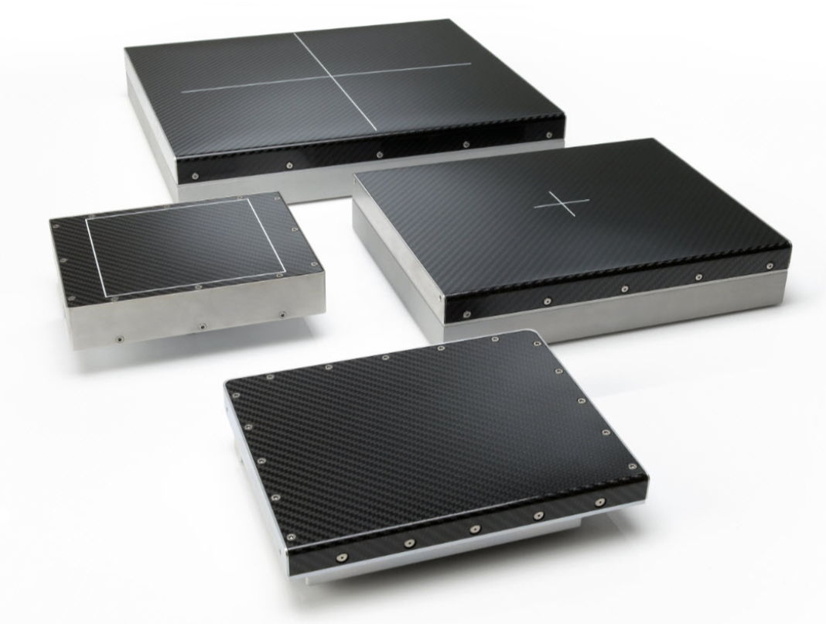
X-ray detectors

Slide 8
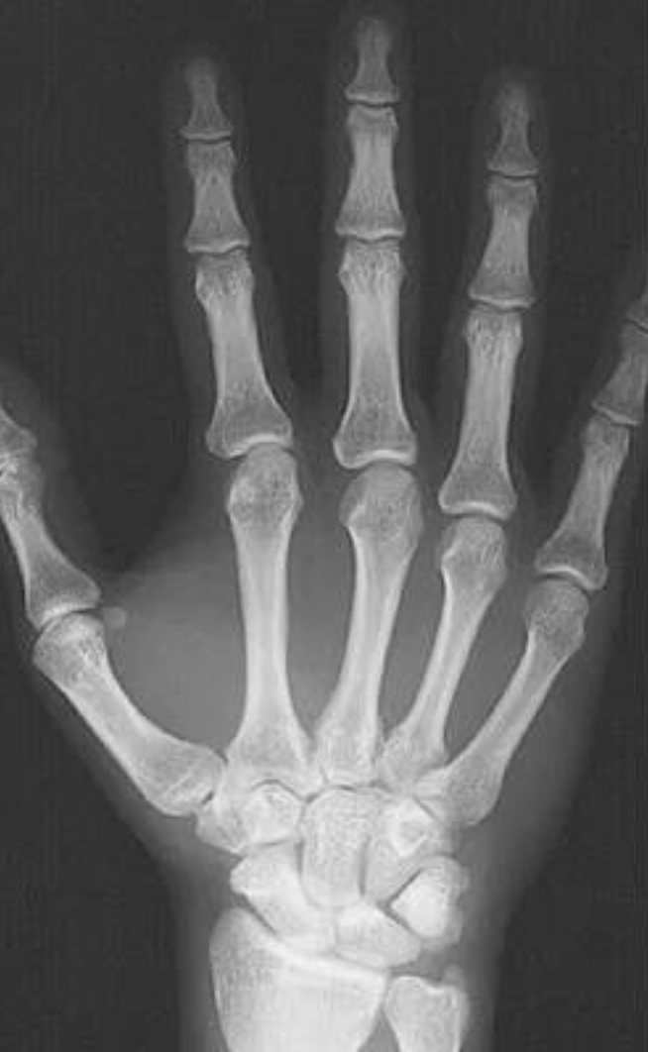
Radiography

Slide 9
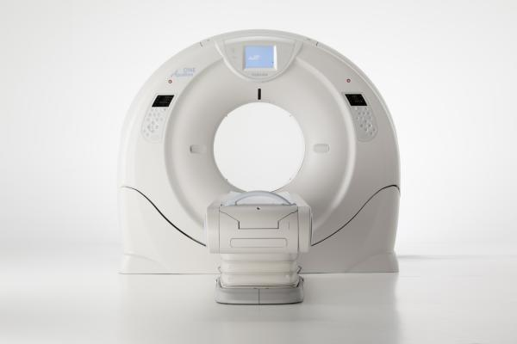
Computed Tomography

Slide 10
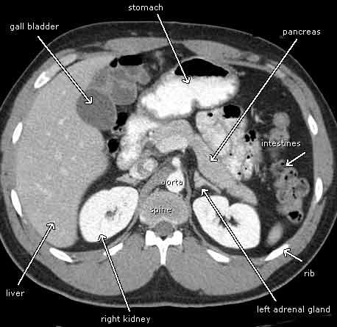
Computed Tomography
Hounsfield
From 2D to 3D
Computing power
Speed

Slide 11
Computed Tomography
Morphological imaging

Slide 12
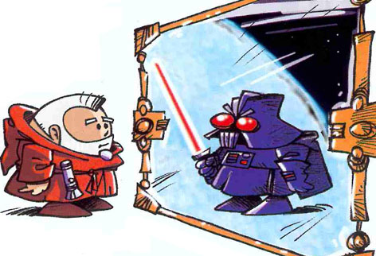
Antimatter

Slide 13
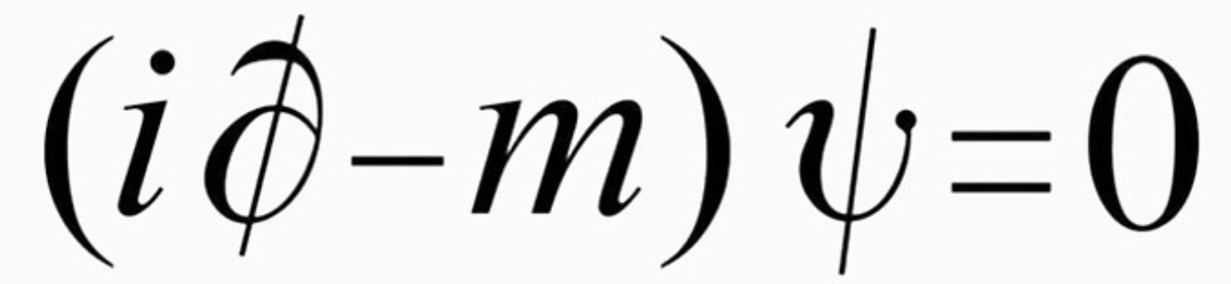
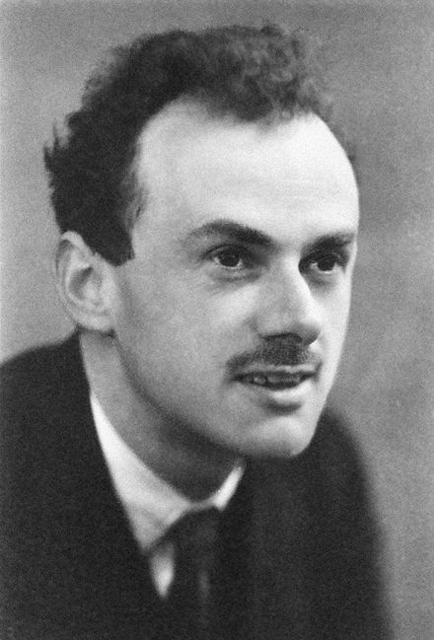
Antimatter
Dirac, 1928
Solutions with negative energy

Slide 14
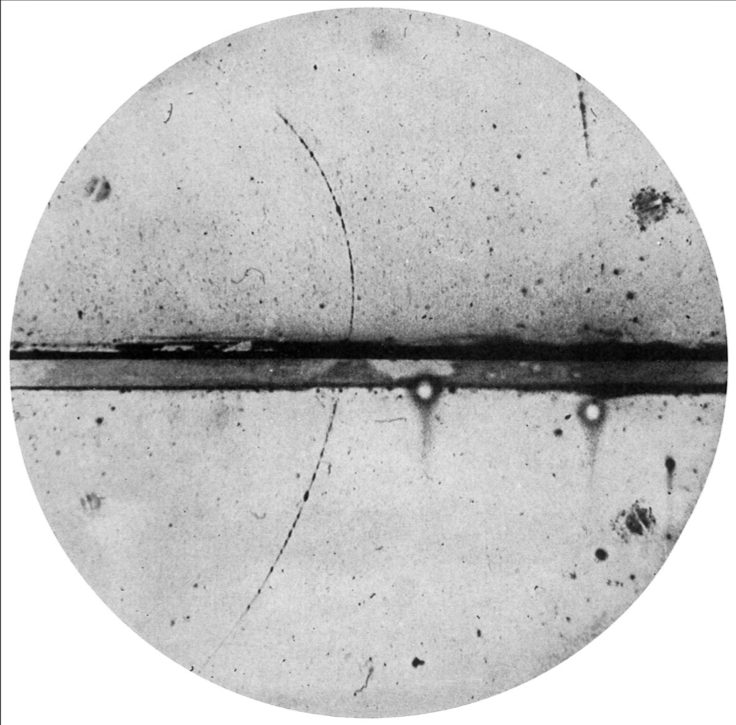
Antimatter
Anderson, 1932
the positron (e⁺)
e⁺e⁻ annihilation

Slide 15
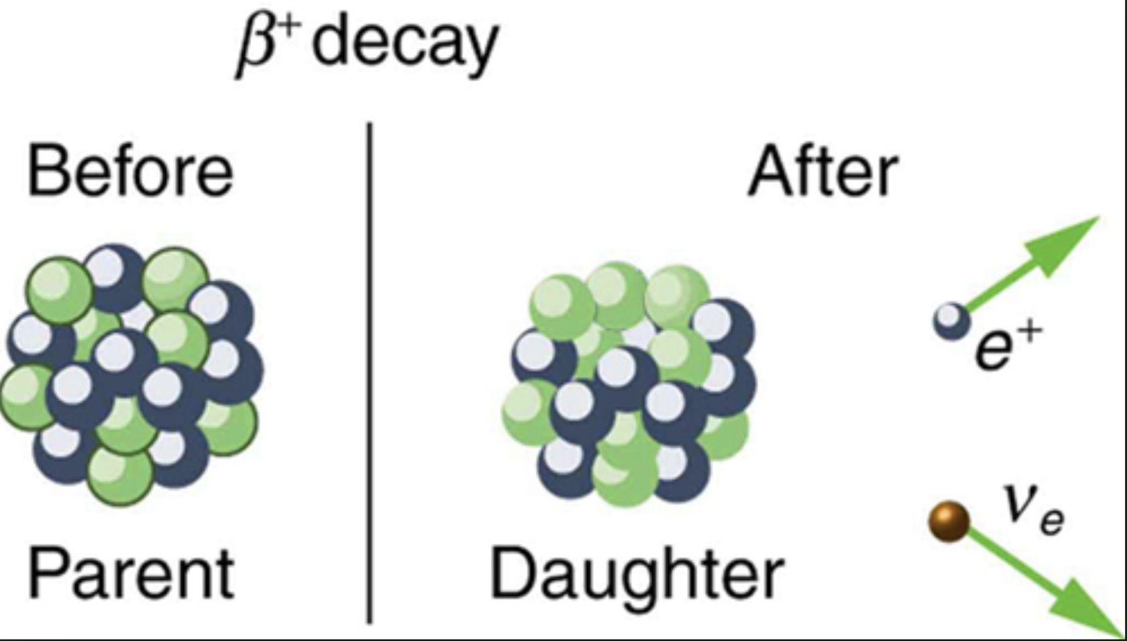
The β decay
n p + e⁺ + ν_{e}

Slide 16
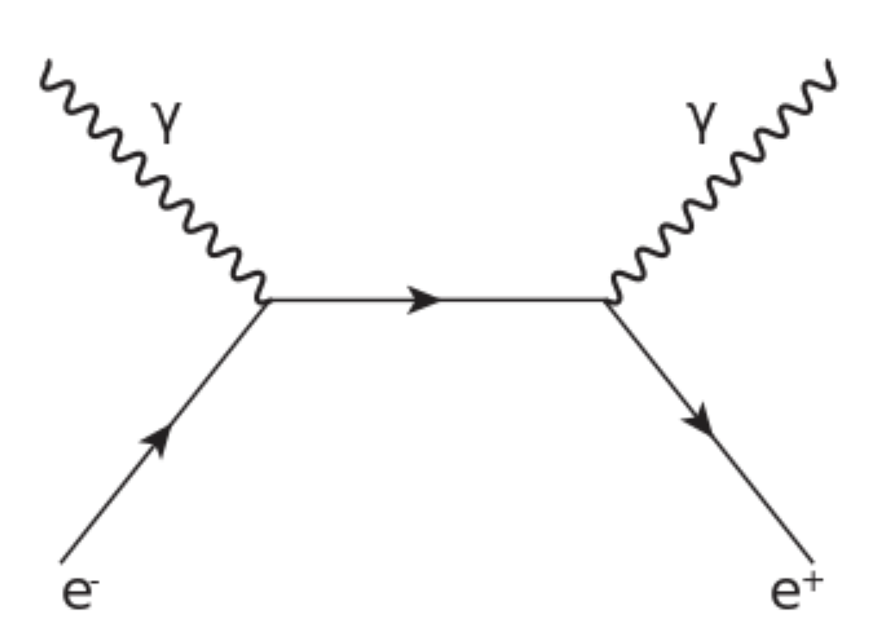
e⁺e⁻ annihilation at rest

Slide 17
Why?

Slide 18
Functional
Imaging!

Slide 19
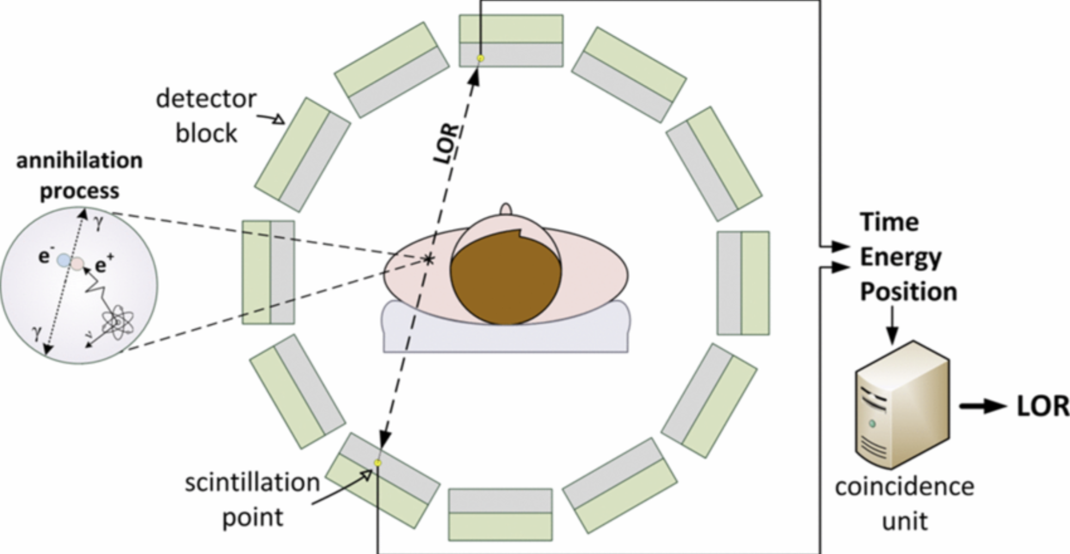
Positron Emission Tomography

Slide 20
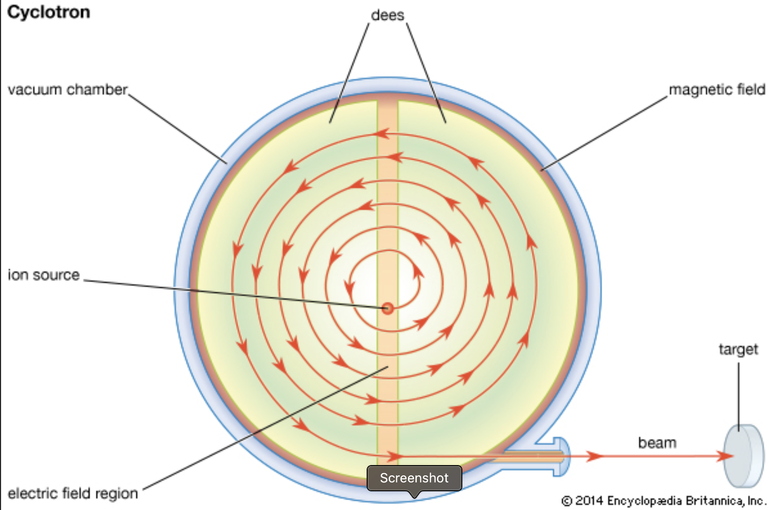
The Cyclotron

Slide 21
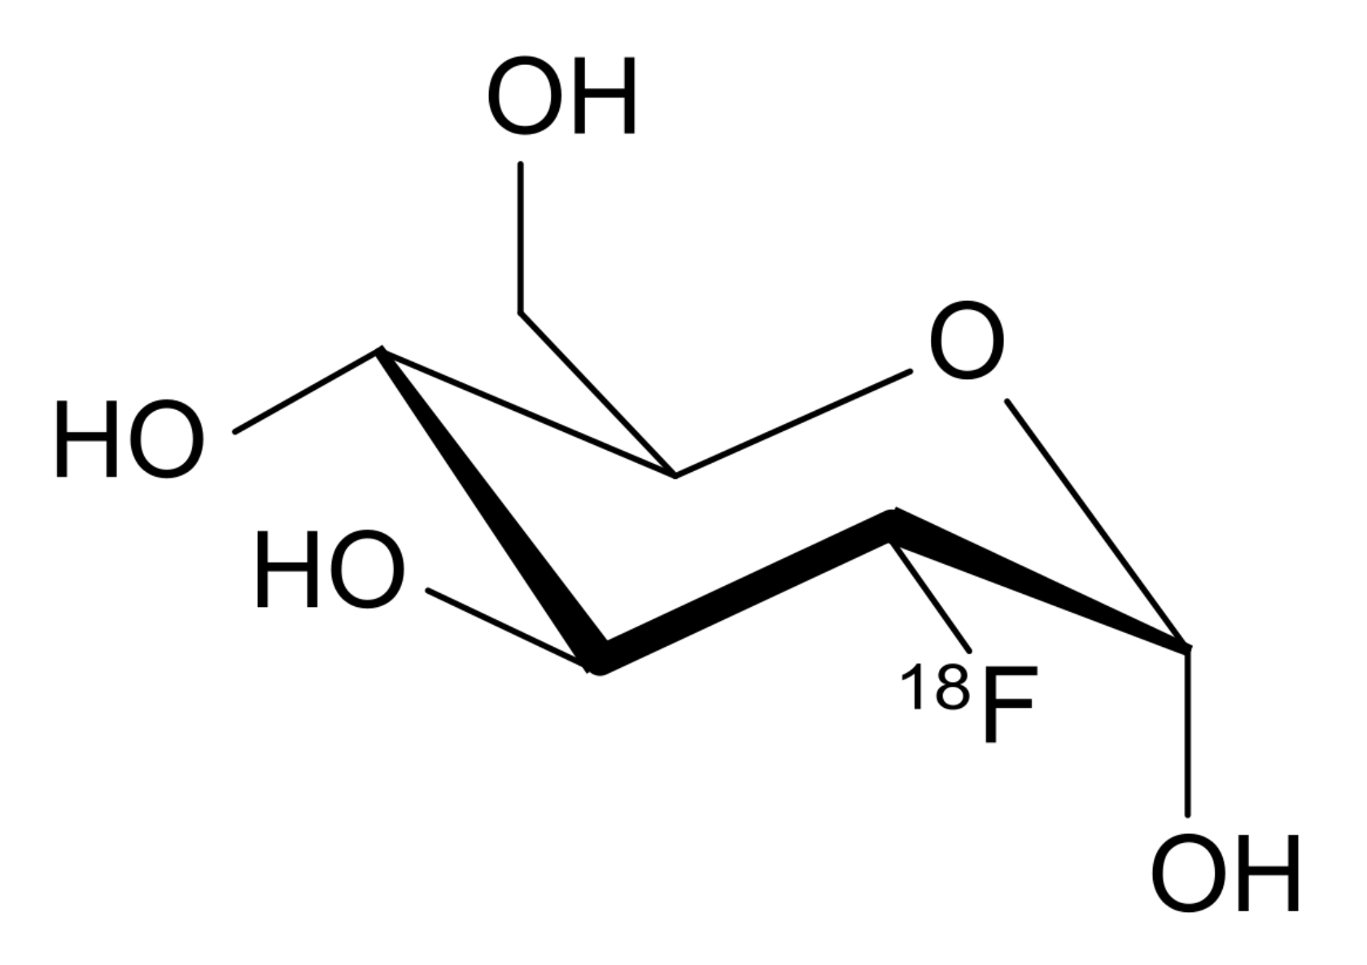
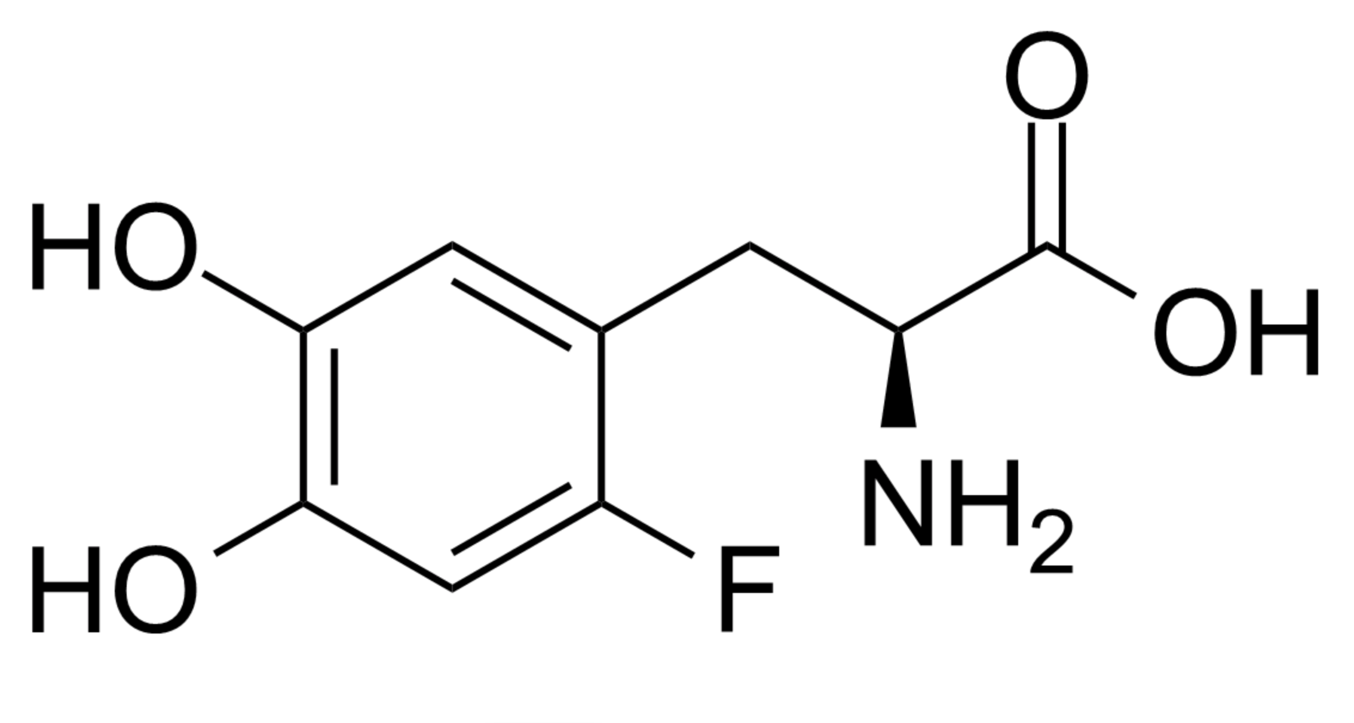
The Radiotracer
Deoxyglucose
L-DOPA
18F-Deoxyglucose
18F-L-DOPA

Slide 22
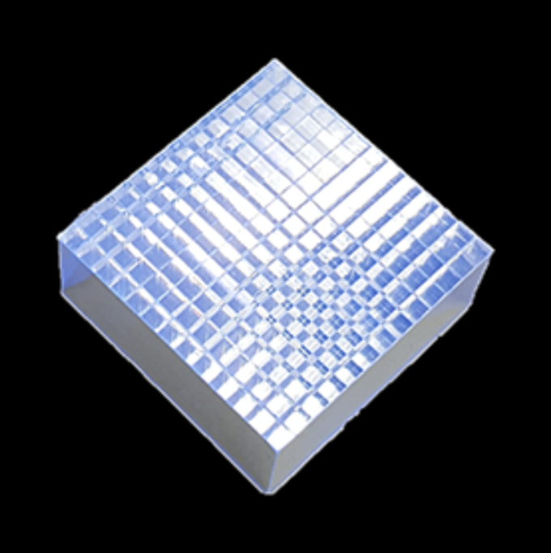
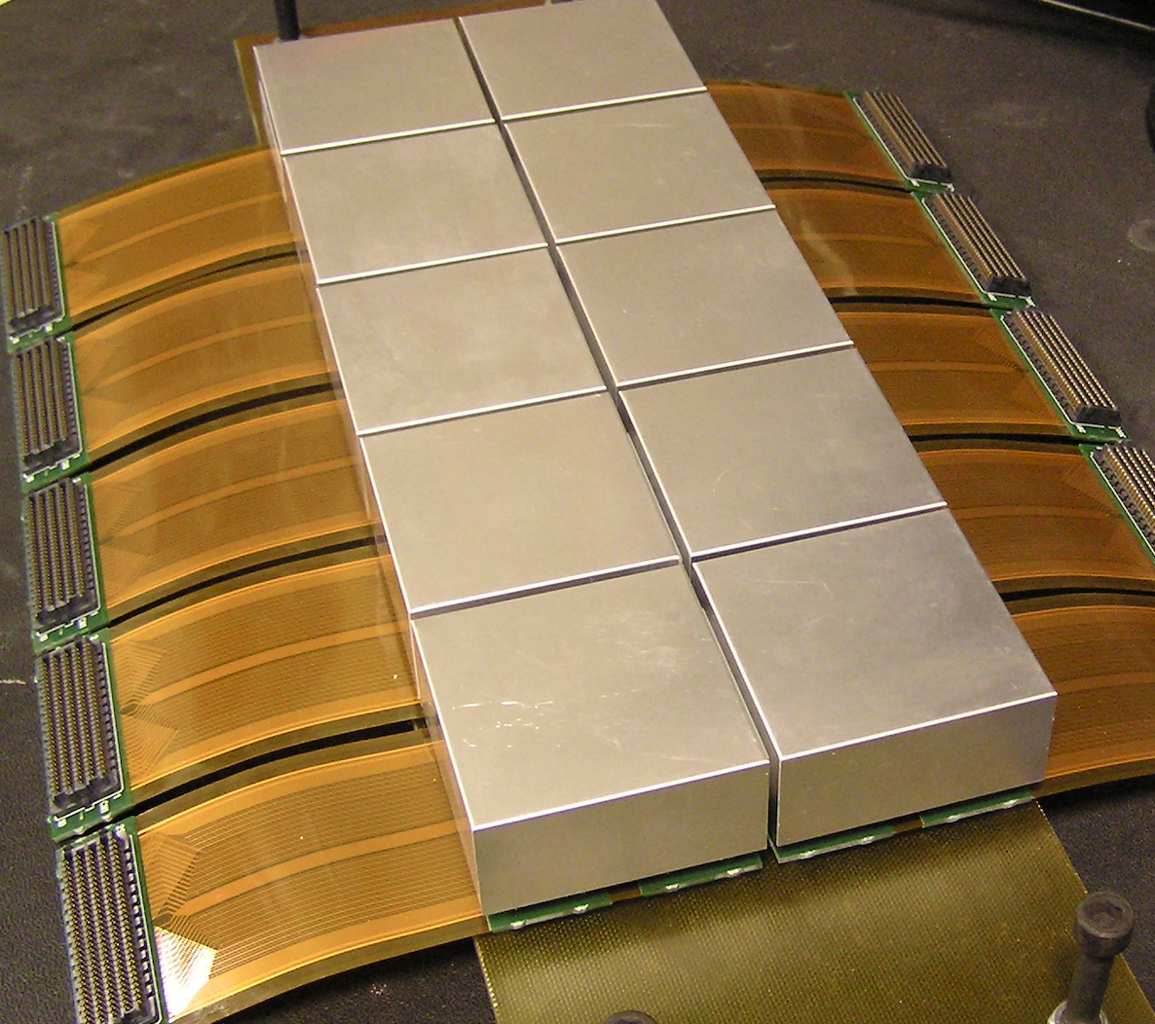
PET detectors

Slide 23
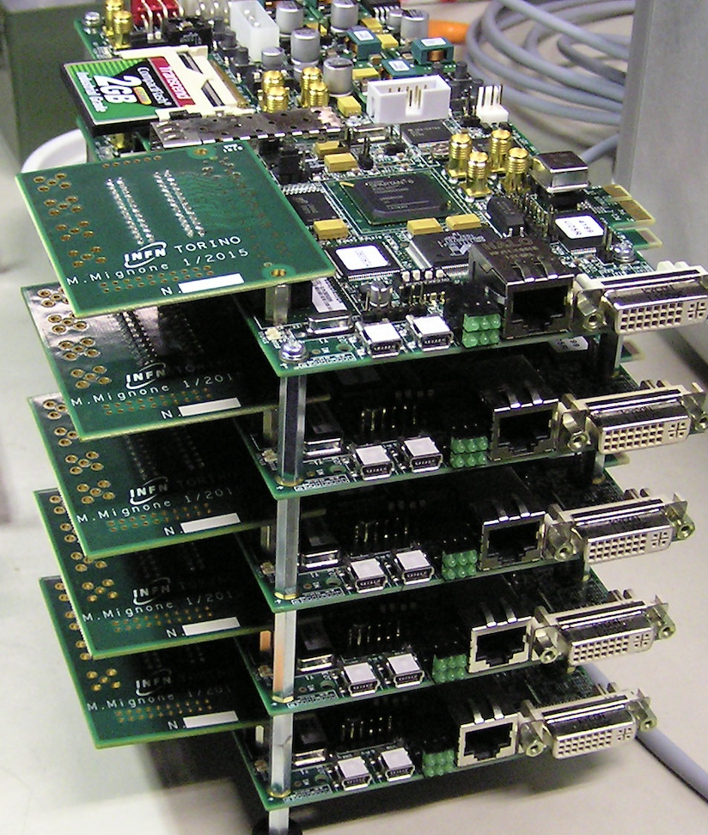
PET detectors

Slide 24
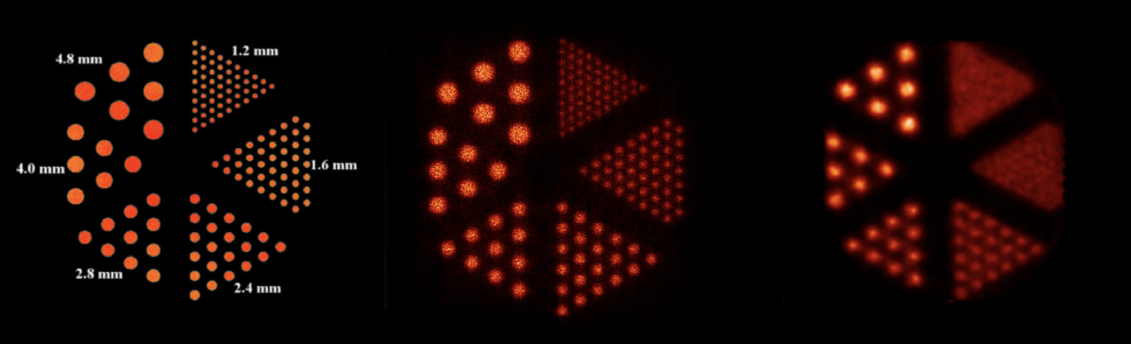
PET Phantom

Slide 25
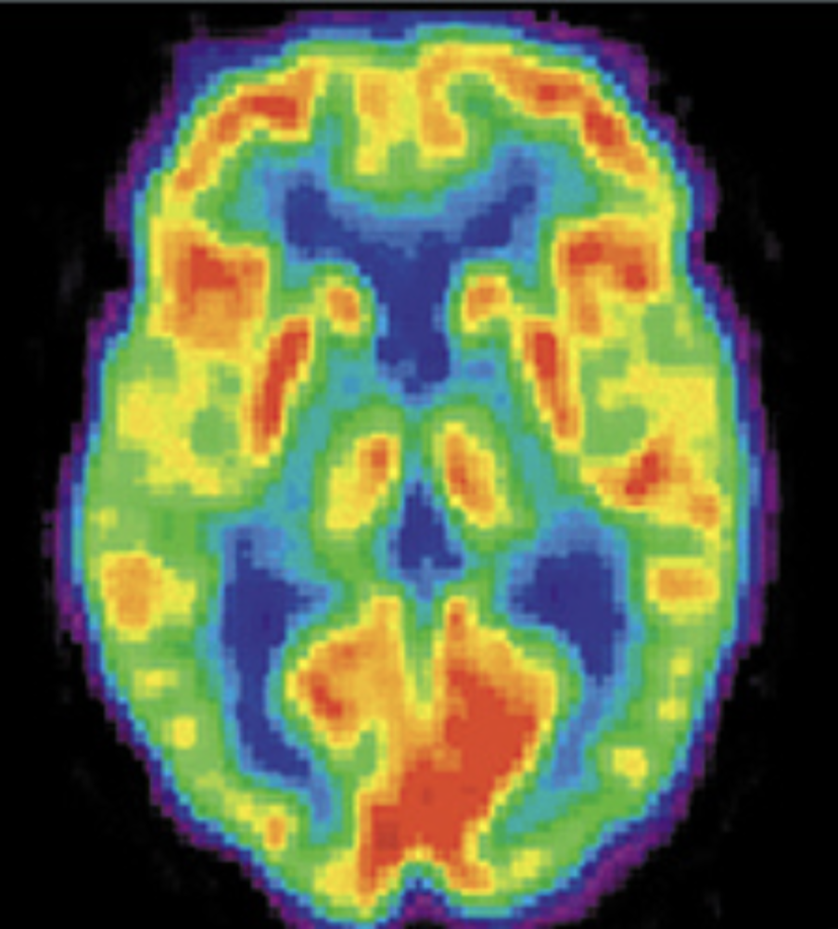
The brain in the early times

Slide 26
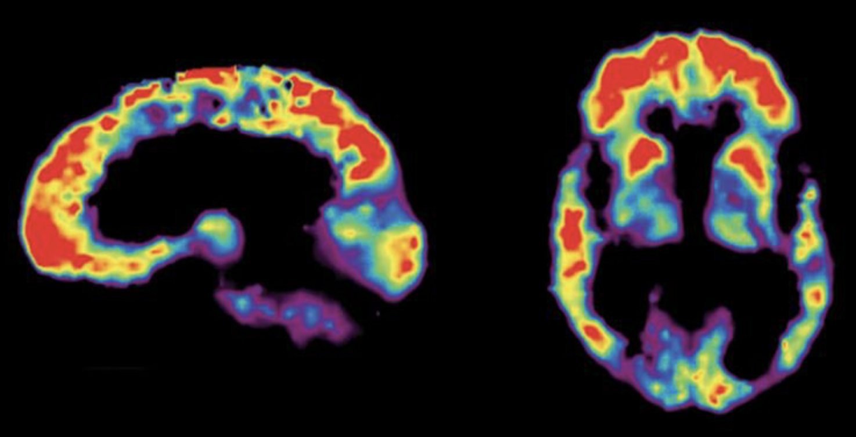
Brain Views

Slide 27
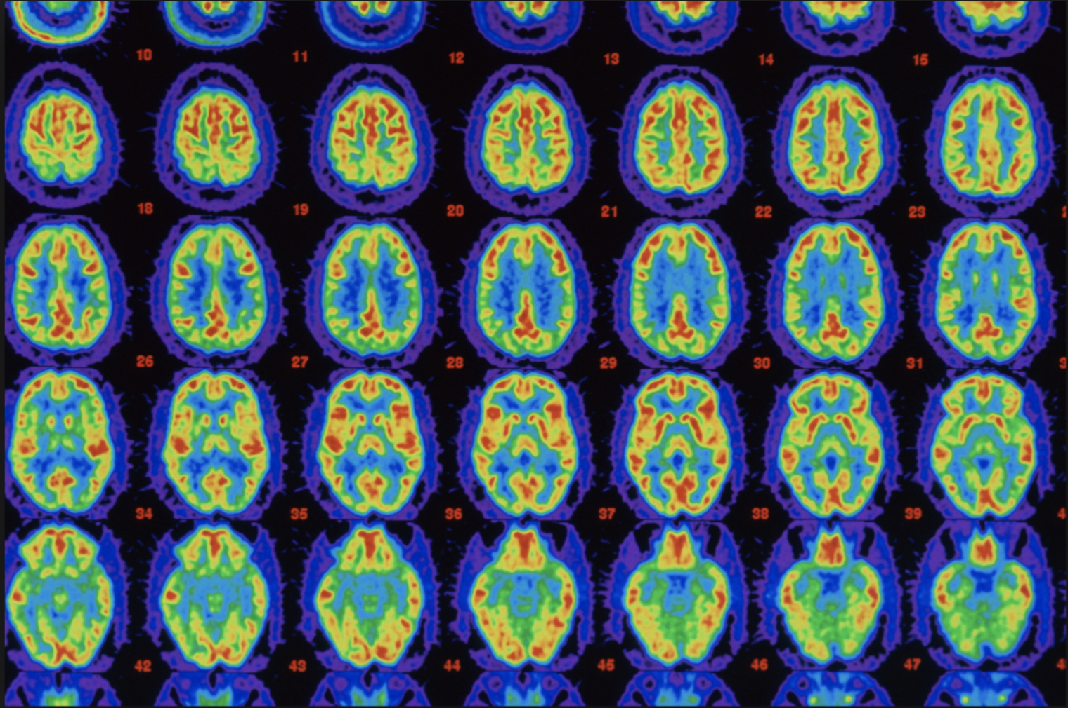
Brain PET

Slide 28
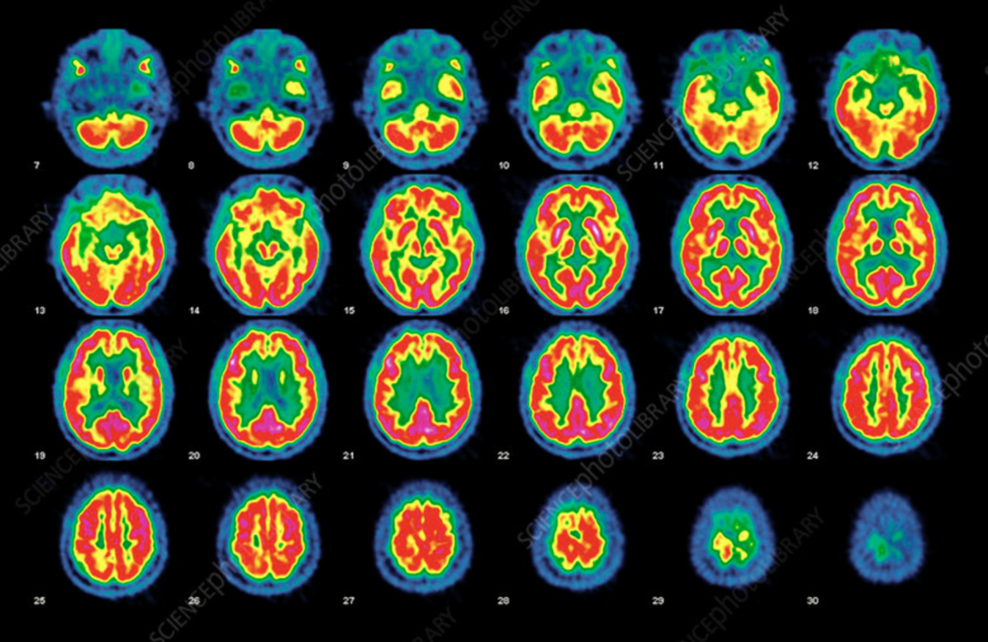
Normal Brain Activity

Slide 29
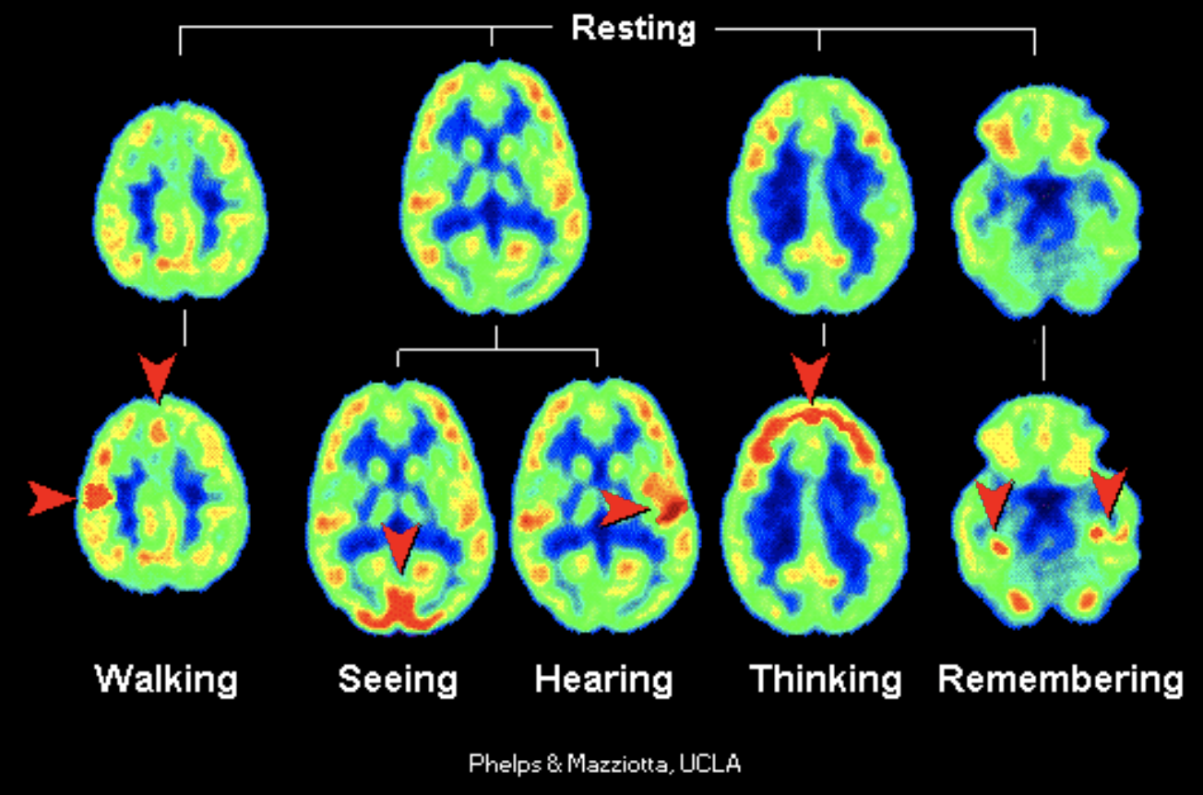
Brain at Work

Slide 30
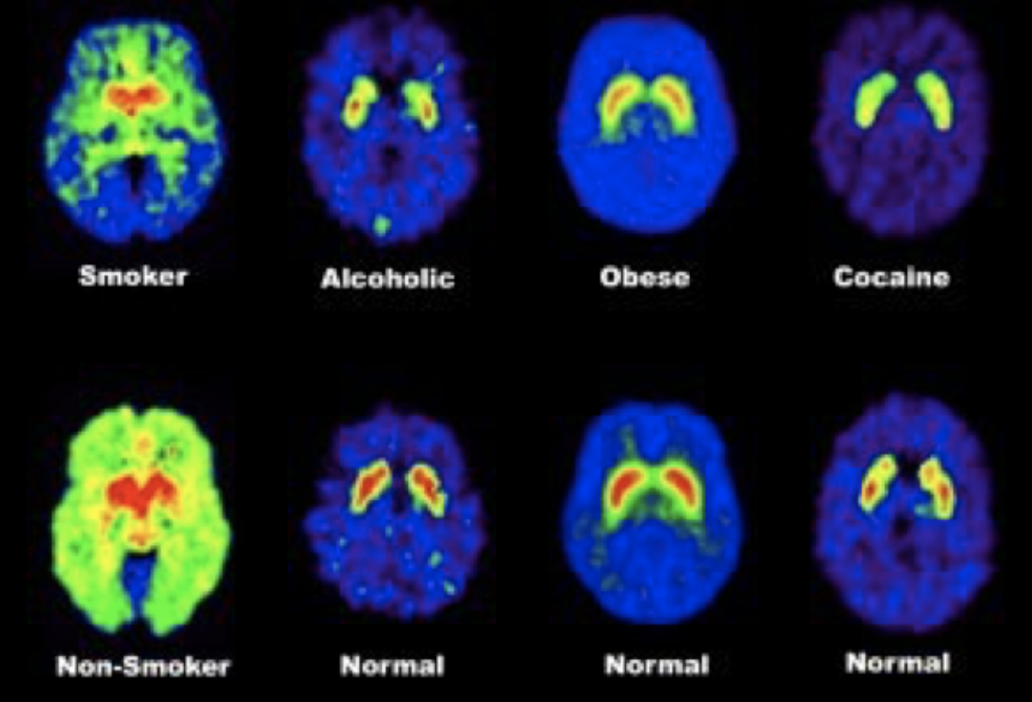
Health Issues
Smoker Alcoholic Obese Cocaine
Non-Smoker Normal Normal Normal

Slide 31
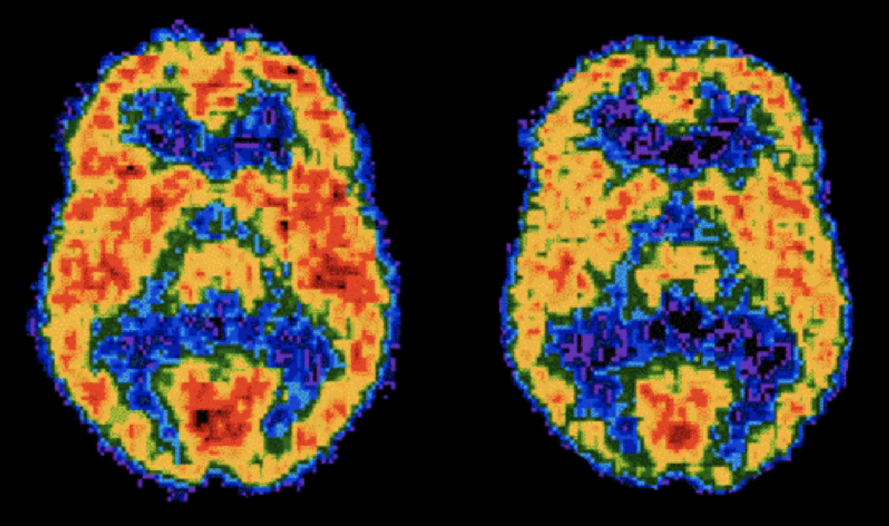
Normal vs. Cocaine

Slide 32
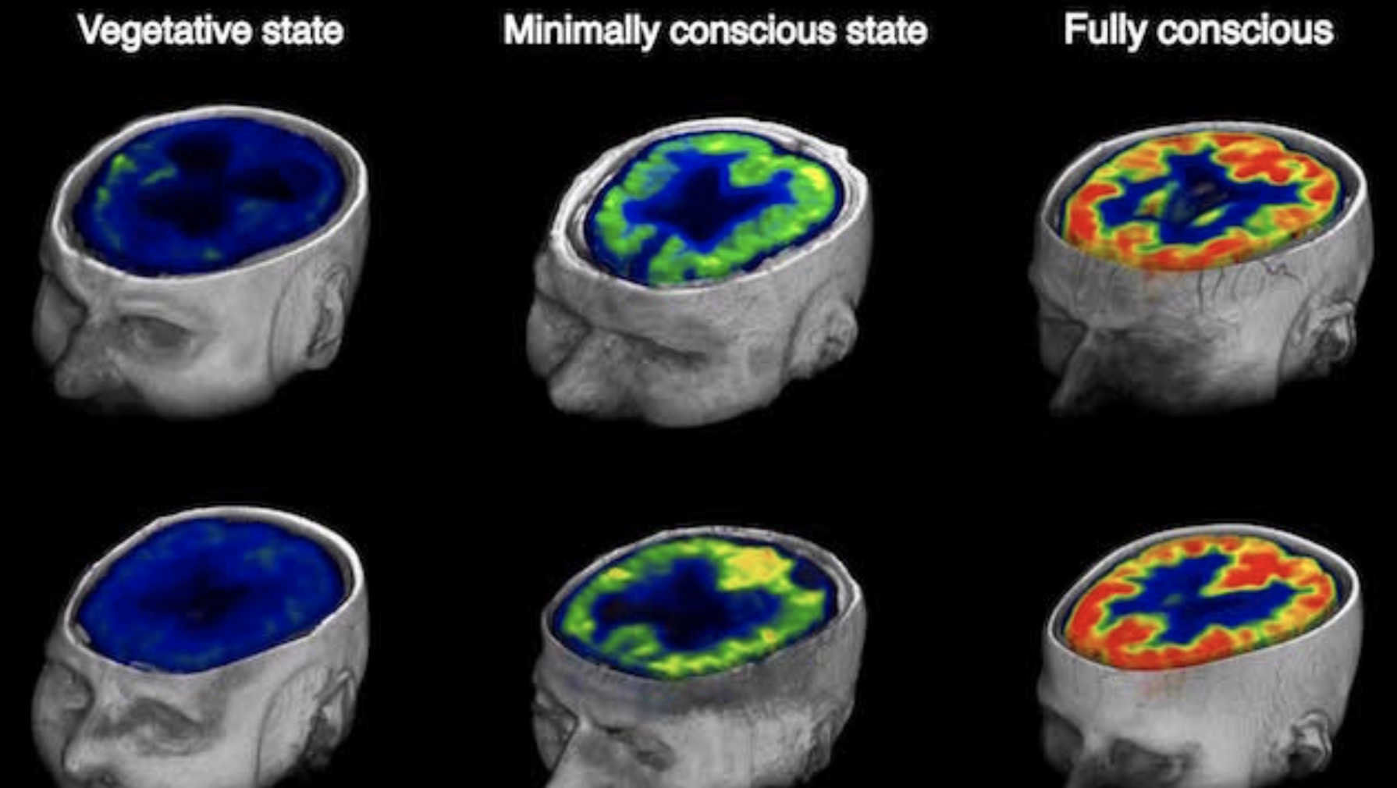
Brain Status
Vegetative
Minimally Conscious
Fully Conscious

Slide 33

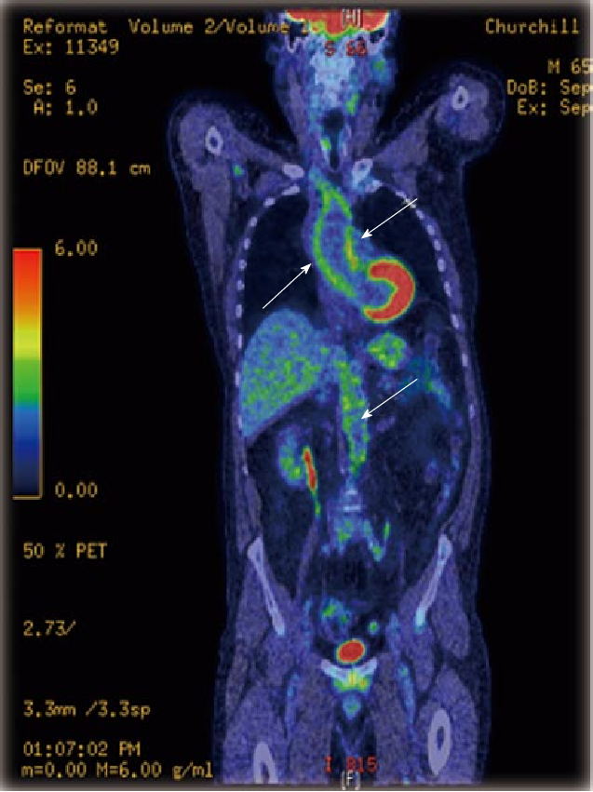
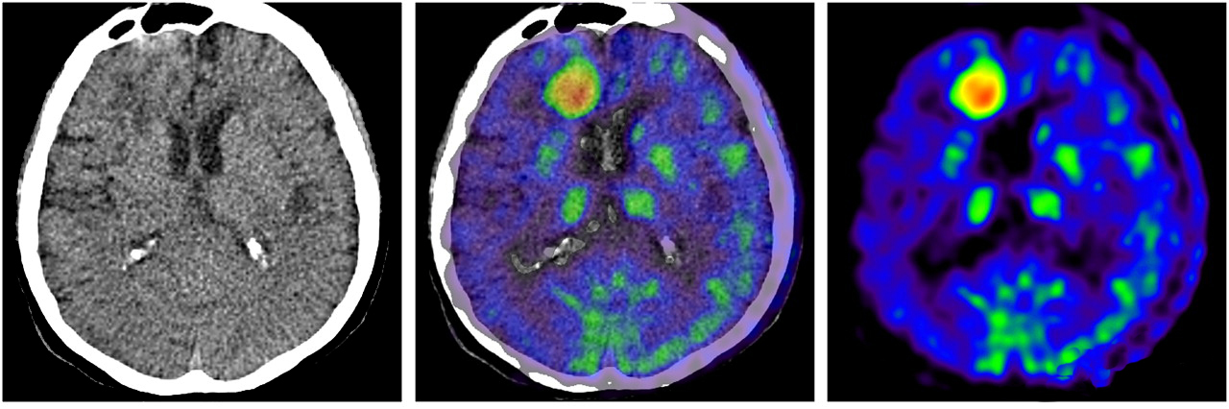
PET/CT – Hybrid Imaging
David
Townsend

Slide 34
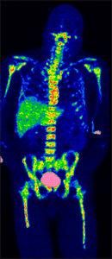
Full-body PET

Slide 35
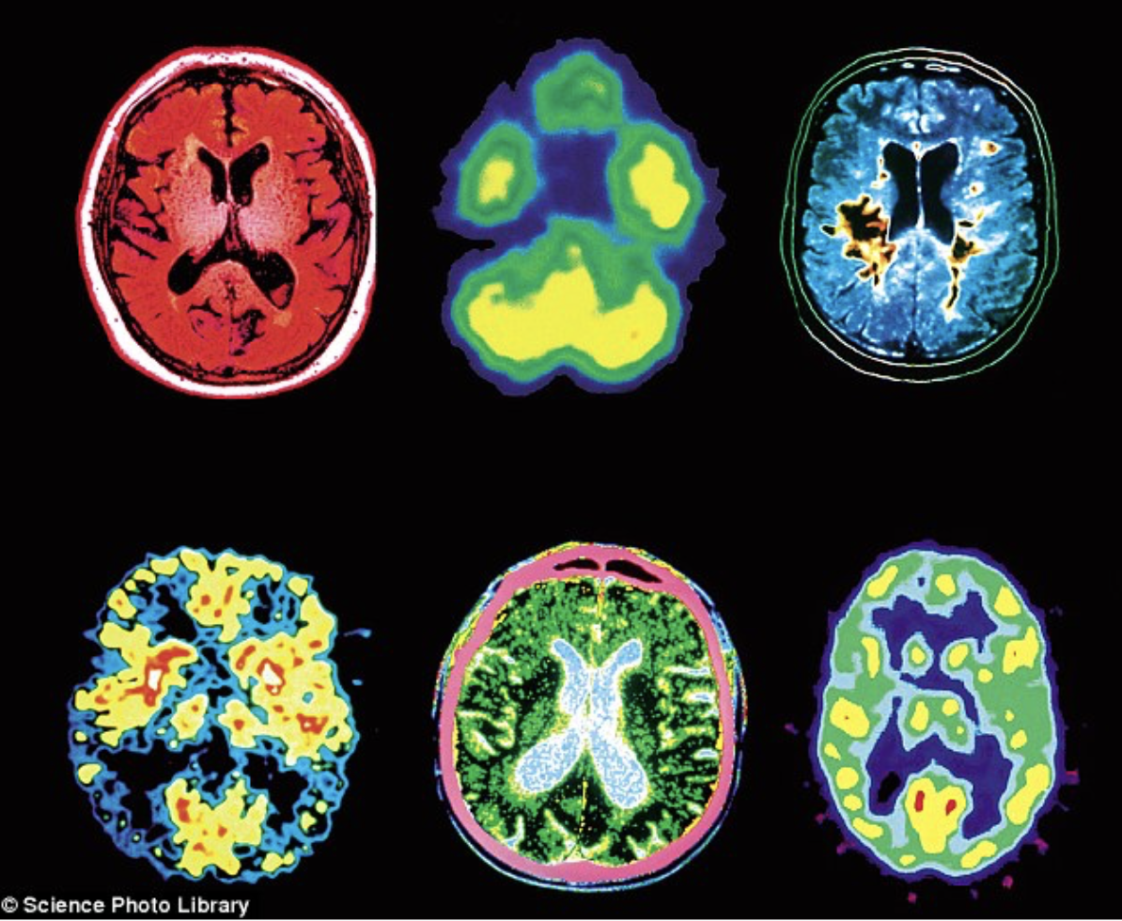
Brain colours

Slide 36
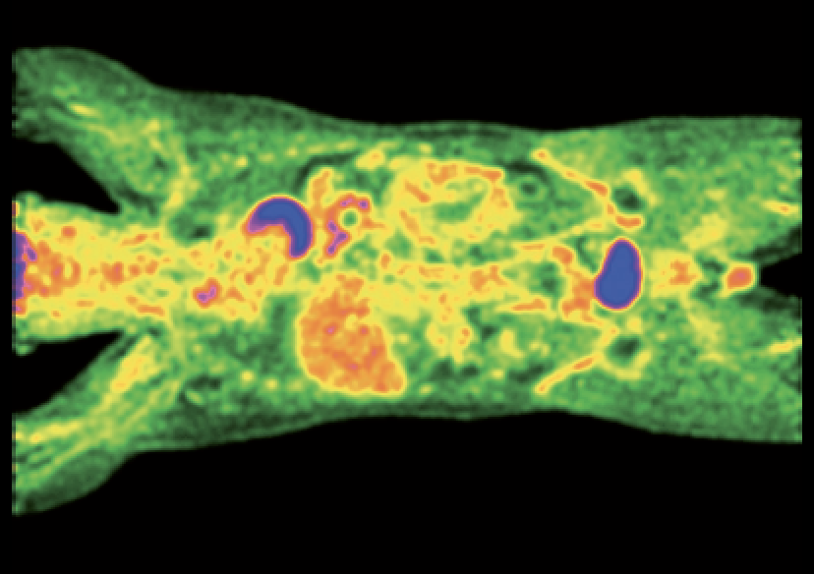
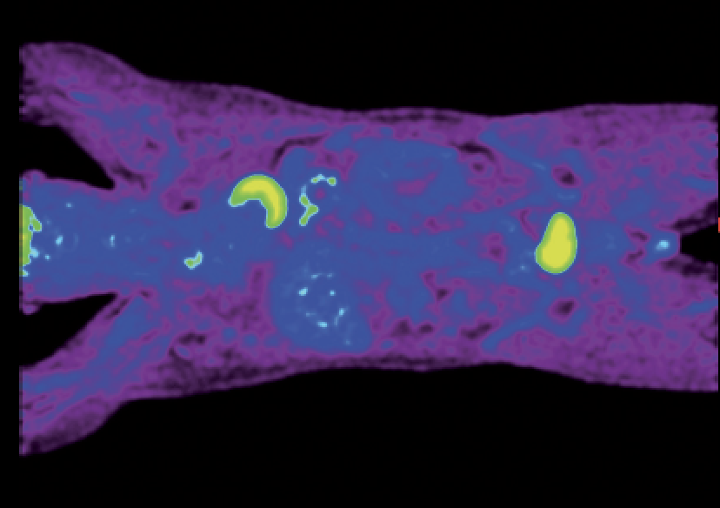
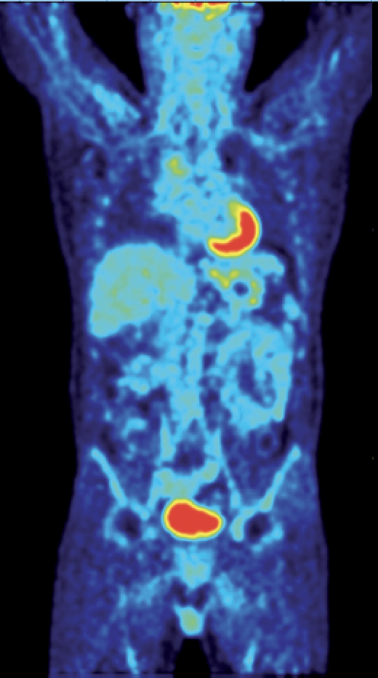
Full-body PET

Slide 37
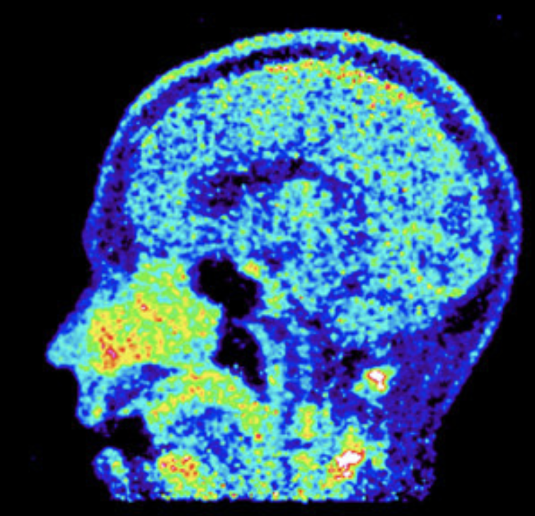
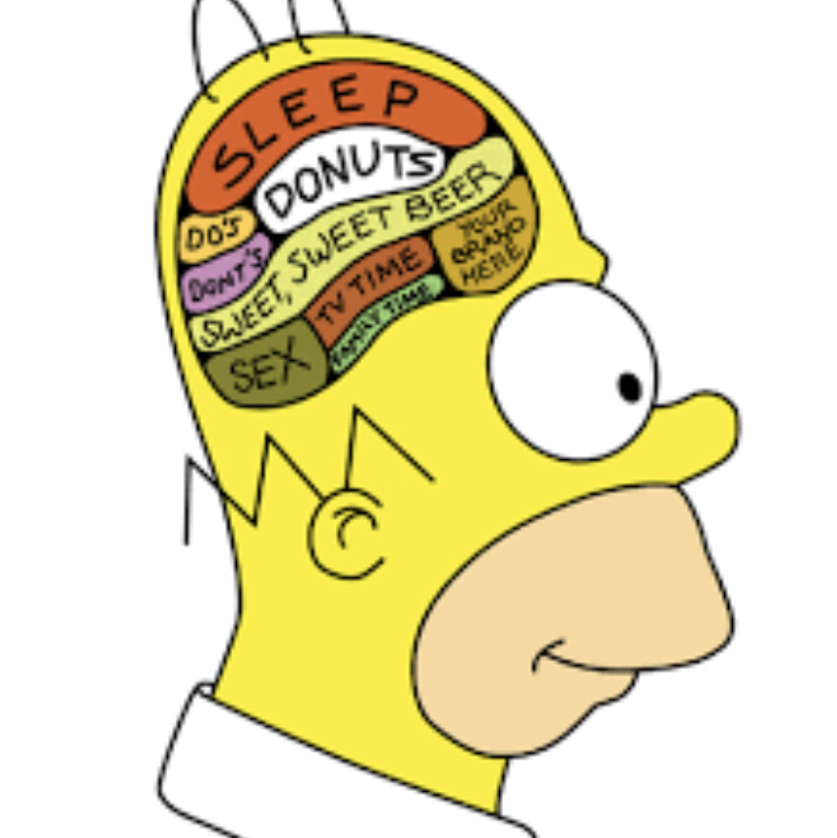
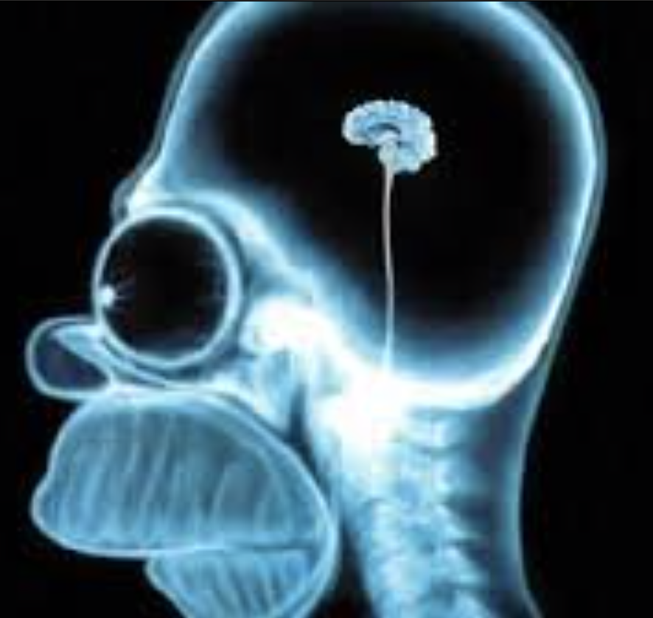
What have we learnt?

