Slide 1
A. Embriaco
FOOT Collaboration Meeting
5-7 June 2019 - CNAO

Slide 2
MoVe-IT
Modeling and Verification
for Ion beam Treatment planning

Slide 3
MoVe-IT project
The main effects that will be explored in MoVe-IT project are:
biological impact of target nuclei fragmentation
relative biological effectiveness (RBE)
intra-tumor heterogeneity
The radiobiological implementation in research treatment planning system will be coupled with design of patented tools for in-vitro and in-vivo irradiation, the development and update of the 3 complementary Italian facilities for experiments on therapeutic ion beams, and advanced models for related risk estimation (NTCP) and tumor control assessment (TCP).

Slide 4
MoVe-IT project

Slide 6
Target fragmentation
In order to describe the target fragmentation and estimate the biological effect of fragments, MoVe IT propose an approach based on a RBE modellization:
Fragments fluence
RBE
Biological dose
describe the physical dose including the contribution of each single fragment produced by a proton in water
evaluate the total RBE by using a mixed field approach to weights all the single fragments contributions
import the results in TRiP98 TPS and test the biological dose differences respect to the default calculations

Slide 7
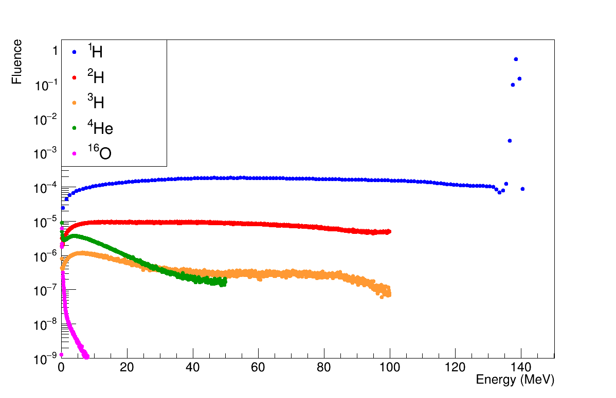
Fragments Fluence
The fluence spectra have been obtained performing Monte Carlo simulations as separate single beams, scoring the fluence of all the produced particles.
Fluence Database
(E_{k}, E_{f} , A, Z, z_{depth})
Fluence of main fragments produced by proton beam of 150 MeV after 2 cm in water.

Slide 8
The mixed field model
Primary proton’s fragments are considered as secondary particles; each single spectra of those fragments is evaluated separately, considering its impact on the RBE.
The total RBE is evaluated by using Zeider & Rossi formula for mixed field irradiation and LEM IV model:

Slide 9
FRAGMENTS FLUENCE
MIXED FIELD
TPS
BIOLOGICAL DOSE
Notes:
these results have been compared with the default LUT of
TRiP98 TPS
Comparison between the biological dose and survival obtained
by using the new tables and the default system’s tables.

Slide 10
FLUKA Simulation for
Target Fragmentation

Slide 11
Waiting for FOOT experimental data
Target fragmentation has been studied using FLUKA MC code.
Fragments characterization:
Energy & angular spectra
Fragments fluence

Slide 12
Energy and Angular spectra
The energy and angular distribution of main fragments produced by proton beam in water have been simulated with FLUKA.
Simulation setup
p beam on water target
The energy and angular distribution of main fragments produced by proton beam in water have been analyzed, considering initial kinetic energy Ep=50, 100, 150, 200 and 250 MeV.
p
R=
100 μm

Slide 13
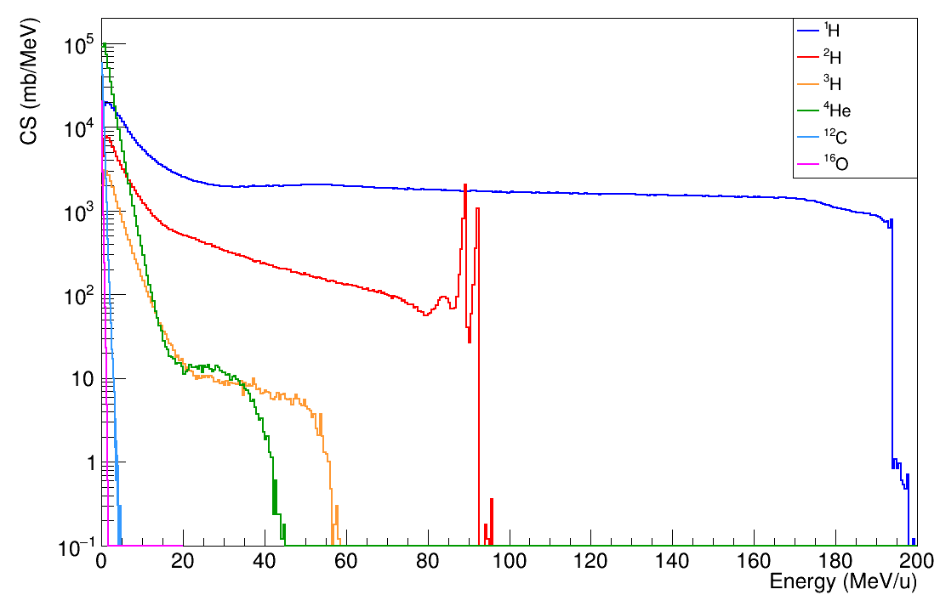
Energy distribution of fragments
Production CS of inelastic interaction induced by proton beam of 200 MeV in water.
 | E_{MAX} (MeV/u) | E_{mean} (MeV/u)
¹H | 200 | 65.4
²H | 95 | 16.7
³H | 58 | 3.9
⁴He | 45 | 1.7
¹²C | 4.7 | 0.4
¹⁶O | 1.7 | 0.1

Slide 14
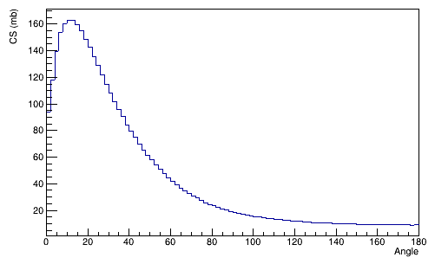
Angular distribution of fragments
Production CS of inelastic interaction induced by proton beam of 200 MeV in water.
¹H

Slide 15
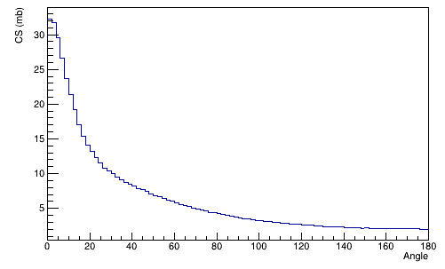
Angular distribution of fragments
Production CS of inelastic interaction induced by proton beam of 200 MeV in water.
¹H
The emission of Hydrogen fragments is focused forward.
²H

Slide 16
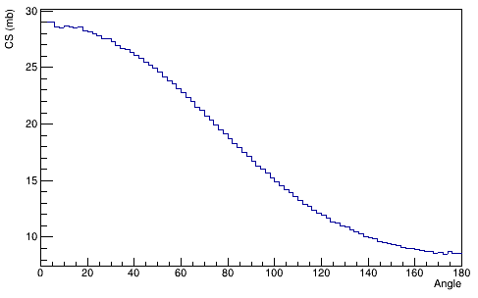
Angular distribution of fragments
Production CS of inelastic interaction induced by proton beam of 200 MeV in water.
⁴He

Slide 17
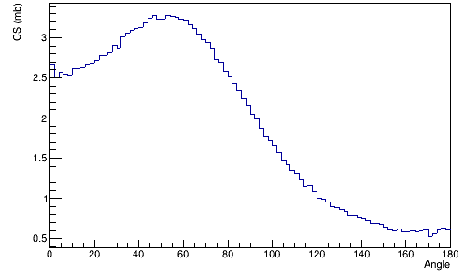
Angular distribution of fragments
Production CS of inelastic interaction induced by proton beam of 200 MeV in water.
⁴He
For heavy fragments, the angular distribution present a mean value of 60 degree.
¹²C

Slide 18
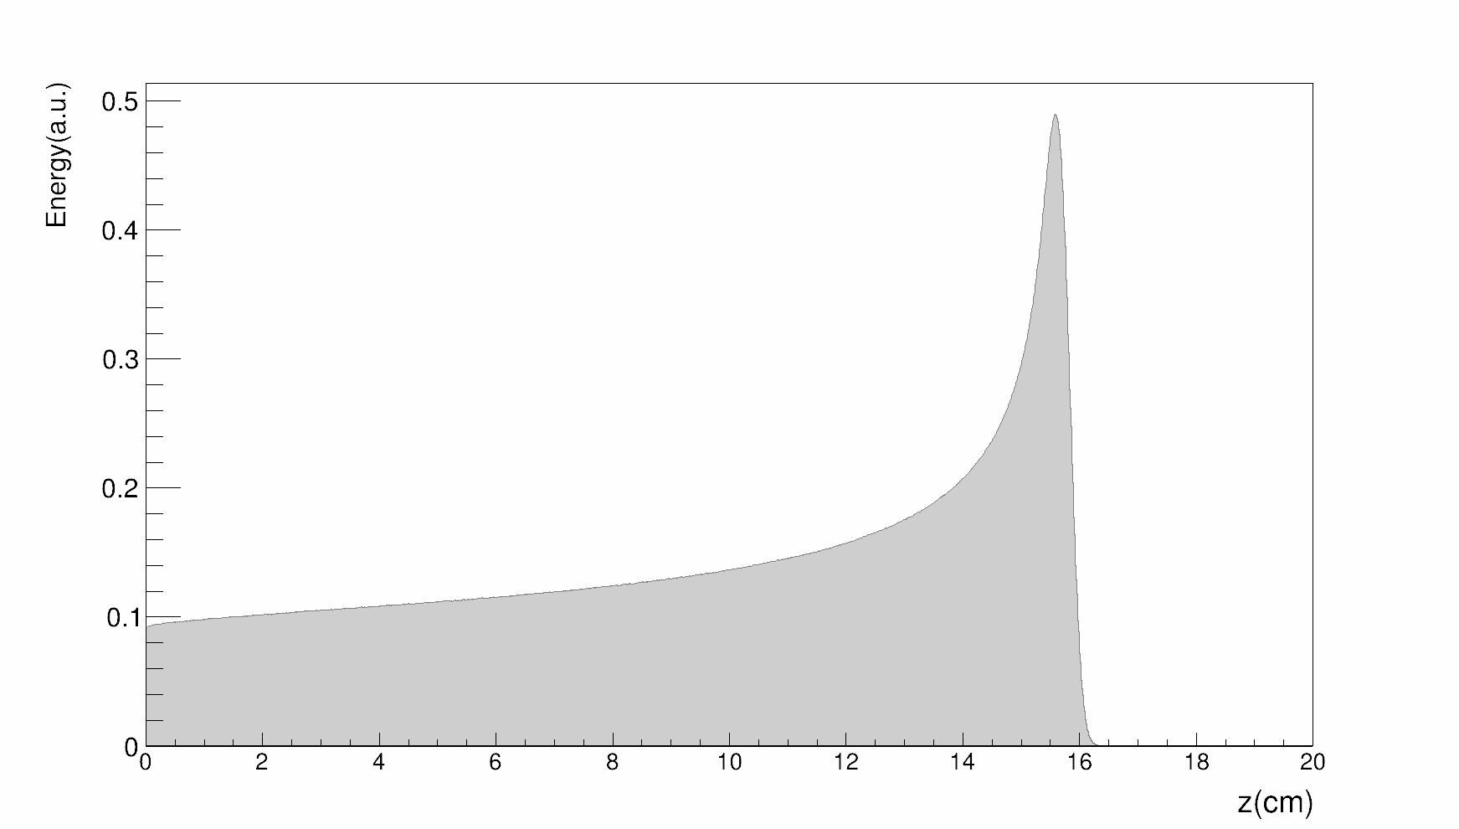
Fragments Fluence
To include the impact of fragmentation in the TPS (TRIP98) and estimate the biological effect of fragments, their production in water has been calculated with FLUKA.
Fragments fluence as a function of energy evaluated at different depth
Source: proton beam E=150 MeV
Geometry & Material: parallelepiped of WATER
Scored quantity: Fluence of charged particles as a function of energy
Statistics: 10⁹ primaries

Slide 19
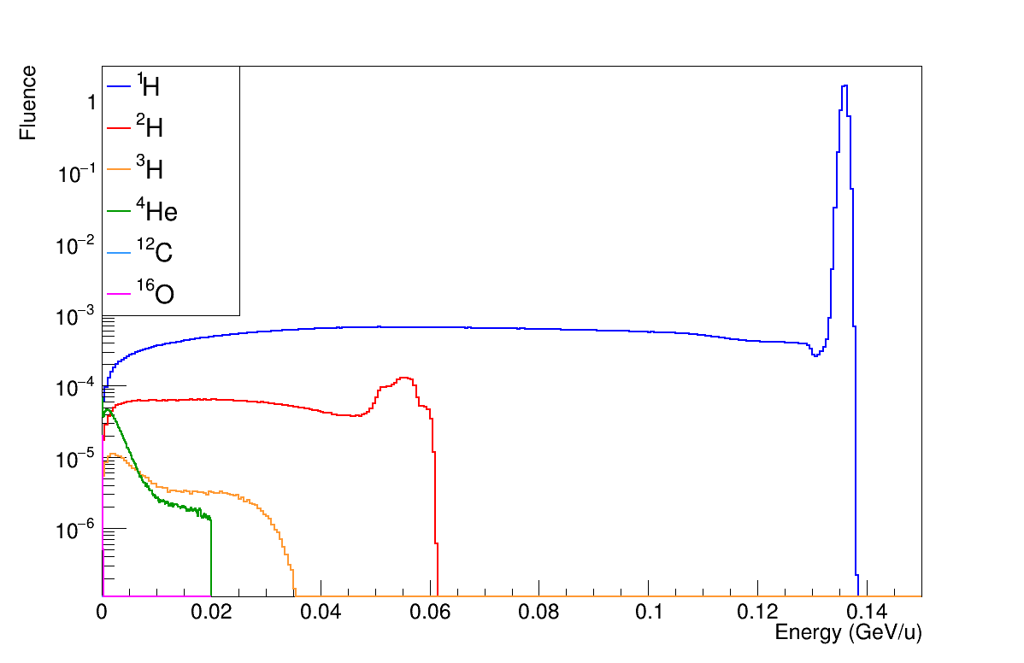
Fragments Fluence

Slide 20
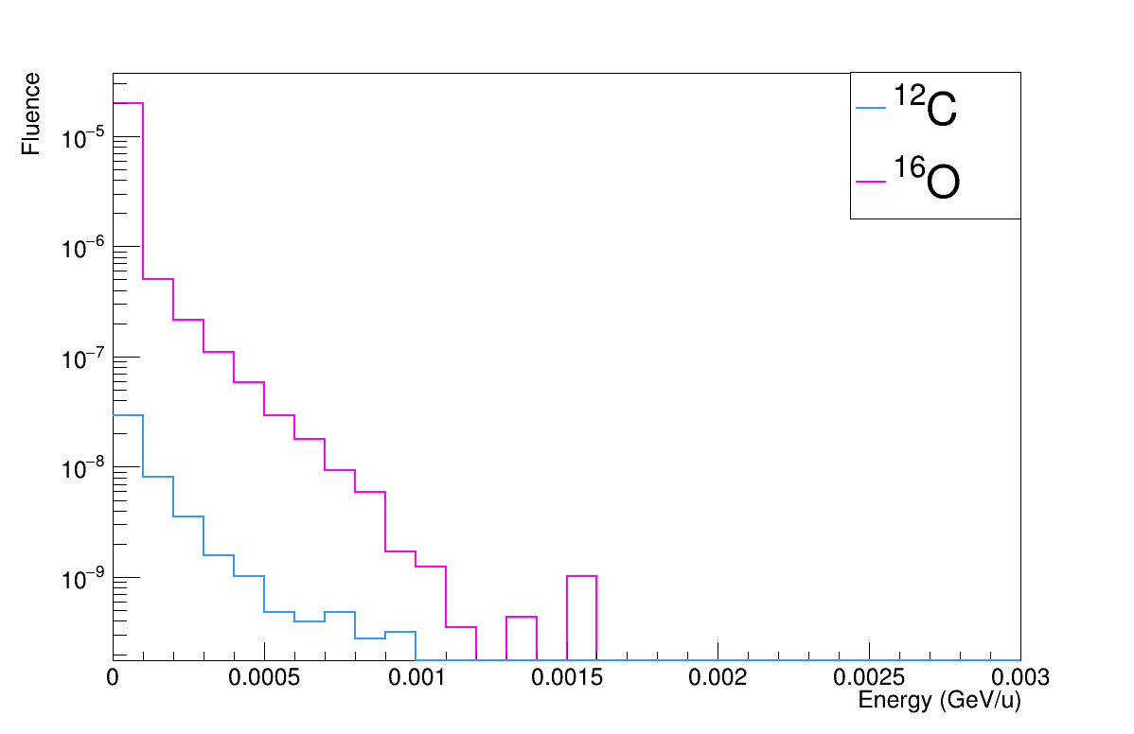
Fragments Fluence

Slide 21
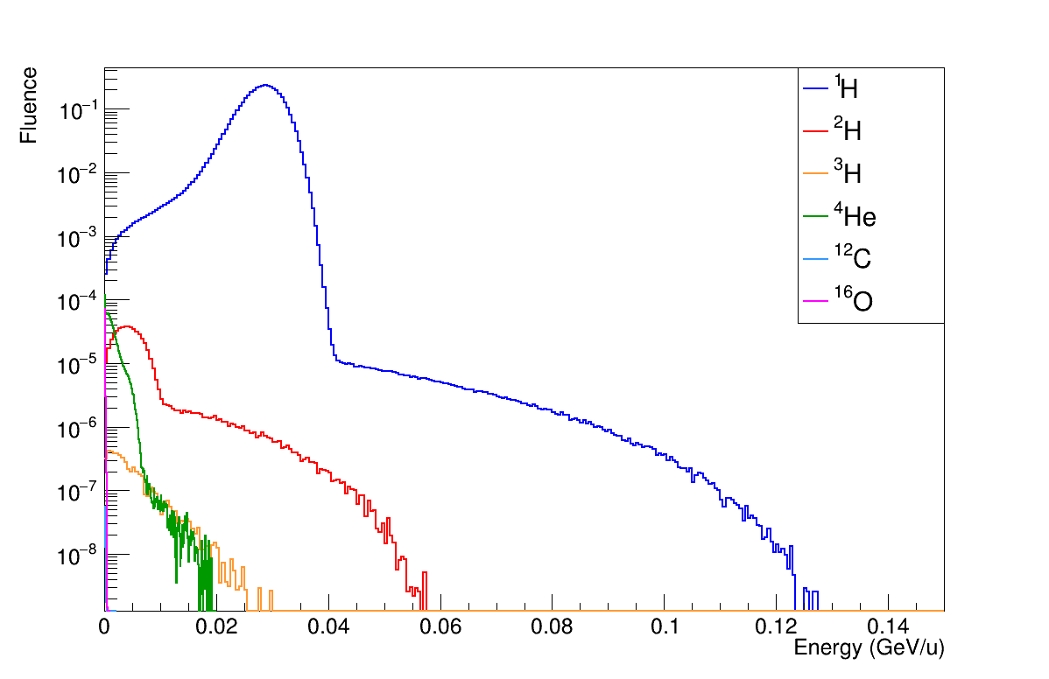
Fragments Fluence

Slide 22
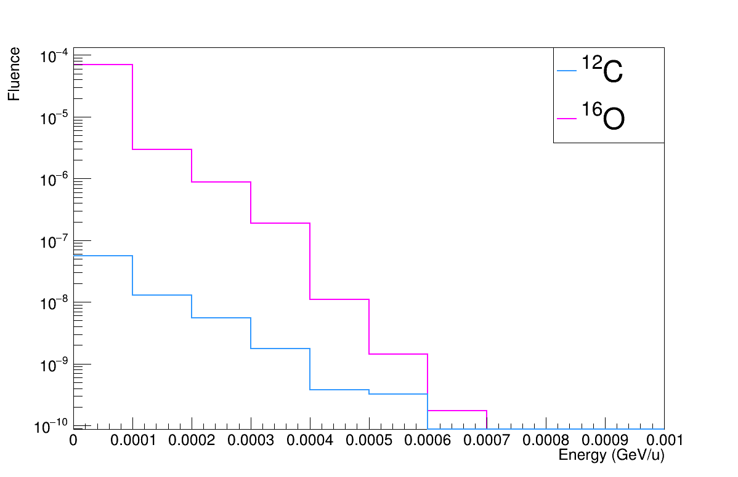
Fragments Fluence

Slide 23
Ongoing studies
Creation of fragments fluence database (E_{k}, E_{f} , A, Z, z_{depth})
Results validation with different MC simulations (FLUKA, GEANT4, TOPAS)
Description and modellization of each secondary particle contribution to RBE
Biological dose evaluation of SOPB with TRIP98, starting from MC databases, for two water boxes at two depths (entrance channel and distal depth)
WAITING FOR FOOT EXPERIMENTAL DATA

Slide 24
Fragments Range
Courtesy of A. Attili

Slide 25
Fragments Range
Courtesy of A. Attili
SRIM evaluation of projected range as a function of energy:
Low Z fragments
R> cell nucleus
Heavier fragments
R< cell nucleus
Colocalization effects

Slide 26
Biological dose and RBE comparison:
Courtesy of E. Bellinzona
Default TRiP98 data vs new TOPAS-base data.
Tissue comparison:
Synthetic tissues obtained from LEM-IV model and
characterized by α/β = 2Gy to represent respectively a normal tissue and a general tumor one.
Particles contribution comparison:
only primaries (Z=1 primary)
only protons (primary and secondaries) (Z=1 )
All produced fragments

Slide 27
Biological dose and RBE comparison
Courtesy of E. Bellinzona

Slide 28
Biological dose and RBE comparison
Courtesy of E. Bellinzona

Slide 29
Biological dose and RBE comparison
Courtesy of E. Bellinzona

Slide 30
Fragment impact
Courtesy of E. Bellinzona
The fluence contribution of single fragments has been enhanched to analyse the dependence of species contribution on the RBE and further, on the biological dose.
The fluence of the listed ions have been increased of factors 10,50,100,1000:
He
C
O
All particles Z>2

Slide 31
Fragment impact
Courtesy of E. Bellinzona

Slide 32
You can find me at:
alessia.embriaco@mi.infn.it

Slide 33
BACKUP SLIDE

Slide 34
MoVe-IT project
Advancing Particle Therapy requires models for biologically optimized treatment planning systems (TPS) in ion beam therapy and dedicated devices for plan verification, allowing validation accounting for a wide range of complex physical and biological effects.
The main effects that will be explored and implemented in MoVe-IT are:
biological impact of target nuclei fragmentation
relative biological effectiveness (RBE)
intra-tumor heterogeneity
The radiobiological implementation in research treatment planning system (TPS) will be coupled with design of patented tools for in-vitro and in-vivo irradiation, the development and update of the 3 complementary Italian facilities for experiments on therapeutic ion beams, and advanced models for related risk estimation (NTCP) and tumor control assessment (TCP).

Slide 35
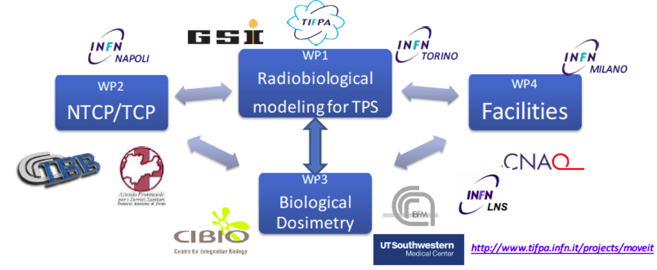
MoVe-IT project

Slide 36
MoVe-IT: WP Structure

Slide 37
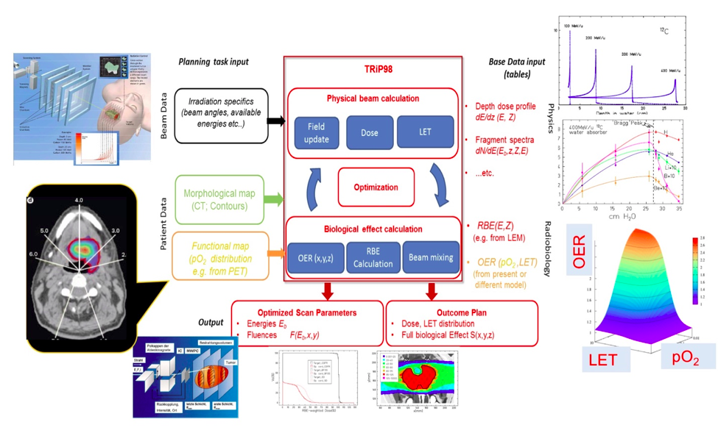
MoVe-IT project

Slide 38
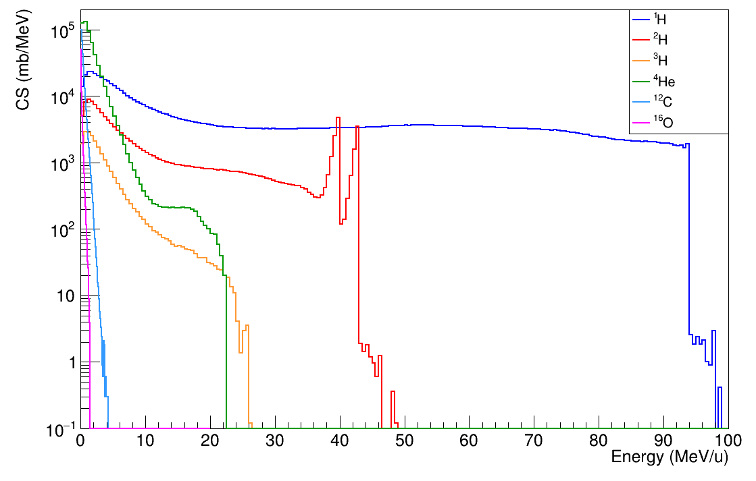
Energy distribution of fragments
Production CS of inelastic interaction induced by proton beam of 100 MeV in water.
 | E_{MAX} (MeV/u) | E_{mean} (MeV/u)
¹H | 100 | 32.2
²H | 43 | 12.6
³H | 27 | 3.5
⁴He | 22 | 1.6
¹²C | 2.1 | 0.3
¹⁶O | 1.0 | 0.1

