Slide 1
Editorial board: 2019 report
Conference | Where | when | what | who | Sez
Bormio 2019 | Bormio | 1/19 | talk | Franchini | Bo
15th Vienna Conf Instr (VCI) | Vienna | 2/19 | ” “ | Aafke Kraan | Pi
15th Vienna Conf Instr (VCI) | Vienna | 2/19 | ” “ | Cerello | To
Detector school | Padova | 4/19 | Poster | Silvestre | Pg
IFAE | Napoli | 4/19 | Poster | Silvestre | Pg
1st Biophysics Coll Meeting | Darmstadt | 5/19 | talk | Battistoni | Mi
1st Biophysics Coll Meeting | Darmstadt | 5/19 | ” “ | Patera | Roma1
FAIRness 2019 | Genova | 5/19 | ” “ | Ridolfi | Bo
CRETE19 Int Conf Appl Nucl Tech | Crete | 6/19 | ” “ | Mengarelli | Bo
PTCOG58 | Manchester | 6/19 | ” “ | Finck | Str
RAD 2019 | Montenegro | 6/19 | ” “ | Bartosik | To
Nucleus 2019 | Dubna | 7/19 | “ “ | Scavarda | To
African Nuclear Phys Conf ANPC | Kruger Park S. Africa | 7/19 | ” “ | Cerello | To
INPC 2019 Int Nucl Phys Conf | Glasgow | 7/19 | ” “ | Traini | Roma1
36th Masurian Lakes Conf on Phys | Poland | 9/19 | ” “ | P. Carra | Pi
SIF | Aquila | 9/19 | ” “ | Spiriti | Lnf
SIF | Aquila | 9/19 | ” “ | Ubezio | Bo
SIF | Aquila | 9/19 | ” “ | Scavarda | To
PTCOG North America | Miami | 10/19 | ” “ | Galati | Na
NSS/MIC-IEEE Nucl Sci & Med Imag | Manchester | 10/19 | ” “ | Morrocchi | Pi
ICRA2019 Int Conf on Rad & Appl | Alger | 10/19
2019
Talks: 18
Posters: 2
2018
Talk: 12
Poster: 7
Seminar: 1

Slide 2
Paper
  Published
    NIMA 916 (2019) 116-124 “ Development and characterization of a ΔE-TOF detector prototype for the FOOT experiment”
    Open Phys. 2019; 17:233–240 “Ion charge separation with new generation of nuclear emulsion films”
  Submitted:
    special issue on Particle Therapy on IEEE Transactions on Radiations & Plasma Medical Science (TRPMS): Differential Cross Section Production of Proton and Deuterons from Carbon Ion Beam on C, O and H target compounds
    Physics in Medicine and Biology: “Charge identification of nuclear
    fragments in particle therapy” (signed by Pisa Group)
    Proceedings of various conferences
  Preparation
    Technical paper on MSD: test beam at Trento in july 2017
    General FOOT paper

Slide 3
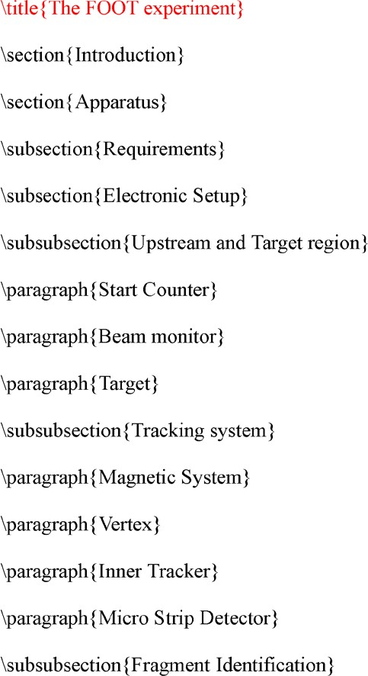
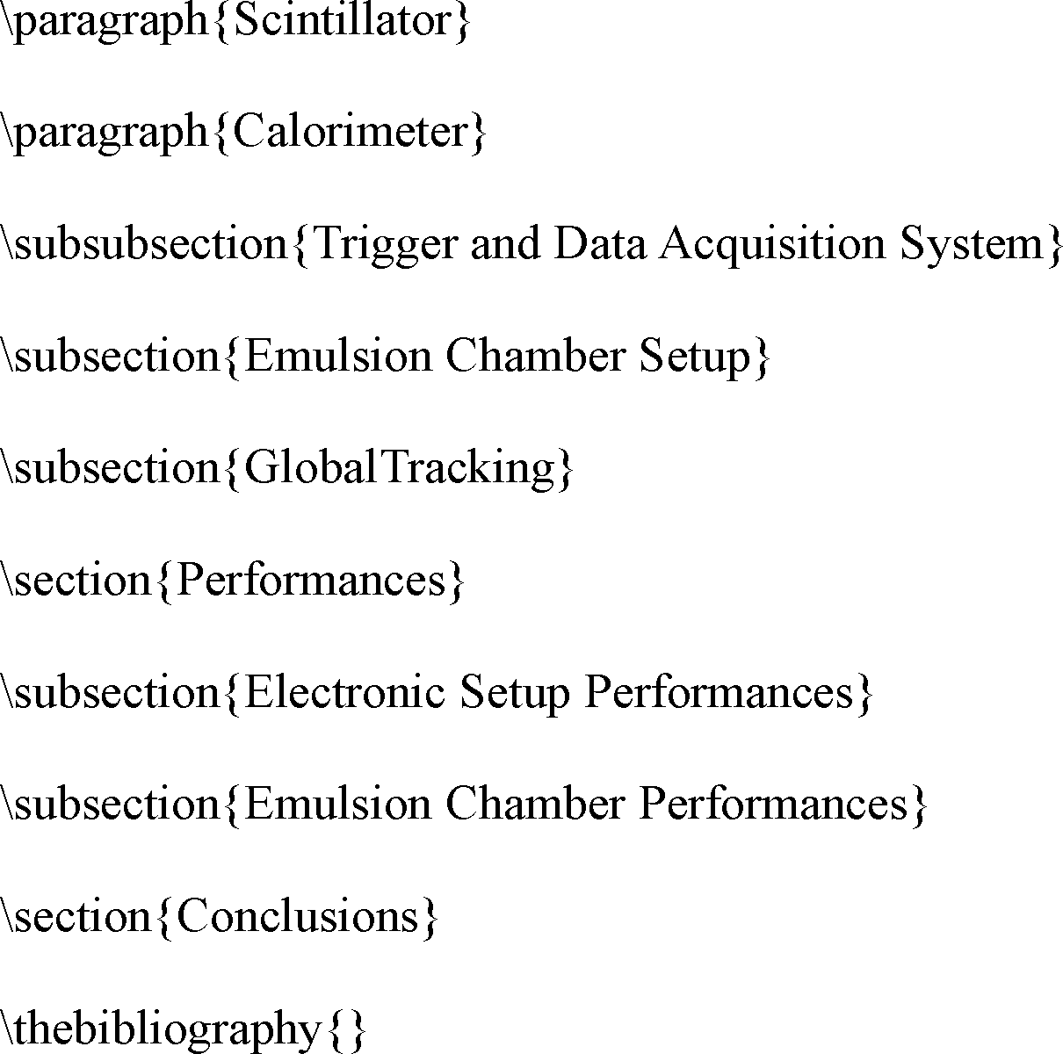
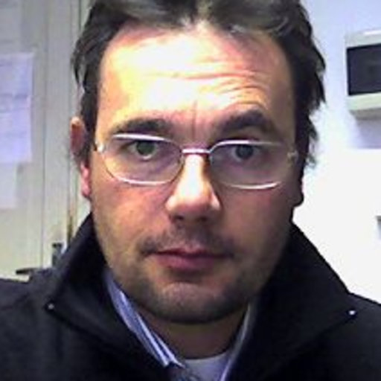
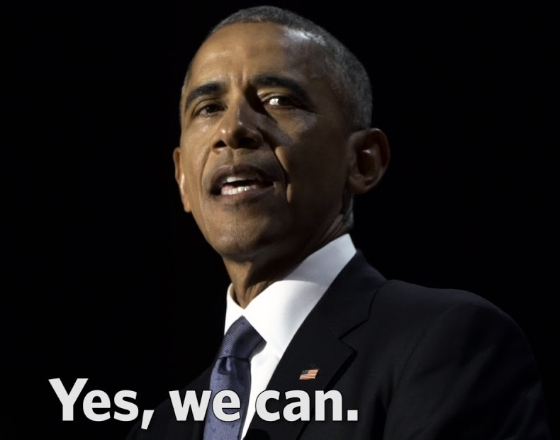
Editorial board report
All the files are in baltig (thanks to Alessio)
Vincenzo
Hoping to finish in 2019
Napoli
NO! we must
Perugia

Slide 4
FOOT Collaboration
Place | members
Aachen | 3
Bari | 1
Bologna | 11
CNAO | 3
Frascati | 6
Gran Sasso | 1
GSI | 3
Havana | 1
Milano | 5
Nagoya | 1
Napoli | 7
Perugia | 8
Pisa | 17
Roma 1 | 11
Roma 2 | 2
Strasbourg | 3
Torino | 12
Trento | 6
Number of authors: 101

