Slide 1
FOOT calorimeter
Status Report
Crystals
Photodetector
Readout
DAQ
Mechanics
Contributions by:
S. Argiro’
R. Arteche Diaz
N. Bartosik
G. Giraudo
N. Pastrone
L. Ramello
M. Rolo
L. Scavarda
Piergiorgio Cerello

Slide 2
BGO Crystals
BGO crystals: to do list
Crystal size measurement
Crystal painting vs. wrapping
reflective paint available @ LNF
offer for painting 320 crystals (Gestione Silo): 36 kE
SiPM pairing (commercial glue)
Plan
Crystals measurements, glueing and wrapping at CERN, then transport to Torino for assembly – CERN availability to be verified
Open issue: wrapping vs. painting

Slide 3
SiPM tiles
SiPM tiles: to do list
Connector defined
Size defined: 25x25 mm2
Micropitch defined: 15 um
Extra money for second silicon batch: 22 kE (need green light from referees)
Batch for test module being packaged (silicon already available)
Start tile production for whole calorimeter (September 2019)

Slide 4
SiPM readout
SiPM readout: to do list
Define amplification circuit – double exit with different gains?
Design readout board (1 or 2 / crystal) – started
V1742 digitizers
approximate cost (320 channels): 8x V1742: 104 kE
Define power supplies
Evaluate QDC option to replace V1742

Slide 5
DAQ
Calorimeter DAQ: to do list
Assumptions: must store data for all crystals neighbouring a triggered one
Data size
Average Occupancy: 3 (?) fragments/event, 21-27 channels/event
Trigger rate: 1 kHz
V1742: 1000 samples / channel, 12 bits/sample
320 kbits / event, 320 Mbits/s
Concept: DAQ PC receives data from digitizers via optical fiber and CAEN PCI board, performs zero-suppression and signal analysis, feeds common DAQ system
PCI board + 5(10) optical fibers: 2.3 (2.7) kE - ordered
DAQ Server: 10 kE

Slide 6
Mechanics
Mechanics: to do list
Requirements
nothing but crystals and air in the first 12 cm
minimize air gaps, no long gaps in any direction
thermal stability
dark environment
Concept
Crystal holding from the back
Crystal horizontal ‘strips’ mounted one on top of the other vs. 3x3 modules
Structural holder (front side as thin as possible, back side also patch panel for readout)

Slide 7
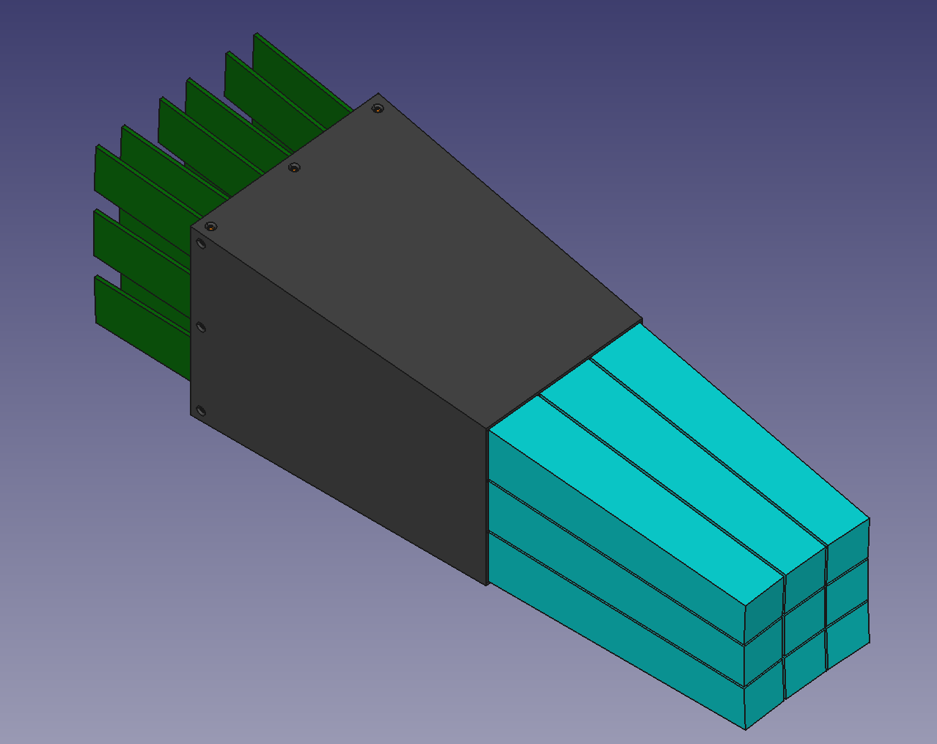
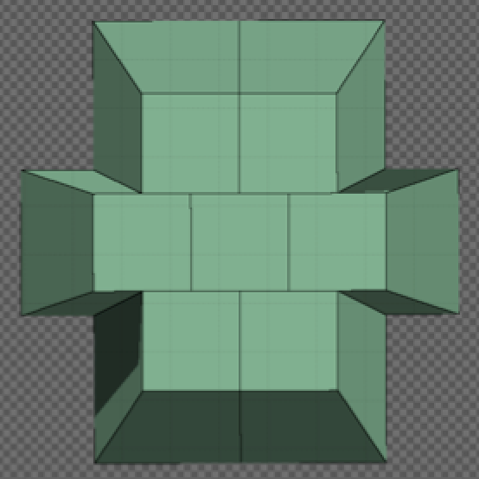
Mechanics
Mechanics: to do list

