Slide 1
Nuclear emulsions:
status of the analysis
A. Alexandrov, G. De Lellis, A. Di Crescenzo, G. Galati, A. Iuliano, A. Lauria, M. C. Montesi, A. Pastore, V. Tioukov
Università di Napoli “Federico II”, INFN Napoli, INFN Bari

Slide 2
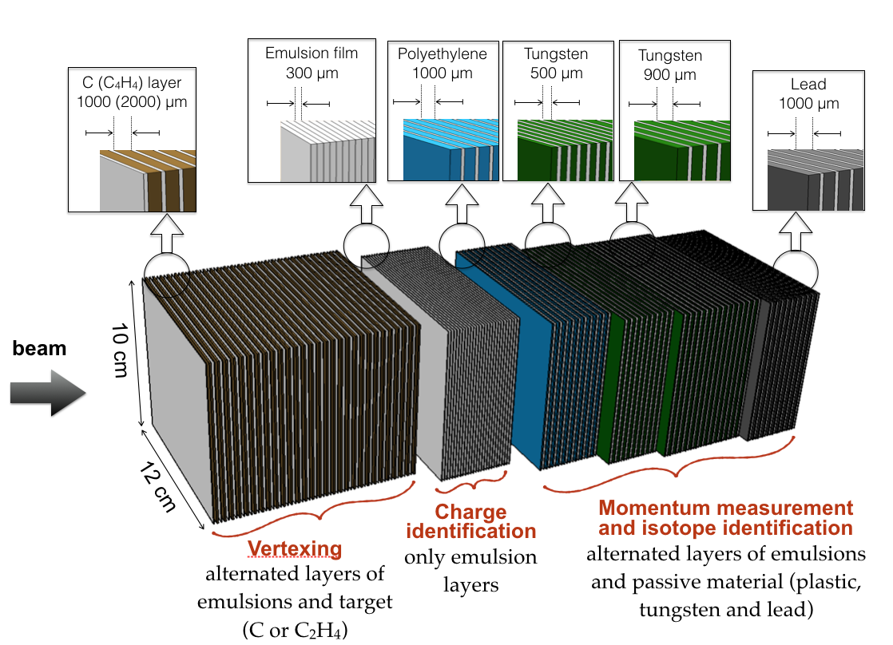
Analysis On-Going
 | Oxygen 200 MeV/n | Oxygen 400 MeV/n
Carbon | GSI1 | GSI3
Polyethylene | GSI2 | GSI4
Beam
Target

Slide 3
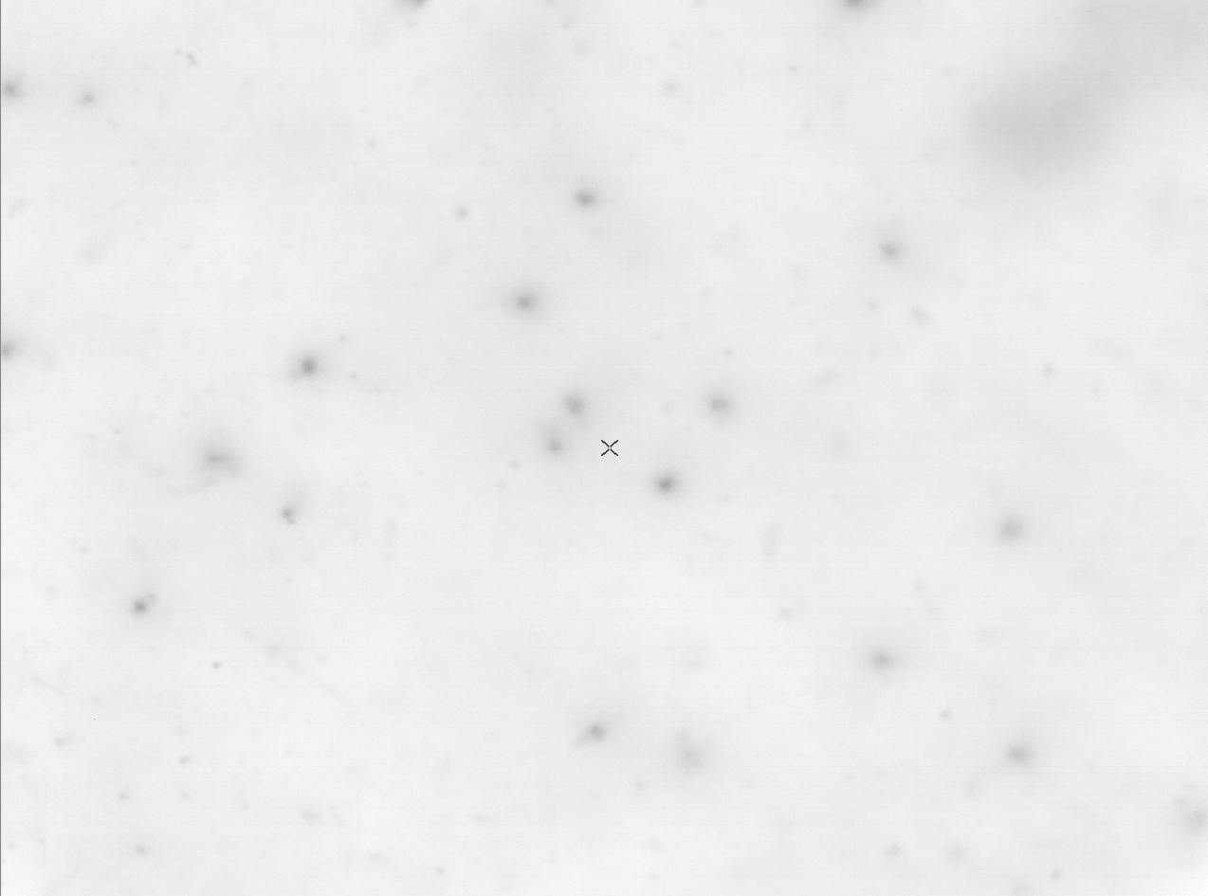
590 μm
797 μm

Slide 4
Efficiency Plate by Plate (All Tracks)
Plate Id | eff all tracks | eff Oxy
1 | 100.0% | 100.0%
2 | 100.0% | 100.0%
3 | 100.0% | 100.0%
4 | 86.8% | 86.6%
5 | 93.8% | 94.0%
6 | 98.0% | 99.8%
7 | 72.2% | 22.9%
8 | 96.4% | 99.6%
9 | 92.9% | 93.5%
10 | 93.4% | 93.3%
11 | 91.2% | 91.8%
12 | 92.2% | 91.8%
13 | 92.1% | 92.2%
14 | 92.4% | 89.8%
15 | 89.7% | 88.8%
Plate Id | eff all tracks | eff Oxy
16 | 92.8% | 91.2%
17 | 100.0% | 100.0%
18 | 89.9% | 85.0%
19 | 93.5% | 92.9%
20 | 94.8% | 94.2%
21 | 89.5% | 77.2%
22 | 93.1% | 94.0%
23 | 93.9% | 92.5%
24 | 95.6% | 94.5%
25 | 93.7% | 94.8%
26 | 97.3% | 98.8%
27 | 100.0% | 100.0%
28 | 100.0% | 100.0%
29 | 100.0% | 100.0%
30 | 100.0% | 100.0%
Mean Efficiency all = 94%
Mean Efficiency Oxy = 91%

Slide 5
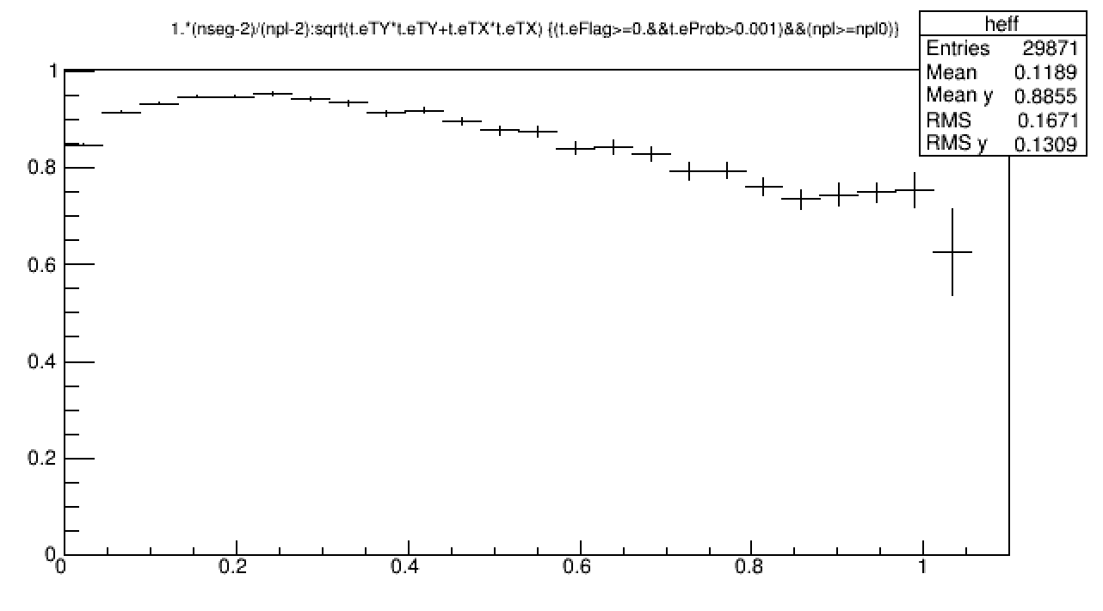
Track Efficiency by Angle
Efficiency
Signal Region
Angle (rad)
To be improved…

Slide 6
Oxygen Counting

Slide 7
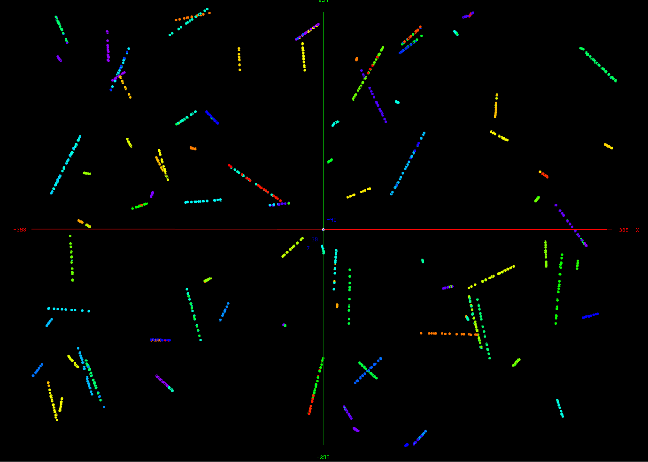
Oxygen Counting
Our scanning software is not optimized for such ionizing particles
The grains along the oxygen trajectory are not separated and on a straight line
Oxygen grains created by the same particle are associated with close segments

Slide 8
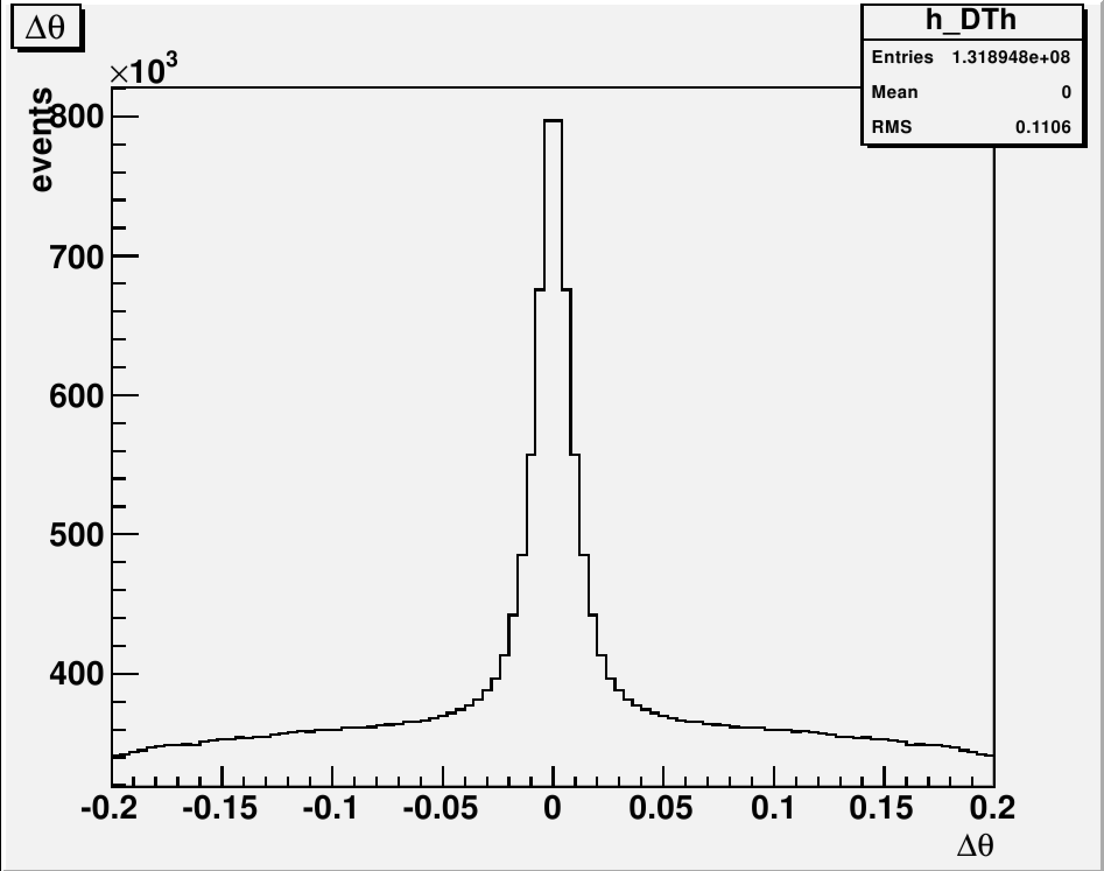
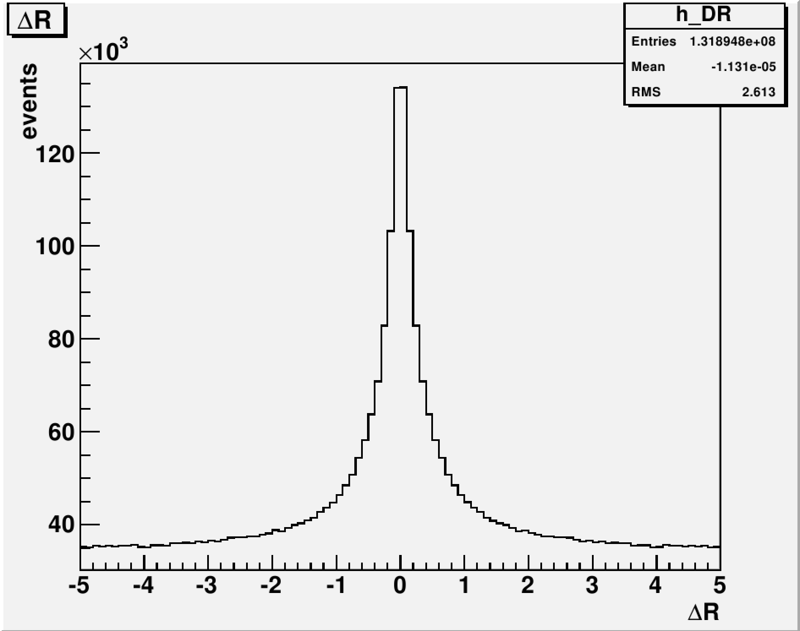
Oxygen Counting
Segments with ΔRxy<1.5 μm && Δθ<0.04 rad are replaced by a single segment that combines properly all the information
Notes:
couples->Draw("s.eX:s.eY", "TMath::Abs(eX-62000)<797&&TMath::Abs(eY-48000)<590&&Theta()<0.04", "COLZ")

Slide 9
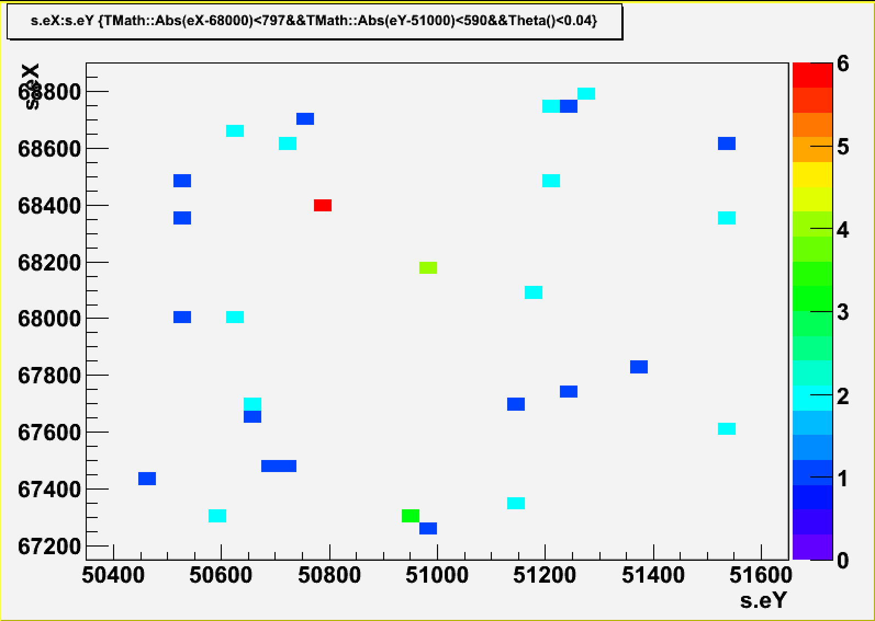
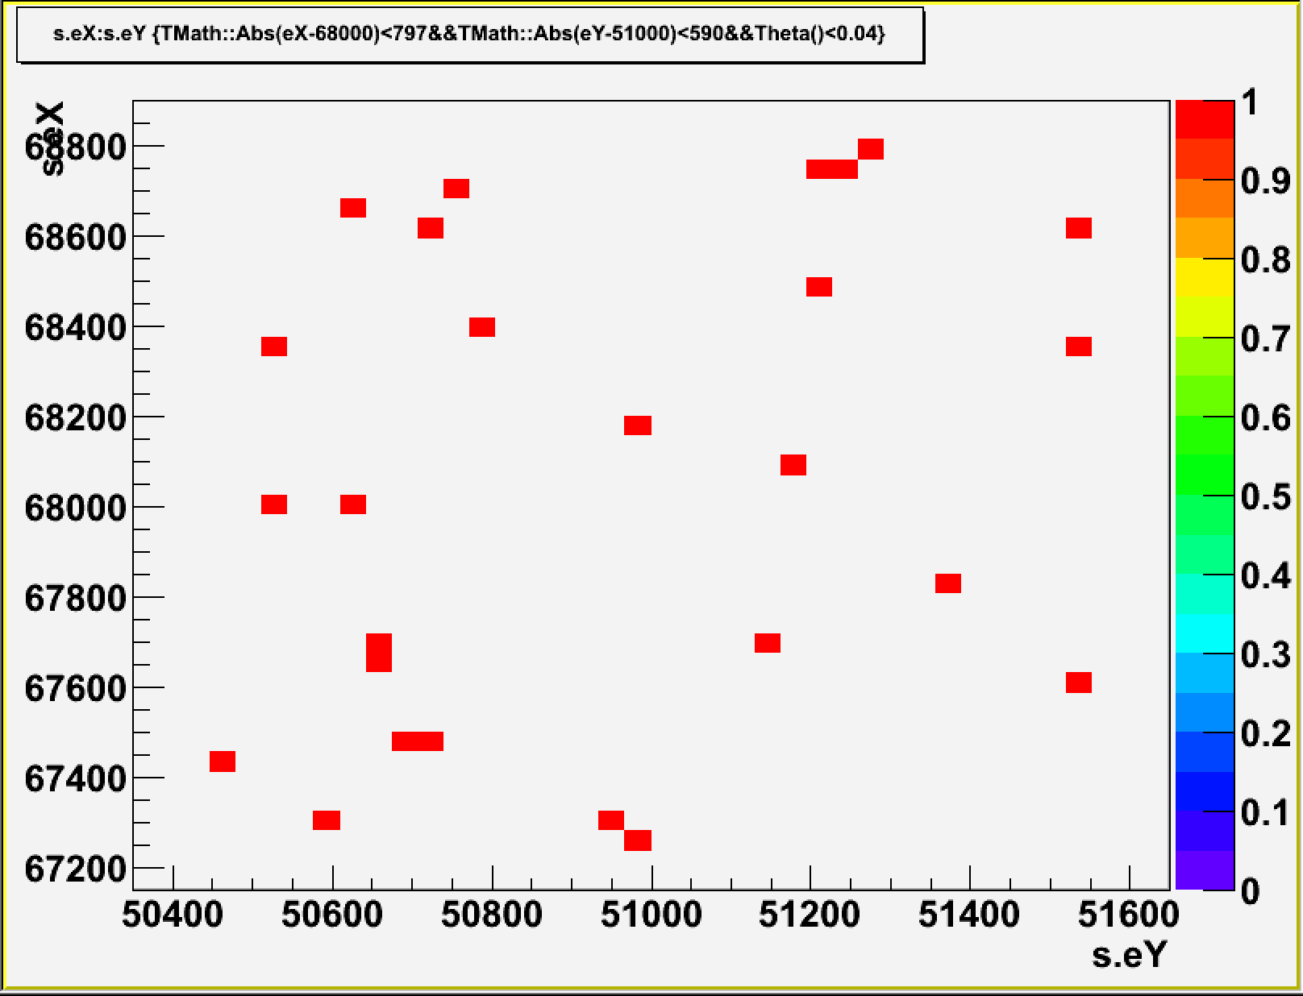
Oxygen Counting
Before
After
Notes:
couples->Draw("s.eX:s.eY", "TMath::Abs(eX-68000)<797&&TMath::Abs(eY-51000)<590&&Theta()<0.04", "COLZ")

Slide 10
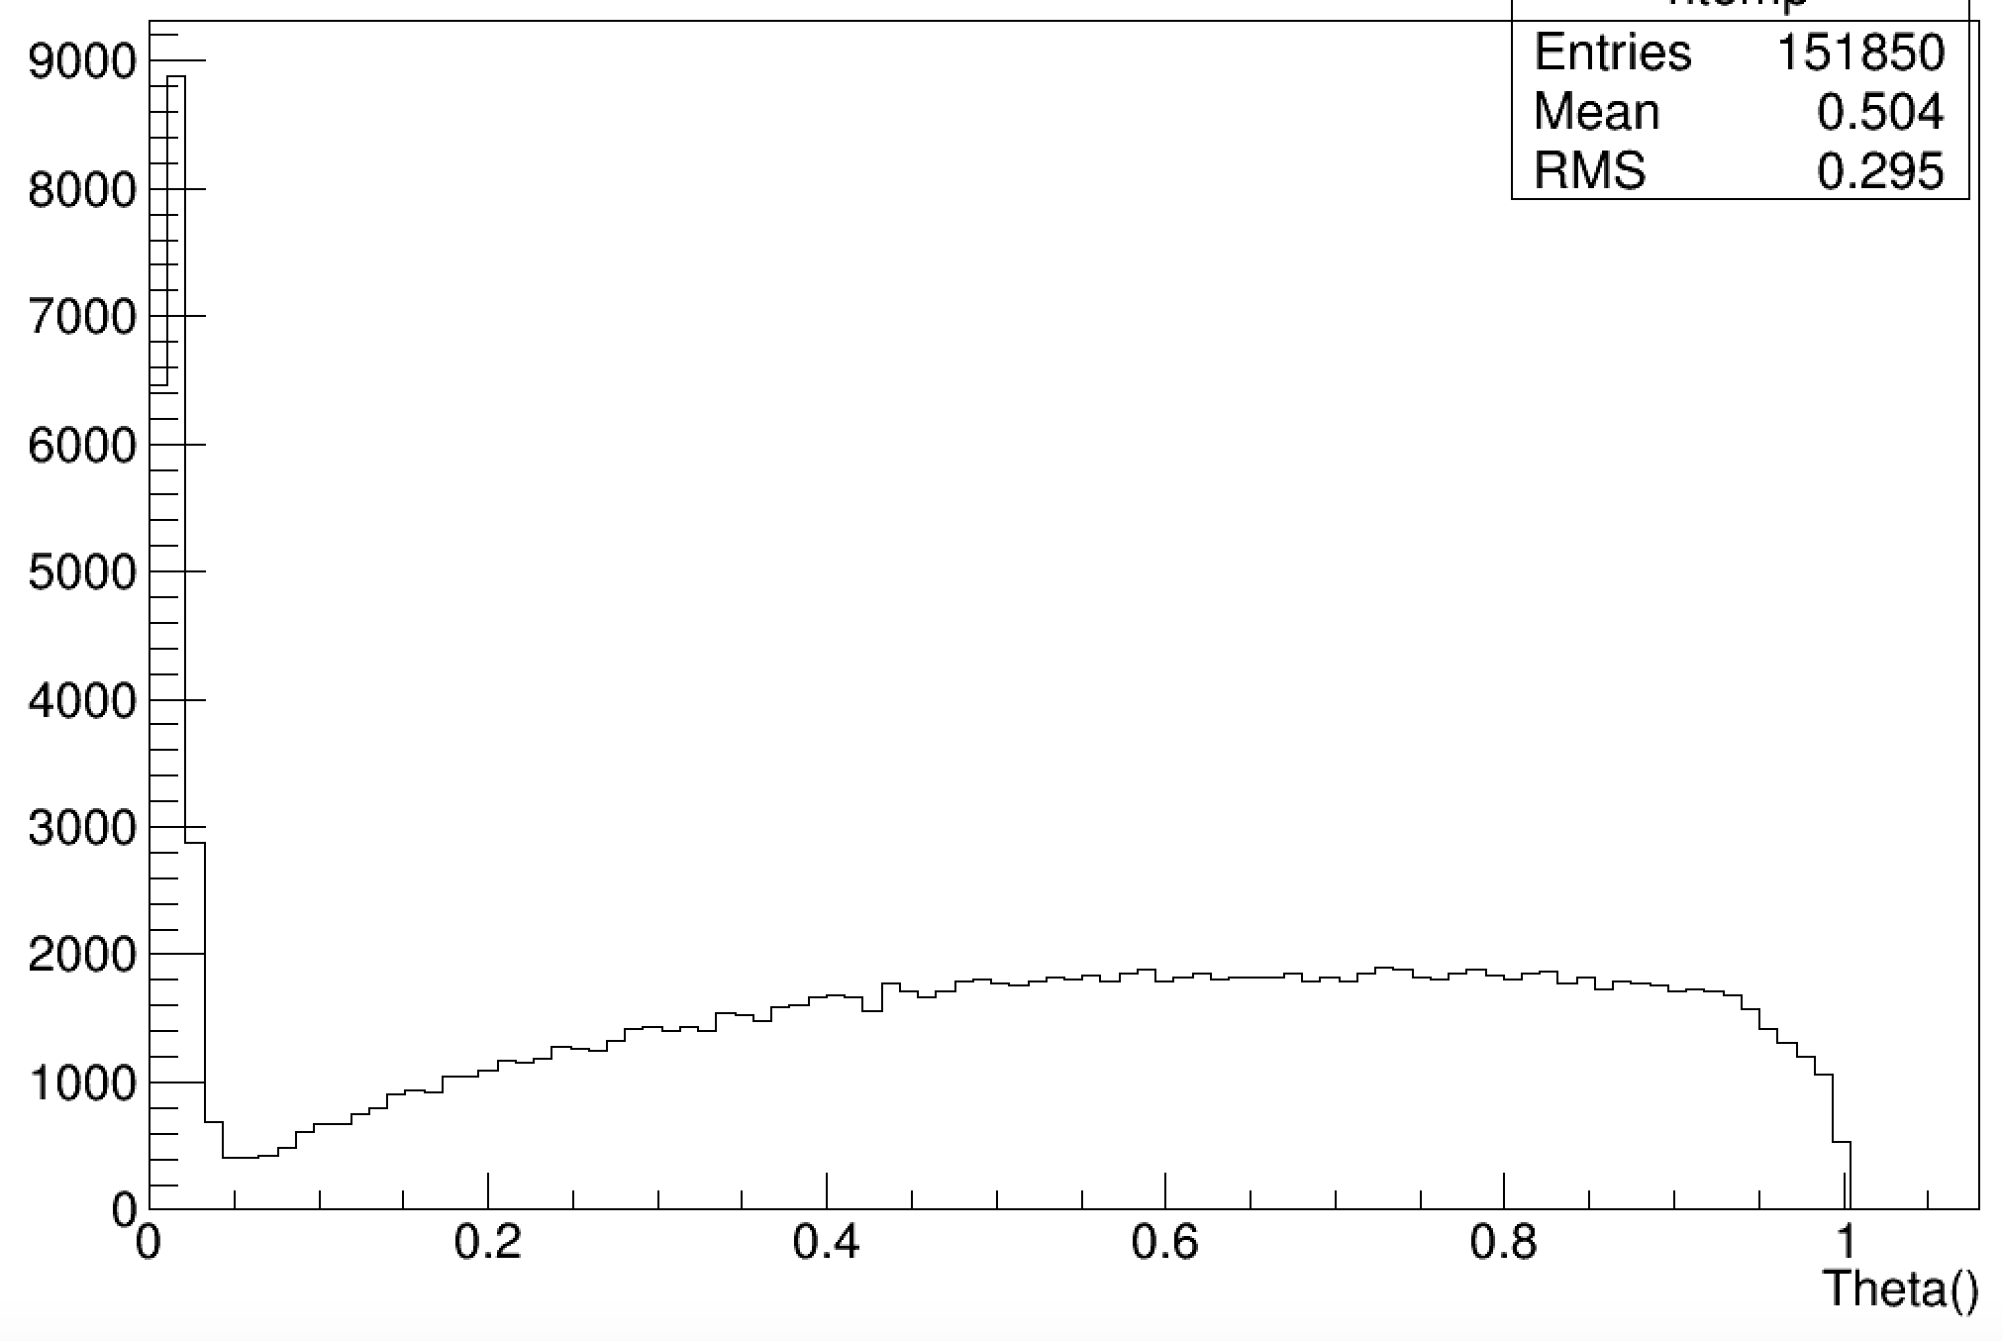
Oxygen Counting
Beam: 19375 Oxygen ions
Reconstructed base tracks with θ<0.04 rad rad on Plate 1: 18778
Efficiency ~ 97%

Slide 11
MicroTracks
PLATE 1
PLATE 30
X - Y microtrack distributions
Slope X microtrack distributions

Slide 12
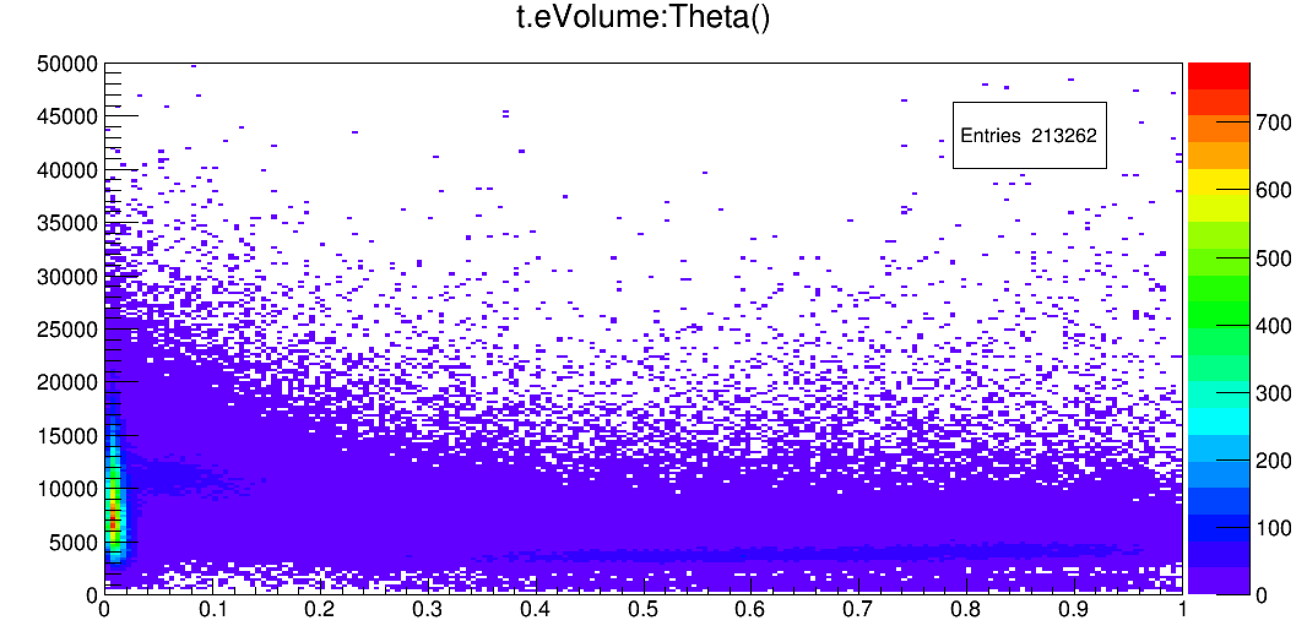
Signal vs Cosmic Rays Separation
Volume
Cosmic Rays
Signal
Angle (rad)
Notes:
couples->Draw("s.eVolume:Theta()>>h(200,0,1,200,1500,14000)", "", "COLZ")

Slide 13
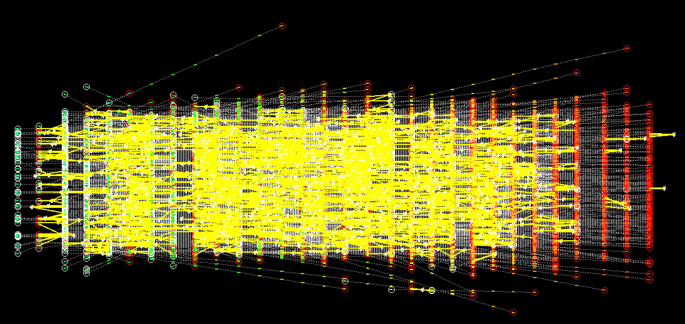
All Oxygen Vertices

Slide 14
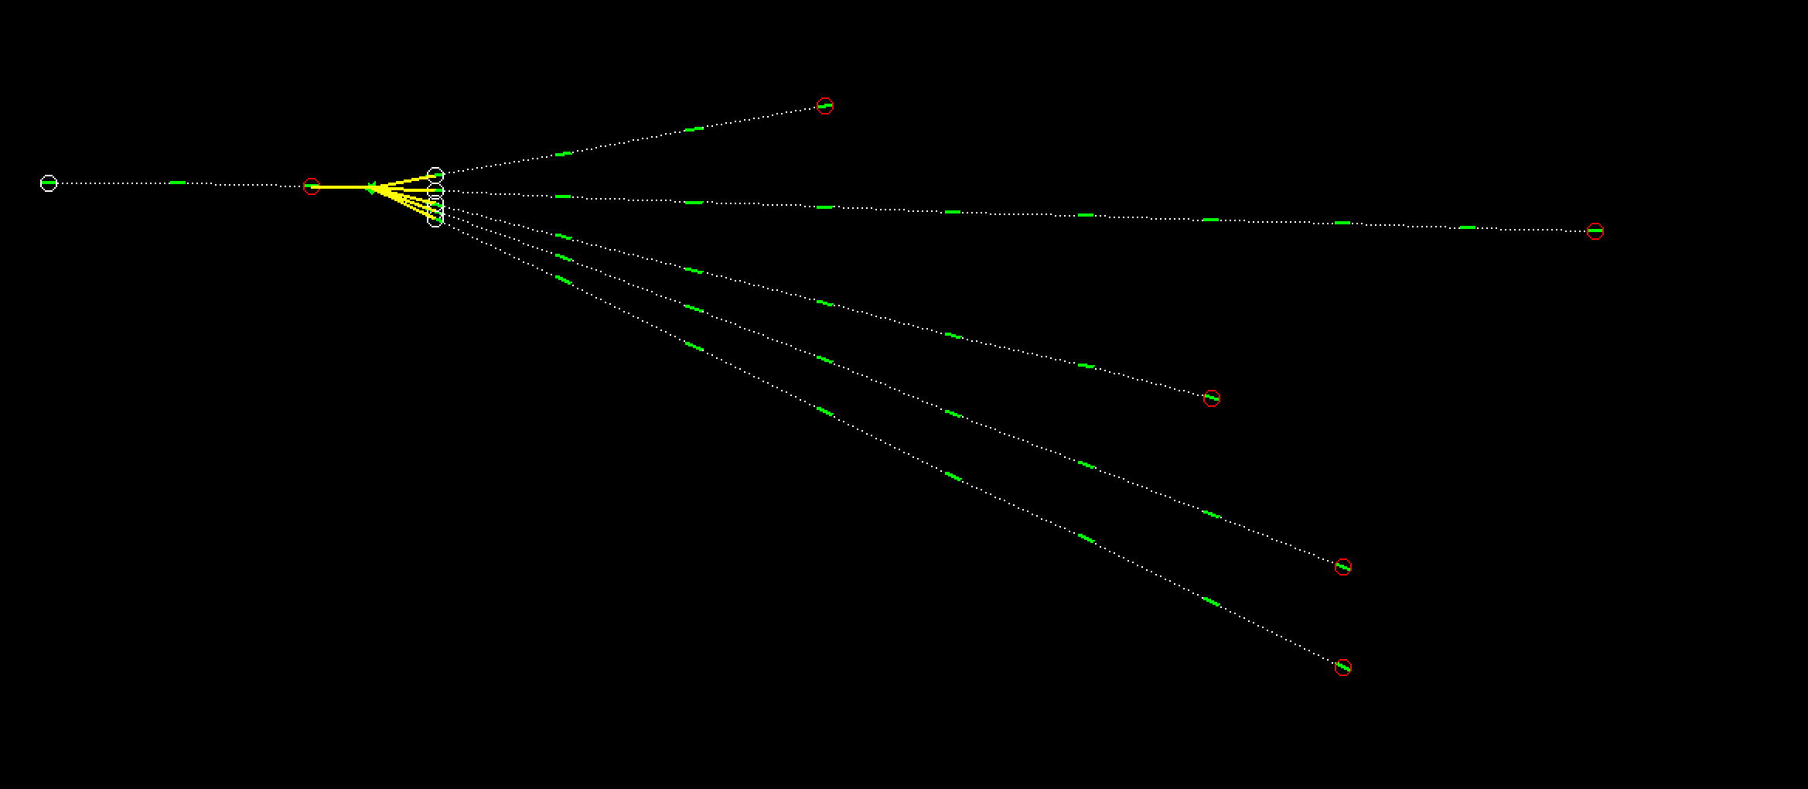
Vertexing - Example
470 μm
3 cm

Slide 15
Comparison with Simulation
MonteCarlo Simulation was converted into the raw data files format and underwent the tracking reconstruction
Flat efficiency was set at 94%
4 mrad smearing was applied on angles
No misalignment was simulated
No cosmic rays or background were simulated

Slide 16
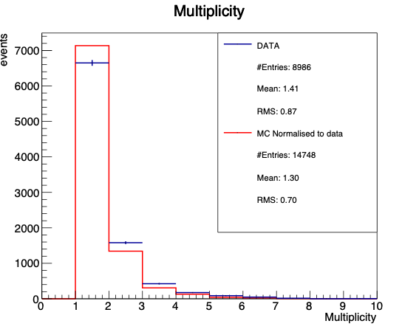
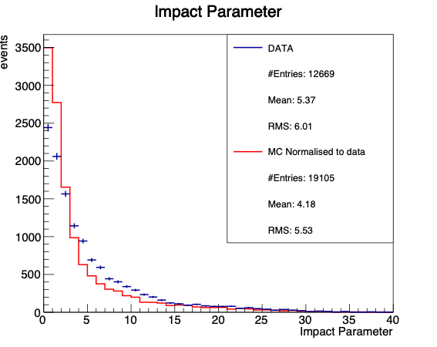
Comparison with Simulation
Selection: incoming particle with θ<0.04 rad
Vertex probability>0.5
MC normalized to data

Slide 17
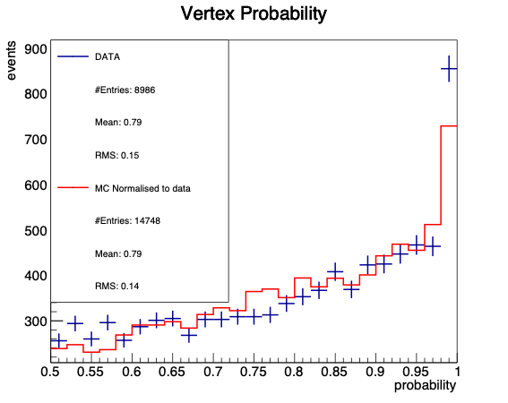
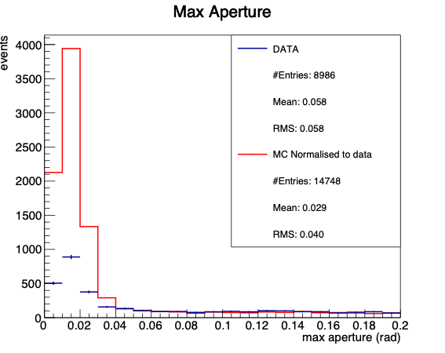
Comparison with Simulation
Selection: incoming particle with θ<0.04 rad
Vertex probability>0.5
MC normalized to data

Slide 18
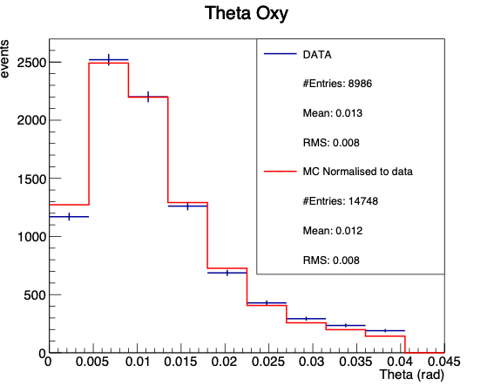
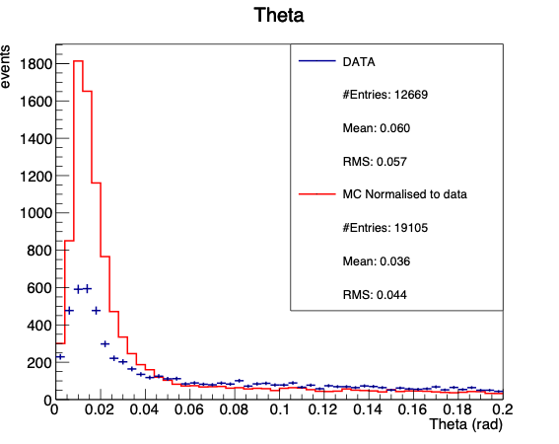
Comparison with Simulation
Selection: incoming particle with θ<0.04 rad
Vertex probability>0.5
MC normalized to data

Slide 19
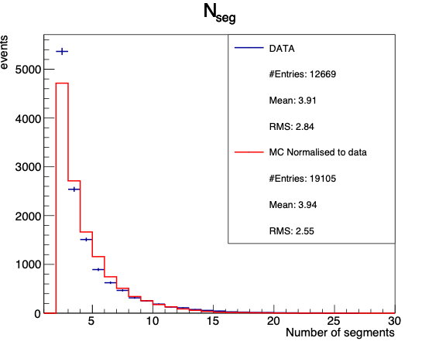
Comparison with Simulation
Selection: incoming particle with θ<0.04 rad
Vertex probability>0.5
MC normalized to data

Slide 20
Next Steps
Improve tracking efficiency
Vertices manual check and one by one analysis to better understand interactions characteristics and validate the analysis
Continue emulsion scanning and microscope tuning

Slide 21
Back Up Slides

Slide 22
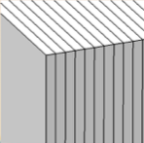
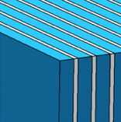
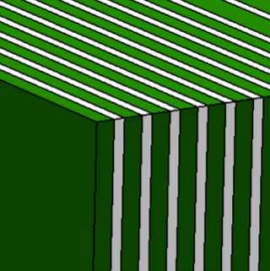
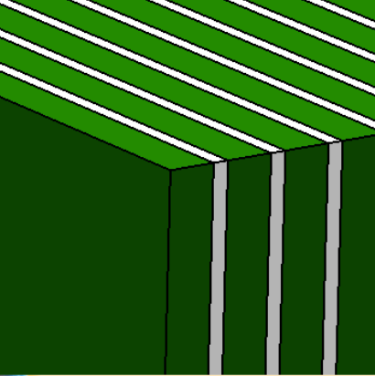
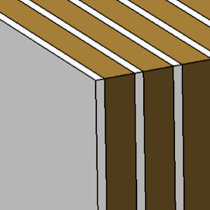
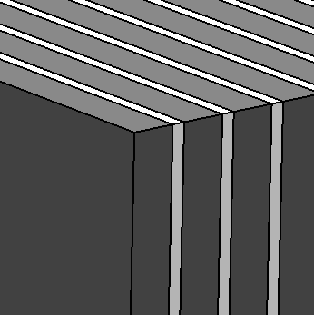
Emulsion spectrometer design
Emulsion film
300 μm
Polyethylene
1000 μm
Tungsten
500 μm
Tungsten
900 μm
C (C4H4) layer
1000 (2000) μm
Lead
1000 μm
beam
10 cm
12 cm
Charge identification
only emulsion layers
Momentum measurement
and isotope identification
alternated layers of emulsions and passive material (plastic, tungsten and lead)
Vertexing
alternated layers of emulsions and target (C or C2H4)
Notes:
The Emulsion Cloud Chamber detector is made of three sections:
SECTION 1: alternated layers of emulsion films and target (C/C2H4)
Vertex detector
Tracking of all charged particles
SECTION 2: emulsion films only
Charge identification for low Z fragments
SECTION 3,4,5: alternated layers of emulsion films and passive material
Momentum measurement by range and Multiple Coulomb Scattering (MCS)
Isotopic identification

Slide 23
Detector Structure
 | Oxygen 200 MeV/n | Oxygen 400 MeV/n
S1 | C (30x1mm) / C2H4 (30x2mm) + 29 emu
S2 | Emu (36)
S3 | Polyethylene (10x1mm)+10emu
S4 | W (10x0.5mm)+10emu
S5 | W (15x0.9mm)+15emu
S6 | Pb (20x1mm)+20emu | Pb (40x1mm)+40emu
S1
S2
S3
S4
S5
S6
S1
S2
S3
S4
S5
S6
S1
S2
S3
S4
S5
S6
S1
S2
S3
S4
S5
S6

Slide 24
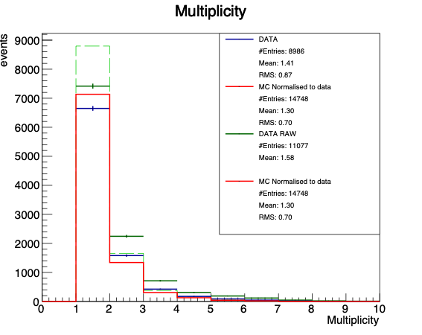
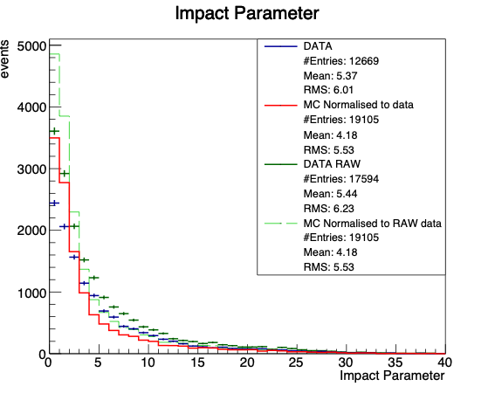
Comparison with Simulation
RAW Data = Data before replacing fragmented
oxygens with a single segment
Selection: incoming particle with θ<0.04 rad
Vertex probability>0.5

Slide 25
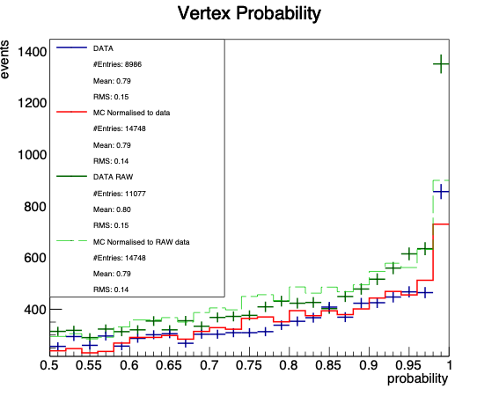
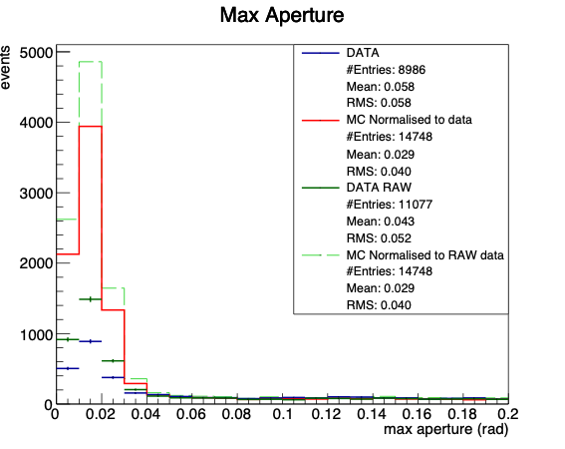
Comparison with Simulation
RAW Data = Data before replacing fragmented
oxygens with a single segment
Selection: incoming particle with θ<0.04 rad
Vertex probability>0.5

Slide 26
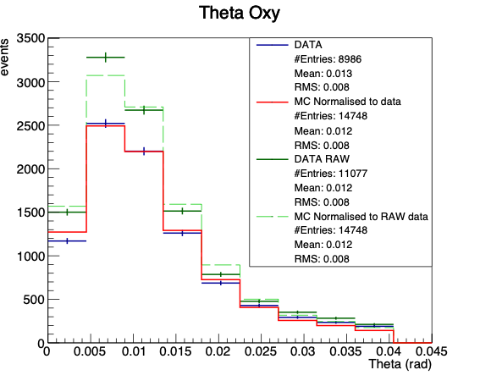
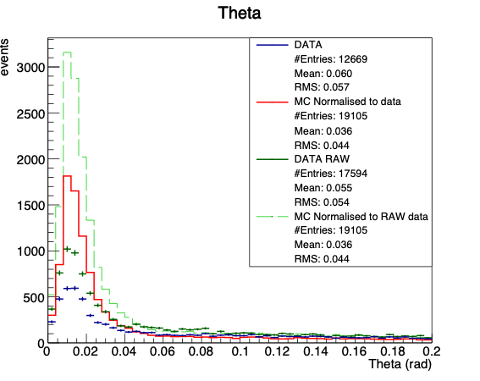
Comparison with Simulation
RAW Data = Data before replacing fragmented
oxygens with a single segment
Selection: incoming particle with θ<0.04 rad
Vertex probability>0.5

Slide 27
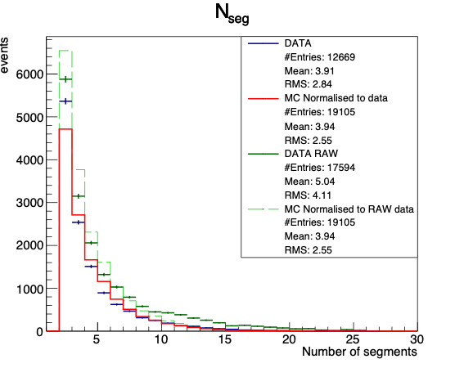
Comparison with Simulation
RAW Data = Data before replacing fragmented
oxygens with a single segment
Selection: incoming particle with θ<0.04 rad
Vertex probability>0.5

