Slide 1
FOOT data taking@GSI: a quick overview
FOOT Collaboration Meeting – Pavia 2019

Slide 2
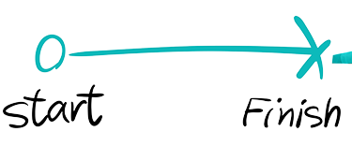
4th April
10th April
IBER beam time 2019 ESA
Expected 16 hours beam time (parasitic beam)
Oxygen beam (200 and 400 MeV/u), Cave A
Two setups: Emulsions + Electronic
Overall 32 people joined the test beam

Slide 3
Organization & Logistic: how to bother your colleagues
Practical Organization started in January 2019:
  Dosimeter requests at GSI
  Accommodation information
  GSI accounts IT Department
Since February:
  Skype calls for run organization every 2 weeks
  Parallel Skype calls with Uli Weber@GSI
Main concerns from GSI:
  Number of people involved
  Material to bring in Cave A
  Special needs (e.g. gas flux for beam monitor)
  Beam time schedule

Slide 4
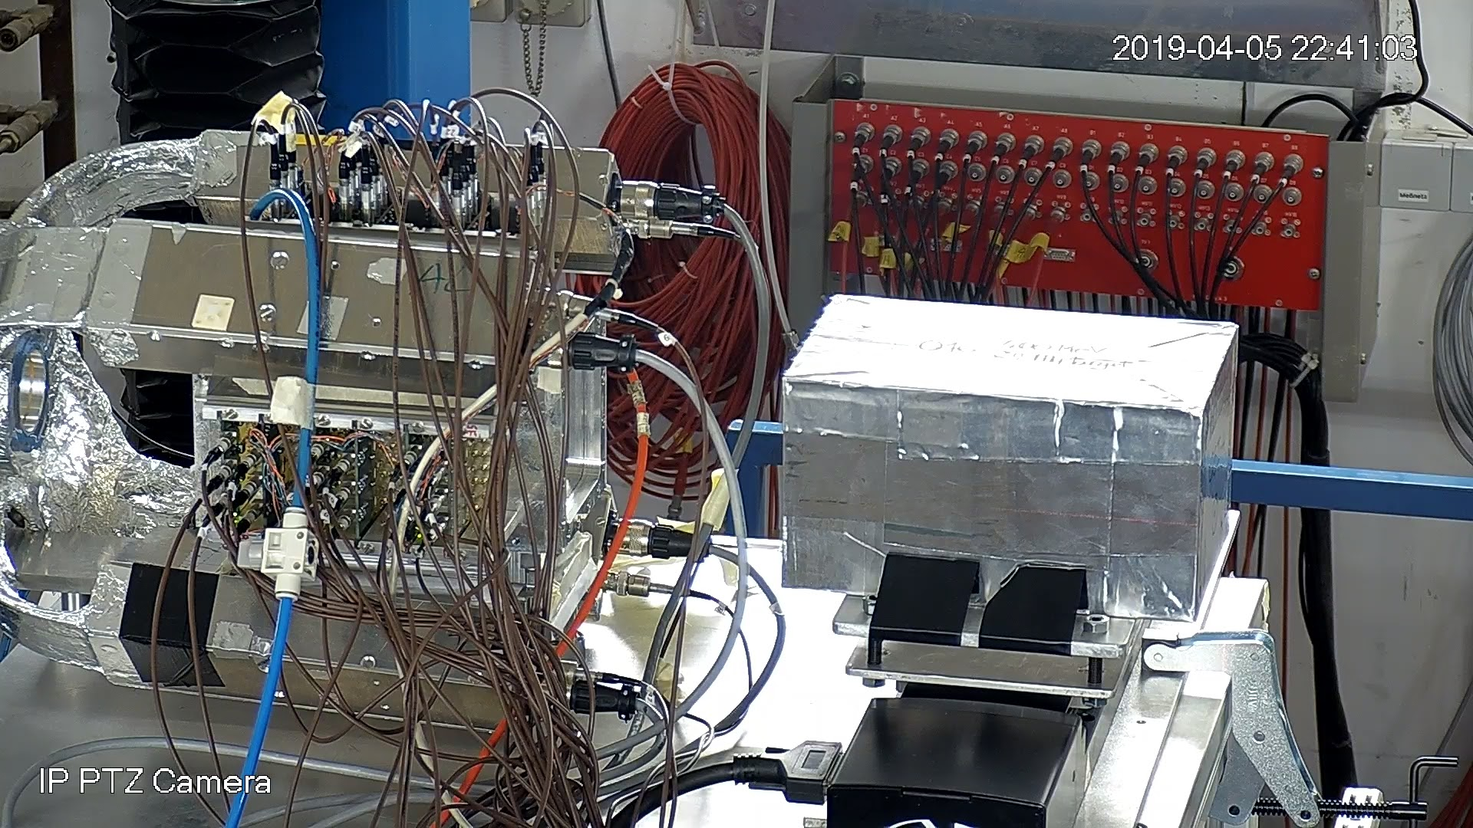
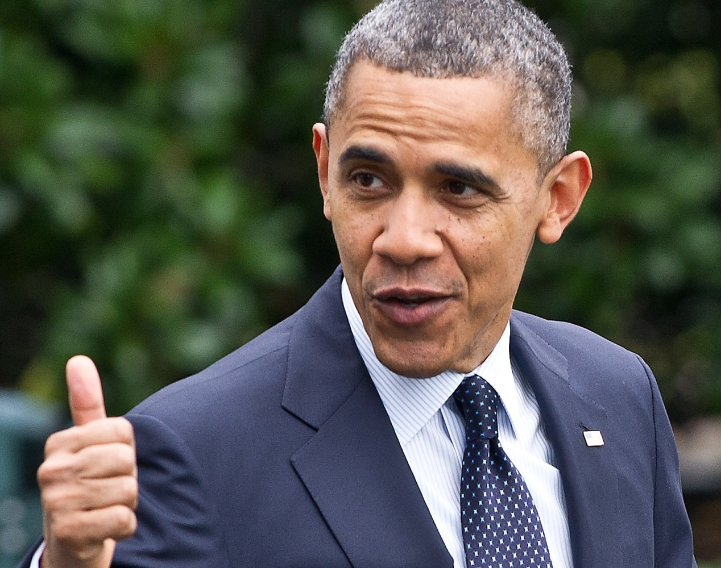
Emulsion Setup
On-line monitoring: SC + BM
4 emulsions chambers exposed
200 MeV/u and 400 MeV/u
Scanned field (2.5 cm x 2.5 cm)
Overall fluence 14-19 x 10³ ions
Start position in the middle
1 mm grid in x/y
-12 … +12 mm size

Slide 5
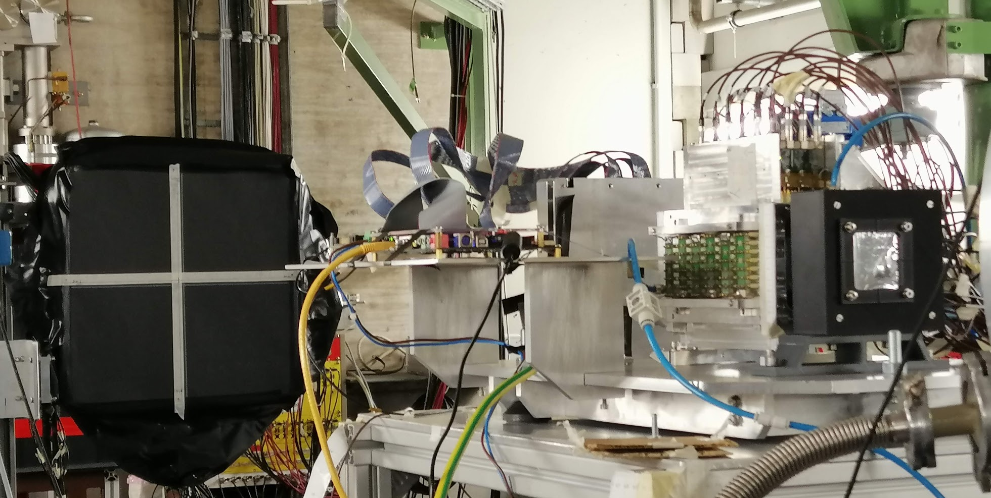

Electronic Setup
Setup@April 2019:
SC+BM
VTX
TOF Wall
Calorimeter Crystal
Goal:
To test integration if sub-detectors in global DAQ
To test sub-detector performances on Oxygen beam
To take at least some data with target (C/C₂H₄)
Goal:
To test integration if sub-detectors in global DAQ
To test sub-detector performances on Oxygen beam
To take at least some data with target (C/C₂H₄)

Slide 6
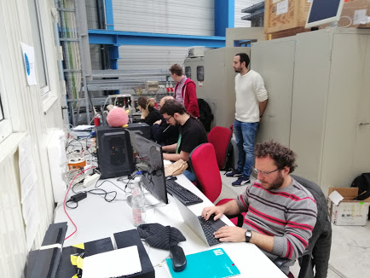
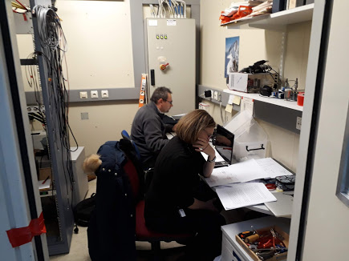
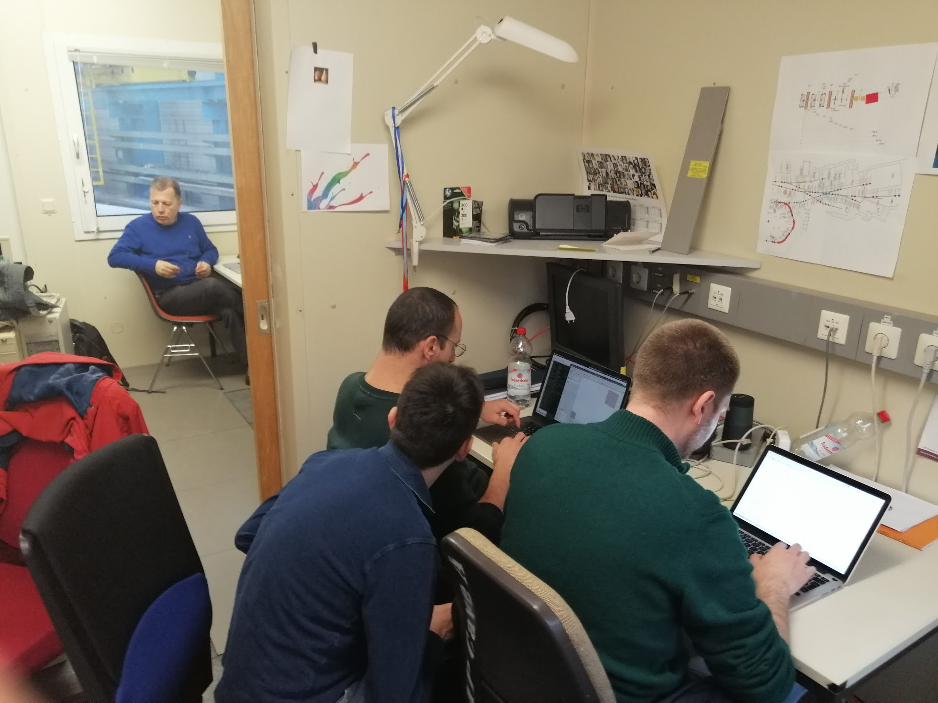
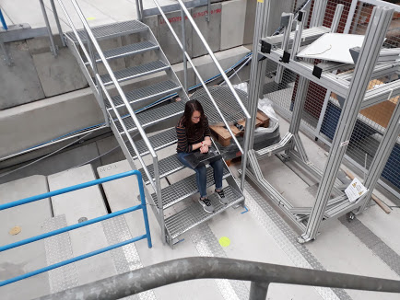
Cave A control room and surroundings
Too many persons involved?
Most likely not…but dedicated space not so comfortable
This is not going to improve in near future (Cave M?)

Slide 7
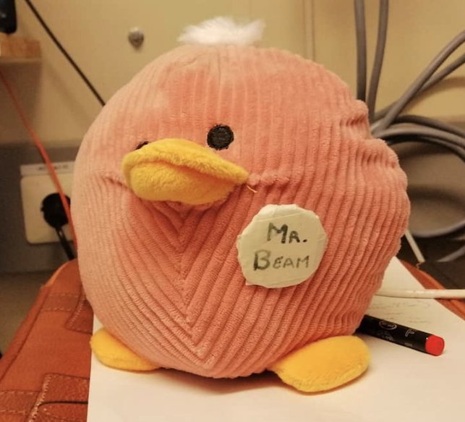
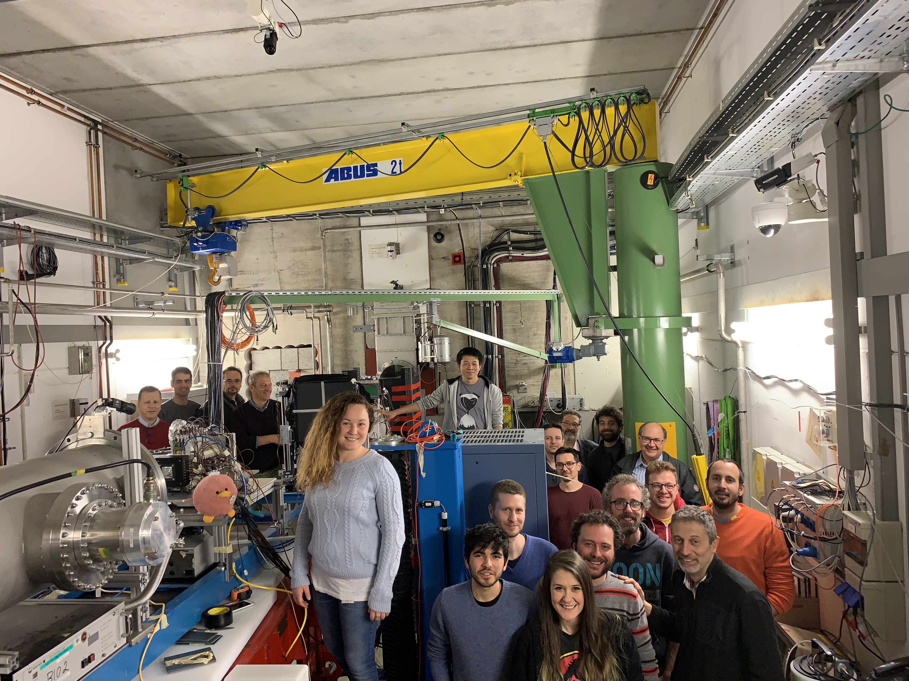
The Day After: few considerations
First meeting “on the field” for large part of the collaboration
We managed to quickly set-up the FOOT “workplace”
Lessons Learned:
  Beam tuning delicate process (focus on 1-2 energies)
  Open/close the cave during weekend is an issue
We had to cut the last part of our program (3-4 hours)
Was the Elog detailed enough?
We could have the chance to get beam in Spring 2020 (Helium?)
Our current budget is 16-20 hours
Logistic might be more complicated (additional detectors)
We could “deserve” to run as Main Users

