Slide 1



Aspects of Pairing in Nuclei
Augusto O. Macchiavelli
Nuclear Science Division Lawrence Berkeley National Laboratory
aom@lbl.gov
Work supported under contract number DE-AC02-05CH11231.

Slide 2
Lecture II
Pairing plus Quadrupole 101
Shape and pairing phase transitions
Rotational motion and pairing

Slide 3
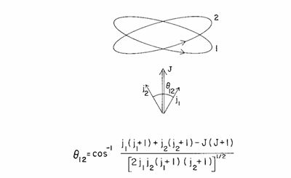
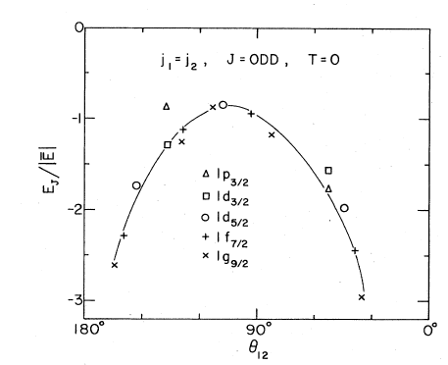
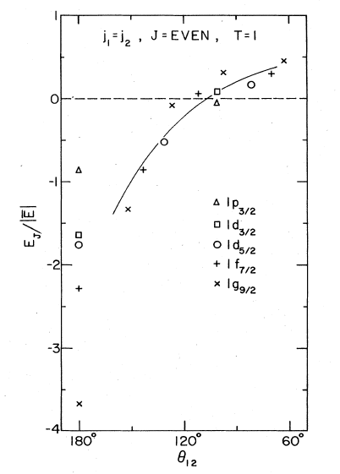
Short-range (Pairing ) + long-range (Quadrupole)

Slide 4
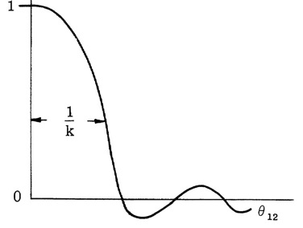
The pairing coupling scheme
s
Short range force favors 0⁺ pairs
j
l
Wave function is
Correlations within a distance
r ≤ R/l
1/l
j
I
For I ≠ 0 the distance is ≈ IR/l

Slide 5
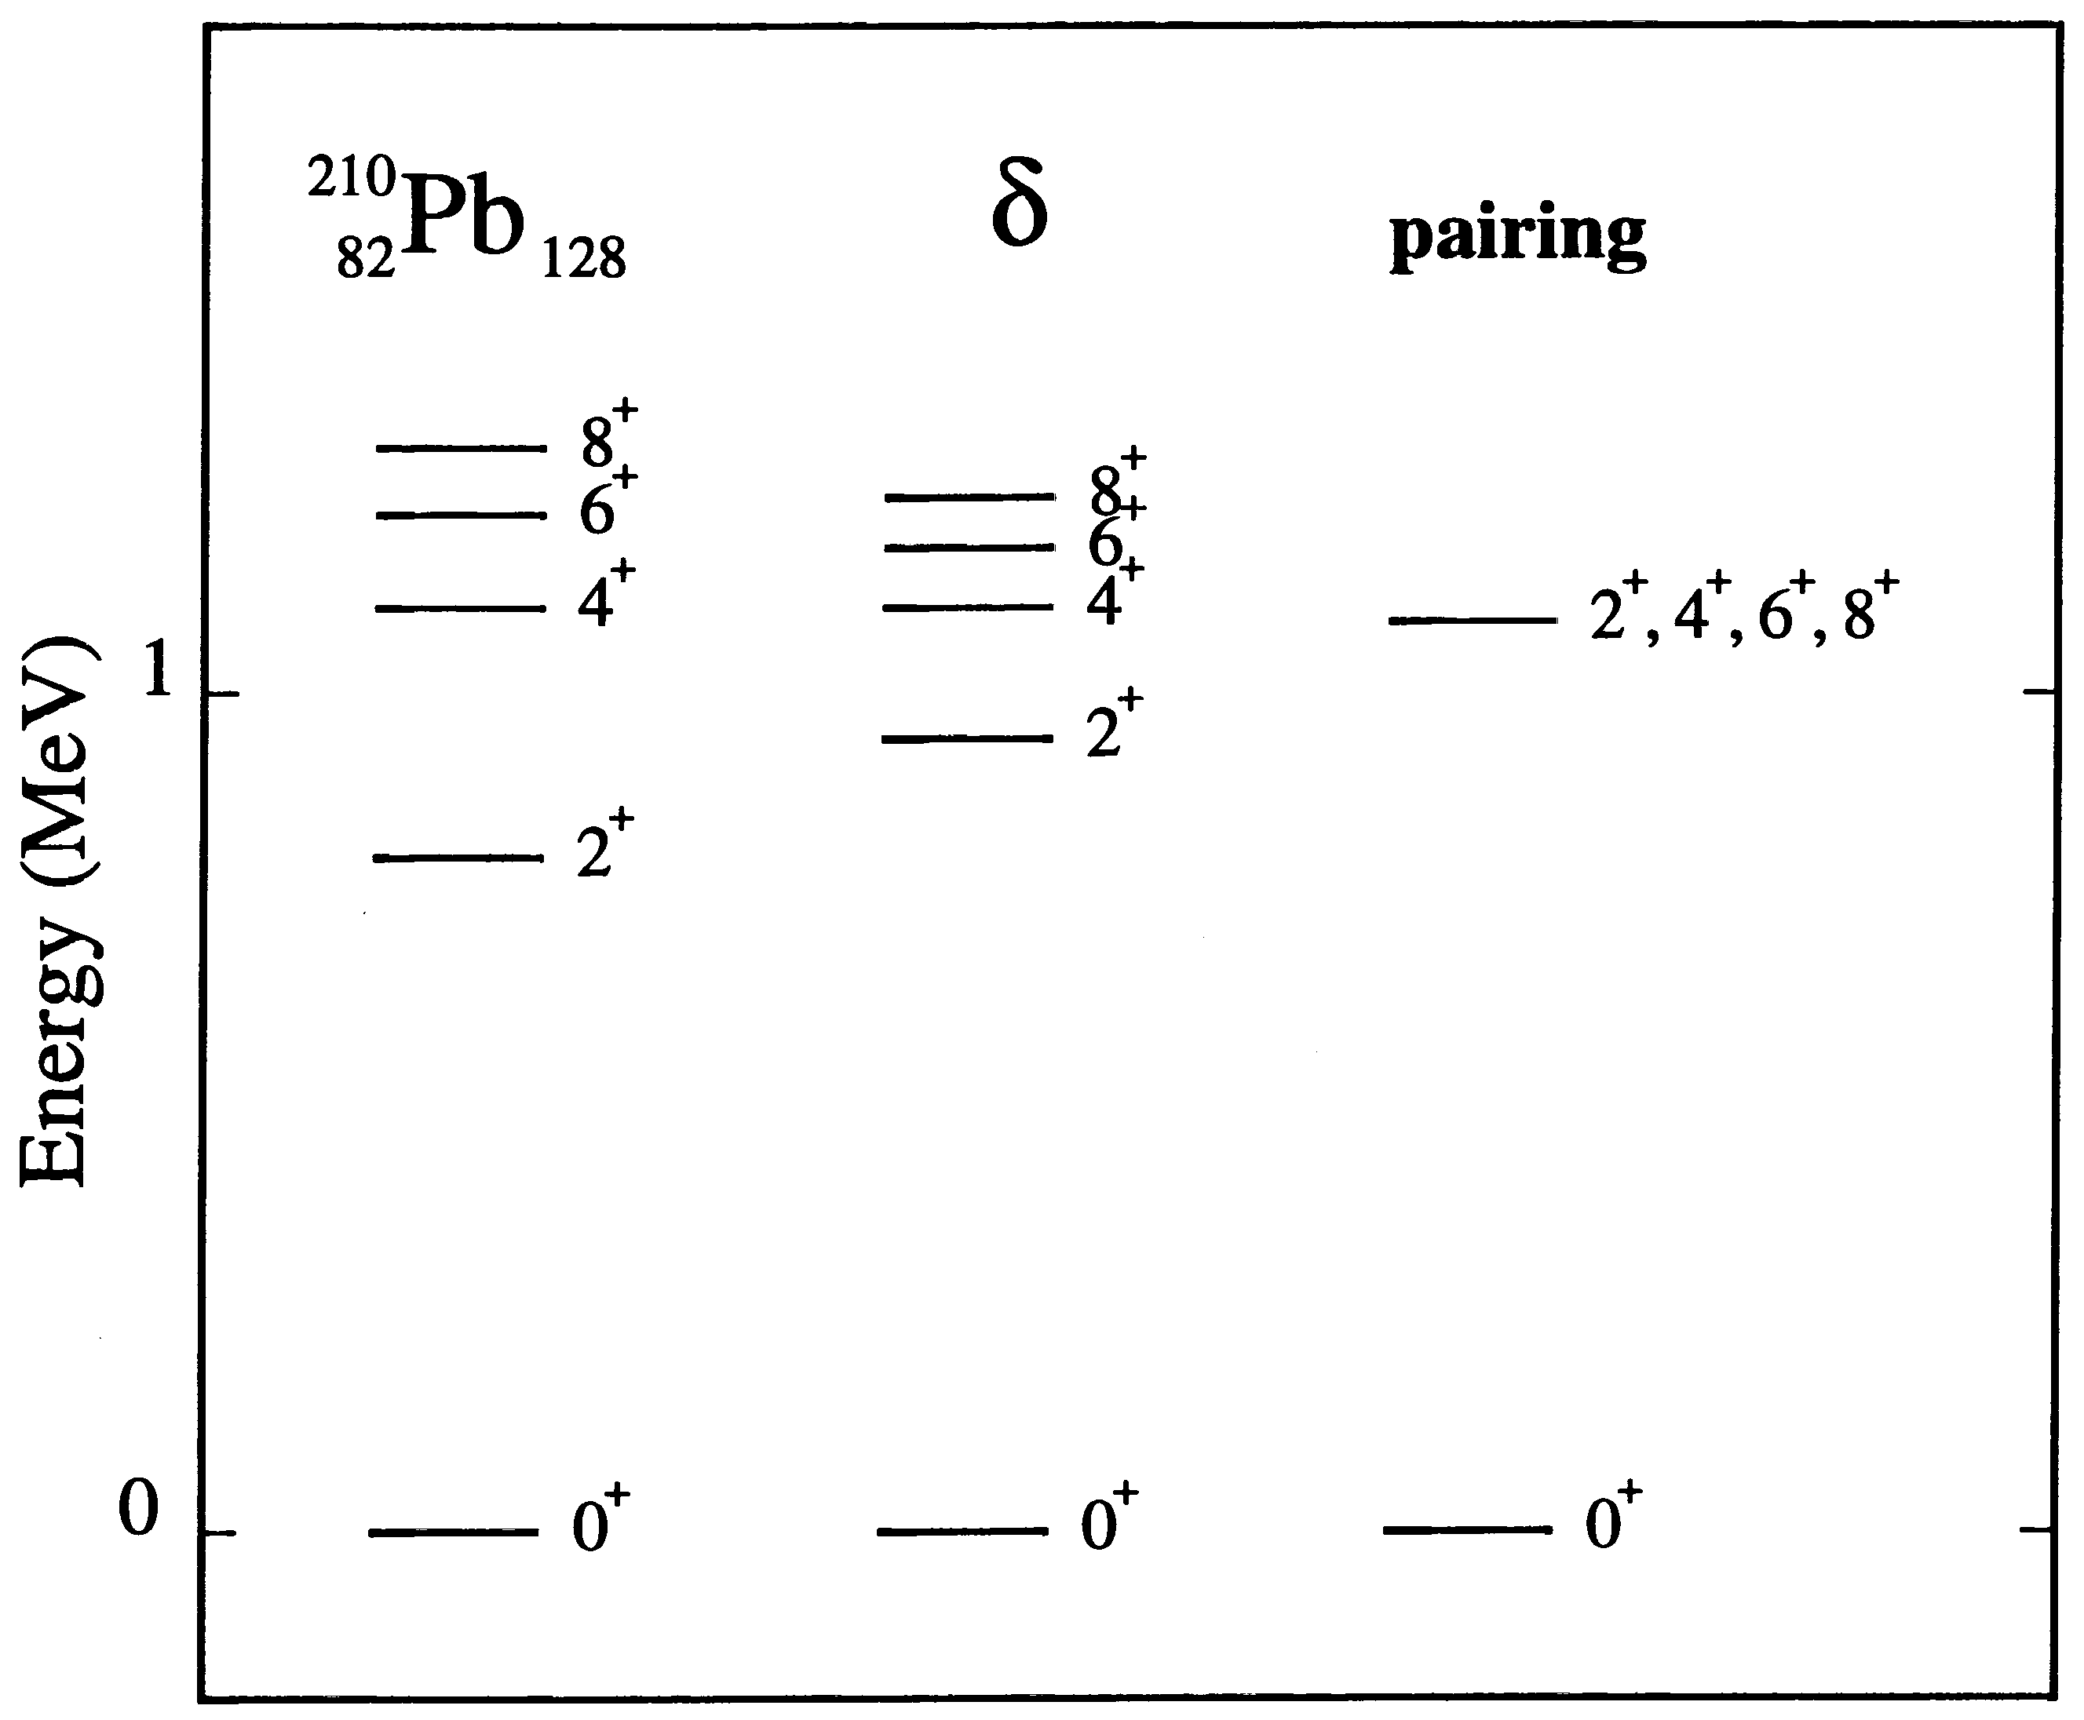
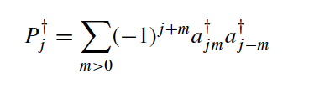

Slide 6
The aligned coupling scheme
j
Small compared to the range of the P₂ term ~ π/2

Slide 7
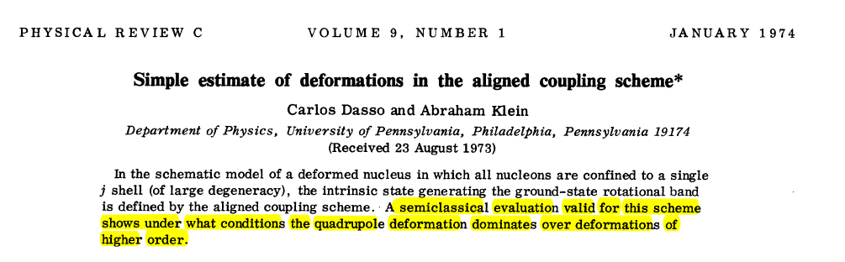

Slide 8
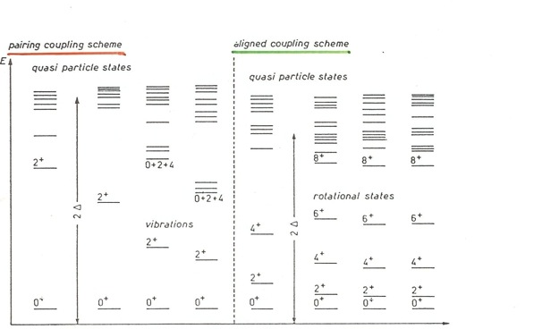
and
N
N*

Slide 9
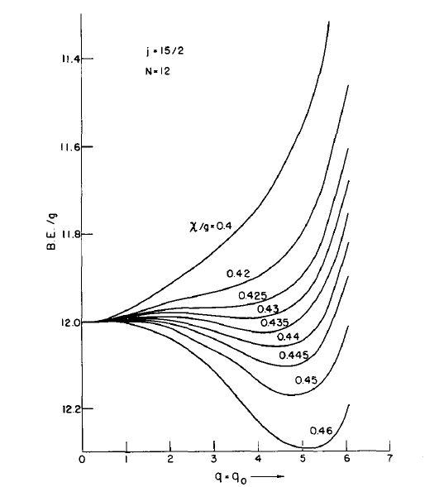
M. Baranger and Krishna Kumar, Nulc. Phys. 62 (1965) 113.
Quadrupole/Pairing

Slide 10
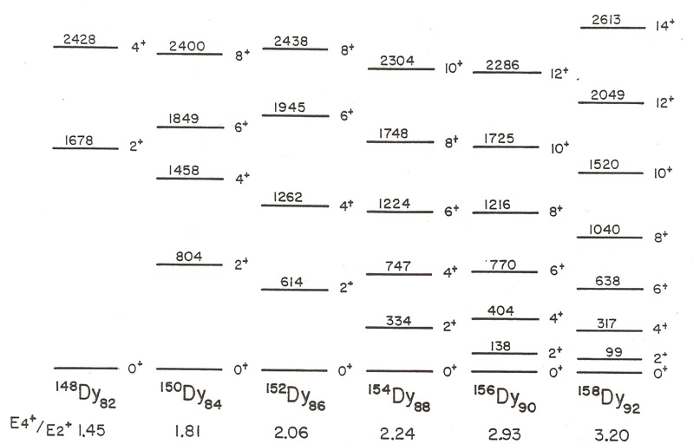

Slide 11
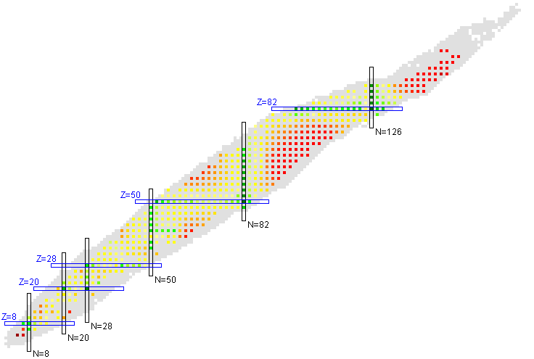

Major ingredient is V_{πν}
Scaling of nuclei properties with N_{n}N_{p}
Federman, Pittel, Phys. Rev. C 20, 820–829 (1979)
I. Hamamoto, Nucl. Phys. 73 (1965) 225.
R. Casten, Phys. Lett. 152B (1985) 145.

Slide 12
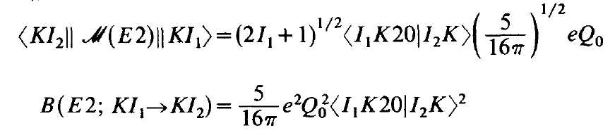
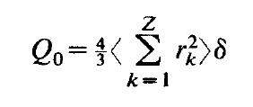
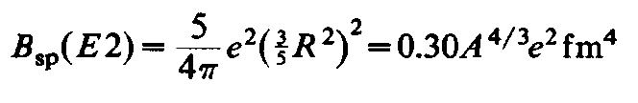

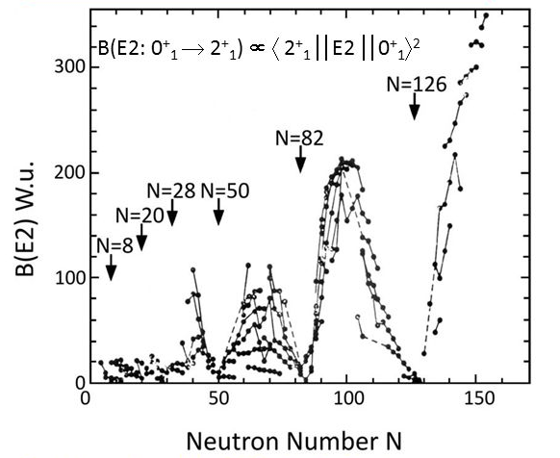
E2 Transition Probabilities

Slide 13
R_{4/2}= ~2.0
vibrations
rotations
V(β)
N
β
β₀
R_{4/2}= 3.33

Slide 14
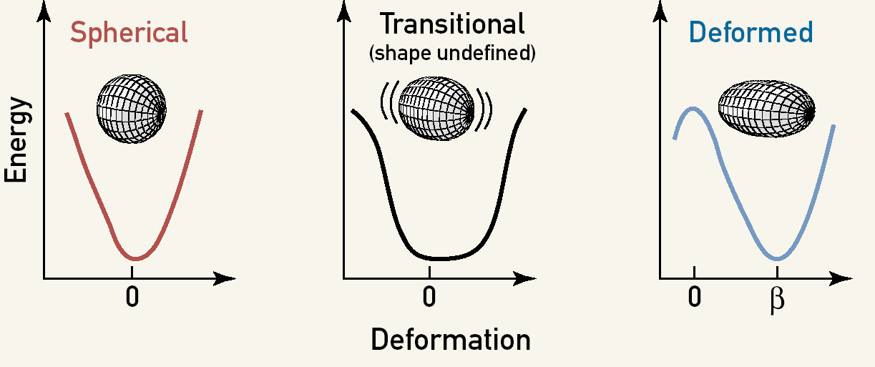
Critical-Point Descriptions of Shape Transitions
F. Iachello, Phys. Rev. Lett. 85 (2000) 3580, Phys. Rev. Lett. 87 (2001) 052502.
Solve using an approximation to the “true” potential V(β,γ)

Slide 15
The Analogy of the Collective Model for Shapes and Pairing
(R.A. Broglia, O. Hansen, C. Riedel, Adv. Nucl. Phys. 6 (1973) 287)
Shape Transitions
Pairing Transitions
R(θ)=exp(−iIθ)
G(φ)=exp(−iNφ)
Angular Momentum, I
Particle Number, N
Z
Z
G(φ)
R(θ)
θ
φ
Z'
Z'
Pair deformation, α
Gauge angle, φ
β, γ, Euler angles θ
Violation of spherical symmetry
Violation of particle number
Physical space
Abstract “gauge” space

Slide 16
“Control parameter X”
vibrations
rotations
V
X<1
X>1
α₀∼ Ω
Deformation of the pair-field

Slide 17
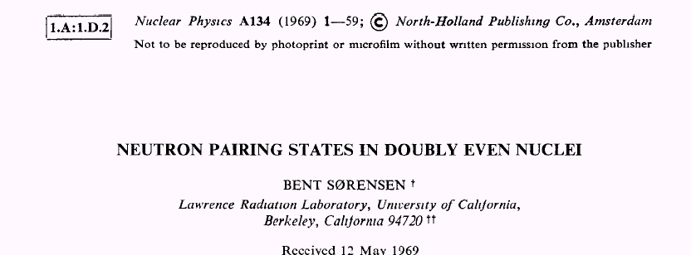
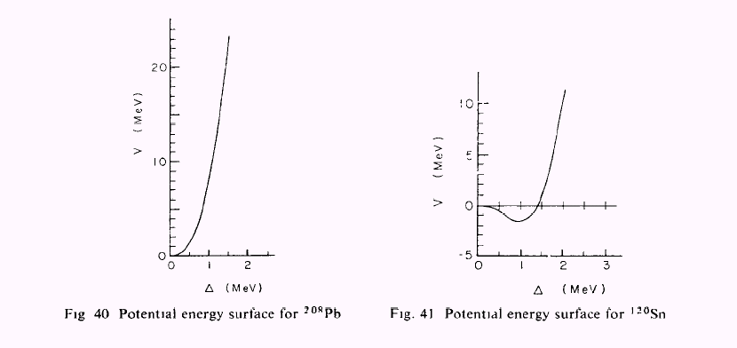
“Realistic” potentials

Slide 18
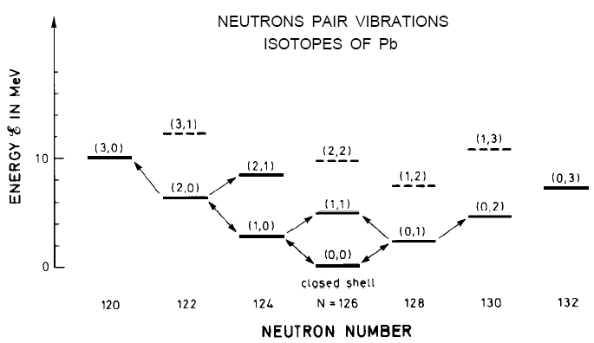
Pair-Vibrational Structures
(Nobel Lecture, Ben R. Mottelson, 1975 “Elementary Modes of Excitation in the Nucleus”)
Near closed shell nuclei (like ²⁰⁸Pb) no static deformation of pair field.
Corresponds to the “normal” nuclear limit.
Fluctuations give rise to a vibrational-like excitation spectrum.
Large anharmonicities in spectrum must be accounted for.
⇨

Slide 19
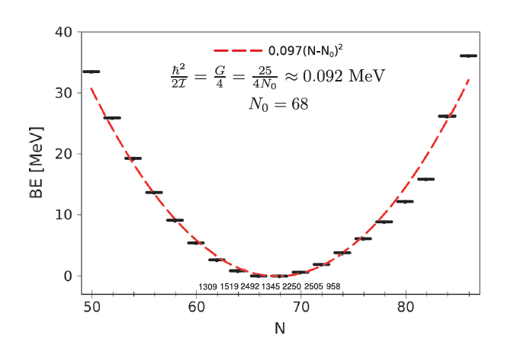

Pair-Rotational Structures

Slide 20
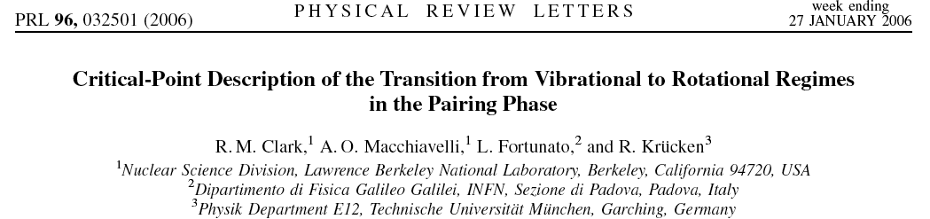
Critical-Point Descriptions of Shape Transitions
F. Iachello, Phys. Rev. Lett. 85 (2000) 3580, Phys. Rev. Lett. 87 (2001) 052502.
The Collective Pairing Hamiltonian
D.R. Bès, R.A. Broglia, R.P.J. Perazzo, K. Kumar, Nucl. Phys. A 143 (1970) 1.
α is the deformation of the pair field (can be related to the gap parameter, Δ).
B is a mass parameter. M=(A-A₀) (number of particles, A, relative to reference, A₀).
V(α) is the potential.

Slide 21
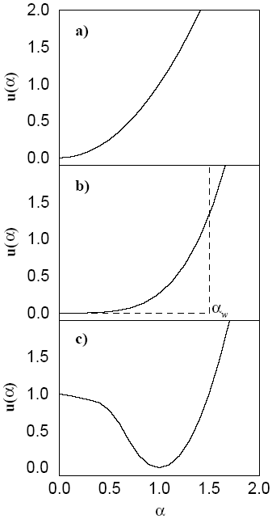
Approximations to the potential
Vibrational Limit
(“Normal”)
Transitional
(“Critical-Point”)
Rotational Limit
(“Superconducting”)

Slide 22
The Critical-Point
Use infinite square-well as approximation to potential:
One obtains a Bessel equation:
where,
Boundary condition
determines eigenenfunctions:
Normalization constant
Bessel function of integer order
With associated eigenvalues:
Where x_{ξ,M} is the ξ^{th} zero of the Bessel function J_{M/2}(z).

Slide 23
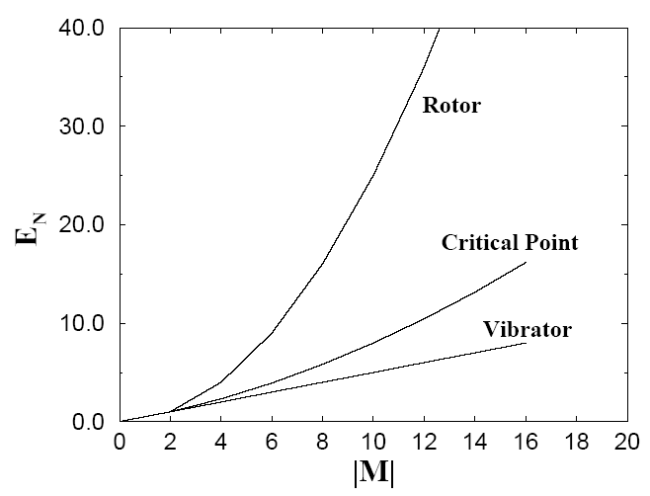
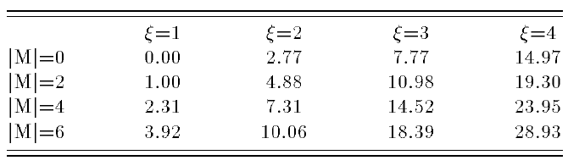
The Reduced Energy Spectrum
Normalizing energies of excited states to that of the first excited state:
ξ=1 sequence of states correspond empirically to the sequence formed by the
0⁺ ground-states of neighboring even-even nuclei along isotopic or isotonic chain.
ξ=1 sequence of states follows behavior between the linear dependence of a
harmonic vibrator and the parabolic dependence of a deformed rotor, as expected.
ξ>1 correspond to excited 0⁺ states formed from pair excitations.

Slide 24
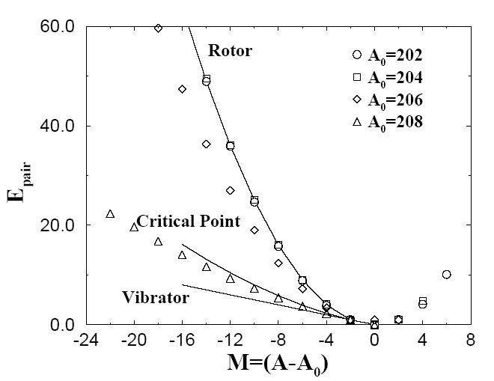
Comparison with Data
Empirical neutron pairing energy defined as:
is difference in mass excess between isotope of mass A and reference
nucleus of mass A₀ (G. Audi et al., Nucl. Phys. A 729 (2003) 337)
Only a few nucleons outside of the closed shell are required for a static pair deformation
(“superconductivity”) and pair rotational sequences develop.

Slide 25
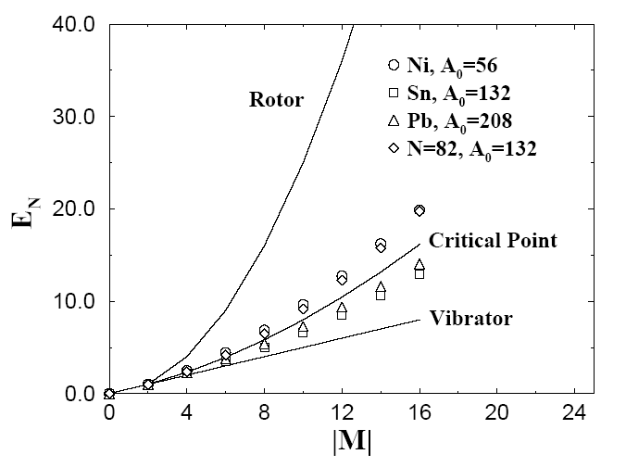
“Pair-Vibrational” Structures Near Doubly Magic Nuclei
General feature that all pairing sequences based on doubly magic nuclei display
large anharmonicities → much closer to “critical-point” description.
Flat-bottomed potential may provide better description of these sequences.

Slide 27
A comment on anharmonicities
From Bohr & Mottelson Vol. II pag. 646
Our simple estimate is

Slide 28
Solutions of the Bohr Hamiltonian and the Casten Triangle
Symmetric
Rotor
SU(3)
X(5)
Harmonic
Vibrator
γ-Soft
Rotor
U(5)
E(5)
O(6)
Following Iachello (Phys. Rev. Lett. 87 (2001) 052502), the square-well approximation of the transition from U(n) to SO(n+1), with n≥2, has an E(n) Euclidean group dynamic symmetry.
For the pairing phase transition n=2 ( gauge angle, φ, and pair deformation, α)
CMFK SEGMENT !
U(2) E(2) SO(3)

Slide 29
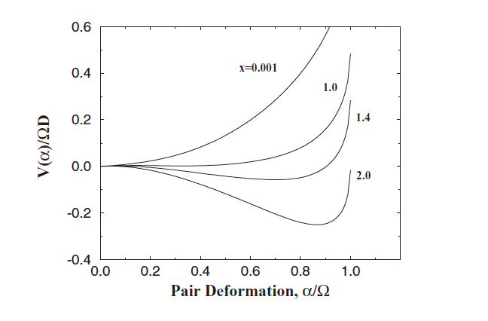
Two j-shells
Potentials

Slide 30
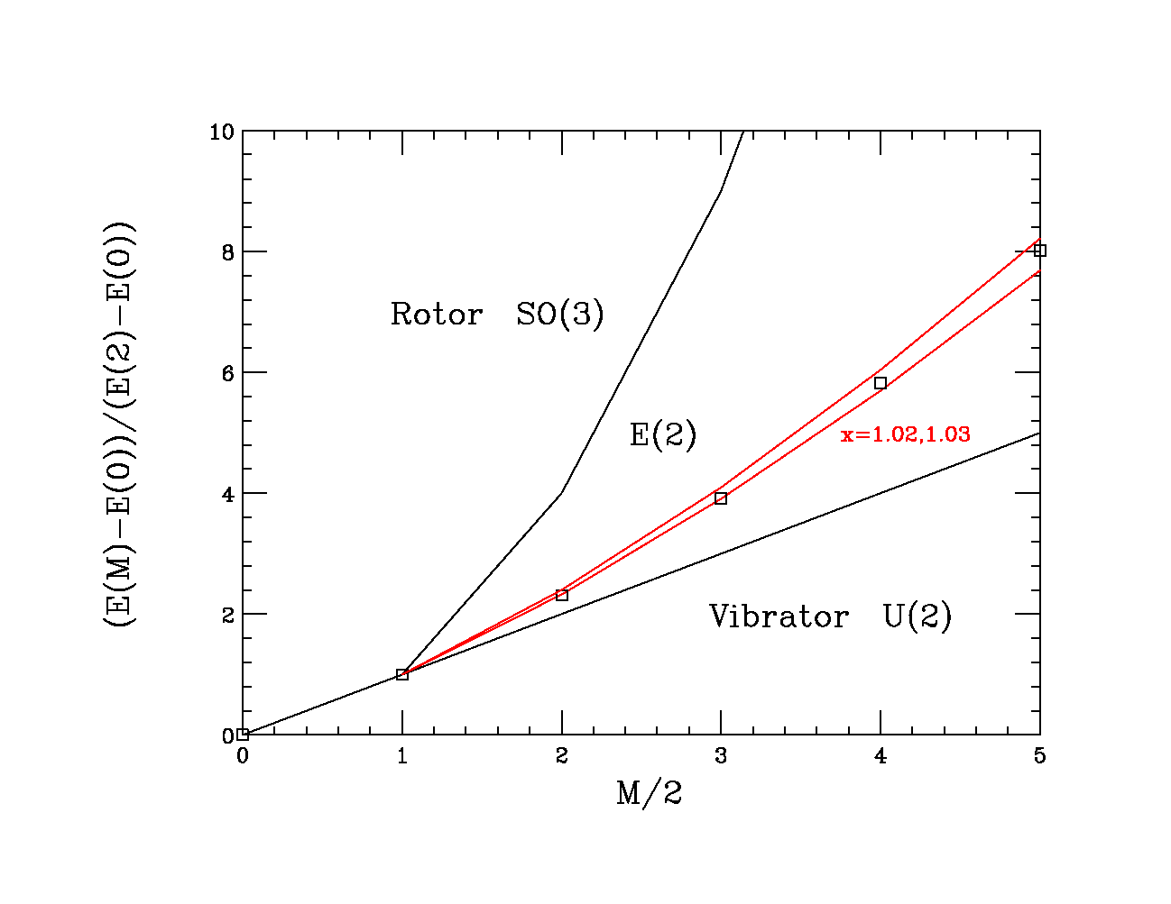
Two j-shells
Energies
X→∞
X~0

Slide 31
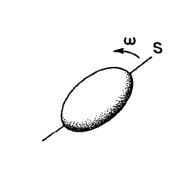
Nuclear Rotation
I
The nucleus rotates as a whole
(collective degrees of freedom)
Lab
Intrinsic
The nucleons move independently
in the deformed potential
(intrinsic degrees of freedom)
The nucleonic motion is much faster than the rotation (adiabatic approximation)

Slide 32

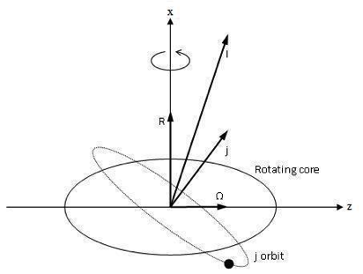
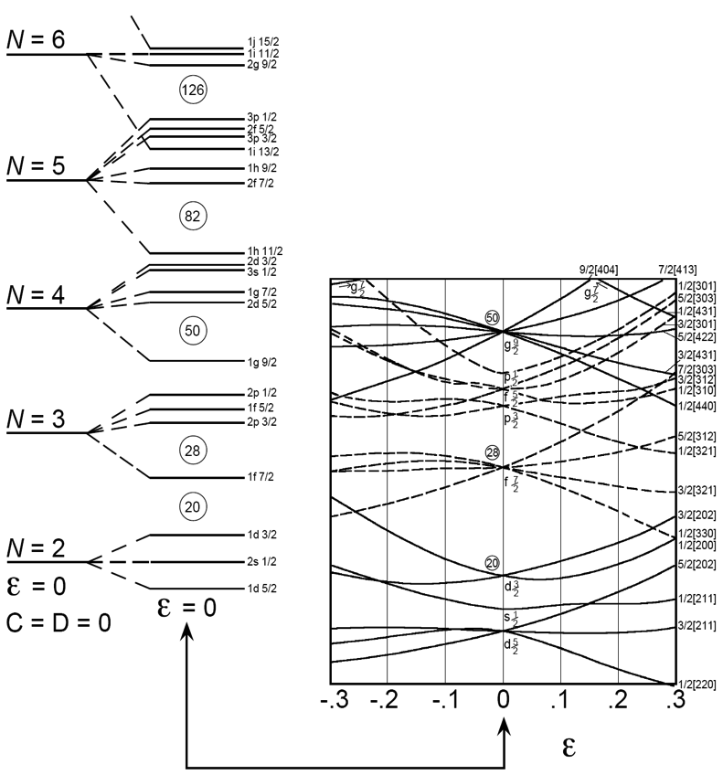
Nilsson Diagram
Each spherical level labeled
by N, j, l at ε=0, is split into
(2j+1)/2 levels with
Nilsson levels are labeled:
[Nn₃Λ]Ω^{π}
Deformed Mean Field

Slide 33
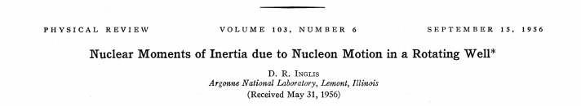
Lab
Intrinsic
Correlated two particle states have much less angular momentum than the corresponding free particle motion ➔ quasi-particles

Slide 34
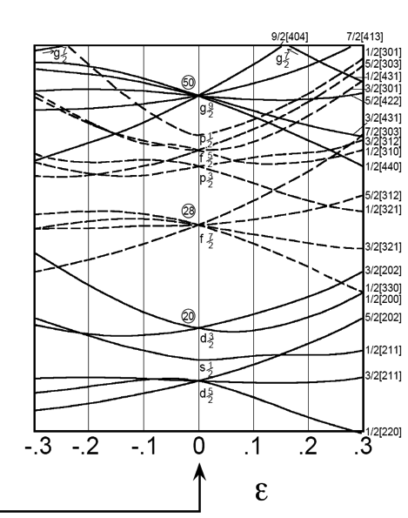
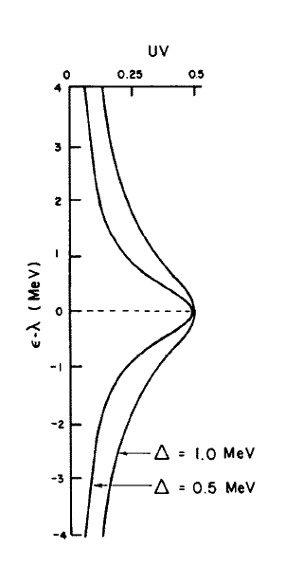

Slide 35
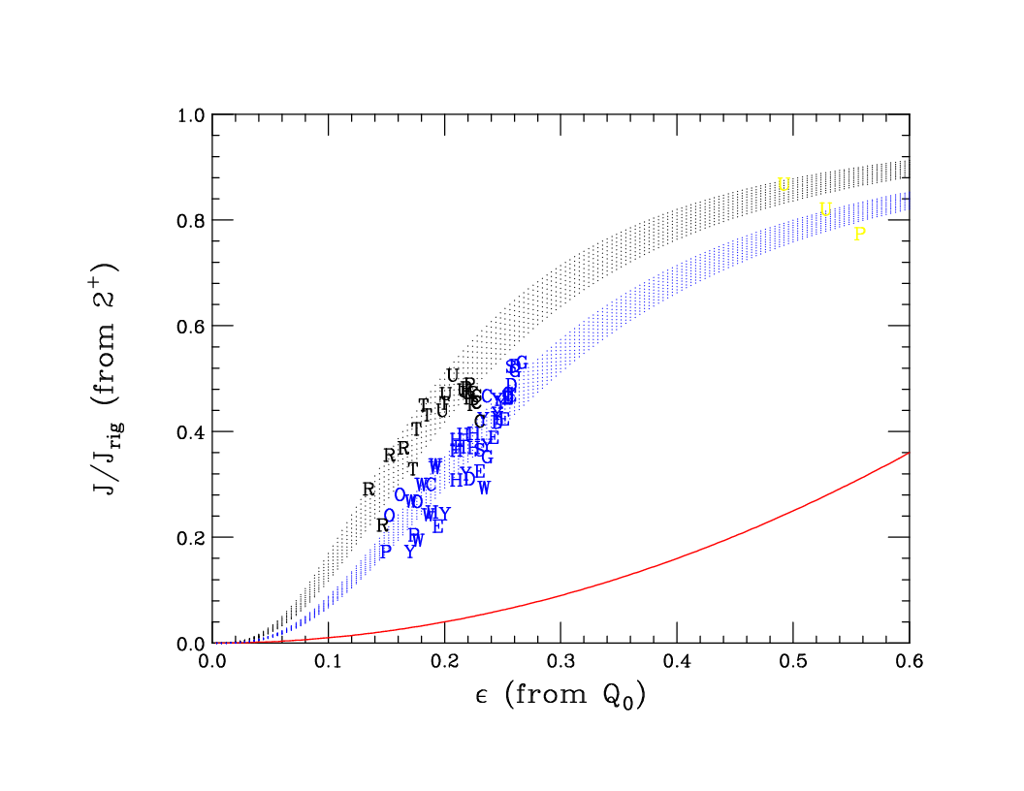
A. B. Migdal, Nucl. Phys. 13 655, (1959).
Irrotational flow

Slide 36
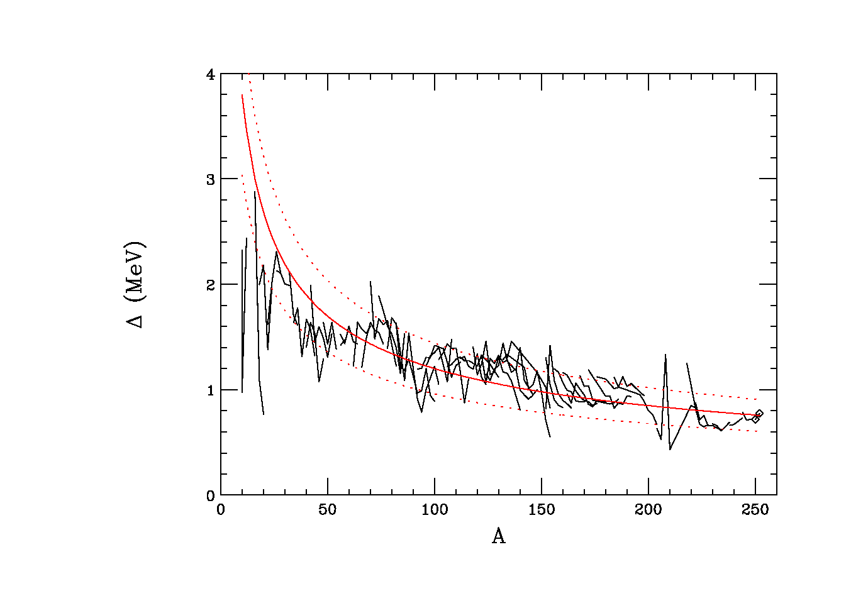
Pair gaps from rotational properties
12 A^{-1/2}

Slide 37
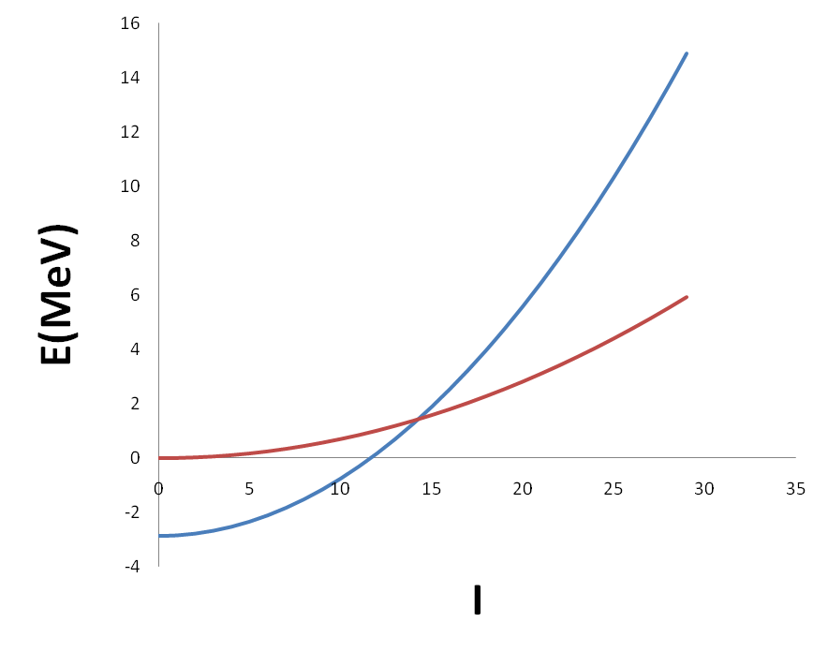
Quenching of Pairing correlations?
B. R. Mottelson and J. G. Valatin, Phys. Rev. Lett. 5, 511 (1960).

Slide 38
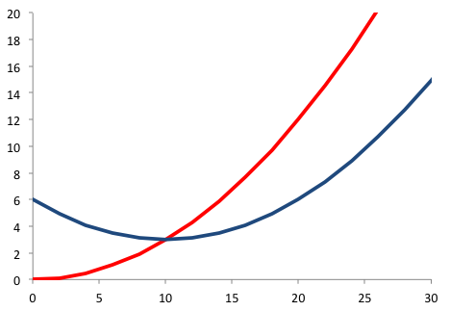
Coriolis effects
jΙ/J ∼ 2Δ
E(MeV)
I
I
F. S. Stephens and R. S. Simon, Nucl. Phys. A183,257 (1972).

Slide 39
Cranking Analysis Dictionary:
Angular momentum and moments of inertia as functions of the rotational frequency

Slide 40
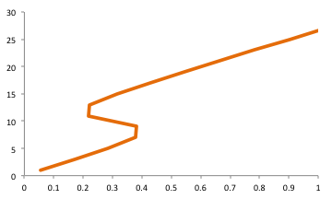
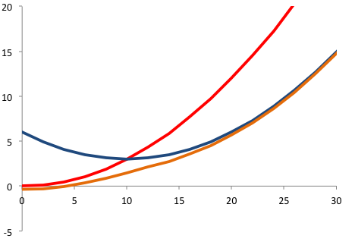
E(I)
Problem #6

Slide 41
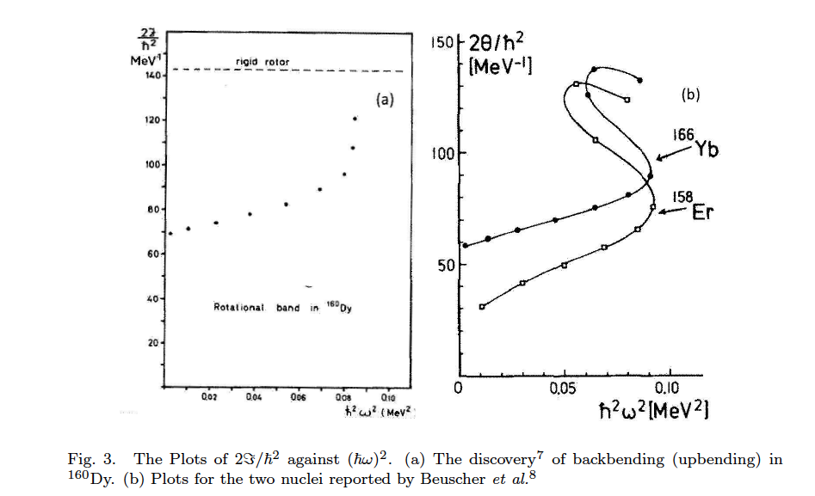
Johnson, H. Ryde, and J. Sztarkier, Phys. Lett. B34, 605{608 (1971).
H. Beuscher, W. F. Davidson, R. M. Lieder, C. Mayer-Boricke, Phys. Lett. B40, 442-447 (1972).

Slide 42
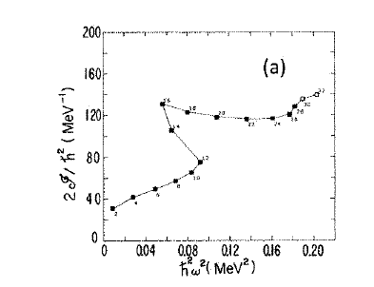
2nd Backbending (alignment) ….
I.Y. Lee, et al., Phys. Rev. Lett. 38, 1454{1457 (1977)

Slide 43
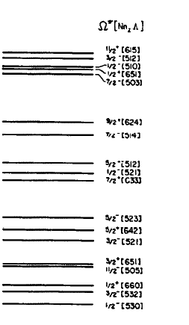
Blocking
✖
✖

Slide 44
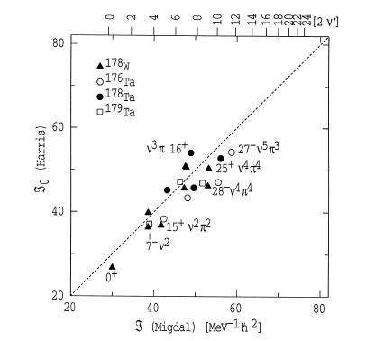
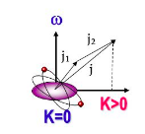
High-K Isomers
G. D. Dracoulis, F. G. Kondev and P. M. Walker,
Phys. Lett. B419, 713 (1997).

