Slide 1



Nuclear Reactions: a tool to study nuclear matter
Fabiana Gramegna
Laboratori Nazionali di Legnaro
Selected Topics in Nuclear and Atomic Physics 2019
30 September - 4 October 2019
Fiera di Primiero (TN)

Slide 2

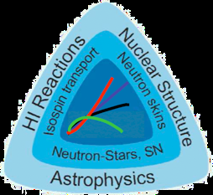
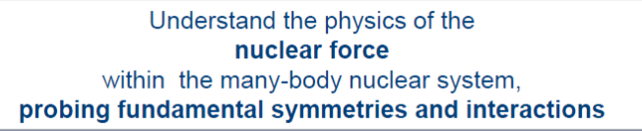
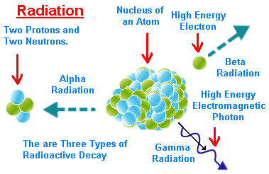
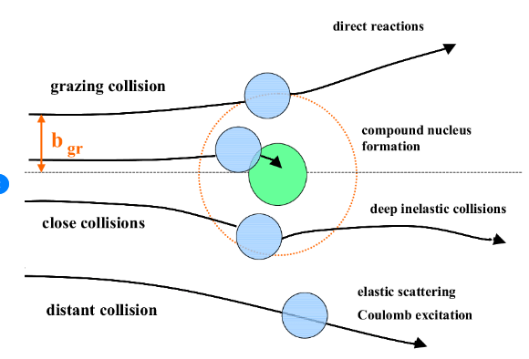
Nuclear Reactions: a tool to study nuclear matter
In order to study nuclear properties, beside radioactive decay a further tool is given by nuclear reactions, which induce enhanced effects in the behavior of the nuclear system: the induced variations can, therefore, be studied, trying to get back as much as possible detailed information on nuclear matter behavior, structure and composition.
We can distinguish mainly two items:
Using nuclear reactions as a tool to populate excited nuclei so to study the properties of the system through its decay to the fundamental state;
Studying nuclear reactions themselves to understand the interplay between different mechanisms which may compete as a function of different parameters in the entrance channel (energy, mass asymmetry, centrality, mass of the involved partners etc.) to get information on the gross properties of nuclear matter like its viscosity and its behavior as a function of the Temperature, Excitation Energy, Density, Angular Momentum, Isospin. In particular conditions of energy and colliding partners information on the Nuclear Equation of State can be inferred, with a great interest in the symmetry term of that equation.

Slide 3
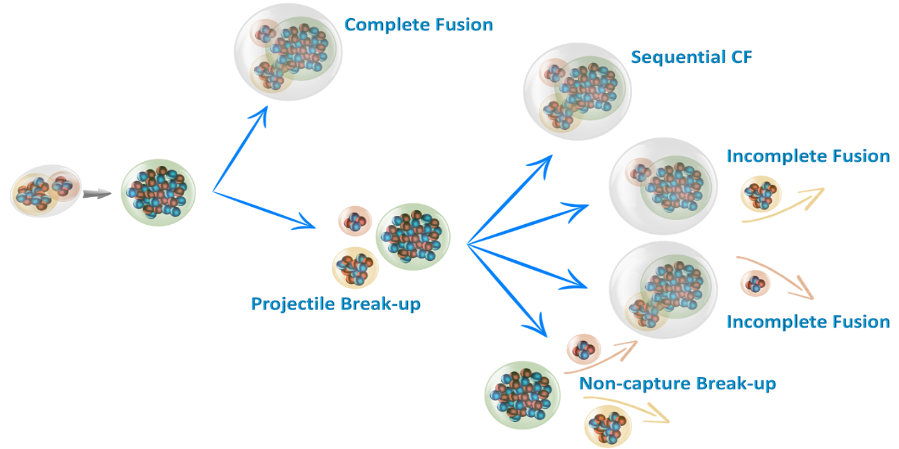
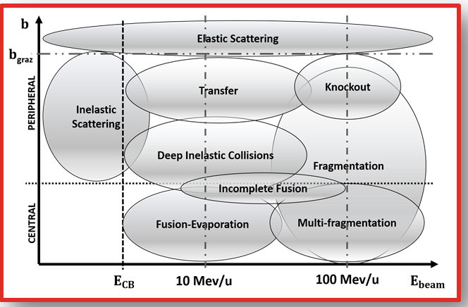
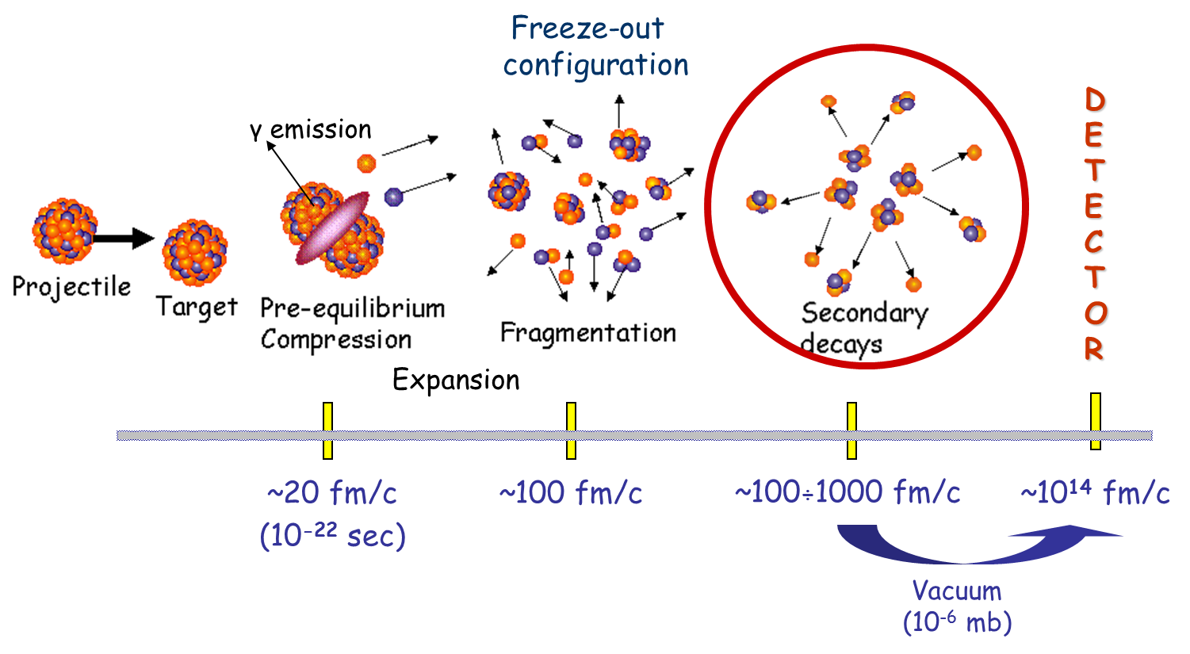
Nuclear Reactions: a tool to study nuclear matter
The complexity grows up with the energy up to the region when the competition between mean field properties and nucleon-nucleon scattering become important → Fermi energies
It is important to clarify and understand nuclear reaction mechanisms, which is a transition of quantum many-body system from initial state to final state. How quantum many-body system scatters? Which channels are essential? What kind of interactions cause the nuclear reaction?
Liquid –gas Phase Transiton

Slide 4
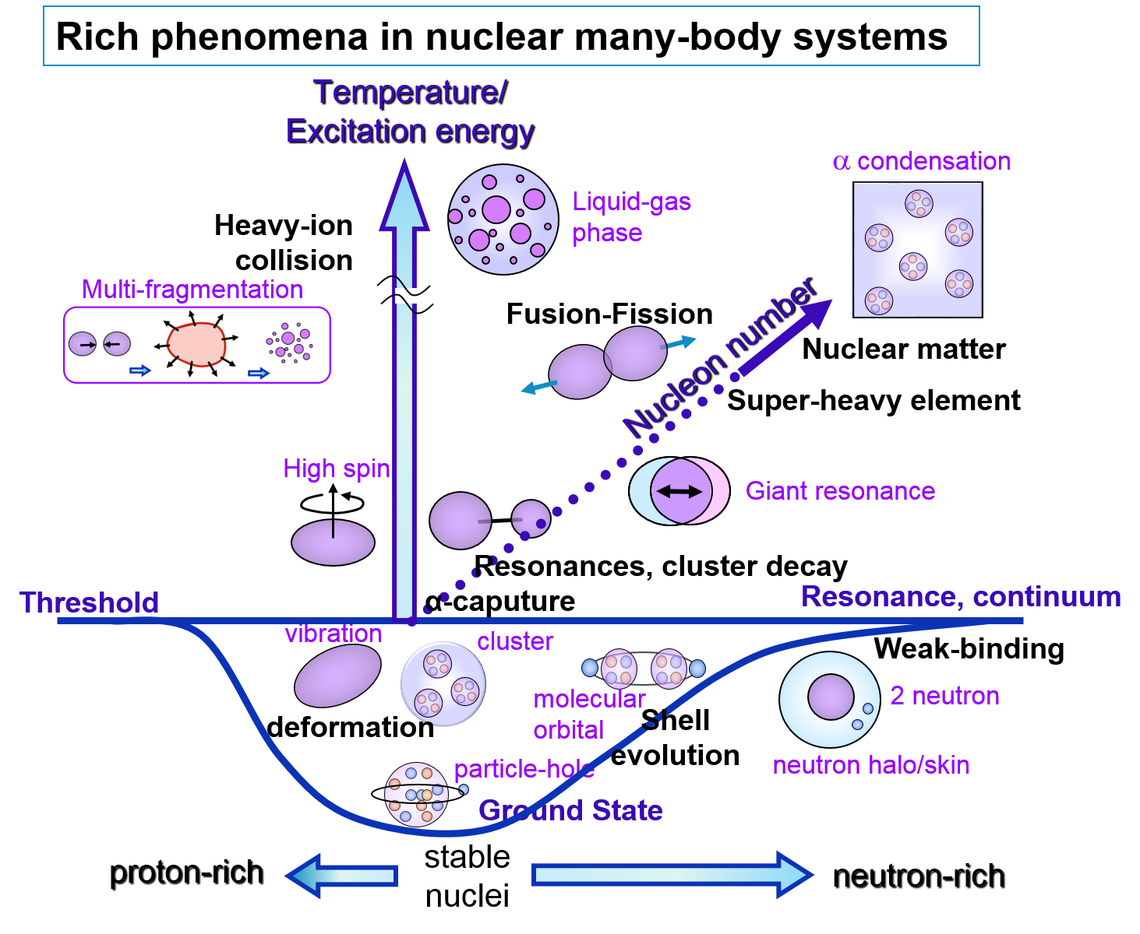
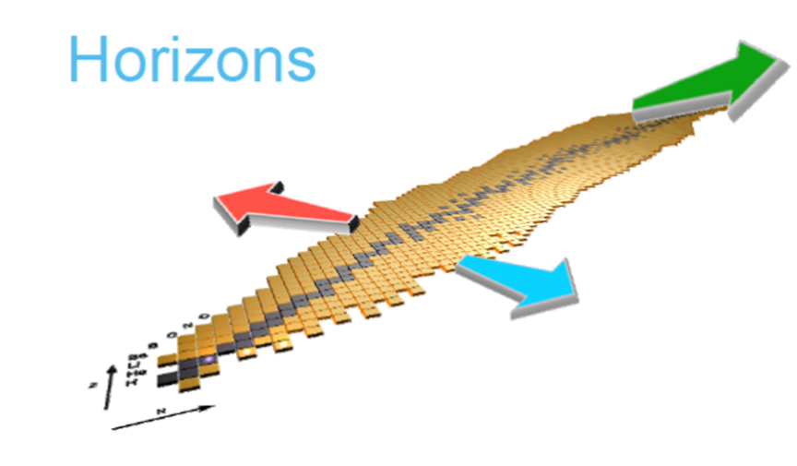
Nuclear Reactions: a tool to study nuclear matter
Which information from nuclear reactions from low to Fermi energies?
Can we understand the behavior of nuclear matter in different phases?
Energy dissipation
Viscosity
Nuclear Structure
Collective modes
Clustering
Level density
Excitation Energy
Angular Momentum
Isospin
Timing of processes
Nuclear Equation of State
Liquid gas phase transition
Symmetry energy
Isospin drift/isospin distillation
Limiting Temperature
Compressibility
Time competition
Y. Kanada‐En’yo, International School of Physics "Enrico Fermi“, course 201 (Nuclear Physics with Stable and Radioactive Beams), 14-19 July 2017

Slide 5
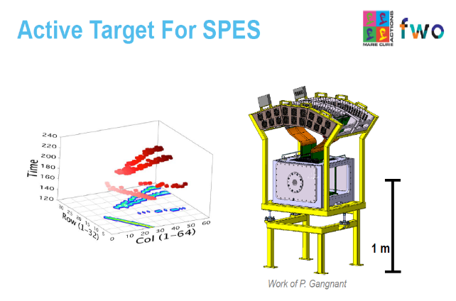
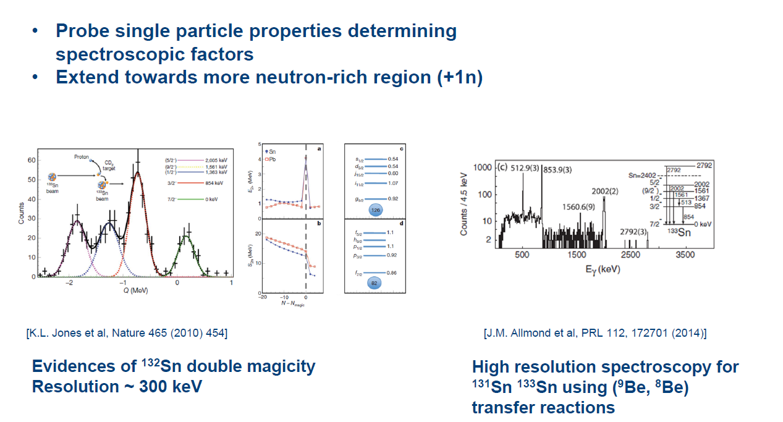
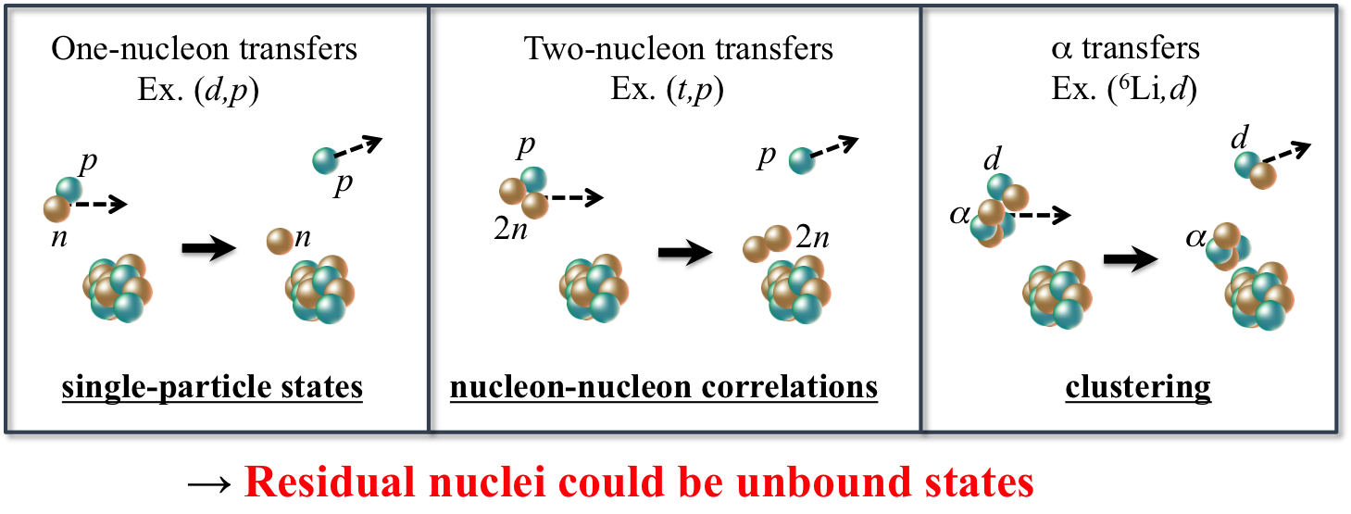
Nuclear Reactions: Direct reactions
The importance of peripheral reactions → a direct tool to study important characteristics of nuclei.
In particular they can be a mean to probe single –particle excitation and even to produce and study new states of nuclear matter.
Finite quantum many-nucleon system, which has no bound states (unbound nuclei), or which populates beyond the particle threshold (unbound-excited states) can be observed as resonance states induced by a dynamical process. Those unbound states may extend a concept of presence of nuclei or have new structure.
Direct reactions can give a straight information on the transferred angular momentum (angular distribution of the outgoing particles), on the Spectroscopic Factor (which is a measure of the overlap between the initial and final state in the reaction channel)
Inverse kinematics with RIBS

Slide 6
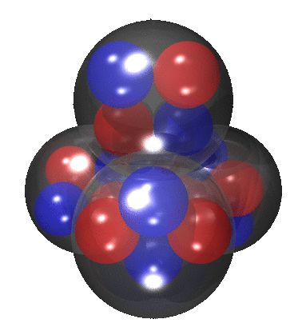
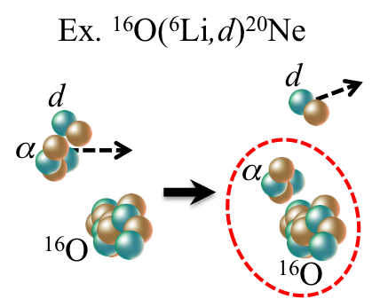
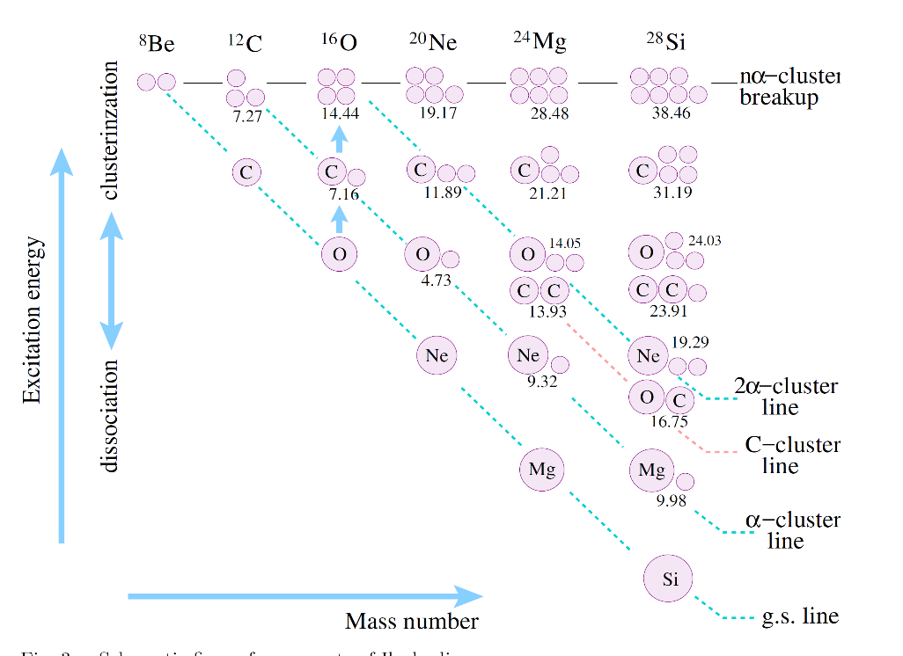
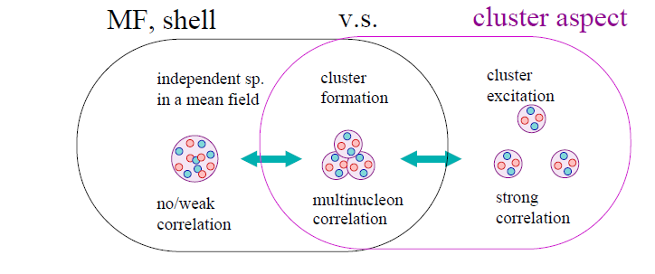
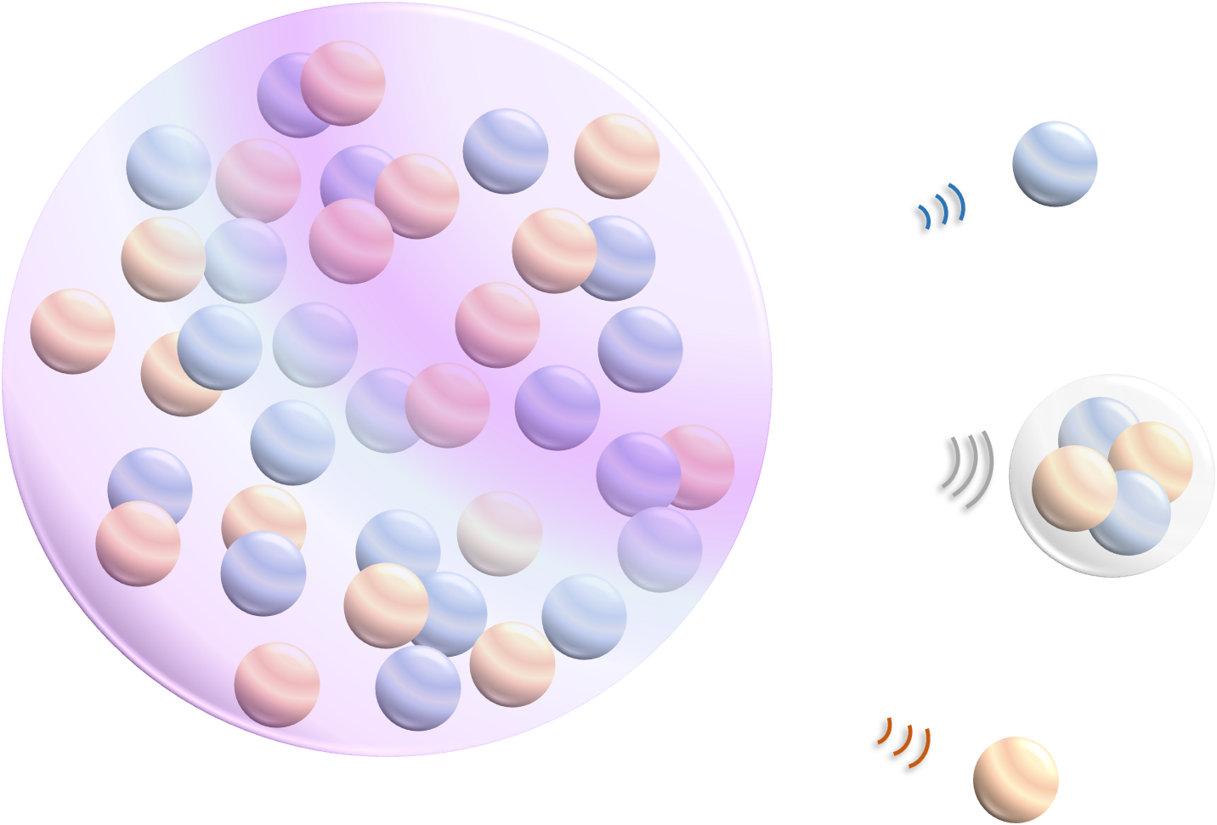
Nuclear Reactions: clustering
Among the interesting aspects of nuclear matter is the competition between mean fields aspects and the possibility of cluster states.
Light Nuclei
Coexistence of cluster and mean-fields aspects:
connection between cluster emission and nuclear structure.
The cluster structure develops on the peripheral region of wave functions. It will contribute on transfer reactions dominantly.
Medium Mass Nuclei
Clustering effects on reaction dynamics can be observed. Are they due to cluster pre-formation either in the colliding partners or in the CN* or do they derive by a dynamical formation.
Y. Kanada‐En’yo, International School of Physics "Enrico Fermi“, course 201 (Nuclear Physics with Stable and Radioactive Beams), 14-19 July 2017
Analizying the competition of CF with fast processes →
Thermal vs pre-equilibrium particles emission
Studying the competition between evaporation (surface) and fast (volume) emission of LCP.

Slide 7
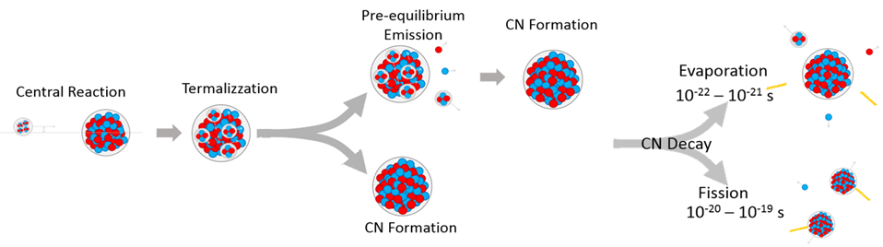
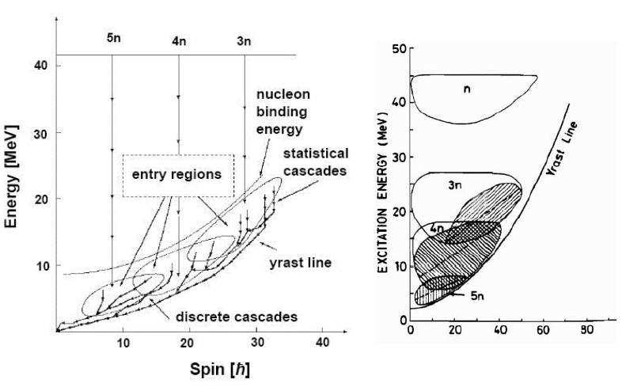
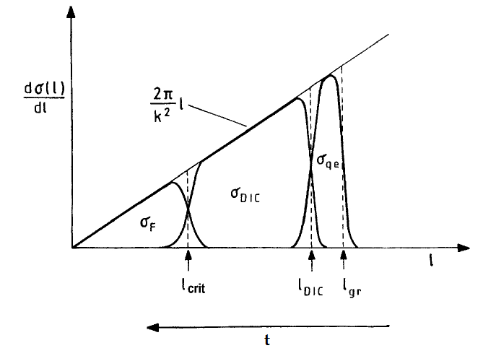
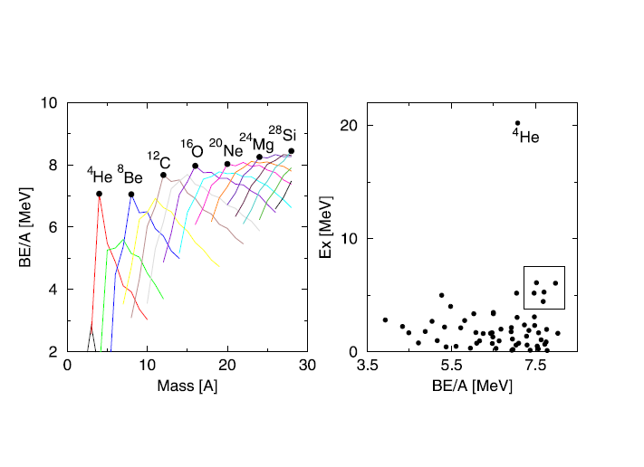
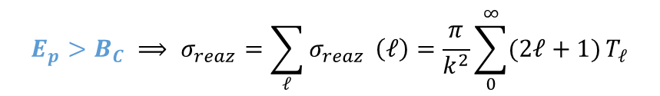

Nuclear Reactions: central collisions – at low energy & structure effects
At low energy “Complete Fusion (CF)” is the dominating mode for central collisions.
$$E_{p}>B_{C} ⟹ σ_{reaz}=\sum_{ℓ}{σ_{reaz}} \left(ℓ\right)=\frac{π}{k^{2}}\sum_{0}^{∞}{(2ℓ+1)}T_{ℓ}$$
What happen when these nuclei interacts ?
α-particle nuclei
Possible clusters:
¹²C, ¹⁴C, ¹⁴O, ¹⁵N, ¹⁶O
$$l_{evap}$$

Slide 8
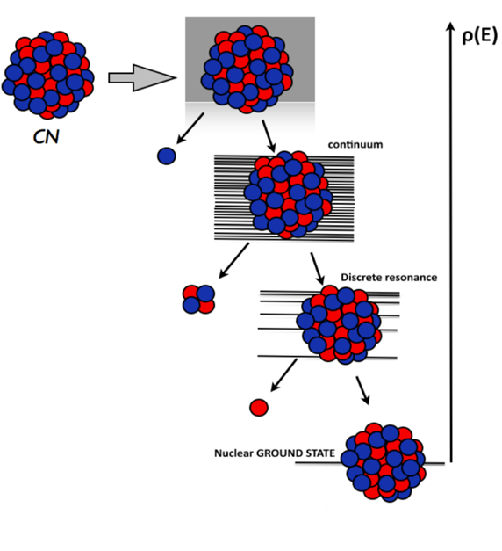
Nuclear Reactions: central collisions – at low energy & structure effects
Parent nucleus A,Z, J, E*)
Entrance channel effects in heavy ion induced central collisions: asymmetry, structure effects.
Bohr hypothesis and dynamical effects
Inclusive data and correlations
Decay from the continuum
Hot light nuclei (E*~3 A.MeV) → produced in multi-fragmentation in a wide range of N/Z → TRACING BACK → access to the symmetry energy term in the NEOS
Limiting Temperature
only access to Level densities above the thresholds for particle decay via evaporation reactions (compound nucleus decay theory) → decreasing of NLD as a function of increasing N-Z
mainly inclusive experiments → lack of complete studies on the evaporation from light nuclei especially in the mass region A~20
Some excited states of different nuclei in this mass region are known to present pronounced clustered structures → persistence of α-structure at high excitation?
Medium light nuclei → studying the competition between fast and thermal emission from a hot source→ pre-equilibrium processes → cluster emission→ link to structure effects or dynamical formation?
Daughter nucleus
A_{d},Z_{d}, J_{d}, E*_{d})
Decay from Discrete resonance
Theory: decay codes constrained to available data
Compound Nucleus formation and decay
Level Density for A ~ 20, e* ~ 3 A. MeV
Monte Carlo Hauser-Feshbach (HFl)
excited states from the online archive NUDAT2

Slide 9
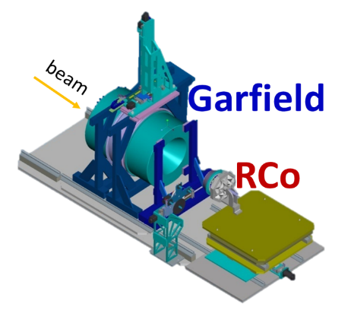
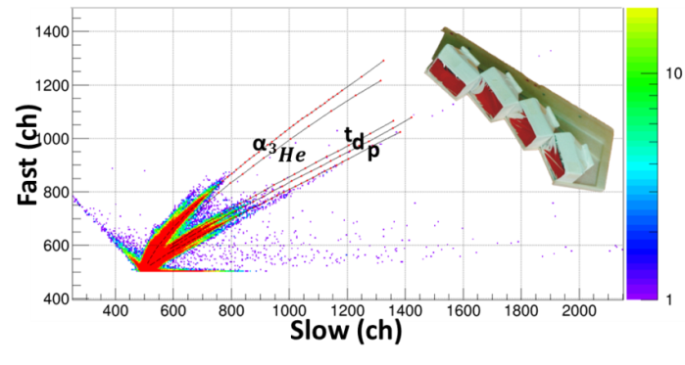
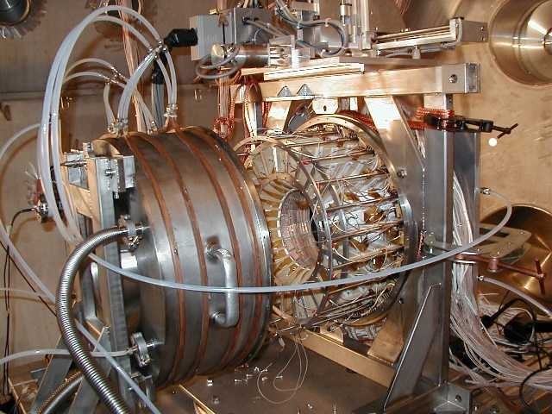
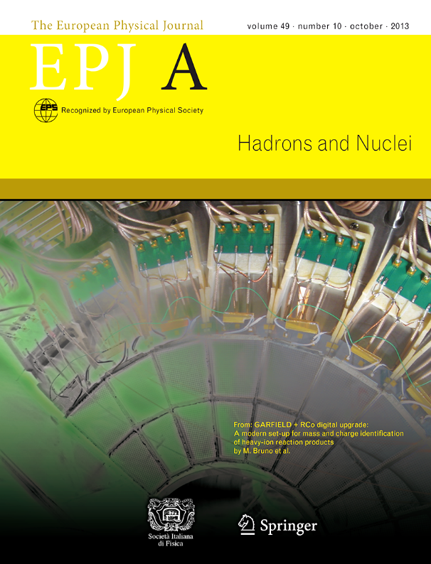
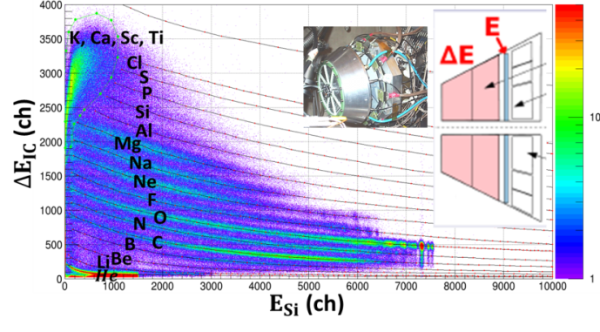
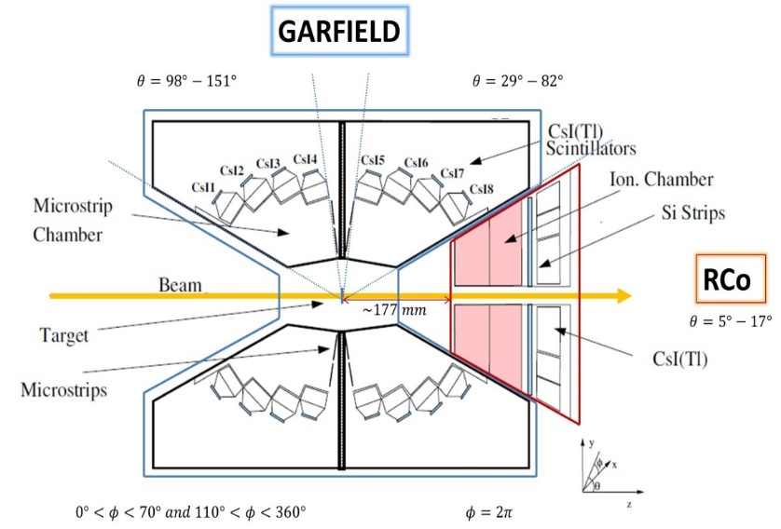
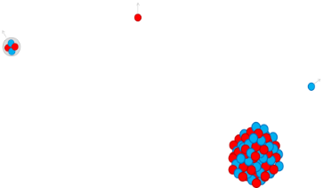
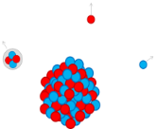





Nuclear Reactions: the importance of the experimental set-up
GARFIELD
μSGC + CsI(Tl), 180 CsI
detection of LCP and fragments:
low identification thresholds (0.8–1MeV/u)
angular coverage 30º<θ_{lab}<150º 24 azimuthal sector
Z identication, A identication for 1 ≤ Z ≤ 3
LCP identification
EXP: highly exclusive detection NUCL-EX collaboration campaign:
STATistical properties of LIGHT nuclei from Fus-Evap.
GARFIELD+RCo @ LNL
low multiplicity evts. & high detection coverage
high energy and angular resolution
complete evt. Reconstruction
global control on the decay mechanism
RCo
IC+Si+CsI(Tl), 64 telescopes
detection of ER, LCP, QP
low E thresholds (~1MeV/n)
high granularity and θ-resolution: 0.8º for 5º<θ_{lab}<17º
energy resolution of Si strips 0.3%
energy resolution CsI(Tl) 2-3%
RESIDUE identification
GArFIELD + RCo
GARFIELD + RCo digital upgrade…
M. Bruno, F. Gramegna et al.
Eur. Phys. J. A (2013) 49: 128
Three stage telescope: IC + Si Strip + CsI(Tl)

Slide 10
Nuclear Reactions: the ¹²C+¹²C reaction @ 95 MeV
Two event selections:
central & peripheral collisions
Courtesy of L. Morelli
Complete events
Dedicated HFl calculation for ²⁴Mg (E* = 62 MeV) decay → comparison to EXP DATA
good reproduction of global variables (Y(Z), multiplicities
... but for certain channels 3α-4α light ER missing yield in model prediction → underestimation of Z=6 yield))
energy spectra and angular distributions of protons and alpha particles in coincidence with a residue:
OK for protons; discrepancies for α (excess at backward angles)
largest discrepancy for α-particles measured in coincidence with Z_{ER}=8
From calorimetry → discrepancy in the 2α+xn channels with respect to the 1α+2H+xn channels (1H → Z=1)
¹²C excited state
uncomplete events – no ER detected
Z_{ER}=5
Z_{ER}=6
Z_{ER}=7
Z_{ER}=8
Z_{ER}=9
Z_{ER}=10
Simulation: vs experiment:
Underestimation of Z=4 & Z=6 in the Z distribution
Underestimation of 2α channel & larger multplicities.
Overestimating of channel with zero α emitted.
Predicted sequential 6α channel
Oxygen + 2α + xn channel
exp
HFl
Q>
Q<
Q>
Q<
L. Morelli et al. J.Phys.G 41 (2014) 075107
L. Morelli et al. J.Phys.G 41 (2014) 075108

Slide 11
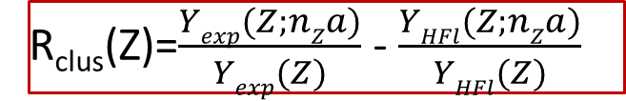
Nuclear Reactions: comparing entrance channels
¹²C+¹²C vs ¹⁴N +¹⁰B
Channels with maximum α multiplicity for each residue
C+C
N+B
Zres | channel | B.R._{exp} (C+C) | B.R._{exp} (C+C) | B.R. _{exp} (N+B) | B.R._{exp} (N+B)
6 8 10 | C+3α+xn O+2α+xn Ne+α+xn | 98% 63% 26% | 78% 15% 3% | 96% 56% 47% | 77% 15% 3%
B + 3α + p
C + 3α + xn
N + 2α + p +xn
Yield (a.u.)
C+C
N+B
O + 2α + xn
F + α + p +xn
Ne + α + xn
Q_{kin} MeV
channels with Carbon, Oxygen and Neon residues show a preferential α decay.
residual α − structure correlations in the excited ²⁴Mg or in its daughter nucleus.
Common pattern for the Q_{kin}-value
Difference in the relative Q>/< population
Entrance channel effects confirmed
Full line total events
Dotted line more dissipative events
R_{clus}(Z)=$\frac{Yexp(Z;nZa)}{Yexp(Z)}$ - $\frac{YHFl(Z;nZa)}{YHFl(Z)}$
Partial contribution of direct reaction in the C+C case in the ^{A}O+2α channel → reduction of the difference in B.R. → however still a not negligible difference remain with respect to pure statistical decay
Y(Z; n_{Z}α) coincidence yields
Y(Z) inclusive yields
n_{Z} -> maximum α multiplicity associated to the residue of charge Z
Courtesy of L. Morelli

Slide 12
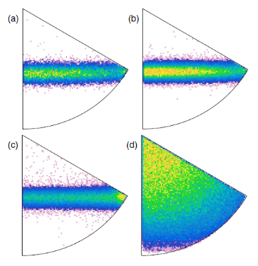
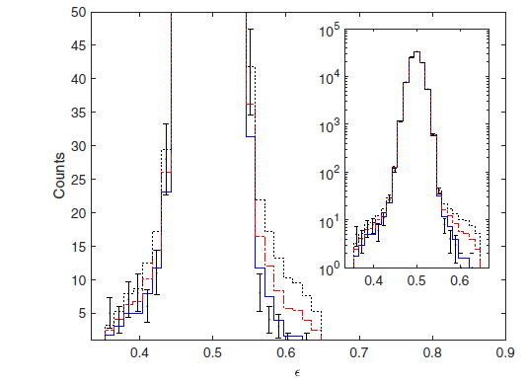
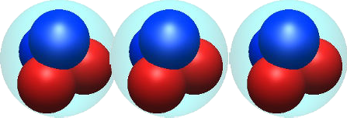

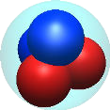
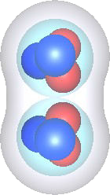
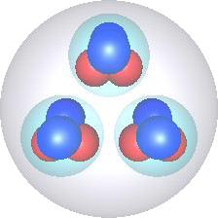
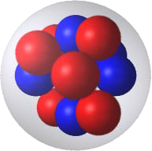
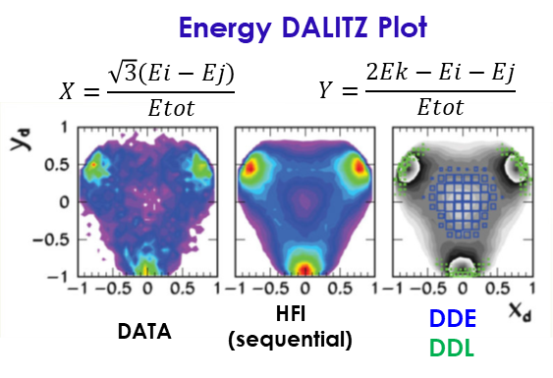
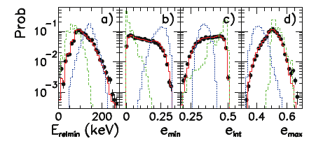
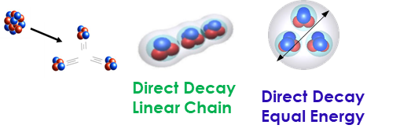
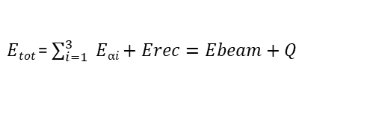
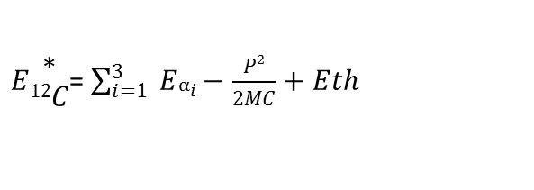
Nuclear Reactions: Hoyle State in ¹²C + ¹²C reaction
Total Energy Spectrum
¹²C Excitation Energy Spectrum
R, Smith et al. PRL119(2017) 132502
$Etot$ = $\sum_{i=1}^{3}{ Eαi+Erec=Ebeam+Q}$
$E\begin{matrix}∗ \\ 12C\end{matrix}$= $\sum_{i=1}^{3}{ Eαi−\frac{P2}{2MC}+Eth}$
9.64 MeV 3⁻
Recoil ¹²C in G.S.
7.65 MeV 0⁺
Hoyle state
S-orbit
10.84 MeV 1⁻
Reject direct decay of the Hoyle state → DDΦ < 0,047%,
DDE<0.026%, DDL<0.004%
Decay of ¹²C* quasi-projectile (peripheral collisions) and ¹²C* in the ²⁴Mg* decay (central collisions → comb. 3α over the 6α – minimum Excitation Energy in 12C*)
Compatibility with sequential decay
¹²C*→⁸Be+ α → α+α+α described by a dedicated Hauser-Feshbach prediction (HFl)
Negligible contribution of direct ¹²C* -> α+α+α decay
1.1% ± 0.8% (DDL) – 0.02% upper limit DDE
γ
⁸Be
¹²C*(0⁺ or 2⁺)
12_{C}
α
L. Morelli et al. J.Phys.G 43(2016) 045110

Slide 13
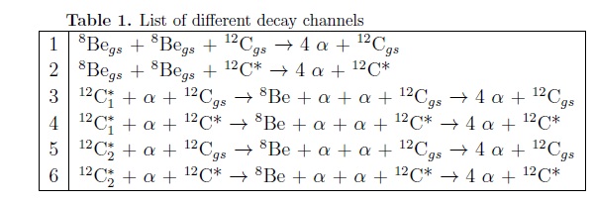
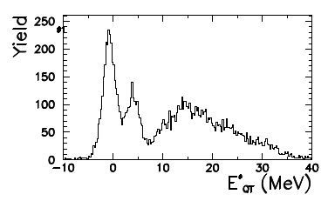
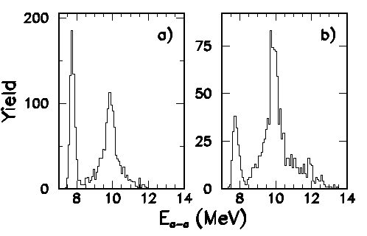
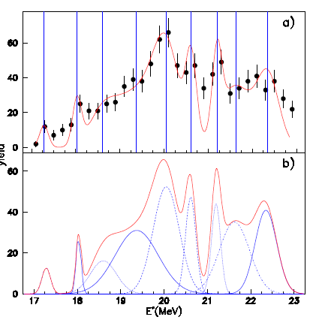
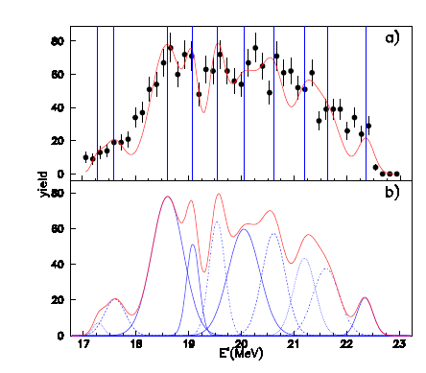
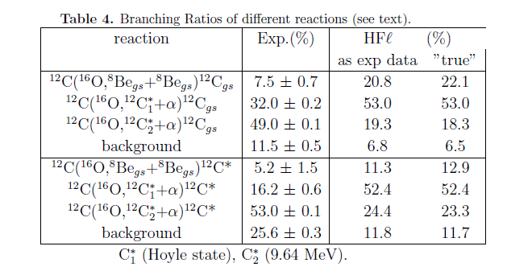



102932.R1
Nuclear Reactions: ¹⁶O quasi- projectile excitation (peripheral and semiperipheral collisions)
102932.R1
130 MeV ¹⁶O+¹²C
Dedicated HFl calculation, which include all the discrete known levels for light nuclei taken from the NUDAT2 database → suitability to describe light nuclei (A~ 30)
QT excitation spectrum
¹²C* excitation spectrum
1
2
${12C}_{1}^{∗ }$→$0_{2}^{+ }$Hoyle state at 7.65 MeV
${12C}_{2}^{∗ }$→$3^{−}$state at 9.64 MeV
1
2
M.Bruno et al. J.Phys G (2019) – 102932.R1
BR different from model (especially Hoyle state) → structure effects on the decay?
Events related to two simultaneous ⁸Be_{gs} ~ 7.5% QT_{gs}
¹⁶O* excitation spectrum
1
1
2
2
Minimum rel energy
Complementary rel energy

Slide 14




Nuclear Reactions Four different entrance channels and the ⁴⁶Ti* decay
GARFIELD+RCo @ Legnaro National Laboratory, Italy
16O

Slide 15








Nuclear Reactions Four different entrance channels and the ⁴⁶Ti* decay
DEFORMED NUCLEUS
{M. Brekiesz et al., Nucl.Phys A 788 (2007) 224c-230c}
Effects of Structure of Interacting Nuclei & Reaction Dynamics
8 MeV/n ¹⁶O+³⁰Si
7 MeV/n ¹⁶O+³⁰Si
7 MeV/n ¹⁸O+²⁸Si
7 MeV/n ¹⁹F+²⁷Al
⁴⁶Ti*
Cacarizo
DECAY
GEMINI⁺⁺ (R. J. Charity, Phys Rev C82 (2010) 014610.}
Simulate the decay of hot nuclei formed in fusion/quasi-fusion reaction.
Standalone → a good selection of central events can be performed; different code parameters can be set.
LSD
$$β$$ | $$δ_{1}$$ | $$δ_{2}$$ | Shape
$$0.2$$ | $$RLDM parameters$$
$$0.6$$ | $$4.6×{10}^{−4}$$ | $$1.0×{10}^{−7}$$ | $$Quasi−SUPERDEFORMED$$
$$1.0$$ | $$1.1×{10}^{−3}$$ | $$1.0×{10}^{−7}$$ | $$Quasi−HYPERDEFORMED$$
Antisymmetrized Molecular Dynamics
{A. Ono, Phys. Rev. C59, 853 (1999)}
describes the cluster structure of the interacting particles.
takes into account the particle-particle correlations.
HIPSE {D. Lacroix, et al., Phys. Rev. C69, 054604 (2004)}
describes nuclear collisions of heavy-ions in the intermediate energy range.
Based on sudden approximation.
Macroscopic Rotational Energy
Transmission coefficients
GEMINI++ as Afterburner (after a dynamical code) to produce secondary particles distributions from primary fragments → to be compared with exp data.
Level density
a) w=0.0 G00, b) w=1.0 G10, c) w=1.1 G11

Slide 16






Nuclear Reactions Four different entrance channels and the ⁴⁶Ti* decay
COMPARISON with MODELS
Effect of the Experimental filter (software)
Simulated Data: RESIDUES
Simulated Data: ALL PARTICLES
4π
filt.
Statistical (GEMINI⁺⁺) & Dynamical (AMD & HIPSE) codes
Simulated events are:
filtered with a software replica of the experimental setup;
selected in the same way of the experimental data.

Slide 17




Nuclear Reactions Four different entrance channels and the ⁴⁶Ti* decay
DATA SELECTION
Experimental Data: TOTAL EVENTS
CENTRAL EVENTS
$$Z_{detected}^{tot}>16 \& \frac{q_{Z}}{q_{beam}}<1.2$$
COMPLETE EVENTS SELECTION
$$Z_{detected}^{tot}=Z_{proj}+Z_{Targ}=22$$
Longitudinal Momentum vs. Total Charge
Charge vs. lab Energy
selected events 0.3-0.6% of the total exp. events
$$\frac{\#_{Evts Z_{tot}=22}}{\#_{Tot Evts}}$$ | ¹⁶O+³⁰Si 111 MeV | ¹⁶O+³⁰Si 128 MeV | ¹⁸O+²⁸Si 126 MeV | ¹⁹F+²⁷Al 133 MeV
Experimental | 0.3% | 0.3% | 0.4% | 0.6%
GEMINI⁺⁺ | 3.8% | 3.9% | 4.4% | 4.3%
AMD+GEMINI⁺⁺ | 2.5% | 2.8% | 3.4% | 3.3%
HIPSE+GEMINI⁺⁺ | 2.8% | 2.9% | 3.2% | 2.7%

Slide 18



Nuclear Reactions Four different entrance channels and the ⁴⁶Ti* decay
Results: Z_{tot}=Z_{p}+Z_{t}=22
Complete events - Z-distribution
TOTAL CHARGE DETECTED →Only neutrons missing

Slide 19





Nuclear Reactions Four different entrance channels and the ⁴⁶Ti* decay
Results: Z_{tot}=Z_{p}+Z_{t}=22
Complete events - Multiplicities
α & p multiplicities
¹⁶O+³⁰Si 111 MeV
α
α
¹⁶O+³⁰Si 128 MeV
¹⁸O+²⁸Si 126 MeV
α
p
¹⁹F+²⁷Al 133 MeV
α
Normalization to # of residues

Slide 20




Nuclear Reactions Four different entrance channels and the ⁴⁶Ti* decay
Results: Z_{tot}=Z_{p}+Z_{t}=22
Complete events – Multiplicities
p – α complementary behaviour

Slide 21


Nuclear Reactions Four different entrance channels and the ⁴⁶Ti* decay
Results: Z_{tot}=Z_{p}+Z_{t}=22
Complete events – Angular Distributions
¹⁶O+³⁰Si 128 MeV
α
p
over-production
under-production
Normalization to # of Evaporation Residues
Notes:
Let us now go and look at an example of the angular distributions in the Laboratory frame: and here we start observing something particular: lpha particles are reasonably reproduced in the angular region between 29 and 150° while there is a huge overproduction at small angles (between 8 and 18)
A different behavior is observed for protons, which seem reasonably described in the forward region, whilst an experimental underproduction is observed at larger angles. By comparing both the three experimental data at 7 MeV/n and the two systems at the same E* the observed trend seem reasonable as a function of the growing V_CN

Slide 22




Nuclear Reactions Four different entrance channels and the ⁴⁶Ti* decay
Results: Z_{tot}=Z_{p}+Z_{t}=22
Complete events – Angular Distributions
4 reactions:
Ratio EXP/G11
Notes:
The behavior is similar for all reactions at large angles and for protons in the whole angular range, while a quite strong trend is observed for alphas at small angles: the major difference is observed for the lowest excitation energy and if looking at the two reactions with the same excitation energy the effect seem larger for the 16O induced reaction.

Slide 23




Nuclear Reactions Four different entrance channels and the ⁴⁶Ti* decay
Results: Z_{tot}=Z_{p}+Z_{t}=22
Complete events – Energy spectra
G11

Slide 24


Nuclear Reactions Four different entrance channels and the ⁴⁶Ti* decay
Results: Z_{tot}=Z_{p}+Z_{t}=22
Complete events – Energy Spectra
8 AMeV

Slide 25



Nuclear Reactions Four different entrance channels and the ⁴⁶Ti* decay
Results: Z_{tot}=Z_{p}+Z_{t}=22
Complete events – α-excess for the 4 reactions
Ratio of α-particles yields in exclusive channels

Slide 26


Nuclear Reactions Four different entrance channels and the ⁴⁶Ti* decay

Slide 27


Nuclear Reactions Four different entrance channels and the ⁴⁶Ti* decay
A first summary of results
Reactions at the same beam velocity
E=7AMeV ¹⁶O+³⁰Si, ¹⁸O+²⁸Si, ¹⁹F+²⁷Al
Reactions at the same excitation energy
E*=98.5 MeV ¹⁶O+³⁰Si 8AMeV, ¹⁸O+²⁸Si 7AMeV
GLOBAL VARIABLES Charge distribution Multiplicities Angular Distributions
COMPARISON TO MODELS Multiplicity Angular Distributions Energy Spectra
Expected behavior with respect to entrance channel properties when comparing only the experimental data Extra α-particle production at forward angles and in general of light cluster production (d,t,3He)
Underestimation of high α multiplicities – corresponding underproduction of protons Forward α overproduction for Z_{ER}>17 Yield overproduction with respect to GEMINI++ is larger at smaller E* / larger for 16O
Dependence on E* and /or η of α forward overproduction
Dependence on v_{beam} and /or η of α forward overproduction
Shape reproduction
Onset of visible pre-equilibrium yield at 8 AMeV

Slide 28


Nuclear Reactions Four different entrance channels and the ⁴⁶Ti* decay
Results: Z_{tot}=22
Complete events - Branching Ratios of the most populated channels
$n$ are not detected => all channels include possible$n$

Slide 29
Nuclear Reactions Four different entrance channels and the ⁴⁶Ti* decay
Results: Z_{tot}=22
Complete events - Branching Ratios of the most populated channels

Slide 30




Nuclear Reactions Four different entrance channels and the ⁴⁶Ti* decay
Results: Z_{tot}=22 Complete events –
Branching Ratios of the most populated channels
R= Y_{exp}(Z;n_{Z}α)/Yexp(Z)- Y_{theo}(Z;n_{Z}α)/Y_{theo}(Z)
R= Y_{exp}(Z;chan)/Yexp(Z)- Y_{theo}(Z;chan)/Y_{theo}(Z)

Slide 31
Nuclear Reactions Four different entrance channels and the ⁴⁶Ti* decay
Continuing the discussion on experimental results
Reactions at the same beam velocity
E=7AMeV ¹⁶O+³⁰Si, ¹⁸O+²⁸Si, ¹⁹F+²⁷Al
Reactions at the same excitation energy
E*=98.5 MeV ¹⁶O+³⁰Si 8AMeV, ¹⁸O+²⁸Si 7AMeV
The trend of Branching Ratios for the different reactions follows what expected from the growing of E* (opening of new channels → diminishing of the importance of specific exit channels) ODD RESIDUES: yields reasonably well reproduced by STATISTICAL MODEL EVEN RESIDUES: trend reproduced by STATISTICAL MODEL but HIGH DISCREPANCIES observed in the YIELDS → extra production of “pure” α-channels
Confirmation: Statistical Models may not be appropriate to describe the decay of light nuclei May the observed discrepancies be related to “extra” structure effects?→ Clustering ? Need of studying exclusive channels and particle correlations to better explain the differences

Slide 32






Nuclear Reactions Four different entrance channels and the ⁴⁶Ti* decay
Results: Z_{tot}=22
Exclusive channels
Peculiarities of specific α-decay (1α, 2α, 3α) channels
$$Q_{miss}=Q−\sum_{j=1}^{xn}{E_{j}}=\sum_{i=1}^{α}{E_{i}}+E_{ER}−E_{beam}$$
“Missing” Q-value:
More experimental n-evaporation than predicted in the α-decay channels
^{34-x}S + 3α + xn
More dissipative
Jacobian variable (angle):
^{38-x}Ar + 2α + xn
More dissipative

Slide 33

Nuclear Reactions Four different entrance channels and the ⁴⁶Ti* decay
Results: Z_{tot}=22
Z_{ER}=18 – 2α correlations
Jacobian variables
Example for the ¹²C+¹²C at 95 MeV case
L. Morelli – J. Phys. G Nucl. Part. Phys 41 (2014) 075108
The shape of the cos(θ_{k}) distribution: dependence on spin distribution involved in the process, which depends on the priority of neutron emission in the cascade.
n as 1st
n as 2nd
n as 3rd
^{38-x}Ar + 2α + xn
Blue and red distributions are obtained by Hauser Feshbach model developed for light nuclei (HFl) respectively with J_{0max}=18 ħ (DJ=2) and J_{0max}=12 ħ (sharp cut off).
Need of n emission

Slide 34

Nuclear Reactions Four different entrance channels and the ⁴⁶Ti* decay
Results: Z_{tot}=22
Z_{ER}=18 – 2α correlations
Jacobian variables
Example for the ¹²C+¹²C at 95 MeV case
L. Morelli – J. Phys. G Nucl. Part. Phys 41 (2014) 075108
+xn
^{38-x}Ar + 2α + xn

Slide 35


Nuclear Reactions Four different entrance channels and the ⁴⁶Ti* decay
Results: Z_{tot}=22
Z_{ER}=18 – 2α correlations
Larger dissipation (missing Q-value) → larger experimental n-emission observed in α-decay channels
EXP
G11
Larger experimental production of ⁸Be → 2α channel

Slide 36





Nuclear Reactions Four different entrance channels and the ⁴⁶Ti* decay
Peculiarities of specific α-decay (1α, 2α, 3α) channels
Results: Z_{tot}=22
DALITZ PLOTS with CM ENERGIES
Starting from ordered $E_{i}^{lab}$:
$$E_{1}^{lab}<E_{2}^{lab}<E_{3}^{lab}$$
$$x_{D}=\sqrt{3}\frac{E_{3}^{cm}−E_{2}^{cm}}{2}$$
$$y_{D}=\frac{2E_{1}^{cm}−E_{3}^{cm}−E_{2}^{cm}}{2}$$

Slide 37






Nuclear Reactions Four different entrance channels and the ⁴⁶Ti* decay
Results: Z_{tot}=22
Exclusive channels
Peculiarities of specific α-decay (1α, 2α, 3α) channels
^{34-x}S + 3α + xn
Framework: CM of the 3α
Da
Energy - Dalitz PLOT
PRELIMINARY
PRELIMINARY
PRELIMINARY
$$x_{D}=\frac{\sqrt{3}}{2}\left(E_{3}−E_{2}\right)$$
$$y_{D}=\frac{1}{2}\left(2E_{1}−E_{2}−E_{3}\right)$$
$$3ρ=\sqrt{x_{D}^{2}+y_{D}^{2}}$$

Slide 38


Nuclear Reactions Four different entrance channels and the ⁴⁶Ti* decay
Peculiarities of specific α-decay (1α, 2α, 3α) channels
Results: Z_{tot}=22
Dalitz Plots Relative energies→
3α with equal energy and equal relative energy.

Slide 39






Nuclear Reactions Four different entrance channels and the ⁴⁶Ti* decay
Results: Z_{tot}=22
Peculiarities of specific α-decay (1α, 2α, 3α) channels
DALITZ PLOTS with RELATIVE ENERGIES: ^{34-x}S + 3α + xn
$$y_{D}=\frac{2E_{max,min}−E_{max,med}−E_{med,min}}{2}$$
$$x_{D}=\sqrt{3}\frac{E_{max,med}−E_{med,min}}{2}$$
2.5%
3α with equal energy and equal relative energy.
¹²C → 3α
¹²C → ⁸Be + α
PRELIMINARY
PRELIMINARY

Slide 40








Summary & Conclusions
EXP. GLOBAL VARIABLES | Z distribution & Multiplicity | Expected behavior
 | Angular Distribution | Dependence on $v_{beam}^{}$ & $E_{CN}^{∗}$ of the A.D. behavior
 |  | Strong over-production of α at very forward angles (the highest is for ¹⁶O @ 7 AMeV)
COMPARISON WITH STATISTICAL MODEL (RATIO)) | Multiplicity | Underestimation of high multiplicity α
 | Angular Distribution | Dependence on $E_{CN}^{∗}$ and/or η of α forward overproduction | Dependence on η and/or $v_{beam}$ overproduction | Dependence on η and/or $v_{beam}$ overproduction
 |  | Forward α over-production for $Z_{residue}>17$
 | Energy Spectra | Yields underestimation (higher as $E_{CN}^{∗}$ decreases)
 |  | Shape reproduction | ¹⁶O → signature of pre-equilibrium onset
EXP. vs. GEMINI++: $E_{CN}^{∗}$ dependence of the B.R. trend. | ODD RESIDUES: trends and yields are well reproduced by statistical model;
 | EVEN RESIDUES: trends are reproduced; HIGH DISCREPANCIES in the reproduction of yields in pure α ($+xn$) exit channels.
seems to be higher for ¹⁶O @ 7 AMeV, but in comparison with model the discrepancies have the same trend for all the reactions.
Statistical model DON’T REPRODUCE light nuclei => may be due to the important rule of the structure.
Exp. peculiarities of α-α CORRELATIONS in 1α, 2α, 3α–DECAY CHANNELS: | larger experimental DISSIPATIONS at higher E*: more n-evaporation expected; larger exp. yields in 2α−correlations: ⁸Be decay; equal energy and equal relative energy of the 3α → not accounted for by models both in yields and shapes: ¹²C → 3α or ¹²C → ⁸Be + α;

Slide 41

NUCL-EX Collaboration
M.Cicerchia^{1,2}, F. Gramegna¹, D. Fabris³, T. Marchi¹, M. Cinausero¹, G. Mantovani^{1,2}, A. Caciolli^{2,3}, G. Collazzuol^{2,3}, D. Mengoni^{2,3}, M. Degerlier⁴, L. Morelli⁵, M. Bruno⁵, M. D’Agostino⁵, S. Barlini⁶, S. Piantelli⁶, M. Bini⁶, G. Pasquali⁶, P. Ottanelli⁶, G. Casini⁶, G. Pastore⁶, C. Frosin⁶, D. Gruyer⁷, A. Camaiani⁶, S.Valdré⁶, N. Gelli⁶, A. Olmi⁶, G.Poggi⁶, I. Lombardo⁸, D. Dell’Aquila^{8,9}, S. Leoni¹⁰, N. Cieplicka-Orynczak¹⁰⁻¹¹, B. Fornal¹¹, V.L. Kravchuk¹².
¹INFN Laboratori Nazionali di Legnaro, Legnaro (PD), Italy.
²Dipartimento di Fisica e Astronomia dell’Università di Padova, Padova, Italy.
³INFN Sezione di Padova, Padova, Italy.
⁴Science and Art Faculty, Physics Department, Nevsehir Haci Bektas Veli Univ., Nevsehir, Turkey.
⁵INFN Sezione di Bologna e Dipartimento di Fisica e Astronomia, Univ. di Bologna, Bologna, Italia.
⁶INFN Sezione di Firenze e Dipartimento di Fisica e Astronomia, Univ. di Firenze, Firenze, Italia.
⁷Grand Accélérateur National d'Ions Lourds, 14076 Caen, France,
⁸INFN Laboratori Nazionali del Sud, Catania, Italia.
⁹Institut de Physique Nuclèaire (IPN) Université Paris-Sud 11, Orsay, Île-de-France, France.
¹⁰INFN Sezione di Milano e Dipartimento di Fisica, Univ. di Milano, Milano, Italia.
¹¹Institute of Nuclear Physics, Polish Academy of Sciences Krakow, Poland.
¹² National Research Center - Kurchatov Institute- Moscow, Russia
With the help of :
F. Gulminelli – Normandie Univ., ENSICAEN, UNICAEN, CNRS/IN2P3, LPC Caen,
D. Lacroix – IPN Orsay
K. Mazurek - Inst. Nucl. Phys. PAN – Krakw - Poland
Akira ONO – Tokay University - Japan
T. Kokalowa – Unversity of Birmingham - UK

Slide 42
Thank you

Slide 43



Nuclear Reactions: central collisions – at low energy & structure effects
ELASTIC (or EXCLUSIVE) BREAKUP:
$$a+A⟶b+x+A_{gs}, where a=b+x$$
NON-ELASTIC (or INCLUSIVE) BREAKUP:
  INELASTIC BREAKUP:
  $$a+A⟶b+x+A^{∗}$$
  $$a+A⟶b^{∗}+x+A_{gs}$$
  PARTICLE TRANSFER:
  $$a+A⟶b+B, where B≡A+x≡bound system$$
  INCOMPLETE FUSION:
  $$a+A⟶b+C, where C⟹decay emitting γ or particles$$
COMPLETE FUSION:
$a+A⟶CN$ $⟹decay emitting γ or particles$
$a+A⟶preequilibrium particles+ICN$ $⟹decay emitting γ or particles$
dissipation
Incomplete Fusion and pre-equilibrium emission start competing depending on energy and properties of the colliding nuclei
J. Cabrera, Phys. Rev. C 68 (2003) 034613-1. - - - X. Campi et al., Phys. Lett. B 142 (1984) 8. ---
J. Pouliot et al., Phys. Lett. B 299 (1993) 210. --- W. D. M. Rae et al., Phys. Rev. C 30 (1984) 158.

Slide 44


Nuclear Reactions Four different entrance channels and the ⁴⁶Ti* decay
Results: Z_{tot}=22
Dalitz Plots 1→
DALITZ PLOTS with RELATIVE ENERGIES

Slide 45






Nuclear Reactions Four different entrance channels and the ⁴⁶Ti* decay
Results: Z_{tot}=22
Exclusive channels
More dissipative
^{42-x}Ca + 1α + xn
More dissipative
More dissipative
^{34-x}S + 3α + xn
^{38-x}Ar + 2α + xn
Observed differences from the entrance channels
Dynamical models (Hypse) better describe dissipation: cross check undergoing

Slide 46


Nuclear Reactions Four different entrance channels and the ⁴⁶Ti* decay
Results: Z_{tot}=22
Z_{ER}=18 – 2α correlations

Slide 47



Nuclear Reactions Four different entrance channels and the ⁴⁶Ti* decay
Results: Z_{tot}=22 Complete events - Branching Ratios
Reaction | E*(MeV) | η | ηE*
¹⁶O+³⁰Si 111 MeV | 88,0 | 0,304 | 27
¹⁶O+³⁰Si 128 MeV | 98,4 | 0,304 | 30
¹⁸O+²⁸Si 126 MeV | 98,5 | 0,217 | 21
¹⁹F+²⁷Al 133 MeV | 103,5 | 0,174 | 18

Slide 48
Nuclear Reactions Four different entrance channels and the ⁴⁶Ti* decay
Results: Z_{tot}=Z_{p}+Z_{t}=22
Complete events – Angular Distributions
¹⁶O+³⁰Si 128 MeV
Reaction | E*(MeV) | η | ηE*
¹⁶O+³⁰Si 111 MeV | 88,0 | 0,304 | 27
¹⁶O+³⁰Si 128 MeV | 98,4 | 0,304 | 30
¹⁸O+²⁸Si 126 MeV | 98,5 | 0,217 | 21
¹⁹F+²⁷Al 133 MeV | 103,5 | 0,174 | 18
α
p
over-production
under-production
Normalization to # of Evaporation Residues
4 reactions:
Ratio EXP/G11

Slide 49




Nuclear Reactions Four different entrance channels and the ⁴⁶Ti* decay
AMD + G11

Slide 50
Nuclear Reactions Four different entrance channels and the ⁴⁶Ti* decay
Results: Z_{tot}=Z_{p}+Z_{t}=22
Complete events – Angular Distribution ratios

Slide 51


Nuclear Reactions: a tool to study nuclear matter
Looking into more details the complexity of heavy ion collisions is also the richness of the processes which may be studied, together with their interplay which depends on Energy, centrality and partners charge and masses to get information on the behavior of nuclear matter
The complexity grows up with the energy up to the region when the competition between mean field properties and nucleon-nucleon scattering become important → Fermi energies

Slide 52


Nuclear Reactions: clustering
α-particle nuclei
Exp methods: resonant scattering; break up
Possible clusters:
¹²C, ¹⁴C, ¹⁴O, ¹⁵N, ¹⁶O
Inelastic scattering reaction ²⁴Mg(¹²C, ¹²C+¹²C)¹²C: Excitation energy of the ²⁴Mg
²²Ne excited states from the ¹⁸O+α resonant elastic scattering reaction – excitation function –
from M. Freer - Clustering in light nuclei

