Slide 1


Measuring the Gravitational constant with Atom interferometry for Novel fundamental physics Test (MEGANTE)
Gabriele Rosi
Consiglio di Sezione
04/03/2019

Slide 2
Outline
Introduction to Atom Interferometry (AI)
The history: INFN MAGIA experiment (2002-2014)
Geometry free determination of the gravity gradient with AI
An improved G determination using cold atoms
MEGANTE: testing gravity measuring G
Conclusions and prospects: the new apparatus at INFN FI
G. Rosi MEGANTE

Slide 3
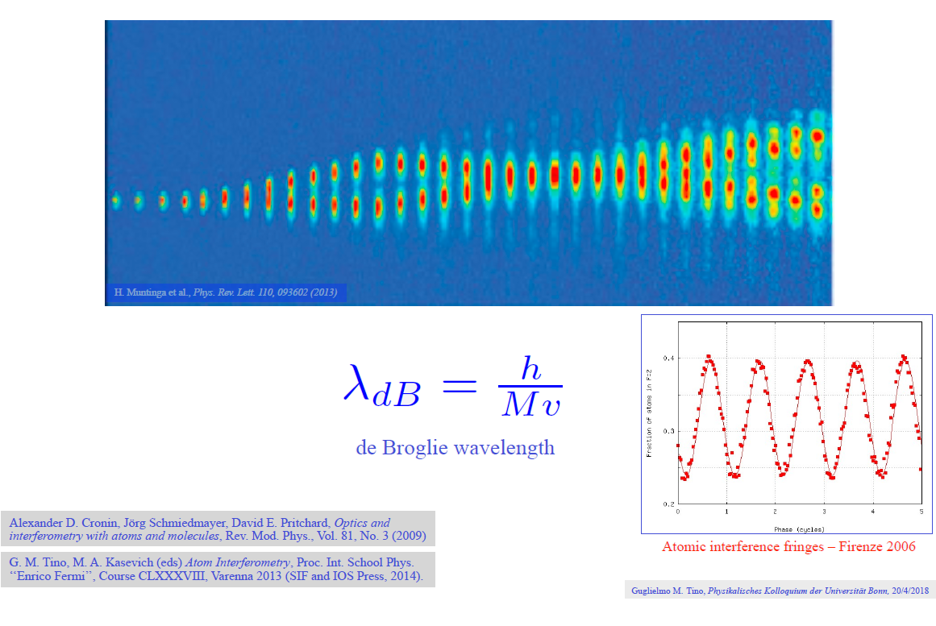
Atom Interferometry
G. Rosi MEGANTE

Slide 4
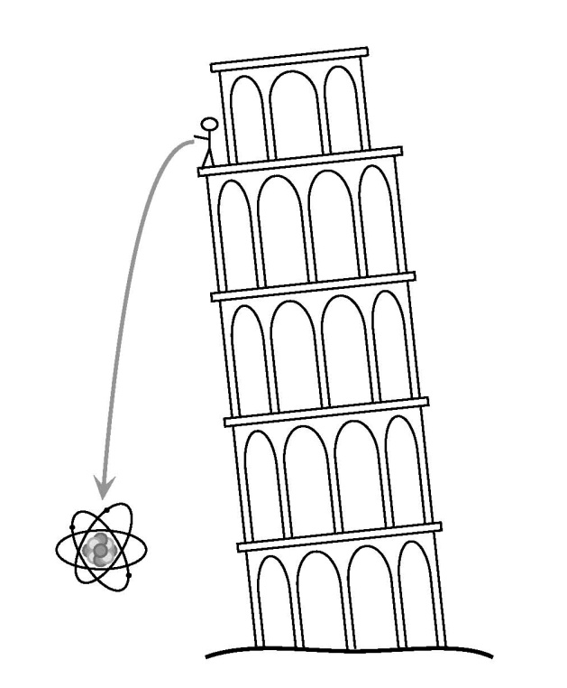
Atom Interferometry for gravity measurement
Atom Interferometry can measure accelerations
We use Cold Atoms as free falling microscopic masses
Quantum features of matter allow to improve the sensitivity
(not just a time-of-flight measurement in the “classical way”)
Ingredients:
A source of Cold Atoms (~ μ K or less)
(the sample must be slowly expanding and weakly interacting )
A laser system to cool the sample and to manipulate
the wavepacket
G. Rosi MEGANTE

Slide 5
Atom / light Interferometry: the analogy
Optical interferometer
π /2 pulse works like a beamsplitter
momentum transfer
π pulse works like mirror;
momentum transfer
Mirror
interference
fringe
state |1>
beamsplitter
state |2>
Atom interferometer
Once you have an atomic two level system you can make the analogy with light looking at the Rabi’s population oscillations scheme
P₁₋₂
|2 ›
|1 ›
Interaction time τ [1/Ω]
π/2
π
SPLIT
REFLECT
RECOMBINE
G. Rosi MEGANTE

Slide 6
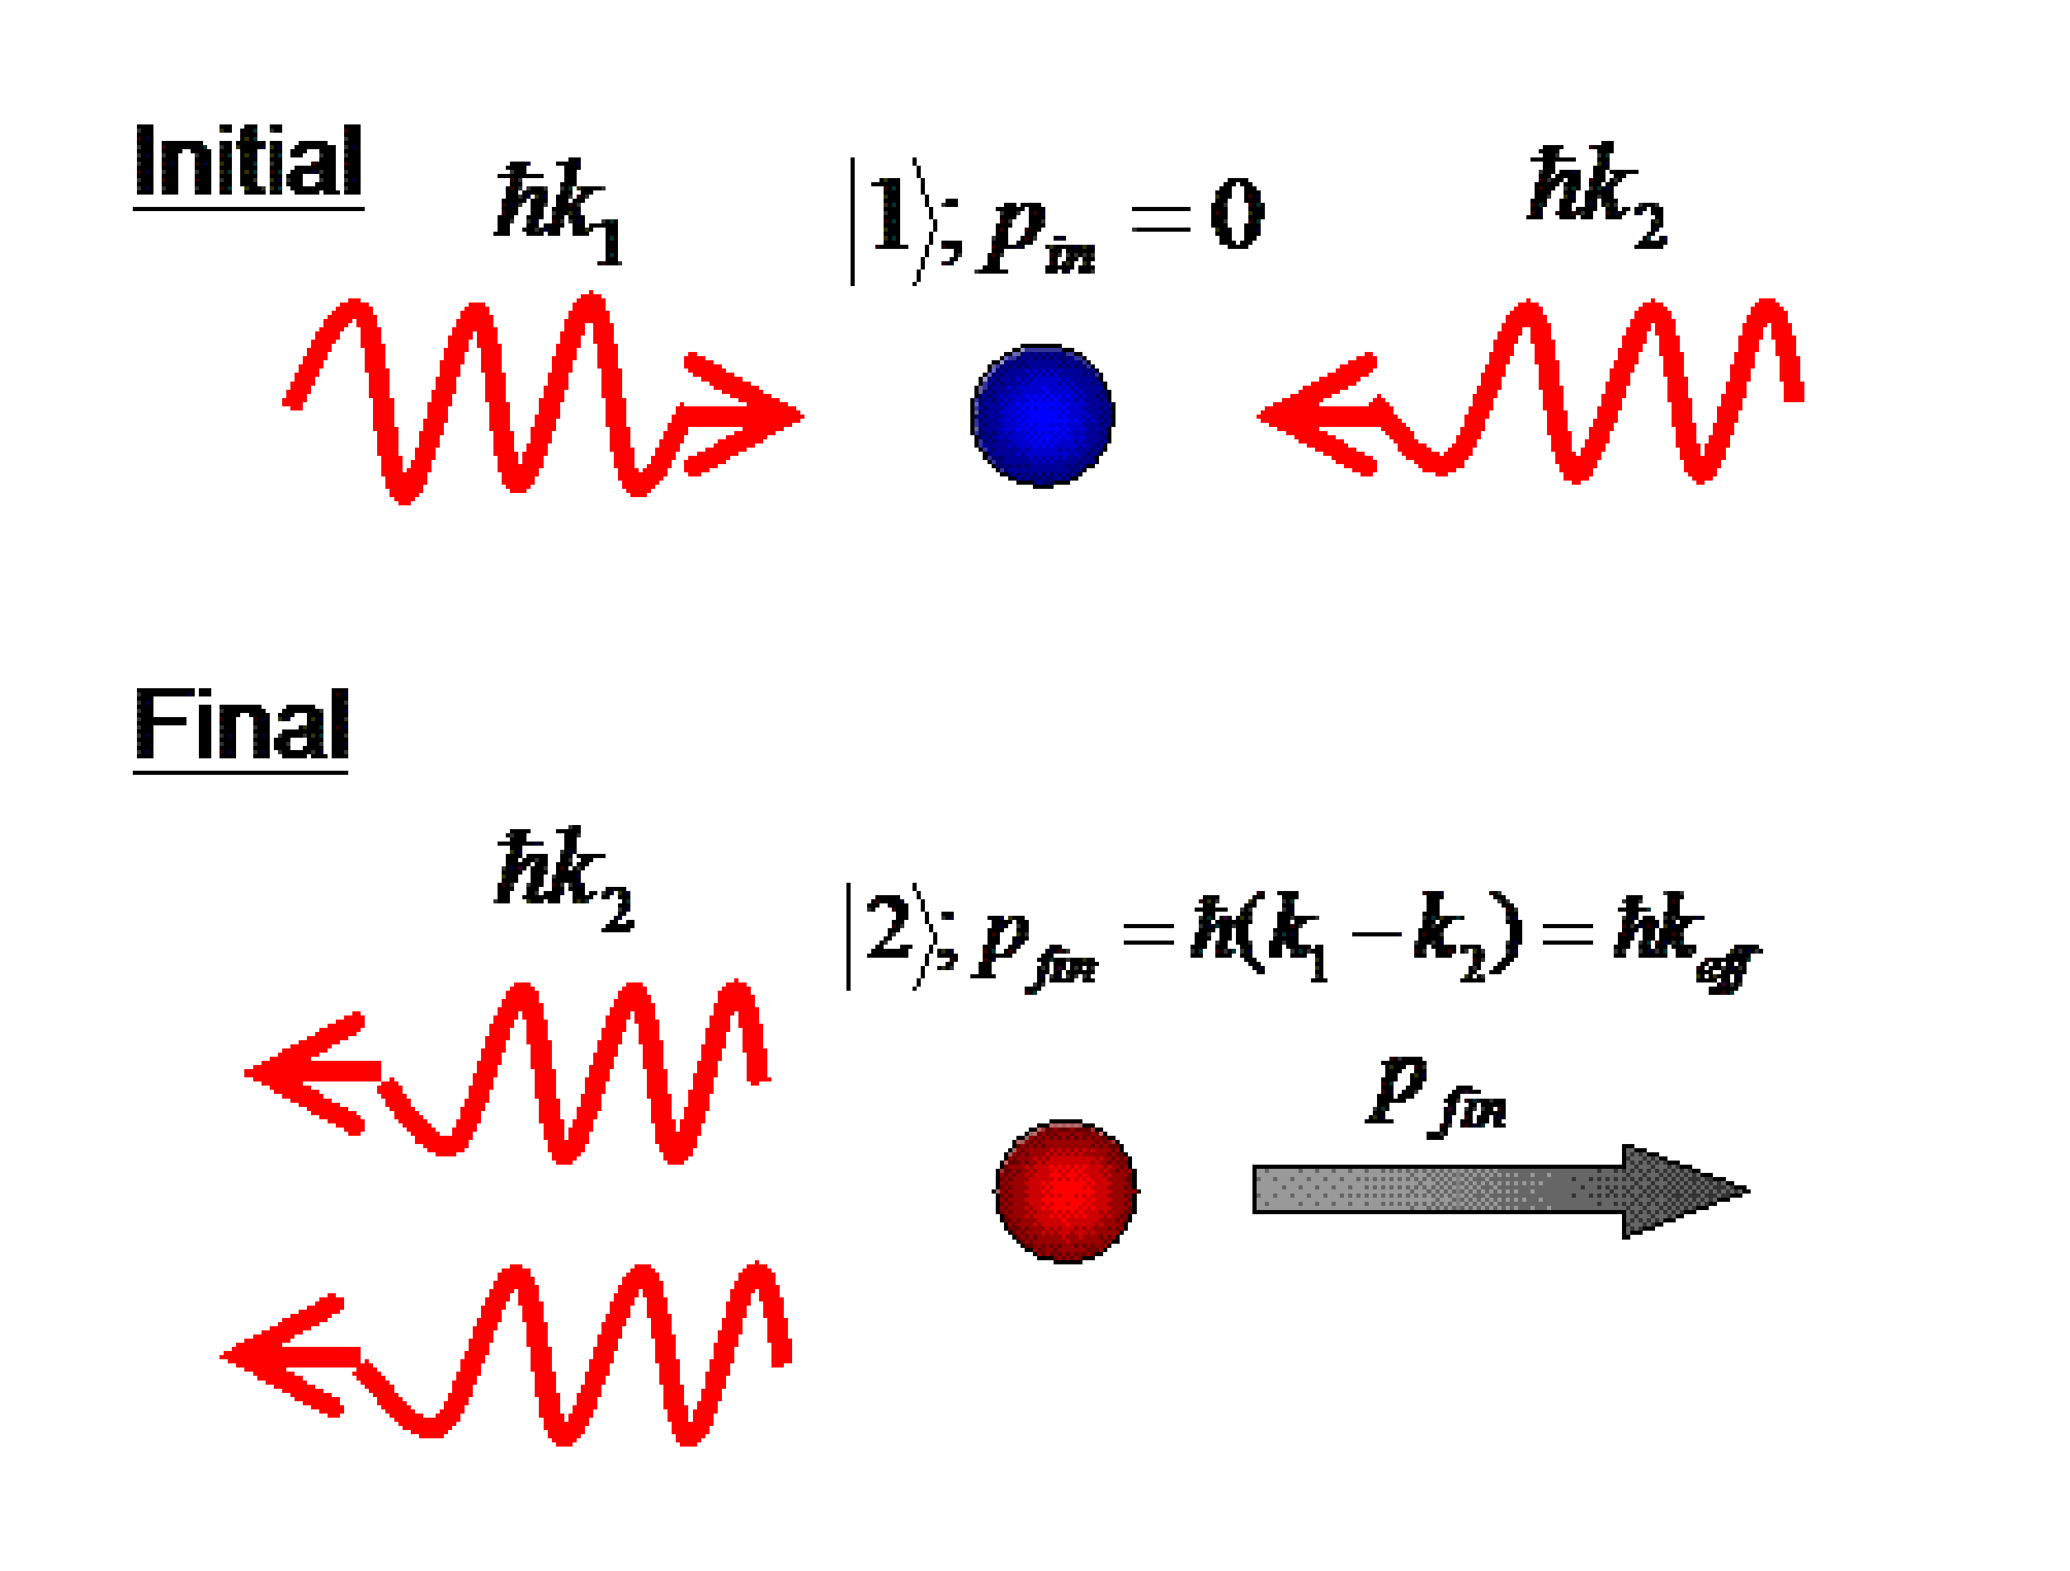
Atom Interferometry: theory
Two hyperfine states are coupled by two photon RAMAN Transition
using two couterpropagating beams
frequency difference must be equal to hyperfine states separation
ω₁
ω₂
We need to couple two long-lived states
Why RAMAN: we need large momentum recoil (arms separation)
Momentum recoil and arms separation
Δω=ω_{HF}
z
|2>
|1>
t
SPLIT
G. Rosi MEGANTE

Slide 7
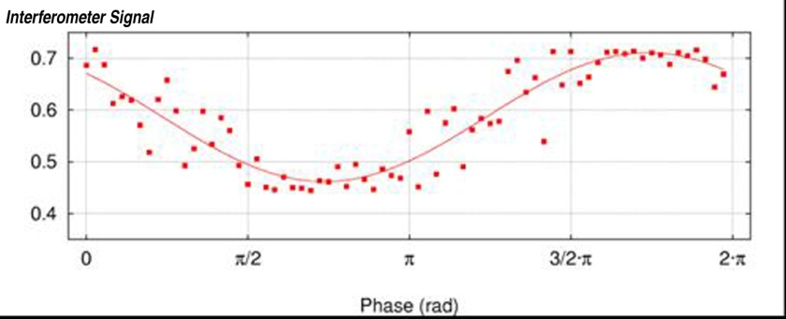
Atom Interferometry: theory
Wave function PHASE evolution
GRAVITY BREAKS
THE SIMMETRY
totally symmetric
evolution
If
Population on final State depends
On the interferometer phase
z
|2>
fringes
|1>
varying RAMAN laser’s phase
t
G. Rosi MEGANTE

Slide 8

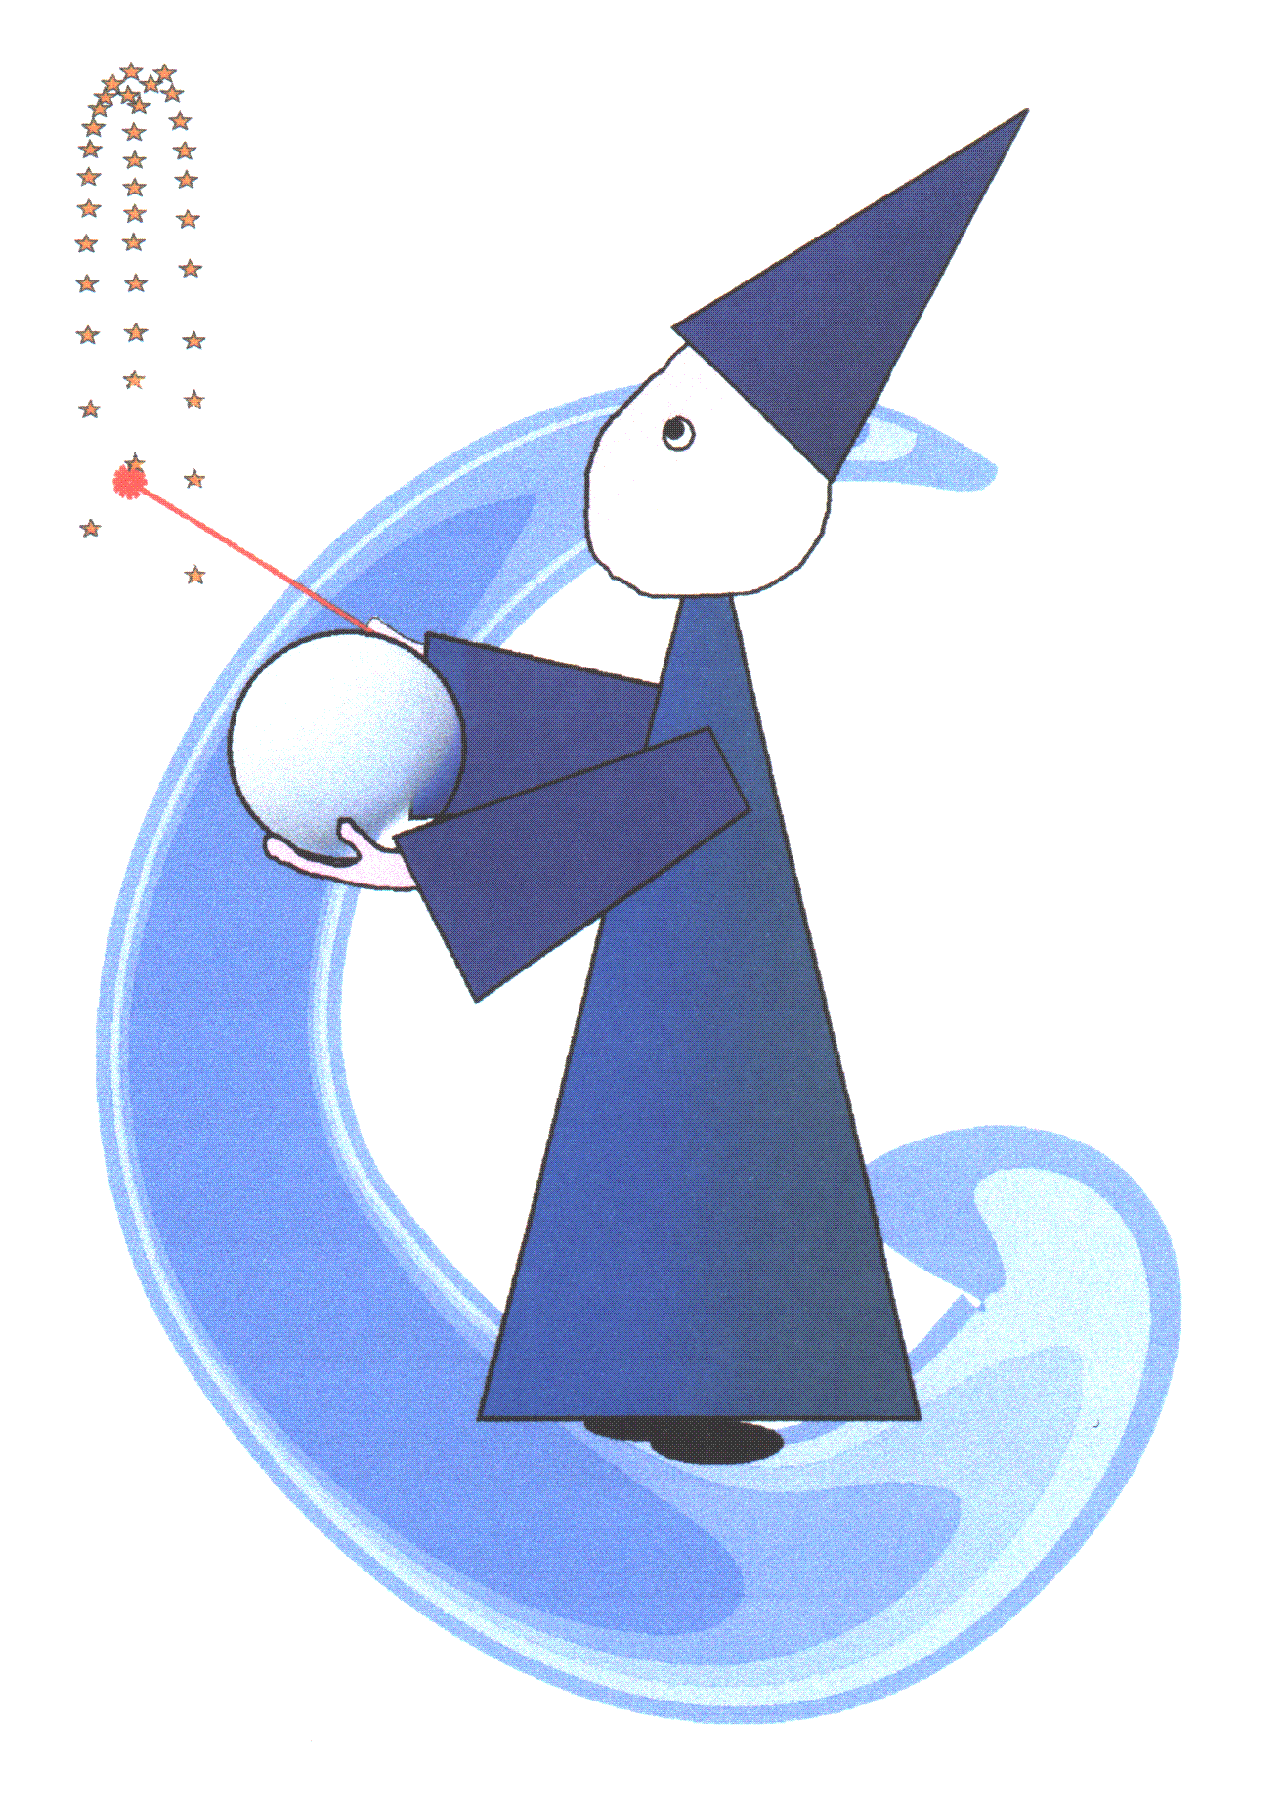
MAGIA
Misura Accurata di G mediante Interferometria Atomica

Slide 9
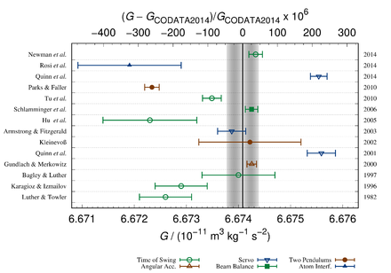
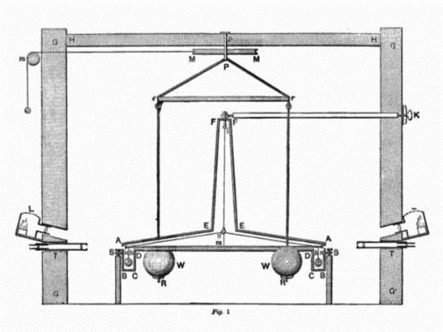
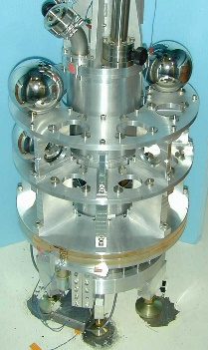
The big G issue
«Classical»» Instruments
Macroscopic probe (detailed modelling)
Mechanical influences hard to control (gravity is weak!)
Two-centuries old concept
“The wide disagreement among recent measured values of G must cast some doubt on our abilities in this crucial area of small-force measurement and in other areas where similar techniques are used. This is an unsatisfactory situation” [*]
[*] Outcome of the Royal Society meeting ‘The Newtonian constant of gravitation, a constant too difficult to measure?’ (2014)
G. Rosi MEGANTE

Slide 10
MAGIA - the procedure
SOURCE MASSES
Well-characterized tungsten cylinders
PROBE MASSES
Cold, freely falling ⁸⁷Rb atoms
MEASUREMENT METHOD
Raman atom interferometry (local acc.)
Spatial & temporal differential scheme
CALCULATION of gravitational attraction
G
G. Rosi MEGANTE

Slide 11
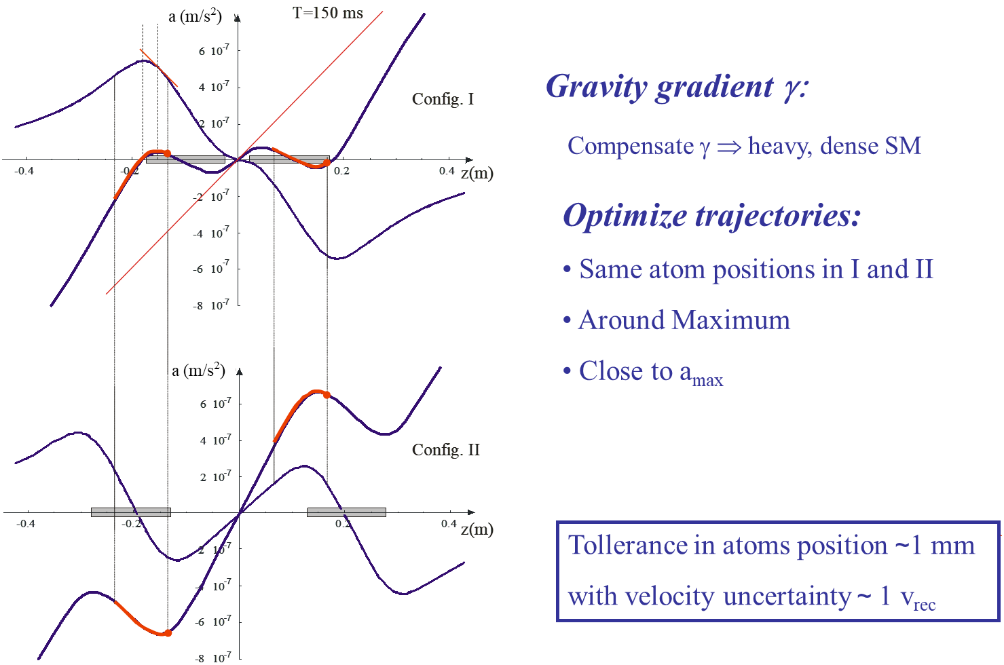
MAGIA - the idea
G. Rosi MEGANTE

Slide 12
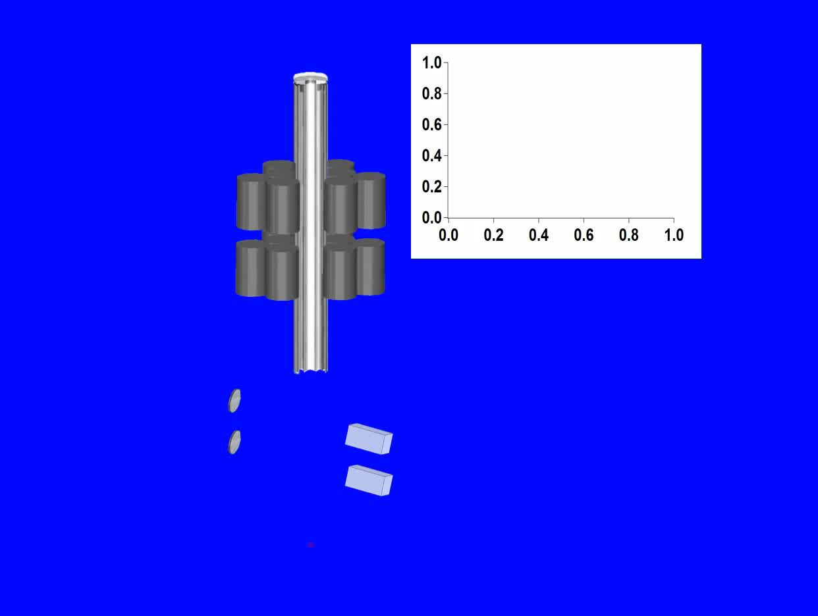
MAGIA - the experimental sequence
G. Rosi MEGANTE

Slide 13
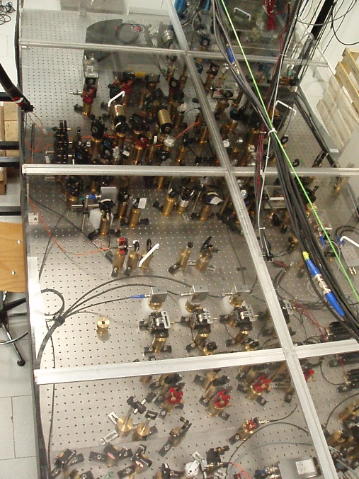
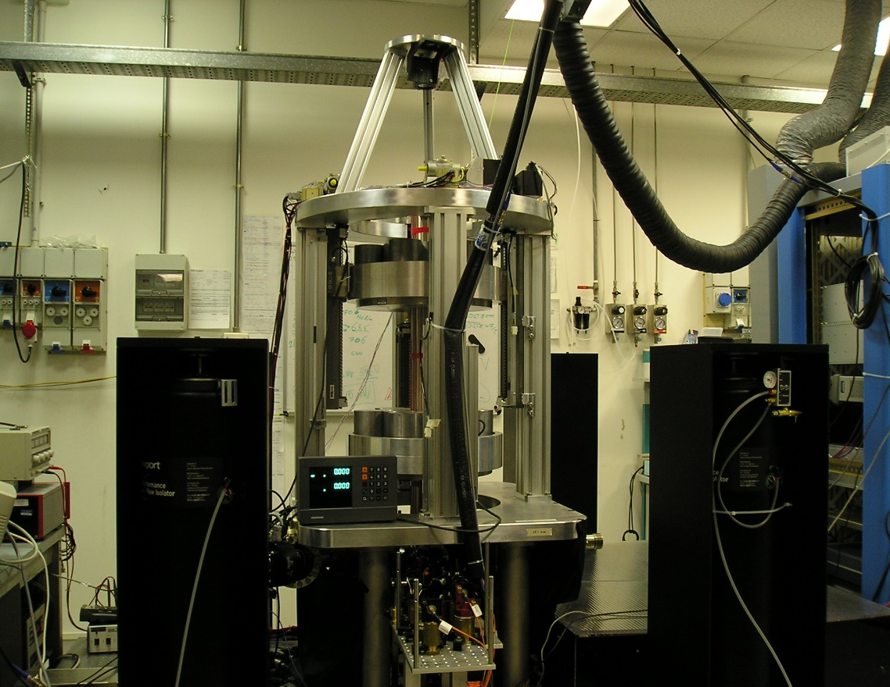
MAGIA - the apparatus
Manipulate ⁸⁷Rb atoms
LASER SYSTEM
G. Rosi MEGANTE

Slide 14
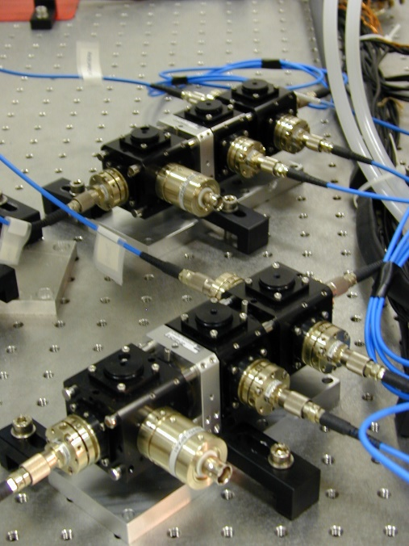
MAGIA - the apparatus
Manipulate ⁸⁷Rb atoms
LASER SYSTEM
Transport light
OPTICAL FIBERS
G. Rosi MEGANTE

Slide 15
MAGIA - the apparatus
Manipulate ⁸⁷Rb atoms
LASER SYSTEM
Transport light
OPTICAL FIBERS
Long interaction times
VACUUM SYSTEM
G. Rosi MEGANTE

Slide 16
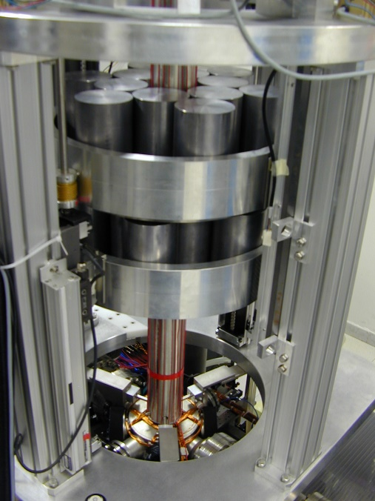
MAGIA - the apparatus
Manipulate ⁸⁷Rb atoms
LASER SYSTEM
Transport light
OPTICAL FIBERS
Long interaction times
VACUUM SYSTEM
Gravitational field
SOURCE MASSES*
*G. Lamporesi, A. Bertoldi, A. Cecchetti, B. Dulach, M. Fattori, A. Malengo,, S. Pettorruso, M. Prevedelli, G.M. Tino, Source Masses and Positioning System for an Accurate Measurement of G, Rev. Scient. Instr. 78, 075109 (2007)
G. Rosi MEGANTE

Slide 17
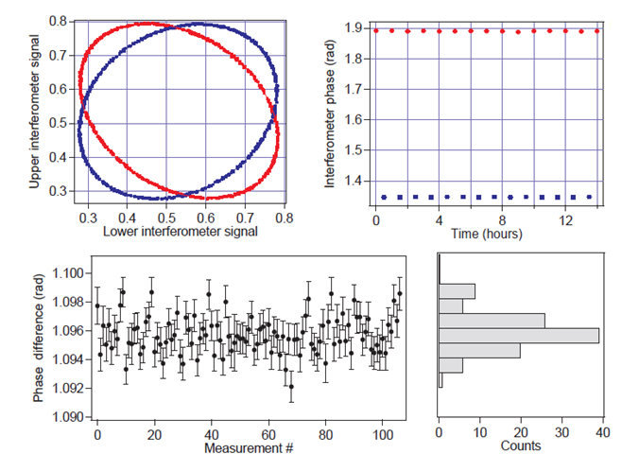
The G measurement
Features:
Source masses modulation time: 30 mins
Integration time:
more than 100 hours over 2 weeks (July 2013)
Sensitivity: 3x10⁻⁹ g/Hz^{1/2}
Final sensitivity: ~ 10⁻¹¹ g
G = 6.67191(77)_{stat}(62)_{sys}× 10⁻¹¹ m³ Kg⁻¹ s⁻²
G. Rosi MEGANTE

Slide 18
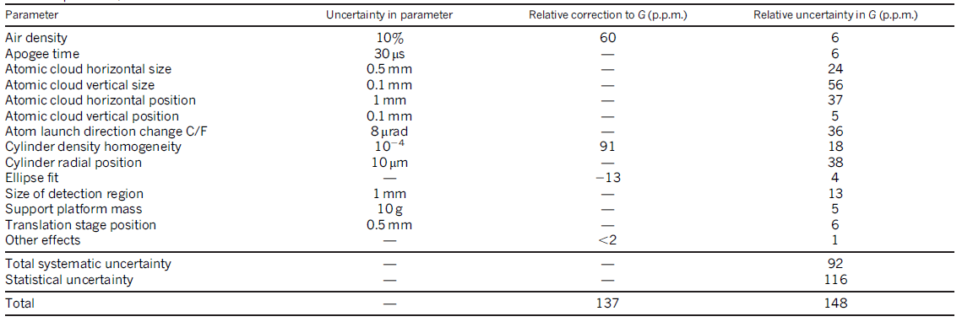
Systematic
Error budget:
Most of the entries are evaluated through MonteCarlo simulation of the experiment, evaluating
the derivative of Φ with respect to each parameters
Final inaccuracy: 92 ppm
Limiting parameters: atomic samples dimensions, source masses position (Radial), Coriolis Effect
G. Rosi MEGANTE

Slide 19
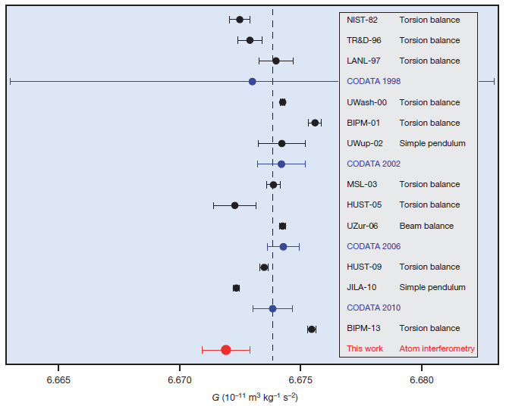
Current status
6.67191(77)_{stat}(62)_{sys}× 10⁻¹¹ m³ Kg⁻¹ s⁻²
G. Rosi MEGANTE

Slide 20
Current status
6.67191(77)_{stat}(62)_{sys}× 10⁻¹¹ m³ Kg⁻¹ s⁻²
“Although the final uncertainty is not presently competitive, determinations of G using atom interferometry could be more competitive in the future.”
How to improve? Two ways:
Improve the cold atoms technology using the same method
Change the method maintaining the same technology
G. Rosi MEGANTE

Slide 21
Cancelling gravity gradients
The tidal forces on the atoms in a uniform gravity field and gradient modify the wavepacket trajectories. The gravimetric phase shift is
φ = k_{eff}gT² + k_{eff}Γ_{zz}(z₀ + v₀T)T²
z₀, v₀ initial atomic position and velocity.
The error on z₀ and v₀ is one of the major sources of noise and systematics:
For WEP tests at 10⁻¹⁵ level is required a control on z₀ and v₀ of 1 nm and 0,3 nm/s.
In the AI determination of G^{[1]} one of the major sources of systematic error arises from the limited control on the thermal cloud degrees of freedom.
[1] G. Rosi, F. Sorrentino, L. Cacciapuoti, M. Prevedelli & G. M. Tino, “Precision measurement of the Newtonian gravitational constant using cold atoms”, Nature 510, 518-521 (2014).
G. Rosi MEGANTE

Slide 22
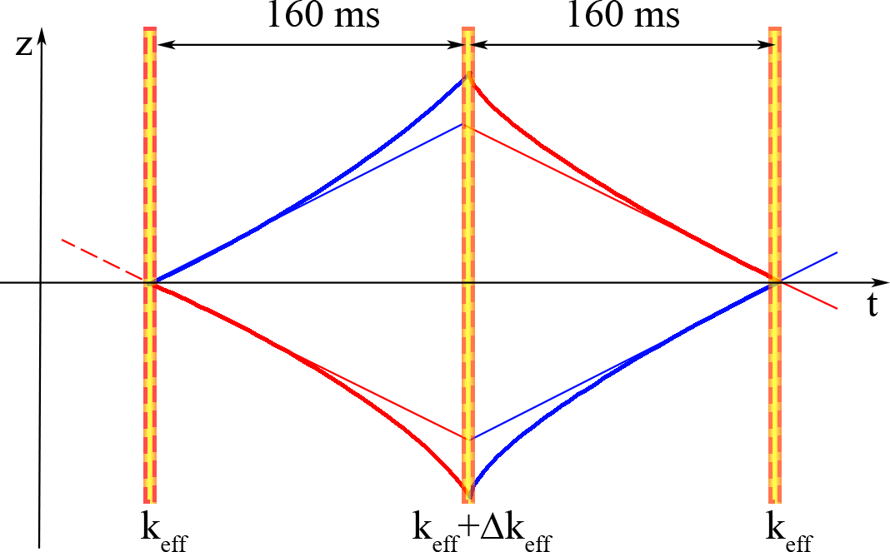
Cancelling gravity gradients
Readapting the effective wave vector k_{eff} of the π pulse it is possible to compensate the effect of Γ_{zz}^{[1]}
Δk_{eff} = (Γ_{zz}T²/2)k_{eff}
φ no longer depends on z₀ and v₀.
This procedure simulates the effect of a gravity gradient on the atomic trajectories. We implement it to measure gravity gradients, gravity curvature
[1] A. Roura, Phys. Rev. Lett. 118, 160401 (2017).
G. Rosi MEGANTE

Slide 23
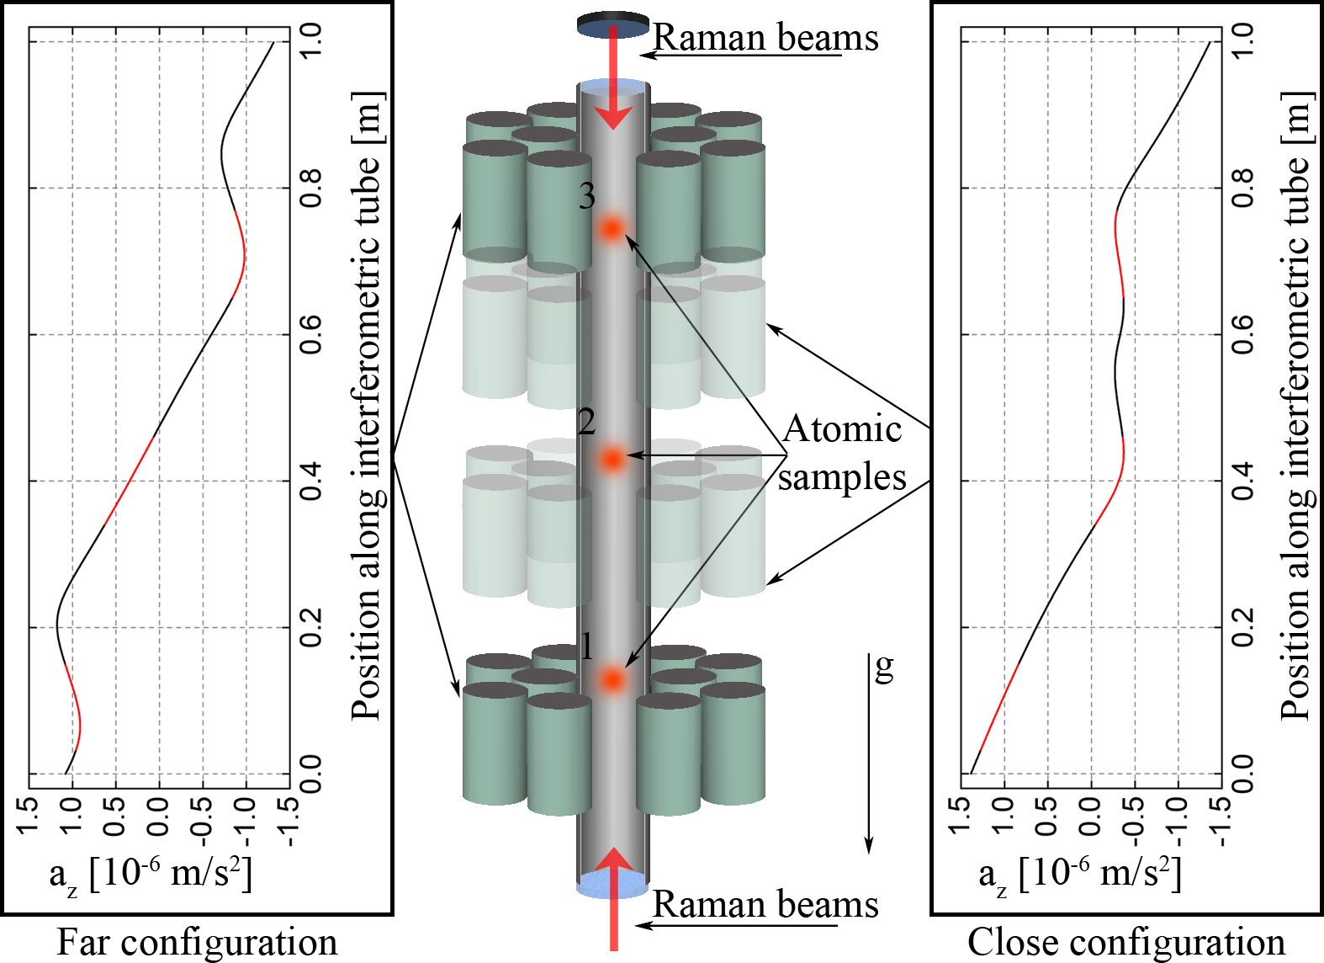
Cancelling gravity gradients
We simultaneously interrogate three clouds with the Raman interferometer for two source masses configurations. During the π pulse the frequency of the Raman lasers is changed by Δν*.
For the three gravity gradiometers (1-2, 2-3, 1-3) we measure the linear dependence Φ(Δν) vs Δν (Φ gradiometric phase)
Gravity gradient is traslated into a frequency!*
G. Rosi MEGANTE

Slide 24
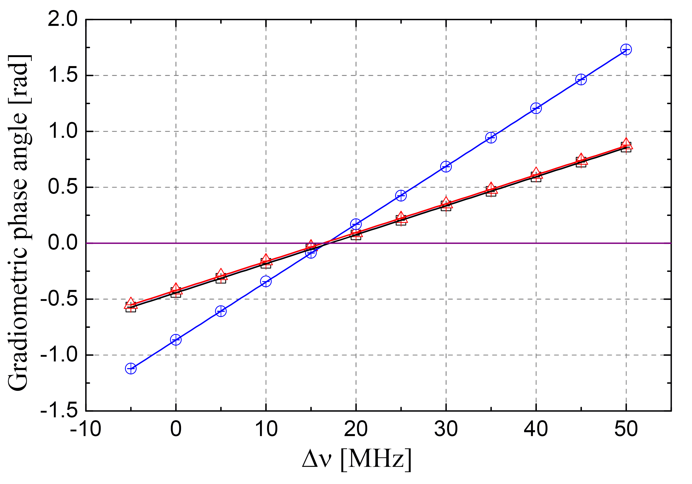
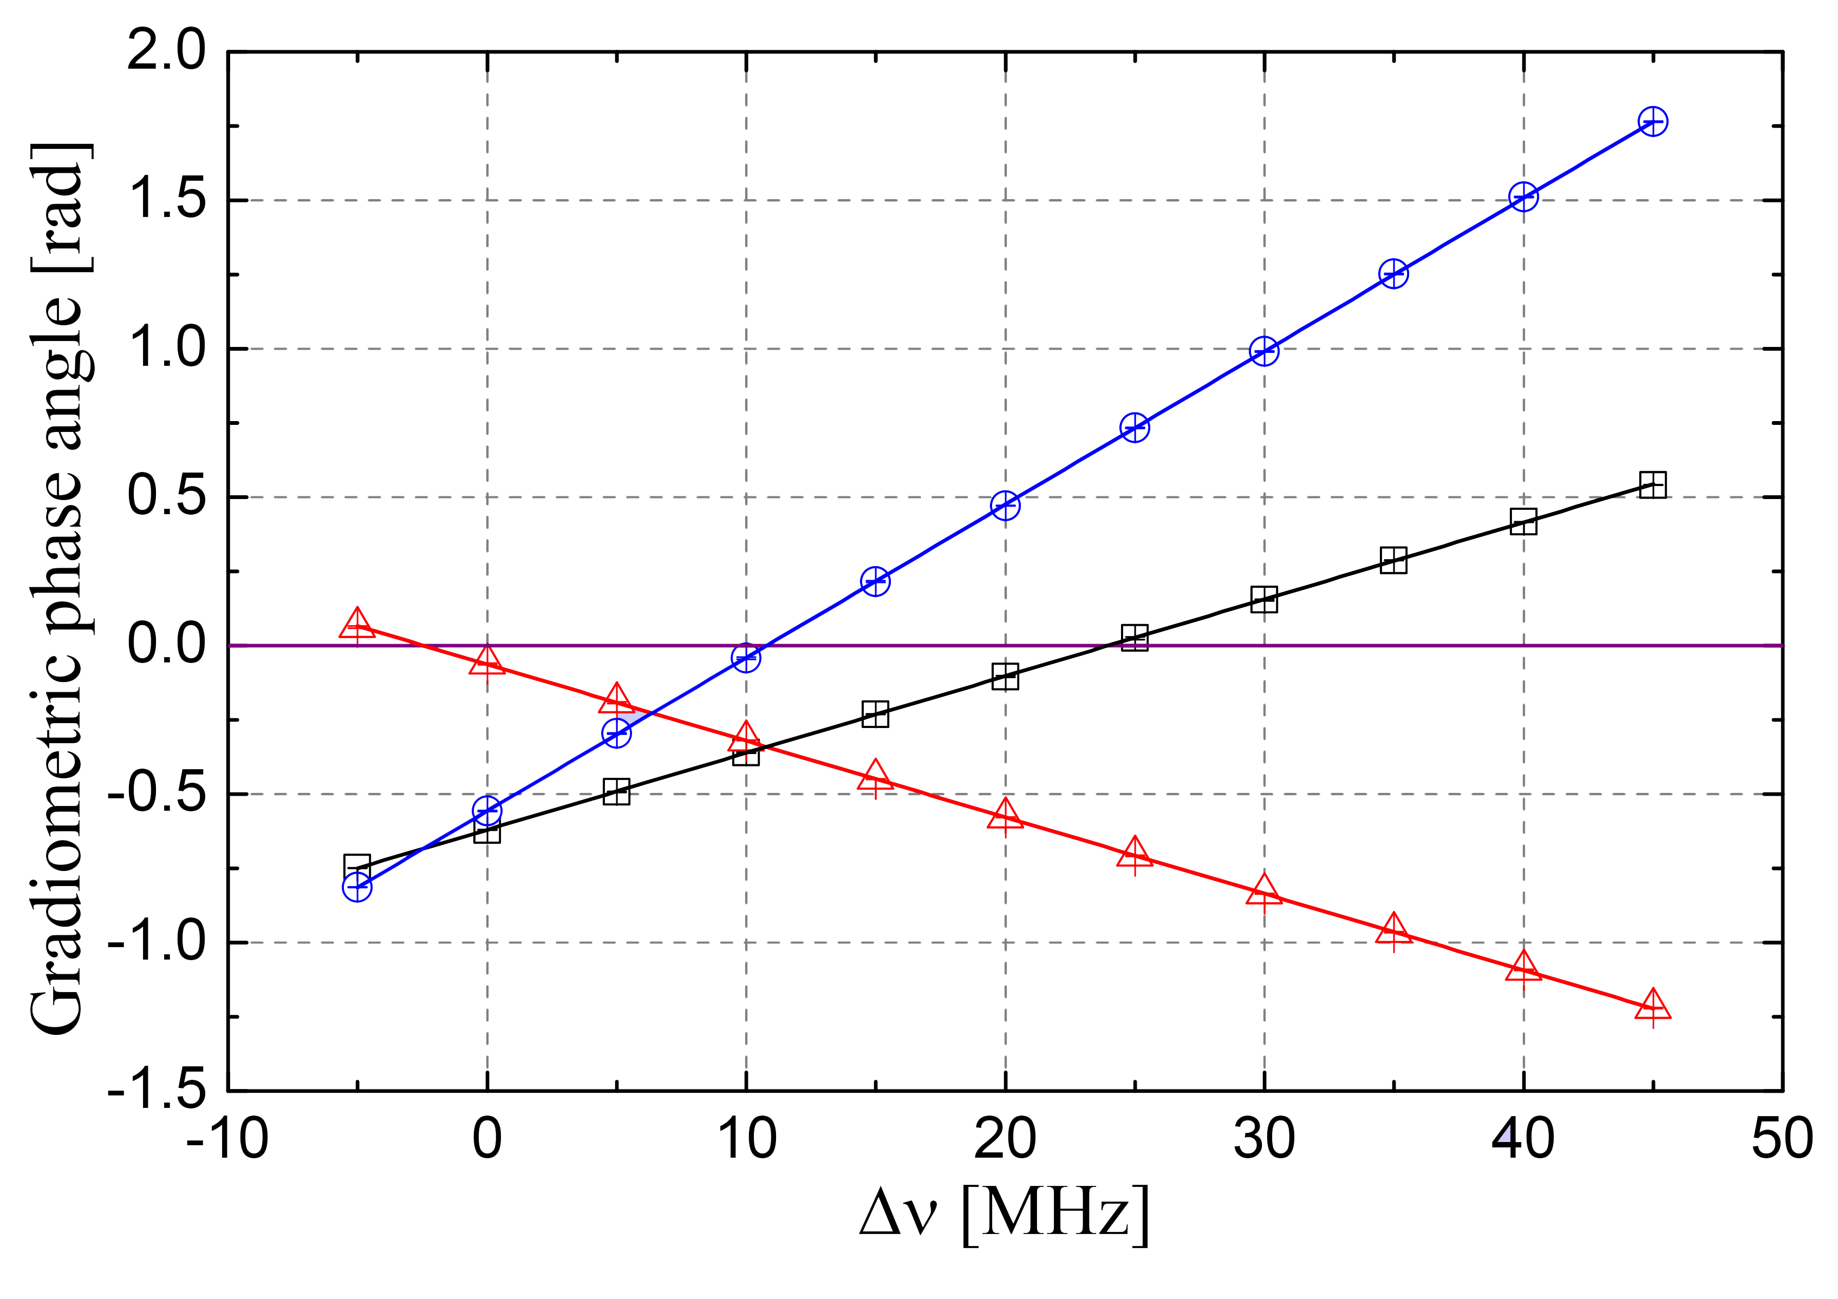
Cancelling gravity gradients
Final results*:
Far configuration
Close configuration
 | Γ₂₃ [10⁻⁶ s⁻²] | Γ₁₂ [10⁻⁶ s⁻²] | Γ₁₃ [10⁻⁶ s⁻²]
Far | -3,32 ± 0,02 | -3,48 ± 0,01 | -3,40 ± 0,01
Close | 0,497 ± 0,006 | -4,87 ± 0,01 | -2,193 ± 0,006
Measurements also provide gravity gradient sign.
As expected Γ₁₃ = (Γ₁₂ + Γ₂₃)/2.
Measured cloud distances and gravity curvature in close configuration:
d₂₃ = (307,2 ± 0,3)mm d₁₂ = (308,6 ± 0,4)mm
ξ_{close} = (Γ₂₃ - Γ₁₂)/d = (1,743 ± 0,004) x 10⁻⁵ m⁻¹s⁻²
*D’amico et al. PRL 2017
G. Rosi MEGANTE

Slide 25

A new experimental strategy for G*
The value of the gravity constant can be retrieved by measuring the corresponding modulation of the gravity gradient and thus of the zero crossing frequency Δν₀ :
$G∝ ΔΓ$ $∝$
The measurement is independent by the atomic sample size and velocity distribution if the gravity gradient produced by the source mass is perfectly linear
- Advantages: “easy” to implement (same technology of MAGIA, no need of ultra-cold atomic samples)
- Disadvanges: need of a large source mass
F
C
*G. Rosi, Metrologia (2018)
G. Rosi MEGANTE

Slide 26
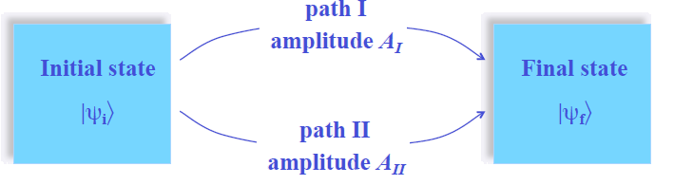
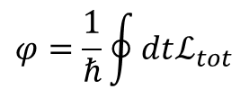
Another approach: the gravitational AB effect
Interferometer phase:
$$φ=\frac{1}{ℏ}\oint{dtℒ_{tot}}$$
The idea: determine G by probing the gravitational potential produced by a given source mass while the force acting on the wave-packets is zero*
*Hohensee et al., PRL, 2012
G. Rosi MEGANTE

Slide 27
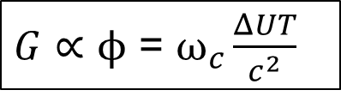
Another approach: the gravitational AB effect
- Advantages: phase accumulates at Compton frequency rate => light and small source masses
- Disadvanges: need of ultracold (1 nK or less) and small (< 1 mm) atomic samples; technique not yet experimentally demonstrated
$G∝$ $ϕ$ = $ω_{c}\frac{ΔUT}{c^{2}}$
G. Rosi MEGANTE

Slide 28


MEGANTE
MEasuring the Gravitational constant with Atom interferometry for Novel fundamental physics TEest

Slide 29
MEGANTE
A unique apparatus for independent measurements of G towards the puzzle solution & precision tests of gravity to unveil new physics scenarios
G. Rosi MEGANTE

Slide 30
MEGANTE
A unique apparatus for independent measurements of G towards the puzzle solution & precision tests of gravity to unveil new physics scenarios
TASK 1
Target relative accuracy on G: < 10⁻⁵
Investigation of the gravitational force
G. Rosi MEGANTE

Slide 31
MEGANTE
A unique apparatus for independent measurements of G towards the puzzle solution & precision tests of gravity to unveil new physics scenarios
TASK 1
Target relative accuracy on G: < 10⁻⁵
Investigation of the gravitational force
TASK 2
Target relative accuracy on G: ~10⁻⁵
Investigation of the gravitational potential
G. Rosi MEGANTE

Slide 32
MEGANTE
A unique apparatus for independent measurements of G towards the puzzle solution & precision tests of gravity to unveil new physics scenarios
TASK 1
Target relative accuracy on G: < 10⁻⁵
Investigation of the gravitational force
TASK 2
Target relative accuracy on G: ~10⁻⁵
Investigation of the gravitational potential
TASK 3
Precision test of gravity searching for dark energy signatures due to Chameleon scalar fields
G. Rosi MEGANTE

Slide 33
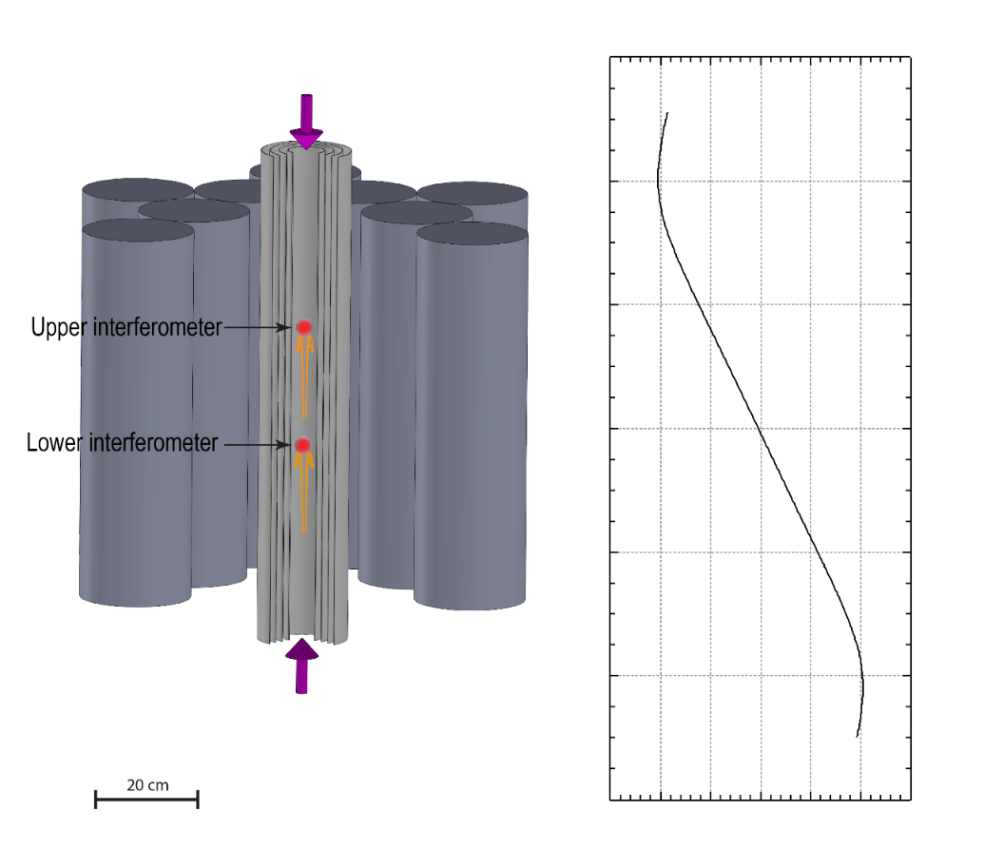
Focus on task 1
Acceleration (10⁻⁶ m/s²)
-3.0
3.0
1
Stationary point with vertical coordinates
Vertical coordinate z (m)
Statistics
0
Statistics:
12 stacks of tungsten cylinders (diameter 10 cm, height 0.6 m) => 4 tons of source masses to lift up!
T=0.22 s, d=0.23 , ΔΓ=5x10⁻⁶ s⁻², k_{eff} = 1.6x10⁷
5 μrad on phase for 10 ppm on G! (9 times better than MAGIA):
More atoms (less shot noise)
Larger k_{eff}
G. Rosi MEGANTE at LNF

Slide 34
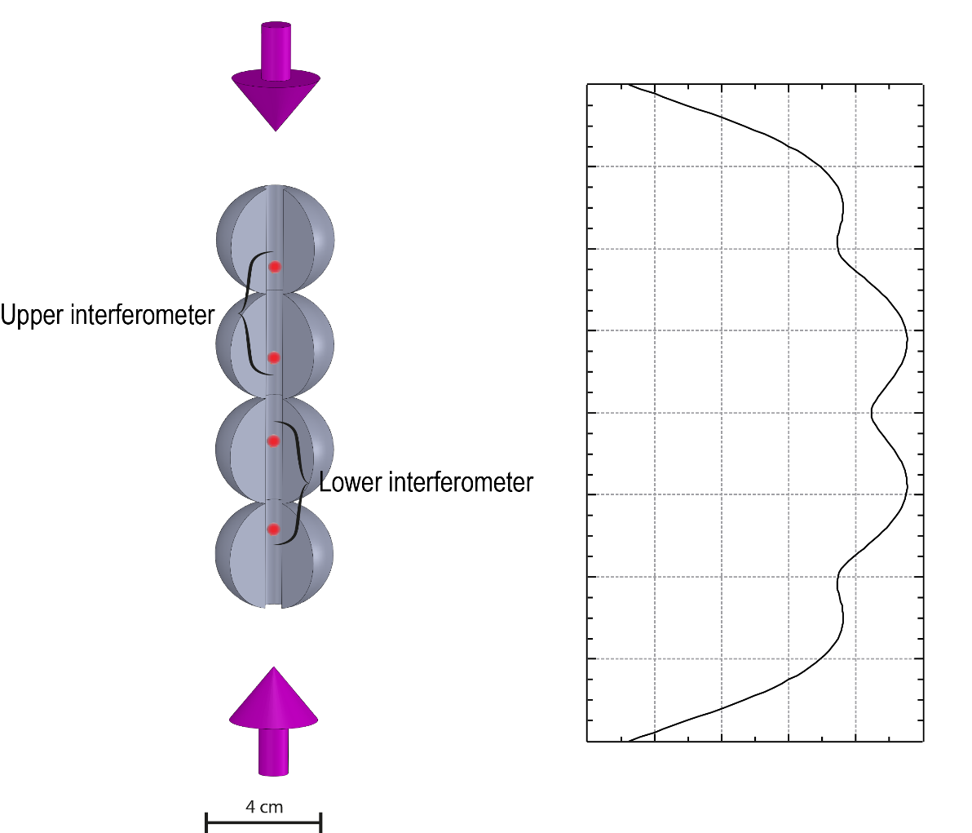
Focus on task 2
The idea: determine G by probing the gravitational potential produced by a given source mass while the force acting on the wave-packets is zero (Gravitational Aharonov-Bohm effect¹ ).
MEGANTE experimental strategy:
State-of-art atom optics for wave packet manipulation 2
+
Source mass design to allow
gradiometric configuration
Atom optic laser
Source mass grav. potential
Vertical coordinate z
Issue: Small potential from the source mass in a large gravitational field
Solutions:
Gradiometer baseline fixed by splitting a single atomic sample
Systematics from initial position fluctuation attenuated by the common local value of second derivative of the potential
Atom optic laser
¹ Hohensee et al., PRL, 2012 ² Kovachy et al., Nature, 2015
G. Rosi MEGANTE

Slide 35
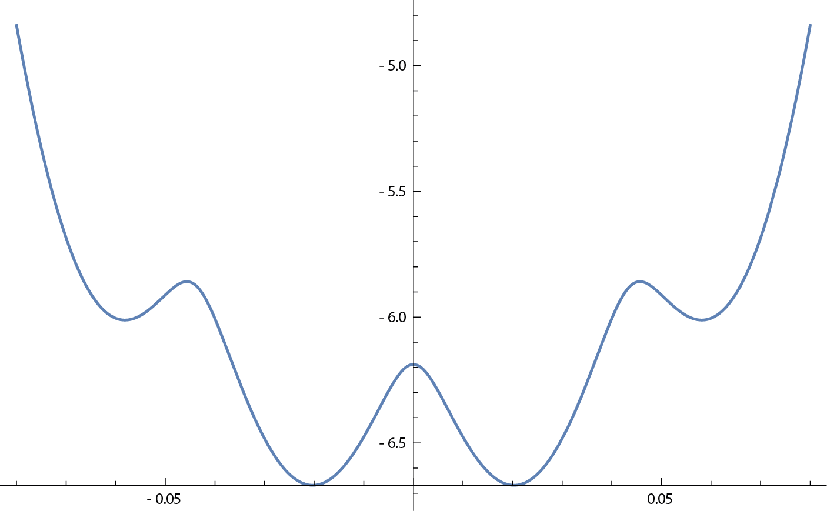


Focus on task 2
Phase (T=1s)
Gradiometric phase
$$Φ=\frac{m_{Rb}2ΔUT}{ℏ}$$
$$=ω_{c}\frac{2ΔUT}{c^{2}}$$
ΔU
Gravitational red shift!
z (m)
Relative shift on Φ (ppm)
High immunity from sample size and position!
Gradiometer displacement (m)
2
4
G. Rosi MEGANTE

Slide 36
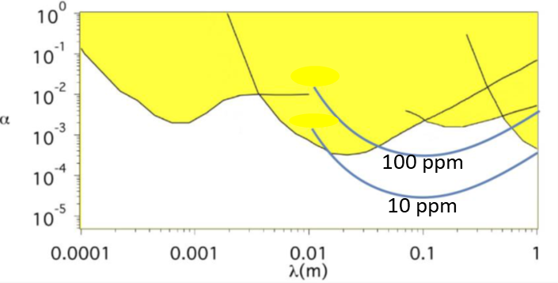
Newtonian ISL test
Several theories (involving extradimensions) predict deviations from the Newtonian law of Gravitational according to the Yukawa formula
The quantity (G_{F}/G_{AB}-1) can be used as a null test to improve the current constrains in the 0.01-1 m range!
G. Rosi MEGANTE

Slide 37


Chameleon gravity
Chameleon is a hypothetical scalar particle recently postulated as a dark energy candidate.
Its main characteristic consists to have a coupling mechanism which gives to the scalar field a value depending on the local density of matter:
  Λ sets the strength of the self-interaction/Dark energy scale;
  M determines the coupling between the chameleon and matter;
n=1
n=1
$$\text{φ}\text{C}$$
$$\text{φ}\text{C}$$
Low density
High density
From Burrage C, Sakstein J. Tests of chameleon gravity. Living Reviews in Relativity. 2018
G. Rosi MEGANTE

Slide 38
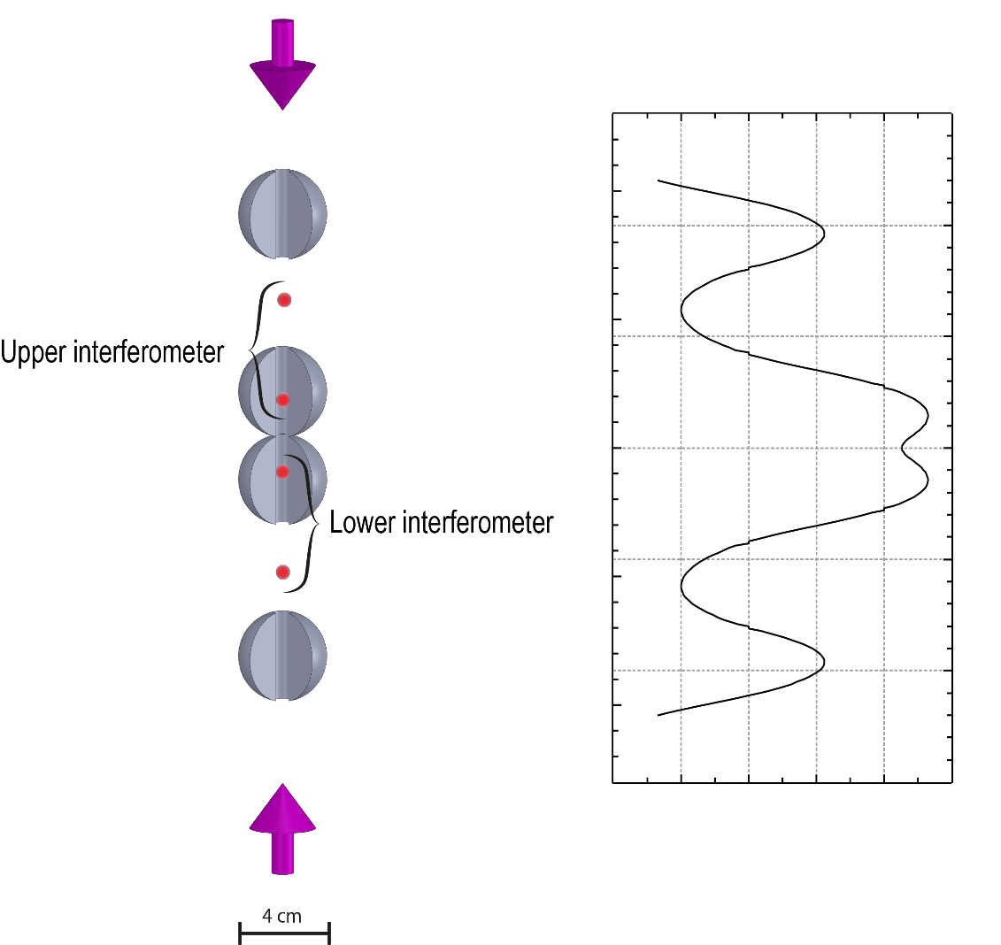
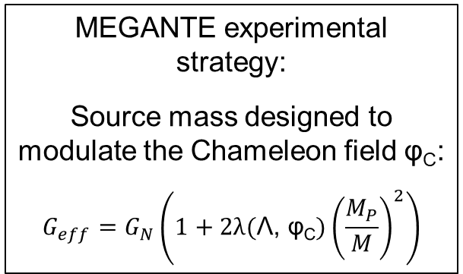
Focus on task 3
Atom optic laser
Source mass grav. potential
MEGANTE experimental strategy:
Source mass designed to modulate the Chameleon field φ_{C}:
$$G_{eff}=G_{N}\left(1+2λ(\text{Λ}\text{, }\text{φ}\text{C}{)\left(\frac{M_{P}}{M}\right)}^{2}\right)$$
Vertical coordinate z
Internal
pair
External
pair
Opposite value of second derivative of the potential
Larger systematic effects due to the cloud position jittering!
Target relative accuracy on G: 100 ppm
Atom optic laser
G. Rosi MEGANTE

Slide 39
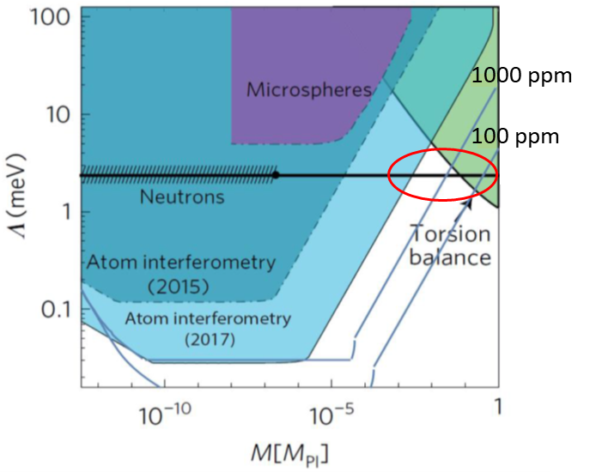
Expected results
Complete exploration of M parameter for Λ~2.4 meV (<= cosmic acceleration)
G. Rosi MEGANTE

Slide 40
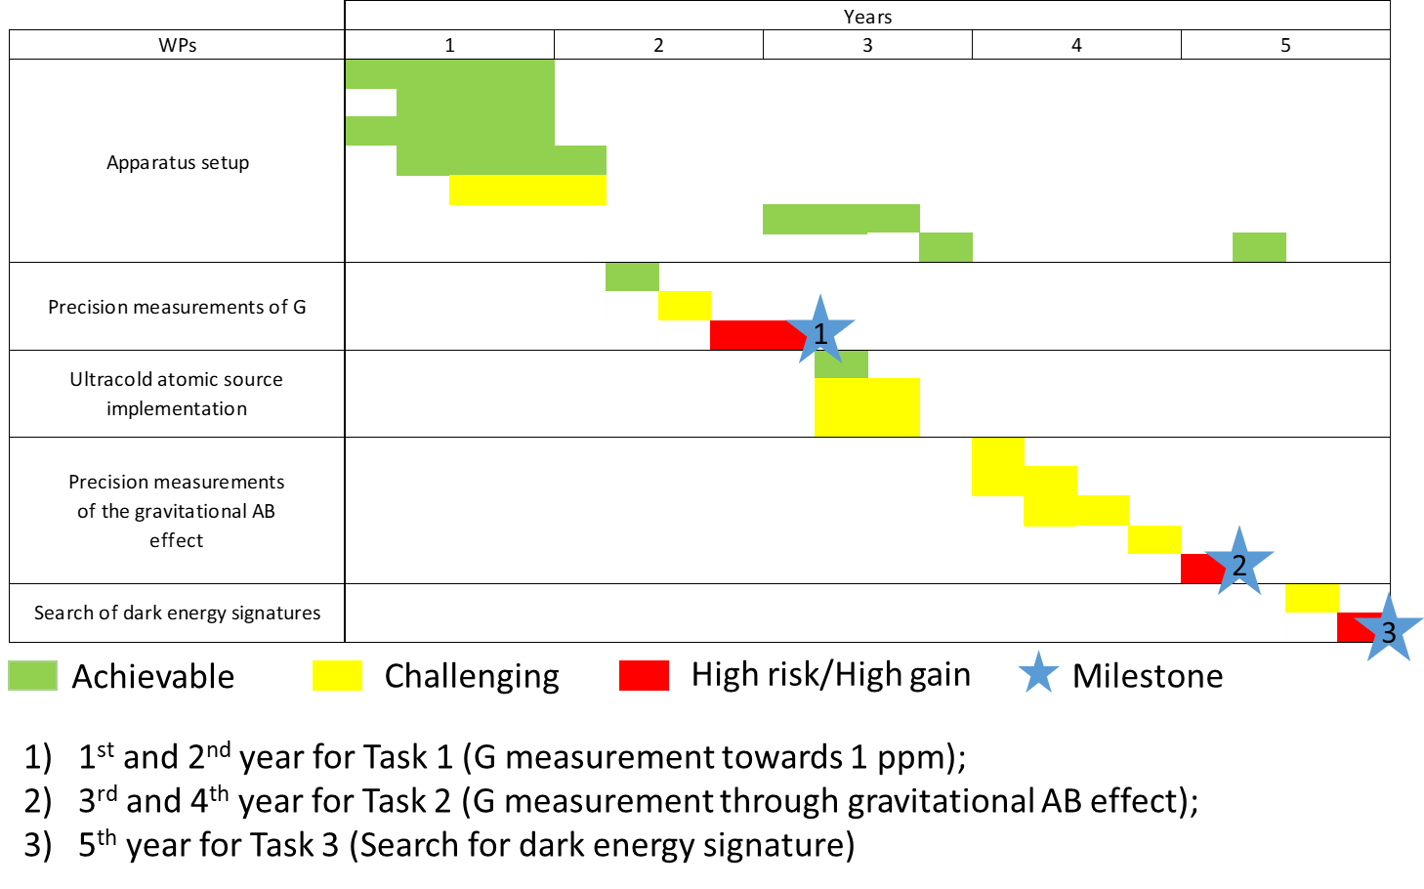
The Roadmap
Starting date: 1st of February 2019
G. Rosi MEGANTE

Slide 41
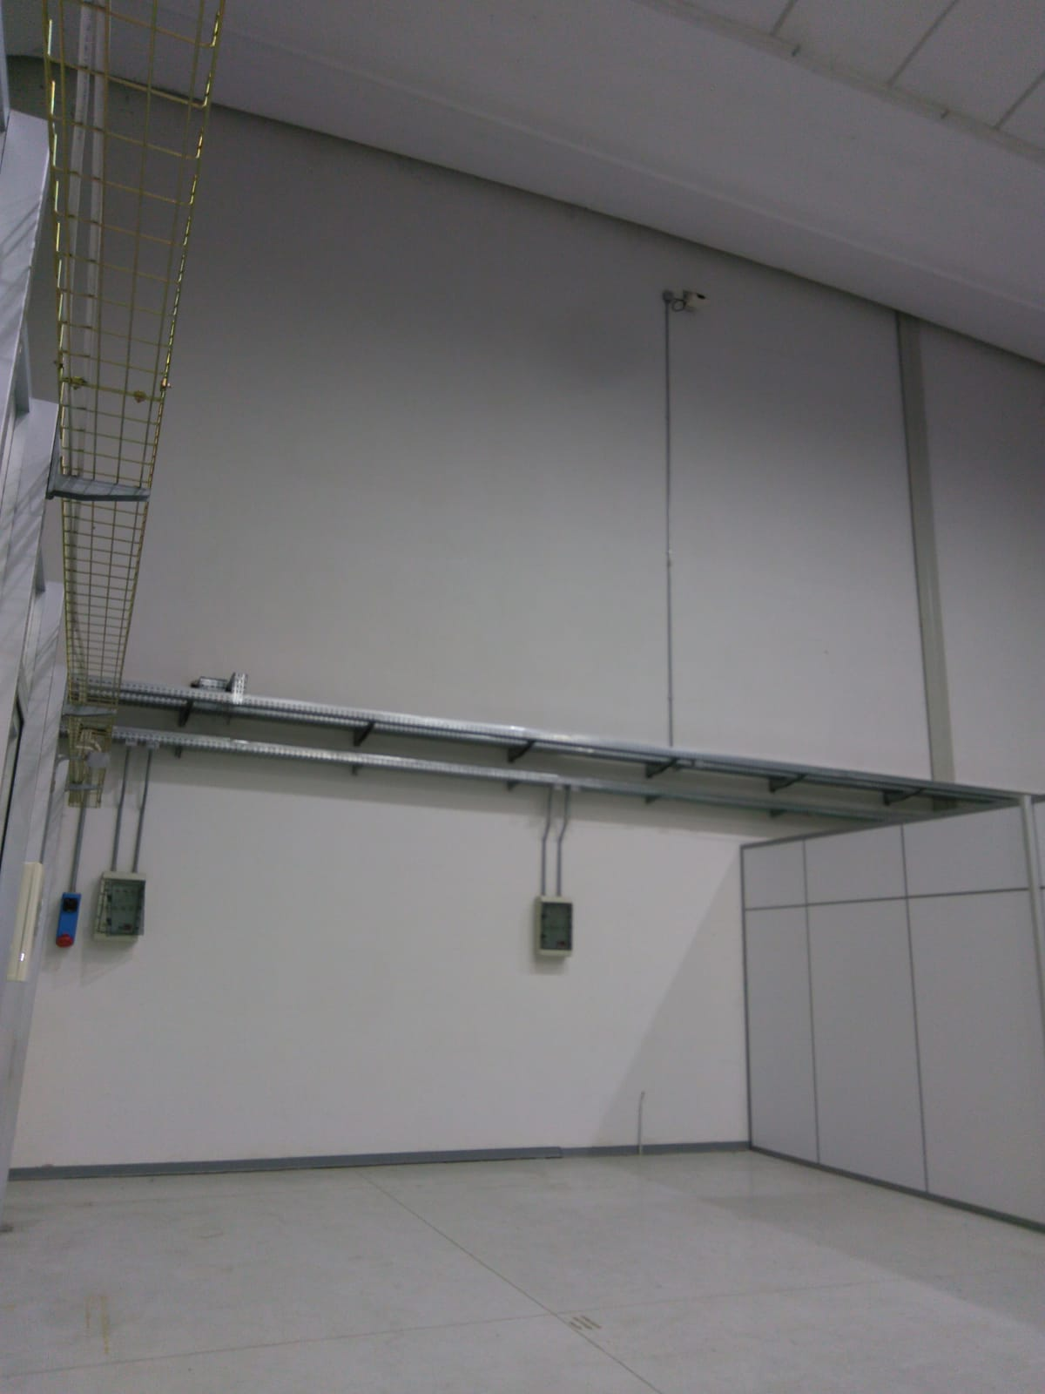
Location
G. Rosi MEGANTE

Slide 42
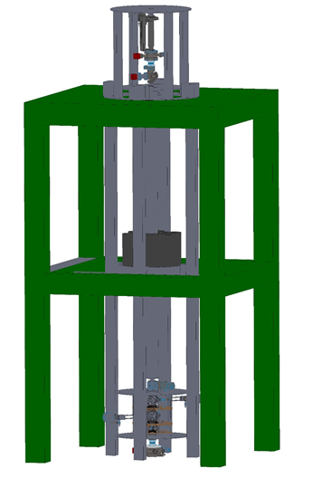

Conclusions
Lab space (50 m² for 7 m of maximum height)
Building equipped with a crane
Design of the vacuum system
Design of the laser system
Preliminary Monte Carlo simulation of the system
Open points:
Infrastructure design
Source mass handling system design
(4-5 tons to be lifted for 4 m)
Air conditioning of the room (0.1 °C)
Need of the Engineering Support
for Experimental Apparatus (SPAS)
of the LNF
G. Rosi MEGANTE

