Slide 1
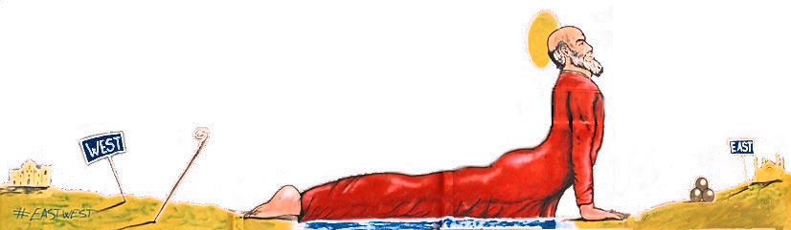



News of the Local Organising Committee
2nd Scientific Committee Meeting
28 February 2019
Piet Verwilligen
INFN sez. Bari
On behalf of the local organising committee:
A. Colaleo, A. Ranieri, R. Venditti, P. Verwilligen (INFN)
G. Iaselli (PoliBA), S.Nuzzo (UniBA)
A. Lorusso, D. Manno, M. Martino A. Perrone (UniSAL)
BARI, Febr 28 2019

Slide 2
Overview
Communication:
  Indico.infn.it/e/rcgd19
  Poster
  Need to spread the voice now
Organisation:
  Hotels
  Catering
Invited Speakers
Agenda Proposal
Scientific Discussion

Slide 3
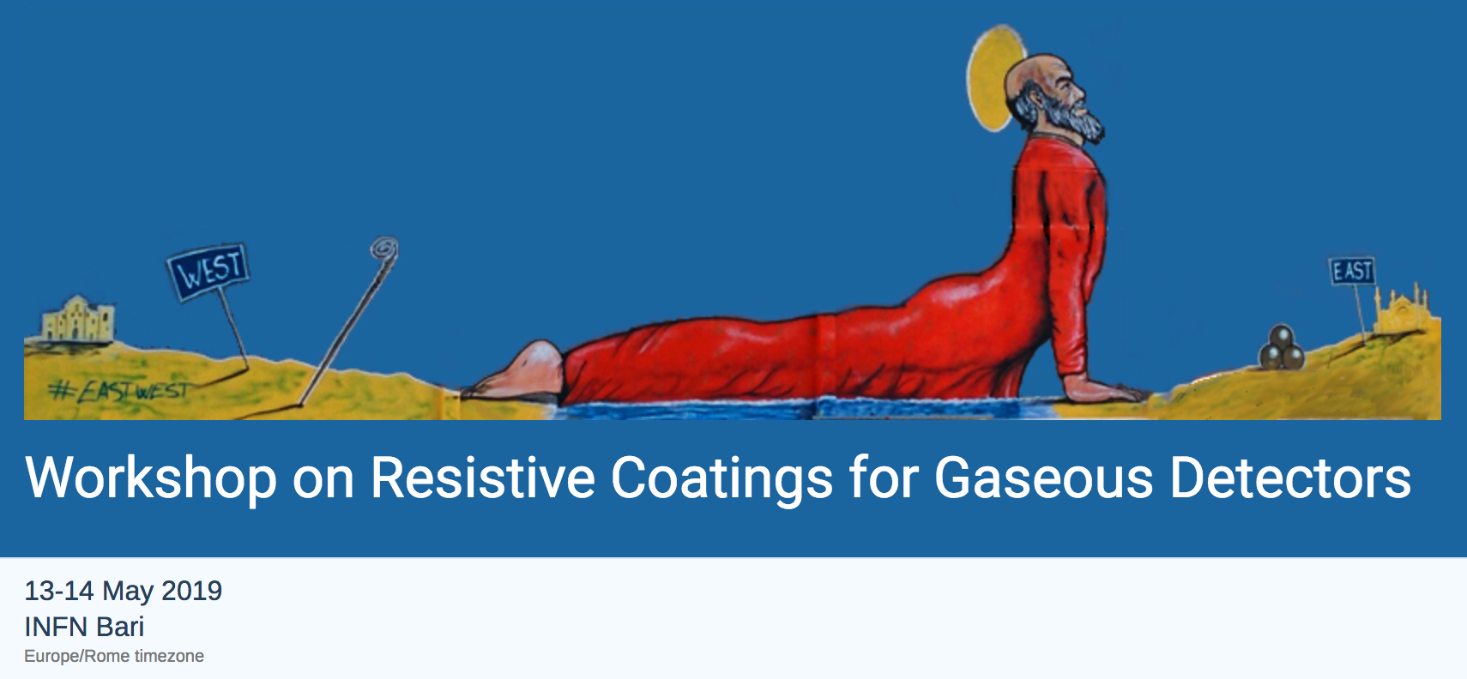
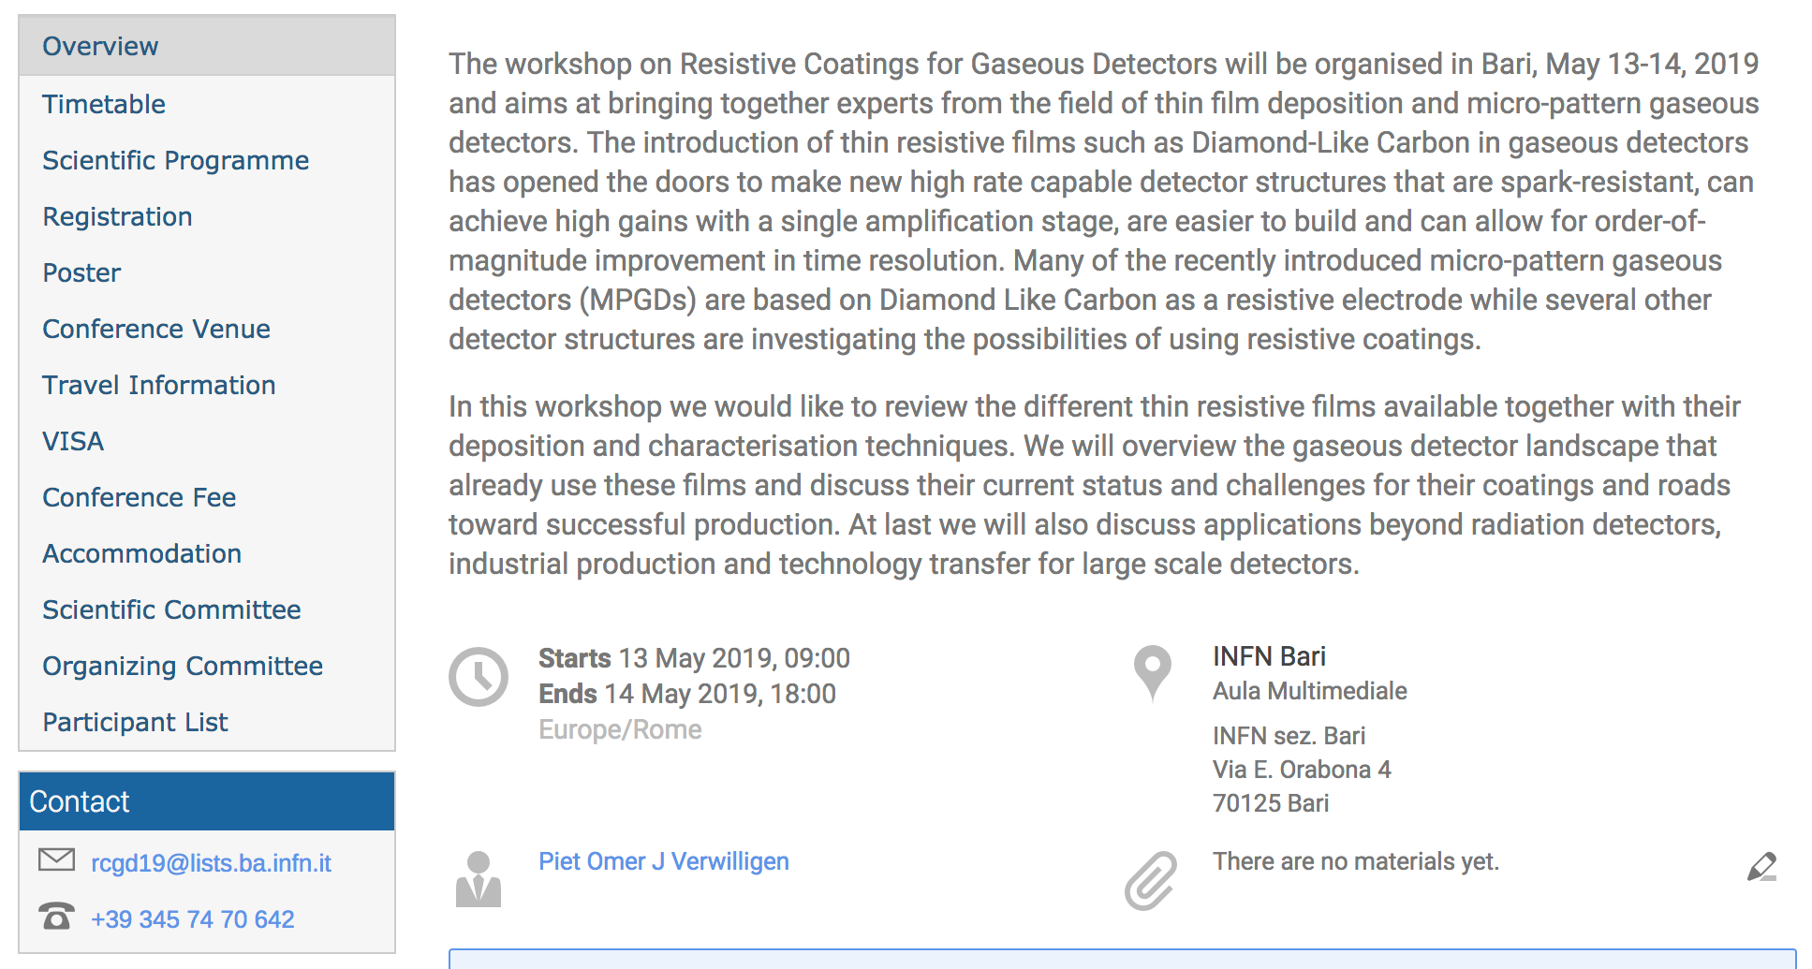

Slide 4
Invited Speakers
Andrea Ferrari - DLC State of the Art
Antonio Miotello - Deposition Techniques
Esteban Broitman - DLC Characterization

Slide 5
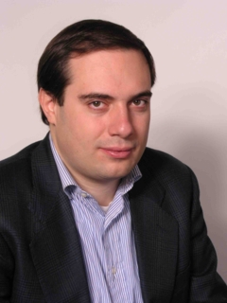

Andrea C. Ferrari
Professor of nanotechnology at the University of Cambridge. He founded and directs the Cambridge Graphene Centre and is the Science and Technology Officer of the 1B EUR European Graphene Flagship, on Future Emerging Technologies.
He is Fellow of the American Physical Society and has also received three European Research Council Awards
His research interests include growth, modelling, characterisation and devices based on nanomaterials. In particular he has made pioneering contributions in the field of carbon-based nanotechnology, developing graphene, nanotubes, diamond-like carbon for electronics and photonics. He has published over 330 scientific articles and his work has been cited over 71,000 times, with an H index of 96. In 2014, 2015, 2016 he was among the most cited researchers in the world (info from 2017)

Slide 6
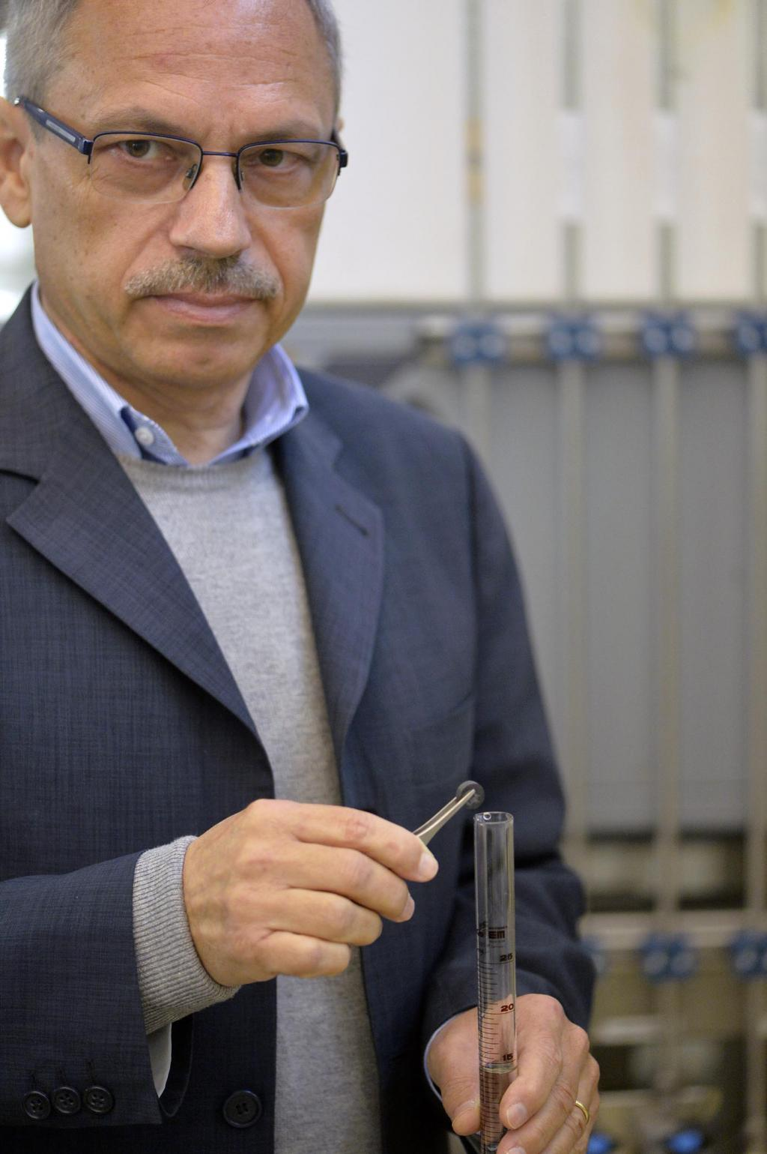
Antonio Miotello
Vice Director Department of Physics University of Trento
Full Professor of Physics
Expert in Pulsed Laser Deposition

Slide 7
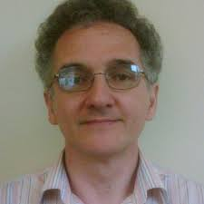
Esteban Broitman
Senior Scientist
SKF Research & Technology Development Center
Nieuwegein, Utrecht, Netherlands
Esteban Broitman holds a Ph.D. in Physics from the University of Buenos Aires (Argentina), and a Docent (Habilitation) degree in Tribology from Linköping University (Sweden). He has been doing research and teaching at the University of Buenos Aires, The College of William & Mary (USA), Carnegie Mellon University (USA), Linköping University, and invited Professor at University of Sao Pablo (Brazil), and the Chinese Academy of Sciences. He is presently a Senior Scientist in the area of Coatings at the SKF Research and Technology Development Center in Netherlands. His activities focus on the use of advanced surface engineering to control friction and wear at the macro-, micro-, and nano-scales. He is especially world-wide known for his work on carbon-based coatings (like carbon-nitride films)

Slide 8
Agenda Proposal: Monday 13/05
1st Session: Introduction & Past Experience with DLC for MPGD
  Atsuhiko Ochi with input of us all to give direction to the meeting
2° Session: Resistive Thin Films
  Invited speaker: prof Andrea Ferrari – DLC state of the Art
  Overview of different materials – Editor Applied Surface Sciences
  Traditional techniques for Gaseous Detectors (e.g. screen printing) - Paul Colas?
  Diamond Powder for Photo Cathodes – Antonio Valentini
3° Session: Deposition Techniques
  Invited speaker: prof Antonio Miotello – DLC Deposition Techniques
  Properties of Thin Films made by Magnetron Sputtering in China & Japan – L Shang?
  Properties of Thin Films made by Pulsed Laser Deposition in Italy – AP Caricato
  Properties of Thin Films made by Ion Beam Deposition in Italy – A Valentini
  Adhesion of DLC to other materials and Temperature effects on Thin Films – ???
4° Session: Production of MPGDs with DLC
  Etching Procedure for DLC coated Polyimide foils (uRWELL, FTM) – Rui De Oliveira
  Techniques for Micro-Patterning and lift-off technique for MicroMegas and uPIC – A. Ochi?
Leave additional Discussion time at the end of each session?

Slide 9
Agenda Proposal Tuesday 14/05
3° Session: Characterization of Thin Films
  Invited speaker: Esteban Broitman – Characterization of DLC films
  Talks on different characterisation techniques?
5° Session: Physics Simulation & Signal Propagation
  Need to discuss here…
6° Session: Applications in HEP & Beyond
  Here we could go in more detail on the different detectors and the development schedule?
7° Session: Industrialization
  Contacts with external companies: ELTOS, Techtra, Micropack, … ?
Discussion & Wrap-Up

