Slide 1




Fabio Fuschino
(INAF – OAS Bologna)
on behalf of the
THESEUS international collaboration
http://www.isdc.unige.ch/theseus/
Amati et al. 2017 ( Adv.Sp.Res., arXiv:1710.04638 )
Stratta et al. 2017 (Adv.Sp.Res., arXiv:1712.08153)
16-18 May 2019 Rocca di Sant’Apollinare

Slide 2
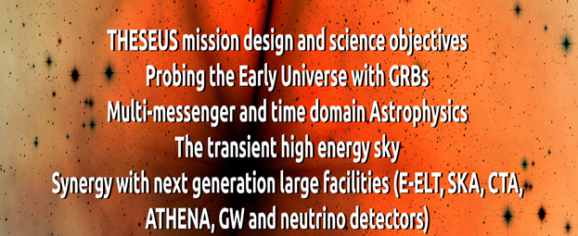
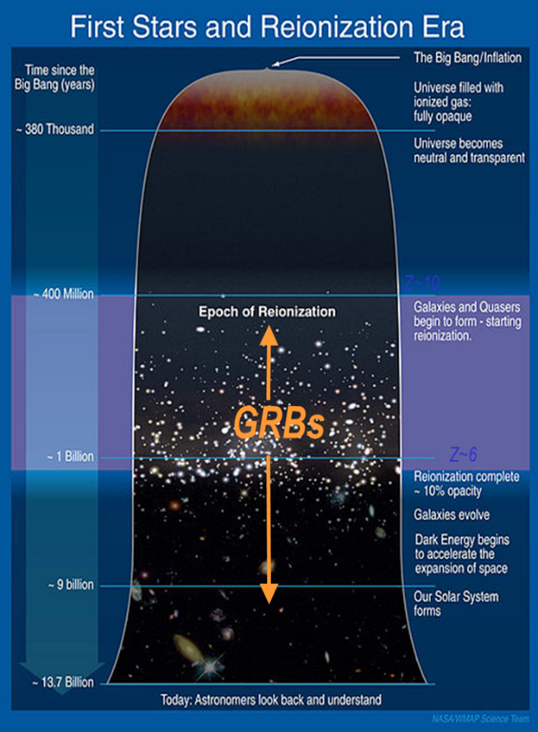
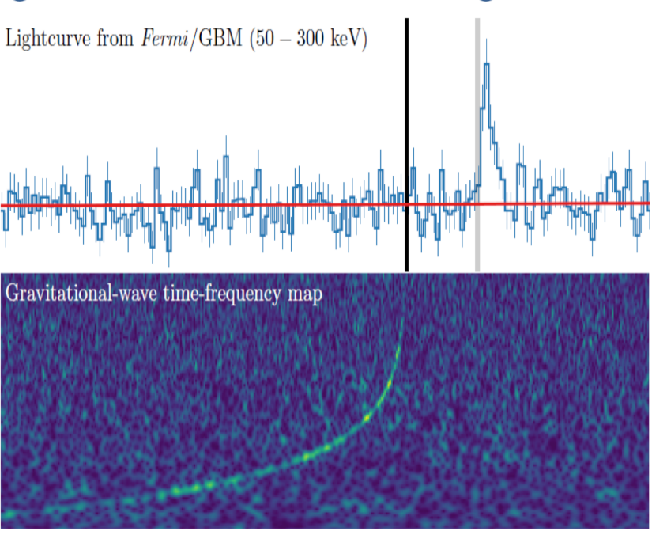

Slide 3
THESEUS Transient High Energy Sky and Early Universe Surveyor Lead Proposer (ESA/M5): Lorenzo Amati (INAF – OAS Bologna, Italy) Coordinators (ESA/M5): Lorenzo Amati, Paul O’Brien (Univ. Leicester, UK), Diego Gotz (CEA-Paris, France), C. Tenzer (Univ. Tuebingen, D), E. Bozzo (Univ. Genève, CH) Payload consortium: Italy, UK, France, Germany, Switzerland, Spain, Poland, Czech Republic, Ireland, Hungary, Slovenia , ESA Interested international partners: USA, China, Brazil

Slide 4

May 2018: THESEUS selected by ESA for M5 Phase 0/A study
Smooth CDF study, successful MDR -> Phase A
Efficient and positive interaction between ESA and consortium

Slide 5
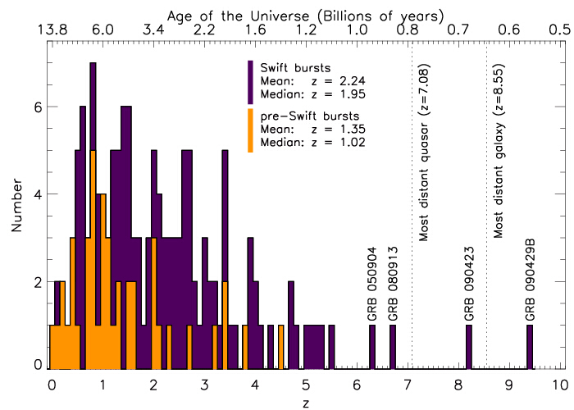
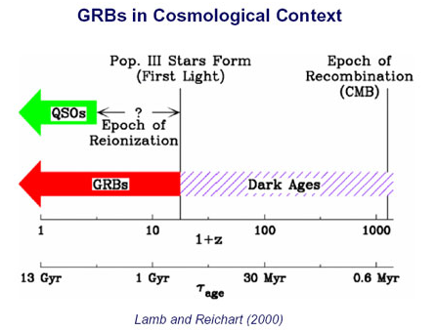
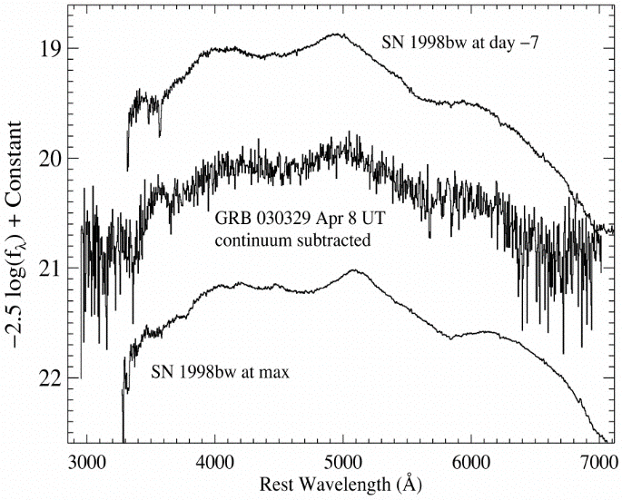
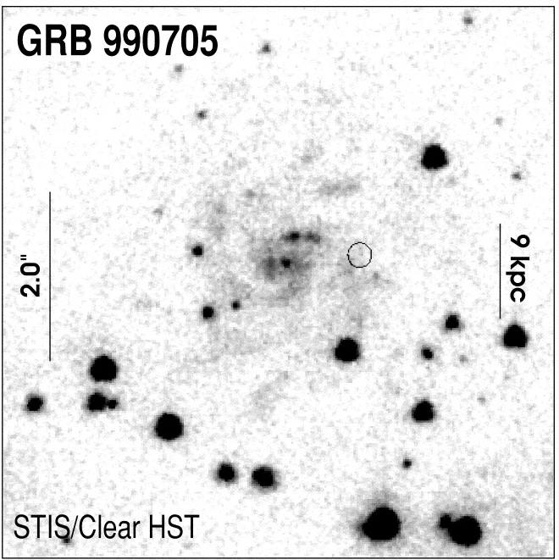
Shedding light on the early Universe with GRBs
Because of their huge luminosities, mostly emitted in the X and gamma-rays, their redshift distribution extending at least to z ~9 and their association with explosive death of massive stars and star forming regions, GRBs are unique and powerful tools for investigating the early Universe: SFR evolution, physics of re-ionization, galaxies metallicity evolution and luminosity function, first generation (pop III) stars

Slide 6
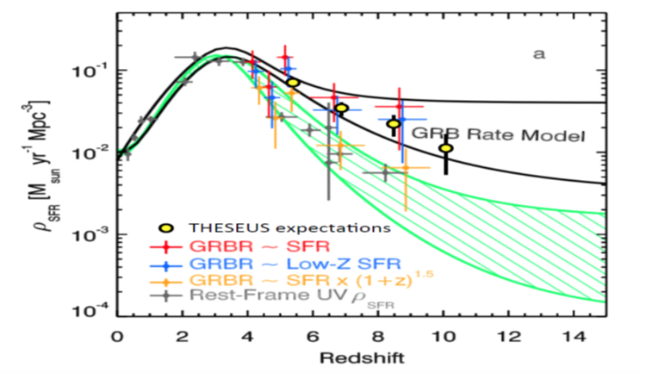
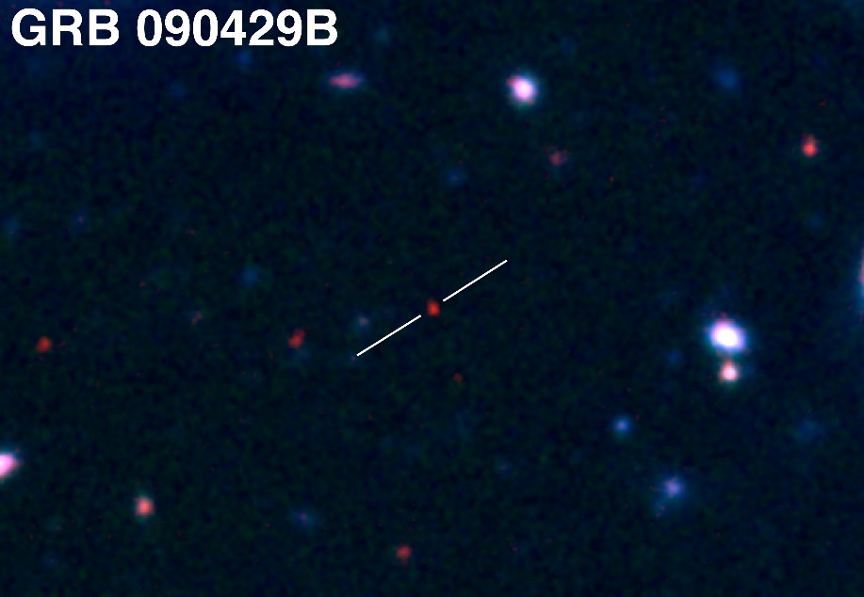
A statistical sample of high–z GRBs can provide fundamental information:
measure independently the cosmic star–formation rate, even beyond the limits of current and future galaxy surveys
directly (or indirectly) detect the first population of stars (pop III)
From Robertson&Ellis12
Z = 9.2

Slide 7
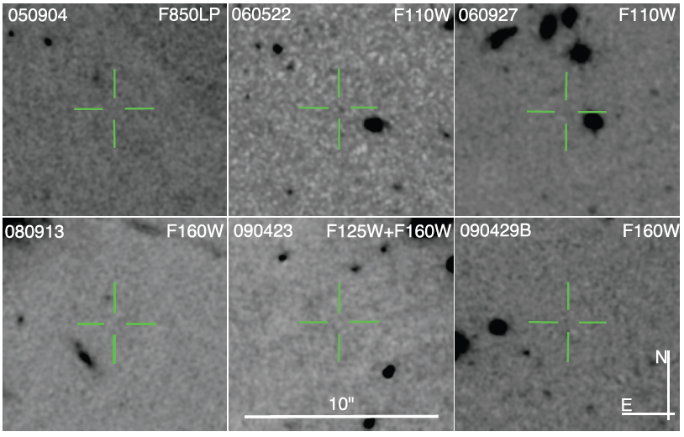
the number density and properties of low-mass galaxies
z=6.29; M_{AB} > 28.86
Z=5.11; M_{AB} > 28.13
Z=5.47; M_{AB} > 28.57
Z=6.73; M_{AB} > 27.92
Z=8.23; M_{AB} > 30.29
Z=9.4; M_{AB} > 28.49
Tanvir+12
Robertson&Ellis12
Even JWST and ELTs surveys will be not able to probe the faint end of the galaxy Luminosity Function at high redshifts (z>6-8)

Slide 8
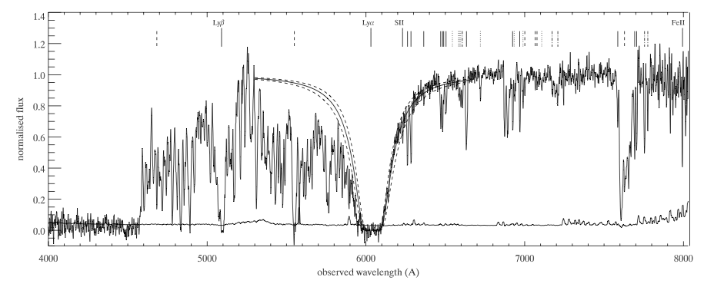
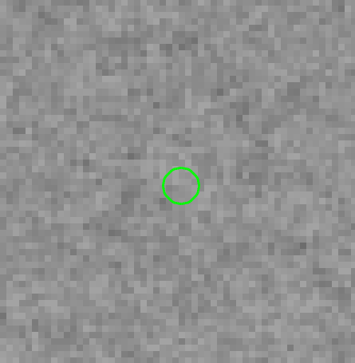
the neutral hydrogen fraction
the escape fraction of UV photons from high-z galaxies
the early metallicity of the ISM and IGM and its evolution
Abundances, HI, dust, dynamics etc. even for very faint hosts. E.g. GRB 050730: faint host (R>28.5), but z=3.97, [Fe/H]=-2 and low dust, from afterglow spectrum (Chen et al. 2005; Starling et al. 2005).
Forest (IGM)
Metals
HST/ACS
Ly-limit
HI(Lya)
Courtesy N. Tanvir

Slide 9
the neutral hydrogen fraction
the escape fraction of UV photons from high-z galaxies
the early metallicity of the ISM and IGM and its evolution
Abundances, HI, dust, dynamics etc. even for very faint hosts. E.g. GRB 050730: faint host (R>28.5), but z=3.97, [Fe/H]=-2 and low dust, from afterglow spectrum (Chen et al. 2005; Starling et al. 2005).
Forest (IGM)
Metals
HST/ACS
Ly-limit
HI(Lya)
Courtesy N. Tanvir

Slide 10
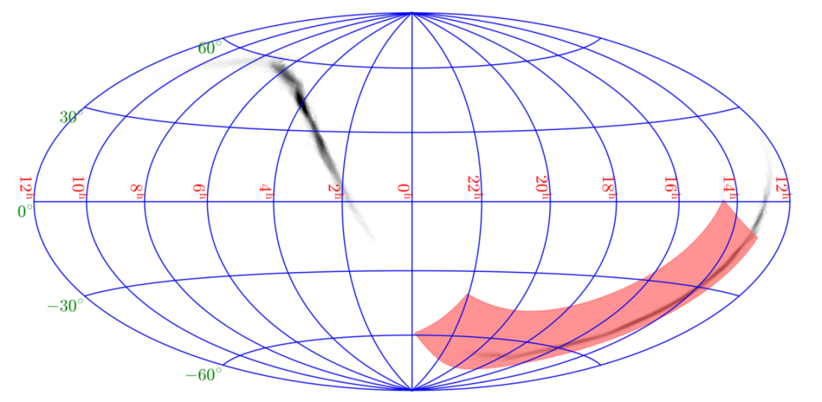
Exploring the multi-messenger transient sky
Locate and identify the electromagnetic counterparts to sources of gravitational radiation and neutrinos, which may be routinely detected in the late ‘20s / early ‘30s by next generation facilities like aLIGO/aVirgo, ET, CE, LISA or Km3NET;
Provide real-time triggers and accurate (~1 arcmin within a few seconds; ~1’’ within a few minutes) high-energy transients for follow-up with next-generation optical-NIR (E-ELT, JWST if still operating), radio (SKA), X-rays (ATHENA), TeV (CTA) telescopes; synergy with LSST
Provide a fundamental step forward in the comprehension of the physics of various classes of transients and fill the present gap in the discovery space of new classes of transients events
Notes:
SI PUO SALTARE?????

Slide 11
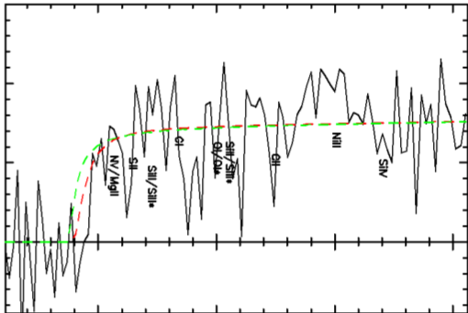
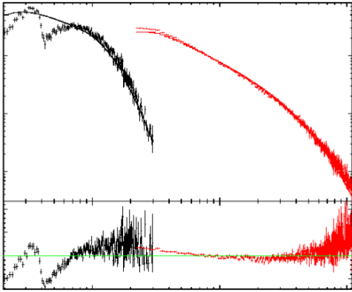
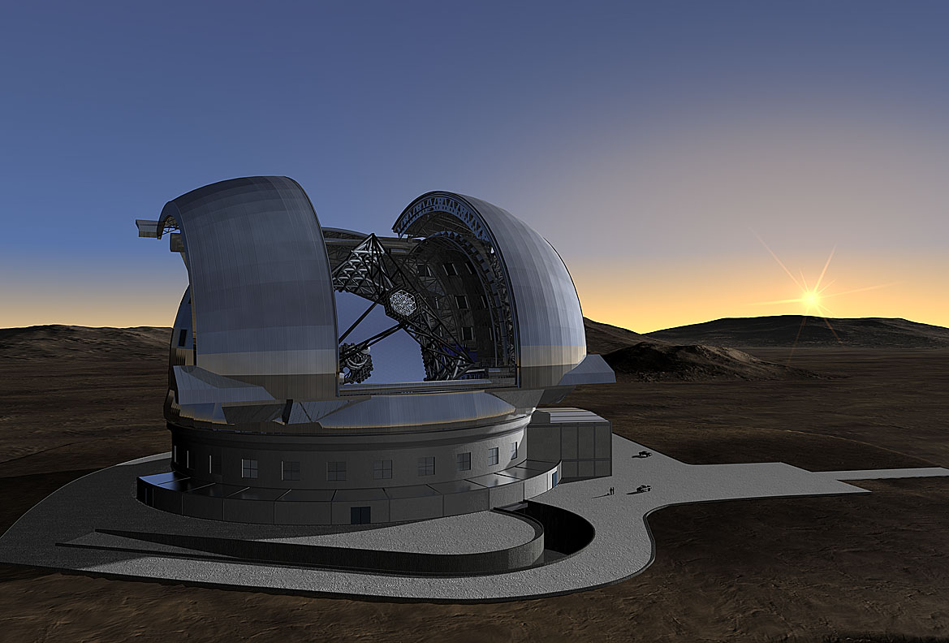
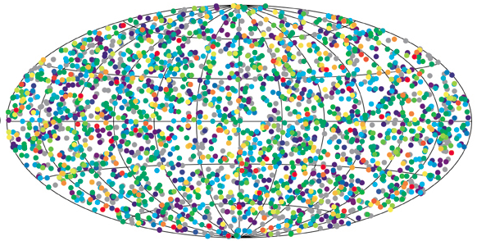
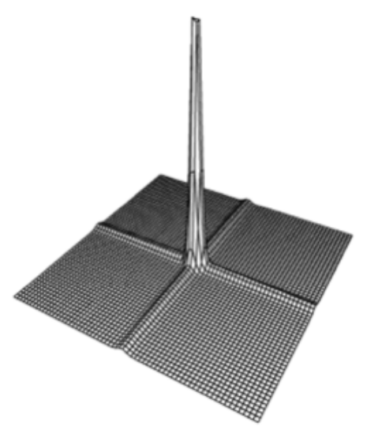
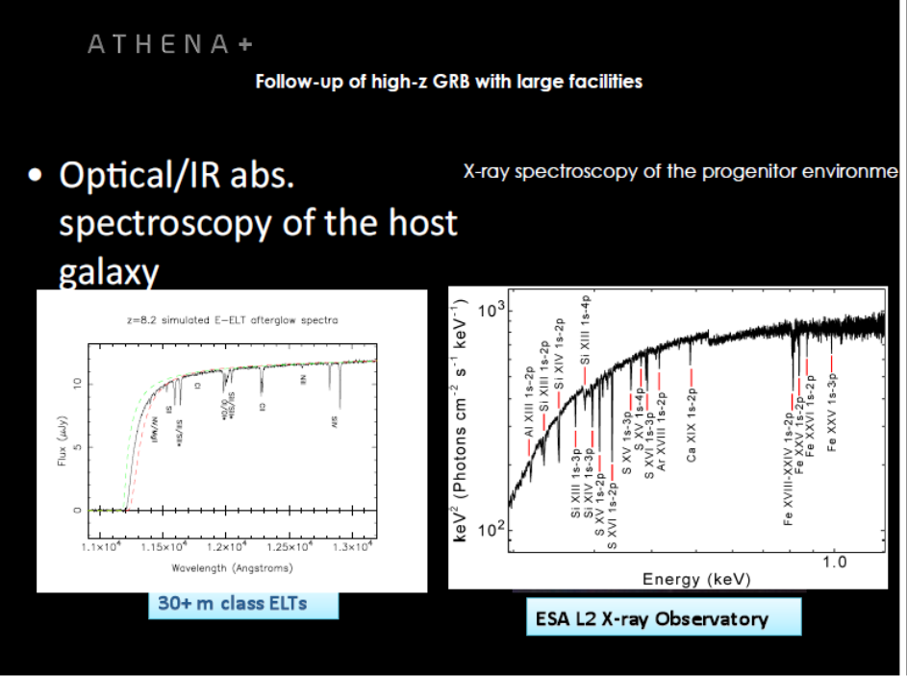
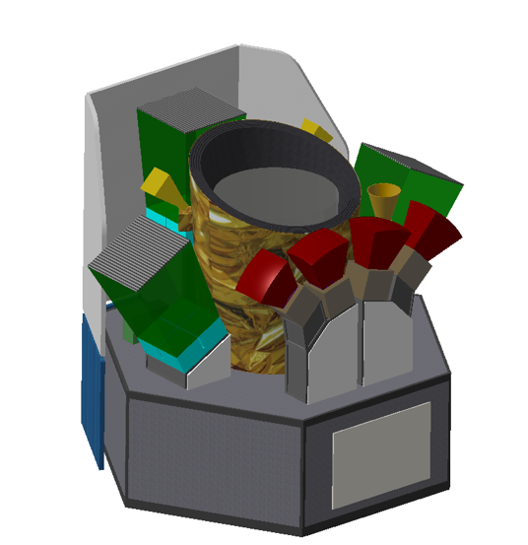
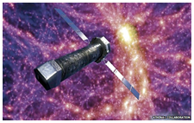
  Star formation history, primordial galaxies
  GRB accurate localization and NIR, X-ray, Gamma-ray characterization, redshift
ELT TMT GMT
Neutral fraction of IGM, ionizing radiation escape fraction
Cosmic chemical evolution, Pop III
ELT TMT GMT
ATHENA
THESEUS SYNERGIES
Notes:
Darach mentions paper on envelope stripping by the general environment in rich OB assocs.

Slide 12

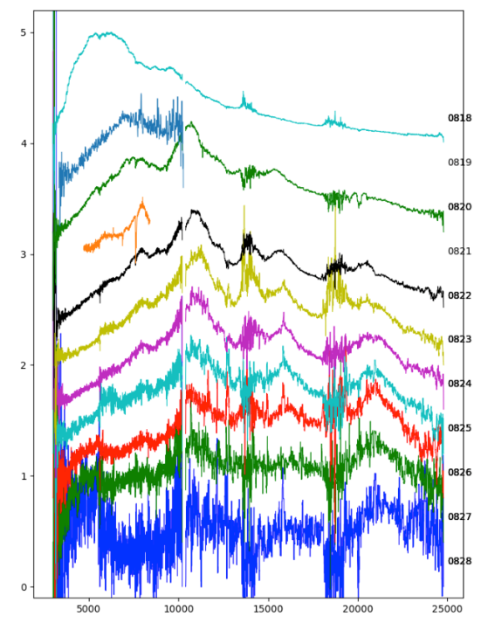

Slide 13
THESEUS:
short GRB detection over large FOV with arcmin localization
Kilonova detection, arcsec localization and characterization
Possible detection of weaker isotropic X-ray emission

Slide 14
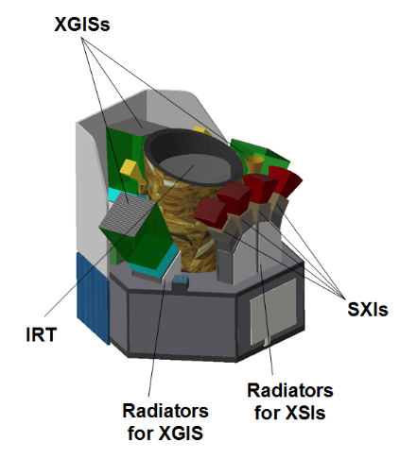
THESEUS mission concept
Soft X-ray Imager (SXI): a set of four sensitive lobster-eye telescopes observing in 0.3 - 5 keV band, total FOV of ~1sr with source location accuracy 0.5-1’;
X-Gamma rays Imaging & Spectrometer (XGIS): 3 (2) coded-mask X-gamma ray cameras using bars of Silicon devices coupled with CsI crystal scintillators observing in 2 keV – 10 MeV band, a FOV of ~2-4 sr, overlapping the SXI, with ~5’ source location accuracy;.
InfraRed Telescope (IRT): a 0.7m class IR telescope observing in the 0.7 – 1.8 μm band, providing a 10’x10’ FOV, with both imaging and moderate resolution spectroscopy capabilities (-> redshift)
LEO (< 5°, ~600 km)
Rapid slewing bus
Prompt downlink

Slide 15

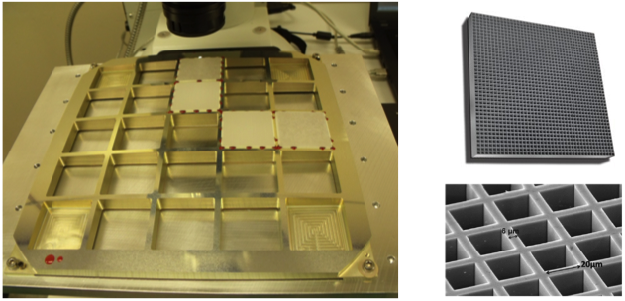
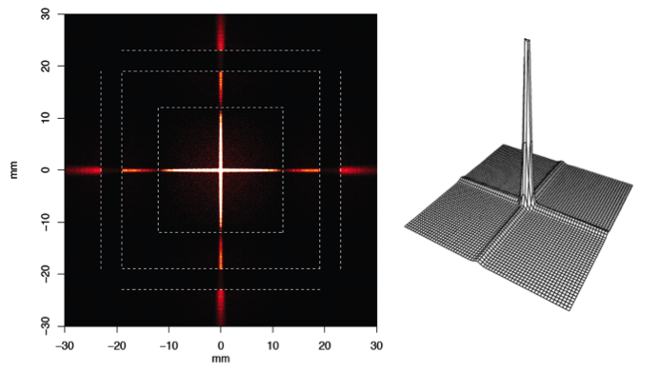
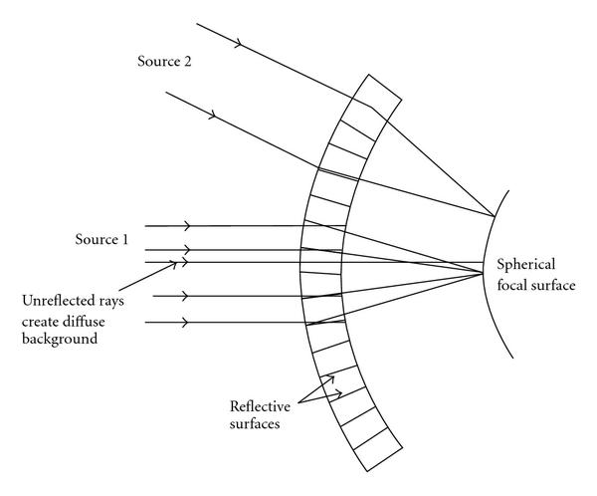
The Soft X-ray Imager (SXI)
4 DUs, each has a 31 x 26 degree FoV

Slide 16

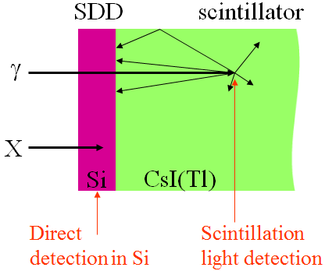
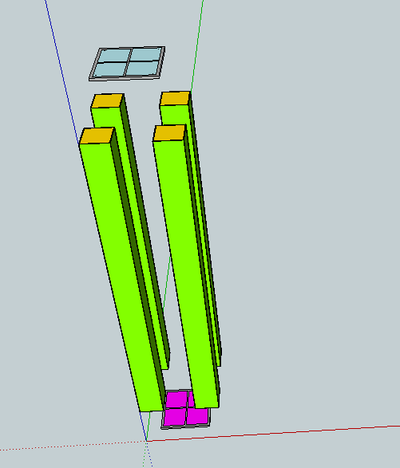
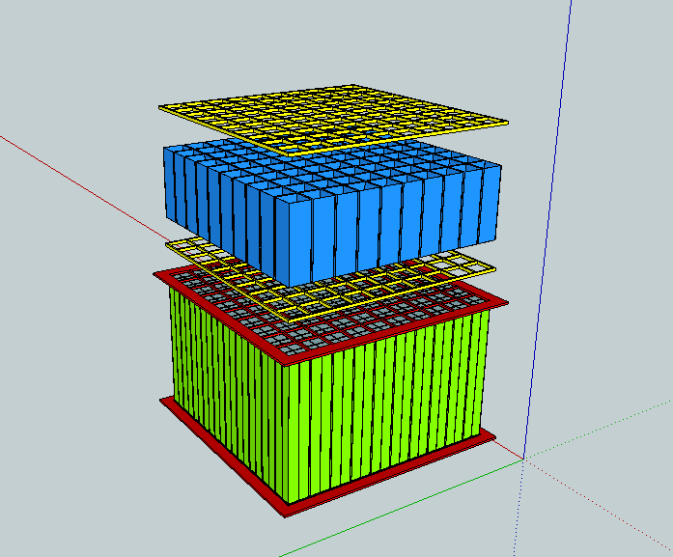
The X-Gamma-rays Imager & spectrometer (XGIS)
Silicon
Scintillator
Key rule of SDD technology
Notes:
Da correggere

Slide 17

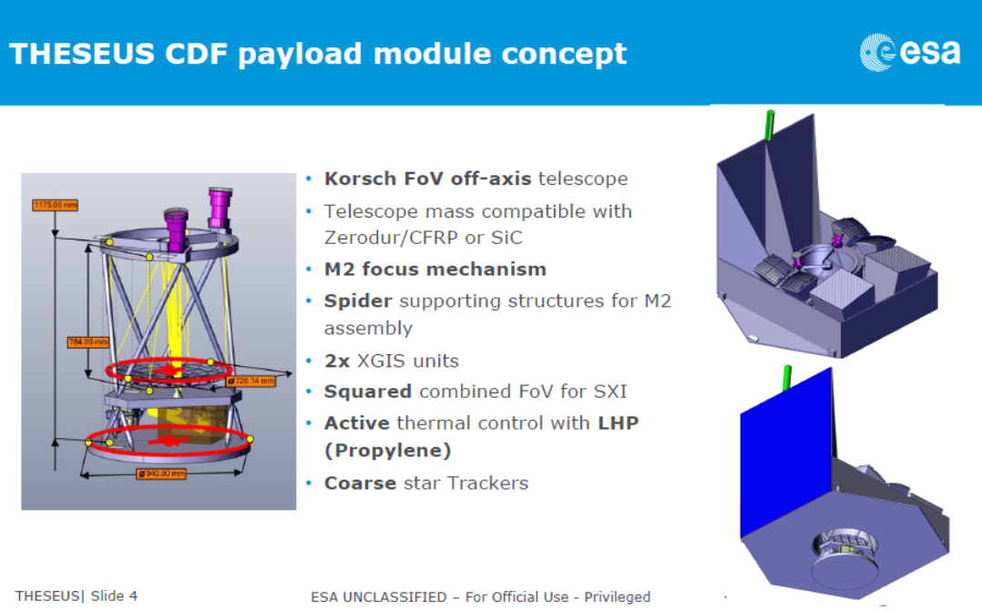
The InfraRed Telescope (IRT)

Slide 18
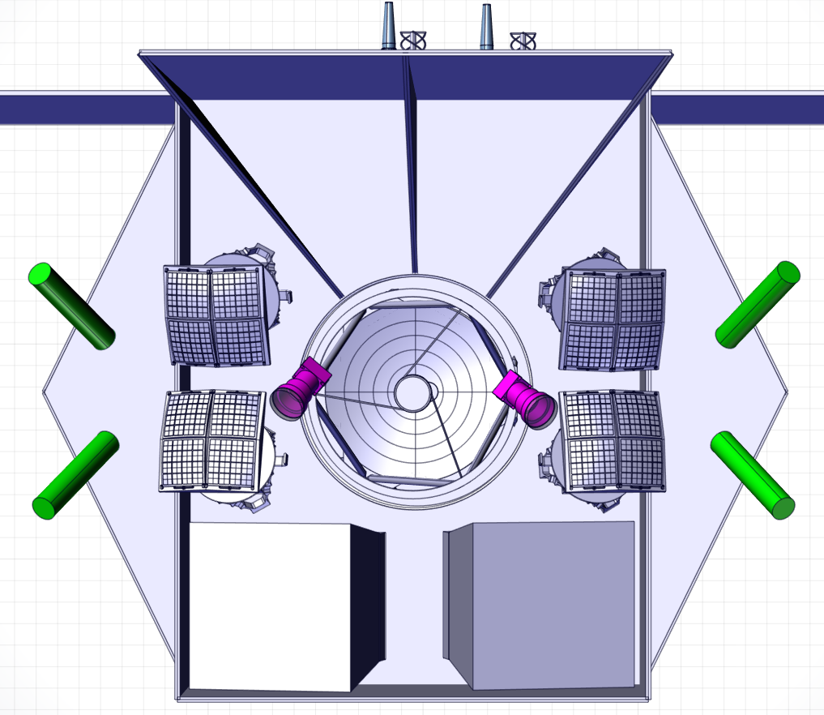
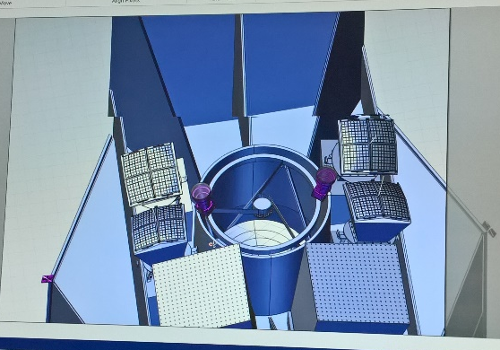
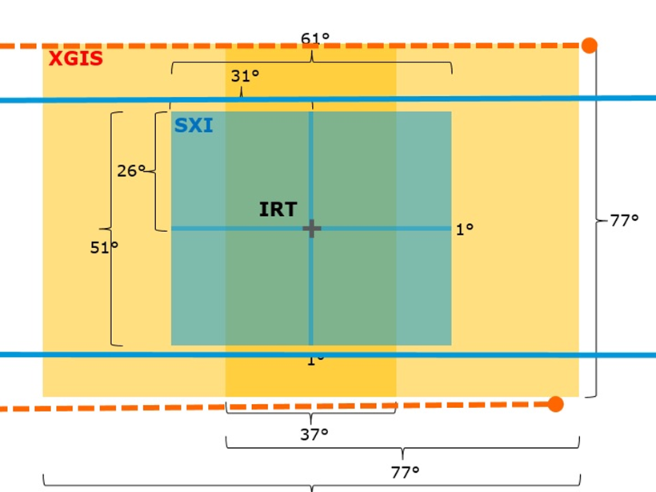
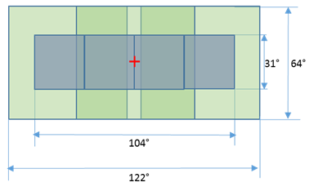
THESEUS mission concept: ESA study
PROPOSAL
CDF STUDY

Slide 19
THESEUS will have the ideal combination of instrumentation and mission profile for detecting all types of GRBs (long, short/hard, weak/soft, high-redshift), localizing them from a few arcmin down to arsec and measure the redshift for a large fraction of them
Fermi/GBM
GRB170817A/GW170817
High-redshift

Slide 20
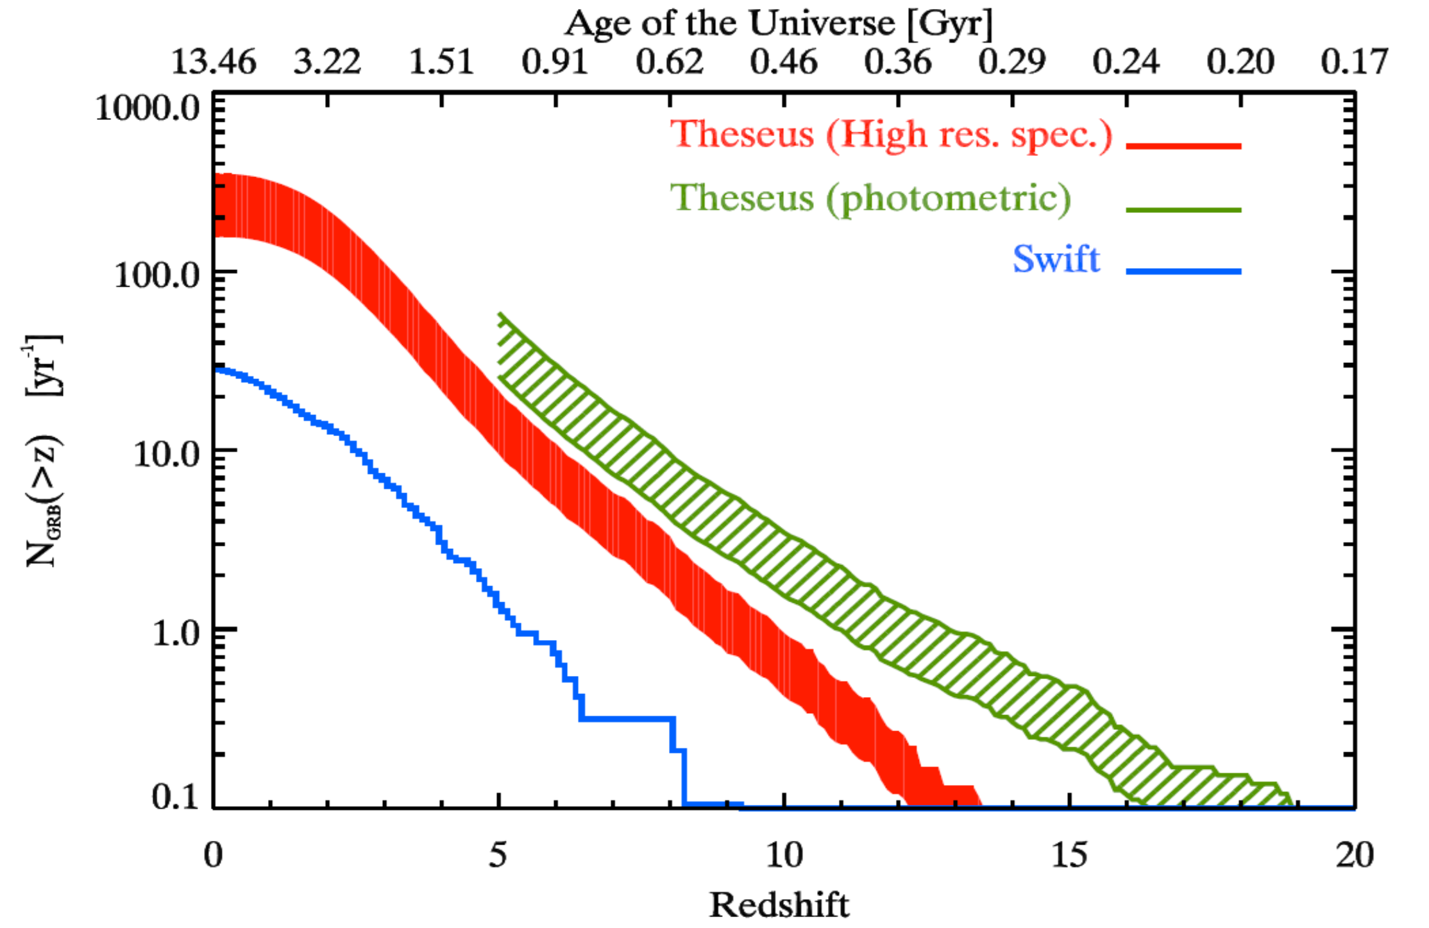
Shedding light on the early Universe with GRBs
Notes:
Baseline 3 anni

Slide 21
GW/multi-messenger and time-domain astrophysics
GW transient sources that will be monitored by THESEUS include NS-NS / NS-BH mergers:
  collimated on-axis and off-axis prompt gamma-ray emission from short GRBs
  Optical/NIR and soft X-ray isotropic emissions from kilonovae, off-axis afterglows and, for NS-NS, from newly born ms magnetar spindown
Notes:
tenere

Slide 22
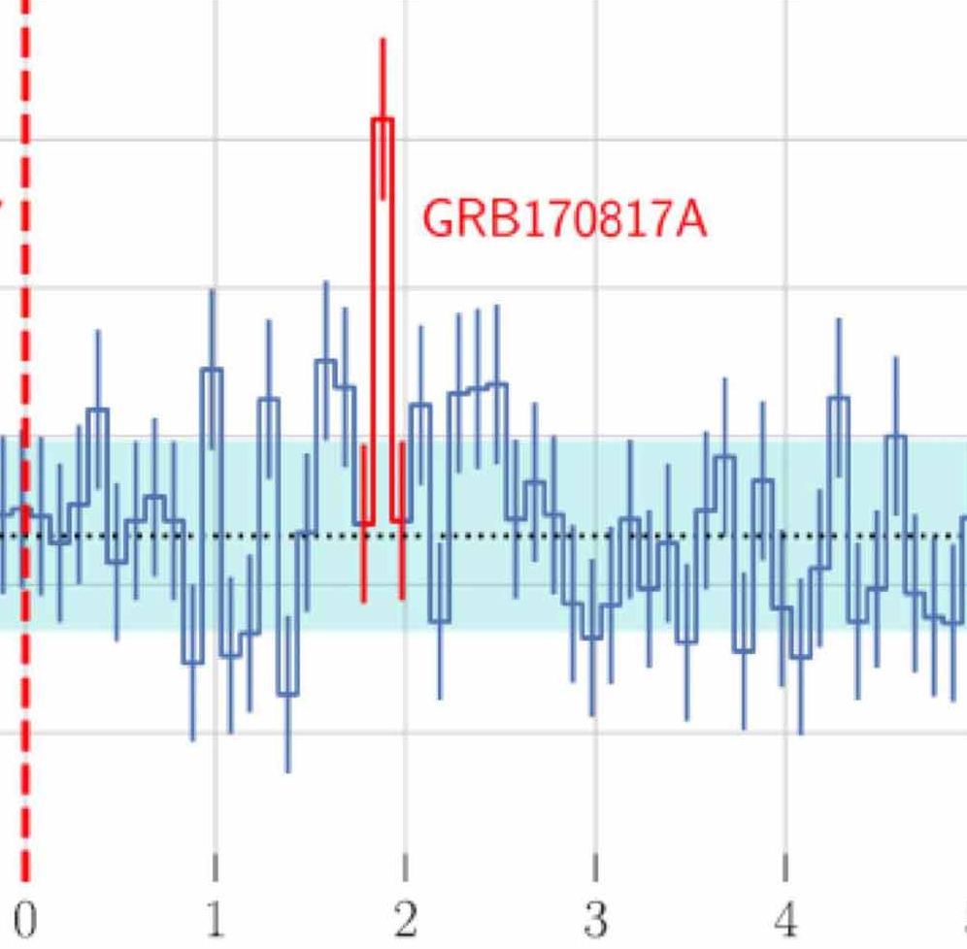
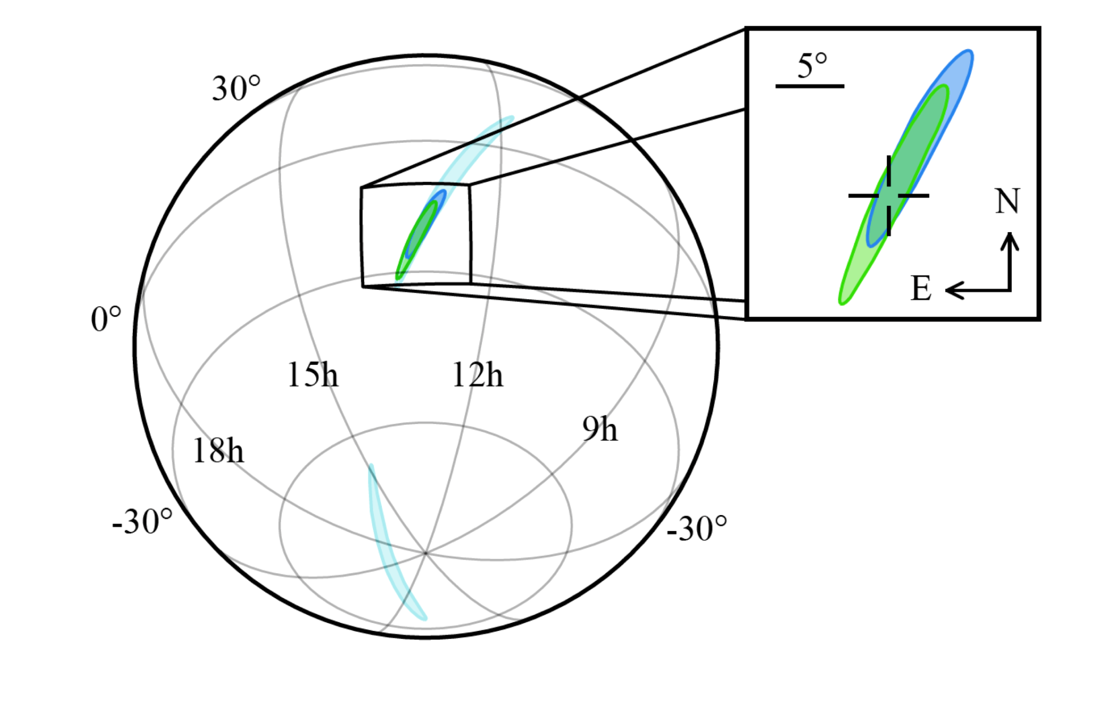
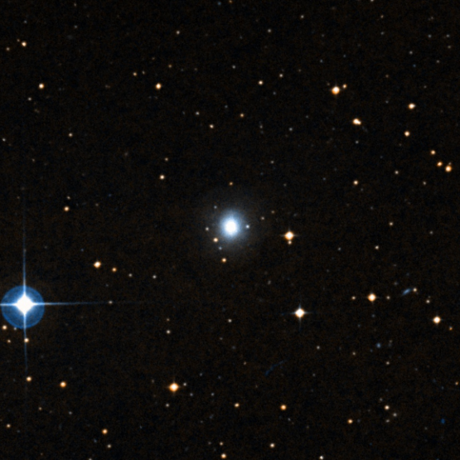
Promptly and accurately localizing e.m. counterparts to GW events with THESEUS
110∘× 30∘
15 ʹ
1ʹ (SXI) to 10’ (XGIS)
5 ʹ
1 arcsec !
Notes:
Modificare con 10’ XGIS fino a 0.5’ per SXI

Slide 23
Detection, study and arcsecond localization of afterglow and kilonova emission from shortGRB/GW events with THESEUS/IRT
Precise localization is mandatory to activate large ground-based telescopes as VLT or ELT from which detailed spectral analysis will reveal the intrinsic nature of these newly discovered phenomena

Slide 24
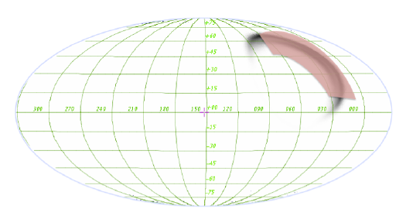
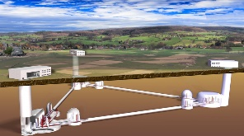
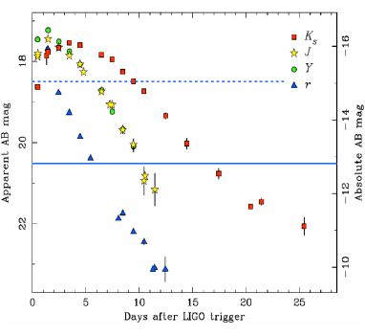
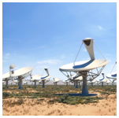
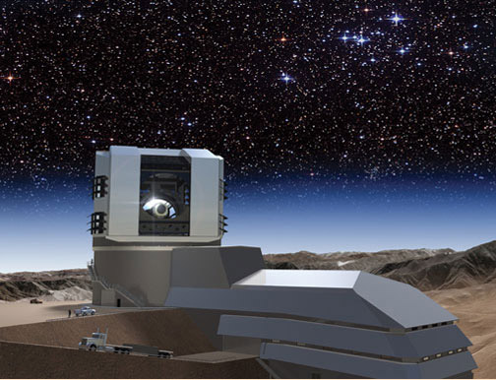
  Localization of GW/neutrino gamma-ray or X-ray transient sources NIR, X-ray, Gamma-ray characterization
  NS-BH/NS-NS merger physics/host galaxy identification/formation history/kilonova identification
Transient sources multi-wavelength campaigns
Einstein Telescope
Accretion physics
ELT TMT GMT
Jet physics
Hubble constant
Star formation
SKA
LSST
r-process element chemical abundances
THESEUS SYNERGIES
ATHENA
Notes:
Darach mentions paper on envelope stripping by the general environment in rich OB assocs.
forse

Slide 25
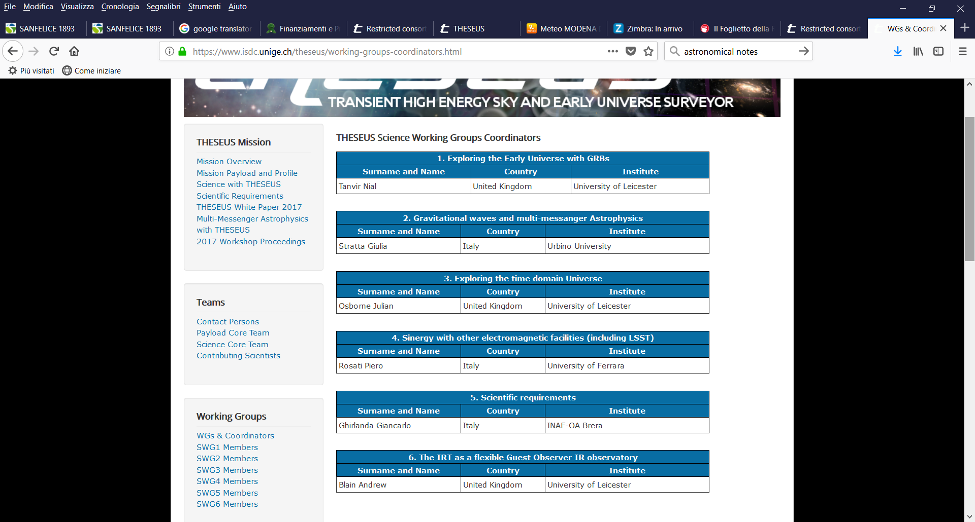
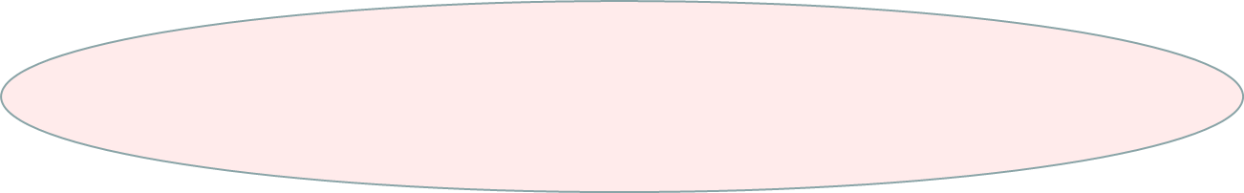
THESEUS consortium science: 6 WGs, > 200 contributing scientists
http://www.isdc.unige.ch/theseus/

Slide 26
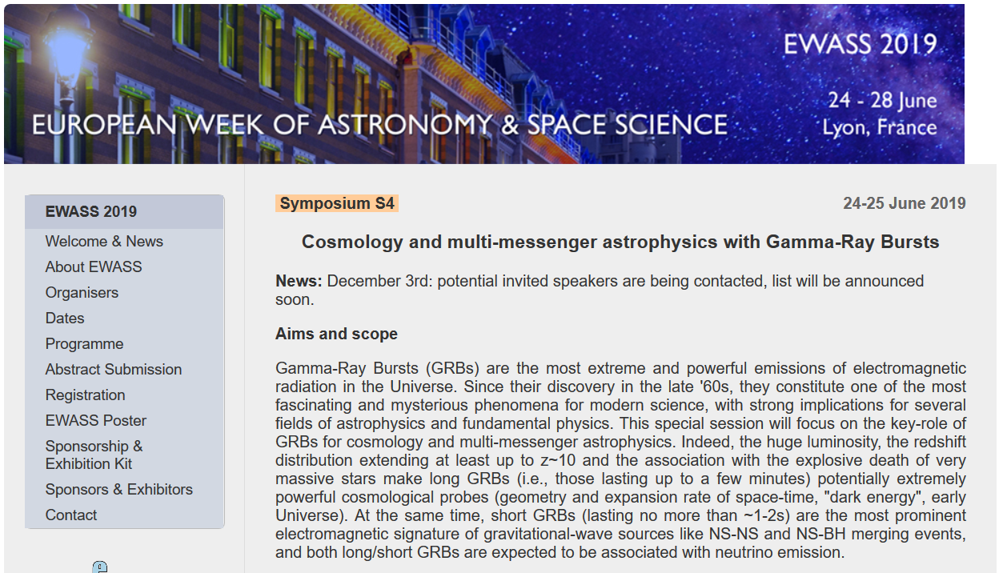

Slide 27
In summary
THESEUS, under study by ESA as candidate next M5 mission and a large European collaboration with strong interest by international partners (e.g., US) will fully exploit GRBs as powerful and unique tools to investigate the early Universe and will provide us with unprecedented clues to GRB physics and sub-classes.
THESEUS will also play a fundamental role for GW/multi-messenger and time domain astrophysics at the beginning of the ‘30s, also by providing a flexible follow-up observatory for fast transient events with multi-wavelength ToO capabilities and guest-observer programmes
THESEUS will enhance importantly the scientific return of next generation facilities in the multi messenger (aLIGO/aVirgo, LISA, ET, or Km3NET) and e.m. (e.g., LSST, E-ELT, SKA, CTA, ATHENA) domain
Great perspective synergy between THESEUS and ET, enhancing scientific return of both facilities -> proposed collaboration in scientific WGs, white papers, etc. (invite you to THESEUS consortium meeting in Bologna on July 3-5 2019)

