Slide 1
Studies on MS Performance with 2009 Cosmics Data
Several people involved:
Igor: See yesterday presentation
Ahmimed, Eve, Niels, Peter, Egge: two presentations in this meting
Fabio: this talk

Slide 2
MRATF publication on 2008-2009
Draft 1 of the paper attached to the agenda: it contains many performance studies based on cosmic data analysis
http://agenda.infn.it/getFile.py/access?contribId=0&amp;resId=0&amp;materialId=paper&amp;confId=1821

Slide 3
Outline
Introduction on Sagitta and Momentum Resolution for BARREL
Alignment Expectations: sagitta mean values
“Expected” Sagitta and P resolution
Sagitta studieds on Cosmics
Sagitta resolution vs P(ID)
Momentum Studies on Cosmic
Uses ID as reference
Conclusions

Slide 4
Introduction: Sagitta Resolution
Sagitta Resolution contributions from 2 terms
σs(P) = K0/P + K1
K0 Multiple Scattering ~ L/4 x 13.6(MeV) √(x/X0)
K1 Intrinsic resolution:
[tube-resol.+alignment+calibration+ cham-geometry…] ~ 60um
Does NOT depend on B-field and Energy-Loss before MS
→ Study part of P MS resolution contribution

Slide 5
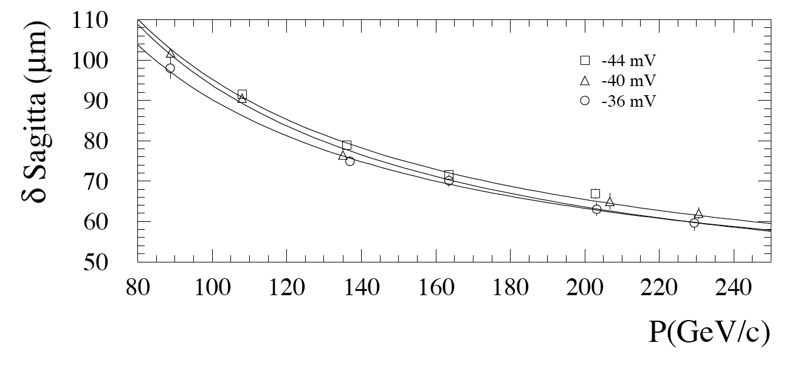
100 GeV → ~90 μm
Published on NIM A: Measured in H8 Large Sector (only BML material)
K0 = 9 mm x GeV → √x/X0 ~ 0.5
K1 = 50 μm (Perfect alignment + very limited region)

Slide 6
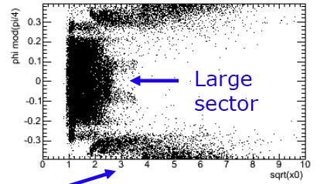
What do we expect in ATLAS: Barrel ?
K0 Multiple Scattering much larger in Small Sectors:
Small sectors:
√(x/X0) ~1.5 → Small
L ~ 6.0 m → Small
Large Sectors
√(x/X0) ~0.7 → Large
L ~ 4.5 m → Large
K0_{Large} ~ 11 mm x GeV
K0_{Small} ~ 28 mm x GeV
K1 cosmics dominated by alignment + calibrations + … ?
Use recent run 121737 (July) to measure it
Peter Kluit
Small

Slide 7
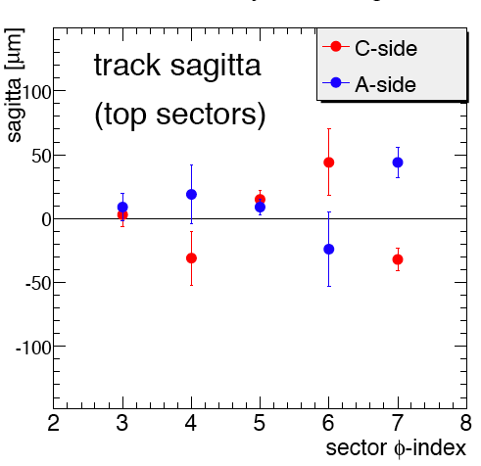
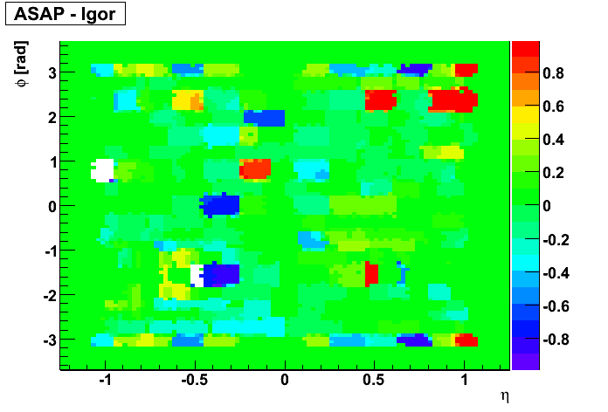
Expected Alignment Performance
Alignment based on straight tracks from Run 113860 + Optical in Relative Mode
Pierre-Francois
Igor Potrap
Igor Checks on Run 121737
On average <sag> for sectors 3→7 and 11→15
Single towers ~ 50-250um
Optical Relative corrections for run 121737 (both runs have B-field OFF) ~0.3-1 mm

Slide 8
Sagitta Resolution: Method description
Use run 121737 - Toroid=OFF + Solenoid=ON:
Pμ measured by ID
Alignment from Tracks (run ) + optic-relative mode
Measure sagitta resolution for I-M-O segments measured in MS vs Pμ and fit for K0 and K1

Slide 9
Sagitta run 121737: MS segments
Used calibration ntuples
Re-processed by Kevin with new Constants from Tracks(113860)+OpticalRelative
Select segments from MOORE: quality cuts have impact on results !:
N-MDT hits ≥ 5 (BM, BO)
N-MDT hits ≥ 7 (BI)
N-RPC hits ≥ 3
Chi-2 < 1.
==1 Segment same sector in I, M and O (Top Sectors)
Processed ~3.3 M events RPCwBeam Stream

Slide 10
Sagittas run 121737
Select Inner Detector Tracks (loose quality)
|d0|< 1000 mm
|z0|< 1000 mm
Chi-2/ndf < 5.
N-hits>100
Pμ = [P(ID)+ 3 GeV] to take into account E-loss
3.3M events Left → 1000 muons
Make 5 bins in P: Bin Center → <P>
Fit sagitta resolution (single Gaussian fit OK) in each P bin

Slide 11
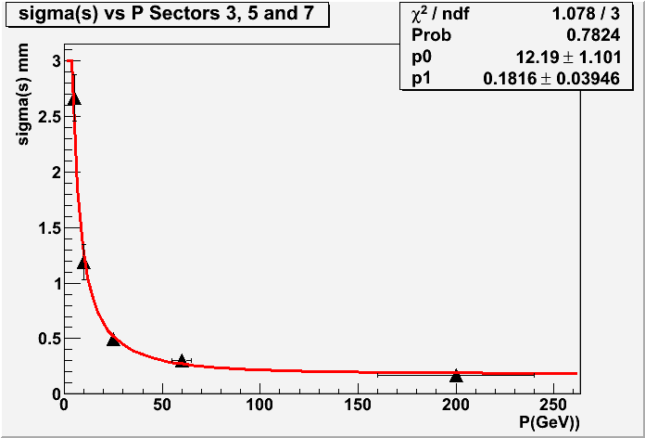
Large Sector: 3, 5 and 7
K0 → 12± 1 mm GeV
K1 Intrinsic→ ~180 ± 40um

Slide 12
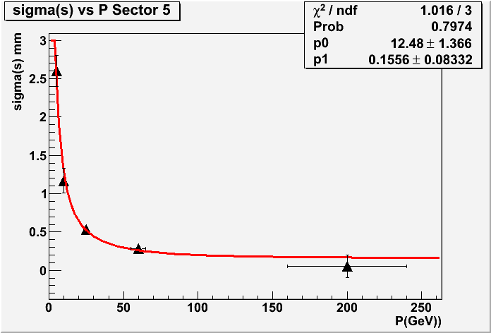
Large Sector: 5 ONLY
K0 → 12 ± 1 mm GeV
K1 Intrinsic→ ~160 ± 80 um

Slide 13
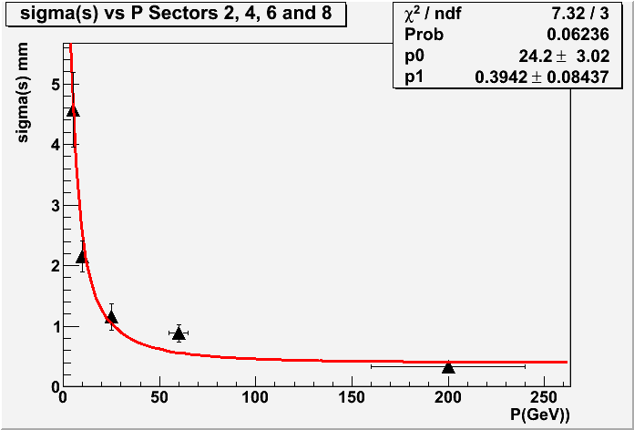
Small Sectors: 2, 4, 6 and 8
K0 → 24 ± 3 mm GeV
K1 Intrinsic → ~ 390 ± 80 um
Poor Fit !

Slide 14
Conclusions on sagitta resolution
Multiple Scattering term look reasonable
Intrinsic term at the level of 150-300 μm
Best sector5: ~100-150 um
On COSMICS: quality requirement on segments very important (correct t0-refit, outliers,..): intrinsic term going down from 250 to 150 um just changing cut on segment χ²
Waiting for FINAL reprocessing of run 121737 with better calibration to converge on a single number

Slide 15
Momentum scale and resolution
Method:
Run 121080 Toroid=ON + Solenoid=ON
Pt(μ) measured by ID as reference
Plot the relative difference [Pt(MS)-Pt(ID)]/Pt(ID)
Study MS Pt-resolution vs Pt after subtracting expected ID resolution

Slide 16
Expected in ATLAS: From CSC notes
10 GeV 5% → E- Loss fluctiations
100 GeV 4% → Mul. Scatt.
1 TeV 12% → σ(s) ~ 60um
-------------------------------
Crude Parameterization:
Res. = P₀ Pt + P₁ + P₂/Pt
Intr. MS E-loss
-------------------------------
E-Loss ~ 0.450 GeV
MS ~ 3.5%
Intrinsic Sagitta ~ 60um
|η| < 1.5

Slide 17
P resolution: Naïve estimate 1
To simplify assumed Barrel P_{t} ~ P
Error on B neglected (<1% ?)

Slide 18
P resolution: Naïve estimate 2

Slide 19
Results from Cosmics run 121080
Use DP3D produced from AOD by Fabrizio Petrucci run 121080 → 2M ID-cosmic stream events
Track selection (all sectors accepted):
MS - MuonBoySA tracks at IP:
Pt > 4 GeV ; 23>nMDT>16; nRpcPhi>2 ;
|d0| < 1m ; |z0| < 1m , chi2/ndf < 2 ; |η|<1
ID tracks:
Pt>2 GeV; nTRT>16; n(SCT+Pixel)>6 ; |η|<1
|d0| < 0.5m ; |z0| < 0.75m , chi2/ndf < 1 ; θ=(90±25)°
15K Muons selected:
Fit σ(P)/P in 8 Pt bins with single-Gaussian fit

Slide 20
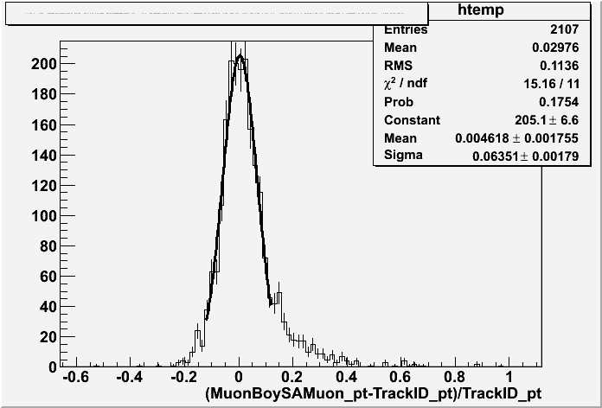
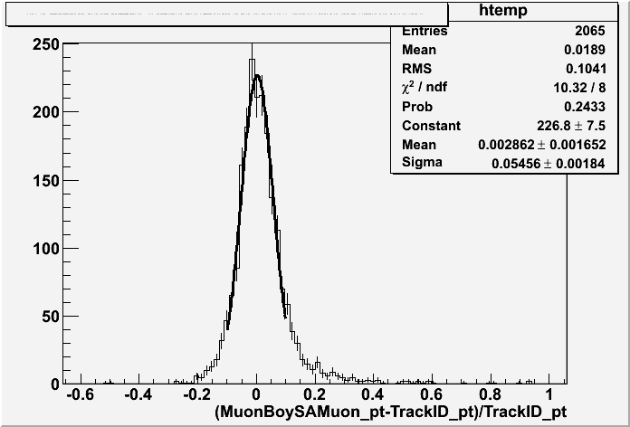
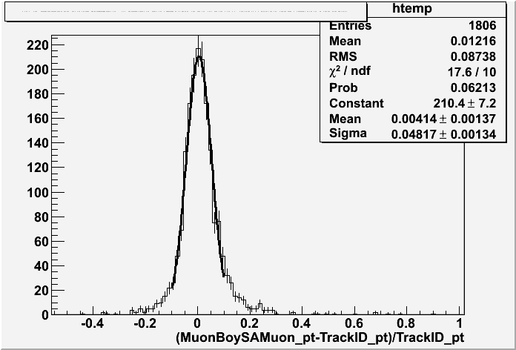
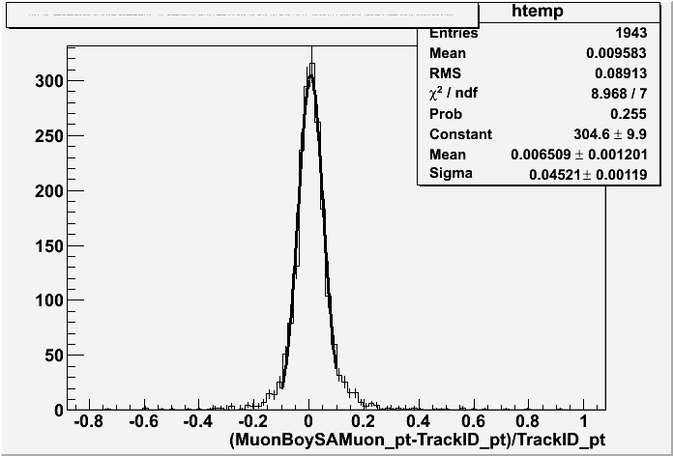
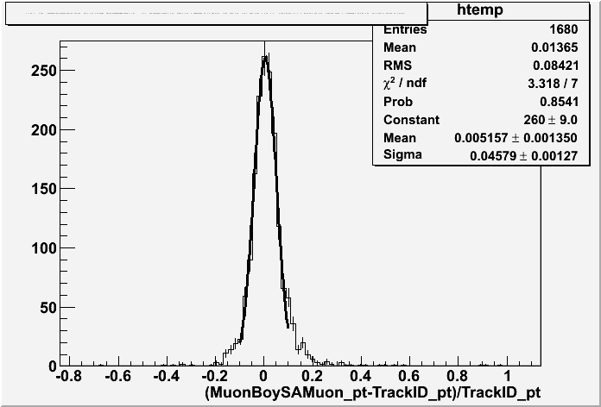
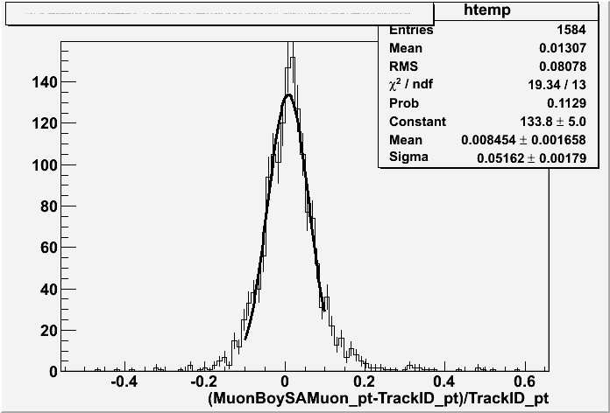
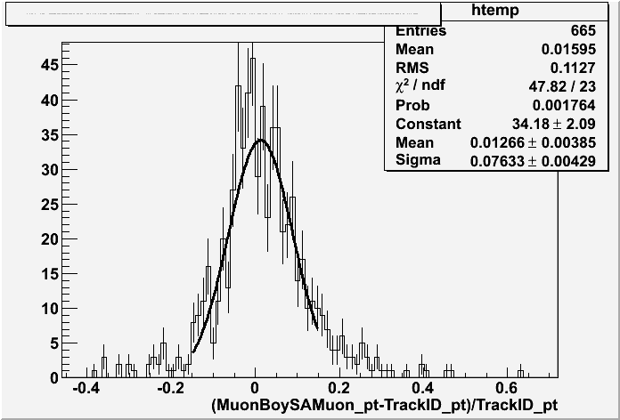
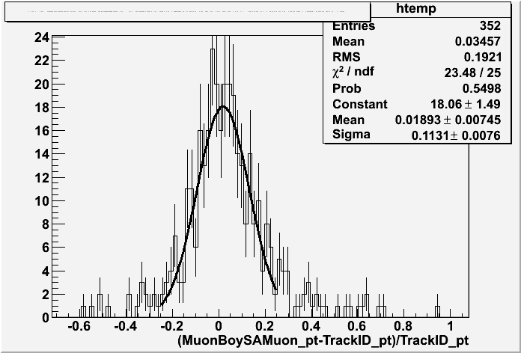
Run 121080
Reasonable Fit: 2 sigma core
Some non gaussian tails

Slide 21
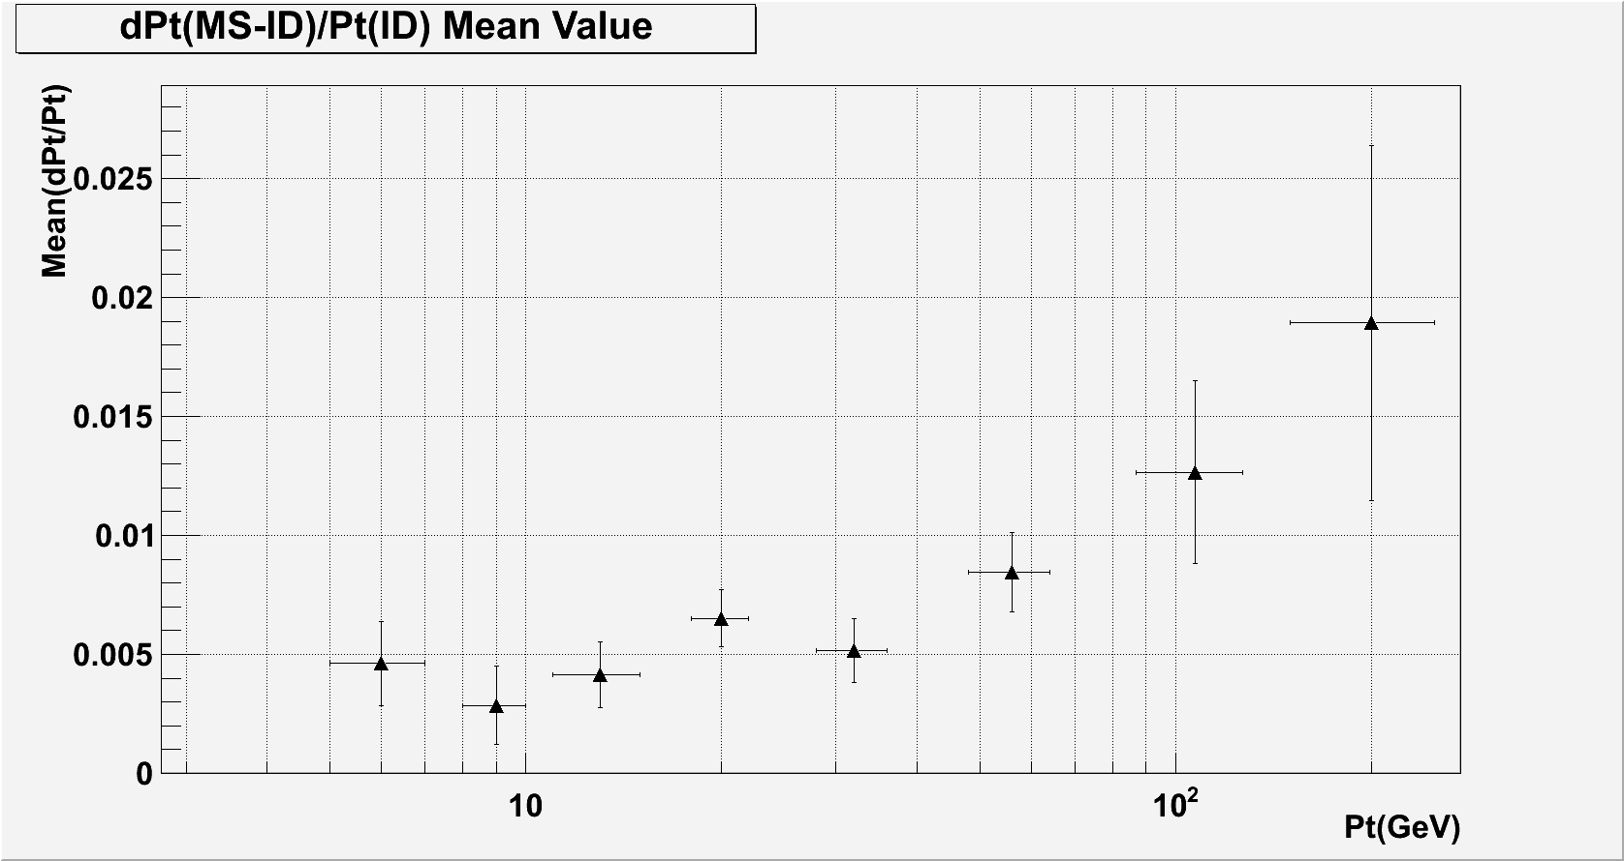
<[Pt(MS)-Pt(ID)]/Pt(ID)>
Mean-Pt=Pt-SCALE Agreement with ID at <1% up to 100 GeV !

Slide 22
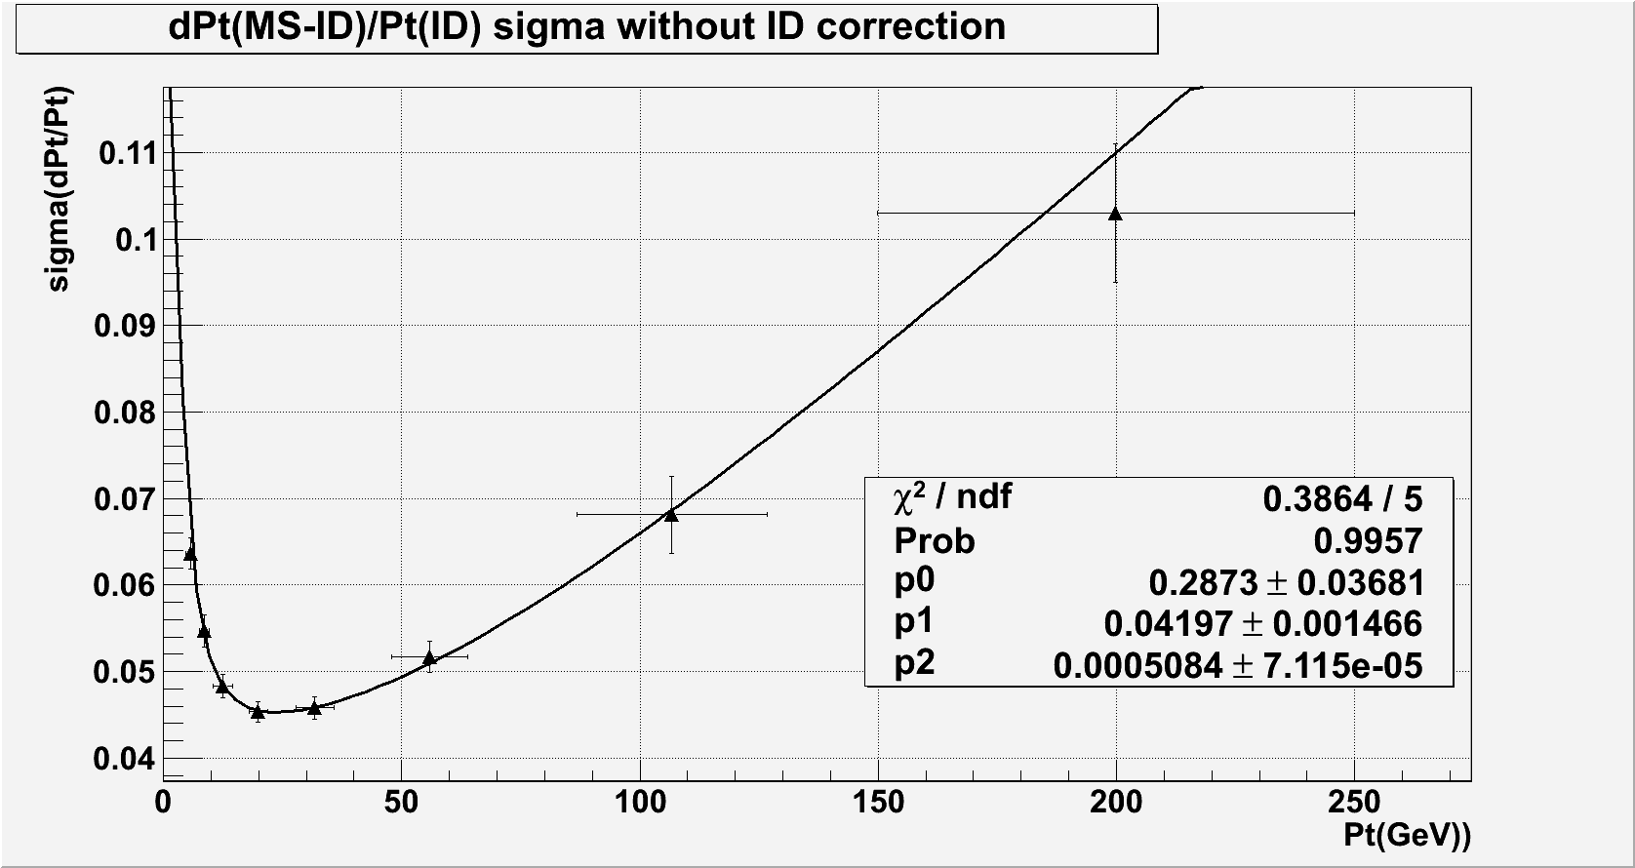
σ([Pt(MS)-Pt(ID)]/Pt(ID)
Before Subtracting ID resolution

Slide 23
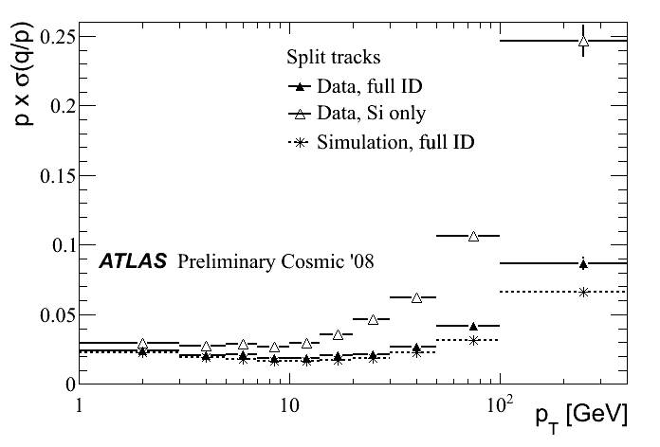
ID resolution
* ID resolution: 2,5% up to 50 GeV - 3% at 60 GeV - 5% at 100 GeV – 7% 200 GeV
BUT for “LONG track” they claim scale as L² → factor 4 SMALLER → Negligible

Slide 24
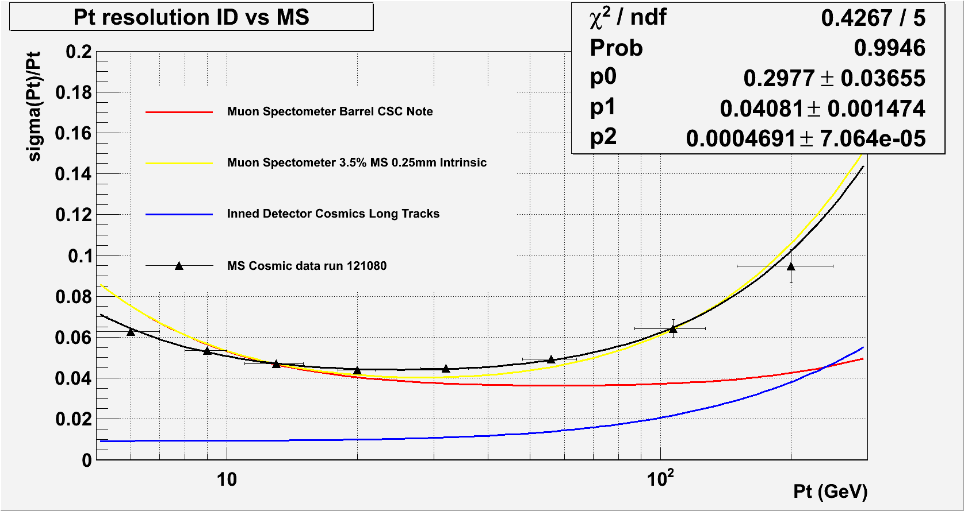
Resolution FIT: All sectors
- Energy Loss Error = 300 ± 40 MeV
- MS = 4.1 ± 0.1 %
Intrinsic resolution = (4.6 ± 0.7) x 10⁻⁴ → ~40% @ 1 TeV
Up to 50 GeV very close to expected Performance !

Slide 25
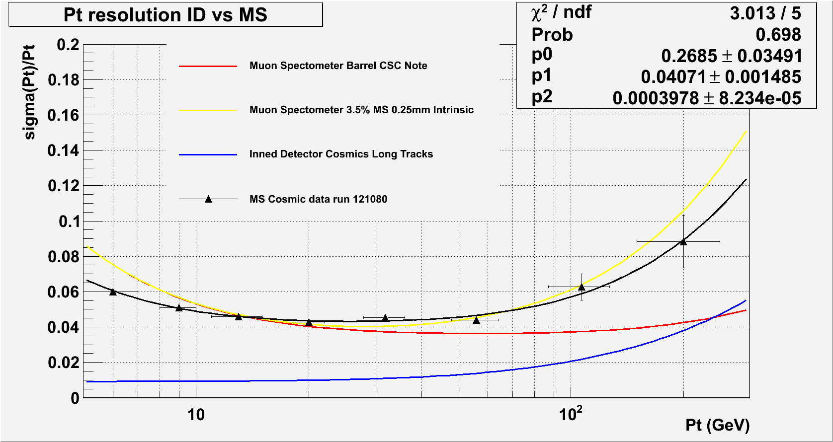
Resolution FIT: Sector 5+13
Cut on Phi ID Track
- Energy Loss Error = 270 ± 30 MeV
- MS = 4.1 ± 0.1 %
- Intrinsic resolution = (4.0 ± 0.8) x 10⁻⁴ → 40% @ 1 TeV Only a factor 2 w.r.t. CSC ?

Slide 26
Conclusions 1
Sagitta studies in Barrel:
Alignment concept in Barrel tested for runs 121737 seems to work at least at 50-300 μm (for movements ~0.2-1mm)
Resolution Approaching 150-200 μm at high-Pt for some sectors: probably alignment is NOT the only contribution (calibrations, segment reconstruction quality, ..)
Resolution still quite large for small sectors (not understood) ?
P-scale in agreement with ID at 1-2% level: OK at this stage

Slide 27
Conclusions 2
P-resolution:
E-loss term seems better than expected (200 MeV)
MS term of the order of 3-4% : OK
Sector-5 Intrinsic term approaching 150 um or better
For several sectors compatible with 200um
For cosmics quality of segments and tracks play a role: still margin for improvements – optimization of recons. Parameters
Still very difficult to KNOW and/or to USE right calibration and alignment in reconstruction !
Below 40 GeV very close to NOMINAL performance but for limited detector region

Slide 28
Spare Slides

Slide 29
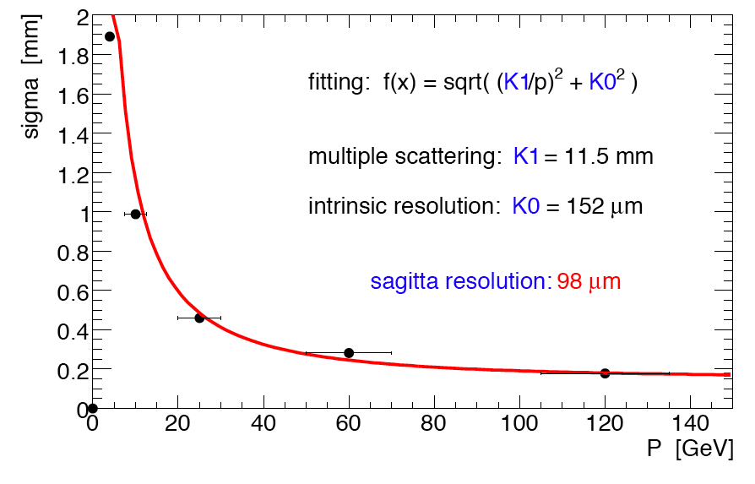
Sagitta analysis from Igor: RPC time corrections+ better r(t)
Igor: Sector 5
Single hits instead of segment: K0 sagitta should be smaller: better then my result

Slide 30
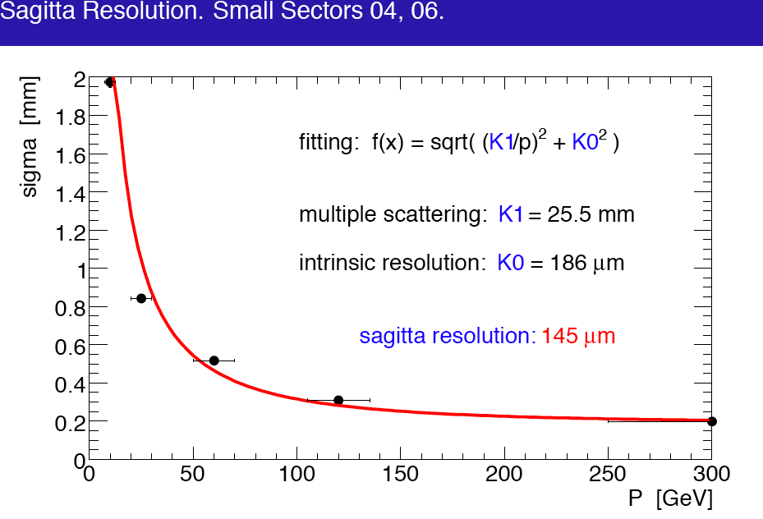
Sagitta analysis from Igor: RPC time corrections+ Better r(t)
Igor: Sector 4 and 6 side C only
Single hits instead of segment: K0 sagitta should be smaller: better then my result

Slide 31
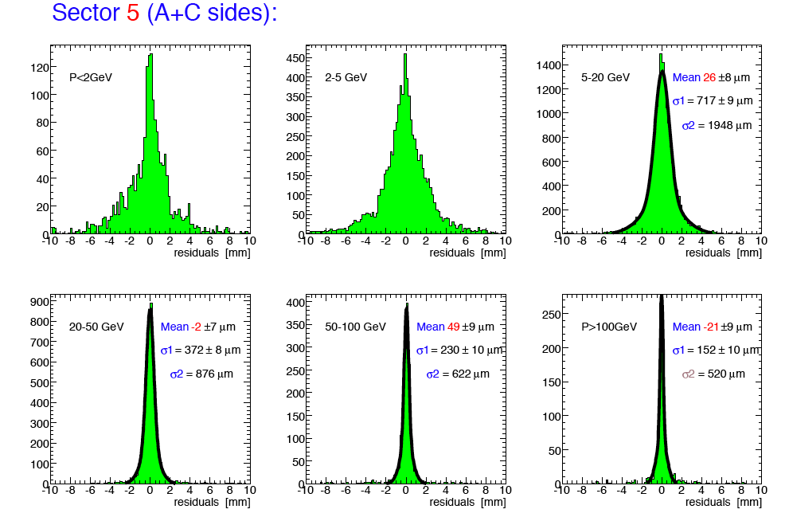
Results from Igor Sector 5
Igor Potrap
Hit resolution 150um → σ(s) intrinsic ~100um → better calibration used HERE !
Kevin reprocessing this run with correct calibrations now

Slide 32
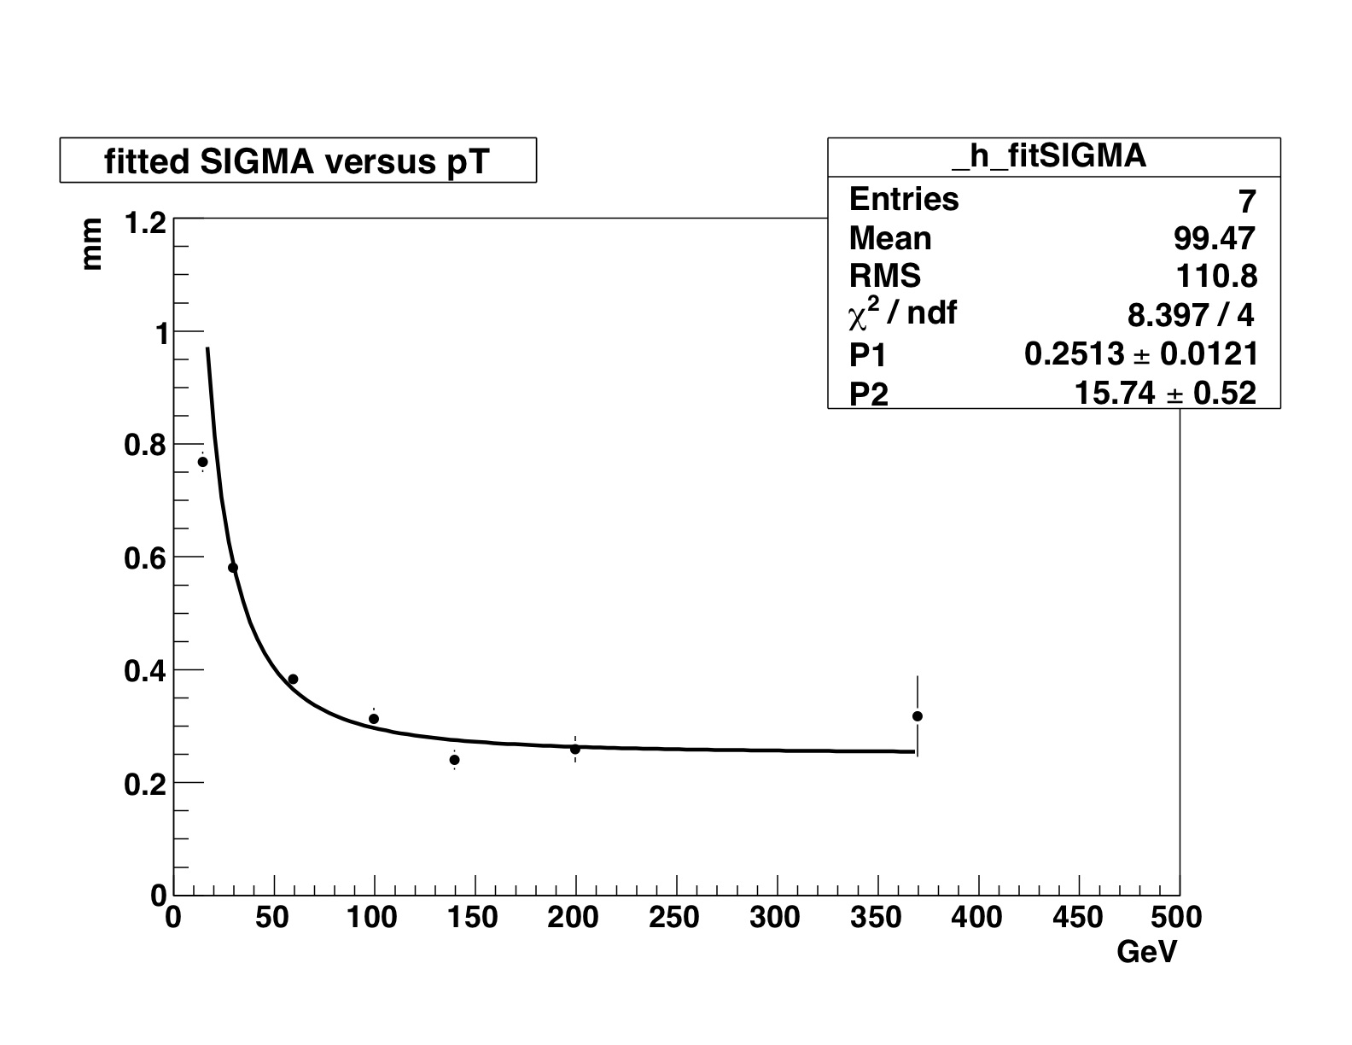
Egge Fits Sectors 3, 5 and 7
K0 =16 ± 1 mm → 90% x/X0
K1 =250 ± 12 μm
Fit quality NOT perfect but acceptable

Slide 33
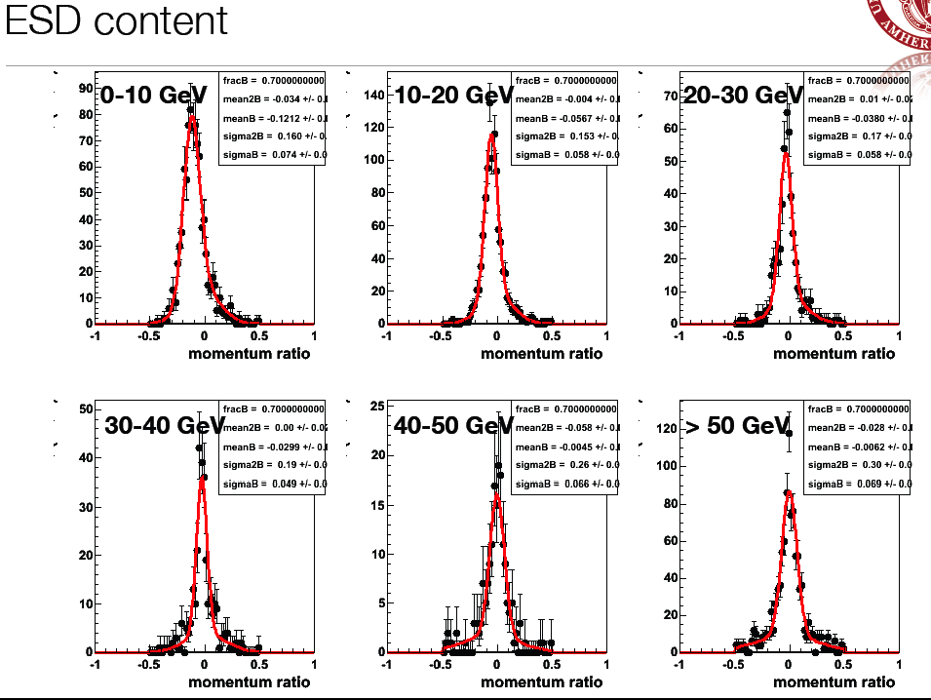
Dependency on track quality: Niels
σ=4.9%

Slide 34
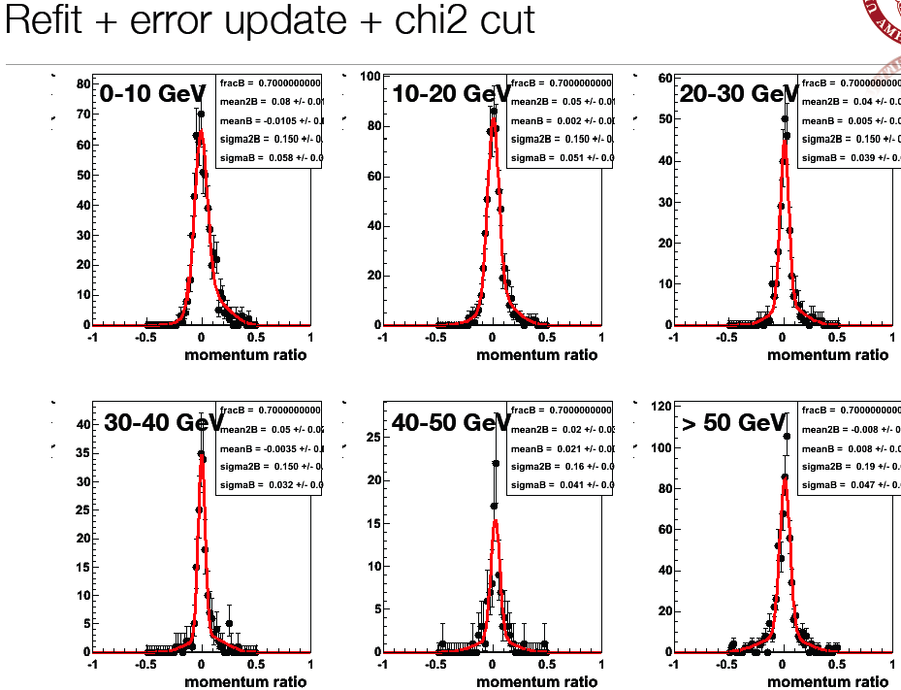
Dependency on track quality: Niels
σ=3.2%

Slide 35
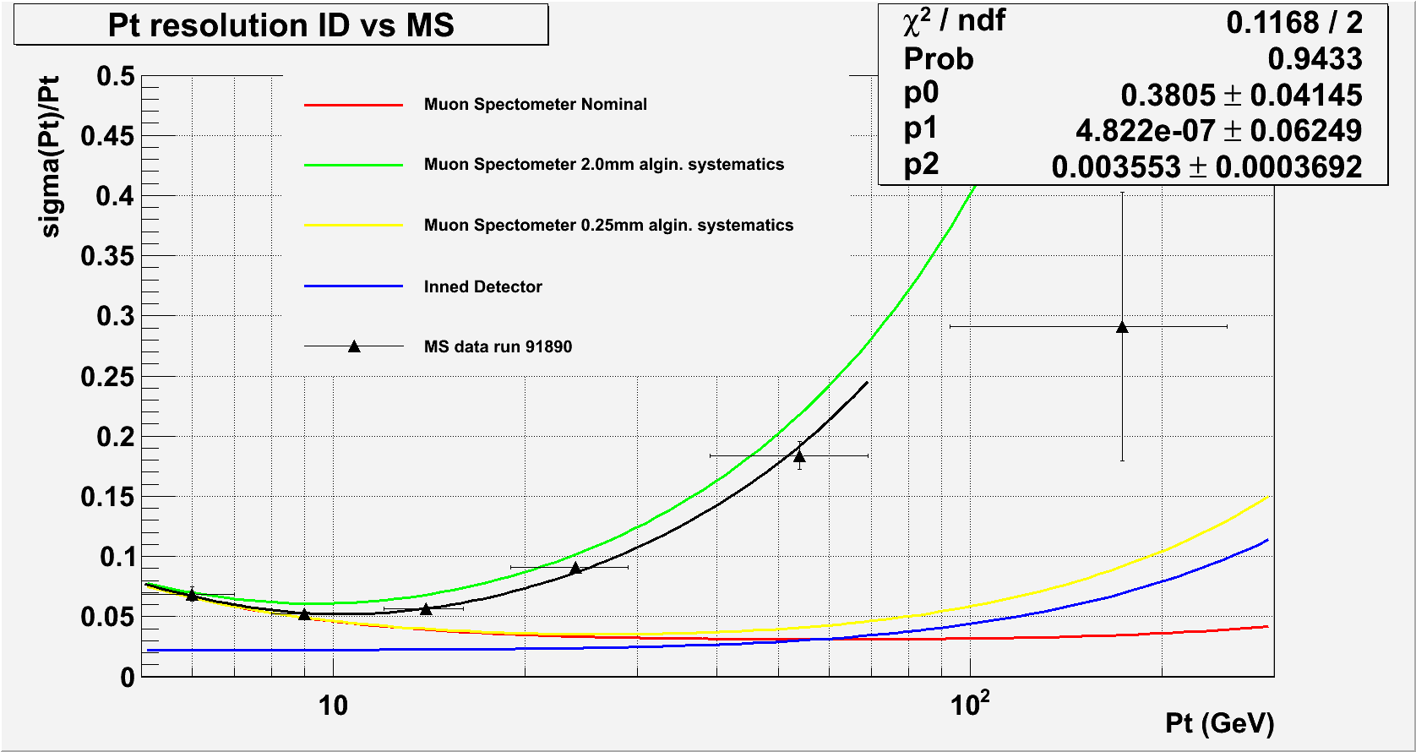
Same Analysis on 91890 !!! Only Optical Absolute Alignment Corrections !!!
E-loss 380 MeV
Fit insensitive to MS (6% error)
Intrinsic term 36 times larger than Nominal → 1.8 mm

