Slide 1
Exotics searches at NA62 R. Fantechi INFN – Sezione di Pisa and CERN on behalf of the NA62 Collaboration Birmingham, Bratislava, Bristol, Bucharest, CERN, Dubna (JINR), Fairfax GMU, Ferrara, Florence, Frascati, Glasgow, Lancaster, Liverpool, Louvain-la-Neuve, Mainz, Moscow (INR), Naples, Perugia, Pisa, Prague, Protvino (IHEP), Rome I, Rome II, San Luis Potosi, TRIUMF, Turin, Vancouver (UBC) ~200 participants
LDMA2019
Venezia, October 20th-22nd, 2019

Slide 2
Outline
NA62 at CERN
Main goal: measurement of BR(K⁺ → π⁺ νν )
But also rare decays and exotics searches
NA62 results
Heavy neutral lepton search
Dark photon search
Prospects
Operation in dump mode after LS2
Expected limits for Heavy Neutral Leptons, Axion-like particles, dark photon, dark scalar
Notes:
Aggiornare 3-10-2016

Slide 3
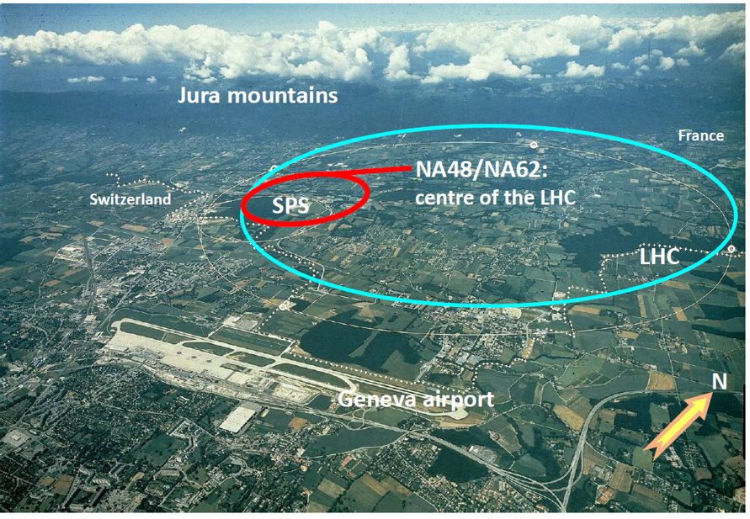
Kaon decays at CERN – NA62
The main goal is the measurement of BR(K⁺ → π⁺ νν ) with O(10%) precision
Abundance of other kaon decays for
Rare kaon decays
LNV/LFV studies
Exotics
_

Slide 4
Why exotics at NA62?
Production of feebly-interacting particles originates from the heavy hadrons produced by protons on a target. The cross sections increase with the energy, so a high-energy, high-intensity beam is needed.
The CERN SPS provides a 400 Gev/c beam, with high intensity and the possibility to produce large fluxes of beauty and charmed hadrons with protons hitting a high-Z target
The couplings are such that the hidden sector mediators have a long lifetime [O(Km)]
The best detection is achieved with a long decay volume followed by a spectrometer and a set of detectors for particle identification
NA62 and its beam fulfill these requirements

Slide 5
NA62 goals and challenges
Measurement of the K⁺ → π⁺ νν branching ratio
This requires at least 10¹³ Kaon decays
In-flight decay technique
75 GeV beam helps in background rejection
Event selection with P_{π}<35 GeV/c
i.e. K_{π2} decays have more than 40 GeV of electromagnetic energy
O(10¹²) rejection factor of common K decays
Good tracking devices
Accurate measurement of the kaon momentum
Accurate measurement of the pion momentum
Missing mass cut: O(10⁵) rejection on K_{μ2}, O(10⁴) on K_{π2}
Veto detectors
Photons: to reduce the background by a factor of 10⁸
Muons: add a rejection factor of O(10⁵)
Particle identification
Identify kaons in the beam
Identify positrons
Additional π/μ rejection [O(10²)]
Precise sub-ns timing
Kaon-pion time association
To reduce random veto
Notes:
Merge with the following

Slide 6
The NA62 detector
SPECTROMETER
IRC
SAC
Dipole magnet
4 straw-tracker stations
γ veto
γ veto
KTAG
RICH
CHANTI
π/μ ID
17m, 1 atm Ne
Differential Cherenkov for K+ ID in beam
KTAG
Charged veto
Target
CHOD
Beam Pipe
GTK
Beam tracker
Si pixels, 3 stations
MUV
6
LAV
LKr
Large angle photon vetoes
OPAL lead glass
11 stations in vacuum [O(10⁻⁶) mbar]
1 in air
Forward γ veto
NA48 LKr calorimeter
Muon veto
Fe/Scint
← Beam detectors →← Decay products detectors →
Beam
Momentum 75 GeV/c, 1% momentum bite
Divergence (RMS) 100 μrad
Transverse Size 60 × 30mm²
Composition K⁺ 6%, π⁺ 70%, p 24%
Nominal Intensity 33 × 10¹¹ ppp (750 MHz at GTK3)
Fiducial region
60 m decay region
10⁻⁶ mbar vacuum
Downstream rate ~ 10 MHz
Notes:
Aggiungere differenziazione beam detector- decay detector

Slide 7
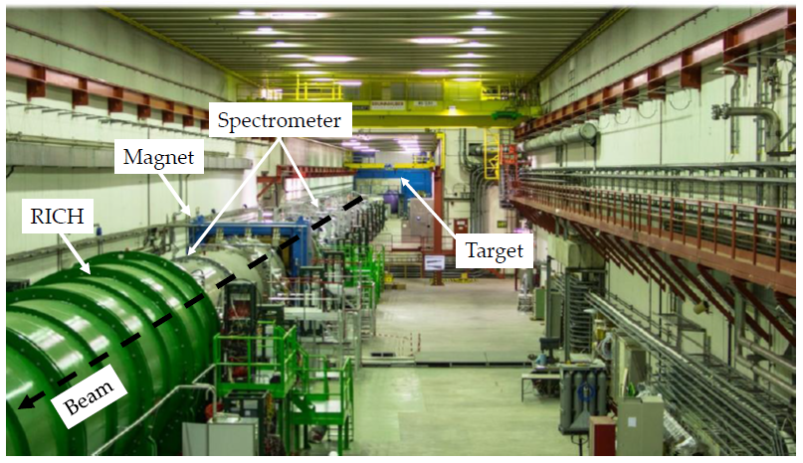
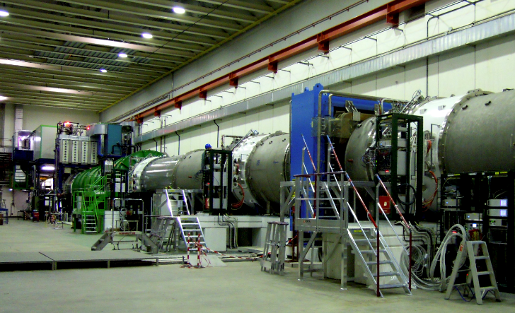
NA62 runs
2015: Commissioning run
Minimum bias data ~3×10¹⁰ ppp
2016: 30 days physics run
2×10¹¹ useful K⁺ decays
2017: 161 days data taking
2×10¹² useful K⁺ decays
2018: 217 days data taking
4×10¹² useful K⁺ decays
Several special runs taken with the proton beam hitting the dump formed by the beam taxes closed
Total of O(10¹⁶) protons
Analysis ongoing to prepare for future longer beam dump runs

Slide 8
Heavy neutral leptons
Possibility of a set of sterile neutrino mass states
The νMSM: the most economical theory accounting for ν masses and oscillations, baryogenesis and dark matter
[Asaka, Blanchet, Shaposhnikov PLB 631 (2005) 151]
Three Heavy Neutral Leptons (HNLs), one with m₁~10KeV/c², two with m_{2,3} ~1 GeV/c², these last ones observable via production and decay
NA62: K⁺ → l⁺N (l =e,μ)

Slide 9
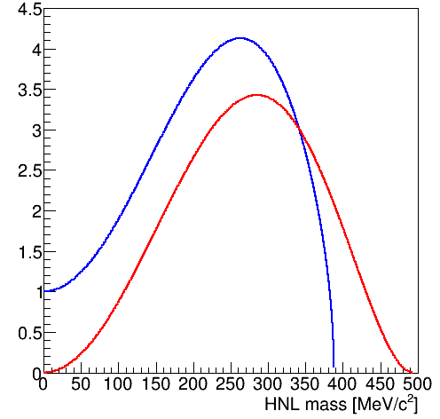
HNL production in K decays
Strength of mixing with SM neutrinos.
Parameter of interest
Phase space factor
ρ_{μ}
HNL production is enhanced wrt to SM decays
A very strong enhancement in the K⁺ → e⁺ N case, because the helicity suppression is relaxed
ρ_{e} × R_{K}
R_{K}~2.5 × 10⁻⁵

Slide 10
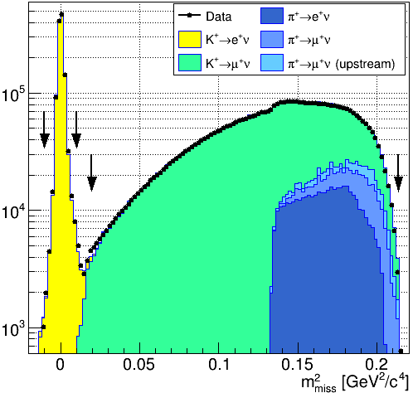
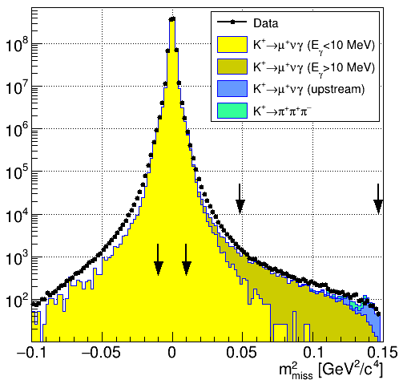
Analysis of 2016-2017 data sample
Decays in the fiducial volume:
(1.17±0.01) × 10¹² for e⁺, (4.29±0.02) × 10⁹ for μ⁺
Compute m²_{miss}=(P_{K}-P_{l})² with STRAW and GTK
PID with E/p, Muon veto, RICH (for P<40 GeV/c)
Apply photon vetoes
The arrows on the right indicate the search region

Slide 11
Mass scan
Use the following scan procedure
K_{e2}:
Mass range: 141-462 MeV/c²
Scan steps: σ_{m}/2
Number of tested hypotheses: 260
K_{μ2}:
Mass range: 220-383 MeV/c²
Scan steps: 1 (0.5) Mev/c² below (above) M_{N}= 300 MeV/c²
Number of tested hypotheses: 247
Signal region half-width 1.5σ_{m}
For each mass hypothesis, determine the background from fits to the data in the sidebands
Compare observed and expected number of events to put limits on |U_{l4}|²

Slide 12
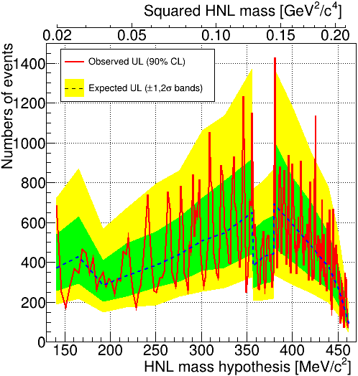
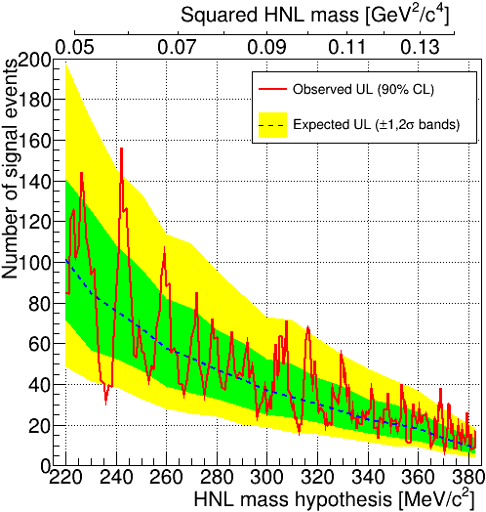
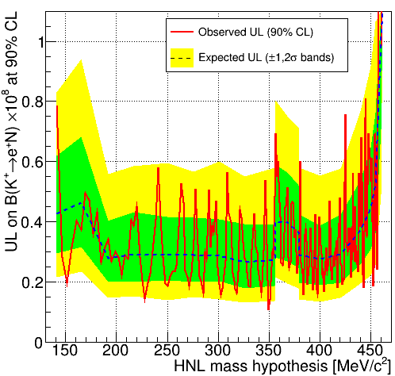
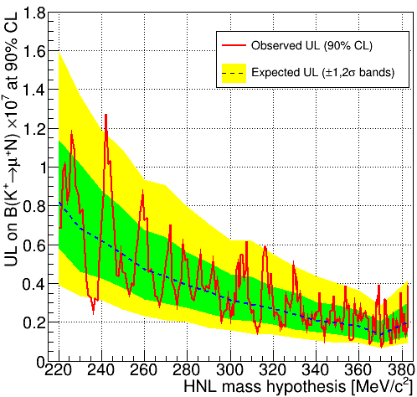
Mass scan results
K⁺ → e⁺N
K⁺ → μ⁺N
Upper limit on number of signal events
Upper limit on BR(K⁺ → l⁺N)

Slide 13
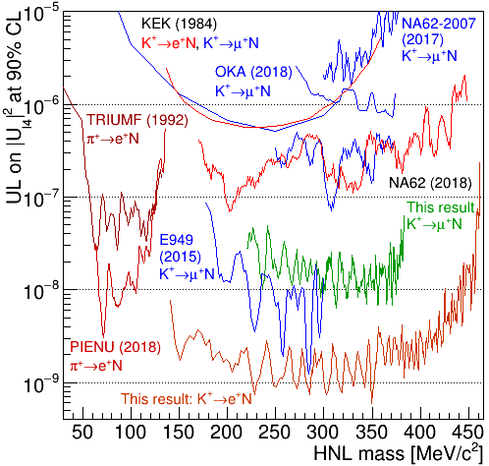
HNL production search summary
Preliminary result from NA62
1/3 of the data set
More than two order of magnitude improvements over previous results
For the muon case, the result approaches the one from E949, extending the mass to 383 MeV/c²
The analysis of the complete data set will improve by about a factor 2

Slide 14
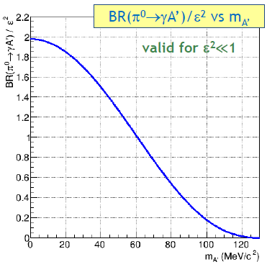
The dark photon
B. Holdom, Phys. Lett. B166 (1986) 196
The simplest hidden sector model introduces an extra U(1) gauge symmetry with its gauge boson: the dark photon A’ with mass m_{A’}
Coupling constant and charges can be generated through kinetic mixing between the QED and the new U(1) gauge boson
Batell et al., PRD80 (2009) 095024
Two unknown parameters: mass (m_{A’}) and mixing (ε²)
Sensitivity for m_{A’} < m_{π0}
Low sensitivity to ε² near π⁰ mass, due to kinematical suppression of the π⁰ ⟶ γA’ decay

Slide 15
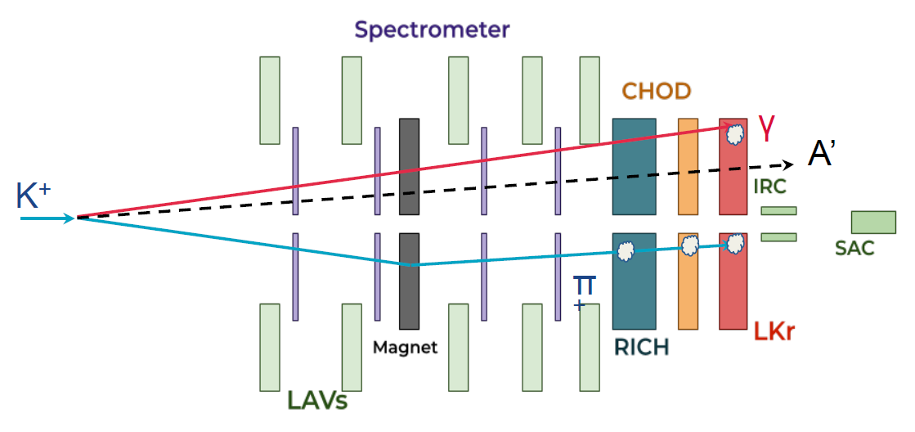
Search for dark photon in π⁰ to invisible
Pure, tagged and intense beam of π⁰ from K⁺ decays
Tagging done with missing mass cuts
Less than 10⁻³ contamination only from missing mass condition
Signal selection
π⁰ tagging, one photon in the LKr calorimeter, missing momentum, no extra activity
Same trigger line as πνν
Normalization selection
Based on minimum-bias K⁺ → π⁺ π⁰
Z vertex cut, 15 <p_{π}< 35 GeV/c to have at least 40 GeV missing energy, cut on the missing mass (P_{K}-P_{π})², no conditions on π⁰ photons
From 1% of the 2016 data set, 412M π⁰ tagged from K⁺ → π⁺ π⁰ decays

Slide 16
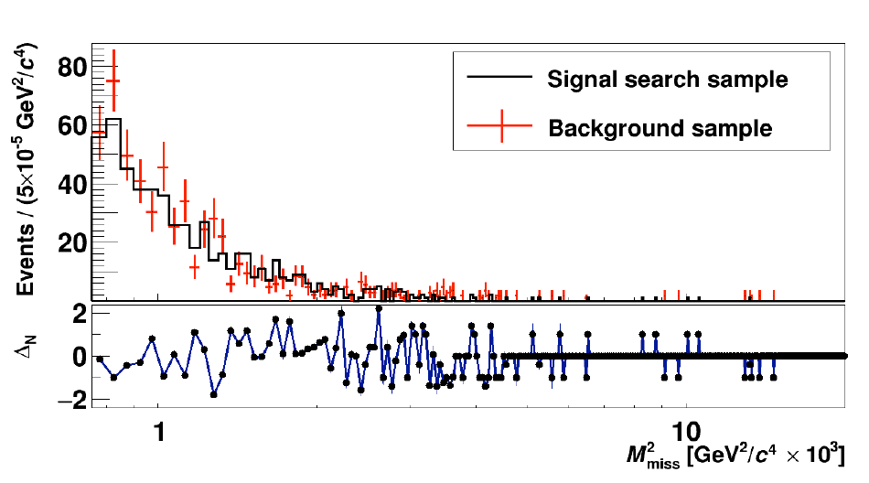
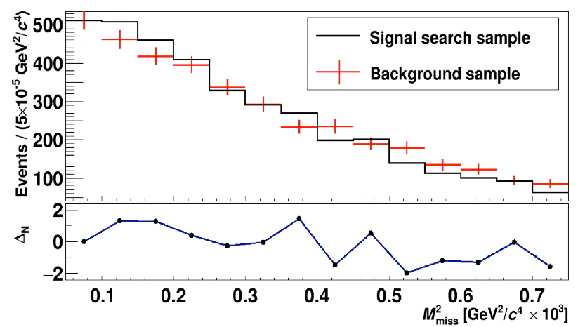
Background
Main background from π⁰ → γγ, 10⁻⁴÷10⁻⁵ reduction by the photon vetoes
Inefficiency dominated by conversion upstream the calorimeter
Evaluation of the background from data, inverting the veto conditions based on the charged hodoscopes
Background normalized to data in the region already excluded by previous experiments
Compare observed counts to expected background in the missing mass plot, with a mass scan Signal region 30 < m_{A’} <120 MeV/c²
Background at the level of O(1) event from a sample of 4×10⁸ π⁰ for m_{A’} >60 Mev/c²

Slide 17
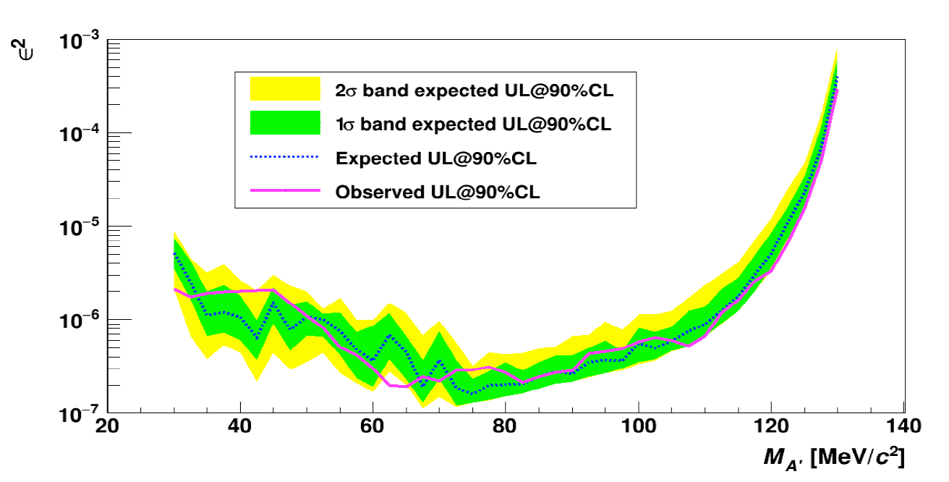
Result
Analysis of a subsample of 2016 data: 1% of the 2016-2018 data set
No excess observed
Upper limit set at 90% CL on number of signal events and translated to ε²
JHEP 05 (2019) 182

Slide 18
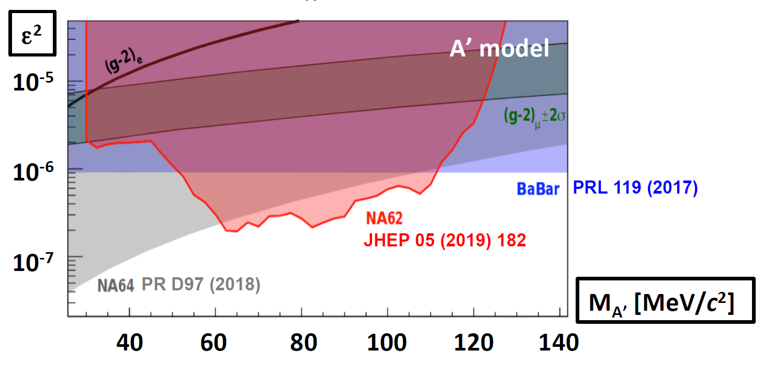
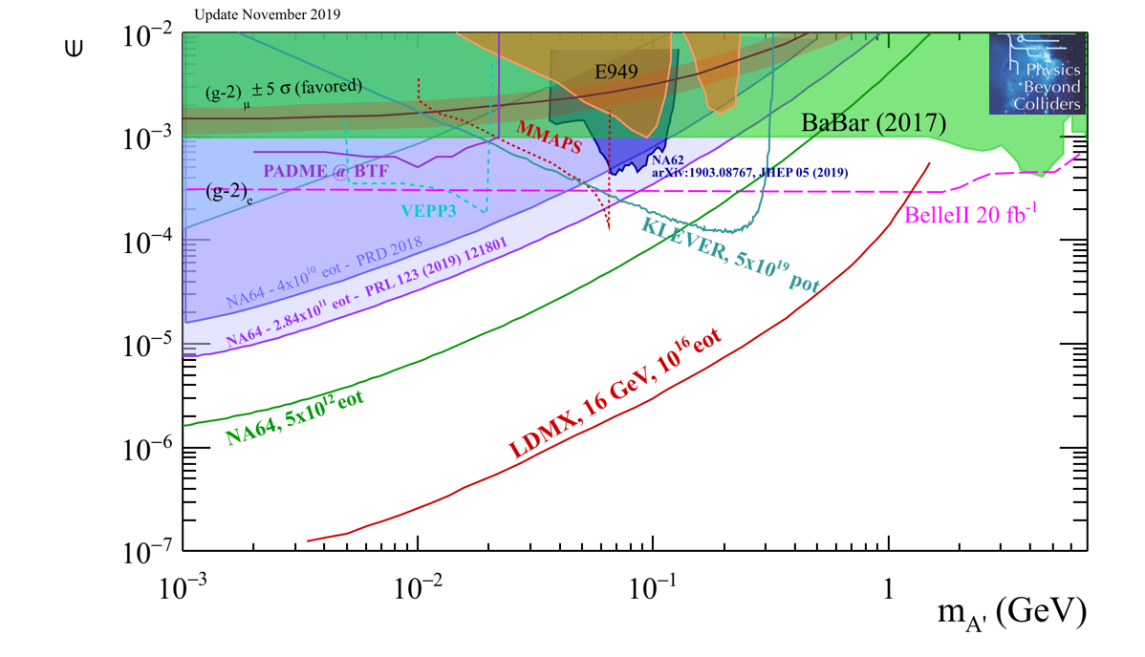
Implications
Improved upper limit in the range 60-110 MeV
Improvement by more than three orders of magnitude for
BR(π⁰ → γνν) < 1.9×10⁻⁷ (90%CL)
Possible improvement on BR(π⁰ → invisible) over the current limit of 2.7×10⁻⁷
Latest result from NA64
PRL 123 (2019) 121801

Slide 19
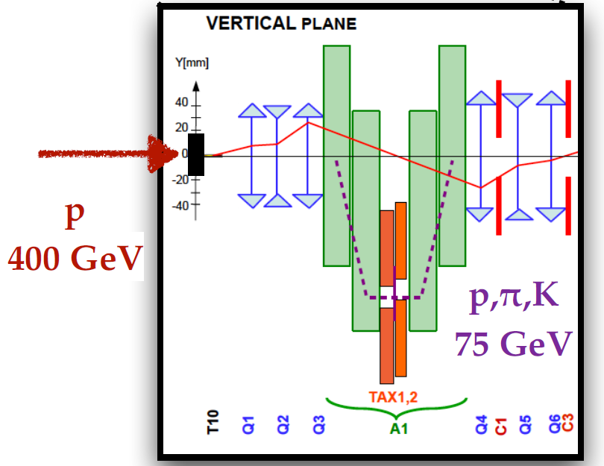
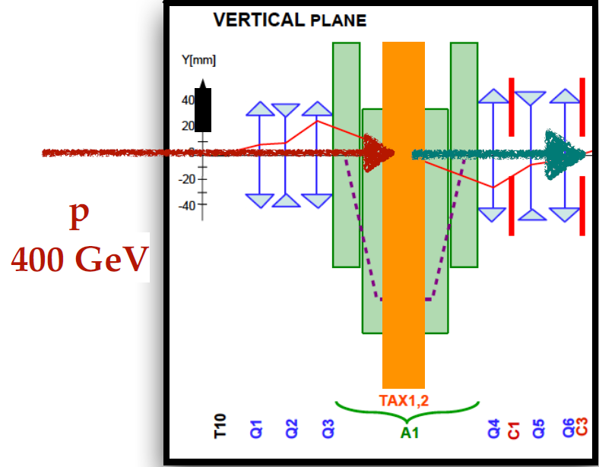
Beam dump mode
The large amount of available K⁺ decays limits the search for exotics to the mass of the kaon
Dumping the beam ahead of the detector will allow to produce B and D mesons decaying promptly to exotics mediators and SM particles
Exotic particles could be produced also in the dump
Exotics searches extended up to m ~ 1.7 GeV
As mentioned, 3×10¹⁶ POT has been collected in dump mode in 2017-2018. Analysis is ongoing to study the backgrounds
3-4 months of run in dump mode are foreseen during run 3 for a total of O(10¹⁸) POT
An additional veto counter ahead of the decay volume will improve the background rejection, mainly on not-closed channels
Next slides will show expected limits in 5 years
Standard K+ mode
Dump mode

Slide 20
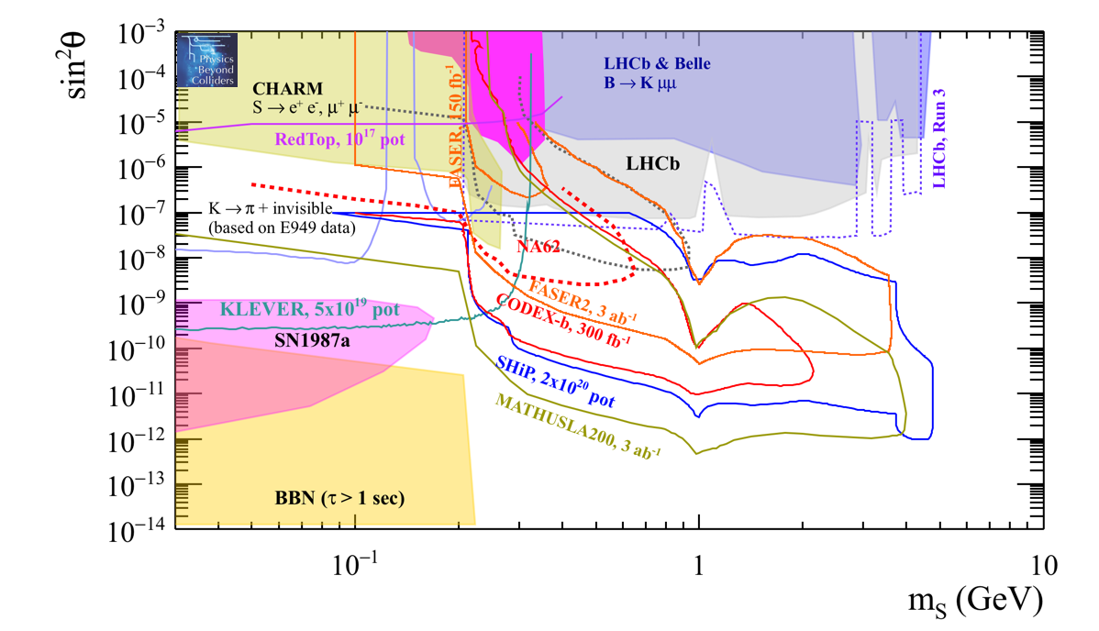
Dark scalar
S → μ⁺μ⁻
(μS+λS²)H†H
μ = sin θ
λ = 0
Search for two opposite sign charged tracks in the NA62 fiducial volume
Expected 90% CL exclusion contours
Including trigger/acceptance/selection efficiencies
Assume zero background

Slide 21
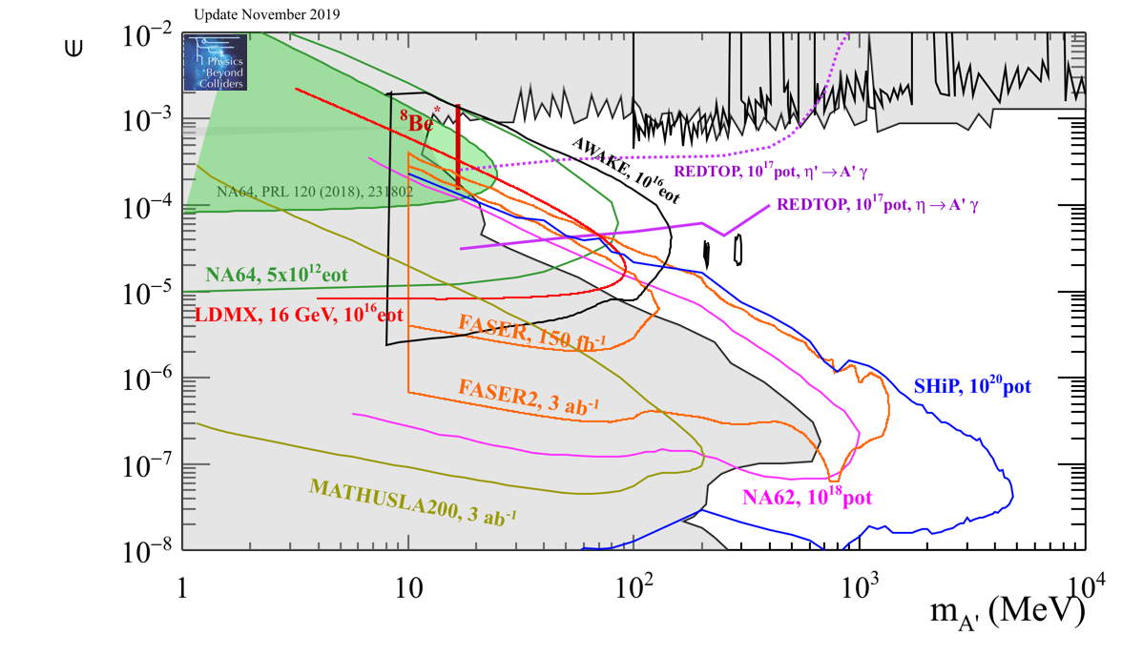
Dark photon
A’ → e⁺e⁻, A’ → μ⁺μ⁻
Search for two opposite sign charged tracks in the NA62 fiducial volume
Possible improvement on current limits
Here only p-Be target considered
Including direct QCD production of A’ and A’ production in the dump, the sensitivity will be higher
Expected 90% CL exclusion contours
Including trigger/acceptance/selection efficiencies
Assume zero background

Slide 22
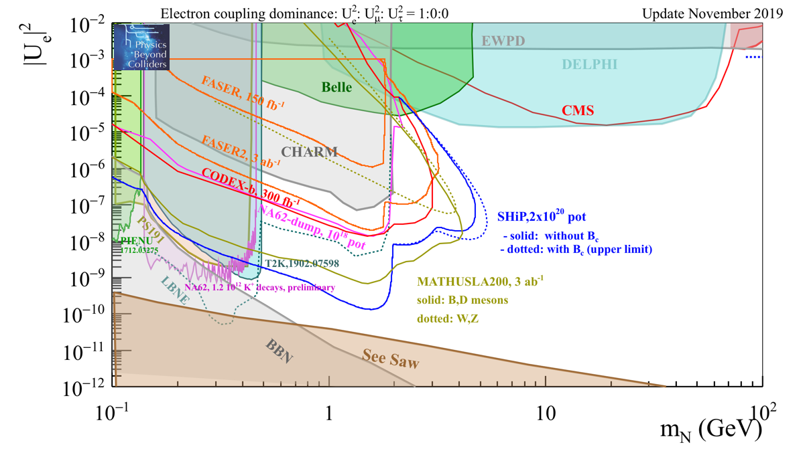
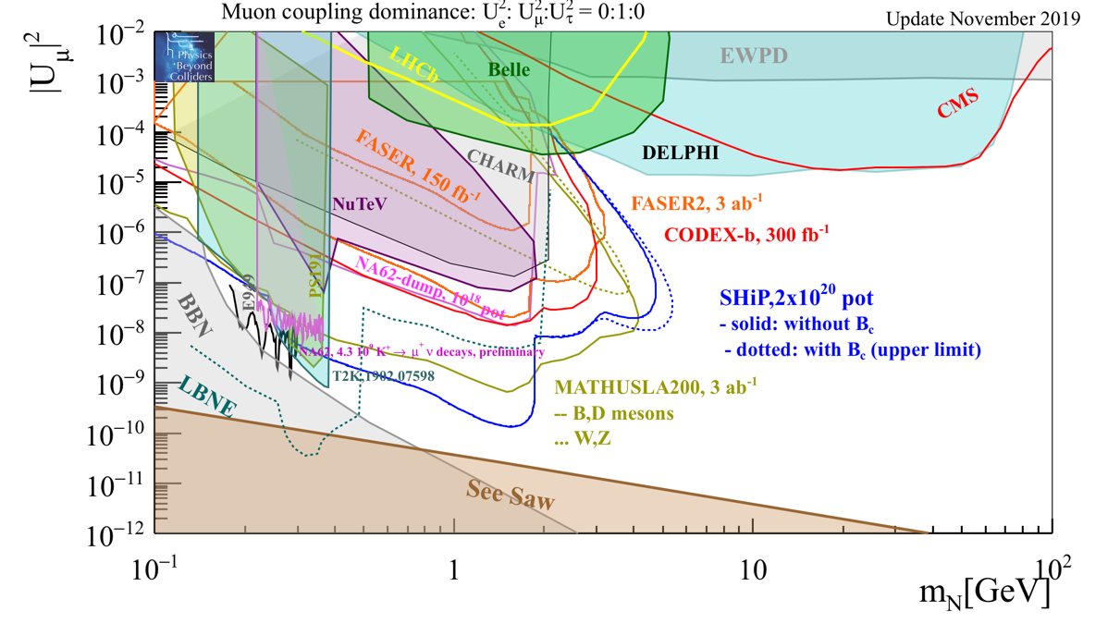
Heavy neutral leptons
D/D_{s} → l⁺ν_{H}, ν_{H} → πe, ν_{H} → πμ
Also the τ coupling can be probed
Expected 90% CL exclusion contours
Including trigger/acceptance/selection efficiencies
Assume zero background

Slide 23
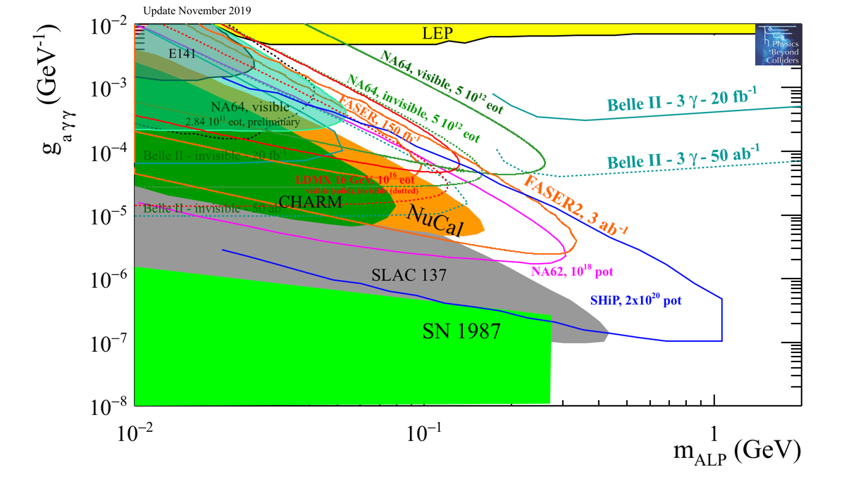
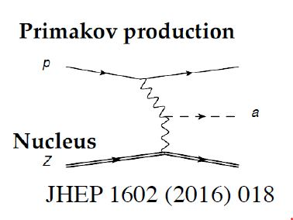
Axion-like particles (ALPs)
Production via elastic scattering of beam protons on the dump
Expected 90% CL exclusion contours
Including trigger/acceptance/selection efficiencies
Assume zero background
Coupling to photons is the main one
Search for decay A → γγ
Signature: 2 photons in the LKr calorimeter

Slide 24
Conclusions
The data taken during the πνν runs in NA62 allow to do exotic searches
Preliminary stronger limits on Heavy Neutral Lepton couplings
Preliminary new limit on dark photon coupling
Improvements expected with the analysis of the full data sample
Special runs using the beam taxes as beam dump have been performed
To study backgrounds for future beam dump data taking
We expect to have a dedicated run with the dump in 2023, with O(10¹⁸) protons on target
Improve limits on a variety of dark sector models

Slide 25
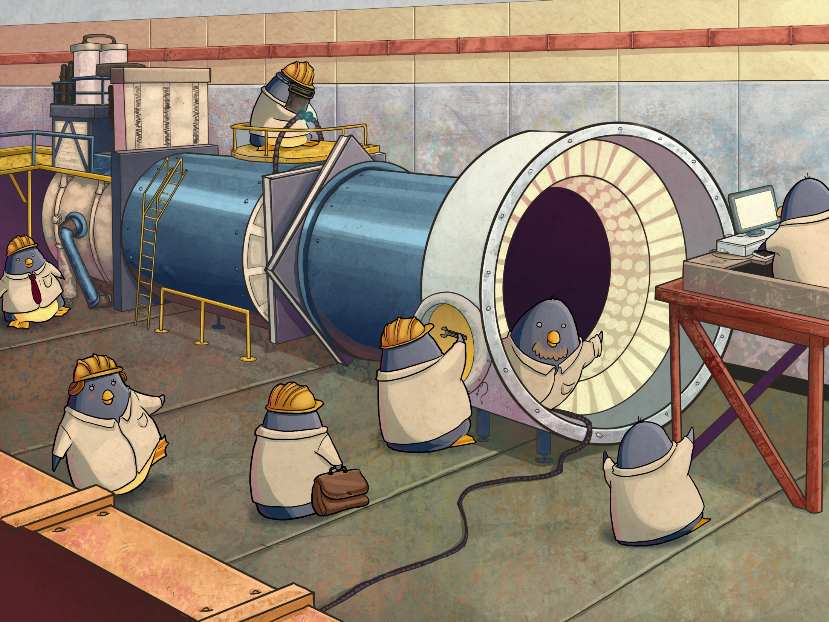
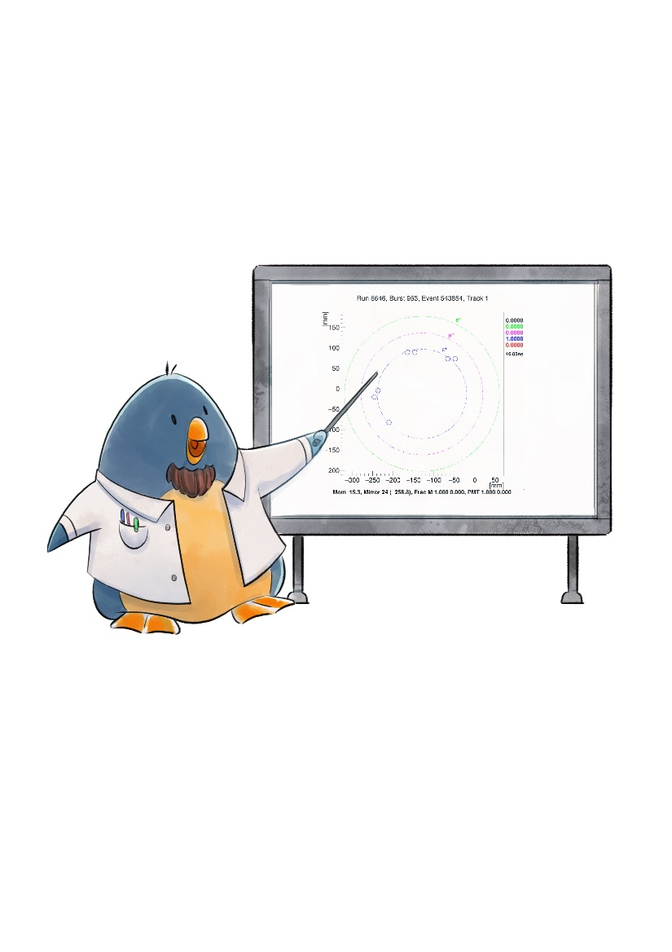
Artist’s view of the past installation activity…
Thank you!
… and of the current analysis work…

