Slide 1



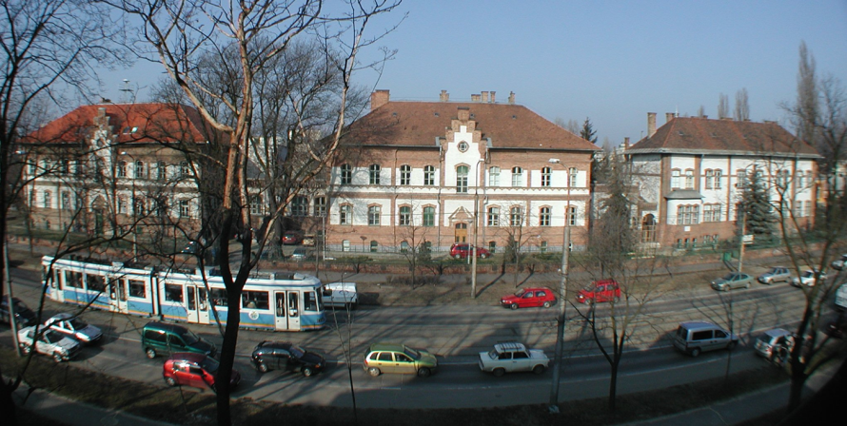
Anomalies observed in nuclear transitions indicate the existence of a new particle with mass of 17 MeV/c²
Attila J. Krasznahorkay
Inst. of Nucl. Res. (Atomki)
3 main divisions:
  Nuclear Physics Division
  Atomic Physics Division
  Applied Physics Division
  Size: 100 scientists, 100 other staff
In the downtown of Debrecen, www.atomki.mta.hu

Slide 2
Leitmotif of my present talk:
In an age of giant accelerators, of complex experiments and of mystifying theories it is a pleasure to report on some simple experiments, made with simple equipment and having a simple interpretation
Robert Hofstadter (Nobel, 1961)

Slide 3

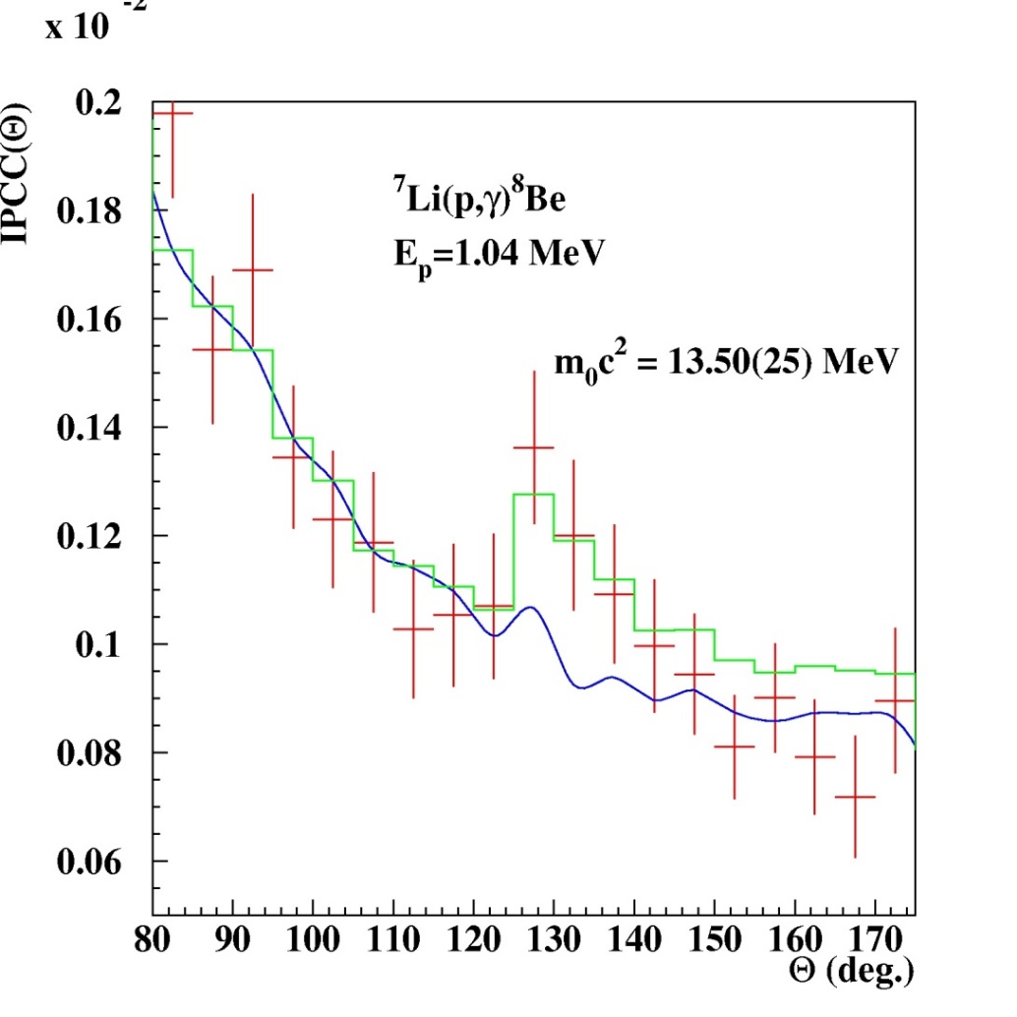
Search for a light neutral boson in nuclear transitions
Attila Krasznahorkay, F.W.N. de Boer, M. Csatlós,
L. Csige, Z. Gácsi, J. Gulyás, M. Hunyadi, T.J. Ketel,
A. Krasznahorkay Jr., R.G. Lovas, B.M. Nyakó,
L. Stuhl, T. Tornyi, J. Van Klinken
The boson showed up with ≈3σ confidence → inspiration for further more precise experiments !!!

Slide 4
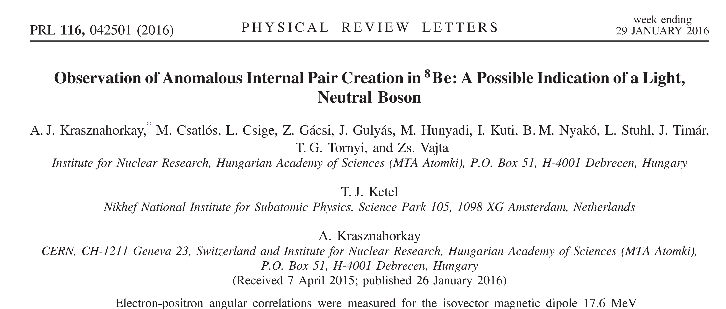
~200 citations, ⁸Be anomaly, X17 boson

Slide 5
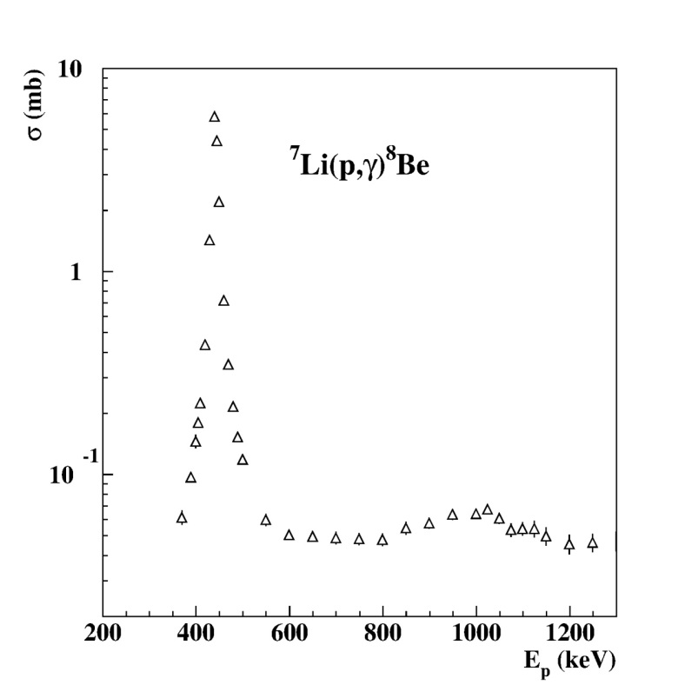
Study the ⁸Be M1 transitions
Excitation with the
⁷Li(p,γ)⁸Be reaction
18.2
1⁺
Ep= 1030 keV
17.6
1⁺
Ep= 441 keV
3.0
2⁺
0
0⁺
⁸Be

Slide 6
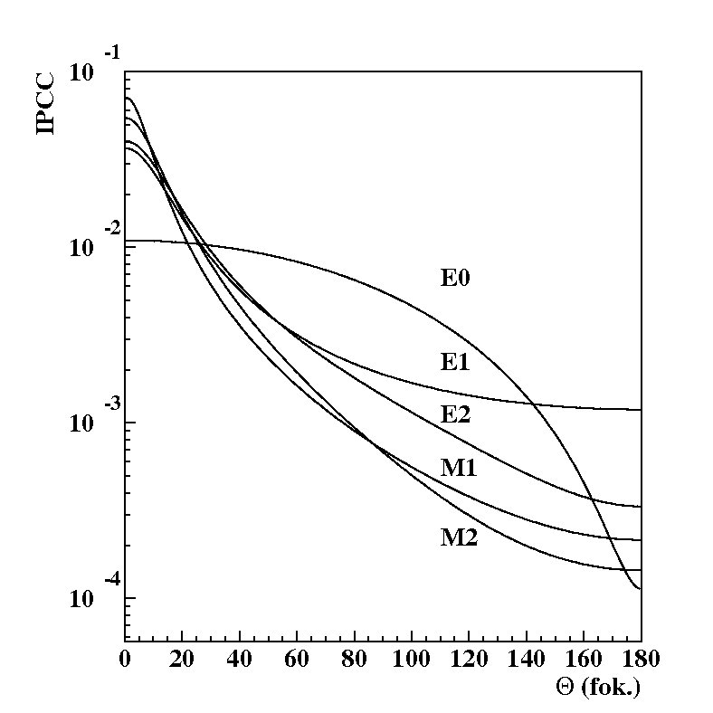
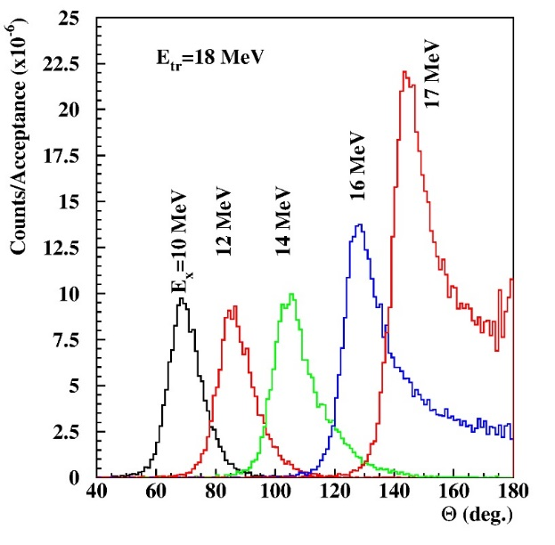
Internal pair creation and particle decay
Background Signature
J^{π}
i
e⁺
J^{π}
f
e–

Slide 7
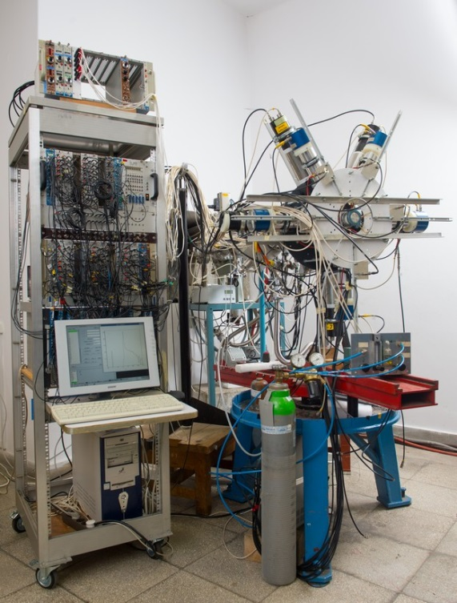
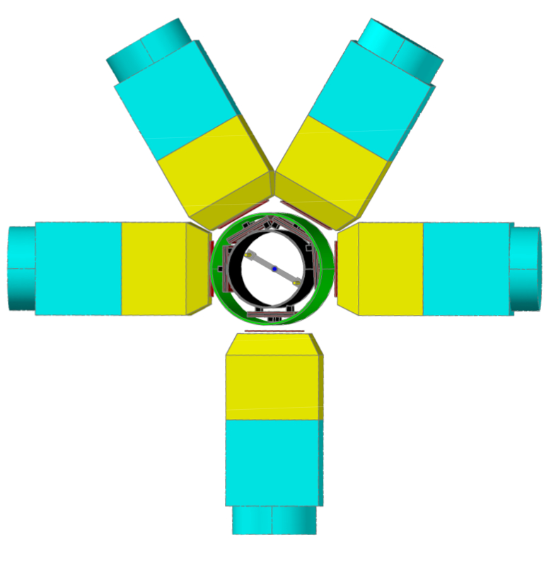
Experiments with a new e⁺e⁻ spectrometer (NIM, A808 (2016) 21)
Proton decay: B(p + ⁷Li) ≈ 100%
γ-decay: B(⁸Be + g) ≈ 1.5 x 10⁻⁵
Internal pair creation: B(⁸Be + e⁺ e⁻) ≈ 5.5 x 10⁻⁸
Ejection of a new particle: B(⁸Be + X) ≈ 5.5 x 10⁻¹⁰

Slide 8
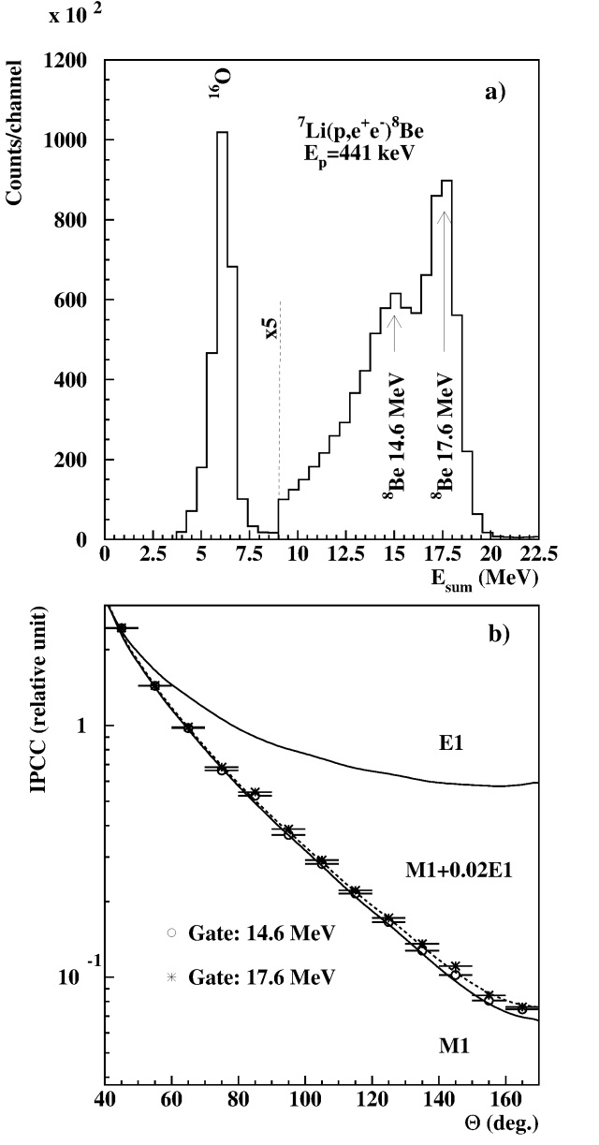
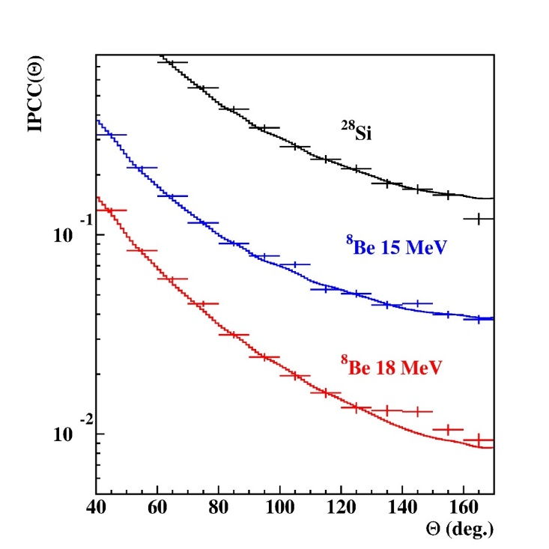
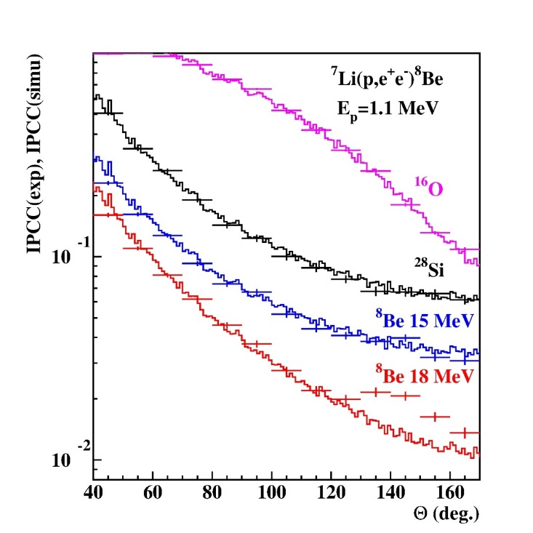
Results e⁺ - e⁻ sum energy spectra and angular correlations
Ep=1.04 MeV Ep=1.10 MeV
Deviation from IPC
Blind analysis, tuning the parameters…

Slide 9
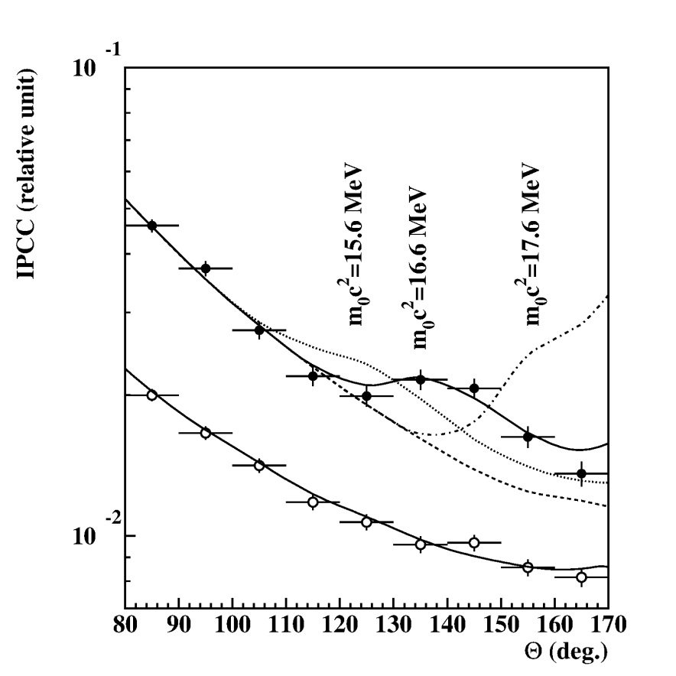
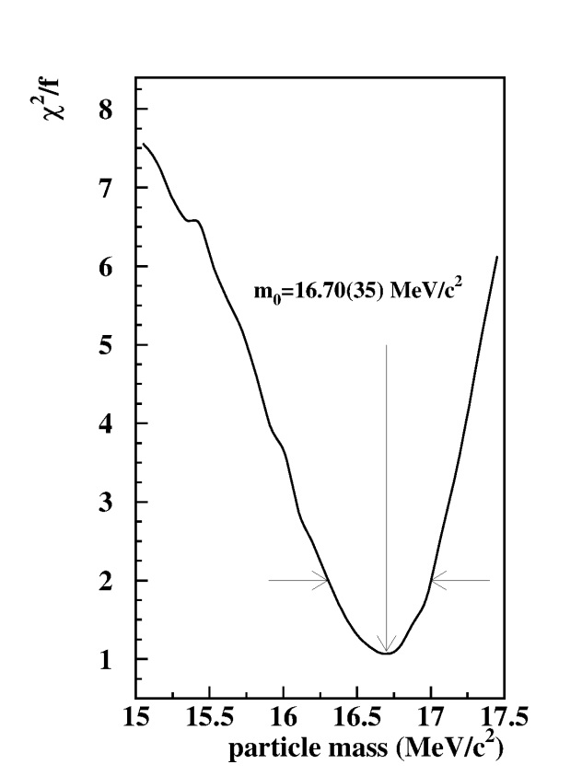
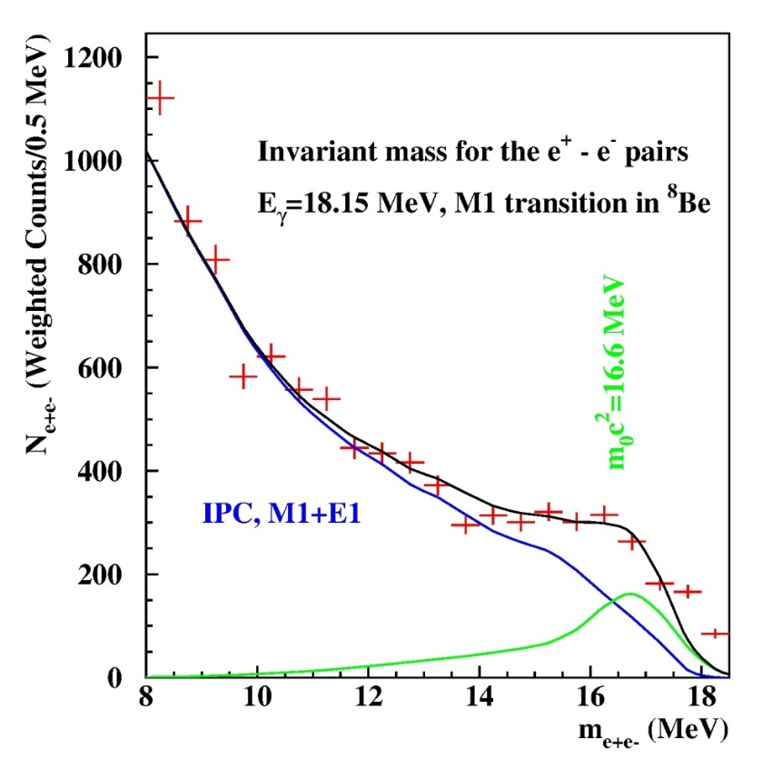
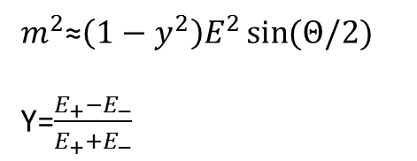
How can we understand the peak like deviation?
Fitting the angular correlations
Experimental angular e⁺e⁻ pair correlations measured in the ⁷Li(p,e⁺e⁻) reaction at Ep=1.10 MeV with -0.5< y <0.5 (closed circles) and |y|>0.5 (open circles), where y=(E1-E2)/(E1+E2).
Determination of the mass of the new particle by the Χ²/f method
$m^{2}$≈$\left(1−y^{2}\right)E^{2}\sin{(Θ/2)}$
Y=$\frac{E_{+}−E_{−}}{E_{+}+E_{−}}$

Slide 10
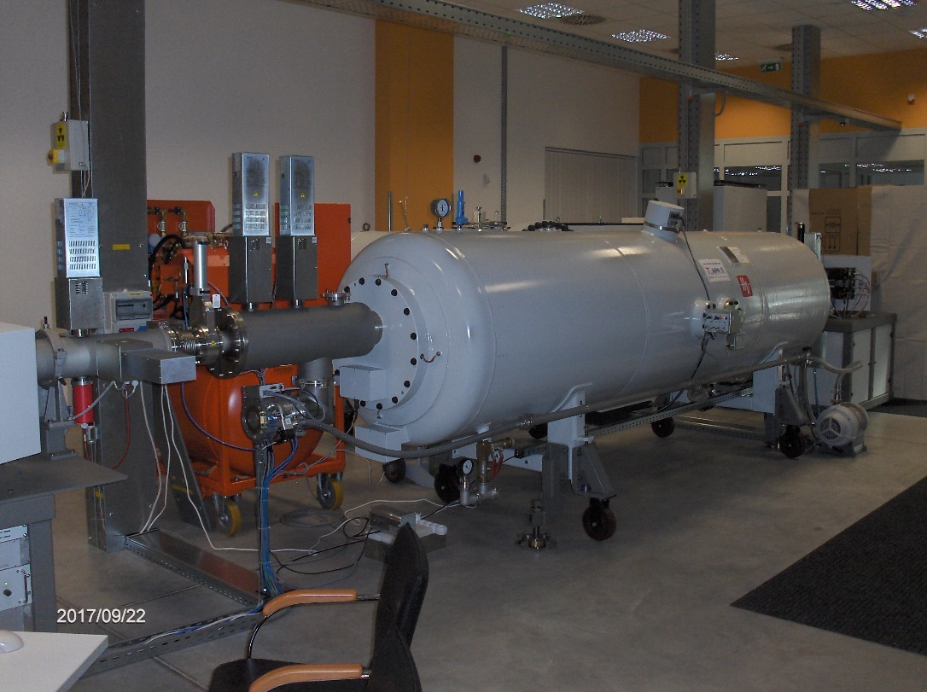
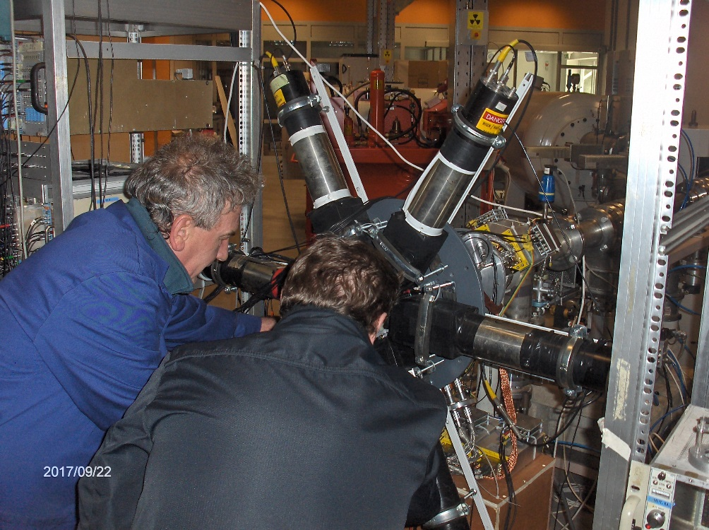
Repeating the experiments at a new Medium-Current Tandetron Accelerator in Atomki
Main specifications:
  TV ripple: 25 V_{RMS,} TV stability: 200 V (GVM), 30 V (SLITS)
  Beam current capability at 2 MV: 200 µA proton, 40 µA He

Slide 11
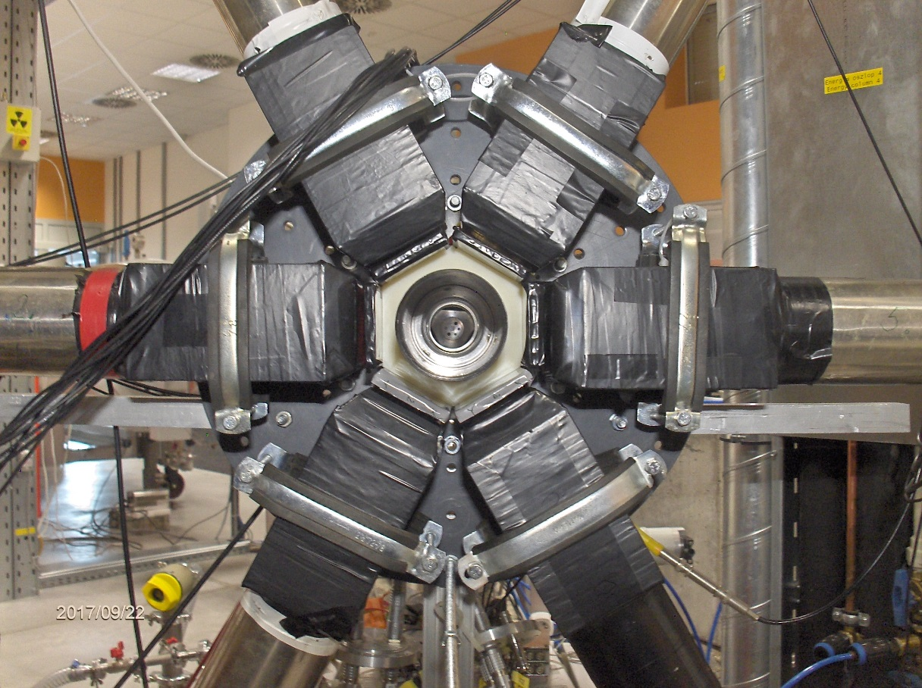
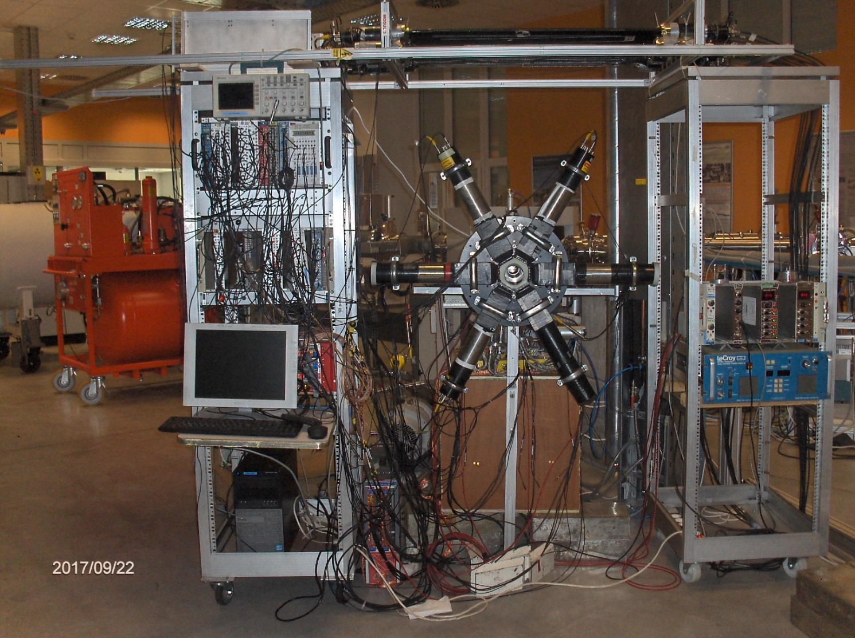
The new e⁺e⁻ pair spectrometer with six telescopes equipped with Si DSSD’s

Slide 12
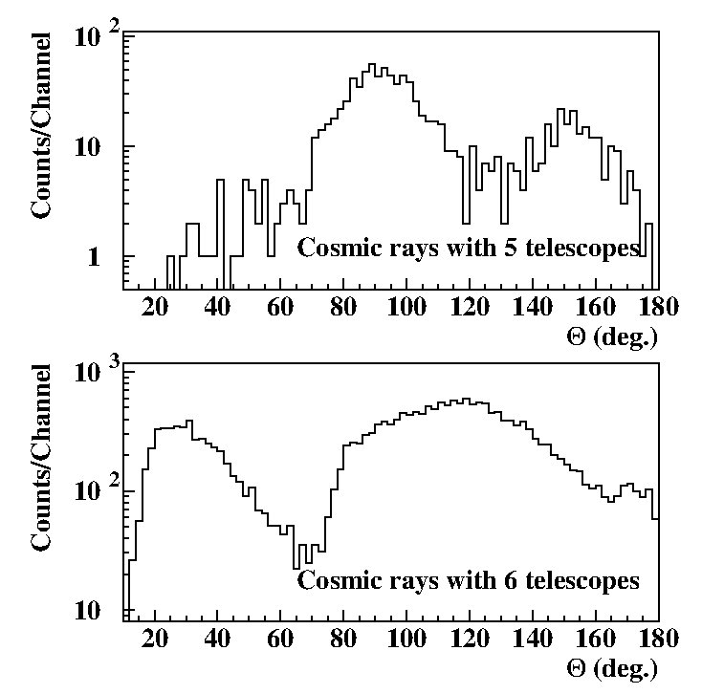
Background from cosmic rays in the setups with 5 and 6 telescopes

Slide 13
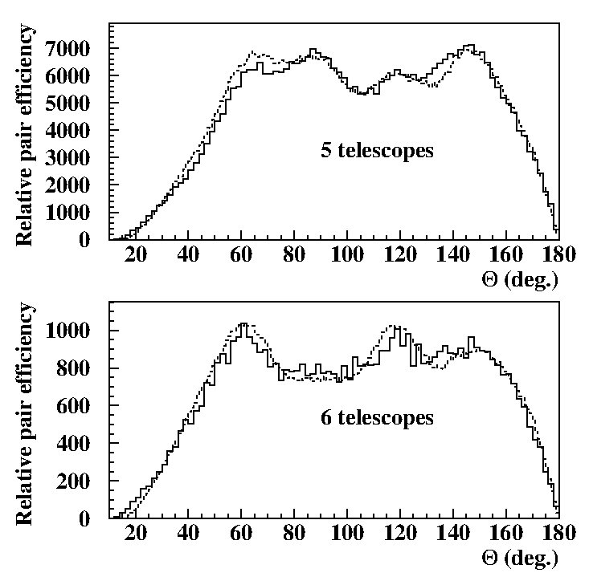
Efficiency curves for the setups with 5 and 6 telescopes
Relative numbers!
The absolute efficiency for 6 detectors is certainly larger!
The results of the present experiment can be considered independent from the one we published in PRL in 2016.

Slide 14
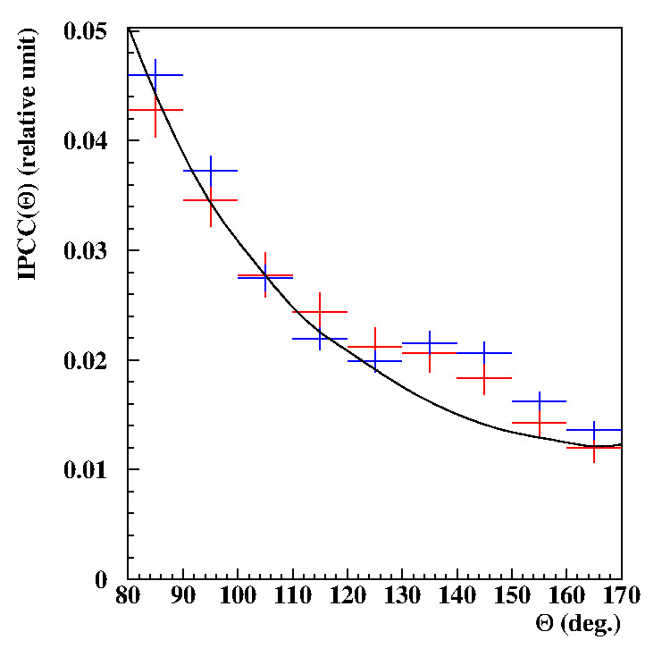
Recent results for the 18.15 MeV transition
PRL results
Present results

Slide 15
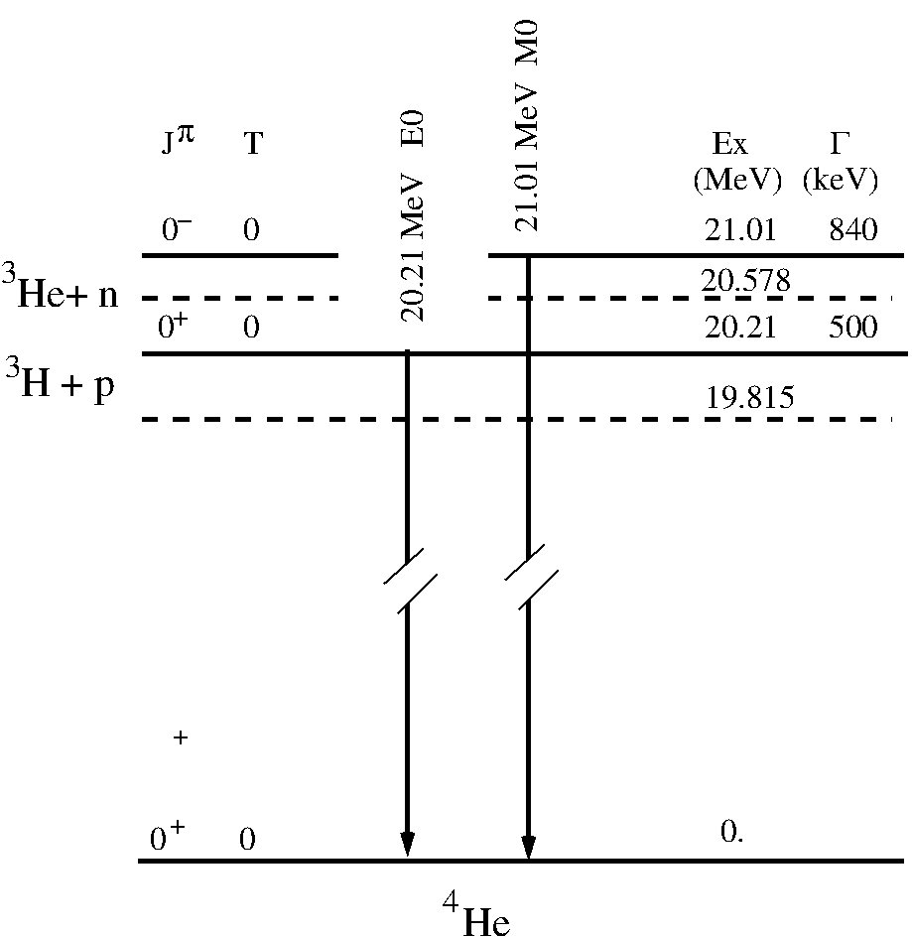
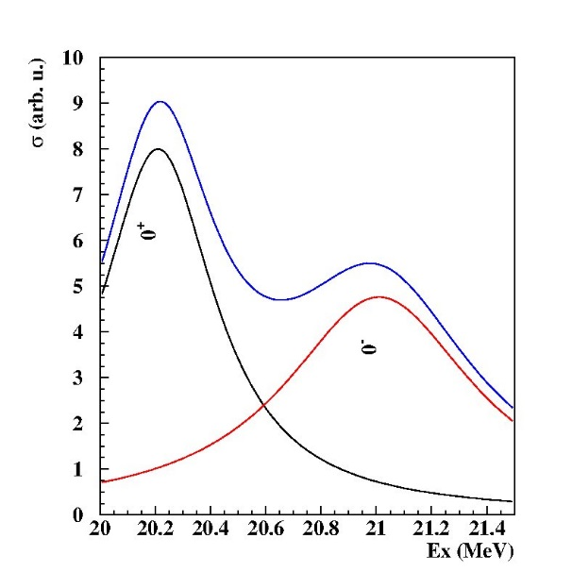
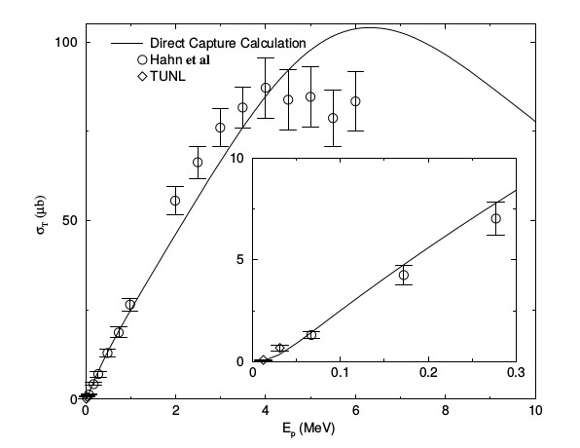

Study of the 21 MeV M0 transition in ⁴He excited by ³H+p, and ³He+n reactions
$Γ_{E0}$=3.3x10⁻⁴ eV
Forbidden transition!!!
γ-ray production with direct proton capture.
The main source of background produced by external pair creation on the backing of the target and on the other surrounding materials. GEANT simulations.

Slide 16
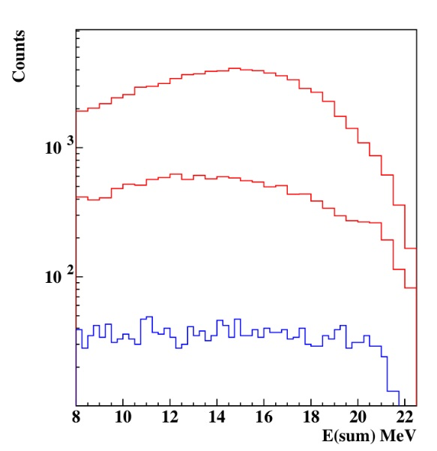
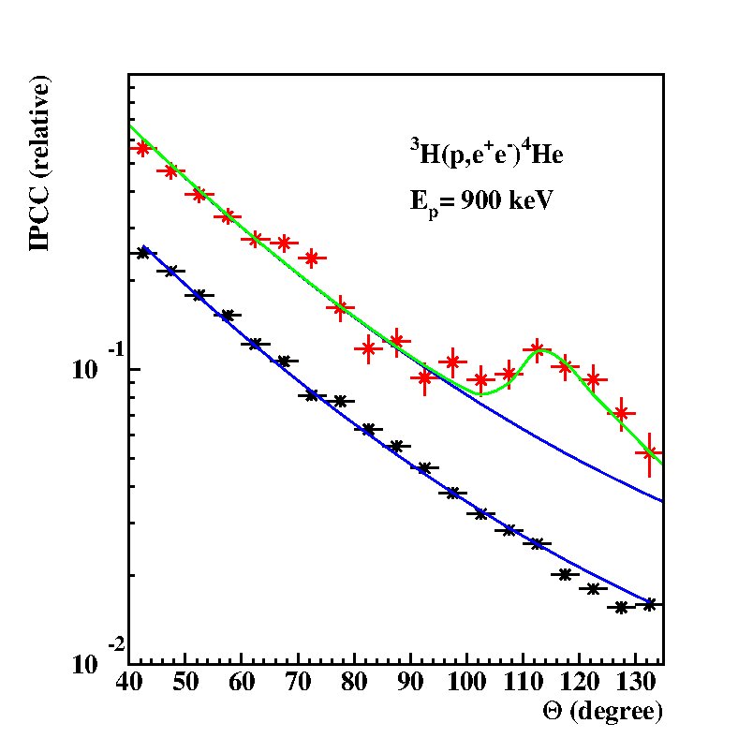
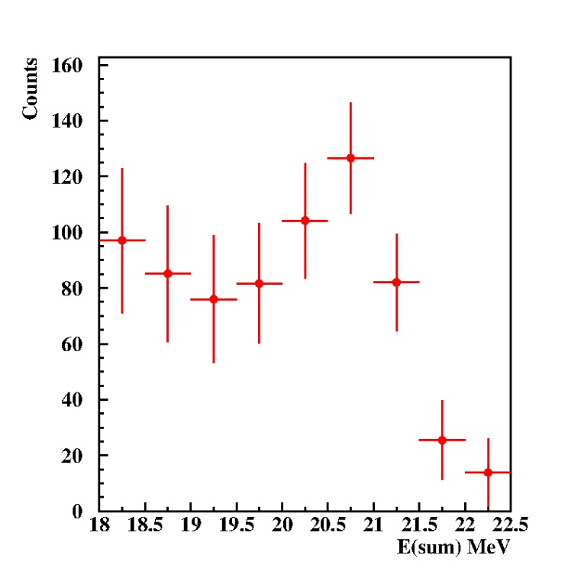
Results for the e⁺e⁻ decay measured in Debrecen
Measured e⁺e⁻ sum-energy spectra for different detector combinations.
60º
120º
180º
Simulation for
m₀c²= 17.0 MeV
Significance: 7.6 σ
Difference between spectra measured at 120º and 60º.
Measured (gated) e⁺e⁻ pair correlation for the full energy pairs.

Slide 17
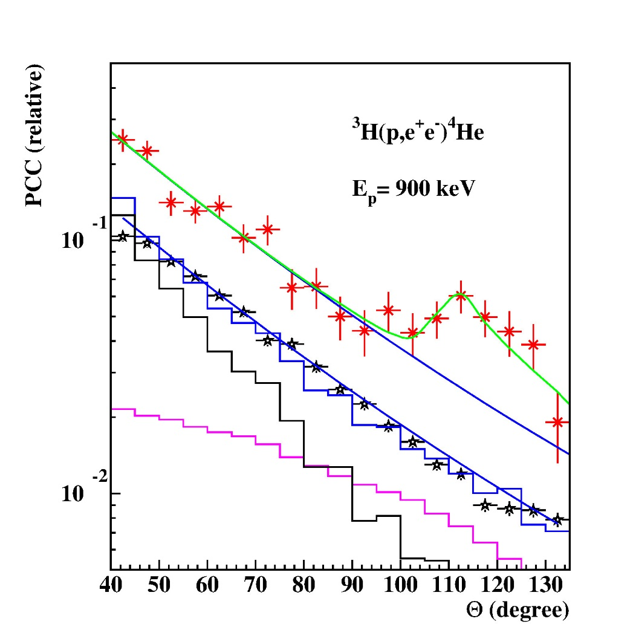

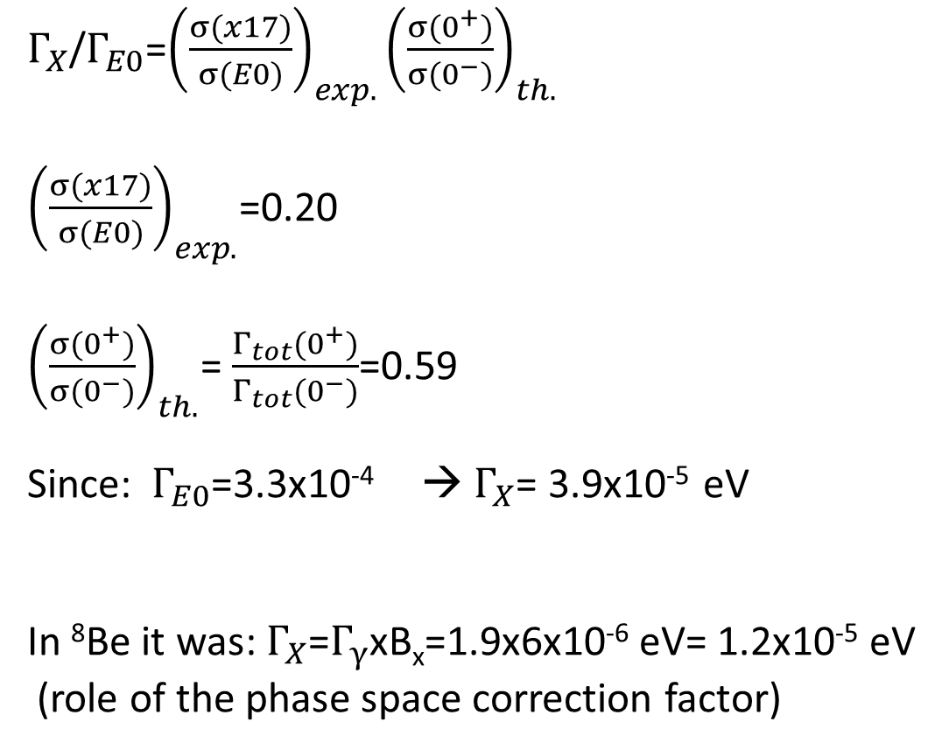
On the partial width ($Γ_{X}$) of the X17 particle
$Γ_{X}$/$Γ_{E0}$=${\left(\frac{σ(x17)}{σ(E0)}\right)}_{exp.}{\left(\frac{σ(0^{+})}{σ(0^{−})}\right)}_{th.}$
${\left(\frac{σ(x17)}{σ(E0)}\right)}_{exp.}$=0.20
${\left(\frac{σ(0^{+})}{σ(0^{−})}\right)}_{th.}$= $\frac{Γ_{tot}(0^{+})}{Γ_{tot}(0^{−})}$=0.59
Since: $Γ_{E0}$=3.3x10⁻⁴ → $Γ_{X}$= 3.9x10⁻⁵ eV
In ⁸Be it was: $Γ_{X}$=$Γ_{γ}$xB_{x}=1.9x6x10⁻⁶ eV= 1.2x10⁻⁵ eV
(role of the phase space correction factor)
EPC
E0

Slide 18
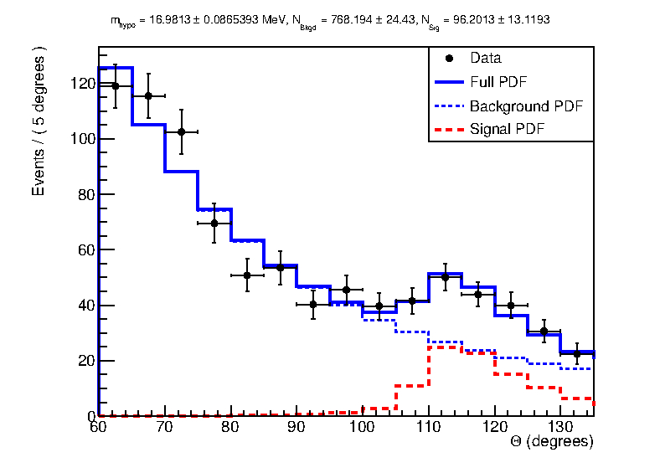
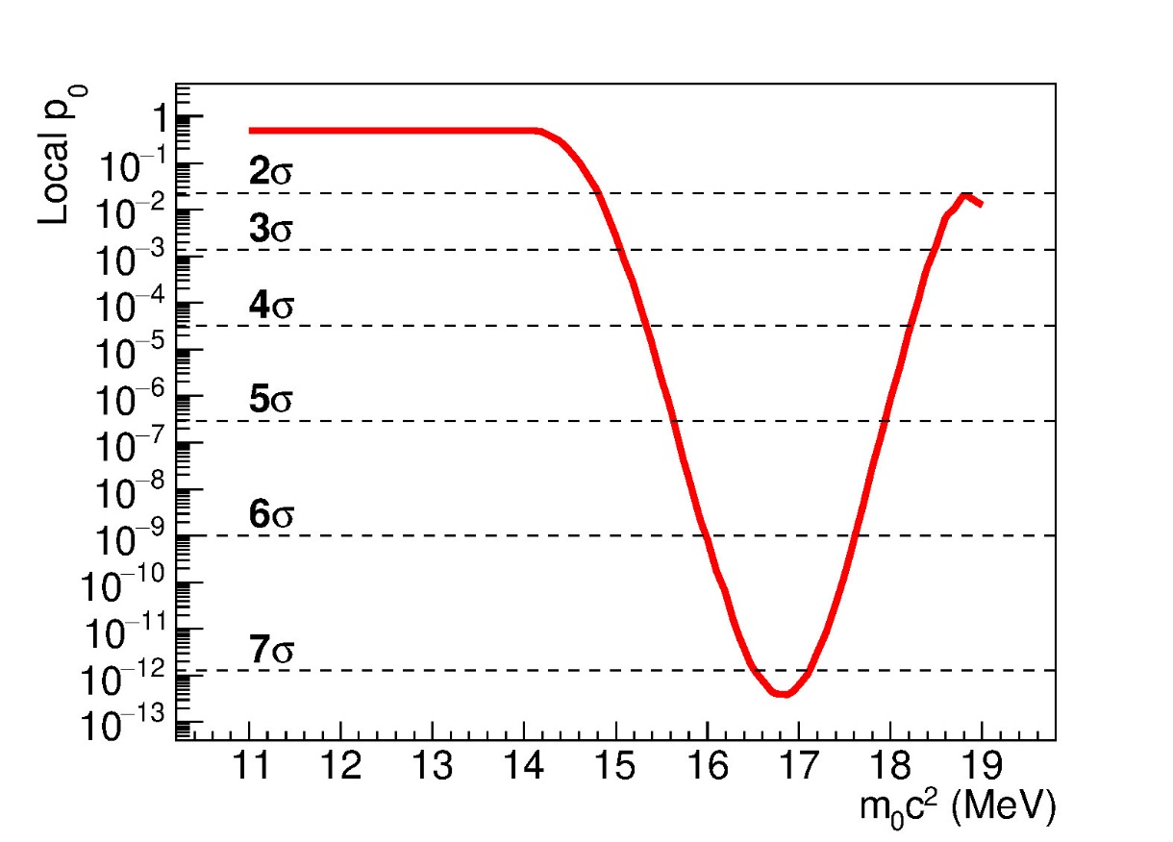
Details of the fit performed by RooFit

Slide 19
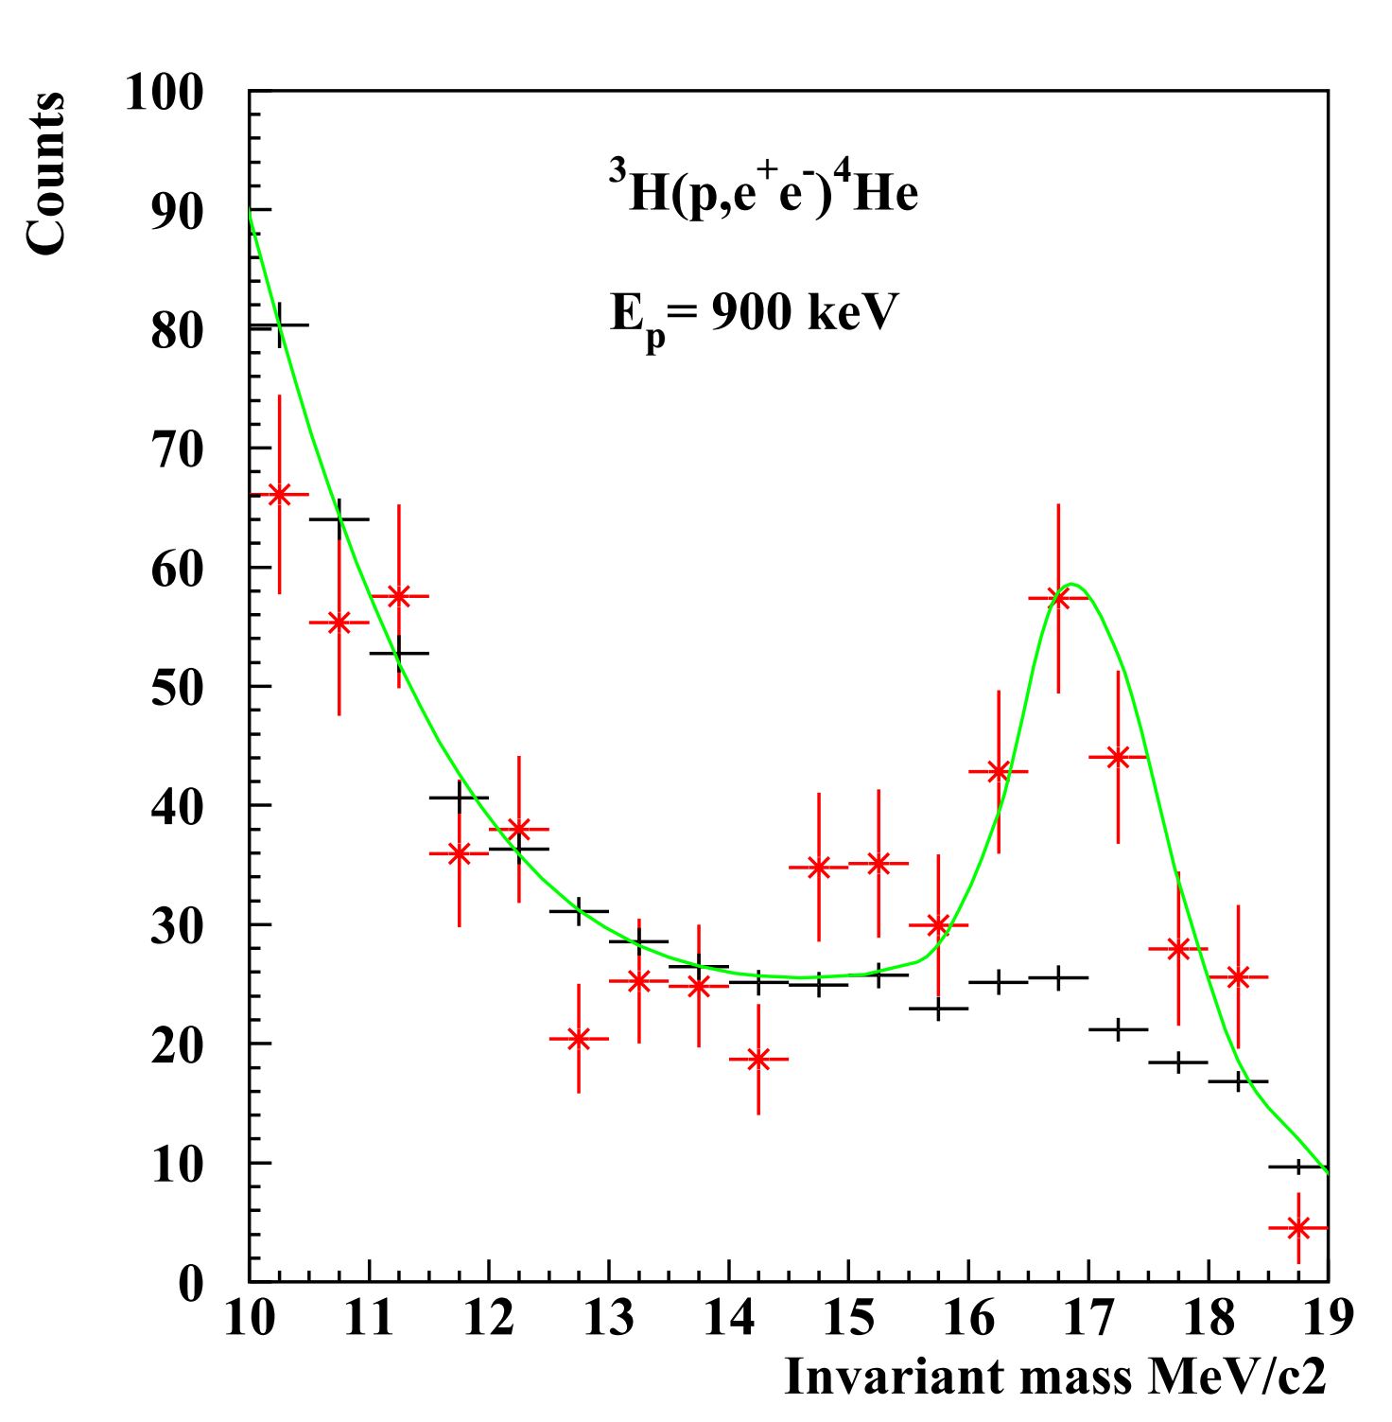
Invariant mass distribution
Gated invariant mass distr. for full energy pairs.
Gated invariant mass distr. for external pairs.
mc²=$\sqrt{\left(1−y^{2}\right)}E\sin{(Θ/2)}$
y=$\frac{E_{+}−E_{−}}{E_{+}+E_{−}}$
Simulated result for
m₀c²= 17.0 MeV

Slide 20
Conclusion
The ⁸Be anomaly has been reproduced with an upgraded spectrometer.
The effect can not be explained within nuclear physics.
The anomaly can be successfully described by a new particle called X17.
The effect of X17 was observed also in ⁴He in a 21.01 MeV 0⁻ →0⁺ transition at a correspondingly smaller angle. The significance of the peak is 7.2 σ.
We are planning to study the γγ-decay of X17 to determine their spin.
Promising outlook.

Slide 21
Acknowledgement
M. Csatlós, L. Csige, Z. Gácsi, J. Gulyás, D. Firak,
M. Hunyadi, M. Koszta, Á. Nagy, N. Sas, B. Szihalmi,
J. Timár, T. Tornyi

Slide 22
To ⁸Be continued…
Thank you very much for your attention

Slide 23
Backup slides

Slide 24
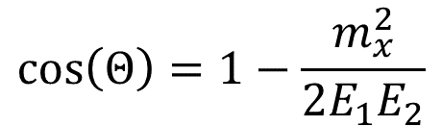
Study the γγ-decay of X17 in ⁴He
Vector particle (1+) or axialvector (0-)? If axialvector than it can decay by γγ emission.
γγ-decay only known in a special case: 0⁺ → 0⁺ (⁹⁰Zr, ⁴⁰Ca, ¹⁶O) ⁴He
J. Schirmer et al., PRL 53, 1897 (1984)
J. Kramp et al., NPA 474, 412 (1987)
Walz, N. Pietrala et al., Competitive Double-Gamma
(Decay Nature 526, 406 (2015)
$$\cos\left(Θ\right)=1−\frac{m_{x}^{2}}{2{E_{1}E}_{2}}$$
Study the angular correlation with state of the art 3”x3” LaBr₃ detectors!

Slide 25
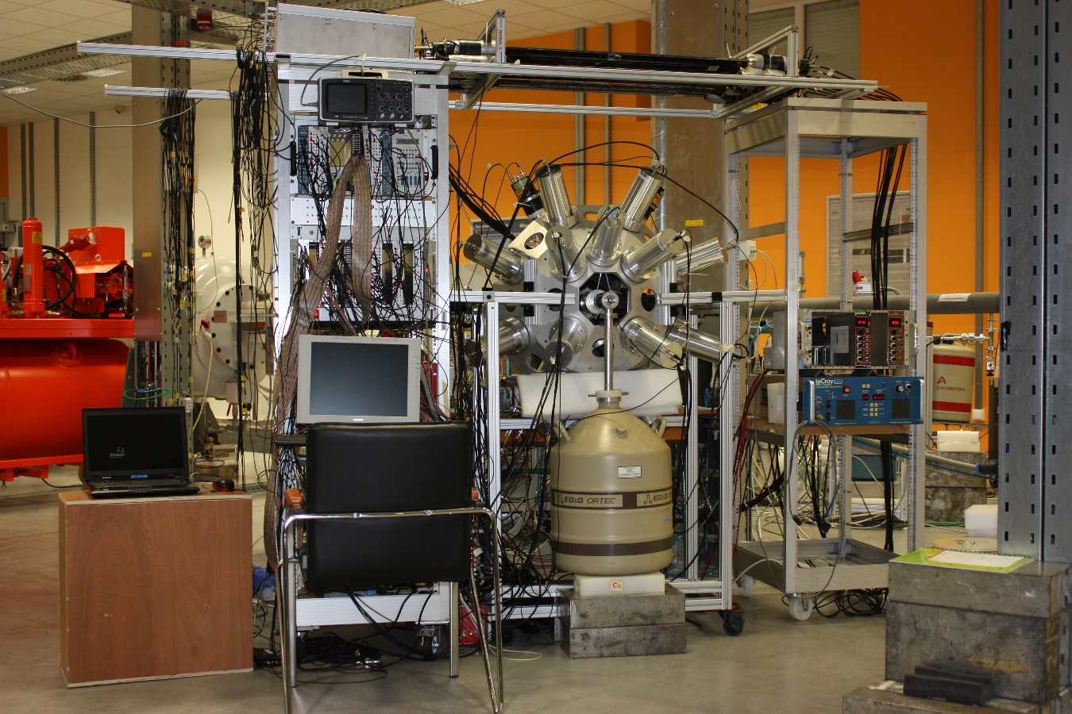
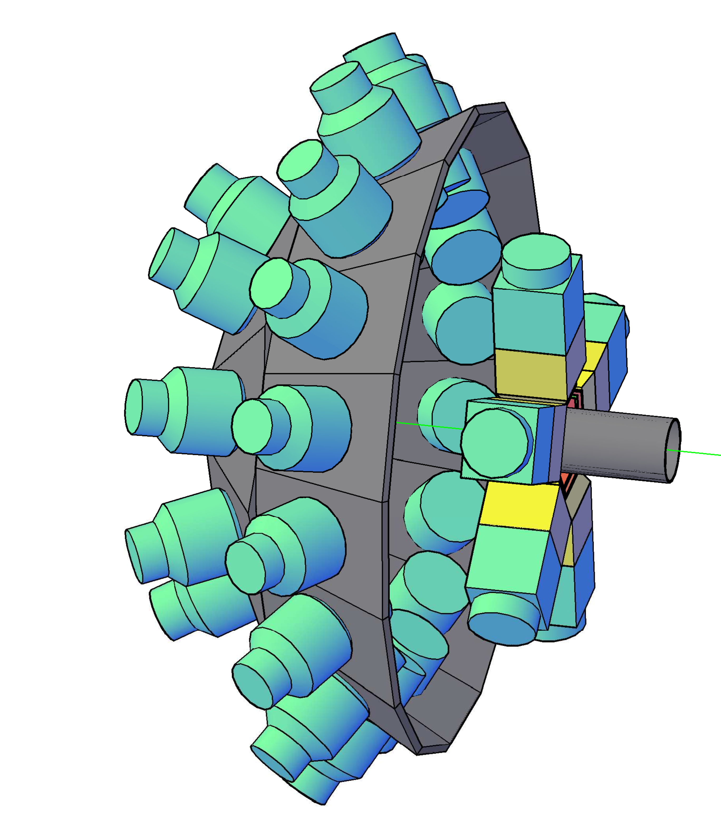
The experimental setup in Debrecen including both the e⁺e⁻ and the γ-ray spectrometers

Slide 26
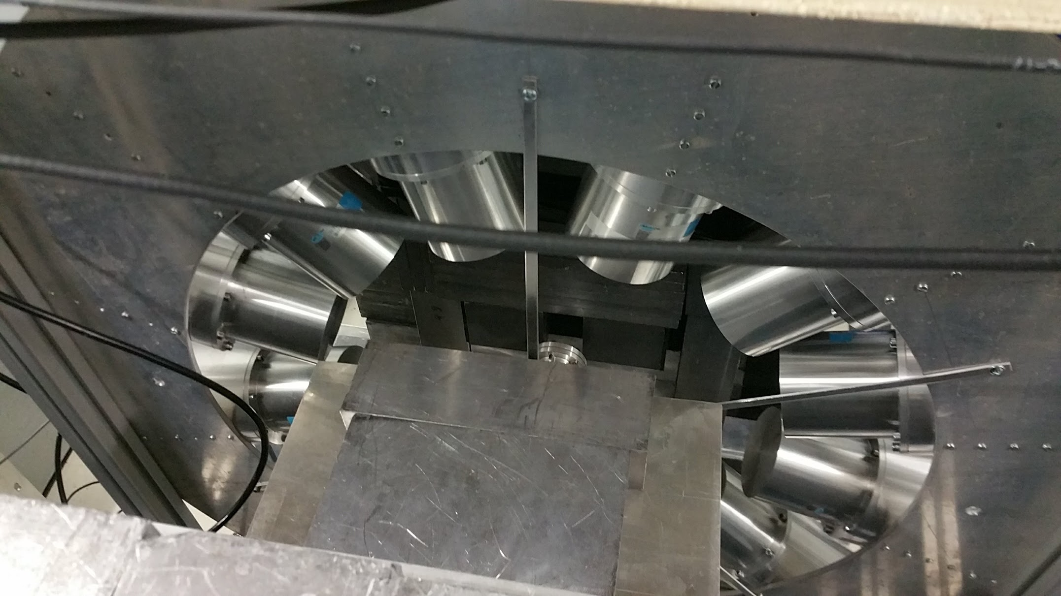
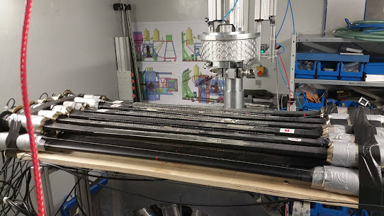
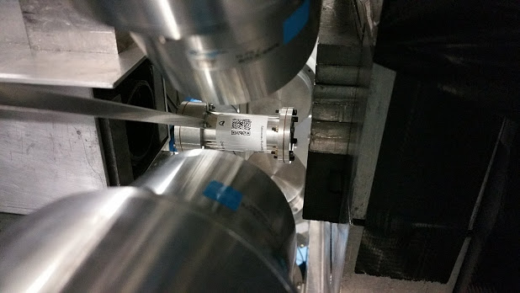
The ³He(n,γγ)⁴He experiment in Garching with the FRM II High Flux Reactor (10¹⁰ cold n/cm2)
Coincidence γ-ray spectrometer with twelve 3”x3” LaBr3 detectors.
The angle between the detectors is 30 degree, and the detector plain
Is perpendicular to the beam.
The pressurized (2 bar) ³He target located in the middle of the spectrometer, and the active cosmic-ray shield (above).

Slide 27
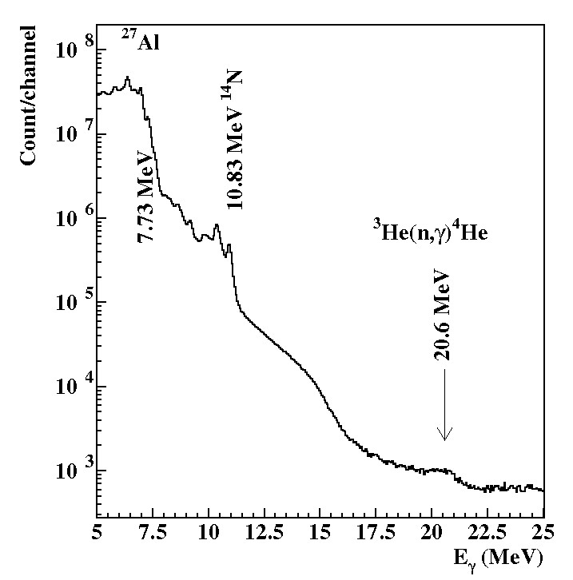
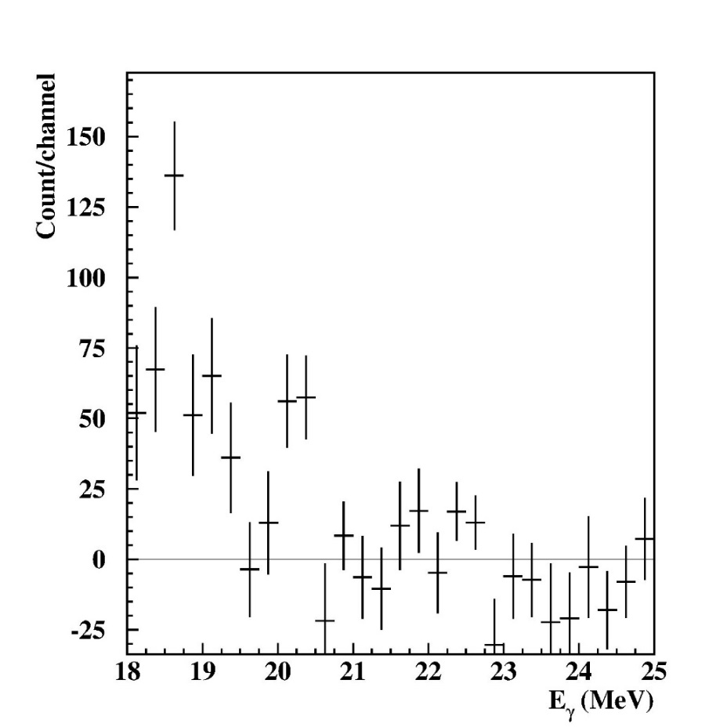
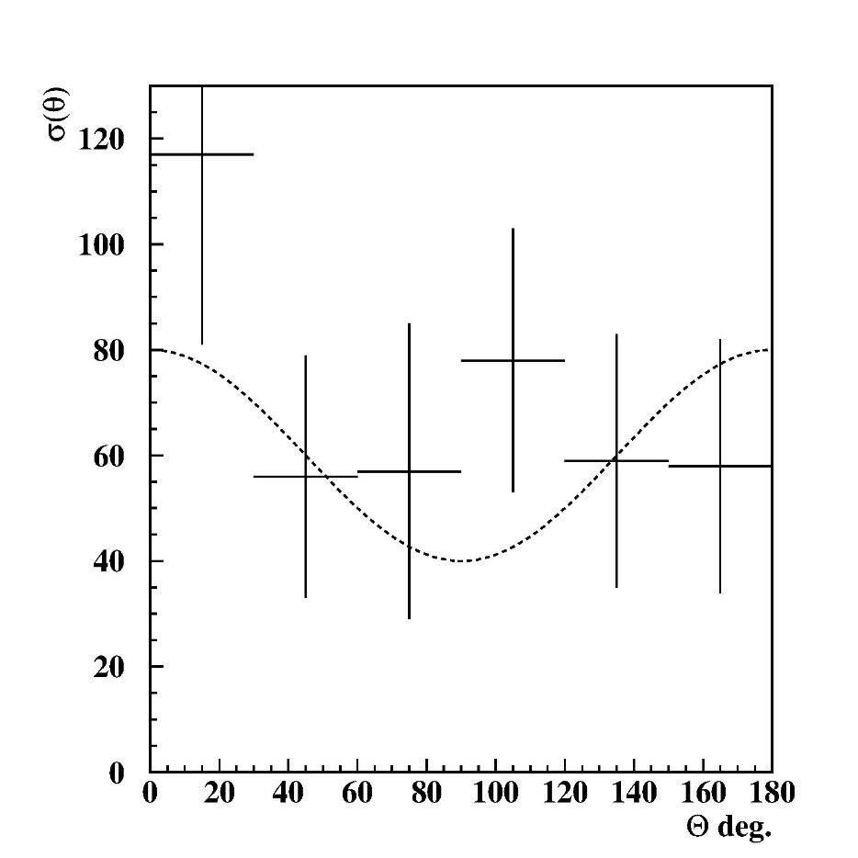
The first (very preliminary) results obtained in Garching
A typical singles γ-ray spectrum
Typical sum-energy spectra for coincident detectors
Preliminary γγ-angular correlation

Slide 28
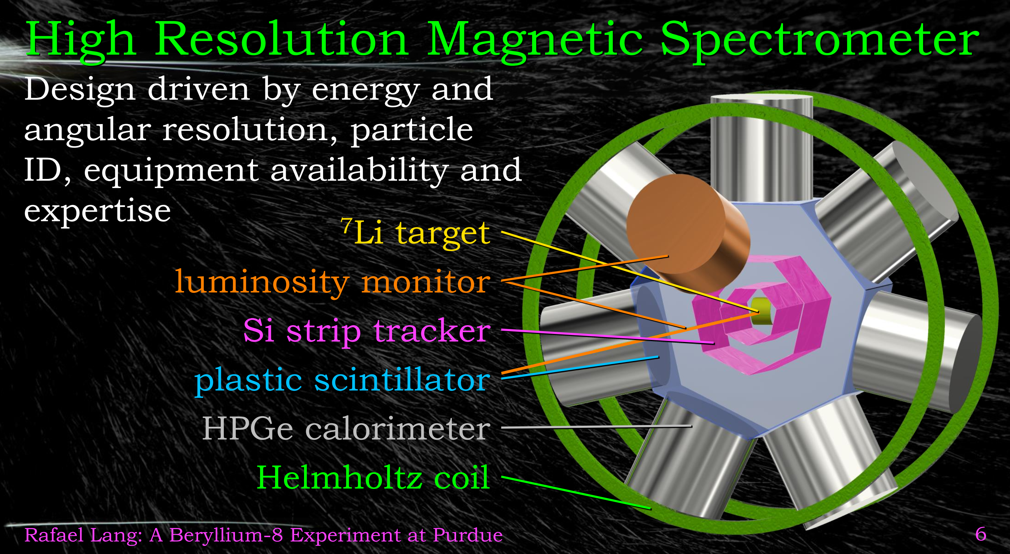
Promising outlook

Slide 29
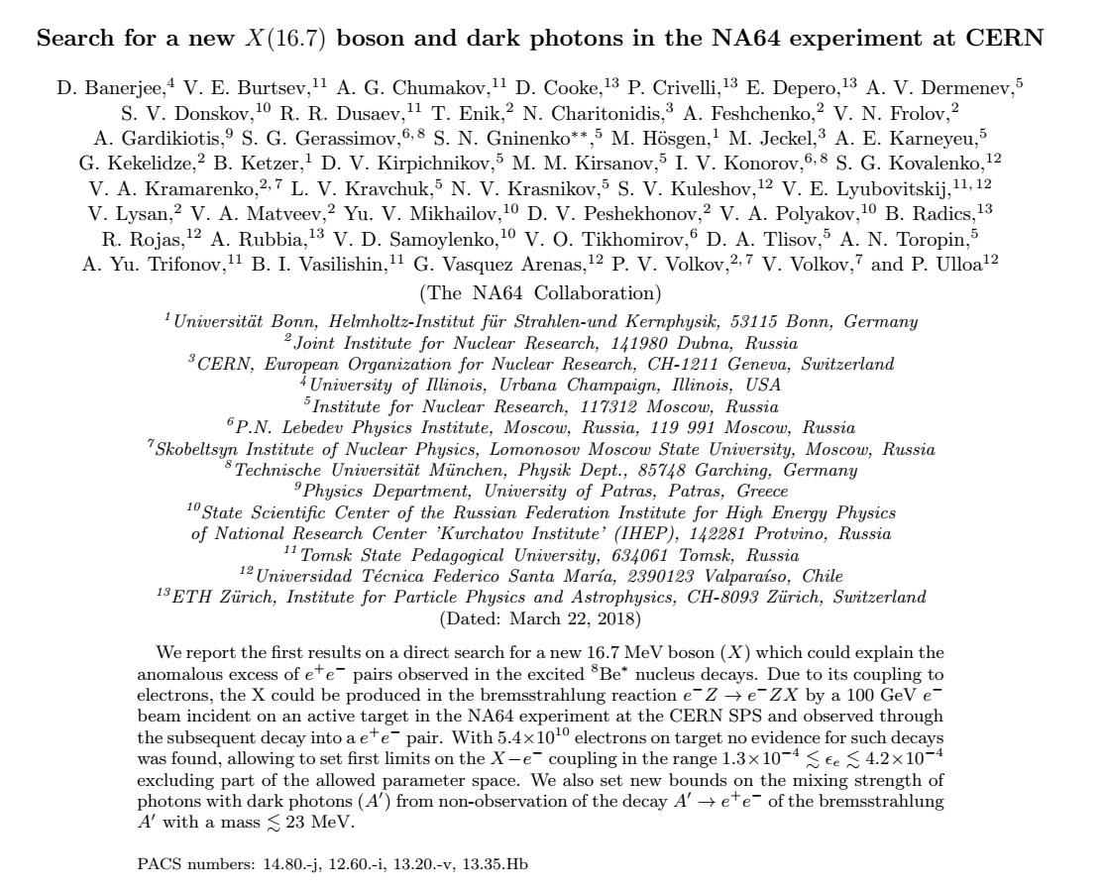
Recently, the NA64 experiment at CERN presented the first direct search with a 100 GeV/c e⁻ beam for this hypothetical 16.7 MeV/c² boson and excluded part of its allowed parameter space, but leaving the still unexplored region
4.2x10⁻⁴<ε_{e}<1.4x10⁻³ as quite an exciting prospect for further research.

Slide 30
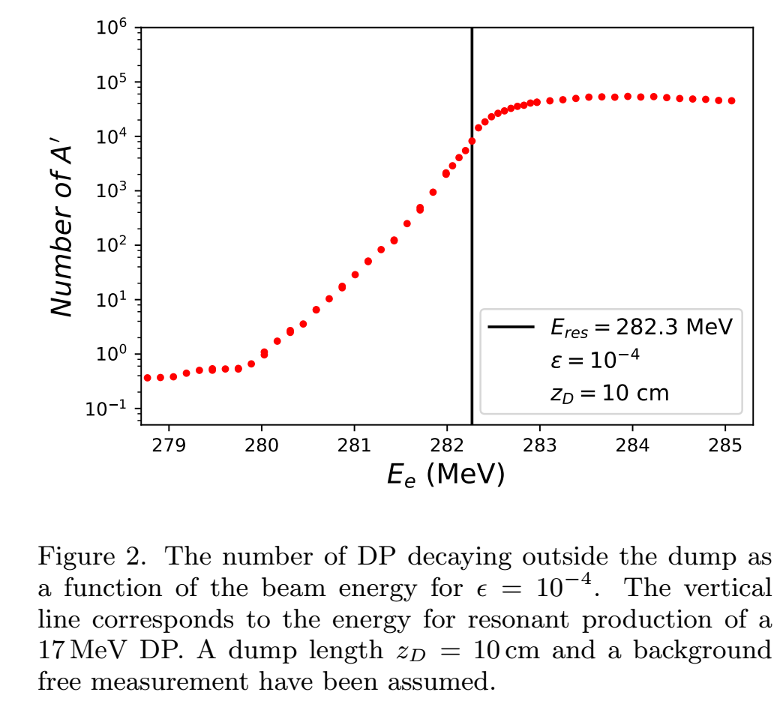
Resonant production of X17 in positron beam dump experiments
PADME experiment in Frascati
It is running and taking some test data
The project will be improved for mc²<20 MeV/c2, and after the experimental setup will be moved to Cornell and/or JLAB.

Slide 31
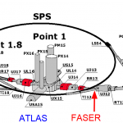
ForwArd Search ExpeRiment (FASER) at the LHC
FASER can discover ALPs with masses m_{a}∼10–400 MeV
Exp. Starts at 2023.

Slide 32
A few other planned experiments to study X17
Mu3e is a particle physics experiment at the Paul Scherrer Institute, searching for decays of anti-muons (Mu) to an electron and two positrons (3e).
VEPP-3 is planned experiment in Vladivostok, Russia. They are planning to use intense positron beams.
Annual Conference on Large Hadron Collider Physics - LHCP2019,
Jürgen Engelfried, Dark sector searches in non-LHC experiments,
DarkLight is an experiment at the JLAB in USA using electron–proton collisions.
https://scholar.google.hu/scholar?hl=hu&as_sdt=2005&sciodt=0,5&cites=17391295264019262192&scipsc=&q=

Slide 33
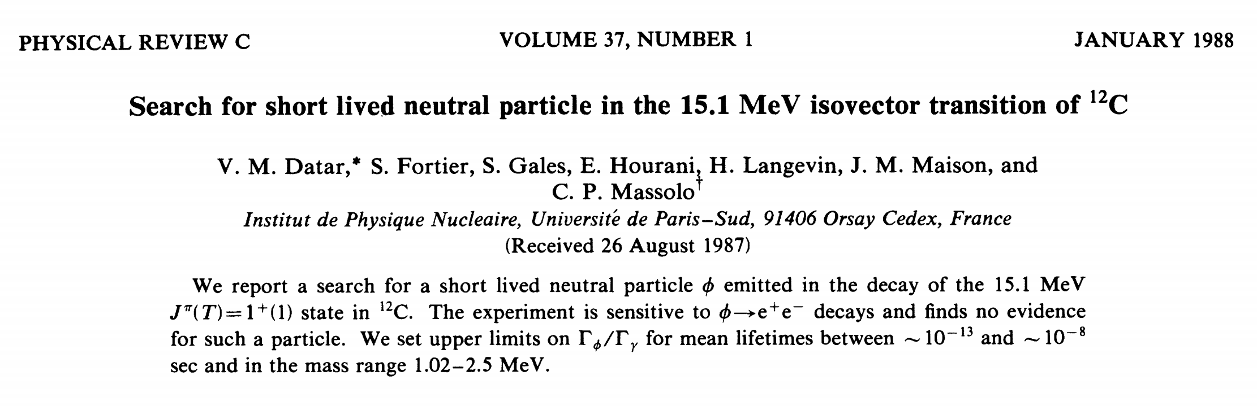
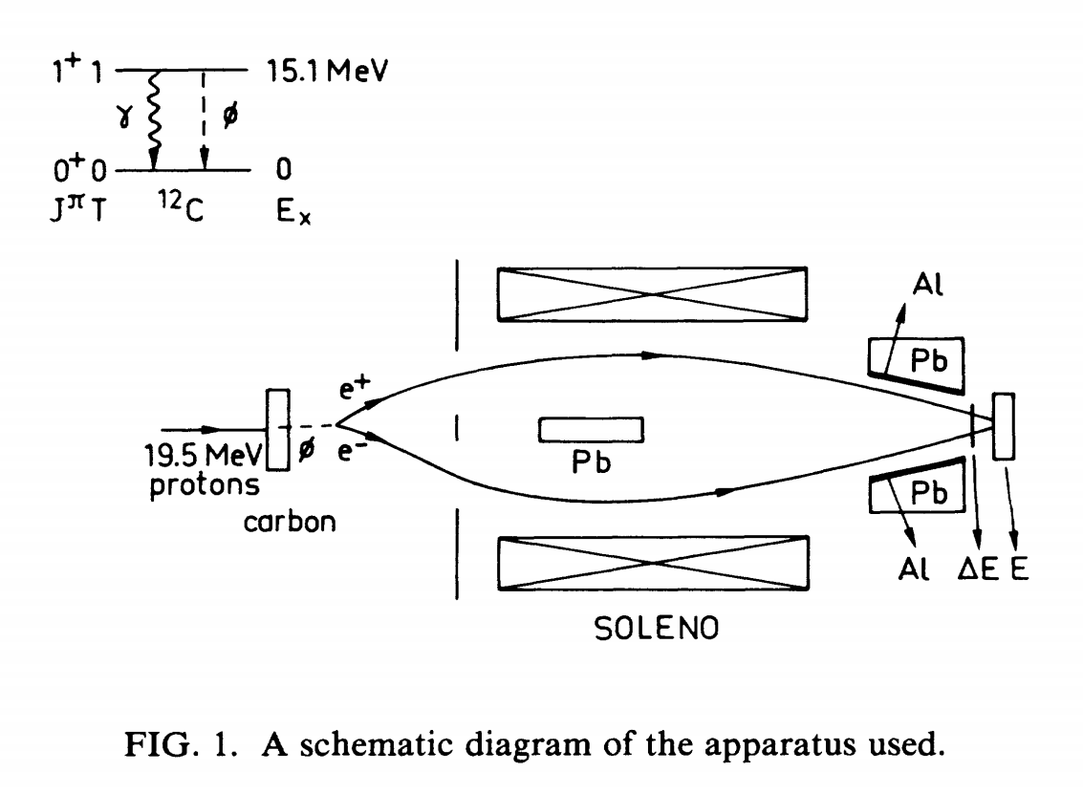

Slide 34
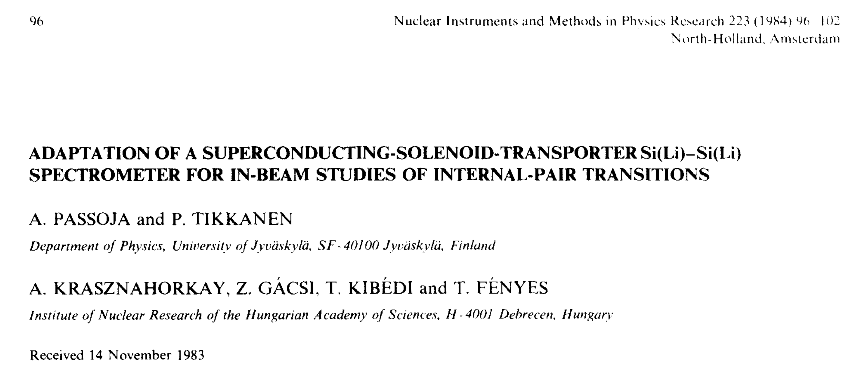
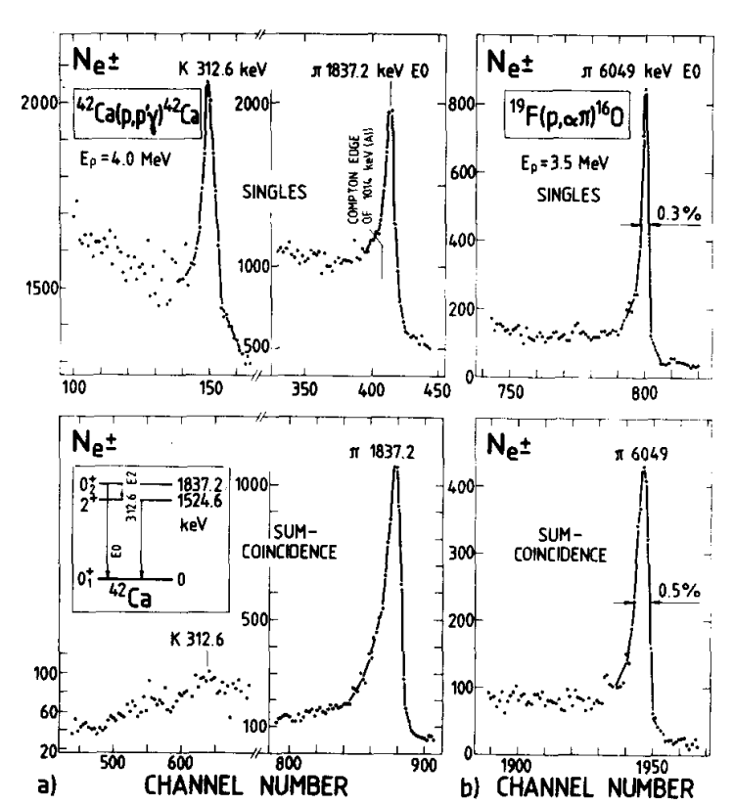


Slide 35






A Compact Positron Electron spectrometer (COPE) for internal pair creation studies (ENSAR support)
B
Beam
COPE 100:1
ATLAS
GEM detectors,
µ-TPC technology
for particle tracking,
DSP cards for readout.

Slide 36

e⁺-e⁻ internal pair creation
Born approximation.
Good for small Z.
R(nucleus)=0
M.E. Rose Phys. Rev. 76 (1949) 678
E.K. Warburton Phys. Rev. B133 (1964) 1368.
P. Schlüter, G. Soff, W. Greiner, Phys. Rep. 75 (1981) 327.

Slide 37



The first motivation to research the dark matter
Study of the velocity of stars as a function of distance
Dark halo around the galaxies
Andromeda galaxy
Mass: 370 billion M☉
Distance: 2.5 million Light year
In grammar school we learned that the movements of planets around the Sun can be interpreted precisely with the Newton's laws .
Census in the Universe
Stars and galaxies: 0.5 %
Visible matter: 5 %
Dark matter: ≈ 30 %
Dark energy: ≈ 65 %
Gravitational lensing
Dark galaxies

Slide 38


Searching from the basement to the attic already for 30 years, every corner with tremendous strength ...
With state-of-the-art underground detectors,
            with high-sensitivity spectrometers built in space

Slide 39

The physicists of the world's largest accelerator laboratory, the Large Hadron Collider (LHC), built at CERN, are also involved in the search.
Lake Genova
Jura
LEP/ LHC
France
SPS
Switzerland
PS

Slide 40

Searching for Dark Matter
Should not have to defend this too much…
Light, Weakly Interacting DM, the dark photon concept
It is speculated that within dark matter there might be a family of particles and forces—a so-called “dark sector”—that has thus far escaped detection. In analogy with electromagnetism, for which the massless photon is the force carrier between charged particles, there could be a dark electromagnetism with a possibly massive dark photon that transmits the forces between dark particles
M. Pospelov and A. Ritz, “Astrophysical Signatures of Secluded Dark Matter,” Phys. Lett. B 671, 391 (2009)

Slide 41
Theoretical predictions for the dark photon
Branching ratio
Lifetime

Slide 42
Wherever there is a photon there is a dark photon...

Slide 43
What do we know and what we do not about the dark matter?
We observe its gravitational effect on the visible stars. Their contribution to the mass of the Universe is huge (95%)
We are searching diligently for the associated particles with more and more sensitive detectors.
What particle (s) are they consist of?
What (new) interactions affect these particles?
Very recently, a distant galaxy that appears completely devoid of dark matter has baffled astronomers: P. van Dokkum et al., Nature volume 555, 629 (29 March 2018). The general validity of Modified Newtonian Dynamics as an alternative to dark matter is now disproved, thus further supporting the idea of dark matter.

Slide 44
Searching for new particles created in nuclear transitions has a very long history…
The axion particle was proposed by Weinberg and by Wilczek as one mechanism for preserving CP invariance of strong interactions in the presence of instantons almost 40 years ago.
The search for axions in nuclear transitions culminated in 1982.
It turned out that nuclear transitions provide a useful laboratory to search for light particles which couple to quarks and/or gluons. The spin and parity of a particle emitted in nuclear decay can be constrained by an appropriate choice of the nuclear transition.
The atomic nucleus can be considered as a femto-laboratory including probably all of the interactions in Nature. A real discovery machine like LHC, but at low energy.

Slide 45
Introduction of the protophobic fifth force
(J. Feng et al.PRL 117, 071803, (2016))
Branching ratio:
Pion decay
constrain:

Slide 47



Slide 48


Slide 49
More generally, we also find that the Atomki measurements of the ⁸Be system can provide the most sensitive model-independent probe of the interactions of a light vector with quarks. This motivates future searches for light vector bosons and other particles in rare nuclear transitions.

Slide 50



Slide 51

Experimental searches for the X(17) boson
The ATLAS Collaboration (ATLAS NOTE ATLAS-CONF-2016-042) presented results of a search for long-lived neutral particles decaying into collimated jets of light leptons and mesons, so-called “lepton-jets”, using a sample of 3.4 fb⁻¹ of proton-proton collisions data at a center-of-mass energy of $\sqrt{s}$=13 TeV collected during 2015 with the ATLAS detector at the LHC. Assuming conventional production cross section σ∙BR to the dark sector of 5.0 pb for a 800 GeV heavy scalar boson, dark photon cτ is excluded in the range 0.6 mm <cτ< 63 mm for the Higgs → 2γ_{d}+ X model and in the range 0.8 mm <cτ< 186 mm for the Higgs → 4γ_{d}+ X model.
2x10⁻⁴ < ε_{e} <1,4x10⁻³ esetén → 2.5 μm <cτ< 120 μm
Our results are not affected.

Slide 52
The DarkLight experiment at JLAB
The DarkLight experiment proposes to search for dark photon through complete reconstruction of the final states of electron–proton collisions. In order to accomplish this, the experiment requires a moderate-density target and a very high intensity, low energy electron beam.
Projected reaches in mass and coupling for upcoming experiments near the Beryllium-8 anomaly. Note that these are taken in the fully protophobic limit, so the sensitivities of experiments that search for the dark photon through hadronic probes are heavily suppressed. The DarkLight projection marks the region where an anomaly yields a 5σ with 1 ab⁻¹ of data, which is readily achievable with anticipated luminosities.

Slide 53
Searching for the X(17) in particle decays
Araki et al, (Phys. Rev. D 95, 055006 (2017)) discussed the feasibility of detecting the gauge boson of the U(1) symmetry, which possesses a mass in the range between MeV and GeV, at the Belle-II experiment. They have found that the Belle-II experiment with the design luminosity can examine a part of the parameter region that evades the current experimental constraints and, at the same time, is favored by the observation of the muon anomalous magnetic moment.
Rare leptonic kaon and pion decays K⁺(π⁺) →μ⁺ν_{μ}e⁺e⁻ can also be used to probe a dark photon of mass O(10)MeV. Cheng-Wei Chiang (Physics Letters B 767 (2017) 289) evaluated the reach of future experiments for the dark photon with vectorial couplings to the standard model fermions except for the neutrinos, and show that a great portion of the preferred 16.7-MeV dark photon parameter space can be decisively probed.

Slide 54

Data mining and new projects
Long-Bin Chen et al., (arXiv:1607.03970v2) discussed, the production of this yet-not-verified new boson in electron-positron collision, using BaBar, and the results are encouraging. The data collected at BESIII and BaBar turn out to be enough to perform a decisive analysis and hence give a definite answer to the existence of X(16.7).
Marin Benito et al., (IOP Conf. Series: Journal of Physics: Conf. Series 800 (2017) 012031) discussed the prospects for the search of K_{S}⁰ → π⁺π⁻e⁺e⁻ at LHCb. LHCb has proved to be very competitive in the search for such rare strange decays. The feasibility of observing such K0 decay at LHCb is studied using simulated and real data. During the Run I of LHC (2012), the yield of events expected per fb⁻¹ of pp collisions at $\sqrt{s}$= 8 TeV is found to be N_{Run1} =120+280-100. A dedicated trigger selection has been developed for the 2016 data-taking. A large signal yield, N_{Upgrade}= (5±0.3)∙10⁴ per fb⁻¹, is expected in the LHC upgrade phase. Pseudo experiments have been run to assess the feasibility of discovering evidence for the observation of the signal already in the Run I data-set.

Slide 55


