Slide 1
The Clock/Sync Distribution & a Streaming Readout TDC
William Gu
Streaming Readout IV
22-24 May 2019, Camogli
1. JLAB Trg/Clk/Sync/Busy overview
2. Clock recovery study
3. VETROC streaming TDC
4. ReadOut interfaces test
5. Prototype board
6. Summary

Slide 2
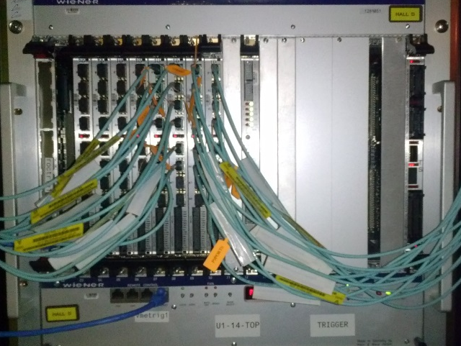
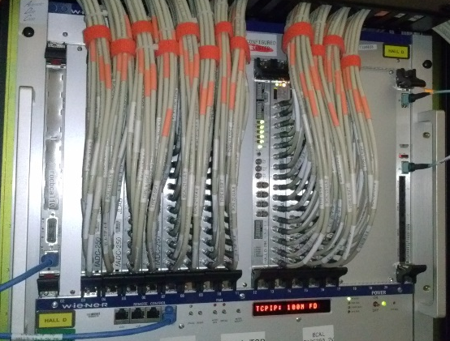
1. JLAB HallB/D Trg/Clk/Sync/Busy overview
TS
MTP Fiber assignment:
SD
(TS) Trigger
Supervisor
TD (up to 16)
Trigger etc.
Signal Distribution
VXS backplane
Clock
Sync
(TD) Trigger
Distribution
FiberMeas
TI (front end)
TS/TD
FiberMeas
Not_used
MTP fibers
~60
Not_used
Acknowledge/Busy
Same clock for the system;
Frontend electronics is Synced to one clock period (4 ns);
Delay adjustment on TI to compensate for the fiber delays;
Clock jitter: several ps
(TI) Trigger
Interface
Signal Distribution
VXS backplane
TI
FrontEnd
TDC/ADC
FronEnd Readout electronics

Slide 3
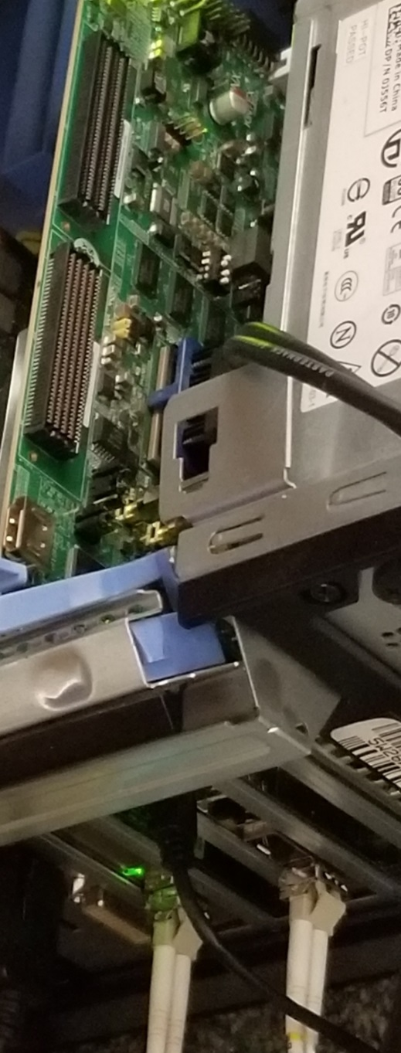
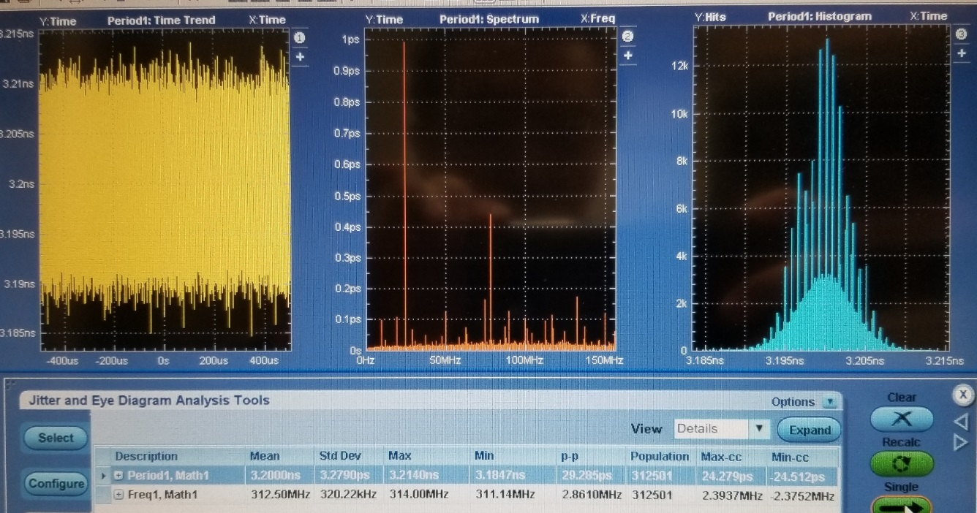
2. Clock Recovery Study
2.1 Low jitter clock can be recovered
Mellanox
10 GBE
Xilinx KCU040 312.5 MHz
Mellanox
(10 GBE)
Fiber
Xilinx KCU105
(UltraScale Kintex)
Co-ax/copper
Tektronix DPO7254
Recovered clock to Tektronix DPO7254
Clock result:
Period: 3.2000ns, Frequency: 312.50 MHz
Std Dev: 3.28 ps, 320.2 KHz
P_P: 29.3ps, 2.86 MHz
Enabling the Mellanox TX, Std Dev → 3.30 ps
Enabling the KCU040 TX, Std Dev → 6.42 ps
Single pulse period measurement: Std Dev: 6~7 ps
DPX mode (200 GSps): 700~900 fs

Slide 4
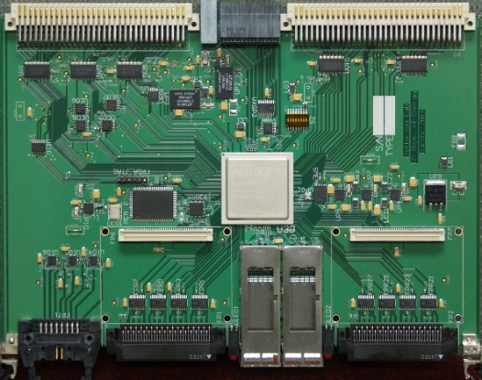
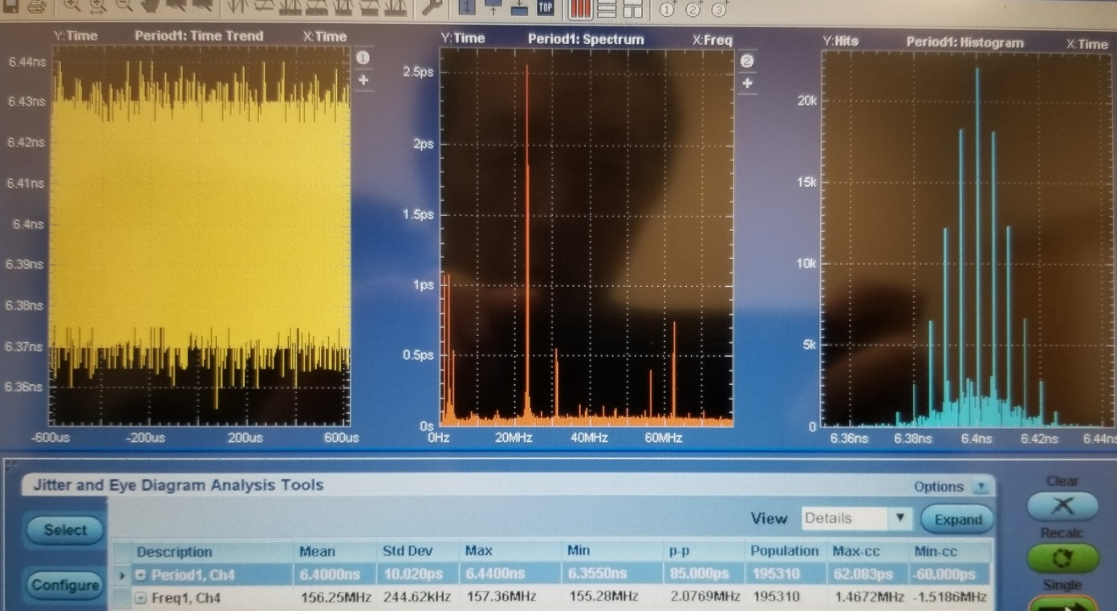
2. Clock Recovery Study
2.2 One→Two clock recovery
Xilinx KCU1500 6.25 Gbps
VETROC
Xc7a200
312.5/2
QSFP transceivers/Fiber
Xilinx Aurora-64B66B
& Aurora-8b10b
VETROC
Xc7a200
312.5/2
Clock result:
Period: 6.4000ns, Frequency: 156.25 MHz
Std Dev: 10.02 ps, 244.6 KHz
P_P: 85ps, 2.08 MHz
Single pulse period meas.: Std Dev: 7.5 ps
DPX mode (200 GSps): 778 fs
*VETROC FPGA → Scope: long LVCMS, then differential PCB traces. 312.5 MHz impossible

Slide 5
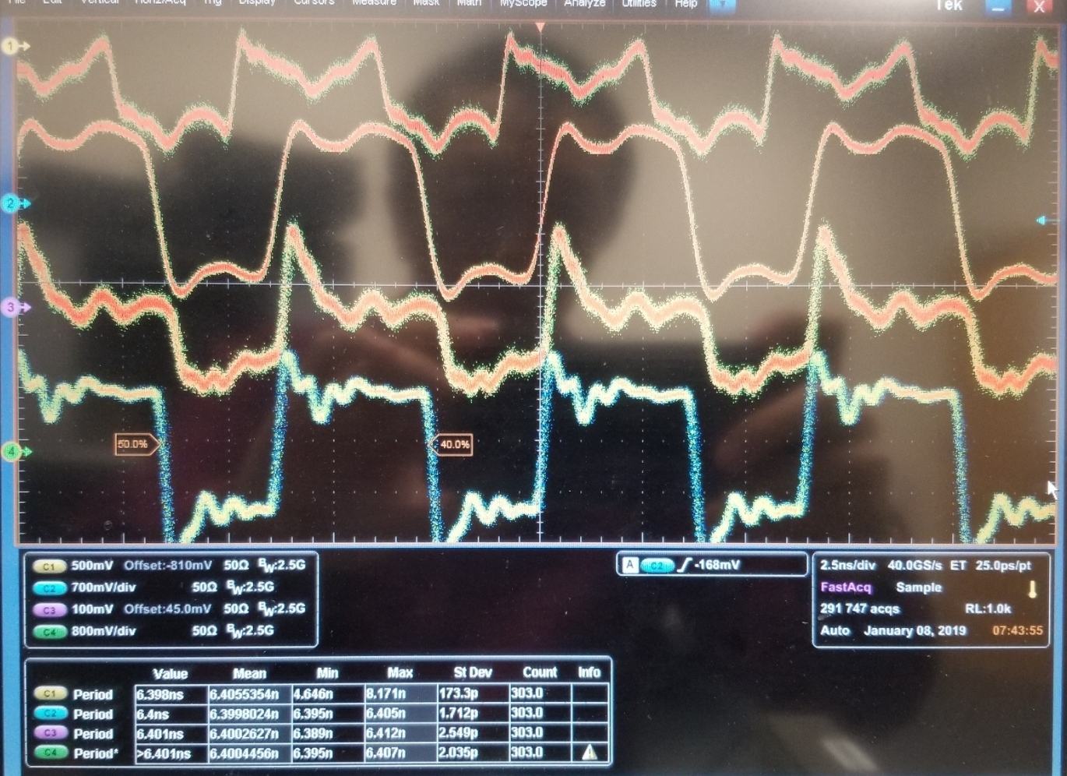
2. Clock Recovery Study
2.3 Clock wandering probem
Trigger on the VETROC_A recovered clock, the VETROC_B recovered clock width P_P is about 200ps !
All these four channels are reconstructed KCU1500 clock
Ch#1 and Ch#2 have narrow spread as ch#2 is the trigger source
Ch#3 and Ch#4 have wide spread (~200ps)
Ch#2: Width: 6.4ns, Std Dev: 1.71ps
Ch#4: Width: 6.4ns, Std Dev: 2.54ps
The phase between Ch#1/2 and Ch#3/4 are changing (within a clock cycle) when re-link, though the phase is pretty stable. This is caused by the CDR clock devision.
Ch#1: VETROC_A, MGT#2 RxClk, single-ended probe
Ch#2: VETROC_A, MGT#3 RxClk, differential probe
Ch#3: VETROC_B, MGT#2 RxClk, single-ended probe
Ch#4: VETROC_B, MGT#3 RxClk, differential probe

Slide 6
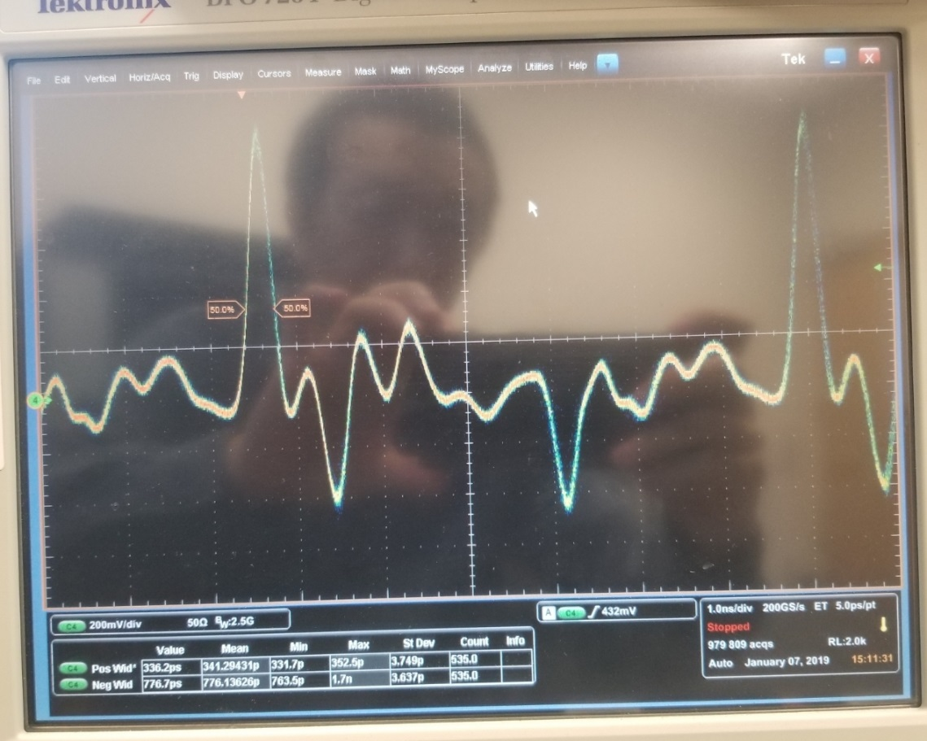
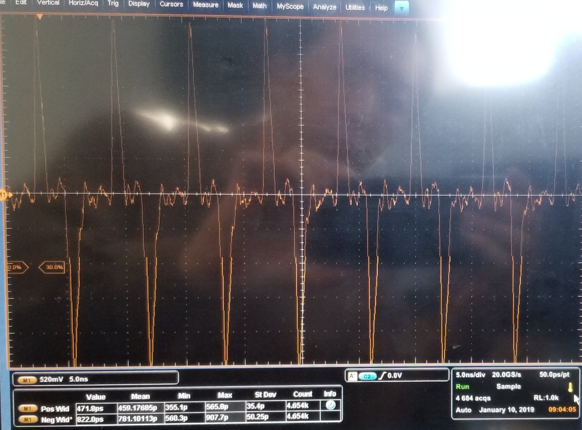
2. Clock Recovery Study
2.3 Clock wandering probem (continued)
The difference between two reconstructed clocks.
The width of the difference of the two reconstructed clocks from the SAME vetroc board is measured to be (one differential probe):
Width: 336 ps
Std Dev: 3.75 ps
The width of the difference of the two reconstructed clocks from two VETROC boards is measured (two differential probes with scope math) to be:
Width: ~472/822 ps (mean 458/781 ps)
Std Dev: ~35/50 ps (p_p ~210/347 ps)
(Positive/Negative, not precise meas.)

Slide 7
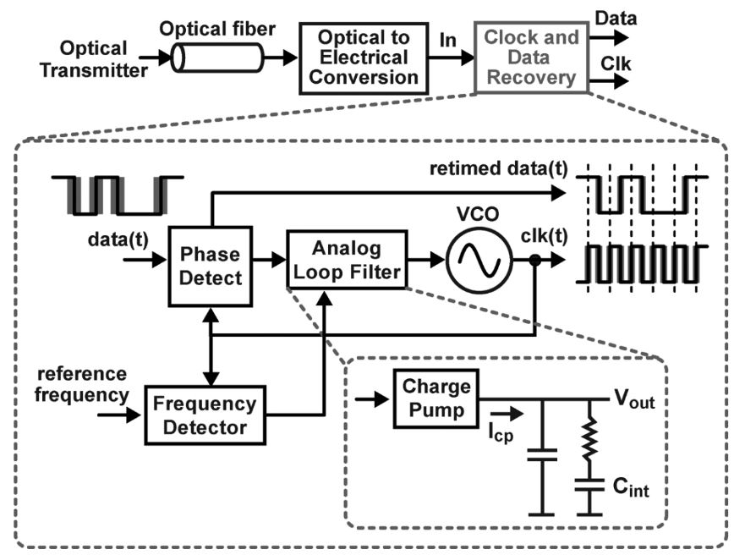
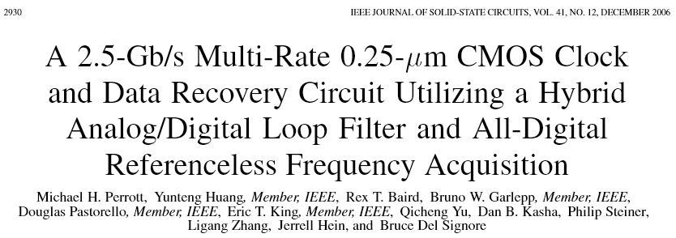
2. Clock Recovery Study
2.3 Clock wandering probem (continued)
Fundamental problem: TIE (Total Interval Error), not jitter. The TIEs are asynchronous among the recovered clocks.
The recovered clock depends on the data protocol (consecutive number of 1s or 0s in the data stream)
A typical clock recovery circuit
ADC measurement effects:
Clock Jitter affects the measurement precision;
The TIE effect is not critical
TDC measurement effects:
The TIE affects the measurement precision (channel to channel alignment, unless a precision common signal is used as the time reference);
The jitter effect is not critical as the jitter is much smaller than the TDC measurement precision
Data transmission effects:
Clock Jitter affects the data transmission;
The TIE effect is not critical

Slide 8
2. Clock Recovery Study
2.4 Clock/Sync distribution tree
It is not expensive ($50 for a 40 Gbps optic transceiver) to keep QSFP (easy) for Clock/Sync distribution and streaming data readout
Dedicated clock to keep the edge information (low jitter, no wandering), but, we will keep an eye on the LpGBT development at the LHC
MTP Fiber assignment:
Something? (10GBE TCP/IP etc.)
Clock
Sync
Clock extraction,
Clock cleanup,
Sync etc.
FiberMeas /Data/Backpressure
Computer (Event ID)
FiberMeas / Streaming Data
Detector (front end)
Streaming Data
Streaming Data
Streaming Data

Slide 9
3. VETROC Streaming TDC
3.1 TDC measurement principle
Ch_In
One CLB
One CLB
One CLB
One CLB
Calib_In
Carry Chain
33x4 units
The edges of the pulse is measured against the system clock:
precision part: phase in the clock (using Xilinx FPGA carry chain delay and clock registers);
coarse part: number of clock cycles since system reset (T_zero) (a synchronous counter)
Calib_sel
DoubleClock
500MHz
Register
132
FD
FD
FD
FD
FD
FD
FD
FD
FD
FD
FD
FD
FD
FD
FD
FD
FD
FD
FD
FD
Rising/Falling edge finder
Pipelined edge position encoder
Rising edge
Falling Edge
Fine_Time(5:0)
Clock
250MHz
Rising edge
Falling edge
Fine_Time(5:0)
Detect the edge phase (relative to the 250 MHz clock)
Edge
Detected
FineTDC(7:0)
Free running timer,
(one timer for all channels)
Coarse Time
Fine Time
Valid
“ZERO”
suppressed
SYNC
(T_zero)
TDC data/Data Valid

Slide 10
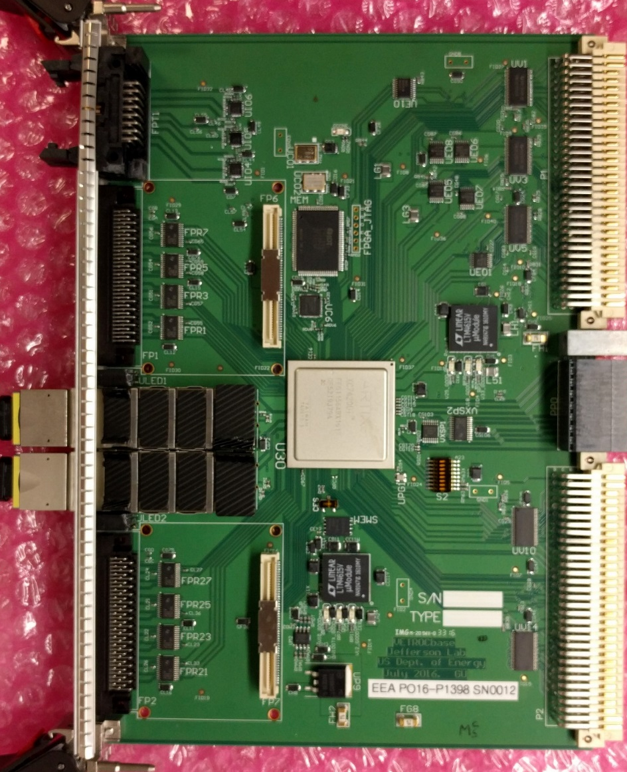
3. VETROC Streaming TDC
Data Format (128 bits)
Bits (127-124) (123:104) (103:78) (77:52) (51:26) (25:0)
TYPE Timer Ch#A Ch#B Ch#C Ch#D
Timer(28:9)
3.2 VETROC Streaming TDC
Ext_Calib_In
( 25:20 : 19:8 : 7 : 6 : 5 : 0 )
CH# Coarse_time Clk250 pulse Fine_time
0-63 Time(11:0) edge edge ~35ps
Ref_Ch_In
VME 64
32-channels LVDS inputs
32-channels LVTTL inputs
Bit(127:124) decoding:
0x8 for channels 1-32;
0x9 for channels 33-64;
0xA for channels 65-96;
0xB for channels 97-128;
0xF for reference channels
xc7A200 FPGA
4*6.25 Gbps
Streaming outputs
32-channels LVDS inputs
For reference channels, the full 48-bit timer is included, which keeps the unique time for about 290 hours after SYNC.
32-channels LVTTL inputs

Slide 11
3. VETROC Streaming TDC (backup slide)
Edge separation: <2.5ns;
LSB: ~35ps;
TimeStamp: ~10 days;
Streaming rate: ~2.5 Gbyte/s
Channel count: 128
3.2 VETROC Streaming TDC – 128 TDC channels with extra reference channels
Timer(11:0)
Timer(28:9)
Ch#1 data(19:0)
Timer(47:0)
Clock 250 MHz
/20
Clk 250 MHz
Ch#2 data(19:0)
/20
Merged data(127:0)
128(wide) x 1024(deep)
Channels 1-4
Computers do not recognize the AURORA data stream
/20
Ch#3 data(19:0)
/20
Merges the eight
Streams to one (127:0)
(round robin)
And buffer in memory
Two 4→1, empty control
One 2→1, timer control
Ch#4 data(19:0)
Merged data(127:0)
128(wide) x 1024(deep)
Channels 5-8
/128
128
Data merging and Clock domain transition.
Aurora_8b10b
3x128
MGT (4*6.25Gbps)
Ch#32 data(19:0)
/20
Channels 29-32
128
Ch#33-64, 65-96, 97-128
QSFP fiber
Ref_Ch

Slide 12
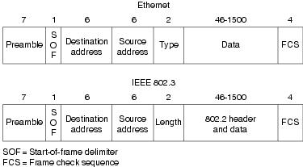
4. Streaming Readout:
4.1 10-GBE test using KCU105 eval board
10 GbE to a Mellanox card
(UDP) and skip the 802.2 header:
Reached: ~1.1 GByte/s (sustained)
(from ifconfig ?trusted?)

Slide 13
4. Streaming Readout:
4.2 xDMA PCIe3x8 test using KCU1500 accelerator card
Using Xilinx’s PCIe DMA driver, and modified test software:
QSFPs: Aurora 8-lane, 8x10 Gbps, 64b66b encoding, loopback through fiber
Achieved on the computer:
Computer (memory) → KCU1500: 5600 MB/s
AND KCU1500 → Computer (memory): 5200 MB/s.

Slide 14
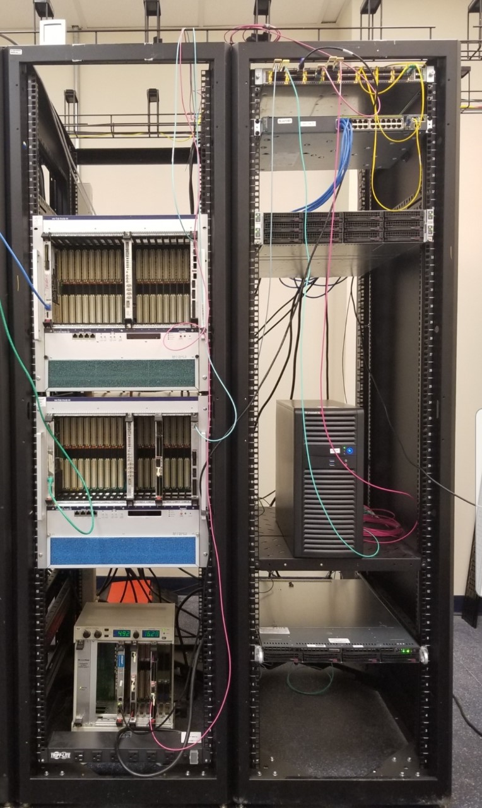
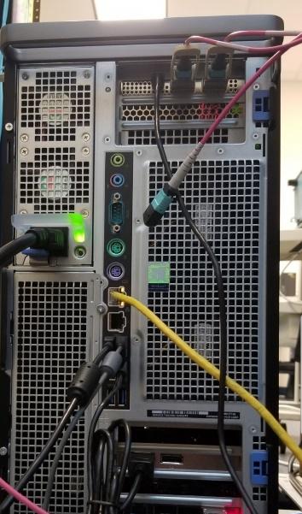
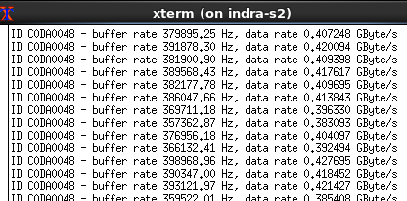
4. Streaming Readout:
4.3 TCP/IP readout (INDRA lab setup)
KCU1500
In ALKAID
ARISTA
7170-32C
KCU1500
TCPIP
10 GBE
ARISTA 7170-32
Aurora
8b10b
20 gb/s
TCPIP
10 GBE
Graham’s
Stream_Router
~400 Mbyte/s
VETROC TDC
MLX 10GBE
MLX 10_GBE
in INDRA-S2
VETROC TDC
In VXS crate

Slide 15
4. Streaming Readout:
computer
10 GBE
4.4 KCU1500 functional diagram
Double
Mon(127:0)
Reg(31:0)
PCIe3x8(xdma)
10 GBE
IN
TX
QSFP
RX
Aurora
20 gbps
Duplicate
10 GBE
D1(31:0)
IN
StreamTDC
QSFP (4x6.25gbps)
FIFO
10 GBE
D2(31:0)
IN
OUT
D3(31:0)
Playback
ROM
10 GBE(TCP/IP)
IN
Merge
Data_Sel
RX
QSFP
TX
DB(127:0)
ARISTA 7170
MLX 10GBE/Computer
* The Data flows are in parallel

Slide 16
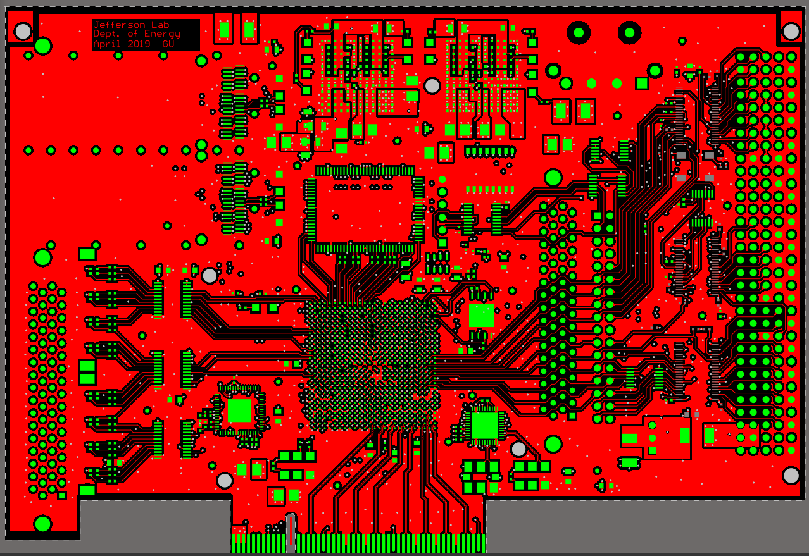
5. Prototype board:
5.1 STDCpcie
Two QSFPs
(2x4x10 GbE
Or 2x40 GbE
Or others)
PRELIMINARY
32 LVDS inputs
+ 10MHz clock
Clock, Sync
Combining the VETROC streaming readout TDC and the KCU105 into one:
64-CH Streaming TDC with standard interfaces (PCIexpress_Gen3 and Ethernet_10GBE)
XCKU040-2
PCIe3x8 (64 Gb/s)
32 LVDS inputs
+ SYNC
12-layer, PCIe x8 or VME (~3U)

Slide 17
5. Prototyping board:
5.2 STDCpcie Status
This board will be able to test:
Standalone 64-channel streaming TDC (~20ps) with up to eight 10 GBE interfaces;
64-channel TDC → PCIe Gen3 x8 interface;
Sync/clock/Readout test of many boards (system) with the proposed fiber assignment (sec. 2.4);
8x MGT (1 Gbps ~ 16 Gbps) ←→ PCIe3 x8;
4x MGT (1 Gbps ~ 16 Gbps) ←→ 4x 10 GbE;
Serial link beyond 10 Gbps (PCIe GEN4, 25_GBE/100_GBE) with more advanced FPGAs;
The board is ready to be manufactured: the PCB is fully routed and DRC checked; budget secured.

Slide 18
6. Summary:
The CLOCK/SYNC distribution is feasible
The dedicated clock distribution tree is better and easier, and cost manageable;
The SYNC can be accomplished with the fiber length measurement, and delay compensation;
We will keep an eye on the CLOCK/SYNC developments (LpGBT etc.);
The STREAMING READOUT is feasible
A 128-ch Streaming TDC is tested;
Some readout interfaces are tested;
Several (prototype) boards will be manufactured for CLOCK/SYNC/StreamingTDC test
Thank You

