Slide 1



THIN FILMS CHARACTERIZATION
A. Serra
CEDAD - CEnter of Applied Physics, DAting and Diagnostics
Department of Mathematics and Physics "Ennio De Giorgi
University of Salento
INFN-National Institute for Nuclear Physics
Via per Arnesano, 73100, Lecce

Slide 2
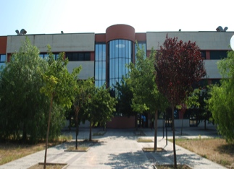
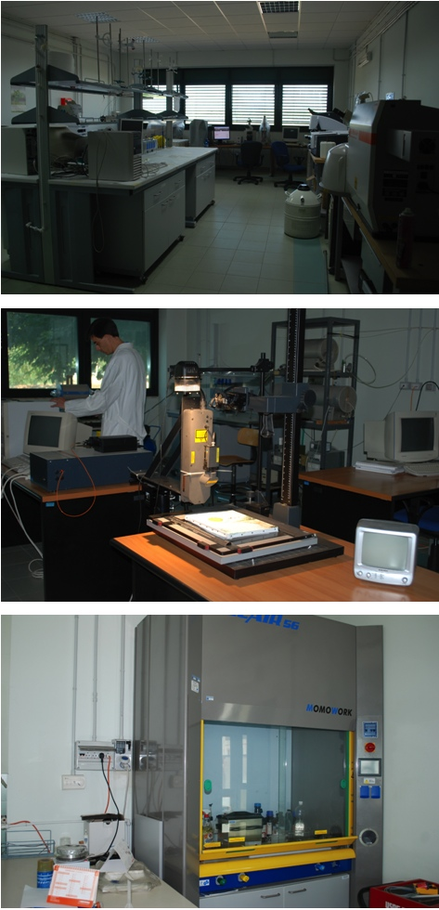
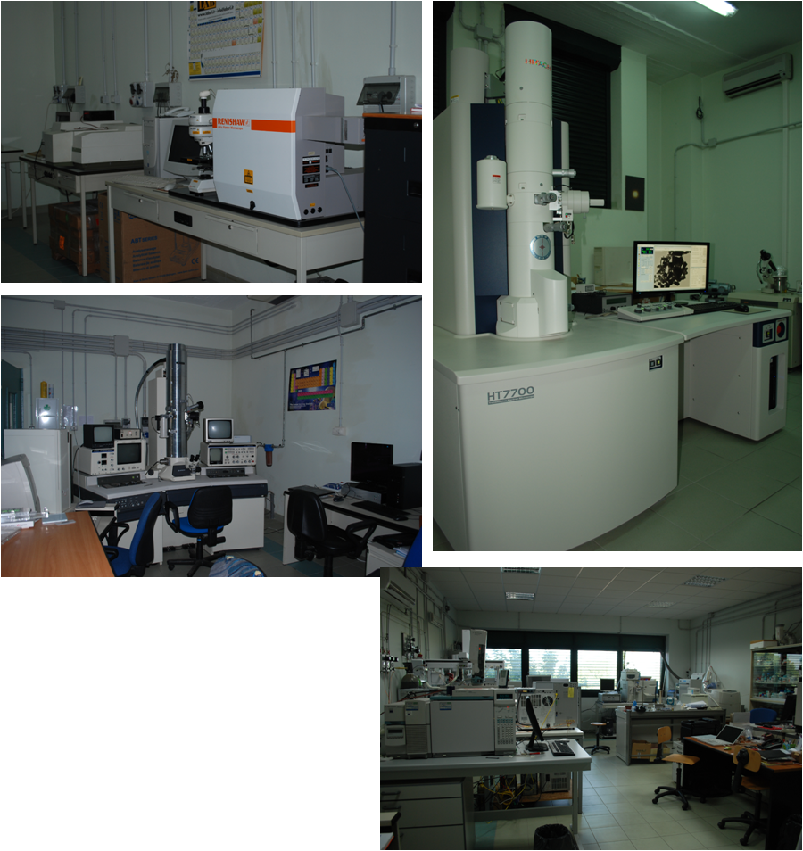
Characterization facilities

Slide 3
Characterization Techniques
Electrical measurements
X-rays diffraction
Transmission electron microscopy
Scanning electron microscopy
Scanning tunneling microscopy and spectroscopy
UV-Vis-NIR and Raman spectroscopy

Slide 4
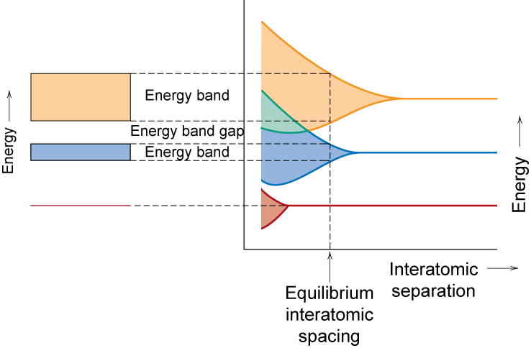
From single atom to solid-state
Metal semiconductor insulator
BC
BV
Adapted from Fig. 18.3, Callister & Rethwisch 8e.
Fermi level

Slide 5
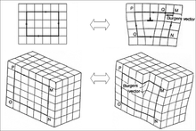
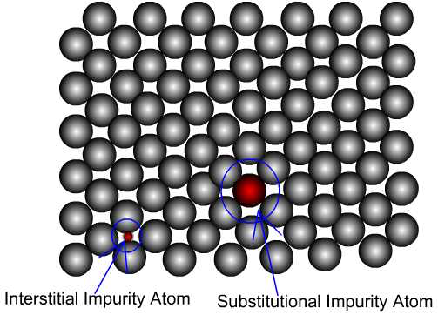
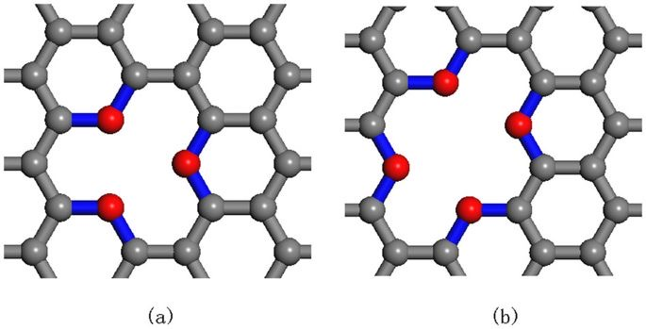
Chemical-physical properties depend on:
-- grain boundaries
-- dislocations
-- impurity atoms
-- vacancies
Modulate the physical features: energy levels
free charges type
mean free path……..

Slide 6
It is well known that Insulators & Semiconductors ........
• Insulators:
-- wide band gap (> 2 eV)
-- few electrons excited
across band gap
• Semiconductors:
-- narrow band gap (< 2 eV)
-- more electrons excited
across band gap
Energy
empty
Energy
empty
conduction
conduction
band
band
GAP
?
GAP
filled
filled
valence
valence
band
band
filled states
filled states
filled
filled
band
band

Slide 7
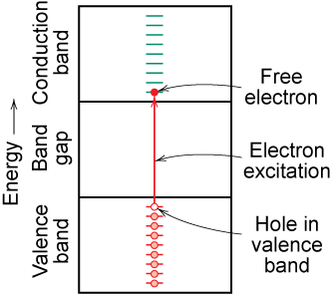
...........................charge carriers in insulators and semiconductors
Adapted from Fig. 18.6(b), Callister & Rethwisch 8e.
Two types of electronic charge carriers:
Free Electron
– negative charge
– in conduction band
Hole
– positive charge
– vacant electron state in
the valence band

Slide 8
Intrinsic semiconduction in terms of electron and hole migration
• Electrical Conductivity given by:
# holes/m³
hole mobility
# electrons/m³
electron mobility
• Concept of electrons and holes:
valence
electron
hole
electron
hole
electron
C atom
pair creation
pair migration
-
+
-
+
no applied
applied
applied
electric field
electric field
electric field

Slide 9
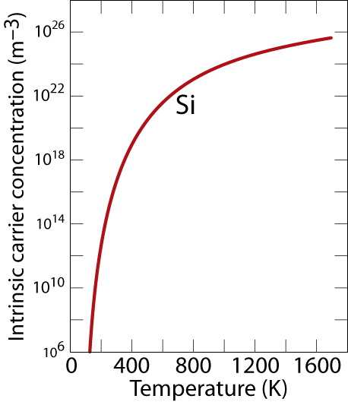
Number of Charge Carriers
Intrinsic Conductivity
for intrinsic semiconductor n = p = n_{i}
material
Diamond
Si
Ge
GaP
CdS
band gap (eV)
5
1.11
0.67
2.25
2.40

Slide 10
Intrinsic vs Extrinsic Conduction
Intrinsic:
# electrons = # holes (n = p)
• Extrinsic:
-- electrical behavior is determined by presence of defects
that introduce excess electrons or holes
-- n ≠ p
• n-type Extrinsic: (n >> p)
• p-type Extrinsic: (p >> n)

Slide 11
Resistivity measurements
Two-point probe
Four-point probe
R_{contact}
R_{contact}
R_{contact}
R_{contact}
R_{sample}
R_{sample}
Notes:
In four-point probe, negligible current flows through the voltmeter, the only voltage drop measured is across R_{sample}.

Slide 12
Resistivity
Two-point probe
Four-point probe
R_{contact}
R_{contact}
R_{contact}
R_{contact}
R_{sample}
R_{sample}
Measures sample + contact resistance + probe resistance
Measures sample only
Notes:
In four-point probe, negligible current flows through the voltmeter, the only voltage drop measured is across R_{sample}.

Slide 13
Collinear contacts
Semi-infinite sample

Slide 14
Collinear contacts
Correction factor

Slide 15
Collinear contacts
For samples thinner than the probe spacing s, F can be written as a product of three independent correction factors.
F₁ corrects for sample thickness
F₂ corrects for lateral sample dimensions
F₃ corrects for placement of probes near edges

Slide 16
Collinear contacts
For films deposited
on non-conducting substrates:
on conducting substrates replace sinh with cosh.
If

Slide 17
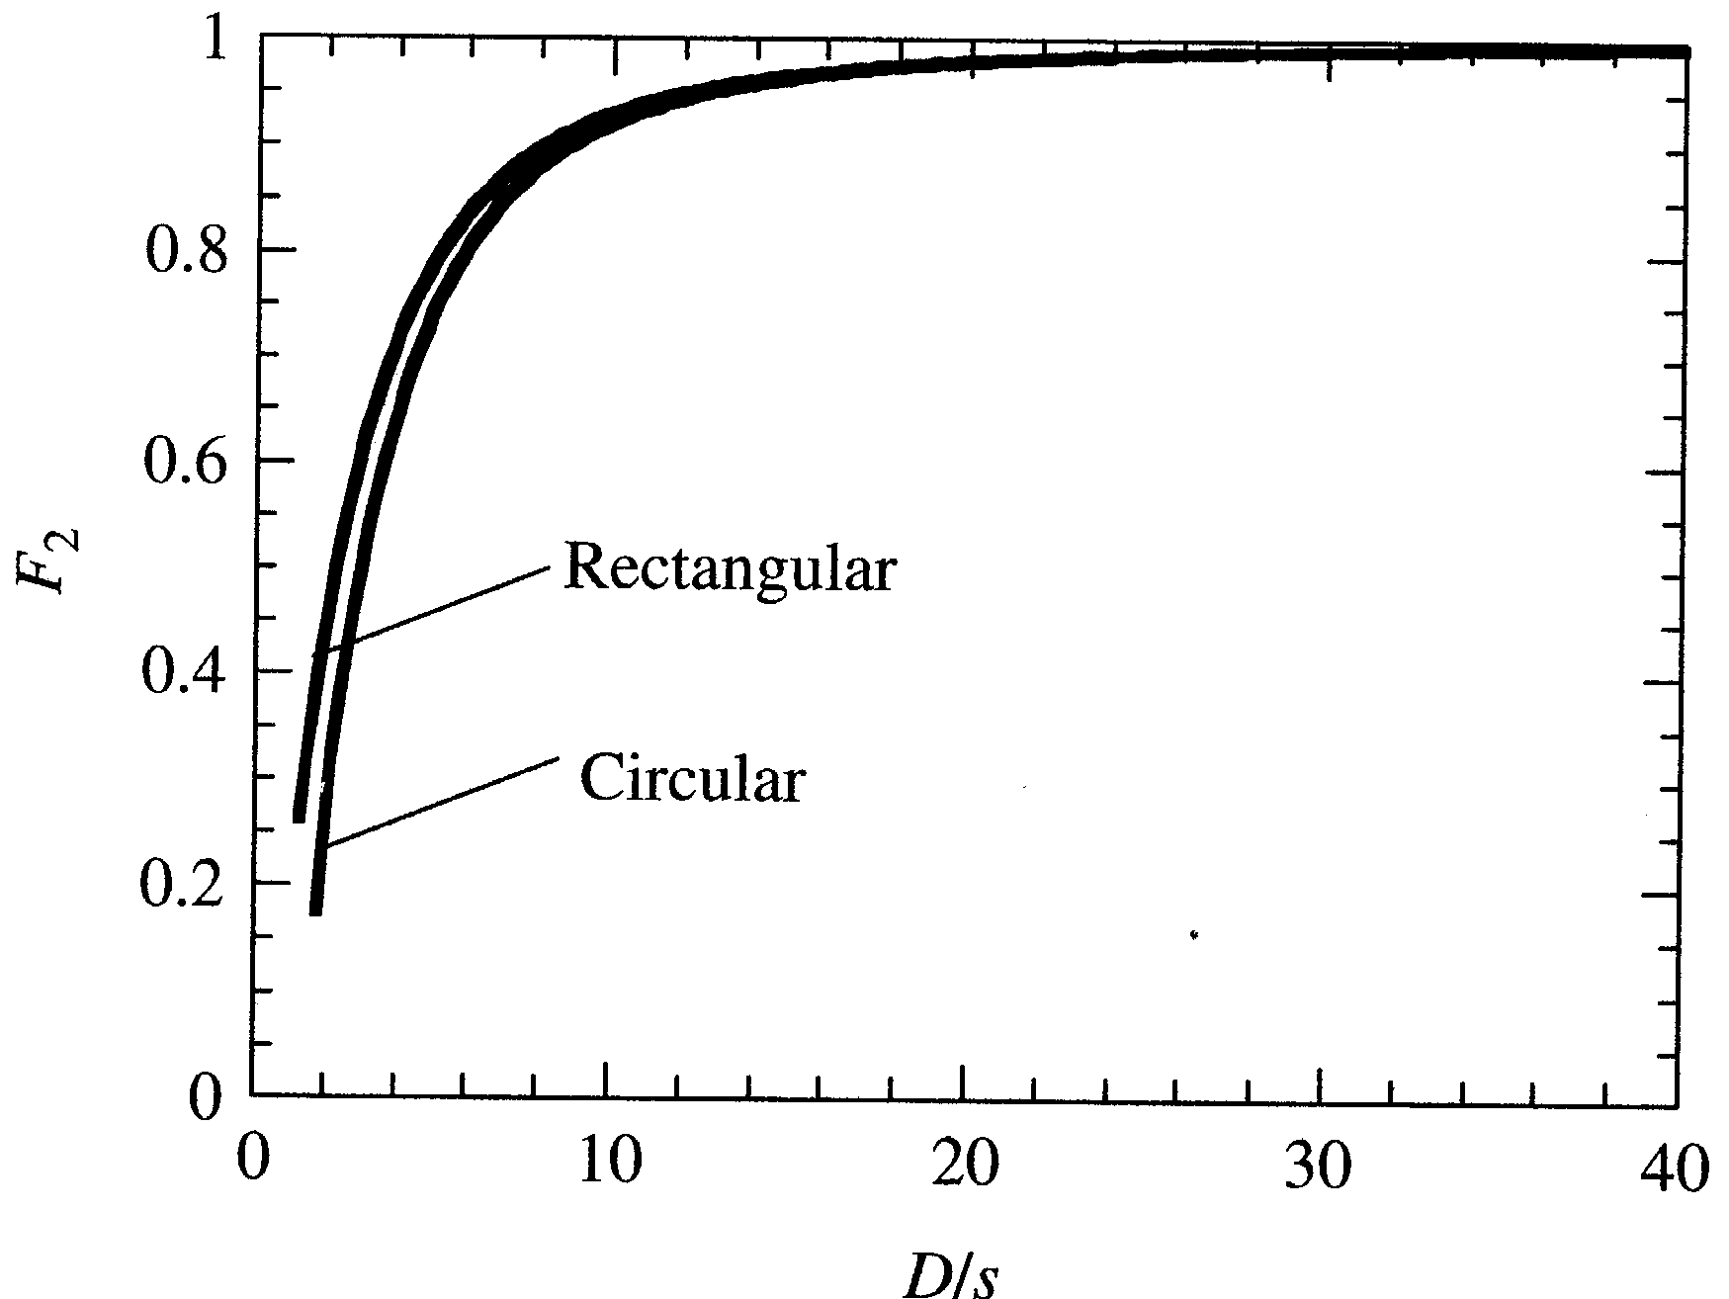
Collinear contacts
For circular samples of diameter D:
D/s ~ 6
F₂ ~ 0.8

Slide 18
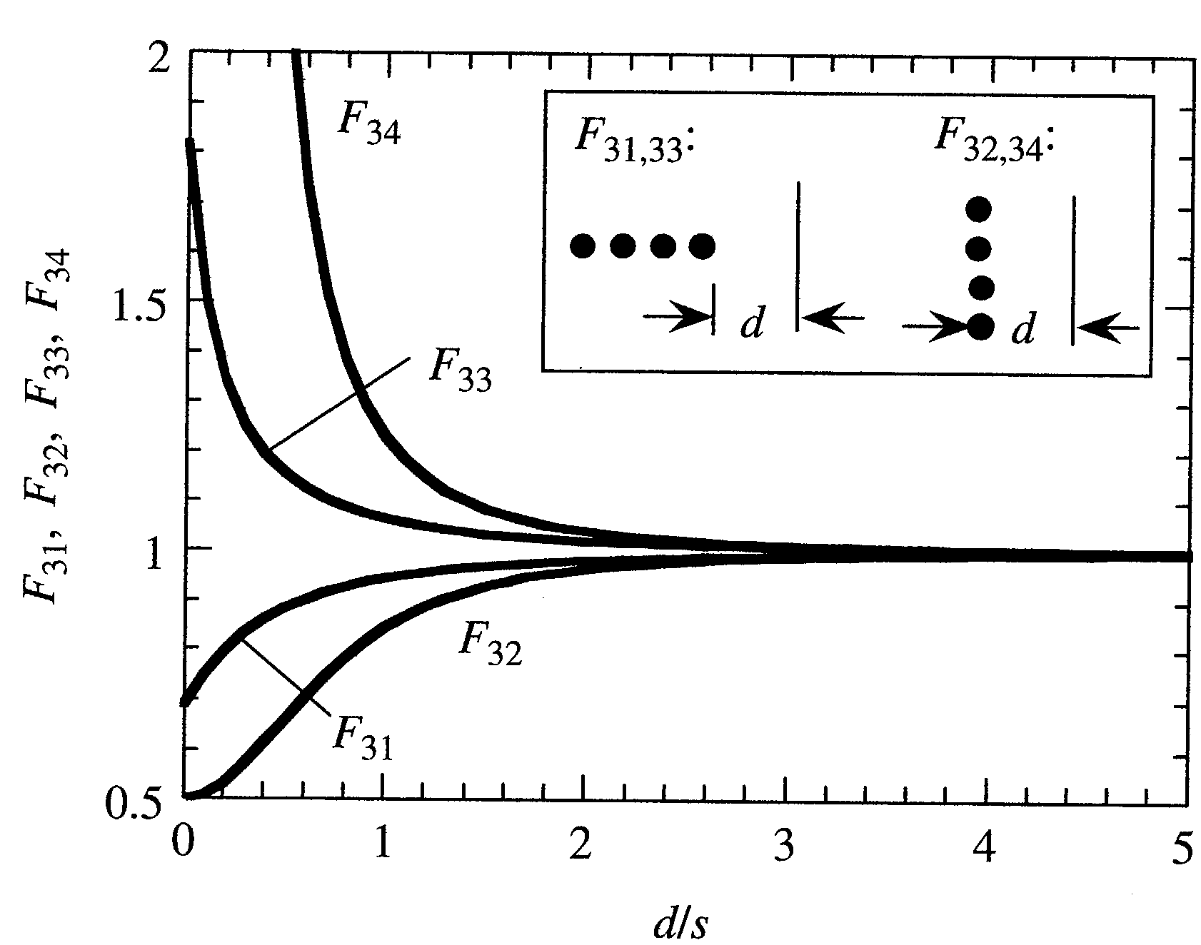
Collinear contacts
F₃ accounts for contacts placed near sample edges
conducting substrates
Parallel:
d/s ~ 1.7
F₃₁ ~ 0.9
Perpendicular:
d/s ~ 3
F₃₂ ~ 1
non-conducting substrates

Slide 19
Van der Pauw method
Van der Pauw found a method to determine the resistivity of an arbitrarily shaped sample subject to the following conditions:
a) the contacts are at the boundary of the sample
b) the contacts are infinitely small (point contacts)
c) the sample has uniform thickness
d) the surface of the sample is singly connected, i.e., the sample does not have isolated holes

Slide 20
Van der Pauw method
I₁₂
#1
#4
V₃₄
#2
#3

Slide 21
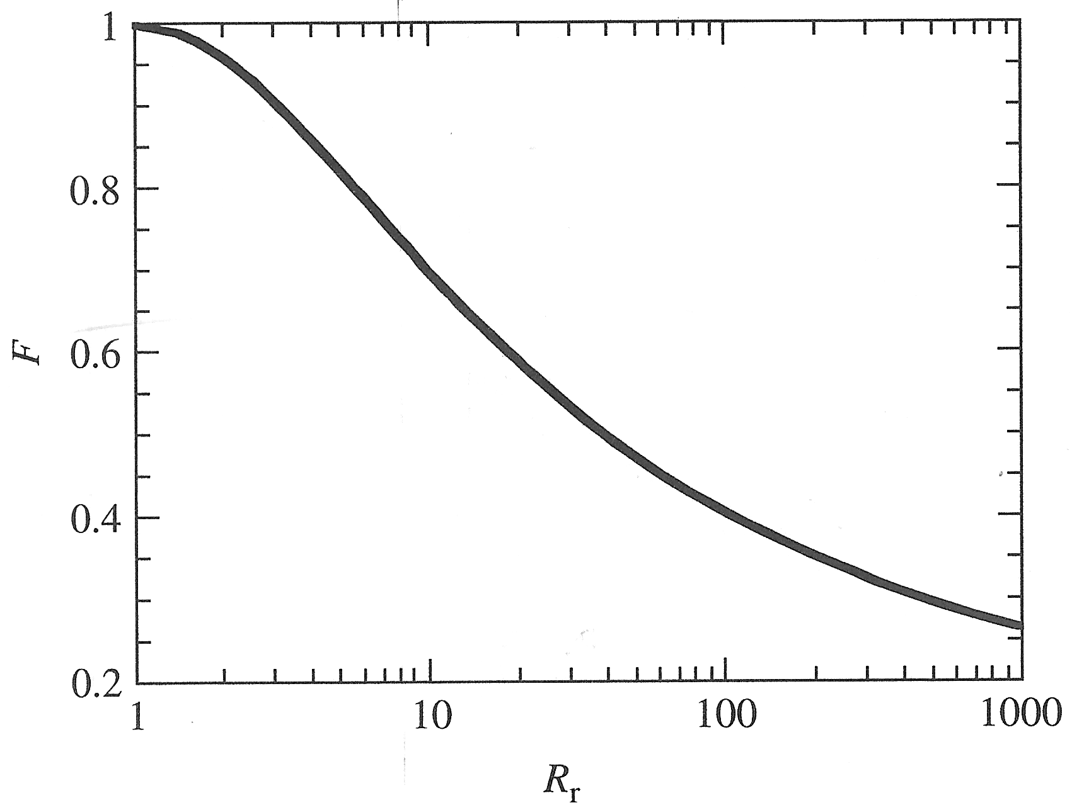
Van der Pauw method
f must satisfy the relation:
For symmetric contacts f = 1

Slide 22
Van der Pauw method
The previous equations were formulated assuming that contacts are point contacts. For contacts of finite size d on a circular disc of diameter D with d/D << 1, the percent increase in resistivity per contact can be found:
van der Pauw, Philips Research Reports 13 pg. 1-9
for d/D ~ 0.08 Δρ/ρ ~ 0.000559
total change for 4 contacts ~ 0.224%

Slide 23
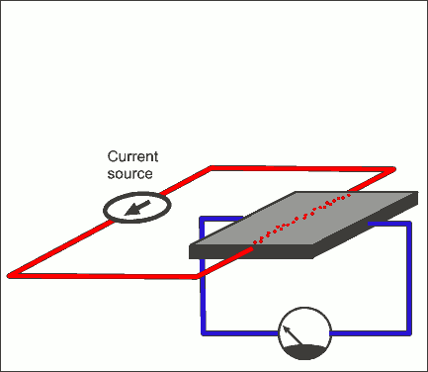
Van der Pauw method
Hall effect measurements
2
1
3
4

Slide 24
…and from Hall coefficient we determine the free charges concentration:

Slide 25
In intrinsic semiconductors the main factor that affects mobility is the lattice scattering so that mobility always reduces with temperature.
In extrinsic semiconductors there are two contributions
lattice (μ_{L}) and
the impurities (μ_{I} ).
So the total mobility is given by Matthiessen’s rule, which is

Slide 26
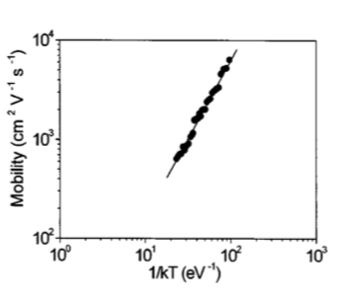
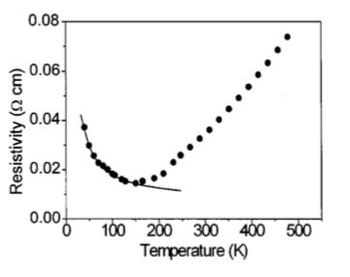
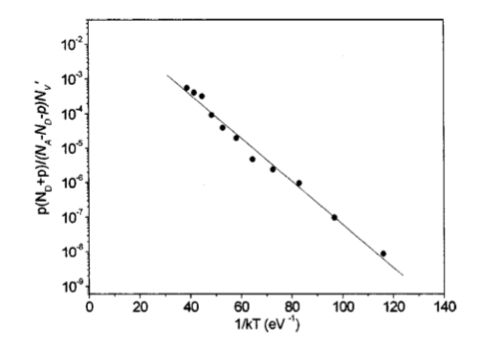
Electrical transport in doped-DLC coating examples
Ionized impurities Nd doped
A. Serra et al., Modulation of charge transport in diamond- based layers , J. Appl. Phys. 94 (2003) 416
W doped percolating network
p-type conduction

Slide 27
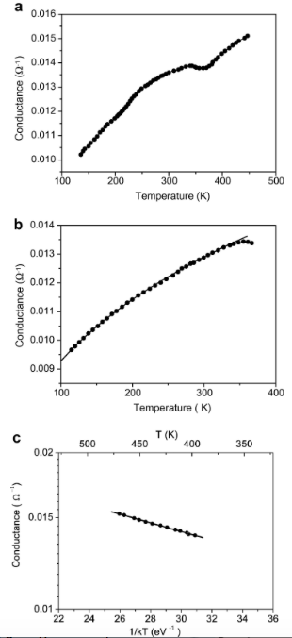
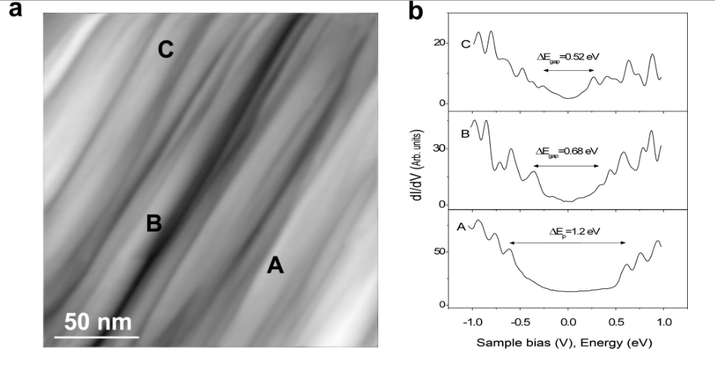
Electrical transport in aligned CNT bundles film examples
A. Serra et al., Electronic properties of individual and assembled homotype SWCNT bundles, Chem. Phys. Lett. 509 (2011) 152

Slide 28
For example DLC#9
Thermal activated process, with low activation energy,
about 60 meV
Long term stability

Slide 29
Structural and morphological characterization

Slide 30
X-ray diffraction in the Bragg – Brentano geometry represents the more consolidated method to determine the crystal structure of a sample
Based on Bragg law
One obtain the peaks that allows to determine the lattice spacing set
2d sin θ = n λ

Slide 33
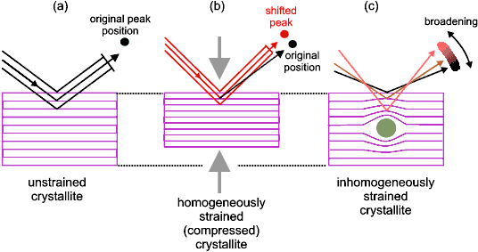
K is a factor form (for spherical nanocrystals K=1)

Slide 34
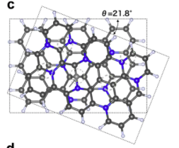
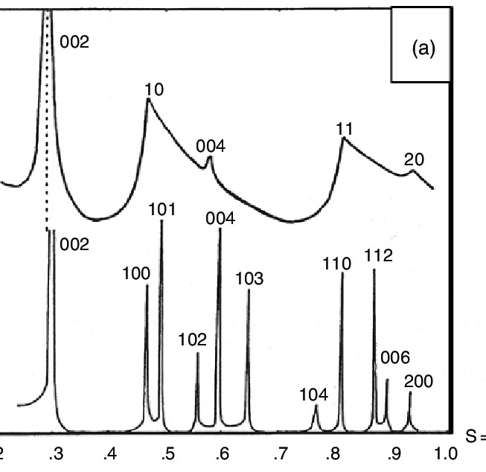
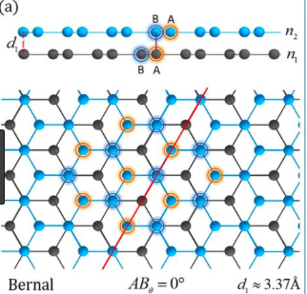
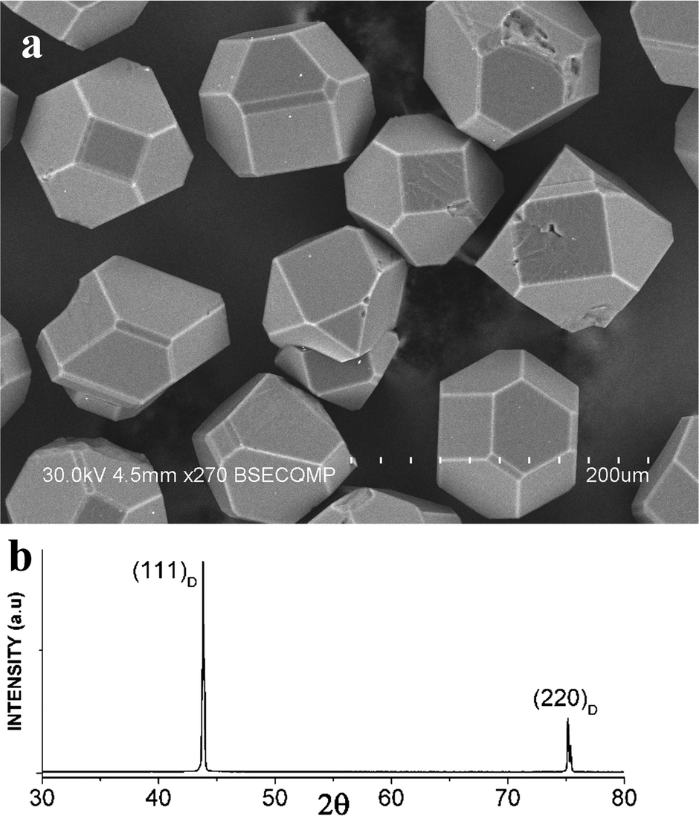
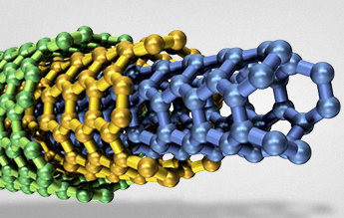
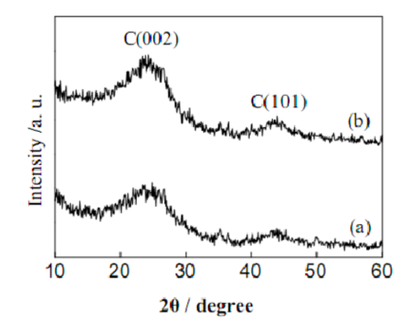
HOPG
Turbostratic graphite
MWCNT
Microdiamond

Slide 35
From X-ray diffraction to Raman spectroscopy:
From structure to chemistry

Slide 36
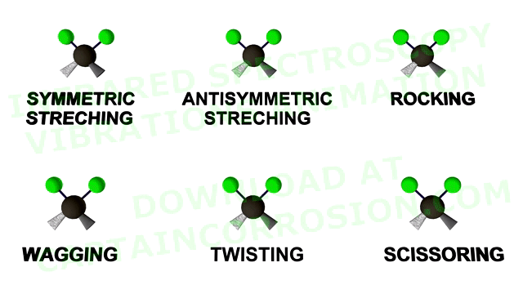
Raman spectroscopy
Raman spectroscopy is particularly well suited to molecular morphology characterization of carbon materials. Every band in the Raman spectrum corresponds directly to a specific vibrational frequency of a bond within the molecule.

Slide 37
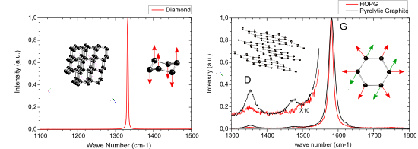
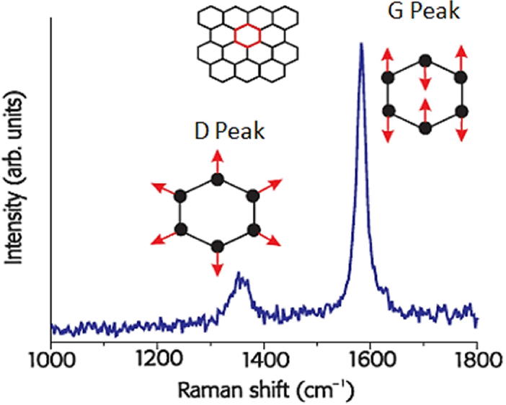
The graphite spectrum has several bands in the spectrum and the main band has shifted from 1332 cm⁻¹ in diamond to 1582 cm⁻¹ in graphite.
The reason for this is that graphite is composed of sp₂ bonded carbon in planar sheets in which the bond energy of the sp2 bonds is higher than the sp₃ bonds of diamond.
The higher energy of the sp₂ bonds in graphite pushes the vibrational frequency of the bonds and hence the frequency of the band in the Raman spectrum to higher frequency. The 1582 cm⁻¹ band of graphite is known as the G band.

Slide 38
Raman spectra of DLC films show two contributes G and D peaks.
The simplest fit consists of 2 Lorentzians or 2 Gaussians. In alternative it is used a Breit-Wigner-Fano line for the G peak and a Lorentzian for D peak.

Slide 39
Sample | ID/IG Gauss | ID/IG Lorentz | ID/IG BWF-L
DLC9 | 0.75 | 0.69 | 0.67
DLC30 | 0.72 | 0.59 | 0.57
DLC38 | 0.78 | 0.53 | 0.54

Slide 40
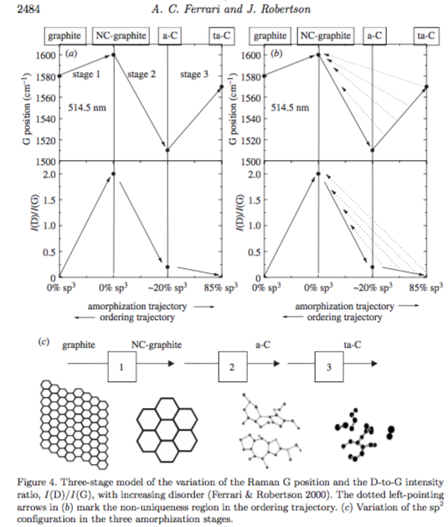
Diamond-like carbon is amorphous carbon with a significant sp₃ fraction.
Three-stage model:
1) Graphite (G)– nanocrystalline graphite (nc-G)
2) nanocrystalline graphite (nc-G) – amorphous carbon (a-C)
3) amorphous carbon (a-C) – tetrahedral amorphous carbon (ta-C)

Slide 41
The plane size L_{a} of crystallites can be determined by using the Raman spectrum of nanographite.
The local arrangement of atoms in nanographite has defined the edges as an armchair or zigzag shape. This local arrangement of atoms can determined by the disorder induced bands in the Raman spectrum of nanographite.
The D and G band ratio can be used to measure the crystalline size L_{a} of nanographite.
For stage 1, Tuinstra-Koenig model:
For stage 2 and 3, Ferrari-Robertson model:

Slide 42
The shifts of the G band are correlated with stress conditions within the DLC films, so the residual stress σ can be calculated by the following relation (Miki, Nishimoto et al. Surf. Coat. Technol. 283 (2015) 274-280)
Where S is the shear modulus about 70 GPa, υ is the Poison’s ratio about 0.3, and Δω is the shift in the Raman wavenumber of the G band, ω₀ is the Raman wavenumber of reference

Slide 43
HOPG reference
 | D cm⁻¹ | G cm⁻¹ | I_{D}/I_{G} | σ (GPa) | L (nm) | ρ_{sheet} (ohm/sq)
#2 | 1391 | 1549 | 0.905 | 5.42 | 1.28 | 2.75x10⁶
#3 | 1387 | 1550 | 0.828 | 5.26 | 1.23 | 1.44x10⁵
#8 | 1392 | 1553 | 0.885 | 4.77 | 1.27 | 1.2x10⁵
#9 | 1391 | 1551 | 0.618 | 5.09 | 1.04 | 1.02x10⁸
#10 | 1401 | 1553 | 0.486 | 4.76 | 0.94 | 1.2x10⁹

Slide 44
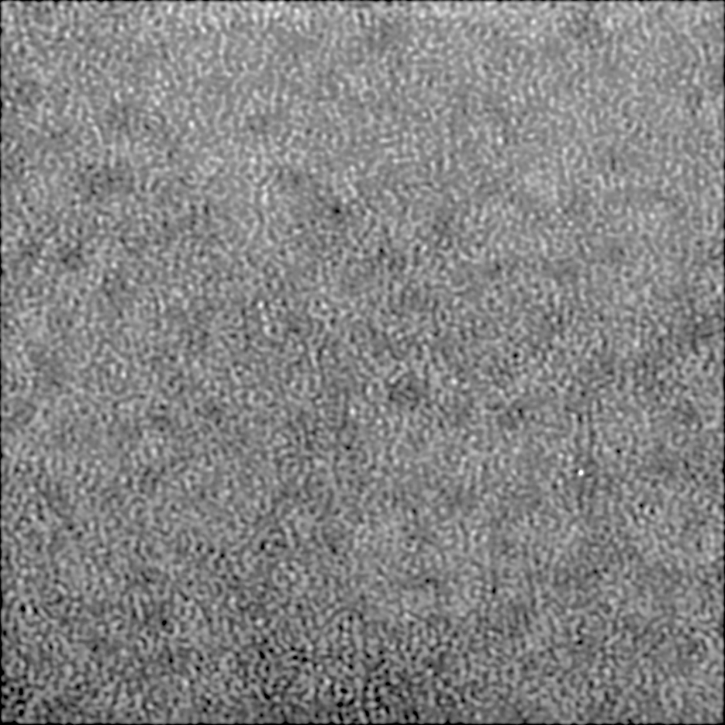
D=(1.8 ±0.5) nm
ε=(0.020±0.05)
5 nm

Slide 45
Thank you for attention

