Slide 1
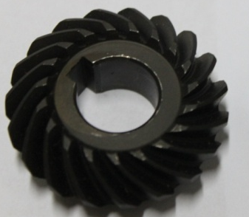
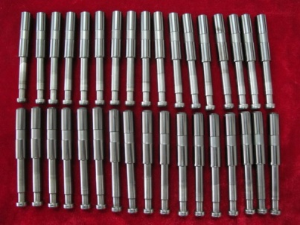
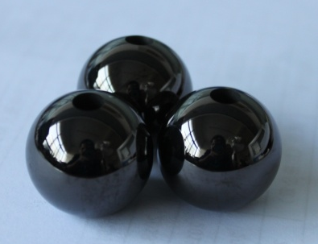
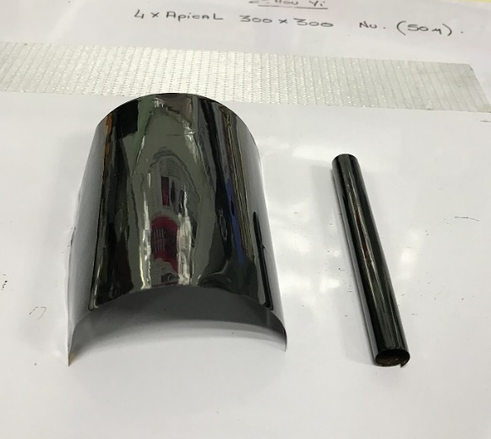
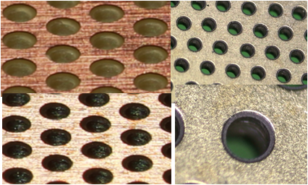
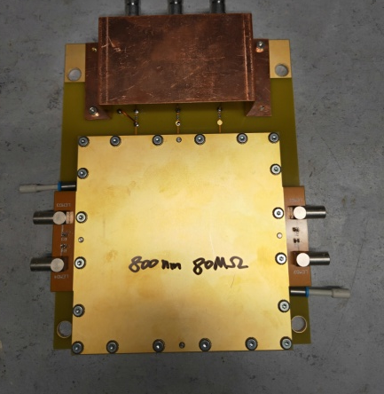
DLC films deposited by magnetron sputtering in LICP
—From solid lubricating material to resistive electrodes
Lunlin Shang, Guangan Zhang
State Key Laboratory of Solid lubriication,
Lanzhou Institute of Chemical Physics, Chinese Academy of Sciences

Slide 2
Outline
Principle and characters of magnetron sputtering
Devices & infrastructures for DLC coatings in LICP
Research & Applications as solid lubricant material
Research & Applications as resistive electrodes

Slide 3
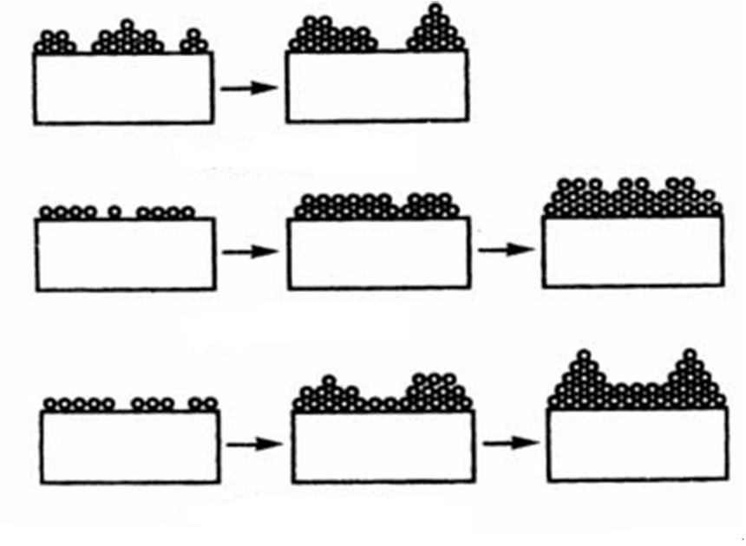
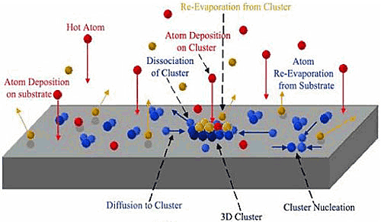
Sputtering Model & Deposition Principle
Volmer-Weber Modle
Frand-van der Merwe Modle
Stranski-Krastanov Modle
Schematic diagram of nucleation and growth process
Three growth modes of the film
The gas phase atoms with amount of energy from the evaporation source or the sputtering source
The phenomenon of complete inelastic collision, partial elastic collision and complete elastic collision
The remaining atoms are diffuse, migratory and nucleate on the surface
The growth is a non-equilibrium phenomenon governed by a competition between kinetics and thermodynamics
Notes:
I give a brief introduction of sputtering model and deposition principle. As shown in the schematic diagram of nucleation and growth process, the gas phase atoms with amount of energy from the evaporation source or the sputtering source. The phenomenon of complete inelastic collision, partial elastic collision and complete elastic collision occurred when the atoms bombard the surface of substrate, and the remaining atoms are diffuse, migratory and nucleate on the surface. Therefore, the growth of thin films is a non-equilibrium phenomenon governed by a competition between kinetics and thermodynamics. As shown in the right, there are three models of the film formation process. For example, Volmer-Weber Modle with growth likes island; Frand-van der Merwe Modle with growth likes layer; Stranski-Krastanov Modle with growth mixes island and layer.

Slide 4
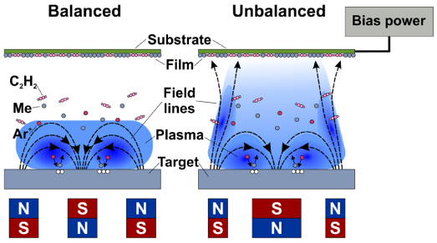
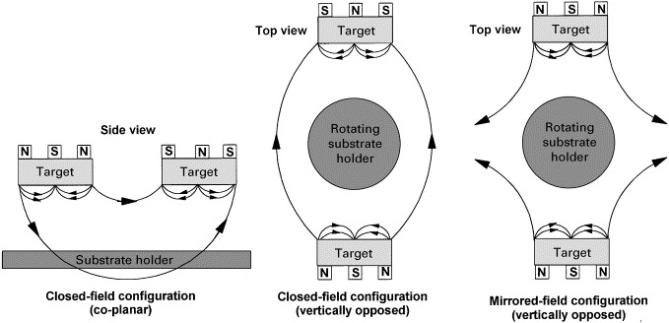
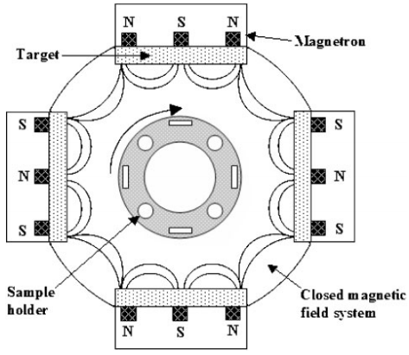
Principle of Magnetron Sputtering
v
The bombardment process causes target atoms condense on a substrate as a thin film
The magnetic field can constrain secondary electron motion to the vicinity of the target
The increased ionisation efficiency achieved in the magnetron mode allows the discharge to be maintained
The plasma allowed to flow out towards the substrate by unbalanced magnetron
Schematic of magnetron sputtering & distribution of magnetic field
Notes:
Magnetron sputtering is a method of constraining electrons near surface of the target and continuously dissociating argon to bombard the target. And the bombardment process causes target atoms condense on a substrate as a thin film. Compared to the balanced magnetron, the plasma allowed to flow out towards the substrate and by unbalanced magnetron, which widely used due to high deposition rate, low temperature and good adhesion strength.Schematics on the right are different unbalanced magnetron configurations, their magnetic field lines are closed or opened.

Slide 5
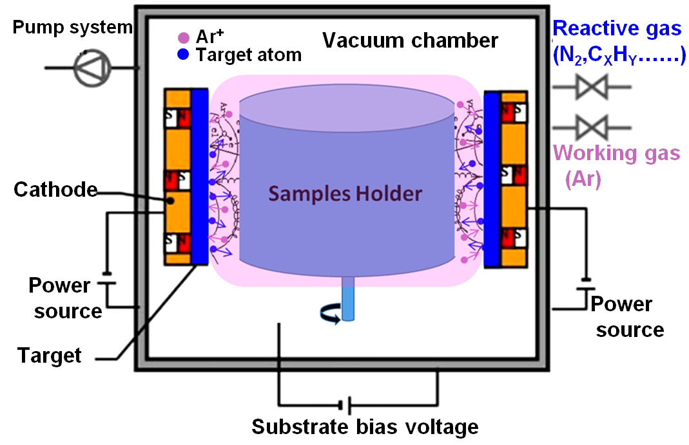
Principle of HPCVD
Can be Deposited by chemical reaction or magnetron sputtering (or together)
Low deposition temperature, high bonding strength, high deposition rate
Pure DLC, Cr, Cu are deposited by magnetron sputtering
Hydrogen doped DLC (a-C:H) is deposited by graphite targets sputtering and hydrocarbon gas dissociating at the same time
Notes:
HPCVD is a common and flexible method for different films deposition. It is a hybrid deposition method which contains both sputtering and chemical reactions.

Slide 6
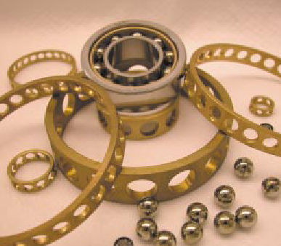
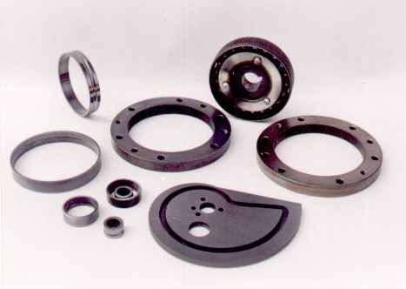
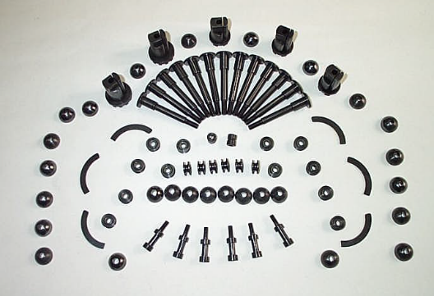
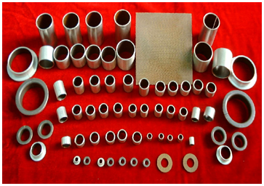
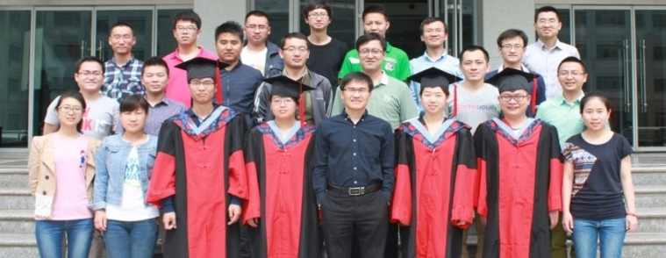
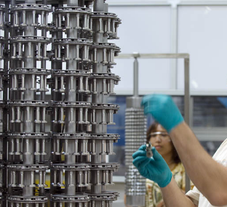

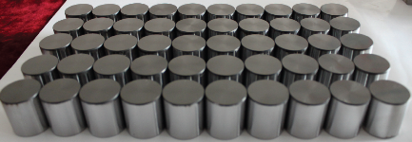
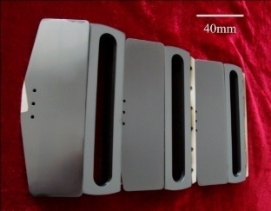
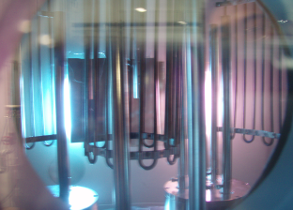
Introduction of our Lab
  Lubricating materials and techniques under special working conditions
  Friction and wear of materials and surface engineering
  High-performance lubricating materials and tribo-chemistry
  Advanced lubricating and functional protective materials
Fundamental research
Key techniques/processes
High-tech applications
Focus on the Carbon-based tribological coatings
Notes:
Our lab focuses on many research fields, one of them is deposition films by magnetron sputtering. These pictures shown the films as solid lubricating materials apply to mechanical engineering. The research of our group focus on the carbon-based coatings and other tribological films, which is from the fundamental research of the films deposition, microstructure, and performance, finally to High-tech applications.

Slide 7
Principle and characters of magnetron sputtering
Devices & infrastructures for DLC coatings in LICP
Research & Applications as solid lubricant material
Research & Applications as resistive electrodes

Slide 8
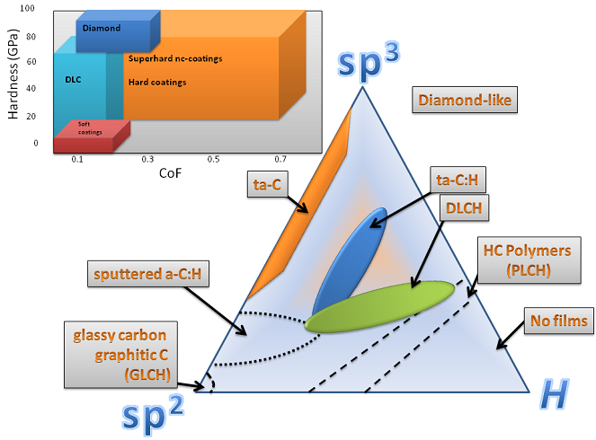
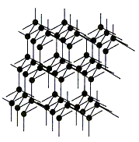
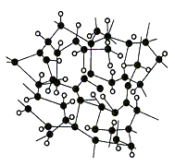
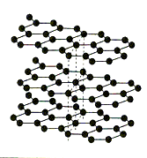
Diamond-Like carbon
  Amorphous solid carbon films deposited by thin film techniques
  Composed of diamond structure (sp3) and graphite structure (sp2)
  High hardness, low friction, Wear Resistance, excellent electrical and optical properties
  …………
Diamond structure
DLC structure
Graphite structure
Notes:
As stated in the previous representations, DLC is a type of amorphous carbon which contains both graphite structures and diamond structures. The microstructure of DLC as shown here. DLC has high hardness, low friction, wear resistance, excellent electrical and optical properties. So, it can be applied to many field.

Slide 9
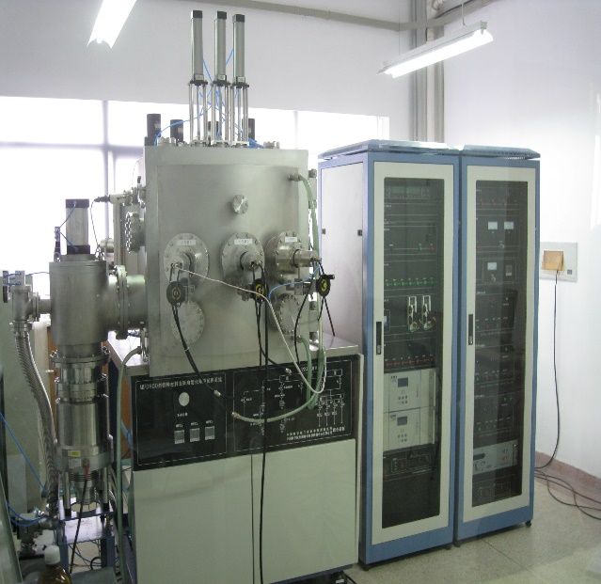
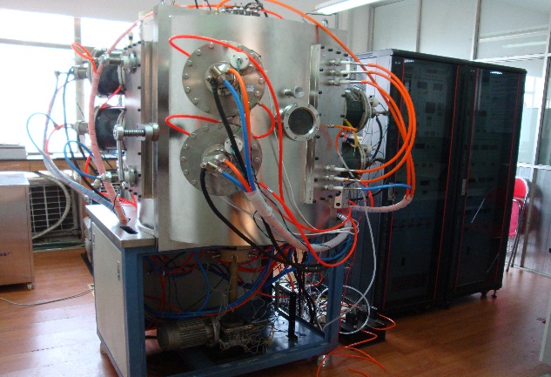
DC & RF Magnetron Sputtering
Direct-current (DC)
Magnetron Sputtering
Radio frequency (RF)
Magnetron Sputtering
Use DC power suppliers
Small (60mm*130mm) and conductive targets
Depositing thin film material by sputtering, such as DLC, metal film
Lower deposition temperature
Use RF power suppliers
Small (60mm*130mm) and mostly various targets
Depositing thin film material by sputtering, especially ceramic film
Notes:
The photo on the left is direct-current（DC）magnetron sputtering and the photo on the right is radio frequency magnetron sputtering. There are many similarities between DC Magnetron Sputtering and RF Magnetron Sputtering , such as lower deposition temperature, denser film structure, stronger adhesion, and smaller targets. The main difference is power supply. Compared with DC power, RF power can not only sputter graphite targets and metal targets, but also sputter non-conductive targets such as polymers and metal oxides.

Slide 10
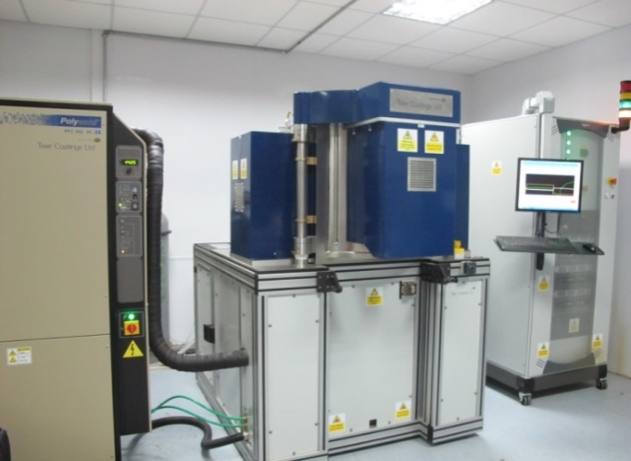
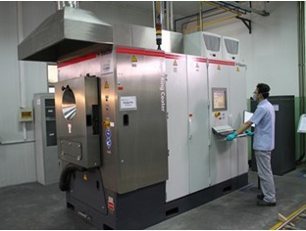
CFUDC & MAIP Magnetron Sputtering
Closed field unbalanced
DC magnetron sputtering
Cathode multi-arc ion plating and magnetron sputtering
4 targets (345mm*145mm) in vacuum chamber
Closed field unbalanced magnetron sputtering
Higher bonding strength
Lower deposition temperature (<200℃)
For DLC, Mos2， Nitride coatings deposition
2 large magnetron targets (600mm*120mm) and 6 large (φ106mm) arc targets
Pre-heating treatment
Very high deposition rate
Variable magnetic field
Typical plant-size equipment
Notes:
This is the closed field unbalanced DC magnetron sputtering. It has many advantages to deposit DLC, such as higher deposition rate, lower deposition temperature, better adhesion and so on. It is used to deposit DLC, Mos2 (Molybdenum disulfide/ məˈlibdənəm daɪ'sʌlfaɪd / ), and Nitride coatings for mechanical parts because of the films with outstanding tribological properties and excellent mechanical properties. Currently, we used it to deposit resistive DLC. And the device on the right is named cathode multi-arc ion plating and magnetron sputtering, it has 6 small arc targets and 2 large magnetron targets. It can be used to deposit DLC and nitride coatings. We will use it to deposit resistive DLC with large area.

Slide 11
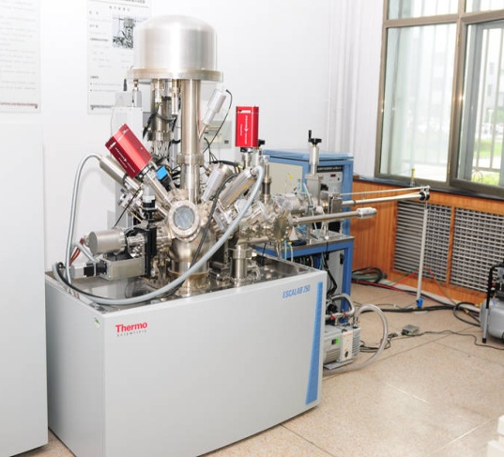
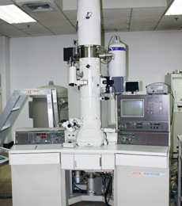
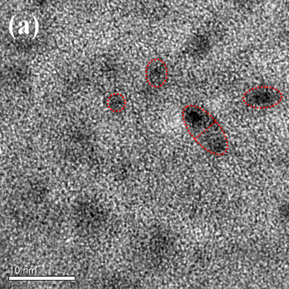
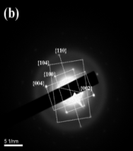
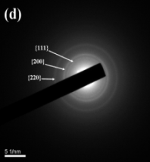
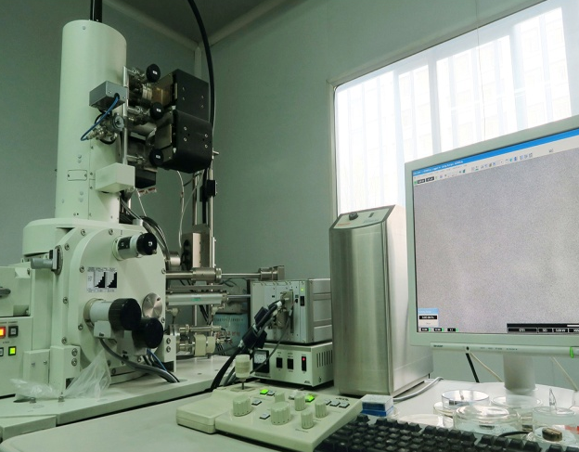
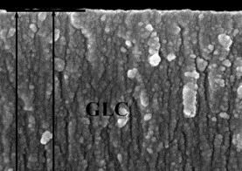
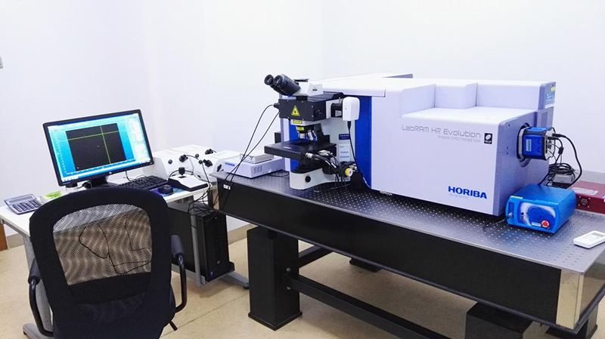
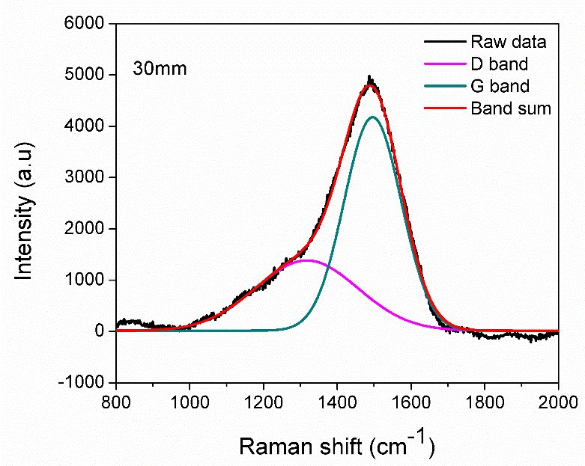
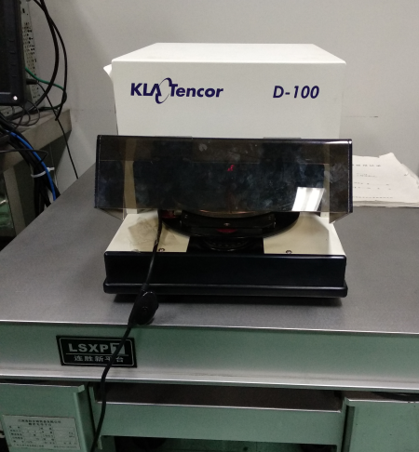
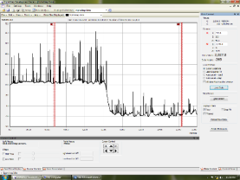
Characterization analysis
amorphous
Nanocrystalline clusters
X-ray Photoelectron Spectrometer （XPS）
Transmission Electron Microscope(TEM)
Scanning Electron Microscope(SEM)
Raman spectrometer
Two-dimension profilograph
7
Notes:
There are many methods of characterization test for DLC films. For example, XPS is used to analyze the type and chemical states of the elements. Generally, the content of sp3 and sp2 type carbon bonds, binding energies of the carbon elements, and new chemical products in DLC can be determined.
TEM is used to observe the microstructure in the films, such as nanocrostalline structure. SEM generally used to observe the morphology of surface and cross-section. Raman spectroscopy using visible light excitation to study the structural characteristics of DLC films. Two-D profile is used to measure surface roughness and thickness of films.

Slide 12
Principle and characters of magnetron sputtering
Devices & infrastructures for DLC coatings in LICP
Research & Applications as solid lubricant material
Research & Applications as resistive electrodes

Slide 13
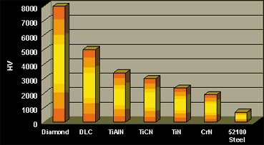
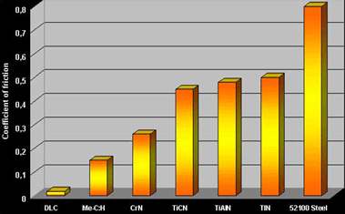
Mechanical & tribological properties of DLC
High Hardness
Wear Resistant
Properties of relative hardness of DLC at 4000+ HV is:
About 5 times harder than the stainless steel
More or less the same as sapphires
Around half of the diamond
Significantly harder than other PVD coatings
Properties of relative low friction and wear of DLC:
Low friction coefficient (~ 0.05)
Enhanced durability
Extremely high wear resistance
Notes:
DLC possess excellent mechanical and tribological properties due to high hardness and wear resistant. As shown in the graph, the hardness of DLC is about 5 times than stainless steel and more or less the same as sapphires. DLC has extremely high wear resistance and the friction coefficient is low to 0.05.

Slide 14
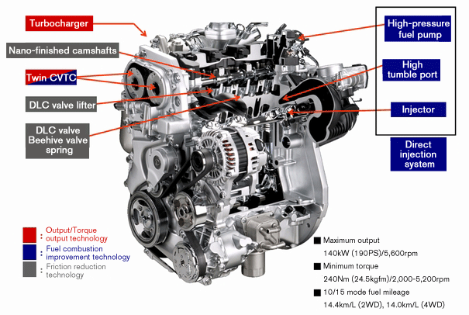
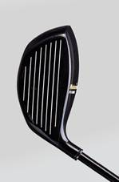
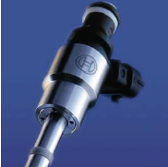
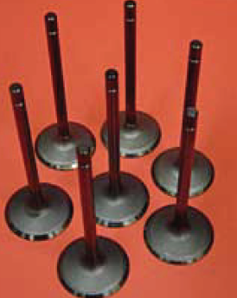
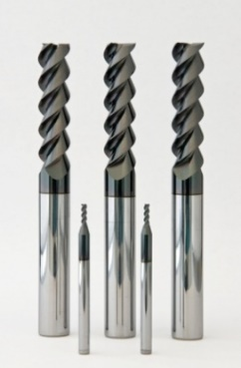

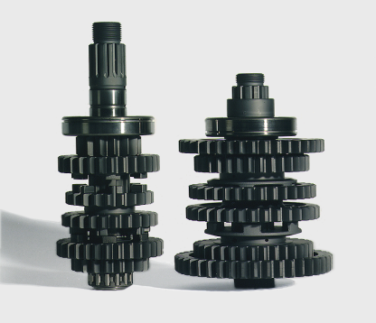
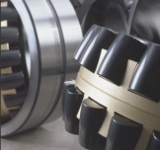
Applications of DLC
DLC is already used in many fields, it can be coated on mechanical tools, engine parts, aerospace parts, medical implants and so on, to extend their durability and wear resistance.

Slide 15
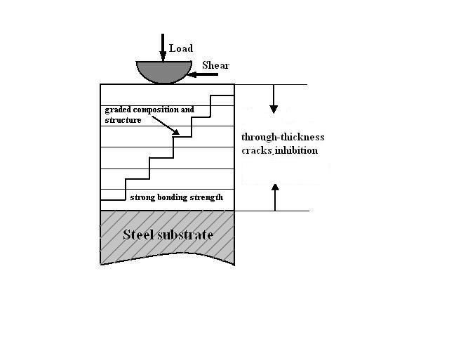


The design of DLC
  Ion implantation
  Plasma enhanced
  Magnetron Sputtering
  ……
  Multilayer structure
  Gradient structure
  Multi-component doping
  Multi-phase composite
  Solid-liquid
  High hardness
  High toughness
  Bearing capacity
  Adhesive
  Low Friction
  Wear resistance
Multilayer Structure
Gradient Structure
Composite Structure
Notes:
In our research works, we design the structure during DLC deposition for the certain application. We developed novel multilayer structure, gradient structure, composite structure, in order to deposit DLC with excellent mechanical and tribological properties.

Slide 16










As shown in these pictures, the multilayer structure and multi-component doping of DLC were designed on mechanical parts such as tappet and piston rings, it is can significantly improve wear resistance and reduce friction coefficient.
Application on engine parts
Cr doped DLC
Mass production of DLC coated piston rings
Without engine oil lubrication
Tribological testor
Load-resistant multilayer structure
The friction coefficient and wear rate of piston rings are reduced under engine oil after DLC coated
The production of DLC coated tappet
Under engine oil lubrication
Notes:
As shown in these pictures, the multilayer structure and multi-component doping of DLC were designed on mechanical parts such as tappet and piston rings, it is can significantly improve wear resistance and reduce friction coefficient.

Slide 17






Improving the performance in vacuum
Typical vacuum failure
Increasing of the content of hydrogen
Design of nanocomposite coatings
Developing of multilayer films
Special elements doping
Choosing of the counterpart friction material
Solid-liquid composite lubricants
Friction coefficient, wear track and wear scars of the a-C:H films
The influence of speed and pressure
DLC/MoS2 multilayer films
Fluorine doped DLC films
Sliding against different counterpart
DLC+MACs composite lubrication
Notes:
We also design the structure of DLC to improve the performance in vacuum, and developed DLC apply to the parts of aerospace. There are several measures to take, for example, increasing of the content of hydrogen, design of nanocomposite coatings, developing of multilayer films, special elements doping, choosing of the counterpart friction material and design solid-liquid composite lubricants system. As shown in these graphs, the results indicate that the tribological properties improved significantly. It is has lower friction coefficient and longer life time of DLC by design structure.

Slide 18


Structure design for applications under water
Micro-plough and delimitation of DLC sliding in water
Schematic drawing of failure mechanism
improve the tribological properties
Improve the bond of DLC and substrate
Choose the suitable interlayer
Reduce the micro-cracks of DLC
Optimize the SP2 of film (GLC)
Si interlayer-GLC on the substrate of Si3N4
Notes:
It is one of researches to develop DLC for applications under water. As shown in the pictures, there is micro-plough and delimitation of DLC during sliding in the water. So, we developed a type of DLC film based on the study of damage mechanism for applications under water. It is to improve the tribological properties by several methods, for example, improving the bond of DLC and substrate, choosing the suitable interlayer, reducing the micro-cracks of DLC and optimizing the SP2 of film such as GLC.

Slide 19









Other researches
Deposition super thick DLC films
Plasma enhanced chemical vapor deposition (PECVD)
Reducing the internal stress by designing Si doped and multilayer
53 μm
37 μm
Super DLC by designing of Si_{x}-DLC/Si_{y}-DLC multilayer
Super thick DLC on surface of piston rings
DLC films deposited on the internal surface
Apply to field such as oil, gas, automotive and others
Hollow cathode Plasma enhanced chemical vapor deposition (HC-PECVD)
Deposition based on element doping and multilayer structure
The DLC deposited on the inner wall of the tube
Cross-section image of DLC
Notes:
图上标注In addition, we deposited super thick DLC films by Plasma enhanced chemical vapor deposition , which thickness was up to 53 microns based on reducing the internal stress by designing Si doped and multilayer structure. The picture shows the thick DLC can deposited on the surface of piston rings.
We also deposited DLC films on the inner wall of the tube by hollow cathode plasma enhanced chemical vapor deposition, which still based on Si element doping and multilayer structure.

Slide 20
Principle and characters of magnetron sputtering
Devices & infrastructures for DLC coatings in LICP
Research & Applications as solid lubricant material
Research & Applications as resistive electrodes

Slide 21







Deposition DLC for resistive electrode
Sample Baking
Sample Clamping
Vacuum Pumping
Sample Pre-treating
Deposition
Cooling in Vacuum
Sample
taking down
Measurement
9
Resistive DLC prepared by magnetron sputtering the high purity graphite targets
Resistivity controlled by adjusting target power, deposition time, vacuum degree, and so on.
Notes:
As we know, lots of works have indicated that the DLC is a type of potential material can be used in MPGDs. So, we have also carried out some research works for developing resistive DLC. It was deposited by magnetron sputtering method. Here is the flow chart of the deposition, including sample baking, clamping, pumping, pre-treating, deposition and so on. The resistivity of DLC is controlled by the preparation parameters, such as target power, deposition time, vacuum degree.

Slide 22




Resistivity vs thickness
The resistance is greatly effected by the target current
The smaller target current, the better uniform of resistivity
The resistivity tends to decrease with the increasing of the target current and deposition time
The larger thickness of the DLC, the smaller resistivity
Notes:
Thickness is a key factor affecting the resistivity of DLC, which is determined by target current and deposition time. As shown in the graphs, the resistivity of DLC is greatly affected by the target current, it is very repeatable at the lower target current. And the resistivity of DLC decreases with the increasing of the target current and deposition time, which is due to sputtering a large number of carbon atoms and clusters at higher target current, and the the larger thickness of the DLC, the smaller resistivity.

Slide 23


Resistivity vs element doped
Hydrogen doped by adding C₄H₁₀ during DLC deposition can significantly increase the resistivity
The resistivity of nitrogen-doped DLC is unstable, which increasing with the time exposed in air
Notes:
Then, we studied the influence of element doping on the resistivity of DLC. As shown in the left graph, it is found that the hydrogen doped by adding C4H10 during DLC deposition can significantly increase the resistivity. The resistivity is higher than 500MΩ when add the C4H10 with the flow rate of 4sccm.
As shown in the right graph, the nitrogen doping also increases the resistivity of DLC. And the resistivity is very unstable, which increasing with the time exposed in air. As point A shows, the resistivity of DLC deposited with a nitrogen flow rate of 8 sccm was significantly increased after leaving the vacuum chamber for a few minutes. After 15 days, the DLC deposited at 5 sccm was raised from 30 MΩ to higher than 500 MΩ.

Slide 24


Resistivity vs vacuum degree & heat treatment
Higher vacuum
Lower vacuum
The higher vacuum degree, the lower resistivity
Better uniformity resistivity during higher vacuum
The resistivity of DLC reduced to around 1/3 after 5 hrs
The resistivity of DLC will be stable exposed in air
Notes:
We also studied the inflence of vacuum degree and heat treatment on the resistivity of DLC. As shown in the left graph, the resistivity of DLC is decreased with the increasing of the vacuum degree. At higher vacuum degree, the resistivity of DLC is uniform. It is maybe the resistivity is greatly influenced with residual gas molecules in the chamber. As shown in the right graph, we study the influence of heat treatment under nitrogen at 200 °C on the resistivity of DLC. The result indicated that the resistivity of DLC reduced to around a third after 5 hrs, and it would be stable exposed in air.

Slide 25



Deposition of thick DLC
The resistivity is stable with higher thickness
Cover the roughness of the substrate such as PSB
Stronger resistance to discharge/spark
Higher internal stress due to curl phenomenon because of soft substrate
Improved deposition process because of resistivity is closed to thickness
VS
Sample clamping
Vacuum Pumping
N-doped DLC
Pumping for Residual Gas
H-doped DLC
Isobutane Start
Up to 1.1μm
Nitrogen
Start
Better stability
Deposition Start
Nitrogen Stop
Deposition Stop
Isobutane
Stop
PCB
APICAL
Cooling in Vacuum
OK！
Failed！
Sample
taking down
Notes:
There are several advantages for thick DLC, for example, thick DLC with stable resistivity, can cover the roughness of the substrate such as PCB, has stronger resistance to electric discharge sparking. However, Thick DLC with higher stress which can cause the curling of soft substrate such as APICAL. So, we need to improve the method of DLC deposition.
For the DLC with the same structure, the one with larger thickness will have lower resistivity, so that we can increase the thickness of DLC and control the resistivity by element doping. As the flow chart shows, we deposited hydrogen doped and nitrogen doped DLC by adding isobutene and nitrogen during sputtering. The results indicates that the resistivity of nitrogen doped DLC is difficult to control, while the resistivity of hydrogen doped DLC is uniform and stable. These pictures show thick DLC was deposited on THGEM PCBs and APICAL.

Slide 26
Deposition of “DLC+Cu”
DLC + Cu Sample taking down
Advantages of “DLC + Cu”
Sample Clamping
Cooling in Vacuum
Simplifying the manufacture process and improving the quality of resistive MPGDs
Allowing precise printed circuit layouts on DLC resistive electrode thus realizing complex functions
Expanding the capacity and applications of the MPGDs and opening the way for new MPGD architectures
Vacuum Pumping
Deposition Cu
Deposition DLC
Deposition Cr-Cu
Cooling in Vacuum
Deposition Cr
Cu layer
DLC Sample taking down
Vacuum Pumping
Cr-Cu interlayer
Cr layer
DLC layer
DLC sample Clamping
Apical foil
Notes:
DLC+Cu electrode have lots of advantages as listed here.
However, the adhesion strength of copper on DLC is very bad due to the copper is difficult to form chemical bond with carbon. So, we chose chromium as the bonding layer. Finally, we deposited copper on DLC successfully by designing the multi-layer composite structure of DLC layer, Cr layer, Cr and Cu co-deposition layer and Cu layer. Here is the deposition process.

Slide 27








Deposition of DLC photocathode
DLC applied as the radiation-hard photocathode for PICOSEC MM detector
Pure DCL & Boron doped DLC
Increase sp³/sp² ratio (ta-C)
Increase sp³/sp² ratio (ta-C)
C or B₄C target
MgF₂ in the device chamber
C or B₄C target
C target
B4C target
Magnetron sputtering deposition
Cathodic vacuum arc deposition
Pulsed laser deposition
Sample pure B4C_10nm has the highest QE than the other
PLD samples have higher QE than the Magnetron Sputtering Deposition samples (at the same thickness)
Notes:
We deposited DLC on the MgF2 as radiation hard photocathode. As shown in the pictures, pure DLC was deposited by magnetron sputtering graphite targets under high vacuum condition, while the boron doped DLC was deposited by magnetron sputtering boron carbide targets. Then, we deposited tetrahedral amorphous carbon (ta-C) by vacuum cathodic arc deposition and pulsed laser deposition. For vacuum cathodic arc deposition, the graphite targets can be evaporated by arc discharge and deposited on surface of MgF2, while, for pulsed laser deposition, the graphite targets can be evaporated by high temperature ablation using pulsed laser.

Slide 28
Summary & Outlook
Magnetron sputtering is one of excellent method to deposited DLC, especially for resistive electrodes in MPGDs
There are lots of works to do in order to make the DLC resistivity be controllable
Explore reliable methods for the resistive DLC characterization
Optimizing process of resistive DLC deposition and developing large area resistive DLC electrodes
Thank You

